Slide 1
HIV Recency Testing with Index Testing Can Identify New Infections Earlier in Rwanda
Suzue Saito, PhD MIA MA
ICAP at Columbia University, New York, NY/ USA
Giles Reid, Eugenie Poirot, Jean Claude Irabona, Collins Kamanzi, Veronicah Mugisha, Beata Sangwayire, Eric Remera, Tom O. Oluoch, Richard C.N. Mwesigwa, Elysee Tuyishime, Kemba Lee, David Miller, Amitabh Suthar, Gallican Rwibasira, for the Rwanda HIV Recency Evaluation Study Team.
No disclosures
This research was supported by the United States President’s Emergency Plan for AIDS Relief (PEPFAR) through the U.S. Centers for Disease Control and Prevention (CDC) under the terms of Cooperative Agreement Numbers NU2GGH002171. The contents are solely the responsibility of ICAP and do not necessarily reflect the views of the United States Government.
A major global health organization with projects in more than 40 countries, ICAP at Columbia University works to transform the health of populations through innovation, science, and global collaboration. Since its founding in 2003 at the Columbia Mailman School of Public Health, more than 2.8 million people have received HIV care through ICAP-supported programs. Learn more online at icap.columbia.edu
Notes:
On behalf of my co-authors, I am pleased to present our abstract entitled “HIV Recency Testing with Index Testing Can Identify New Infections Earlier in Rwanda.”

Slide 2
Background
Since 2018, Rwanda has been offering HIV recency testing to all individuals newly diagnosed as HIV positive
As part of index testing and partner notification services, sexual contacts of newly diagnosed individual are contacted and offered HIV testing; if positive, recency testing is offered
This study examined yields of HIV positivity and HIV recency among sexual contacts of newly diagnosed individuals
Notes:
Since 2018, Rwanda has been offering HIV recency testing to all individuals newly diagnosed as HIV positive
Additionally, as part of index testing and partner notification services, sexual contacts of newly diagnosed individuals are contacted and offered HIV testing and if diagnosed positive, HIV recency testing is offered
This study examined yields of HIV positivity and HIV recency among sexual contacts of newly diagnosed individuals in Rwanda.

Slide 3
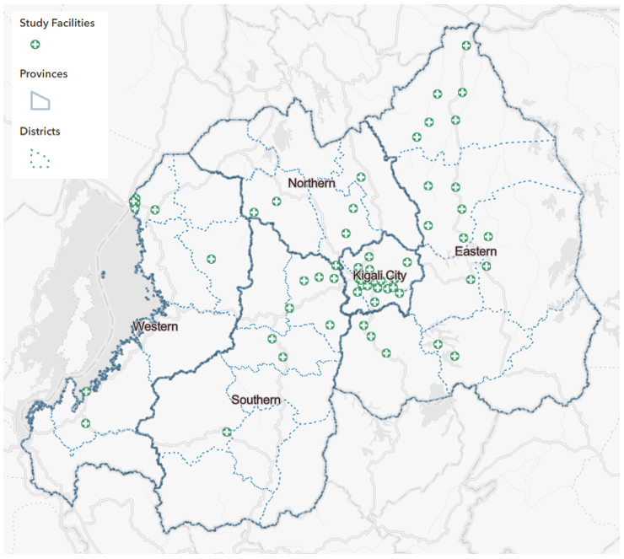
Methods: Study Location and Population
August 2021–October 2022 in 60 health facilities selected using probability sampling in all five provinces in Rwanda
1,238 newly diagnosed individuals ≥15 years (index cases) were enrolled
Sexual contacts underwent HIV testing and recency testing
Notes:
This study was conducted from August 2021–October 2022 in 60 health facilities selected using probability sampling in all five provinces in Rwanda. The green circles on the map to the right show the location of the facilities selected.
A cohort of 1,238 newly diagnosed individuals 15 years and older were enrolled in the study. I will refer to these individuals as index cases in this presentation.
Sexual contacts were elicited when index cases were newly diagnosed with HIV and those who were successfully contacted and came to the health facility underwent HIV testing, and if positive, recency testing.

Slide 4
Methods: HIV Recency Testing
HIV recency testing distinguishes recent and long-term (LT) infections
Recent infection – Less than 6-12 months
LT infection – More than 12 months
1: Control line
2: HIV verification line
3: Long-term line
Photo: Yufenyuy EL et al, PLOS Global Public Health, May 2022
Notes:
HIV recency testing distinguishes recent and long-term (LT) infections among newly diagnosed individuals.
A recent infection here we mean an infection of less than 6-12 months from diagnosis
A long-term infection we mean an infection of more than 12 months from diagnosis
We used the rapid test shown on the bottom right here, which requires only a drop of whole blood from newly diagnosed individuals...

Slide 5
Methods: Recency Testing
Diagnosed HIV+ on
National Testing Algorithm
Rapid Test for Recent Infection (RTRI)
Baseline viral load (VL) testing
VL ≥ 1000 copies/mL
RTRI LT + VL ≥
1000 copies/mL
RTRI recent + VL ≥ 1000 copies/mL
Long-term infection
Recent infection
Notes:
In this study, to improve the accuracy of recency classification, we followed a recent infection testing algorithm shown here.
When an individual received an HIV diagnosis based on the national testing algorithm starting at the top in the orange box, they underwent a rapid test for recent infection (RTRI) shown in the grey box, and regardless of their RTRI result, underwent baseline viral load (VL) testing shown in blue here. RTRI recent with a VL of ≥1000 copies/mL were classified as a recent case as shown in purple on the right. RTRI LT with a VL of ≥1000 copies/mL were classified as a newly diagnosed LT case as shown on the left here.

Slide 6
Methods: Measures
Outcome 1 - Elicitation: the average number of sexual contacts per index case
Outcome 2 - HIV positivity yield:
Numerator: the number of new HIV positive sexual contacts
Denominator: all sexual contacts tested for HIV
Outcome 3 - HIV recency yield:
Numerator: the number of sexual contacts with a recent infection
Denominator: all sexual contacts tested for HIV
Previously diagnosed sexual contacts were excluded
Statistical comparison using Wilcoxson Rank-Sum test for elicitation and Fisher’s exact test for the positivity and recency yields
Notes:
We examined three outcome measures
The first outcome was
Elicitation as defined as… the average number of sexual contacts listed by the index cases at diagnosis or during subsequent clinical visits,
The second outcome was.. HIV positivity yield as the number of new HIV positive sexual contacts identified among all sexual contacts tested for HIV
The third outcome was HIV recency yield as the number of sexual contacts with a recent infection identified among all sexual contacts tested for HIV
Previously diagnosed sexual contacts were excluded from these calculations.
Statistical comparisons were made using Wilcoxson Rank-Sum test for the elicitation outcome and Fisher’s exact test for the HIV positivity and recency yield outcomes.

Slide 7
Results: Index Cases Characteristics
 | Total Index (n = 1,238) n (%) | Recent Index (n = 98) n (%) | LT Index (n = 1,140) n (%) | P value
7.9% Recent
Notes:
Turning to results..
1238 index cases enrolled in the study, as a reminder these are all newly diagnosed with HIV, 98 or 7.9% had a recent infection at the time of HIV diagnosis.

Slide 8
Results: Index Cases Characteristics
 | Total Index (n = 1,238) n (%) | Recent Index (n = 98) n (%) | LT Index (n = 1,140) n (%) | P value
Age (years)
15-34 | 759 (61.3) | 71 (72.4) | 688 (60.4) | 0.008
35-49 | 408 (33.0) | 19 (19.4) | 389 (34.1)
50+ | 71 (5.7) | 8 (8.2) | 63 (5.5)
Sex
Male | 459 (37.1) | 21 (21.4) | 438 (38.4) | 0.001
Female | 779 (63.0) | 77 (78.6) | 702 (61.5)
Notes:
Turning to characteristics of index cases, and note % listed are column%...
Recent Index cases were more likely to be under 35 years of age compared to LT cases at 72% vs. 60%.
They were also likely to be more female compared to LT cases at 79% vs. 62%

Slide 9
Results: Index Cases Characteristics
 | Total Index (n = 1,238) n (%) | Recent Index (n = 98) n (%) | LT Index (n = 1,140) n (%) | P value
Marital status
Single | 374 (30.2) | 37 (37.8) | 337 (29.6) | 0.008
Married & Cohabitating | 629 (50.8) | 46 (46.9) | 583 (51.1)
Widowed | 49 (4.0) | 2 (2.0) | 47 (4.1)
Divorced/separated | 186 (15.0) | 13 (13.3) | 173 (15.2)
Population group
General population | 1117 (90.2) | 76 (77.6) | 1041 (91.3) | 0.001
Female sex worker | 114 (9.2) | 20 (20.4) | 94 (8.2)
Men who have sex with men | 7 | 2 (2.0) | 5 (0.4)
Notes:
Additionally, recent index cases were more likely to be single compared to LT cases at 38% vs. 30%.
Recent index cases were more likely to identify as a female sex worker compared to LT cases at 20% vs. 8% and were more likely to identify as men who have sex with men at 2% vs. 0.4% although these numbers small.

Slide 10
Results: Sexual Contacts Characteristics
 | Total sexual contacts (n = 1,738) n (%)
Age (years)
15-34 | 1007 (57.9)
35-49 | 625 (36.0)
50+ | 106 (6.1)
Sex
Male | 1096 (63.1)
Female | 642 (36.9)
Notes:
Turning to characteristics of sexual contacts, as their index counterparts, they were also more likely to be younger than 35, were more likely to be male partners of their female index cases and nearly half were characterized as casual partners.

Slide 11
Results: Sexual Contacts Characteristics
 | Total sexual contacts (n = 1,738) n (%)
Relationship type of contact(s) as reported by index
Spouse/husband/fiancé | 203 (11.7)
Girlfriend/boyfriend | 178 (10.2)
Cohabiting | 378 (21.8)
Casual partner | 842 (48.5)
Someone who pays me to have sexual relations | 94 (5.4)
Someone I pay to have sexual relations | 43 (2.5)
Notes:
And nearly half were characterized as casual partners.

Slide 12
Outcome 1: Elicitation of Sexual Contacts by Recency Status of Index Cases (n= 1,738)
 | Total | Recent | LT | P value
Total index cases, n | 1,238 | 98 | 1,140
Total sexual contacts, n | 1,738 | 164 | 1,574
Sexual Contact to Index Ratio | 1.40 | 1.67 | 1.38 | 0.06
Notes:
Turning to the first outcome on elicitation..
The 1238 index cases listed a total of 1738 sexual contacts, 164 were linked to the 98 recent cases and 1574 were linked to 1140 LT cases. For every recent index case, 1.67 sexual contacts were elicited compared to 1.38 contacts per LT case with a trend toward statistical significance at p value of 0.06.

Slide 13
Outcome 2: HIV Positivity Yield among Sexual Contacts by Recency Status of Index Cases (n=789/1,738)
P = 0.3
Notes:
Turning to the second outcome on HIV positivity yield…
Of the 1738 sexual contacts, 789 or 45% completed HIV testing. Of those, 123 were HIV positive or 15.5% and when stratifying by recency status of the linked index cases, sexual contacts linked to recent index cases represented in the purple bar here had a positivity of 20% compared to 15.1% in sexual contacts linked to LT cases represented in the green bar here with a p value of 0.3.

Slide 14
Outcome 3: HIV Recency Yield among Sexual Contacts by Recency Status of Index Cases (n=789/1,738)
P = 0.045
Notes:
Turning to the third outcome on HIV recency yield ….
Of the 789 sexual contacts who tested for HIV, 9 were recent or with a 1.1% recency yield overall and when stratifying by the recency status of the linked index case, sexual contacts linked to recent index cases represented again in the purple bar here had a recency yield of 4% compared to 0.8% in sexual contacts linked to LT cases represented in the green bar here with a p value of 0.045.

Slide 15
Conclusions
Newly diagnosed index cases with recent infections compared to those with LT infections were more likely to have sexual contacts with recent infections
HIV recency with index testing and partner notification services provided an important opportunity to identify new infections earlier and tailor prevention efforts to high-risk groups
Surveillance and program benefit of recency testing warrants further research
Notes:
To conclude..
Newly diagnosed index cases with recent infections compared to those with LT infections were more likely to have sexual contacts with recent infections
As such HIV recency with index testing and partner notification services provided an important opportunity to identify new infections earlier and tailor prevention efforts to high-risk groups
As other presentations at this conference has also shown, surveillance and program benefit of recency testing warrants further research

Slide 16
Thank you
To all people living with HIV
And to:
Jessica Justman
Bharat Parekh
Yen Pottinger
Monita Patel
Koen Frederix
Jarjieh Fang
Vedaste Masengesho
David Miller
Emah Ndengo
Canisious Musoni
Jared Omolo
Samuel Sewava
Eugenie Kayirangwa
Augustin Mulindabigwi
Alice Kabanda
This research was supported by the United States President’s Emergency Plan for AIDS Relief (PEPFAR) through the U.S. Centers for Disease Control and Prevention (CDC) under the terms of Cooperative Agreement Numbers NU2GGH002171. The contents are solely the responsibility of ICAP and do not necessarily reflect the views of the United States Government.
A major global health organization with projects in more than 40 countries, ICAP at Columbia University works to transform the health of populations through innovation, science, and global collaboration. Since its founding in 2003 at the Columbia Mailman School of Public Health, more than 2.8 million people have received HIV care through ICAP-supported programs. Learn more online at icap.columbia.edu
Notes:
With that I would like to thank the study team, Rwanda Biomedical Center and Centers for Disease Control and Prevention for their collaboration and PEPFAR for their funding support for this study.
And sincere thank you to those who live with HIV who inspire our work every day.

