Slide 1
Is the End of AIDS in Sight?
ICAP’s World AIDS Day Virtual Event
December 1, 2023

Slide 2
Wafaa El-Sadr, MD, MPH, MPA Global Director, ICAP at Columbia University Executive Vice President, Columbia Global University Professor of Epidemiology and Medicine Mathilde Krim-amfAR Chair of Global Health

Slide 3
Reminders
Agenda
Welcome and Introduction
Keynote Address
Panel Discussion
Q&A
For questions to the panelists, use the Q&A box
The webinar recording and slides will be posted on www.icap.columbia.edu

Slide 4
Jessica Justman, MD Senior Technical Director, ICAP at Columbia University Associate Professor of Medicine in Epidemiology, Columbia University

Slide 5
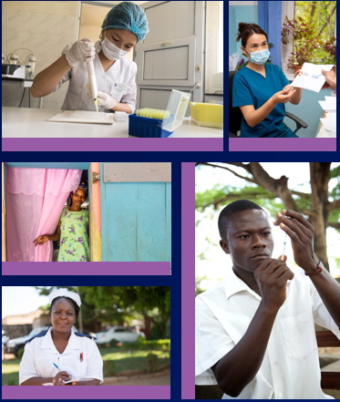
Accomplishments and Way Forward
HIV:
Jessica Justman, MD
Senior Technical Director, ICAP
December 1, 2023
Notes:
Good morning, afternoon and evening. Thanks for joining us. I’ll start off with some reflections on the HIV epidemic.

Slide 6
Overview
Background: Global Snapshots
Accomplishments of the HIV Response
Gaps in Epidemic Control
Threats
Moving forward

Slide 7
Global Snapshots: Progress Over 20 Years
 | 2003 | 2023
# globally living with HIV | 40 Million | 39 Million
# accessing ART | 400,000 | 29.8 Million
# newly infected with HIV | 5 Million | 1.3 Million
# AIDS related deaths | 3 Million | 630,000
Source: UNAIDS AIDs Epidemic Update, 2003; UNAIDS Global AIDS Update, 2023
Notes:
# living with HIV is about the same.
ART is 75x higher
# newly infected is nearly 4 times lower
# deaths is nearly 5 x lower one fifth
How was all of this accomplished?

Slide 8
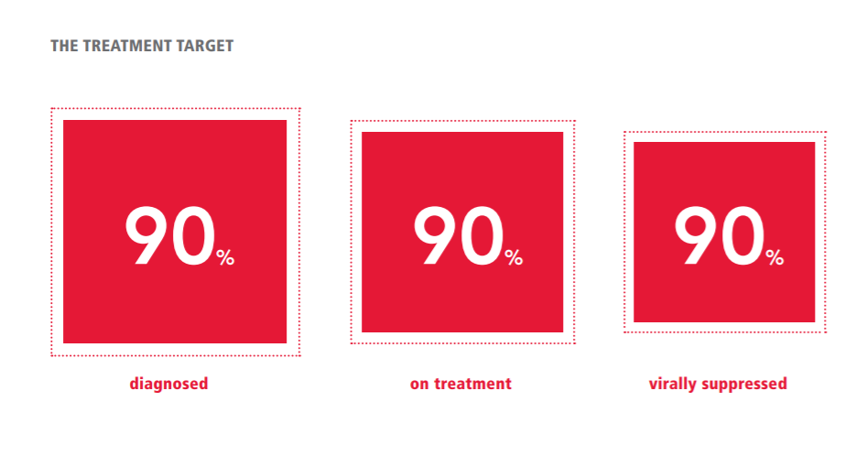
UNAIDS Care Continuum Targets
2014:
90-90-90 global target for 2020
Source: UNAIDS 2025 targets for the HIV response, https://www.unaids.org/sites/default/files/media_asset/90-90-90_en.pdf
Notes:
An important part of the story of accomplishments of the global HIV response consists of the three red squares here in this image.
In 2014, nine years ago, UNAIDS defined care continuum targets for 2020 and these squares represent the three targets (90-90-90).
This model laid out the path to HIV elimination by 2030.

Slide 9
UNAIDS Targets
Source: UNAIDS Fast Track: Ending the AIDS Epidemic by 2030
Notes:
The 2014 plan to eliminate HIV by 2030 depended on achieving the 90-90-90 targets by 2020 and achieving 95-95-95 by 2025. The plan included a reduction in the number of new infections to the target of 500,000 or fewer by 2020 and 200,000 or fewer by 2030.
The UNAIDS plan also includes dramatic reductions in punitive laws, and in the experience of stigma, gender inequality and violence., with the goal of zero discrimination.
a total of ten targets. These additional targets are for both PLWH and those at risk such as use of combination prevention by 95% of those at risk (top and going counterclockwise), access to sexual and reproductive health services and 95% coverage of services to prevent vertical transmission of HIV, 90% linkage to integrated services (red) and (in light blue) dramatic reductions in punitive laws, and in the experience of stigma, gender inequality and violence.

Slide 10
Accomplishments: Global Status as of 2022
86%
89%
93%
Adults living with HIV knew their HIV status
Adults who were aware of their HIV status were on ART
Adults who were on ART had viral load suppression (VLS)
VLS among global population of people living with HIV: 0.86 x 0.89 x 0.93 = 71%
As of 2022, Botswana, Eswatini & Zimbabwe achieved 95-95-95 targets
Another 16 countries (8 in SSA) are close to achieving targets
Source: UNAIDS Global AIDS Update 2023; KFF the Global HIV/AIDS Epidemic, 2023
Notes:
We can look at accomplishments according to the UNAIDS targets, which are measures of prevalence instead of absolute numbers. Globally 86%.... This comes out to 71% pop VLS

Slide 11
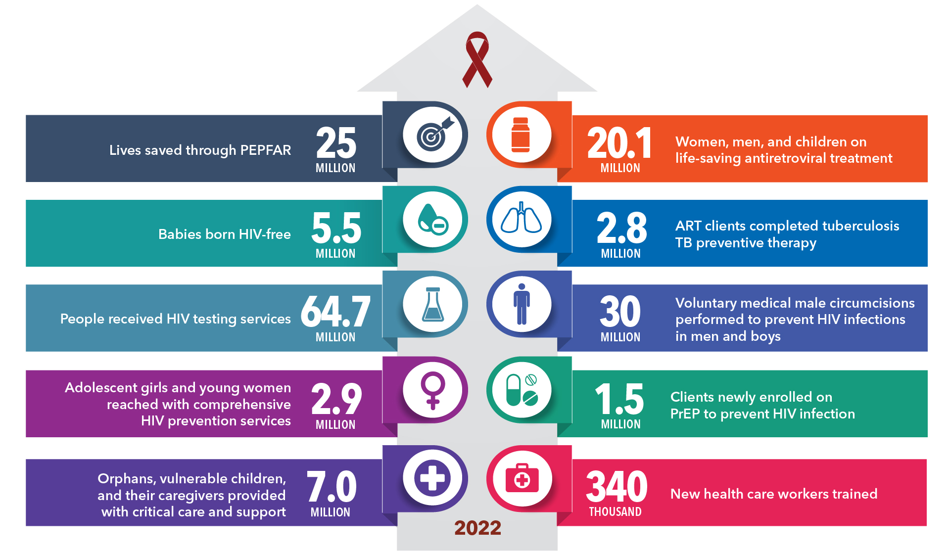
Accomplishments: PEPFAR Impact (2003-2023)
in 2022
Source: Results and Impact - PEPFAR
Notes:
This diagram illustrates PEPFAR’s impact by the numbers. For example, 25 million lives have been saved through PEPFAR’s impact (will not walk through the whole image)

Slide 12
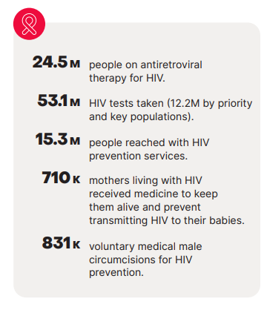
Accomplishments: Global Fund Impact (2022)
Source: The Global Fund Results Report, 2023
Notes:
Global Fund has also played an important role in global achievements, and has supported for example, over 24 million people receiving ART in 2022

Slide 13
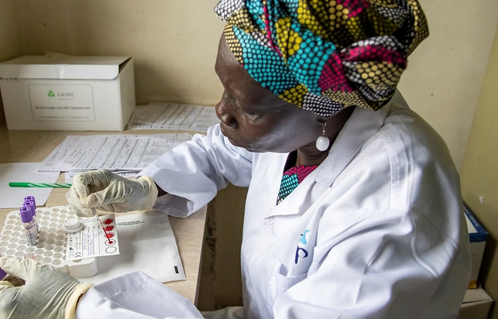
51 Million people tested for HIV
9.2 Million HIV patients screened for TB
2.4 Million people provided with HIV treatment
ICAP Impact Over 20 Years in the Global HIV Response
218,000 people given access to pre-exposure prophylaxis (PrEP)
>424,000 health workers trained
>7,983 health facilities & > 7,239 laboratories supported with technical assistance
Notes:
ICAP’s accomplishments reflect the work of the many people on the ground and the partners who made it happen. Every number on this slide is a testament to the healthcare workers at clinics and hospitals, community workers, civil society groups, ministries of health and the generous support of PEPFAR , Global Fund and others. The impact on health systems has played an important role in all these accomplishments. For example, ICAP has provided TA to over 7000 labs

Slide 14
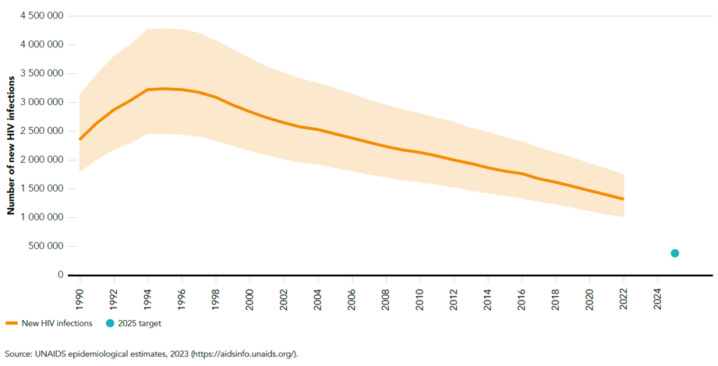
Adults and children newly infected with HIV, 1990-2022
43% decline in new infections since 2012
1.3 million
Target
Notes:
2012: 2.3 million
2022: 1.3 million

Slide 15
How was this achieved?
Partnerships with ministries and communities
Commitment
Task shifting
Evidence based programs
Comparing performance to targets
Surveillance
Data systems
Better medications
Strengthening of capacity and systems
Innovations
Notes:
No single magic bullet

Slide 16
Why are New HIV Infections Declining so Slowly?
2022
1.3 million
2025 Target
370,000
Notes:
And yet. And yet new infections are declining very slowly. We need to keep pushing. How can we do better?

Slide 17
Recent Infection Surveillance
HIV Case Surveillance
Modeling
Program Data
Population
surveys
(PHIA, BBS, etc.)
Research Studies
Notes:
In order to continue to make progress, we have to understand where the gaps are and that requires continued measure of how we are doing.
All of these measures when taken together, helps us to “know our epidemic” and guide resources and programs to the geographic and demographic groups most in need. Let’s look at some population survey data (green)

Slide 18
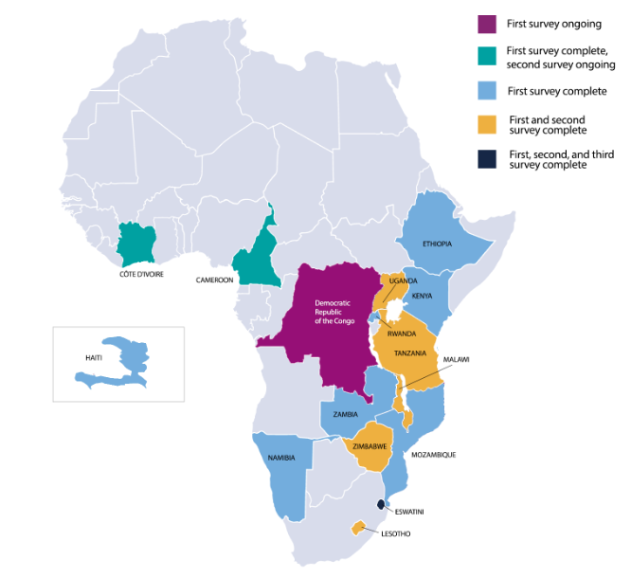
Population-Based HIV Impact Assessment (PHIA) Project
Goal: Conduct nationally representative, HIV-focused household surveys to assess the status of the HIV epidemic and the impact of national response programs
1st objectives:
national HIV incidence, and
national prevalence of viral load suppression (HIV RNA <1,000 c/mL)
2nd objectives: subnational adult and pediatric HIV prevalence, HIV drug resistance, detectable ARVs, CD4 distribution, among others
Notes:
Since 2014, the Population-based HIV Impact Assessment (PHIA) Project has conducted nationally representative surveys to capture the state of the HIV epidemic in the most-affected countries. PHIA surveys are being conducted in fifteen (15) PEPFAR supported countries

Slide 19
PHIA2 vs PHIA1 UNAIDS 95-95-95*: First 95 Remains a Gap
(Knowledge of HIV-Positive Status)
95%
PHIA 2
95%
PHIA 1
https://phia.icap.columbia.edu/
*Conditional proportions
Notes:
Population surveys is one way to understand where the gaps are.
Here is an example of data from population surveys funded by PEPFAR, the Population-based HIV Impact Assessment or PHIA surveys.
We are looking at the care continuum for four PEPFAR supported countries that have each conducted 2 PHIA surveys. These 95-95-95 graphs are displayed as conditional proportions to highlight how the major gap remains with the first 95, awareness of diagnosis. This remains true in the PHIA 2 surveys (above) although we see improvement. The biggest gaps are among men and young adults.
Globally, 5.5 million people were living with HIV but unaware of their status

Slide 20
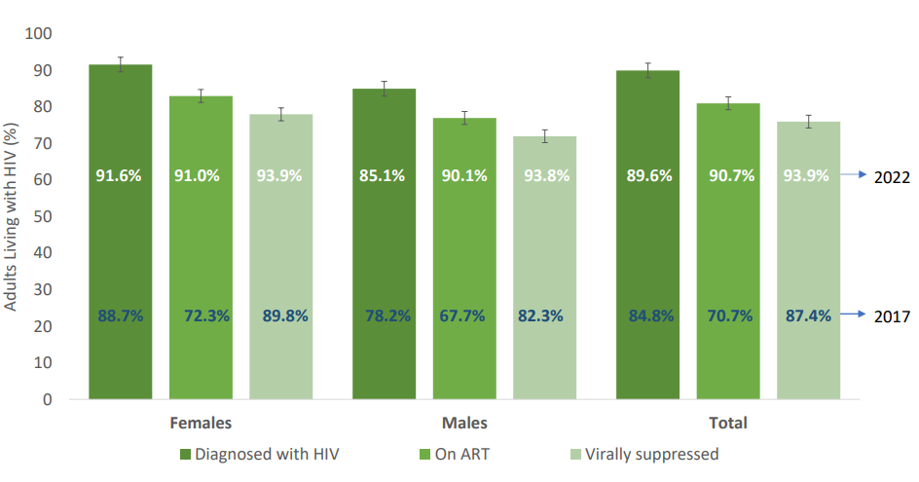
95-95-95 Indicators for People Aged 15+ Living with HIV: South Africa, 2022
Population VLS
62% (2017) v. 81% (2022)
Source: SABSSM VI Summary Sheet, 2023
Notes:
Total PLWH 7.8 mil in both 2017 and 2022 so number PWH without VLS went from 3 million to 1.5 million
Released earlier this week (Monday)
Percentages written out for 2017 and 2022 are both conditional
Percentages shown in the figure refer to the conditional 95-95-95 targets (for 2022 and 2017), heights of bars represent unconditional (overall) percentages for each indicator among all PLWH. Error bars represent 95% Cis
On ART defined as having detectable ARV or self reported use of ART

Slide 21
Gaps in Epidemic Control: State of the Epidemic in the United States, 2021
Ending the HIV Epidemic Initiative (ETE) and # new diagnoses:
36,500 in 2017: ETE target set for 2030 of 3,650 (90% reduction)
36,136 in 2021
12% decline in the 4 years from 2017
Corresponds to 20,000 new infections by 2030
Source: Justman et al., 2023 (AIDS); https://www.cdc.gov/hiv/basics/statistics.html
Notes:
Eswatini essentially achieved 95-95-95 targets in 2021, 9 years ahead of the 2030 deadline set by UNAIDS, and achieved an overall population viral load suppression among PWH of 88%
In the US, on the other hand, in 2021 with 87% of PWH diagnosed and 66% of diagnosed persons having viral load suppression, population viral load suppression was only 57%

Slide 22
Gaps in Epidemic Control: State of the Epidemic in the United States, 2021
New diagnoses in the US and Ending the HIV Epidemic Initiative (ETE):
36,500 in 2017: ETE target set for 2030 of 3,650 (90% reduction)
36,136 in 2021
12% decline in the 4 years from 2017
Corresponds to 20,000 new infections by 2030
Of the 1.2 million PLWH:
87% diagnosed
66% of diagnosed persons had VLS
VLS among diagnosed: Whites 72%, Hispanic 64%, Black 62%
Population VLS (0.87 x 0.66) = 57%
Likely lower in those facing structural and individual barriers
43% without clinical and transmission benefits of ART
Source: Justman et al., 2023 (AIDS); https://www.cdc.gov/hiv/basics/statistics.html
Notes:
Eswatini essentially achieved 95-95-95 targets in 2021, 9 years ahead of the 2030 deadline set by UNAIDS, and achieved an overall population viral load suppression among PWH of 88%
In the US, on the other hand, in 2021 with 87% of PWH diagnosed and 66% of diagnosed persons having viral load suppression, population viral load suppression was only 57%

Slide 23
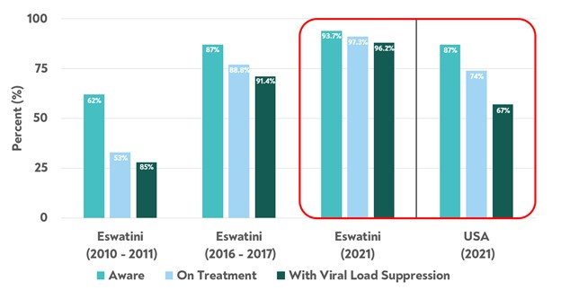
Gaps in Epidemic Control: Eswatini and United States Progress Toward 95-95-95 Targets, 2011-2021
Source: Justman et al., 2023 (AIDS); https://www.cdc.gov/hiv/basics/statistics.html
Notes:
Eswatini essentially achieved 95-95-95 targets in 2021, 9 years ahead of the 2030 deadline set by UNAIDS, and achieved an overall population viral load suppression among PWH of 88%
In the US, on the other hand, in 2021 with 87% of PWH diagnosed and 66% of diagnosed persons having viral load suppression, population viral load suppression was only 57%

Slide 24
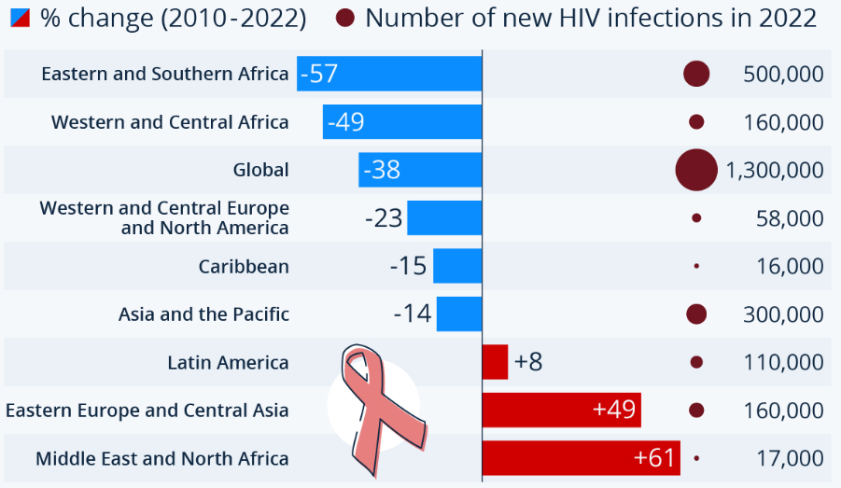
Gaps: Are we there yet with decline in new infections?
Source: UNAIDS epidemiological estimates, 2023

Slide 25
Gaps: Key and Priority Populations
Median HIV prevalence of key populations
and comparison to median prevalence of 0.7% among general population [adults, 15-49 y] in 2022
Key and priority populations and their partners accounted for 70% of all new HIV infections in 2021
2.5%
5.0%
7.7%
10.3%
Source: UNAIDS Global AIDS Update 2023
Notes:
key and priority populations and their partners account for 70% of all new HIV infections
(https://www.usaid.gov/global-health/health-areas/hiv-and-aids/technical-areas/key-populations#:~:text=Globally%2C%20key%20populations%20are%20disproportionately,percent%20of%20new%20HIV%20infections)

Slide 26
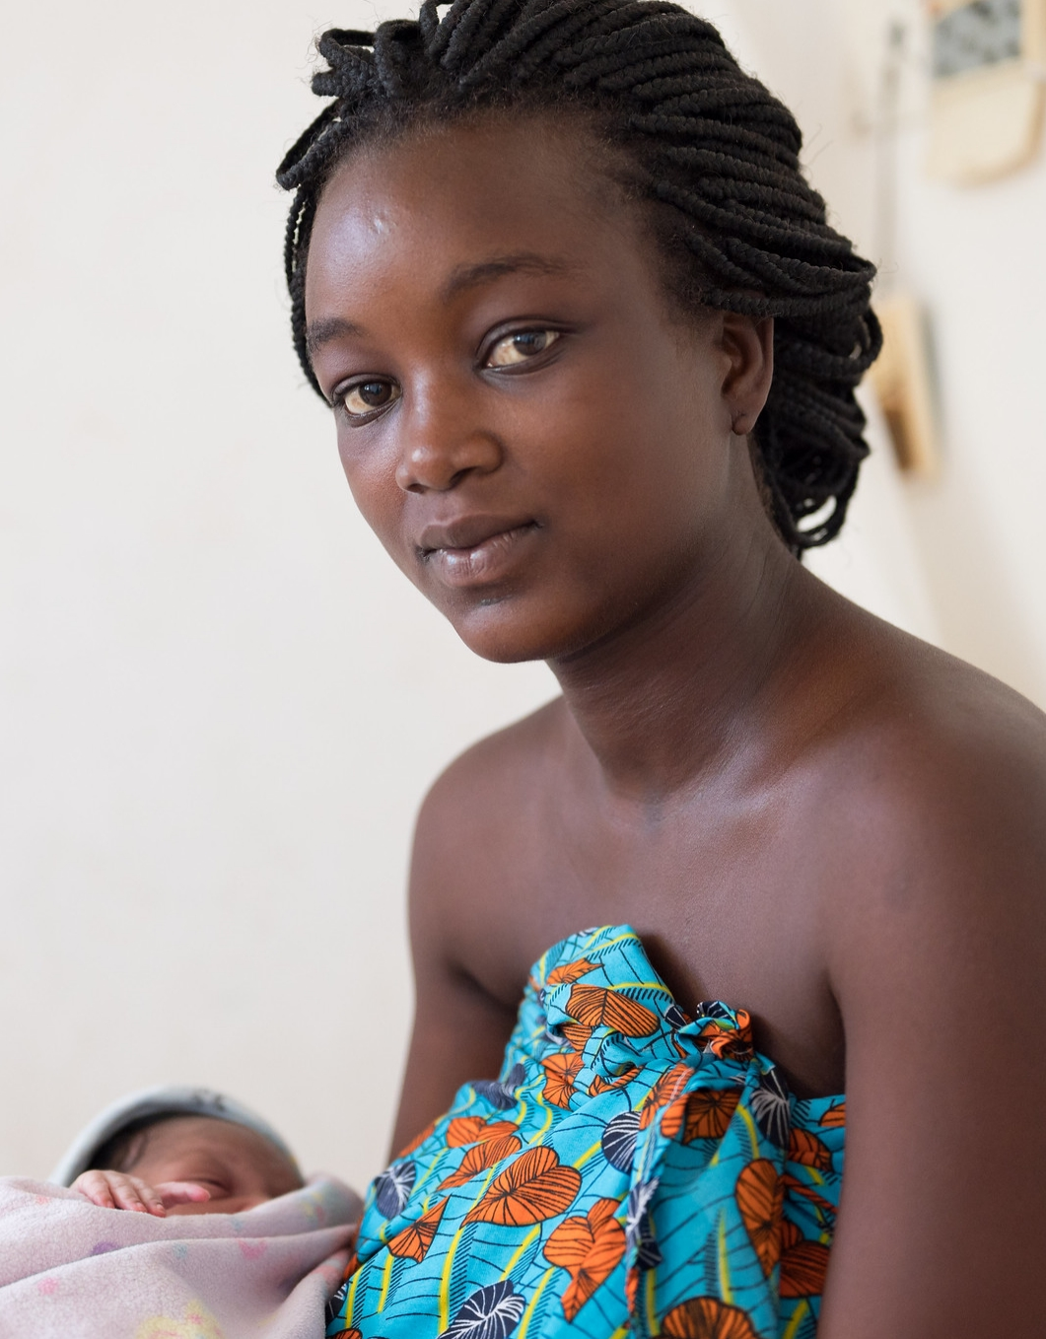
Gaps: Pediatric and Maternal Child Health
18% of pregnant or breastfeeding women (~ 220,000) living with HIV did not receive antiretroviral therapy in 2022
2022: only 57% of children (aged 0-14) living with HIV were receiving antiretroviral treatment coverage compared with 77% among adults, and the gap is widening
Children accounted for 4% of PLWH but 14% of AIDS-related deaths in 2022
Source: UNAIDS Global AIDS Update 2023

Slide 27
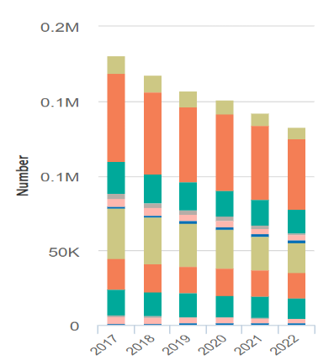
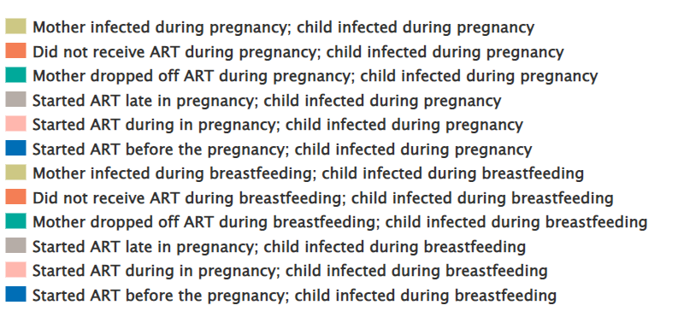
Gaps: Pediatric and Maternal Child Health
New child infections due to gaps in prevention of vertical transmission
Most new pediatric infections are occurring among children born to women who never started ART or who stopped ART during pregnancy or breastfeeding
Source: UNAIDS epidemiological estimates, 2023

Slide 28
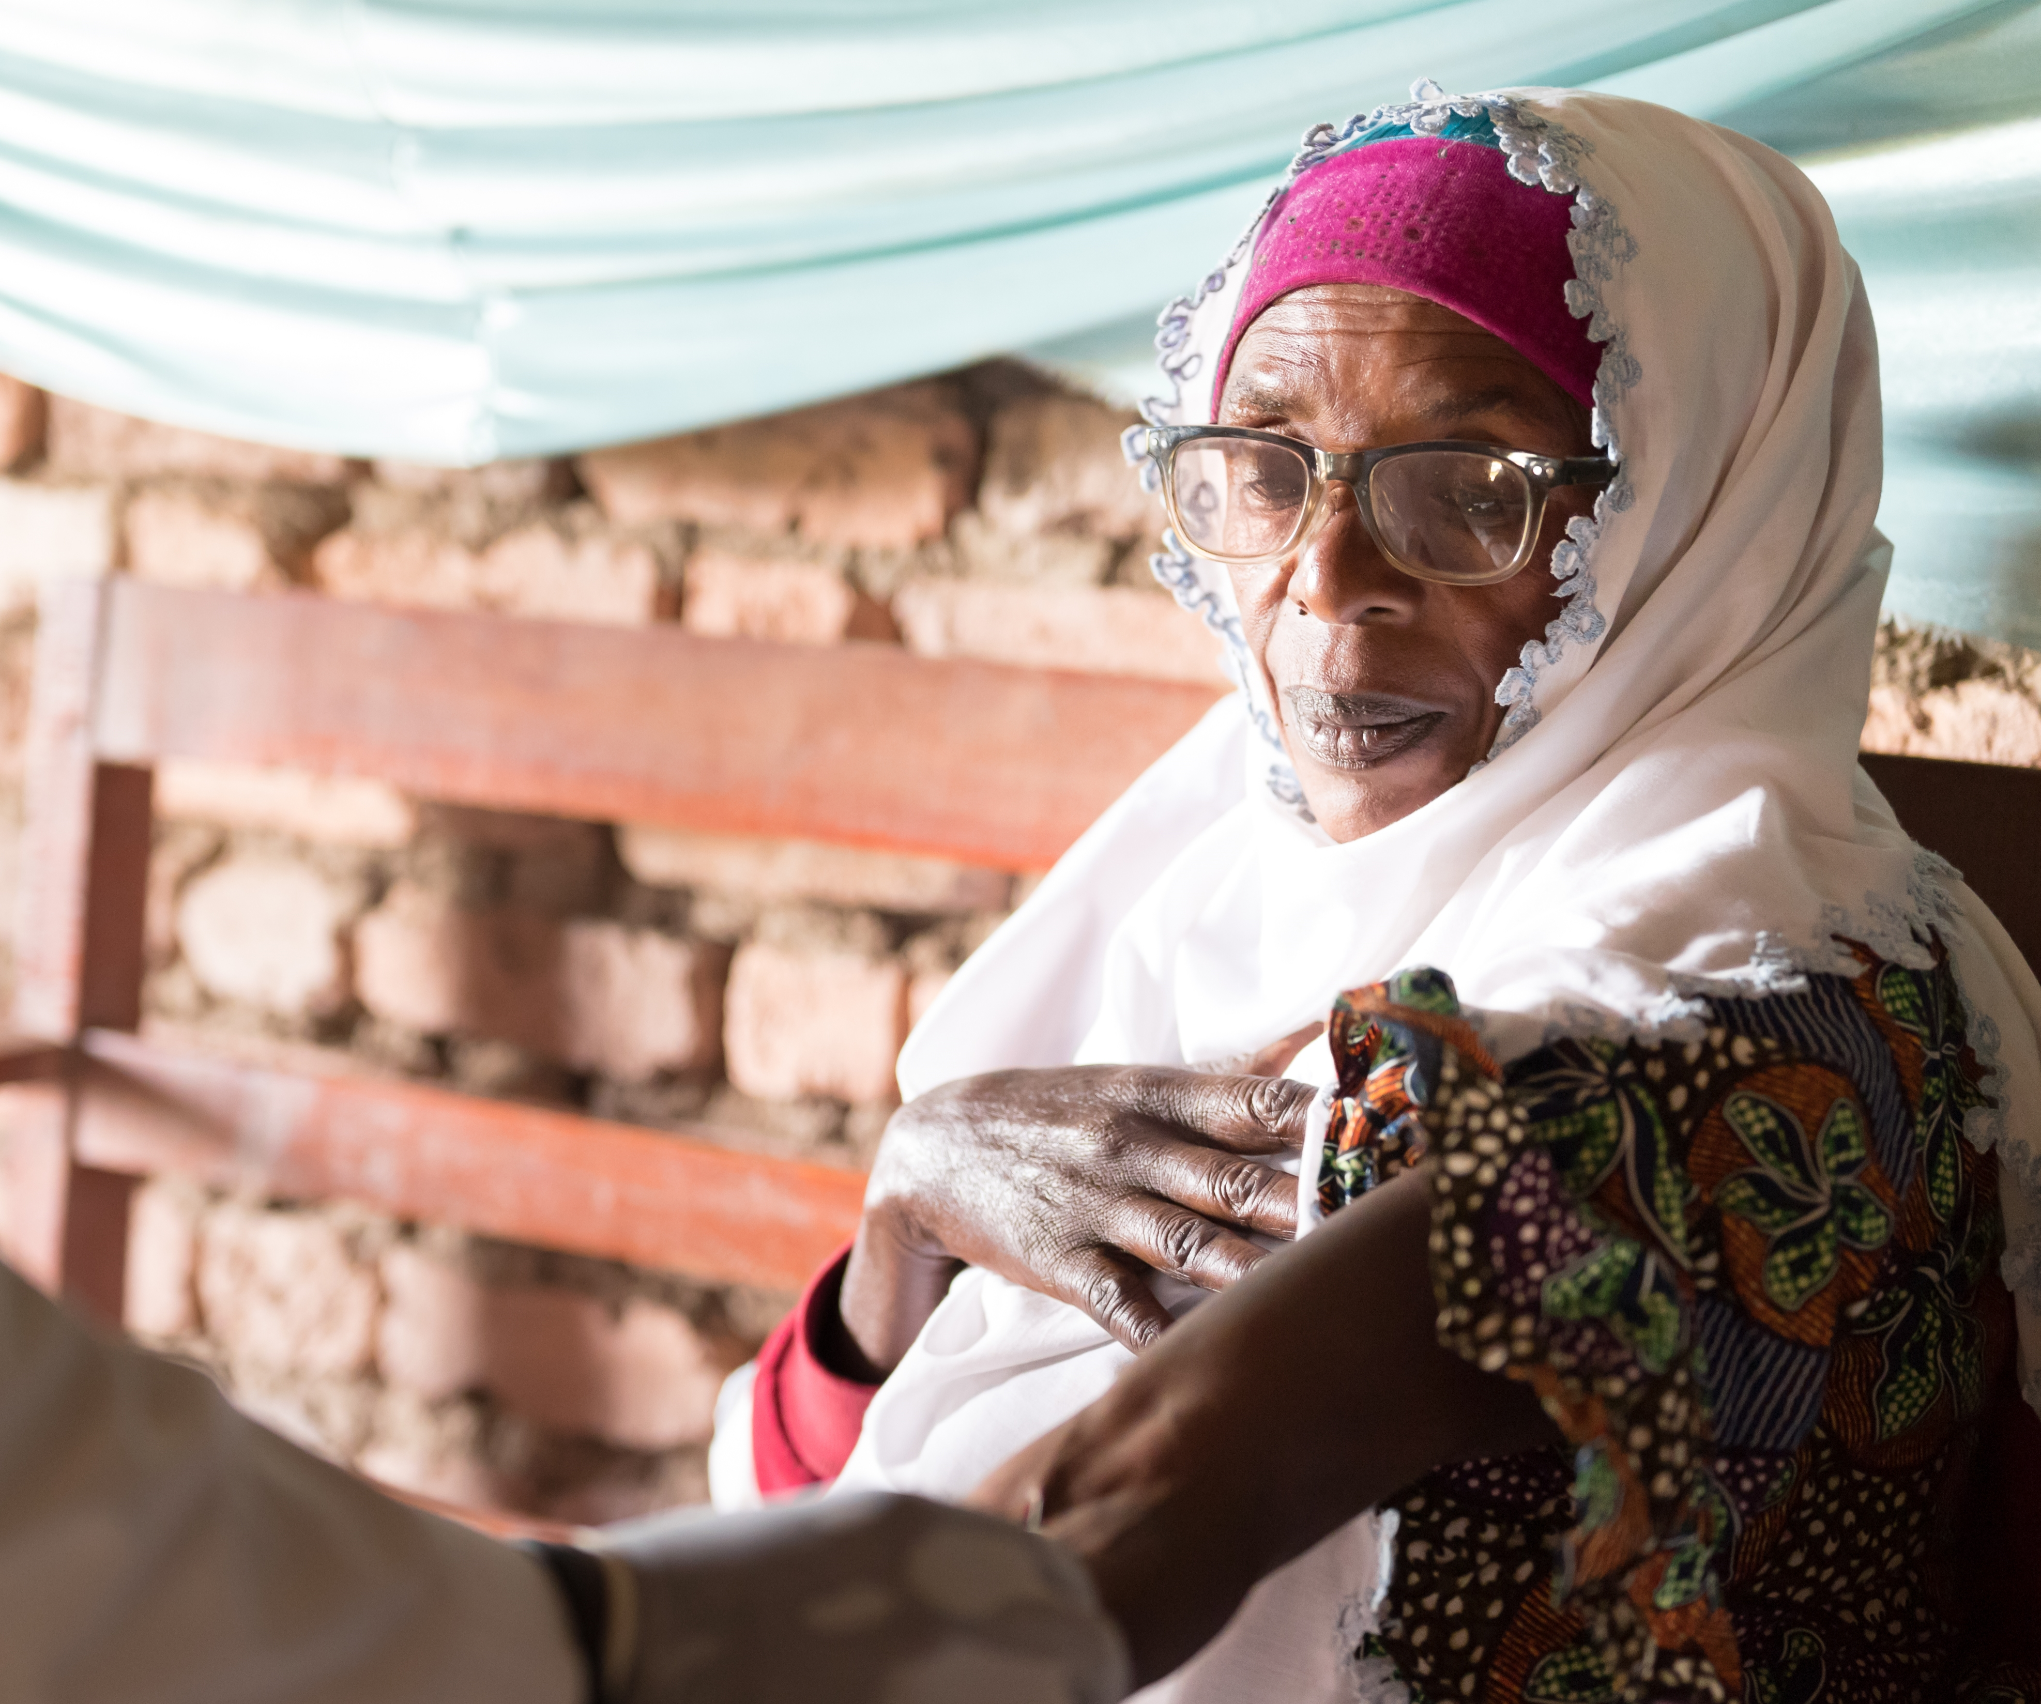
Gaps: Older Adults (> 50 y) Living with HIV
Gaps in awareness of HIV-positive status among OPLWH (first 90)
21% unaware of their HIV status before the surveys
Of these, half (54%) had never had HIV test
Source: Farley et al., 2022 (JIAS)
Notes:
In addition to the coming youth bulge, or “youth quake,” the global HIV picture includes an increasing number of older people living with HIV globally and in Eastern and Southern Africa in particular. OPLWH face unique challenges, including being more likely than younger people to have multiple comorbid conditions (exacerbated in resource-poor settings)
In this study, OPLWH in these 13 countries (Cameroon, Cote d'Ivoire, Eswatini, Ethiopia, Kenya, Lesotho, Malawi, Namibia, Rwanda, Tanzania, Uganda, Zambia and Zimbabwe) were slightly more likely to be aware of their HIV-positive status (first 90)

Slide 29
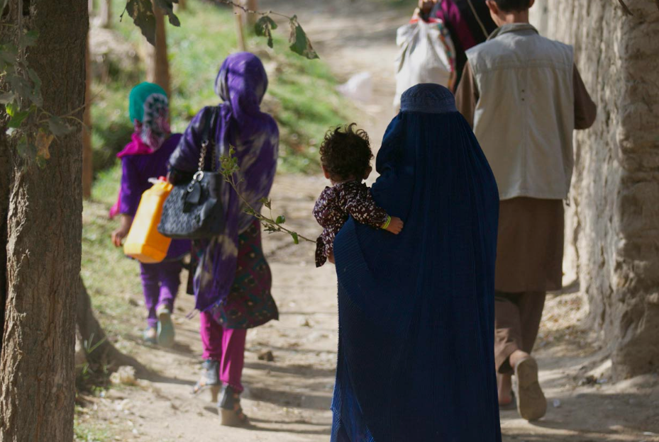
Gaps: mobile, migrant, and displaced populations
Mobile populations more likely to acquire HIV compared to more permanent residents across many settings
Often via more frequent sexual risk behaviors and expanded sexual networks
In Namibia, migration was associated with lower VLS, primarily due to lack of awareness of HIV infection
Mobility also increases risk of HIV treatment interruptions
Photo credit: UNFPA
Source: Santoso et al., 2022 (eClinical Medicine); Khalifa et al., 2022 (J Acquir Immune Defic Syndr)
Notes:
Mobility is a key driver of the HIV epidemic, particularly in SSA and affects all aspects of HIV: new infections, awareness of diagnosis and continuity of treatment.
Certain subgroups of migrants appear to have higher HIV prevalence than other migrants: refugees, asylum seekers, the undocumented

Slide 30
Threats

Slide 31
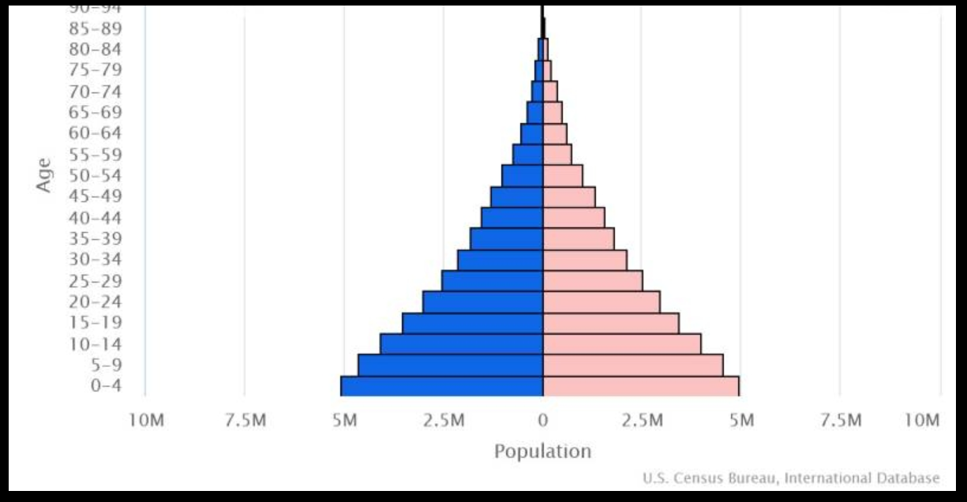
The Coming Youth Bulge
Tanzania fertility rate:
4.4 children per women
(2022)
https://www.cia.gov/the-world-factbook/countries/tanzania/#people-and-society
Notes:
Let’s look at the TZ population pyramid as an example. Over 60% of the population was under 25 years of age as of 2020.
With a high total fertility rate of 4.4 children per woman, as of 2022, Tanzania’s youth bulge will continue.

Slide 32
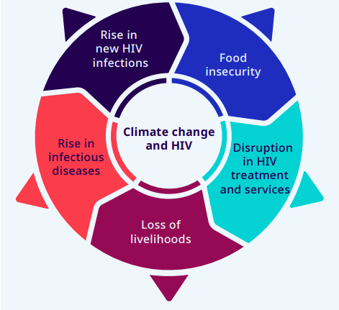
Climate change as a threat to HIV services
By MODIS image captured by NASA’s Aqua satellite - EOSDIS Worldview, Public Domain, https://commons.wikimedia.org/w/index.php?curid=77346975
Source: https://factor.niehs.nih.gov/2023/8/science-highlights/climate-change-and-hiv ; https://www.ilo.org/wcmsp5/groups/public/---ed_emp/---emp_ent/documents/publication/wcms_867187.pdf
Notes:
- climate change is impacting people living with HIV by causing disruptions in treatment, slowing down HIV services and affecting the food, nutrition and livelihood needs of people living with and affected by HIV and AIDS
- The health impacts and inequalities exacerbated by climate change are unevenly distributed in society and have an adverse effect on groups in marginalized and disadvantaged situations, including people living with HIV
- Climate change-induced extreme weather events such as floods, droughts and cyclones cause disruptions in life-saving antiretroviral treatment (ART) for people living with HIV
Ex: When Cyclone Idai made a landfall in 2019 in Southern Africa people living with HIV were among those who were much affected.
By MODIS image captured by NASA’s Aqua satellite - EOSDIS Worldview, Public Domain, https://commons.wikimedia.org/w/index.php?curid=77346975

Slide 33
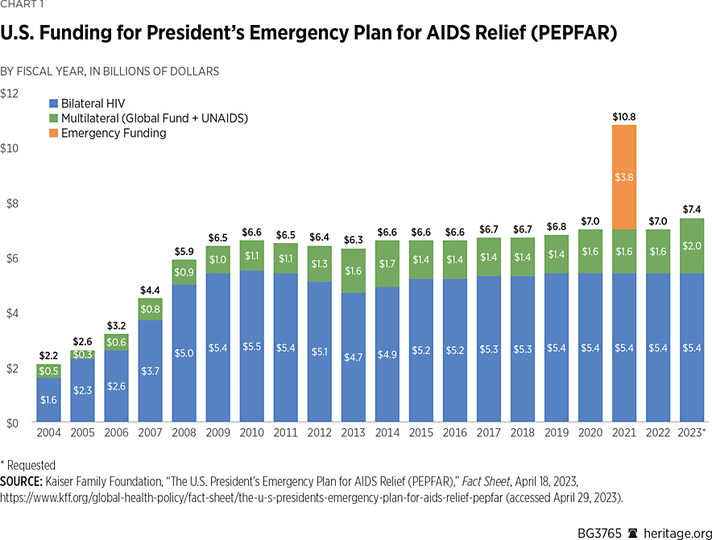
Threats to Funding
Threats to Funding
How to build sustainable systems?

Slide 34
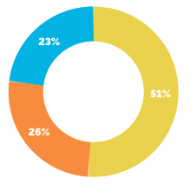
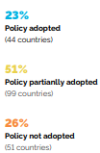
Increasing Equitable Access to Services: Reducing Stigma and Discrimination
Global progress toward adopting non-discrimination laws, 2021
Source: HIV Policy Lab, 2021
Notes:
Another threat is stigma and discrimination.
Legal reforms are needed to achieve a supportive environment, This means decriminalizing drug use or possession, sex work and same sex relationships, legal recognition of trans or gender diverse status, lowering age of consent for accessing health services, considering exceptions to standard age of consent policies
Only 23% of countries (blue) have adopted such laws and just over half (yellow) have partially adopted such laws

Slide 35
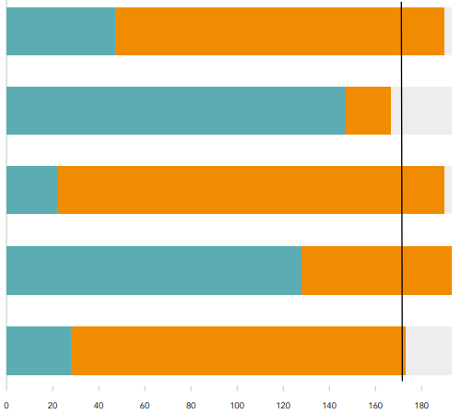
Increasing Equitable Access to Services: Reducing Stigma and Discrimination
Global status of discriminatory and punitive laws, 2023
Source: UNAIDS National Commitments and Policy Instrument 2017-2022
Notes:
Here is a different view on this topic. We are looking at the global status of punitive laws, orange means Yes punitive laws are in place. There is a lot of orange. ,

Slide 36
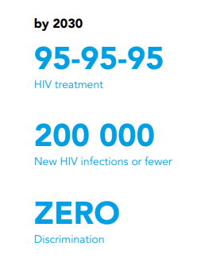
Increasing Equitable Access to Services: Reducing Stigma and Discrimination
UNAIDS 2030 Target:
<10% of PLWHIV and key populations experience stigma
PHIA surveys in Eswatini, Malawi, Tanzania and Zambia (2015-17), Adults age 15+
9.3% of PLWH reported feeling the need to hide their HIV status at a health facility
2% of PLWH reported being denied health services because of their HIV status
Individuals who reported experiencing stigma were significantly less likely to initiate ART at all time points out to 60 months (p < 0.001)
Source: Wright, C., Wang, C., Yuenglen, K., Justman, J. (IAS, 2021)
Notes:
This was a retrospective cohort analysis of adults ≥ 18 years who self-reported as HIV+, had a reactive HIV test, provided dates of their first HIV+ test result and ART initiation, and completed the survey stigma module in one of the four surveys.

Slide 37
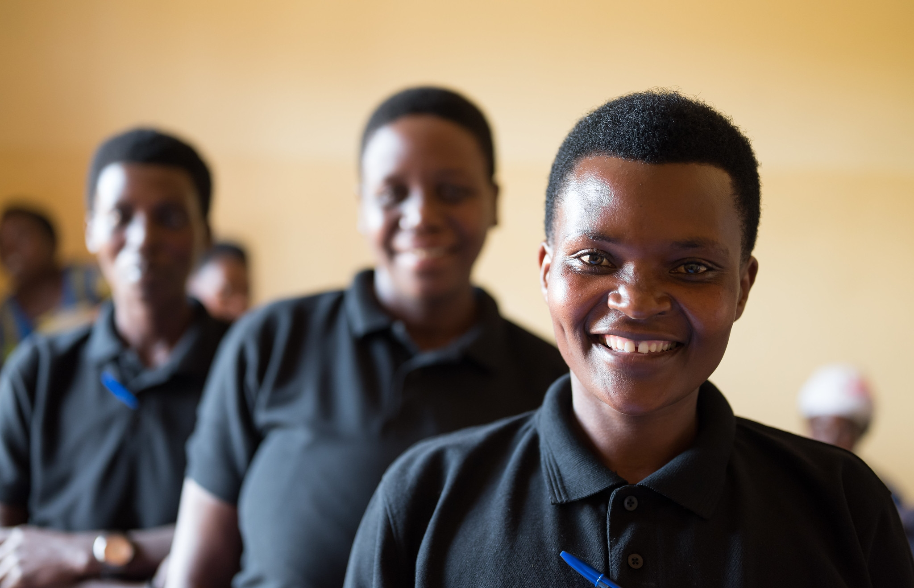
The Way Forward
Notes:
The way forward needs to accelerate prevention
Ongoing measurement to ‘Know your epidemic’
Continued treatment as prevention to reach 95-95-95 in all populations
Broader access to innovations in biomedical prevention and health delivery
Youth and KP friendly prevention services that reduce stigma
Differentiated service-delivery methods for prevention

Slide 38
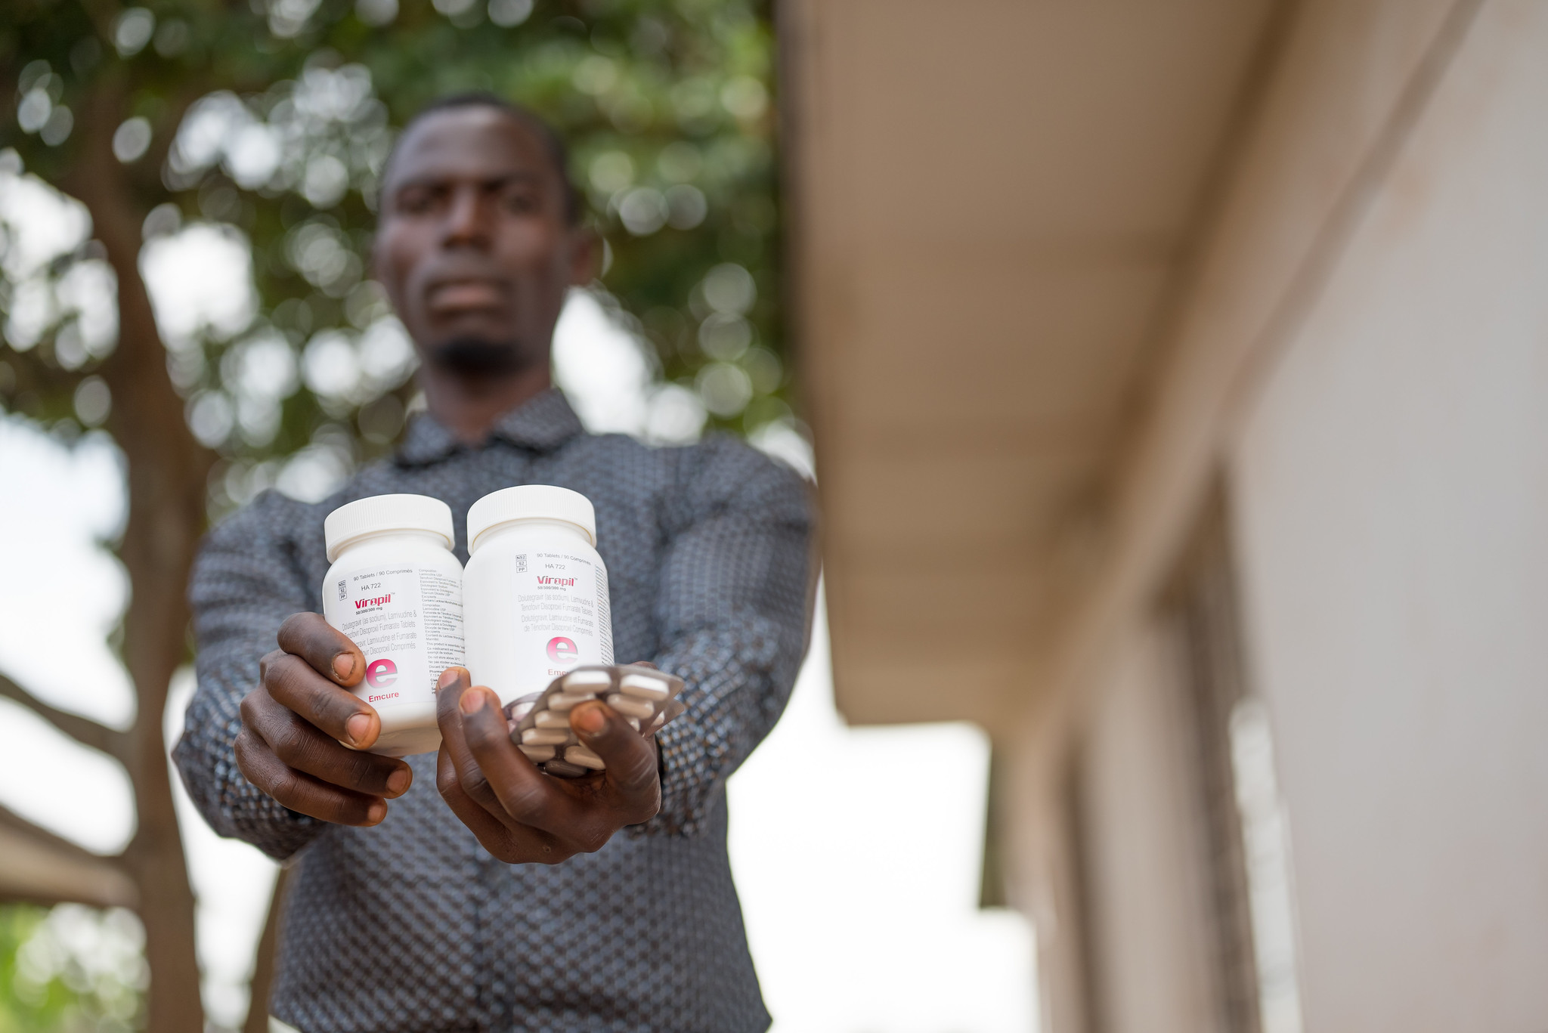
Continued Treatment As Prevention
To Reach 95-95-95 In All Populations
Notes:
CAB plus RPV LA Clinical trial data
- approved for maintenance in HIV-1 treatment in select PWH with virological suppression in Jan 2021
Demonstration projects have revealed implementation challenges: human resource capital to attain drug, administer injections, support enrolled patients; delayed therapy initiation due to insurance denials; patient ineligibility primary due to possible RPV resistance; inability to provide drug regardless of paoyor source
First demonstration project
- small demonstration project of LAI-ART in diverse group of patients with high levels of substance use and marginal housing demonstrated promising early treatment outcomes, including n those with detectable viremia due to adherence challenges

Slide 39
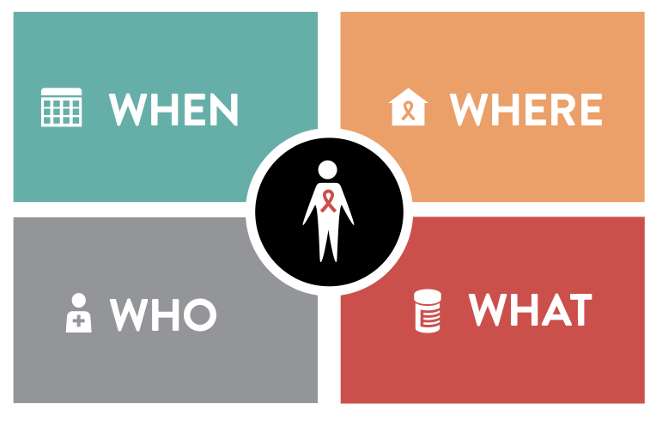
Rethinking HIV Service Delivery: Person-centered differentiated service delivery (DSD)
Notes:
DSD models of care adjust the “how” of service delivery, including:
Where: (community vs. facility based)
What: what services are needed? Lab tests, psychosocial support, refills in community settings, etc
Who: (HCW vs. peer/layperson)
When: i.e., frequency (much less frequent people doing well on ART)
Enhancing quality efficiency, and recipient care satisfaction through varying design and delivery of services offered to different groups
Studies of less-intensive models for people doing well on treatment (previously called “stable patients”) suggest they are at worst non-inferior and sometimes have better outcomes; they are typically preferred by recipients of care, who also save money and time
Applications for key populations, mobile populations

Slide 40
DSD for Mobile Populations
 | Multi-month dispensing (MMD) Flexibility on when people access services
 | Expanding service delivery beyond clinic setting for mobile populations Strengthen health facility network connectivity Creating multi-focus access points for ARV delivery eg transit hubs ARV distribution integrated in Mobile Brigades ART dispensing at private pharmacies
 | Social network-based interventions rather than fixed-location clinic- and community-based approaches
 | New therapeutic technologies that permit mobile individuals to visit clinics less often Longer-acting formulations of ART and PrEP HIV self-testing
Source: Rabkin et al., “Differentiated HIV Services for Mobile, Migrant, and Displaced Populations” (IAS, 2021)
Notes:
- HIV treatment programs must understand and adapt to human mobility
https://theprogramme.ias2021.org/Programme/Session/165

Slide 41
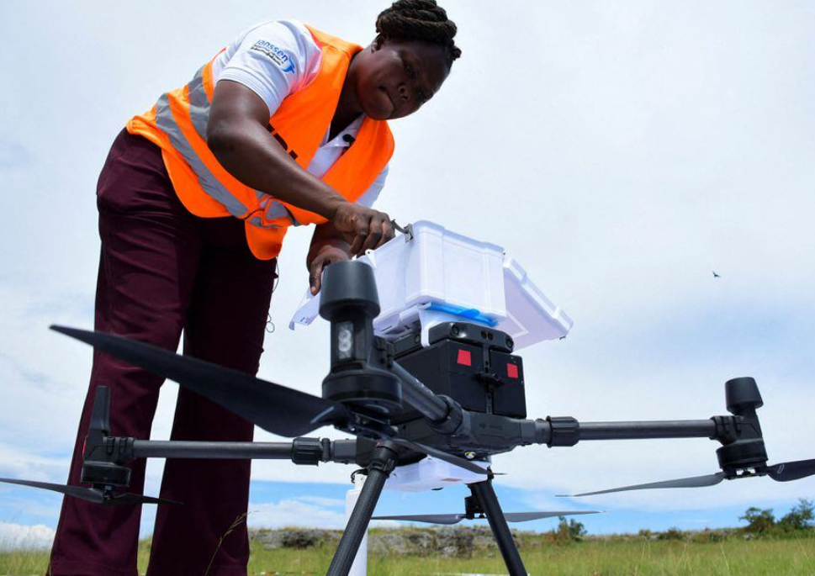
Adapting HIV Service Delivery in Response to Climate Change
MMD6 during the rainy season
Drones to supply ARVs to remote locations after climate events
Storing medical records on cloud servers so they can be recovered after climate events
Reuters, 2021
Notes:
Joan Akullo, Project Coordinator for Medical Drones Project, loads bottles of ARVs on a drone for delivery to patients from Bufumira sub-county to Kusu Village in Kalangala district in Uganda (Reuters, 2021)

Slide 42
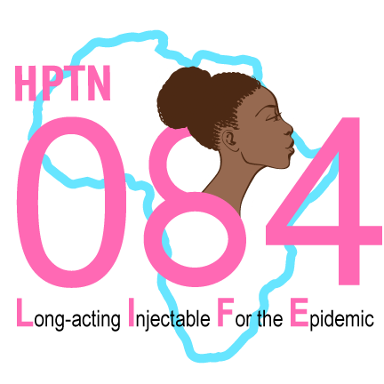
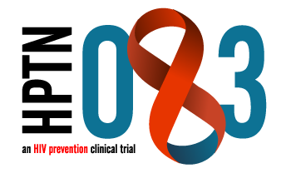
3 Types of Pre-Exposure prophylaxis (PrEP)
Oral PrEP
Dapivirine
vaginal ring
CAB LA
(New York)
(Eswatini)
Notes:
Pills: Effective if you take it, may not be discreet, daily pill
Ring: moderately effective, discreet, need new ring every month
CAB LA: Highly effective, discreet but need injections every 8 weeks
CAB has many implementation complexities. Demonstration projects needed.

Slide 43
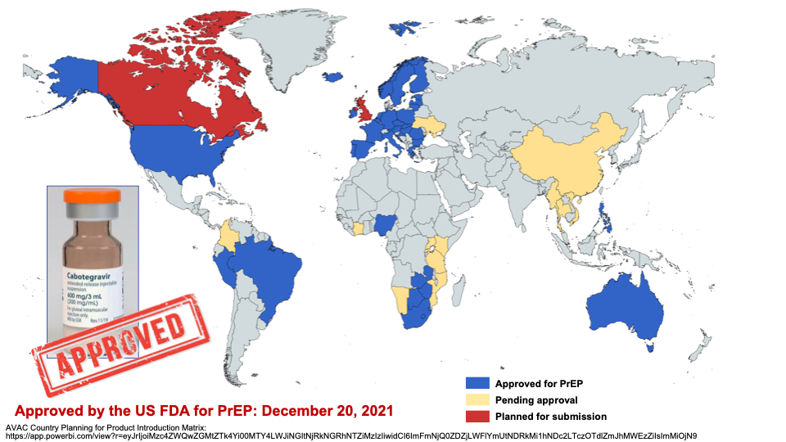
Approval of Long-Acting Cabotegravir Worldwide
Notes:
Based on 083 and 084 CAB was approved almost 2 years ago and has approval or is pending approval yellow in multiple countries plans for submission (red) in Canada and the UK.

Slide 45
Summary and Key Takeaways
We have made progress with global targets: program targets, data systems, partnerships, better medications and strengthening of capacity and systems
Persistent gaps and threats
Demographic and geographic gaps (men and young people, some countries)
Key populations account for majority of new infections
Youth quake, climate change, funding landscape, stigma and discrimination

Slide 46
Summary and Key Takeaways
The way forward must accelerate prevention
‘Strategic’ plans to end the epidemic for each country
Continued treatment as prevention to reach 95-95-95 in all populations
Broader access to biomedical and health delivery innovations
Youth and key population-friendly services that reduce stigma
Differentiated service-delivery methods
Continued community partnerships
The ‘Last Mile’ – what will it take?
Notes:
Prevention is hard work.
.With 5.5 million not diagnosed I’m not sure if we are at the last Mile. And what if the Last Mile costs as much as the first 30 million miles?

Slide 47
Thank you!

Slide 48
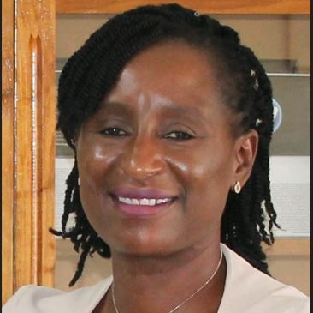
Chris Beyrer, MD, MPH Director, Duke Global Health Institute, Professor of Medicine, Duke University Associate Director, Global HIV, Duke Center for AIDS Research (CFAR)
Nyaradzo Mgodi, MBChB, MMed
University of Zimbabwe, Harare, Zimbabwe
Jeffrey Walimbwa
Health and Programs Coordinator
ISHTAR, Nairobi, Kenya

Slide 49
Q&A

Slide 50
This webinar recording and slides will be posted on www.icap.columbia.edu

Slide 51
Thank you!

