Slide 2
Wafaa El-Sadr,
MD, MPH, MPA
Director of ICAP at Columbia University, Professor of Epidemiology and Medicine at Columbia Mailman School of Public Health, Executive Vice President of Columbia Global, and Lead of the New York City Pandemic Response Institute

Slide 3
What Will It Take to Reach HIV Epidemic Control?
Jessica Justman, MD
Senior Technical Director
ICAP at Columbia
Associate Professor of Medicine in Epidemiology
Columbia University
December 1, 2022
Notes:
Thanks for the opportunity to talk about HIV Epidemic control.

Slide 4
Overview
Trajectory of the global HIV epidemic
Different approaches to defining ‘Epidemic Control’
Using data to find the gaps and inform interventions
Looking forward:
New models of care
New tools
Notes:
We’ll review the global HIV epidemic in countries most affected by HIV, and look at different approaches, to defining epidemic control.
We’ll talk about how data are helping us find the gaps in epidemic control so we can see who is being left behind and what interventions are most suitable
Then we’ll look ahead to new models of care and new tools that all aim to leave no one behind

Slide 5
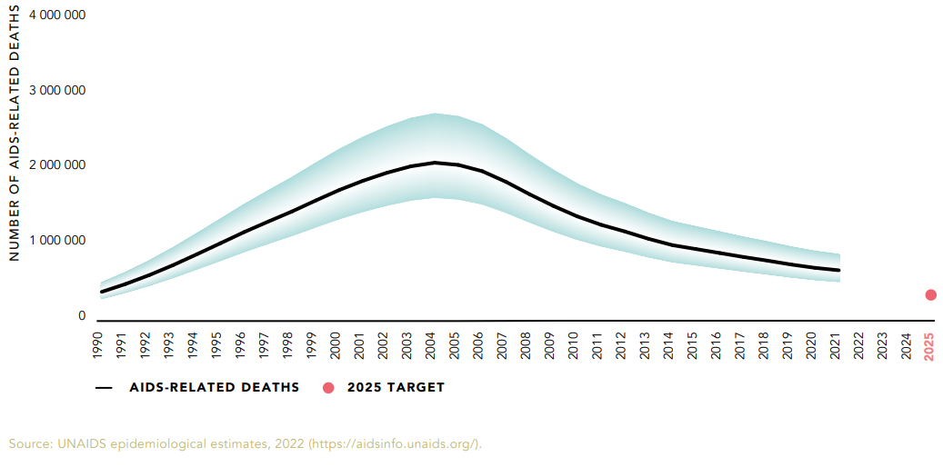
Adult and Child Deaths due to AIDS 1990–2021
~50% decline in AIDS deaths since 2010
Actual
650,000
Target
250,000
Notes:
Let’s start by looking back, Here is graph of adult and child deaths due to AIDS over past 30 years. The good news is AIDS deaths have been declining since 2005 and have decreased by almost 50% in last ten years . Unfortunately, the global target of 250,000 deaths by 2025 looks like it will be hard to achieve.

Slide 6
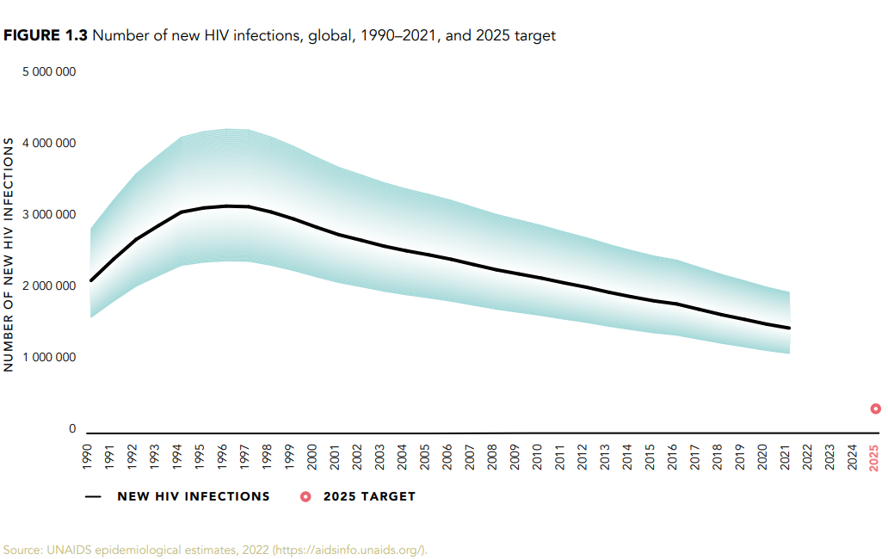
Adults and children newly infected with HIV 1990–2021
32% decline in new infections since 2010
Actual
1.5 million
Adults and children newly infected with HIV
Range of uncertainty
500,000
Target
Notes:
New infections have been declining too but not by as much. The plan had been for annual new infections to fall below 500,000 by 2020 but instead, it was three times higher, 1.5 million.

Slide 7
What Does Epidemic Control Look Like?
Progress toward Targets
percentage achieved of predetermined targets:
e.g., 95% HIV awareness, 95% ARV coverage & 95% viral suppression
Absolute Rate
absolute rates of HIV incidence or AIDS related mortality: <1/1,000 adults per year, or <1/10,000 adults per year
Incidence-Prevalence Ratio
e.g., < 3 new infections : 100 PLWH/year
Incidence-Mortality Ratio <1
total # new HIV infections/year
total # deaths (all causes) among PLWH/year
Percentage Reduction
[New infections, 2010 – New infections, 2020]
[New infections, 2010]
X 100%
Source: UNAIDS (2017)
Notes:
What does HIV epidemic control look like? How will we know when we’re there? There is not a SINGLE way to define HIV epidemic control. Here are a few approaches to define epidemic control and they each have advantages and disadvantages.
Some definitions include mortality, others do not. We’ll look at examples of three of these – Progress Toward Targets, Percentage Reduction and Incidence Mortality Ratios.

Slide 8
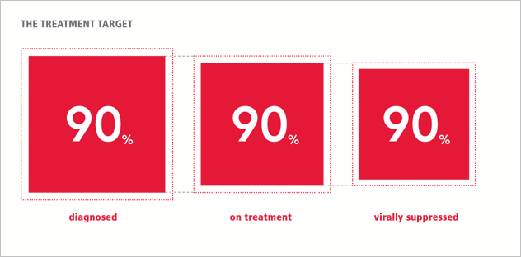
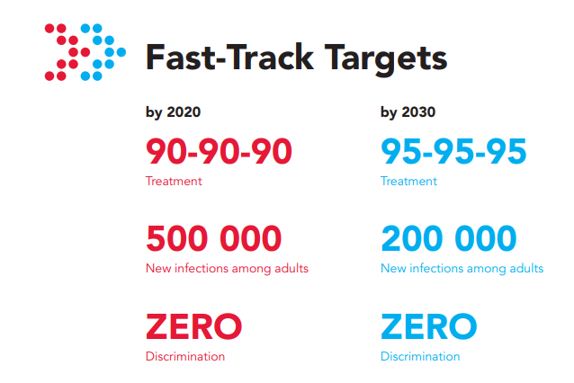
Defining Epidemic Control
UNAIDS’ Fast-Track strategy to end the AIDS epidemic by 2030 (95-95-95)
Progress toward targets
New HIV infection target
& zero discrimination target
CDC’s “Ending the HIV Epidemic in the US”
Percentage Reduction
Reduction in new HIV infections in the United States by 75% in five years and by 90% in ten years
PEPFAR Vision 2025
Incidence-Mortality Ratio
Total # new HIV infections
less than total # deaths
from all causes among HIV-positive individuals
Source: UNAIDS; PEPFAR; US CDC
Notes:
UNAIDS uses Progress Toward Targets for its Fast Track strategy to end the epidemic by 2030. You may have heard of the 90-90-90 targets: this called for 90% of …., all by 2020, to be followed by 95-95-95 targets by 2030.
We’re going to refer to these targets.
CDC by contrast uses the percentage reduction approach for it’s Ending the Epidemic initiative. This calls for reductions….
PEPFAR, the President’s Emergency Plan for AIDS Relief, is the US government program that supports the global HIV response. PEPFAR uses an incidence mortality ratio of less than 1 to define epidemic control. This occurs when the total # of ….
Now let’s look at some examples of these three approaches.

Slide 9
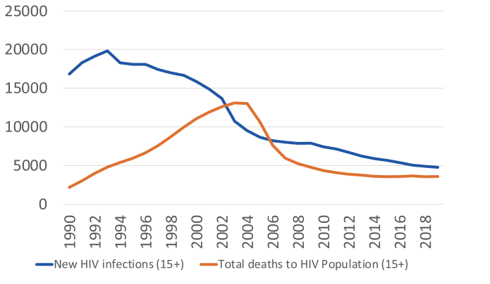
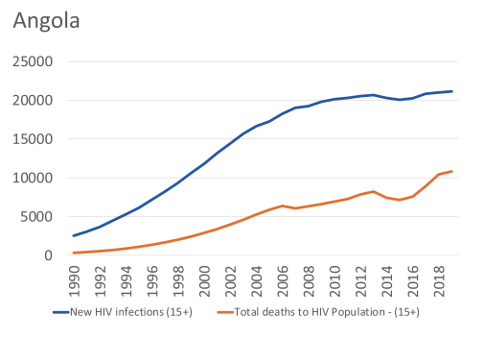
Epidemic Trajectory Examples: Incidence-Mortality Ratio
Rwanda
Angola
Source: PEPFAR 2021 Annual Report to Congress
Notes:
Here are two epidemic trajectories from PEPFAR.
On the left, the incidence-mortality ratio in Rwanda shows dramatic and consistent declines in both new infections (blue) and mortality (red)
Angola: unfortunately, both new infections and mortality have been increasing and new infections (blue) consistently exceed mortality (red) by at least a 2 fold margin

Slide 10
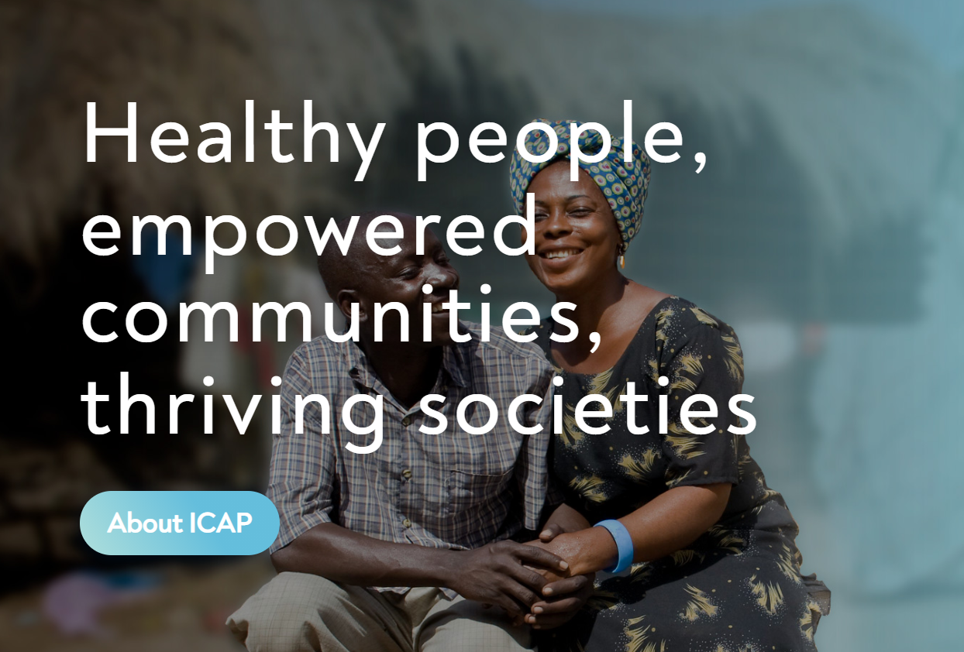
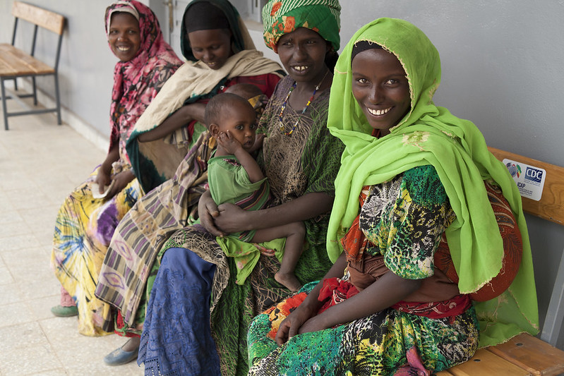
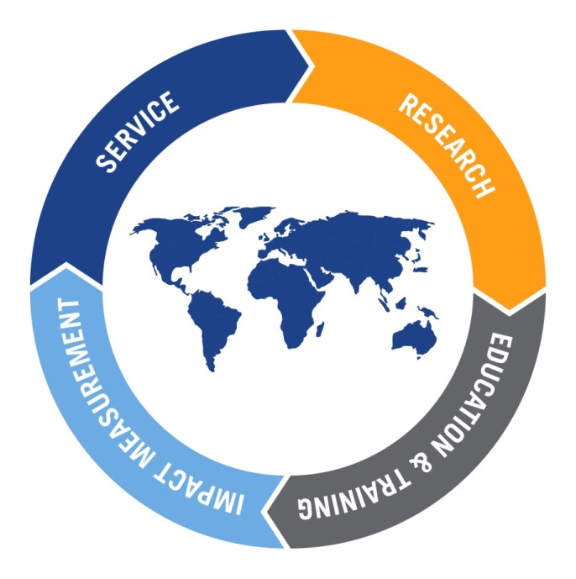
ICAP at Columbia University
Healthy people,
empowered communities,
thriving societies
Works through collaborations at every level of the health system
national governments, district health management teams, individual health facilities, local educational institutions and NGOs
Core approaches inform activities :
technical assistance
implementation support
capacity building
thought and scientific leadership
Notes:
As Dean Fried mentioned, ICAP at Columbia is a leading global health center that works collaboratively at every level of the health system.
ICAP has played a major role in measuring the status of the national HIV epidemics through surveys that have informed the HIV response within countries and globally

Slide 11
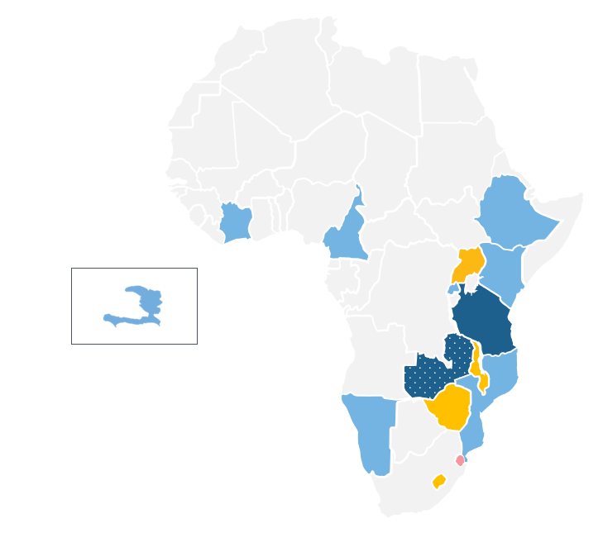
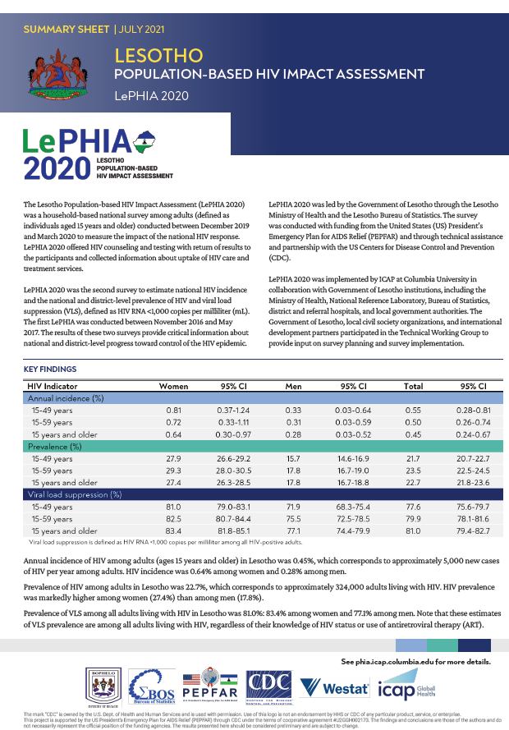
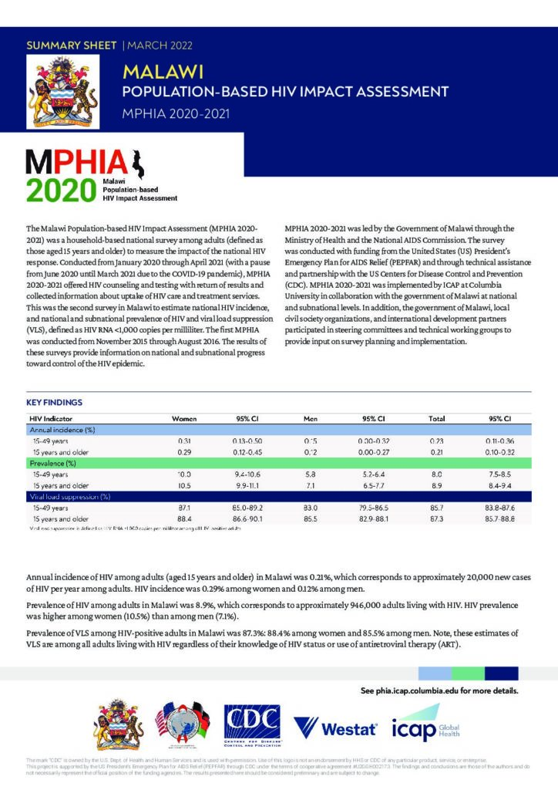
PHIA Project: Measuring Progress Toward Targets
1st survey complete
1st survey completed; 2nd survey ongoing
1st survey completed; 2nd survey in data analysis
1st and 2nd survey complete
3rd survey complete
Population-based Impact Assessments (PHIAs)*
Data collection completed for 21 surveys in 15 countries (22nd survey ongoing)
20 summary sheets released
16 final reports released
Public datasets available for 13 surveys
phia.icap.columbia.edu
*Including releases from World AIDS Day 2022 Events
Notes:
The data we just saw from PEPFAR draws from the PHIA surveys…. With PEPFAR funding, ICAP has led the implementation of these large, household-based national surveys since 2014.
The map gives you a picture of the locations of these surveys
21 surveys have been completed and the 22nd is now underway. The website contains summary sheets and final reports information

Slide 12
Where are the Gaps? Men Lag Behind Women in Awareness of HIV+ Diagnosis
*adjusted for ARVs unless otherwise specified;
†not adjusted for ARVs
PHIA Data Collected from 2015 - 2018
Notes:
As new infections decrease at least in some countries, it becomes increasingly important to focus on the gaps. Who is getting left behind? PHIA surveys are helping to identify who is getting left behind.
Here PHIA data clearly show how the percentage of HIV+ men who are aware of their diagnosis (gray bars) is consistently lower than it is for women (greenbars), in other words, in every one of these 12 countries, the men lag behind women when it comes to awareness of HIV+ diagnosis.

Slide 13
Treatment for HIV: Men Do Not Lag Behind Women
Viral Load Suppression: Men Do Not Lag Behind Women
*adjusted for ARVs unless otherwise specified;
†not adjusted for ARVs
PHIA Data Collected from 2015 - 2018
Notes:
The good news is this is not the case when it comes to treatment and viral load suppression. Here men and women are similar.

Slide 14
Where are the Gaps? HIV Care Cascade, Younger vs. Older Populations
*Adjusted for ARVs unless otherwise specified; †Not adjusted for ARVs;
Column labels indicate conditional proportions; Column heights indicate unconditional proportions
PHIA Data Collected from 2015 - 2018
Notes:
These PHIA data compare THE HIV CARE CASCADE for younger adults with older adults by country. Older is defined as age 25 and above.
The outcomes we looked at a moment ago are stacked together. As a reminder, the lightest green is awareness of diagnosis, the middle green is being on treatment for HIV and the darkest shade o green is for VLS.
Whether you look at the countries on the left, with the highest rates, or the ones on the right, with lower rates, younger adults are getting left behind

Slide 15
Progress Toward Targets: HIV Care Cascade, 2011 to 2021, Eswatini
28% VLS
66% VLS
88% VLS
94
97
96
84
86
91
62
53
85
*SHIMS 2010 included adults 18-49 y; SHIMS2 and SHIMS 3 included adults 15 y and older
Notes:
Not everything is about gaps. I want to share these three bar graphs that summarize ten years of tremendous progress in Eswatini.
In 2011, on your left, only 28% of HIV+ adults had viral load suppression. Ten years later, it is 88%. This means Eswatini has reached the 95-95-95 target

Slide 16
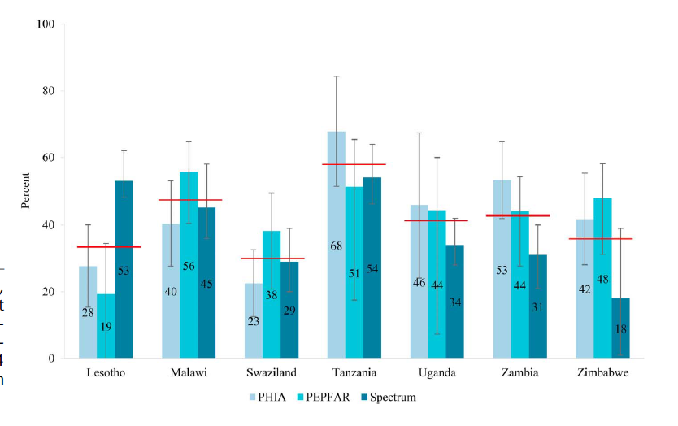
Gaps in Pediatric Progress
48% of children (0–14 years) living with HIV in 7 countries were not on ART
(PHIA, PEPFAR, Spectrum, 2016–2017)
Percentage of children living with HIV not on ART
Average treatment coverage gap across PHIA, PEPFAR and Spectrum estimates
Saito et al., JAIDS (2018)
Notes:
Let’s focus in on children with HIV.
Here we see three different sources of treatment data for CLHIV: PHIA, PEPFAR program data and Spectrum models.
Each red horizontal line shows the average…
Overall, for these 7 countries, about half of all children were not on ART
With some variation in the estimate by data source.
Sadly , as of 2021, this gap across HALF of CLHIV was THE SAME

Slide 17
Ending the HIV Epidemic (EHE) in the US
2019 initiative: Diagnose, Treat, Prevent, and Respond
Using the percentage reduction approach, the initiative calls for a 75% decrease in new HIV diagnoses in 5 years and a 90% decrease in 10 years
Source: US CDC
Notes:
In 2019 it was 34,800 so the slope is decreasing. The decline is on track until you unpack it and see that the declines are not proportionately across all races.

Slide 18
Population Level Findings
Awareness of HIV diagnosis is lower among men than women, indicating need for testing campaigns focused on men
Prevalence of treatment and VLS are similar for men and women
Awareness of HIV+ diagnosis is lower among younger populations (15-24 y) than those 25 y and older
Only half of children living with HIV are on treatment, leading to low rates of VLS among diagnosed children

Slide 19
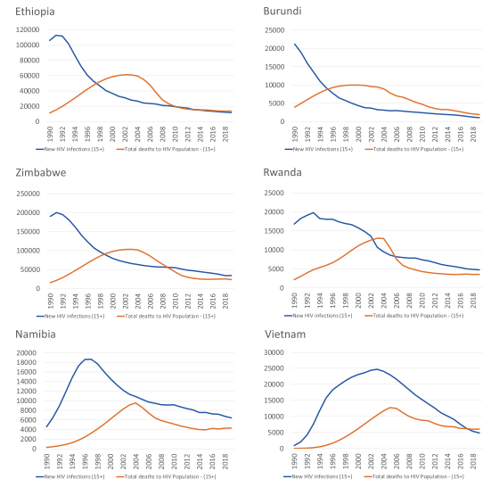
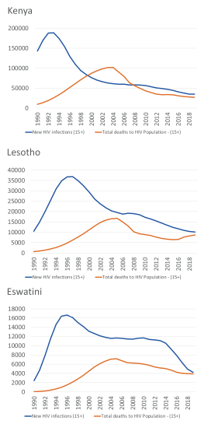
Preparing for the Future
Notes:
We’ve looked at where the gaps are and we’ve also seen some impressive progress. These graphs on your left show 9 countries approaching epidemic control. What happens as HIV incidence in the general population decreases?
It will be increasingly important to focus HIV control among what are called key populations (click).
Key populations are groups at increased HIV risk based on specific sexual or other behaviors.
In 2021, key populations (MSM, PWID, and TGW) and their sexual partners accounted for 70% of HIV infections globally:
94% of new HIV infections outside of sub-Saharan Africa.
51% of new HIV infections in sub-Saharan Africa.

Slide 20
Preparing for the Future
In 2021, key populations (MSM, PWID, and TGW) and their sexual partners accounted for 70% of HIV infections globally:
94% of new HIV infections outside of sub-Saharan Africa.
51% of new HIV infections in sub-Saharan Africa.
UNAIDS
Notes:
We’ve looked at where the gaps are and we’ve also seen some impressive progress. These graphs on your left show 9 countries approaching epidemic control. What happens as HIV incidence in the general population decreases?
As pointed out in this recent commentary, as HIV incidence decreases, it will become more important to focus HIV programs among what are called key populations (click).
Key populations are groups at increased HIV risk based on specific sexual or other behaviors.
UNAIDS estimated that in 2021, key populations (MSM, PWID, and TGW) and their sexual partners accounted for 70% of HIV infections globally:
94% of new HIV infections outside of sub-Saharan Africa.
51% of new HIV infections in sub-Saharan Africa.

Slide 21
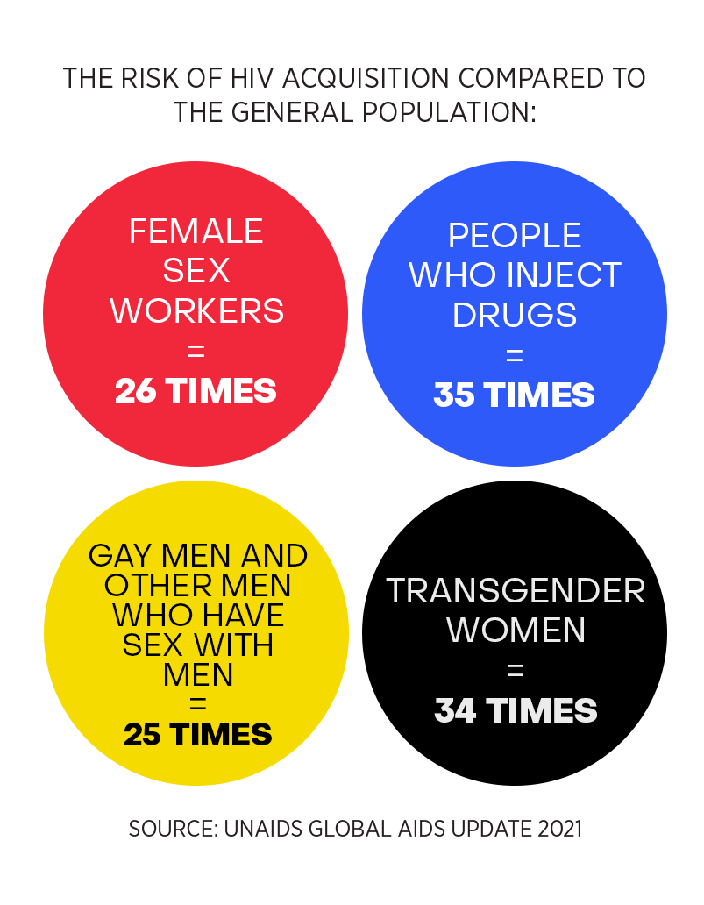
Where Are the Gaps in Epidemic Control? Priority Populations and Key Populations
Adolescent girls and young women
Globally, around 5,000 adolescent girls and young women aged 15–24 years become infected with HIV every week
In sub-Saharan Africa, 6 of 7 new HIV infections among adolescents aged 15–19 years are among adolescent girls
Source: Global Fund 2021; UNAIDS 2019
Notes:
Adolescent girls and young women in particular, continue to acquire new HIV infections at extremely high rates (box on left), 5000 new infections each week. And in SSA, 6 out of 7 new infections….
Adolescent girls and young women are considered a “priority population,” a segment of the population at especially high risk of HIV based on characteristics such as age and gender.
On the left we see that the risk of HIV acquisition as compared to the general population is at least 25 times higher among key populations such as female sex workers, people who inject drugs, transgender women, and gay men and other men who have sex with men.
Important to note these groups are often medically underserved and face violence, criminalization, stigma, and discrimination, including in health care settings.

Slide 22
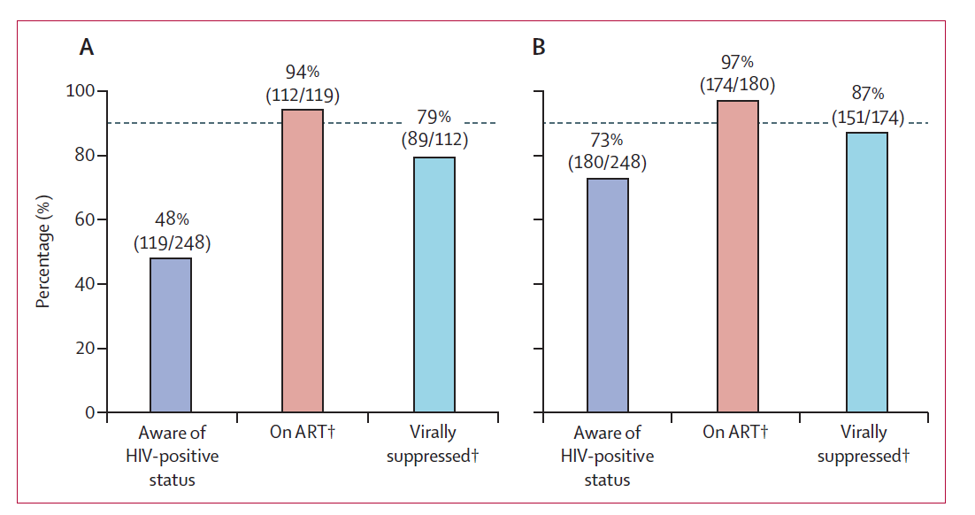
HIV Care Cascade Among Men Who Have Sex With Men Biobehavioral Survey Using Respondent-driven Sampling, Zimbabwe, 2019
Progress towards 90–90–90 targets
(A) self-reported HIV and ART status (B) after viral load recategorization*
Harris et al., Lancet HIV (2022)
Notes:
Risks for acquisition are not identical to risks for transmission
To understand how, where and what services are most needed, we need better data. Biobehavioral surveys…
HIV prevalence among MSM in the urban areas of Harare and Bulawayo, Zimbabwe was 21%. Among the HIV+ men, only 48% were aware of their diagnosis however, after those with a viral load <200 were recategorized as aware of their status and on treatment, then 73% were aware. Again, we see the major gap is in awareness. Results were similar for transgender women and gender queer individuals in this same survey
*those who reported they were HIV negative or had an unknown status but then tested HIV positive and had a viral load of less than 200 copies per mL or said they were HIV positive and not on ART but had a viral load of less than 200 copies per mL were aware of their HIV status and on ART (referred to as the viral load recategorisation in the results

Slide 23
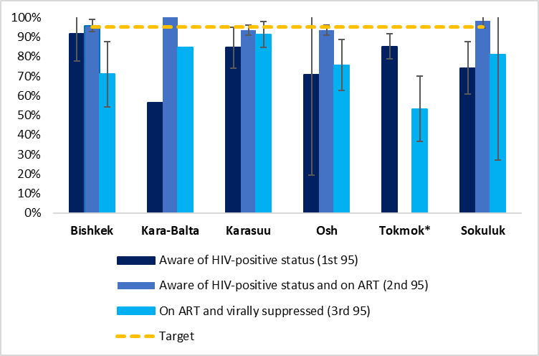
HIV Prevalence and Care Cascade Among People Who Inject Drugs, Biobehavioral Survey, Kyrgyz Republic, 2021 (N=985)
Notes:
Central Asia – HIV Prevalence ranged from 13.3% to 46.3%
Bishkek N=256 Karasuu N=222 Osh N=184 Sokuluk N=120 Tokmok N=147 Kara-Balta N=56

Slide 24
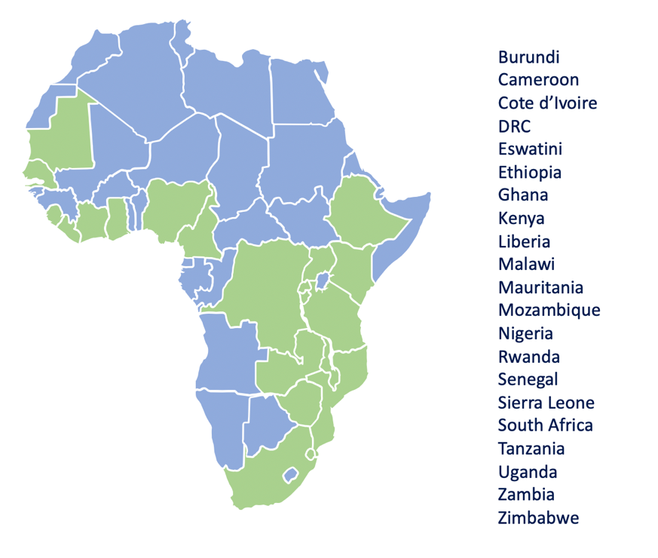
CQUIN: HIV Coverage, Quality and Impact Learning Network
Accelerating high-quality differentiated service delivery
DSD: Health services tailored to groups of people, not relying on one-size-fits all
Goal of DSD is to enhance
client outcomes
health system efficiency
HIV epidemic control
Supported by community advocates
21 African countries
Funded by Gates
Notes:
We’re going to talk about new technologies and tools in a few minutes. But we have to know how to use them, especially if they involve new models of care.
CQUIN is funded by the Bill and Melinda Gates Foundation and convened by ICAP.
As a learning network, CQUIN brings together health system leaders from 21 countries in sub-Saharan Africa for joint learning and information exchanges.
The goal is to foster the scale-up and spread of high-quality, high-impact differentiated service delivery models of care.
DSD consists of health services tailored to groups…..This kind of person-centered strategy designs different models for different groups of people. It’s been a major shift from the early days of a one-size-fits-all ‘public health’ model of care

Slide 25
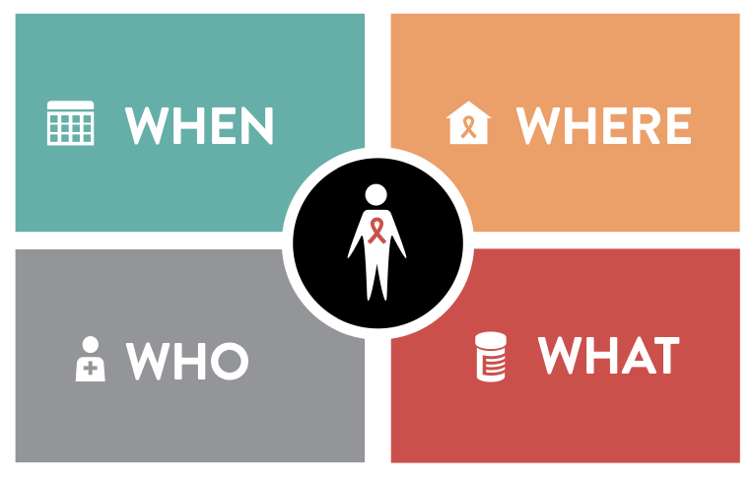
What is Differentiated Service Delivery?
Notes:
What is differentiated service delivery?
DSD models of care adjust the “how” of service delivery, including:
Where: (community vs. facility based)
What: what services are needed? Lab tests, psychosocial support, refills in community settings, etc
Who: (HCW vs. peer/layperson)
When: i.e., frequency (much less frequent people doing well on ART)

Slide 26
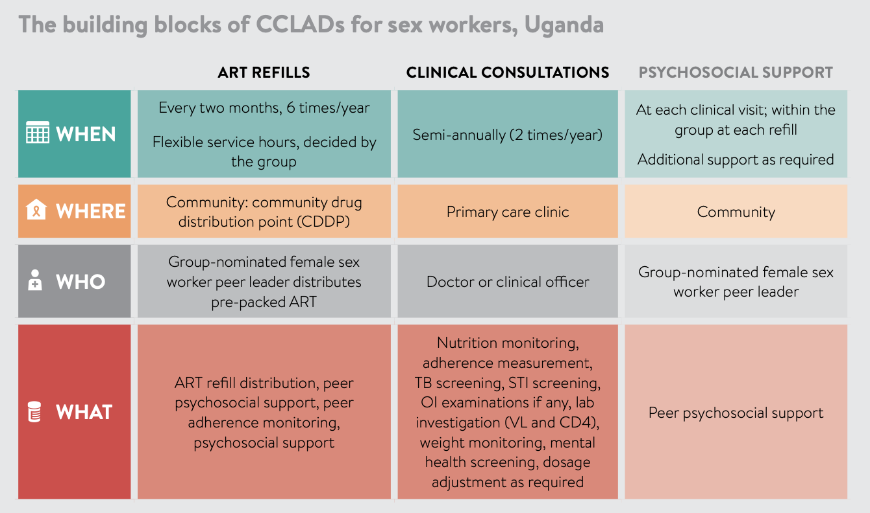
Differentiated Service Delivery for Female Sex Workers: Community Client-led ART delivery groups in Uganda
Notes:
Here is an example of DSD that consists of a community client led ART delivery groups in Uganda. The CCLAD functions as a peer support group that provides ART refills
The when, where, who and what are described in the table. The point is that the service ART refills is client centered.
Peer support group with 5-10 sex workers from geographical area
Group selects a peer leader who collects 3-month ART refills from the nearest community drug distribution point
The peer leader then distributes the refills to the CCLAD members at the agreed venue, documents the distribution and monitors the treatment among her peers.
https://www.differentiatedservicedelivery.org/Portals/0/adam/Content/2a0WxWUHfUKtul1mKWdmGQ/File/Decision%20Framework%20Key%20Population%20Web_Post_Conference_FINAL.pdf page 27
And here: https://cquin.icap.columbia.edu/wp-content/uploads/2021/08/Muzaaya_Session-9b_FINAL.pdf

Slide 27
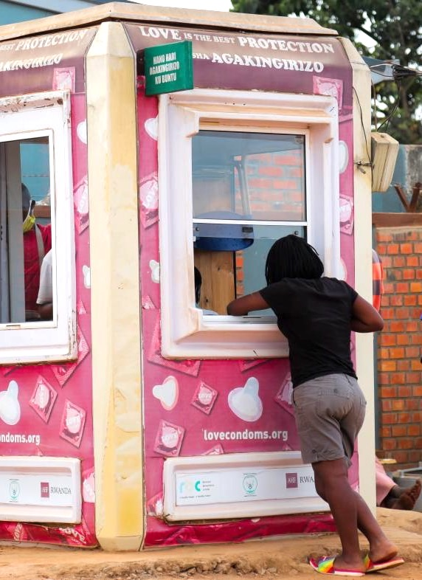
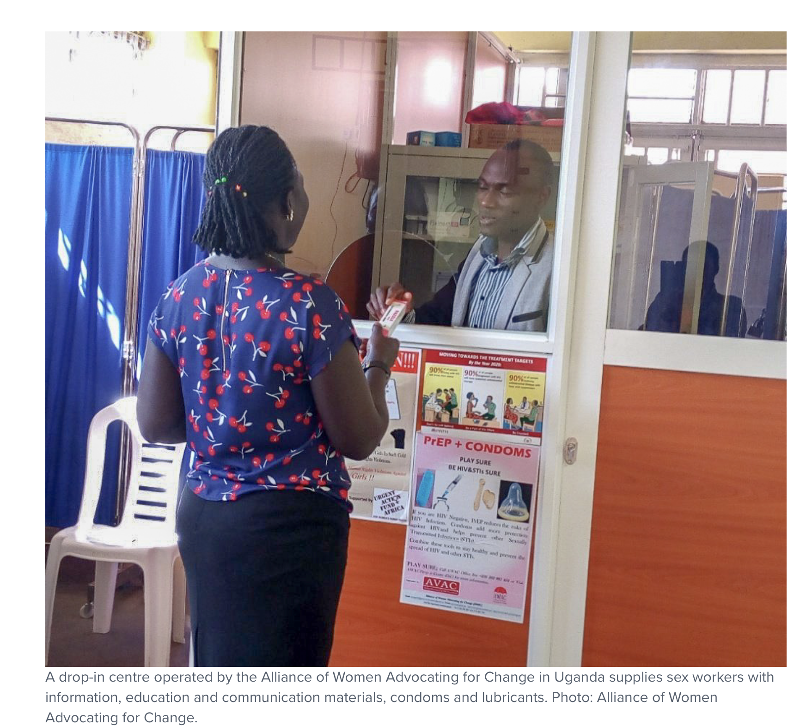
Sources: Rwanda Biomedical Center; Alliance of Women Advocating for Change; Wits RHI Trans Health
Notes:
Here are some photographs: a Trans Health Centre in South Africa, a pink Condom Kiosk in Rwanda, and a drop in center for sex workers in Uganda in the lower half of the slide
https://cquin.icap.columbia.edu/wp-content/uploads/2021/08/Narcisse_Final.pdf

Slide 28
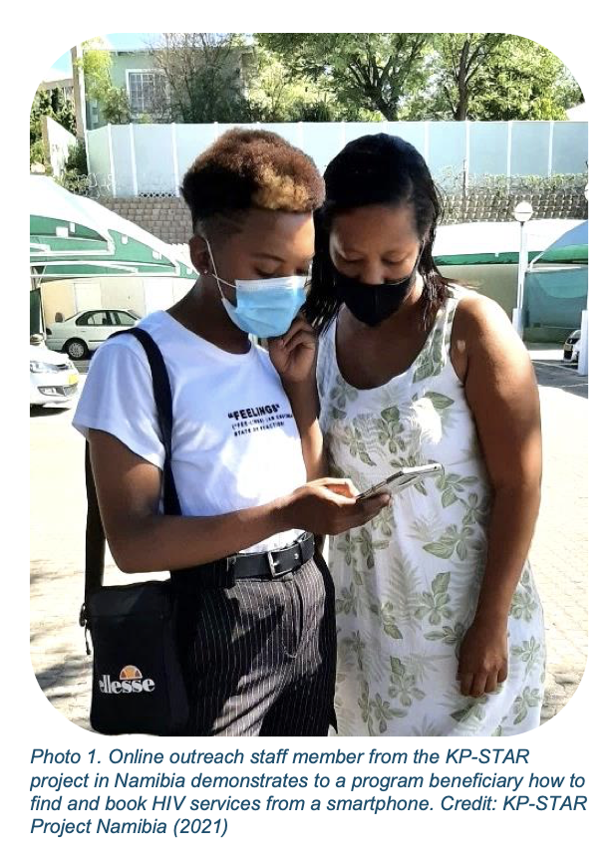
https://quickres.org/100
Notes:
Peer led ART refills and drop in centers work for those who are willing to join or attend.
For those who are not comfortable doing this, online tools such as smartphone apps, offer flexibility and privacy. While booking HIV services
an i Another example https://cquin.icap.columbia.edu/wp-content/uploads/2021/08/Blest_Session-10_FINAL.pdf

Slide 29
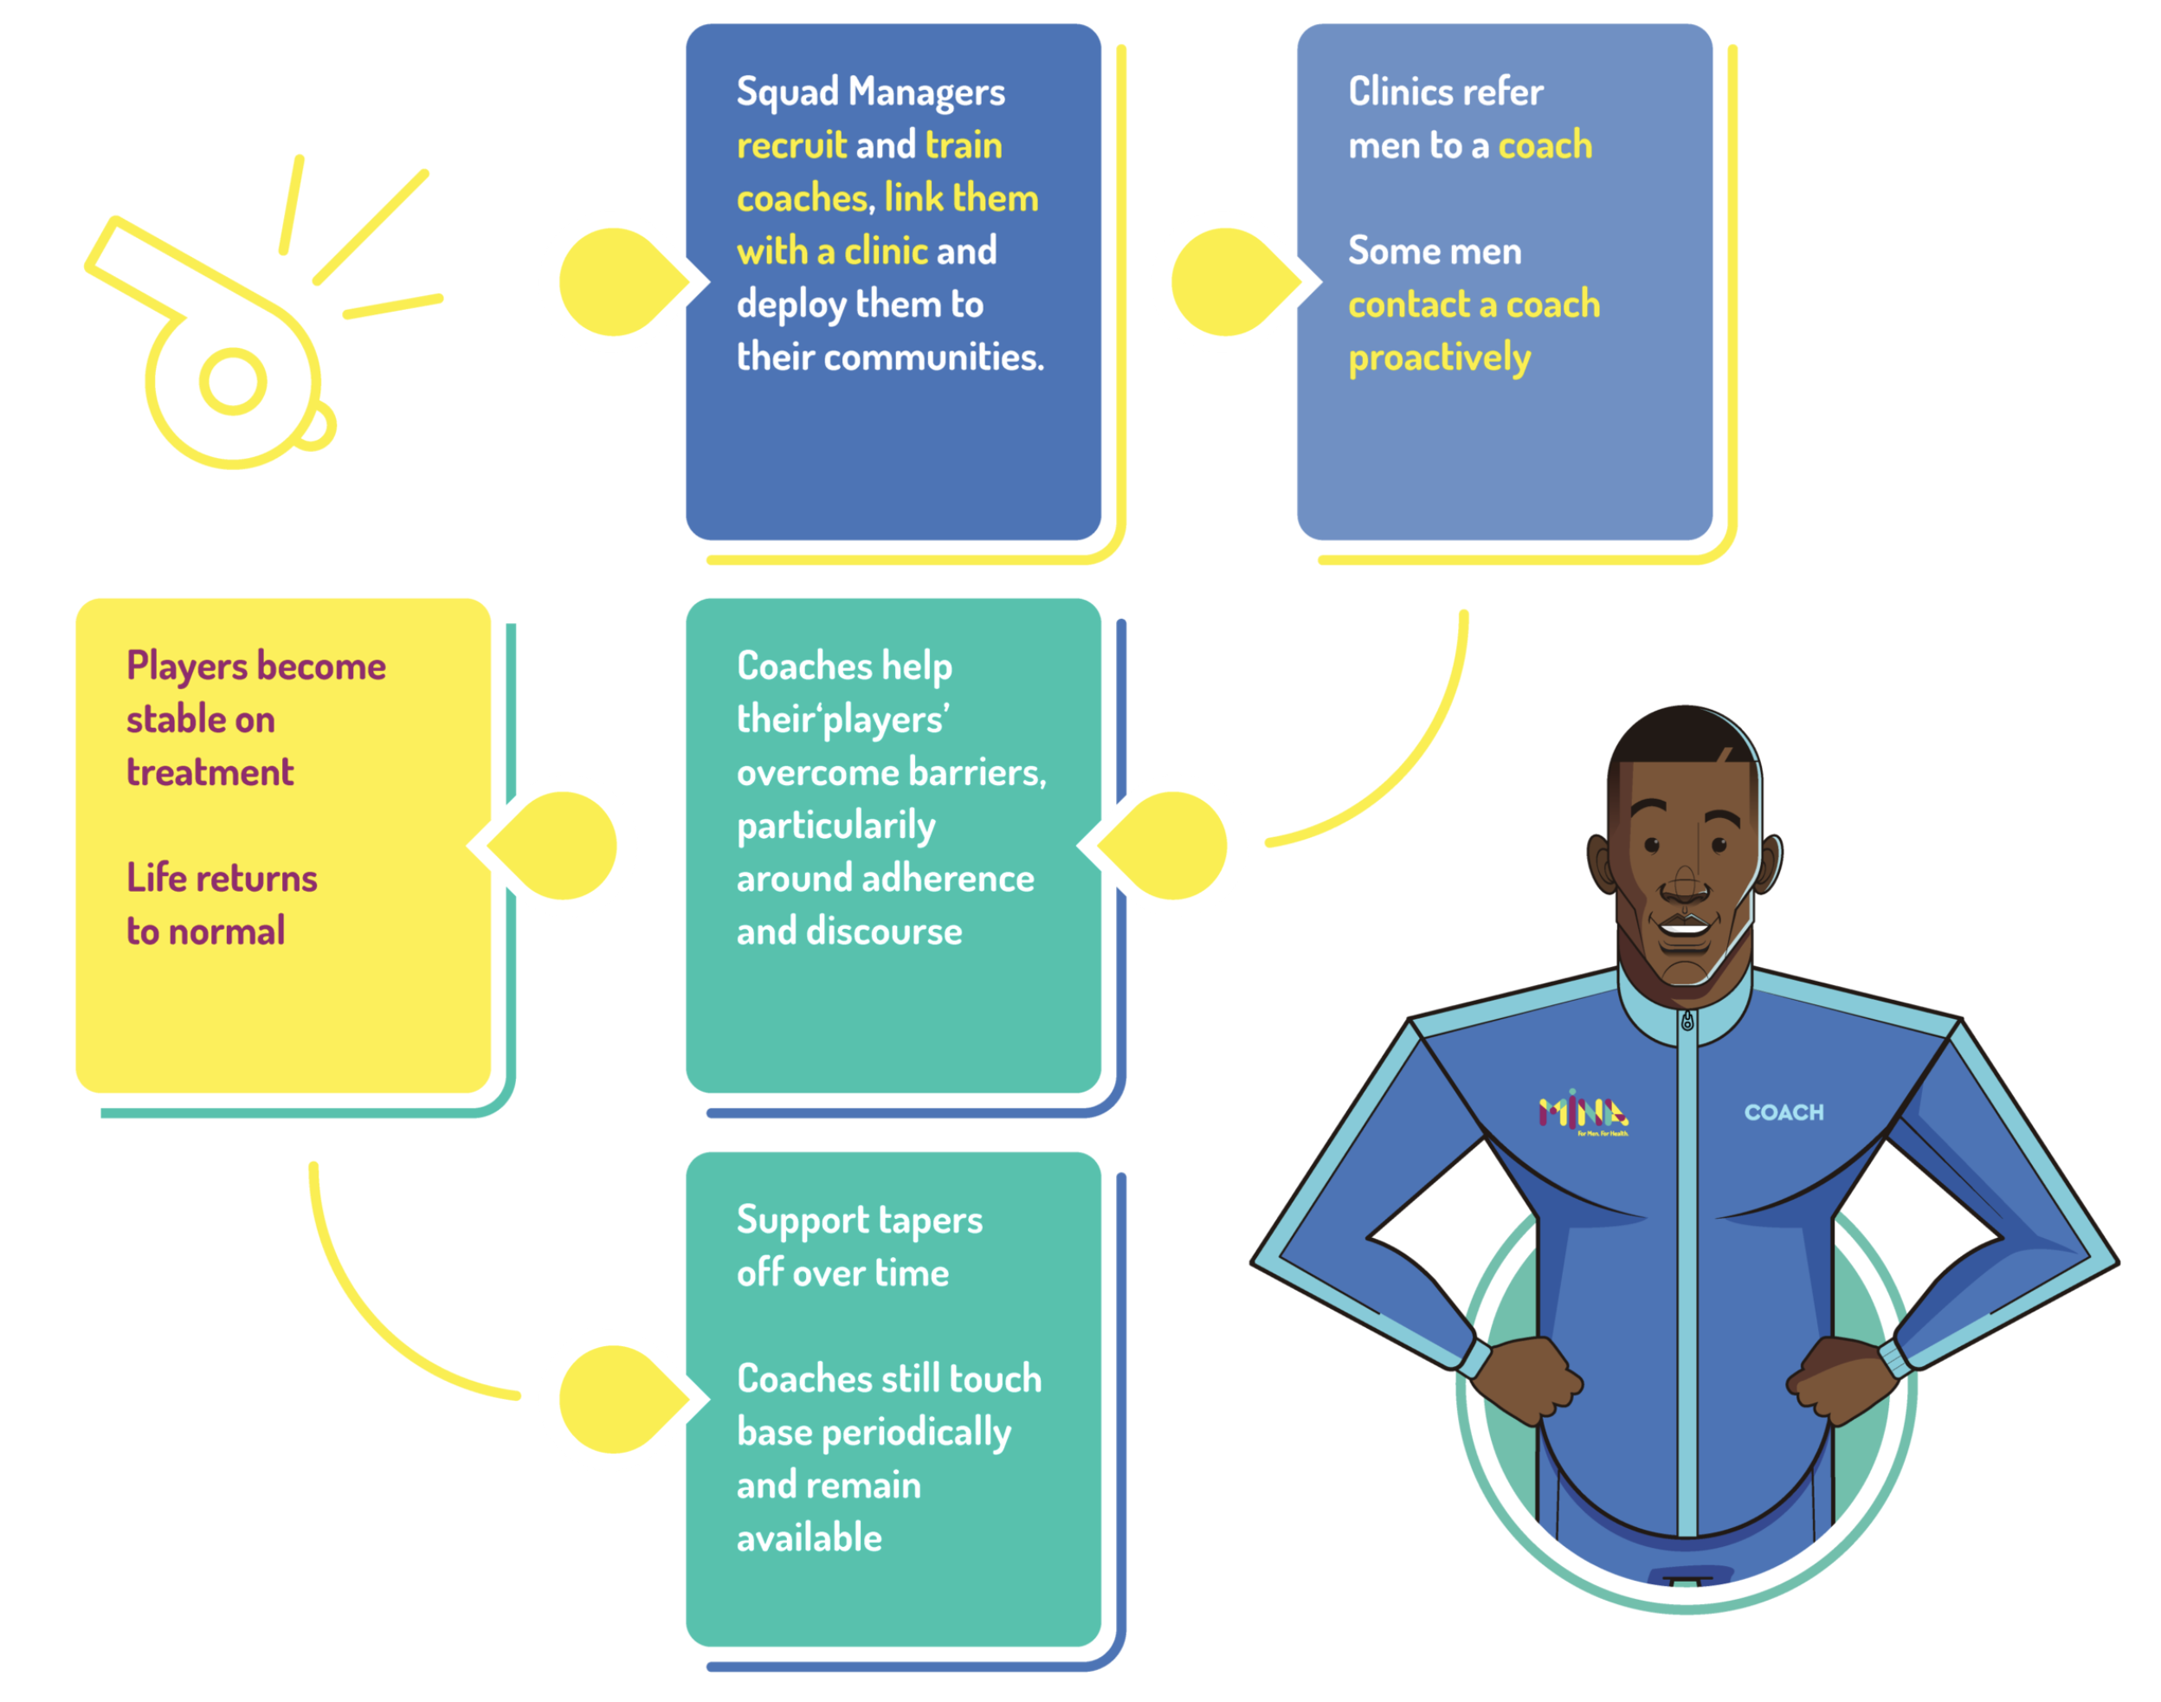
Differentiated Service Delivery for Men
Coach Mpilo project in South Africa
Peer navigator/case manager model for men
Squad Managers: train the coaches
Coaches: men with HIV serve as ‘coaches’ for newly diagnosed men and men who have returned to care
Goal: to help men see treatment as a strategy for gaining control over HIV and feeling strong, healthy, safe, desirable and, ultimately, reach a point where they can live openly and confidently with HIV
https://www.coachmpilo.co.za
Notes:
Her is an example of a DSD program for me that uses a sports oriented approach, with squad managers and coaches

Slide 30
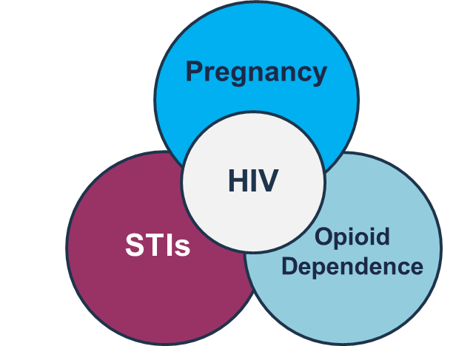
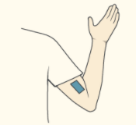
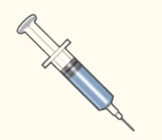
New Tools for HIV Prevention
Novel PrEP Methods and Delivery Systems
Multi-Purpose Prevention Technologies (MPTs)
Source: Adapted from Dr. Wafaa El-Sadr; HPTN
Notes:
Now let’s look at some new tools that are coming. We’ll focus on PrEP

Slide 31
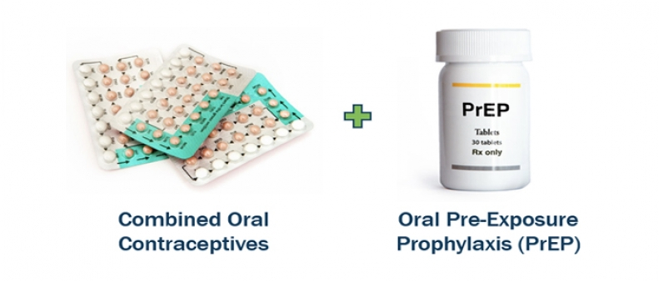
Multipurpose Prevention Technologies
Pregnancy, Sexual Health, and HIV MPTs:
A dual-prevention pill for the prevention of pregnancy and HIV
A vaginal ring for the prevention of pregnancy and HIV
A non-hormonal vaginal ring with the potential to prevent pregnancy, HIV and sexually transmitted infections
A non-hormonal contraceptive fast-dissolving insert for on-demand prevention of pregnancy, HIV, and other sexually transmitted infections
Source: Population Council
Notes:
One new tool is MPTs

Slide 32
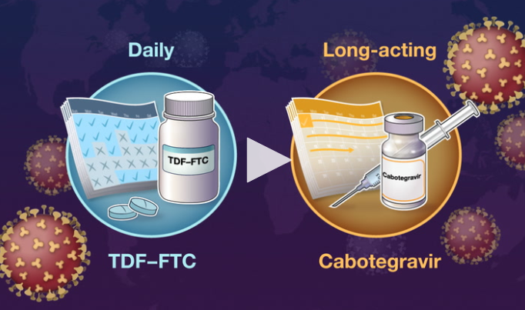
Long-Acting injectable PrEP – Cabotegravir
Randomized, double-blind trial indicated LA cabotegravir every 8 weeks was superior to daily TDF-FTC
Source: Landowitz et al., NEJM (2021)
Notes:
ICAP helped conduct this trial

Slide 33
Approved by the US FDA for PrEP:
December 20, 2021
Approved for PrEP
Submitted for approval
for PrEP
Slide from R. Landovitz
Notes:
Approved in 5 countries as of Nov 29th: US, Australia, Zimbabwe and Uganda and as of yesterday South Africa

Slide 34
Key Takeaways
 | Evolution of HIV epidemic, measuring epidemic control
 | Focusing on the gaps in awareness: men, young adults and KPs
 | Continued refinements in differentiated service delivery models of care
 | New advances in HIV prevention
 | Leaving no one behind: equity
Notes:
What are our takeaways?
We talked about the evolution of the HIV epidemic and the progress toward epidemic control. We talked about some ways to measure epidemic control and these all call for high quality, granular data.
The data help us understand the gaps, especially gaps in awareness of diagnosis (men, young adults and key populations) and gaps in treatment (children). These are the groups getting left behind.
We talked about differentiated service delivery, which has been a major advance from the earlier one-size-fits-all ‘public health’ model of care
New advances in HIV prevention are rapidly expanding
Woven through all of this is a greater appreciation of the need to address health equity. The ‘last mile’ in the global HIV response will require attention to the barriers of existing stigma, discrimination, violence, and lack of human rights that affect KPs and PPs

Slide 35
Thank You
Connor Wright

Slide 36
Reaching Men Who Have Sex With Men (MSM) in the U.S. South
LaRon E. Nelson,
PhD, RN, FNP, FNAP, FNYAM, FAAN
Associate Dean for Global Affairs & Planetary Health Independence Foundation Associate Professor & Associate Professor of Nursing at Yale University

Slide 37
Reaching Men who have Sex with Men in the US South
LaRon E. Nelson, PhD, RN, FNP, FNYAM, FAAN
Associate Dean for Global Affairs & Planetary Health Independence Foundation Associate Professor of Nursing

Slide 38
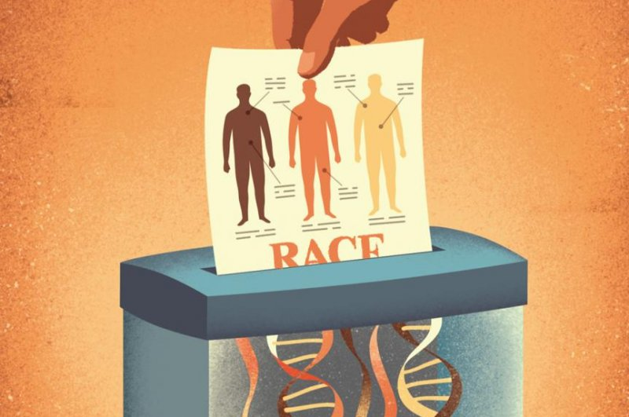
TISHKOFF IMAGE FROM SCIENCE

Slide 39
Race is a social concept
Modern humans originated in what is now known as Africa
Single origin
Features used to categorize people into a “race” is a function of movement distance from origin
The idea of race as a scientifically valid biological taxonomy is thoroughly discredited
Race is a social concept
Credit: Tishkoff SA & Kid KK (2004). Implications of biogeography of human diversity for ‘race’ and medicine. Nature Genetics, 36(11): S21-S27

Slide 40
RACISM IS A SOCIAL SYSTEM
Multi-dimensional organizing logic of human power relations
Continuously operating and does not require conscious participation
Distributes social status benefits based on race category assignment
White vs Black
Access vs Barriers
Immunity vs Punishment
Justice vs Apathy
High status (whiteness) can be assigned provisionally and can be revoked
Credit:

Slide 41
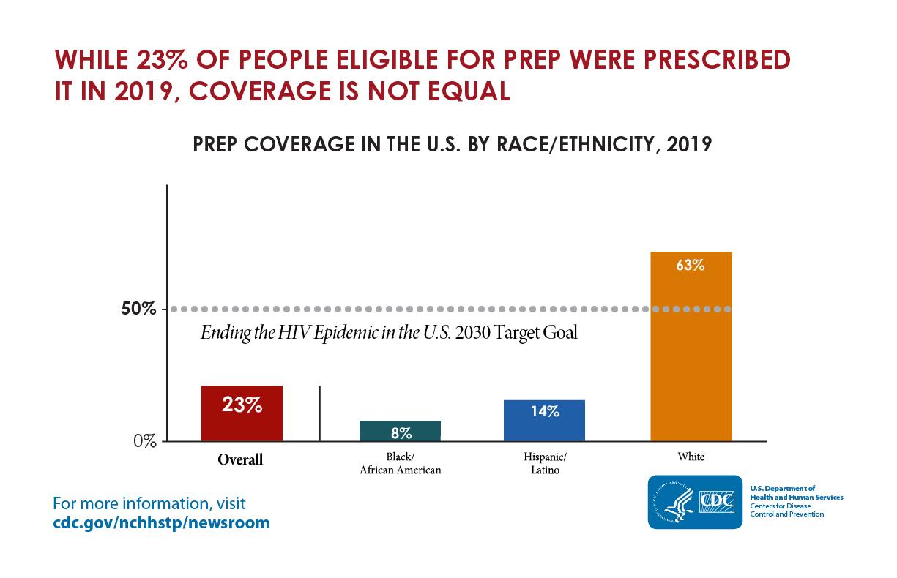
There remains a marked racial disparity in PrEP coverage…
Notes:
One of the worst disparities between Black and White gay men along the entire HIV continuum.
THIS IS UNACCEPTABLE!!
From - https://www.cdc.gov/nchhstp/newsroom/2021/2019-national-hiv-surveillance-system-reports.html
The graphic states that while 23% of people eligible for pre-exposure prophylaxis (PrEP) were prescribed it in 2019, coverage is not equal.
The bar graph shows that in 2019, only 8% of African Americans and 14% of Hispanics/Latinos who were eligible for PrEP were prescribed it, compared to 63% of whites.
The bar graph also shows that the Ending the HIV Epidemic in the U.S. target goal is 50% PrEP coverage by 2030.

Slide 42
…as well as HIV viral suppression
Notes:
From - https://www.cdc.gov/nchhstp/newsroom/2021/2019-national-hiv-surveillance-system-reports.html
The graphic states that even though 66% of people with HIV were virally suppressed in 2019, disparities remain.
The bar graph shows that just 61% of African Americans and 65% of Hispanics/Latinos with diagnosed HIV were virally suppressed, compared to 71% of whites.
The bar graph also shows that the Ending the HIV Epidemic in the U.S. target goal is 95% viral suppression by 2030.

Slide 43
Political Ecology
Interdisciplinary field that emerged out of Geography
Primary concern with understanding changes in the environment that were not explained by nature alone.
Considered that non-natural, non-physical environmental forces contributed to changes in environment.
Variation from place-to-place were influenced by interactions with the physical environment:
Socio-cultural environment
Political environments
Economic environments

Slide 44
Political Ecology of Health
Health and health decisions are shaped by the social, political, economic environments dominant within a specific geo-context
Local
State
Federal
This disadvantages some people and privileges others
Legal status
Economic status
Gender and gender-conformity status
Race
Hardships are inequitable impacts of policies on marginalized communities that may lead to poor health outcomes

Slide 45
Political Ecology of Health, Hardships and HIV Risk
Political ecology of health situates hardships within a frame for understanding how health inequities and their impact patterns are produced by larger social and political forces
at operation in particular locations
at operation at particular times
If individual level behavioral characteristics are equal, why then would HIV incidence be differ from place-to-place.
There is probably not one answer to this question.

Slide 46
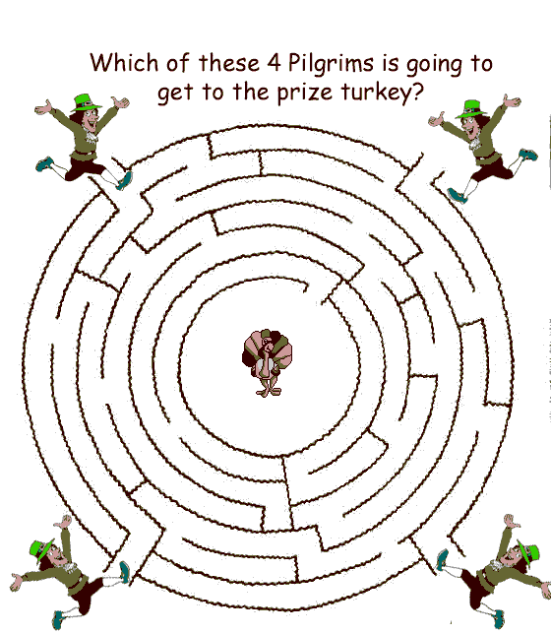
Social Conditions and Pathways
Socio-cultural, economic, and political processes structure opportunities that support or thwart healthy decisions.
Imagine a maze with some doors that are systematically closed to some people. Leads to a limited, predictable path and set of outcomes.

Slide 47
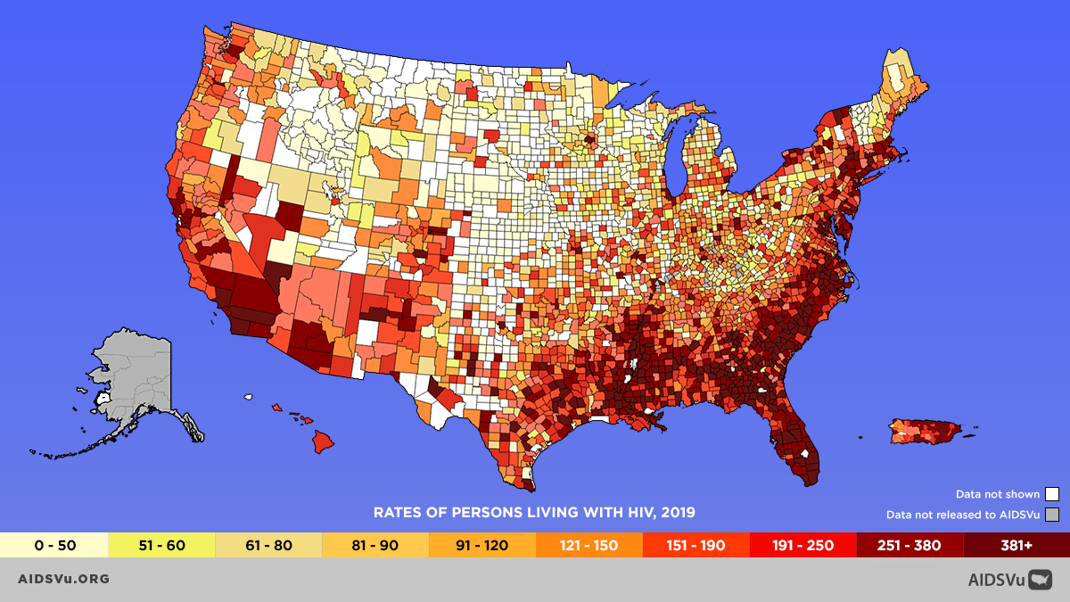
There is a marked geographic disparity in HIV prevalence in the Southern US.
1.2 million living with HIV
46% in the South
41% Black
18% Black MSM
(CDC, 2019)
Diagnosed HIV Prevalence by US County, 2019
CDC. Estimated HIV Incidence and Prevalence in the US, 2015-2019. May 2021
P. Sullivan, AIDSVu. June 2021
Notes:
The US has an HIV epidemic marked by significant geographic, racial and sexual and gender minority disparities. This heat map of the estimated 1.2 million prevalent infections in 2019, shows the geographic disparity in the South and Southeast. Black MSM accounted for 18% of all prevalent infections.

Slide 48
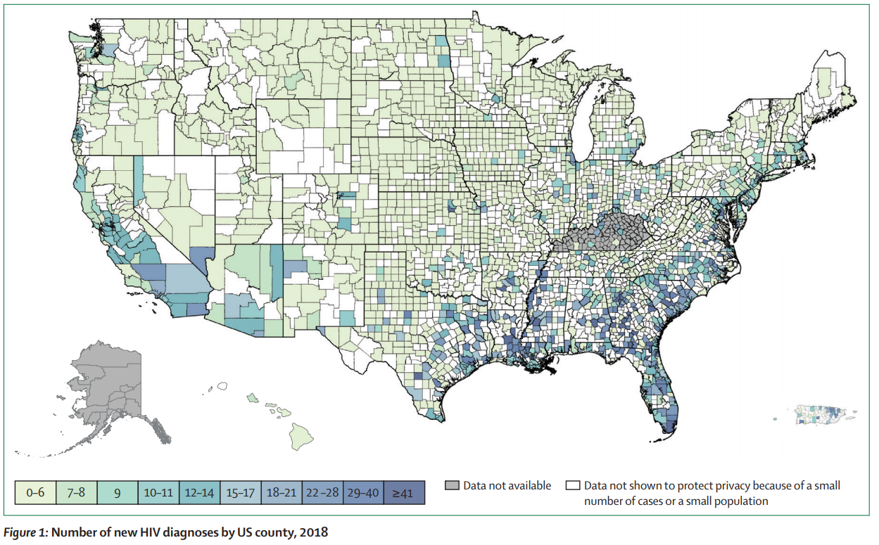
The HIV Epidemic in the U.S. South
48

Slide 49
Overlay of Health and Social Disparities
Credit: Figure courtesy of amfAR, excerpted from Greg Millet’s July AIDS 2020 plenary.
Credit: Poteat T, Millett GA, Nelson LE, Beyrer C. (2020). Understanding COVID-19 risks and vulnerabilities among Black communities in America: The lethal force of syndemics. Annals of Epidemiology, 47: 1-3.

Slide 50
Blacks in the U.S. South had the highest number of new HIV diagnoses compared to other regions.
Northeast
N=5,275
41%
21%
31%
Midwest
N=4,759
48%
33%
14%
Black/African American
White
South
N = 19,135
Hispanic/Latino
50%
22%
24%
Asian
West
N=7,229
18%
30%
44%
Multiple Races
CDC, Diagnoses of HIV Infection in the US and Dependent Areas, 2019. HIV Surveillance Report, 2021:32.
Notes:
Here we see the geographic disparity in new diagnoses, again in South, and the marked disproportionate burden in the South among Black and African Americans.

Slide 51
Blacks have highest HIV incidence among Men who have Sex with other Men
Notes:
https://www.cdc.gov/hiv/library/reports/hiv-surveillance/vol-33/content/technical-notes.html
(Downloaded 6/21/22 – just released by CDC
CDC Notes:
South: Alabama, Arkansas, Delaware, District of Columbia, Florida, Georgia, Kentucky, Louisiana, Maryland, Mississippi, North Carolina, Oklahoma, South Carolina, Tennessee, Texas, Virginia, and West Virginia
The South had more diagnoses of HIV infection among MSM – 10,421 diagnoses in 2020 – than any other region. The largest group of MSM with diagnosed HIV infection in the South were blacks/African Americans (5079), followed by Hispanics/Latinos (2642), whites (2282), males of multiple races (266), Asians (110), American Indians/Alaska Natives (36), and Native Hawaiians/other Pacific Islanders (0).
Caution: Data for the year 2020 should be interpreted with caution due to the impact of the COVID-19 pandemic on access to HIV testing, care-related services, and case surveillance activities in state/local jurisdictions.

Slide 52
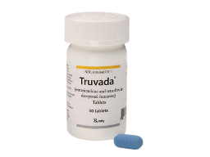
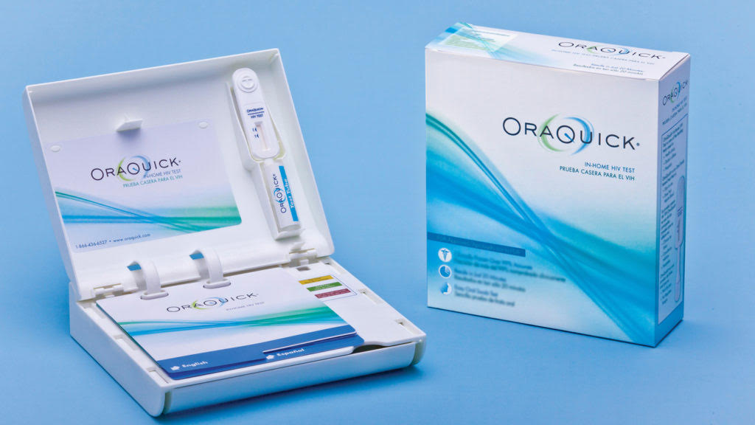
Racial inequities in HIV persist despite scientific biomedical advances
Black/African American
HPTN 052 (U=U) 2011
Estimated HIV Incidence, No.
White
Truvada and 1st rapid HIV home test kit approved
2012
Year of Infection
Estimated HIV Incidence among MSM Aged ≥13 Years by Race (United States, 2010-2019)
CDC, Estimated HIV Incidence and Prevalence in the United States 2015-2019, May 2021
CDC, Estimated HIV Incidence and Prevalence in the United States 2010-2015, March 2018
Notes:
CDC incidence estimates from 2010-2019 show the impact of key biomedical interventions including Treatment as Prevention (HPTN 052), oral PrEP, and HIV self testing on White MSM, and the failure of these innovations to reduce incident infections among Black MSM. This is a stubborn and persistent health disparity which biomedical innovation alone has failed to address.

Slide 53
Racial inequities in HIV persist despite scientific biomedical advances
Black/African American
HPTN 052 (U=U) 2011
Estimated HIV Incidence, No.
White
Truvada and 1st rapid HIV home test kit approved
2012
Year of Infection
Estimated HIV Incidence among MSM Aged ≥13 Years by Race (United States, 2010-2019)
CDC, Estimated HIV Incidence and Prevalence in the United States 2015-2019, May 2021
CDC, Estimated HIV Incidence and Prevalence in the United States 2010-2015, March 2018
Notes:
CDC incidence estimates from 2010-2019 show the impact of key biomedical interventions including Treatment as Prevention (HPTN 052), oral PrEP, and HIV self testing on White MSM, and the failure of these innovations to reduce incident infections among Black MSM. This is a stubborn and persistent health disparity which biomedical innovation alone has failed to address.

Slide 54
If IT geopolitical context is co-implicated, THEN WhAT??
What is the role of science in addressing these issues?

Slide 55
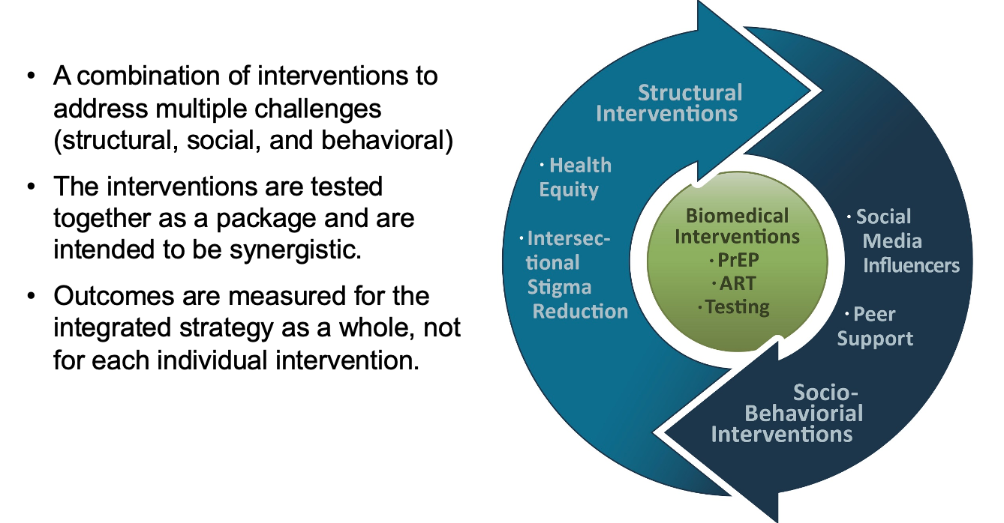
A Scientific Revolution?

Slide 56
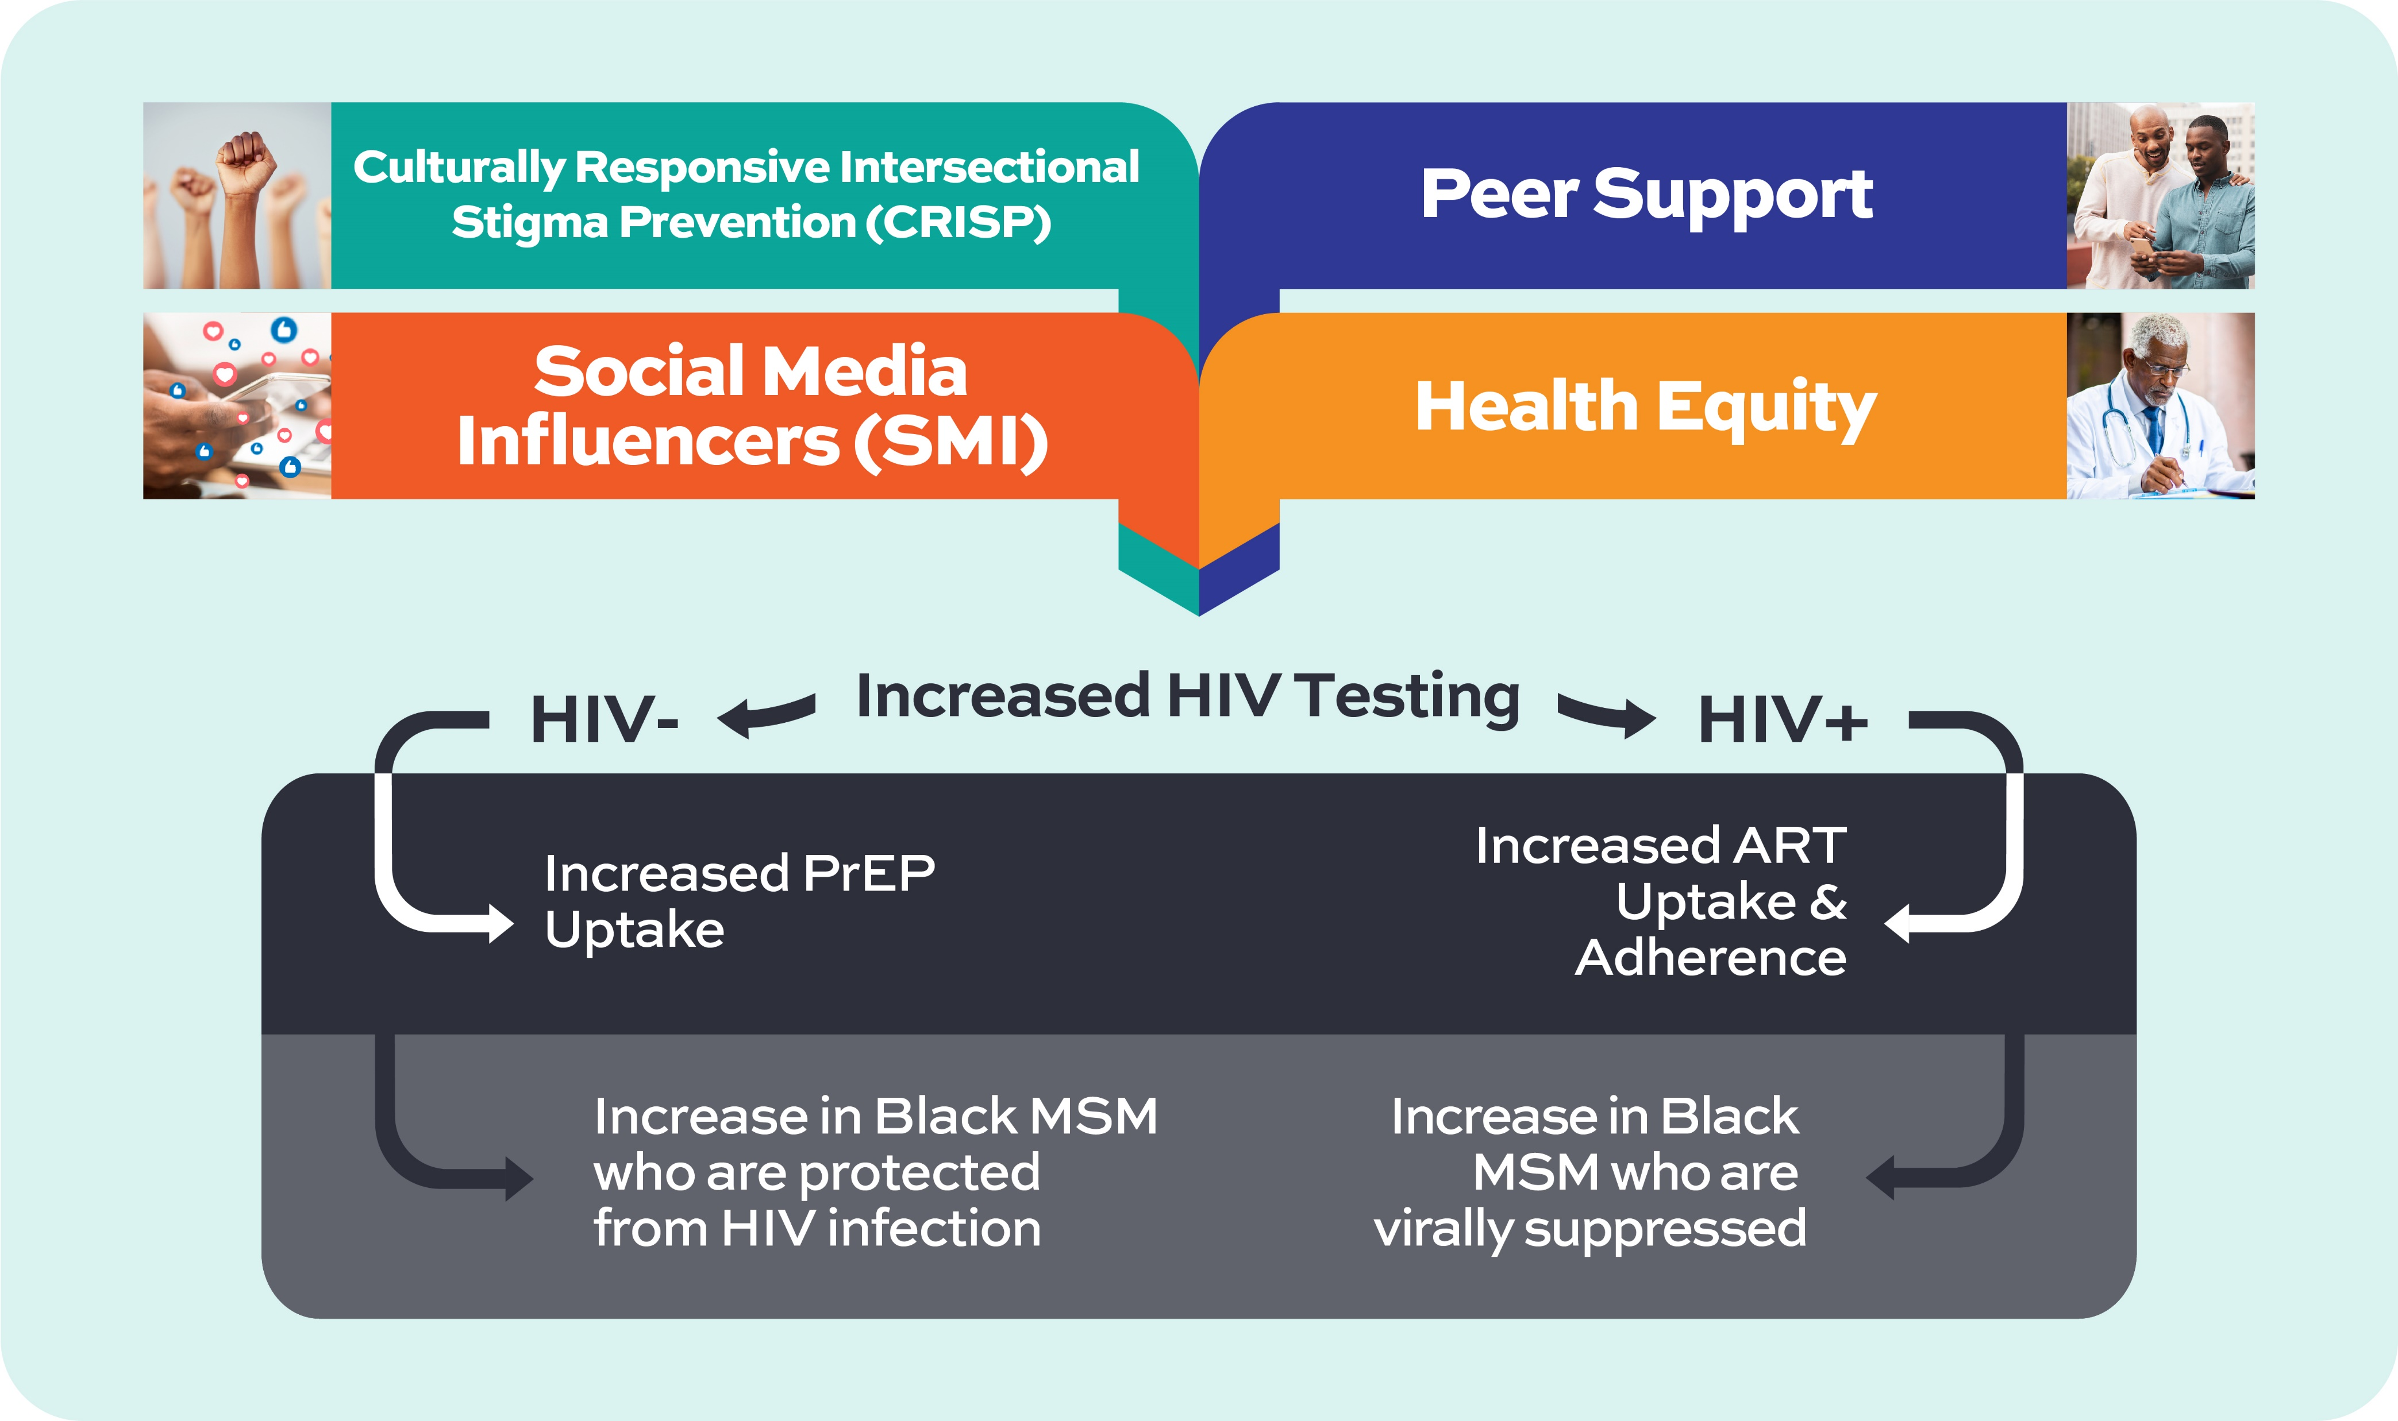
Multi-Level Approach Integrating Self Determination Theory & Political Ecology
Community-Level Integrated Strategy
Community-Level Outcomes
Notes:
LaRon

Slide 57
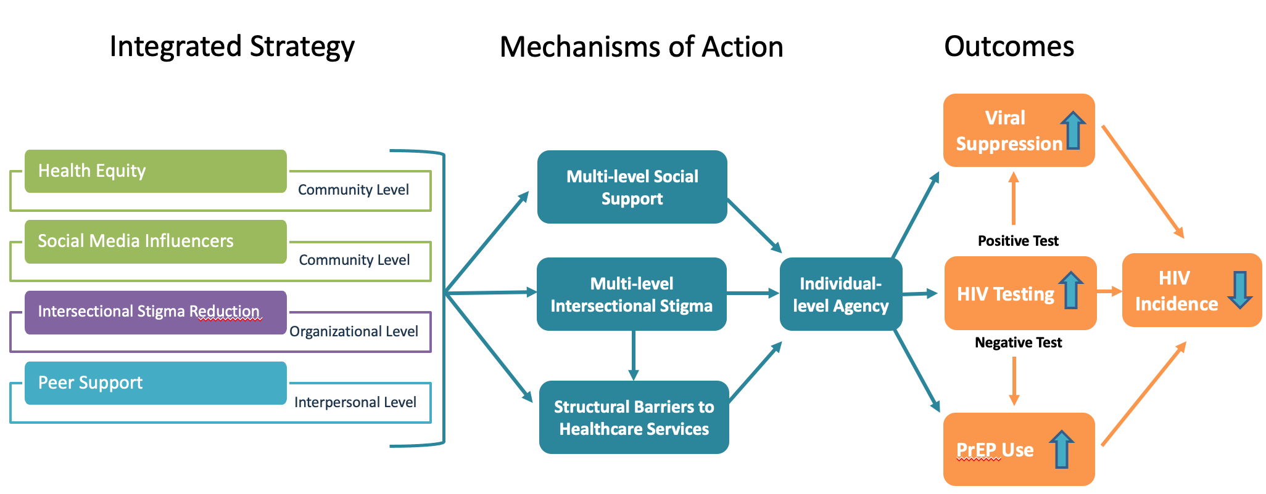
Attending to Factors that Constrain HIV Prevention and Treatment

Slide 58
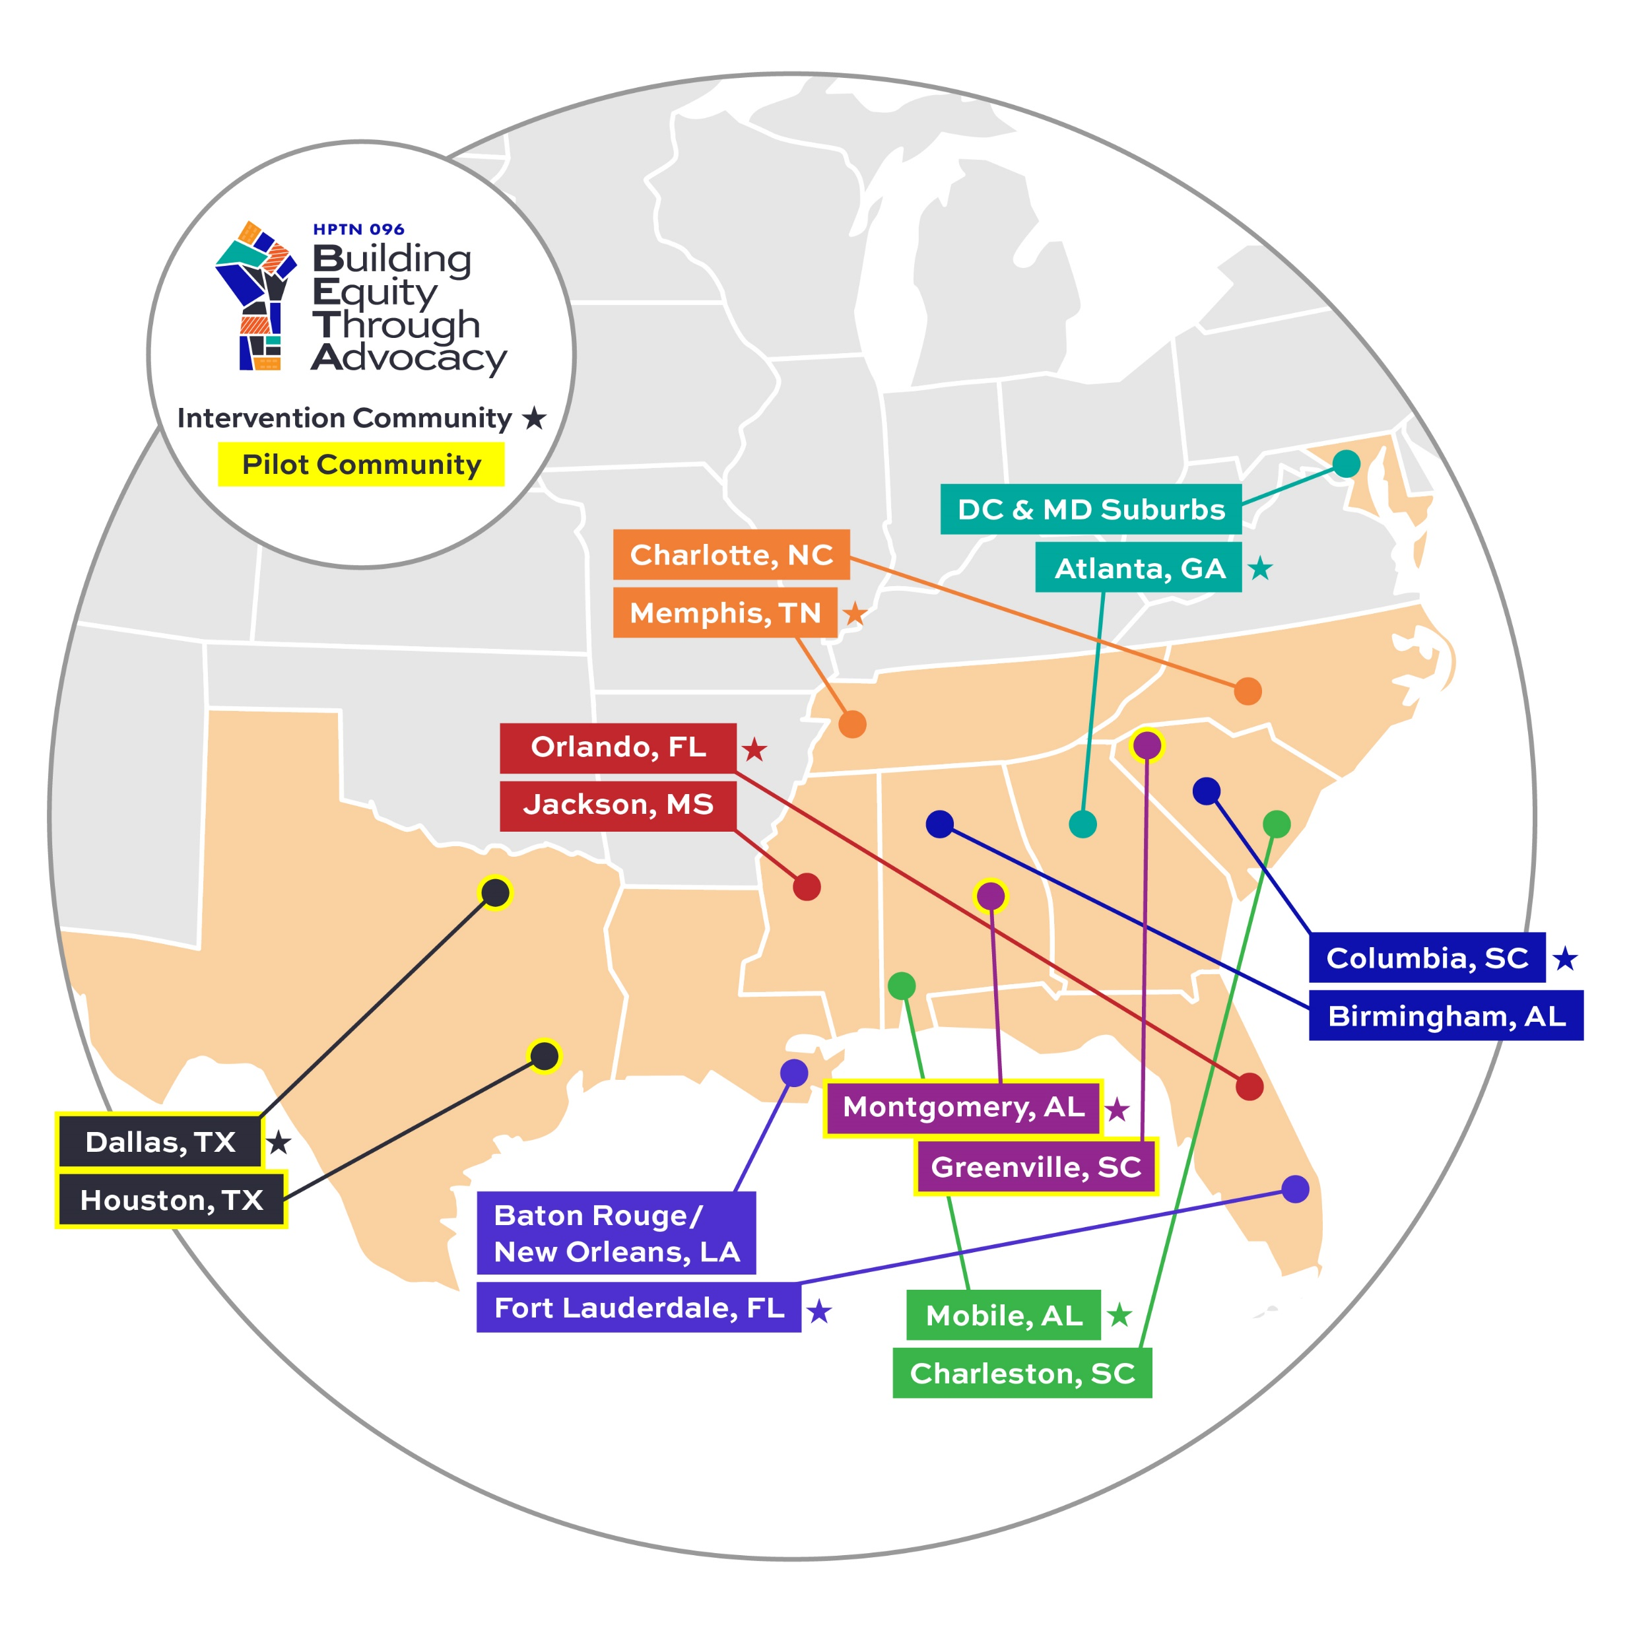
Impact-Focused Discovery
The 16 study communities were organized into 8 matched pairs based on these criteria:
All EHE counties/states in southern US
Geographically distinct
Similar populations – emphasis on Black men
Similar HIV prevalence for Black men (+/- 35%)
Similar rates of viral suppression for Black MSM (+/- 30%)

Slide 59
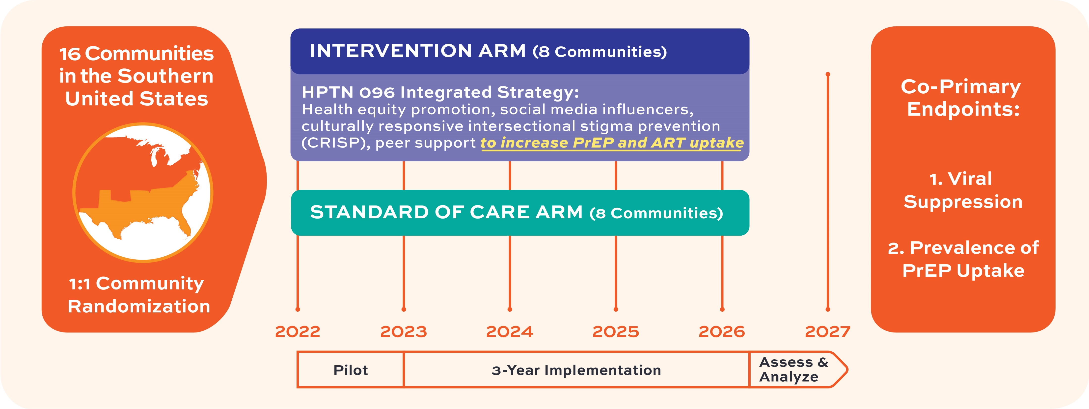
Implement and Investigate
Notes:
LaRon – note why we are doing a pilot, note endpoint data

Slide 60
Science and Policy Alignment

Slide 61
Conclusion
Where people live matters with respect to being situated within geopolitical places where they are rendered overexposed to HIV (or protected from risk)
Needed attention to health and health behavior patterns that may emerge when comparing municipal contexts
Patterns may indicate underlying social policies and political processes that disadvantage MSM communities
HIV prevention science needs to test strategies that match the character and magnitude of the problem

Slide 62
ThANK YOU

Slide 63
Panelists
LaRon E. Nelson,
PhD, RN, FNP, FNAP, FNYAM, FAAN
Associate Dean for Global Affairs & Planetary Health Independence Foundation
Associate Professor & Associate Professor of Nursing at Yale University
Jessica Justman,
MD
Senior Technical Director, ICAP
Associate Professor of Medicine and Epidemiology at Columbia University
Nassoro “Sammy” Said
HIV Peer Counselor
ICAP in Tanzania
Rashaunna K. Redd,
DNP, MPH, WHNP-BC
Nurse Practitioner / Site Clinician
ICAP’s Bronx Prevention Center

