Slide 1
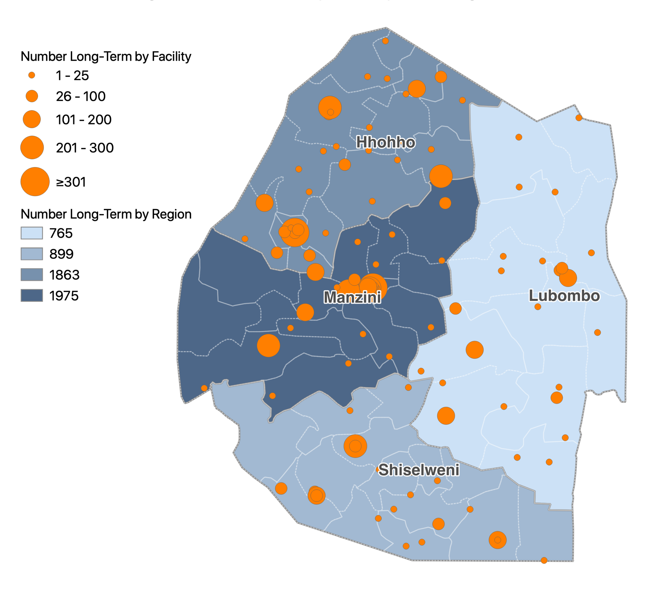
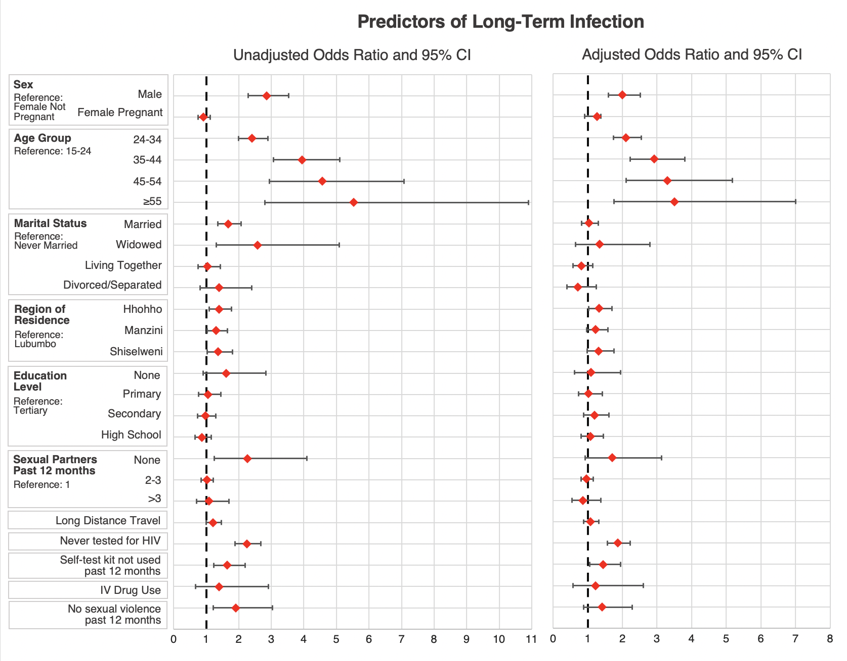
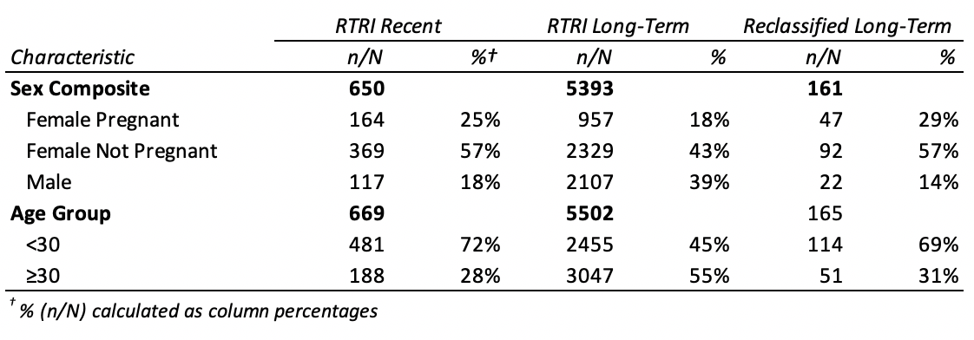
POSTER NUMBER: XXXX
Determinants of long-term HIV infections
at point of HIV diagnosis in the Kingdom of Eswatini: Results from the HIV-1 recent infection surveillance program
Authors: S. Saito^{1,2}, A. Pasha¹, D. Sibandze³, L. Dube³, E. Poirot¹, M. Arons⁴, S. Simelane⁵, V. Lokotfwako³, N. Mahlalela³, C. Ngcamphalala⁵, R. Sahabo⁵, M. Pasipamire⁶, H. Nuwagaba-Biribonwoha^{2,5}
Affiliations: ¹ICAP at Columbia University, Mailman School of Public Health, New York, United States,
²Columbia University, Department of Epidemiology, Mailman School of Public Health, New York, United States,
³Ministry of Health, Government of the Kingdom of Eswatini, Mbabane, Eswatini,
⁴CDC Atlanta, Atlanta, United States,
⁵ICAP at Columbia University, Mailman School of Public Health, Mbabane, Eswatini,
⁶CDC Eswatini, Mbabane, Eswatini
Background
Results
Delayed HIV diagnosis continues to be a major obstacle for epidemic control. Utilizing the rapid test for recent infection (RTRI) implemented within the routine Eswatini National HIV Testing Services (HTS) as part of the Eswatini HIV-1 Recent Infection Surveillance (EHRIS) program, we classified newly diagnosed people living with HIV (PLHIV) into those with RTRI recent and RTRI long term (LT) infection. We examined determinants of LT infection among EHRIS participants.
Analyzed 6,171 newly diagnosed clients from 113 testing facilities
5,502 (89.2%) had LT infection and 669 (10.8%) had a RTRI recent infection
In adjusted multivariate analyses (Figure 1), LT infection was associated with:
Male sex (aOR_{vs.non-pregnant female}: 2.00; 95% CI: 1.59 – 2.51)
Clients who were >25 years of age in the following age categories:
25-34 (aOR_{vs.15-24}: 2.10; 95% CI: 1.74 – 2.54)
35-44 (aOR _{vs.15-24}: 2.92; 95% CI: 2.23 – 3.81)
45-54 (aOR _{vs.15-24}: 3.30; 95% CI: 2.10 – 5.16)
≥55 (aOR _{vs.15-24}: 3.5; 95% CI: 1.76 – 7.07)
Residence in the Hhohho region (aOR_{vs.Lobombo}: 1.32; 95%CI: 1.03 – 1.70)
Clients with no prior testing history (aOR: 1.86; 95%CI: 1.55 – 2.23)
Clients who reported no use of HIV self-test kit in the past 12 months (aOR: 1.44; 95%CI: 1.06 – 1.94)
Distance traveled for HIV diagnosis, marital status, education, injection drug use, number of partners in the past 12 months and experiencing forced sex in the past 12 months were not associated with LT infection.
Map 1: Number of Long-Term Infections by Facility and Region of Residence in Eswatini, July 2019–September 2020
Figure 1: Unadjusted Odds Ratio and Adjusted Odds Ratio with 95% Confidence Interval for Determinants of Long-Term Infection
Methods
Used individual-level programmatic data collected during July 2019–Sept 2020 for individuals ≥15 years of age and newly diagnosed with HIV in routine HTS who opted-in to receive a RTRI test
Characterized individuals with RTRI recent and LT infections and RTRI recent cases reclassified as RITA LT by various behavioral, sociodemographic, geographic, and risk factors (Table 1).
Because RTRI recent cases reclassified as RITA LT shared similar characteristics with RTRI recent cases vs. RTRI long-term cases, we used RTRI results for our main analysis
LT infection was defined as a RTRI LT result, which likely indicates infection of ≥12 months.
Bivariate logistic regression was used to assess associations between LT infection and hypothesized predictors in unadjusted models
Stepwise backward multivariate logistic regression was performed to calculate adjusted odds ratios (aORs) between a range of sociodemographic, geographic, and health risk factors and LT infection in a final adjusted model
Sensitivity analyses were conducted using RITA LT infection
Data analysis was conducted using Python 3.7
Conclusions
Table 1: Select demographic characteristics of RTRI Recent, RTRI Long-term and RITA Reclassified Long-term Infections
Recent infection surveillance can sharpen program response to accelerate epidemic control. Further promotion of frequent HV testing, including through expanded access to self-test kits, particularly among men and older individuals, is critical to reduce delayed HIV diagnosis—a major impediment to achieve epidemic control.
A major global health organization with projects in more than 30 countries, ICAP at Columbia University works to transform the health of populations through innovation, science, and global collaboration. Since its founding in 2003 at the Columbia Mailman School of Public Health, more than 2.6 million people have received HIV care through ICAP-supported programs. Learn more online at icap.columbia.edu
PRESENTED AT IAS 2021 – the 11th IAS Conference on HIV Science|18-21 JULY 2021

