Slide 1




Viral Load Monitoring and Enhanced Adherence Counseling
Flipchart
Pregnant and Breastfeeding Women
The mark “CDC” is owned by the US Dept. of Health and Human Services and is used with permission. Use of this logo is
not an endorsement by HHS or CDC of any particular product, service, or enterprise.

Slide 2
This job tool was created by ICAP at Columbia University with funding from the U.S. President’s Emergency Plan for AIDS Relief (PEPFAR) through the Centers for Disease Control and Prevention (CDC) under the terms of cooperative agreement #U2GGH000994. Its contents are solely the responsibility of the authors and do not necessarily represent
the views of the U.S. Government.
This flipchart is intended for use by health care workers to provide information to pregnant and breastfeeding women living with HIV and their families. For questions about the contents or use, please contact ICAP at icap-communications@columbia.edu.

Slide 3
HOW TO USE THE VIRAL LOAD MONITORING AND
ENHANCED ADHERENCE COUNSELING FLIPCHART
The purpose of this flipchart is to provide pregnant and breastfeeding women who are receiving antiretrovirals (ARVs) information about viral load monitoring—including the meaning of viral load results and implications for transmission to their newborns—as well as guidance on adherence assessment and counseling, especially for those with elevated viral loads who warrant enhanced adherence counseling. It was developed for use by a range of health care workers (e.g. adherence counselors, doctors, nurses, pharmacists, community health workers) who work with pregnant and breastfeeding women living with HIV and their families
Each card, or set of cards, focuses on a specific topic important in the care and support of pregnant and breastfeeding women receiving ART who are undergoing viral load testing, or who already have a viral load result. Topics are color-coded for ease of use.
Directions on how to use the flip chart:
Place flip chart on table so that the patient has a good view of the pictures while you can read the side with notes.
Key messages for patients and instructions to providers are in bold.
There are notes to prompt and guide discussion with the patient, including questions to review covered material and assess the patient’s understanding.
There are cards for specific visits, including when starting ARVs, when undergoing a viral load test, and when results are available. There is another set of cards to guide the discussion with the women whose viral load result 1000 or less, and
another set if viral load result is greater than 1000.
A separate document, the Enhanced Adherence Plan tool, should be used in conjunction with this counselling flipchart to assess and document findings and the patient’s plan; it should be included in the patient’s file.
After the first enhanced adherence counseling session (second and beyond), begin the session with card 18 and repeat cards 5- 17 as needed..

Slide 5








Card Topic (also shown to patient)
Image from
card front
KEY MESSAGES:
Also shown to the
TALKING POINTS:
Some instructions for providers
patients
Notes to prompt and guide discussion
Key points are bolded
Let’s Review:
Points to guide review with the patient
Document:
Tells providers which forms to use to document discussions with the patient
Provider Instructions:
Gives providers specific instructions about their interaction and conversation with the patient

Slide 7
Good counseling and communication skills
Good counseling and communication skills are essential. Here are some useful tips:
  Always make eye contact with the patient
  Sit face to face
  Speak clearly and in a non-threatening voice
  Be non-judgmental and respectful—do not blame or criticize!
O Open-ended questions
A Affirmation
R Reflective listening
S Summary statements
2. To be most effective in increasing adherence to ARVs, use the following OARS techniques (Open-ended questions, Affirmation, Reflective listening, Summary statements):
O: Open-ended questions (avoid questions that are answered as Yes/No)
What makes it difficult to take your ARVs every day?
What have you already done to try and take your ARVs every day?
Why do you think you (will need to) need to give infant ARV prophylaxis to your baby?
What do you think is likely to happen if you keep taking your ARVs as you are now?

Slide 9
Good counseling and communication skills
A: Affirmation
I appreciate that you are able to be honest about the way you take your ARVs.
You are clearly a resourceful person to manage so many challenges, especially with a newborn baby.
You’ve worked really hard to take your medications despite these challenges.
R: Reflective listening
You’re wondering if ARVs will harm your baby.
So you said you feel angry when you think about taking your ARVs and that makes it really hard.
What I hear you saying is you are so overwhelmed, your health is the least of your problems right now.
O Open-ended questions
A Affirmation
R Reflective listening
S Summary statements
S: Summary statements
Let me see if I understand so far. You are struggling to take your ARVs because you want to be healthy and don’t want your baby to get HIV, but you also have
other problems in your life that make it difficult to focus on your health.
Here’s what I’ve heard you say, let me know if it is right. You feel fine when you
miss a dose and are feeling really uncertain about whether ARVs will really prevent your baby from getting HIV.

Slide 11







HOW TO USE THE COUNSELING CUE CARDS FLIPCHART: BY VISIT
Initiating ART: 1
Sending viral load test: 2
First viral load test result is low: 3
First viral load test result is high: 4 Enhanced adherence counseling: 5 – 17 Follow-up viral load test: 18
Follow-up viral load test result is low: 19
Follow-up viral load test result is high: 20

Slide 13




















COUNSELING CUE CARD TOPICS
How to use the viral load monitoring and enhanced adherence counseling flipchart Good counseling and communication skills
You’re starting ARVs
What is a viral load?
The viral load is LOW
The viral load is HIGH
How are you taking ARVs?
What are the challenges in taking your ARVs? (1 of 3)
What are the challenges in taking your ARVs? (2 of 3)
What are the challenges in taking your ARVs? (3 of 3)
Tips to improve taking ARVs (1 of 3)
Tips to improve taking ARVs (2 of 3)
Tips to improve taking ARVs (3 of 3)
Giving ARVS to your baby
Tips for giving medication to your baby
Additional help to take ARVs
Remembering to take ARVs
Understanding your ARVs
Managing privacy and getting support
Follow up on how you are taking ARVs
You’ve successfully reduced your viral load
ARVs are not working well

Slide 14
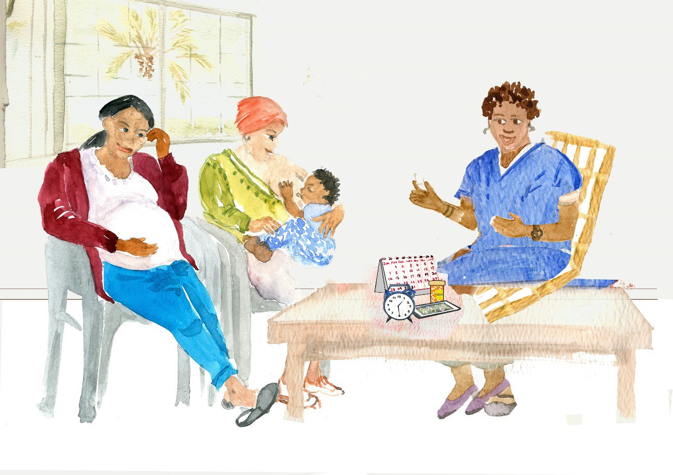
1. You’re starting ARVs
HIV is a virus that lives in your blood.
ARVs stop HIV from making more virus, allowing you to become healthier.
A viral load test can measure how much HIV virus is in your blood.

Slide 15





1. You’re starting ARVs
KEY MESSAGES:
HIV is a virus that lives in your blood.
ARVs stop HIV from making more
TALKING POINTS:
What is HIV? What do you know about ARVs?
If you are not on ARVs, HIV makes a lot of virus
virus, allowing you to become healthier.
A viral load test can measure how much HIV virus is in your blood.
which can make you sick and more likely to pass it to your baby during pregnancy, birth or breastfeeding or spread to your partner during sex.
ARVs stop HIV from making more virus. With less virus in your blood, it is unlikely that you will get sick or pass HIV to your baby or partner.
It is important to take all ARVs every day—as your health care provider has told you—to make sure they work as they are supposed to.
A late dose is better than a missed dose.
ARVs do not cure HIV, which is why you must continue taking them every day.
3–6 months after you start taking your ARVs, we will do a test called a “viral load”. This test will tell us if your ARVs are working well.
Keeping the virus low in your body has many benefits:
Let’s Review:
In your own words, what do ARVs do?
Why is it important for you to take ARVs?
Why is it import for your baby that you take ARVs?
What might make it difficult for you to take your ARVs every day?
What medicines do you take and when?
It will help you live a long, healthy life. If you feel well you will be able to achieve your goals and take care of your children.
It will help prevent your baby from getting HIV while you are pregnant and breastfeeding.
Low viral load can help your disease-fighting cells, called CD4s, increase and keep you from getting sick.
It will prevent serious illnesses from developing over time.
It will keep your brain healthy. Having a low viral load prevents damage to your brain.
It will keep you from having extra visits to the clinic.
Always using condoms is the best way to prevent spread of HIV to your sexual partners. Having a low viral load can help further.

Slide 16
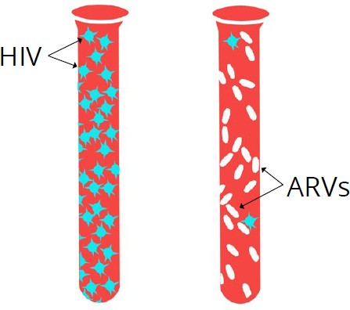
2. What is a viral load?
Before ART After ART
ARVs help prevent your baby from getting HIV.
Viral load measures how much HIV is in the blood and if ARVs are working well — the goal is a low viral load.
It is important to know your viral load results.

Slide 17
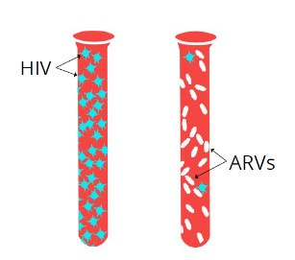

2. What is a viral load?
KEY MESSAGES:
ARVs help prevent your baby from getting HIV.
Viral load measures how much HIV is in the blood and if ARVs are working well — the goal is a low viral load.
It is important to know your viral load results.
TALKING POINTS:
If you are not on ARVs, the HIV in your body
will produce a lot of virus, which can make you sick and more likely give HIV to your baby during pregnancy, birth and breastfeeding and to your partner during sex.
The viral load test measures how much virus is in approximately one drop of blood.
ARVs stop HIV from making more virus and bring the viral load down.
If you have a high viral load, you may not look sick but the virus may be harming your body (causing CD4 cells to die off), and over time as it produces more virus you will get sick.
If ARVs are working well, and you are taking them every day, the viral load will usually be low (less than 1000).
The goal is a low viral load and a high CD4 count.
CD4 count is also used to see if ARVs are working, but viral load is more accurate. In the future, it is possible that we will not conduct CD4 testing.
Keeping the virus low in your body has many benefits. A low viral load is important for you: it keeps you healthy, prevents serious illness, allows you to have the energy to do the things you enjoy, and makes you feel good. A low viral load also helps prevent your baby from getting HIV during pregnancy, birth and breastfeeding. A low viral load means you can take care of your children and keep your sexual partners healthy.
Please come back in weeks for your next visit and we will give you your viral load results then as well.
Let’s Review:
In your own words, what is a viral load?
Is the goal a high or low viral load?
What are the benefits of achieving a low viral load?
What are the benefits to your baby?
When were you instructed to return for your viral load results? We may contact you sooner if necessary.

Slide 18



3. The viral load is LOW
HIV
A low viral load
means your ARVs are working.
This does not mean ARVs can be stopped.
ARVs
Continue to take your ARVs every day.

Slide 19


3. The viral load is LOW
TALKING POINTS: _{KEY MESSAGES:} • A low viral load (less than 1000) [insert patient’s result here] is a sign that your ARVs are working.
A low viral load means your ARVs are working.
This does not mean ARVs can be stopped.
Continue to take your ARVs every day.
This does not mean you can stop taking your ARVs; you should continue using condoms.
It is important to continue to take ARVs as instructed every day to keep HIV from making more virus, to prevent HIV from spreading to your baby or sexual partners and to stay healthy. If you don’t take your ARVs, your virus may become more difficult to treat and some of the medicine will not work.
A late dose is better than a missed dose.
Pregnant/early postpartum women: In addition to staying on your ARVs after giving birth you will give your baby ARVs every day for at least [insert national guidelines] months of life. Infant ARVs give the baby extra protection from HIV.
What has helped you remember to take your ARVs?
Are there things that have made it hard at times to take your ARVs [or another medication]?
Let’s Review:
What does a low viral load mean?
Why is it important to continue taking your ARVs every day?
Pregnant/early postpartum women: Why do you need to give ARVs to your baby?
When will the next viral load be checked?
What medicines do you take and when?
A few reminders:
It’s important to keep all of your appointments.
If you notice that your ARVs are running low, come to the clinic even if you don’t have an appointment.
We will check the viral load again in six months for those newly initiated and this is your first viral load result, or a year for those with more than one low viral load] if there are no new clinical problems or problems taking ARVs.
Please let your provider know if there are any problems taking ARVs in the future, so that he/she can help you to address them.
Your next (ANC/PNC) appointment is . Even if you still have medications, it is important for you to come to all of your appointments. Please let your provider know if you will be away from the clinic for a long period of time (for example to deliver in your hometown) to ensure you have a sufficient supply of medication while you are away.
Postpartum women: Return to the clinic if your baby develops a fever or seems unwell for any reason.

Slide 20
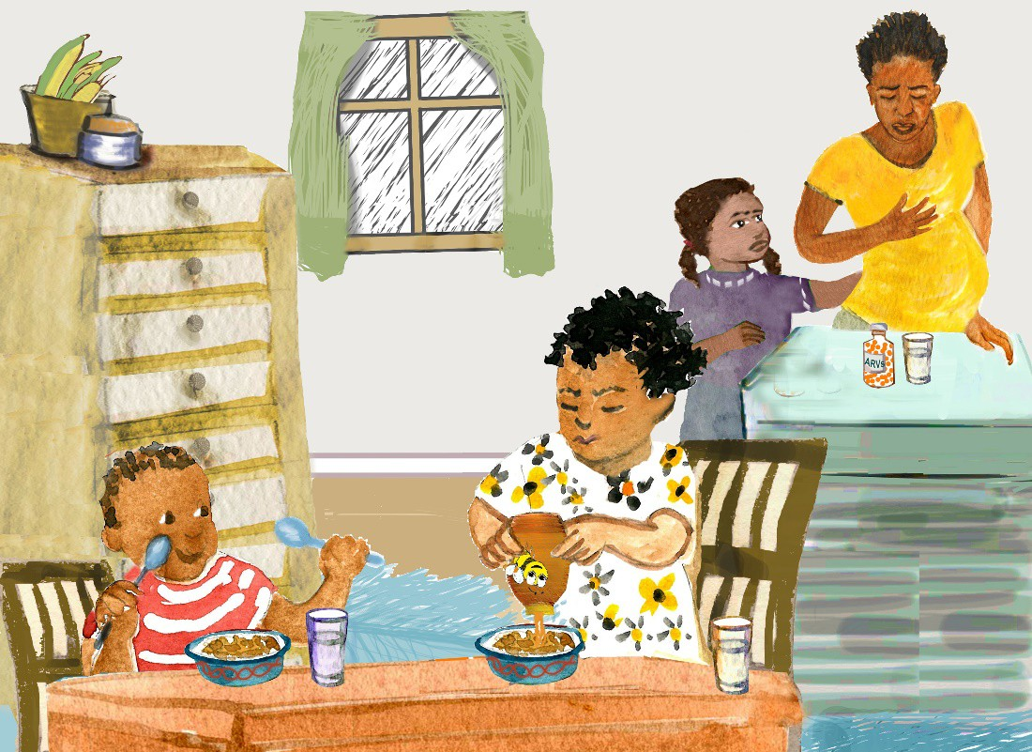

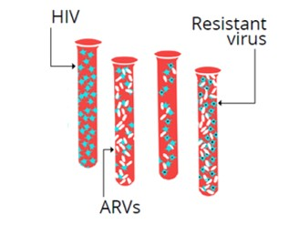
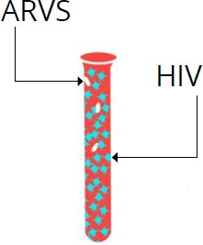
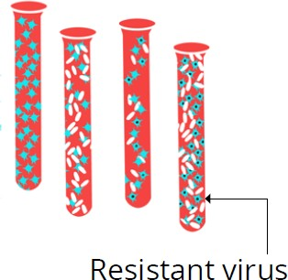
4. The viral load is HIGH
This means that HIV is making more virus and will eventually make you sick.
It also means that your baby could get HIV during pregnancy, birth and breastfeeding.
You may be missing doses of your ARVs.
The virus may be resistant, meaning it has changed and ARVs are no longer working.

Slide 21


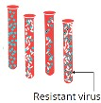



4. The viral load is HIGH
KEY MESSAGES:
TALKING POINTS:
This means that HIV is making more virus and will eventually make you sick.
It also means that your baby could get HIV during pregnancy, birth and breastfeeding.
You may be missing doses of your ARVs.
The virus may be resistant, meaning it has changed and ARVs are no longer working.
The viral load test result is high [insert patient’s result], the goal is to keep it below 1000.
This means that HIV is making more virus in the body.
This may be because you are not taking ARVs as instructed.
Your immune (defense) system will become weaker as your CD4 cells decrease. This can affect your brain, heart, liver and kidneys and make you sick.
With so much virus in the blood it is also more likely that your baby will get HIV during pregnancy, birth or breastfeeding.
If ARVs are not taken as instructed, every day, the virus can change and become “resistant” to the ARVs, meaning that even if taken properly, they will no longer work.
Using ARVs to lower your viral load can help prevent your baby from getting HIV during pregnancy, birth or breastfeeding.
With a high viral load it’s also easier to spread HIV to your partner, so it is especially important to use condoms all the time.
Pregnant/early postpartum women: You will give your baby ARVs every day for at least [insert national guidelines] months. Infant ARVs give the baby extra protection from HIV.
Let’s Review:
What are the possible reasons for a high viral load?
What can happen when your viral load is high?
What can happen to your baby when your viral load is high?
What would be good about a low viral load?
How important do you think it is for your long-term health?
What do you think happens if you don’t take ARVs regularly?
Provider Instructions:
Remember to use non-judgmental and respectful language – do not blame or criticize:
“I am glad you came to get your viral load test results. Now we can help you work towards a low viral load to protect yourself and your baby.”

Slide 22
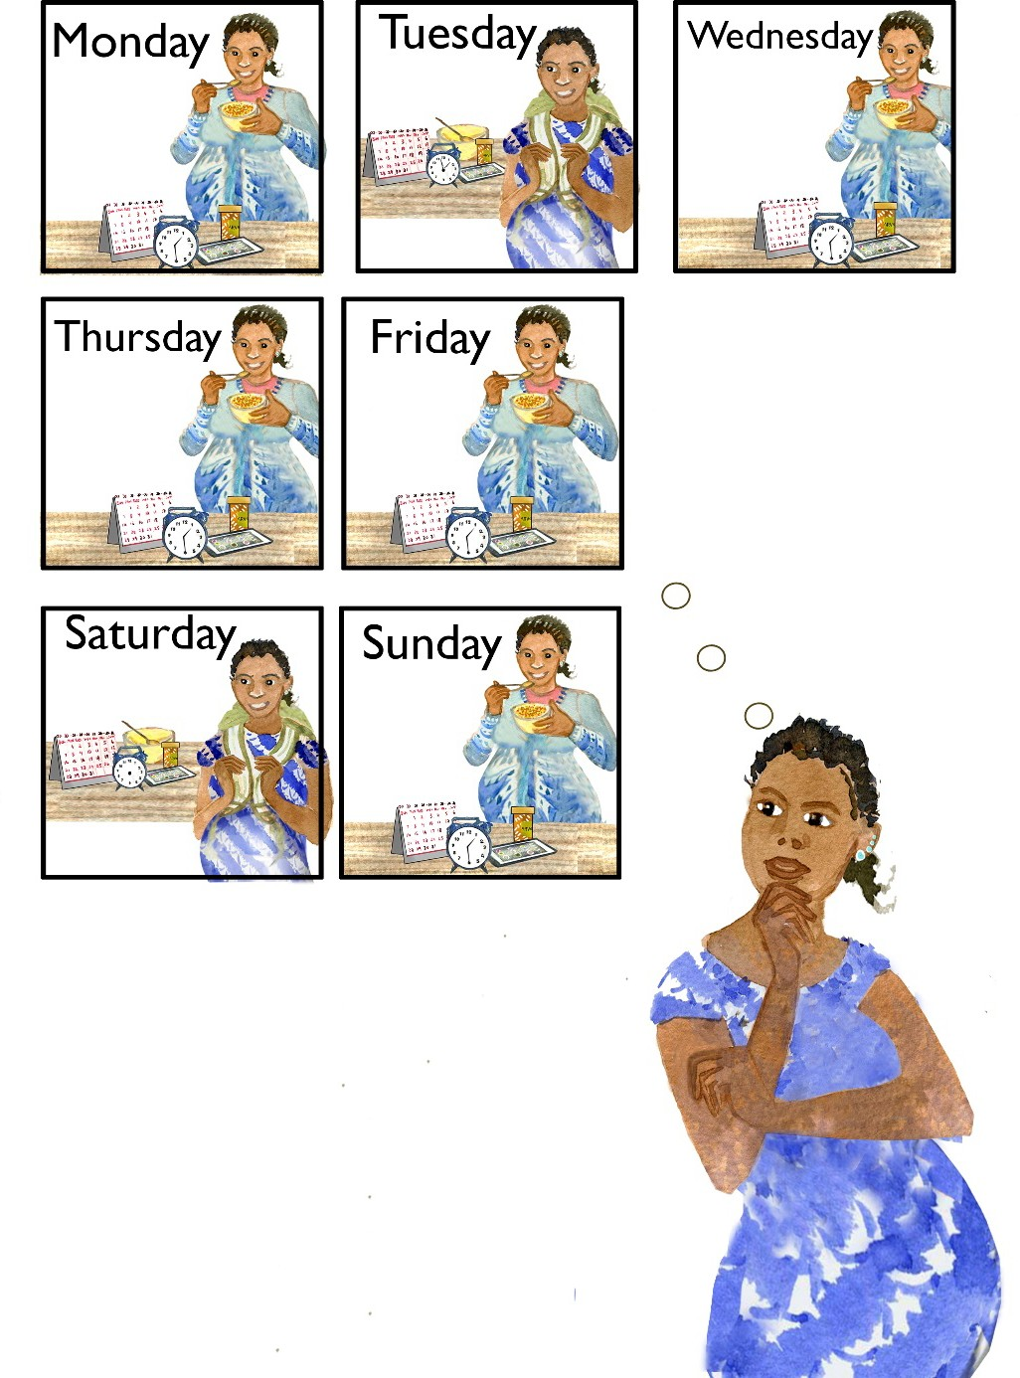
5. How are you taking ARVs?
It can be hard to take ARVs every day.
Together we will review how often you take your ARVs and see how it can improve.
How many times would you say you missed an ARV dose in the past week?

Slide 23
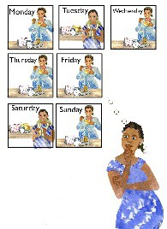



5. How are you taking ARVs?
KEY MESSAGES:
It can be hard to take ARVs every day.
Together we will review how often you take your ARVs and see how it can improve.
How many times would you say you missed an ARV dose in the past week?
TALKING POINTS:
Some people find it difficult to take ARVs every
day.
Early postpartum: When do you give your baby his/her ARVs? Most mums give infant ARVs immediately after they take their own dose.
Many people have problems taking their pills at some point.
Early postpartum: How many times would you say you missed giving a dose of your baby’s ARVs in the past week?
Please think back to the past WEEK, how many (of your own) ARV doses (days) do you think you missed? How many of the baby’s doses have you missed?
  Was this a typical week?
Now what about the past month?
Provider Instructions:
Ask the patient to recall the last week and how many doses she missed.
Ask if this is typical.
Determine how many doses were missed in the last month.
Using the table to the left, determine if the patient’s adherence is good, fair or poor.
Document
Number of doses missed per month | Adherence category
Patients taking once daily regimens
0-1 doses | Good
2–4 doses | Fair
4+ doses | Poor
Patients taking twice daily regimens
0-3 doses | Good
4–8 doses | Fair
8+ doses | Poor
Complete the first column of enhanced adherence session 1 on the Enhanced Adherence Plan Tool and mark the mother’s adherence as good, fair, or poor, according to the number of doses missed per month (as per table).
Early postpartum women: Do the same for adherence to the infant ARV prophylaxis regimen.

Slide 24

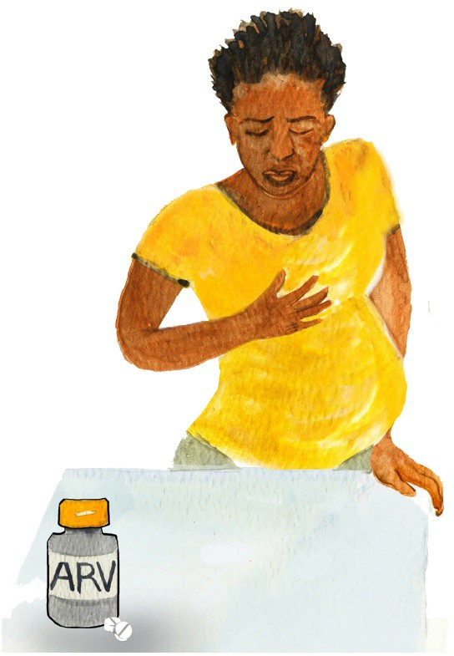
6. What are the challenges in taking your ARVs?
Sometimes there are barriers to taking ARVs. We can support you to overcome these barriers.
Take your ARVs every day, even if you are feeling better.

Slide 25

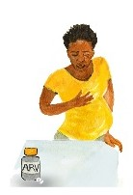



6. What are the challenges in taking your ARVs?
KEY MESSAGES:
Sometimes there are barriers to taking ARVs. We can support you to overcome these barriers.
Take your ARVs every day, even if you are feeling better.
TALKING POINTS:
Let’s explore any challenges you may be having when taking ARVs [or giving ARVs to your baby].
Please feel comfortable telling me about challenges you
are facing; I am asking because I want to try to find ways to make it easier.
Can you recall and describe circumstances around the last time you missed your dose?
Early postpartum women: Can you recall and describe circumstances around the last time your baby missed a dose?
Provider Instructions:
Explore barriers and challenges with the patient.
O: Open-ended Questions (Avoid questions that are answered as Yes/No), for example:
What makes it difficult to take your
ARVs every day?
Pregnant/early postpartum women:
What might make it/makes it difficult to give ARVs to your baby every day?
What have you already done to
remember to take your ARVs every day?
What do you think will happen if you are not taking your ARVs the same way every day?
BARRIERS | QUESTIONS TO ASSESS BARRIERS
INDIVIDUAL
Knowledge deficit | Can you tell me the names of your [and your baby’s] ARVs? What is your understanding of how you are supposed to take ARVs [give ARVs to your baby] (e.g. what time of day, how much [if liquid], how many [if pills]? What is your understanding of the purpose of ARVs?
Side effects | Have the ARVs affected the way you feel? Do you think the ARVs have made you feel ill in any way? If yes, please describe what problems they cause (e.g. nausea, diarrhea, sleep disturbance).
Forgot | Have you ever forgotten or do you often forget to take ARVs [give ARVs to your baby]? Do you take them at a set time of day? What is your method of remembering/reminding yourself?
Feeling better | Do you take ARVs even when you are feeling well? Do you give ARVs to you baby even if he/she is unwell?
Physical illness | Have you had illnesses that have prevented you from taking ARVs?
Alcohol or drug use | Do you use alcohol? Do you use drugs? Do you feel this affects your ability to take ARVs [give ARVs to your baby]?
Depression | How is your mood in general? Have you been feeling sad or confused? If yes, has this affected your ability to take ARVs [give ARVs to your baby]?
Health beliefs | Do you believe that taking ARVs every day is beneficial for your health [beneficial for your baby’s health]? What do you think is the best way to treat HIV? Have you ever tried other remedies for treating HIV?
Document
Document the specific barriers you identify with the patient on the Enhanced Adherence Plan Tool.

Slide 26

7. What are the challenges in taking your ARVs?
Have you ever missed a dose because you ran out of ARVs or were too busy?
If you plan on being away from the clinic, let us know so that we can plan ahead.

Slide 27



7. What are the challenges in taking your ARVs?
KEY MESSAGES:
Have you ever missed a dose because you ran out of ARVs or were too busy?
If you plan on being away from the clinic, let us know so that we can plan ahead.
TALKING POINTS:
Let’s continue to explore any challenges you
may be facing when taking ARVs [or giving ARVs to your baby]
(individual and household level barriers).
BARRIERS | QUESTIONS TO ASSESS BARRIERS
INDIVIDUAL (continued)
Pill burden | Is the number of pills or amount of liquid a challenge for you?
Lost/ran out of pills | Have you lost or run out of ARVs?
Pregnancy & delivery | What changes in routine do you expect over the coming months? Where do you plan to have the baby? When do you intend to go there? Will you be able to get refills there? (If not, ensure she has sufficient ARVs for herself and the baby for the entire duration of her stay.)
Scheduling difficulty | Have you been too busy to take [give] ARVs? Does work take you way from home for long periods of time? Do you have trouble finding privacy at work for taking ARVs?
HOUSEHOLD
Share with others | Have you ever shared your ARVs with others? Or given your baby’s ARV to anyone else?
Fear of disclosure | Have you disclosed your HIV status to your family or your partner?
Family/partner relationships | Has your family or partner been non-supportive or kept you from taking ARVs [giving ARVs to your baby]?
Inability to pay | Have clinic or other fees kept you from taking [giving] ARVs?
Food insecurity | Has a lack of adequate food ever been a problem for taking ARVs?
Provider Instructions:
Summarize what was learned from the patient about any specific barriers identified on this card.
A: Affirmations, for example:
I appreciate that you are able to be honest about the way you take your ARVs [give ARVs to your baby].
You are clearly a resourceful person to manage so many challenges.
You’ve worked really hard to take your medications despite these challenges.
Document
Document the specific barriers you identify with the patient on the Enhanced Adherence Plan Tool.

Slide 28
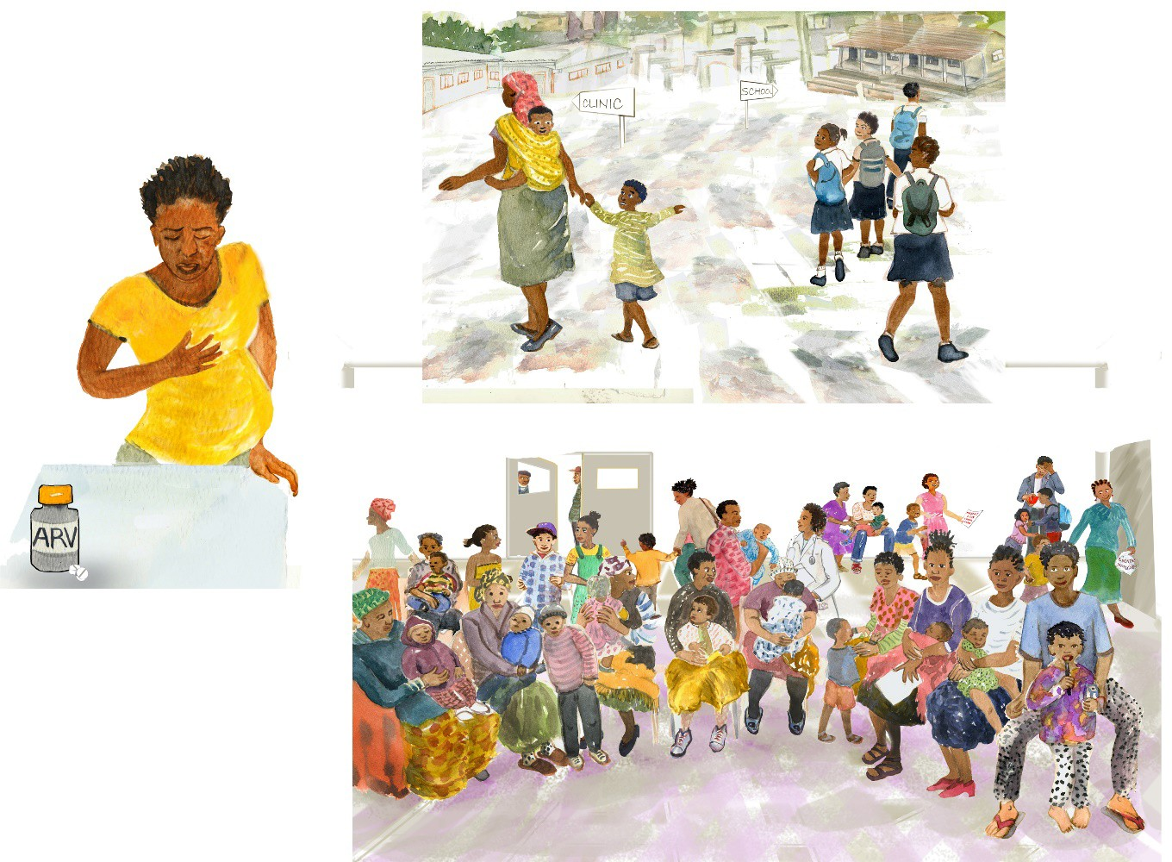
8. What are the challenges in taking your ARVs?
Sometimes there are clinic or community barriers to taking ARVs. We can support you to overcome these barriers.
Are there family traditions around delivery that we should know about?
Let’s plan for your delivery and post- partum care.

Slide 29



8. What are the challenges in taking your ARVs?
KEY MESSAGES:
Sometimes there are clinic or community barriers to taking ARVs. We can support you to overcome these barriers.
Are there family traditions around delivery that we should know about?
Let’s plan for your delivery and post- partum care.
TALKING POINTS:
Let’s continue to explore any challenges you may be facing when taking ARVs [giving
ARVs to your baby] (institutional and community level barriers).
BARRIERS | QUESTIONS TO ASSESS BARRIERS
INSTIUTIONAL/COMMUNITY
Drug stock-out | Have you ever come to the health facility and found that there were no ARVs available, or you were only given a small supply?
Long wait times | Have you ever left the health facility before receiving your ARVs because of long wait times?
Stigma and discrimination | Are you fearful that people in the community will find out about your HIV? Does that prevent you from coming to clinic or taking ARVs?
Political crisis/ war/natural disaster | Is it ever unsafe for you to pick up ARVs from the health facility?
Traditions around birth/delivery | Where will you be delivering the baby? When do you plan to leave to go there? How long after the birth will you stay there?
Provider Instructions:
Summarize what was learned from the patient about any specific barriers identified on this card.
R: Reflective listening, for example:
You’re wondering if it matters if you take your ARVs [give ARVs to your baby].
So you said you feel angry when you think about taking your ARVs and that makes it really hard.
What I hear you saying is you are so overwhelmed, your health is the least
of your problems right now.
S: Summary statements, for example:
Let me see if I understand so far. You are struggling to take your ARVs because you want [your baby] to be well and healthy, but you also have other problems in your life that make it difficult to focus on your health.
Here’s what I’ve heard you say, let me know if it is right. You feel fine when you miss a dose and are feeling really uncertain about whether ARVs are necessary to keep you healthy.
What I hear you saying is that you are concerned that taking ARVs might harm your baby. Let’s discuss that concern…
Document
Document the specific barriers you identify with the patient on the Enhanced Adherence Plan Tool.

Slide 30
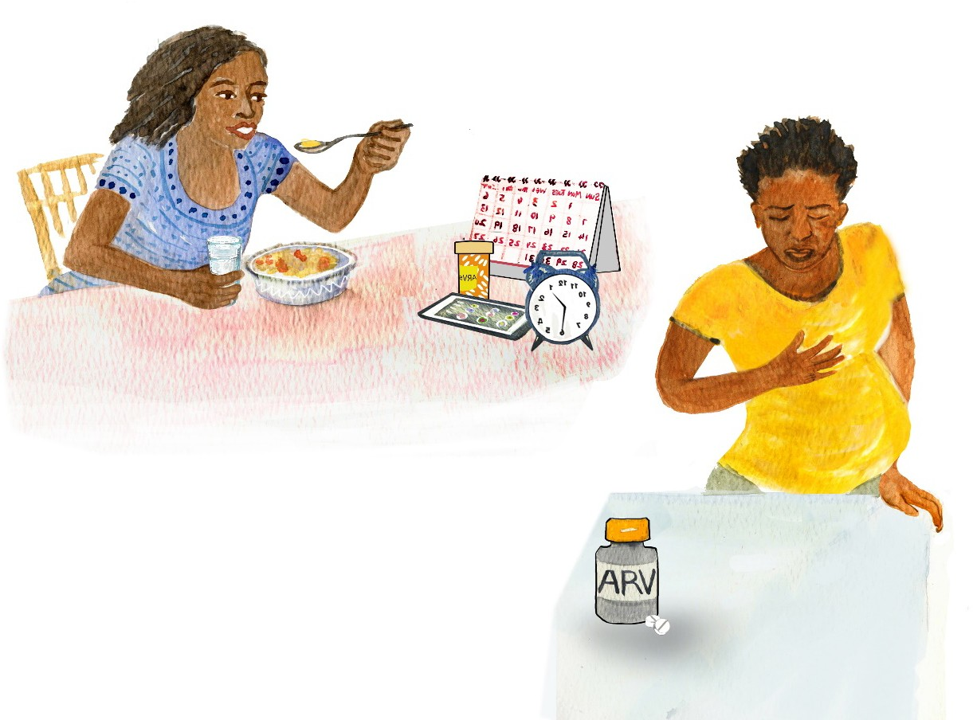
9. Tips to improve taking ARVs
Let’s discuss how to deal with any side effects you have experienced.
There are many ways to help you remember to take your ARVs.

Slide 31
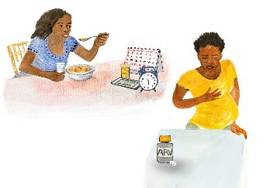


9. Tips to improve taking ARVs
KEY MESSAGES:
Let’s discuss how to deal with any side effects you have experienced.
There are many ways to help you remember to take your ARVs.
TALKING POINTS:
I appreciate that you are able to be honest about challenges of taking ARVs.
What I hear you saying is… (summarize main challenges and barriers).
Let’s explore ways in which we can make it better for you to take ARVs [and give ARVs to your baby].
Do you have suggestions to make it easier to take [give] ARVs in response to each barrier we discussed?
BARRIERS | INTERVENTIONS TO ADDRESS BARRIERS AND IMPROVE ADHERENCE
INDIVIDUAL
Knowledge deficit/worried that ARVs may harm infant | Individual counseling for basic HIV/ARV education | Group counseling/peer support group | Written instructions
Side effects | Nausea à take with food, anti-emetic Headache à paracetamol, evaluate for meningitis | Diarrhea à anti-diarrheal once infections ruled out, hydration Fatigue à check Hgb, consider substitution if on AZT | Anxiety/depression à take before bed
Forgot | Medication organizer (i.e. pillbox) Treatment buddy or supporter Directly Observed Therapy | Visual medication schedule (e.g. calendar, journal/log) Announced pill count at next session | Reminder devices (e.g. phone calls, SMS, alarm) Take pills late, do not skip dose
Feeling better/doesn’t feel the need for continued medication | Basic HIV/ARV education | Group counseling/peer support group | Mentor mother Treatment buddy
Physical illness | Clinical care to address comorbidities | Directly Observed Therapy | Treatment buddy
Provider Instructions
After giving a tip, ask if it seems helpful or if there are questions:
“How likely do you think
it is that this will help you?”
How likely are you to try…?”
“What questions do you
have about…?”
• Missing more than
two or three doses in a month can lead to medications not working well.
Document
Document planned interventions to address barriers identified by patient on the Enhanced Adherence Plan Tool.

Slide 32


10. Tips to improve taking ARVs
Together we will find ways to make it easier to take ARVs.

Slide 33


10. Tips to improve taking ARVs
KEY MESSAGES:
Together we will find ways to make it easier to take ARVs.
TALKING POINTS:
Let’s continue to explore ways in which we can make taking ARVs better (individual level).
BARRIERS | INTERVENTIONS TO ADDRESS BARRIERS AND IMPROVE ADHERENCE
INDIVIDUAL (continued)
Depression | Screening for and management of depression | Individual counseling Peer support group | Treatment buddy
Pill burden | Change to fixed-dose combination or once-daily dosing if possible
Lost/ran out of pills | Extra supply of pills | Drug pick-up group | Educate patient to alert facility if it occurs
Transportation problems | Drug pick-up group | Three month supply when feasible | ART group
Health beliefs/concerns that ARVs harm infant | Individual counseling for basic HIV/ARV education | Group counseling | Peer support group Mentor mothers
Scheduling difficulty | Education (e.g. combine with daily routine such as bedtime, brushing teeth, infant feeding schedule) Three month supply when feasible | Reminder devices (e.g. phone calls, SMS, alarm) ART group | Treatment buddy Keep a few doses of ARVs in different locations (e.g. at work) for easy access
Alcohol or drug use | Opioid substitution therapy Individual counseling | Directly Observed Therapy | Peer support group
Provider Instructions
Collaborate to come up with solutions, for example:
“What have you already tried?”
“You have thought a lot about this, what are other ways to solve this problem?”
Document
Document planned interventions to address barriers identified by patient on the Enhanced Adherence Plan Tool.

Slide 34

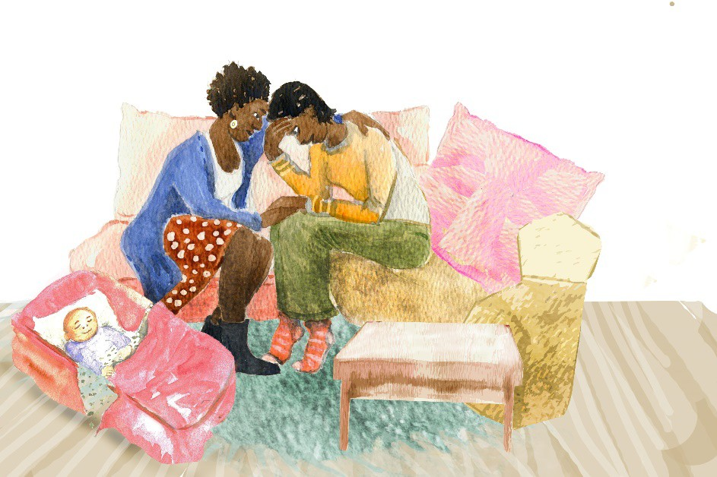
11. Tips to improve taking ARVs
Together we will find ways to make it easier to take ARVs.

Slide 35




11. Tips to improve taking ARVs
KEY MESSAGES:
Together we will find ways to make it easier to take ARVs.
TALKING POINTS: Let’s continue to explore ways in which we can make taking ARVs better (household and institutional/community level).
BARRIERS |  | INTERVENTIONS TO ADDRESS BARRIERS AND IMPROVE ADHERENCE
HOUSEHOLD
Share with others | Individual counseling for basic HIV/ARV education |  | Group counseling | Facilitate enrollment into care/PrEP for family members
Fear of disclosure | Individual counseling Treatment buddy Couples counseling and testing |  | Group counseling Unmarked pill bottle | Peer support group ART group
Family/partner relationships | Group counseling
Inability to pay | Refer to social worker, peer worker or NGO
Food insecurity | Refer to social worker, peer worker or NGO
INSTITUTIONAL/COMMUNITY
Long wait times | Nurse-led or community- based care |  | Three month supply where feasible | ART group
Stigma and discrimination | Individual /group counseling |  | Peer support group | ART group
Political crisis/war/natural disaster | Individual counseling |  | Case management | Reconsider distribution, transportation networks Consider alternative & non-conventional sites for prescription refills
Provider Instructions
Offer suggestions to overcome specific barriers that have been identified.
Document
Document interventions and any needed referrals on the Enhanced Adherence Plan Tool.
Summarize results and plan made. Have the patient repeat back the plan.
Tell the patient the next follow-up date and whether it is for ANC/PNC follow up, another adherence session or for repeat viral load test.

Slide 36
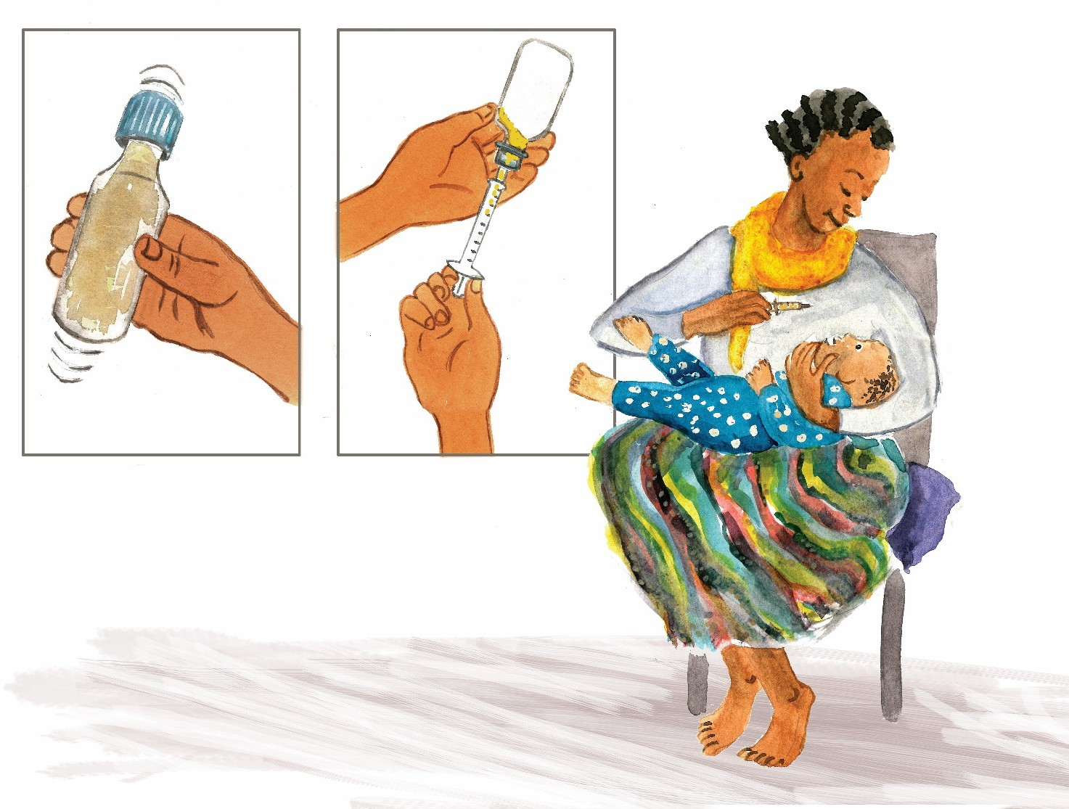
12. Giving ARVs to your baby
Your baby will need to take ARVs every day for a while.
This medicine helps prevent the baby from becoming infected with HIV.

Slide 37
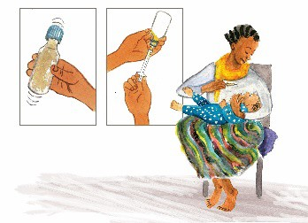



12. Giving ARVs to your baby
KEY MESSAGES:
Your baby will need to take ARVs every day for a while.
This medicine helps prevent the baby from becoming infected with HIV.
TALKING POINTS:
Give your baby his/her ARVs immediately after you take your own (this is a good way to remember).
Give medicine to your baby when baby is hungry; he/she doesn’t need to be really hungry, just so long as he isn’t full.
Giving medication to infants (directions here are for syrups, though tabs can be used as shown in table below)
First, shake the medicine bottle 10–15 times.
Then draw the medicine into the syringe, to the line indicated by your provider.
Sit comfortably with the baby in your lap and filled syringe within reach. If you are right handed, hold the baby in your left arm. The baby should be level (i.e., head and feet about the same distance from the floor). Hold the baby’s head in the crook of your left elbow, using your left hand to gently push your thumb and fingers on either side of the outside of the mouth so that the baby cannot close his/her mouth .
Using your right hand to pick up the filled medication syringe and gently squirt the medicine inside his/her mouth into the baby’s cheek (not down the throat as it may cause choking). Then release your left hand so that the baby can close his mouth and swallow.
You may feed your baby immediately after giving medicine to “wash” the medicine down.
Provider Instructions
Be sure to mention cotrimoxazole/Septra when indicated
Let’s Review:
Ask the parent questions to ensure they understand what you have discussed:
Which medicine will your baby take? How much will you give?
How often? For how long?
Show me how you’ll administer ARVS to your baby.
What’s a good way to remember your baby’s ARV dose?
Give written resources if available.
Which medicine and how much?
National guidelines will state which ARV medication or medications are used for infant ARV prophylaxis and how much. WHO recommendations are listed in the table below. As the baby grows, the dosage will need to be increased.
Dosage forms | Dose 0–6 weeks* AZT and NVP | Dose 6–12 weeks NVP only
Syrups AZT 10/mg/ml NVP 10mg/ml | AZT 1.5 ml twice daily (15 mg) | NVP — 2 ml once daily (20mg)
 | NVP 1.5 ml once daily (15 mg)
Tablets AZT 60 mg NVP 50 mg | AZT ¼ tablet twice daily (15mg) | NVP — ½ tablet once daily (25mg)
 | NVP ¼ tablet once daily (12mg)
* If infant weighs between 2000–2500 grams, give 1.0 ml

Slide 38
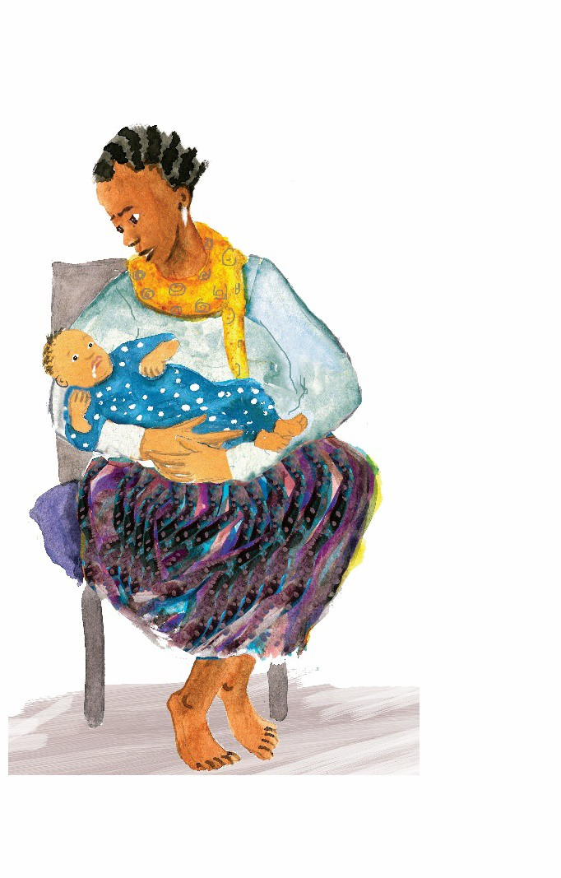
13. Tips for giving medication to your baby
Together we will find ways to make it easier to give ARVs to your baby.

Slide 39
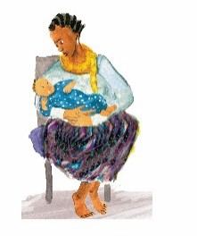
13. Tips for giving medication to your baby
KEY MESSAGES:
Together we will find ways to make it easier to give ARVs to your baby.
TALKING POINTS:
Let’s explore ways to make it easier to give ARVs to your baby (individual level).
BARRIERS |  | INTERVENTIONS TO ADDRESS BARRIERS AND IMPROVE ADHERENCE
INDIVIDUAL (continued)
Baby spits out medicine (or hates taste) | Give baby’s medicine when s/he is hungry and breastfeed baby as soon as the medicine is swallowed.
Baby vomits after taking medicine | If baby vomited within 30 minutes of giving medicine, then re-administer. If more than 30 minutes has passed, then there’s no need to re-administer.
Baby won’t open his/her mouth | Hold the baby’s head in such a way that your fingers (from the outside of the face) force the mouth open. You can do this in a way that is gentle. Do not force the mouth open by putting your fingers into the baby’s mouth. Try offering the breast, and when the baby starts to “root” (search for breast with mouth open), insert the syringe and give medication. Offer the breast immediately after.
Baby squirms | Hold baby firmly, baby’s head should be nestled into the crook of the left elbow—if you are right handed—so that it can’t move during the few seconds it takes to administer the medicine. It’s difficult to do! It takes confidence and practice, so don’t worry if you don’t get it right the first time.
Mum hasn’t disclosed HIV status | If you haven’t disclosed your HIV status, then you’ll probably want to administer the baby’s medicine when you take your own and hide the baby’s medicine where you hide your own. If you choose to disclose your or your baby’s HIV status, please reach out to your provider for support.
Mum away from home | If you’re away from home, for work or for longer, then you will need to provide the baby’s caregivers with training on how to administer ARVs. Show the caregiver and then watch him/her give infant ARVs at least once before you leave the first time. You can even bring other caregivers to the clinic to learn about the importance of ARVs and how to give them to your baby.
Provider Instructions
Offer suggestions to overcome specific barriers that have been identified.
Document
Document interventions and any needed referrals on the Enhanced Adherence Plan Tool.
Summarize results and plan made. Have the patient repeat back the plan.
Tell the patient the next follow-up date and whether it is for ANC/PNC follow up, another adherence session or for repeat viral load test.

Slide 40

14. Additional help to take ARVs
Ways to improve taking ARVs.

Slide 41

14. Additional help to take ARVs
KEY MESSAGES:
Ways to improve taking ARVs.
TALKING POINTS:
Let’s look closer at a few of the
common barriers to taking ARVs.
Of the areas we discussed, what is the biggest problem you have taking your ARVs?
Early postpartum women: Of the areas we discussed, what is the biggest problem you have giving ARVs to your baby?
You: “Here’s what I’ve heard you say. Let me know if I understand correctly.” [Reflect back on identified challenges]
  Go to card 15 (labeled Remembering to take ARVs) for “Forgets”
  Go to card 16 (labeled Understanding your ARVs) for “Knowledge,” “Side Effects” and “Physical Illness”
  Go to card 17 (labeled Managing privacy and getting support) for “Disclosure”

Slide 42


15. Remembering to take ARVs
It can be difficult to Ø Missing ARV doses can
Missing infant ARV prophylaxis doses can put your baby at risk of HIV infection.
always remember to take ARVs.
be a reason for high viral load and can harm you.

Slide 43






15. Remembering to take ARVs
KEY MESSAGES:
It can be difficult to always remember to take ARVs.
Missing ARV doses can be a reason for high viral load and can harm you.
Missing infant ARV prophylaxis doses can put your baby at risk of HIV infection.
TALKING POINTS:
What have you already tried to help you remember?
Let me make sure I understand. What I hear you saying is [circumstance for missing doses]. Here are some things others have found helpful:
Let’s Review:
Remembering to take ARVs can be challenging, I’d like to check with you about a few things we discussed.
What changes do you plan to make to help you remember to take your ARVs?
Pregnant/early postpartum women: What changes do you plan to make to help you remember to give ARVs to your baby?
How do you/how will you track whether you have taken [given] your ARVs?
Put ARVs somewhere easy to remember, near something that you use every day, and keep a bottle of water [the baby’s medicine syringe] there if needed.
Set an alarm on your phone to remind you to take your ARVs [give your baby his/her ARV prophylaxis].
Carry ARVs with you so if you forget before leaving for the day, you have a spare.
Use pillboxes and a calendar to mark and keep track of when ARVs are taken for the day.
Ask for extra ARVs if you will not be able to return to the health facility in time for your next refills.
Provider Instructions:
Identify with the patient a daily activity that they can schedule taking their pills around.
If there are other resources such as directly observed therapy (DOT), peer support, SMS reminders, or other supports in your area, assess the need and discuss with the patient.
Document
Document planned interventions to address barriers identified by patient on the Enhanced Adherence Plan Tool.

Slide 44
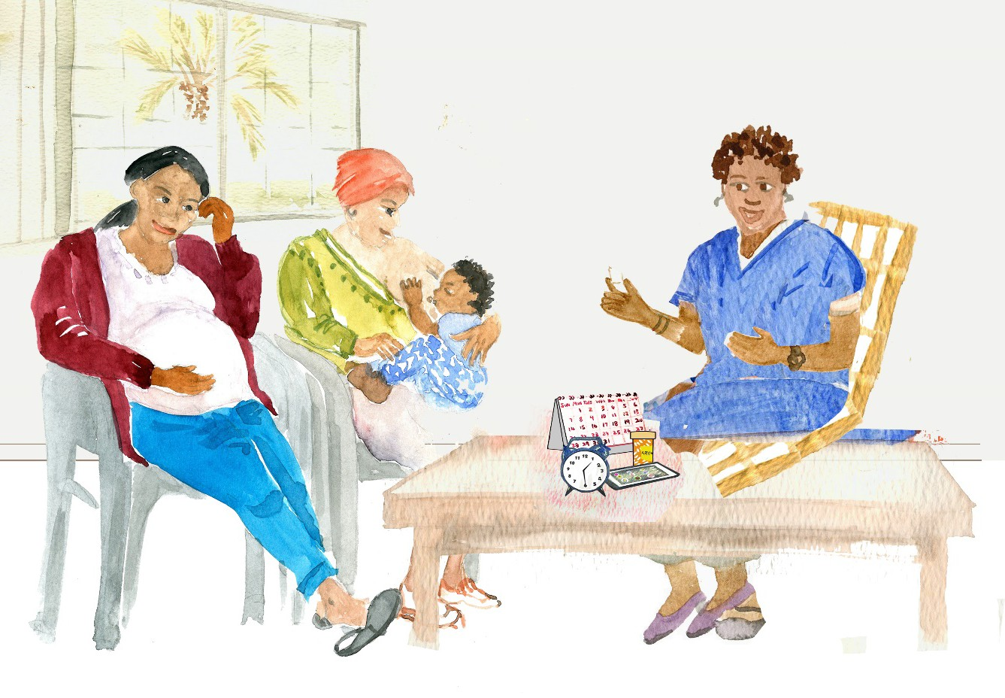
16. Understanding your ARVs
To be successful with ARVs it is important that you learn:
how they work,
how to take them daily,
how to avoid or manage side effects.

Slide 45
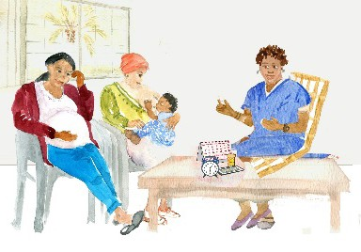


16. Understanding your ARVs
KEY MESSAGES:
To be successful with ARVs it is important that you learn:
how they work,
how to take them daily,
how to avoid or manage side effects.
TALKING POINTS:
Which area is the patient having the most
difficulty with? (If patient has given birth in the
past 12 weeks and is administering infant ARV prophylaxis review the topics below for both her medication and her infant’s.)
Names and frequency of medications
à Provide education and fact sheets.
How medications work
à Review earlier cards from prior visits or answer questions.
Health beliefs
à Instruct patient to take ARVs whether they feel healthy or sick, unless otherwise specified by a doctor.
à Early postpartum women: Instruct patient to give ARVs to her baby for [insert national guidelines] of life.
àProbe for specific beliefs about ARVs and health, for example:
  “Have you heard others say negative things about ARVs during pregnancy or breastfeeding?”
  “Are there other remedies that you think work better than ARVs?”
Managing side effects
à Take with food (nausea/headache).
à Take at night (drowsiness/mood).
Let’s Review:
Let’s go over these instructions again to see if you have any questions.
Can you tell me how you understand what ARVs do and how you are supposed to take them, and tips to avoid side effects?
Early postpartum women: When will you stop giving infant ARV prophylaxis?
Provide patient with written resources if available.
Document
Document planned interventions to address barriers identified by patient on the Enhanced Adherence Plan Tool.

Slide 46
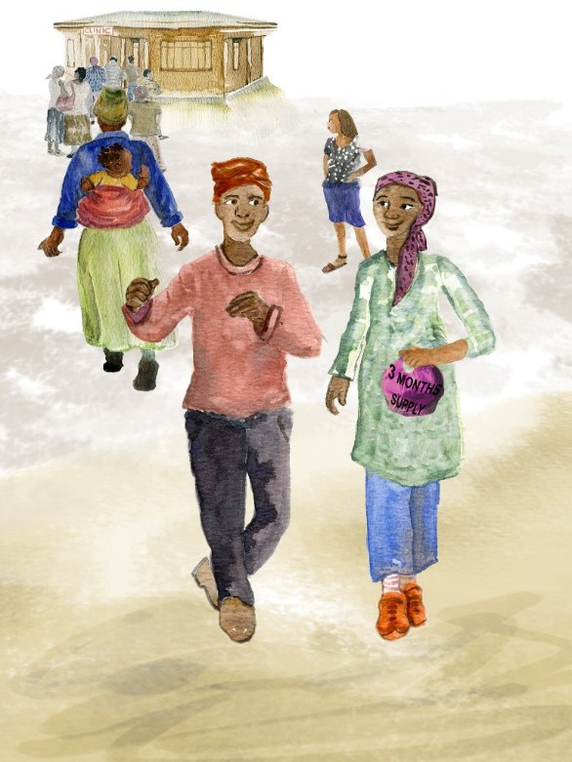

17. Managing privacy and getting support
Your privacy is important and should be respected.
Sharing your status with someone you trust can help you take your ARVs every day.

Slide 47




17. Managing privacy and getting support
KEY MESSAGES:
Your privacy is important and should be respected.
Sharing your status with someone you trust can help you take your ARVs every day.
TALKING POINTS:
Ways to protect privacy:
Use an unmarked pill bottle.
Use pill boxes rather than bottles.
Brainstorm places where the patient can keep ARVs out of the sight of others, but that are easily visible/accessible to the patient.
Discuss ways to decide who to share their diagnosis with and how to share. Provide the patient with fact sheets and information to assist as needed.
What characteristics do you think make a good choice for someone to share your status with?
What are benefits of someone knowing your status?
How do you decide whether you can trust someone?
How do you tell someone your status?
Are you concerned that harm might come to you if you disclose your HIV status?
If someone asked about your baby’s HIV status or why the baby is taking ARVs what would you say?
Will/does anyone else care for your baby? What will you tell/have you told that person about your HIV status? What will you tell that person about your baby’s HIV status? About his/her risk of getting HIV from the baby?
If the person is in a relationship:
Why and how might it be beneficial for your partner if you were taking your ARVs every day?
How do you think your partner might support you to take your ARVs?
How do you think your partner might support you to give ARVs to your baby?
Document
Document planned interventions to address barriers identified by patient on the Enhanced Adherence Plan Tool.

Slide 48
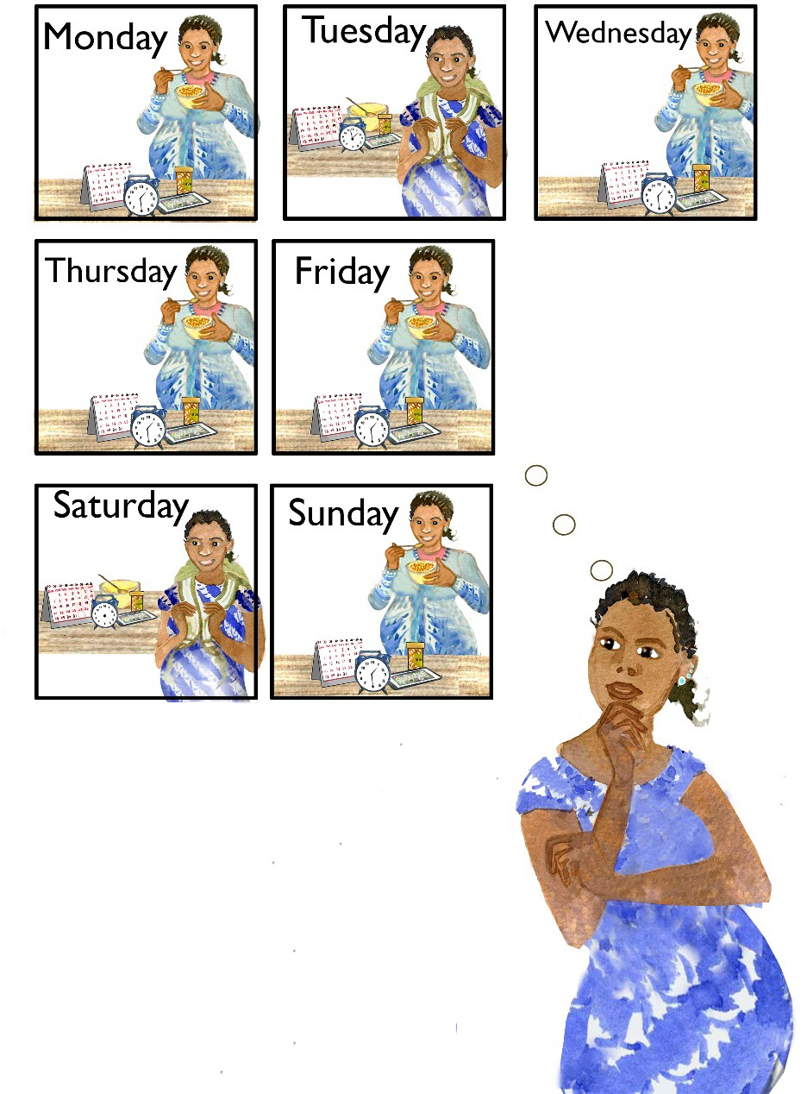
18. Follow up on how you are taking ARVs
Together we’ll review the plan made last time to see how you are taking ARVs.

Slide 49
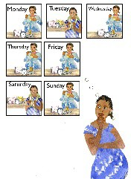



18. Follow up on how are you taking ARVs
KEY MESSAGES:
Together we’ll review the plan made last time to see how you are taking ARVs.
TALKING POINTS:
Last time we met, we identified (fill in barriers discussed at last session) and planned (fill in interventions decided upon at last session) to help you take ARVs.
How have things been going since we last spoke?
Are there any new challenges taking ARVs?
Please think back to the past WEEK, how many ARV doses (days) do you think you missed?
Was this a typical week?
Now what about the past month?
Provider Instructions
Repeat viral load to be sent after
months of “good adherence.” Advise patient of when repeat viral load will be done.
Do not repeat viral load while adherence is fair or poor as it will likely be elevated due to this, but rather continue monthly enhanced adherence sessions until adherence is good for three months.
Patients with persistent adherence problems should be referred for additional assistance as available (e.g. psychologist or other available staff dedicated to adherence).
The baby will be tested for HIV at 4–6 weeks, and again at 9 months/18 months of age or 3 months after stopping breastfeeding (whichever is later).
Early postpartum women: Are there any new challenges to giving infant ARV prophylaxis to your baby?
Please think back to the past WEEK, how many of your baby’s ARV doses (days) do you think you missed?
Was this a typical week?
When will you stop giving ARV prophylaxis to your baby?
I can see you’ve been putting a lot of effort into this. Do you have any new ideas on how to make it easier to take your ARVs [give infant ARV prophylaxis to your baby]?
Use adherence assessment tables on prior cards as needed to look for new barriers and
interventions.
Document
Number of doses missed per month | Adherence category
Patients taking once daily regimens
< 2 doses | Good
2–4 doses | Fair
> 4 doses | Poor
Patients taking twice daily regimens
< 4 doses | Good
4–8 doses | Fair
> 8 doses | Poor
Complete the first column of enhanced adherence session 2 or 3 on the Enhanced Adherence Plan Tool and mark the mother’s as good, fair, or poor, according to the number of doses missed per month (as per table). Complete the other two columns with any new barriers found and interventions planned.
Early postpartum women: Do the same for adherence to the infant ARV prophylaxis regimen.

Slide 50
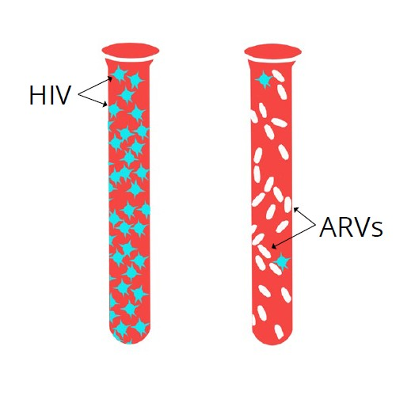

19. You’ve successfully reduced your viral load
Before ART
After ART
You have taken your ARVs well, the medications are working, and you are keeping yourself healthy.

Slide 51
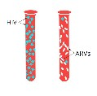



19. You’ve successfully reduced your viral load
KEY MESSAGES:
You have taken your ARVs well, the medications are working, and you are keeping yourself healthy.
TALKING POINTS:
A low viral load (less than 1000)
[insert patient’s result here] is a sign that
you are taking your ARVs well and the medications are working.
Your changes in (insert intervention) have been successful and you are getting the ARVs you need to stay well.
It is important that you continue to take your ARVs every day to keep HIV from making more virus, to stay healthy, and to prevent passing HIV to your baby.
It’s important to keep track of how much medication you have so that you don’t run out of ARVs before the next appointment.
If you notice that medication is running low, come to the clinic
even if you don’t have an appointment.
If you expect to travel to your homestead for the baby’s birth, before and/or after the birth, please let us know so we can give you an additional supply of medication and an appointment for your return.
We will check the viral load again in six months if there are no new problems or problems taking ARVs.
Please let your provider know if there are any problems taking ARVs in the future, so that he/she can help you address them.
Let’s Review:
Let’s briefly review what a low viral load means, and your plans for continuing to take your ARVs:
In your own words, what does having a low viral load mean?
Why is it important to continue ARVs?
What has helped you remember to take your ARVs?
Are there new things or do you expect there to be new things that will make it hard at times to take your ARVs?
Pregnant women: How do you think having a new baby at home will change
your daily routine and timing of when you take your ARVs?
Document
Document results of repeat viral load on Enhanced Adherence Plan Tool.

Slide 52
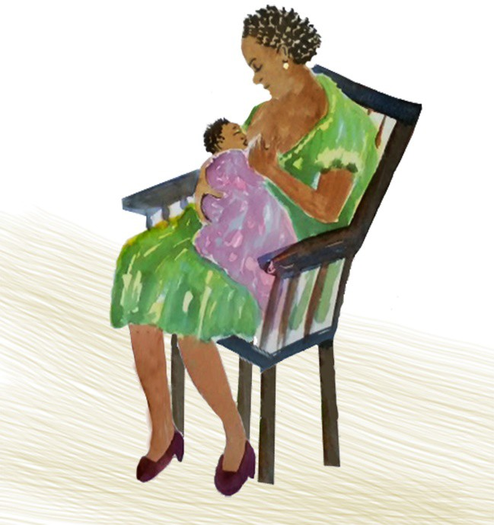
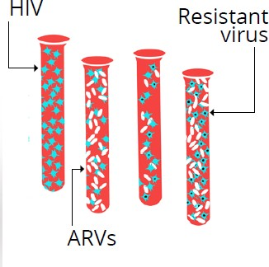
20. ARVs are not working well
It is likely that the virus is resistant, meaning that it has changed and your current ARVs are no longer working.
Switching ARVs is recommended.

Slide 53
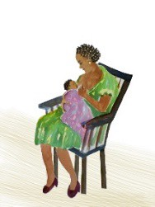
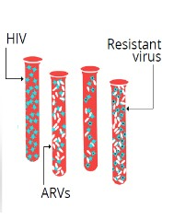




20. ARVs are not working well
KEY MESSAGES:
It is likely that the virus is resistant, meaning that it has changed and your current ARVs are no longer working.
Switching ARVs is recommended.
TALKING POINTS:
Even though you are taking ARVs every
day, your repeat viral load result is still high.
It is likely that ARVs are not working well due to the virus being resistant.
We are going to change your ARV regimen to .
Provide detailed instructions on new regimen.
Discuss possible side effects and how to avoid/manage.
Provide written instructions.
Let’s Review:
We have discussed a lot of new information. I’d like to make certain that I have explained everything well and I have answered your questions.
Can you please tell me what you understand to be the next steps and why we advise changing ARVs?
In your own words, what does resistance mean?
What are the new ARVs and how will you take them?
What has helped you to take your ARVs? It will be important to continue doing these things as you
start your new ARVs. It is important to take the new ARVs exactly as prescribed.
When is your next appointment?
If you have any problems taking your ARVs before then, come to the clinic.
We will check your viral load again in months to see how the new ARVs are working.
What questions do you have?
We expect now that you are able to take ARVs every day, the new medications will reduce the viral load and keep you well.
It is extremely important to take your new ARVs properly, for your own health and for your baby’s health. If you’re unwell you’re more likely to pass HIV to your baby.
Postpartum women: Continue to breastfeed your baby as recommended in national guidelines and take your ARVs.
Please let a provider know if you have any trouble so that you can get assistance.
If you start other medications, such as TB medications, please let your provider know that you are also taking ARVs.
Your next appointment is .
Document
Document new ARVs on the Enhanced Adherence Plan Tool.
Provider Instructions:
At subsequent visits use relevant cards for adherence assessments and counseling, and explanation of viral load results. For example, at the first follow-up visit after ARV switch, use the cards beginning with “How are you taking ARVs?” (Card 5) to assess adherence to new regimen and provide counseling.

Slide 54
A global health leader since 2003, ICAP was founded at Columbia University with one overarching goal: to improve the health of families and communities. Together with its partners—ministries of health, large multilaterals, health care providers, and patients—ICAP strives for a world where health is available to all. To date, ICAP has addressed major public health challenges and the needs of local health systems through 6,000 sites across 30 countries.
For more information about ICAP, visit: icap.columbia.edu

