Slide 1
PrEP Training for Providers in Clinical Settings (Version 2.0)

Slide 2
Welcome!
Please sign the registration sheet.
Please make a name tag for yourself.
Please take a participant manual, notebook, and pen.
Any component of this document may be reproduced or adapted without prior permission from ICAP, provided that: 1) ICAP is acknowledged; 2) appropriate attribution is given for all changes that are made; and 3) the material is made available free of charge.
These materials were made possible by the U.S. President’s Emergency Plan for AIDS Relief (PEPFAR) through the U.S. Centers for Disease Control and Prevention (CDC) under the terms of cooperative agreement number U2GGH000994. Its contents are solely the responsibility of ICAP and do not necessarily represent the views of the U.S. Government.
2
Notes:
Please circulate the registration sheet so that everyone may complete it.
Please take a nametag and write your name on it.
Please take a participant manual, pen, and notebook. You will use your manuals during this training and will take them home at the training’s end.

Slide 3
Introductions
Take 1 minute (and only 1 minute, please!) to:
State your name, organization and position.
3
Notes:
Please introduce yourselves briefly by sharing your name, organization, and position.

Slide 4
PrEP-Specific Competencies
After completing today’s training program, participants will be able to:
Identify eligible candidates for PrEP.
Assess individual risk for HIV.
Educate and counsel PrEP candidates and users.
Assess medical eligibility for PrEP.
Prescribe PrEP.
Conduct clinical and laboratory assessments during follow-up PrEP visits.
Assess PrEP Monitoring and Evaluation tools for local use.
Provide adherence education, counseling and support to PrEP candidates and users.
4

Slide 5
Training Overview
1
PrEP Basics
2
PrEP Screening and Eligibility
3
Initial and Follow-up PrEP Visits
4
Monitoring and Managing PrEP Side Effects, Seroconversion, and Stigma
5

Slide 6
Training Overview, cont.
5
Post-test, Evaluation, and Closing
6
PrEP Monitoring and Evaluation Tools
6

Slide 7
Ground Rules
Punctuality
Confidentiality
Respect for differing opinions
Active participation in all training activities
Agreement on cell phone use
Questions encouraged
Allow others to finish speaking before responding or commenting yourself.
7
Notes:
For the training to be effective, the group will agree on some ground rules. These ground rules will help the training run smoothly, maximize learning, and encourage participation.
Do any other rules need to be added?

Slide 8
Pre-Program Assessment
The purpose of this assessment is to determine what you know about implementing PrEP. Your responses will help determine if there is anything in this training that needs to be adjusted in the future.
We assume that know little about PrEP, so do not worry if you do not know all of the answers.
You will have approximately 20 minutes to complete the pre-assessment.
Please give me your pre-assessment when you have finished.
8

Slide 9
Pre-Program Assessment Debriefing
How did you feel about the pre-program assessment questions?
Were the questions easy or difficult? Why or Why not?
You will receive answers to the questions after you complete the post-test at the end of today’s training.
9

Slide 10
PrEP Training for Providers in Clinical Settings
This training is for HIV providers in clinical settings and is based on these approved HIV training resources:
[Insert country-specific approved HIV national training curriculum citation/web address.]

Slide 11
Module 1
1
PrEP Basics
11
Notes:
The next several sessions will cover Module 1 content.

Slide 12
Module 1 Learning Objectives
After completing Module 1, participants will be able to:
Define PrEP.
Differentiate PrEP from PEP and ART.
Describe the need for PrEP.
Identify people at risk and people at substantial risk for HIV infection.
Identify key populations (KP) for PrEP at the local level.
Explain the relationship between PrEP effectiveness and adherence.
12

Slide 13
Module 1 Learning Objectives, cont.
After completing Module 1, participants will be able to:
State key reasons why PrEP is needed.
Specify the PrEP regimens approved by WHO and within one’s own country.
Identify concerns regarding the implementation of PrEP.
Explain the risks and benefits of PrEP.
13

Slide 14
Introduction
HIV prevention needs change during a person’s lifetime.
Combination prevention is a mix of biomedical, behavioral, and structural interventions that decrease risk of HIV acquisition.
Combining approaches may result in greater impact than using single interventions alone.
Antiretroviral drugs (ARVs) used as PrEP provide an important additional prevention tool.
14

Slide 15
Combination Prevention
Structural
Policies
Laws
Behavioral
Education
Counselling
Biomedical
HIV testing
Condoms
Regulatory environment
Culture
Stigma reduction
Harm reduction
VMMC
PMTCT
Treatment of STIs
ARV
Pre-Exposure Prophylaxis (PrEP)
Cash transfers
Adherence interventions
Post-Exposure Prophylaxis (PEP)
Antiretroviral therapy for prevention (ART)
15
Notes:
This training will focus on biomedical interventions, specifically the use of ARV for pre-exposure prophylaxis (PrEP).

Slide 16
Question
What is Pre-Exposure Prophylaxis (PrEP)?
16

Slide 17
Pre-Exposure Prophylaxis (PrEP)
PrEP is the use of ARV drugs by HIV-uninfected persons to prevent the acquisition of HIV before exposure to HIV.
Pre
Exposure
Activity that can lead to HIV infection
Prophylaxis
Prevention
Before
17
Notes:
The concept of providing a preventive drug before exposure to an infectious agent is not new. We have been using this concept for other diseases (e.g., for malaria prophylaxis—taking anti-malarial drugs before traveling to an endemic area to prevent infection).

Slide 18
Question
What is Post-Exposure Prophylaxis (PEP)?
18

Slide 19
Post-exposure Prophylaxis (PEP)
Post-exposure prophylaxis (PEP) is short-term antiretroviral treatment to reduce the likelihood of HIV infection after potential exposure, either occupationally or through sexual intercourse. Within the health sector, PEP should be provided as part of a comprehensive universal precautions package that reduces staff exposure to infectious hazards at work.
19
Notes:
http://www.who.int/hiv/topics/prophylaxis/en/

Slide 20
Questions
What are some similarities and differences between Pre-Exposure Prophylaxis (PrEP) and Post-Exposure Prophylaxis (PEP)?
What are the main differences between ART and PrEP?
20

Slide 21
Comparing PrEP (Pre-Exposure Prophylaxis) and PEP (Post-Exposure Prophylaxis)
What’s the same?
Both are used by HIV uninfected persons
Both use ARVs to prevent HIV acquisition
Both are available from a clinical provider by prescription
Both are effective when taken correctly and consistently
What’s different?
PrEP is started BEFORE potential exposure and PEP is taken AFTER exposure
PEP is taken for 28 days only. PrEP requires ongoing use as long as HIV risk exists
21

Slide 22
Questions
What are some similarities and differences between Pre-Exposure Prophylaxis (PrEP) and Post-Exposure Prophylaxis (PEP)?
What are the main differences between ART and PrEP?
22

Slide 23
Differences Between ART and PrEP
HIV treatment requires adherence to life-long therapy with consistent, fully-suppressive dosing.
PrEP is needed during “periods” of high HIV risk.
Both ART and PrEP require optimal adherence.
Individuals taking PrEP require ongoing risk assessment and PrEP can be discontinued if they:
acquire HIV infection.
are no longer at substantial risk for HIV infection.
decide to use other effective prevention methods.
Motivation for adherence is different: ART is taken by HIV-infected persons who may have symptoms to remain healthy and prevent onward transmission, while PrEP is taken by HIV uninfected persons who are largely healthy to prevent acquisition of infection.
23

Slide 24
Why We Need PrEP
There are already several effective HIV prevention interventions (e.g. condoms, harm reduction for people who inject drugs (PWID)).
However, globally there were more than 2 million new HIV infections in 2015.
HIV incidence among key and vulnerable populations remains high (e.g. men who have sex with men (MSM), sex workers (SWs), PWIDS, transgender persons, etc.).¹
PrEP provides an additional prevention intervention to be used together with existing interventions (e.g. condoms).
PrEP is not meant to replace or be a substitute for existing interventions.
1. UNAIDS, Gap Report 2016.
24

Slide 25
Local HIV Epidemiology
Most new infections are happening amongst <insert populations>, making these the populations appropriate target for PrEP.
In <insert country name> there are <insert most recent incidence data> new infections annually.
25
Notes:
ADD COUNTRY-SPECIFIC DATA TO THIS SLIDE
Add 1 or 2 slides to explain the local HIV epidemiology, where most new HIV infections are happening and the different KPs targeted for PrEP use at a local level.

Slide 26
Question
Who are Key Populations (KPs) or other populations targeted for PrEP at the local level?
26

Slide 27
Small Group Activity
Find this information in your participant manuals and read it: ARVs Used in PrEP Trials; iPrEx Study, PROUD: Immediate vs. Deferred PrEP; ANRS IPERGAY; Partners PrEP Demonstration project; Key HIV PrEP Trials table; Effectiveness and Adherence in Trials. Do not read beyond this point.
Then discuss these questions with your small group:
From these studies, what can you conclude about the effectiveness of PrEP?
When was PrEP found to be most effective (in what circumstances)?
You will have 10 minutes to work.
27

Slide 28
Evidence PrEP Works
PrEP efficacy was measured in:
11 randomized control trials (RCT) comparing PrEP with placebo.
3 RCTs comparing PrEP with no PrEP (e.g. delayed PrEP or ‘no pill’).
3 observational studies.
PrEP was found to be effective in reducing HIV acquisition.
PrEP was most effective in studies with high adherence.
Quantifiable drug in plasma increased the efficacy estimates to 74% –92%.
28

Slide 29
PrEP Efficacy Depends on Adherence
PrEP works when taken as prescribed!
Trials where PrEP use was more than 70% demonstrated the highest PrEP effectiveness (risk ratio = 0.30, 95% confidence interval: 0.21–0.45, P<0.001) compared with placebo.¹
As the graph that you studied shows, the higher the percentage of participant samples that had detectable PrEP drug levels, the greater the efficacy.
¹ Fonner VA, Dalglish SL, Kennedy CE, et al. Effectiveness and safety of oral HIV pre-exposure prophylaxis (PrEP) for all populations: A systematic review and meta-analysis. Aids. May 5 2016.
29
Notes:
Graph in participant manual: Effectiveness and Adherence in Trials of Oral and Topical Tenofovir-based Prevention

Slide 30
Question
How would you define adherence?
30

Slide 31
Defining Adherence
Adherence to drug(s) means that an individual is taking prescribed medications correctly and consistently, it involves taking the correct drug:
in the correct dose,
at a consistent frequency (number of times per day), and
at a consistent time of day.
Adherence with follow–up means patients attend all scheduled clinical visits/procedures, including:
Clinic and lab assessments.
Drug collection/repeat prescription.
31

Slide 32
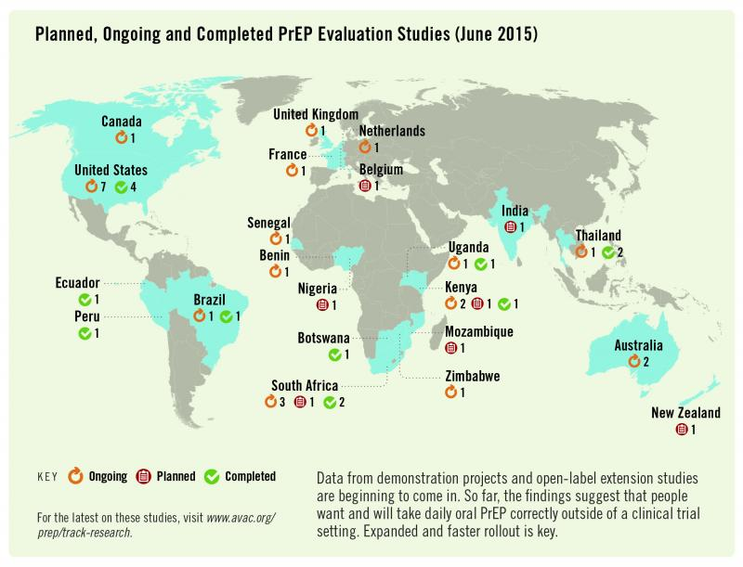
32
http://www.prepwatch.org/about-prep/research/#ongoingResearch
Notes:
This slide shows planned, ongoing and completed PrEP studies. You can get updated information on the PrEPwatch website.

Slide 33
Summary
PrEP works when taken
CORRECTLY and CONSISTENTLY.
33

Slide 34
ARVs Recommended for Oral PrEP
The WHO recommends that oral PrEP regimens should contain tenofovir disoproxil fumarate (TDF).
According to the WHO, the following regimens should be considered for use as PrEP¹:
Combined tablet of emtricitabine (FTC) 200 mg / tenofovir disoproxil fumarate (TDF) 300 mg PO Daily
Combined tablet of lamivudine (3TC) 300 mg / tenofovir disoproxil fumarate (TDF) 300 mg PO daily
Single-agent tenofovir disoproxil fumarate (TDF) 300 mg PO daily* (*Limited evidence on the use of TDF alone for PrEP for MSM)
In <insert country name> the available recommended PrEP regimens include: <insert available regimen>
WHO (2016) Consolidated guidelines on the use of antiretroviral drugs for treating and preventing HIV infection.
34
Notes:
ADD COUNTRY-SPECIFIC DATA TO THIS SLIDE
This training focuses on daily oral PrEP.

Slide 35
PrEP Side Effects: Reports from RCTs
In clinical trials, approximately 10% of participants experienced side-effects.
The side-effects were mild and short-term, and did not persist beyond the first month.
Side effects may include:
Gastrointestinal (GI) side-effects (nausea/vomiting/abdominal pain).
Creatinine elevation (typically reversible).
Loss of bone mineral density; recovers after stopping PrEP.
35

Slide 36
Side-effects Reported from iPrEx Open-Label Extension (iPrEx OLE): Observational study
iPrEx OLE multi-site PrEP cohort taking daily oral TDF/FTC:
39% of participants reported any PrEP-related (mainly mild) side effects.
A “start-up syndrome” has been reported:
GI symptoms (nausea, flatulence, diarrhea, abdominal pain, vomiting), headaches, skin problems/itching.
The “start-up syndrome” is transient but can influence adherence:
Side-effects among PrEP users peaked around month one and symptoms resolved by month three.
Adherence counseling should focus on the transient nature of a “start-up syndrome”.
36
Notes:
Participants in the study reported a “start syndrome” with GI symptoms, headaches and some skin problems. This start–up syndrome was transient in most cases, and it is important to counsel clients about this.

Slide 37
Will PrEP users engage in more risk behaviors?
Will PrEP encourage people to use condoms less often or to have more sexual partners – i.e. “risk compensation”?
There was no evidence of this in clinical trials.
The PROUD study showed that for participants who were at high risk before initiating PrEP, sexual behavior remained unchanged whether or not participants received PrEP.
37

Slide 38
Will PrEP lead to more HIV drug resistance (HIVDR)?
HIVDR in PrEP users was rare in clinical trials!
HIVDR occurred mostly in cases where the person had undiagnosed HIV infection at the time of starting PrEP.
When adherence to PrEP is high and HIV seroconversion does not occur, HIVDR will not occur.
If adherence is suboptimal and HIV infection occurs while on PrEP, there can be a risk of HIVDR.
Optimal adherence to PrEP is crucial.
Health providers must support and monitor adherence and teach PrEP users to recognize signs/symptoms of acute HIV infection.
38

Slide 39
Questions
Does PrEP protect against other STIs?
What can people do to protect themselves against STIs while they are taking PrEP? What should the package of prevention services include?
39

Slide 40
Does PrEP protect against other STI?
Only condoms protect against STI and pregnancy.
PrEP protects against HIV and also against herpes simplex virus type 2 in heterosexual populations.
PrEP does NOT protect against syphilis, gonorrhea, chlamydia, or human papilloma virus (HPV).
PrEP should be provided within a package of prevention services, including STI screening and management, risk reduction counseling, condoms, contraceptives, etc.
40

Slide 41
Module 1 Summary
What we know about PrEP:
PrEP can be used by HIV uninfected persons to reduce the risk of HIV acquisition.
Daily oral PrEP with TDF- containing regimens is currently recommended.
PrEP should be taken as an additional prevention intervention.
PrEP is effective if taken correctly and consistently.
PrEP can be used by at risk populations, including heterosexual men and women, MSM, SWs, PWIDs, and transgender women among others.
PrEP is safe and has minimal side effects.
41

Slide 42
MORNING BREAK
42

Slide 43
Module 2
2
PrEP Screening and Eligibility
43
Notes:
The next several sessions will cover Module 2 content.

Slide 44
Module 2 Learning Objectives
After completing Module 2, participants will be able to:
Name the 5 main eligibility criteria for PrEP.
Use the standard medical screening form for PrEP eligibility and substantial risk.
Name the contraindications for PrEP.
Explain how to exclude acute HIV infection.
44

Slide 45
WHO Recommendations
Oral PrEP containing TDF should be offered as an additional prevention choice for people at substantial risk of HIV infection as part of combination HIV prevention approaches.¹
¹ WHO (2016) Consolidated guidelines on the use of antiretroviral drugs for treating and preventing HIV infection.2016
45

Slide 46
Questions
Who should receive PrEP?
What are the eligibility criteria for initiating PrEP?
46

Slide 47
Eligibility for PrEP
Eligibility criteria include:
HIV seronegative
No suspicion of acute HIV infection
At substantial risk* of HIV infection
Creatinine clearance (eGFR) >60ml/min**
Willingness to use PrEP as prescribed
* Defined below
** eGFR: estimated glomerular filtration rate. Waiting for creatinine result should not delay initiation of PrEP
47

Slide 48
Exclude HIV infection before starting PrEP
PrEP is a prevention intervention for people who are HIV uninfected.
All persons at substantial risk for HIV and who may be eligible for PrEP should be offered HIV testing prior to PrEP initiation
HIV testing must be done using national guidelines and algorithms.
Ideally use rapid HIV tests at point of care.
Promptly link clients who test HIV positive to HIV treatment and care services.
48

Slide 49
National HIV Testing Algorithm
>>Add country-specific text here <<
49
Notes:
Countries should add their national HIV testing algorithm.

Slide 50
Question
What is acute HIV infection?
50

Slide 51
Acute HIV Infection
Acute HIV infection (AHI) is the early phase of HIV disease that is characterized by an initial burst of viremia.
AHI infection develops within two to four weeks after someone is infected with HIV.
Approximately 40% to 90% of patients with AHI will experience “flu-like” symptoms.
These symptoms are not specific to HIV, they occur in many other viral infections.
Remember that some patients with AHI can be asymptomatic.
The figure on the next slide depicts some of the presenting signs and symptoms of AHI.
Do NOT start PrEP in clients with suspected AHI.
51

Slide 52
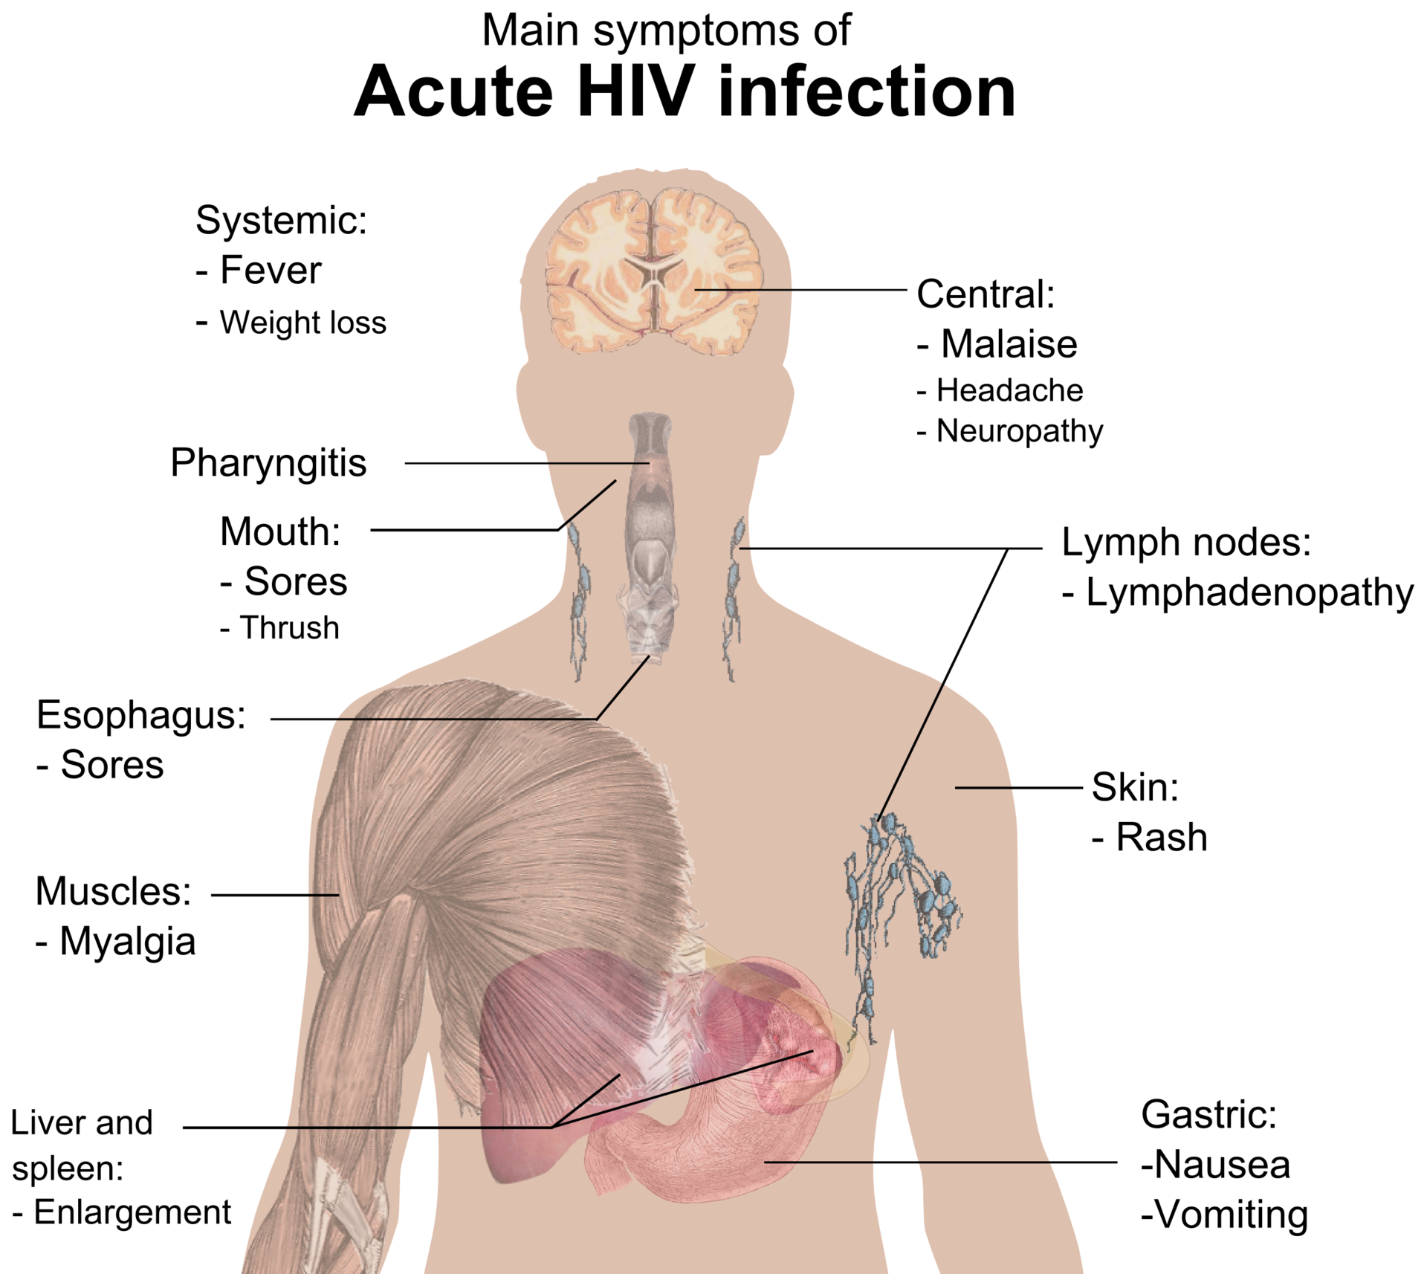
52
Source: Medical gallery of Mikael Häggström 2014
Notes:
An estimated 40-90 percent of patients with acute HIV infection will experience ‘flu-like” symptoms which usually appear days to weeks after exposure and include:
Fever
Fatigue
Anorexia
Rash (often erythematous maculopapular)
Pharyngitis
Generalized lymphadenopathy
Mucocutaneous ulceration
Headache
Aseptic meningitis
Radiculitis, myelitis
May present with OI, thrush, zoster (if CD4 depressed)
These symptoms are not specific to HIV; they occur in many other viral infections.
Remember that some patients with acute HIV infection will be asymptomatic.

Slide 53
Question
Why must you diagnose for acute HIV infection?
53

Slide 54
Diagnosis of Acute HIV Infection
During AHI, antibodies might be absent or be below level of detection.
Serological testing using rapid test might be negative.
AHI can be diagnosed using “direct” viral tests like HIV RNA or HIV antigen testing.
In the absence of HIV RNA and antigen testing, PrEP should be deferred for four weeks if AHI is suspected.
Repeat HIV serological test after four weeks to reassess eligibility.
54

Slide 55
Question
Who is at substantial risk for HIV infection?
55

Slide 56
Substantial risk for HIV infection (based on history in the past six months)
Client who is sexually active in a high HIV prevalence population (either in the general population or key population group) PLUS reports ANY of the following in the past six months:
Vaginal or anal intercourse without condoms with more than one partner, OR
Sex partner with one or more HIV risk, OR
History of an STI (based on lab test, syndromic STI treatment, self-report), OR
History of use of post-exposure prophylaxis (PEP)
Client who reports history of sharing of injection material/equipment with another person in
the past six months.
Client who reports having a sexual partner in the past six months* who is HIV positive AND who has not been on effective HIV treatment.
*On ART for less than six months, or has inconsistent or unknown adherence
OR
OR
56

Slide 57
Small Group Brainstorm
Close your participant manuals. With your small group, brainstorm a list of questions to screen for substantial risk.
Please keep in mind that you must ask about the person’s sexual behaviors, their partners’ sexual behaviors, issues with serodiscordant couples, and other aspects of a person’s situation, for example their current life circumstances.
Choose one group member to record your questions on a sheet of notebook paper.
When you have finished your brainstorm, find the list of sample screening questions in your manuals. Compare your brainstormed questions to this list. Make a note of any types of questions you missed. Also note any questions on your list that do not appear in the manual.
You will have 15 minutes to work.
57

Slide 58
Screening for Substantial Risk
Screening questions should be framed in terms of people’s behavior rather than their sexual identity and should refer to a defined time period (six months, etc.).
It is important for PrEP providers to be sensitive, inclusive, non-judgmental, and supportive.
Be careful not to develop a screening process that might discourage PrEP use.
58
Notes:
Asking questions should not be seen as a way of rationing PrEP or excluding people from PrEP services.
Screening questions can be used to introduce the consideration of PrEP and to offer PrEP to people who are attending services but had not presented specifically to access PrEP.

Slide 59
General Screening Questions
Consider PrEP if a client from a high prevalence population or in a high prevalence setting answers yes to any of the following questions:
“In the past six months,:
“Have you had sex with more than one sexual partner?”
“Have you had sex without a condom?”
“Have you had sex with people whose HIV status you do not know?”
“Are any of your partners at risk of HIV?”
“Have you had sex with a person who has HIV?”
59

Slide 60
Serodiscordant Couples
PrEP can protect the HIV uninfected partner in a heterosexual serodiscordant relationship with an HIV-infected partner if:
The partner with HIV has been taking ART for less than six months.
ART takes three to six months to suppress viral load.
In studies of serodiscordant couples, PrEP has provided a useful bridge to full viral suppression during this time.
The uninfected partner is not confident of the HIV-infected partner’s adherence to treatment or has other sexual partners besides the partner on treatment.
The uninfected partner is aware of gaps in the HIV- infected partner’s treatment adherence or the couple is not communicating openly about treatment adherence and viral load test results.
60
Notes:
ART that suppresses viral load is highly effective for preventing transmission to partners.
PrEP may provide additional protection to serodiscordant couples in a number of situations.
In addition, any sign of intimate partner violence (IPV), controlling behavior, or anger or fear in response to questions about HIV treatment should prompt discussion about PrEP as a way to control risk for HIV.

Slide 61
For a Person Who Has a Partner with HIV
The following questions will help to ascertain whether that person would be a good candidate for PrEP:
“Is your partner taking ART for HIV?”
“Has your partner been on ART for more than six months?”
“Do you discuss your partner’s adherence to HIV treatment every month?”
“Do you know your partner’s last viral load? What was the result? And when was it done?
“Do you desire having a child with your partner?”
“Are you and your partner consistently using condoms?”
61

Slide 62
Additional Factors to Ask About
“Are there aspects of your situation that may indicate higher risk for HIV? Have you…:
“Received money, housing, food or gifts in exchange for sex?”
“Been forced to have sex against your will?”
“Been physically assaulted, including assault by a sex partner?”
“Taken PEP to prevent HIV infection?”
“Had a sexually transmitted infection (STI)?”
“Injected drugs or hormones using shared equipment?”
“Used recreational/psychoactive drugs?”
“Been required to leave your home?”
“Moved to a new place?”
“Lost your job?”
“Had less than 12 years schooling or left school early?”
62

Slide 63
Creatinine and Estimated Creatinine Clearance
TDF can be associated with a small decrease in estimated creatinine clearance (eGFR) early during PrEP use and usually this does not progress.
PrEP is not indicated if eGFR* is < 60ml/min.
*eGFR: estimated glomerular filtration rate using Cockroft-Gault equation: Estimated CrCl = [140-age (years)] x weight (kg) x f where f=1.23 for men and 1.04 for women Serum creatinine (μmol/L)
63

Slide 64
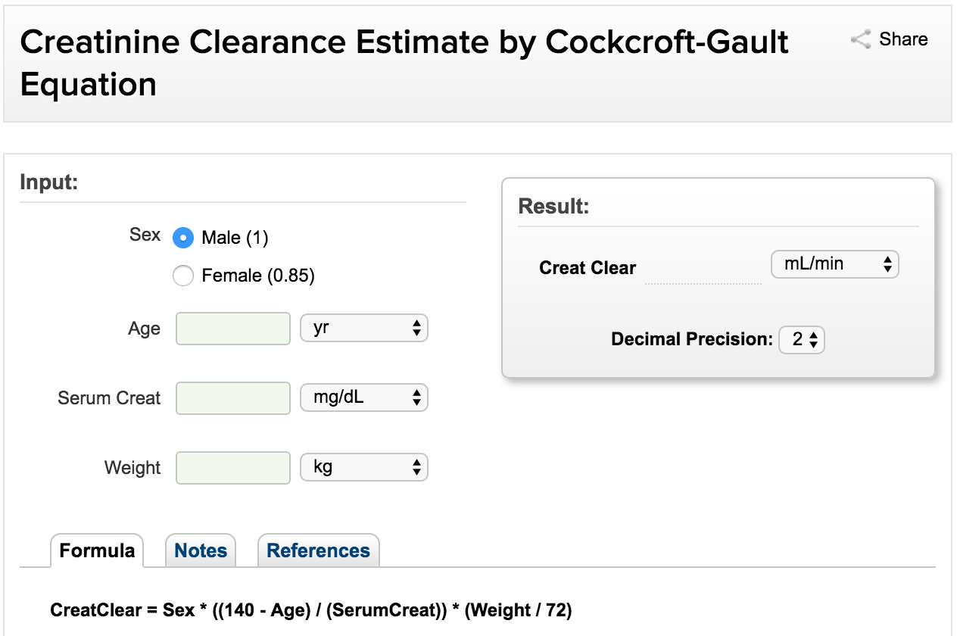
Online Cockcroft-Gault Calculator
http://reference.medscape.com/calculator/creatinine-clearance-cockcroft-gault
64
Notes:
You can also use an online calculator to calculate the eGFR.
Let’s use the example of a 26 year-old woman with a weight of 55Kg and serum creatinine is 6.9 umol/L.

Slide 65
Question
Is PrEP safe during pregnancy?
65

Slide 66
PrEP use During Pregnancy
TDF appears to be safe in pregnant women, however, evidence comes from studies of HIV infected women on ART.
Among HIV uninfected pregnant women, evidence of TDF safety comes from studies of hepatitis B (HBV) mono-infected women.
PrEP benefits for women at high risk of HIV acquisition appear to outweigh any risks observed to date.
WHO recommends continuing PrEP during pregnancy and breastfeeding for women at substantial risk of HIV.
There is however a need for continued surveillance for this population group.
66
Notes:
Several systematic reviews have evaluated TDF safety in pregnant women with chronic hepatitis B (HBV) and TDF safety in pregnant women living with HIV.
FEM-PrEP and Partners PrEP also evaluated effects of PREP on adverse pregnancy-related events, however the study drug was discontinued for women once pregnancy was confirmed across trials; therefore, the effect of PrEP throughout pregnancy duration was not assessed.
TDF appears to be safe in pregnancy, and while the safety data are reassuring, most are not from the population of interest – HIV-uninfected women.
PrEP benefits in women at high risk of HIV acquisition appear to outweigh any risks observed to date.
As PrEP in women of childbearing age is implemented, it will be important to continue surveillance of maternal, pregnancy, and infant outcomes to confirm the safety that reviews to date suggest.

Slide 67
Willingness to Use PrEP as Prescribed
Education and counseling is provided to support clients to make an informed choice about PrEP.
Clients should not be coerced into using PrEP.
67
Notes:
Education and counseling is provided to support clients to make an informed choice about PrEP.
Clients should not be coerced into using PrEP.

Slide 68
Eligibility Criteria Recap
HIV seronegative
No suspicion of acute HIV infection
Substantial risk of HIV infection
Creatinine clearance (eGFR) >60ml/min
Willingness to use PrEP as prescribed
68

Slide 69
LUNCH
69

Slide 70
Standard PrEP Screening Form
In the brainstorming session, we identified what types of questions you must ask in order to screen for PrEP eligibility.
Use of a standard form can ensure that screening is done in a consistent manner and is well documented.
Please find the Pre-Exposure Prophylaxis (PrEP) Screening for Substantial Risk and Eligibility form in your participant manuals.
70

Slide 71
Small Group Clinical Scenarios
Read the clinical scenario assigned to your small group.
Then discuss the scenario questions.
Refer to the PrEP screening tool during your discussion as needed.
You will have 10 minutes to work.
71

Slide 72
Clinical Scenario 1
Joseph is a 22 year-old man who presents at the clinic because he is interested in starting PrEP. He reports using condoms sometimes during sex with his HIV-positive male partner. His partner is healthy and has been on ART for 4 years. His most recent viral load from “a few months ago” was reported as 1200 copies/mL. Their last unprotected intercourse was last week. Joseph is in good health and is taking no medications. His rapid HIV antibody test today is negative.
Is Joseph a candidate for PrEP?
If so, what did you consider in order to determine eligibility?
72
Notes:
Is Joseph a candidate for PrEP?
Yes
If so, what did you consider in order to determine eligibility?
Joseph is at substantial risk for HIV infection (intercourse without condoms, partner with HIV)
Joseph’s partner’s viral load
Rapid HIV antibody test window
No other eligibility issues. Any potential modifiable challenges or barriers should not be equated with eligibility. Eg, we know he is ‘in good health’ so he might have limited experience taking a daily medication. Developing the habit can be a topic for adherence education and counseling.

Slide 73
Clinical Scenario 2
Marie is an 18 year-old woman who presents at the clinic because she feels sick and is afraid she might have HIV. She reluctantly explains that, during the past year, she has been having sex for money or gifts in order to support her two children. Some of her partners have used condoms and others have not. She does not know if her partners have HIV. Marie reports that she has been feeling run down and sick for the past few weeks. Her rapid HIV antibody test today is negative.
Is Marie a candidate for PrEP?
If so, why?
What other information would you need in order to determine eligibility?
73
Notes:
Is Marie a candidate for PrEP?
Yes, if she does not have AHI or creatinine clearance greater than 60ml/min
If so, why?
Marie is at substantial risk (multiple partners sometimes without condoms)
What other information would you need in order to determine eligibility?
AHI must be ruled out
Creatinine clearance must be determined

Slide 74
Clinical Scenario 3
Geraldine, a 30 year-old wife and mother, presents at the clinic because she has heard that she can get drugs that will prevent her from getting HIV. She suspects that her husband has been injecting drugs, as he has needle marks on his arms. Geraldine is afraid that her husband might have HIV and that he will infect her. She reports that her husband has not been tested. Geraldine’s rapid HIV antibody test today is negative.
Is Geraldine a candidate for PrEP?
If so, why?
What other information might you need in order to determine eligibility?
74
Notes:
Is Geraldine a candidate for PrEP?
Yes
If so, why?
Geraldine is at substantial risk (partner possibly using drugs)
What other information might you need in order to determine eligibility?
AHI must be ruled out; creatinine clearance determined

Slide 75
Clinical Scenario 4
Daniel is a 25 year-old man who presents at the clinic seeking treatment for “blisters.” He reports that, during the past several days, he has had a few painful blisters around his mouth and on his genitals. He declines to report his sexual activity; he says he is a married man and faithful to his wife. He asks if he can take just one pill for the blisters here at the clinic, so that his wife or neighbors do not find out that he is taking pills. Daniel does not want to take any medications ongoing, as his neighbors or church might find out and conclude that he has HIV. He declines to take an HIV test.
Is Daniel a candidate for PrEP?
Why?
75
Notes:
Is Daniel a candidate for PrEP?
Not at this visit.
Why?
Daniel is possibly at substantial risk (a possible STI) but has declined HIV testing.

Slide 76
AFTERNOON BREAK
76

Slide 77
Trainer Role-play Debrief
Based on the role-play, how would you complete Section 5 of the screening tool? What other information would you need to gather in order to determine eligibility?
What was most challenging about this screening?
How did the clinician handle the challenges?
What other questions or comments do you have about the role-play?
77

Slide 78
Screening Role-play 1
Find Screening Role-play Scenario 1 in your manuals.
Decide who will play the clinician and who will play the client.
Practice a brief role-play. The client should answer using the information in Screening Role-play Scenario 1 in your participant manual.
The clinician should use the screening tool and complete it as if he/she were interviewing a real client. Start with Section 3 of the form.
As you are practicing, I will observe and choose a pair to perform. I will not tell you which pair I choose, so everyone must be prepared to perform.
You will have 15 minutes to work.
78

Slide 79
Screening Role-play 1 Debrief
Based on the role-play, how would you complete Section 5 of the form? What other information would you need in order to determine eligibility?
What did you learn by doing these role-plays?
What worked best? Why?
What was most challenging? Why?
How could you address the challenges? What strategies would you use?
79

Slide 80
Screening Role-play Performance Debrief
Based on the role-play, how would you complete Section 5 of the form? What other information would you need in order to determine eligibility?
What did you learn by doing these role-plays?
What worked best? Why?
What was most challenging? Why?
How could you address the challenges? What strategies would you use?
80

Slide 81
Screening Role-play 2
Find Screening Role-play Scenario 2 in your manuals.
Participants who played the clinician for Role-play Scenario 1 should play the client; those who played the client should play the clinician.
Practice a brief role-play. The client should answer using the information in Screening Role-play Scenario 2 in your participant manual.
The clinician should use the screening tool and complete it as if he/she were interviewing a real client. Start with Section 3 of the form.
As you are practicing, I will observe and choose a pair perform. I will not tell you which pair I choose, so everyone must be prepared to perform.
You will have 15 minutes to work.
81

Slide 82
Screening Role-play 2 Debrief
Based on the role-play, how would you complete Section 5 of the form? What other information would you need in order to determine eligibility?
What did you learn by doing these role-plays?
What worked best? Why?
What was most challenging? Why?
How could you address the challenges? What strategies would you use?
82

Slide 83
Module 2 Summary
PrEP Eligibility, Screening, Side Effects, and Contraindications
Providers should inform and counsel potential PrEP users and conduct an individualized risk assessment.
Eligibility for PrEP includes:
At substantial risk of HIV infection
HIV seronegative
No suspicion of acute HIV infection
No contra-indications to ARVs used in PrEP regimen
Willingness to use PrEP as prescribed
PrEP screening questions should be framed in terms of a person’s behavior.
Side effects in clinical trials were rare and when they occurred they were mild.
Contraindications for PrEP include:
Current or suspected HIV infection
Renal impairment as defined by estimated creatinine clearance of <60 ml/min
83

Slide 84
Module 3
PrEP Basics
PrEP Screening and Eligibility
3
Initial and Follow-up PrEP Visits
84

Slide 85
Module 3 Learning Objectives
By the end of Module 3, participants will be able to:
Specify the procedures for the initial PrEP visit.
Demonstrate knowledge of national HTS guidelines and local algorithms for HIV testing.
Describe the rationale and content for brief counseling during the initial PrEP visit.
Follow the Integrated Next Step Counseling (iNSC) process to counsel clients on sexual health and PrEP adherence.
85

Slide 86
Module 3 Learning Objectives, cont.
By the end of Module 3, participants will be able to:
Specify the suggested procedures for follow-up PrEP visits.
Describe the rationale and content for follow-up counseling at each visit.
Name typical challenges that facilities and providers may face when implementing PrEP, and strategies for addressing them.
86

Slide 87
Initial PrEP Visit: Suggested Procedures
Investigation | Rationale
HIV test (using algorithm in national HTS guidelines) | Assessment of HIV infection status Symptom checklist for possible acute HIV infection
Serum creatinine | To identify pre-existing renal impairment
Hepatitis B surface antigen (HBsAg) | To identify undiagnosed hepatitis B (HBV) infection To identify those eligible for vaccination against hepatitis B
RPR | To diagnose and treat syphilis infection
STI screening | To diagnose and treat STI Syndromic or diagnostic STI testing, depending on local guidelines
Pregnancy testing | To ascertain pregnancy
Brief counseling | To assess whether the client is at substantial risk for HIV To assess HIV prevention options and provide condoms and lubricants To discuss desire for PrEP and willingness to take PrEP To develop a plan for effective PrEP use, sexual and reproductive health
87

Slide 88
Initial PrEP Counseling
Initial counseling should focus on:
Increasing awareness of PrEP as a choice.
Helping the client to decide whether PrEP is right for them.
Preparing individuals for starting PrEP.
Explaining how PrEP works.
Providing basic recommendations.
The importance of adherence and follow-up visits.
Potential PrEP side effects.
Recognizing symptoms of acute HIV infection.
Building a specific plan for PrEP.
Discussing sexual health and harm reduction measures.
88
Notes:
Before the client starts PrEP, you should counsel the client (this is the last of the suggested procedures from the previous slide).
This initial counseling should focus on these areas.

Slide 89
Initial PrEP Counseling, cont.
Assess client’s understanding that the protection provided by PrEP is not 100%.
Explain need for repeat clinic visits and repeat blood tests.
Additional information for women:
PrEP does not affect the efficacy of hormonal contraceptives.
PrEP does not protect against pregnancy.
PrEP can be continued during pregnancy and breastfeeding.
89

Slide 90
PrEP Counseling
During the counseling session “Assess client understanding that the protection provided by PrEP is not complete, and does not prevent other STIs or unwanted pregnancies, and therefore PrEP should be used as part of a package of HIV prevention services (inclusive of condoms, lubrication, contraception, risk reduction counseling and STI management). ¹”
90
Source: From the Southern African Clinician Society Guidelines for Provision of PrEP

Slide 91
Key Initial Visit Counselling Messaging: PrEP Efficacy
PrEP works when taken!
PrEP reaches maximum effectiveness after seven daily doses.
PrEP does not prevent most sexually transmitted infections other than HIV. Condoms used with every act of sexual intercourse provides some protection against many of these infections.
PrEP does not prevent pregnancy. Use effective contraception unless you want pregnancy.
PrEP is safe.
91
Notes:
These are key messages that you should give during counseling at the initial visit. These messages emphasize how PrEP works best.

Slide 92
Key Initial Visit Counselling Messaging: Supporting Adherence
Taking PrEP each day is easiest if you make taking the tablets a daily habit, linked to something else that you do every day without fail.
If you forget to take a tablet, take it as soon as you remember.
PrEP tablets can be taken any time of day, with food or without food.
PrEP is safe and effective even if you are taking hormonal contraceptives, sex hormones or non-prescription drugs.
Drinking alcohol will not affect the safety or effectiveness of PrEP. But drinking alcohol could make you forget to take the PrEP tablets.
92
Notes:
These messages will help the client to adhere to the PrEP regimen.

Slide 93
Small Group Brainstorm
Close your participant manuals.
With your small group, you will brainstorm one of these questions:
1) What are some common reasons for low adherence? Remember to include individual, medication, and structural reasons.
2) What can providers do in order to promote and support adherence? Include counseling and programmatic strategies.
Choose one group member to record your questions on a sheet of notebook paper.
You will have 10 minutes to work.
93

Slide 94
Common Reasons for Low Adherence to ART
Individual Factors
Medication Factors
Adverse events
Distance to health services
Structural Factors
Forgetting doses
Being away from home
Changes in daily routines
Depression or other illness
Limited understanding of treatment benefits
Lack of interest or desire to take the medicines
Substance or alcohol use
Absence of supportive environment
Fear of stigma and discrimination
Complexity of dosing regimens
Pill burden
Dietary restrictions (PrEP will require taking just one tablet daily and there are no dietary restrictions)
Burden of direct and indirect costs of care
Long waiting times to receive care and obtain refills
Access to pharmacies
94
Notes:
Remember that reasons for low adherence may be related to the client, the ARV drug regimen, or the health system.

Slide 95
Understanding Voluntary vs. Involuntary Non-Adherence
Voluntary Non-Adherence | Involuntary Non-Adherence
Not convinced PrEP is needed Does not believe PrEP works or is working Does not like taking pills Has experienced side-effects; wishes to avoid side effects Has experienced stigma while taking PrEP | Forgot to take pill Forgot to refill prescription Has competing priorities (e.g. employment, child care) Has difficulty with personal organization and scheduling Affected by depression or other unaddressed mental illness Can not afford PrEP (in settings where clients pay for PrEP services)
95
Notes:
It is helpful to think about non-adherence as voluntary or involuntary non-adherence in order to better target adherence support strategies.

Slide 96
Understanding Voluntary vs. Involuntary Non-Adherence, cont.
Voluntary Non-Adherence | Involuntary Non-Adherence
Does not believe it is necessary to take every day Does not want to take with alcohol or other drugs Wishes to avoid others witnessing pill-taking | Does not want/has no time/cannot afford to come to health care facility Dissatisfaction with health care provider interactions No place to store medication Unaddressed substance use issues, especially dependence on alcohol or other drugs Insufficient food to take pills
96

Slide 97
Adherence: Lessons from ART Programs
Health providers can positively influence adherence by:
Facilitating accurate knowledge and understanding of medication benefıts and requirements
Preparing for and managing side-effects
Monitoring of adherence
Identifying social support
Encouraging medication optimism
Building self-effıcacy for adherence
Developing a routinized daily schedule in which to integrate regular dosing
Maintaining an open line of communication with PrEP clients
97
Notes:
The health provider can support adherence by learning from ART programs some of the general strategies that have been shown to positively influence adherence.

Slide 98
Approaches to PrEP Medication Adherence Support
Support Issue: | Provider Options:
Adequate and accurate PrEP knowledge | Briefly explain or provide materials about: Indications for medication. The anticipated risks and benefits of taking medication. How to take it (one pill per day). What to do if one or more doses are missed. Assess for misinformation.
Preparing for and managing side effects | Educate about what side effects to expect, for how long, and how to manage them. Educate about the signs and symptoms of acute HIV infection and how to obtain prompt evaluation and care.
Fostering self-efficacy | Foster discussion of personal perception of HIV risks. Recommend or provide medication-adherence tools: Pill boxes Phone apps, pager, or SMS reminder services
Routinized daily schedule | Discuss how to integrate daily dose with other daily events and what to do when away from home.
98
Notes:
The provider can use each of the options/strategies on the right side of the table to address each of the specific support issues listed on the left side of the table.

Slide 99
Approaches to PrEP Medication Adherence Support, cont.
Support Issue: | Provider Options:
Provider support | Regularly assess adherence. Ask for a patient self-report. Complete the prescription/visit record. Use new technologies (text reminders). Offer allied clinical support services (e.g., pharmacist).
Social Support | Discuss privacy issues for PrEP user. Offer to meet with partners or family members if they are supportive.
Mental health and substance abuse | Consider screening for depression or substance-abuse problems. Provide or refer to indicated mental health or substance-abuse treatment and relapse-prevention services.
Population-specific challenges | Consider additional medication-adherence support for: Adolescents. People with unstable housing. Transgender women. Others with specific stressors that may interfere with medication adherence.
99
Notes:
The provider can use each of the options/strategies on the right side of the table to address each of the specific support issues listed on the left side of the table.

Slide 100
Adherence Assessments
Ask about adherence at each visit:
Encourage the PrEP user to self-report in order to understand what they believe about their adherence.
Ask about adherence over the last three days (short recall).
Avoid judgment to encourage a realistic and honest description.
Additional methods to monitor adherence:
Pharmacy refill history
Pill-count
Blood level of drugs
Hair sample to test drug-level
100
Notes:
Note that measuring drug levels in blood and hair samples is more expensive than the other options.

Slide 101
Promoting Adherence
Several approaches can be used to promote adherence:
Motivational interviewing
Informed Choice Counseling (ICC)
Integrated Next Step Counseling (iNSC)
And others
101

Slide 102
Integrated Next Step Counseling (iNSC)
Integrated next step counseling (iNSC) was used in the iPrEx OLE study to counsel individuals on sexual health promotion more generally, with specific emphasis on PrEP adherence for individuals on PrEP.
Implementation of iNSC is positioned with delivery of negative HIV test results and serves as pre/post-test HIV counseling as well as adherence counseling in one brief, targeted, tailored conversation.
102

Slide 103
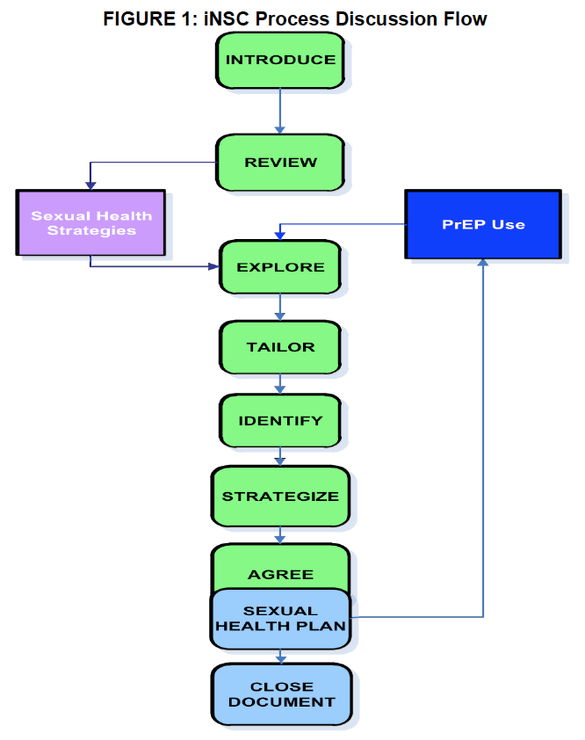
103
Notes:
This is the recommended flow for a step-by-step counseling process that leads to clear strategies and formal plans for PrEP use and non-PrEP-related sexual health.

Slide 104
iNSC Step | Critical Components | Example Prompts
Introduce the counseling session | Explain what you’re talking about and why Get permission to proceed | I would like to take a few minutes to check in with you about your goals and how to meet them. Is that okay?
Review client’s experiences | Ask about what the client already knows about PrEP and how they learned it | Thank you. Can you tell me a little about what you have heard about PrEP and about your experiences with PrEP?
Explore context of client-specific facilitators and barriers | Use open-ended questions to explore factors or situations that help make pill-taking a little easier; and those that make it harder or a little more difficult | What seems to make PrEP easy to take or harder to take?
Tailor the discussion to focus on increasing ease of pill-taking | This is a pause to allow the provider/counselor to consider what information gathered in earlier steps is used to tailor the next question | Let me think for a moment about what you have said.
Identify adherence-related needs | Guide the conversation towards identifying participant perceptions of what would help to best integrate PrEP use into their daily life | Given everything going on right now, what would need to happen for it to feel a little easier to work this regimen into your daily life?
Strategize with the participant on the next step | Work with participant so that they identify one or a few viable strategies for increasing effective PrEP use | How could that happen? What are some ideas for how you could approach that?
Agree on which strategy will be tried next | Ask participant which strategy(ies) they are willing to try or continue using | Of the things that we have talked about, which might you be willing to try between now and the next time we meet?
Close/document | Provide a summary of the discussion and thank the patient | What I’m hearing is that ______ would really make it feel easier to work PrEP into your life and that you’ll give it a try between now and the next time we meet. Thank you for talking with me and I look forward to talking again.
104
Amico K R, McMahan V, Goicochea P, et al. Supporting study product use and accuracy in self-report in the iPrEx study: next step counseling and neutral assessment. AIDS and behavior. Jul 2012;16(5):1243-1259

Slide 105
Clinical Scenario for Role-play
Anne is a sex worker and is interested in starting PrEP. She uses condoms during sex with commercial clients but not with her long-term partner of unknown HIV status. She had a negative HIV test 6 months ago and wants to avoid HIV infection, as she would like to have a baby with her partner. She is using injectable hormonal contraceptive as she used to forget to take oral contraceptives on a daily basis.
We will now role-play this scenario. Please observe the role-play and follow along with the table of iNSC steps in your manuals.
As you observe, think about how you might use iNSC yourself in this scenario.
105

Slide 106
Role-play Debrief
How well did the provider follow the iNSC steps?
What types of prompts or strategies worked best? Why?
What were the most challenging aspects of the counseling?
How did the provider handle the challenges?
What other questions or comments do you have about iNSC so far?
106

Slide 107
MORNING BREAK
107

Slide 108
iNSC Role-play 1
Find iNSC Role-play Scenario 1 in your manuals.
Decide who will play the provider and who will play the client.
Practice a brief role-play. The client should answer using the information in iNSC Role-play Scenario 1 in your participant manual.
The provider should use the iNSC steps and sample prompts as if he/she were counselling a real client.
As you are practicing, I will observe and choose a pair perform. I will not tell you which pair I choose, so everyone must be prepared to perform.
You will have 15 minutes to work.
108

Slide 109
iNSC Role-play 1 Debrief
What did you learn by doing these role-plays?
What worked best? Why?
What was most challenging? Why?
How could you address the challenges? What strategies would you use?
109

Slide 110
iNSC Role-play Performance Debrief
How well did the provider follow the iNSC steps?
What types of prompts or strategies worked best? Why?
What were the most challenging aspects of the counseling?
How did the provider handle the challenges?
What could the clinician improve the next time around?
110

Slide 111
iNSC Role-play 2
Find iNSC Role-play Scenario 2 in your manuals.
Participants who played the provider for Role-play Scenario 1 should play the client; those who played the client should play the provider
Practice a brief role-play. The client should answer using the information in iNSC Role-play Scenario 2 in your participant manual.
The provider should use the iNSC steps and sample prompts as if he/she were counselling a real client.
As you are practicing, I will observe and choose a pair perform. I will not tell you which pair I choose, so everyone must be prepared to perform.
You will have 15 minutes to work.
111

Slide 112
iNSC Role-play 2 Debrief
What did you learn by doing these role-plays?
What worked best? Why?
What was most challenging? Why?
How could you address the challenges? What strategies would you use?
112

Slide 113
Key Initial Visit Consideration: Drug Supply
Providing an extra month’s supply of medication at the first visit will assure an adequate supply for daily dosing until the next visit.
This is important in case the follow-up visit is delayed for any reason.
Patients who have some medication supply in reserve
tend to show better adherence!
113

Slide 114
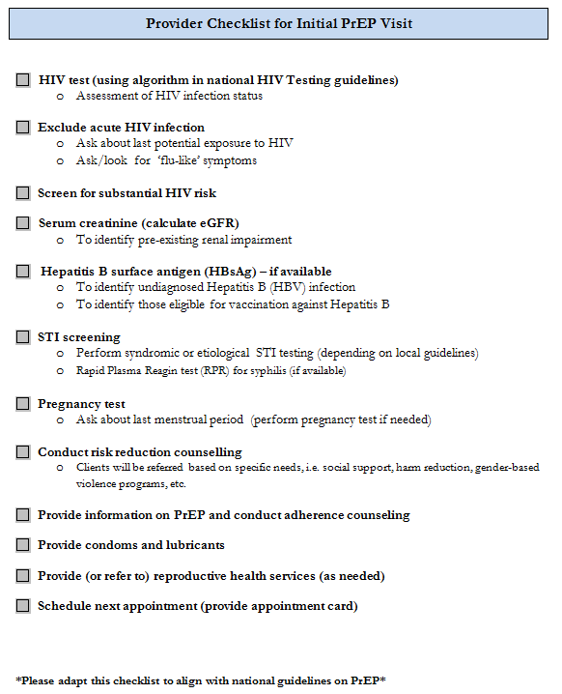
114
Notes:
Please find this checklist in your participant manuals. You may customize this checklist to align with national guidelines.

Slide 115
LUNCH
Notes:
HAD TROUBLE WITH THIS IMAGE; WILL FIX.

Slide 116
PrEP Follow-up Visits
Clients on PrEP require regular visits with the health provider.
Programs should decide on the optimal frequency of visits for monitoring PrEP use.
It is suggested to have a follow- up visit:
one month after initiating PrEP, and
thereafter every three months.
Outside regular monitoring visits, clients should also consult if they have severe adverse events or signs/symptoms of AHI.
116

Slide 117
Follow-Up PrEP Visit Procedures
Intervention | Schedule following PrEP initiation
Confirmation of HIV-negative status | Every three months (consider also testing at one month if HIV RNA or antigen testing was not performed before starting PrEP)
Address side-effects | Every visit
Brief adherence counseling | Every visit
Estimated creatinine clearance | At least every six months, or more frequently if there is a history of conditions affecting the kidney, such as diabetes or hypertension
Provide STI screening, condoms, contraception as needed. Counsel regarding symptoms of acute HIV infection, and to come back as soon as possible for evaluation if these symptoms occur.
117
Notes:
During the follow-up visit repeat the HIV test to confirm HIV-negative status. You need repeat HIV testing to inform decisions on whether to continue or discontinue PrEP.
Repeat HIV testing:
One month after starting PrEP
Every three months thereafter
Programs should use national HIV testing algorithms.
During the follow-up visit repeat the HIV test to confirm HIV-negative status. We need repeat HIV testing to inform decisions on whether to continue or discontinue PrEP.
Repeat HIV testing:
One month after starting PrEP
Every three months thereafter
Use HIV testing algorithms in line with national guidelines.
It is useful to remember that the main limitation of antibody-based testing is the window period (time from HIV infection to detection of antibodies). Rapid will not detect acute HIV infection, which must be clinically assessed at every follow up visit.

Slide 118
Repeat HIV Testing
Repeat HIV testing is needed to inform decisions on whether to continue or discontinue PrEP.
Repeat HIV testing (using national guidelines):
One month after starting PrEP
Every three months thereafter
Remember the limitation of serological tests during AHI in the window period (time from HIV infection to detection of antibodies), and also that exposure to ARVs can decrease sensitivity of serological tests.
Stop PrEP if AHI is suspected.
118

Slide 119
Follow-Up PrEP Counseling
Follow-up counseling should focus on:
Checking in on the current context of sexual health
The patient’s desire to remain on and assessment of continued risk of PrEP
Facilitators & barriers to PrEP use
Additional non-PrEP related sexual health protection strategies (condoms, etc.)
Dosing requirements for highest protection
What to do if a dose is missed
Common adherence strategies
Reasons for ongoing monitoring while on PrEP
How to recognize symptoms of acute HIV infection
Side-effects & side-effects management
How to safely discontinue and restart PrEP as appropriate
119

Slide 120
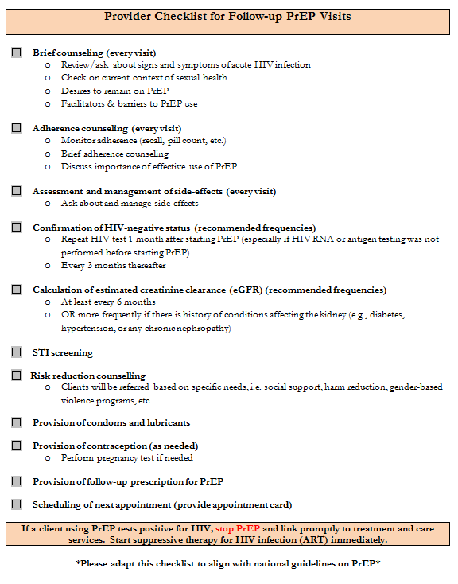
120
Notes:
Please find this checklist in your participant manuals.
This checklist may be customized to align with national guidelines.

Slide 121
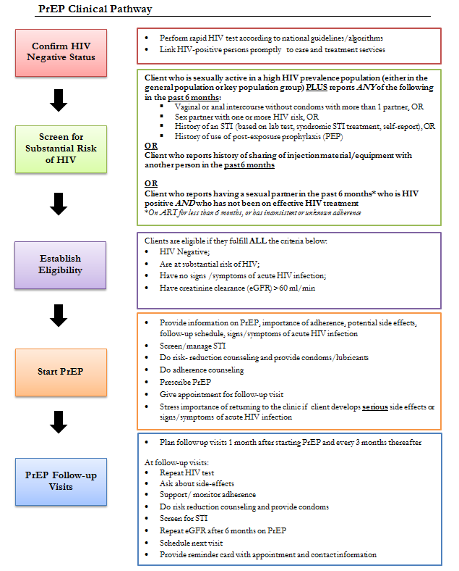
121
Notes:
Please find this checklist in your participant manuals.
This checklist may be customized to align with national guidelines.

Slide 122
Clinical Scenario for Discussion
Jonathan has been on PrEP (TDF/FTC) for the last nine months. At the follow-up visit he is in good health and his repeat HIV test is negative. Jonathan reports recently starting a monogamous relationship with a man who tested HIV negative last year and feels he might no longer need PrEP.
How would you manage this case?
122
Notes:
PrEP can be started and stopped as needed.
People can move through periods of substantial risk (change in sexual practices, change in relationship status, etc.).
Clients can choose to discontinue PrEP if they are no longer at substantial risk of HIV:
Clients should inform the provider of their wish to stop PrEP.
Provider should document HIV test result at the time of stopping PrEP.
Providers should counsel about other prevention methods.
Clients wishing to restart PrEP later should undergo HIV testing and other baseline tests (covered in Module 2).
Please note that PrEP is also discontinued if:
Client tests HIV positive (in which case you would refer for treatment and care).
There is suspicion of acute HIV infection.
There is an increase in creatinine clearance >60ml/min.
Discontinuation of TDF-containing PrEP in patients with active hepatitis B virus can cause exacerbations of hepatitis B (hepatic flare).

Slide 123
Small Group Brainstorm
With your small group, you will brainstorm responses to these questions:
1) What are some of the challenges you will face when implementing PrEP?
2) What strategies might you use to address these challenges?
Choose one group member to record your responses on a sheet of notebook paper.
You will have 15 minutes to work.
123

Slide 124
Module 3 Summary
Prescribe PrEP as part of a comprehensive HIV prevention strategy.
Confirm a negative HIV test immediately prior to initiating PrEP.
Ensure there are no contra-indications to PrEP.
Ensure clients have correct information about PrEP.
Develop an adherence support plan with the client and monitor adherence at each visit.
Conduct risk-reduction counseling at each visit.
124

Slide 125
AFTERNOON BREAK
125

Slide 126
Training Overview
PrEP Basics
PrEP Screening and Eligibility
4
Monitoring and Managing PrEP Side Effects, Seroconversion, and Stigma
126

Slide 127
Module 4 Learning Objectives
By the end of module 4, participants will be able to:
Explain how to manage creatinine elevation.
List additional causes of creatinine elevation.
Explain how to manage seroconversion.
Develop strategies to minimize PrEP stigma.
Give examples of gaps in knowledge about PrEP.
Describe how M&E tools might be adapted for local use.
127

Slide 128
Monitoring Creatinine Elevation
Approximately 1 in every 200 PrEP users may develop an elevation of serum creatinine.
Defined as a 50% increase above baseline or an elevation above the normal range.
Reminder: Renal impairment is defined as having an estimated creatinine clearance of <60 ml/min.
Creatinine elevations have usually reversed after stopping PrEP.
It is important to monitor transient creatinine elevation and for signs of chronic or severe renal insufficiency.
128
Notes:
Ideally, clients should have eGFR measured at baseline and after six months of PrEP.

Slide 129
Question
How would you manage increase in creatinine clearance?
129

Slide 130
Managing Creatinine Elevation
Discontinue PrEP if creatinine elevation is confirmed on a separate specimen and if estimated creatinine clearance decreases to <60 ml/min.
After PrEP is stopped, creatinine should be checked for another one to three months and PrEP restarted if eGFR returns to > 60 ml/min.
Additional causes and management of creatinine elevations should be considered if:
Creatinine elevations are more than 3x the baseline.
Renal function or creatinine elevations do not return to normal levels within three months after stopping PrEP.
Creatinine elevations progress at one month or more after stopping PrEP.
Common causes of chronic or severe renal insufficiency include: diabetes mellitus, uncontrolled systemic hypertension, hepatitis C infection, liver failure, and pre-eclampsia during pregnancy.
130

Slide 131
Seroconversion on PrEP
PrEP works when taken. In clinical trials, the level of protection was strongly correlated with adherence.
HIV infection can be prevented with consistent use of PrEP.
HIV seroconversion after prescribing PrEP can occur if PrEP is not used correctly or consistently, or if HIV infection was undiagnosed at the time of PrEP initiation.
Part of counseling should include information to help PrEP users recognize signs/symptoms of AHI, which should prompt a clinic visit without delay.
131
Notes:
In clinical trials there were very few cases of seroconversion on PrEP.

Slide 132
Question
How would you manage seroconversion on PrEP?
132

Slide 133
Managing Seroconversion
If a person using PrEP tests positive for HIV, PrEP should be stopped immediately and the person referred for prompt initiation of HIV treatment.
Transitions from PrEP to HIV treatment without a gap avoid the risk of resurgence in viral load, immunological injury, and secondary transmissions.
133

Slide 134
PrEP “Special Situations”
Situation | Recommendation/Follow-Up
Hormonal Contraception | PrEP does not affect the efficacy of hormonal contraceptives and hormonal contraceptives do not affect PrEP efficacy.
Pregnancy and breastfeeding | PrEP may be continued during breastfeeding in women who are at substantial risk for HIV acquisition.
Hepatitis B infection | Hepatitis B vaccination is appropriate for people at substantial risk for HBV or HIV infection.
Management of Recent HIV Exposure with PEP | People who have been exposed to HIV in the past 72 hours should be offered post-exposure prophylaxis (PEP). WHO recommends PEP consisting of TDF/3TC (or FTC), preferably combined with a boosted protease inhibitor, for 28 days (use national guidelines). PEP should be transitioned to PrEP after 28 days if the HIV test remains negative and there is substantial ongoing risk of HIV acquisition.
134

Slide 135
Minimizing PrEP Stigma
Confidentiality is essential in PrEP services.
People may face stigma if their PrEP use becomes known.
PrEP use can exacerbate stigma if others mistakenly consider PrEP use to be evidence of irresponsible behavior or mistakenly think that PrEP is HIV treatment.
Such stigma will decrease PrEP uptake and adherence among people who would otherwise benefit from it.
Presenting PrEP to your communities as a responsible choice
that protects both partners will increase the impact of PrEP,
prevent more HIV infections, and can help reduce stigma.
135
Notes:
Key populations usually face stigma and discrimination. Use of PrEP may add more stigma.

Slide 136
Small Group Brainstorm
With your small group, brainstorm a list of possible strategies to minimize the stigma that your PrEP clients may face.
Choose one group member to record your ideas on the sheet of flip chart paper.
You will have 20 minutes to work.
136

Slide 137
Current Gaps in Knowledge and Need for Continued Surveillance
Current gaps in knowledge related to implementation of PrEP include:
Renal safety of FTC/TDF PrEP in people with diabetes mellitus and uncontrolled systemic hypertension has not been evaluated.
Although 3TC is equivalent to FTC for HIV treatment, use of 3TC in combination with TDF for PrEP has not been studied.
Comparison of daily vs. on-demand PrEP regimens is still limited.
Effectiveness of on-demand oral PrEP regimens for women has not been evaluated.
Although cases of clinical HBV rebound when stopping FTC/TDF PrEP have not been observed among people with current HBV infection in clinical trials, most trials excluded such individuals.
Need for continued surveillance:
The benefits of PrEP in women at substantial risk of HIV acquisition appear to outweigh any risks observed to date, however, there is a need for continued surveillance of maternal, pregnancy and infant outcomes to confirm the safety that studies to date suggest.
137
Notes:
You have learned the basics of implementing PrEP at you sites. However, there are still gaps in knowledge related to the implementation of PrEP.
The evidence for PrEP efficacy and safety presented in theses slides is based on current knowledge. There are ongoing PrEP studies and knowledge will evolve.
There are still gaps in knowledge related to PrEP safety, especially among pregnant women.

Slide 138
PrEP M&E Tools
You will find sample PrEP M&E Tools at the back of your participant manual:
Facility-held card
PrEP register
PrEP monthly report form
Substantial Risk and Eligibility Assessment
You will receive further training at your facilities on using and adapting these tools.
138
Notes:
If your training includes Module 6, tell participants that they will practice using these M&E tools in Module 6.

Slide 139
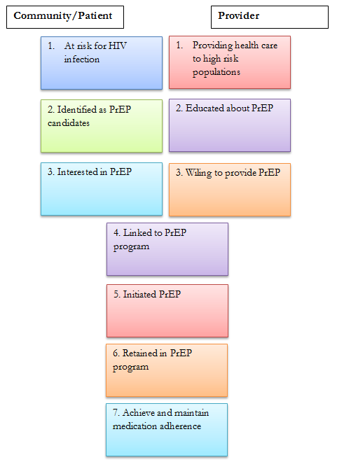
PrEP Cascade
PrEP is more than just a biomedical intervention.
Success will also depend on structural and behavioral interventions.
Lui A, et al. IAPAC 2012; Miami. #80040. U.S. Centers for Disease Control and Prevention SHIPP Study 2013-2016
139
Notes:
PrEP is a biomedical intervention but it is more than prescribing a medication. PrEP effectiveness depends on the complementary provision of structural and behavioral interventions.
There is a need for concerted efforts at each step of the cascade to:
Create demand for PrEP
Link potential PrEP clients to services
Start PrEP
Retain clients on PrEP
Counsel and support clients on behavioral risk reduction
Support good adherence

Slide 140
Module 4 Summary
PrEP users should be informed about how to recognize signs and symptoms of acute HIV infection.
If persons using PrEP test positive for HIV, stop PrEP immediately and start ART as soon as possible, without a gap after PrEP is discontinued.
If confirmation of positive HIV test result is delayed for more than a few hours, transition to fully suppressive ART (three ARVs as per national treatment guidelines).
Ideally, blood creatinine (eGFR) should be measured before starting PrEP and at least every six months after PrEP is started.
Initiation of PrEP should not be delayed while waiting for creatinine result.
140

Slide 141
Question
What final questions or concerns do you have about implementing PrEP?
141

Slide 142
Module 5
5
Post-test, Evaluation, and Closing
PrEP Monitoring and Evaluation Tools
142
Notes:
In Module 5, you will take a post-test and complete an evaluation of the training.

Slide 143
Training Post-test
The objective of this post-test is to find out what you know about implementing PrEP and how much your knowledge and skills have improved since the pre-test assessment.
Results of the pre-program assessment and post-test will help improve future trainings.
Remember to write your name on your post-test.
You have 15 minutes to complete the post-test.
You will receive a copy of the correct answers as you leave the training.

Slide 144
PrEP Specific Competencies
After completing this training program, participants will be able to:
Identify eligible candidates for PrEP.
Conduct an individualized risk assessment.
Educate and counsel PrEP candidates and users.
Conduct clinical and laboratory assessments during the initial PrEP visit.
Prescribe PrEP.
Conduct clinical and laboratory assessments during follow-up PrEP visits.
Review PrEP M&E tools.

Slide 145
Training Evaluation
Please take a few minutes to complete this Training Evaluation Form.
We welcome your honest feedback in order to improve future trainings.
Your evaluation will be confidential. You do not need to include your name.

Slide 146
PrEP Resources for Providers
http://www.who.int/hiv/pub/arv/arv-2016/en/
http://www.who.int/hiv/topics/prep/en/
http://www.unaids.org/sites/default/files/media_asset/UNAIDS_JC2764_en.pdf
http://www.prepwatch.org/
http://www.cdc.gov/hiv/risk/prep/
Glidden, DV, Amico, KR, Liu AY, et al. Symptoms, side effects and adherence in the iPrEx open-label extension. Clin Infect Dis. 2016;62(9):1172-7.
Fonner, VA, Dalglish, SL, Kennedy, CE, et al. Effectiveness and safety of oral HIV preexposure prophylaxis for all populations. AIDS 2016;30(12):1973-1983.
The Fenway Institute. Pre-exposure prophylaxis clinical study data sheet. http://www.projectinform.org/pdf/prepstudydata.pdf . Accessed October 5, 2016.
World Health Organization. Review: Safety of tenofovir PrEP in pregnant and breastfeeding HIV-uninfected women and their infants. http://emtct-iatt.org/wp-content/uploads/2016/08/WHO-TDF-pregnancy-Lynne-Mofenson.August-21-2016.pdf . Accessed October 5, 2016.
http://www.unaids.org/en/dataanalysis/monitoringandevaluationguidance

Slide 147
PrEP Resources for PrEP Users
http://www.whatisprep.org
http://www.PleasePrEPMe.org/resources
http://www.iwantprepnow.co.uk
http://www.cdc.gov/hiv/pdf/risk_PrEP_TalkingtoDr_FINALcleared.pdf
https://www.facebook.com/groups/PrEPFacts/

Slide 148
Thank you for your participation!
Notes:
Skip this slide if you are covering Module 6 as part of the training

Slide 149
Module 6
Post-test, Evaluation, and Closing
6
PrEP Monitoring and Evaluation Tools
149
Notes:
In Module 6, you will practice using 3 PrEP monitoring and evaluation (M&E) tools – the PrEP Facility Record, PrEP Follow-up Visits Form and PrEP Client Register.

Slide 150
Module 6 Learning Objectives
After completing this session, participants will be able to:
Complete the PrEP Facility Record, PrEP Follow-up Visits Form, and the PrEP Client register correctly.
Complete the PrEP Monthly Summary Form and PrEP Quarterly Cohort Report correctly.
Describe how PrEP M&E tools might be adapted for local use.

Slide 151
PrEP Facility Record
Please find the PrEP Facility Record in your participant manuals.
This form is completed after the initial PrEP screening, for patients who agree to start PrEP.
The provider must ask questions of the client in order to complete some sections of the form.
Other sections are completed using test results and information obtained during PrEP screening.

Slide 152
Practice: PrEP Facility Record
Find the M&E Practice Scenarios in your manuals.
Choose one scenario. Decide who will play the provider and who will play the client.
The participant playing the client should review the synopsis of their character in order to be able to respond appropriately.
Conduct a brief role-play in which the provider completes the PrEP Facility Form with the client (as if with a real client). Use today’s date or other appropriate dates for test dates on the form.
Then repeat this process for another scenario, with roles reversed.
You will have approximately 15 minutes to work.

Slide 153
PrEP Follow-up Visits
Please find the PrEP Follow-up Visits Form in your participant manuals.
One form per client is used to record information after each follow-up visit.

Slide 154
PrEP Client Register
Please find the PrEP Client Register in your participant manuals.
As each new client starts PrEP, the relevant information is added to this register, and the client’s follow-up visits recorded.

Slide 155
Practice: PrEP Follow-up Visits & Client Register
Choose one of the same scenarios from your previous role-play (PrEP Facility Record). Decide who will play the provider and who will play the client.
Role-play a brief initial PrEP follow-up visit. The provider should use the Provider Checklist for Follow-up PrEP Visits as a guide. The client should invent appropriate answers for questions about adherence, side effects, signs and symptoms of acute HIV infection, etc. Use the date 1 month from today for the visit date, and other appropriate dates, as needed.

Slide 156
Practice: PrEP Follow-up Visits & Client Register, cont.
Repeat this process for another scenario, with roles reversed.
Then complete the PrEP Follow-up Visits and PrEP Client Register forms (follow-up visit 1) for the “client” that you interviewed. You will each complete your own form.
You will have approximately 20 minutes to work.

Slide 157
Question
How might you adapt and use these M&E Forms for your facilities?

Slide 158
MORNING BREAK

Slide 159
PrEP Monthly Summary Form
Please find the PrEP Monthly Summary Form in your participant manuals.
This form is used to collect and summarize monthly PrEP data.

Slide 160
Practice: PrEP Monthly Summary Form
Find the Sample Data for PrEP Monthly Summary Form in your manuals.
With your small group, complete the PrEP Monthly Summary Form using this data.
Discuss as a group how to complete each section. Then each participant should complete her or his own form.
You will have 15 minutes to work.

Slide 161
PrEP Quarterly Cohort Report
Please find the PrEP Quarterly Cohort Report and completed example in your manuals.
This form is used to collect and track data per quarter and PrEP Cohort.

Slide 162
Practice: PrEP Quarterly Cohort Report
Find the Instructions for PrEP Quarterly Cohort Report in your manuals.
With your small group, complete the PrEP Quarterly Cohort Report using this information.
Discuss as a group how to complete each section. Then each participant should complete her or his own form.
You will have 15 minutes to work.

Slide 163
Question
How might you adapt and use these M&E Forms for your facilities?

Slide 164
Thank you for your participation!

