Slide 1
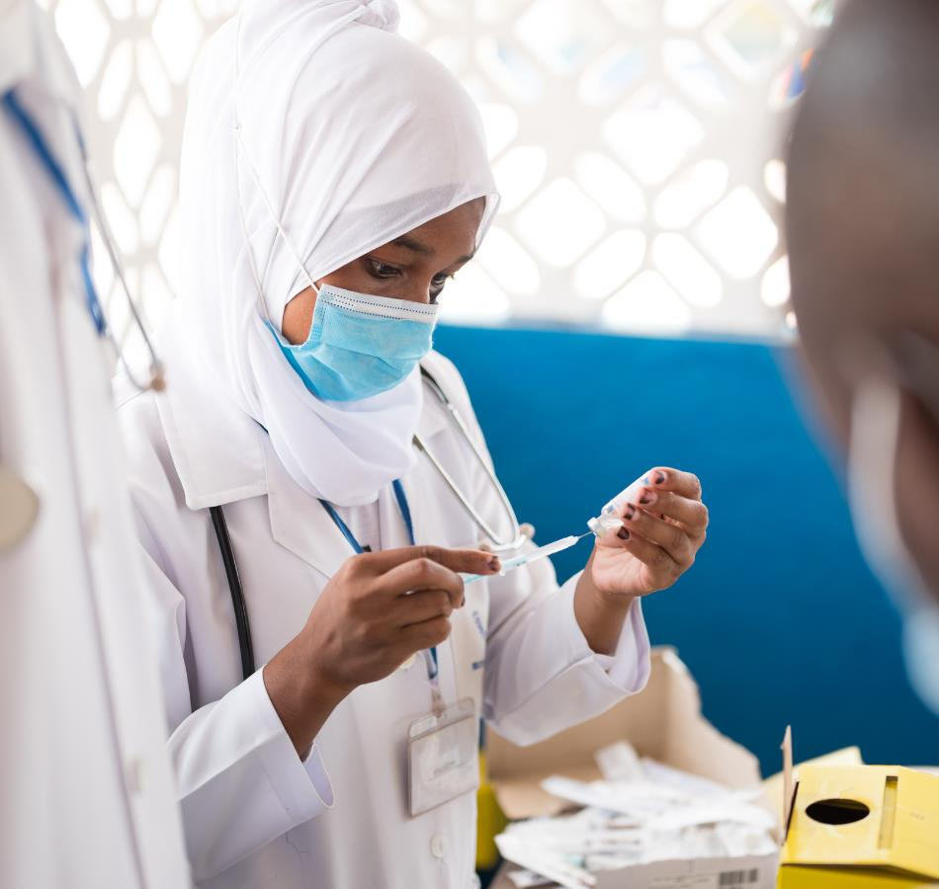
Understanding Vaccine Hesitancy:
Global Drivers and the Misinformation Challenge
ICAP GRAND ROUNDS
October 21, 2025

Slide 2
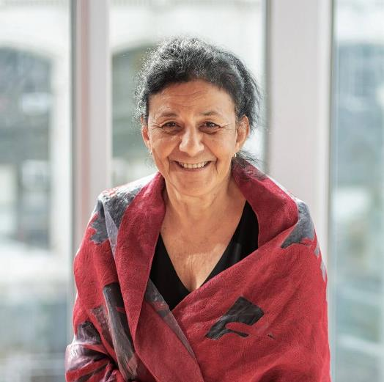
Wafaa El-Sadr, MD, MPH, MPA
Global Director,
ICAP at Columbia University

Slide 3
Agenda
Reminders:
For questions to the panelists, use the Q&A box
The webinar recording and slides will be posted on www.icap.columbia.edu
Welcome and Introduction – Presentation
Announcements
Q & A

Slide 4
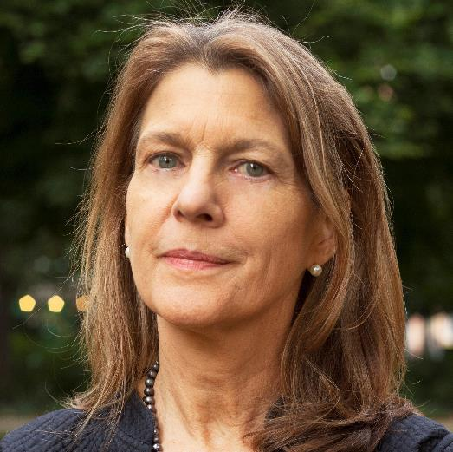
Heidi J. Larson, PhD
Director, The Vaccine Confidence Project

Slide 5


Slide 6
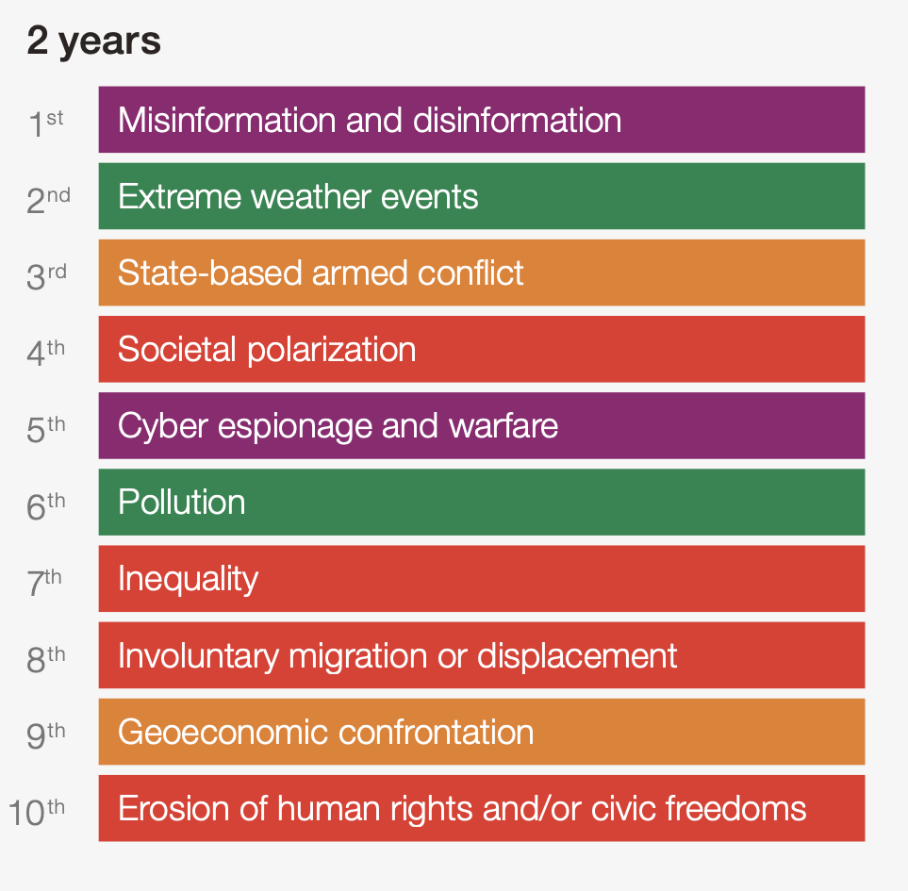
Please estimate the likely impact (severity) of the following risks over a 2-year period
World Economic Forum Global Risks
Perception Survey 2024-2025.

Slide 7


Public Emotions
Private Emotions
Emotional Contagion

Slide 8
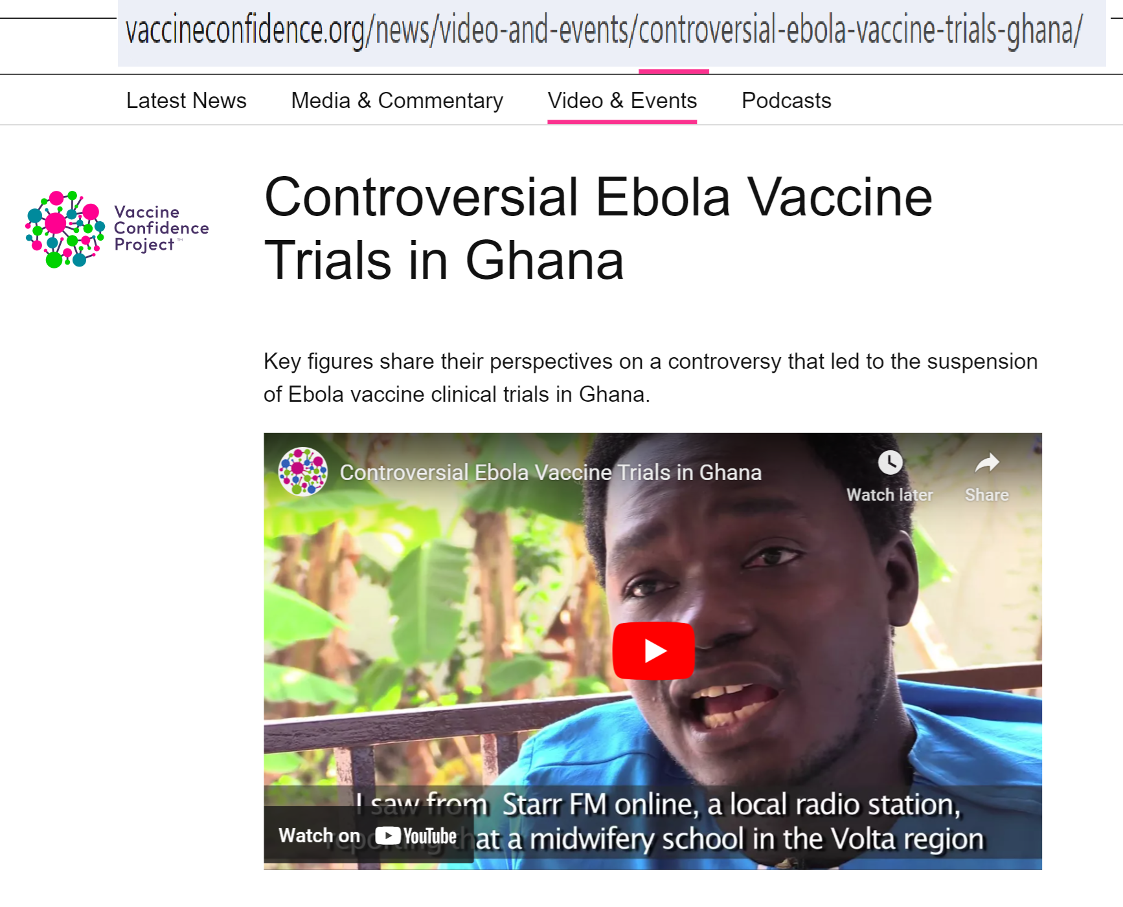
Heidi.Larson@LSHTM.ac.uk

Slide 9
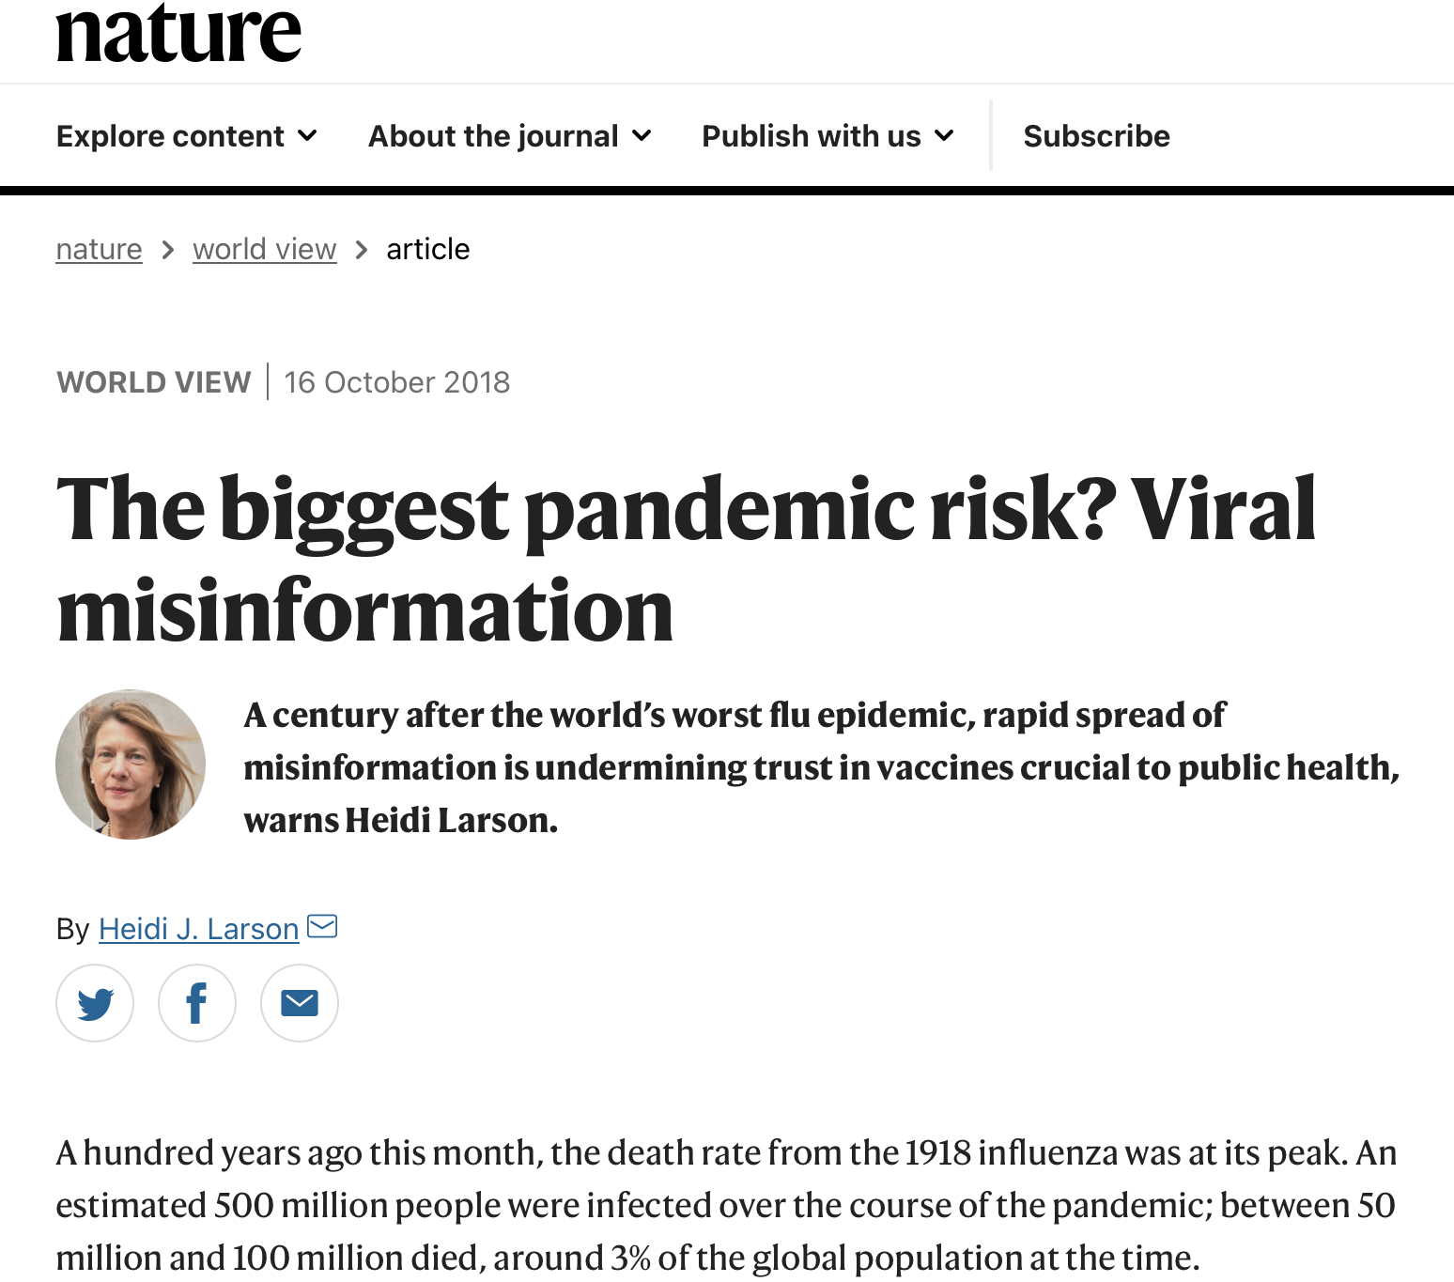

Slide 10
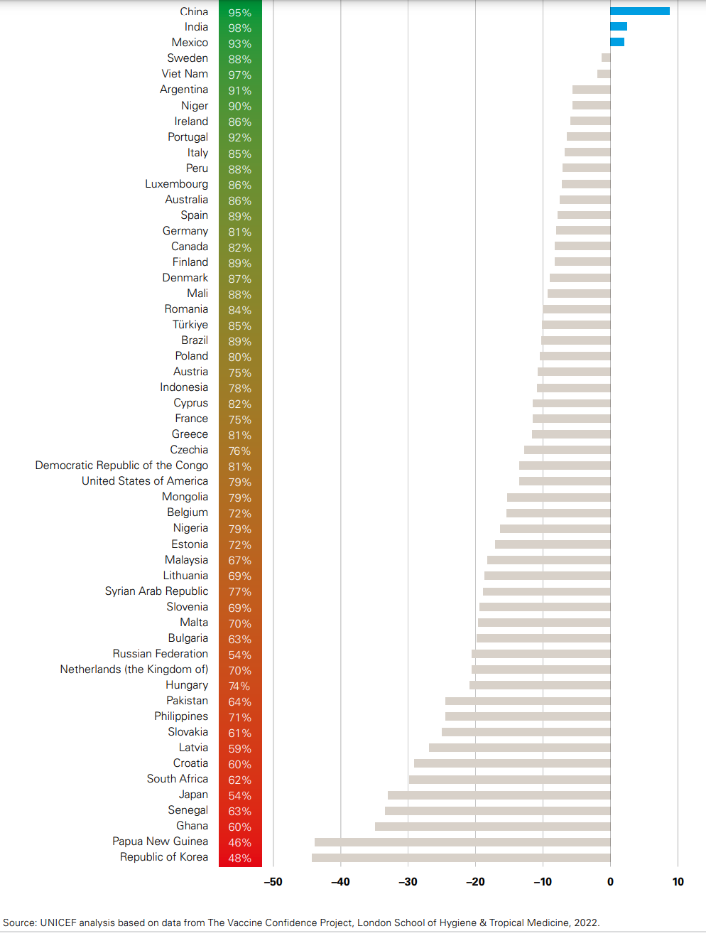

Slide 11
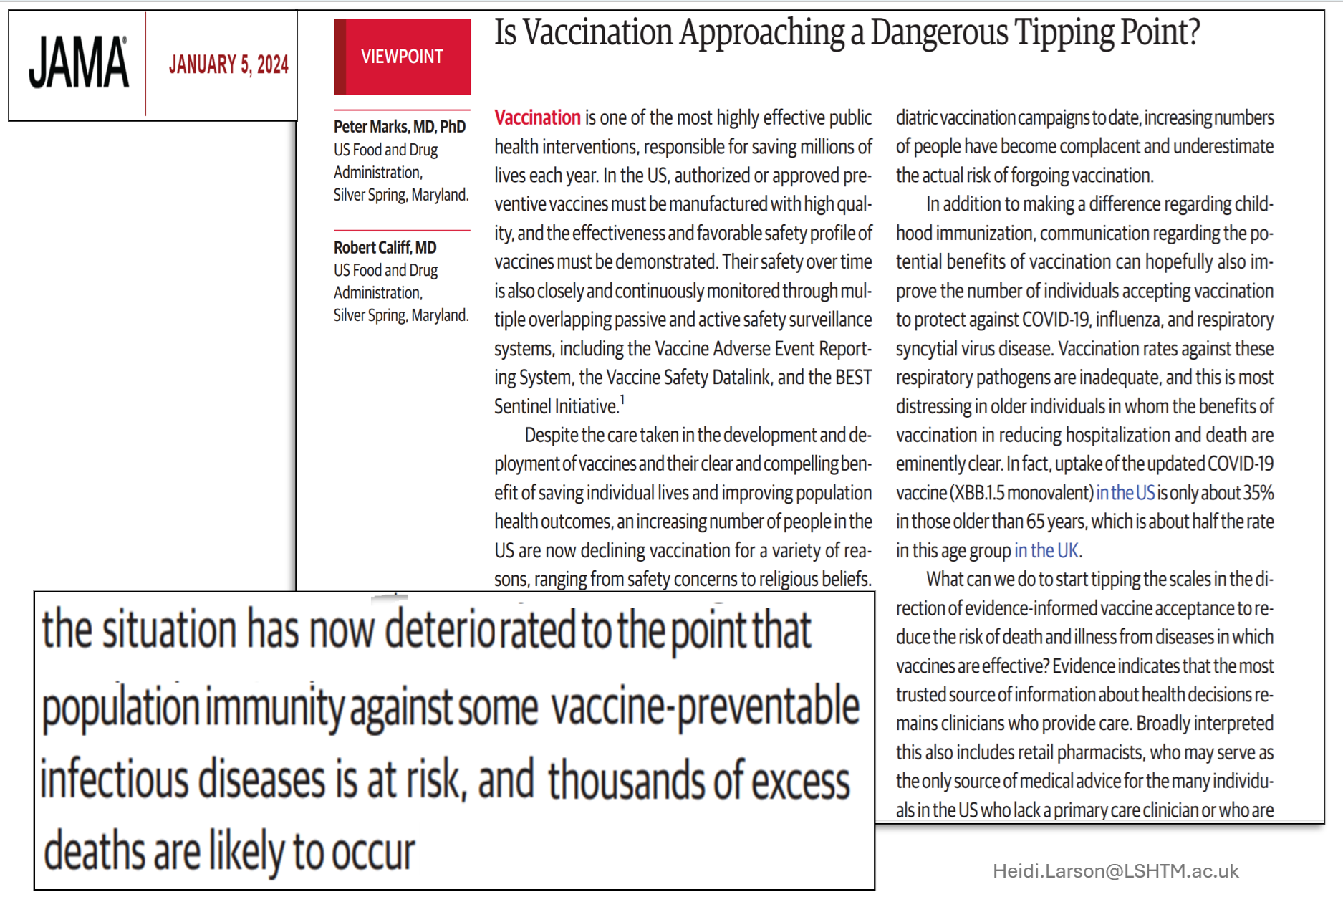

Slide 12
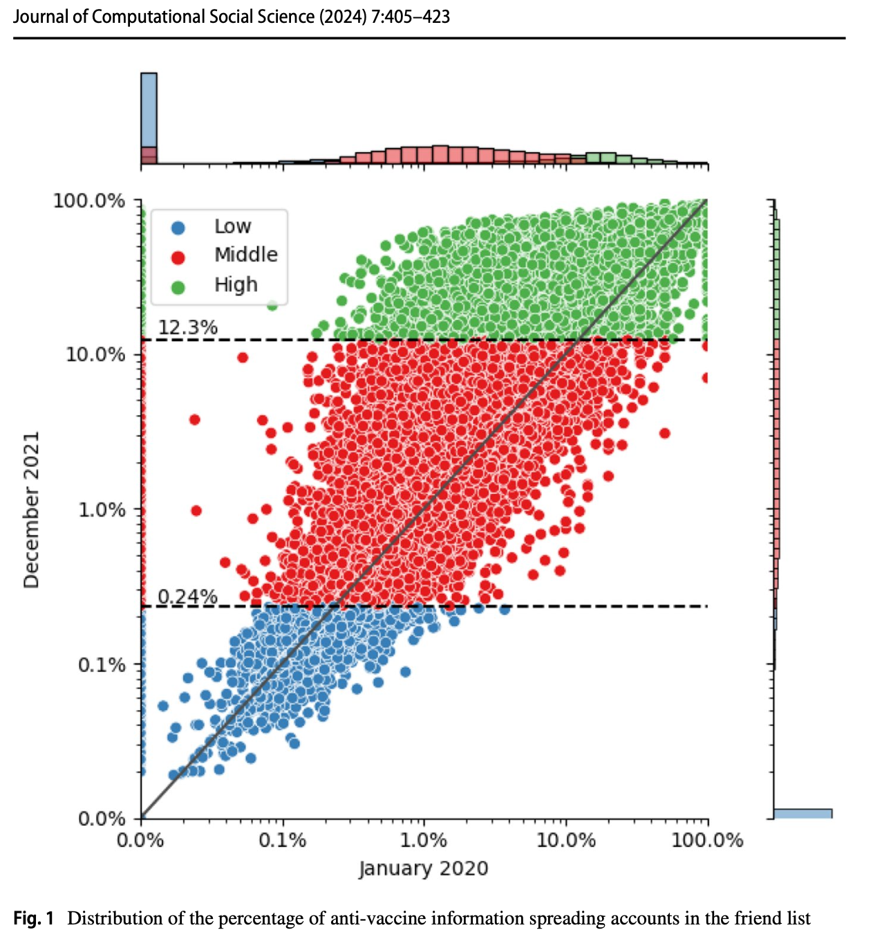

Slide 13
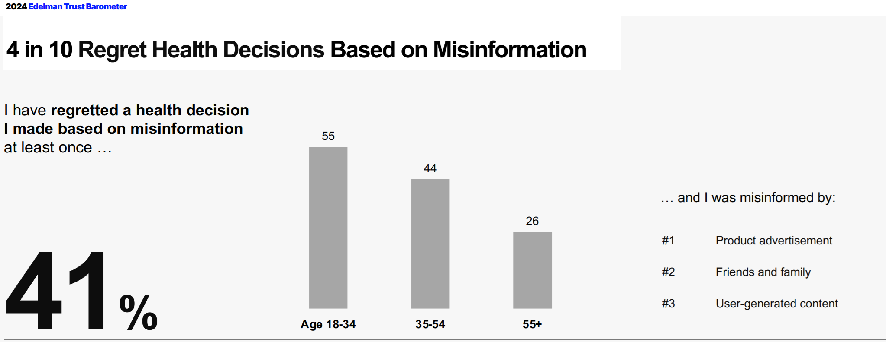

Slide 14
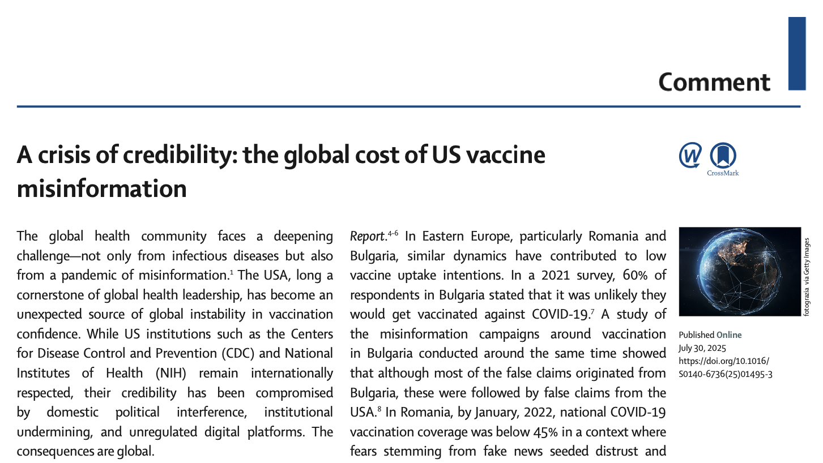

Slide 15
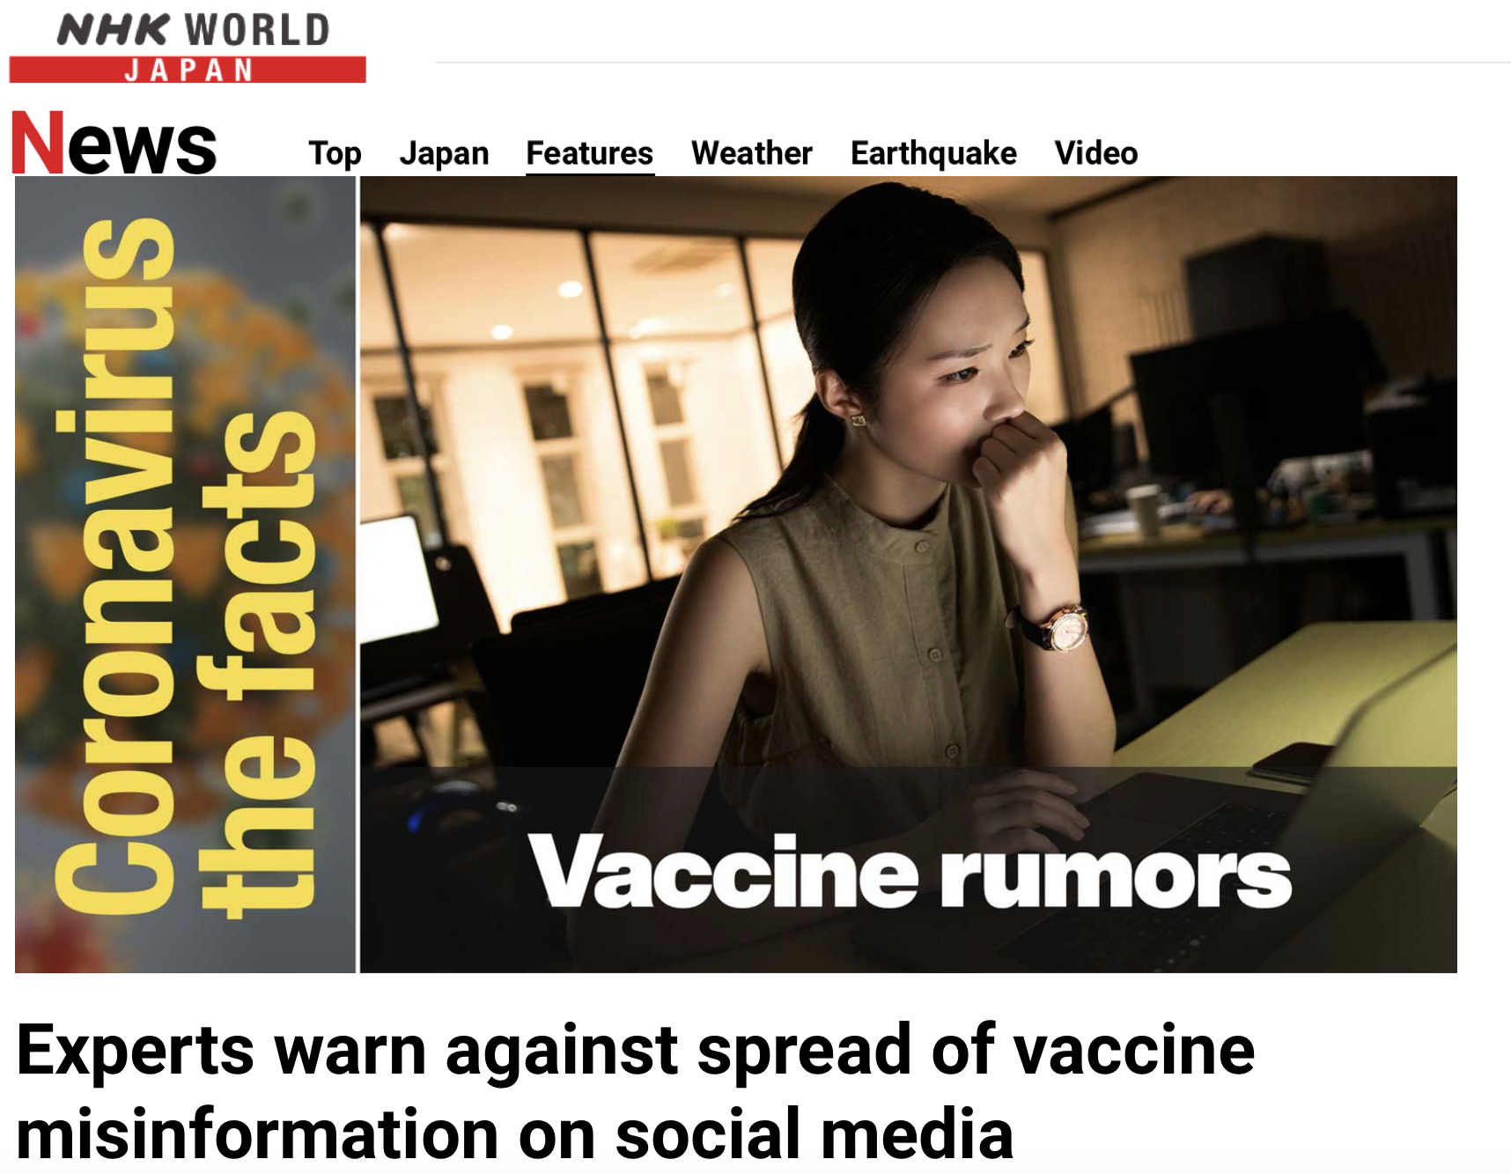

Slide 16
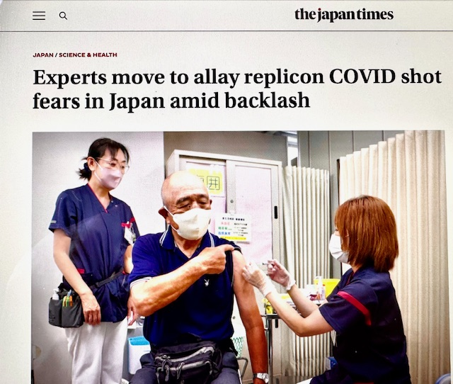
Scientists Say NIH Officials Told Them To Scrub mRNA References on Grants. (KFF Health News, 16 March 2025)

Slide 17
mRNA Vaccine Acceptance
F4. If a new mRNA vaccine is approved, would you take it to protect yourself from a disease?
All interviews n= 70,781

Slide 18

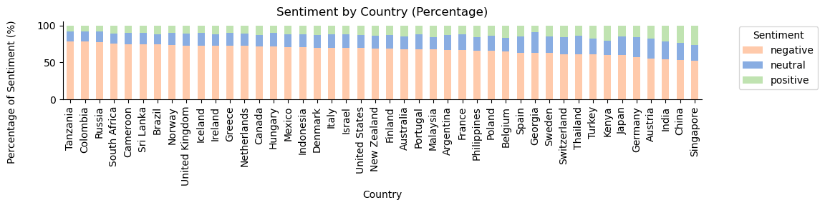
Methods: GPT labelled n=740,533 Twitter posts on 4 dimensions of confidence

Slide 19
Heidi.Larson@LSHTM.ac.uk The Global Listening Project

Slide 20
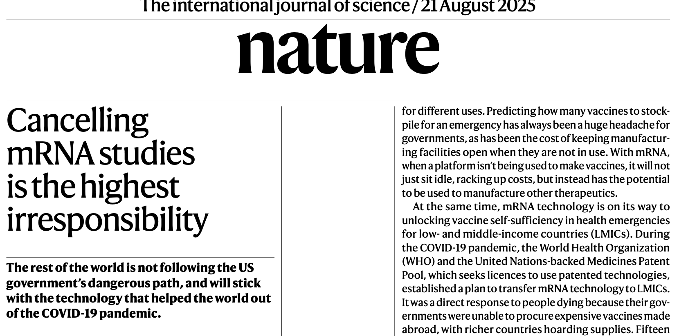

Slide 21
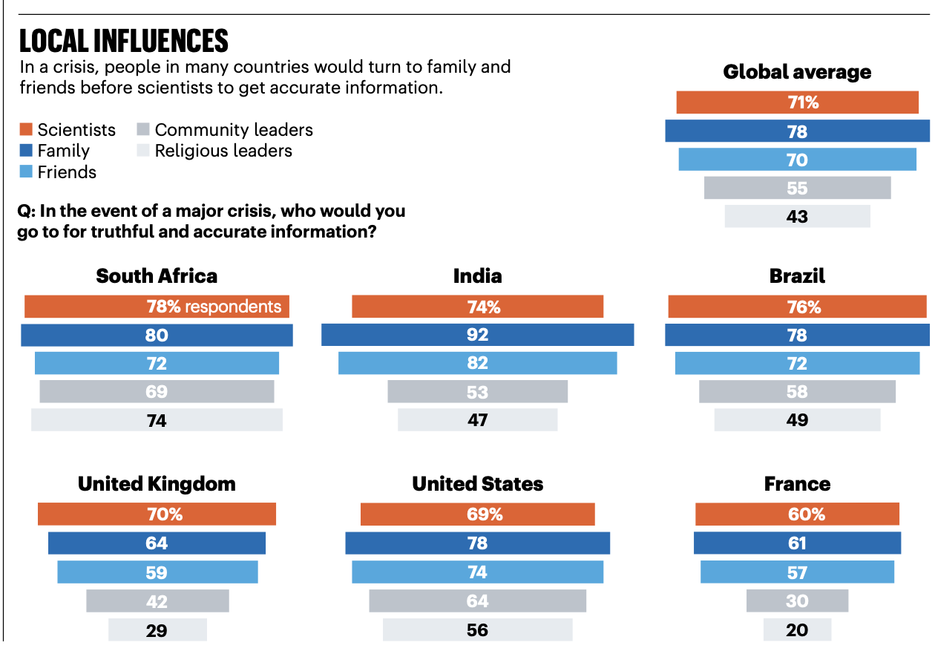
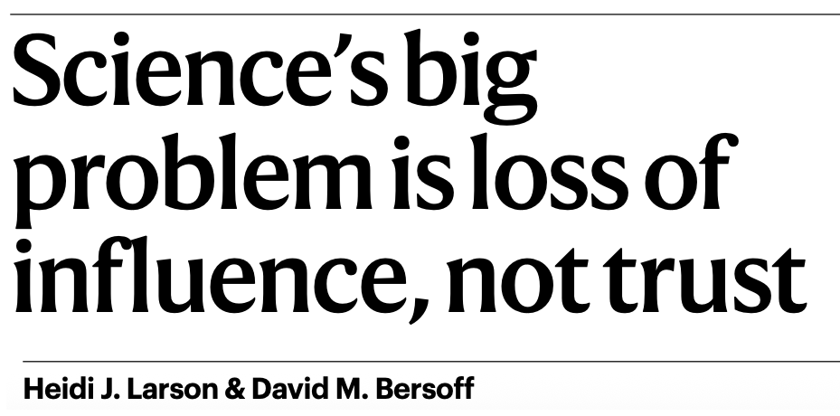
Larson HJ, Bersoff DM. Nature. 2025 Apr;640(8058):314-317.

Slide 22
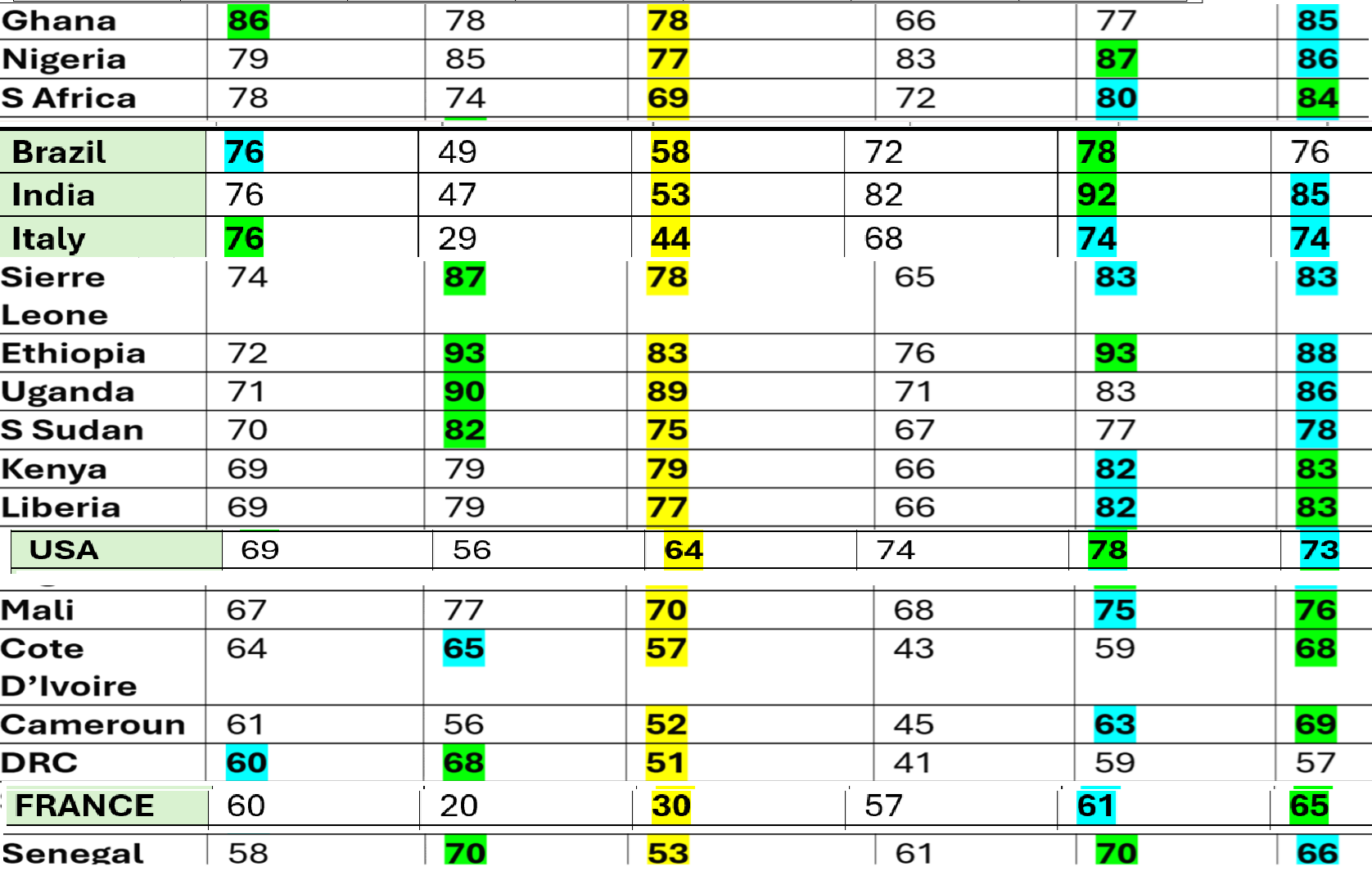

Slide 23
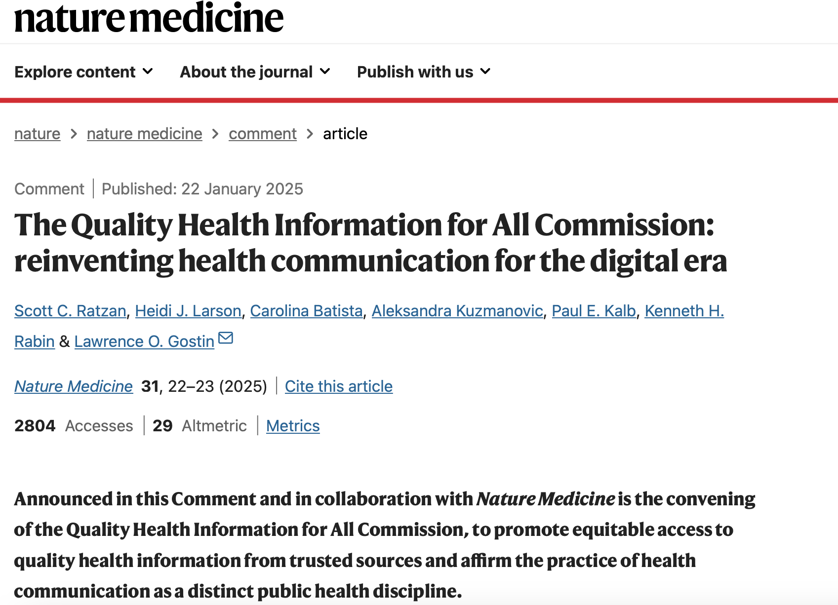

Slide 24
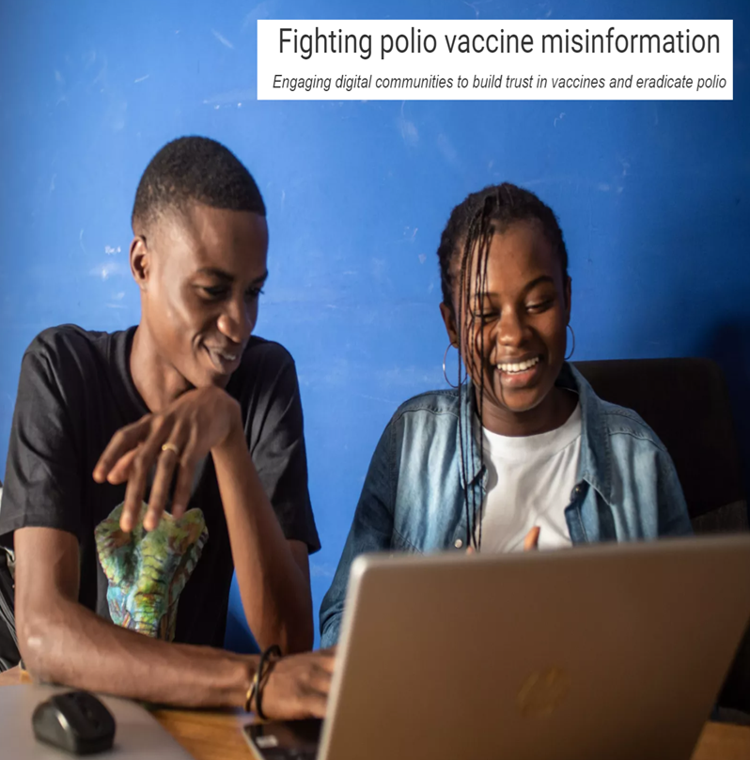
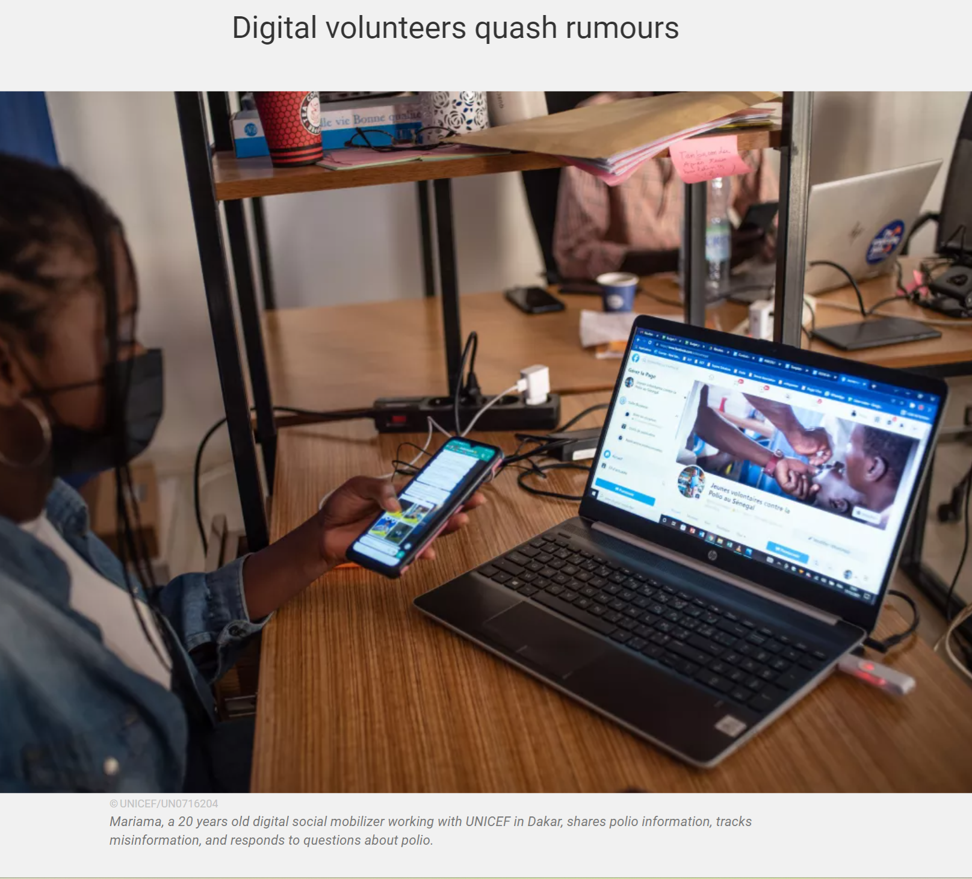
https://www.unicef.org/stories/fighting-polio-vaccine-misinformation
Heidi.Larson@LSHTM.ac.uk
https://uinfluence.com/

Slide 25

1.On Rumor
2. Dignity and Distrust
3. On Risk
4. Volatility of Opinion
5.Wildfires
6. Emotional Contagion
7.The Power of Belief
8.Pandemics and Publics
Heidi.Larson@LSHTM.ac.uk
Notes:
25

Slide 26


Slide 27
Q&A

Slide 28
This webinar recording and slides will be posted on www.icap.columbia.edu

Slide 29
Thank you

