Slide 1
Module One: COVID-19 Clinical Care: Confirm
V4: August 2022

Slide 2
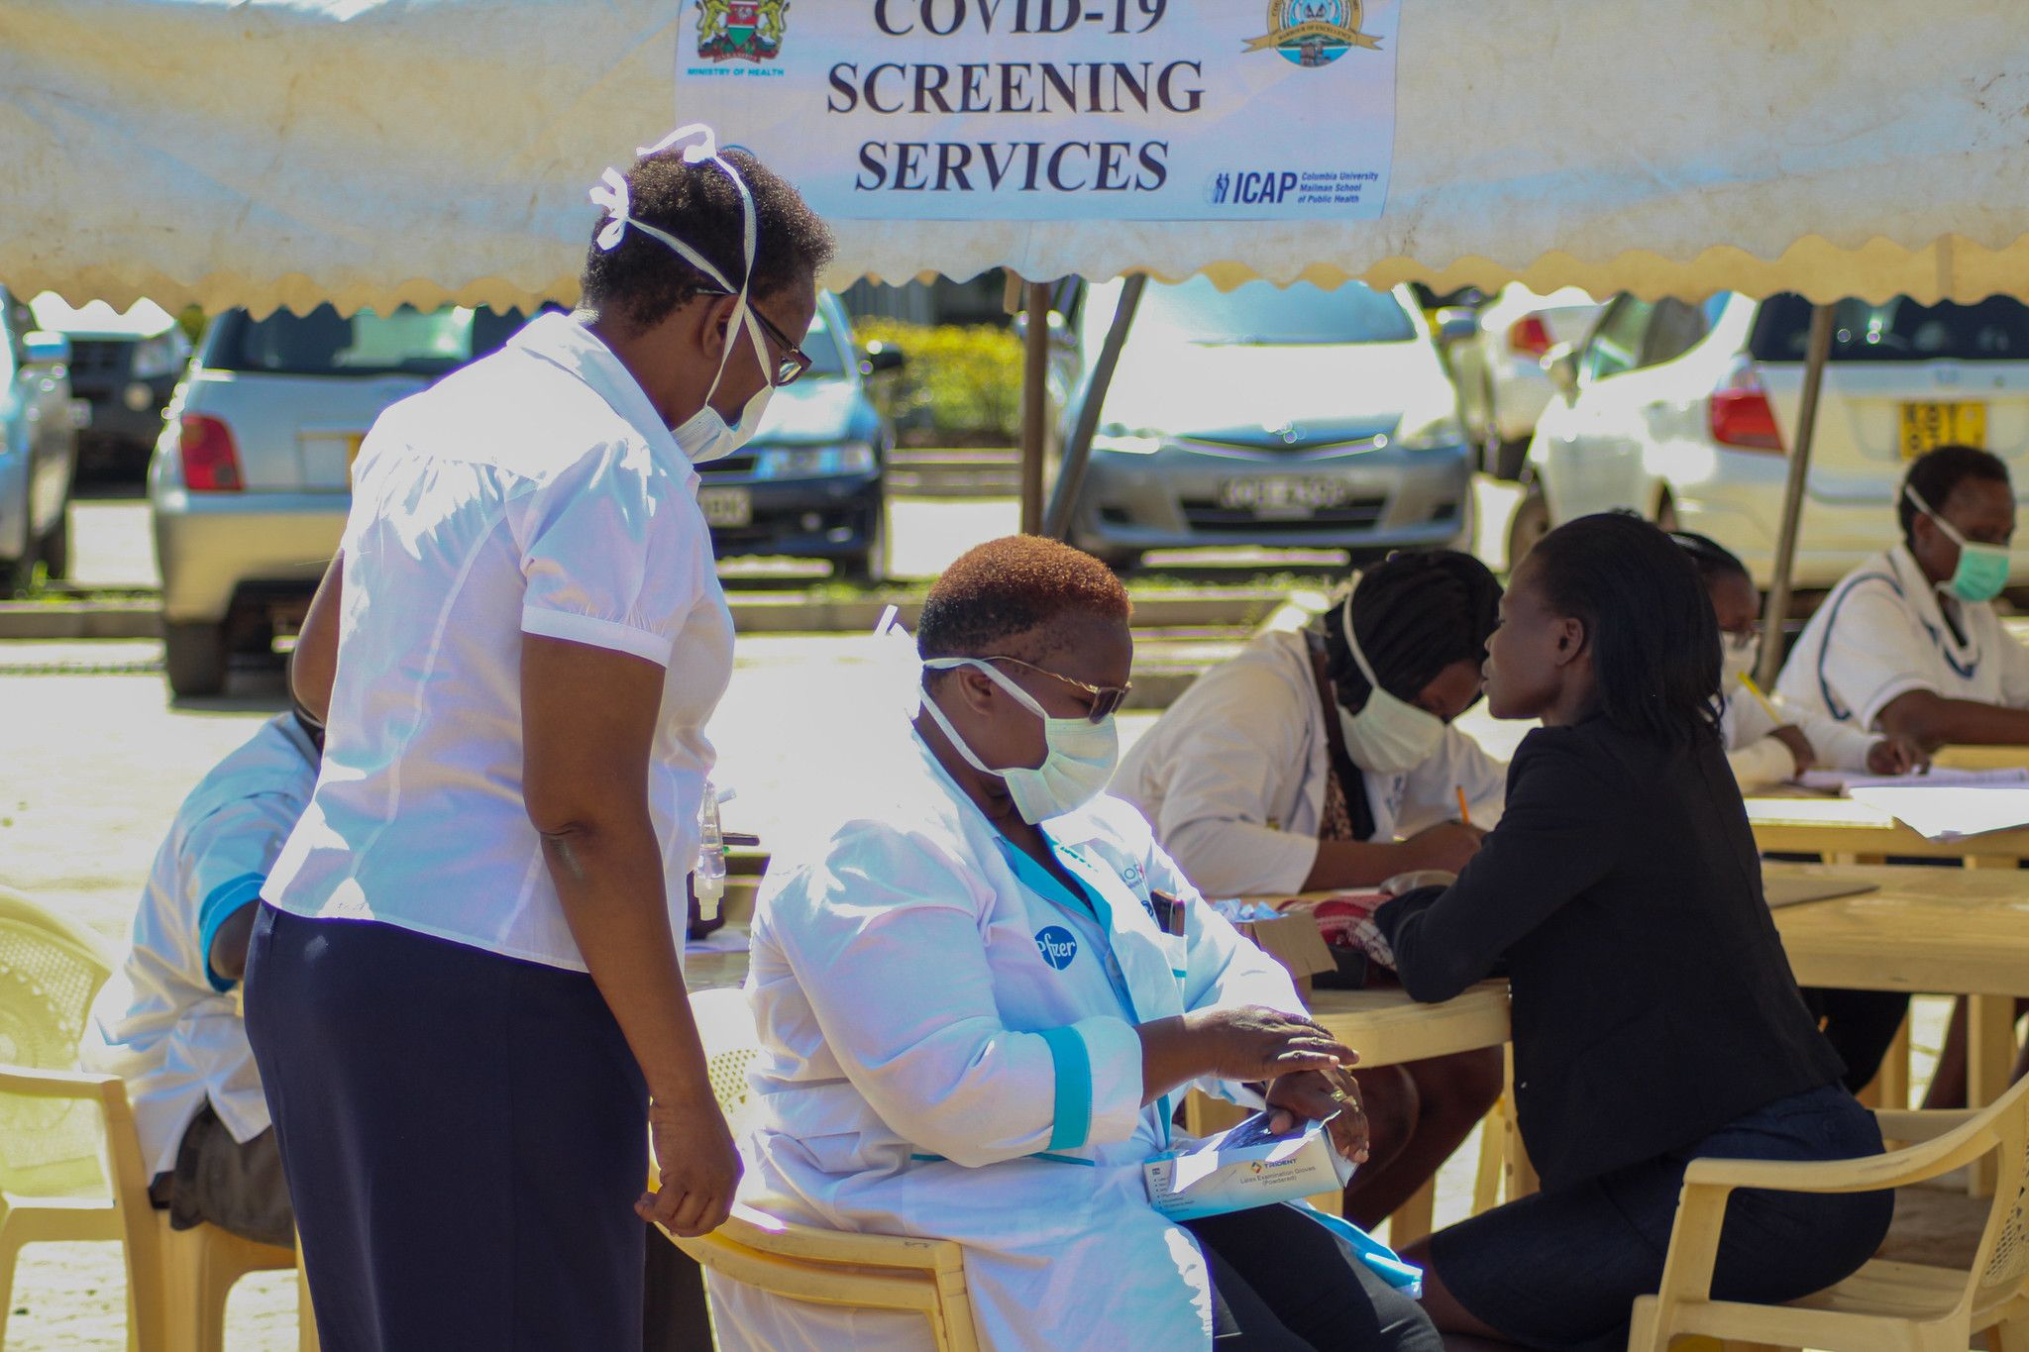
Module 1 Outline
1) Learning Objectives
2) SARS-CoV-2 Epidemiology
3) Signs and Symptoms
4) Testing

Slide 3
By the end of this module, the learner should be able to:
Understand what Coronaviruses are
Appreciate the global and local epidemiology of COVID-19, including the significance of viral variants
Identify symptoms and signs of COVID-19 disease
Understand the criteria for confirmed, suspected or probable case of COVID-19
Consider other diagnoses that might be confused with COVID-19
Describe national/facility criteria for COVID-19 testing (i.e. who should be tested)
Describe the steps of the COVID-19 testing procedure
List the personal protective equipment required for administering a COVID-19 test

Slide 4
Pre-test Questions
The most common signs and symptoms of COVID-19 are:
Vomiting, confusion, skin rash
Fever, fatigue, sore throat, shortness of breath, cough
Diarrhea
Fever, rash
(True/False) COVID-19 patients may be contagious before they develop symptoms.
True / False
(True/False) Masks and gloves are sufficient personal protective equipment (PPE) when testing patients symptomatic for COVID-19.
True / False
(True/False) When COVID-19 enters a community, the number of cases often increases rapidly.
True / False
SARS-CoV-2, the virus that causes COVID-19, is transmitted by :
Droplets that tend to spread less than 6 feet (2 meters).
Objects (fomites) that became contaminated when patients sneeze or cough near them.
Aerosols that spread over distances greater than 6 feet.
All of the above, but most transmission is by short distance droplets (a).
Notes:
Answers:
B
True
False
True
d

Slide 5
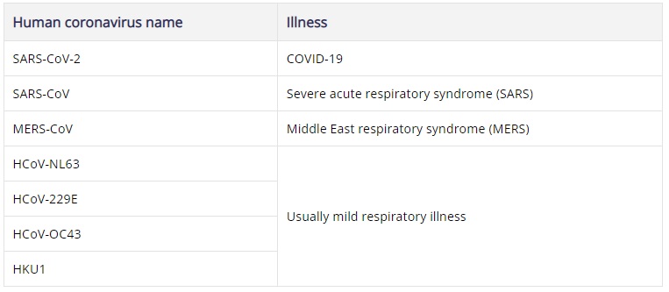
Coronaviruses
RNA viruses that may infect humans, animals, or both. 4 major human Coronaviruses were known prior to 2019, in addition to SARS-CoV and MERS
https://coronavirusexplained.ukri.org/en/article/cad0003/

Slide 6
Module 1 Outline
1) Learning Objectives
2) SARS-CoV-2 Epidemiology
3) Signs and Symptoms
4) Testing

Slide 7
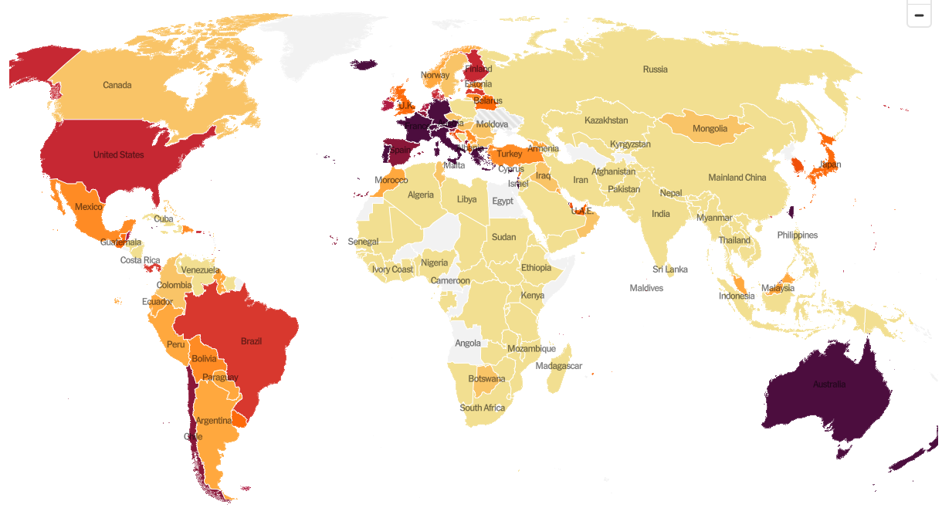
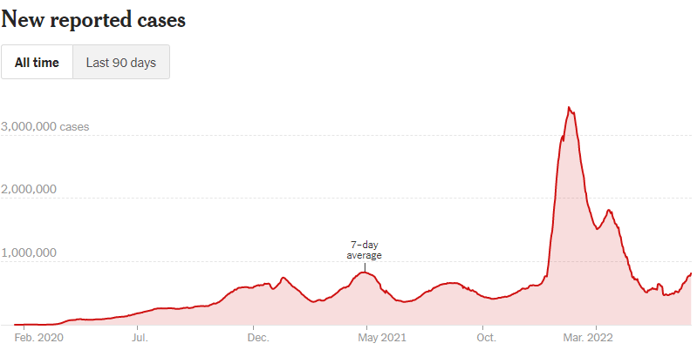
COVID-19 Global Snapshot
As of July 6, 2022:
551,050,303 confirmed cases
6,339,400 reported deaths
11,485,039,303 vaccine doses administered
By WHO Region:
New cases in last 7 days:
52% in Europe
24% in the Americas
18% in the Western Pacific
3% in South-East Asia
2% in the Eastern Mediterranean
0% in Africa
Our World in Data, John Hopkins University, WHO
Notes:
At this point COVID-19 has spread across the globe and affected populations on all continents and regions of the world

Slide 8
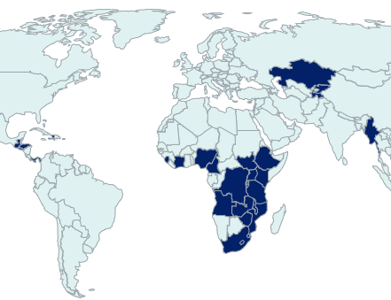
Confirmed COVID-19 Cases in ICAP-Supported Countries
as February 2, 2022
South Africa 3,605,222
Kazakhstan 1,325,293
Panama 697,124
Guatemala 689,609
Myanmar 535,532
Ethiopia 465,158
Honduras 391,874
Kenya 321,381
Zambia 305,047
Nigeria 253,181
Zimbabwe 229,666
Mozambique 223,827
Kyrgyzstan 198,518
Uganda 161,929
Rwanda 128,891
Cameroon 116,718
Angola 98,076
Malawi 84,475
Côte d’Ivoire 80,718
Eswatini 68,367
Tanzania 32,920
Burundi 37,432
Lesotho 32,176
Haiti 29,217
Tajikistan 17,716
South Sudan 16,802
Sierra Leone 7,622
Notes:
Confirmed cases represent a gross undercount of actual cases as confirmation is limited by the recognition of symptoms and the local resources for testing.

Slide 9
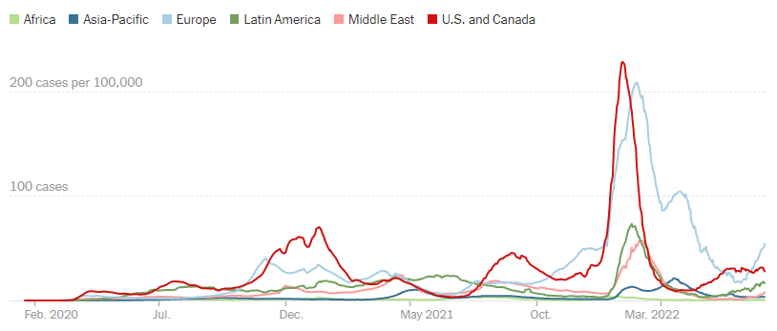
Cases by Region
New York Times

Slide 10
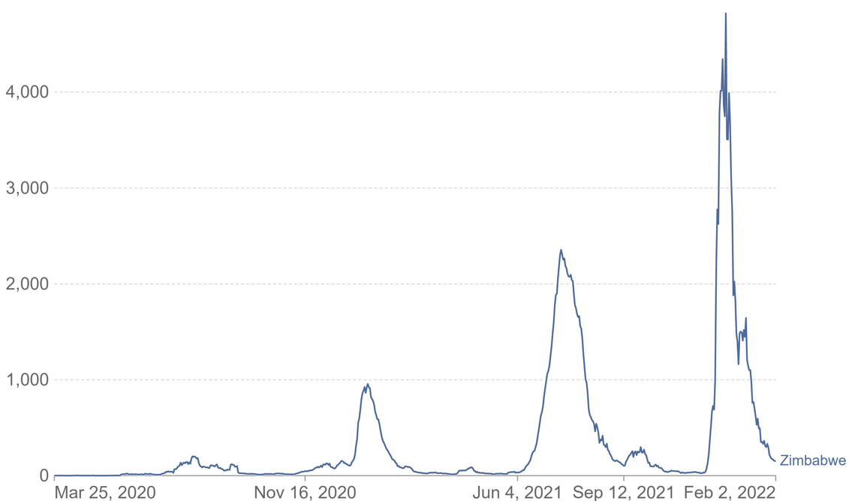
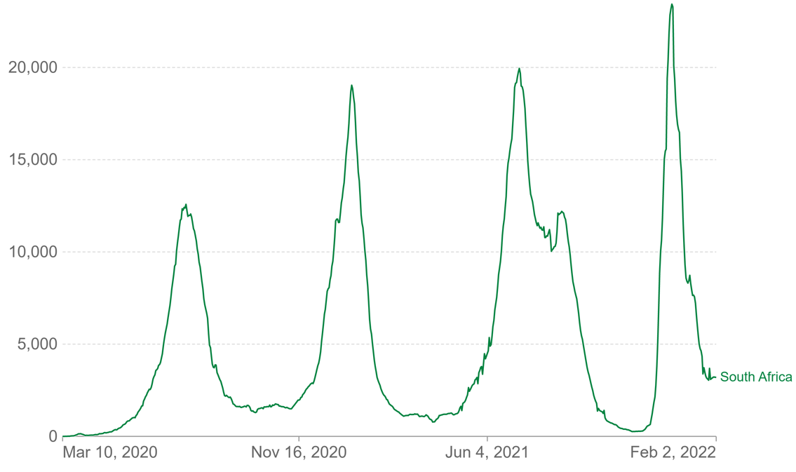
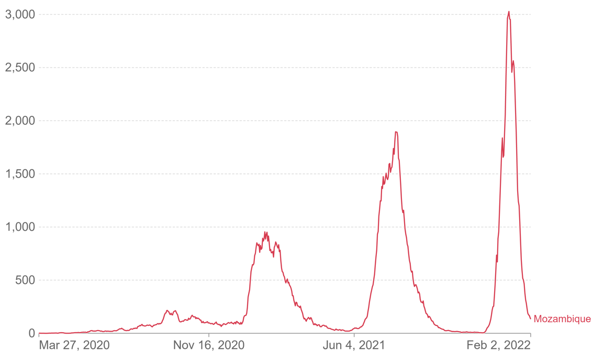
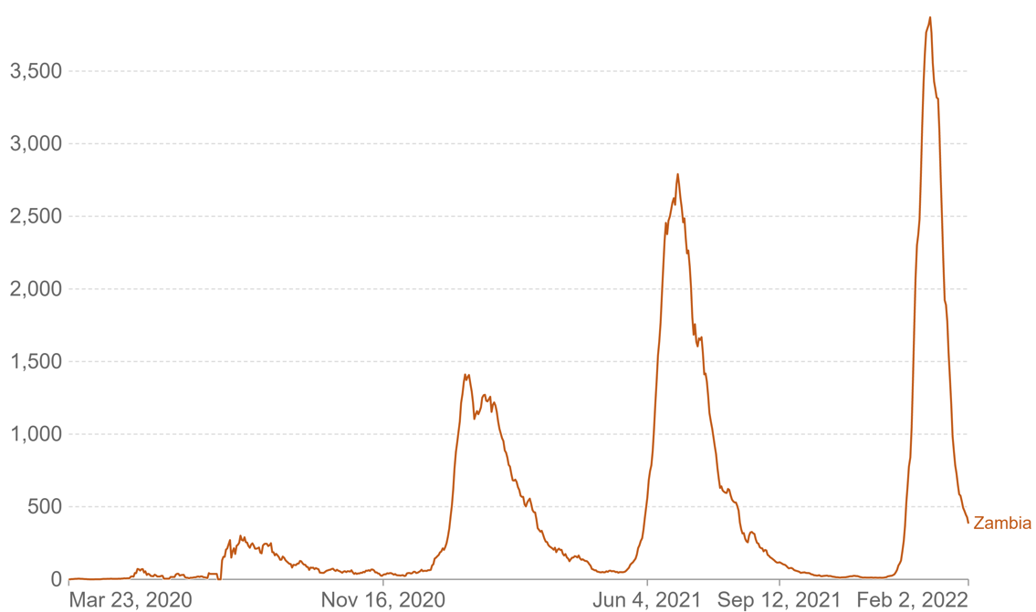
Case Trends in Southern Africa
South Africa
Zimbabwe
Zambia
Mozambique
Our World in Data
Notes:
Transmission of SARS-COV-2 and subsequent cases of Covid-19 in a given community have been noted to occur in successive waves. Waves may be due to changes in human behavior (such as lockdowns or masking), development of immunity in susceptible populations or the introduction of new viral variants

Slide 11
[Country Specific] Local Epidemiology
[Insert information on local epidemiology, ]
[It is particularly important for healthcare providers to know if transmission is limited to travelers or other risk groups as opposed to ongoing community transmission]
Notes:
Insert as many slides as needed. Sources as described previously https://ourworldindata.org/coronavirus; https://coronavirus.jhu.edu/data/new-cases or https://covid19.who.int/; or https://coronavirus.jhu.edu/data/new-cases

Slide 12
Variants & subvariants of SARS-CoV-2
Notes:
SARS-CoV-2 has been undergoing rapid genetic mutation (at a rate that has far exceeded initial scientific expectations). Variants are distinct genetic lineages and may be particularly important if they permit the virus to escape control of the human immune response.

Slide 13
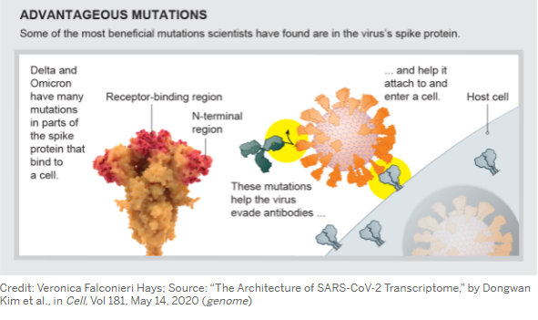
Variant - a virus that has one or more mutations (differing from the “parent” virus)
Mutations that impact the ability to the virus to efficiently complete its lifecycle may lead to decreases in viral virulence (infection that is clinically less severe).
Mutations that make it more difficult for antibodies from prior infection or vaccination to block the virus may lead to “break through” infection . In essence, the virus “escapes” from the immune response.
Notes:
Mutations are viral “errors” in reproduction

Slide 14
Variant of Concern (VOC)
A variant for which there is evidence of an increase in transmissibility, more severe disease (more hospitalizations or deaths), significant reduction in neutralization by antibodies generated during previous infection or vaccination, reduced effectiveness of treatment or vaccines or diagnostic detection failures.

Slide 15
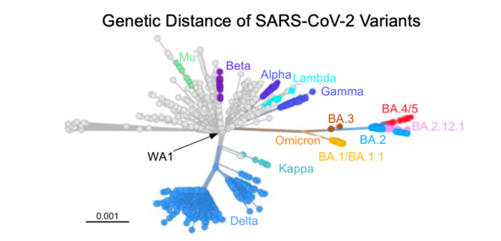
Major SARS-Cov-2 Variants
The delta variants evolved in a manner that was quite genetically distinct from the later omicron variants
There are two new major omicron subvariants, BA.4
and BA.5
Notes:
This is a schematic map of the genetic diversity of SARS-CoV-2. Many variants contain mutations in key areas of the virus (such as the spike which attaches virus to human cells) that allow the variant to escape from the immune response.

Slide 16
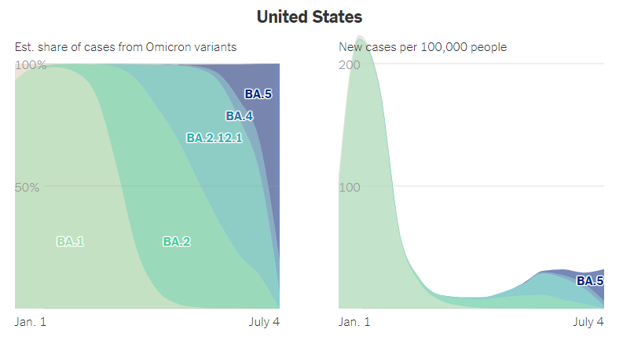
Evolution of Omicron Subvariants
Figure: nytimes.org
Notes:
Newer subvariants have been observed to quickly replace those variants that were previously circulating in the population.

Slide 17
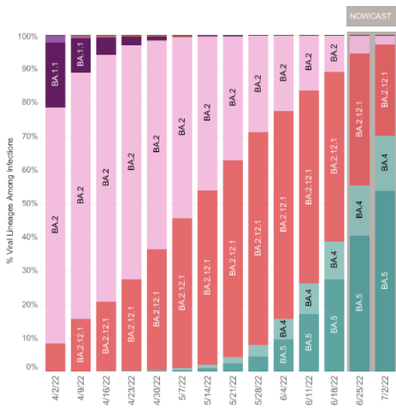
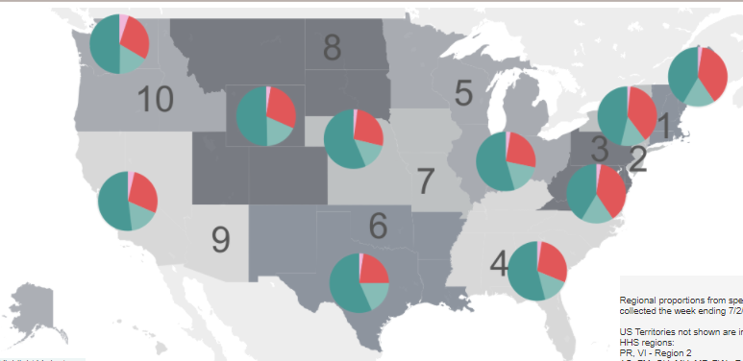
Variant Proportions in the US
2.8%
BA.5: 46.2%
27.2%
16.5%
53.6%
CDC

Slide 18
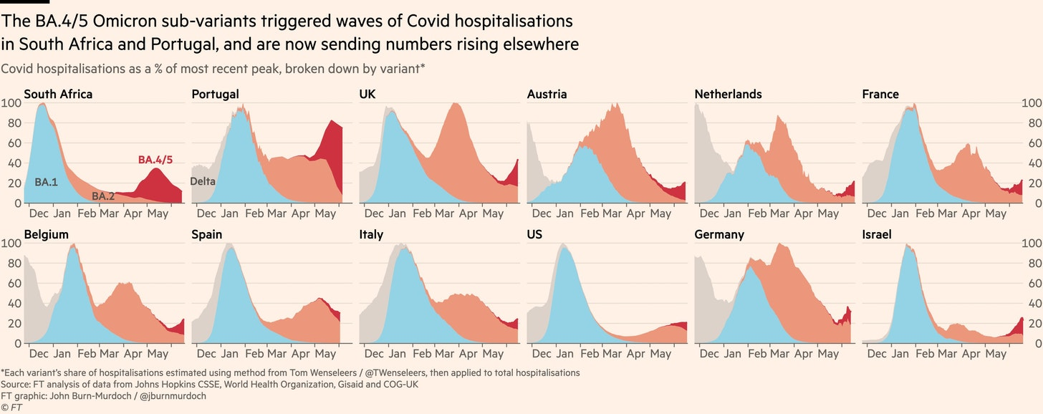
BA.4/BA.5 Hospitalization Trends

Slide 19
Globally, COVID-19 cases are increasing in some regions of the world, largely due to highly transmissible BA.4/BA.5 Omicron subvariants
COVID-19 vaccination coverage continues to vary widely by region with gradual progress being made in African countries
The rapid emergence and predominance of Omicron subvariants warrants close monitoring, particularly in terms of virulence or pathogenicity
Early data suggest vaccine effectiveness against BA.5 is similar to that of BA.2
Variant-specific booster vaccination may provide advantages in terms of boosting immunologic response to new variants

Slide 20
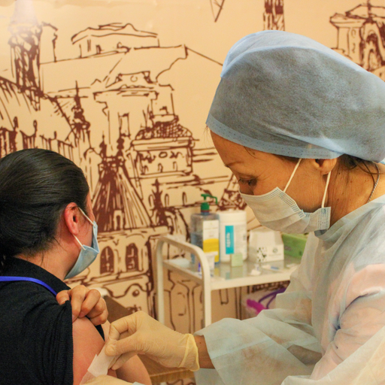
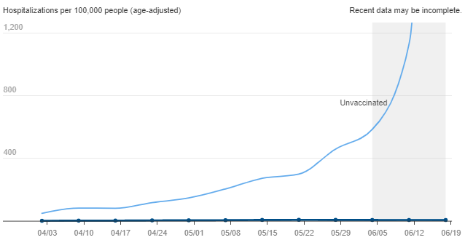
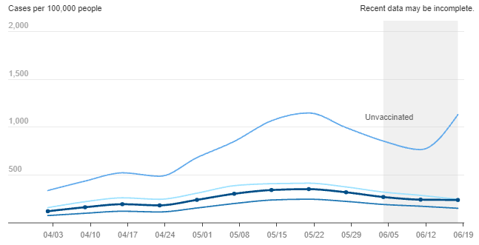
Vaccination Status of Cases and Hospitalizations (NYC)
Vaccinated, boosted
Citywide
Vaccinated, not boosted
NYC DOHMH
Notes:
Although currently available vaccines are directed at the original SARS-CoV-2 virus, updated vaccines directed at viral variants are under development. Despite “break through” infections, current vaccines remain highly effective at preventing severe disease (using the surrogate of hospitalization) as illustrated in this recent data from NYC

Slide 21
Transmission of SARS-CoV-2
Notes:
SARS-CoV-2 has been undergoing rapid genetic mutation (at a rate that has far exceeded initial scientific expectations). Variants are distinct genetic lineages and may be particularly important if they permit the virus to escape control of the human immune response.

Slide 22
SARS-CoV-2 Transmission
Leung, 2021
Notes:
Terminology has led to confusion in our understanding of SARS-CoV-2 transmission. SARS-Cov-2 is primarily spread by droplets. The terms “droplet” usually refers to larger respiratory particles that are formed and expelled during coughing, sneezing, or speaking. Droplets transmit virus primarily to those who are within 6 feet of the infected person. In addition, smaller respiratory particles may be aerosolized by deep breathing, singing or may be formed from larger droplets that remained suspended because of air movement or lower humidity and become smaller due to evaporation. These may travel longer distancing and may occasionally account for SARS-CoV-2 transmission over distances that far exceed 6 feet. In addition, the environment can be contaminated by droplets that fall onto surfaces near an infected person. Virus may be transmitted by hands that becomes contaminated from environmental surfaces (fomites). From “Transmissibility and transmission of respiratory viruses” in Nature Reviews Microbiology, 2021

Slide 23
Environmental Determinants of SARS-Co-2 Transmission
Leung, 2021
Notes:
It is worth noting that SARS-CoV-2 transmission is quite unusual in open, outdoor environments and much more efficient in poorly ventilated indoor environments.

Slide 24
Module 1 Outline
1) Learning Objectives
2) SARS-CoV-2 Epidemiology
3) Signs and Symptoms
4) Testing

Slide 25
Common Signs and Symptoms
https://commons.wikimedia.org/wiki/File:Symptoms_of_coronavirus_disease_2019_(cropped).png
People become contagious 2-3 days before developing symptoms
Many people are infected but recover without ever developing symptoms
Loss of smell or taste was common in the first wave of COVID-19 but seems much less common now
Sore throat and runny nose have become more common
CDC.gov

Slide 26
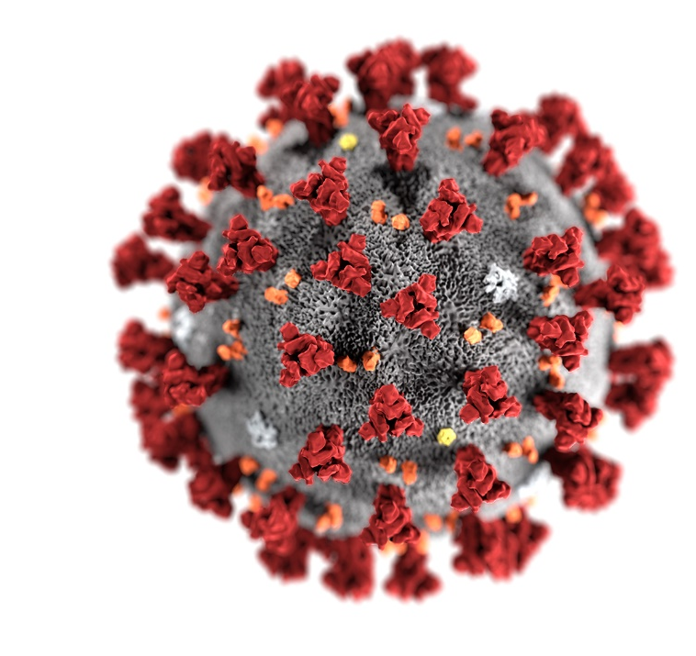
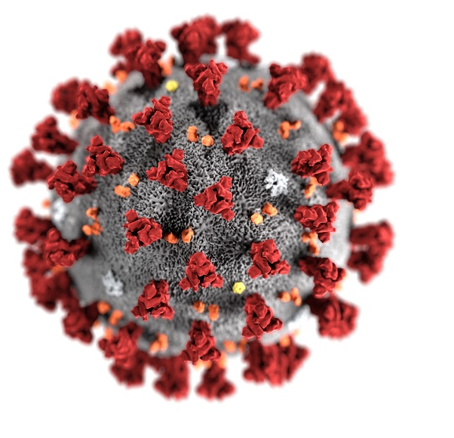
COVID-19 Spectrum of Disease
COVID-19 is associated with a broad clinical spectrum of disease.
Most patients appear to have mild disease: common symptoms include fever, cough, sore throat, fatigue, myalgia.
It is estimated that 15% have severe disease, which includes severe pneumonia and sepsis; and 5% have critical illness.
Of these, some patients progress to acute respiratory failure requiring mechanical ventilation. Death has occurred in ~ 0.3-5% of cases, but an accurate estimate of mortality is still not available.

Slide 27
Discussion
Discussion Question:
Are there other common conditions in your facility that have similar signs and symptoms to COVID-19?
What can you do if you have a patient that exhibits numerous signs and symptoms with different common conditions?
Notes:
These can be discussed as a large or small group or considered by individual trainees. Consider what diagnostic tests might help in differentiating COVID-19 from other illnesses. If SARS-CoV-2 tests are available, one may want to defer other tests until the SARS-CoV-2 testing has resulted.

Slide 28
Recognizing COVID-19
he
COVID-19 COMPARED TO OTHER COMMON CONDITIONS
COVID-19 and other illnesses have similar symptoms and can be spread in similar ways.
Although respiratory symptoms are most common, COVID-19
symptoms can be confused with other respiratory viruses (influenza or the common cold), TB, bacterial pneumonia, or even seasonal allergies
How will knowing the signs and symptoms of COVID-19 impact your work at your facility?
When COVID-19 patients present with fever and systemic symptoms in the absence of cough, the diagnosis can easily be confused with other infections such as malaria, dengue, or typhoid
Some patients with COVID-19 may have gastrointestinal
symptoms that mimic appendicitis or infectious gastroenteritis but such presentations are relatively infrequent

Slide 29
Case 1: 45 year-old nurse
A 45 year-old nurse who works on the COVID-19 isolation unit calls in sick and says she cannot report to work. She has a low-grade fever of 100.4°F (38.2°C), mild cough and sore throat.
Note that several coworkers have recently developed COVID-19.
She denies any shortness of breath. Appetite is normal and she doesn’t feel particularly sick. She is healthy with no significant PMH and is not taking any medication.
She lives at home with her husband who is 52 years-old and has hypertension and her 72-year-old mother-in-law. She has 4 children aged 10-18 years living at home.
Is she likely to have COVID-19?
Should she be tested for COVID-19?
Notes:
Let’s review a case of a nurse and think about the signs and symptoms of COVID-19 and begin to consider who should receive COVID-19 testing.

Slide 30
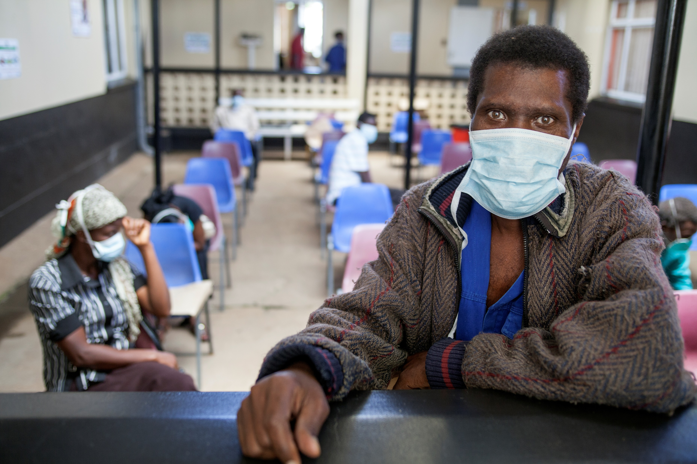
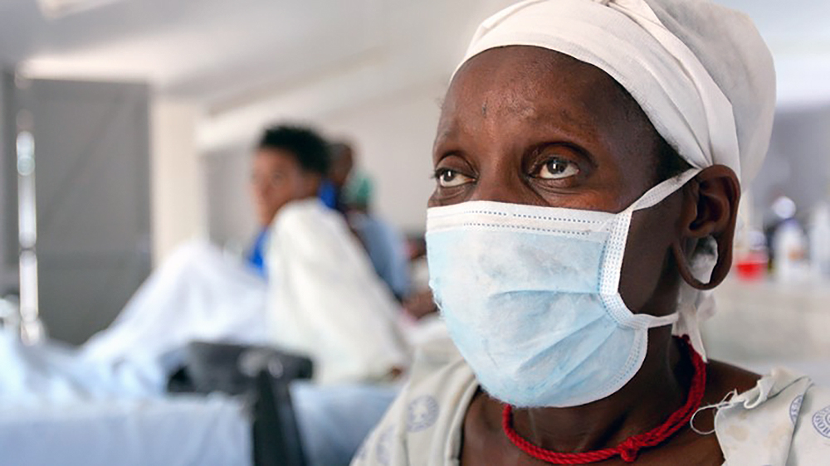
WHO Definition of a Suspected Case of SARS-CoV-2 Infection
WHO COVID-19 Case Definitions, July 2022
A patient with acute respiratory illness (fever AND cough) OR 3 or more symptoms (fever, cough, weakness/fatigue, headache, myalgias, sore throat, coryza, dyspnea, nausea/diarrhea/anorexia) OR a contact of a probable or confirmed COVID-19 case or cluster
or
A patient with severe acute respiratory illness (SARI - fever & cough) onset within the last 10 days who requires hospitalization
or
An asymptomatic person not meeting epidemiologic criteria but with a positive SARS-CoV-2 Antigen rapid diagnostic test
Notes:
A suspected case meets any of the criteria (A, B, or C). A are the clinical and epidemiological criteria for being a suspected SARS-COV-2 infection. A suspected case can fit the clinical or epidemiological definition and does not have to meet both. Note: our nurse fits criteria for COVID-19 suspected case (A). B. All cases of SARI are COVID-19 until proven otherwise. C. Antigen tests are not as accurate as PCRs tests. Hence, this asymptomatic person without known exposure is considered a suspected case.

Slide 31
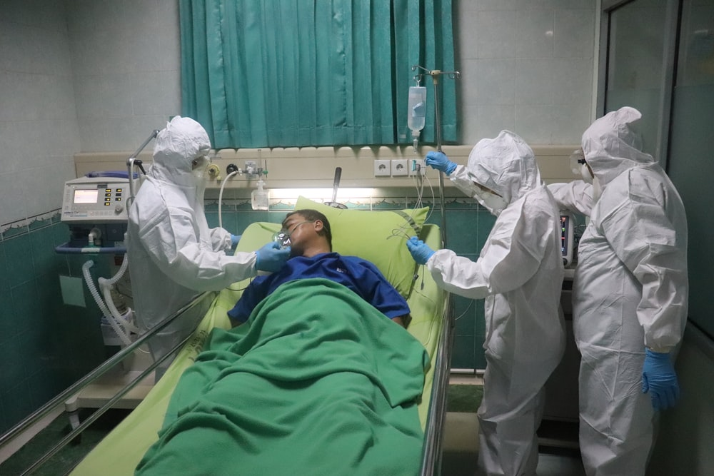
WHO Definition of a Probable Case of SARS-CoV-2 Infection
WHO COVID-19 Case Definitions, July 2022
PROBABLE CASE
A. A patient who meets clinical criteria AND is a contact of a probable or confirmed case or linked to a COVID-19 cluster
OR
B. A death, not otherwise explained, in an adult with respiratory distress preceding death AND who was a contact of a probable or confirmed case or linked to a COVID-19 cluster
.
Photo credit: Majnun on Unsplash
Notes:
Now we realize that our nurse is actually a probable case of COVID-19 as she meets clinical and epidemiological criteria.

Slide 32
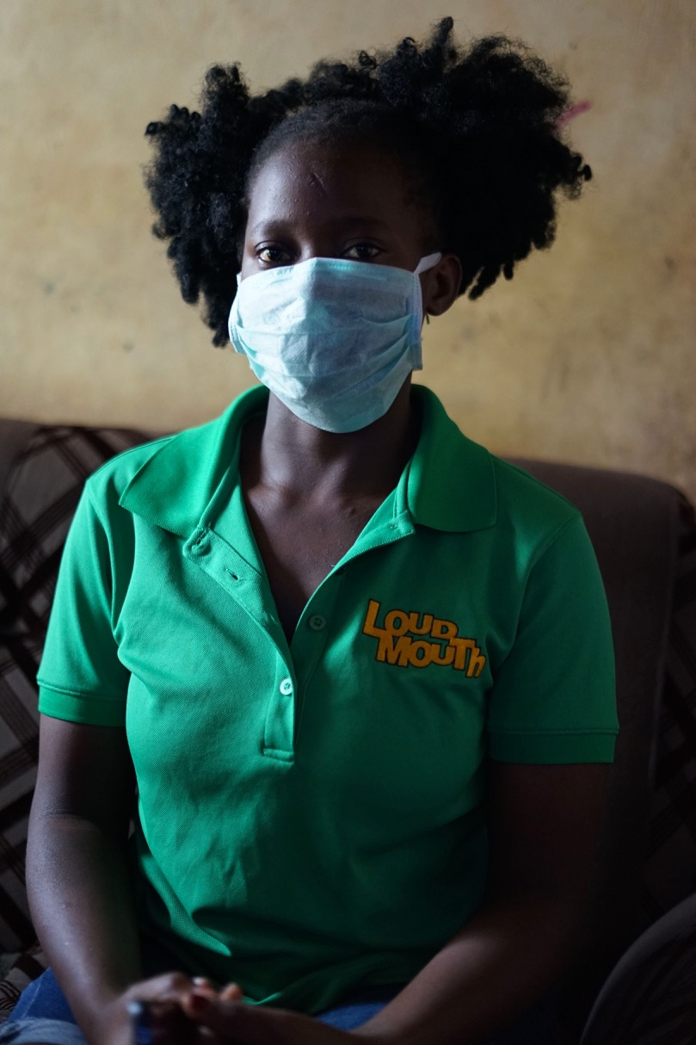
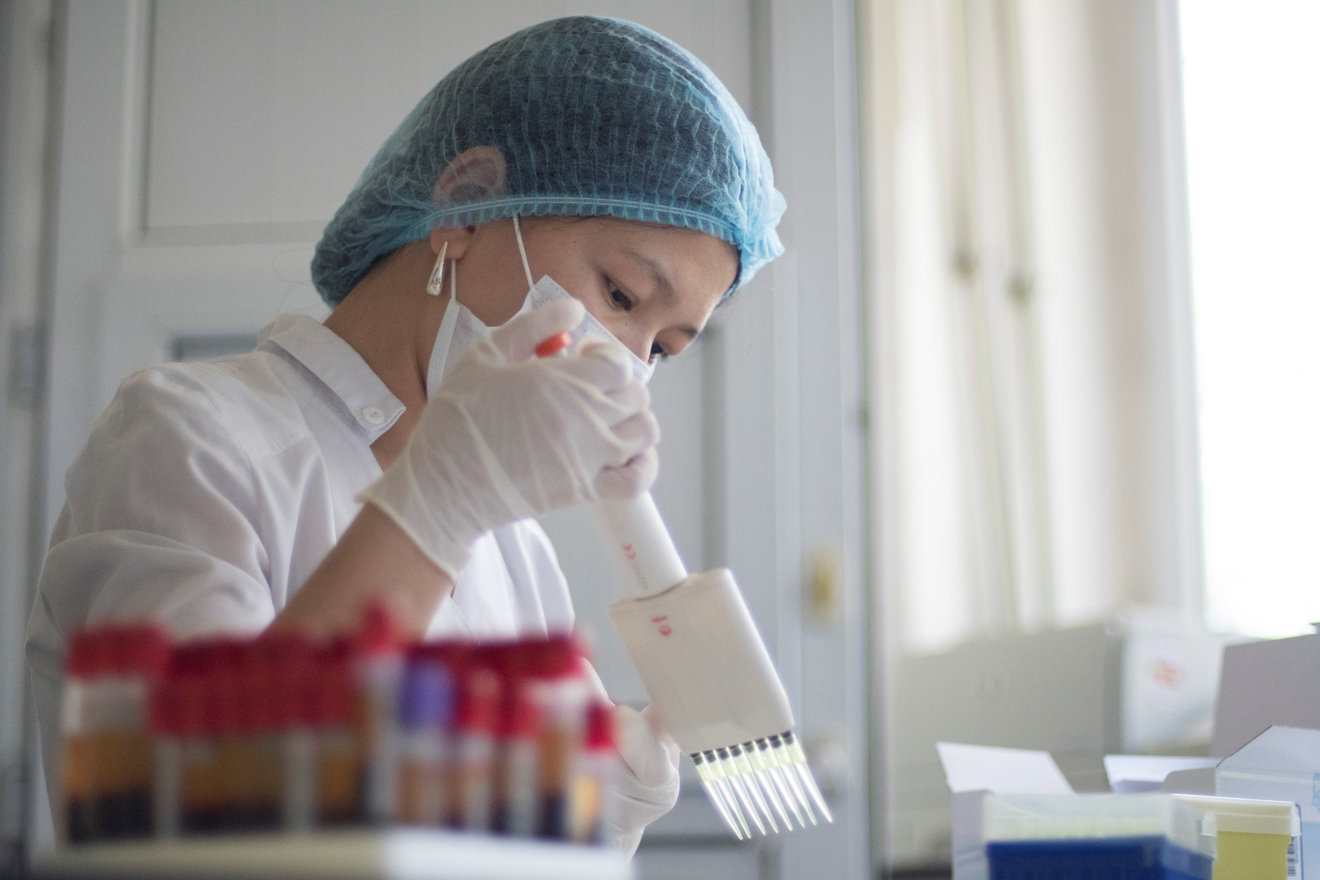
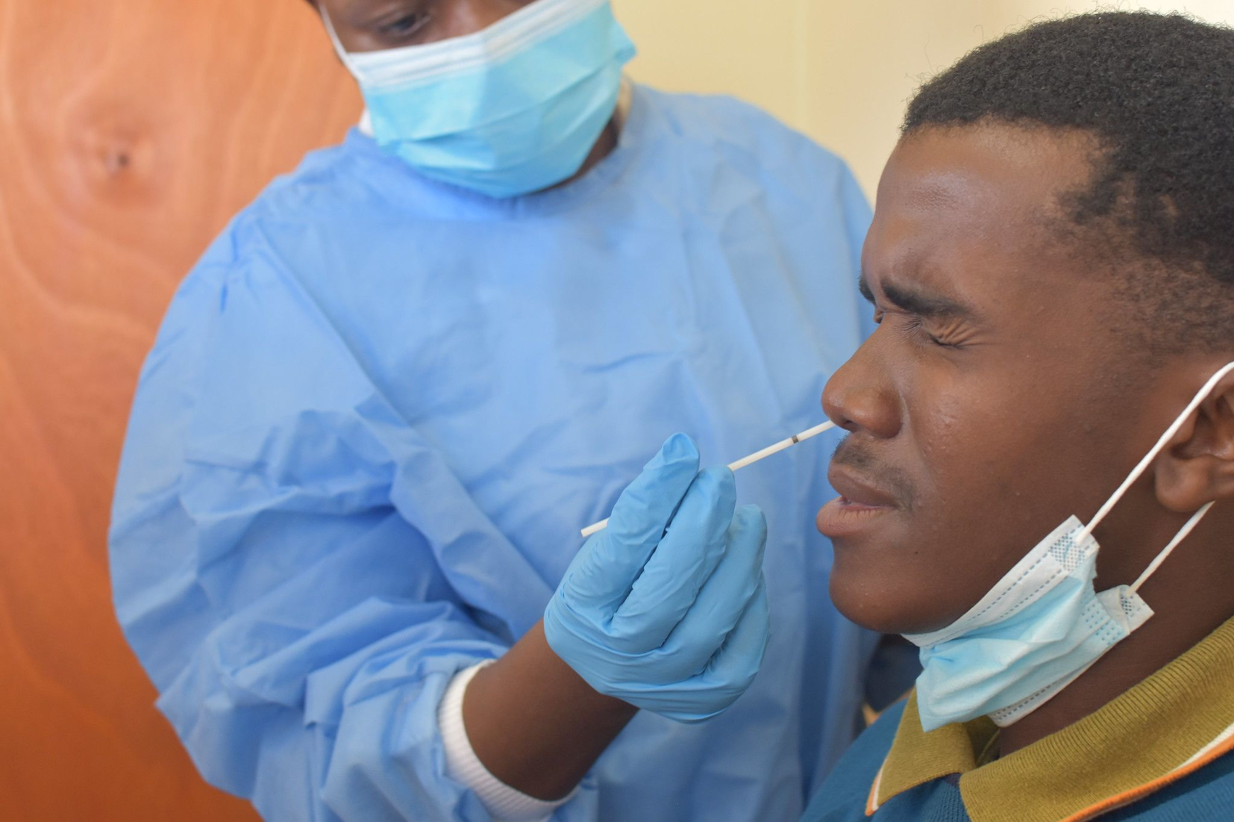
WHO Definitions of a Confirmed Case of SARS-CoV-2 Infection
WHO COVID-19 Case Definitions, July 2022
CONFIRMED CASE
.
A person with a positive NAAT for SARS-CoV-2 regardless of symptoms or epidemiological criteria
OR
A person who meets the criteria for being a suspect case (clinical and/or epidemiological criteria) and has a positive SARS-CoV-2 rapid antigen test
** Clinical and public health judgment should
be used in applying these definitions

Slide 33
Back to Case 1: 45 year-old nurse
A 45 year-old nurse who works on the COVID-19 isolation unit calls in sick and says she cannot report to work. She has a low-grade fever of 100.4°F (38.2°C), mild cough and sore throat.
She denies any shortness of breath. Her appetite is normal, and she doesn’t feel particularly sick. She is healthy with no PMHx of significance and is not taking any medication.
She lives at home with her husband who is 52 year-old and has hypertension and her 72 year-old mother-in-law. She has 4 children aged 10-18 years living at home.
Is this nurse a suspected COVID-19 case? A probable case? A definite case?
Notes:
This nurse fits the WHO case definition of a probable COVID-19 case. She meets clinical and epidemiological criteria (working with coworkers who now have COVID-19). Please note that healthcare workers who wear appropriate PPE do not have high rates of acquiring COVID-19 from patients. Many work exposures occur because of spread from one healthcare worker to another during breaks or eating.

Slide 34
Module 1 Outline
1) Learning Objectives
2) SARS-CoV-2 Epidemiology
3) Signs and Symptoms
4) Testing

Slide 35
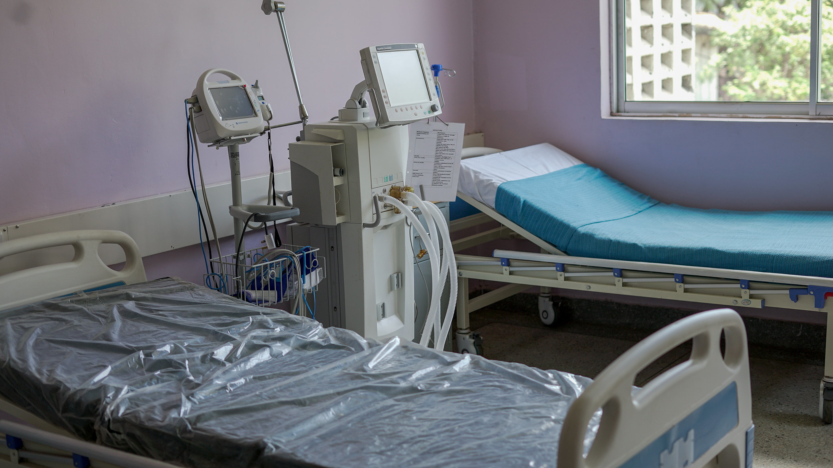
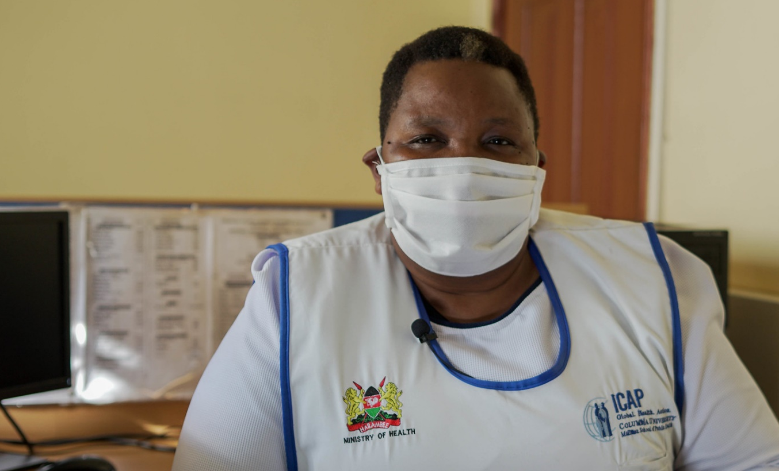
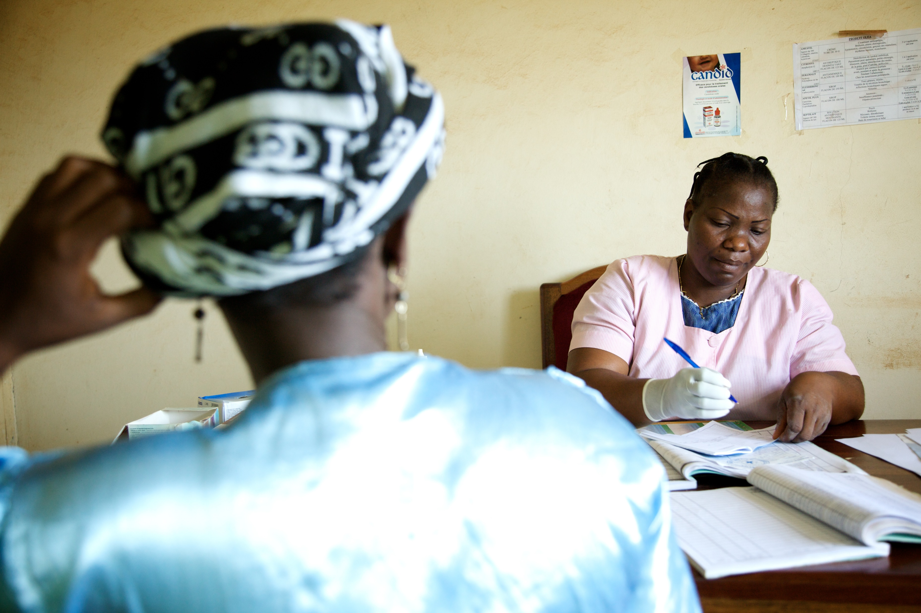
Testing may be considered for clinical evaluation of symptomatic patients, contract tracing, or disease surveillance
Note: It is important to adhere to national guidelines
Hospitalized Patients
Healthcare Workers
Patients with Underlying Conditions
Close Contact with Confirmed Case
Notes:
High Priority
Hospitalized patients
Healthcare facility workers, workers in congregate living settings, and first responders with symptoms
Residents in long-term care facilities or other congregate living settings, including prisons and shelters, with symptoms
Persons identified through public health cluster and selected contact investigations
Guidelines and priorities may change as the dynamics of the COVID-19 pandemic shift and change over time.

Slide 36
Surveillance* versus Diagnostic Testing
Surveillance
Monitor SARS-CoV-2 incidence and COVID-19 morbidity and mortality among different populations
Track changes in these over time
Detect and contain outbreaks
Implement control measures including isolation of cases, contact tracing and/or quarantine
Evaluate the impact of control measures
Contribute to scientific understanding about respiratory viruses
Diagnostic Testing
Confirm the diagnosis in order to provide clinical care for an individual patient
* WHO, Surveillance Guidance, Feb 2022
Notes:
It is very important to follow local testing guidelines and to note that local guidelines may be changed during periods of high community transmission. Diagnostic testing may not add value to the clinical care of a young healthy person who has mild symptoms.

Slide 37
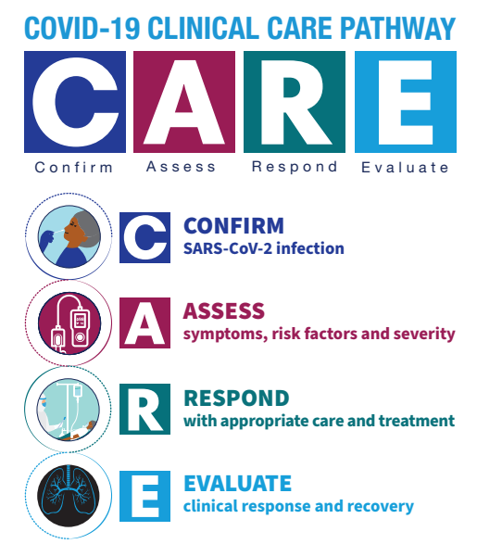
WHO Clinical Care Pathway updated April 2022
https://www.who.int/tools/covid-19-clinical-care-pathway
Notes:
Clinical management should proceed via the COVID-19 clinical care pathway. In April 2022, the WHO updated their clinical care pathway. This training will focus on the WHO clinical care pathway. However, clinicians should know how their local clinical care pathway differs and should follow the local pathway.

Slide 38
COVID-19 Clinical Care Pathway
[Insert local clinical care pathway here and be prepared to discuss this and answer participant questions]

Slide 39
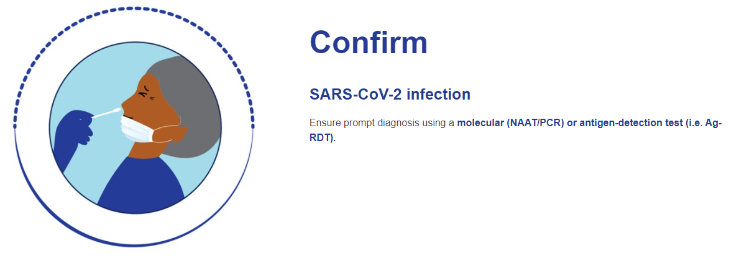
Notes:
Testing is the first step in the COVID-19 care pathway.

Slide 40
SARS-Cov-2 Testing Guidelines
[Insert local guidelines here as applicable]

Slide 41
Back to Case 1: 45 year-old nurse
A 45 year-old nurse who works on the COVID-19 isolation unit calls in sick and says she cannot report to work. She has a low-grade fever of 100.4°F (38.2°C), mild cough and sore throat.
She denies any shortness of breath. Her appetite is normal, and she doesn’t feel particularly sick. She is healthy with no PMHx of significance and is not taking any medication.
She lives at home with her husband who is 52 year-old and has hypertension and her 72 year-old mother-in-law. She has 4 children aged 10-18 years living at home.
Should this nurse be tested for
SARS-CoV-2? Would testing be
diagnostic testing or surveillance?
Notes:
Trainer should emphasize that a decision to test would depend on local guidelines. If testing is done to establish a diagnosis in the nurse, it would be diagnostic testing. However, testing might be also done for surveillance and public health purposes (monitoring the epidemic, making decisions for quarantine, implementing better infection control on the COVID-19 unit, etc). This nurse is a probable case of COVID-19, even prior to testing.

Slide 42
Case 1 45 year-old nurse: Additional Considerations
A 45 year-old nurse who works on the COVID-19 isolation unit calls in sick and says she cannot report to work. She has a low-grade fever of 100.4°F (38.2°C), mild cough and sore throat.
She denies any shortness of breath. Her appetite is normal and she doesn’t feel particularly sick. She is healthy with no significant PMHx and is not taking any medication.
She lives at home with her husband who is 52 years-old and has hypertension and her 72-year-old mother-in-law. She has 4 children aged 10-18 years living at home.
Should her family members be tested for SARS-CoV-2 infection?
Notes:
Lets go back to the case of the nurse and think about the signs and symptoms of COVID-19 and begin to consider who should receive SARS-CoV-2 testing. Follow local guidelines. Most LMIC have limited capacity to test asymptomatic people. However, the family members are contacts of a probable case (the nurse) and should quarantine per local guidelines.

Slide 43
Patient 2: a worker from the central market
A 35 year-old woman presents to the health center with 2 days of fever to 39°C, a mild sore throat, and a mild dry cough. She takes no medications and has no significant medical history.
She lives in the community with her 38 year-old husband and two young children. They are not sick. She works in the central town market selling fruits and vegetables in an area of very busy commerce. Of note, she lives in a town that has experienced some cases of community acquired COVID-19, but infection is not believed to be widespread.
What diagnoses are you considering?
How would you proceed with her evaluation?
Should she be tested for SARS-CoV-2 infection?
Notes:
Testing should be done in accordance with national guidelines. Note that community transmission of COVID-19 can increase quickly and may rapidly become widespread. Public facing workers are at high risk once community transmission is widespread. WHO classifies this case as a suspected case because she has a respiratory illness that includes fever and cough.

Slide 44
Patient 3: a 72 year-old with respiratory distress and hypoxemia
A 72 year-old man presents to the health facility with fever, dry cough, and shortness of breath that has been worsening over 6 days. He has no known medical problems and has not been to the health center or seen a healthcare provider during the last 15 years.
He lives at home in a multi-generational household with his daughter, son-in-law and their six children (ages 5 years to 22 years). He works as a passenger van driver.
PE: + moderate respiratory distress
Vitals : T 39.4°C; BP 100/60; P 120; RR 32; SpO2 by pulse oximeter 88%
Crackles throughout both lung fields and mild scattered wheezing
Heart sounds difficult to auscultate, tachycardic, rhythm is regular
Abdomen soft and nontender
Extremities cool and cyanotic
No rash
Should this patient be tested for SARS-CoV-2 infection?
Notes:
You might again note that people who have significant contact with the public (passenger van driver) are at increased risk of COVID-19 during an outbreak with community transmission. Follow local guidelines for testing. Per WHO classification, he is a suspected case of SARS-CoV-2 infection.

Slide 45
Additional Case Studies
A young woman who has had a fever and body aches that started a week ago. She also reports a loss of smell and taste but no other underlying conditions. She has a six-month-old daughter who lives with her at home who she reports developed a fever the night before.
A middle-aged man presents with a cough and a fever. He has HIV and has been on antiretrovirals for 5 years. He did not take his medications for the past two weeks because his provider has not been able to see him and give him refills because of ongoing community cases of COVID-19.
A 67 year-old man presents with a fever and a cough that started two days before. He says that he lives with his son who reports similar symptoms. He reports no underlying conditions, but when you take his vitals, he has elevated blood pressure. No known SARS-CoV-2 transmission has occurred in the area where he lives.
What are the signs and symptoms of COVID-19?
What are the risks for each patient?
Who do you prioritize for testing?
What guidance do you give each patient?
Notes:
Theoretically, fever and body aches are only two symptoms. In the absence of an epi link, she does not meet WHO suspect case criteria. However, loss of smell is distinctively associated with COVID-19. She should be questioned about fatigue, weakness or any other symptoms. Presence of a third symptom would make her a suspect case.
The middle-aged man with HIV is a suspected case of SARS-CoV-2 infection. If he has an epidemiological link to a case of COVID-19, he would become a probable case.
The 67 y/o man has typical symptoms (fever and cough) and is a suspected COVID-19 case. Because there is no known SARS-CoV-2 in his community, he might be prioritized for testing for surveillance purposes. Be alert to early cases. Clinical and public health judgment should be used. Local guidelines should be followed.

Slide 46
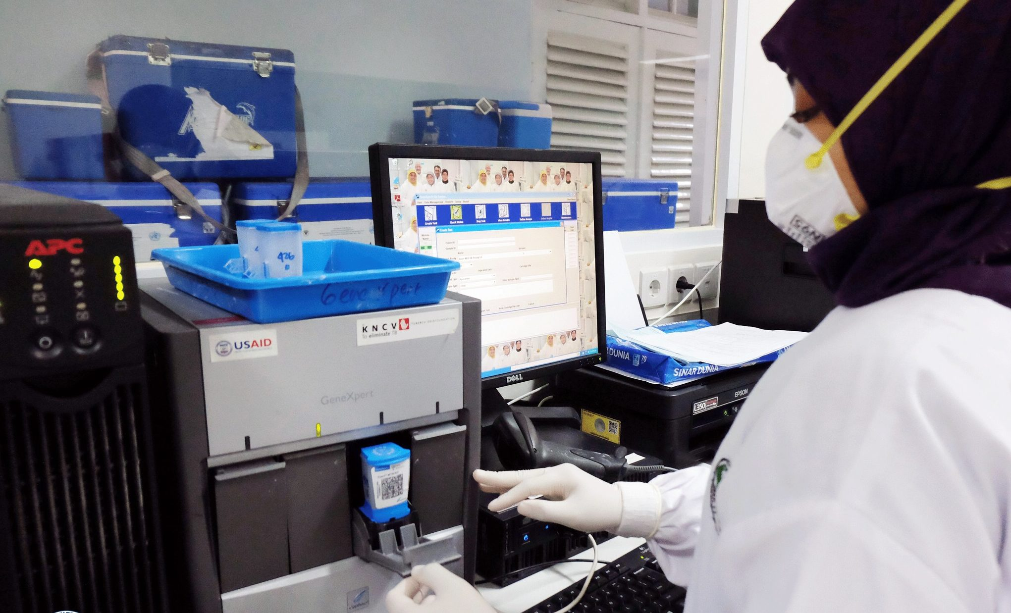
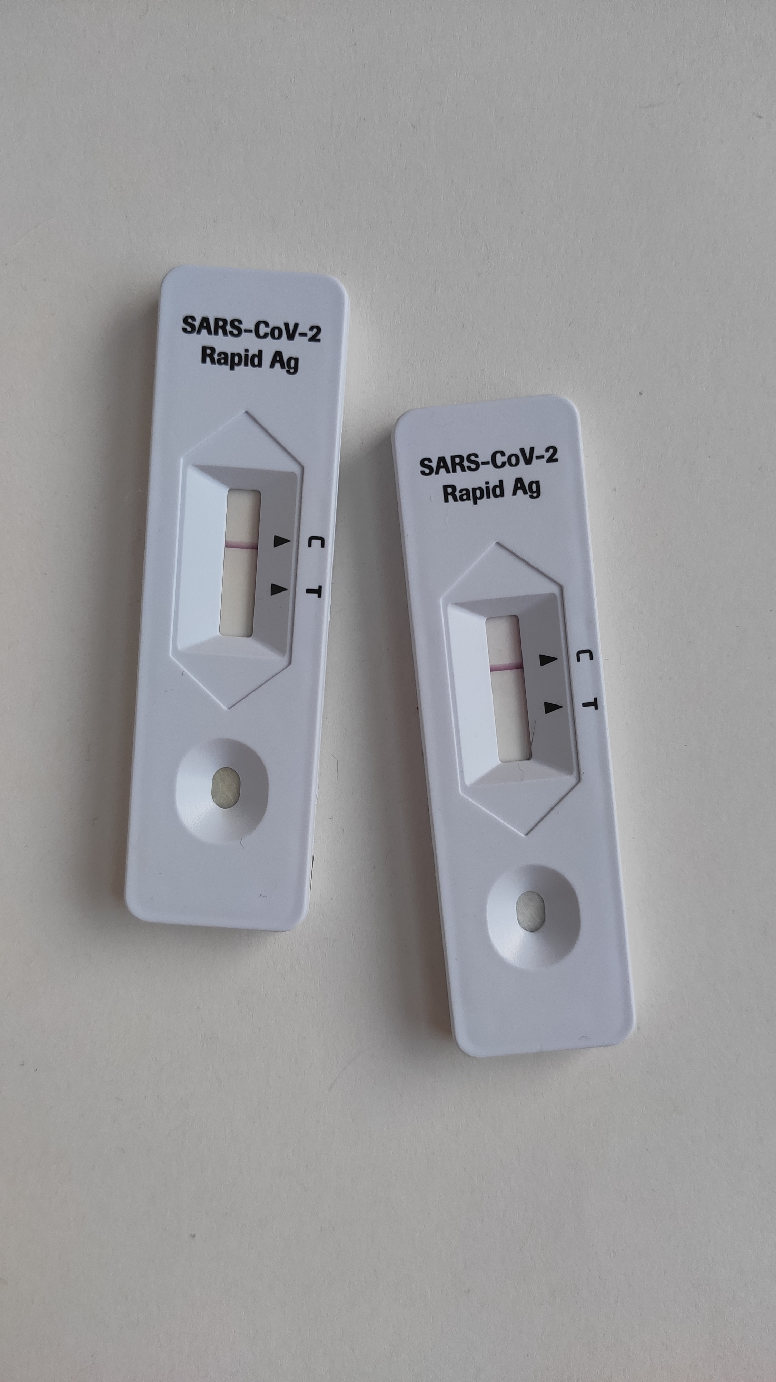
Confirming Infection
USAID
Detection of the SARS-CoV-2 virus
Molecular testing or viral antigen detection to identify virus in nasal secretions, throat, or saliva
Molecular testing is much more sensitive than detection of viral antigen (which is only 60-70% sensitive)
Used to determine if people are currently infected with SARS-CoV-2, the virus that causes COVID-19
Useful for diagnostic testing, disease surveillance, and assisting with isolation/quarantine decisions
Serologic (blood) tests for antibodies to the SARS-CoV-2 virus
Tests whether a person had SARS-CoV-2 infection or vaccination in the past
Antibodies are not present early in infection, so serologic testing is not advised for diagnostic testing
Most useful for epidemiologic investigation or research efforts
It is now understood that having antibodies to SARS-CoV-2 is not completely protective against re-infection
Not all vaccinated people test positive on the blood test, because many serologic tests look for response to parts of the virus that are not in the vaccine. These people may still be protected against infection.
Nomax on Unsplash

Slide 47
Molecular tests versus Antigen tests
Molecular tests for the SARS-CoV-2 virus
are quite accurate
require specialized laboratory equipment and resources
personnel training, transport, and turnaround time must be considered
Antigen tests to detect the SARS-CoV-2 virus
are simple and convenient, require very little training, may be done at the point of care
yield results in as little as 20 minutes
are much less sensitive than molecular tests (may fail to detect infection, giving a false negative result)

Slide 48
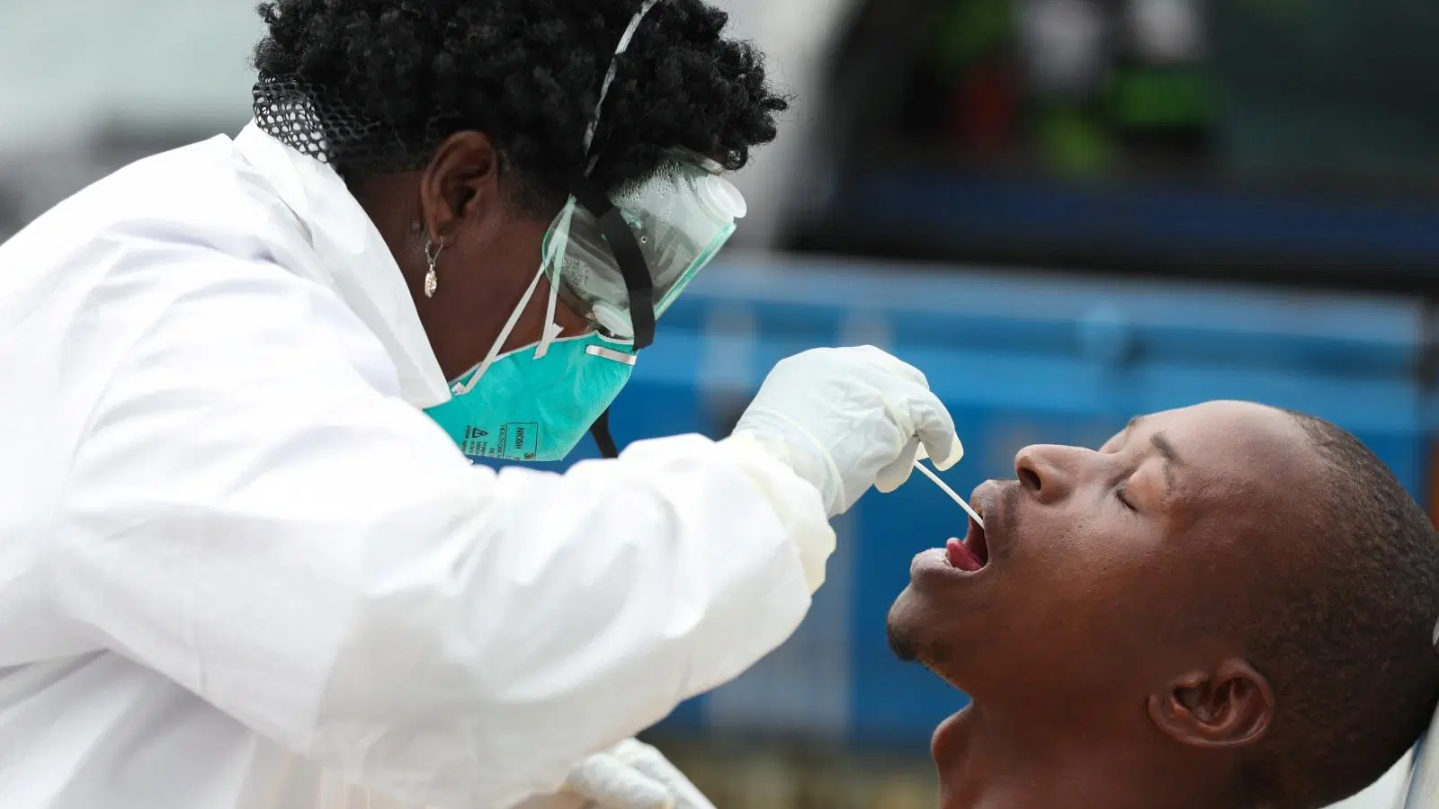
Steps to Complete Testing
Don appropriate PPE
Confirm specifics (including whether nasal or nasopharyngeal swab required ) and gather supplies for the test used at your facility
Complete the nasal or nasopharyngeal swab
Insert the swab into tube with viral transport media
Label sample and complete lab requisition forms
Package sample for transport
Disinfect testing area
Doff PPE including hand washing
Image source: https://cms.qz.com/wp-content/uploads/2020/04/RTS37QE2-e1585941469433.jpg?quality=75&strip=all&w=1600&h=900&crop=1

Slide 49
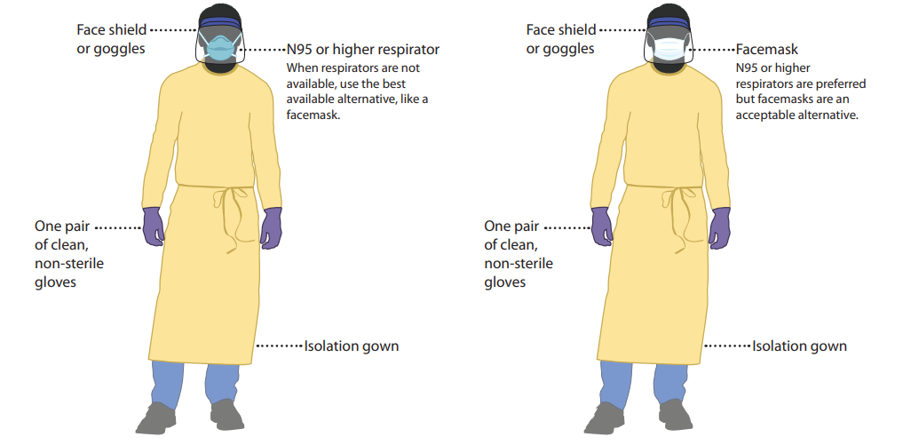
Step 1) Don appropriate PPE
Notes:
Note the different masks in the pictures (N95 vs surgical facemask)

Slide 50
Step 1) Don appropriate PPE
How to Safely Put on Personal Protective Equipment (PPE)
Video https://www.youtube.com/embed/of73FN086E8

Slide 51
Step 2) Confirm test specifics and gather supplies
Confirm whether nasal or nasopharyngeal swab is required for the test used at your facility
All COVID-19 test kits contain the same basic components.
1 Nasopharyngeal Swab (Copan flocked swab or other approved type, such as APTIMA)
1 tube of Viral Transport Media (e.g., UTM-RT red top)
Other supplies include ice, a spare bio bag and any forms for documentation.
Source: BILH COVID-19 PCR TESTING NASOPHARYNGEAL SWAB COLLECTION TECHNIQUE
Notes:
Replace photos with national approved testing supplies. Delete or modify according to the national testing procedure

Slide 52
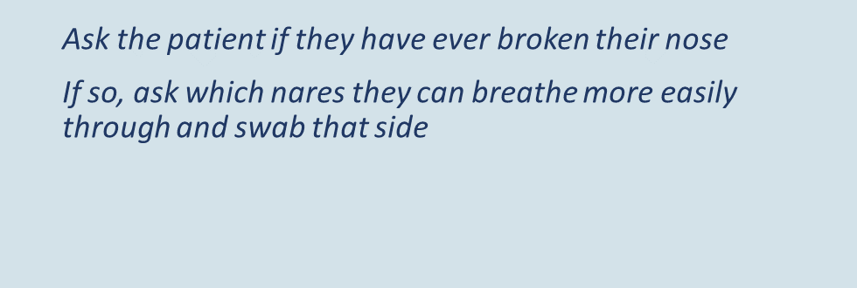
Step 3) Completing a Nasopharyngeal Swab
How to collect a nasopharyngeal specimen for SARS-CoV-2
https://www.youtube.com/watch?v=DVJNWefmHjE
Source: NEJM Procedure: COVID-19 PCR TESTING NASOPHARYNGEAL SWAB COLLECTION TECHNIQUE
Notes:
Note that some diagnostic tests can be conducted from anterior nasal swabs, throat swabs, or saliva. Follow the instructions of the test used in your locality

Slide 53
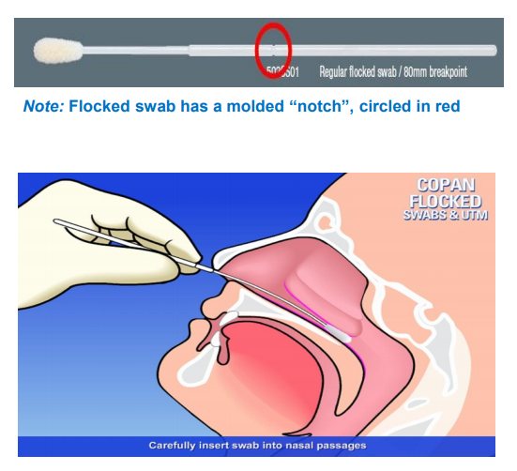
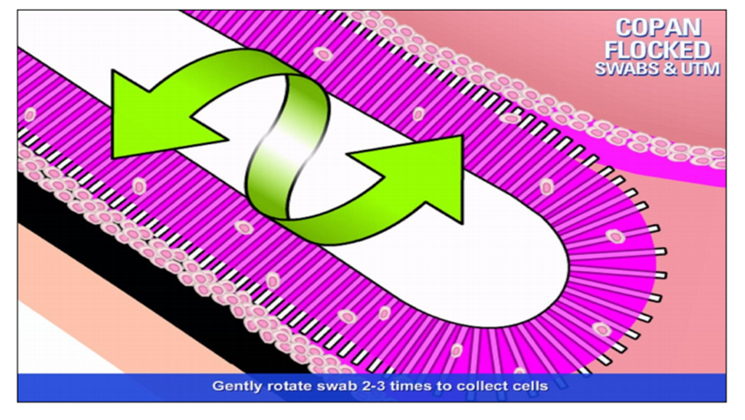
Step 3) Completing a Nasopharyngeal Swab
Gently insert the swab using a twisting motion
If notch is present, advance until it is at the tip of the patient’s nose (present on flocked swabs)
Gently rotate the swab 2-5 times once in place to collect cells
Swabs should be rotated in the nares for 10-15 seconds
If the tip is not saturated with fluid after the first nares, try the other nares
Source: BILH COVID-19 PCR TESTING NASOPHARYNGEAL SWAB COLLECTION TECHNIQUE

Slide 54
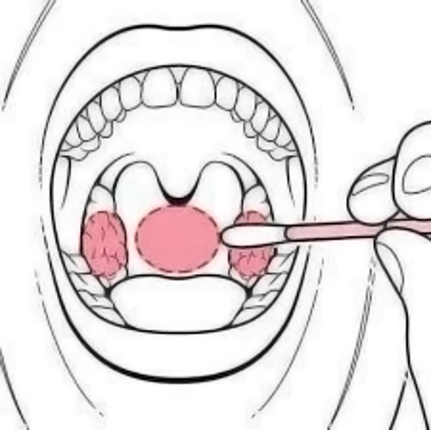
Step 3) Completing an Oropharyngeal Swab
Collect the throat specimen by rubbing the sterile swab tip on the surface of one or both tonsils, the tonsillar pillars, or the posterior pharyngeal wall. Other areas of the oropharynx and mouth are not acceptable sites and could lead to false negative results.
Gently move the swab without touching the teeth, gums or tongue.
Image Source: https://health.ri.gov/publications/instructions/COVID-19-Specimen-Collection-Kit.pdf

Slide 55
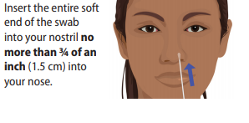
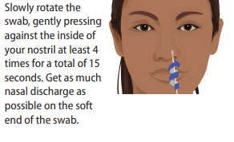
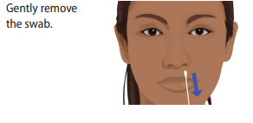
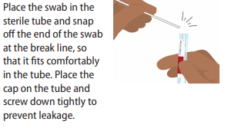
Step 3) Completing an Anterior Nasal Swab
Many people can perform their own anterior nasal swab with minimal assistance
1.
2.
3.
4.
Repeat in the second nostril, using the same swab
cdc.gov/coronavirus

Slide 56
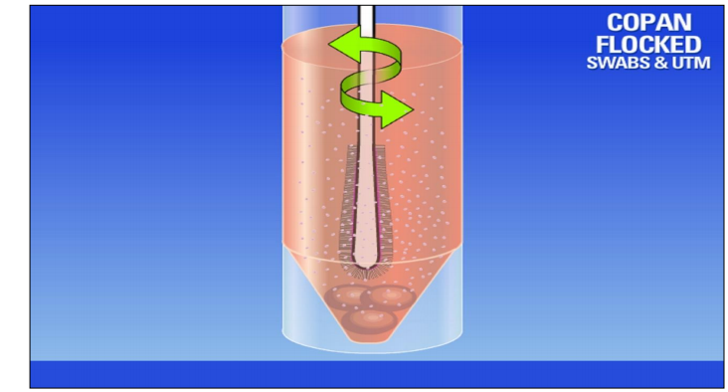
Step 4) Inserted the Swab into Tube with Viral Transport Media
Insert the swab into the tube of viral transport media
Gently swirl the swab
Source: BILH COVID-19 PCR TESTING NASOPHARYNGEAL SWAB COLLECTION TECHNIQUE

Slide 57
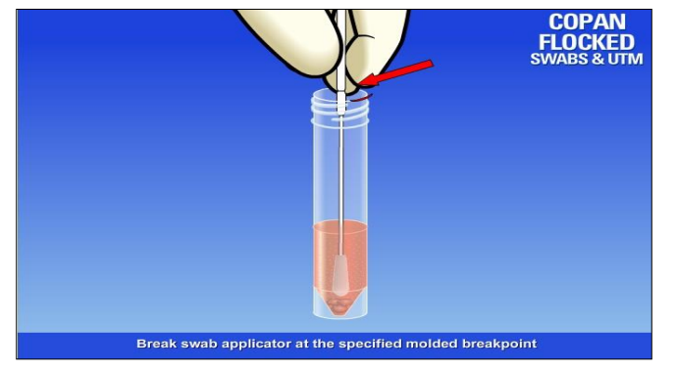
Step 4) Inserted the Swab into Tube with Viral Transport Media
Break off the swab to complete the collection process
Break the swab by gently pressing it against the side of the tube
If using a flocked swab, press the notch against the side of the tube to break
Source: BILH COVID-19 PCR TESTING NASOPHARYNGEAL SWAB COLLECTION TECHNIQUE

Slide 58
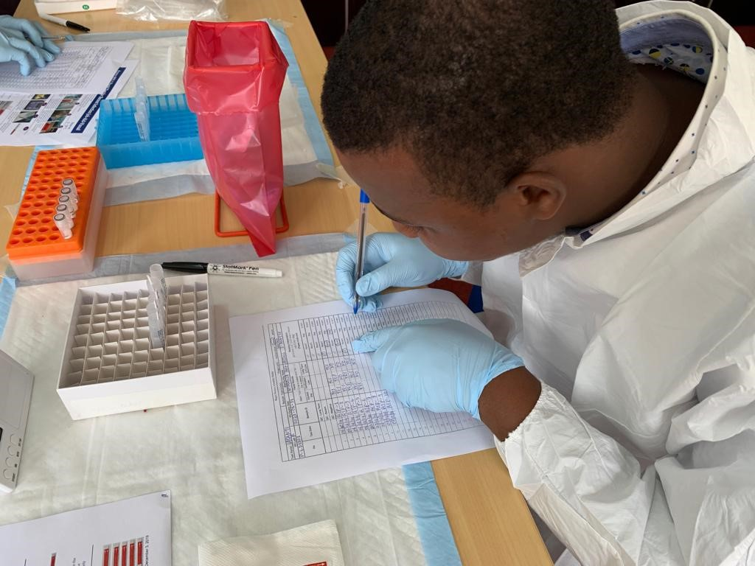
Step 5) Label Samples and Complete Data Collection Form
It is very important to properly label the samples that you collect. This process may vary by facility, but each sample should have the patient name or ID and the type of sample collected.
Follow your facility’s guidelines for labeling carefully.

Slide 59
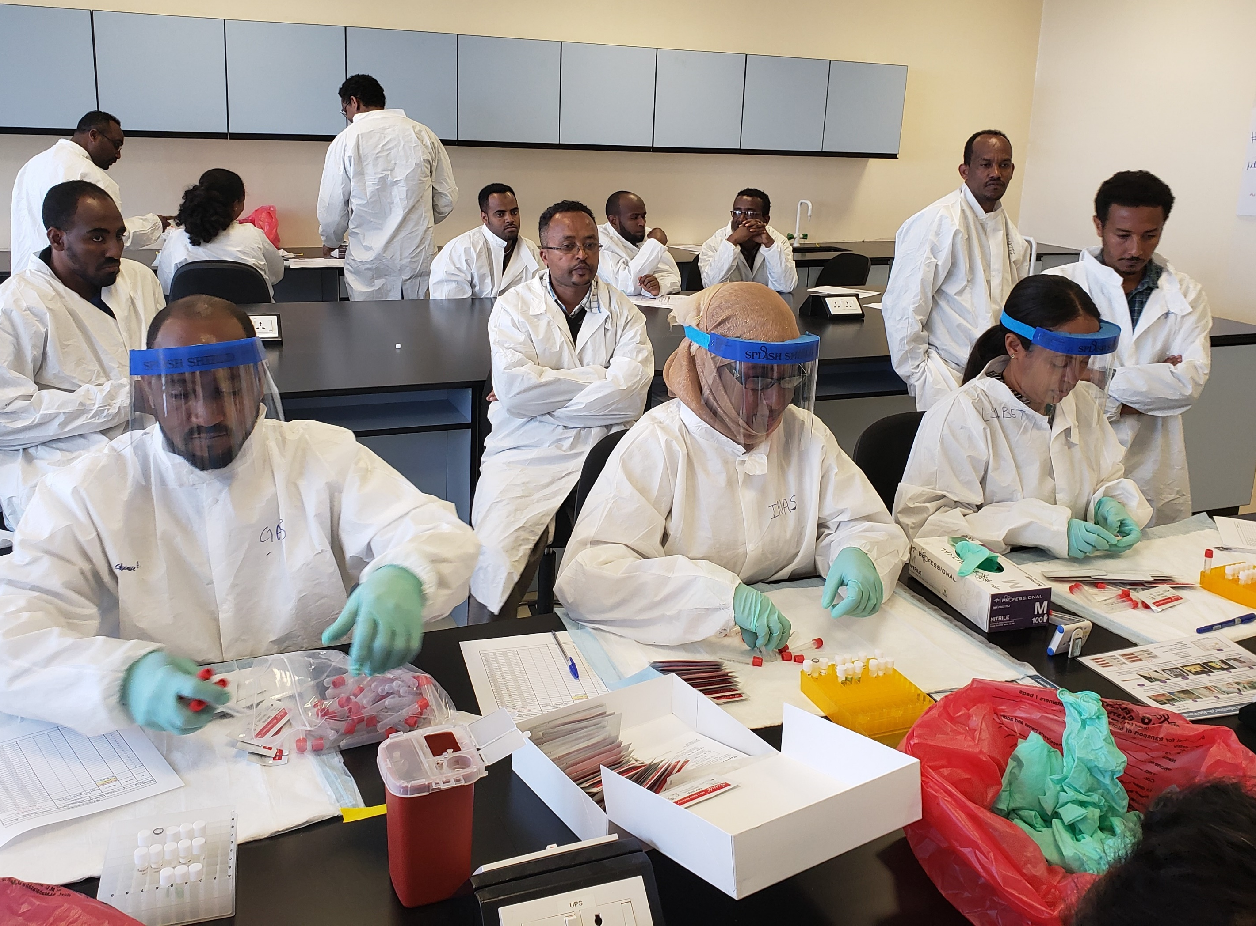
Step 5) Label Samples and Complete Data Collection Form
Data should also be collected for each patient and each sample. The forms may be different at each facility, but some sample data collected may be:
Patient name and contact information such as phone number or email
Clinical submitter, affiliation, and contact information such as phone number or email
Relevant clinical information (symptoms, date of symptom onset, travel history, history of exposure)
Follow your facility’s guidelines for labeling carefully.

Slide 60
Step 6) Package sample for Transport
[insert facility packaging instructions here]

Slide 61
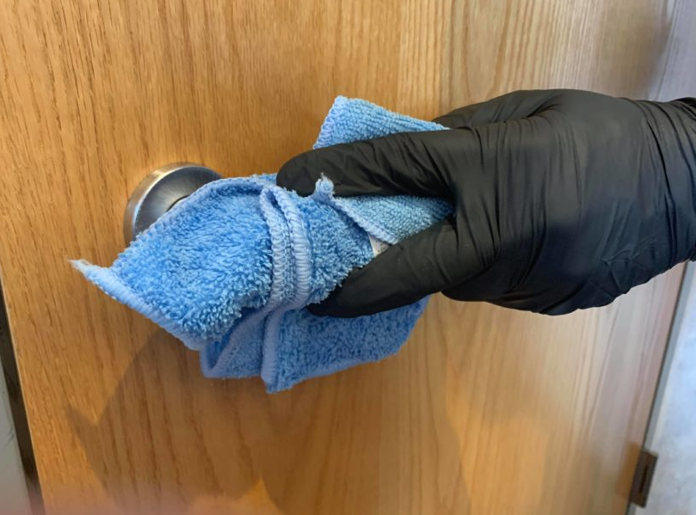
Step 7) Disinfect Testing Area
Wear disposable gloves to clean and disinfect.
Clean surfaces using soap and water, then use disinfectant. Cleaning with soap and water reduces the number of germs, dirt and impurities on the surface. Disinfecting kills microbes on surfaces.
Practice routine cleaning of frequently touched surfaces.
More frequent cleaning and disinfection may be required based on level of use.
https://www.cdc.gov/coronavirus/2019-ncov/community/disinfecting-building-facility.html
Notes:
https://www.cdc.gov/coronavirus/2019-ncov/community/disinfecting-building-facility.html

Slide 62
Step 8) Doff PPE including Hand Washing or Sanitizing
How to Safely Take off Personal Protective Equipment (PPE)
Video https://www.youtube.com/watch?v=PQxOc13DxvQ

Slide 63
Step 8) Doff PPE including Hand Washing or Sanitizing
Image Source: https://www.debgroup.com/sites/default/files/resize/uploads/hand_washing_technique-505x359.png

Slide 64
Nasopharyngeal Test Video
COVID-19 Diagnostics: Performing a Nasopharyngeal and Oropharyngeal Swab
Video https://www.youtube.com/watch?v=syXd7kgLSN8
Source: AMBOSS: Medical Knowledge Distilled

Slide 65
Role Play
Return to one of the patients you met earlier:
Create a script for how you would explain COVID-19 to him. It must include the following:
A 67 year-old man who presents with a fever and cough that started two days before. He says that he lives with his son who reports similar symptoms. He reports no underlying conditions, but when you take his vitals, he has elevated blood pressure.
You have decided to test him for SARS-CoV-2 because there have been scattered cases of community acquired infection in communities near where he lives. He is confused because he has never heard of COVID-19.
The signs and symptoms of the disease
Why you think that he should be tested
Why you are wearing PPE
An explanation of how the testing is done
Notes:
Can be done in a group if done in person.

Slide 66
Post-test Questions
The most common signs and symptoms of COVID-19 are:
Vomiting, confusion, skin rash
Fever, fatigue, sore throat, shortness of breath, cough
Diarrhea
Fever, rash
(True/False) COVID-19 patients may be contagious before they develop symptoms.
True / False
(True/False) Masks and gloves are sufficient personal protective equipment (PPE) when testing patients symptomatic for COVID-19.
True / False
(True/False) When COVID-19 enters a community, the number of cases often increases rapidly.
True / False
SARS-CoV-2, the virus that causes COVID-19, is transmitted by :
Droplets that tend to spread less than 6 feet (2 meters).
Objects (fomites) that became contaminated when patients sneeze or cough near them.
Aerosols that spread over distances greater than 6 feet.
All of the above, but most transmission is by short distance droplets (a).
Notes:
Answers:
B
True
False
True
d

Slide 67
Reflection Questions
Reflect on the learning from today. Consider the following questions:
What did you learn about the signs and symptoms of COVID-19?
What did you learn that will affect how you engage with patients?
What do you think will be difficult about testing patients in your facility? How will you overcome this challenge?
Health care workers testing people in Nairobi, Kenya during a mass testing exercise for COVID-19.
Photo by SIMON MAINA/AFP via Getty Images
Notes:
Can be done in a group if done in person.

Slide 68
Q&A / Discussion
Notes:
Are there any other questions?

Slide 69
Videos In Portuguese, French, and Russian follow

Slide 70
Nasopharyngeal Test Video | Portuguese
Orofaringe e nasofaringe swabs
Video https://www.youtube.com/watch?time_continue=8&v=lgpb-vZ54Zw&feature=emb_logo

Slide 71
Nasopharyngeal Test Video | Portuguese
Coleta - Aprenda na prática como colher swabs de nasofaringe e orofaringe da maneira correta
Video https://www.youtube.com/watch?v=aB6ac6gRT9Y&feature=emb_logo

Slide 72
Nasopharyngeal Test Video | Portuguese
COVID-19: Colocação e remoção de EPIs
Video https://www.youtube.com/watch?v=zQi1zpZEYVM&feature=emb_logo

Slide 73
Nasopharyngeal Test Video | French
Procédure de prélèvement oropharyngé et nasopharyngé et transport du spécimen au laboratoire
Video https://www.youtube.com/watch?v=2eHsKvobqhs&feature=emb_logo

Slide 74
Nasopharyngeal Swab (Russian)
https://m.youtube.com/watch?v=MSZBV84Tfys
Image courtesy NEJM

