Slide 1
Adolescent HIV Care and Treatment
Module 9:
Positive Living for Adolescents

Slide 2
Module 9 Learning Objectives
After completing this module, participants will be able to:
Define positive living and describe the key components of positive living for ALHIV
Support ALHIV to achieve and maintain a healthy mind – having a positive outlook toward living and life
Provide ongoing support and counseling to adolescent clients on maintaining a healthy body
Provide basic nutritional recommendations to ALHIV and their family members
Help adolescent clients prevent or recover from alcohol and other substance use problems

Slide 3
Session 9.1
Supporting ALHIV to Live Positively and Maintain a Healthy Mind

Slide 4
Session 9.1 Objectives
After completing this session, participants will be able to:
Define positive living and describe the key components of positive living for ALHIV
Support ALHIV to achieve and maintain a healthy mind – having a positive outlook toward living and life

Slide 5
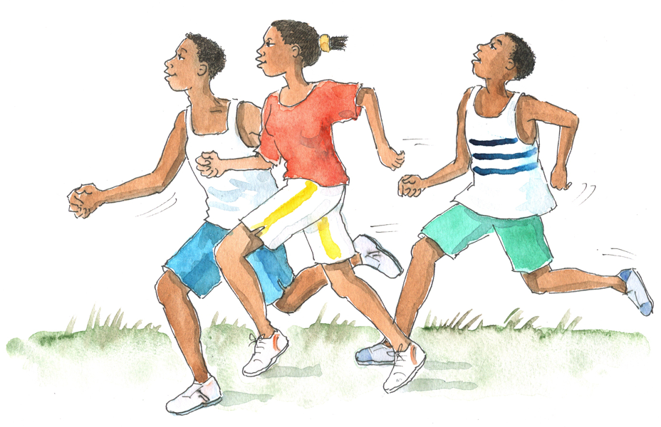
Brainstorming
What is meant by the phrase “positive living?”
How can health workers share information about positive living with adolescent clients?

Slide 6
Positive Living Includes:
Keeping one’s mind healthy (having a positive outlook toward living and life)
Keeping one’s body healthy
Keeping one’s soul and spirit healthy
Living responsibly with HIV and preventing new HIV infections
ALHIV can live full and healthy lives if they take care of themselves, access care and treatment, and feel supported by health workers and caregivers to make healthy choices.
Health workers play a key role in helping ALHIV live positively and follow the “recipe for positive living.”

Slide 7
Recipe for Positive Living
KNOWLEDGE + DETERMINATION TO LIVE
with actions for a
HEALTHY MIND + HEALTHY BODY + HEALTHY SOUL
= A LONG, HEALTHY LIFE
Source: Orr, N.M. (2004). Positive health. Cape Town: Double Storey Books.

Slide 8
Remember:
ALHIV’s questions about and understanding of living with HIV changes over time.
Health workers should communicate information on positive living often and through multiple channels, such as:
Individual counseling sessions
Individual health education sessions
Group health education sessions
Support group meetings
Youth-friendly written materials
TV shows or videos about living positively
Web sites and youth-friendly Internet resources (see Appendix 9A)

Slide 9
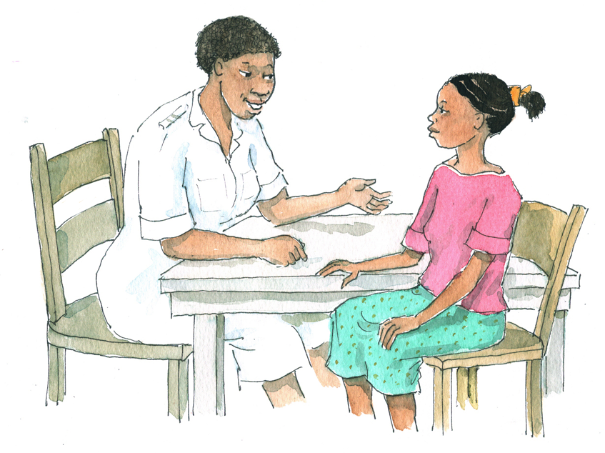
Discussion Question
Think about other modules taught in this course.
What are some of the ways health workers can support adolescents to have and maintain a healthy mind (meaning that they have a positive outlook toward living and life)?

Slide 10
Supporting Adolescents to Have Healthy Minds and a Positive Outlook
Health workers should always try to build trusting, positive, and respectful relationships with their adolescent clients.
Ensure that ALHIV have access to adolescent-specific support groups and peer support (see Module 5).
Ensure that psychosocial support and mental health referrals are part of comprehensive HIV care and treatment (see Module 5 and 6).
Ensure that adequate attention is paid to ongoing disclosure support for ALHIV and their caregivers (see Module 7).
Ensure that ALHIV and their caregivers receive ongoing adherence support (see Module 8).

Slide 11
Supporting Adolescents to Have Healthy Minds (continued)
Encourage ALHIV to go to and stay in school.
Talk with ALHIV about their spiritual, religious, and cultural beliefs and practices.
Encourage ALHIV to develop life skills to help them live positively with HIV.

Slide 12
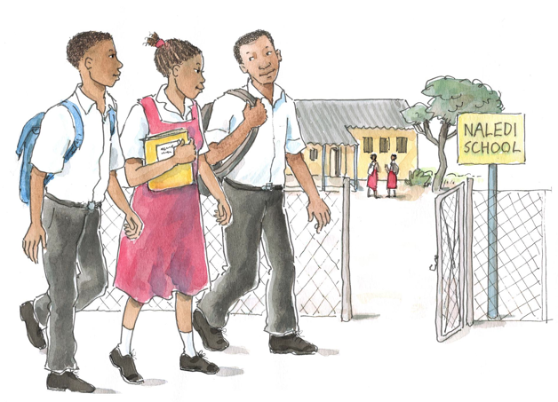
Discussion Questions
What do you think we mean by the term “life skills?”
What are some of the most important life skills for ALHIV to have?
What role can health workers play in linking adolescent clients with life skill training and support?

Slide 13
Supporting Adolescents to Develop Life Skills
Life skills education helps adolescents:
Be confident, knowledgeable, and able to take responsibility for their own lives
Develop into stronger, more aware, and more caring human beings
Better cope with the demands and pressures of everyday life and living with HIV
Assess risks and make decisions that will lead to positive outcomes and a better, healthier life
Health workers are not responsible for teaching ALHIV all life skills, but they should keep them in mind when working with ALHIV and should link ALHIV to life skills trainings when possible.

Slide 14
Examples of Adolescent Life Skills
See Table 9.1 and Appendix 9B: Life Skills Training Resources.
Communication and Interpersonal Skills | Decision-making and Critical Thinking Skills | Coping and Self-Management Skills
Interpersonal communication skills Negotiation/ refusal skills Empathy Cooperation and teamwork Advocacy skills | Decision-making and problem-solving skills Critical thinking skills | Skills for increasing internal locus of control Skills for managing feelings Skills for managing stress

Slide 15
Questions or comments on this session?

Slide 16
Session 9.2
Supporting ALHIV to Live Positively and Maintain a Healthy Body

Slide 17
Session 9.2 Objectives
After completing this session, participants will be able to:
Provide ongoing support and counseling to adolescent clients on maintaining a healthy body
Provide basic nutritional recommendations to ALHIV and their family members
Help adolescent clients prevent or recover from alcohol and other substance use problems

Slide 18
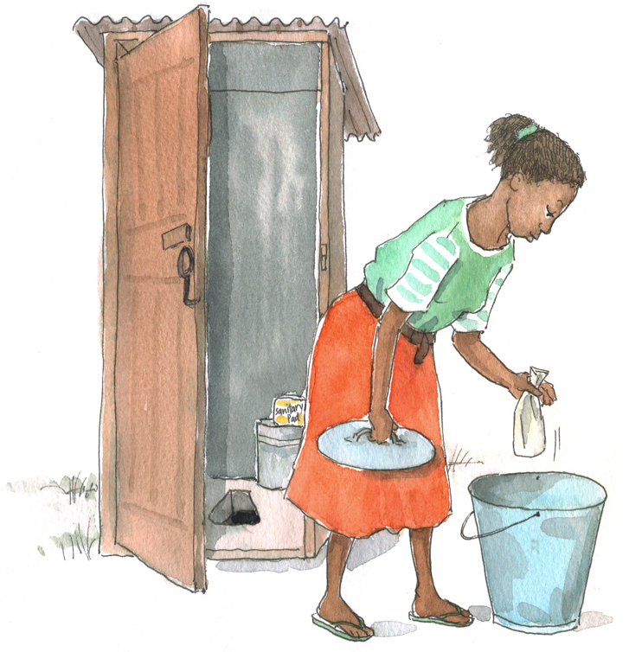
Brainstorming in Teams
What are some of the ways that health workers can support adolescents to have and maintain a healthy body?

Slide 19
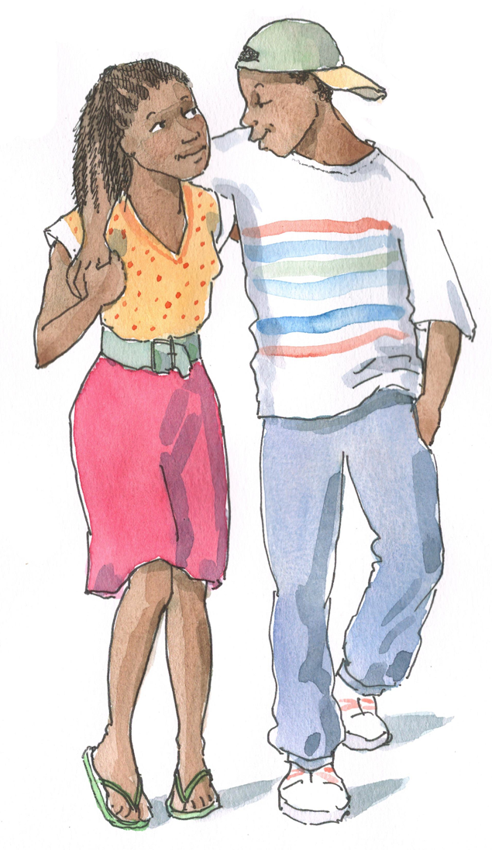
“Living Positively” with HIV includes:
Health care
Sexual health
Staying active and socially engaged
Rest
Personal Hygiene
Oral health
(See Table 9.2 for a more complete list.)

Slide 20
Unhealthy Behaviors to Avoid:
Drinking alcohol, smoking, and using drugs
Having unsafe sex
Sharing medicines, stopping medicines, or missing doses
Taking traditional medicines that have not been discussed with a doctor or nurse
Missing appointments
Not eating enough healthy foods or eating too many junk foods
Avoiding social contact, staying alone too much, and being inactive
Remember: Education and counseling on positive living may not result in immediate behavior change among adolescent clients. Changing behavior takes time, self-confidence, and a supportive environment!

Slide 21
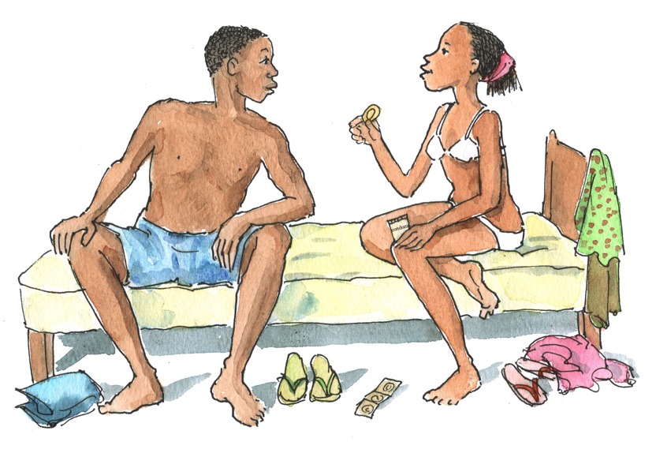
Discussion Questions
What do you think we mean by “positive prevention?”
What are some examples of “positive prevention?”

Slide 22
Helping Clients Practice Positive Prevention
Positive prevention includes:
Partner disclosure and testing
Sexual risk reduction and sexual health (see Module 10)
Prevention and treatment of STIs (see Module 10)
Prevention of mother-to-child transmission (PMTCT, see Module 11)
Prevention of blood-borne HIV transmission (including through injecting drug use or sharing sharp instruments)
Positive prevention is a key component of positive living. Health workers should help ALHIV understand how to prevent the further spread of HIV to sexual partners and children!

Slide 23
Discussion Questions
What are the common nutritional challenges you see in adolescent clients (and their families)?
Other than lack of food/money to buy food, what are some of the common challenges adolescents have with good nutrition (for example, eating a lot of “junk food”)?
What does it mean to eat a “balanced diet?”

Slide 24
Common Nutritional Issues for Adolescents
Many adolescents face food insecurity.
Many adolescents develop bad eating habits, such as eating a lot of “junk food,” skipping meals, and having erratic eating patterns.
Some ARVs may cause adolescents to lose their appetite and some may cause changes in physique, such as lipodystrophy.
Health workers should provide regular weight and nutrition monitoring as part of ALHIV’s routine care.

Slide 25
Junk Food
Health workers should help ALHIV understand why it is important to avoid “junk foods” like soft drinks, sweets, and potato chips/crisps:
They cost a lot of money
They have little nutritional value
It is always best to eat fresh, natural foods, which are also usually cheaper than packaged and pre-prepared food.

Slide 26
Eating a “Balanced Diet”
This means eating a variety of foods from each of the 3 food groups (see Appendix 9C: Basic Food Groups) and eating enough food every day.
It is always best to eat foods grown at home or produced locally instead of eating foods that have been imported or processed, which do not have as many nutrients.
Refer to your national nutrition guidelines for more information.

Slide 27
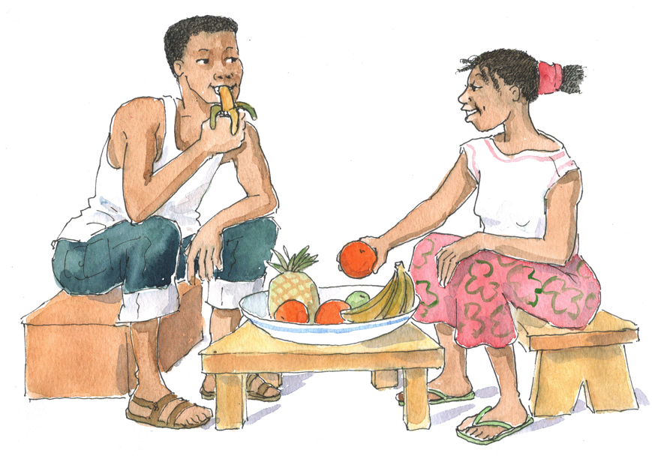
Discussion Questions
What do you think health workers can do to help ALHIV and their caregivers/families eat well?
What nutrition-related recommendations can health workers give ALHIV and their caregivers?

Slide 28
General Nutrition Recommendations for ALHIV
Eat a well-balanced diet.
Make “energy giving”/”GO” foods/starches the biggest part of every meal.
Eat “body building”/”GROW” foods with every meal.
Eat “protective”/”GLOW” foods every day.
Use fats and oils in moderation.
Avoid junk food.
Increase caloric intake, especially with “GO” and “GROW” foods (applies mostly to symptomatic ALHIV).

Slide 29
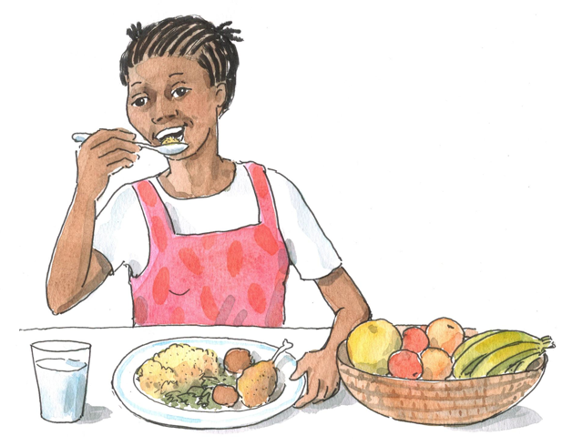
General Nutrition Recommendations for ALHIV (Continued)
Try to eat small meals frequently and have a regular meal schedule.
Have your weight routinely monitored and recorded.
Receive nutritional education and counseling as a part of all HIV care appointments.
Take a daily multivitamin supplement to prevent micronutrient deficiencies.

Slide 30
Conducting a Nutritional Assessment
Goal is to determine if nutritional problems exist and, if so, the severity and probable causes
Follow national guidelines and be sure to:
Weigh ALHIV at each visit, record weight, plot it on a growth curve (for adolescents who are not yet fully grown), and look for changes
Conduct regular anthropometric, clinical, and dietary assessments
Discuss ability of the client and his or her family to buy or grow enough healthy foods to eat
Adapt counseling, education, and advice to the client’s situation
See Appendix 9D: Key Components of a Nutritional Assessment.

Slide 31
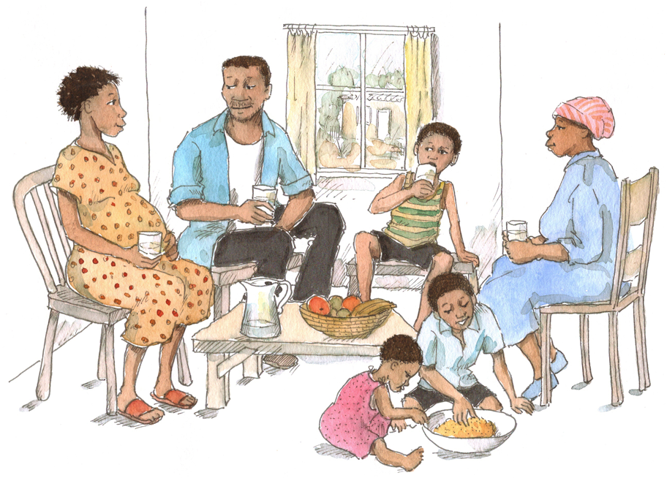
Remember:
Weight monitoring
It is important to weigh EVERY client at EVERY visit. Their weights should be plotted on growth curves (or at least recorded in a table) for easy comparison with previous weights. Even adolescents who have stopped growing and adults need to be weighed at every visit!

Slide 32
Discussion Questions
What nutrition and eating problems do you see in your adolescent clients (such as loss of appetite, taste changes, etc.)?
How do you manage these problems?
See Appendix 9E: Nutritional Management of Common Symptoms Related to Advanced HIV Infection.
Remember: Nutritional management and ART together will help clients with most nutrition and eating problems.

Slide 33
Common Nutritional and Eating Problems and Advice for ALHIV and Caregivers
Management of many HIV-related signs and symptoms — such as diarrhea, nausea, vomiting, mouth and throat sores, and loss of appetite — can be supported with food-based interventions (in combination with ART).
Support clients with nutritional problems and work with them/their caregivers to address these problems with home-based nutrition interventions.
Prompt symptom treatment can support clients to adhere to their care and treatment plan, which in turn can prevent or reduce many symptoms.
See Appendix 9E: Nutritional Management of Common Symptoms Related to Advanced HIV Infection.

Slide 34
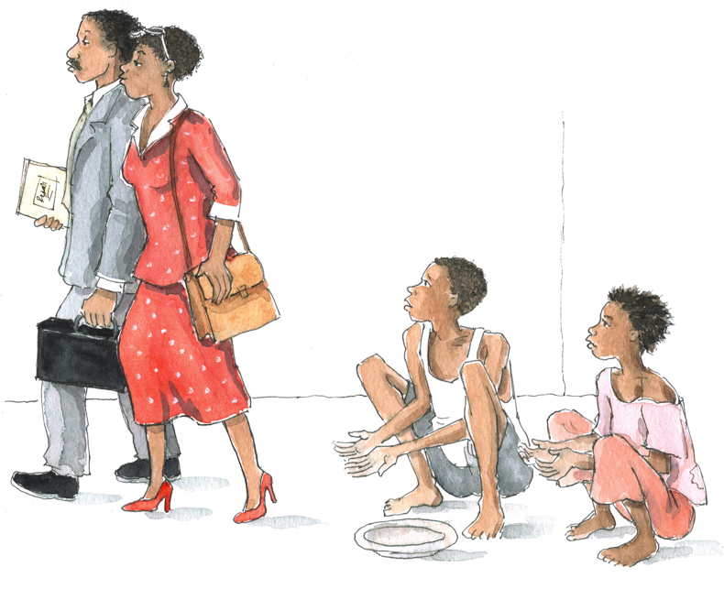
Discussion Questions
What do you do if adolescents and their families do not have enough food to eat?
What are some specific strategies that could work in your setting?

Slide 35
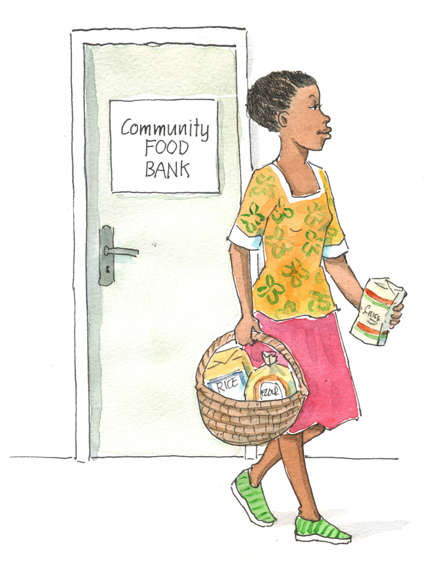
What to Do When Clients and Families Do Not Have Enough Food
Provide practical counseling and education on good nutrition, gardening, purchasing locally available foods, and how to store and prepare food.
Make sure clients take multivitamins.
Work with the care team to link the clinic to agricultural and food support organizations.
Link clients to community-based agricultural, nutrition, animal husbandry, and other programs.

Slide 36
Discussion Questions
What are some of the common challenges adolescents have related to alcohol and other substance use?
What are some causes and consequences of alcohol and other substance use among adolescents?
What do you think health workers can do to help ALHIV prevent alcohol and other substance abuse?
What do you think health workers can do to help ALHIV recover from alcohol and other substance use problems?

Slide 37
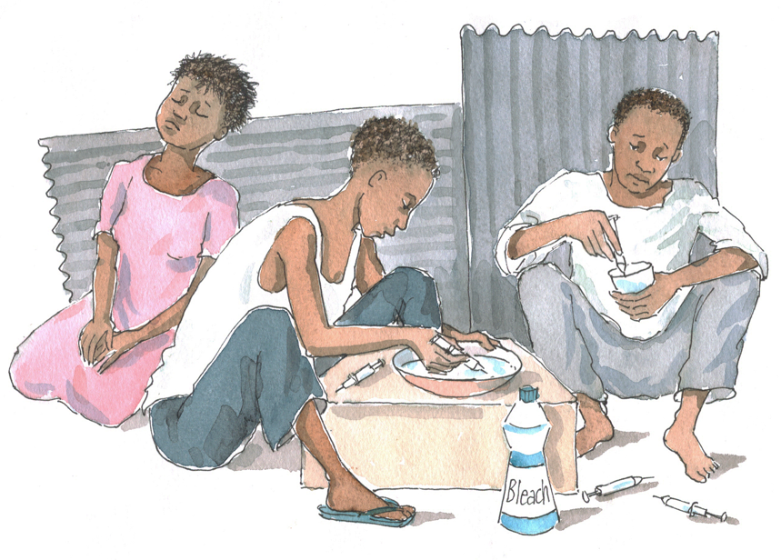
Substance Use Versus Abuse
Not everyone who uses drugs becomes addicted, but alcohol and other substance use can cause problems for ALHIV, whether addicted or not.
Health workers can help adolescents avoid alcohol and other substance use in the first place.
Health workers should watch for signs of alcohol and other substance use and screen when indicated (see Module 6 for more information and for screening tools).
Health workers can help clients using or abusing drugs and alcohol by providing counseling, support, and referrals.

Slide 38
Drugs and Alcohol: A Part of Life for Many Adolescents
Adolescents often face challenges and temptations related to drugs and alcohol.
People sometimes drink or use drugs to take away their worries; however, this will make them feel worse in the long term.
Drug and alcohol use may lead to addiction, which is when a person’s body starts to need the substance.
People who are addicted to drugs and alcohol often do not eat well.
Helping adolescents learn about risks before they begin use (through individual counseling, group education sessions, etc.) can help prevent addiction and harmful effects.
Screening ALHIV for alcohol and drug abuse and providing counseling, referrals, and treatment if needed are key components of adolescent HIV care and treatment and of supporting ALHIV to live positively.

Slide 39
Predictors of Abuse
Family factors | Observing parents or family members using or abusing drugs or alcohol; genetic risk factors; parental absence; inconsistent discipline; lack of communication within family; conflict between parents and adolescents; death of parents due to HIV, family breakup
Peer factors | Spending time with peers who use alcohol and drugs is perhaps the strongest predictor of adolescent substance use and abuse.
Mental health problems | There is a strong link between mental health problems and substance abuse.
Response to stress | Feeling out of control, feeling hopeless, having a lack of direction in life

Slide 40
Consequences of Adolescent Alcohol and Other Substance Use
Poor adherence to HIV care and treatment
School-related problems
Risky sexual practices
Delinquent behavior and juvenile crime
Developmental problems
Physical and mental consequences
Short-term: memory loss
Long-term: cancers, heart and respiratory failure, stomach ailments, central nervous system damage, and sexual impotence
May interact with depression and contribute to suicide; may accelerate HIV disease progression; increases risk of violence and accidental death

Slide 41
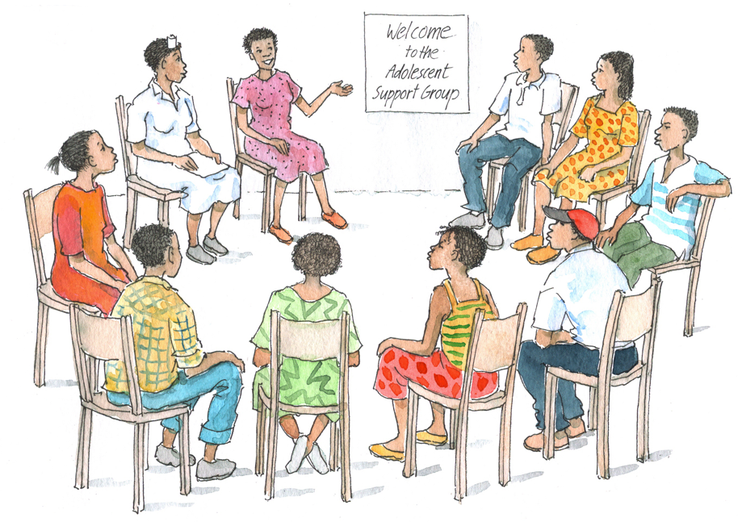
Prevention of Alcohol and Substance Use
Strategies should be linked to the overall goal of prevention or less harm/safer use
Possible strategies include:
Ensuring peer support networks and linkages to support groups
Counseling on consequences of alcohol and drug use
Counseling on risk reduction
Ensuring provision of psychosocial support
Ensuring clients with mental health problems are referred for support and treatment

Slide 42
Identifying and Treating Alcohol and Substance Use Disorders
The use of alcohol and other substances can become severe enough to constitute the diagnosis of a mental disorder.
See Module 6 for more information, including Appendix 6C: Screening for Alcohol Dependency and Appendix 6D: Screening for Drug Abuse.

Slide 43
Exercise 1
Supporting ALHIV to Live Positively: Case studies and large group discussion

Slide 44
Exercise 1: Case Study 1
During a routine visit, A___, a 16-year-old young woman, tells you that she has been feeling sad a lot lately and hardly ever feels hungry anymore. You also notice that she does not appear to have bathed in several days. She tells you that she has been living with HIV her whole life and isn’t sure what is causing her to feel so down.
→ How would you proceed with A___?
→ How will you assess the major issues?
→ What things would you discuss with the client and/or caregiver?
→ How would you counsel the client? What are some of the key “positive living” points that you should make?

Slide 45
Exercise 1: Case Study 2
E___ is a 16-year-old who recently found out that she has HIV. She comes to the clinic every month but is always quiet. One of the Adolescent Peer Educators mentioned that he saw her hanging out with some older men outside of a store. She was smoking a cigarette and sharing some beer.
→ How do you plan to talk to E___ about positive living when she comes for her next clinic visit?
→ How will you assess the major issues?
→ What things would you discuss with the client and/or caregiver?
→ How would you counsel the client? What are some of the key “positive living” points that you should make?

Slide 46
Exercise 1: Debriefing
What did we learn?
Key points:
Supporting ALHIV to live positively can be challenging — be prepared to deal with difficult situations that may not have any easy answers.
Remember to use non-judgmental and youth-friendly counseling and communication skills.
Remember that behavior change takes time, self-confidence, and an enabling environment.
Be aware of the resources available to clients in the clinic and community; link clients with several resources to help them get the support they need.

Slide 47
Exercise 2
Planning a Presentation on Living Positively: Small group work and large group discussion

Slide 48
Exercise 2: Small Group Work Topics
Group 1: Keeping the mind healthy
Group 2: Keeping the body healthy
Group 3: Nutrition and hygiene
Group 4: Alcohol and drugs
Plan a 30-minute health education session for adolescent clients and their caregivers on your assigned topic.
Make an outline of the topics and sub-topics you would cover.
Choose 1 part of your outline and role play a 5-minute segment of the session to present to the large group.

Slide 49
Exercise 2: Debriefing
What did we learn?
Key points:
Group sessions are a great way to educate many people at the same time; they also help clients share ideas and establish connections.
Make sure to dedicate time to planning and regularly facilitating group sessions to help ALHIV live positively.
Education and counseling may not result in immediate behavior change among adolescent clients. Remember that behavior change takes time, self-confidence, and an enabling environment.

Slide 50
Questions or comments on this session?

Slide 51
Module 9: Key Points
The concept of “positive living” encompasses not only maintaining one’s physical health but also taking care of one’s mind and soul.
Health workers should routinely address positive living with their adolescent clients, using a variety of channels.
There is a lot health workers can do to help adolescents find and maintain emotional and psychosocial health.
As ALHIV develop and age, so does their need for information about staying healthy. Examples of healthy living include: using condoms and family planning, adhering to care and medicines, staying active, making friends, getting rest, eating healthy foods, and exercising regularly.

Slide 52
Module 9: Key Points (Continued)
“Positive prevention” is also a part of positive living. This refers to preventing the further transmission of HIV.
Good nutrition is an important component of positive living. Health workers should provide regular weight and nutritional monitoring and counseling as part of ALHIV’s routine care.
Health workers can help adolescents avoid alcohol and other substances use and can also help clients already using alcohol or other substances by providing counseling and referrals.
Health workers should remember that education and counseling may not result in immediate behavior change among adolescent clients. Behavior change takes time, self-confidence, and an enabling environment.

