Slide 1
ART Resistance and Management of Treatment Failure

Slide 2
Learning Objectives
Understand when to switch to a second-line regimen
Know preferred second-line regimens for adults
(including pregnant and breastfeeding women), adolescents, and children
Describe common drug resistance mutations and
how they influence choosing a second-line regimen
Be familiar with characteristics of the drugs commonly used in second-line regimens

Slide 3
Management of Treatment Failure: When to Switch to Second Line?
Improve clinical outcomes
Prevent drug resistance
Decrease risk of transmission
Avoid unnecessary switches

Slide 4
Management of Treatment Failure: When to Switch to Second Line?
Not Too Late Not Too Soon
The longer an individual is maintained on a failing regimen, the longer there is ongoing viral replication & immune damage
Worse clinical outcomes
Greater opportunity for drug resistance to develop [more mutations, resistance to more medications]
Increased risk of transmission
Patients should report good adherence, and assessment by health care worker should confirm adherence
Suboptimal adherence may lead to failure of the new ART regimen. Address adherence first.
Sufficient time to achieve viral suppression must be provided prior to viral load testing

Slide 5
Management of Treatment Failure: Switching to Second Line
Adherence Assessment and Intervention
Improved Adherence Reported and Detected
Treatment Failure Confirmed (Repeat Viral Load high)
Need to consider:
Reproductive issues
Drug resistance
Comorbidities
Switch to Second Line Regimen

Slide 6
Management of Treatment Failure: When to Switch to Second Line?
In general, failure to achieve a low viral load 1-3 months after improved adherence suggests that the virus has acquired resistance to the ART regimen
– follow country guidelines regarding the cutoff for “low”
However, it may be useful to consider the extent of viral load reduction by log scale.
A reduction of >1 log per month with good adherence may suggest viral load suppression is achievable on current regimen with additional time.
Should continue the current regimen and repeat viral load in another few months if virus is not yet suppressed

Slide 7
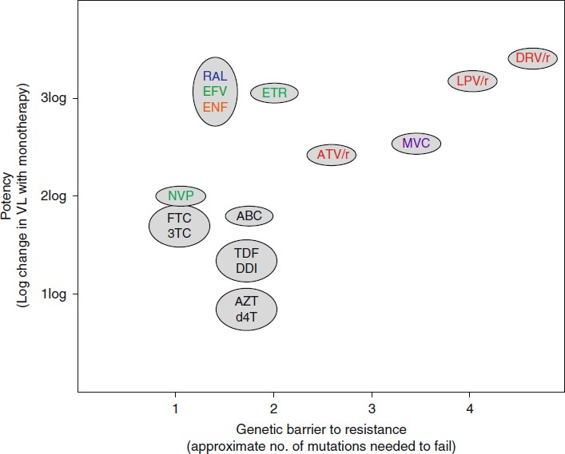
ARV Characteristics
Tang and Shafer, Drugs 2012

Slide 8
ARV Characteristics (2)
Tang and Shafer, Drugs 2012

Slide 9
ARV Characteristics (3)
K103N
Y181C
K65R
M184V
Thymidine analogue mutations (TAMs)
Tang and Shafer, Drugs 2012

Slide 10
ARV Characteristics (4)
K103N
Y181C
K65R
M184V
Thymidine analogue mutations (TAMs)
Tang and Shafer, Drugs 2012

Slide 11
The risk of continuing a failing regimen…..
Early in virologic failure, the virus may have acquired resistance to only one medication in the regimen
The longer that a patient remains on a regimen that is not fully suppressing viral replication, the greater the risk that additional resistance mutations will be acquired and that the virus will become resistant to additional drugs in the ART regimen

Slide 12
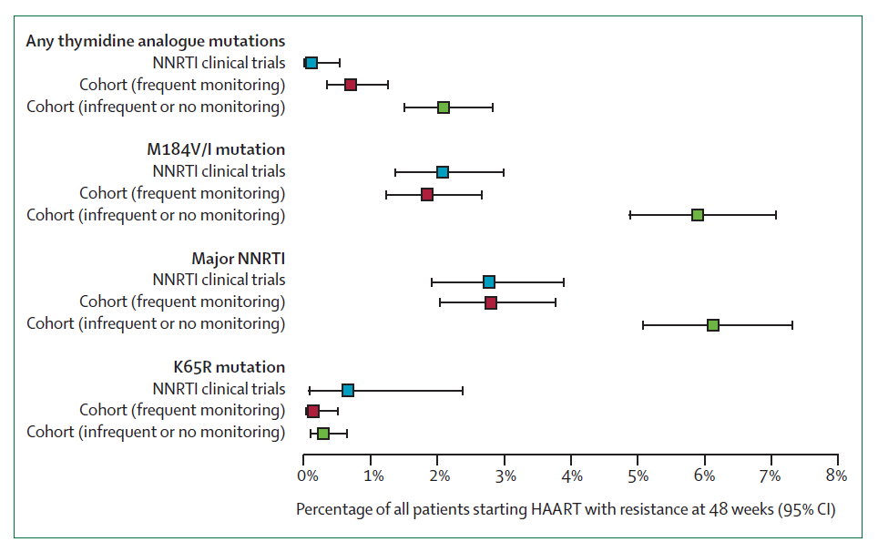
Prevalence of Resistance Mutations by Frequency of VL Monitoring
Gupta et al., Lancet Infect Dis, 2009

Slide 13
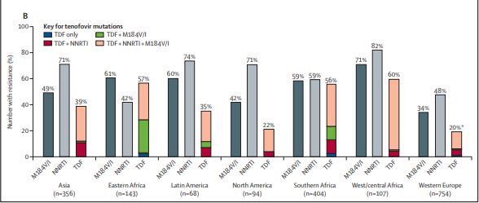
Failing regimens….TDF/3TC/NNRTI
Lancet Infect Dis, 2016

Slide 14
Failing regimens….TDF/3TC/NNRTI (2)
This has been a recommended 1st line ART
The TenoRes Study Group looked at resistance mutations from 1926 patients from 36 countries who failed such regimens between 1998-2015
There were marked differences in the frequency of multidrug resistance mutations (especially to TDF) based on geographic location of the patient
– Likely due to lower frequency of VL monitoring and longer period on a failing regimen in LMIC
Lancet Infect Dis, 2016

Slide 15
Failing a first line regimen…..
TDF/3TC/NNRTI
All agents in this regimen have a low genetic barrier to resistance
– All compromised by a single amino acid change
In the TenoRes study, risk for resistance to TDF was related to the regimen:
NVP > EFV 3TC > FTC

Slide 16
Common Resistance Mutations
 | Low Barrier to Resistance | Not Quite as – but Still Low Barrier to Resistance
NRTI’s | 3TC/FTC à M184V | AZT and d4T à thymidine analogous mutations (TAM), acquired over time TDF à K65R
NNRTI’s | NVP and EFV à Y181C and K103N
Tang and Shafer, Drugs 2012

Slide 17
M184V
Selected by and causes high level resistance to 3TC and FTC
Reduces viral fitness or replicative capacity
Confers increased susceptibility to AZT and TDF
Tang and Shafer, Drugs 2012

Slide 18
Y181C and K103N
Y181C selected by and causes high level resistance to NVP
– Also causes resistance to EFV
K103N selected by NVP or EFV and causes high level resistance to both
Tang and Shafer, Drugs 2012; Stanford University, HIV Drug Resistance Database

Slide 19
K65R
Selected primarily by TDF, but can sometimes emerge with d4T, ABC, ddI
Causes intermediate resistance to TDF, ABC, ddI, 3TC/FTC and low-level resistance to d4T
Confers increased susceptibility to AZT
Tang and Shafer, Drugs 2012

Slide 20
TAMs
TAMs include M41L, D67N, K70R, L210W, T215F/Y, and K219Q/E
Selected by AZT and d4T
Confer cross-resistance to multiple NRTI’s
Mutations emerge over time in two distinct patterns, but can overlap
Tang and Shafer, Drugs 2012; Marcelin et al., Journal Medical Virology 2004

Slide 21
Integrase Inhibitors (INSTIs)
Raltegravir (RAL)and elvitegravir (EVG) had a lower barrier to resistance
Dolutegravir (DTG) has a higher barrier
– There were no failures due to resistance in the dolutegravir pre-marketing randomized control trials
RAL: 400 mg tab, 100mg scored chewable tab, 25 mg chewable tab, granules (50mg) for oral suspension
DTG: 50, 25, 10 mg tabs
Minimal drug interactions
Few side effects, but hypersensitivity reaction or insomnia and dizziness can be seen

Slide 22
Dolutegravir as 1st-Line Advantages over Efavirenz or Nevirapine
lower potential for drug interactions
a shorter time to viral suppression
a higher genetic barrier to drug resistance
long half-life
Small size of tablets (easier to swallow)
Activity against HIV-2 infection, which is naturally resistant to EFV
availability as a generic fixed-dose formulation
potential price reductions applicable to most low- and middle-income countries

Slide 23
Q148H/K/R/N
There are several possible amino acid substitutions at position 148 of the integrase gene that lead to INSTI resistance
These rarely develop when a potent INSTI is used in a regimen that contains 2 or 3 active drugs
More common when a low potency 1st
generations INSTI (RAL or EVG) is used first, then the patient is later switched

Slide 24
WHO Guidance

Slide 25
WHO 1st Line Guidance, 2019

Slide 26
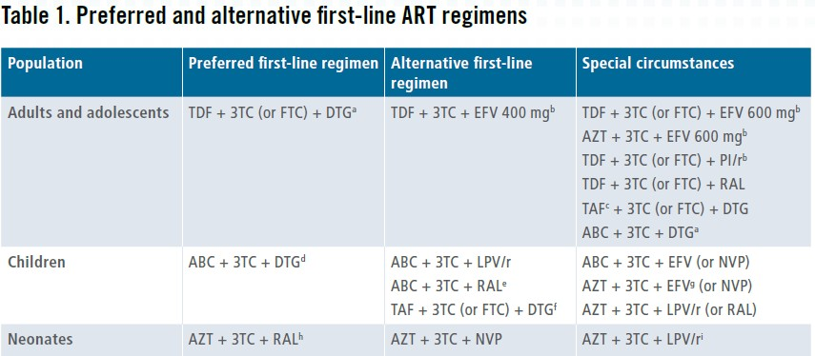
WHO 1st Line Guidance, 2019 (2)

Slide 27
Second-line Therapy
2nd line therapy should consider what medications the patient has taken previously and what resistance their virus has likely acquired

Slide 28
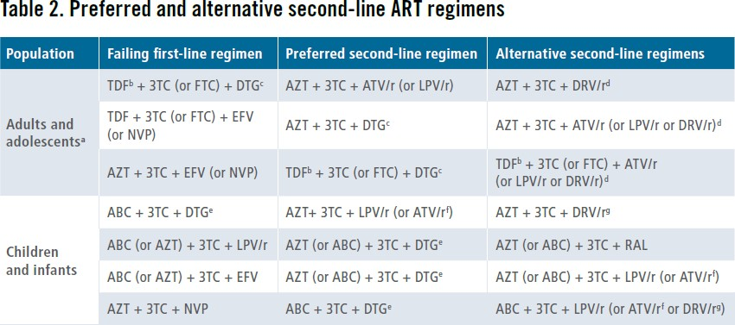
WHO 2nd Line Guidance, 2019 (2)

Slide 29
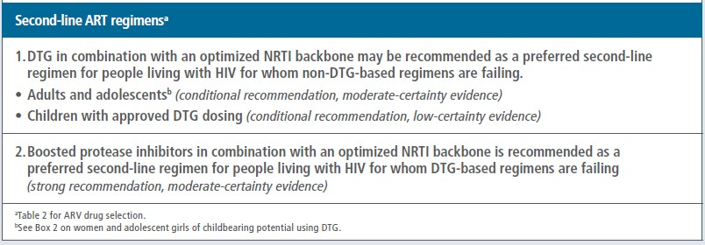
WHO 2nd Line Guidance, 2019

Slide 30
WHO Recommendations: Second Line Regimens (2)
Optimization of the NRTI backbone
Consider genotyping
Empiric changes - use AZT/3TC if TDF/3TC was in the prior regimen and vice versa
Dolutegravir with at least one active NRTI (predicted by genotypic testing) is generally an adequate regimen

Slide 31
Second Line Regimens in Country: Adults
Fill in according to national guidelines

Slide 32
Second Line Regimens in Country: Children
Fill in according to national guidelines

Slide 33
Neural Tube Defects & DTG
Prevalence in Tsepamo study is 5 in 1683 DTG exposures at the time of conception
Three times higher than in women not on DTG
0.30% (1 in 1000 exposures during conception)
DTG appears to be safe after closure of the neural tube (~ 8 weeks of gestation)

Slide 34
Protease Inhibitors
Acceptable for adolescents and women of childbearing potential
High barrier to resistance
DRV/r highest barrier to resistance
ATV/r and LPV/r available in heat stable fixed dose combinations
Drug interactions, including TB drugs
GI side effects (including nausea and diarrhea) common
Tang and Shafer, Drugs 2012; WHO Guidelines, 2013

Slide 35
Third Line Regimens
Include drugs without cross-resistance to previously used regimens
Integrase inhibitors, second generation PIs (darunavir/r) and NNRTIs (etravirine)
Customized to what is available in country
Genotyping can be useful, but mutations present in cDNA but not replicating can be missed
Most useful for current or recent ART

Slide 36
Common Mutations and Effect on Regimen Selection
Component of Original Regimen | Common Mutations | Effects on Future Regimens
3TC/FTC | M184V | Maintain because likely benefit despite resistance due to fitness cost and increased susceptibility to AZT and TDF
EFV or NVP | K103N, Y181C, others | Likely cross resistance to both EFV and NVP à Integrase or Protease Inhibitor
TDF | K65R | Switch to AZT, usually still active
AZT or d4T | TAMs | If multiple TAMs limited NRTI activity, but if early benefit from TDF. Alternate is INSTI/PI with NRTIs

Slide 37
Third Line Regimens in Country: Adults
Fill in according to national guidelines

Slide 38
Third Line Regimens in Country: Children
Fill in according to national guidelines

Slide 39
Summary
Avoid premature or delayed switching of ART
When switching for treatment failure avoid single agent switches
Selection of 2nd and 3rd regimens must take into account common resistance mutations that arise from prior regimens.

Slide 40
Case 1
47 year old woman on TDF/FTC/EFV for 2 years who has had periods of poor adherence.
Routine VL monitoring becomes available, her results return at 4,500 copies/ml.
You call her to come into the clinic and adherence assessment reveals fair adherence.
Over the course of 5 monthly enhanced adherence sessions, she achieves 3 months of good adherence and repeat VL is 3,300 copies/ml.

Slide 41
Case 1 (2)
What is your assessment?
What are next steps?

Slide 42
Case 2 (3)
28 year old man newly diagnosed with HIV in the OPD.
Started on TDF/FTC/EFV and first VL returns at 890,000 copies/ml.
Enhanced adherence sessions are conducted and he achieves good adherence quickly.
After three months of reported good adherence, repeat VL is 3,700.

Slide 43
Case 2 (4)
What is your assessment?
What are next steps?

Slide 44
Questions?

