Slide 1
Adolescent HIV Care and Treatment
Module 5:
Providing Psychosocial Support Services for Adolescents

Slide 2
Module 5 Learning Objectives
After completing this module, participants will be able to:
List common psychosocial needs of both adolescents in general and ALHIV specifically
Identify strategies to support adolescent clients and caregivers in dealing with stigma and discrimination
Recognize psychosocial challenges among most-at-risk ALHIV and provide support and referrals

Slide 3
Module 5 Learning Objectives (Continued)
Conduct a psychosocial assessment with adolescent clients and caregivers to better determine their specific psychosocial needs and the types of support they require
Provide adolescents and caregivers with ongoing, age-appropriate psychosocial support services, including referrals
Understand the importance of peer support in meeting adolescents’ psychosocial support needs

Slide 4
Session 5.1
The Psychosocial Needs of Adolescent Clients

Slide 5
Session 5.1 Objectives
After completing this session, participants will be able to:
List common psychosocial needs of both adolescents in general and ALHIV specifically
Identify strategies to support adolescent clients and caregivers in dealing with stigma and discrimination
Recognize psychosocial challenges among most-at-risk ALHIV and provide support and referrals

Slide 6
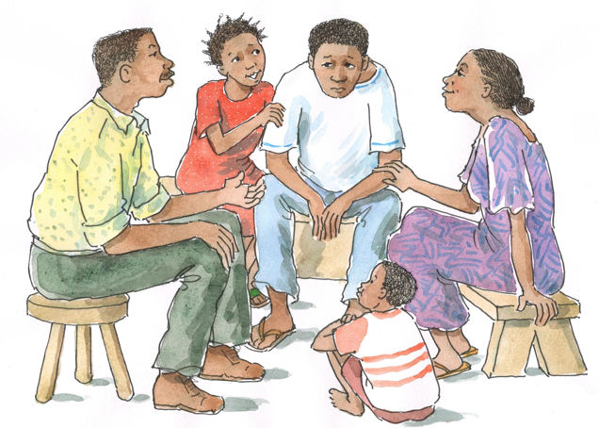
Brainstorming
What do you think are the definitions of “psychosocial,” “psychosocial support,” and “psychosocial well being”?

Slide 7
Overview of Psychosocial Support
Definitions:
“Psycho-” refers to the mind and soul of a person.
“Social” refers to a person’s external relationships and environment.
Psychosocial support addresses the ongoing emotional, social, and spiritual concerns and needs of PLHIV, their partners, and their caregivers.
Psychosocial well being is when a person’s internal and external needs are met and he or she is physically, mentally, and socially healthy.
Psychosocial support can help people make informed decisions, cope better with illness, deal more effectively with discrimination, and improve the quality of their lives.

Slide 8
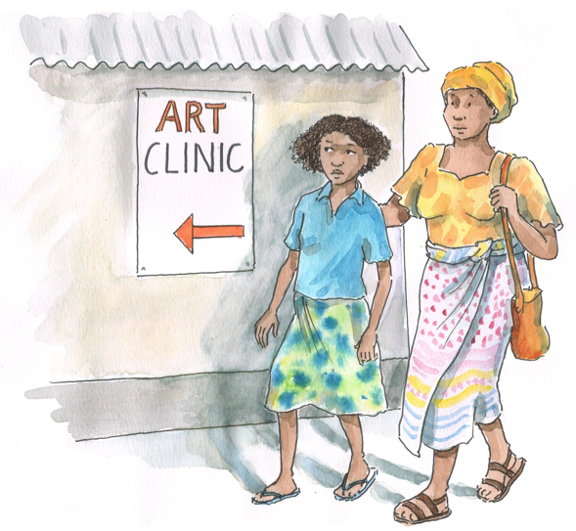
Complete the Statements Below
All adolescents, including ALHIV, need psychosocial support to cope with the changes of adolescence.
All adolescents, regardless of HIV-status, need psychosocial support because…
Adolescents’ psychosocial needs and challenges are different from those of both children and adults because…

Slide 9
Psychosocial Support Needs of ALHIV
All adolescents have unique psychosocial needs, which are different from those of children and adults.
Adolescence is characterized by:
Physical, emotional, and mental changes
Risk-taking behavior and experimentation
Sexual desire, expression, and experimentation
Insecurity/confusion
Anxiety
Reactive emotions
Criticism of caregivers or elders
A focus on body image
A sense of immortality
Need to challenge authority figures while also still needing their support

Slide 10
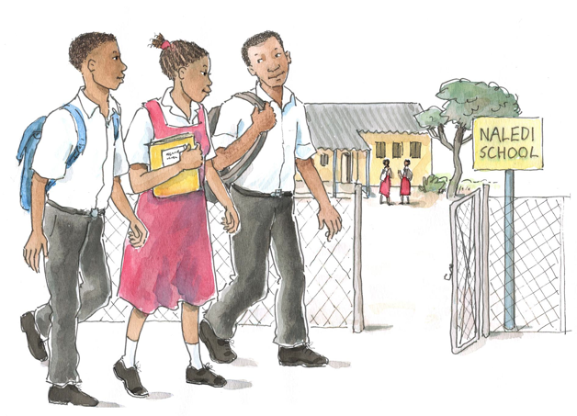
Brainstorming
What do you think are the most common support needs of ALHIV?

Slide 11
ALHIV May Require Extra Support in These Areas:
Understanding and coming to terms with own and family members’ HIV-status
Grieving the illness or loss of family members and coping with added responsibilities
Coping with cycles of wellness and poor health
Long-term adherence
Disclosure
Sexual and reproductive health
Anxiety over physical appearance and body image
Developing self-esteem, confidence, and a sense of belonging
Dealing with stigma, discrimination, and social isolation
Accessing education, training, and work opportunities
Managing mental health issues

Slide 12
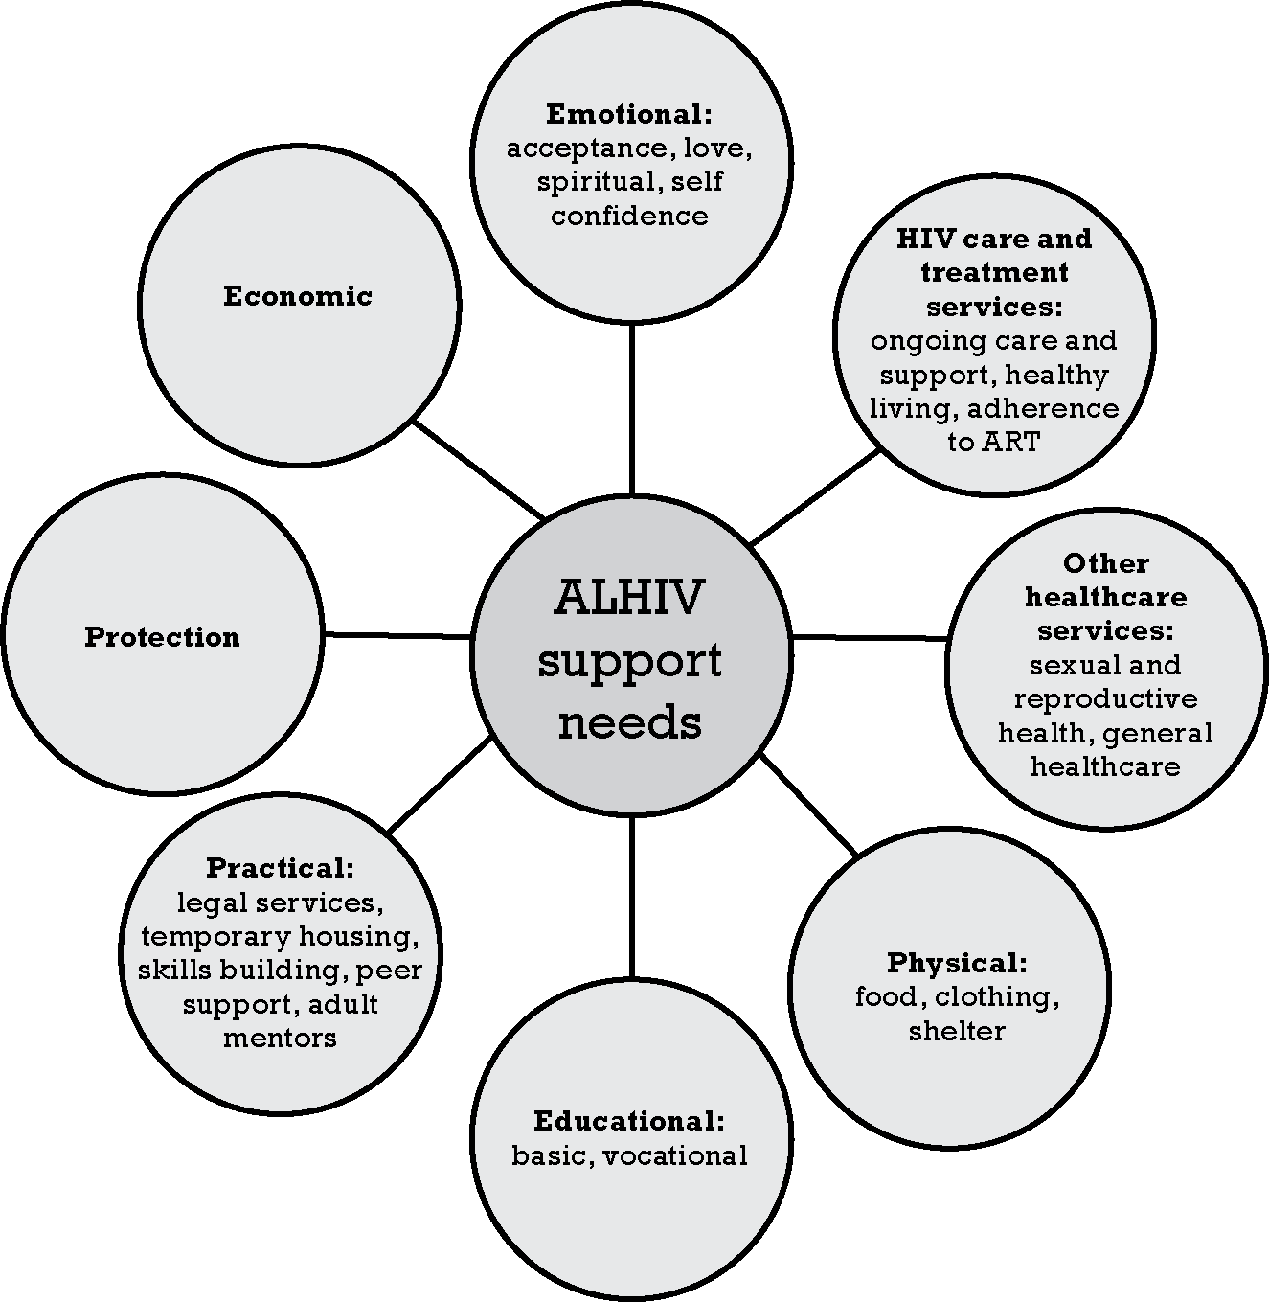
Support Needs of ALHIV

Slide 13
Providing Psychosocial Support to ALHIV and Their Caregivers is Important Because:
All adolescents need support coping with normal developmental issues.
ALHIV may also experience HIV-related stressors and challenges.
It can help clients and caretakers gain confidence.
It can increase clients’ understanding and acceptance of all HIV care and support services.
Psychosocial well being is associated with better adherence.
HIV can be a chronic stressor that places ALHIV and their families at risk for mental health problems.
It may help prevent ALHIV from entering the “most-at-risk” category.
An adolescent’s psychosocial needs change over time and should be discussed and given consideration at every clinic visit.

Slide 14
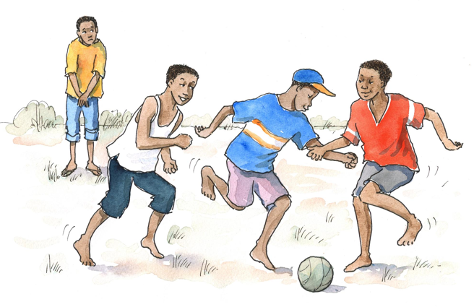
Brainstorming
How would you define stigma?
How would you define discrimination?

Slide 15
Overview of Stigma and Discrimination
Definitions:
Stigma: Having a negative attitude toward people we think are not “normal” or “right.” For example, stigma can mean not valuing PLHIV or people associated with PLHIV. To stigmatize someone: Seeing a person as inferior (less than or below others) because of something about him or her. Discrimination: Treating someone unfairly or worse than others because he or she is different (for example, because a person has HIV). Discrimination is an action that is typically fuelled by stigma.

Slide 16
There Are Different Kinds of Stigma:
Stigma toward others: Having a negative attitude about others because they are different or assumed to be different
Self-stigma: Taking on or feeling affected by the cruel and hurtful views of others, which can lead to isolating oneself from family and community
Secondary stigma: When people are stigmatized because of their association with PLHIV

Slide 17
There Are Different Forms of Discrimination:
Facing violence at home or in the community
Not being able to attend school
Being kicked out of school
Not being able to get a job
Being isolated or shunned from the family or community
Not having access to quality health or other services
Being rejected from a church, mosque, or temple
Police harassment
Verbal discrimination: gossiping, taunting, or scolding
Physical discrimination: insisting a person use separate eating utensils or stay in a separate living space

Slide 18
Remember:
Stigma and discrimination have short- and long-term effects on clients’ and caregivers’ psychosocial well being. Stigma and discrimination deter access to HIV prevention, care, and treatment services for many people and can prevent ALHIV and their families from living healthy and productive lives.
18

Slide 19
Brainstorming and Discussion
Brainstorm:
What examples of stigma and discrimination have you observed against ALHIV of PLHIV in the clinic or community?
Then discuss...
What can you suggest to adolescents to help them deal with stigma and discrimination?
What can you do in the clinic to reduce stigma and discrimination against ALHIV?

Slide 20
Stigma and Discrimination Can:
Keep ALHIV from accessing services
Cause anxiety, stress, and/or depression
Make ALHIV feel isolated and as if they do not fit in
Make it difficult for ALHIV to succeed in school
Result in poor adherence to medications
Make disclosure difficult
Make it hard to for people to discuss safer sex with partners
Discourage pregnant women from accessing PMTCT services
Prevent people from caring for PLHIV
Impact some ALHIV more than others

Slide 21
Individual Strategies for Dealing with Stigma:
Stand up for yourself!
Educate others.
Be strong and prove yourself.
Talk to people with whom you feel comfortable.
Join a support group.
Try to explain the facts.
Ignore people who stigmatize you.
Avoid people who you know will stigmatize you.
Take ART openly.

Slide 22
Strategies for Dealing with Stigma within Health Care Settings:
Make sure PLHIV and ALHIV are part of the care team.
Make sure young people are given opportunities to evaluate clinical services and that feedback is formally reviewed.
Ensure linkages to community-based groups for ALHIV.
Support each other to discuss attitudes, feelings, fears, and behaviors (to avoid burnout).
Challenge any discrimination you see in the health care setting and report it to the manager.
Listen to clients’ concerns about stigma and discrimination.
Work with the entire multidisciplinary team to identify and reduce stigma and discrimination in the clinic.

Slide 23
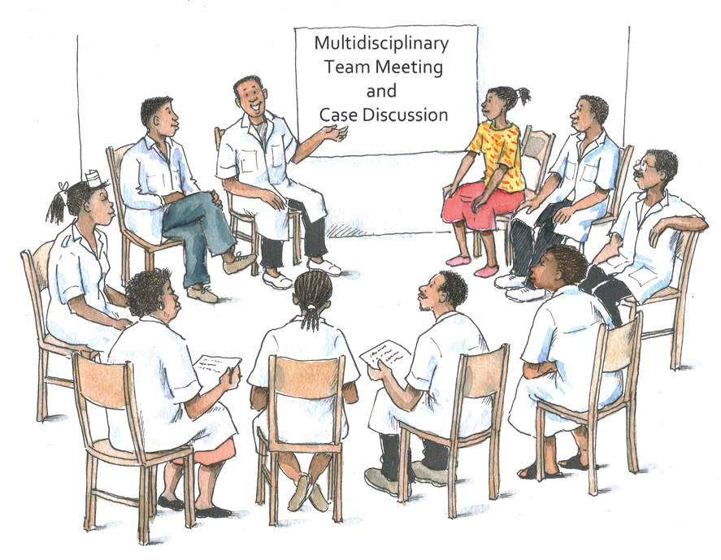
Remember:
As health workers, we are all responsible for challenging stigma and discrimination.
We should all play a role in educating others and in advocating for new attitudes and practices.

Slide 24
Discussion Questions
Thinking back to Module 2, what are some factors that make adolescents especially vulnerable to the impacts of HIV?
What are some of the physical, social, and psychological problems that ALHIV who are especially vulnerable or most-at-risk experience in your community?
Are any of these problems or psychosocial needs different for young men and women? How?

Slide 25
All Adolescents Are Vulnerable and At-Risk Because:
Their behavior is less fixed; may be experimental
They are less likely to identify as “at risk”
They are more easily exploited
They, especially girls, are the most common victims of GBV
Many young women are vulnerable to transactional sex
They have less experience coping with marginalization
They may have concerns about the legality of behaviors and informed consent
They are less oriented toward long-term planning
Some are living without parental guidance and support
There is a lack of accessible resources for adolescents
Laws, cultural practices, or social values in some communities may force them to behave in ways that place them at risk

Slide 26
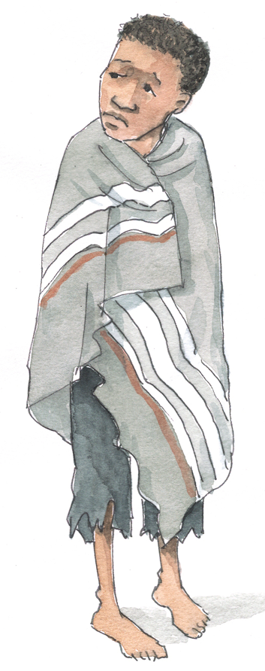
Most-at-Risk ALHIV:
Young people who are both HIV-positive and particularly vulnerable or at-risk, such as those who are:
Homeless
Homosexual or bisexual
Transgendered
Disabled
Imprisoned
Caregivers
Orphans
Migrants
Refugees
Gang members
Sex workers
Injecting drug users
“Most-at-risk” refers to behaviors, while “vulnerability” refers to the circumstances and conditions that make most-at-risk behaviors more likely.
26

Slide 27
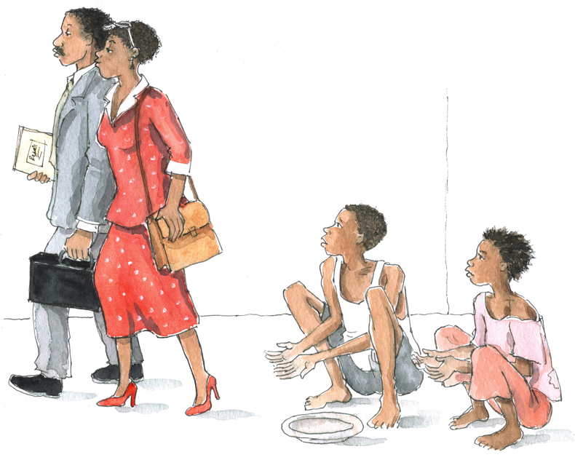
Most-at-Risk ALHIV: (Continued)
Most-at-risk ALHIV are among society’s most marginalized groups. They generally have few connections with social institutions like schools and organized religion, where many support services are traditionally provided.
They often have greater, more complex psychosocial and mental health needs. They are generally more vulnerable to risky sexual behaviors and mental health problems, and they often have less access to education and health care.

Slide 28
Most-at-Risk ALHIV May Require More Psychosocial Support Due to Extreme Challenges, Such As:
Displacement
Severe social exclusion, isolation, stigma, and discrimination
Extreme poverty
Substance abuse
Physical or sexual abuse/ violence
Exploitation
Migration
Stigma, discrimination, violence, and fear of arrest due to sexual orientation
Chronic mental health issues, psychiatric disorders, and learning disorders
Disabilities
A stressful past
28

Slide 29
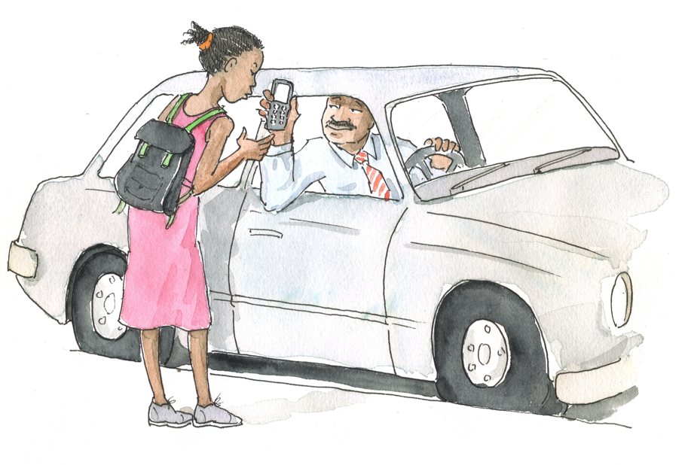
Non-violence: A Human Right
Ensure that all clients, particularly those who are most-at-risk, recognize that they have a right to say "no" to sex and a right to live in a world without abuse. Encourage them to recognize that violence and forced sex is not only wrong but also unethical and punishable by law.

Slide 30
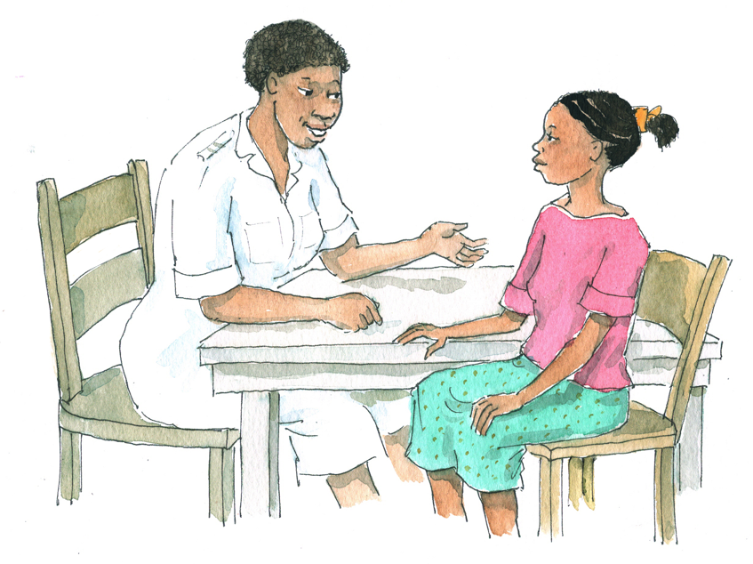
Remember:
Most-at-risk adolescents may be more fearful and reluctant to disclose personal information to health workers.
As with all adolescents, it is important to always use good communication skills and to adopt adolescent-friendly approaches in order to engage and support most-at-risk ALHIV.

Slide 31
Questions or comments on this session?

Slide 32
Session 5.2
Assessing Psychosocial Support Needs

Slide 33
Session 5.2 Objective
After completing this session, participants will be able to:
Conduct a psychosocial assessment with adolescent clients and caregivers to better determine their specific psychosocial needs and the types of support they require

Slide 34
Remember:
While we may not able to address all of a client’s needs, there are many things we can do to improve ALHIV’s psychosocial well being.
The use of tools, such as the Psychosocial Assessment Tool in Appendix 5A, can help determine what services and referrals a client needs. Findings should be recorded on the tool and stored in the client’s file.
A psychosocial assessment should be conducted when a client enrolls in HIV services — and again each year after that and whenever the client’s situation changes significantly.
Be patient and always have a positive, non-judgmental attitude when talking about psychosocial needs with clients.

Slide 35
Conducting a Psychosocial Assessment
See Appendix 5A: Psychosocial Assessment Tool.
Tips to remember during the assessment process:
Emphasize confidentiality, but explain that some info may be shared with other providers to ensure the best care for the client.
Ensure visual and auditory privacy.
Involve the adolescent during all phases of the process.
Respect the dignity and worth of the adolescent at all times.
Do not talk down to the adolescent.

Slide 36
Conducting a Psychosocial Assessment (Continued)
Tips (continued):
Always be positive and offer encouragement and praise.
Be patient! Allow the adolescent to speak for him- or herself.
Respect the adolescent’s coping skills and ideas.
Do not judge! Make adolescents feel comfortable instead of fearful.
Offer to include caregivers’ input while simultaneously ensuring confidentiality of information.
Always keep a copy of the assessment in the client’s file.

Slide 37
Pair Work
Please break into pairs.
Now we will review and practice using the Psychosocial Assessment Tool (see Appendix 5A).
For 15 minutes, take turns role playing how you would use this tool with an adolescent client.
Debriefing questions:
What do you think of this Psychosocial Assessment Tool?
How did you feel using the tool? What was challenging?
How could you use this tool with adolescents in your clinical setting?

Slide 38
Discussion Questions
Can anyone remember the 5 “A’s” we discussed in Module 3? What are the 5 “A’s” and how do you think they apply to psychosocial support?
What should health workers do if, during an assessment, they think the adolescent client’s immediate safety, health, or well being is threatened?
What coping strategies could you suggest to adolescent clients?
What coping strategies could you suggest to caregivers?

Slide 39
The 5 “A’s”
Use the 5 “A’s” when conducting a psychosocial assessment (remember that these were also covered in Module 3).
ASSESS | The client’s psychosocial needs, ideally using a standardised assessment tool
ADVISE | And guide
AGREE | On an action plan given the particular situation
ASSIST | Provide take-away information, provide psychosocial support and referrals, address obstacles, help client come up with solutions, and offer to talk to family members and caregivers
ARRANGE | A follow-up appointment and for the client to participate in a support group or group educations sessions
See Table 5.1 for more description of the 5 “A’s.”

Slide 40
Remember:
If, during the “ASSESS” phase, you think that an adolescent client has serious issues that threaten his or her life or immediate safety, these issues must be addressed IMMEDIATELY. For example, if the client reports:
Homelessness
Thoughts of suicide or severe depression
Violence
In these cases, instead of working through the 5 “A’s,” focus on the client’s immediate safety and well being.
You may need to break confidentiality and take actions to ensure the client’s immediate safety.
We will discuss managing emergencies further in Module 6.

Slide 41
Overview of Coping Strategies
If there are no emergency issues, suggest coping strategies to the client and his or her caregivers to help them reduce stress, deal with challenges, and promote their psychosocial well being.
Examples of coping strategies include:
Talking about problems with someone trusted
Seeking help from clinic staff, especially if sad, depressed, or anxious
Joining a support group
Creating an “escape” by taking a walk or listening to music
Seeking spiritual support
Participating in recreational activities or cultural events
Returning to a daily routine
Doing something to feel useful

Slide 42
Overview of Coping Strategies (Continued)
Helping clients express themselves and encouraging them to tell their stories and to share their problems helps them to:
Feel a sense of relief
Reduce feelings of isolation
Think more clearly about what has happened
Feel accepted, cared, and valued
Develop confidence
Build self esteem
Explore options or solutions to make better decisions
Prevent bad feelings from coming out as aggressive behavior
Maintain needed support from family members and other adults

Slide 43
Overview of Coping Strategies (Continued)
Encourage caregivers to strengthen their relationship with the adolescent. Suggest that they:
Spend time with and listen to the adolescent.
Let the adolescent know their feelings are normal.
Communicate unconditional love.
Help the adolescent plan activities.
Involve the adolescent in family activities.
Get enough rest and eat well.
Get help from counselor or social worker.
Be aware of changes in behavior or mood.
Talk to someone if they need help.
Get help from a community-based support organization.
Continue their regular religious or spiritual practices.

Slide 44
Exercise 1
Assessing Psychosocial Support Needs: Case studies in small groups and large group discussion

Slide 45
Exercise 1: Case Study 1
A 17-year-old woman named T___ tested positive for HIV 6 months ago. She is currently caring for her 3 younger sisters with the help of her grandmother. She is so busy that she has missed a couple of appointments at the ART clinic, including refill appointments for ARVs. Her partner is the only one who knows she is HIV-positive, but he himself has not been tested.
→ How do you proceed with T___ today?

Slide 46
Exercise 1: Case Study 2
A 12-year-old boy named M___ has come to the clinic today with his mother. He looks like he is “feeling down.” You sense that he wants to talk to someone, but he seems very quiet and won’t make eye contact with anyone.
→ How do you proceed with M___?

Slide 47
Exercise 1: Case Study 3
K___ is a 17-year-old young woman living with HIV. Her mother died when she was 5 years old and she doesn’t know her father. For the last year, K___ has been living with her 28-year-old boyfriend. She has come to the clinic today because she thinks she is pregnant.
→ How would you proceed with K___?

Slide 48
Exercise 1: Debriefing
What did we learn?
Key points:
A client’s psychosocial needs change over time and should be informally assessed and considered at every visit.
The 5 “A’s” — ASSESS, ADVISE, AGREE, ASSIST, and ARRANGE — can help structure counseling sessions so none of the key steps are forgotten.

Slide 49
Questions or comments on this session?

Slide 50
Session 5.3
Peer Support in Psychosocial Services for Adolescents

Slide 51
Session 5.3 Objective
After completing this session, participants will be able to:
Understand the importance of peer support in meeting adolescents’ psychosocial support needs

Slide 52
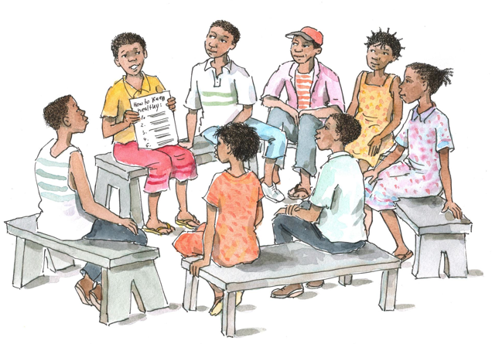
Discussion Questions
How can peer support help address the psychosocial needs of ALHIV?
What roles can Adolescent Peer Educators play in HIV programs and services?
How are Adolescent Peer Educators different from Adult Peer Educators (in terms of roles, limitations, need for supervision, etc.)?
52

Slide 53
Importance of Peer Support for ALHIV
Peer outreach is an important way of making contact and engaging ALHIV in care and treatment services. Peer support can help clients understand their illness and the need to return to the clinic even if not on ART.
Adolescents depend on peers for information, approval and connection. They may also trust advice from peers more than they trust advice from adults.
Peer support can help ALHIV:
Counter stigma and discrimination
Cope with fear and hopelessness after diagnosis
Improve adherence to care and treatment services
Deal with issues like disclosure to partners, friends, and family
53

Slide 54
Adolescent Peer Educators Can Help Improve Services for ALHIV
Their participation in the health facility and in outreach services can expand the clinic’s ability to provide quality care to ALHIV.
Their work allows already overburdened health workers to concentrate on more technical tasks.
Adolescent Peer Educators can be an important part of the multidisciplinary team. However, their roles should be carefully considered, including their limitations and need for training and ongoing supervision.

Slide 55
Adolescent Peer Educators Can Play Important Roles in HIV Service Delivery
Can provide counseling and long-term support
Can provide psychosocial support to clients and family members
Can lead health talks and group education sessions
Can assist clients with disclosure
Can link young pregnant women to ANC and PMTCT services
Can assist with referrals within or between health facilities
Can provide referrals and linkages to community-based services
Can trace clients who miss appointments
Can serve as a communication link
Can participate in HIV-related outreach activities in the community
Can assist with the design and delivery of peer support groups for ALHIV and caregivers
55

Slide 56
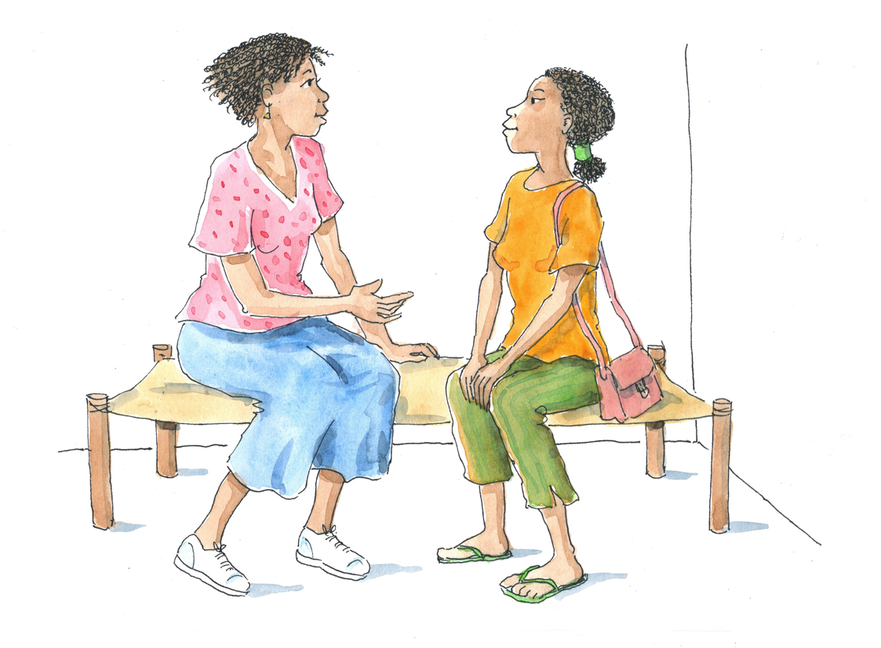
Peer Support Can Help Address ALHIV’s Psychosocial Support Needs By:
Helping them feel accepted and valuable; reducing their sense of isolation
Helping them solve their own problems
Providing emotional support
Promoting learning, sharing, and skill building around disclosure, adherence, and dealing with stigma and discrimination
Maintaining their motivation and commitment to HIV care and treatment
Effectively engaging most-at-risk adolescents

Slide 57
Discussion Questions
Have you ever facilitated a support group meeting (raise your hand if you have)?
Why do you think peer support groups would be helpful for ALHIV?
What topics and activities do you think could be incorporated into a peer support group for ALHIV? For younger adolescents?
What could you do to start or improve a support group in your area?
57

Slide 58
Peer Support Groups
Groups of people who come together because they share a common situation
Members help and support each other to:
Better manage their situations, share challenges, and discuss solutions
Implement decisions
Can reduce isolation and provide encouragement to live positively
Can be a safe place to talk about personal issues
Are beneficial because adolescents trust information from peers
Can help members better understand clinical services
Can link members to community-based services
May provide income-generating or educational assistance

Slide 59
There Are Many Types of Support Groups
Adolescent support groups
Playgroups for younger adolescents
Young mothers support groups
Couples support groups
Post-test clubs
Groups for other specific populations
While there are many different types of support groups, their purpose is the same: to reduce isolation and provide psychosocial and emotional support to members.

Slide 60
Health Education and Related Topics That Can Be Incorporated into Support Group Meetings:
Positive living
Adherence
Disclosure
Sexual and reproductive health
Relationships and sexuality
Preventing new HIV infections and positive prevention
Preventing OIs
Coping with school
Finding work
Strategies to reduce gender- based violence
Dealing with stigma
Nutrition
Getting help for mental health problems
Dealing with dying and the death of a friend or family member
Managing disabilities

Slide 61
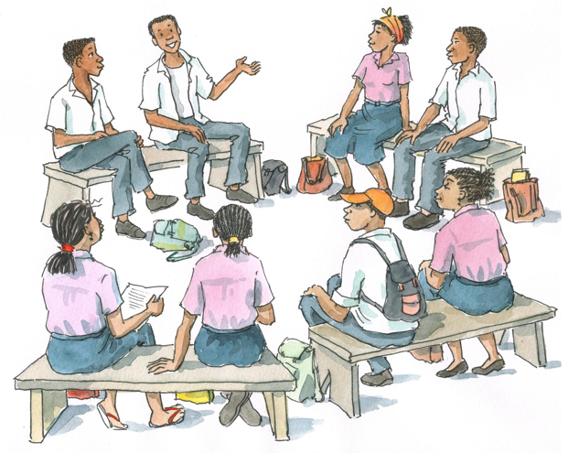
Further Information on Support Groups
See Appendix 5B: Starting/Planning a Peer Support Group, Appendix 5C: Facilitating a Peer Support Group, and Appendix 5D: Ideas for Peer Support Group Activities.

Slide 62
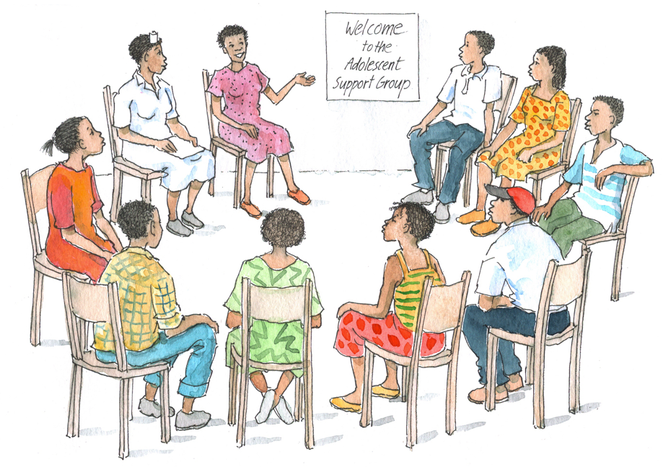
Remember:
Health workers have a role in initiating and facilitating peer support groups — and in linking ALHIV with existing support groups.

Slide 63
Questions or comments on this session?

Slide 64
Module 5: Key Points
Psychosocial support addresses the ongoing emotional, social and spiritual concerns and needs of PLHIV and their partners/families.
All adolescents need support coping with normal developmental issues. ALHIV may also experience HIV-related stressors and additional vulnerabilities and challenges.
Stigma and discrimination can deter people from accessing HIV services.
Health services need to be adapted to identify and meet the needs of most-at-risk adolescents.
Health workers play a key role in assessing clients’ and caregivers’ psychosocial needs — they can use the Psychosocial Assessment Tool in Appendix 5A.

Slide 65
Module 5: Key Points (Continued)
Health workers should remember the 5 “A’s” when conducting a psychosocial assessment: ASSESS, ADVISE, AGREE, ASSIST, and ARRANGE.
If a health worker thinks an adolescent client has serious issues that threaten his or her life or immediate safety, these must be addressed IMMEDIATELY.
An important part of helping adolescents cope is encouraging caregivers to strengthen their relationship with them.
Peer support is an important source of psychosocial support for ALHIV.
Health workers have a role in initiating and facilitating peer support groups — and in linking ALHIV with existing support groups.

