Slide 1
Adolescent HIV Care and Treatment
Module 4:
Communicating with
and Counseling Adolescents

Slide 2
Module 4 Learning Objectives
After completing this module, participants will be able to:
Discuss ways of establishing trust and rapport with adolescent clients
Demonstrate effective counseling skills

Slide 3
Session 4.1
Establishing Trust and Rapport with Adolescent Clients

Slide 4
Session 4.1 Objective
After completing this module, participants will be able to:
Discuss ways of establishing trust and rapport with adolescent clients

Slide 5
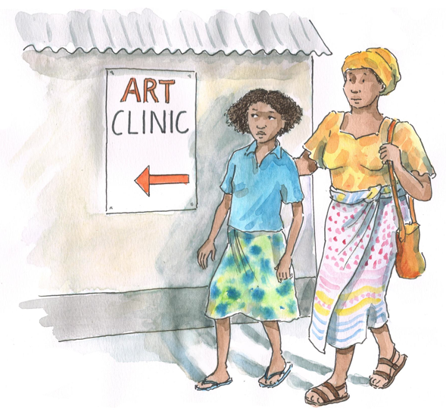
Discussion Questions (Continued)
What are some things a health worker might do to build trust and rapport with an adolescent?
How do you think your adolescent clients feel when they come to the clinic? (Are they scared? Excited? Anxious?)
How might these feelings affect their trust of and relationship with you as a health worker?

Slide 6
Why the Need to Establish Trust and Rapport?
ALHIV may have concerns related to:
  Their diagnosis
  Disclosure of their HIV-status
  Feelings of isolation
  Coping with a chronic condition
Health workers must first establish trust and rapport with ALHIV in order to provide them with support and information.
Trust is the starting point for good communication.

Slide 7
Establishing Trust with an Adolescent Can Be Difficult
Adolescents are going through dramatic biological and emotional changes that affect their self-confidence, relationships, social skills, and general thinking.
Adolescents may feel fearful, embarrassed, or uncomfortable around health workers.
Most adolescents have concerns about confidentiality – reassure them that health workers will practice confidentiality.

Slide 8
When Speaking with a Health Worker, Many Adolescents Feel:
Shy Embarrassed Worried Inadequate Anxious Afraid | Intimidated Defensive Resistant Unsure Loyal Hopeful
8

Slide 9
Tips for Building Rapport with Adolescents
Treat everyone equally and with respect. Be open to their questions. Do not use judgmental words or body language. Use understandable language; use educational materials to explain complicated information. Do not be critical. Ensure that conversations are private. Reassure clients about confidentiality; discuss what confidentiality means in terms of sharing with other HWs. | Do not threaten to break confidentiality. Re-state confidentiality policy, as needed. Allow enough time for them to ask questions and express concerns. Empathize with their situation and concerns. Reassure them that you “are here to help.” Reassure them that their feelings and experiences are normal. Be honest and admit when you do not know the answer to a question.

Slide 10
Remember:
Building trust and rapport with adolescent clients starts with understanding their feelings and mindset. Being able to understand the perspective of the adolescent will enable the health worker to respond appropriately and create a positive and effective service experience.
10
10

Slide 11
Exercise 1
Establishing Rapport and Building Trust:
Role play and large group discussion

Slide 12
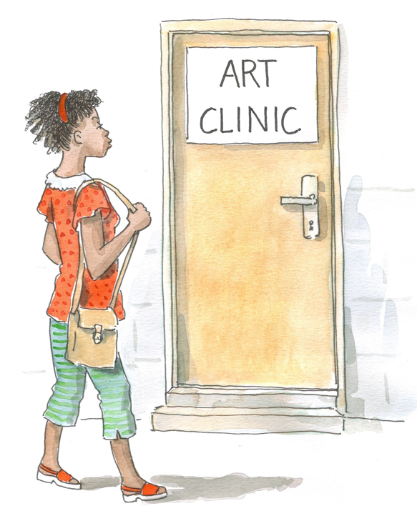
Exercise 1: Case Study 1
M___ is 18 years old and recently found out that she is HIV infected. She disclosed her HIV-status to her boyfriend who, much to her surprise, broke up with her immediately. Now M___ is not only heart-broken but also worried that her ex-boyfriend will, out of spite, disclose her-HIV status to others.
  → How do you proceed with M___?

Slide 13
Exercise 1: Case Study 1 (Continued)
Discussion Questions:
What do you think the adolescent was thinking/experiencing in this situation? What do you think he or she was concerned with?
How did the health worker try to build rapport and trust with the client?
What was done well?
What would you have done differently?

Slide 14
Exercise 1: Case Study 2
E___ is 15 years old and has been living with HIV since she was an infant. Her mother passed away a few years ago and she lives with her father now. She is responsible for caring for her 3 younger siblings. She comes to the clinic today claiming that she is having some stomach pains. You suspect that the real reason she has come is because she wants to talk about something.
  → How do you proceed with E___?
  → How could the health worker build rapport and trust with the client in this situation?
  → What should the health worker say and do?

Slide 15
Exercise 1: Debriefing
What did we learn?
Key points:
  Our effectiveness with adolescents depends on how well we engage them and make them feel comfortable.
  Establishing trust and rapport with adolescents can be challenging, but it is crucial to communication and ensuring that their needs are addressed.
15

Slide 16
Questions or comments on this session?

Slide 17
Session 4.2
Effective Techniques for Counseling Adolescents

Slide 18
Session 4.2 Objective
After completing this session, participants will be able to:
Demonstrate effective counseling skills

Slide 19
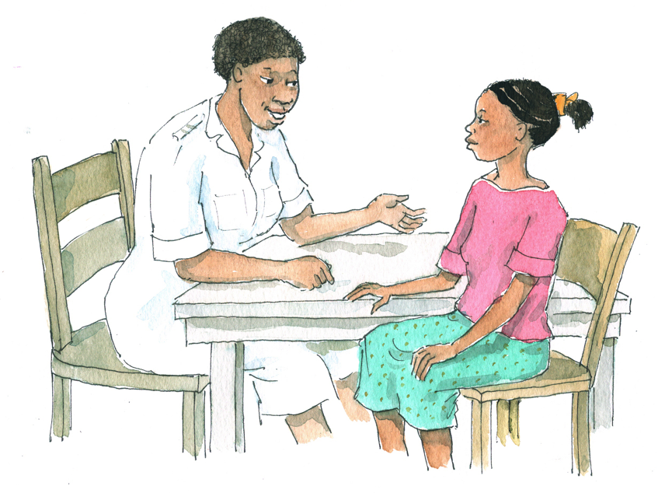
Discussion Questions
19
Reflect on a time when you received good counseling — from a friend, a colleague, or a counselor.
What is counseling?
What does good counseling
include? What does it not include?

Slide 20
Why Do We Counsel People?
To help them talk about, explore, and understand their thoughts and feelings
To help them work out for themselves what they want to do and how they want do it

Slide 21
Counseling Includes:
Establishing supportive relationships Having conversations with a purpose (not just chatting) Listening carefully Helping people talk without fear of stigma or judgment Giving correct and appropriate information Helping people make informed decisions | Exploring options and alternatives Helping people recognize and build on their strengths Helping people develop a positive attitude and become more confident Respecting everyone’s needs, values, culture, religion, and lifestyle Being willing to trust clients’ feelings and decisions
Effective counselors recognize their own values and ensure that their values are not imposed on others!

Slide 22
Counseling Does NOT Include:
Solving another person’s problems Telling another person what to do Making decisions for another person Blaming another person Interrogating or questioning another person | Judging another person Preaching to or lecturing another person Making promises that cannot be kept Imposing one’s own beliefs on another person Providing inaccurate information
Think back to the “Values Clarification” exercise in Module 1 (“Agree”/”Disagree”). What did we learn?
See Appendix 4A: Common Counseling Mistakes.

Slide 23
Discussion Questions
What suggestions do you have for communicating with adolescents?
How would your counseling style differ for an 11-year-old versus an 18-year-old?
What can you do to communicate effectively with younger adolescents and to help them express themselves?
Your counseling and communication approach will be different for every client.

Slide 24

Tips for Communicating with Adolescents:
Start by talking about non-threatening issues.
Ask indirect questions at first — ask about the behavior of peers:
    FOR EXAMPLE: “Do any of your friends smoke pot/dagga? Have you ever joined them?”
Reduce stigma around an issue by normalizing it:
  FOR EXAMPLE: “Some adolescents are in sexual relationships and others are not. Whether your answer is yes or no, it is OK…”
  Hang posters in common areas that communicate important messages

Slide 25
Tips for Communicating with Adolescents:
Repeat information back to clients in the form of a question to encourage them to re-think what they have just said
  FOR EXAMPLE: An adolescent might say: "I do not care that my cousin stopped talking to me when I told him I had HIV." Respond by asking: “So it doesn't bother you that your family is giving you a hard time?”
Encourage peer support
See Appendix 4B: General Tips on How to Talk with Adolescents and Appendix 4C: Basic Counseling Guidance for ALHIV.
25

Slide 26
Considerations with Younger Adolescents:
They need time to feel safe and to trust.
They may feel scared and may fear being judged; they may feel anxious or embarrassed when asking for help.
    TIP: Start by doing something together, like playing a game. Allow plenty of time and be patient.
Younger adolescents understand concrete things they can touch and see.
  TIP: Explain things in simple terms. Drawing, demonstration, or visual aids can be used to make information more concrete.

Slide 27
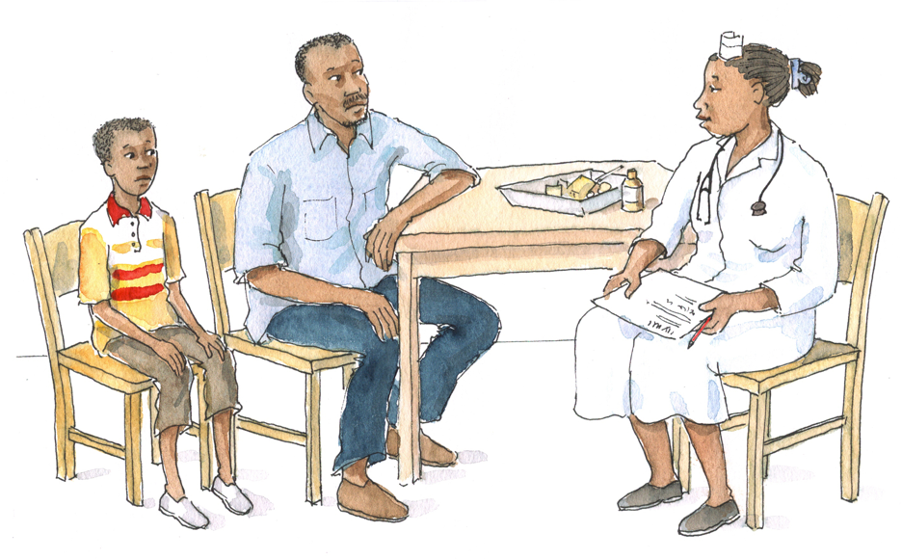
Considerations with Younger Adolescents: (Continued)
Just because an adolescent is not asking questions does not mean he or she is not thinking about what is being said.
  TIP: Do not force adolescents to share. Positively reinforce their efforts to express themselves.
If a youth is rude or aggressive, remember that this behavior may not be directed at you.
  TIP: Be patient and don’t take it personally.

Slide 28
Considerations with Older Adolescents:
Strategies to gain the trust of older adolescents differ from those used with younger adolescents:
Ask older adolescents about the things that are important to them.
Try to understand the perspective of adolescent clients.
  TIP: When providing advice to adolescents, do so from the perspective that they have not yet had the opportunity to learn what you are explaining to them.
  TIP: Never criticize them.
28

Slide 29
Considerations with Older Adolescents: (Continued)
Never assume that they are not yet sexually active. Also never assume that they are sexually active.
Do not assume that any adolescent has the same interests or issues as other adolescents you have met recently.
  Adolescents may pride themselves on having the confidence to be different.
In summary:
  Never make assumptions.
  Use open-ended questions.
  Always remain non-judgmental.
29

Slide 30
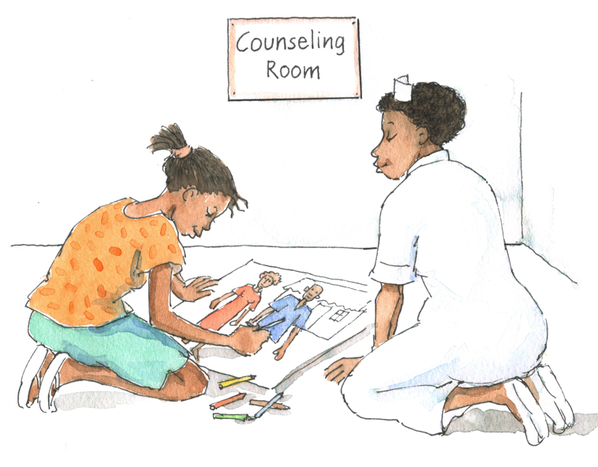
Activities to Do with Adolescents to Promote Expression:
Storytelling or reading together and asking questions to encourage discussion (younger adolescents)
Journaling about feelings and daily activities (younger and older adolescents)
Drawing pictures of their families or homes (younger adolescents)
Writing letters to friends or family members (younger and older adolescents)
Doing something fun while talking
(younger and older adolescents)

Slide 31
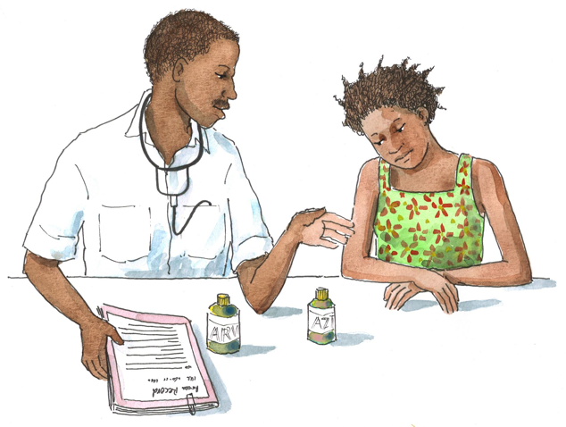
Remember:
Health workers need to adjust their counseling and communication style to the adolescent they are counseling, keeping in mind his or her age and developmental stage.
31

Slide 32
Listening and Learning Skills
Clear and effective communication is the key to good counseling.
Skill 1: Use helpful non-verbal communication
Skill 2: Actively listen and show interest in the client
Skill 3: Ask open-ended questions
Skill 4: Reflect back what the client is saying
Skill 5: Empathize — show that you understand how the client feels
Skill 6: Avoid words that sound judging
Skill 7: Help the client set goals and summarize each counseling session
See Appendix 4D: Listening and Learning Skills Checklist.

Slide 33
Skill 1: Use Helpful Non-Verbal Communication
Discussion Questions:
What is meant by “non-verbal communication?”
What is an example of non-verbal communication?
33

Slide 34
Skill 1: Use Helpful Non-Verbal Communication (Continued)
Includes gestures, gazes, posture, and expressions that convey information without the use of words
Suggests that the health worker is listening and cares about what is being said
Non-verbal behavior that conveys caring
R | A relaxed and natural attitude with clients is important.
O | Adopt an open posture to show that you are open to what the client is saying.
L | Leaning forward toward the client is a natural sign of involvement.
E | Maintain culturally appropriate eye contact to communicate interest.
S | Sitting squarely facing another person shows involvement.

Slide 35
Skill 1: Use Helpful Non-Verbal Communication (Continued)
Short exercise:
Pair up with 1 other person
Person 1: Take 1 minute to talk about the best day of your life
Person 2: Listen and use non-verbal communication (without talking)
Switch roles
35

Slide 36
Skill 1: Use Helpful Non-Verbal Communication (Continued)
Discussion Questions:
What non-verbal communication was used?
How did it feel to be the speaker?
How did it feel to be the listener?
How would it have felt if the listeners had not been allowed to use any non-verbal communication?
36

Slide 37
Skill 2: Actively Listen and Show Interest in the Client
Discussion Questions:
What are some examples of gestures that show interest?
If a 12-year-old client says to you, “I hate school, I want to quit!,” how might you respond if you were trying to use a gesture that shows interest?
Why not respond by saying something like, “You can’t leave school, you’re only 12.”?
37

Slide 38
Skill 2: Actively Listen and Show Interest in the Client (Continued)
Gestures, such as nodding and smiling; using “Mmm” or “Aha”
Clarifying: Prevents misunderstanding and sorts out what has been said, for example:
  Adolescent: “All my friends will abandon me if they find out I have HIV!”
  HW: “Tell me more about why disclosing to your friends is a concern for you.”
Summarizing: Pulling together themes of the discussion to present the whole picture; helps ensure mutual understanding
  Health workers should review important points of the discussion and highlight any decisions made.
  Summarizing can be done at any time during the session.

Slide 39
Skill 3: Ask Open-Ended Questions
Open-ended questions begin with words like “how,” “what,” “when,” “where,” or “why.”
  They encourage responses that lead to further discussion.
  Example: “When was the last time you used a condom?”
Closed-ended question usually only require a “Yes” or “No” answer.
  They are good for gathering basic information at the start of a counseling or group education session.
  Example: “Do you use condoms?”

Slide 40
Skill 3: Ask Open-Ended Questions
Change the following closed-ended questions into open-ended questions:
  Are you scared to talk with your family about your status?
  Are you taking your ARVs?
  Are you having sex?
  Do you use condoms every time?
40

Slide 41
Skill 4: Reflect Back What the Client is Saying
Repeating back or paraphrasing what the client has said to encourage further discussion
Shows that the health worker is actively listening, encourages dialogue, and helps the health worker understand the client’s feelings in greater detail
Formulas for reflecting back: “You feel ____________ because ____________.” “You seem to feel that ___________ because __________.” “You think that _____________ because ______________.” “So I sense that you feel __________ because __________.” “I’m hearing that when ___________ happened, you did not know what to do.”

Slide 42
Exercise 2
Reflecting Back: Pair work
See your Participant Manual for this exercise.

Slide 43
Exercise 2: Debriefing
What did we learn?
Key points:
  Reflecting back is a powerful tool that can be used to encourage clients to discuss an issue further.
  Reflecting back is a non-judgmental way of encouraging discussion.
  Further discussion can provide the background information health workers need to provide clients with better assistance and support.
43

Slide 44
Skill 5: Empathize — Show That You Understand How the Client Feels
Empathy:
When one person is able to understand another person’s feelings
Encourages the client to discuss issues further
Is not the same as sympathy — sympathy implies that you pity or feel sorry for the other person
Is used to respond to emotional statements; the health worker articulates the emotions behind a client’s statement

Slide 45
Skill 5: Empathize — Show That You Understand How the Client Feels (Continued)
Examples of empathy:
Client: “I just cannot tell my partner that I have HIV!”
HW: “It sounds like you might be afraid of your partner’s reaction.”
Client: “My partner argues with me all the time about using condoms! I’m so sick of fighting with him.”
HW: “That must be really upsetting. It sounds like you feel very frustrated with him.”

Slide 46
Skill 5: Empathize — Show That You Understand How the Client Feels (Continued)
Examples of empathy:
Client: “I’m scared of asking my partner to use condoms. To be honest, I actually think he might hit me.”
What is an empathetic response to this statement?

Slide 47
Skill 5: Empathize — Show That You Understand How the Client Feels (Continued)
Examples of empathy:
Client: “I’m scared of asking my partner to use condoms. To be honest, I actually think he might hit me.”
HW: “It sounds like you’re often scared of your boyfriend.”
Empathy is different from reflecting back. If the HW were reflecting back, he or she would have said something like: “It sounds like you’re worried about bringing up the subject of condoms with your partner.”
Empathy is also different from sympathy. If the HW were sympathizing, he or she would have said something like: “I understand what you mean, my sister’s partner refuses to use condoms too.”
When empathizing, the HW does not summarize the client’s statement, but rather focuses on the emotion the client is feeling.

Slide 48
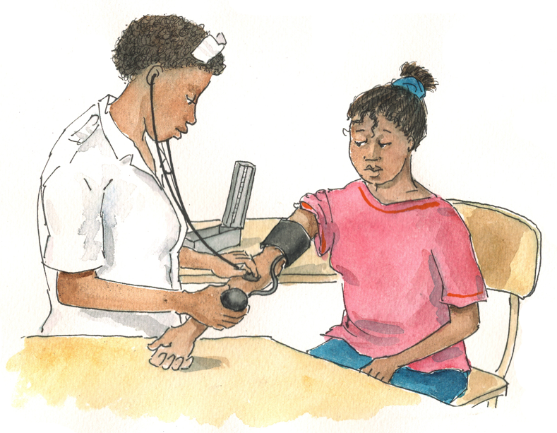
Skill 5: Empathize — Show That You Understand How the Client Feels (Continued)
Examples of empathy:
Client: “I really do not want to start attending the adult clinic. The people who work there are so cold and uncaring, can’t I just stay here at the pediatric clinic forever?”
What is an empathetic response to this statement?

Slide 49
Skill 5: Empathize — Show That You Understand How the Client Feels (Continued)
Examples of empathy:
Client: “I really do not want to start attending the adult clinic. The people who work there are so cold and uncaring, can’t I just stay here at the pediatric clinic forever?”
HW: “It sounds like you’re very fearful of transitioning to the adult clinic. It’s normal to feel scared, it’s a big transition.”

Slide 50
Skill 5: Empathize — Show That You Understand How the Client Feels (Continued)
Examples of empathy:
Client: “I can’t wait to start music school on Monday. My best friend already goes there and now I’ll finally be able to pursue my dream of studying music!”
What is an empathetic response to this statement?
Client: “There is no way I’m going to tell my mother that I’m pregnant.”
What is an empathetic response to this statement?

Slide 51
Skill 5: Empathize — Show That You Understand How the Client Feels (Continued)
Examples of empathy:
Client: “I can’t wait to start music school on Monday. My best friend already goes there and finally, I’ll be able to pursue my dream of studying music!”
HW: “It sounds to me like you feel you’ve found a place where you might really belong!”
Client: “There is no way I’m going to tell my mother that I’m pregnant.”
HW: “I get the feeling that you’re really afraid of your mother’s reaction if she finds out you’re pregnant.”

Slide 52
Skill 6: Avoid Judging Words
Words like: right, wrong, well, badly, good, enough, and properly
Judging words and questions may lead clients to feel they are wrong or that they need to respond in a certain way to avoid disappointing the health worker.
OK to use “good” judging words to:
  Build confidence
  Recognize and praise the client for doing the right thing
Examples:
  “You are doing a great job remembering to come to your appointments.”
  “You are doing the right thing for yourself and your baby by taking your ARVs.”

Slide 53
Skill 6: Avoid Judging Words (Continued)
Change the following judging questions into non-judging questions:
  Did you listen to me and use a condom?
  Did you take your medicine correctly?
  Didn’t you understand what I told you about taking your medicine?
  Did you do the right thing and talk to your mother about your HIV-status?
When we ask questions that do not lead or judge clients, they are more likely to give honest responses.

Slide 54
Skill 7: Help The Client Set Goals and Summarize Each Session
Toward the end of the session:
Develop “next steps.” To help the client develop a more specific plan, the health worker could ask:
    “What do you think might be the best thing to do?”
    “What will you do now?”
    “How will you do this?”
    “Who might help you?”
    “When will you do this?”

Slide 55
Skill 7: Help The Client Set Goals and Summarize Each Session (Continued)
Summarize client’s plan and review next steps
    “I think we’ve talked about a lot of important things today. (List main points.) We agreed that the best next steps are to ___________________. Does that sound right? Let’s plan a time to talk again soon.”
Next steps and goals should:
Be developed by the health worker and client together
Empower the client to achieve what he or she wants
Be results-oriented
Be clear enough to help the client measure progress

Slide 56
Skill 7: Help The Client Set Goals and Summarize Each Session (Continued)
Give the client a chance to ask questions
Make referrals, if needed
Make an appointment for return visit
Record key points and next steps in the client’s file
See Appendix 4E: Motivational Interviewing for more tips.

Slide 57
Tips for Counseling Adolescents
Involve them in their own care.
Assess their emotional and developmental level.
Be aware of the client’s changing capacities and adapt accordingly.
Be guided by client’s questions.
Listen to ALHIV, reflect back feelings, offer empathy, and show that you care about what they are going through.
57

Slide 58
Tips for Counseling Adolescents
Encourage questions to check understanding.
Be aware of the client’s attention span.
Watch the client’s body language. If inattentive, stop and try again at a later time.
Schedule adolescents to see the health worker with whom they best get along/relate.
Use the skills, strengths, and approaches of different health workers on the multidisciplinary team to meet clients’ needs.
See Appendix 4F: Common Counseling Scenarios.
58

Slide 59
Exercise 3
Practice Listening and Learning Skills: Case studies in small groups and large group discussion
See Appendix 4D: Listening and Learning Skills Checklist.

Slide 60
Exercise 3: Role Play/Demonstration
G___, who has had HIV since she was a baby, has been coming to your clinic ever since you can remember. G___ is now 19 years old and, while at clinic today, she asked for a pregnancy test. Although she has had the same boyfriend since she was 14, she looks upset when you tell her that the test results is positive.

Slide 61
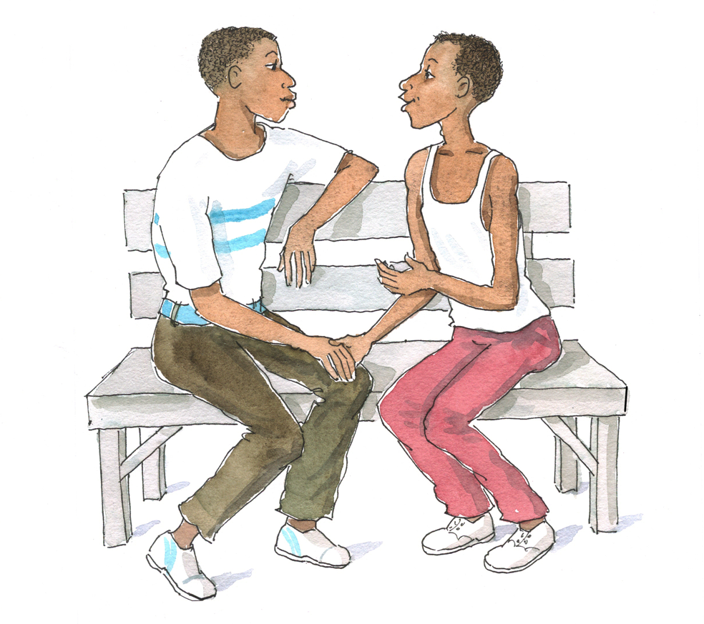
Exercise 3: Case Study 1
M___ is an 18-year-old client you see regularly at the ART clinic. He tells you that he has a male partner he sees on the weekends. He also tells you that he is very worried that his family and friends at school will find out that he is HIV infected.
→ What did the health worker do to build trust and rapport with the client?
→ Which listening and learning skills worked well?
→ Which listening and learning skills were not used? Could they have been used? If so, how?

Slide 62
Exercise 3: Case Study 2
P___ is a 12-year-old girl who acquired HIV perinatally. Her mother died when she was 5 and she has been living with her grandmother ever since. Her grandmother does not like to talk about P___’s HIV-status and none of P___’s friends know she has HIV. When you speak to P___, she doesn’t say anything and keeps looking at the floor with her arms crossed.
→ What did the health worker do to build trust and rapport with the client?
→ Which listening and learning skills worked well?
→ Which listening and learning skills were not used? Could they have been used? If so, how?

Slide 63
Exercise 3: Case Study 3
G___ is a 16-year-old young man who tested positive for HIV 4 weeks ago. When you see him at the clinic today, he appears upset. He says that he hasn’t told anyone about his HIV-status, that he isn’t doing well in school, and that he feels really angry most of the time. His girlfriend is threatening to break up with him because of his moodiness. When you ask him questions, he gives you short responses in an angry voice.
→ What did the health worker do to build trust and rapport with the client?
→ Which listening and learning skills worked well?
→ Which listening and learning skills were not used? Could they have been used? If so, how?

Slide 64
Exercise 3: Debriefing
What did we learn?
Key points:
  Improving listening and learning skills takes practice as well as continuous self-exploration.
64

Slide 65
Questions or comments on this session?

Slide 66
Module 4: Key Points
Establishing a comfortable and open relationship is the foundation for communication and education, and it increases the chances that the client will return to the clinic and stay engaged in care.
When asked by health workers about sensitive issues like sexual activity, adolescents may be reluctant or embarrassed to disclose information because they fear being scolded or mocked.
When communicating with adolescent clients, it is important to be respectful, to ensure privacy, to maintain confidentiality, to be honest, to use language they understand, and to be open to their ideas and choices.

Slide 67
Module 4: Key Points (Continued)
Some communication and counseling tips for adolescents are: start the conversation by building rapport and by discussing non-threatening issues, ask indirect questions, and try to reduce stigma around a sensitive issue by normalizing it.
Younger adolescents sometimes require a more activity-based approach to counseling — using storytelling, games, reading, art, etc.

Slide 68
Module 4: Key Points (Continued)
Good communication is the key component to effective counseling. The 7 key listening and learning skills health workers should always use are:
  Use helpful non-verbal communication.
  Actively listen and show interest in the client.
  Ask open-ended questions.
  Reflect back what the client is saying.
  Empathize — show that you understand how the client feels.
  Avoid words that sound judging.
  Help the client set goals and summarize each counseling session.

