Slide 1
Adolescent HIV Care and Treatment
Module 13:
Supporting the Transition to Adult Care

Slide 2
Module 13 Learning Objectives
After completing this module, participants will be able to:
Understand the key considerations when transitioning a client from pediatric/adolescent care to adult care
Prepare adolescents for and support them during the transition to adult care

Slide 3
Session 13.1
Key Considerations for Health Care Transition

Slide 4
Session 13.1 Objectives
After completing this module, participants will be able to:
Understand the key considerations when transitioning a client from pediatric/adolescent care to adult care

Slide 5
Health Care Transition
After a certain age, ALHIV attending pediatric clinics may have to transition from the pediatric to the adult ART clinic.
Encouraging and helping older ALHIV transition to adult care:
  Supports their healthy development
  Increases their overall ability to advocate for themselves and to adequately manage their own care and treatment

Slide 6
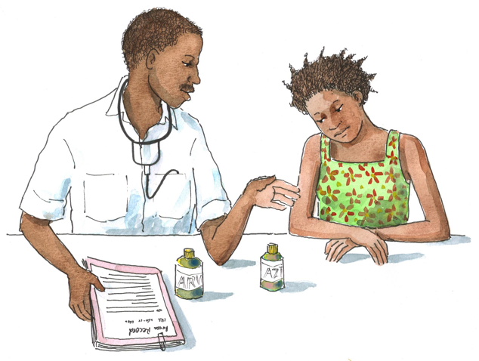
Discussion Questions
What are some fears, concerns, and challenges ALHIV might face when transitioning to adult care?
What are some of the challenges that we, as health workers, face when transitioning our adolescent clients into adult care?
How can health workers help manage these fears, concerns, and challenges, and support adolescents’ transition to adult care?
6

Slide 7
Transition from Pediatric to Adult Care
The goal of transition is to ensure the provision of uninterrupted, coordinated, developmentally- and age-appropriate, and comprehensive care before, during, and after the transition.
ALHIV may face challenges:
  In their transition to adult care
  In learning to independently manage their own care
These challenges affect ALHIV, their caregivers, and health workers in pediatric and adult clinics.

Slide 8
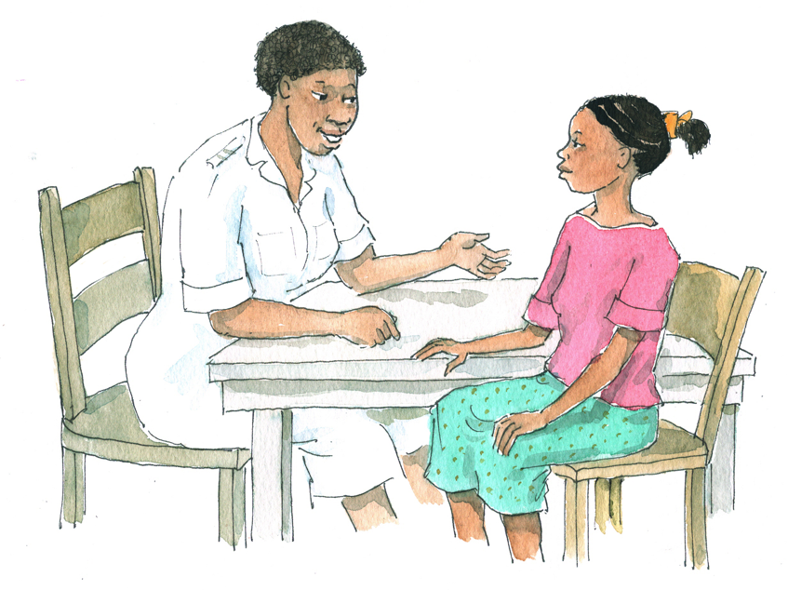
Transition: The Role of the Health Worker
To provide ALHIV and their caregivers with support
To help ALHIV increase their capacity to manage their own care
To help ALHIV advocate for themselves in the clinical setting

Slide 9
Transition: Challenges for ALHIV
Balancing complicated care: ALHIV have to manage multiple medications and appointments and must deal with many different health workers and health services.
Leaving a familiar care network: ALHIV may feel reluctant to leave a familiar care setting and they may feel uncertain about how to manage a new clinic setting with new providers.
Psychosocial and developmental challenges: ALHIV are coping with the typical changes and worries of adolescence and they may be struggling with disclosure and adherence.
System challenges: Adult clinics typically lack specific, youth-friendly services for adolescents.

Slide 10
Key Considerations for the Transition to Adult Care
All adolescents require support both within and outside of the clinic setting to take greater ownership over their health care, behavior, lives, and adherence.
The transition to adult care often occurs in parallel with an adolescent’s emotional and physical maturation. Effective transition must allow for the fact that adolescents are undergoing changes that impact much more than just their clinical care.
Health workers should:
  Help ALHIV set and achieve goals for independence and self-management of care
  Encourage ALHIV to develop as much independence as possible
  Support caregivers to understand their changing role

Slide 11
Key Considerations for the Transition to Adult Care (Continued)
Reaching the overall goal of helping adolescents achieve independent management of their own care is a gradual process and should, whenever possible, involve caregivers and family.
Some caregivers will need assistance understanding their changing role as the focus of care shifts toward a confidential relationship between the adolescent and the health worker.
Not every adolescent will be able to reach 100% independence from his or her caregivers. This is particularly true for adolescents with moderate or severe developmental delays.

Slide 12
Questions or comments on this session?
12

Slide 13
Session 13.2
Preparing and Empowering Adolescents to Transition into Adult Care

Slide 14
Session 13.2 Objective
After completing this session, participants will be able to:
Prepare adolescents for and support them during the transition to adult care

Slide 15
Preparing and Empowering Adolescents to Transition into Adult Care
Programs and facilities may not adequately plan for client transition to adult care.
This can result in:
  An abrupt transfer to adult services
  Maintaining adolescents in the pediatric clinic longer than may be appropriate
  Discontinuation of care
  Adherence challenges
Helping all ALHIV achieve greater independence to manage their own care is essential.

Slide 16
Discussion Questions
What do you think is important for older adolescents to know when transitioning to the adult clinic?
What youth-friendly activities and/or counseling methods/exercises do you think could help adolescents with the transition process?
Who should be involved in the transition process?

Slide 17
Helping ALHIV Prepare for Transition
Transition requires an individualized, developmental approach – not all ALHIV will be ready to transition at the same age.
Begin the process early, working as a team with the adolescent client, his or her caregivers, and other members of the multidisciplinary team.
The transition should:
  Enhance the adolescent’s autonomy
  Cultivate a sense of personal responsibility
  Facilitate self-reliance and self-efficacy
  Boost the adolescent’s capacity for self-care and self-advocacy
  Consider each adolescent's developmental stage and readiness

Slide 18
Helping ALHIV Prepare for Transition (Continued)
Some innovative strategies that health workers and programs can undertake to support transition:
Orienting adult HIV providers on adolescent-friendly services and the needs of ALHIV
Bringing adult providers to the pediatric/adolescent clinic for a joint weekly clinical session so they can get to know more about adolescent clients and their unique needs
Having a provider from the pediatric/adolescent clinic attend the adult clinic on a regular basis for “transition sessions”

Slide 19
Helping ALHIV Prepare for Transition (Continued)
Some ways that health workers and Adolescent Peer Educators can help ALHIV prepare for the transition process:
Reviewing the client’s medical history with him or her and encouraging the client to ask questions
Ensuring that the client understands diagnosis, medications, adherence, and how to live positively
Promoting linkages to adolescent peer support groups and support groups at the adult clinic
Transitioning adolescents to adult care in cohorts or groups
Organizing health talks for transitioning adolescent clients

Slide 20
Helping ALHIV Prepare for Transition (Continued)
Encouraging older adolescents to take responsibility in making and keeping appointments and adhering to medicines (e.g. by using appointment and medicine calendars)
Identifying and orienting adult providers on the necessity of youth-friendly services through meetings, orientations, and trainings
Accompanying the adolescent to the adult clinic for an orientation
Transferring the client’s medical records to the new clinic and holding a case conference to discuss key issues

Slide 21
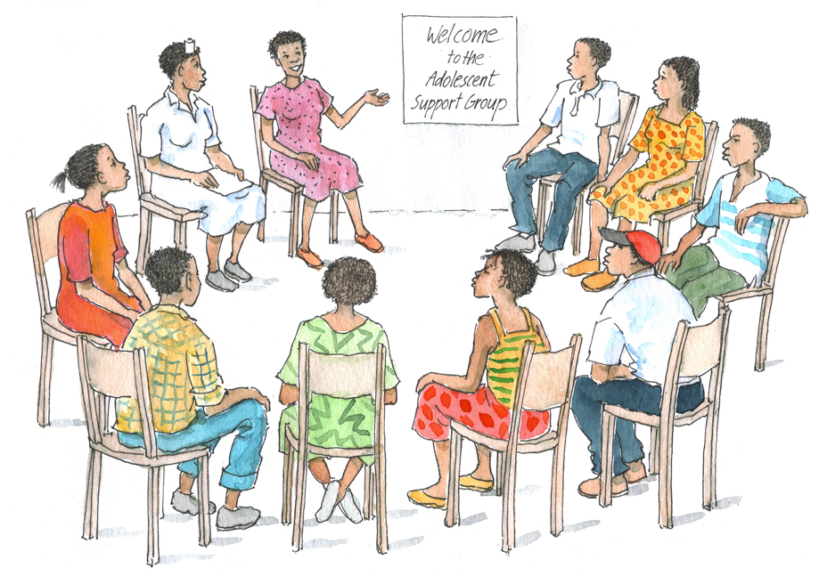
Helping ALHIV Prepare for Transition (Continued)
Involving Peer Educators, social workers, and counselors when planning for a client’s transition, especially for most-at-risk ALHIV
Using a variety of youth-friendly activities, such as journaling or creating a Transition Workbook (see Appendix 13B)
Connecting ALHIV to other community-based services

Slide 22
Helping ALHIV Prepare for Transition (Continued)
Help older ALHIV be more involved in their own care. Ideally, they should be able to:
Make, cancel, and reschedule appointments
Arrive to appointments on time
Call ahead to schedule urgent visits
Request prescription refills correctly
Know when to seek care for symptoms or emergencies
Identify symptoms and describe them
Negotiate multiple providers and different types of clinic visits
Establish a good working relationship with a case manager
Ask questions and ask for help
Have a full understanding of their care and treatment plan, including the medicines they are taking
Get the results of every test and understand the results
Join an ALHIV association and support group
Follow up on all referrals

Slide 23
Transition Tools
It is possible for adolescents to have a smooth transition to adult care and to receive adolescent-friendly services in the adult clinic.
There are a number of tools that can help health workers and ALHIV prepare for and carry out the transition to adult care:
  Review and discuss Table 13.1, which is a self-care and transition timeline for ALHIV.
  Review and discuss Appendix 13A: Transition Checklist for Health Workers.
  Also see Appendix 13B: Transition Resources for Health Workers and ALHIV.

Slide 24
Exercise 1
Supporting ALHIV in Their Transition to Adult Care: Case studies and large group discussion
See Appendix 13A: Transition Checklist for Health Workers.

Slide 25
Exercise 1: Case Study 1
P___ is a 16-year-old ALHIV. In a few months, he is moving to a new town with no pediatric clinic and he will have to start getting care and treatment at an adult clinic. He is nervous about this change because he does not know the staff there and because he will now have to deal with a large, crowded clinic.
→ What fears or concerns do you think this client has about transitioning to adult care?
→ What could health workers do to prepare this client for his or her transition to adult care?
→ What follow up could health workers provide once the adolescent has enrolled in the adult clinic?

Slide 26
Exercise 1: Case Study 2
M___ is an ALHIV who is 19 years old. She has been receiving services from the adult clinic for the past year. Today, M___ has returned to the adolescent clinic to see you. When you ask her about her care and treatment, she tells you that she stopped taking her ARVs 3 weeks ago. When you try and discuss this situation with her in more detail, she cries and tells you that she doesn’t like the people at the adult clinic.
→ What fears or concerns do you think this client has about transitioning to adult care?
→ What could health workers do to prepare this client for his or her transition to adult care?
→ What follow up could health workers provide once the adolescent has enrolled in the adult clinic?

Slide 27
Exercise 1: Case Study 3
B___ is 20 years old and is a client at the pediatric clinic where you work. Her auntie supports her and usually brings her for clinic visits. B___ has been diagnosed with some learning problems and developmental delays and, although she should transition to the adult clinic soon because of her age, you have some concerns about her development and ability to independently manage her own care. You are afraid she will get “lost” at the adult clinic.
→ What fears or concerns do you think this client has about transitioning to adult care?
→ What could health workers do to prepare this client for his or her transition to adult care?
→ What follow up could health workers provide once the adolescent has enrolled in the adult clinic?
→ What might be some of the implications of B___’s developmental delays for her transition to adult care?

Slide 28
Exercise 1: Debriefing
What did we learn?
Key points:
  To prepare for the transition from the pediatric to the adult clinic, older ALHIV need support from the multidisciplinary care team and family members.
  Ideally, health workers from the pediatric and adult clinics collaborate and problem solve together during a client’s transition.
  As ALHIV transition to the adult clinic, we can help them advocate for themselves, be involved, and understand their care and treatment.
  Appendix 13A: Transition Checklist for Health Workers and Appendix 13B: Transition Resources for Health Workers and ALHIV can be used/adapted to support ALHIV during the transition process.

Slide 29
Questions or comments on this session?
29

Slide 30
Module 13: Key Points
In some places, adolescents attend pediatric clinics where they may have been getting services since birth, or for many years. After a certain age, they usually have to transition to an adult ART clinic.
This care transition can be difficult for adolescents, caregivers, and health workers because during this period, adolescents have to adjust to a new, less nurturing environment and to new health workers.
Taking on a greater role in self-care and self-advocacy may be challenging for adolescents, depending on their level of development and maturation. Not all adolescents, especially those with developmental delays, will be able to achieve 100% transition and independence.

Slide 31
Module 13: Key Points (Continued)
Health workers should help ALHIV set and achieve goals for independence and self-management of care as a way of recognizing their increasing maturation, capacity to make choices, and independence.
Not all ALHIV will be ready to make the transfer to adult care at the same age. Health workers must take into account their cognitive and physical development, their emotional maturity, their support at home and in the community, and their health.
It is possible for adolescents to have a smooth transition to adult care and to receive adolescent-friendly services at the adult clinic. This requires planning and preparation for transition with the adolescent and ensuring that adult clinic staff understand the special needs of ALHIV.

