Slide 1
Adolescent HIV Care and Treatment
Module 7:
Providing Disclosure Counseling and Support

Slide 2
Module 7 Learning Objectives
After completing this module, participants will be able to:
Apply a developmental approach to the process of disclosure preparation
Understand the reasons to disclose to children and young adolescents
Discuss common barriers that health workers and caregivers have to disclosure and possible solutions for each
Work with caregivers to understand the importance of disclosure and to prepare for and move through the disclosure process with children and adolescents
Work through the disclosure process with children and young adolescents
Provide counseling and support to adolescents on disclosing their HIV-status to others

Slide 3
Session 7.1
The Disclosure Process: A Developmental Approach

Slide 4
Session 7.1 Objective
After completing this session, participants will be able to:
Apply a developmental approach to the process of disclosure preparation

Slide 5
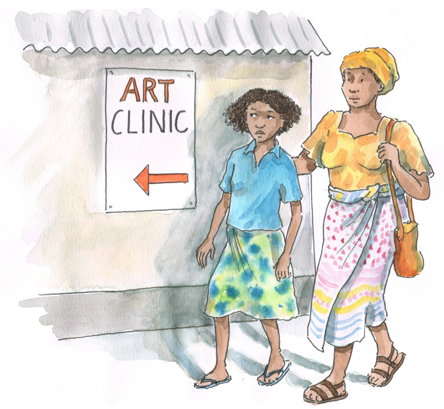
Discussion Questions
What have been some of your personal experiences and challenges working with caregivers who need assistance disclosing to children/adolescents?
What about with ALHIV who know their status and need assistance disclosing to others?

Slide 6
Discussion Questions
What is meant by the term “disclosure?” How does this translate into the local language?
What do you think is meant by the phrase, “Disclosure is an ongoing process?”
What is meant by a “developmental approach” to disclosure? What are some examples of this with younger and older adolescents?
See Appendix 7A: Guidance for Developmentally Appropriate Disclosure.

Slide 7
Overview of Disclosure and ALHIV
Disclosure is an ongoing process of:
Telling a child/young adolescent that he or she has HIV
Helping him or her understand what this means
Helping him or her disclose his or her HIV-status to others
Disclosure is a 2-way conversation that involves:
Speaking truthfully with the child/adolescent, over time, about his or her illness
Disclosing the diagnosis at an appropriate time, or helping the caregiver to do so
Helping the ALHIV prepare to disclose to others and providing follow-up support

Slide 8
Overview of Disclosure and ALHIV (Continued)
The disclosure process should begin early by addressing the child’s health status and his or her need for care and treatment. In the early stages, very simple terms should be used.
Through the process, the child/young adolescent should come to know about:
The diagnosis, the infection and disease process, and health changes that could occur
Strategies to lead a healthy life (e.g., adherence) and his or her responsibilities now and in the future
How to cope with the possible negative (and positive) reactions of others

Slide 9
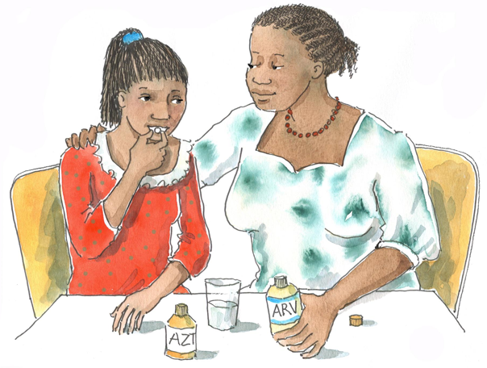
Remember:
Ideally, adolescent clients will already know their HIV-status and their caregivers will be well into the disclosure process. However, some adolescent clients, especially those on the younger end of the adolescent spectrum, may not be fully disclosed to.

Slide 10
Overview of Disclosure and ALHIV (Continued)
Using a developmental approach to disclosure:
Decisions should be based on the readiness of the caregiver and the developmental stage of the child.
Each phase of childhood development has characteristic features. Understanding a child’s/adolescent’s developmental stage and needs is vital to disclosure and will help ensure that information is presented when the young person is able to cope with it.
Developmental stages are associated with approximate ages. It is essential that health workers ask questions to assess each ALHIV’s understanding (see Appendix 7A).

Slide 11
Questions or comments on this session?

Slide 12
Session 7.2
Disclosure Preparation, Counseling, and Support for Children, Young Adolescents, and Caregivers

Slide 13
Session 7.2: Objectives
After completing this session, participants will be able to:
Understand the reasons to disclose to children and young adolescents
Discuss common barriers that health workers and caregivers have to disclosure and possible solutions for each
Work with caregivers to understand the importance of disclosure and to prepare for and move through the disclosure process with children and adolescents
Work through the disclosure process with children and young adolescents

Slide 14
Discussion Questions
Do you think it is important for children and adolescents to know their HIV-status? Why or why not?
When do you think the disclosure process should start? Why?
What challenges have you encountered with adolescents who do not know their status? How can health workers prevent these challenges?
What is the difference between partial and full disclosure? How does this apply to children and young adolescents?
Do you think there are times when disclosure to a child/young adolescent should be delayed?

Slide 15
Disclosure of HIV-Status to ALHIV
Remember: Disclosure of a child’s HIV-status is often one of the most sensitive issues for caregivers. All young people have a right to participate in decision-making about their health care. Start talking about disclosure with caregivers and start working with older children to prepare them for disclosure WELL before the child is an adolescent. Partial disclosure should begin by the time the child is 6 years old (for perinatally infected children). Full disclosure is recommended by age 10-12, but this depends on each individual child and family.

Slide 16
Reasons to Disclose a Child’s HIV-Status
Can result in health and psychological benefits for the child
Children/adolescents have a right to know
Adolescents often want and ask to know what is wrong
Non-disclosure may lead to incorrect ideas, feelings of being alone, learning one’s status by mistake, or poor adherence
May improve social functioning and school performance
Caregivers can provide comfort and reassurance
Children are exposed to unintended “clues“ of their diagnosis
Orphans and other vulnerable children may wonder why they’ve lost a parent or been rejected by family
They can then take an active role in their care and live positively
Levels of anxiety, depression, and low self-esteem are higher in adolescents who have not been disclosed to
Parents who have disclosed also experience better mental health outcomes

Slide 17
Partial and Full Disclosure
Partial disclosure:
Appropriate for younger children
Refers to giving information about a child’s illness without using the words “HIV” or “AIDS”
Helps move the disclosure process forward; prepares client and caregivers for full disclosure later on
Is an effective strategy to help caregivers who do not feel ready for full disclosure
Is useful for creating a context in which full disclosure can be more meaningful for the child
Consider partial disclosure by the time a child is 6 years old, particularly if he or she has started asking questions related to his or her health.

Slide 18
Partial and Full Disclosure (Continued)
Full disclosure:
When a child/young adolescent is told that he or she is HIV-infected and is given further HIV-related details
Caregivers are ideally the ones who should decide when it is time for full disclosure
It is generally recommended that full disclosure happen by the time a client is 10-12 years old
Full disclosure should be considered when the child/young adolescet starts asking specific questions about his or her illness
Easiest if child/young adolescent has been partially disclosed to over time and has been supported throughout the disclosure process

Slide 19
Delaying Disclosure
There are occasional times when it may be more appropriate to delay the disclosure process, such as:
When the child/young adolescent has severe cognitive and developmental delays
When the child/young adolescent is grappling with serious health or mental health conditions
When one or both parents/the caregiver has an acute health problem or mental health crisis

Slide 20
Brainstorming: Barriers to Disclosure
First, please write on flip chart:
What are some barriers that health workers have to disclosure?
What are some barriers that caregivers have to disclosure?

Slide 21
Barriers to Disclosure and Solutions
Next, as a large group discuss:
What are possible solutions to each barrier?
See Tables 7.1 and 7.2.

Slide 22
Debriefing
Health workers should start talking about disclosure with caregivers (and in some cases young clients) WELL before a particular child has become an adolescent. Health workers play an important role in helping children, adolescents, and their families negotiate the challenges and barriers to moving through the disclosure process. Knowledge of their status may help promote clients’ adherence to care and treatment, while not knowing or having a confused understanding may cause difficulties with adherence, psychosocial well being, and positive living.

Slide 23
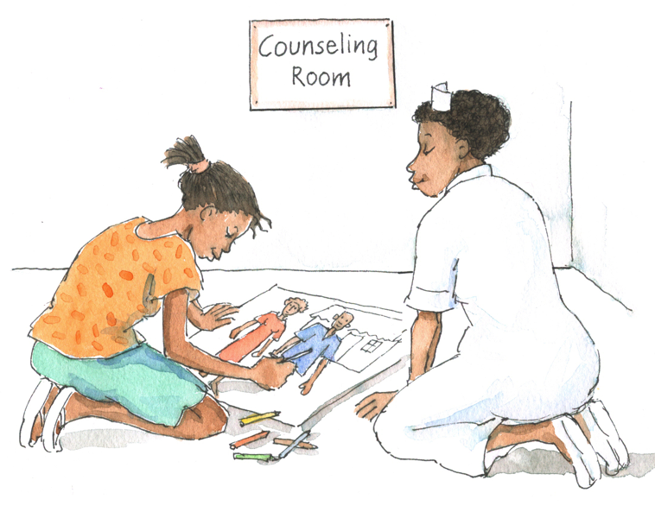
Discuss in Pairs
How would you summarize the health worker’s role in the disclosure process with children/young adolescents?

Slide 24
Health Worker’s Role in Disclosure
Encourage open dialogue and disclosure
Offer practical and developmentally appropriate strategies
Assess the child/young adolescent’s readiness for disclosure and communicate impressions with caregivers
Help family develop and follow a disclosure plan
Prepare the client for disclosure
Facilitate disclosure discussions and, if needed, take a more active role in the disclosure process
Support client and caregiver throughout the process
Advocate for the needs of the client
Remember: Work with and consult the MDT to best support children, adolescents, and caregivers through the disclosure process.

Slide 25
Discussion Questions
How can health workers help parents and caregivers prepare for different stages of the disclosure process?
What is the health worker’s role in the process?
How would you respond if a caregiver did not seem ready to start or move forward with the disclosure process?
How can health workers provide ongoing support to caregivers throughout the disclosure process?

Slide 26
Overview of the Health Workers’ Role in the Disclosure Process
The health worker’s role may include:
Encouraging open dialogue and disclosure
Offering practical and developmentally-appropriate strategies
Assessing the child’s readiness for partial/full disclosure
Working with caregivers to develop and follow a disclosure plan
Preparing the child for disclosure
Facilitating disclosure discussions
Supporting the client and caregiver throughout the disclosure process
Advocating for the needs of the child/young adolescent

Slide 27
Health Worker’s Role in Supporting Caregivers with Disclosure
Build trust by getting to know them; find out what HIV means to them
Assess their psychosocial situation and ability to cope; answer their questions; identify their sources of support
Discuss implications of disclosure and possible reactions of the child and others
Assess client’s readiness for disclosure and share impressions with the caregiver
Help caregivers develop a plan for disclosure
Arrange follow-up visits
If there is disagreement between family members, assess concerns and discuss benefits and risks
Respect and try to understand their reasons for fearing or resisting disclosure
Remember: If the caregiver is not ready to disclose, the process cannot be forced. However, the health worker should always advocate for what is in the best interest of the child/young adolescent.

Slide 28
Providing Ongoing Disclosure Support to Caregivers
Caregivers will also need ongoing support — from health workers, family members, and peers — as the disclosure process proceeds over time.
At each visit, ask the caregiver follow-up questions, such as:
Have you noticed any changes in your child’s behavior since he or she learned about his or her HIV-status?
Who else at home knows about the child’s status?
What kind of help, support, or information do you still need?
What feelings or concerns do you have about the disclosure process with your child?
Who does your child have to talk with if he or she has questions?
What questions do you have?
When will we meet again?

Slide 29
Discussion Questions
How can health workers assess a child/young adolescent’s readiness for disclosure?
How can health workers help prepare children/young adolescents for disclosure?
How can health workers advocate for the needs of the child/young adolescent client, especially if there is disagreement between caregivers and health workers regarding disclosure?
How can health workers provide ongoing support to young clients through the disclosure process?

Slide 30
Health Worker’s Role in Supporting Children and Young Adolescents with Disclosure
Prepare the child/young adolescent for disclosure.
Actively assess the client’s readiness for partial or full disclosure.
In some cases, be part of the disclosure discussions with the client.
Provide post-disclosure and ongoing support.
See Appendix 7A: Guidance for Developmentally Appropriate Disclosure.
Remember: Health workers can and should be advocates for the needs of their child/adolescent clients, including their disclosure needs.

Slide 31
Providing Ongoing Disclosure Support to Children/Adolescents
Disclosure does not begin or end with a single conversation. As children/adolescents grow and develop, they need to be able to continue to ask questions and discuss their feelings.
At each visit, ask the client questions about disclosure, such as:
Why do you think you take these medications? What do you know about HIV?
How have you been feeling since you learned about your HIV-status?
Who else do you talk to about HIV and who do you ask if you have questions?

Slide 32
Providing Ongoing Disclosure Support to Children/Adolescents (Continued)
Who else knows about your HIV-status? What do you think about disclosing your status to (other) people you are close to?
What are some of the ways you are taking care of yourself? How do you think you can live positively with HIV?
How are you doing with your medications?
What other questions do you have?
When should we meet again to talk more?

Slide 33
Special Cases
When working with children and adolescents who do not have caregivers or do not have caregivers who are actively involved:
The health worker (and if possible, more than one member of the multidisciplinary team) may have to take a more active or “parental” role in the disclosure process.
When working with children and adolescents in institutional care:
Health workers should identify the person who is legally responsible for the child or adolescent and, if possible, invite that person to the clinic for a session related to disclosure.

Slide 34
Exercise 1
Supporting Caregivers with the Disclosure Process: Start-stop role plays and large group discussion

Slide 35
Exercise 1: Start-Stop Role Play 1
A mother named E___ has been caring for her HIV-infected 10-year-old son, T___. T___ keeps asking you why he has to take these pills and says he wants to know when he will be done with them. When you ask the mother what T___ knows about his health, she becomes quiet.
→ How would you proceed?

Slide 36
Exercise 1: Case Study Discussion Questions
What types of questions is T___ likely to ask about his illness? What are some possible responses? (See Appendix 7A.)
What can the health worker do to help the caregiver prepare for the disclosure process?
How can the health worker assess the caregiver’s readiness for or knowledge about disclosure?
What age-specific activities, if any, can the health worker introduce during the session?

Slide 37
Exercise 1: Start-Stop Role Play 2
A___is 11 years old. She has lived with her grandmother since her mother died 3 years ago. A___ and her grandmother have been coming to the clinic since A___ started to become symptomatic and the doctor wants her to start ART soon. The grandmother is having problems giving A___ her CTX. You believe that A___ would cooperate better if she understood more about the medication and why she needs it, especially since ART is now about to become part of their everyday lives. The grandmother thinks A___ is too young to know her status and insists she does not need to know yet.
→ How would you proceed?

Slide 38
Exercise 1: Case Study Discussion Questions
What types of questions is A___ likely to ask about her illness? What are some possible responses? (See Appendix 7A.)
What can the health worker do to help the caregiver prepare for the disclosure process?
How can the health worker assess the caregiver’s readiness for or knowledge about disclosure?
What age-specific activities, if any, can the health worker introduce during the session?

Slide 39
Exercise 1: Start-Stop Role Play 3
G___ is a 12-year-old boy living with HIV and taking ART. He lives with his mother, uncle, and 5 older siblings and cousins. G___ has come to the clinic with his mother today. She tells you that before she thought she was doing the right thing by moving from partial to full disclosure with her son over the last couple of months. Now, however, she thinks she might have done the wrong thing by fully disclosing because her son hasn’t asked any questions about his status, seems sad all the time, doesn’t want to take his medicines, and is acting out in school. Today, G___ seems very withdrawn even though he tells you, “I am fine.”
→ How would you proceed?

Slide 40
Exercise 1: Case Study Discussion Questions
What types of questions is G___ likely to ask? What are some possible responses? (See Appendix 7A.)
What can the health worker do to support the caregiver?
What can the health worker do to support the client?
What age-specific activities, if any, can the health worker introduce during the session?

Slide 41
Exercise 1: Debriefing
What did we learn?
Key points:
The disclosure process can be affected by many complex personal and family issues. We need to take a multidisciplinary approach to best support clients and families.
As health workers, we may be asked to act as intermediaries, helping to guide and support caregivers through the disclosure process and/or we may need to take a more active or “parental” role in disclosure preparation, discussion, and follow-up with young clients.
In all cases , it is important that we balance what is in the best interest of the client with the needs, wishes, and views of the caregivers.

Slide 42
Questions or comments on this session?

Slide 43
Session 7.3
Disclosure Counseling and Support for Adolescents Who Know Their Status

Slide 44
Session 7.3 Objective
After completing this session, participants will be able to:
Provide counseling and support to adolescents on disclosing their HIV-status to others

Slide 45
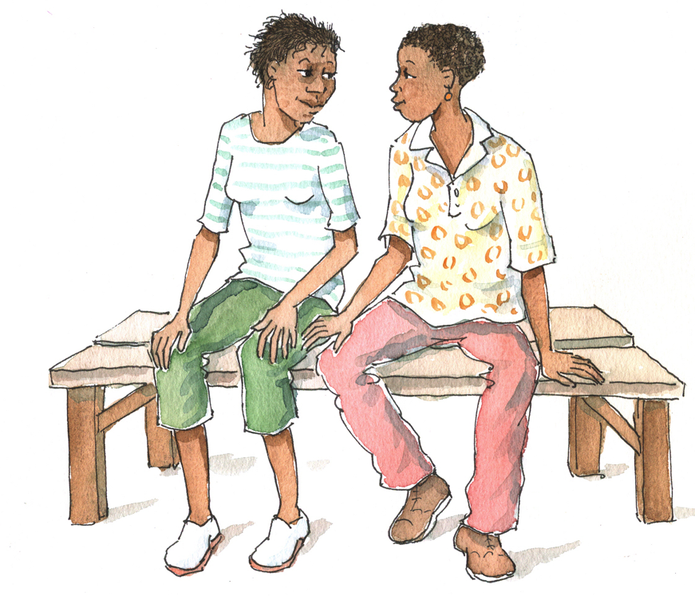
Brainstorming
What are some potential advantages of disclosure for ALHIV?
What are potential disadvantages?

Slide 46
Advantages of Disclosure May Include:
Avoiding the burden of secrecy
Avoiding anxiety about accidental disclosure
Gaining access to emotional and practical support
Easier access to health care
Better adherence
Easier to discuss safer sex and family planning with partners
Easier to talk about testing with partners
Gaining the freed to find a treatment buddy
Gaining access to peer support groups and community organizations
Serving as a disclosure role model for others

Slide 47
Disadvantages of Disclosure May Include:
Blame from partner or family
Distancing, fear, rejection, or abandonment from family, partners, or friends
Discrimination or rejection at school, in the community, or at work
Assumptions made by others about one’s sexuality, promiscuity, or lifestyle choices
Partner reluctance to enter into intimate relationships or have children
Physical violence
Self-stigma
Loss of economic/ subsistence support from family members or partners

Slide 48
Remember:
ALHIV can feel very isolated. Health workers can help adolescents understand that one of the advantages of disclosure is that they will have friends who know their diagnosis and who can support them. Because of their special status (no longer children, not yet adults), adolescents need support with the disclosure process from the entire MDT. Adolescents should always make their own decisions about disclosure. Health workers can support ALHIV to decide whom to disclose to, to decide when and where to disclose, to weigh the advantages and disadvantages of disclosure, and to anticipate likely responses.

Slide 49
Discussion Questions
What are some different ways health workers can help support adolescents when they are considering disclosing their HIV-status to others?
What are some of the main considerations when providing disclosure counseling to ALHIV?

Slide 50
Disclosure Counseling:
Should not include pressure to disclose
Is a confidential conversation that helps clients work through issues
Is important to reduce stigma, enhance adherence, and reduce the spread of HIV
Should promote informed decision-making
Assists and supports clients who have decided to disclose
Enhances coping strategies post-disclosure
Uses a tailored and developmental approach
Is an ongoing process requiring preparation, practice, and follow-up support

Slide 51
Remember:
Because disclosure is a process, it is important that health workers continue to check in with clients about the progress they are making and the challenges they are encountering disclosing their HIV-status to others. This should NOT include putting pressure on clients to disclose, but should rather focus on supporting clients to work through issues related to disclosure and heping them make a plan.

Slide 52
Ways to Assist ALHIV in the Disclosure Process:
Use good communication and counseling skills
Talk about their feelings and fears
Discuss advantages and disadvantages
Support them to make their own decisions
Help them decide whom to disclose to, when, and where
Help them identify barriers and possible solutions
Provide accurate information in response to questions
Help them anticipate likely responses to disclosure
Talk about sexual partners
Offer reassurance and emotional support
Identify sources of support and refer clients to peer support
Encourage them to take time to think things through
Practice disclosure through role plays
Provide ongoing follow-up and support

Slide 53
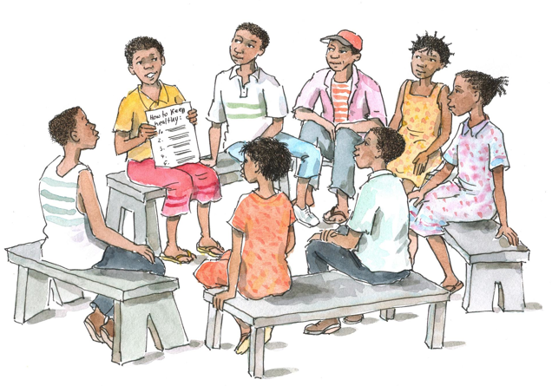
Peer Support and Disclosure
Peer support can be an excellent resource for adolescents making decisions about disclosure. Peer Educators and peer support groups: Adolescents may find it helpful to meet each other for mutual support. Groups for caregivers of ALHIV: Family members of ALHIV may benefit from talking with other families or with a health worker in a support group setting

Slide 54
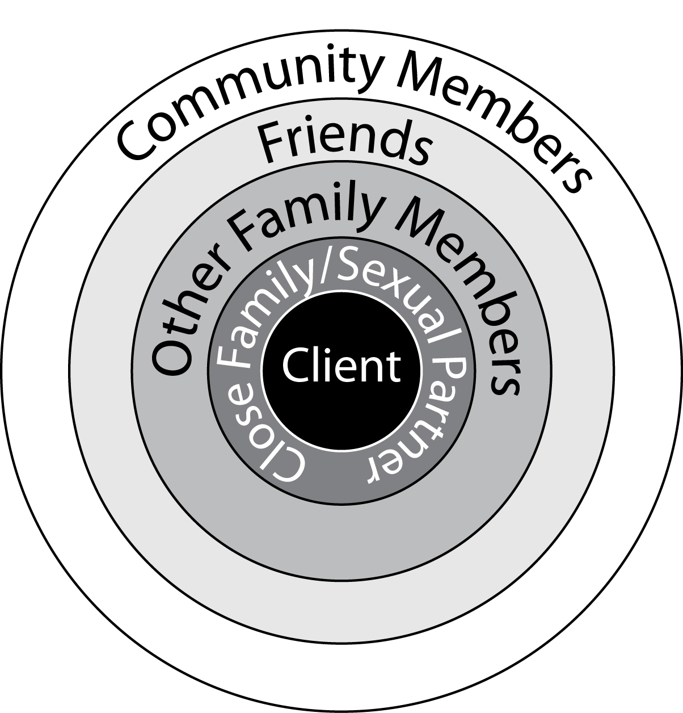
Deciding About Disclosure
Creating disclosure circles can help adolescents decide who to disclose to; each level represents a process in itself (see Figure 7.1)
People adolescent is closest to
People adolescent is less close to

Slide 55
Exercise 2
Supporting ALHIV with the Disclosure Process: Role plays and large group discussion

Slide 56
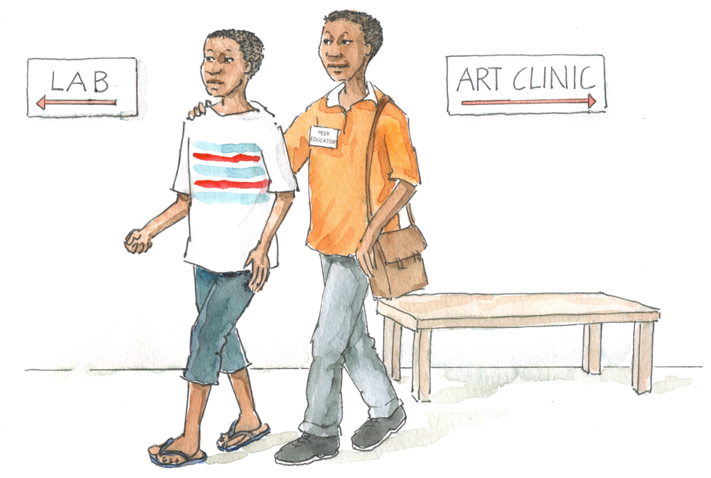
Exercise 2: Case Study 1
C___ is 15 years old and found out that he is HIV-infected at a VCT clinic 2 months ago. Today, he has returned to the ART clinic for a second visit and says that he has not yet told anyone about his HIV-status because he is too ashamed and scared to tell his family.
→ How would you help C___?

Slide 57
Exercise 2: Case Study 2
L___ is a 16-year-old girl who was perinatally infected with HIV. L___ mentions that she really wants to disclose her status to one of her male friends at school. L___ likes this boy very much and she knows that he likes her, but she is nervous about her friend’s reaction. They have been arguing recently because L___ has been avoiding him. She asks your opinion about what to do.
→How do you proceed?

Slide 58
Exercise 2: Case Study 3
J___ is a 14-year-old female orphan with HIV who lives with her maternal aunt and uncle. J___ just started a new school and is afraid that she will be thought of as different from the other kids if anyone finds out she is living with HIV. She has not disclosed her status to anyone at school.
→How would you proceed with J___?

Slide 59
Exercise 2: Case Study 4
An 18-year-old named I___ tested positive for HIV about 2 years ago. He got tested because his girlfriend at that time found out she was HIV-infected. He has since changed girlfriends, however, and has not yet told his new girlfriend about his HIV-status. He takes good care of himself and feels fine. He has come to the clinic today for his regular appointment and wants to talk with you about how to tell his girlfriend that he is living with HIV.
→ How would you help I___ prepare for the process of disclosing to his girlfriend?

Slide 60
Exercise 2: Additional Case Study Discussion Questions
How would you counsel and support the client during the disclosure process? How would you help them to prepare for disclosure?
What are some of the client’s potential questions/fears/ concerns related to disclosure and how would you address them?
What age-appropriate communication techniques/ approaches would you use to build trust and rapport?

Slide 61
Exercise 2: Debriefing
What did we learn?
Key points:
Everyone needs a unique disclosure plan. Adolescents are a diverse group and we should take these differences into account when conducting disclosure counseling.
Creating disclosure circles can help clients think through their own disclosure process to others.
Our role as health workers is to support the disclosure process. Remember, it is the adolescent who will make the final decision about who to disclosure to, when, and how.

Slide 62
Questions or comments on this session?

Slide 63
Module 7: Key Points
Disclosure is an ongoing process, not a one-time event.
Disclosure can help young clients access prevention, care, treatment, and support. It can also improve adherence, reduce stigma and discrimination, and slow the spread of HIV by helping people protect themselves and their partners.
Disclosure can result in health benefits for the child/ adolescent and caregiver.
Health workers and caregivers may face barriers to disclosure, such as not knowing where to start or feeling concerned about harming the child/adolescent.

Slide 64
Module 7: Key Points (Continued)
Health workers play several important roles in the disclosure process, including assessing the client’s and caregiver’s readiness, working with the caregiver to develop and follow a disclosure plan, preparing the client for different stages in the disclosure process, and supporting the client and caregiver throughout the process.
Health workers should advocate for the best interests of the child/adolescent and, in some cases, they may have to take a more active or “parental” role in the disclosure process.
Health workers can support adolescents to decide to whom to disclose, when, and where; to weigh the advantages and disadvantages of disclosure; and to anticipate likely responses.

