Slide 1


Pre-Exposure Prophylaxis (PrEP) Training for Providers in Clinical Settings
Module 6: Person-Centered PrEP Counseling
Last update: January 2024​

Slide 2

Training Overview
Oral PrEP
MODULE 1: PrEP Basics ​
MODULE 2: Oral Daily PrEP​
MODULE 3: Oral Event-Driven PrEP (ED-PrEP)​
MODULE 4: Injectable Long-Acting
Cabotegravir (CAB-LA)​
MODULE 5: Dapivirine Vaginal Ring (DVR)​
MODULE 6: Person-Centered PrEP Counseling
PrEP Vaginal Ring
Injectable PrEP

Slide 3
PrEP Competencies​
By the end of this training program, you should be able to:​
Explain the use of PrEP for HIV prevention​
Identify candidates eligible for PrEP​
Initiate clients on PrEP​
Conduct follow-up management for PrEP ​
Provide person-centered counseling for PrEP​

Slide 4
Symbols Key​
Preliminary recommendation based on available evidence and may change​
Adaptation required or suggested based on local context​
Content repeated in other modules​
Unknown at the moment, more information required​

Slide 5

Learning Activities​
Question & Answer​
Fill in the blank​
Review national guidelines
True/false
​Case scenario​
Role-play​
Discussion​
Share experiences​
Notes:
Facilitator Guidance:
This training is designed to be interactive and to engage participants in learning and knowledge sharing. Rather than simply lecturing to participants, we encourage facilitators to use a variety of participatory methodologies, including question and answer, discussion, case scenarios, role-play, and other small group activities. These activities are provided for you and were designed to elicit and build on participants’ experience and knowledge, to promote discussion and reflection on key issues, to provide hands-on practice of content learned, and to help participants learn from one another. In addition, these participatory methodologies promote higher retention of content and create an open, engaging, and supportive learning environment.
Review the learning activities in advance of facilitation:
Question & Answer
Questions and answers are included throughout the module to keep learners engaged and actively participating. Q&A are offered to encourage participants to reflect on their existing knowledge before a new topic is introduced. Q&A are also offered after lecture content is delivered to test participants knowledge recall.
How To Facilitate Q&A
Read the question on the slide.
Ask participants to raise their hands to answer the question.
Take a few volunteer responses.
Reveal the answer on the following slide.
Allow time for follow-up discussion as needed (see below).
2. Discussion
A discussion is a dialogue between participants and the trainer, with participants responding to discussion questions and to one another’s ideas. During discussions, new questions may surface. When the trainer leads a large group discussion, she or he must manage the discussion by keeping participants focused, actively eliciting responses, and limiting participants who like to talk a lot. When participants have small group discussions, they must do likewise.
How To Facilitate Discussion
• Set a time limit and keep track of time.
• Explain that participants who want to speak should raise their hands.
• Keep the discussion on target and moving along.
• Encourage everyone to participate and call on everyone who raises a hand.
• Limit participants who like to talk a lot.
• Ask questions to encourage more responses to a question—for example: “What else?” “What other ideas do you have?”
• Wrap up the discussion by repeating and summarizing main points.
3. Case scenarios
A case scenario is a brief description of a realistic situation that participants discuss and analyze. Case scenarios give participants the opportunity to apply newly acquired knowledge to a particular problem or situation and to generate possible solutions to challenges presented in the scenario.
How to Facilitate Case Scenarios
• If participants will use the scenario in small groups or pairs, give clear instructions.
• If you write your own scenarios, make them simple and brief. Use realistic situations similar to those that participants face. Give essential information and leave out unnecessary details.
• Provide questions to guide participants in analyzing the scenario and a list of essential points to be covered in discussion for yourself and co-trainers.
4. Role-play
A role-play is a brief informal performance where participants act out roles in order to practice handling a particular problem or situation and to experience what it is like to be in those roles. Role-playing is informal; participants do not need to memorize dialogue or perform perfectly— the point is to experience the situation and learn from that experience.
How To Facilitate a Role-Play
• Give clear instructions for the role-play
• Set a time limit for role-play practice and performance, and manage the time well.
• Remind participants that role-playing does not require a perfect performance but rather provides an opportunity to practice handling real-life situations. It is fine to make mistakes during role-play.
• Debrief the role-play with a large group discussion
5. Small group activities
The facilitator divides participants into small groups to do a learning activity. Examples of small group activities include discussions, scenarios, and role-play practice as described above. Small groups allow each person to participate more than they would in the large group. Small group work also helps participants get to know one another and work with new colleagues.
How To Facilitate Small Group Work
• Before you divide participants into small groups, give clear instructions for the small group task.
• Group participants so that they are not always working with people they know well. To vary groups’ composition: Ask participants to count off or draw at random from a deck of playing cards and then group by suit or numbers. Or ask participants to draw at random from a container of colored objects or slips of paper and then group by colors. Or group participants by birthday (seasons or months), by first letter of first or last name, by last digit of their phone number, or by height—then, based on how many fall into each category, regroup these groups so that you have groups of an optimal size.
• Instruct the groups to make sure that all group members participate.
• Have each group choose a timekeeper.
• Keep track of time yourself and provide half-time, 5-minute, and 1-minute warnings.
• As the groups are working, move from one to another to make sure that participants have understood the task and are making progress.

Slide 6
Module 6: Person-Centered PrEP Counseling

Slide 7
Introduction​
Welcome to Module 6: Person-Centered PrEP Counseling
In this module you will learn how to apply principles of person-centered counseling for PrEP. You will learn how to use informed choice counseling to support clients to choose the PrEP option that best suits their needs and preferences when more than one option is available to them. After completing the module, you will be able to support clients to address common challenges to using PrEP effectively.

Slide 8
Module 6 Learning Objectives​
After completing Module 6, participants will be able to:​
Describe the basic principles of person-centered counseling
Help clients think through the benefits that PrEP offers them
Use informed choice counseling to help clients select among available PrEP options
Define the concept of effective PrEP use
Use person-centered counseling to support effective PrEP use
Identify and respond to common barriers to effective PrEP use and continuation

Slide 9
What is YOUR EXPERIENCE counseling PrEP clients? ​
Do you have any successes or challenges to share?​
What would you like to learn about counseling clients to use PrEP?​
DISCUSSION​
Notes:
Facilitator guidance:
• Time: 10-20 minutes. Timing will vary based on size of the group and time allowed for training. Set a time limit and keep track of time.
• Explain that participants who want to speak should raise their hands.
• Keep the discussion on target and moving along.
• Encourage everyone to participate and call on everyone who raises a hand.
• Limit participants who like to talk a lot.
• Ask questions to encourage more responses to a question—for example: “What else?” “What other ideas do you have?”
• Wrap up the discussion by repeating and summarizing main points.

Slide 10
6.1 Introduction to Person-Centered PrEP Counseling

Slide 11
Putting the Person at the Center of Counseling
Person-centered counseling focuses on what is important to the individual client, rather than on the provider’s ideas of what counseling objectives should be.
In person-centered counseling:
  Clients’ values, priorities and preferences are paramount
  Providers give information and support clients to progress at their own speed
  Clients are the judge of how well healthcare, including PrEP, works in their life
One measure of success in person-centered counseling for PrEP is that clients can identify their health priorities, including ways to protect themselves from HIV.
Institute of Medicine, 2001

Slide 12
Counseling for PrEP Engagement, Choice, Use, and Continuation
To use PrEP effectively, clients go through distinct phases of decision making and behavior change. These include:
Perceive the benefits of PrEP in their life (Section 6.2)
Choose among different options for PrEP (Section 6.3)
Integrate PrEP into life routines, including PrEP adherence, regular clinic visits, and regular HIV testing (Section 6.4)
Adjust PrEP use according to changes in circumstances to ensure continuation of protection against HIV (Section 6.5)
Different counseling techniques can help during each phase, but all the techniques take a common person-centered approach.
Dubov et al., 2018

Slide 13
Phases of PrEP Counseling
Decision to start PrEP
Choice of PrEP option
Initiation of PrEP
Continuation on PrEP
Engagement in PrEP initiation
Informed choice counseling
Counseling to support effective use
Counseling to support PrEP continuation
Section 6.2
Section 6.3
Section 6.4
Section 6.5

Slide 14
PrEP Counseling Compared to Antiretroviral Therapy Counseling
Providers may be familiar with and skilled in antiretroviral therapy (ART) counseling, but there are some key differences between ART and PrEP counseling to keep in mind:
  ART is essential to prevent significant HIV-related morbidity and mortality, whereas PrEP is an optional prevention strategy used among people who many be clinically well.
  ART is the only way to manage HIV disease, and is recommended for everyone living with HIV, whereas PrEP is one of many interventions for HIV prevention that a client can chose from.
  ART requires consistent, life-long use, whereas PrEP is used when clients are at risk for HIV and therefore is often cyclical, with clients stopping for periods and then restarting.
  ART is only available as a daily pill in most contexts, whereas there are now multiple forms of PrEP, requiring counseling to support informed choice.

Slide 15
QUESTION
What is person- centered counseling for PrEP?
Notes:
Facilitator guidance:
Read the question on the slide.
Ask participants to raise their hands to answer the question.
Take a few volunteer responses.
Reveal the answer on the following slide.
Allow time for follow-up discussion as needed.

Slide 16
ANSWER
Person-centered PrEP counseling supports clients’ values, priorities, and preferences.
Clients decide when and how to make PrEP part of their HIV prevention strategy.
Notes:
Facilitator guidance:
Reveal the answer on the slide.
Reinforce these key points about person centered counseling for PrEP:
Clients’ values, priorities and preferences are paramount.
Providers give information and support clients to progress at their own speed.
Clients are the judge of how well healthcare, including PrEP, works in their life.
One measure of success in person-centered counseling for PrEP is that clients can identify their health priorities, including protection from HIV.
Allow time for questions and follow-up discussion as needed.

Slide 17
What is YOUR EXPERIENCE with person-centered counseling, including for PrEP?
What successes and challenges can you share?
What do you want to learn in this training?
DISCUSSION​
Notes:
Facilitator guidance:
• Time: 10-20 minutes.
• Explain that participants who want to speak should raise their hands.
• Keep the discussion on target and moving along.
• Encourage everyone to participate and call on everyone who raises a hand.
• Limit participants who like to talk a lot.
• Ask questions to encourage more responses to a question—for example: “What else?” “What other ideas do you have?”
• Wrap up the discussion by repeating and summarizing main points.

Slide 18
6.2 Client Engagement in PrEP Initiation

Slide 19
Where Are Potential PrEP Clients Engaged?​
Outpatient clinic or site​
  HIV testing (the most common)​
  Sexually transmitted infection (STI) services​
  Post-exposure prophylaxis (PEP) services
  Key or priority population services​
  Sexual and gender-based violence services ​
  Harm reduction and other drug treatment services​
  Antenatal, gynecology and other reproductive health services​, including referrals of HIV-negative partners of pregnant women living with HIV
Community-based and outreach HIV services
Inpatient services

Slide 20
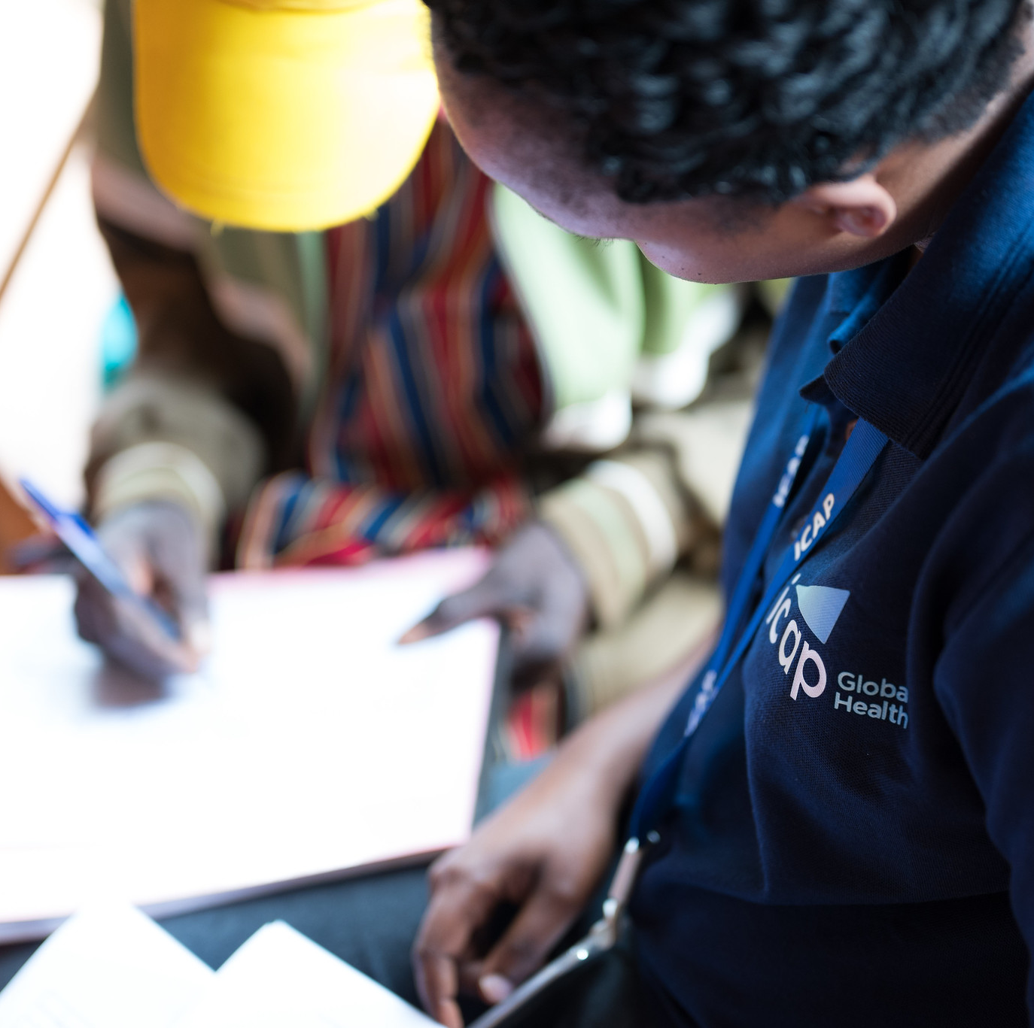
Counselors from all service delivery points where potential PrEP clients are engaged should be trained to provide initial counseling on the benefits of PrEP.

Slide 21
Initial Counseling Builds Client Awareness of the Benefits of PrEP
Clients may not know about PrEP or ever considered using it, therefore, some opening questions to help them think about the value of PrEP can be useful.
Start with asking about HIV-related concerns.
For example:
  Do you ever wish that you had better ways to protect yourself against HIV?
  Does thinking about HIV ever interfere with your intimate relationships, or with your sex life?
  Do you worry about the HIV status of a sexual partner or someone you share injection equipment with?
These questions are in addition to standard, HIV-risk related questions asked to establish PrEP eligibility.
Johnson et al., 2023

Slide 22
Focus on the Benefits of PrEP in the Client’s Life
Framing PrEP as a benefit to clients’ lives has been shown to improve PrEP uptake, including among people who do not perceive themselves to be at risk of HIV.
Counsel clients on the good things that will and the bad things that will not happen if the behavior is adopted.
  For example: Planning for sex is not always possible. Taking daily oral PrEP means you are always prepared.
Focusing on benefits of PrEP can be more impactful than describing the bad things that will, and the good things that will not, happen without PrEP.
  For example: If you don’t use PrEP, you are not protected from HIV.
This approach is sometimes called “gain-framed” counseling as key messages are framed as what a client will gain from the behavior.
Srimanus et al., 2022

Slide 23
Fill In the Blanks
Re-frame the counseling messages below into "gain-framed" messages focusing on the benefits of PrEP use.
 | RISK-FRAMED | GAINED-FRAMED
1 | If you don’t use PrEP, you are not protected from HIV.
2 | When you have sex with a partner of unknown HIV status, you are at risk for HIV unless you use PrEP.
3 | Since you are at high risk for HIV, you need regular testing with your PrEP visits.
4 | If you don't use PrEP, you will be at risk for HIV when you have sex with a partner who does not agree to use condoms.
5 | Because you are engaged in sex work, you are at high risk for HIV.
Notes:
Facilitator guidance:
Time: 20 minutes
Ask participants to work in pairs to fill in the table.
Guide participants to reframe the "risk-framed" counseling messages in the table into "gain-framed" counseling messages. Gain-framed counseling messages should focus on the benefits of PrEP use. There is not one right answer. There can be many examples. Encourage participants to be creative and share their ideas.
Allow 10 minutes for partners to complete the table.
Ask participants to return to the group and share their answers by raising their hands.
Allow 10 minutes for groups to share their answers.
Continue to the following slide to reveal the example answers.

Slide 24
Answer
Which do you think is more effective? Why?
 | RISK-FRAMED | SAMPLE GAINED-FRAMED MESSAGES
1 | If you don’t use PrEP, you are not protected from HIV. | PrEP empowers you with more ways to protect yourself from HIV, based on your needs and preferences.
2 | When you have sex with a partner of unknown HIV status, you are at risk for HIV unless you use PrEP. | Knowing your partner’s HIV status is not always possible. Using PrEP means you are always protected.
3 | Since you are at high risk for HIV, you need regular testing with your PrEP visits. | If you see us regularly for PrEP, you will have access to other services like regular HIV testing, STI treatment and family planning.
4 | If you don't use PrEP, you will be at risk for HIV when you have sex with a partner who does not agree to use condoms. | Taking PrEP is your choice and discreet, so you can use it to protect yourself from HIV without your partner knowing.
5 | Because you are engaged in sex work, you are at high risk for HIV. | PrEP will make you safer in your work.
Adapted from Johnson et al., 2023
Notes:
Facilitator guidance:
Read the risk-framed messages and the sample gain-framed messages on the slide.
Explain that these are sample answers. There is not a single right answer.
Encourage participants to compare the example risk-framed messages and gain-framed messages.
Prompt participants to reflect, "What differences do you notice between risk-framed messages and gain-framed messages? Which do you think is more effective? Why?"
Allow time for follow-up discussion, questions, and clarification as needed.

Slide 25
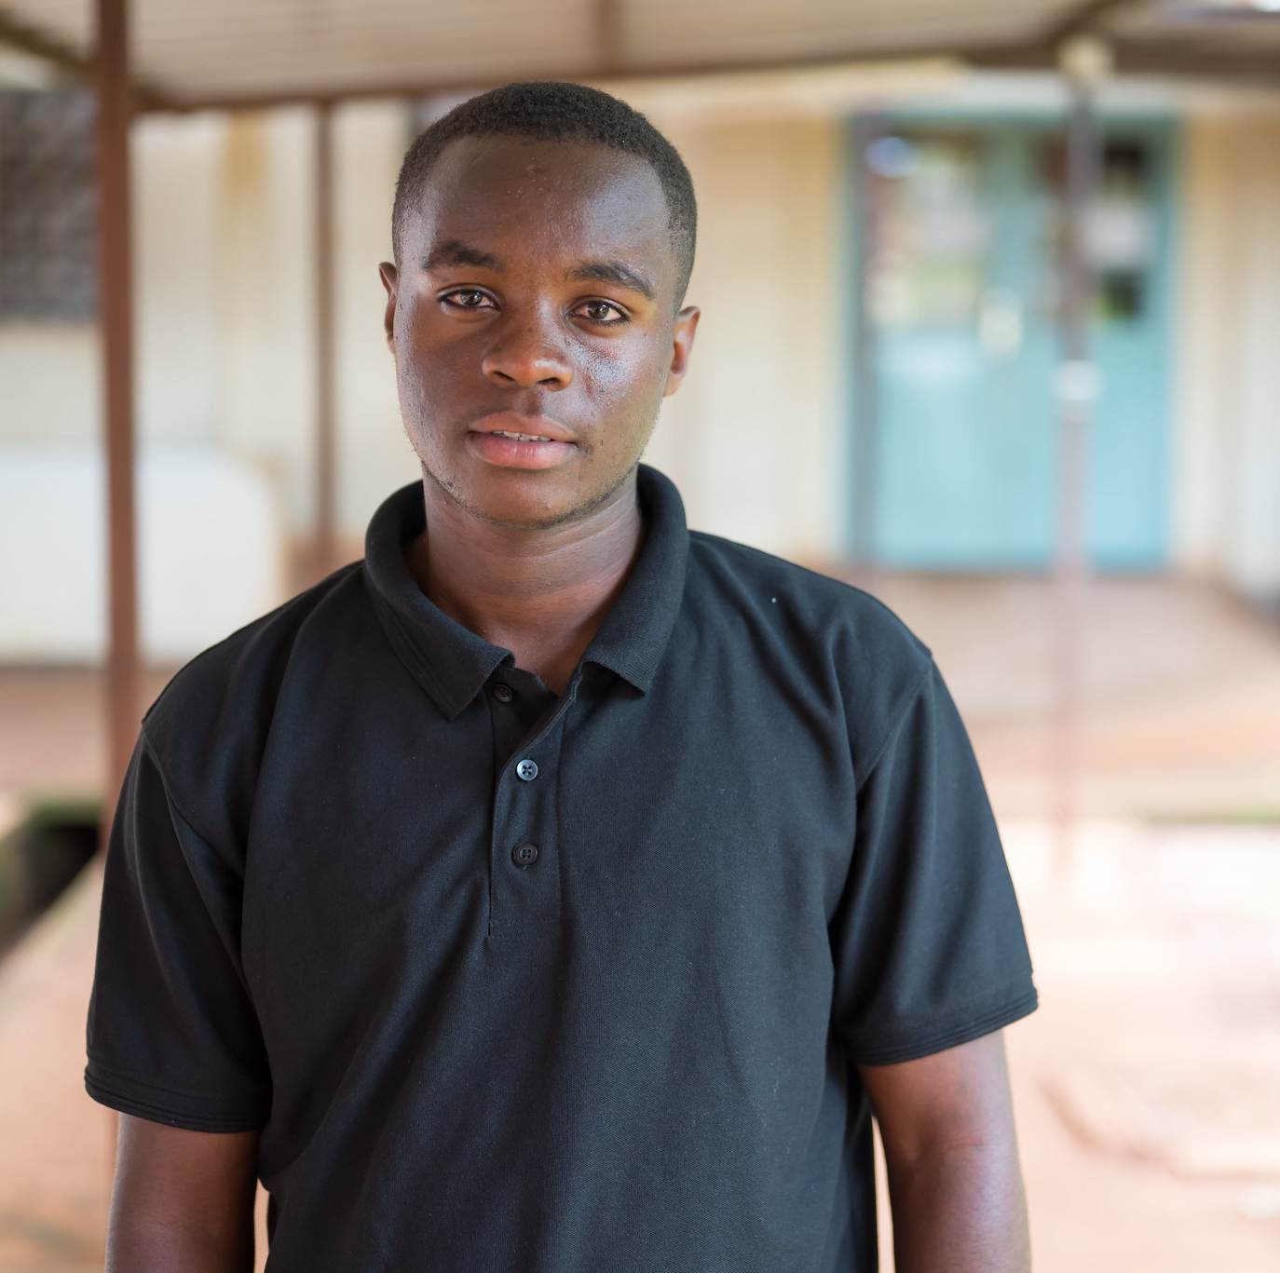
Case Scenario​
Thomas is a 22-year-old gay man who comes to the clinic today to get tested for HIV.
During pre-test counseling, Thomas mentions that he has sex with multiple partners of unknown HIV status and uses condoms sometimes.
What questions would encourage Thomas to consider the benefits of PrEP?
What gain-framed messages would you use in counseling Thomas?
Notes:
Facilitator guidance:
Explain to participants that a case scenario is provided to apply their knowledge of person-centered PrEP counseling using gain framed messages.
Read the scenario and question on the slide asking participants, "What questions would encourage Thomas to consider the benefits of PrEP? What gain-framed messages would you use in counseling Thomas?"
Ask participants to raise hands and share their answers.
Continue to the following slide to provide the answer after receiving inputs from participants.

Slide 26

Case Scenario​
Some phrase to include in counseling Thomas:
Do you ever wonder about the HIV status of the partners you described?
Does thinking about HIV ever interfere with your experience during sexual encounters?
Do you ever wish that you had a way to protect yourself against HIV in addition to condoms?
Knowing your partners’ HIV status is not always possible. PrEP is a way to make sure you are always protected.
Notes:
Facilitator guidance:
Read the answers on the slide.
Explain that these are some examples of questions you could ask to prompt discussion using the gain-framed counseling approach. There is no single right answer.
Encourage participants to compare the example gain-framed messages with their answers.
Prompt participants to reflect, "What do you find useful about these questions? Are there other questions that you would ask? Why?"
Allow time for follow-up discussion, questions, and clarification as needed.

Slide 27
How would you engage clients in a conversation about PrEP?
What questions would you ask to encourage clients to consider the use of PrEP?
How would you communicate the benefits of PrEP to clients?
DISCUSSION​
Notes:
Facilitator guidance:
• Time: 10-20 minutes.
• Explain that participants who want to speak should raise their hands.
• Keep the discussion on target and moving along.
• Encourage everyone to participate and call on everyone who raises a hand.
• Limit participants who like to talk a lot.
• Ask questions to encourage more responses to a question—for example: “What else?” “What other ideas do you have?”
• Wrap up the discussion by repeating and summarizing main points.

Slide 28
QUESTION
Why is it important to ensure that clients are actively engaged in the decision to start PrEP?
Notes:
Facilitator guidance:
Read the question on the slide.
Ask participants to raise their hands to answer the question.
Take a few volunteer responses.
Reveal the answer on the following slide.
Allow time for follow-up discussion as needed.

Slide 29
ANSWER
When clients are actively engaged in starting PrEP, they are more likely to use it consistently.
Notes:
Facilitator guidance:
Reveal the answer on the slide.
Reinforce these key points about engaging clients in the decision to start PrEP:
Gain-framed counseling messages ensure that clients see the benefit of PrEP in their lives
In the following slides we will go on to discuss informed choice counseling for PrEP options, empowering clients to voluntarily choose an option that aligns with their individual preferences and life context.
When clients see the benefit of PrEP in their lives AND choose the best option for them, they will be more likely to use it consistently
Allow time for questions and follow-up discussion as needed.

Slide 30
6.3 Informed Choice Counseling for PrEP Options

Slide 31
What is Informed Choice Counseling?
Informed choice counseling is a systematic approach to supporting clients with more than one medically-appropriate option to understand and evaluate each option and make the choice that is best for them.¹⁻³
It empowers clients to voluntarily choose an option that aligns with their individual preferences and life context.
When a client has two or more appropriate options, the best choice depends on how important each option’s features are to the individual client.^{4, 5}
1. Braddock et al., 1997; 2. Braddock et al., 1999; 3. Woolf, 2005; 4. D’Souza et al., 2022; 5. Yeh et al., 2022

Slide 32
Informed Choice Counseling Is Widely Used in Family Planning Programs
For decades, family planning has included informed choice counseling¹⁻³ to ensure clients have:
  Adequate information to choose an optimal family planning method
  Consistently high-quality services
  A reliable supply of products
  Support to continue or switch to another family planning method as desired
Offering choice of family planning methods encourages the use of contraception and the ability to switch methods allows the user to continue engagement with contraception, even when one method proves undesirable.⁴
1. Jain, 1989; 2. Kim, Kols, and Mucheke, 1998; 3. Stanback et al., 2015; 4. Ross and Stover, 2013

Slide 33
Principles of Informed Choice Counseling
The goal is to facilitate a voluntary choice or decision by ensuring the client has access to and understands all available information relevant to the choice or decision.
Clients are acknowledged as the expert on their preferences
  Providers do contribute medical knowledge about options and how options relate to client preferences.
  Providers do not exercise authority over client behavior or health decisions.
Informed choice incorporates the client's values and preferences into medical decisions.
  Sometimes called ‘informed decision making’ or ‘shared decision making’
  Informed choice puts the client at the center of care

Slide 34
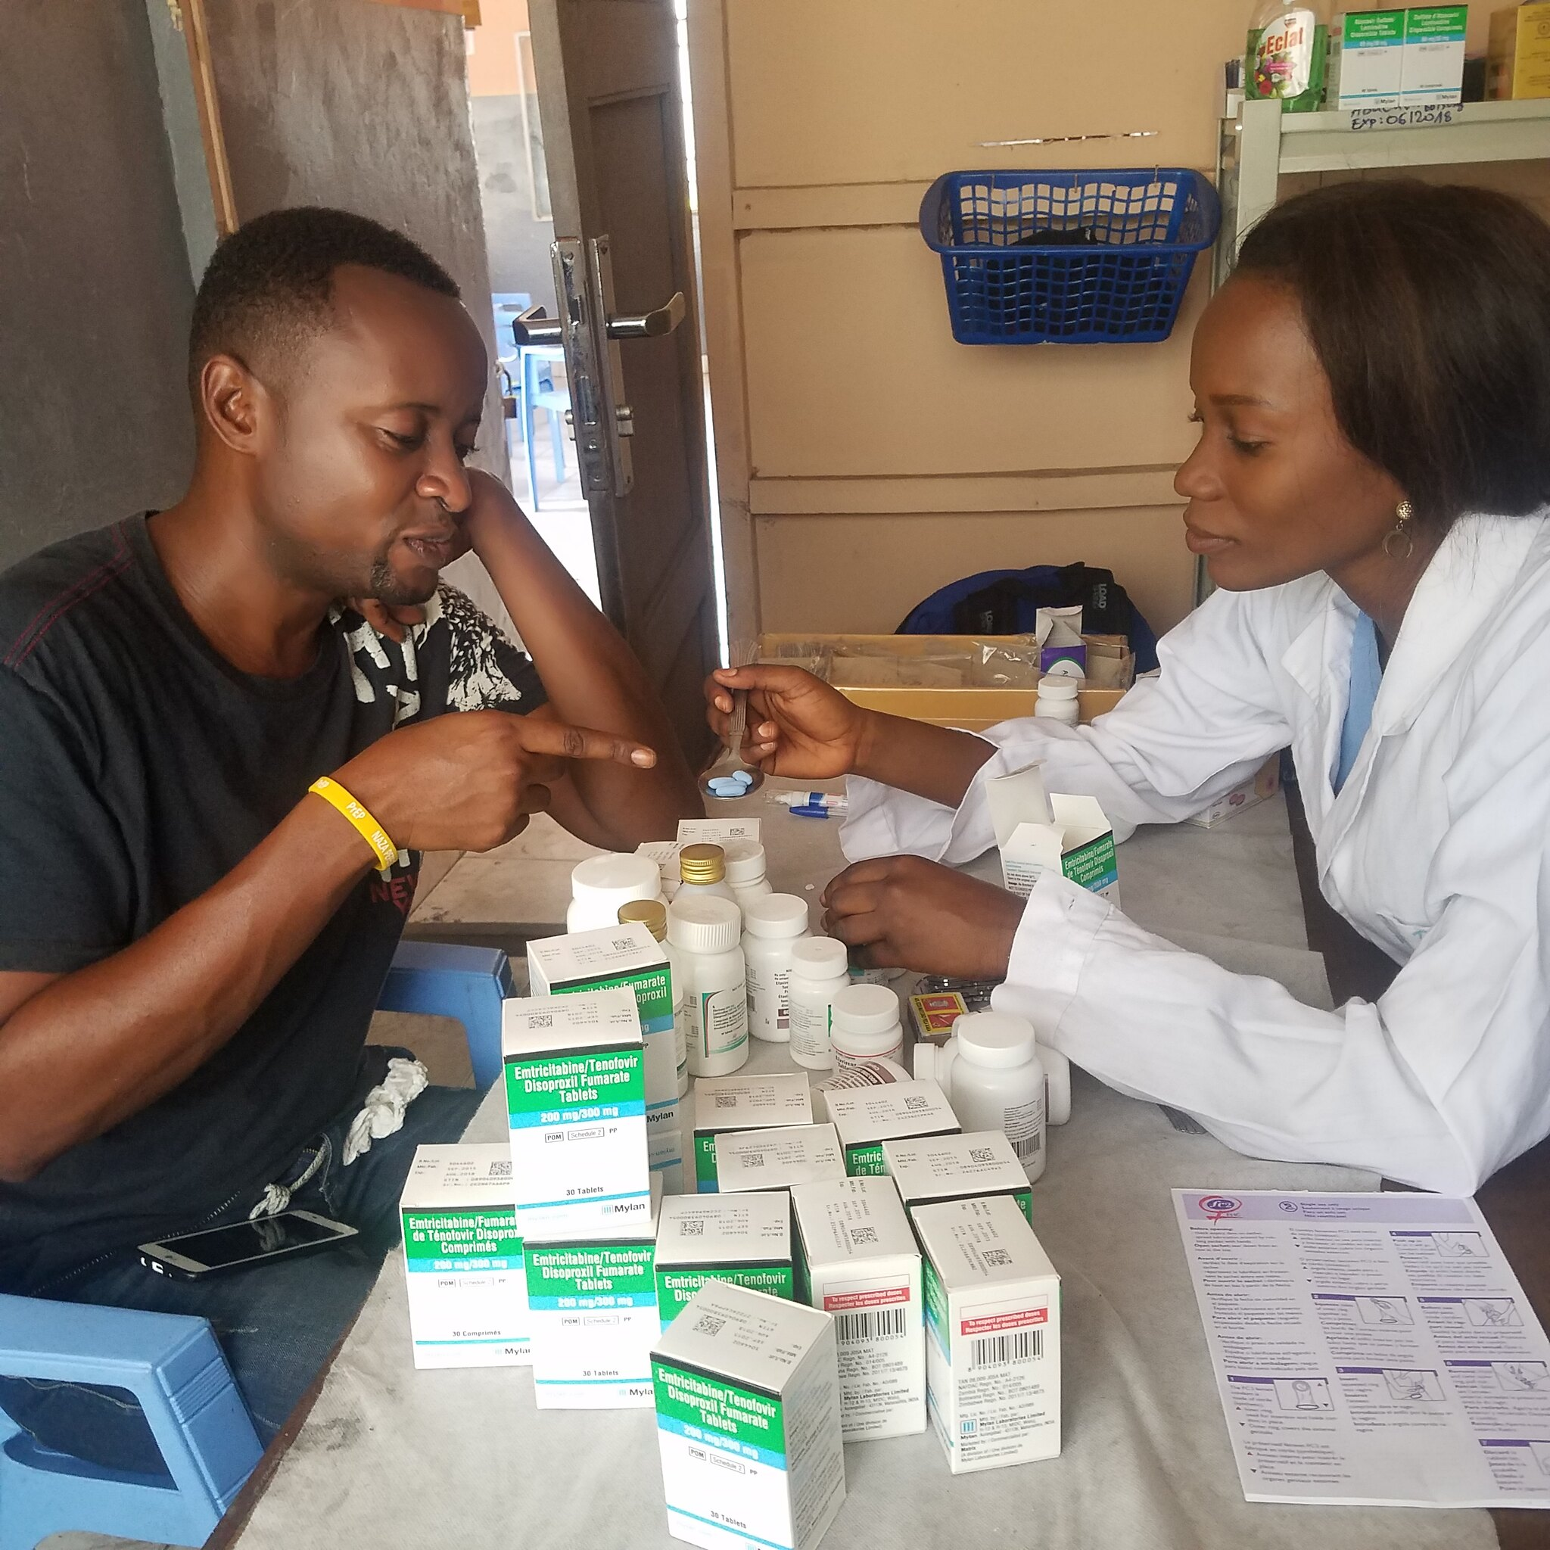
Principles of Informed Choice Counseling (continued)
The client takes an active role in making decisions, instead of passively receiving information.
The informed choice approach is essential when clients have more than one reasonable option, such as choosing among more than one available PrEP product.

Slide 35
Why Is Informed Choice Important?
Accumulating evidence shows that clients are more likely to achieve adequate adherence to health interventions that align with their personal preferences.¹
Preference among available choices is driven by multiple factors including convenience, discretion, related costs, efficacy, and safety.^{2, 3}
When clients can choose their preferred option,
they are more likely to use it consistently!
1. Losi et al., 2021; 2. D’Souza et al., 2022; 3. Yeh et al., 2022

Slide 36
Informed Choice Counseling for PrEP
When more than one effective PrEP option is available, clients need support to make a decision about which option is right for them.
To do this, providers must understand all available options and be able to effectively explain their key differences to clients.
Providers should also understand and respect personal preferences that may influence a client’s choice of one PrEP option over another.
Note: Informed choice counseling can be used to decide between using PrEP and alternative HIV prevention options, such as condoms. However, the following slides focus on choosing among available PrEP options.
Graybill and Choi, 2023

Slide 37
How Does Informed Choice Counseling Fit Into PrEP Visits?
At PrEP initiation visit
After screening to establish general PrEP eligibility, additional questions are asked to establish eligibility for specific PrEP options that are available.
Informed choice counseling steps must be tailored to educate clients only on the options that they are eligible for, based on available products and eligibility criteria.
At PrEP follow-up visits
After initiating a PrEP option, it is important to regularly assess client satisfaction with the PrEP product at follow up visits.
Present the option to switch products as part of person-centered counseling.

Slide 38
True or False?
Are the following statements about informed choice counseling for PrEP true or false?
 | TRUE | FALSE
Enabling clients to make an informed and voluntary choice of HIV prevention options is the foundation of effective PrEP counseling.
It is most effective for the provider to choose the best HIV prevention option for the client based on their clinical expertise and authority.
Clients can make informed decisions about their sexual health.
Providers should understand and respect personal preferences that may influence a client’s choice of HIV prevention options.
Clients should only be given the option to use PrEP in combination with condoms 100% of the time.
Notes:
Facilitator guidance:
Time: 20 minutes
Ask participants to stand up and participate in an interactive activity.
Read the statements in the table out loud to the group.
Tell participants to move to the right side of the room if they believe the statement is true and move to the left side of the room if they believe the statement is false.
Give participants an opportunity to share why they believe the statement is true or false.
Continue to the following slide to reveal the answers.
Allow time for follow up questions and discussions as needed.

Slide 39
True or False?
Are the following statements about informed choice counseling for PrEP true or false?
 | TRUE | FALSE
Enabling clients to make an informed and voluntary choice of HIV prevention options is the foundation of effective PrEP counseling. | X
It is most effective for the provider to choose the best HIV prevention option for the client based on their clinical expertise and authority. |  | X
Clients can make informed decisions about their sexual health. | X
Providers should understand and respect personal preferences that may influence a client’s choice of HIV prevention options. | X
Clients should only be given the option to use PrEP in combination with condoms 100% of the time. |  | X
Notes:
Facilitator guidance:
Reveal the answers on this slide.
Allow time for follow up questions and discussions as needed.

Slide 40
What experiences have you had helping clients choose actions to improve their sexual health and protect themselves from HIV?
What information would you want from clients to help them make an informed choice between PrEP options?
What are some challenges you foresee with providing informed choice counseling?
DISCUSSION​
Notes:
Facilitator guidance:
• Time: 10-20 minutes.
• Explain that participants who want to speak should raise their hands.
• Keep the discussion on target and moving along.
• Encourage everyone to participate and call on everyone who raises a hand.
• Limit participants who like to talk a lot.
• Ask questions to encourage more responses to a question—for example: “What else?” “What other ideas do you have?”
• Wrap up the discussion by repeating and summarizing main points.

Slide 41

Case Scenario​
Hope is a 24-year-old woman who comes to the clinic asking for information about PrEP.
She says that having sex without condoms is often necessary for her to receive material goods and financial assistance from her partners.
She thinks PrEP could provide her with reassurance in these situations.
How does informed choice counseling fit into Hope’s PrEP initiation visit?
Notes:
Facilitator guidance:
Explain to participants that a case scenario is provided to apply their knowledge of informed choice counseling for PrEP initiation.
Read the scenario and question on the slide asking participants, "How does informed choice counseling fit into Hope’s PrEP initiation visit? When would you include informed choice counseling during the visit flow?
Ask participants to raise hands and share their answers.
Continue to the following slide to provide the answer after receiving inputs from participants.

Slide 42
Suggested Pathway: Informed Choice Counseling at PrEP Initiation
Confirm HIV Negative & Substantial Risk for HIV
Assess Eligibility for Available PrEP Options​
Conduct Informed Choice PrEP Counseling
Confirm Client is Good Candidate
for ​Selected Option
Initiate PrEP
Determine client’s sex at birth, HIV exposure risk factors and pregnancy status (if applicable) to identify PrEP options available to the client
Provide education about available PrEP options Guide client through shared decision making to select a preferred option
Evaluate for contraindications to selected option If any contraindication is identified, repeat shared decision making process for other available options Counsel on effective use of selected option and confirm willingness to use as prescribed

Slide 43
Begin by Determining if the Client is a Candidate for Any Form of PrEP
Before discussing PrEP options, ensure the client is a candidate for any form of PrEP, in accordance with national guidelines.
Eligibility criteria across all PrEP options:
Programs may opt to also screen for acute HIV infection (AHI) at this point or wait until after informed choice counseling has been completed and a PrEP option has been selected.
 | HIV negative
 | At substantial risk for HIV infection or requesting PrEP
See Module 1 for more information about HIV testing, risk assessments and AHI screening.​

Slide 44
Suggested Pathway: Informed Choice Counseling at PrEP Initiation
Confirm HIV Negative & Substantial Risk for HIV
Assess Eligibility for Available PrEP Options​
Conduct Informed Choice PrEP Counseling
Confirm Client is Good Candidate
for ​Selected Option
Initiate PrEP
Determine client’s sex at birth, HIV exposure risk factors and pregnancy status (if applicable) to identify PrEP options available to the client
Provide education about available PrEP options Guide client through shared decision making to select a preferred option
Evaluate for contraindications to selected option If any contraindication is identified, repeat shared decision making process for other available options Counsel on effective use of selected option and confirm willingness to use as prescribed

Slide 45
Conduct Additional Assessments to Determine Potential PrEP Options​
Before proceeding with informed choice counseling, it is important to determine which PrEP options a client could be eligible for.
A few basic questions can help narrow down which options should be presented during informed choice counseling:
  Determine the client’s sex at birth.
    If female at birth, determine if pregnant or breastfeeding.
    If transgender or non-binary person, assess for use of estradiol-based hormone therapy.
  Assess potential exposure to HIV through vaginal sex, anal sex, injection drug use or a combination of these.
Based on this assessment and national guidelines, determine what PrEP options may be appropriate.

Slide 46
What PrEP Options Are Available?
In the national guidelines, [insert populations] are considered eligible for PrEP.​​
Currently in [insert country name], available PrEP options include [insert approved and available options].​
Priority populations for specific options include [insert populations by available PrEP options].
Notes:
Facilitator guidance:
Edit this slide in advance to the training by inserting the name of the country where you work, the populations eligible for PrEP, the approved and available PrEP options, and priority populations for specific PrEP options.
Note that availability may vary by setting and ask participants to comment on which PrEP options are available where they work.
Allow time for questions and discussion as needed.

Slide 47
PrEP Options Recommended by the World Health Organization​
Oral Daily PrEP​ | Oral Event-Driven PrEP (ED-PrEP)​ | Injectable Long-Acting Cabotegravir (CAB-LA) | Dapivirine Vaginal Ring (DVR)

Slide 48
PrEP Options​
Short-acting​
Long-acting​
Oral Daily PrEP​ | CAB-LA
Oral ED-PrEP​ | DVR
For everyone at substantial risk​
For some groups at substantial risk​

Slide 49

PrEP Options for Clients Assigned Female Sex at Birth
NO
Pregnant or breastfeeding?
YES
HIV risk factors?
Oral Daily PrEP
Vaginal sex only
Inject drugs and share needles
Vaginal and anal sex
Oral Daily PrEP
Oral Daily PrEP
The safety of using CAB-LA and the DVR during pregnancy and breastfeeding is being evaluated.​ While data are limited, some countries may consider pregnancy, breastfeeding or intentions to become pregnant a contraindication to CAB-LA or DVR use.​
CAB-LA
CAB-LA
DVR

Slide 50
PrEP Options for Clients Assigned Male Sex at Birth
NO
Taking estradiol-based hormones?
YES
HIV risk factors?
Sexual exposure only
Inject drugs and share needles
Oral Daily PrEP
Oral Daily PrEP
Oral Daily PrEP
CAB-LA
CAB-LA
CAB-LA
Oral ED-PrEP

Slide 51
Case Scenario​
Hope’s HIV test is negative. Her initial wish for PrEP means she is eligible for PrEP, and she reports exchanging sex for money or goods
You determine that she is a good candidate for PrEP.
What additional information would you need to determine which PrEP options to discuss with her?
Notes:
Facilitator guidance:
Explain to participants that a case scenario is provided to apply their knowledge of informed choice counseling for PrEP initiation.
Read the scenario and question on the slide asking participants, "What additional information would you need to decide which PrEP options to discuss with her? [Answer: confirm sex at birth, assess HIV risk behaviors (vaginal sex, anal sex or injection drug use) and if she is pregnant or breastfeeding]
Ask participants to raise hands and share their answers.
Continue to the following slide to provide the answers after receiving inputs from participants.

Slide 52
Case Scenario​
Hope is a cisgender female (assigned female sex at birth).
She only engages in vaginal sex with her partners and has never injected any drugs.
She is not pregnant or breastfeeding.
What potential PrEP options will you explore with Hope?
Notes:
Facilitator guidance:
Read the scenario and question on the slide asking participants, "What potential PrEP options will you explore with Hope?"
Ask participants to raise hands and share their answers.
Continue to the following slide to provide the answer after receiving inputs from participants.

Slide 53
Case Scenario​
Based on what she has told you, there are three potential options for PrEP you can explore with Hope:
Oral daily PrEP
CAB-LA
DVR
Notes:
Facilitator guidance:
Reveal the answer on the slide. Refer back to the slide “PrEP Options for Clients Assigned Female Sex at Birth” as needed.
Allow time for questions and follow-up discussion as needed.

Slide 54
Suggested Pathway: Informed Choice Counseling at PrEP Initiation
Confirm HIV Negative & Substantial Risk for HIV
Assess Eligibility for Available PrEP Options​
Conduct Informed Choice PrEP Counseling
Confirm Client is Good Candidate
for ​Selected Option
Initiate PrEP
Determine client’s sex at birth, HIV exposure risk factors and pregnancy status (if applicable) to identify PrEP options available to the client
Provide education about available PrEP options Guide client through shared decision making to select a preferred option
Evaluate for contraindications to selected option If any contraindication is identified, repeat shared decision making process for other available options Counsel on effective use of selected option and confirm willingness to use as prescribed

Slide 55
The Informed Choice Counseling Process Step by Step
Define the client’s role in decision making
  Many clients are not aware that they can and should participate in the decision making process.
Discuss the nature of the decision
  A clear statement of what is at issue helps clarify the factors involved in choosing an option.
  Clients may also need counseling to better understand their personal level of risk for HIV.
  Guide clients to prioritize key factors of their choice, such as cost, convenience, discretion, efficacy, and safety.
Present the alternatives
  A decision is always a choice among certain options, including doing nothing at all. This is not always clear to the client without explicit discussion.
Braddock et al., 1999

Slide 56
The Informed Choice Counseling Process Step by Step (continued)
Explore characteristics of available PrEP options to assess potential benefits and drawbacks
  A balanced presentation allows the client’s decision to be truly informed.
  Benefits and drawbacks will vary for each client.
Discuss the uncertainties associated with PrEP use and specifically with the relevant options
  Thoughtful discussion of what is known and unknown about an option can promote trust and is crucial for a client’s comprehensive understanding of the options.
  Support clients to think through the practical and personal implications of how each option may impact their life.
Braddock et al., 1999

Slide 57
The Informed Choice Counseling Process Step by Step (continued)
Assess the client’s understanding
  Once core information has been shared, check in with the client to see how they have interpreted the information and what questions they have.
  This is very important to foster understanding.
Explore client preferences
  Do not assume clients will speak up to express concerns and preferences; they often need to be asked for their opinion.
  Ensure clients know that they can ask more questions or ask for more time to decide.
Braddock et al., 1999

Slide 58
Informed Choice Counseling Step 1:
Define the Client’s Role in Decision Making

Slide 59
Step 1: Define the Client’s Role in Deciding on a PrEP Option
Begin the conversation by making it clear that there is a choice to be made between more than one suitable option.
Also make it clear that the client is expected to actively participate in the decision making process and that their needs and preferences will guide this decision.
For example:
  Based on what you have told me, you may be eligible for a few different PrEP options.
  To help you make the best choice of option, I need to understand what is important to you.

Slide 60

Case Scenario: Step 1
Hope is relieved to learn that she is eligible for PrEP.
What is the first step in providing informed choice counseling for PrEP?
What key messages would you include in this step?
Notes:
Facilitator guidance:
Explain to participants that a case scenario is provided to apply their knowledge of seven steps to informed choice counseling for PrEP.
Read the scenario and question on the slide asking participants, "What is the first step in providing informed choice counseling for PrEP? What key messages would you include in this step?"
Ask participants to raise hands and share their answers.
Continue to the following slide to provide the answer after receiving inputs from participants.

Slide 61
Case Scenario: Step 1
The first step in providing Hope with informed choice counseling is to define her role in deciding on a PrEP option.
For example:
Based on what you have told me, you may be eligible for three different PrEP options.
To help you choose among these options, I want to understand what is important to you.
We will decide on the best option for you based on your needs and preferences.
Notes:
Facilitator guidance:
Reveal the answer on the slide.
Allow time for questions and follow-up discussion as needed.

Slide 62
Informed Choice Counseling Step 2: Discuss the Nature of the Decision

Slide 63
Step 2: Discuss the Nature of the Decision
A clear statement of what is being discussed and why helps to guide and focus the conversation.
Include information on why choosing a PrEP option is an important decision and what factors may influence the decision.
Key messages to include:
  All PrEP options will help prevent you from getting HIV, but you must use them consistently and correctly to be protected against HIV.
  There are some key differences among the PrEP options that we will discuss.
  When choosing, it is important to consider how well you will be able to use the option.
  I would like to make sure you have all the information you need to decide which option will work best for you.

Slide 64
Step 2: Discuss the Nature of the Decision (continued)
Other key messages to include:
Some factors to consider that are different for each option are:
  How well it works to prevent HIV
  The convenience of getting and using the product you choose
  How discreetly or privately you can use the product
  The safety of the option and any side effects you may experience
  How easy it is to stop and start each product
  Follow-up requirements, like the time and costs of attending clinic visits
  How well an HIV test can detect if you acquire HIV while using the option, and how HIV may be treated if you become HIV positive
These will influence each person’s choice of PrEP option a little differently.
Let’s talk through considerations for each option in detail, so that you can choose the one that you feel most comfortable using.

Slide 65
Considerations for Choosing PrEP
Scientific knowledge about each option
Practical implications
of each option
Personal considerations with each option
How well does it prevent HIV infection?
Will I be able to use my PrEP as instructed?
Will I be able to keep it private from my partner?
What are the side effects?
How will I fit regular clinic visits into my life?
Will I be able to keep it private from other people in my life?
How will it impact detection and treatment of HIV if I become infected?
What kind of HIV testing will I need, and how often?
How easy is it to stop and start if my situation changes?
Figure adapted from Han, Klein, and Arora, 2011

Slide 66

Case Scenario: Step 2
Hope is surprised to learn that there is more than one option for PrEP and that the decision is hers. She says that she is not sure how to choose.
What will you say?
Notes:
Facilitator guidance:
Explain to participants that a case scenario is provided to apply their knowledge of the steps of informed choice counseling for PrEP.
Read the scenario and question on the slide asking participants, “What will you say to Hope? What considerations would you ask Hope to think about when making her decision?"
Ask participants to raise hands and share their answers.
Continue to the following slide to provide the answer after receiving inputs from participants.

Slide 67
Case Scenario: Step 2
Key messages for Hope could include:
All PrEP options provide protection against HIV if you use them correctly. When choosing, it is important to consider how well you can use the option.
Other things to consider include:
How well it protects you from HIV.
The convenience of getting and using the product.
How privately or discreetly you can use the product.
Any side effects you may have.
How easy it is to stop and start.
Notes:
Facilitator guidance:
Reveal the answer on the slide.
Allow time for questions and follow-up discussion as needed.

Slide 68
Informed Choice Counseling Step 3: Present Alternatives ​

Slide 69
Step 3: Present Alternatives
It is important to clearly state what options are being compared and discussed.
It is also important to recognize that not using PrEP is an option and that clients should never feel coerced into choosing PrEP.
For example:
  Based on what you have told me, you could be eligible for [name the appropriate PrEP options].
  You also have the option of not using any PrEP and using other ways to protect yourself against HIV, like using condoms consistently.
  Let’s look at the options in detail and consider their benefits and drawbacks for you. I’d like to know what is important to you and how you think each one could fit into your life.

Slide 70

Case Scenario: Step 3
Hope asks you which of the PrEP options are available for her and if there are alternatives to taking PrEP.
How will you answer her?
Notes:
Facilitator guidance:
Explain to participants that a case scenario is provided to apply their knowledge of seven steps to informed choice counseling for PrEP initiation.
Read the scenario and question on the slide asking participants, “How will you answer her? What key messages will you give to Hope?"
Ask participants to raise hands and share their answers.
Continue to the following slide to provide the answer after receiving inputs from participants.

Slide 71
Case Scenario: Step 3
Key messages for Hope could include:
Based on what you have told me, your PrEP choices are a daily pill, an injectable form of PrEP called CAB-LA, and a PrEP vaginal ring, the DVR.
You also have the option of not using any PrEP and using other HIV prevention methods instead, such as condoms.
Let’s look at the options in detail and consider the benefits and drawbacks for you. I’d like to know how you think each one could fit into your life.
Notes:
Facilitator guidance:
Reveal the answer on the slide.
Allow time for questions and follow-up discussion as needed.

Slide 72
Informed Choice Counseling Step 4: Explore Characteristics of Each Option

Slide 73
Step 4: Explore the Characteristics of Each Option
Review specific characteristics of each PrEP option being considered to identify potential benefits and drawbacks for the client.
  Benefits and drawbacks of each available option will vary according to each client’s context, values, and preferences.
Characteristics for clients to take into consideration include:
  The efficacy of each available PrEP product to protect against HIV, when used as directed
  What side effects each option may have
  Practical requirements of each option, including adhering to medication and attending regular clinic visits
  How each option would fit into client’s routines, including the ability to keep PrEP use private and adjust according to changes in risk for HIV

Slide 74
Draw on Any Client Experience with PrEP
Before describing each available PrEP option in detail, assess the client’s understanding of the options and any preference or experience they already have with an option.
Opening questions may include:
  Tell me what you know about [PrEP option]?
  Have you heard of [PrEP option] before?
  Have you ever used [PrEP option] before?
  Do you know someone who has used [PrEP option] before? What did they tell you about it?

Slide 75
Considerations for Choosing PrEP
Scientific knowledge about each option
Practical implications
of each option
Personal considerations with each option
How well does it prevent HIV infection?
Will I be able to use my PrEP as instructed?
Will I be able to keep it private from my partner?
What are the side effects?
How will I fit regular clinic visits into my life?
Will I be able to keep it private from other people in my life?
How will it impact detection and treatment of HIV if I become infected?
What kind of HIV testing will I need, and how often?
How easy is it to stop and start if my situation changes?
Figure adapted from Han, Klein, and Arora, 2011

Slide 76


Comparison of PrEP Options: HIV Protection with Optimal Adherence
How well does it prevent HIV infection?
Oral Daily PrEP​ | CAB-LA
Oral ED-PrEP​ | DVR
>95%
>95%
>95%
30%
- 50%
Efficacy to prevent HIV infection when PrEP is taken as prescribed with optimal adherence.​

Slide 77
Comparison of PrEP Options: Safety and Side Effects
What are the side effects?
Safe during pregnancy and breastfeeding?
Common side effects​
Possible rare adverse events
Oral Daily PrEP | Gastrointestinal symptoms within first month | Creatinine elevation, typically subclinical and reversible. Loss of bone mineral density, reversible. | Yes
Oral ED-PrEP | Gastrointestinal symptoms within first month | Creatinine elevation, typically subclinical and reversible. Loss of bone mineral density, reversible. | N/A
CAB-LA | Injection site reactions (ISR) | Liver damage Allergic reactions Depression | Unknown
DVR | Urinary tract/vaginal irritation within first month | Pelvic inflammatory disease | Unknown
See Modules 2-5 for more information on safety and side effects for each option

Slide 78
Comparison of PrEP Options: Testing to Detect HIV and HIV Treatment Implications
How will it impact detection and treatment of HIV if I become infected?
Recommended HIV testing modalities
Implications for HIV treatment
Oral Daily PrEP | Rapid test or HIV self test (HIVST) | Potential for NRTI resistance if PrEP is continued after infection
Oral ED-PrEP | Rapid test or HIVST | Potential for NRTI resistance if PrEP is continued after infection
CAB-LA | Rapid, antigen-based or nucleic acid test Potential for delays in detecting HIV infection | Potential for INSTI resistance if PrEP is continued after infection or if infection occurs during the CAB-LA tail period
DVR | Rapid test or HIVST | Potential for NNRTI resistance if PrEP is continued after infection, but believed to be lower than with other forms of PrEP that act systemically in the body
NRTI = nucleoside reverse transcriptase inhibitors
INSTI = integrase strand transfer inhibitors
NNRTI = non-nucleoside reverse transcriptase inhibitors
See Module 4 for more information on HIV testing and treatment with CAB-LA use

Slide 79
Considerations for Choosing PrEP
Scientific knowledge about each option
Practical implications
of each option
Personal considerations with each option
How well does it prevent HIV infection?
Will I be able to use my PrEP as instructed?
Will I be able to keep it private from my partner?
What are the side effects?
How will I fit regular clinic visits into my life?
Will I be able to keep it private from other people in my life?
How will it impact detection and treatment of HIV if I become infected?
What kind of HIV testing will I need, and how often?
How easy is it to stop and start if my situation changes?
Figure adapted from Han, Klein, and Arora, 2011

Slide 80
Comparison of PrEP Options: Delivery Route and Frequency
Will I be able to use my PrEP as instructed?
Delivery Route
Frequency
Oral Daily PrEP | Oral pills​ | Once daily​
Oral ED-PrEP | Oral pills​ | Two pills 2 – 24 hours before sex; one pill 24 hours after first two; one additional pill 24 hours after the third pill.
CAB-LA | Injection into the buttocks by a provider​ | First two injections 4 weeks apart, then every 8 weeks​
DVR | Self-insertion into the vagina​ | Every 28 days​

Slide 81
Comparison of PrEP Options: Follow-up Requirements
How will I fit regular clinic visits into my life?
Follow-up frequency​
Service delivery options
Follow-up procedures
Oral Daily PrEP | Every 3 months | Potential for community follow-up | HIV testing Medication refill Blood draw if indicated for safety
Oral ED-PrEP | Every 3 months | Potential for community follow-up | HIV testing Medication refill as needed Blood draw if indicated for safety
CAB-LA | 1 month after the 1st injection, then every 8 weeks (+/- 1 week) | Administered in clinical setting to ensure privacy for injection and temperature control for product | HIV testing Injection administration
DVR | Every 3 months | Potential for community follow-up | HIV testing DVR refill Optional assisted DVR insertion

Slide 82
Comparison of PrEP Options: HIV Testing and Frequency
What kind of HIV testing will I need and how often?
Testing frequency​
Follow-up HIV testing
Oral Daily PrEP | Every 3 months | Blood-based rapid diagnostic tests Option for HIVST
Oral ED-PrEP | Every 3 months | Blood-based rapid diagnostic tests Option for HIVST
CAB-LA | 1 month after the first injection, then every 8 weeks (+/- 1 week) | Blood-based rapid diagnostic tests Antigen-based or nucleic acid tests No option for HIVST
DVR | Every 3 months | Blood-based rapid diagnostic tests Option for HIVST

Slide 83
Considerations for Choosing PrEP
Scientific knowledge about each option
Practical implications
of each option
Personal considerations with each option
How well does it prevent HIV infection?
Will I be able to use my PrEP as instructed?
Will I be able to keep it private from my partner?
What are the side effects?
How will I fit regular clinic visits into my life?
Will I be able to keep it private from other people in my life?
How will it impact detection and treatment of HIV if I become infected?
What kind of HIV testing will I need, and how often?
How easy is it to stop and start if my situation changes?
Figure adapted from Han, Klein, and Arora, 2011

Slide 84
Comparison of PrEP Options: Privacy and Stigma Considerations
Will I be able to keep it private from my partner and other people in my life?
Will my partner
know about it?​
Will other people
around me know about it?
Will I experience stigma related to PrEP use?
Oral Daily PrEP | No, if you can keep and take pills privately | No, if you can keep and take pills privately | Maybe. Same pills are used for HIV treatment
Oral ED-PrEP | No, if you can keep and take pills privately | No, if you can keep and take pills privately | Maybe. Same pills are used for HIV treatment
CAB-LA | No, if you can keep clinic visits private | No, if you can keep clinic visits private​ | Unlikely, as nothing to take home
DVR | Maybe, some partners can feel the DVR during sex | No, if can keep and insert it privately​ | Unlikely, as vaginal rings are also used for other purposes

Slide 85
Comparison of PrEP Options: Starting and Stopping
How easy is it to stop and start if my situation changes?
How quickly does it work?​
How easy is it to stop?
How easy is it to restart?
Oral Daily PrEP | HIV protection within 24 hours for some men*; 7 days for women and other men | Continue daily after last HIV exposure: 2 days for some men*; 7 days for women and other men | Restart any time by confirming HIV-negative status and resuming daily pills
Oral ED-PrEP | HIV protection within 2-24 hours | Continue daily for 2 days after last potential HIV exposure | Use before and after sexual encounters, with regular HIV testing
CAB-LA | HIV protection a week after 1st injection | Protection for 8 weeks after last injection. Need to use other HIV prevention for 12 months after last injection. | May need to restart with two loading dose injections, 1 month apart
DVR | Partial HIV protection 24 hours after insertion | Partial protection ends when the DVR is removed | Restart anytime by confirming HIV-negative status and inserting a new DVR
*Assigned male sex at birth, not taking estradiol-based hormones and sexual HIV exposure only.

Slide 86
Summary: Essential Information
How well does it protect from HIV?
What are the common side effects?
What kind of follow-up is required?
How do I take it?
Oral Daily PrEP | >95% efficacious | Take 1 pill by mouth every day | Possible mild gastrointestinal side effects in the 1st month | Follow-up HIV testing every 3 months HIVST is an option Blood draw if indicated for safety
Oral ED-PrEP | >95% efficacious | Take 2 pills by mouth 2-24 hours before sex and 1 pill by mouth a day for two days after sex | Possible mild gastrointestinal side effects in the 1stmonth | Follow-up HIV testing every 3 months HIVST is an option Blood draw if indicated for safety
CAB-LA | >95% efficacious | A provider will inject it into your buttock every 8 weeks | Temporary pain and redness at the site of the injection are common | The 2nd injection is 1 month after the 1st injection. Thereafter, injections and HIV testing every 8 weeks. HIVST is not an option
DVR | 30-50% efficacious | You will place it in the vagina for 28 days and then remove it and insert a new ring | Possible mild urinary tract and vaginal irritation in the 1st month | Follow-up HIV testing every 3 months HIVST is an option

Slide 87
Summary: Common Questions
Can I use it if I am pregnant or breastfeeding?
Can I keep it private?
How quickly does it work?
How easy is it to stop?
Oral Daily PrEP | Yes, if you can keep and take pills privately | HIV protection within 24 hours for some men*; 7 days for women and other men | Continue pills 2-7 days after last potential HIV exposure | Yes
Oral ED-PrEP | Yes, if you can keep and take pills privately | HIV protection within 2 hours of loading dose | Continue pills 2 days after last potential HIV exposure | N/A
CAB-LA | Yes, you can keep your clinic visits private | HIV protection a week after the first injection. | Protection for 8 weeks after last injection. You will need to use alternate prevention products for 12 months after last injection | Per national guidelines
DVR | You can keep it and insert it privately. However, partners may be able to feel it during sex. | Partial protection against HIV about 24 hours after insertion. | Partial protection ends when ring is removed | Per national guidelines
*Assigned male sex at birth, not taking estradiol-based hormones and sexual HIV exposure only.

Slide 88
Summary: Key Potential Benefits and Drawbacks of Each Option
Advantages
Disadvantages
Oral Daily PrEP | Widely used, 10+ years of safety information Simple to take Highly efficacious when used as prescribed | Requires remembering to take a daily pill Recognizable HIV treatment pill bottle can be stigmatizing
Oral ED-PrEP | Widely used, 10+ years of safety information Reduced number of pills with infrequent sex Highly efficacious when used as prescribed | Need to be able to anticipate sex Need to remember post-sex doses Recognizable HIV treatment pill bottle can be stigmatizing
CAB-LA | Does not require remembering to take pills Private, with nothing to take home Highly efficacious when used as prescribed | In-person clinic visits every 8 weeks Need for alternate prevention products for 12 months after stopping
DVR | Does not require remembering to take pills Minimal side effects as drug stays in the vagina | LIMITED EFFICACY; use with other prevention products Protective only against vaginal exposure to HIV May require practice for comfortable self-insertion

Slide 89
Teaching Points for All PrEP Options
Remember, for all options:
  None prevent other STIs
    Use condoms for this
  None prevent pregnancy in yourself or your partner
    Use condoms or other family planning methods for this
  None will prevent HIV infection if started after a potential exposure
    Use PEP for this
  None interfere with birth control medication
  None cause infertility
  All are considered safe

Slide 90
Case Scenario: Step 4
Before going into the details, you assess Hope’s understanding of the options and any preference or experience she may already have.
Hope says she has never taken PrEP before. She has a friend who is on daily oral PrEP, but this friend often forgets her pills and doesn’t like to be seen with the pill bottle. She has never heard of CAB-LA or the DVR.
What are some key characteristics of oral daily PrEP, CAB-LA and the DVR to discuss with Hope to make sure she has the information she needs to chose between them?
Notes:
Facilitator guidance:
Explain to participants that a case scenario is provided to apply their knowledge of seven steps to informed choice counseling for PrEP.
Read the scenario and question on the slide asking participants, "What are some key characteristics of oral daily PrEP, CAB-LA and the DVR to discuss with Hope to make sure she has the information she needs to chose between them?
Ask participants to raise hands and share their answers.
Continue to the following slide to provide the answer after receiving inputs from participants.

Slide 91
Case Scenario: Step 4
Characteristics of the three options to compare could include:
Efficacy to prevent HIV infection with optimal adherence
Administration routes and frequency
Common side effects and potential adverse reactions
Follow-up requirements
Ease of stopping and starting
Privacy and stigma concerns
Notes:
Facilitator guidance:
Reveal the answer on the slide and ensure that trainees are able to compare and contrast characteristics for each option. Refer back to ‘Comparison of PrEP Options’ slides as needed
Some key similarities and differences:
Efficacy of each option when used as prescribed: daily oral PrEP and CAB-LA are both>95%, whereas the DVR is 30 – 50% efficacious and should be used with other prevention methods, such as condoms.
Route of administration: daily oral PrEP is one pill taken daily, CAB-LA is an injection every 8 weeks and the DVR is self-inserted into the vagina every 28 days.
Common side effects: possible mild gastrointestinal side effects in the 1stmonth with oral PrEP; temporary pain and redness at the site of the injection with CAB-LA; possible mild urinary tract and vaginal irritation in the 1st month with the DVR.
Follow up requirements: daily oral PrEP and the DVR require follow-up HIV testing every 3 months and HIVST may be an option. Whereas CAB-LA requires a 2nd injection 1 month after the 1st injection, then injections and HIV testing every 8 weeks. HIVST is not an option for CAB-LA follow up.
Ease of stopping and starting: Daily oral PrEP can be stopped 7 days after last potential HIV exposure and the DVR can be stopped immediately by removing the ring. Both can be restarted any time. After stopping CAB-LA injections, she will need to use alternate prevention products for 12 months and may require two injections 1 month apart (loading dose) to restart.
Privacy: Daily oral PrEP can be kept private if she is able to store and take pills without others’ awareness. CAB-LA can be private if her clinic visits are private. The DVR can be private if she can store and insert it privately, however, her partner may be able to feel it during sex.
Stigma concerns: Daily oral PrEP may lead to HIV-related stigma because the pills are also used to treat HIV disease. CAB-LA is unlikely to lead to stigma as there is nothing to take home and it is administered in a private clinic space. The DVR is unlikely to lead to stigma as vaginal rings are used for other purposes in addition to HIV prevention.
Other characteristics that may be relevant to Hope are: treatment implications, service delivery models available, use with pregnancy.
Allow time for questions and follow-up discussion as needed.

Slide 92
Informed Choice Counseling Step 5: Discuss Uncertainties

Slide 93
Step 5: Discuss Uncertainties
It is important to be honest and transparent about what we do and do not know about each PrEP option.
Sharing uncertainties with clients fosters trust and is part of the information that a client needs to make an informed choice about PrEP.
For example:
  We now have many years of experience with oral PrEP options and high-quality evidence about long-acting injectable PrEP and the ring. However, it is important to understand what is still unknown about each option, so that you can take that into account when making your choice.
Note: It may be difficult for some clients to fully understand the scientific nuances related to uncertainties and it important to tailor counseling accordingly so as not to confuse or overwhelm clients. At a minimum, clients should be provided with basic, plain-language ‘take away’ messages that focus on big-picture implications for them as they consider PrEP options.

Slide 94
Uncertainty Related to Oral Daily and ED-PrEP
Uncertainty | Key Messages
Risk of HIV infection despite good adherence | Daily and ED-PrEP work very well if you use them correctly. However, there is still a very small chance that you may get HIV, even if you are taking your pills correctly. This is very rare. It is not clearly understood why some people who are taking their oral PrEP as directed still get HIV. Take away message: You may still get HIV even if you use your oral PrEP correctly, but this is very rare
See Modules 2 and 3 for more information on oral daily and ED-PrEP

Slide 95
Uncertainties Related to CAB-LA
Uncertainty | Key Messages
Impact of CAB remaining in the body after stopping injections (the CAB-LA ‘tail’) | CAB can stay in your body at low levels for up to 12 months after you stop injections. CAB is also a medicine used to treat HIV. If you get HIV after stopping injections, and you still have some CAB left in your body, the HIV virus may replicate more slowly. This can make it harder for a test to detect HIV, leading to a ‘false-negative’ test result. This could delay diagnosing you with HIV and therefore delay starting HIV treatment. We are still determining the best way to test for HIV in people with CAB still in their body. Take away message: If you get HIV within a year of stopping injections, it may take longer than usual to diagnose and start treatment for it.
 | If you get HIV during this time, there is a chance that the most widely-used HIV medication will not work as well as if there were no CAB left in your body. However, we do not know how common this is and cannot say for sure that this will happen if you get HIV with CAB still in your body. You may be given less widely-used HIV medications for treatment if you get HIV within 12 months of stopping CAB-LA injections. Take away message: If you get HIV within a year of stopping injections, you may need to use a less common medicine for treatment, but you can still get treatment that works.
See Module 4 for more information on CAB-LA

Slide 96
Uncertainties Related to CAB-LA
Uncertainty | Key Messages
Risk of HIV infection despite on-time injections | CAB-LA works extremely well if you receive regular, on-time injections. However, there is still a very small chance that you may get HIV, even with on-time injections. This is extremely rare. Tt is not clearly understood why this happens. Take away message: You may still get HIV even if you receive all your injections on time, but this is extremely rare.
Limited information outside of clinical trials | CAB-LA is a new form of PrEP, and most of what we know about it comes from the large research studies that found it to be safe. As more people use CAB-LA, we may learn about new safety issues and side effects. Take away message: CAB-LA is relatively new, so we may not know about all its side effects yet.
See Module 4 for more information on CAB-LA

Slide 97
Uncertainties Related to the DVR
Uncertainty | Key Messages
Variation in level of protection against HIV infection | It is not completely understood why the DVR’s ability to prevent HIV varied as much as it did in different research studies (approximately 30%-50%), but correct and consistent use is likely important to maximize its prevention effect. Take away message: There is a lot of variation in how well the DVR works to prevent HIV and we are not sure why.
Limited information outside of clinical trials | The DVR is a new form of PrEP and women have mostly used it in research studies. As more people use the DVR, we may learn about new safety issues and side effects. Take away message: The DVR is relatively new, so we may not know about all its side effects yet.
See Module 5 for more information on the DVR

Slide 98
Summary: Key Uncertainties by PrEP Option
Key Uncertainties to Discuss
Oral Daily PrEP | While a very rare event, some people may get infected with HIV even if they are taking their PrEP every day.
Oral ED-PrEP | While a very rare event, some people may get infected with HIV even if they are taking their ED-PrEP as directed.
CAB-LA | Acquiring HIV during the 12 months after stopping CAB-LA injections (the ‘tail period’) could delay HIV diagnosis and affect HIV treatment options, but the real-world impact of this on health outcomes is not well-understood. While an extremely rare event, some people may get infected with HIV even if they are receiving their injections on schedule. Research studies are still ongoing, so what we know about the product may change, including about its safety.
DVR | The DVR’s ability to protect against HIV has varied in research settings and the reason why is not well understood. Research studies are still ongoing, so what we know about the product may change, including about its safety.

Slide 99
Case Scenario: Step 5
After reviewing the characteristics of her three PrEP options, Hope is most interested in something that is long-acting and discreet. She likes the idea of not having to take a daily pill and using a product that is less stigmatizing.
She is leaning towards using either the DVR or CAB-LA as PrEP.
What are some key uncertainties to discuss with Hope so that she can make a fully informed choice about using these PrEP options?
Notes:
Facilitator guidance:
Explain to participants that a case scenario is provided to apply their knowledge of seven steps to informed choice counseling for PrEP initiation.
Read the scenario and question on the slide asking participants, "What are some key uncertainties to discuss with Hope so that she can make a fully informed choice about using these PrEP options? What uncertainties are there about CAB-LA and the DVR that she should know about?”
Ask participants to raise hands and share their answers.
Continue to the following slide to provide the answer after receiving inputs from participants.

Slide 100
Case Scenario: Step 5
Key messages to discuss could include:
Both the DVR and CAB-LA are relatively new products, so we are still learning about their safety and side effects, especially during pregnancy and breastfeeding.
The DVR’s ability to prevent HIV varied substantially in the studies. It is not entirely clear why, but consistent and correct use is likely to be important.
CAB-LA can stay in your body for 12 months after you stop injections, sometimes called the ‘tail period’. If you acquire HIV during this time, there is a chance that it would be more difficult to diagnose and treat.
Notes:
Facilitator guidance:
Reveal the answer on the slide.
Allow time for questions and follow-up discussion as needed.
Other uncertainties that could be discussed: CAB-LA and oral PrEP’s HIV protection is much higher than the DVR, but not 100%

Slide 101
Informed Choice Counseling Step 6:
Assess Client Understanding

Slide 102
Step 6: Assess Client Understanding
After all this information has been shared, check in with the client to see what they have understood and answer any additional questions.
Some clients will not speak up if they are confused or do not understand some information; therefore, it is important to ask them to express key messages in their own words.
For example:
  I have given you a lot of information. Please tell me what are the main points that you have taken away from our discussion so far.
  What questions do you have about what we have discussed?
  What additional questions do you have?

Slide 103
Ensure Client Understands Key Messages About Each Option Under Consideration
Key Messages
Oral Daily PrEP | The medication works best if you take it every day. For people with potential kidney problems, occasional blood tests may be required.
Oral ED-PrEP | You must be able to anticipate or delay sex for at least 2 hours after taking the loading dose and take the remaining doses at 24-hour intervals afterwards. For people with potential kidney problems, occasional blood tests may be required. If you are struggling to keep this dosing schedule, you can switch to taking the pill daily at any time.
CAB-LA | It is very important that you come to all your injection appointments on time. It is important that you continue to get tested for HIV and use effective HIV prevention for a year after you stop CAB-LA.
DVR | The ring stays in place continuously for a month and is then replaced with a new one. This option only offers partial protection against HIV. So you must use other prevention methods while using the DVR for more complete HIV protection.
See Modules 2-5 for more information on characteristics of each option

Slide 104
Case Scenario: Step 6
While you have shared a lot of information, Hope has been relatively quiet throughout the discussion.
How will you assess Hope’s understanding of her PrEP options and determine if further information is needed?
Notes:
Facilitator guidance:
Explain to participants that a case scenario is provided to apply their knowledge of seven steps to informed choice counseling for PrEP initiation.
Read the scenario and question on the slide asking participants, "How will you assess Hope’s understanding of her PrEP options and determine if further information is needed?”
Ask participants to raise hands and share their answers.
Continue to the following slide to provide the answer after receiving inputs from participants.

Slide 105
Case Scenario: Step 6
Questions to assess Hope's understanding for her PrEP options could include:
I have shared a lot of information. What are the main points that you have taken away from our discussion so far about your PrEP options?
What questions do you have about what we have discussed?​
Is there anything else you would like to know about the options we have discussed?​
Notes:
Facilitator guidance:
Reveal the answer on the slide.
Allow time for questions and follow-up discussion as needed.

Slide 106
Informed Choice Counseling Step 7: Explore Client Preferences

Slide 107
Step 7: Explore Client Preferences
Not all clients will feel comfortable expressing their preferences, therefore, it is important to ask and allow time for them to share.
To ensure that your client choses an option that fits with their preferences, ask them about their priorities related to PrEP use.
For example:
  Given everything we have discussed, I would now like to know what PrEP option you think will work best for you. Do you have a preferred option?
  What is most important to you when deciding what PrEP option to use?
    How much protection the option offers? How is it taken? The need for follow-up visits? Side effects? How easy it is to keep your PrEP use private? How easy it is stop and start?

Slide 108
Case Scenario: Step 7
After learning more about each PrEP option, Hope is unsure how to decide.
While she was leaning towards CAB-LA or the DVR, she understands there is relatively less information about them compared to oral PrEP. She is also concerned about the DVR’s variable, partial HIV protection and the follow-up requirements during the CAB-LA tail.
She asks you what she should do.
How can you counsel her to think through her preferences for a PrEP option?
Notes:
Facilitator guidance:
Explain to participants that a case scenario is provided to apply their knowledge of seven steps to informed choice counseling for PrEP initiation.
Read the scenario and question on the slide asking participants, "How can you counsel her to think through her preferences for a PrEP option?”
Ask participants to raise hands and share their answers.
Continue to the following slide to provide the answer after receiving inputs from participants.

Slide 109
Case Scenario: Step 7
You remind Hope about some the characteristics you have talked about, including level of HIV protection, how PrEP is taken, follow-up requirements, side effects, privacy and ease of stopping and starting.
You encourage her to think about which aspects of PrEP are most important to her personally.
You emphasize that the choice is hers, and you want her to make the best choice for herself.
Notes:
Facilitator guidance:
Reveal the answer on the slide.
Allow time for questions and follow-up discussion as needed.
Continue to the following slide for more information on this case scenario

Slide 110
Case Scenario: Step 7
Hope says she is still most interested in something that is long-acting and discreet. She is worried that she won’t remember to take pills and is concerned about being seen with pill bottles that look like HIV treatment.
Protection against HIV is also an important factor for her, as she is not confident that she will always be able to use a condom.
Based on these preferences, she thinks that CAB-LA is her best option, since it is highly efficacious, long-acting and private.
Notes:
Facilitator guidance:
Reveal the answer on the slide.
Allow time for questions and follow-up discussion as needed.
Tell participants that this is the end of the informed choice counseling process, as you have competed all 7 steps and Hope has made an informed choice
.

Slide 111
Suggested Pathway: Informed Choice Counseling at PrEP Initiation
Confirm HIV Negative & Substantial Risk for HIV
Assess Eligibility for Available PrEP Options​
Conduct Informed Choice PrEP Counseling
Confirm Client is Good Candidate
for ​Selected Option
Initiate PrEP
Determine client’s sex at birth, HIV exposure risk factors and pregnancy status (if applicable) to identify PrEP options available to the client
Provide education about available PrEP options Guide client through shared decision making to select a preferred option
Evaluate for contraindications to selected option If any contraindication is identified, repeat shared decision making process for other available options Counsel on effective use of selected option and confirm willingness to use as prescribed

Slide 112
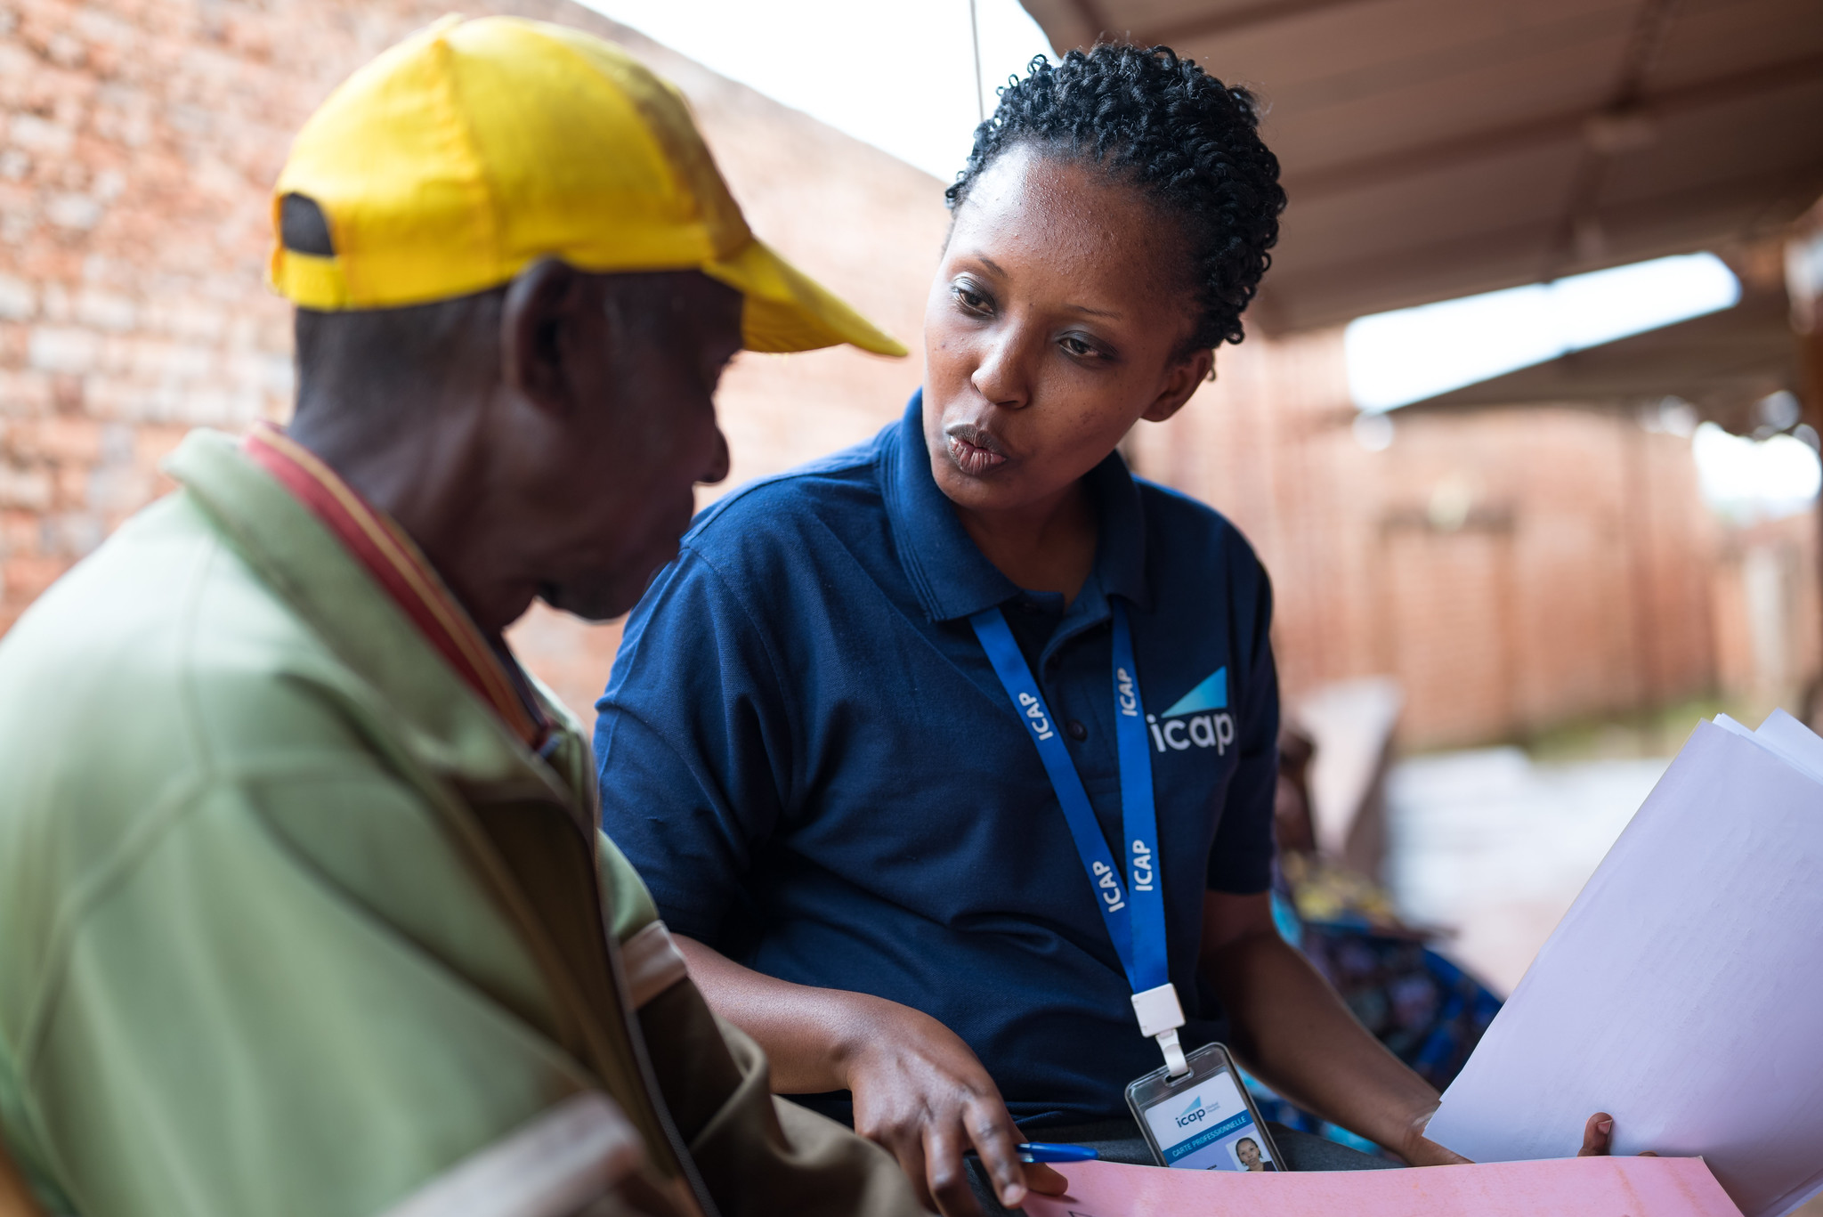
Confirm Client is Good Candidate for ​Selected Option
Once a client has a selected their PrEP option, ask more targeted questions to evaluate for any contraindications or other factors that would make them a poor candidate for that option.
If they have contraindications to that option or are not willing to commit to taking it as recommended, you may need to consider other PrEP options previously discussed and repeat some of the informed choice counseling steps.
If not done previously, screen for AHI before proceeding with PrEP initiation.

Slide 113
Confirm Client Is a Good Candidate for Oral Daily PrEP
 | Targeted Questions | Rationale
Oral Daily PrEP | Do you have high blood pressure, diabetes or have you been told you have problems with your kidneys? | Impaired kidney function is a contraindication for the use of oral PrEP with tenofovir (TDF)​. Oral PrEP can be started with these conditions, but clients should be counseled that a blood test to measure creatinine will be done within 1-3 months of PrEP initiation.
 | What is your current age? | Age can be used to determine who should get a creatinine test within 1-3 months.
See Module 2 for information on oral daily PrEP renal function monitoring

Slide 114
Confirm Client Is a Good Candidate for Oral ED-PrEP
 | Targeted Questions | Rationale
Oral ED-PrEP | Do you have high blood pressure, diabetes or have you been told you have problems with your kidneys? | Impaired kidney function is a contraindication for the use of TDF-based oral PrEP​. Oral PrEP can be started with these conditions, but clients should be counseled that a blood test to measure creatinine will be done within 1-3 months of PrEP initiation.
 | What is your current age? | Age can be used to determine who should get a creatinine test within 1-3 months.
 | Can you plan for sex at least 2 hours in advance, or delay sex for at least 2 hours? | If a client cannot plan for sex or delay sex for at least 2 hours, they are not a good candidate for ED-PrEP.
See Module 3 for information on oral ED-PrEP renal function monitoring and contraindications

Slide 115
Confirm Client Is a Good Candidate for CAB-LA
 | Targeted Questions | Rationale
CAB-LA | Are you pregnant or breastfeeding? Do you intend to become pregnant soon? | Per national guidelines, pregnant or breastfeeding women may not be eligible for CAB-LA.
 | Are you being treated for tuberculosis or taking medications to control seizures? | Several anticonvulsant and anti-tuberculosis medications should not be co-administered with CAB-LA.
 | Will you be able to come for regular injections every two months? | Regular injections are essential to ensure CAB-LA effectiveness and to minimize risk of developing INSTI-resistant HIV infection.
 | What is your weight? | CAB-LA is not recommended in individuals weighing less than 35 kg.
 | Do you have buttock implants or fillers? | Buttock implants or fillers may affect the safe administration and absorption of intramuscular gluteal injections.
See Module 4 for information on CAB-LA contraindications

Slide 116
Confirm Client Is a Good Candidate for the DVR
 | Targeted Questions | Rationale
DVR | If using a ring, diaphragm or cervical cap for contraception, are you willing to switch to another method of contraception? If you practice vaginal cleaning or drying, are you willing to stop these practices? | Women using a ring, diaphragm or cervical cap for contraception, or who engage in certain vaginal practices, should be willing to stop while using the DVR.
 | Are you pregnant or breastfeeding? | Per national guidelines, pregnant or breastfeeding women may not be eligible for the DVR.
 | Are you currently using any medications in your vagina to treat an infection? | Delay initiation of the DVR until vaginal antimicrobial product may be discontinued
 | Are you able or willing to use another form of PrEP? | If a client is willing and able to use another form of PrEP instead of DVR, they should be counseled to do so, as other forms of PrEP offer significantly greater HIV protection.
See Module 5 for information on DVR contraindications

Slide 117
Case Scenario
Through the informed choice counseling process, you haves supported Hope to make an informed decision to use CAB-LA as PrEP.
What additional targeted questions will you ask her to evaluate for any contraindications to using CAB-LA, or other factors that would not make her a good candidate, before proceeding with CAB-LA initiation?
Notes:
Facilitator guidance:
Explain to participants that a case scenario is provided to apply their knowledge
Read the scenario and question on the slide asking participants, “What additional targeted questions will you ask Hope to evaluate for any contraindications to using CAB-LA or other factors that would not make her a good candidate before proceeding with CAB-LA initiation?"
Ask participants to raise hands and share their answers.
Continue to the following slide to provide the answer after receiving inputs from participants.

Slide 118
Case Scenario
To make sure Hope is a good candidate for CAB-LA, you ask her about:
Her weight (or weigh her)
Any medication she is taking, especially for tuberculosis or seizures
If she currently has or plans to get any buttock implants
If she foresees any prolonged travel or other barriers that would make it difficult to keep her appointments.
If she intends to become pregnant in the near future
Notes:
Facilitator guidance:
Reveal the answer on the slide and provide additional information as needed:
Check her weight because CAB-LA users must be >35 kg
Ask about medications because certain TB and seizure medications are contraindicated with CAB-LA use.
Ask about buttock implants because CAB-LA is injected into the buttocks and cannot be injected into implants or fillers
Ask about travel or other barriers to attending clinic appointments, as it is important that she is able to come to her appointments on time.
Ask about pregnancy intentions, as she may not be able to continue CAB-LA if she becomes pregnant (refer to national guidelines)
Allow time for questions and follow-up discussion as needed.

Slide 119
Break into groups of 3. Take turns role-playing informed choice counseling for PrEP options, comparing 2 PrEP options available in your country.
PrEP clinical provider: Deliver informed choice counseling messages for initiating a candidate on PrEP. Go through the seven steps and include all considerations for choosing between the two options.
PrEP candidate: Pretend to be a client considering PrEP. Ask lots of questions to decide which option is right for you.
Observer: Silently observe the interaction and notice if the provider is delivering all of the key counseling messages. Did they miss anything?
Discuss among you. What worked well? What could be improved? Were there any key counseling messages that were missed or should be added?
ROLE-PLAY & DISCUSSION
Notes:
Facilitator guidance:
Time: 40 minutes
Explain that participants will now work in small groups to role-play informed choice counseling.
Divide participants into groups of 3 participants each.
Define participant roles. One participant will role-play as the PrEP clinical provider. One participant will role-play as the PrEP candidate. One participant will observe. Take turns to explore each of the 3 roles.
The participant in the role of the PrEP clinical provider will deliver key counseling messages for providing informed choice counseling for a client choosing between two PrEP options available in the country. Allow this participant to reference the previous slides with key counseling messages.
The participant in the role of the PrEP candidate will pretend to be considering starting PrEP and should ask questions to decide which available option is right for them.
The participant in the role of the observer should silently observe the interaction between the PrEP clinical provider and PrEP candidate and notice if the provider is delivering the key counseling messages or if they missed anything. Allow this participant to reference the previous slides with key counseling messages as needed.
Allow 5 minutes for the role-play.
Discuss among participants in the small group. What worked well? What could be improved? Were there any key counseling messages that were missed or should be added?
Allow 5 minutes for discussion.
Switch roles until each participant has played in each of the 3 roles.
Return to the larger group and discuss what you experienced and learned from the role-play. Allow 10 minutes for large group discussion.

Slide 120
Informed Choice Counseling and Follow Up Visits
Informed choice counseling for PrEP should be integrated into counseling at PrEP follow up visits, as needed.
Supporting clients to switch PrEP product affirms their active role in deciding when and how to incorporate PrEP as a tool to prevent HIV.
It is appropriate for PrEP use to vary by client and over time.
PrEP use is often cyclical, with clients stopping for periods and then restarting.
Informed choice counseling can help keep clients engaged in HIV prevention services even when they wish to stop PrEP.

Slide 121
Reasons to Switch or Stop PrEP
There are many reasons a person my wish or need to stop their chosen PrEP method, including:
  Change in eligibility status, for example:
    A woman using CAB-LA wishes to become pregnant
    A client using ED-PrEP who was assigned male sex at birth and identifies as transgender female wishes to start gender-affirming estradiol-based hormone therapy
  Change in personal preferences or circumstances, for example:
    A client finds taking pills in private is not possible in a new home and they feel uncomfortable taking PrEP around others, resulting in regular missed doses
It is important to identify and explore difficult or dissatisfactory characteristics of the previous PrEP option to clarify preferences and inform decisions going forward.

Slide 122
Return to Informed Choice Counseling Steps as Needed
Eligibility Change and/or Dissatisfaction With Current Product
Reassess for Available
PrEP Options
Conduct Informed Choice Counseling​ for Alternative PrEP Options
Confirm Client is Good Candidate
for ​Alternative Option
Switch PrEP
Reassess HIV exposure risk factors, pregnancy status (if applicable), to identify alternative PrEP options available to client
Provide education about available PrEP options Identify difficult or dissatisfactory characteristics of previous PrEP option to clarify preferences Guide client through shared decision making to select an alternative option
Evaluate for contraindications to selected PrEP option If a contraindication is identified, discuss alternative HIV prevention methods, including any remaining PrEP options

Slide 123
6.4 Counseling Clients to
Support Effective PrEP Use

Slide 124
Periods of HIV Risk and Effective PrEP Use
The fundamental purpose of PrEP is to prevent HIV infection, which requires effective PrEP use during periods of HIV risk.
Effective PrEP use includes:
  Access to PrEP option and skills to use it before potential exposure to HIV
    Pill-taking for oral options, coming for injections of CAB-LA at prescribed intervals, continuous supply and un-interrupted placement of the DVR
  Continuing PrEP until the period of risk has passed
  Using PrEP as prescribed for maximum efficacy
  Following requirements for frequency and type of HIV testing
Counseling to support clients to use PrEP effectively should begin at the PrEP initiation visit and revisited during follow-up encounters as needed.

Slide 125
Social and Cultural Factors Can Affect PrEP Access and Use
People at risk of acquiring HIV infection such as key populations, including men who have sex with men, sex workers, transgender people, and people who inject drugs, often face stigma, discrimination, and violence in public settings.
  Stigma and discrimination are prevalent in healthcare settings, making many people who would benefit from PrEP reluctant to seek care.
PrEP users are generally healthy and may not feel comfortable using medications regularly or attending regular appointments in healthcare settings.
People who could benefit from PrEP may not perceive their level of risk for acquiring HIV or may not want other people in their lives to know they are at risk.
  For example, if a partner knows about a person’s PrEP use it may raise questions of trust and fidelity in relationships.
Power imbalances in partnerships, especially male-to-female power imbalances, can make it difficult to use PrEP effectively if the partner is not supportive.

Slide 126
Peer Support for Effective PrEP Use
Outreach workers, including lay or peer workers, are well-placed to engage people who may benefit from PrEP but do not routinely access healthcare.
Trained peer supporters can:
  Play an important role in promoting PrEP, delivering accurate messaging, and supporting adherence to the option that the client has selected
  Be helpful in counseling clients to perceive their own risk for acquiring HIV and understand the benefits of PrEP
  Provide non-judgmental, respectful support
  Be effective role models, if they have experience with PrEP options
PrEP services that include lay cadre from key population groups can help reduce client concerns about stigma and increase PrEP uptake.

Slide 127
A Person-Centered Approach Is Essential for All Counselors
The term “person-centered” refers to seeing people as the expert on their own lives.
The counselor serves as a guide and resource to support setting and reaching goals.
Person-centered counseling for PrEP use:
  Emphasizes respecting an individual’s experiences and choices
  Requires understanding key aspects of the client’s life context, including available support and potential barriers to PrEP use
  Supports clients’ ability to use PrEP effectively with counseling tailored to their life context and perceptions about the benefits and requirements of their chosen PrEP option
  Addresses client-identified challenges to PrEP use, such as taking PrEP pills with alcohol or difficulty inserting the DVR correctly
World Health Organization, 2017

Slide 128
How Can Healthcare Providers Positively Influence PrEP Use?
Facilitate accurate knowledge and understanding of PrEP requirements
Express confidence in PrEP efficacy
Prepare clients for side effects and how to manage them
Identify sources of social support for PrEP use
Help clients build reminders for PrEP use into their schedule
Maintain an open line of communication about PrEP use
Monitor adherence to pill taking, CAB-LA injections, or DVR placement

Slide 129
Effective Use Counseling at PrEP Initiation
Initiation counseling should prepare clients to successfully incorporate PrEP into their life and provide information and resources to support continued PrEP use.
Note: Such counseling at the PrEP initiation visit is essential, as clients may not return for follow-up if they encounter challenges before their next appointment.
Initiation counseling for effective use should aim to:
  Build self-efficacy for PrEP use
  Support clients to anticipate and overcome potential challenges that may arise between clinic visits
  Assess for common barriers to adherence, such as alcohol and substance dependency, gender-based violence (GBV), depression and other mental health conditions, and make referrals as needed
See Modules 2-5 for specific technical information to cover at initiation for each PrEP option

Slide 130
Increase Self-Efficacy
It is important to build a client’s self-efficacy to use PrEP i.e., their belief in their capacity to use PrEP successfully.
  Self-efficacy increase through recalling successful similar experiences, witnessing success in others and positive encouragement or mentoring.
Highlighting the benefits of PrEP in clients’ lives can increase motivation and confidence to adhere to PrEP as prescribed.¹
Focus on the good things that will and the bad things that will not happen when adherence behavior is strengthened. For example:
  Example: Let’s plan your transportation to the clinic for your next CAB-LA injection. That way you will not risk getting the injection late.
Avoid focus on the negative impact of not adhering to PrEP as prescribed.
  Example: If you don’t come on time to your next injection, you could get HIV.
1. Balan et al., 2021

Slide 131
Healthcare Worker Discussion Prompts: Self-Efficacy
To build self-efficacy provide encouragement and draw on skills, behaviors and experiences a client may have. For example:
What is your experience taking a medicine daily or at regular intervals?
What is your experience with regular injections, such as for family planning?
What is your experience attending regular clinic visits or other types of appointments?
When you have taken medicines in the past, how did you remember to take them? What helps you remember to attend clinic visits or other appointments?
Do you know anyone who is using PrEP or another medication regularly? What strategies do they use to remember their medication and appointments?
I know many people like you who have done very well using PrEP. Would you like me to connect you to someone on PrEP to talk to?

Slide 132
Anticipate and Overcome Potential Challenges
Review potential side effects and discuss how to manage them. Remind the client that frequency and severity of side effects generally diminish over time.
  Without advance preparation, side effects can lead people to stop PrEP prematurely.
Help clients think through how they will adhere to requirements of their PrEP option, including any challenges they foresee in adhering to the medication or appointment schedule.
  Ask the client to think through how they will remember consistent pill-taking, DVR placement or attendance at CAB-LA injection visits.
Discuss any potential social barriers to PrEP use, such as stigma, privacy concerns or expected movement out of the area.
  Anticipating these barriers in advance, allows for problem-solving before challenges are encountered (see Section 6.5)

Slide 133
Healthcare Worker Discussion Prompts: Anticipate and Overcome Challenges
Counsel clients to anticipate challenges to PrEP use and brainstorm solutions together. For example:
What is your plan for using your PrEP as prescribed?
What will you do if you are away from home when you need to take your pill/receive your next injection/insert a new DVR on time?
What is your understanding of possible side effects of your PrEP? How will you cope with side effects if you have them?
Do you foresee any other challenges with using PrEP? Do you feel comfortable with people in your life knowing you are using PrEP?
Where do you plan to store your pills/DVR packs?
Do you think you will have any challenges attending your follow-up appointments on time?
See Modules 2-5 for information on side effects and adherence for each PrEP option

Slide 134
6.5 Supporting Continuation on PrEP

Slide 135
Person-Centered Counseling for Continuation on PrEP
Over the course of their PrEP use, clients will:
  Develop behaviors and practices that support adherence to their chosen option
  Experience challenges to PrEP use
  Undergo life changes that impact on their HIV prevention needs and preferences
Person-centered counseling addresses clients’ changing needs for support in PrEP continuation.
  Focus on client values, priorities and preferences
  Clients judge their need to continue with current PrEP option, switch to a new option, or stop PrEP
  Communication skills are key to person-centered counseling.

Slide 136
Core Communication Skills for PrEP Continuation Counseling
Effective Communication
Open-ended Questions
Affirmations
Reflective Listening
Summary Statements
Problem-solving

Slide 137
Open-ended Questions
Open-ended Questions
Open-ended questions are useful to assess clients’ experience using PrEP, desire to continue using PrEP, and any barriers to PrEP use.
Avoid questions that can be answered with “yes”, “no”, or other simple responses.
Examples of open-ended questions are:
  How do you feel PrEP is working for you so far?
  What makes it difficult for you to use PrEP as prescribed? [i.e., take every day; take before and after sex; come for injection appointments as scheduled; or change the DVR as scheduled]
  What have you already done to try to use your PrEP as it was prescribed?

Slide 138
Affirmations
Affirmations
Part of building clients’ self-efficacy for effective PrEP use is explicitly recognizing and praising their achievements, including behaviors that support continued engagement in PrEP services even when adherence is challenging.
By affirming that clients have made significant steps towards effective PrEP use or have achieved it, providers demonstrate respect for clients and build a trust.
For example:
  Thank you for telling me about your missed doses of PrEP. It sounds like you are identifying specific challenges to adherence, and now we can explore potential ways to overcome them.
  It sounds like you have had a number of challenges with using your PrEP but have been able to overcome many of them.
  Despite challenges you have been facing, you made it to your appointment today, which is an important step.

Slide 139
Reflective Listening
Reflective Listening
In reflective listening, the counselor paraphrases clients’ statements to demonstrate a commitment to understanding clients’ perspectives and experiences.
Reflective listening also allows clients to confirm the counselor has understood or correct their understanding as needed.
Reflective listening can also serve as an invitation to the client to expand on what has been said.
For example:
  You were not sure that you had inserted the DVR correctly, and that worried you. Did I get that right? Could you say more about your worries?

Slide 140
Summary Statements
Summary Statements
Summary statements of what a client has said, or what has been discussed, ensure that the client and counselor have a shared understanding of the situation, including the client's experience with PrEP and any facilitators or barriers to using PrEP.
Summary statements are a useful transition from one counseling topic to the next, e.g., from addressing side effects to scheduling future visits.
For example:
  You described to me the pain that you felt following your first CAB-LA injection, and we agreed on taking a pain-reliever before and after future injections. We also talked about how painful injection site reactions generally diminish over time. We need to look at the calendar and see when you will come for you next injection. May we do that now?

Slide 141
Problem-Solving
Problem-solving
Discuss how you can work together with the client to develop strategies to continue effective PrEP use and/or other HIV prevention approaches according to the client's situation and desires.
Approaching adherence challenges as a problem to be solved ensures that the counselor does not treat poor adherence as the client’s failure or weakness.
Encourage the client to lead the problem-solving process.
For example:
  You have realized that drinking alcohol at a club before you go home with a partner makes it difficult to remember to take your loading dose of ED-PrEP in time. Let’s see if we can find a way for you to work around that. What ideas do you have?

Slide 142

Case Scenario​
Joseph is a 32-year-old man who has been taking oral daily PrEP for 6 months. He comes to a scheduled clinic appointment today saying that he wants to stop taking PrEP.
How would you use core communication skills to begin his counseling session?
Notes:
Facilitator guidance:
Explain to participants that a case scenario is provided to apply their knowledge of communication skills for PrEP continuation counseling.
Read the scenario and question on the slide asking participants, "How would you use core communication skills to begin his counseling session?
Ask participants to raise hands and share their answers.
Continue to the following slide to provide the answer after receiving inputs from participants.

Slide 143

Case Scenario​
Begin by offering reflective listening and then asking open-ended questions to understand Joseph's experience using PrEP.
For example:
I hear you saying you want to stop taking PrEP. Can you tell me more about your experience taking PrEP over the past 6 months? What has gone well? How have you handled challenges you have faced? I’d like to understand what has made you want to stop taking PrEP.
Notes:
Facilitator guidance:
Reveal the answer on the slide.
Allow time for questions and follow-up discussion as needed.

Slide 144

Case Scenario​
Joseph says that he tries to use his PrEP, but he travels for work frequently and remembering to take his PrEP pills with him is a challenge. Even when he has remembered his PrEP, his routines are different enough when traveling that he often forgets to take it.
He has been taking oral daily PrEP for 6 months and has missed multiple doses due to his work schedule.
What core communication skill could you use in response?
Notes:
Facilitator guidance:
Explain to participants that a case scenario is provided to apply their knowledge of communication skills for PrEP continuation counseling.
Read the scenario and question on the slide asking participants, "What core communication skill could you use in response?"
Ask participants to raise hands and share their answers.
Continue to the following slide to provide the answer after receiving inputs from participants.

Slide 145

Case Scenario
Recognize the positive aspects of what he has shared (affirmations)
I appreciate that you are honest about missing PrEP doses due to work travel.
You are clearly a resourceful person to manage the challenges of work travel.
It sounds like you’ve worked hard to continue taking PrEP for several months, despite your work requirements and missed doses.
Notes:
Facilitator guidance:
Reveal the answer on the slide.
Allow time for questions and follow-up discussion as needed.

Slide 146
Case Scenario
Joseph confirms that he has really tried to keep taking PrEP, because he is aware that he needs protection.
When he travels, he often meets new sexual partners, and he doesn’t have an opportunity to learn about their HIV status.
What core communication skill could you use next?
Notes:
Facilitator guidance:
Explain to participants that a case scenario is provided to apply their knowledge of communication skills for PrEP continuation counseling.
Read the scenario and question on the slide asking participants, "What core communication skill could you use next?"
Ask participants to raise hands and share their answers.
Continue to the following slide to provide the answer after receiving inputs from participants.

Slide 147
Case Scenario
Use a summary statement and ask Joseph to correct or clarify any points:
Let me see if I understand. When you travel for work, it can be difficult to remember to bring your PrEP with you and changes to your routine make it harder to remember to take. At the same time, you feel you need the protection it gives you. It sounds like we need to find ways to make sure you have your pills and are reminded to take them when traveling. Did I miss anything?
If Joesph agrees that your summary is accurate, what is your next step?
Notes:
Facilitator guidance:
Reveal the answer on the slide.
Allow time for questions and follow-up discussion as needed.
Ask the follow up question, “If Joesph agrees that your summary is accurate, what is your next step?”

Slide 148
Case Scenario
Problem-solve about ways to ensure he has his PrEP when he is away and is prompted to take it daily. For example:
Let’s think about what works at home and see if we can apply it to travel. How do you use your PrEP at home?
Many people set a daily reminder in their phone to take their pill or link it to a daily routine, might that work for you when you travel? Could you keep a small supply in your luggage, so you don’t have to remember it when you pack?
What other ideas do you have for reminders when you travel?
Notes:
Facilitator guidance:
Reveal the answer on the slide.
Allow time for questions and follow-up discussion as needed.
Continue to the following slide for more information on this case scenario

Slide 149
Case Scenario​
Joseph says at home he keeps the pills by his bedside and takes one before going to sleep each night. However, when he travels, he sleeps in several different places and at different times from his usual routine, so often forgets his pill.
He agrees to try to keep a supply of medication in the bag he uses when he travels. He also will plan to take it when he brushes his teeth at night, which is a daily routine he maintains when traveling.
Notes:
Facilitator guidance:
Reveal the answer on the slide.
Allow time for questions and follow-up discussion as needed.

Slide 150
A Non-judgmental Approach to Assessing Adherence
To encourage realistic, honest discussion about challenges or issues clients may be facing, avoid putting your own judgment on them.
Normalize adherence challenges. For example:
  Many people have trouble remembering to take pills regularly, especially when starting a new medication. Has this happened to you?
Ask about most recent pill-taking, CAB-LA injection, or DVR insertion. Short-term recall tends to be better than long-term recall. For example:
  About how many days this week have you missed a PrEP pill?
  Tell me how you used ED-PrEP during your most recent sexual encounter?
  Think back to your last few injections, did you experience any challenges making it to clinic during the window period?
  Let’s look at the calendar so you can show me when you last inserted and removed your DVR.

Slide 151
Support for Clients Who Experience Difficulties With Effective PrEP Use
Adherence to medical interventions over the long term is universally challenging.
To effectively support clients to overcome adherence challenges, the reasons for nonadherence must be explored and understood. Nonadherence can stem from many factors, including:
  Inadequate knowledge or misunderstandings
  Forgetfulness or difficulty establishing adherence habits
  Difficult experiences with PrEP
  Barriers to accessing PrEP services
Clients who successfully used PrEP in the past may be experiencing significant life changes, such as in employment, place of residence, or relationship status. Understanding the impact of these changes can help tailor counseling to re-establish effective PrEP use.

Slide 152
Common Reasons for Nonadherence
Knowledge | Forgetting
Lack of knowledge contributes to nonadherence to medication or missed appointments | Difficulty remembering PrEP dosing or appointments
Examples: Unaware of PrEP follow-up requirements Not convinced PrEP is needed Does not believe PrEP works or is working Does not believe it is necessary to take PrEP as prescribed (e.g., pills every day or to keep the DVR in place continuously) Does not want to use PrEP with alcohol, drugs or other medications Believes myths or misconceptions about PrEP (e.g., causes infertility) | Examples: Forgot to take pill or insert the DVR on time Forgot to refill prescription Has difficulty with personal organization and scheduling Affected by depression or other unaddressed mental illness Unaddressed substance use issues, especially dependence on alcohol or other drugs

Slide 153
Common Reasons for Nonadherence (continued)
Experience of PrEP use | Barriers to accessing PrEP services
Experienced or anticipated personal, practical or social challenges with PrEP use | Impediments to accessing services required for PrEP continuation
Examples: Does not like taking pills, using the DVR or receiving injections Has experienced side effects or wishes to avoid side effects Has experienced or fears stigma while on PrEP Wishes to avoid others becoming aware of PrEP use (e.g., witnessing oral pill bottle or dosing, or feeling the DVR in place during sex) No place to store medication or DVR packs Insufficient privacy or space to insert the DVR Has experienced or fears GBV due to PrEP use | Examples: Has competing priorities such as employment or childcare Cannot afford transport to clinic visits, laboratory tests, or other costs Dissatisfaction with healthcare provider interactions or other poor experiences at healthcare facility Member of a mobile population or has experienced displacement that makes accessing services difficult

Slide 154
PrEP Support Strategies
Reason | Potential Support Strategies
Knowledge | Individual counseling for PrEP education Group counseling or peer support group Written information or instructions Peer educator or mentor
Forgetting | Store medication in pillbox or another organizer Record dosing schedule on a calendar or in journal/log as a visual reminder Use SMS reminders, alarms, smart phone apps and other technology for reminders and tracking adherence Engage PrEP supporter or peer worker for regular follow-up Tailor PrEP schedule to routine activity, e.g., take pills at bedtime or while brushing teeth, perform DVR change on pay day or when monthly bills are paid Keep a few doses of PrEP in different locations for easy access, such as at work, in a frequently used bag, in partner or family members’ home etc. Screen for and manage depression or substance use problems, with referrals for management as appropriate

Slide 155
PrEP Support Strategies (continued)
Reason | Potential Support Strategies
Experience of PrEP use | Manage side effects, e.g., provide pain medication for ISR. As possible, prepare for side effect management in advance Counsel on short-term nature of many side effects Pair clients with PrEP-experienced peer supporters who can serve as role models Meet with partners or family to answer questions and encourage support for PrEP Host peer support groups for PrEP clients tailored to specific populations, such as young women or key population groups Brainstorm measures to improve privacy, such as transferring oral PrEP to unmarked pill bottles or opaque containers If appropriate, consider switching to alternative PrEP method
Barriers to accessing PrEP services | Consider differentiated service delivery approaches, including multi-month dispensing, community-based PrEP services and the use of HIVST Integrate PrEP into sexual and reproductive health clinics and other services routinely accessed by PrEP clients Provide information and referrals for PrEP services in other areas for mobile populations

Slide 156

Case Scenario: Imani, address privacy issues
Imani is a 22-year-old female sex worker who has been taking oral daily PrEP.
She returns to the clinic two months after starting PrEP saying that she doesn't want to take the pills anymore because her last regular sexual partner saw her PrEP pill bottle and left her, saying that she must have HIV since she is taking an antiretroviral drug.
How would you counsel Imani?
Notes:
Facilitator guidance:
Explain to participants that a case scenario is provided to apply their knowledge of approaches to on-going PrEP adherence support.
Read the scenario and question on the slide asking participants, "How would you counsel Imani?"
Ask participants to raise hands and share their answers. [Answer: Discuss privacy issues with Imani. Counsel Imani on PrEP options that would be more discreet and less stigmatizing such as CAB-LA or DVR, if available. If she prefers oral PrEP, offer her a pill box or other container that she can use to store her PrEP pills discreetly and brainstorm with her about a daily pill-taking schedule that will ensure her partners do not see her taking PrEP.]
Allow for discussion and questions as needed.

Slide 157

Case Scenario: Angel, planning for adherence to CAB-LA schedule
Angel, a transgender woman, attended regular visits for CAB-LA for 8 months, but now she is about 5 weeks late for her next injection.
She returns to the clinic saying that she has just returned after responding to a family emergency some distance away. You explain that she will need to restart CAB-LA.
How would you counsel Angel to avoid missing future injections?
Notes:
Facilitator guidance:
Explain to participants that a case scenario is provided to apply their knowledge of approaches to on-going PrEP adherence support.
Read the scenario and question on the slide asking participants, "How would you counsel Angel?"
Ask participants to raise hands and share their answers. [Answer: Using affirmative language, recognize that by returning to the clinic as soon as she could Angel has taken the first step in continuing her PrEP use. Assess her understanding of the importance of regular CAB-LA injections and counsel as needed. Review the schedule for ongoing injections based on restarting CAB-LA today and brainstorm how to ensure she gets reminders of upcoming visits in time to reschedule if needed. Educate Angel on the option to use oral PrEP as a ‘bridge’ if she alerts you in advance of the need to miss any future injection visits. Assess her satisfaction with CAB-LA as a PrEP option. If CAB-LA is available in other areas, provide her with information on where and how she could get an injection when she is traveling.]
Allow for discussion and questions as needed.

Slide 158
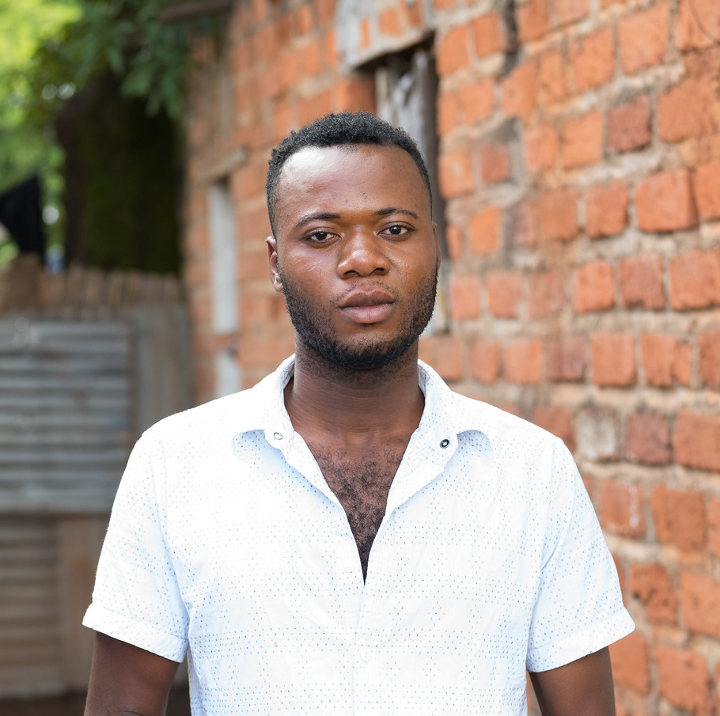
Case Scenario: Innocent, create a routinized schedule
Innocent is a 32-year-old gay man who has been taking oral ED-PrEP.
He wants to continue taking PrEP but often forgets to take his post-sex doses. Sometimes he forgets to bring his pills with him when he travels for the weekend.
How would you counsel Innocent to support his adherence to PrEP?
Notes:
Facilitator guidance:
Explain to participants that a case scenario is provided to apply their knowledge of approaches to on-going PrEP adherence support.
Read the scenario and question on the slide asking participants, "How would you counsel Innocent?"
Ask participants to raise hands and share their answers. [Answer: Brainstorm with Innocent on strategies for remembering post-sex doses, such as setting reminders in his phone as soon as he takes his first two pills, and how to ensure he has the medication with him when away from home, such as storing a small amount of medication in the luggage he normally uses to travel. Recommend or provide medication adherence tools, such as pill boxes for storing PrEP or phone, SMS or app reminders for pill taking. Discuss whether daily oral PrEP dosing would be easier for him to remember]
Allow for discussion and questions as needed.

Slide 159

Case Scenario: Makeba, address safety concerns
Makeba is a married woman who is taking daily oral PrEP because she believes her husband is having sex with other women and is unsure of their HIV status.
She comes to the clinic before her next appointment saying that she is pregnant and worries that PrEP will not be safe for her baby. She wonders if she should stop taking PrEP while pregnant.
How would you counsel Makeba to support her PrEP use?
Notes:
Facilitator guidance:
Explain to participants that a case scenario is provided to apply their knowledge of approaches to on-going PrEP adherence support.
Read the scenario and question on the slide, asking participants, "How would you counsel Makeba?"
Ask participants to raise hands and share their answers. [Answer: Validate her concerns with affirmative statements. Ask open-ended questions to assess her perception of on-going need for PrEP and for any myths or misconceptions she may have heard about taking PrEP when pregnant. Educate on the safety of PrEP during pregnancy and breastfeeding. If peer counselors experienced in PrEP use during pregnancy are available and Makeba is willing, offer to connect her to a peer for tailored adherence support.]
Allow time for questions and discussion as needed.

Slide 160
Periods of Risk and Safe Discontinuation of PrEP
Behaviors and circumstances that put people at risk for HIV change over time. This is sometimes referred to as “seasons of risk.”
If a client’s HIV risk has changed, discontinuation of PrEP may be appropriate. For example, HIV risk may decrease if:
  Partners living with HIV achieve viral suppression and cannot transmit HIV
  Client enters a monogamous relationship with someone confirmed as HIV-negative
  Number of partners decreases, such as when a client leaves sex work, or if drug use stops
Emphasize the importance of regular HIV testing after stopping PrEP and the need for appropriate HIV protection without PrEP, especially following CAB-LA discontinuation.
Remind clients that they can restart the same or another PrEP option if circumstances change.
See Module 4 for information on safely discontinuing CAB-LA use
World Health Organization, 2017

Slide 161
Summary

Slide 162
Module 6 Summary
A person-centered approach is essential to supporting clients to think about potential benefits of PrEP in their lives; how to use it effectively; and how to safely stop PrEP.
Focusing on the benefits of PrEP, in addition to client risk factors, can improve uptake and engagement.
Informed choice counseling is essential when clients are choosing among more than one PrEP option.
  Offering choice allows clients to stay engaged in PrEP when one option proves challenging
A context-specific, problem-solving approach supports clients to use PrEP effectively in their lives.

Slide 163
Module 6 Learning Objectives
Review the learning objectives from this module. After completing Module 6, how confident do you feel to do the following?
Describe the basic principles of person-centered counseling
Help clients think through the benefits that PrEP offers them
Use informed choice counseling to help clients select among available PrEP options
Define the concept of effective PrEP use
Use person-centered counseling to support effective PrEP use
Identify and respond to common barriers to effective PrEP use and continuation

Slide 164
Share your experience with this module.
What did you learn?
What did you find helpful?
What will you implement in your practice?
Do you have any questions?
DISCUSSION​
Notes:
Facilitator guidance:
Time: 10 minutes
Ask participants to raise their hands and share their experience with this module.
Allow time for everyone to share.
Wrap up the discussion by repeating and summarizing main points.

Slide 165
Counseling Resources for Providers
CHARISMA Toolkit: prepwatch.org/resources/charisma-toolkit
Building, Learning, and Understanding Prevention Interventions for HIV (BLUPrInt): hivbluprint.org/keytopics
HIV Prevention User Journey Tool
  Materials: http://prepwatch.org/resources/hiv-prevention-user-journey-tool
  Online version: journeytool.myprep.co.za

Slide 166
Local PrEP Counseling Resources​
[Insert local PrEP counseling materials and resources] ​

Slide 167
References
Balan IC, Giguere R, Lentz C, et al. Client-Centered Adherence Counseling with Adherence Measurement Feedback to Support Use of the Dapivirine Ring in MTN-025 (The HOPE Study). AIDS Behav. 2021;25(2):447-458.
Braddock CH, 3rd, Edwards KA, Hasenberg NM, et al. Informed decision making in outpatient practice: time to get back to basics. JAMA. 1999;282(24):2313-2320.
Braddock CH, 3rd, Fihn SD, Levinson W, et al. How doctors and patients discuss routine clinical decisions. Informed decision making in the outpatient setting. J Gen Intern Med. 1997;12(6):339-345.
Corneli A, Yacobson I, Agot K, Ahmed K. Guidance for Providing Informed-Choice Counseling on Sexual Health for Women Interested in Pre-Exposure Prophylaxis in Kenya and South Africa. AIDS Patient Care STDS. 2016;30(3):106-109.
Dehlendorf C, Grumbach K, Schmittdiel JA, Steinauer J. Shared decision making in contraceptive counseling. Contraception. 2017;95(5):452-455.
D'Souza P, Bailey JV, Stephenson J, Oliver S. Factors influencing contraception choice and use globally: a synthesis of systematic reviews. Eur J Contracept Reprod Health Care. 2022;27(5):364-372.

Slide 168
References
Dubov A, Altice FL, Fraenkel L. An Information-Motivation-Behavioral Skills Model of PrEP Uptake. AIDS Behav. 2018;22(11):3603-3616.
Graybill LA, Chi BH. PrEParing for choice in a new era of HIV prevention. Lancet HIV. 2023.
Han PK, Klein WM, Arora NK. Varieties of uncertainty in health care: a conceptual taxonomy. Med Decis Making. 2011;31(6):828-838.
Institute of Medicine (US) Committee on Quality of Health Care in America. Crossing the Quality Chasm: A New Health System for the 21st Century. Washington, DC, National Academy Press; 2001.
Jain AK. Fertility reduction and the quality of family planning services. Stud Fam Plann. 1989;20(1):1-16.
Johnson MM, Brooks N, Amico KR. Missed Opportunities When We Focus only on Risk: Using the Concerns Based Conversation Starter to Identify Potential PrEP Candidates. AIDS Behav. 2023;27(8):2695-2702.
Kim YM, Kols A, Mucheke S. Informed Choice and Decision-Making in Family Planning Counseling in Kenya. International Family Planning Perspectives. 1998;24(1):4-42.
Notes:
5654++++

Slide 169
References
Losi S, Berra C, Fornengo R, et al. The role of patient preferences in adherence to treatment in chronic disease: a narrative review. Drug Target Insights. 2021;15:13-20.
Ross J, Stover J. Use of modern contraception increases when more methods become available: analysis of evidence from 1982-2009. Glob Health Sci Pract. 2013;1(2):203-212.
Srimanus P, Parkpien P, Janamnuaysook R, et al. Introduction of gain-framed pre-exposure prophylaxis counseling increased uptake among transgender women at the Tangerine Clinic, Bangkok, Thailand. 24th International AIDS Conference (AIDS 2022) Montreal, Canada 29 July – 2 August 2022.
Stanback J, Steiner M, Dorflinger L, Set al. WHO Tiered-Effectiveness Counseling Is Rights-Based Family Planning. Glob Health Sci Pract. 2015;3(3):352-357.
Woolf SH, Chan EC, Harris R, et al. Promoting informed choice: transforming health care to dispense knowledge for decision making. Ann Intern Med. 2005;143(4):293-300.
World Health Organization. WHO Implementation Tool for Pre-Exposure Prophylaxis (PrEP) of HIV Infection. Module 3: Counsellors. Geneva: WHO; 2017.
Yeh PT, Kautsar H, Kennedy CE, Gaffield ME. Values and preferences for contraception: A global systematic review. Contraception. 2022;111:3-21.

Slide 170

Thank You

Slide 171
Acknowledgements
This package is a product of the Clinical and Laboratory Unit of ICAP at Columbia University. The material was conceptualized, designed and developed by Cassia Wells, with support from Julie Franks and technical input from Ellen Morrison, Andrea Howard and Gillian Doherty. Formatting and graphic design was provided by the ICAP Communications Team.
Portions of this training updated and modified previous PrEP package material developed by ICAP at Columbia University in collaboration with the U.S. Centers for Disease Control and Prevention (CDC), with funding from the U.S. President’s Plan for AIDS Relief (PEPFAR) under the terms of cooperative agreement #U2GGH000994.
Its contents are solely the responsibility of the authors and do not necessarily represent the views of the U.S. Government or other organizations.

