Slide 1
Pre-Exposure Prophylaxis (PrEP) Training for Providers in Clinical Settings
Module 5: Dapivirine Vaginal Ring (DVR)
Last update: January 2024​

Slide 2

Training Overview
Oral PrEP
MODULE 1: PrEP Basics ​
MODULE 2: Oral Daily PrEP​
MODULE 3: Oral Event-Driven PrEP (ED-PrEP)​
MODULE 4: Injectable Long-Acting
Cabotegravir (CAB-LA)​
MODULE 5: Dapivirine Vaginal Ring (DVR)​
MODULE 6: Person-Centered PrEP Counseling
PrEP Vaginal Ring
Injectable PrEP

Slide 3
PrEP Competencies​
By the end of this training program, you should be able to:​
Explain the use of PrEP for HIV prevention​
Identify candidates eligible for PrEP​
Initiate clients on PrEP​
Conduct follow-up management for PrEP ​
Provide person-centered counseling for PrEP​

Slide 4
Symbols Key​
Preliminary recommendation based on available evidence and may change​
Adaptation required or suggested based on local context​
Content repeated in other modules​
Unknown at the moment, more information required​

Slide 5

Learning Activities​
Question & Answer​
Fill in the blank​
Review national guidelines​
Case scenario​
Role-play​
Discussion​
Share experiences​
Notes:
Facilitator Guidance:
This training is designed to be interactive and to engage participants in learning and knowledge sharing. Rather than simply lecturing to participants, we encourage facilitators to use a variety of participatory methodologies, including question and answer, discussion, case scenarios, role-play, and other small group activities. These activities are provided for you and were designed to elicit and build on participants’ experience and knowledge, to promote discussion and reflection on key issues, to provide hands-on practice of content learned, and to help participants learn from one another. In addition, these participatory methodologies promote higher retention of content and create an open, engaging, and supportive learning environment.
Review the learning activities in advance to facilitation:
Question & Answer
Questions and answers are included throughout the module to keep learners engaged and actively participating. Q&A are offered to encourage participants to reflect on their existing knowledge before a new topic is introduced. Q&A are also offered after lecture content is delivered to test participants knowledge recall.
How To Facilitate Q&A
Read the question on the slide.
Ask participants to raise their hands to answer the question.
Take a few volunteer responses.
Reveal the answer on the following slide.
Allow time for follow-up discussion as needed (see below).
2. Discussion
A discussion is a dialogue between participants and the trainer, with participants responding to discussion questions and to one another’s ideas. During discussions, new questions may surface. When the trainer leads a large group discussion, she or he must manage the discussion by keeping participants focused, actively eliciting responses, and limiting participants who like to talk a lot. When participants have small group discussions, they must do likewise.
How To Facilitate Discussion
• Set a time limit and keep track of time.
• Explain that participants who want to speak should raise their hands.
• Keep the discussion on target and moving along.
• Encourage everyone to participate and call on everyone who raises a hand.
• Limit participants who like to talk a lot.
• Ask questions to encourage more responses to a question—for example: “What else?” “What other ideas do you have?”
• Wrap up the discussion by repeating and summarizing main points.
3. Case scenarios
A case scenario is a brief description of a realistic situation that participants discuss and analyze. Case scenarios give participants the opportunity to apply newly acquired knowledge to a particular problem or situation and to generate possible solutions to challenges presented in the scenario.
How to Facilitate Case Scenarios
• If participants will use the scenario in small groups or pairs, give clear instructions.
• If you write your own scenarios, make them simple and brief. Use realistic situations similar to those that participants face. Give essential information and leave out unnecessary details.
• Provide questions to guide participants in analyzing the scenario and a list of essential points to be covered in discussion for yourself and co-trainers.
4. Role-Play
A role-play is a brief informal performance where participants act out roles in order to practice handling a particular problem or situation and to experience what it is like to be in those roles. Role-playing is informal; participants do not need to memorize dialogue or perform perfectly— the point is to experience the situation and learn from that experience.
How To Facilitate a Role-Play
• Give clear instructions for the role-play
• Set a time limit for role-play practice and performance, and manage the time well.
• Remind participants that role-playing does not require a perfect performance but rather provides an opportunity to practice handling real-life situations. It is fine to make mistakes during role-play.
• Debrief the role-play with a large group discussion
5. Small group activities
The facilitator divides participants into small groups to do a learning activity. Examples of small group activities include discussions, scenarios, and role-play practice as described above. Small groups allow each person to participate more than they would in the large group. Small group work also helps participants get to know one another and work with new colleagues.
How To Facilitate Small Group Work
• Before you divide participants into small groups, give clear instructions for the small group task.
• Group participants so that they are not always working with people they know well. To vary groups’ composition: Ask participants to count off or draw at random from a deck of playing cards and then group by suit or numbers. Or ask participants to draw at random from a container of colored objects or slips of paper and then group by colors. Or group participants by birthday (seasons or months), by first letter of first or last name, by last digit of their phone number, or by height—then, based on how many fall into each category, regroup these groups so that you have groups of an optimal size.
• Instruct the groups to make sure that all group members participate.
• Have each group choose a timekeeper.
• Keep track of time yourself and provide half-time, 5-minute, and 1-minute warnings.
• As the groups are working, move from one to another to make sure that participants have understood the task and are making progress.

Slide 6
Module 5: Dapivirine Vaginal Ring (DVR)

Slide 7
Introduction​
Welcome to Module 5: Dapivirine Vaginal Ring (DVR)
In this module you will learn how to initiate and conduct follow-up management for clients using the DVR as PrEP. You will learn to identify eligible candidates for the DVR, conduct assessments and counseling to start the DVR, and provide ongoing monitoring for as long as the DVR is used.

Slide 8
Module 5 Learning Objectives​
After completing Module 5, participants will be able to:​
Describe characteristics of the DVR
Explain how the DVR can be used by women as an additional option for protection against HIV infection
Define the eligible and ineligible populations for the DVR
Describe what is known about efficacy, safety and acceptability of the DVR
Guide women to make an informed choice about using the DVR
Counsel women on how to use the DVR effectively
Conduct effective initiation and monitoring visits for women using the DVR
Identify and manage potential side effects with use of the DVR

Slide 9
What is YOUR EXPERIENCE as a provider of PrEP with the DVR or other vaginal rings?
What successes and challenges can you share?
What do you want to learn in this training?
DISCUSSION​
Notes:
Facilitator guidance:
• Time: 10-20 minutes. Timing will vary based on size of the group and time allowed for training. Set a time limit and keep track of time.
• Explain that participants who want to speak should raise their hands.
• Keep the discussion on target and moving along.
• Encourage everyone to participate and call on everyone who raises a hand.
• Limit participants who like to talk a lot.
• Ask questions to encourage more responses to a question—for example: “What else?” “What other ideas do you have?”
• Wrap up the discussion by repeating and summarizing main points.

Slide 10
5.1 Introduction to the DVR

Slide 11
QUESTION
What is the dapivirine vaginal ring (DVR)?
Notes:
Facilitator guidance:
Read the question on the slide.
Ask participants to raise their hands to answer the question.
Take a few volunteer responses.
Reveal the answer on the following slide.
Allow time for follow-up discussion as needed.

Slide 12
ANSWER
The DVR is a flexible silicone ring containing an antiretroviral (ARV) drug that slowly releases directly into the vagina over the course of 28 days.
It provides partial protection against HIV infection for women during vaginal sex.
Notes:
Facilitator guidance:
Reveal the answer on the slide.
Allow time for questions and follow-up discussion as needed.
Continue to the following slide for a detailed description of DVR.

Slide 13

What Is the DVR?
Each ring contains 25 mg of dapivirine (DAP), a non-nucleoside reverse transcriptase inhibitor (NNRTI) ARV drug.
After insertion, the DVR continuously releases the drug into the surrounding vaginal tissue for a month (28 days).
The DVR should be in place continuously and replaced every month.
The DVR comes in one size, with an outer diameter of 56 mm and a thickness of 7.7 mm.
Since January 2021, the World Health Organization (WHO) has recommended the DVR as an additional HIV prevention choice for women.
Source: International Partnership for Microbicides

Slide 14
How Does the DVR Work as PrEP?
Unlike other PrEP methods, the DVR only offers partial protection against HIV infection.
The DVR can be used as PrEP in women who are exposed to HIV through vaginal intercourse only.
Women self-insert the DVR and leave it in place for a month.
After a month, the old DVR is removed and immediately replaced with a new one by the client.
Because the DVR only offers partial protection against HIV, women should only use the DVR if they are unwilling or unable to use other more effective forms of PrEP.
If women use the DVR, they should plan to use other HIV prevention methods, such as condoms, to fully protect themselves again HIV.

Slide 15
QUESTION
What are the major differences between the DVR and other PrEP options?
Notes:
Facilitator guidance:
Read the question on the slide.
Prompt participants by asking, "Who can use DVR for PrEP? How is it administered? How effective is it?"
Ask participants to raise their hands to answer the question.
Take a few volunteer responses.
Reveal the answer on the following slide.
Allow time for follow-up discussion as needed.

Slide 16
ANSWER
The DVR only offers partial protection against HIV infection, so women using the DVR should plan to use other HIV prevention methods, such as condoms.
It comes in the form of a vaginal ring, and therefore is only used by women and only protects against HIV during vaginal sex.
Notes:
Facilitator guidance:
Reveal the answer on the slide.
Allow time for questions and follow-up discussion as needed.

Slide 17

Advantages of a Vaginal Ring for PrEP
Vaginal rings can be used to help achieve sexual reproductive health goals of women. They have been used successfully in many countries to deliver contraception.
A ring offers a discreet PrEP option that women can control.
The drug is released within the vagina, which means fewer systemic side effects.
It is long-acting and can be left in place for a month.
Source: European Medicines Agency

Slide 18

Why Are Long-Acting Forms of PrEP Needed?​
Adherence to oral regimens is challenging for many reasons
Psychological
Pill fatigue
Reminder of vulnerability to HIV
Mental health conditions, such as depression and anxiety
Biological
Biological
Difficulty swallowing
Side effects
Malabsorption
Cognitive difficulties with self-administration
Social
Privacy
Convenience
Lack of supportive norms
HIV-related stigma
Psychological
Social

Slide 19
Why Is an Additional PrEP Option Needed for Women?
In 2021, an estimated 250,000 adolescent girls and young women (AGYW) aged 15 to 24 years acquired HIV.
  The majority (82%) of these AGYW lived in sub-Saharan Africa, with two-thirds living in Eastern and Southern Africa.
Multiple vulnerabilities contribute to women’s HIV risk, including harmful social norms and practices, and social, economic and gender inequalities.
Condoms are highly effective but are not feasible for some women and require a partner’s consent.
Oral PrEP is also highly effective, but women often struggle with adherence and persistence.
More PrEP options allow women to choose the best method, or combination of methods, to meet their HIV prevention needs.
UNAIDS, 2022

Slide 20
QUESTION
Does the DVR protect against HIV exposure through anal sex or injection drug use?
Notes:
Facilitator guidance:
Read the question on the slide.
Ask participants to raise their hands to answer the question.
Take a few volunteer responses.
Reveal the answer on the following slide.
Allow time for follow-up discussion as needed.

Slide 21
ANSWER
NO
The DVR does not protect women exposed to HIV through anal sex or injection drug use, as it only works in the vagina. Efficacy was only assessed for HIV exposure through vaginal sex.
Notes:
Facilitator guidance:
Reveal the answer on the slide.
Allow time for questions and follow-up discussion as needed.

Slide 22


Evidence for the DVR: Randomized Clinical Trials
The Ring Study ¹ | ASPIRE²
Enrolled 1,959 women (18 to 45 years old) from South Africa and Uganda. Participants inserted the rings themselves every 4 weeks for up to 24 months. Found the DVR reduced HIV infections by 31%, compared to a placebo ring. 95% confidence interval 1%-51%; p=0.04 Incidence of 4.1 and 6.1 HIV infections per 100 person-years in the DVR and placebo groups, respectively | Enrolled 2,629 women (18 to 45 years old) in Malawi, South Africa, Uganda and Zimbabwe. Participants inserted the rings themselves every 4 weeks for up to 33 months. Found the DVR reduced HIV infections by 27%, compared to a placebo ring. 95% confidence interval 1%-46%; p=0.046 Incidence of 3.3 and 4.5 HIV infections per 100 person-years in the DVR and placebo groups, respectively
1. Nel et al., 2016; 2. Baeten et al., 2016

Slide 23


Evidence for the DVR: Open Label Extension Studies
At the end of both clinical trials, participants were invited to enroll in an open label extension (OLE) study in which all participants were unblinded and received the DVR.
DREAM Study¹ | HOPE Study²
OLE from The Ring Study Enrolled 941 former Ring Study participants Found HIV incidence of 1.8 per 100 person-years Modeling data estimated the DVR reduced HIV infections by 62% | OLE from the ASPIRE trial Enrolled 1,456 former ASPIRE participants Found HIV incidence of 2.7 per 100 person-years Modeling data estimated the DVR reduced HIV infections by 39%
1. Nel et al., 2021; 2. Baeten et al., 2021

Slide 24
Evidence for the DVR: Understanding Efficacy
Evidence suggests DVR efficacy increases with adherence and correct use.
In The Ring Study and ASPIRE, the DVR was not effective at reducing HIV infections among women 18–21 years old, who also had the lowest adherence to ring use.^{1,2}
DREAM and HOPE found higher efficacy and increased ring adherence compared to the randomized clinical trials. ^{3,4}
  In DREAM, 95% of returned rings showed some use compared to 83% in The Ring Study, while in HOPE, 90% showed use compared to 77% in ASPIRE.
Multiple efficacy analyses among participants who used the ring consistently suggest that the DVR can reduce HIV acquisition by 50% or more with consistent use throughout the month.^{5,6}
Remember, the DVR efficacy only applies to HIV exposure through vaginal sex. It does not protect women exposed to HIV through anal sex or injection drug use.
1. Nel et al., 2016; 2. Baeten et al., 2016; 3. Nel et al., 2021; 4. Baeten et al., 2021; 5. Peebles et al., 2023; 6. Brown et al., 2020
Notes:
CITE:

Slide 25
Evidence for the DVR: Safety and Side Effects
No safety concerns related to the DVR use have been identified thus far.
The DVR delivers DAP locally in the vagina.
  Little of the drug is absorbed elsewhere in the body
Reported side effects are mild and usually resolve in 1-2 weeks without removing the DVR.^{1,2}
Side effects include:
  Urinary tract infections
  Vaginal discharge
  Vulvar itching
  Pelvic and lower abdominal pain
1. Nel et al., 2016; 2. Baeten et al., 2016

Slide 26
Evidence for the DVR: Acceptability
Among trial participants, the DVR was considered acceptable and easy to use.¹
The majority of participants:
  Found it easy to insert
  Did not feel the ring when performing their daily activities
  Did not mind using the DVR every day
Some participants reported their partner could feel the DVR during sex²
  Approximately 1 in 4 women reported that their partner could feel the DVR during sex
  For most women, this was not a barrier for continued use of the DVR
  Reports of this decreased over time
1. Mayo et al., 2021; 2. Nel et al., 2016

Slide 27
Fill in the Blanks
Compare the DVR to other commonly available HIV prevention methods for women.
 | Condoms | Oral Daily PrEP | DVR
Use How frequently must it be used?
Adherence How easy is it to use as intended?
Discretion Can it be used without the partner knowing?
Efficacy How well does it work?
HIV exposure What kind of HIV exposure does it protect against?
Notes:
Facilitator guidance:
Time: 20 minutes
Ask participants to work in pairs to fill in the table, comparing condoms, oral daily PrEP and the DVR
Allow 10 minutes for partners to complete the table.
Ask participants to return to the group and share their answers by raising their hands.
Allow 10 minutes for groups to share their answers.
Continue to the following slide to reveal the answers

Slide 28
Answer
Compare the DVR to other commonly available HIV prevention methods for women.
 | Condoms | Oral Daily PrEP | DVR
Use How frequently must it be used? | Every time a women has sex | Daily | Replaced every month
Adherence How easy is it to use as intended? | Need to remember or negotiate use during every sex act | Need to remember to take daily pills | Need to remember to change every month
Discretion Can it be used without the partner knowing? | No | Yes | Maybe
Efficacy How well does it work? | >95% efficacy when used consistently and correctly | >95% efficacy when used consistently | 30%-50% efficacy
HIV exposure What kind of HIV exposure does it protect against? | Vaginal sex Anal sex | Vaginal sex Anal sex Injection drug use | Vaginal sex
Notes:
Facilitator guidance:
Read the answers on the slide
Allow time for follow-up discussion, questions, and clarification as needed.

Slide 29
Summary of DVR Evidence
4,588 women enrolled in the two randomized clinical trials^{1,2}
2,397 women enrolled in two OLE studies^{3,4}
No major safety concerns
Women generally found the DVR easy to use and acceptable
Efficacy to protect against HIV infection varied, but consistently less than other forms of PrEP
Efficacy of oral and injectable PrEP
1. Nel et al., 2016; 2. Baeten et al., 2016; 3. Nel et al., 2021; 4. Baeten et al.,

Slide 30
Special Populations: Pregnant and Breastfeeding Women
Pregnant and breastfeeding women were excluded from the main clinical trials.
No safety concerns were noted among women who became pregnant during the clinical trials. However, these women stopped the DVR upon learning they were pregnant.
While data collection is ongoing, available data suggest the DVR is safe during pregnancy and breastfeeding for both women and their infants.
  No safety concerns have been noted in women starting the DVR during the third trimester.¹
  Studies of breastfeeding women using the DVR found very low levels of DAP in breastmilk and even lower amounts were ingested by infants, posing no safety concerns.²
1. Bunge et al., 2023; 2. Makanani et al., 2018

Slide 31
Special Populations: Adolescents and Young Women
Only women ≥18 years of age were included in the initial randomized clinical trials.
The DVR was found to be less effective in women under 21 years in the clinical trials, likely due to poorer adherence in this age group.¹
Findings from a study exploring the safety and acceptability of the DVR among AGYW aged 16–21 years in Uganda, South Africa and Zimbabwe² suggest:
  The DVR was acceptable
  The DVR had a favorable safety profile
  The DVR could be used effectively by younger individuals with proper adherence support
Additional counselling should be provided to support adherence for young woman choosing the DVR as a prevention option.
1. WHO, 2021; 2. Nair et al., 2023

Slide 32
Special Populations: Transgender Populations
Transgender men, who were assigned female sex at birth, and who have not undergone gender-affirming genital surgery could use the DVR if they meet other eligibility criteria.
  However, there have been no studies of DVR use among this population, so the product’s acceptability and comfort among this population is unknown.
  Currently, the WHO only recommends the DVR for cisgender women (women assigned female sex at birth).
There have been no studies of the DVR’s use among transgender women who were assigned male sex at birth and have undergone gender-affirming genital surgery and have neovaginas (surgically created vaginas).
  As the efficacy, safety, and acceptability among this populations is unknown, currently the DVR is not recommended as PrEP for transgender women.
WHO, 2021
Notes:
CITE: WHO 2021 guidelines

Slide 33
The DVR and HIV Drug Resistance
As with other forms of PrEP, continued use of the DVR after someone has acquired HIV could lead to being infected with a virus that is resistant to NNRTI medication.
Therefore, as with other forms of PrEP, if acute HIV infection (AHI) is suspected, use of the DVR should be delayed for at least one month and HIV-negative status should be confirmed before initiating or continuing use of the DVR.
However, since the drug acts locally in the vagina, the risk of drug resistance is believed to be lower than with other forms of PrEP that act systemically in the body.
Studies among women who became infected with HIV while using the DVR have not shown higher rates of ARV resistance than among women using a placebo ring.
Parikh et al., 2021

Slide 34
Implementation Considerations
The DVR comes in individual packages that do not require any special temperature storage conditions and have a shelf-life of up to 5 years.
Some women may feel more comfortable with a healthcare provider inserting the first ring, or with an opportunity to practice inserting and removing the first ring while at the clinic.
  If programs decide to offer this option, adequate privacy and sufficient space must be ensured during visits.
Similarly, some programs may suggest a pelvic exam during visits, requiring adequate privacy and space.
To educate women on how to insert the DVR, appropriate materials must be available (e.g., videos, pelvic models, instruction leaflets).

Slide 35
Implementation Considerations (continued)
Multi-month dispensing of the DVR can support continuation.
Whenever possible, DVR dispensing should be aligned with dispensing of family planning regimens.
The DVR has been endorsed by the European Medicines Agency (EMA) and the WHO. However, the US Food and Drug Administration has not approved the DVR. This limits the use of PEPFAR funds for procuring the DVR, however, in some places PEPFAR funds may be used to support other elements of implementation.

Slide 36
Advantages and Disadvantages of the DVR
Advantages
Do not need to remember to take daily pills Long-acting, with infrequent dosing Can be used discreetly Drug is concentrated in vaginal tissue, therefore fewer systemic side effects Easy to store and distribute Potential for less stigma, as product not associated with HIV treatment
Disadvantages
Only offers partial HIV protection and needs to be used with other combination prevention methods Only works in women exposed through receptive vaginal sex Requires women feeling comfortable with inserting and removing the ring Relatively new product, with ongoing collection of safety information

Slide 37
Fill in the Blanks
List at least 3 advantages and 3 disadvantages of the DVR as PrEP.
ADVANTAGES​ | DISADVANTAGES​
1
2
3
Notes:
Facilitator guidance:
Time: 20 minutes
Ask participants to work in pairs to fill in the table, listing 3 advantages and 3 disadvantages of using DVR as PrEP.
Prompt participants to recall the information that was presented on the previous slide.
Allow 10 minutes for partners to complete the table.
Ask participants to return to the group and share their answers by raising their hands.
Allow 10 minutes for groups to share their answers.
Continue to the following slide to reveal the answers

Slide 38
Answer
List at least 3 advantages and 3 disadvantages of the DVR as PrEP.
ADVANTAGES​ | DISADVANTAGES​
Long-acting, so do not need to remember to take daily pills. | Partial HIV protection only. Should be used in combination with other prevention methods.
Can be used discreetly and provides a woman-controlled method of protection. | Protection with vaginal HIV exposure only. Does not protect against exposure through anal sex or injection drug use.
Fewer side effects. Drug is concentrated in vaginal tissue so does not cause systemic side effects. | New product with ongoing collection of safety information
1
2
3
Notes:
Facilitator guidance:
Read the answers on the slide
Explain that there may be additional ADVANTAGES which may include the following:
Long-acting, with infrequent dosing
Easy to store and distribute
Potential for less stigma, as product not associated with HIV treatment
Explain that there may be additional DISADVANTAGES which may include the following:
Requires women feeling comfortable with inserting and removing the ring
Allow time for follow-up discussion, questions, and clarification as needed.

Slide 39
What are the implementation considerations for the DVR in your setting?
What are the opportunities for using the DVR in your setting?
What challenges do you foresee?
DISCUSSION​
Notes:
Facilitator guidance:
Time: 20 minutes
Explain that participants will now work in small groups to discuss DVR implementation considerations, opportunities, and challenges in their settings.
Divide participants into groups of 4 to 6 participants each.
Small groups may go online to research the information. As the groups are working, circulate and help as needed. Allow 10 minutes to work.
When the groups have finished, take volunteer responses from the groups. Allow 10 minutes for discussion.

Slide 40
5.2 DVR Eligibility Screening

Slide 41
QUESTION
Who can use the DVR as PrEP?
Notes:
Facilitator guidance:
Read the question on the slide.
Ask participants to raise their hands to answer the question.
Take a few volunteer responses.
Reveal the answer on the following slide.
Allow time for follow-up discussion as needed.

Slide 42
ANSWER
Cisgender women who are eligible for PrEP and unable or unwilling to use other forms of PrEP.
Women must also be willing to use the DVR as prescribed and have no contraindications to using the DVR.
Notes:
Facilitator guidance:
Reveal the answer on the slide.
Allow time for questions and follow-up discussion as needed.
Continue to the following slides for a detailed description of DVR eligibility criteria

Slide 43
Eligibility Criteria for the DVR
 | Cisgender woman
 | Unwilling or unable to use other forms of PrEP
 | HIV seronegative
 | No suspicion of AHI
 | At substantial risk for HIV infection or requesting PrEP
 | Willingness to use PrEP as prescribed
 | No contraindications to receiving the DVR | Not pregnant or breastfeeding* No history of allergy or hypersensitivity to silicone or dapivirine
*As per national guidelines

Slide 44
Notable Drug-Drug Interactions with the DVR
Due to the low systemic levels of DAP, the risk of systemic drug-drug interactions is considered low.
However, drugs that are co-administered locally in the vagina may interact with DAP, especially vaginal antimicrobial products, which should be avoided:
  Miconazole
  Clotrimazole
  Metronidazole
  Clindamycin
Women requiring treatment for vulvovaginitis should be counseled to remove the DVR and use an alternate form of HIV protection while being treated.
There are no known interactions between DAP and contraceptive hormones. However, concurrent use of contraceptive rings, cervical caps or diaphragms is not recommended.

Slide 45
Pelvic Inflammatory Disease and Genital Infections
It is not known whether continued use of the DVR in women with unrecognized lower genital tract infections increases the risk of developing pelvic inflammatory disease (PID).
Therefore, early detection and appropriate treatment of genital infections, including sexually transmitted infections (STIs), in women using the DVR, as well as treatment of STIs in sexual partners, are considered important.
Some programs may decide to screen women for PID and lower genital tract infections and wait until treatment has been completed before they start the DVR.
A pelvic exam may be considered at initiation or at any follow-up visit, if clinically indicated.
International Partnership of Microbicides, 2022

Slide 46
Other Vaginal Practices
No data are available on the effect of vaginal practices, such as the use of non-medical vaginal products, on the safety and efficacy of the DVR.
Therefore, concomitant use of the DVR with such practices is not recommended.
This includes, but is not limited to:
  Vaginal cleaning practices, such as douching
  Vaginal drying practices for dry sex
If a client is unwilling or unable to stop these practices, she should consider another HIV prevention method.

Slide 47
QUESTION
Who are NOT good candidates for the
DVR as PrEP?
Notes:
Facilitator guidance:
Read the question on the slide.
Prompt the participants by asking, “Based on what you have learnt, what medical conditions, current medications, or vaginal practices might make a client not a good candidate for DVR?"
Ask participants to raise their hands to answer the question.
Take a few volunteer responses.
Reveal the answer on the following slide.
Allow time for follow-up discussion as needed.

Slide 48
ANSWER
A women may not be a good candidate for the DVR if she:
Has a history of allergy or hypersensitivity to silicone or DAP
Is using vaginal antimicrobial products, contraceptive rings, cervical caps or diaphragms.
Engages in vaginal cleaning or drying practices that she is unable or unwilling to stop.
Is pregnant or breastfeeding (per national guidelines)
Notes:
Facilitator guidance:
Reveal the answer on the slide.
Allow time for questions and follow-up discussion as needed.

Slide 49
Other Considerations for Offering the DVR
Because the DVR is less effective at preventing HIV than other forms of PrEP, it should only be considered for women who are unwilling or unable to use other forms of PrEP.
  This may be because they have trouble remembering daily pills, have unwanted side effects, are concerned about stigma or lack privacy.
The DVR only protects against HIV through vaginal sex. Clients who engage in anal sex or injection drug use should be strongly encouraged to use another form of PrEP.
  Counsel on appropriate prevention strategies for these behaviors (e.g., the use of condoms and lubricant for anal sex, clean equipment for injection practices), especially if they are unwilling or unable to use another form of PrEP.

Slide 50
Other Considerations for Offering the DVR (continued)
Clients should be aware that male partners may be able to feel the ring during sex.
  Approximately 1 in 4 women reported that their partner could feel the DVR during sex.
  All potential DVR users should be screened for intimate partner violence (IPV) and managed according to local guidelines.
  If there is a concern about IPV if DVR use is discovered, clients should be supported to make an informed decision, including discussing other PrEP and HIV prevention options.
Nel et al., 2016
Notes:
Add citations from previous slide on this

Slide 51
What are the national guidelines and recommendations for the DVR in your country?
How does this compare to other forms of PrEP available in your country?
DISCUSSION​
Notes:
Facilitator guidance:
Time: 20 minutes
Explain that participants will now work in small groups to review national guidelines and recommendations for DVR in their country.
Divide participants into groups of 4 to 6 participants each.
Small groups may go online to research the information. As the groups are working, circulate and help as needed. Allow 10 minutes to work.
When the groups have finished, take volunteer responses from the groups. Allow 10 minutes for discussion.
Present the next slide in order to summarize and confirm what participants have shared.

Slide 52
National DVR Guidelines
In [insert country name], the DVR is recommended for women [insert local age recommendations] and [is/is not] recommended for use in pregnant or breastfeeding women as PrEP.
Other contraindications to DVR use are:
[insert any other contraindications]
Notes:
Facilitator guidance:
Edit this slide in advance to the training by inserting the country name, local age recommendations, recommendations for use in pregnant or breastfeeding women, and any other contraindications for DVR in your country.
Present this slide in order to summarize and confirm what participants have shared in the previous discussion.

Slide 53
5.3 DVR Initiation Visit

Slide 54
QUESTION
What are some essential procedures when initiating the DVR as PrEP?
Notes:
Facilitator guidance:
Read the question on the slide.
Prompt the participants by saying, "We will now discuss the DVR initiation visit, including procedures for initiating the DVR. Based on what you know, what do you think some of the essential procedures are when initiating someone on the DVR as PrEP?"
Ask participants to raise their hands to answer the question.
Take a few volunteer responses.
Reveal the answer on the following slide.
Allow time for follow-up discussion as needed.

Slide 55
ANSWER
Essential procedures for initiating the DVR include:
Assessing general eligibility for PrEP
Counseling and education about the DVR to support an informed choice to use the DVR as PrEP
Assessing for any contraindications to use of the DVR
Educating the client to support effective DVR use
Notes:
Facilitator guidance:
Reveal the answer on the slide.
Allow time for questions and follow-up discussion as needed.
Continue to the following slide to introduce detailed essential procedures for initiating the DVR as PrEP

Slide 56
DVR Initiation Visit: Essential Procedures
Procedure | Rationale
HIV test using national algorithm or assisted HIV self-test​ (HIVST) | Assessment of HIV infection status
AHI symptom checklist | Assess for AHI
Ask about last potential HIV exposure | If last exposure <72 hours prior, post-exposure prophylaxis (PEP) may be more appropriate before transitioning to PrEP
PrEP initiation counseling, including informed choice counseling on PrEP options | Assess substantial risk for HIV Assess HIV prevention needs and educate about options Discuss desire for PrEP and willingness to take PrEP Support informed decision to start the DVR, including understanding that it only offers partial HIV protection Plan for effective DVR use and sexual and reproductive health
Ask about any known allergies | Assess for any known allergies to DAP or silicone
See Module 6 for more information about informed choice counseling​

Slide 57
DVR Initiation Visit: Essential Procedures (continued)
Procedure | Rationale
Assess for use of other vaginal products or vaginal practices | Woman being treated with vaginal antimicrobial products should complete their treatment before using the DVR. Women using a ring, diaphragm or cervical cap for contraception, or who engage in vaginal cleaning or drying practices, should be willing to stop while using the DVR. Offer other contraception and prevention options as needed
Assess pregnancy and breastfeeding status (per national guidelines) | Determine if they are pregnant or breastfeeding This may make them ineligible for DVR per national guidelines Pregnancy testing may be required by national guidelines Contraception may be required or recommended by national guidelines
Educate the client on effective DVR use, including self-insertion and removal procedures and schedule. | Ensure the client is aware of how the DVR is used and is willing to use the DVR as instructed Offer to assist with the first insertion and answer all client questions about using the DVR
Note: The DVR should only be considered as a PrEP option in women who are unwilling or unable to use other forms of PrEP

Slide 58
DVR Initiation Visit: Suggested Procedures
Procedure | Rationale
STI screening (per national guidelines) | Diagnose and treat STI Syndromic or diagnostic STI testing, depending on local guidelines
Pelvic exam (per national guidelines) | Evaluate for evidence of PID or lower genital tract infections. If evidence of infection, may delay use of the DVR until treated.
Hepatitis B surface antigen (HBsAg) test | Identify undiagnosed hepatitis B (HBV) infection Identify those eligible for HBV vaccination
Refer to national guidelines for any additional procedures that are required or recommended at the DVR initiation visit

Slide 59
QUESTION
What are the steps to start a client on the DVR?
Notes:
Facilitator guidance:
Read the question on the slide.
Prompt the participants by saying, "We will now discuss the suggested clinical pathway for initiating the DVR. What do you think the key steps are for starting a client on the DVR as PrEP?"
Ask participants to raise their hands to answer the question.
Take a few volunteer responses.
Reveal the answer on the following slide.
Allow time for follow-up discussion as needed.

Slide 60
ANSWER
Key steps for initiating a client on the DVR include:
Confirming HIV negative status
Screening for substantial risk for HIV
Providing PrEP counseling, including informed choice counseling
Establish eligibility for the DVR
Prescribing the DVR and scheduling follow up
Notes:
Facilitator guidance:
Reveal the answer on the slide.
Allow time for questions and follow-up discussion as needed.
Continue to the following slide to cover the suggested clinical pathway for initiating the DVR as PrEP in more detail

Slide 61
Suggested Clinical Pathway: DVR PrEP Initiation
1
2
3
4
5
Confirm HIV Negative Status
Screen for Substantial Risk for HIV
Informed Choice PrEP Counseling
Establish Eligibility for DVR
Initiate PrEP
Perform rapid HIV test or assisted HIV self-test per national guidelines Link people found to be living with HIV to care and treatment
Member of a population eligible for PrEP according to national guidelines​
Educate about available PrEP options Shared decision making to start the DVR as PrEP
No evidence of AHI Willingness to use the DVR as prescribed No contraindications to receiving the DVR
Counsel on effective ring use, risk reduction, side effects and AHI symptoms STI screening and management Provide education on DVR self-insertion and removal Prescribe DVR packs and offer to assist with first insertion
See Module 6 for more information about informed choice counseling​

Slide 62
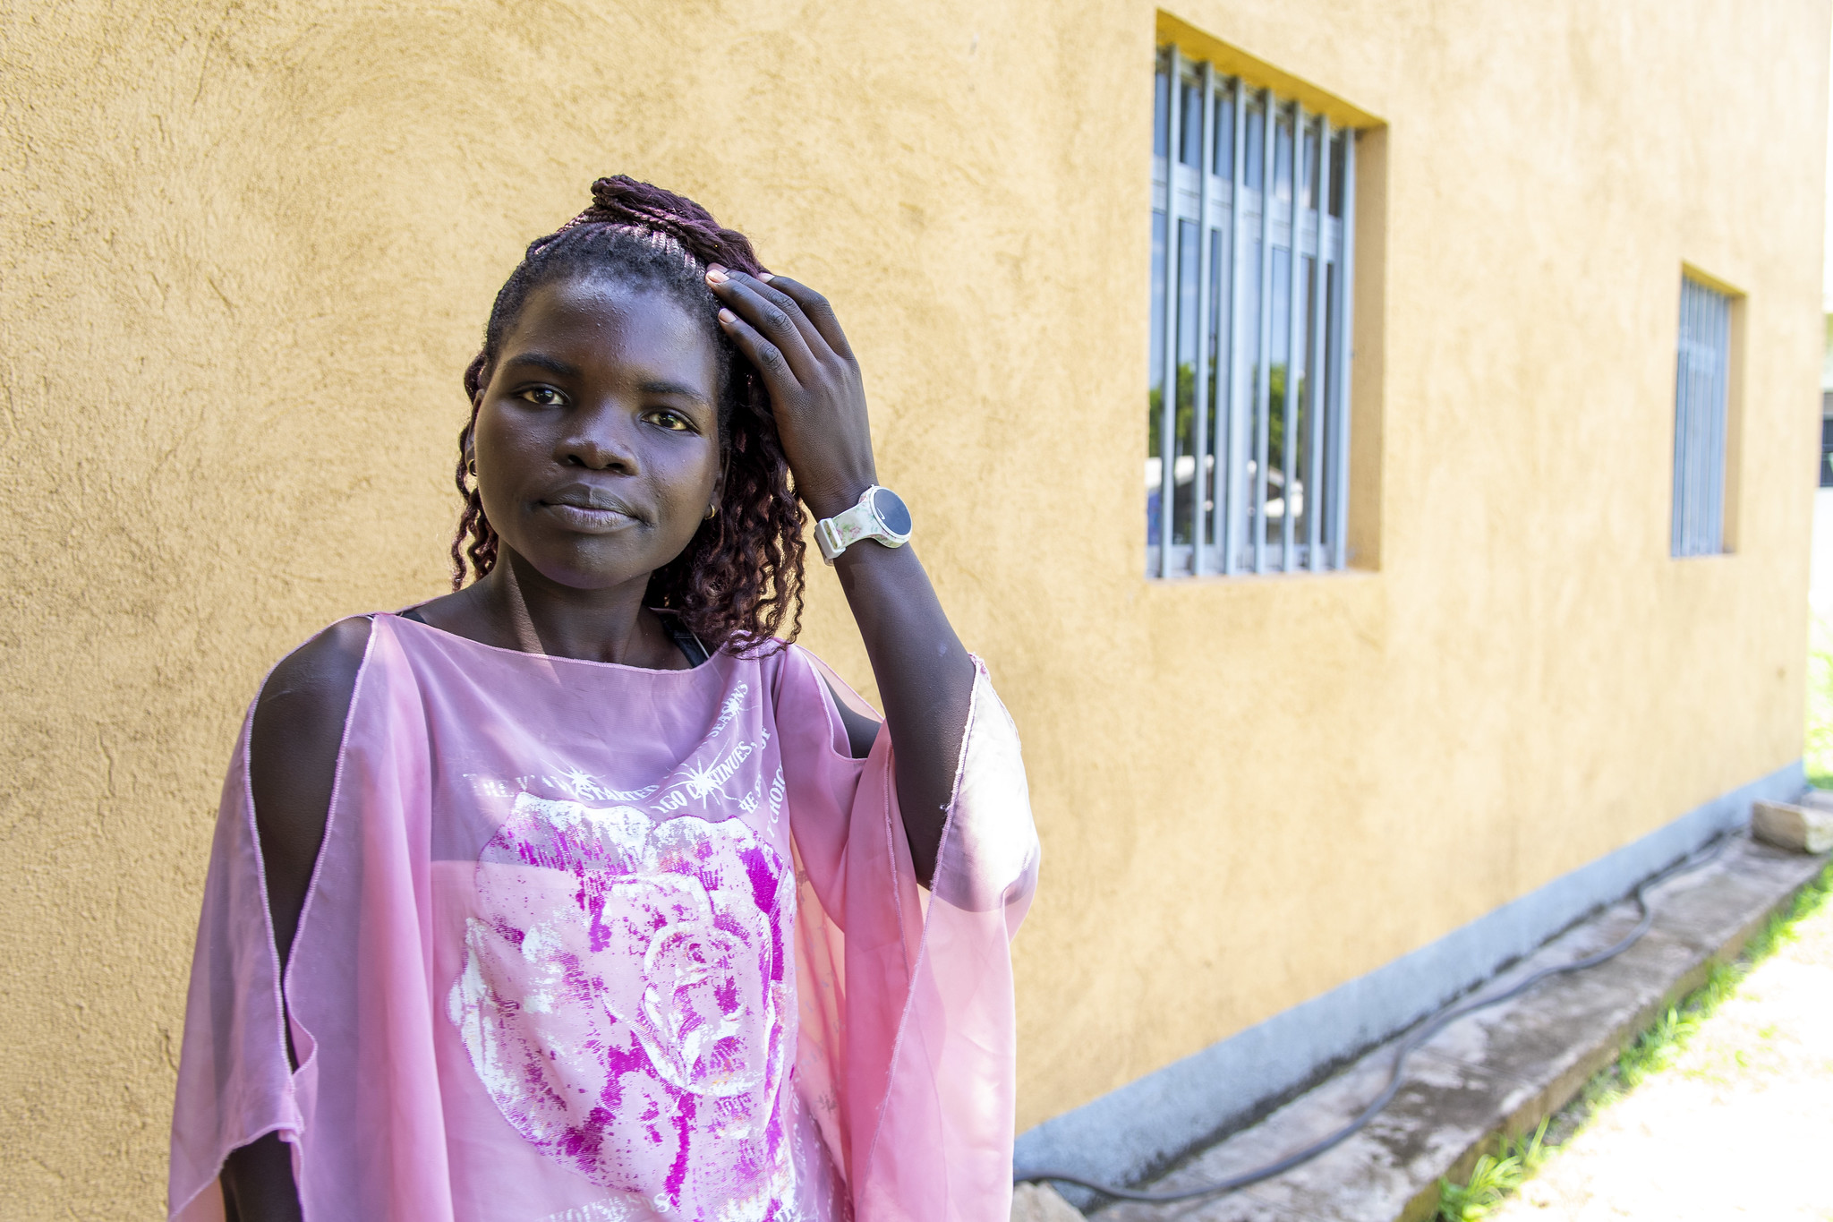
Case Scenario​
Makeba is a 36-year-old woman who comes to the clinic today because she is having vaginal discharge and itchiness.
She reports that she is having unprotected sex with her husband only, but she suspects he might be having sex with other women.
Could Makeba be a candidate for using the DVR for PrEP?
Follow the steps in the clinical pathway to decide.
Notes:
Facilitator guidance:
Explain to participants that a case scenario is provided to apply their knowledge of DVR initiation.
Read the scenario and question on the slide asking participants, "Is Makeba a good candidate for the DVR?"
Prompt the participants with follow up questions, "How will we determine if Makeba is a good candidate for the DVR? What is the first step in the clinical pathway?" [Answer: The first step in the clinical pathway is to confirm HIV negative status.]
Ask participants to raise hands and share their answers.
Continue to the following slide to provide the answer after receiving inputs from participants.

Slide 63
Suggested Clinical Pathway: DVR PrEP Initiation
1
2
3
4
5
Confirm HIV Negative Status
Screen for Substantial Risk for HIV
Informed Choice PrEP Counseling
Establish Eligibility for DVR
Initiate PrEP
Perform rapid HIV test or assisted HIV self-test per national guidelines Link people found to be living with HIV to care and treatment
Member of a population eligible for PrEP according to national guidelines​
Educate about available PrEP options Shared decision making to start the DVR as PrEP
No evidence of AHI Willingness to use the DVR as prescribed No contraindications to receiving the DVR
Counsel on effective ring use, risk reduction, side effects and AHI symptoms STI screening and management Provide education on DVR self-insertion and removal Prescribe DVR packs and offer to assist with first insertion
See Module 6 for more information about informed choice counseling​

Slide 64
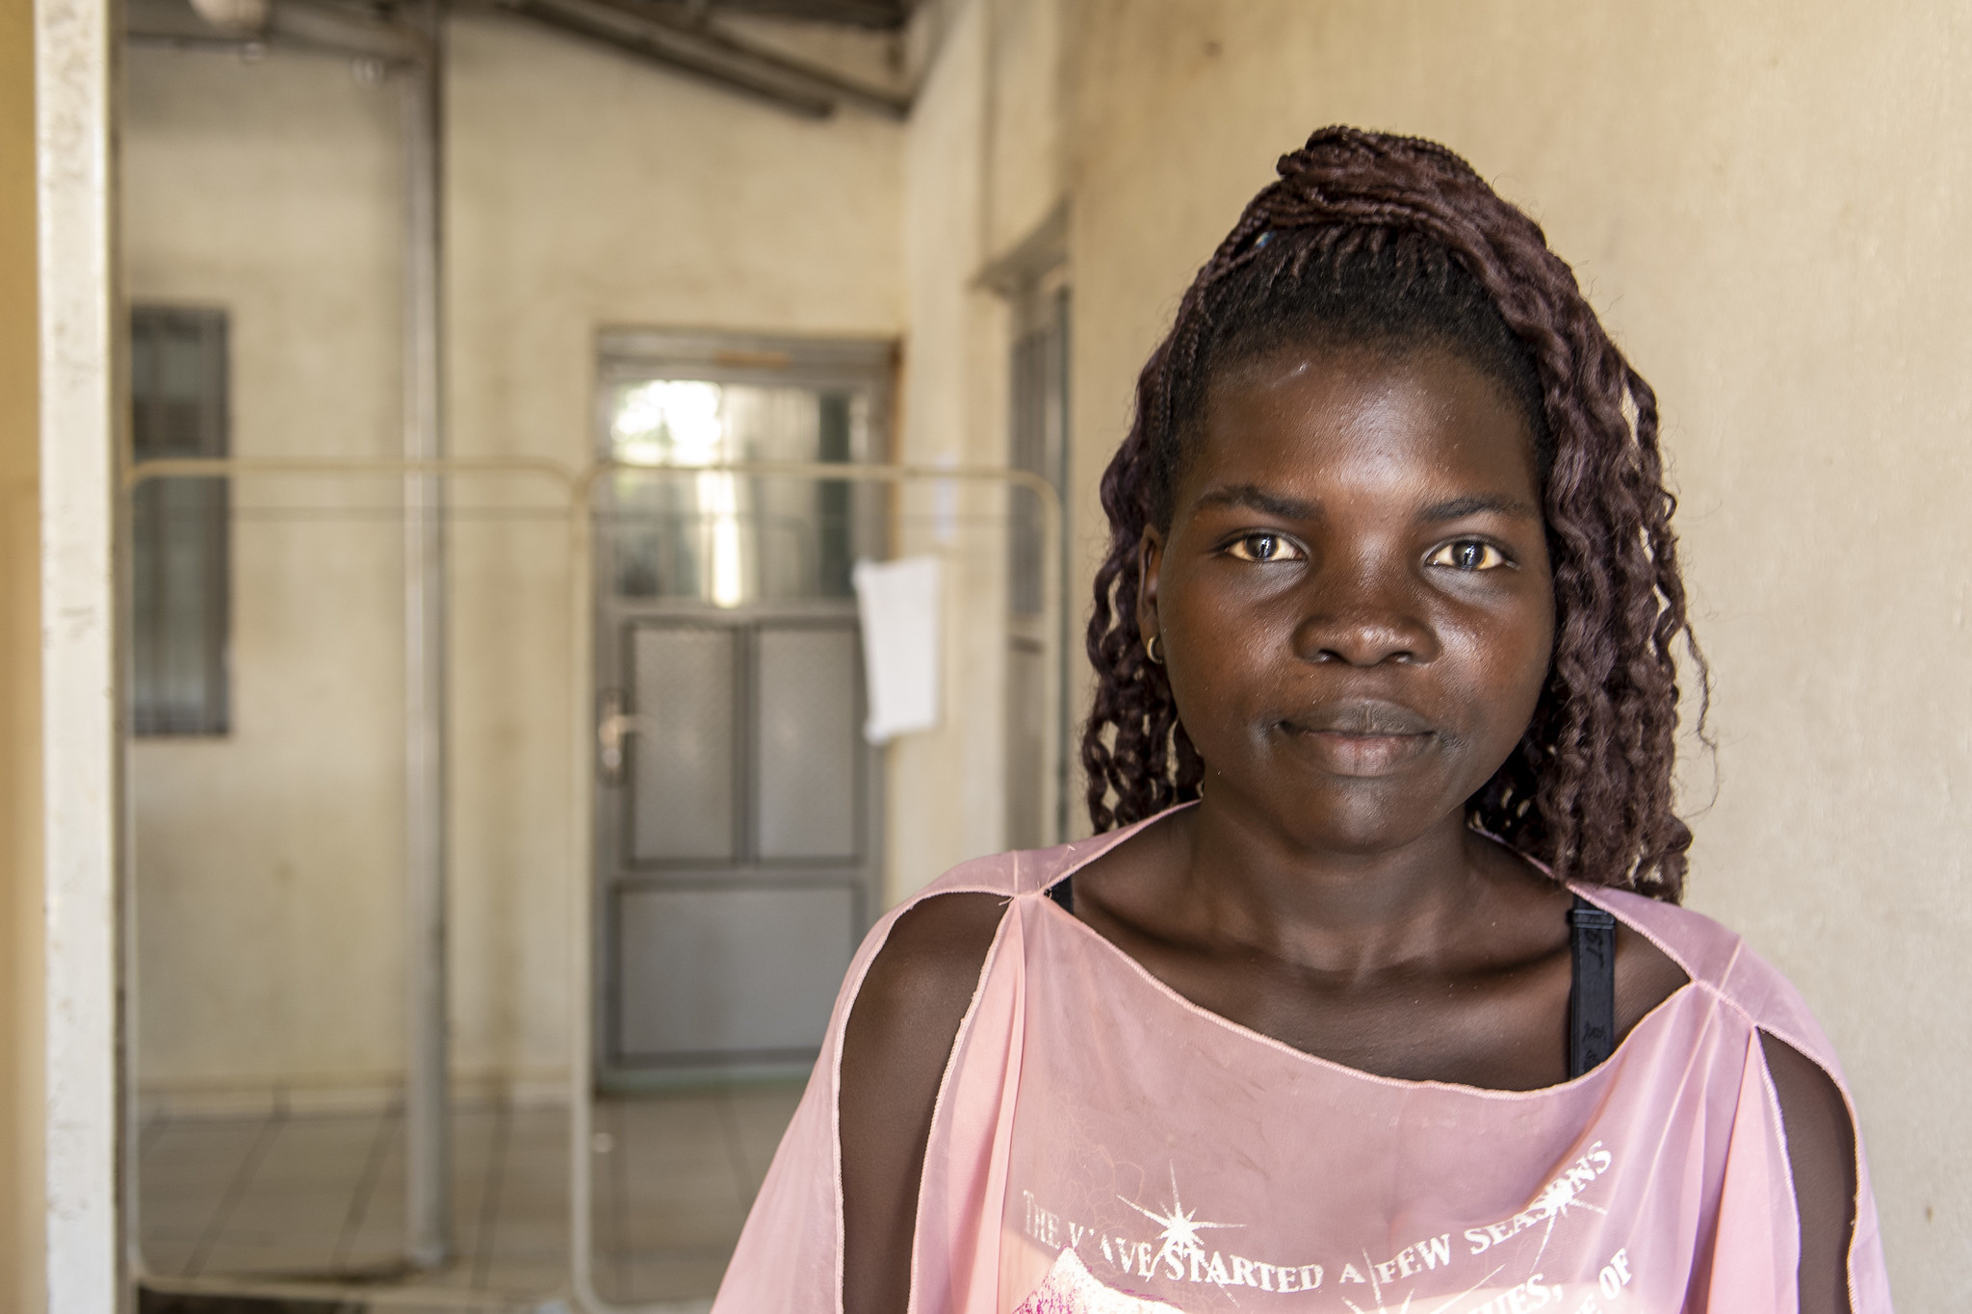
Case Scenario​
Makeba receives a physical exam and testing for HIV.
Her HIV test is negative. However, on exam she has an inflamed vulva and curd-like discharge consistent with a vaginal yeast infection.
She mentions that she has heard about PrEP and says it is something she would be interested in.
Is Makeba at substantial risk for HIV infection and a candidate for using the DVR as PrEP?
Notes:
Facilitator guidance:
Read the scenario and question on the slide.
Prompt the participants with follow up questions, "How will we determine if Makeba is at substantial risk for HIV? What is the next step in the clinical pathway?" [Answer: Screen for substantial risk for HIV according to national guidelines.]
Ask participants to raise hands and share their answers.
Continue to the following slide to provide the answer after receiving inputs from participants.

Slide 65
Suggested Clinical Pathway: DVR PrEP Initiation
1
2
3
4
5
Confirm HIV Negative Status
Screen for Substantial Risk for HIV
Informed Choice PrEP Counseling
Establish Eligibility for DVR
Initiate PrEP
Perform rapid HIV test or assisted HIV self-test per national guidelines Link people found to be living with HIV to care and treatment
Member of a population eligible for PrEP according to national guidelines​
Educate about available PrEP options Shared decision making to start the DVR as PrEP
No evidence of AHI Willingness to use the DVR as prescribed No contraindications to receiving the DVR
Counsel on effective ring use, risk reduction, side effects and AHI symptoms STI screening and management Provide education on DVR self-insertion and removal Prescribe DVR packs and offer to assist with first insertion
See Module 6 for more information about informed choice counseling​

Slide 66

Step 2: Screen for Substantial Risk for HIV​
Does the client report any one of the following in the past six months?​
 | Sexual activity in a high HIV prevalence population or key population group
 | Vaginal or anal intercourse without condoms with more than one partner
 | Sex partner with one or more HIV risk factor
 | History of an STI (based on lab test, syndromic STI treatment, or self-report)
 | History of use of PEP
 | History of sharing of injection material and/or equipment with another person
 | Having a sexual partner who is HIV positive and has been ART for less than 6 months, or has inconsistent or unknown adherence
 | Asking for PrEP. This may indicate risk behavior they are unwilling to share
Screen for substantial risk for HIV according to national guidelines. ​

Slide 67
Case Scenario​
Makeba is considered at substantial risk for HIV because she has a sexual partner (her husband) who may have one or more sexual partners with HIV risk factors. In addition, she is asking for PrEP.
How would you counsel Makeba about her PrEP options?
Notes:
Facilitator guidance:
Read the scenario and question on the slide.
Prompt the participants with follow up questions, "What kind of counseling will you provide for Makeba? What is the next step in the clinical pathway?" [Answer: Provide informed choice PrEP counseling. Educate Makeba about available PrEP options and ensure shared decision making to start the DVR as PrEP.]
Ask participants to raise hands and share their answers.
Continue to the following slide to provide the answer after receiving inputs from participants.

Slide 68
Suggested Clinical Pathway: DVR PrEP Initiation
1
2
3
4
5
Confirm HIV Negative Status
Screen for Substantial Risk for HIV
Informed Choice PrEP Counseling
Establish Eligibility for DVR
Initiate PrEP
Perform rapid HIV test or assisted HIV self-test per national guidelines Link people found to be living with HIV to care and treatment
Member of a population eligible for PrEP according to national guidelines​
Educate about available PrEP options Shared decision making to start the DVR as PrEP
No evidence of AHI Willingness to use the DVR as prescribed No contraindications to receiving the DVR
Counsel on effective ring use, risk reduction, side effects and AHI symptoms STI screening and management Provide education on DVR self-insertion and removal Prescribe DVR packs and offer to assist with first insertion
See Module 6 for more information about informed choice counseling​

Slide 69
Step 3: Informed Choice PrEP Counseling
Initial PrEP counseling should:​
Increase awareness of PrEP as a prevention choice and explain how PrEP works
Discuss sexual health and emphasize that PrEP should be used as part of a package of HIV prevention services​​
Help clients decide whether PrEP is right for them.
Once a decision has been made to start PrEP, counseling should:
Educate about PrEP options and support informed decision making to use the DVR, including ensuring clients understand that the DVR only provides partial protection against HIV and should be used with other HIV prevention methods
  Ensure clients understand how to use the DVR effectively
  Describe common DVR side effects and management
  Educate about how to safely stop and start the DVR as PrEP
See Module 6 for more information about informed choice counseling.​

Slide 70
What are key initial visit counseling messages you would include for a client considering the DVR for PrEP?
DISCUSSION​
Notes:
Facilitator guidance:
Time: 10 minutes
Read the question on the slide.
Prompt the participants by saying, "We will now discuss key counseling messages for initiating the DVR. Let's brainstorm some ideas together first. What do you think should be discussed with a client who is considering the DVR for PrEP?"
Ask participants to raise their hands to answer the question.
Take a few volunteer responses.
Continue to the following slides to introduce key initial visit counseling messages for the DVR.

Slide 71
Key Initial Visit Counseling Messaging: Basics of DVR Use
The DVR is a flexible silicon ring that is inserted into your vagina. The DVR will release medication in your vagina that partially protects you from HIV. This only protects you if you are having vaginal sex. It will not protect you from HIV if you are having anal sex or injecting drugs.
You will insert and remove the DVR yourself. We will teach you how to put in and remove the DVR for yourself.
The DVR is replaced once a month. Keep the DVR in place for a month and then replace it with a new one. We will give you a supply of DVRs and you will need to remember to remove and replace it every month.
You should keep the DVR in place continuously The DVR works best if it is kept in place continuously for the entire month. This ensures you always have some protection against HIV. You should not remove and reinsert the same DVR throughout the month, as this increases your risk of infection.

Slide 72
Key Initial Visit Counseling Messaging: DVR Efficacy
The DVR can prevent HIV infections but does not offer complete protection. The DVR as PrEP is less effective than other forms of PrEP for protection against HIV.
The DVR does not prevent STIs other than HIV. Using condoms with every act of sexual intercourse provides protection against many of these infections.
The DVR does not prevent pregnancy. Use effective contraception unless you want pregnancy.
Need to use other HIV prevention methods Partial HIV protection starts 24 hours after the ring has been inserted and ends as soon as the ring has been removed. It is important that you continue to use other HIV prevention methods, such as condoms, with the ring and immediately after it is removed.

Slide 73
Key Initial Visit Counseling Messaging: Safety and Side Effects
The DVR is safe to use. Very little medication from the DVR gets into the rest of your body and side effects are rare. The DVR is painless, and most women cannot feel it once it is in place.
You may experience minor side effects in your genital area or pelvis. Some women have experienced urinary infections, discharge, itching and pain. These symptoms are usually mild and go away within the first month without removing the ring.
The DVR cannot get lost in your body. The DVR cannot move up into other parts of your body and cannot get lost. However, it can sometimes get pushed high into the vagina such that it is difficult to reach. If you are struggling to reach it, you can ask a medical provider or someone else you trust to assist you with removal.

Slide 74
Key Initial Visit Counseling Messaging: Follow-up Visits and Discontinuation
You will need to be tested for HIV every 3 months. It is important that you attend visits and get tested for HIV every three months while you are using the DVR. You may return sooner if you have problems or questions about the DVR or if you would like to switch PrEP methods.
You may stop using the DVR whenever you like. If you decide to stop using the DVR, we ask that you return to us for an HIV test and to discuss your HIV prevention needs going forward. HIV protection ends as soon as the DVR is removed.
You may switch to another PrEP method at any point. If you would like to switch to another PrEP method, the new method can be started right away.

Slide 75
Key Initial Visit Counseling Messaging: Sex and Contraception
Leave the DVR in place during sex. The ring does not interfere with sexual intercourse and will not get stuck on your partner’s penis. It can be safely used with either male or female condoms and water-based lubricant. Sometimes your male partner may feel the DVR during sex; if this happens it will not cause any harm, but the DVR may need to be pushed further up into the vagina.
The DVR can be used with some, but not all contraceptive methods. The DVR can be used with many contraceptive methods such as condoms, the pill, injectables, IUD and implants. However, it cannot be used with contraceptive methods that are placed in the same part of the vagina, such as diaphragms, cervical caps or contraceptive vaginal rings.

Slide 76
Key Initial Visit Counseling Messaging: Menstruation and Vaginal Practices
You can leave the DVR in place during menstruation. The ring does not cover the cervix or interrupt the flow of menstrual fluid. Pads and tampons can be safely used while wearing the DVR, however menstrual cups are not recommended. If tampons are used, it is important to ensure the DVR is left in place when tampons are removed. Contact with vaginal fluids, and blood during menses, may change the color of the ring, but this does not affect how well the DVR works.
Do not use products to clean or dry out the inside of your vagina while using the DVR. You should not use soap or other products to clean the inside of your vagina when using the DVR. The vagina cleans itself. You should also not use any products to dry out your vagina for sex when using the DVR. These practices may affect how well the ring works.

Slide 77
Break into groups of 3. Take turns role-playing for DVR initiation counseling.
PrEP clinical provider: Deliver key counseling messages for initiating a candidate on the DVR as PrEP.
PrEP candidate: Pretend to be a client considering the DVR as PrEP. Ask lots of questions to decide if the DVR is right for you.
Observer: Silently observe the interaction and notice if the provider is delivering all the key counseling messages. Did they miss anything?
Discuss among you. What worked well? What could be improved? Were there any key counseling messages that were missed or should be added?
ROLE-PLAY AND DISCUSSION
Notes:
Facilitator guidance:
Time: 40 minutes
Explain that participants will now work in small groups to role-play DVR initiation counseling.
Divide participants into groups of 3 participants each.
Define participant roles. One participant will role-play as the PrEP clinical provider. One participant will role-play as the PrEP candidate. One participant will observe. Take turns to explore each of the 3 roles.
The participant in the role of the PrEP clinical provider will deliver key counseling messages for initiating a candidate on the DVR. Allow this participant to reference the previous slides with key counseling messages.
The participant in the role of the PrEP candidate will pretend to be considering starting PrEP and should ask questions to decide if the DVR is right for them.
The participant in the role of the observer should silently observe the interaction between the PrEP clinical provider and PrEP candidate and notice if the provider is delivering the key counseling messages or if they missed anything. Allow this participant to reference the previous slides with key counseling messages as needed.
Allow 5 minutes for the role-play.
Discuss among participants in the small group. What worked well? What could be improved? Were there any key counseling messages that were missed or should be added?
Allow 5 minutes for discussion.
Switch roles until each participant has played in each of the 3 roles.
Return to the larger group and discuss what you experienced and learned from the role-play. Allow 10 minutes for large group discussion.

Slide 78
Case Scenario​
Makeba is encouraged to learn that she has options to protect herself from HIV, as her husband is unwilling to use condoms when they have sex.
She likes that the DVR is discreet, easy to stop and that it does not require taking a daily pill, as she has struggled with that in the past.
Is Makeba eligible to use the DVR as PrEP?
Notes:
Facilitator guidance:
Read the scenario and question on the slide.
Prompt the participants with follow up questions, "How will you determine if Makeba is eligible to use the DVR as PrEP? What is the next step in the clinical pathway?" [Answer: The next step in the clinical pathway is to establish eligibility for DVR by confirming the following: no evidence of AHI; willingness to use the DVR as prescribed; and no contraindications to receiving the DVR.]
Ask participants to raise hands and share their answers.
Continue to the following slide to provide the answer after receiving inputs from participants.

Slide 79
Suggested Clinical Pathway: DVR PrEP Initiation
1
2
3
4
5
Confirm HIV Negative Status
Screen for Substantial Risk for HIV
Informed Choice PrEP Counseling
Establish Eligibility for DVR
Initiate PrEP
Perform rapid HIV test or assisted HIV self-test per national guidelines Link people found to be living with HIV to care and treatment
Member of a population eligible for PrEP according to national guidelines​
Educate about available PrEP options Shared decision making to start the DVR as PrEP
No evidence of AHI Willingness to use the DVR as prescribed No contraindications to receiving the DVR
Counsel on effective ring use, risk reduction, side effects and AHI symptoms STI screening and management Provide education on DVR self-insertion and removal Prescribe DVR packs and offer to assist with first insertion
See Module 6 for more information about informed choice counseling​

Slide 80
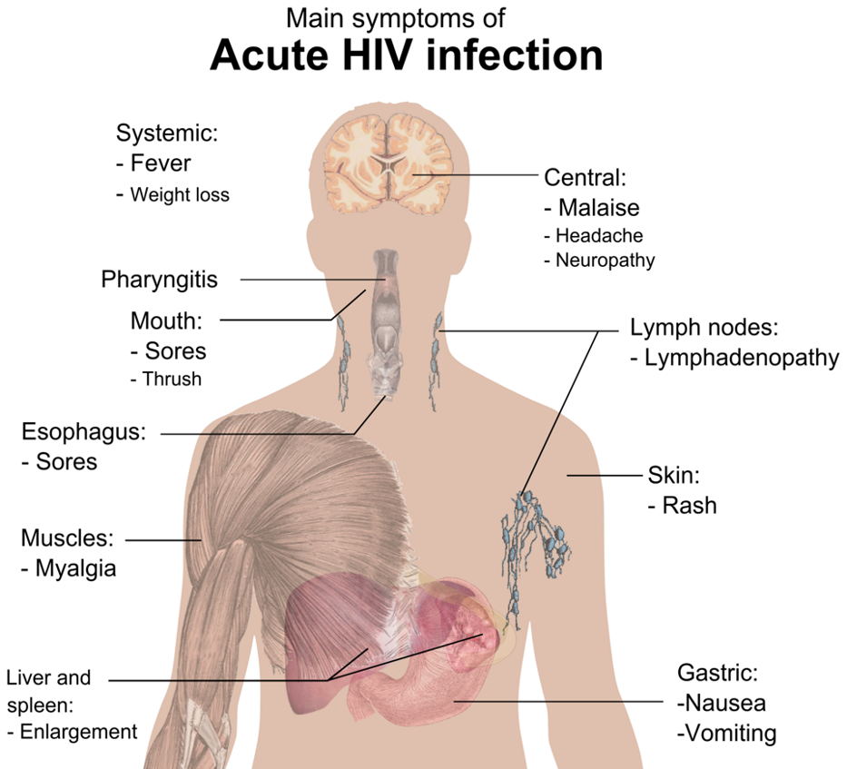
Step 4: Establish Eligibility for the DVR as PrEP
No evidence of AHI​
Assess for flu-like symptoms within the last 4 weeks
No history of allergic or hypersensitivity reactions to silicone or DAP
Willingness to use the DVR as prescribed
Asses understanding that the DVR is self-inserted and needs to replaced once a month
Not pregnant or breastfeeding (per national guidelines)
Pregnancy testing may be required
See Module 1 for more information about AHI screening.​

Slide 81
Other Considerations When Starting the DVR
Concomitant use of other vaginal products or vaginal practices may interfere with the DVR and should be avoided.
Products or practices to ask about:
  Vaginal antimicrobial products (miconazole, clotrimazole, metronidazole or clindamycin)
  Vaginal contraceptive products (rings, cervical caps or diaphragms)
  Vaginal cleaning practices
  Vaginal drying practices
If a woman is unwilling or unable to stop any of these products or practices, she may not be a good candidate for the DVR.

Slide 82
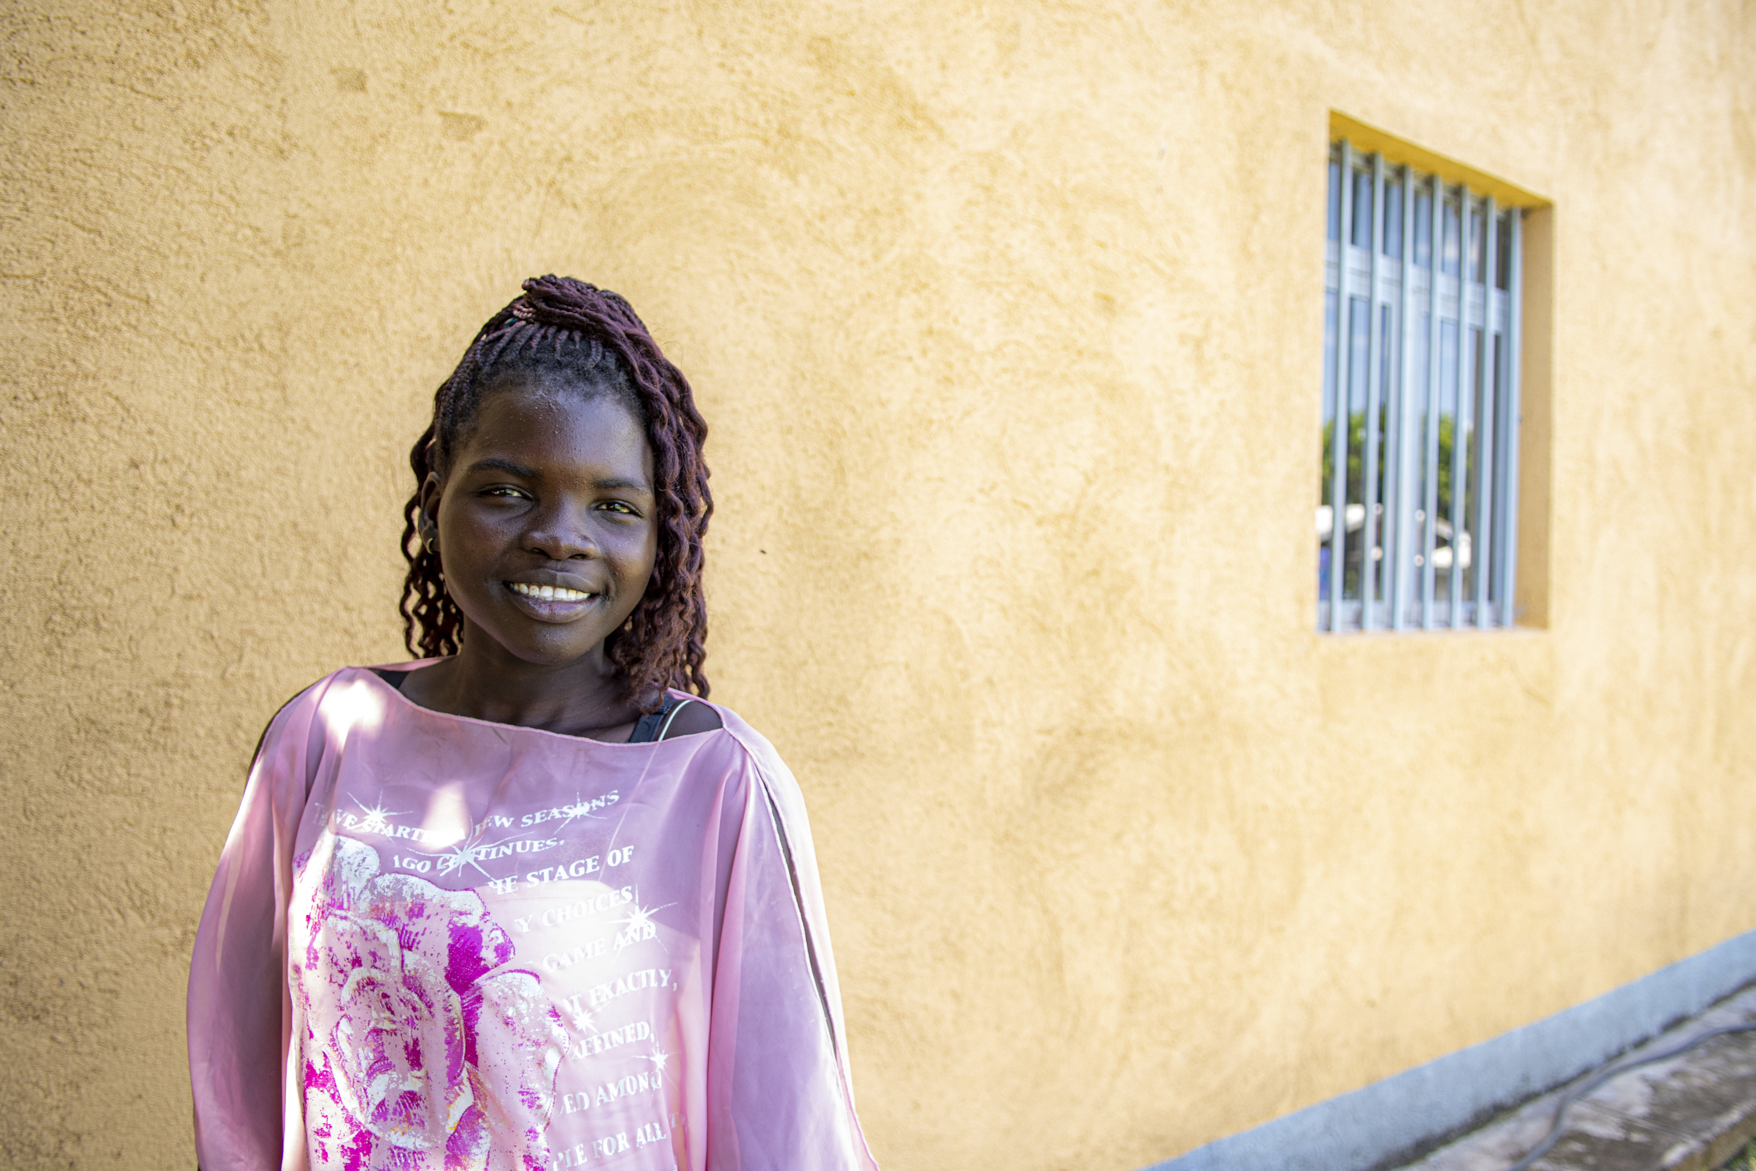
Case Scenario​
Makeba has no AHI symptoms, she is not pregnant or breastfeeding and has no known allergies.
She takes an oral contraceptive pill and occasionally cleans her vagina by douching with a mixture of water and vinegar, but she is willing to stop this practice.
She is willing to self-insert and use the DVR as recommended.
Can she start using the DVR today?
Notes:
Facilitator guidance:
Read the scenario and question on the slide.
Prompt the participants with follow up questions, "How will you determine if Makeba can start to use the DVR as PrEP? Does she meet all the eligibility criteria? Is there anything in her medical history or clinical exam findings that you should consider?" [HINT: why did she come to the clinic? Answer: she was having vaginal discharge and itchiness]
Ask participants to raise hands and share their answers.
Continue to the following slide to provide the answer after receiving inputs from participants.

Slide 83
Case Scenario​
Makeba is eligible for the DVR, but you would like to treat her fungal infection with a vaginal cream first.
You prescribe 7 days of clotrimazole vaginal cream to treat vaginal candidiasis.
She agrees to return to the clinic after one week to begin using the DVR for PrEP.
Notes:
Facilitator guidance:
Read the scenario on the slide and continue to the following slide to complete the scenario.

Slide 84
Case Scenario​
Makeba returns to the clinic after finishing her clotrimazole treatment to begin using the DVR for PrEP.
Her vaginal symptoms have resolved, and you confirm she is still eligible for the DVR.
What else needs to be done to initiate the DVR?
Notes:
Facilitator guidance:
Read the scenario and question on the slide.
Prompt the participants with follow up questions, "Now that she is not longer using a vaginal medication, what remaining procedures need to be completed in order to initiate DVR PrEP?" [Answer: Continue with the following procedures to initiate PrEP: Counsel on effective ring use, risk reduction, side effects and AHI symptoms; provide education on DVR self-insertion and removal; prescribe DVR packs and offer to assist with first insertion.]
Ask participants to raise hands and share their answers.
Continue to the following slide to provide the answer after receiving inputs from participants.

Slide 85
Suggested Clinical Pathway: DVR PrEP Initiation
1
2
3
4
5
Confirm HIV Negative Status
Screen for Substantial Risk for HIV
Informed Choice PrEP Counseling
Establish Eligibility for DVR
Initiate PrEP
Perform rapid HIV test or assisted HIV self-test per national guidelines Link people found to be living with HIV to care and treatment
Member of a population eligible for PrEP according to national guidelines​
Educate about available PrEP options Shared decision making to start the DVR as PrEP
No evidence of AHI Willingness to use the DVR as prescribed No contraindications to receiving the DVR
Counsel on effective ring use, risk reduction, side effects and AHI symptoms STI screening and management Provide education on DVR self-insertion and removal Prescribe DVR packs and offer to assist with first insertion
See Module 6 for more information about informed choice counseling​

Slide 86
Step 5: Initiate the DVR as PrEP
Educate on the importance of continuous use and replacing the DVR every month
Ensure clients understand the DVR as PrEP only provides partial protection against HIV and the need for other combination prevention methods while using the DVR
Provide counseling on the importance of adherence to appointments, risk reduction and AHI symptoms
Provide counseling on side effects and side effect management
STI screening and management
Ensure clients are comfortable with self-insertion and removal of the ring
Educate about how to handle situations that may arise, and how to safely stop and start the DVR
Schedule a follow-up appointment

Slide 87
QUESTION
What information would a woman need to use the DVR at home?
Notes:
Facilitator guidance:
Read the question on the slide.
Prompt the participants by saying, "We will now discuss client education on how to use the DVR. Do you have any ideas about what information a woman would need to use the DVR at home?"
Ask participants to raise their hands to answer the question.
Take a few volunteer responses.
Reveal the answer on the following slide.
Allow time for follow-up discussion as needed.

Slide 88
ANSWER
A woman would need information on:
How to prepare to insert the DVR
Inserting the DVR
Removing the DVR
Disposing of the DVR
Notes:
Facilitator guidance:
Reveal the answer on the slide.
Allow time for questions and follow-up discussion as needed.
Continue to the following slide to introduce education on how to use the DVR as PrEP

Slide 89
Education on How to Use the DVR
Guidance is needed to learn how to use the DVR, but most women are comfortable inserting and removing it on their own, with minimal support from a healthcare provider.
Job aids such as diagrams, models or videos may be helpful when teaching clients how to insert and remove the DVR.
Steps to go over:
  Preparing to insert the DVR
  Inserting the DVR
  Removing the DVR
  Disposing of the DVR

Slide 90
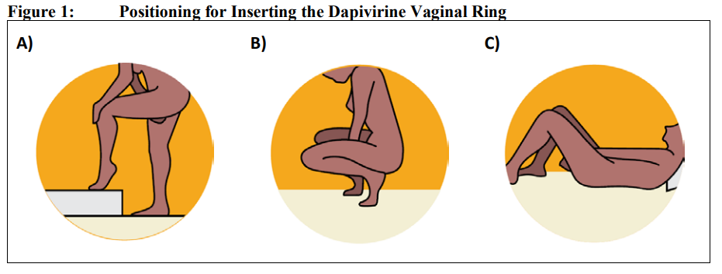
Preparing to Insert the DVR
Position options
Before inserting the DVR, a client should:
Check the expiry date on the package label. If expired, the ring should not be used.
Wash her hands in clean water and dry them before removing the DVR from its package.
Tear the DVR package to open it. She should not use scissors to open the package. If the DVR is damaged or broken, it should not be inserted.
Choose a position that is comfortable for her to insert the DVR, for example raising one leg, squatting or lying down.
Source: European Medicines Agency

Slide 91
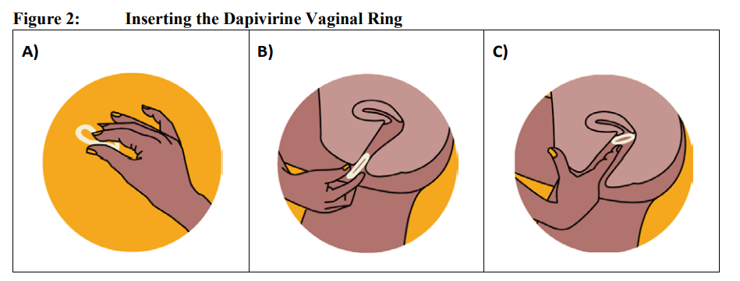
Inserting the DVR
1
2
To insert the DVR, a client should:
Hold the DVR between her thumb and index finger, twisting it into the shape of the number 8 by pressing the sides together (Figure 1).
Use her other hand to hold open the folds of the skin around the vagina.
Place the tip of the ring in the vagina opening (Figure 2), then use her index finger to gently push the folded ring into the vagina as far as possible (Figure 3).
Wash her hands in clean water and dry them after the DVR is inserted.
Note: If the ring feels uncomfortable, it may not be pushed far enough into the vagina. Use an index finger to gently push the ring as far as possible. If it still feels uncomfortable, she should try re-inserting the ring or contacting her healthcare provider.
Ring insertion should be painless. If a client has bleeding or pain, she should contact her healthcare provider
3
Source: European Medicines Agency

Slide 92
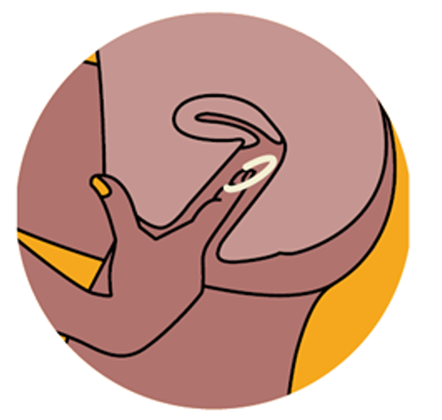
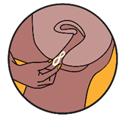
Removing the DVR
1
To remove the DVR, a client should:
Remove the DVR one month from the day it was inserted
Wash her hands in clean water and dry them
Choose a comfortable position with her legs apart (Figure 1)
Use her finger to hook the ring (Figure 2) and gently pull it out of her vagina (Figure 3)
Immediately insert a new DVR, following the instructions for insertion
2
Note: Ring removal should be painless. If a client has bleeding or pain, she should contact her health care provider
3
Source: European Medicines Agency

Slide 93
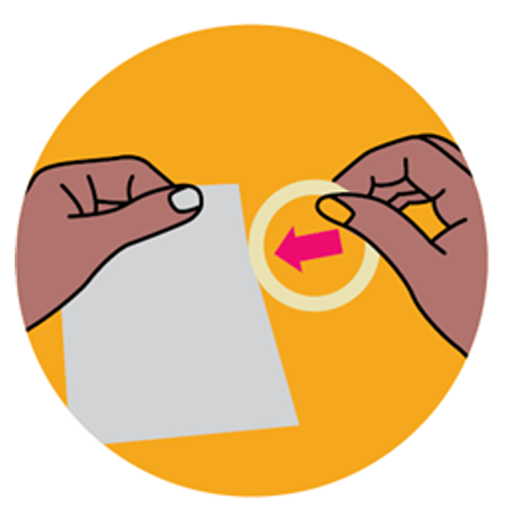
Disposing of the DVR
The used DVR may be placed inside the empty pouch of the new ring. Alternatively, the used DVR may be wrapped in tissue or toilet paper.
A refuse bin that is kept out of reach of children or pets should be used for disposal.
The DVR should not be disposed in the toilet.
The client should wash her hands in clean water and dry them after handling the DVR.
Source: European Medicines Agency

Slide 94
QUESTION
What are some scenarios that may arise at home that a client should be counseled on?
Notes:
Facilitator guidance:
Read the question on the slide.
Prompt the participants by saying, "We will now discuss client guidance for potential scenarios that may arise when using the DVR. Do you have any ideas about what guidance should be provided for scenarios that might arise for a client when using the DVR at home?"
Ask participants to raise their hands to answer the question.
Take a few volunteer responses.
Reveal the answer on the following slide.
Allow time for follow-up discussion as needed

Slide 95
ANSWER
Guidance should include:
What to do if the DVR falls out
What to do if she forgets to change the DVR or accidentally uses more than one DVR
Situations that warrant returning to the clinic early
Considerations for partner disclosure
Notes:
Facilitator guidance:
Reveal the answer on the slide.
Allow time for questions and follow-up discussion as needed.
Continue to the following slide to review guidance for potential scenarios when using the DVR as PrEP

Slide 96
Guidance for Potential Scenarios
The DVR falls out
While rare, the DVR may accidentally come out (e.g., during a bowel movement, urination, menses, removing a tampon, or vaginal intercourse).
  Clients should get in the habit of checking the toilet.
  If this occurs in a clean environment (e.g., in bed or inside clean clothing), and the DVR does not touch an unhygienic surface (e.g., the toilet), the client may rinse the ring in clean water and immediately re-insert it.
  If the DVR touches something unhygienic or is damaged, it should be discarded, and a new ring inserted immediately.
A DVR can be reinserted until the 28-day period of use expires.
The client may need to report the incident to her healthcare provider and obtain additional rings to ensure continuous use.

Slide 97
Guidance for Potential Scenarios (continued)
Forget to change the DVR
If a client realizes she has kept the DVR in the vagina for longer than one month, she should replace it with a new ring immediately.
She should not insert two rings.
Use more than one DVR
If a client realizes she has more than one ring in her vagina, she should remove all rings and insert a new ring immediately.
She should not use any of the rings that she has just removed.

Slide 98
Guidance on Returning Early
A client should contact her provider or return to the clinic early if:
She suspects she may have acquired HIV or has symptoms that are suggestive of AHI, e.g., fever, rash, sore throat, swollen lymph nodes.
The DVR causes persistent discomfort or pain which does not resolve after repositioning the ring.
She suspects she is pregnant, e.g., misses a period (per national guidelines for DVR use during pregnancy).
She is planning to take other medicines or use other products that need to be put in her vagina.

Slide 99
Guidance on Returning Early (continued)
A client should also contact her provider or return to the clinic urgently if she experiences signs or symptoms suggestive of PID or a genital infection.
Signs and symptoms include:
  Itching, discomfort or pain in the vagina
  Discharge from the vagina
  Severe pain in her lower belly
  Pain or bleeding during sex
  Fever, sometimes with chills
  Pain or difficulty in emptying her bladder
  Nausea and vomiting, with an inability to keep food or water down

Slide 100
Partner Disclosure
The DVR offers a discreet, woman-controlled option, making partner disclosure voluntary.
However, there is evidence that male partner involvement can increase the effective use of the DVR, therefore women should be supported to disclose use of the DVR to their partners.¹
A partner may be able to feel the ring during sex, which can lead to inadvertent disclosure.
  Approximately 1 in 4 women reported their partner could feel the DVR.²
Planning for disclosure may minimize the risk of IPV as part of their partner’s response to DVR use.
Some women may elect to bring their partners to the clinic to facilitate disclosure.
1. Montgomery et al., 2022; 2. Nel et al., 2016

Slide 101
Case Scenario​
After you have provided initiation education and counseling, Makeba says that she is nervous about inserting the DVR.
What can you do to support her?
Notes:
Facilitator guidance:
Read the scenario and question on the slide.
Prompt the participants with a follow up question, "How can you support Makeba with DVR insertion?"
Ask participants to raise hands and share their answers.
Continue to the following slide to provide the answer after receiving inputs from participants.

Slide 102
Case Scenario​
In addition to providing education on DVR insertion using a pelvic model and diagrams, you can also assist Makeba with her first insertion in the clinic today.
Advise her to remove the DVR after a month and immediately insert the next ring or to return to the clinic if she needs assistance with insertion.
Notes:
Facilitator guidance:
Reveal the answer on the slide.
Continue to following slides to provide more detailed explanations on provider DVR insertion.
Allow time for questions and follow-up discussion as needed.

Slide 103
Insertion of the DVR by a Provider
Some women may feel more comfortable having a provider insert the first DVR.
It is still important to educate the client on how to remove and insert the DVR herself, as she will need to do this in the following months.
If a provider is inserting the DVR, ensure there is enough space and privacy for the woman to lie down during the insertion.
A provider should use gloves, position the woman on her back and follow the same steps for placement of the DVR.
A provider should confirm that the DVR is positioned correctly by asking the client if she is experiencing any discomfort and pushing it further up if necessary.

Slide 104
Provide DVR Packs and Schedule Next Appointment
After the client is comfortable with DVR use, and all eligibility criteria have been confirmed, provide her with a supply of rings.
Schedule the next appointment and ensure she has enough DVRs to use them continuously until the next appointment.
A strategy to help clients remember the date to change their DVR is for them to pick a consistent day between the 1st and the 28th of the month and plan to change the DVR on that day every month.
Other strategies to help clients remember their DVR change date include:
  Setting a calendar reminder on their phone.
  Providing reminder cards or calendars for clients to take with them.

Slide 105
5.4 DVR Follow-up Visits

Slide 106
QUESTION
When should the first DVR follow-up visit be scheduled and what procedures should be conducted?
Notes:
Facilitator guidance:
Read the question on the slide.
Prompt the participants by saying, "We will now discuss DVR follow up visits. Do you have any ideas about when the first DVR follow up visit should be scheduled and what procedures should be conducted?"
Ask participants to raise their hands to answer the question.
Take a few volunteer responses.
Reveal the answer on the following slide.
Allow time for follow-up discussion as needed.

Slide 107
ANSWER
Schedule the first DVR follow-up visit one month after initiating the DVR.
Some key follow-up visit procedures include:
HIV testing
Review the client's HIV risk, including specific risk behaviors
Address side effects
Adherence evaluation and counseling
Assess for contraindications to continued DVR use
Notes:
Facilitator guidance:
Reveal the answer on the slide.
Allow time for questions and follow-up discussion as needed.
Continue to the following slide to introduce DVR PrEP follow-up visit procedures

Slide 108
DVR PrEP Follow-Up Visit Procedures
Intervention | Schedule Following DVR Initiation
Confirmation of HIV-negative status | At 1 month follow-up Every 3 months
Assess for AHI, counsel on AHI symptoms and advise them to come back as soon as possible for evaluation if these symptoms occur | Every visit
Review the client’s HIV risk, including specific risk behaviors | Every visit
Address side effects | Every visit
Evaluate ring adherence and provide brief counseling on effective ring use | Every visit
Assess for contraindications to continued DVR use | Every visit
Provide STI screening, condoms and contraception | Every visit, and as needed

Slide 109
Follow-up HIV Testing With the DVR
HIV follow up testing schedule:​
  1 month after starting PrEP​
  Every 3 months thereafter​
HIV test result:​
  HIV negative test: safe to continue PrEP use ​
  HIV positive test: stop PrEP and link to HIV care and treatment immediately ​
Method (follow national guidelines): ​
  Rapid HIV test at point-of-care
  HIVST outside of clinical setting ​
Note: Serological tests are limited during AHI in the “window” period from HIV infection to detection of antibodies. Stop PrEP if you suspect AHI

Slide 110
HIV Positive Test Result: Managing Seroconversion on PrEP
HIV seroconversion after prescribing the DVR can occur if additional HIV prevention measures are not taken, even if the DVR is used correctly.
It can also occur if HIV infection was undiagnosed at the time of initiation.
Counseling should include information to help DVR users recognize AHI signs and symptoms, which should prompt a clinic visit without delay.
If a woman using the DVR as PrEP tests positive for HIV, it should be stopped immediately, and she should be referred for prompt initiation of HIV treatment.
Transition from PrEP to HIV treatment without a gap avoids the risk of an elevated viral load, damage to the immune system, and secondary transmissions.​

Slide 111
HIVST Use With PrEP
HIVST can be used for follow-up HIV testing to support PrEP continuation. ​
However, regular interaction between PrEP providers and clients remains important to ensure that PrEP users have adequate counselling and can raise any issues or concerns to providers. ​
HIVST-supported PrEP delivery models that reduce clinic visits should be balanced with the benefits of provision of comprehensive services​.
Clients opting to use HIVSTs should be counseled that following a reactive HIVST, they should continue to use the DVR as PrEP and immediately seek confirmatory testing.
If a client tests positive with confirmatory testing, she should stop using the DVR and be linked to treatment immediately.
WHO, 2022

Slide 112
Assess for Other Contraindications
Assess for any changes in condition or other contraindications to continued DVR use.
Condition or Practice | Rationale
Pregnant or breastfeeding (per national guidelines) | Pregnancy and/or breastfeeding may be a contraindication to using the DVR in some countries.
New microbicides administered vaginally | DVR use may need to be paused if a woman is being treated with a vaginal microbicide.
New contraceptive product used in the vagina | If a woman is unwilling or unable to use other forms of contraception, the DVR should be stopped.
Change in vaginal practices, such as cleaning or drying practices | If a woman is unwilling or unable to stop these practices, the DVR should be stopped.
Pain or bleeding with insertion or removal of the ring | The DVR should be stopped while these symptoms are evaluated. A pelvic exam may be required to evaluate for PID or lower genital tract infection.
If the DVR is stopped for any of these reasons, women should be offered other effective prevention methods, including other forms of PrEP if eligible.

Slide 113
QUESTION
Can a woman who becomes pregnant continue using the DVR as PrEP?
Notes:
Facilitator guidance:
Read the question on the slide.
Ask participants to raise their hands to answer the question.
Take a few volunteer responses.
Reveal the answer on the following slide.
Allow time for follow-up discussion as needed.

Slide 114
ANSWER
Pregnancy and/or breastfeeding may be a contraindication to using the DVR in some countries. Check your national guidelines. If the DVR is stopped, the woman should be offered other effective HIV prevention methods, including condoms and other forms of PrEP, such as oral PrEP if she is eligible.
Notes:
Facilitator guidance:
Reveal the answer on the slide.
Allow time for participants to check the national guidelines to determine if pregnancy/breastfeeding is a contraindication to using the DVR.
Prepare in advance to provide the answer based on your national guidelines.
Allow time for questions and follow-up discussion as needed.

Slide 115
DVR Follow-up Counseling
What to discuss during follow-up visits
Assessment of continued risk of HIV and ongoing need for PrEP, including specific risk behaviors (vaginal sex, anal sex and drug use behaviors)
Non-PrEP sexual health protection strategies, e.g., condom use, STI screening
Intention to remain on the DVR as PrEP
Facilitators and barriers to DVR use, including any difficulties with inserting or removing the ring
Any challenges with adherence to the monthly DVR schedule
Challenges connected with the DVR use, e.g., partner disclosure, stigma

Slide 116
DVR Follow-up Counseling (continued)
What to discuss during follow-up visits
Reasons for ongoing HIV testing while on PrEP
Effective use of the DVR for maximal protection
Partial protection offered by the DVR and need to use other prevention methods
How to recognize symptoms of AHI
Side effects and side effects management
Vaginal medicines and products that should not be used with the DVR
How to safely discontinue and restart the DVR (if appropriate)
Alternative PrEP products (if appropriate)

Slide 117
Break into groups of 3. Take turns role-playing DVR follow up counseling.
DVR clinical provider: Deliver key counseling messages for following up with a client using the DVR.
DVR client: Pretend to be a client using the DVR. Discuss any challenges you might be having with using the DVR or questions you might have.
Observer: Silently observe the interaction and notice if the provider is delivering all of the key counseling messages. Did they miss anything?
Discuss among you. What worked well? What could be improved? Were there any key counseling messages that were missed or should be added?
ROLE-PLAY AND DISCUSSION
Notes:
Facilitator guidance:
Time: 40 minutes
Explain that participants will now work in small groups to role-play DVR follow up counseling.
Divide participants into groups of 3 participants each.
Define participant roles. One participant will role-play as the PrEP clinical provider. One participant will role-play as the PrEP client. One participant will observe. Take turns to explore each of the 3 roles.
The participant in the role of the PrEP clinical provider will deliver key counseling messages for follow up of a candidate on the DVR. Allow this participant to reference the previous slides with key counseling messages.
The participant in the role of the PrEP client will pretend to be a client using the DVR. Discuss any challenges you might be having with using the DVR or questions you might have.
The participant in the role of the observer should silently observe the interaction between the PrEP clinical provider and PrEP client and notice if the provider is delivering the key counseling messages or if they missed anything. Allow this participant to reference the previous slides with key counseling messages as needed.
Allow 5 minutes for the role-play.
Discuss among participants in the small group. What worked well? What could be improved? Were there any key counseling messages that were missed or should be added?
Allow 5 minutes for discussion.
Switch roles until each participant has played in each of the 3 roles.
Return to the larger group and discuss what you experienced and learned from the role-play. Allow 10 minutes for large group discussion

Slide 118
Effective Use
HIV protection improves with effective use of the DVR.
Effective use involves:
  Using the DVR continuously over one month
  Immediately inserting a new DVR at the end of each one-month period
  Keeping the DVR in before, during and after vaginal intercourse
  Not using expired or broken rings
  Not using other vaginal products that may interfere with the ring
Remember, the DVR should be used with a condom during vaginal sex for the best HIV protection.

Slide 119
Assess Adherence to the DVR
Questions to ask to help assess DVR adherence
How has it been for you to use the ring?
Have you had any problems with inserting or removing the ring?
Have you been able to keep the ring in continuously for the whole month?
Have you forgotten to change the ring after one month, or has there ever been a gap between removing a used ring and putting in a new one?
Have you had any side effects?
What else have you been doing to protect yourself from HIV (e.g., using condoms, discussing HIV status and/or testing with partners)?
Have you experienced any other challenges with using the ring?

Slide 120
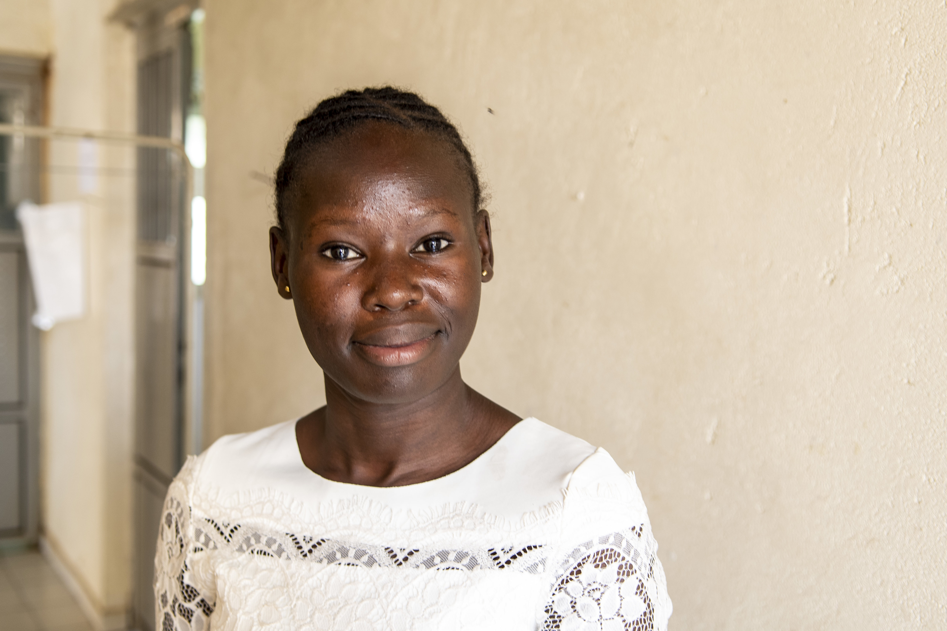
Case Scenario​
Imani returns to the clinic one month after starting use of the DVR reporting that she had difficulty reaching the ring to remove it and insert a new one.
How would you counsel and support her with ring removal and insertion?
Notes:
Facilitator guidance:
Read the scenario and question on the slide.
Ask participants to raise hands and share their answers.
Continue to the following slide to provide the answer after receiving inputs from participants.

Slide 121
Case Scenario​
Steps you could take to help Imani include:
Listening to Imani's concerns in a non-judgmental way.
Use job aids, such as a video or diagrams, to show her the removal and insertion procedures and allow her to practice on a pelvic model.
Allow time to practice different insertion and removal positions while in clinic. Some clients find squatting or lying on their back easier.
Encourage her to return if she has difficulty removing or inserting the DVR again.
Notes:
Facilitator guidance:
Reveal the answer on the slide.
Allow time for questions and follow-up discussion as needed.

Slide 122
Assess Barriers and Facilitators
Questions to help understand contextual factors
Do you have any concerns about using the ring?
Have you disclosed to your partner that you are using the ring? Has your partner been able to feel the ring during sex?
Have you had any trouble with your partner related to the ring use (e.g., violence, verbal abuse, relationship problems)?
  Note: If IPV is reported related to DVR use, provide IPV services and discuss alternative prevention options
Aside from your partner, does anyone else know you are using the ring? What was their reaction?
In addition to using the ring, how do you plan to stay HIV negative?
Do you ever engage in anal sex or injection drug use?
  Note: If a client reports HIV exposure through anal sex or injection drug use, discuss alternative PrEP options

Slide 123
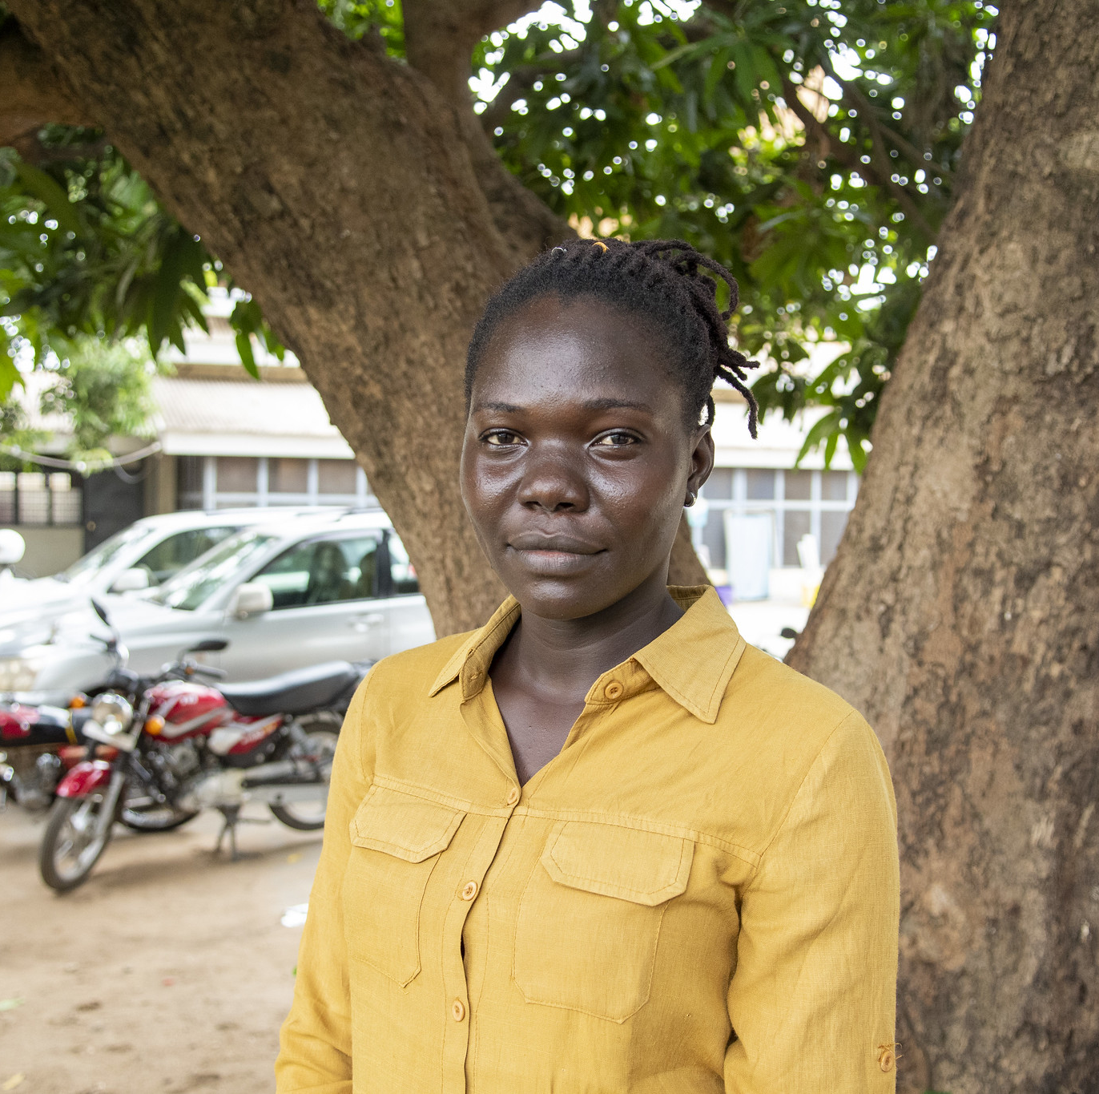
Case Scenario​
Nala returns to the clinic one month after starting to use the DVR and asks if she can remove the ring during sex.
She says that her partner feels the ring during sex and doesn't like it.
How would you counsel Nala and support her to address this barrier to adherence?
Notes:
Facilitator guidance:
Read the scenario and question on the slide.
Ask participants to raise hands and share their answers.
Continue to the following slide to provide the answer after receiving inputs from participants.

Slide 124
Case Scenario​
Counsel Nala to make sure the DVR is placed correctly and push it further up in the vagina if needed.
You can also offer counseling with her partner, if she is willing:
Counsel that the DVR should remain in place during sex, and even if it is felt, reassure them it will not have any effect on the penis.
Ask if they have further questions or concerns and if they are willing to continue using the DVR.
You may also inform them that there are alternative PrEP options they can consider.
Notes:
Facilitator guidance:
Reveal the answer on the slide.
Allow time for questions and follow-up discussion as needed.

Slide 125
Improve Effective Use
Suggestions to improve effective use of the DVR
Always come to your appointments and obtain refills for the DVR on schedule.
Set monthly reminders using the calendar on your phone or add the dates to a physical calendar.
Always replace the old DVR with a new one immediately after you remove it.
It may be helpful to pick one day of the month that is easy to remember, between the 1st and the 28th of the month, and plan to change the ring on that day every month.
If you will be traveling when you are scheduled to replace the DVR, ensure you bring a supply with you.
Remember to use other forms of protection, such as condoms, for the best HIV prevention.

Slide 126
Assess HIV Risk Behaviors
The DVR only protects against HIV during vaginal sex, so it is important to evaluate for other HIV risk behaviors, such as anal sex and injection drug use.
Questions to help understand HIV risk behaviors
When you have sex with your partner(s), what kind of sex do you have? Do you ever have anal sex with your partner(s)?
How often do you use condoms with you partner(s)? Do you use them for vaginal sex and anal sex?
Do you ever inject drugs?
If you inject drugs, do you ever share needles or other injecting equipment with others?
Women reporting HIV exposure through anal sex or injection drug use should be counseled on other prevention methods and strongly encouraged to choose another PrEP method.

Slide 127
Alternative PrEP Options
Based on availability and eligibility, it may be appropriate to discuss other PrEP options.​
Consider offering other PrEP options based on any challenges or preferences expressed​
Challenges | Alternative PrEP Option​
Struggle to remember or perform monthly ring changes | Oral daily PrEP CAB-LA
Discomfort with or dislikes the ring | Oral daily PrEP CAB-LA
Desire or need for more complete HIV protection | Oral daily PrEP CAB-LA
For more information on PrEP options see Module 1 and Module 6​

Slide 128
Provide DVR Packs and Schedule Next Appointment
If the client is comfortable with continuing to use the DVR, and there are no other contraindications, provide her with DVR packs.
Schedule the next appointment and ensure she has enough DVRs to use them continuously until the next appointment.
Remind her that she can return sooner if she has any concerns or challenges.

Slide 129
How confident do you feel about following up with a client on the DVR?
Do you have any questions about following up with clients on the DVR?
DISCUSSION​
Notes:
Facilitator guidance:
• Time: 10 minutes.
• Encourage everyone to participate and call on everyone who raises a hand.
• Prompt participants with questions such as, "On a scale of 1-5, how confident do you feel to follow-up a client on DVR, with 1 being not at all confident, and 5 being completely confident. What do you feel confident about and what do you find challenging? Do you have any further questions for discussion or clarification?"
• Wrap up the discussion by repeating and summarizing main points.

Slide 130
Summary

Slide 131
Module 5 Summary
The DVR is an alternative, discreet PrEP method for women exposed to HIV through vaginal sex.
The DVR is long-acting and self-inserted by women once a month.
The DVR only offers partial HIV protection (30-50%), so should only be considered in women who are unwilling or unable to use other forms of PrEP and should be used with other prevention methods.
The DVR must be worn continuously and should remain in place during sex and menses.
Studies have found the DVR to be safe, easy to use and well tolerated by women.
Counseling and education are essential to support women to make an informed choice and increase their ability to effectively use the DVR.

Slide 132
Module 5 Learning Objectives
Review the learning objectives from this module. After completing Module 5, how confident do you feel to do the following?
Describe characteristics of the DVR
Explain how the DVR can be used by women as an additional option for protection against HIV infection
Define the eligible and ineligible populations for the DVR
Describe what is known about efficacy, safety and acceptability of the DVR
Guide women to make an informed choice about using the DVR
Counsel women on how to use the DVR effectively
Conduct effective initiation and monitoring visits for women using the DVR
Identify and manage potential side effects with use of the DVR

Slide 133
Share your experience with this module.
What did you learn?
What did you find helpful?
What will you implement in your practice?
Do you have any questions?
DISCUSSION​
Notes:
Facilitator guidance:
Time: 10 minutes
Ask participants to raise their hands and share their experience with this module.
Allow time for everyone to share.
Wrap up the discussion by repeating and summarizing main points.

Slide 134
DVR Resources for Providers
World Health Organization. Consolidated Guidelines on HIV Prevention, Testing, Treatment, Service Delivery and Monitoring: Recommendations for a Public Health Approach. Geneva: WHO; 2021.
International Partnership for Microbicides (IPM) training available at: prepwatch.org/resources/global-healthcare-provider-training-package-for-the-dapivirine-vaginal-ring
European Medicines Agency (EMA) product information available at: ema.europa.eu/en/opinion-medicine-use-outside-EU/human/dapivirine-vaginal-ring-25-mg#product-information-section
PrEPWatch resources: prepwatch.org/products/the-dapivirine-vaginal-ring

Slide 135
Local DVR PrEP Resources​
[Insert local DVR resources, organizations, clinics, studies, etc.] ​

Slide 136
References: Articles
Baeten JM, Palanee-Phillips T, Brown ER, et al. Use of a vaginal ring containing dapivirine for HIV-1 prevention in women. N Engl J Med. 2016;375(22):2121-2132.
Baeten JM, Palanee-Phillips T, Mgodi NM, et al. Safety, uptake, and use of a dapivirine vaginal ring for HIV-1 prevention in African women (HOPE): An open-label, extension study. Lancet HIV. 2021;8(2):e87-e95.
Brown ER, Hendrix CW, van der Straten A, et al. Greater dapivirine release from the dapivirine vaginal ring is correlated with lower risk of HIV‐1 acquisition: A secondary analysis from a randomized, placebo‐controlled trial. J Int AIDS Soc. 2020;23(11):e25634.
Bunge K, Balkus JE, Fairlie L, et al. DELIVER: A safety study of a dapivirine vaginal ring and oral PrEP for the prevention of HIV during pregnancy. J Acquir Immune Defic Syndr. 2022:10.1097.
Makanani B, Balkus JE, Jiao Y, et al. Pregnancy and infant outcomes among women using the dapivirine vaginal ring in early pregnancy. J Acquir Immune Defic Syndr. 2018;79(5):566.
Mayo AJ, Browne EN, Montgomery ET, et al. Acceptability of the dapivirine vaginal ring for HIV-1 prevention and association with adherence in a phase III trial. AIDS Behav. 2021;25:2430-2440.

Slide 137
References: Articles
Montgomery ET, Roberts ST, Reddy K, et al. The CHARISMA randomized controlled trial: A relationship-focused counseling intervention integrated within oral PrEP delivery for HIV prevention among women in Johannesburg, South Africa. J Acquir Immune Defic Syndr. 2022;90(4):425-433.
Nel A, van Niekerk N, Kapiga S, et al. Safety and efficacy of a dapivirine vaginal ring for HIV prevention in women. N Engl J Med. 2016;375(22):2133-2143.
Nel A, Bekker L, Bukusi E, et al. Safety, acceptability and adherence of dapivirine vaginal ring in a microbicide clinical trial conducted in multiple countries in sub-Saharan Africa. PloS one. 2016;11(3):e0147743.
Nel A, Van Niekerk N, Van Baelen B, et al. Safety, adherence, and HIV-1 seroconversion among women using the dapivirine vaginal ring (DREAM): An open-label, extension study. Lancet HIV. 2021;8(2):e77-e86.
Parikh UM, Penrose KJ, Heaps AL, et al. HIV‐1 drug resistance among individuals who seroconverted in the ASPIRE dapivirine ring trial. J Int AIDS Soc. 2021;24(11):e25833.
Peebles K, Brown ER, Hendrix CW, et al. Brief report: Dapivirine ring HIV-1 prevention effectiveness for women engaged in vaginal and anal intercourse: Insights from mathematical modeling. J Acquir Immune Defic Syndr. 2023;92(2):122-126.

Slide 138
References: Reports and Guidelines
Consolidated guidelines on HIV prevention, testing, treatment, service delivery and monitoring: recommendations for a public health approach. Geneva: World Health Organization; 2021. License: CC BY-NC-SA 3.0 IGO.​
Differentiated and simplified pre-exposure prophylaxis for HIV prevention: update to WHO implementation guidance. Technical Brief. Geneva: World Health Organization; 2022. License: CC BY-NC-SA 3.0 IGO.
European Medicines Agency. Dapivirine Vaginal Ring 25 mg Product Information; Annex 1: Summary of Product Characteristics. EMA; 2022
IN DANGER: UNAIDS Global AIDS Update 2022. Geneva: Joint United Nations Programme on HIV/ AIDS; 2022. License: CC BY-NC-SA 3.0 IGO.
IPM Global Health Care Provider Training Manual/Ring Package, 1st edition, International Partnership for Microbicides, South Africa, 2022

Slide 139

Thank You

Slide 140
Acknowledgements
This package is a product of the Clinical and Laboratory Unit of ICAP at Columbia University. The material was conceptualized, designed and developed by Cassia Wells, with support from Julie Franks and technical input from Ellen Morrison, Andrea Howard and Gillian Doherty. Formatting and graphic design was provided by the ICAP Communications Team.
Portions of this training updated and modified previous PrEP package material developed by ICAP at Columbia University in collaboration with the U.S. Centers for Disease Control and Prevention (CDC), with funding from the U.S. President’s Plan for AIDS Relief (PEPFAR) under the terms of cooperative agreement #U2GGH000994.
Some technical content in this module was informed by training developed by the International Partnership for Microbicides, an affiliate of the Population Council, supported by the LEADING (Licensure and Ensuring Access to the Dapivirine Ring) Project (Cooperative Agreement Number: AID-OAA-A-17-00013).
Its contents are solely the responsibility of the authors and do not necessarily represent the views of the U.S. Government or other organizations.

