Slide 1
Pre-Exposure Prophylaxis (PrEP) Training for Providers ​ in Clinical Settings
Module 4: Injectable Long-Acting Cabotegravir (CAB-LA)​
Last update: January 2024​

Slide 2

Training Overview
Oral PrEP
MODULE 1: PrEP Basics ​
MODULE 2: Oral Daily PrEP​
MODULE 3: Oral Event-Driven PrEP (ED-PrEP)​
MODULE 4: Injectable Long-Acting
Cabotegravir (CAB-LA)​
MODULE 5: Dapivirine Vaginal Ring (DVR)​
MODULE 6: Person-Centered PrEP Counseling
PrEP Vaginal Ring
Injectable PrEP

Slide 3
PrEP Competencies​
By the end of this training program, you should be able to:​
Explain the use of PrEP for HIV prevention​
Identify candidates eligible for PrEP​
Initiate clients on PrEP​
Conduct follow-up management for PrEP ​
Provide person-centered counseling for PrEP​

Slide 4
Symbols Key​
Preliminary recommendation based on available evidence and may change​
Adaptation required or suggested based on local context​
Content repeated in other modules​
Unknown at the moment, more information required​

Slide 5

Learning Activities​
Question & answer​
Review national guidelines​
Case scenario​
Role-play​
Discussion​
Share experiences​
Notes:
Facilitator Guidance:
This training is designed to be interactive and to engage participants in learning and knowledge sharing. Rather than simply lecturing to participants, we encourage facilitators to use a variety of participatory methodologies, including question and answer, discussion, case scenarios, role-play, and other small group activities. These activities are provided for you and were designed to elicit and build on participants’ experience and knowledge, to promote discussion and reflection on key issues, to provide hands-on practice of content learned, and to help participants learn from one another. In addition, these participatory methodologies promote higher retention of content and create an open, engaging, and supportive learning environment.
Review the learning activities in advance to facilitation:
Question & Answer
Questions and answers are included throughout the module to keep learners engaged and actively participating. Q&A are offered to encourage participants to reflect on their existing knowledge before a new topic is introduced. Q&A are also offered after lecture content is delivered to test participants knowledge recall.
How To Facilitate Q&A
Read the question on the slide.
Ask participants to raise their hands to answer the question.
Take a few volunteer responses.
Reveal the answer on the following slide.
Allow time for follow-up discussion as needed (see below).
2. Discussion
A discussion is a dialogue between participants and the trainer, with participants responding to discussion questions and to one another’s ideas. During discussions, new questions may surface. When the trainer leads a large group discussion, she or he must manage the discussion by keeping participants focused, actively eliciting responses, and limiting participants who like to talk a lot. When participants have small group discussions, they must do likewise.
How To Facilitate Discussion
Set a time limit and keep track of time.
Explain that participants who want to speak should raise their hands.
Keep the discussion on target and moving along.
Encourage everyone to participate and call on everyone who raises a hand.
Limit participants who like to talk a lot.
Ask questions to encourage more responses to a question—for example: “What else?” “What other ideas do you have?”
Wrap up the discussion by repeating and summarizing main points.
3. Case scenarios
A case scenario is a brief description of a realistic situation that participants discuss and analyze. Case scenarios give participants the opportunity to apply newly acquired knowledge to a particular problem or situation and to generate possible solutions to challenges presented in the scenario.
How to Facilitate Case Scenarios
• If participants will use the scenario in small groups or pairs, give clear instructions.
• If you write your own scenarios, make them simple and brief. Use realistic situations similar to those that participants face. Give essential information and leave out unnecessary details.
• Provide questions to guide participants in analyzing the scenario and a list of essential points to be covered in discussion for yourself and co-trainers.
4. Role-Play
A role-play is a brief informal performance where participants act out roles in order to practice handling a particular problem or situation and to experience what it is like to be in those roles. Role-playing is informal; participants do not need to memorize dialogue or perform perfectly— the point is to experience the situation and learn from that experience.
How To Facilitate a Role-Play
• Give clear instructions for the role-play
• Set a time limit for role-play practice and performance and manage the time well.
• Remind participants that role-playing does not require a perfect performance but rather provides an opportunity to practice handling real-life situations. It is fine to make mistakes during role-play.
• Debrief the role-play with a large group discussion
5. Small group activities
The facilitator divides participants into small groups to do a learning activity. Examples of small group activities include discussions, scenarios, and role-play practice as described above. Small groups allow each person to participate more than they would in the large group. Small group work also helps participants get to know one another and work with new colleagues.
How To Facilitate Small Group Work
• Before you divide participants into small groups, give clear instructions for the small group task.
• Group participants so that they are not always working with people they know well. To vary groups’ composition: Ask participants to count off or draw at random from a deck of playing cards and then group by suit or numbers. Or ask participants to draw at random from a container of colored objects or slips of paper and then group by colors. Or group participants by birthday (seasons or months), by first letter of first or last name, by last digit of their phone number, or by height—then, based on how many fall into each category, regroup these groups so that you have groups of an optimal size.
• Instruct the groups to make sure that all group members participate.
• Have each group choose a timekeeper.
• Keep track of time yourself and provide half-time, 5-minute, and 1-minute warnings.
• As the groups are working, move from one to another to make sure that participants have understood the task and are making progress.

Slide 6
Module 4: Injectable Long-Acting Cabotegravir (CAB-LA)​

Slide 7
Introduction​
Welcome to Module 4: Injectable Long-Acting Cabotegravir (CAB-LA)
In this module you will learn how to initiate and conduct follow-up management for clients on CAB-LA as PrEP. You will learn to identify persons eligible for CAB-LA, conduct assessments and counseling to start CAB-LA, and provide ongoing monitoring for as long as the client uses CAB-LA. You will also learn how to safely discontinue CAB-LA and conduct post-discontinuation monitoring.​

Slide 8
Module 4 Learning Objectives​
After completing Module 4, participants will be able to:​
Define injectable CAB-LA as PrEP
Explain the rationale for adding CAB-LA to the array of HIV prevention tools
Describe the evidence base for CAB-LA
Define the eligible and ineligible populations for CAB-LA
Guide clients to make an informed choice about using CAB-LA as PrEP
Describe advantages and disadvantages of CAB-LA
Counsel clients on how to adhere to requirements for CAB-LA
Conduct CAB-LA initiation
Effectively conduct monitoring visits for CAB-LA
Describe the process for resuming, restarting, and discontinuing CAB-LA

Slide 9
What is YOUR EXPERIENCE as a provider with CAB-LA or other injectable medications?​
What successes and challenges can you share?
What are you most excited to learn in this training?
DISCUSSION​
Notes:
Facilitator guidance:
• Time: 10-20 minutes. Timing will vary based on size of the group and time allowed for training. Set a time limit and keep track of time.
• Explain that participants who want to speak should raise their hands.
• Keep the discussion on target and moving along.
• Encourage everyone to participate and call on everyone who raises a hand.
• Limit participants who like to talk a lot.
• Ask questions to encourage more responses to a question—for example: “What else?” “What other ideas do you have?”
• Wrap up the discussion by repeating and summarizing main points.

Slide 10
4.1 Introduction to CAB-LA​

Slide 11
QUESTION
What is CAB-LA?​
Notes:
Facilitator guidance:
Read the question on the slide.
Ask participants to raise their hands to answer the question.
Take a few volunteer responses.
Reveal the answer on the following slide.
Allow time for follow-up discussion as needed.

Slide 12
ANSWER
CAB-LA is a long-acting, injectable form of PrEP. ​
Notes:
Facilitator guidance:
Reveal the answer on the slide.
Allow time for questions and follow-up discussion as needed.
Continue to the following slide for a detailed description of CAB-LA.

Slide 13
What is CAB-LA?​
Cabotegravir (CAB) in an integrase strand transfer inhibitor (INSTI) antiretroviral (ARV) medication.​
Long-acting CAB (or “CAB-LA”) is a formulation of CAB that is given as an injection into muscle tissue.​
CAB-LA is effective as PrEP. ​
The U.S. Food and Drug Administration approved CAB-LA as PrEP in 2021.​
The World Health Organization (WHO) recommended CAB-LA as PrEP in 2022.​

Slide 14
How is CAB-LA Given?​
CAB-LA is an injectable extended-release suspension (200 mg/mL).​
CAB-LA is administered as a single 600 mg (3 mL) intramuscular (IM) injection into a gluteal muscle.​
Dosing schedule:​
Clients receive 2 loading dose injections administered 1 month (4 weeks) apart when initiating CAB-LA.​
Clients then receive 1 injection every 8 weeks thereafter for as long as they remain on CAB-LA.​
Window period for injections is +/- 1 week.​
Month 1
LOADING
DOSES
Month 2
Month 4
CONTINUATION
Month 6
Month 8

Slide 15
QUESTION
What is the dosing schedule for CAB-LA?​
Notes:
Facilitator guidance:
Read the question on the slide.
Prompt participants by asking, "Recall the information from the previous slide. When should clients receive the loading doses of CAB-LA? How often should clients receive continuation injections of CAB-LA?"
Ask participants to raise their hands to answer the question.
Take a few volunteer responses.
Reveal the answer on the following slide.
Allow time for follow-up discussion as needed.

Slide 16
ANSWER
The first two doses (also known as loading doses) are received 1 month apart, after which injections are every 2 months.​
The window period to receive an injection ranges from 1 week before the injection is due to 1 week after the injection is due.​
Notes:
Facilitator guidance:
Reveal the answer on the slide.
Allow time for questions and follow-up discussion as needed.
If necessary, refer to earlier slide "How is CAB-LA Given?" To reinforce this information

Slide 17

Why Are Long-Acting Forms of PrEP Needed?​
Adherence to oral regimens is challenging for many reasons
Psychological
Pill fatigue
Reminder of vulnerability to HIV
Mental health conditions, such as depression and anxiety
Biological
Biological
Difficulty swallowing
Side effects
Malabsorption
Cognitive difficulties with self-administration
Social
Privacy
Convenience
Lack of supportive norms
HIV-related stigma
Psychological
Social

Slide 18
Groups That May Prefer CAB-LA​
People who have irregular schedules that may make it difficult to take medication routinely. ​
People who have limited privacy or concerns about social harms associated with PrEP use.​
  e.g., Adolescent girls and young women, clients at risk for intimate partner violence (IPV), men who have sex with men (MSM)
People who have substance use issues that interfere with daily routines and adherence to daily medication.​
People who know they will struggle to take pills regularly. ​
  e.g., Past medication adherence challenges, difficulty swallowing

Slide 19
Groups That May NOT Be Good Candidates for CAB-LA​
On-time administration of CAB-LA is important.
Therefore, people who would struggle to attend scheduled appointments may not be good candidates for CAB-LA.
This could include:​
  People who travel for prolonged periods, such as seasonal migrant workers who are away from their residence for >2 months​
  People who live in a remote area and who would find travel to the clinic challenging
  People who are not able or willing to commit to attending regular scheduled appointments

Slide 20


Evidence for CAB-LA: Clinical Trials​
Two large randomized, placebo-controlled trials conducted by the HIV Prevention Trials Network (HPTN) compared the efficacy of CAB-LA to daily oral PrEP with tenofovir disoproxil and emtricitabine (TDF/FTC) among people at substantial risk of acquiring HIV.​
HPTN 083​¹ | HPTN 084^{​2}
Enrolled 4,570 cisgender MSM and transgender women who have sex with men between December 2016 and March 2020​ Conducted at 43 sites in Argentina, Brazil, Peru, United States, South Africa, Thailand and Vietnam | Enrolled 3,224 cisgender women (18 to 45 years old), between November 2017 and November 2020 Conducted at 20 sites in Botswana, Eswatini, Kenya, Malawi, South Africa, Uganda, and Zimbabwe
1. Landovitz et al., 2021; 2. Delany-Moretlwe et al., 2022

Slide 21
Evidence for CAB-LA: Efficacy​
Both HPTN 083 and HPTN 084 were stopped early when CAB-LA was shown have greater efficacy than daily oral TDF/FTC PrEP at preventing new HIV infections.^{​1, 2}
In HPTN 083, CAB-LA resulted in a 66% reduction in HIV risk compared with oral PrEP.​¹
  HIV incidence of 0.41 per 100 person-years in the CAB-LA group vs. 1.22 per 100 person-years in the oral PrEP group (hazard ratio, 0.34; 95% confidence interval, 0.18 to 0.62)​
In HPTN 084, CAB-LA resulted in 88% reduction in HIV risk compared with oral PrEP.​²
  HIV incidence of 0.2 per 100 person-years in the CAB-LA group vs. 1.85 per 100 person-years in the oral PrEP group (hazard ratio 0.12; 95% confidence interval, 0.05 to 0.31) ​
1. Landovitz et al., 2021; 2. Delany-Moretlwe et al., 2022

Slide 22
Evidence for CAB-LA: Understanding Efficacy ​
In both HPTN 083 and HPTN 084, CAB-LA was significantly better than oral PrEP for prevention of HIV infection.​
However, many participants receiving oral PrEP in the trials used it inconsistently and the majority of HIV infections in the oral PrEP group occurred in those with sub-optimal adherence.​
By contrast, people on CAB-LA received their injections consistently. ​
Therefore, the superior efficacy of CAB-LA observed in the trials was likely due to differences in adherence.​^{1,2}
Both CAB-LA and oral PrEP are >95% effective at preventing HIV infection if they are used consistently and correctly.
1. Landovitz et al., 2021; 2. Delany-Moretlwe et al., 2022

Slide 23
QUESTION
How efficacious is CAB-LA as PrEP?​
Notes:
Facilitator guidance:
Read the question on the slide.
Prompt participants by asking, "Considering the evidence from CAB-LA clinical trials, how well does CAB-LA work compared to oral PrEP?"
Ask participants to raise their hands to answer the question.
Take a few volunteer responses.
Reveal the answer on the following slide.
Allow time for follow-up discussion as needed.

Slide 24
ANSWER
CAB-LA is highly efficacious as PrEP!​
In the clinical trials it had greater efficacy than daily oral PrEP at preventing new HIV infections. This was likely due to better adherence to the injectable PrEP than the oral PrEP.​
Notes:
Facilitator guidance:
Reveal the answer on the slide.
Allow time for questions and follow-up discussion as needed.
If necessary, review previous slide on "Evidence for CAB-LA: Understanding Efficacy" to reinforce this knowledge.

Slide 25
Evidence for CAB-LA: Safety and Side Effects​
CAB-LA was found to be safe in the clinical trials.​^{1,2}
The most common side effect was injection site reactions (ISRs).
  Reported by 38% to 81% of participants in the clinical trials
  ISRs can include redness, pain, bruising and swelling at the injection site
  ISRs become less frequent over time as clients get used to the injection​
  Very few people in the trials stopped receiving injections because of ISRs
Other occasional side effects, which are usually mild or moderate: ​headache​, nausea, diarrhea​, fatigue​ and fever​.
Other rare (<1%) adverse events: hypersensitivity reactions, hepatotoxicity and depression.​
1. Landovitz et al., 2021; 2. Delany-Moretlwe et al., 2022

Slide 26
Medical Considerations With CAB-LA Use​
CAB-LA may be a good option for people known to have abnormal renal function or those who are at risk for renal dysfunction (e.g., older clients, those with hypertension or diabetes). ​
  Unlike oral PrEP with TDF, CAB-LA does not impact the kidneys and does not require creatinine measurements to monitor kidney function.​
CAB-LA is not a good option for: ​
  People on tuberculosis (TB) treatment or seizure medication due to drug-drug interactions (see Section 4.2)​
  Women who are pregnant or breastfeeding, or who plan to be soon (per national guidelines)​

Slide 27
CAB-LA and Special Populations​
Women of Childbearing Potential
Pregnant women were excluded from the clinical trial, but some women did become pregnant while on CAB-LA and no adverse events have been reported among their infants.​
The safety of CAB-LA use during pregnancy and breastfeeding is being evaluated.​
While data are limited, some countries may consider pregnancy, breastfeeding or intentions to become pregnant a contraindication to CAB-LA use.​
Adolescents and Children: ​
In the original clinical trials, all participants were ≥18 years old. ​
CAB-LA use in adolescents is being evaluated.
CAB-LA is not recommended in individuals weighing less than 35 kg.​

Slide 28
CAB-LA and Special Populations (continued)​
Clients receiving TB treatment or TB preventive therapy (TPT)​
The TB drugs rifampicin, rifapentine and rifabutin should not be used with CAB-LA due to drug-drug interactions.​
Clients receiving TB therapy with any of these drugs can be considered for CAB-LA two weeks after they complete their treatment and should be offered other HIV prevention methods in the interim.​
Similarly, clients receiving TPT with once-weekly rifapentine-isoniazid for 12 weeks (3HP) should not use CAB-LA and can be considered for CAB-LA two weeks after they complete their TPT. ​

Slide 29
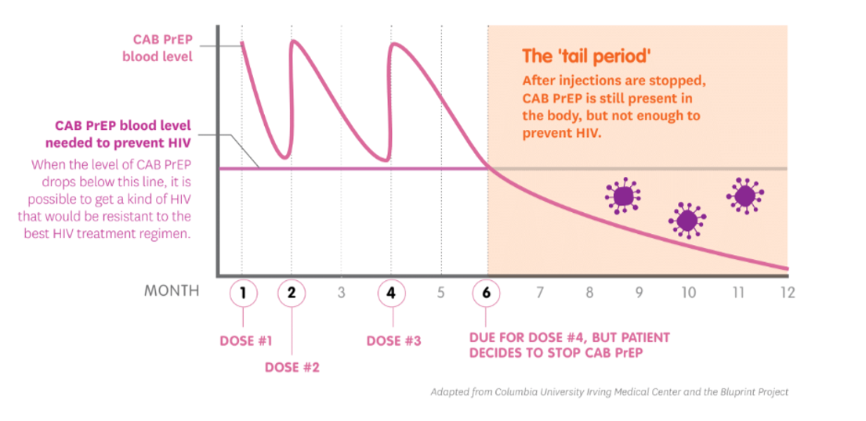
Special Considerations: The CAB-LA ‘Tail’​
CAB-LA has a long half-life and can remain in the body for up to 12 months after the last injection was due.​
The time after a missed injection, but before CAB is gone from the body, is called the ‘tail period’ or ‘tail phase’.​
Once the amount of CAB in the body drops below the protective level there is a risk of acquiring HIV if other prevention measures are not taken.​
Oral PrEP can be used during the tail period to prevent HIV infection.​
Source: MOSAIC Project Template Guidelines

Slide 30
Special Considerations: CAB-LA and Delays in Detection of HIV​
Rare cases of HIV infection have been reported when someone is taking CAB-LA.​
Most of these cases were people who had HIV before they started CAB-LA, but tested negative because they were in the ‘window period’.​
Since CAB is also a medicine to treat HIV, CAB in the body can reduce viral replication and therefore reduce antibody response to the HIV virus (delayed seroconversion). This means antibody-based HIV tests, such a rapid diagnostic tests, can be falsely negative.​
This may delay diagnosis of new HIV infection, which risks development of drug resistance (see next slide)​.
Note: Currently, HIV self tests are not recommended for use with CAB-LA ​
WHO, 2022

Slide 31
Special Considerations: Drug Resistance and CAB-LA​
If a person acquires HIV, and the virus is exposed to a single ARV drug while it replicates in their body, there is a chance the virus will develop mutations that make it resistant to that drug.​
CAB is an INSTI, which is the same class of drug as dolutegravir (DTG). ​
A virus strain that is resistant to CAB may also be resistant to DTG.​
DTG is widely used as part of first-line antiretroviral therapy (ART) globally.
Someone with a virus that is resistant to CAB may require a regimen that does not contain DTG or other INSTI for treatment.​

Slide 32
Risk of Drug Resistance with CAB-LA Use​
There is a chance of developing resistance to CAB if:​
A person has acute HIV infection (AHI) when starting CAB in the ‘window period’.
A person acquires HIV while on CAB because they missed scheduled injections.
A person acquires HIV while receiving CAB injections as scheduled - this is very rare.
A person acquires HIV in the CAB tail period.​

Slide 33
Evidence of Drug Resistance with CAB-LA Use​
Data on the occurrence of INSTI-resistant mutations mostly come from clinical trials, but HIV seroconversions were so rare that only a small number have undergone resistance testing.​ More data are needed from real-world settings.​
  The number testing HIV-positive following CAB-LA PrEP was extremely low (0.5% of users).​
  Of these people, approximately one in four (24%) carried a virus with some predicted resistance to DTG based on genotype modeling.​
  There are limited data on whether people with these mutations would fail the TDF/lamivudine/DTG (TLD) regimen that is widely used as first-line ART.​
Pre-treatment resistance testing is not recommended using public health approach, but programs initiating clients on DTG-based ART should ensure close monitoring and prompt switch to second-line regimens with virological failure.​
​
Programs do not need to have routine genotype testing available to implement CAB-LA.
Ahluwalia et al., 2022

Slide 34
Reducing the Risk of Drug Resistance​
Essential measures to mitigate the risk of CAB-LA drug resistance​:
Ensure quality AHI screening is done at initiation. See Module 1​
Perform HIV testing prior to administration of every injection.
  ​Note: this is more frequent than every 3 months
  The WHO recommends programs use their current national HIV testing algorithm. No additional HIV testing methods are required to implement CAB-LA.
Ensure effective HIV prevention methods are used for the 12-month tail period after CAB-LA injections are discontinued.​
Educate clients and provide informed choice counseling, to allow clients to make an informed decision about using CAB-LA, including a commitment to receiving follow up injections at appropriate intervals. See Module 6
WHO, 2022

Slide 35
Reducing the Risk of Drug Resistance​ (continued)
Additional measures to mitigate the risk of CAB-LA drug resistance​:
Offer a supply of oral PrEP for clients to take when they miss appointments. This is sometimes called an ‘oral PrEP bridge’.
Offer a supply of oral PrEP for clients who stop CAB-LA to cover the tail period.​
If available, antigen-based or nucleic acid tests (NAT), such as viral load tests, may be useful.
  To detect early AHI before CAB-LA initiation
  To detect new HIV infection before antibody seroconversion during CAB-LA follow-up visits
WHO, 2022

Slide 36
Visit Types and Schedule: Initiation and Continuation ​
Initiation visit​
  First loading dose injection for clients starting CAB-LA​
Second loading dose injection visit ​
  Occurs 1 month (4 weeks) after the initiation visit
  There is a window period of 1 week before and after the injection is due, which means this visit can happen 3 to 5 weeks after the first injection.​
Continuation injection visits​
  After the second loading dose injection, subsequent injections occur every 2 months (8 weeks) until discontinuation
  There is a window period of 1 week before and after each injection is due, which means the visit can happen 7 to 9 weeks following the previous injection. ​

Slide 37
Initiation Schedule and Window​
Target Injection Date for second loading dose injection
First loading dose injection
Week 1
Week 2
Week 3
Week 4
Week 5
Week 6
Window period to receive the second loading dose injection

Slide 38
Continuation Schedule and Window​
Target Injection Date
Last Injection
Week 1
Week 2
Week 3
Week 4
Week 5
Week 6
Week 7
Week 8
Week 9
Week 10
Window period to receive the injection

Slide 39
Visit Types and Schedule: Resuming/Restarting Visits After Missed Injections​
Clients are considered to have missed an injection if they return for their injection after the allowed window period (i.e., >1 week after their last Target Injection Date).​
Resuming visit​
  Clients are considered to be resuming CAB-LA if they return for an injection >1 week, but ≤1 month after their last Target Injection Date.​
  They should resume injections as soon as possible and continue with injections every 2 months thereafter.​
Restarting visit​
  Clients are considered to be restarting CAB-LA if they return for an injection >1 month after their last Target Injection Date.​
  They should restart loading dose injections as if they were initiating CAB-LA (i.e., 2 injections 1 month apart, followed by injections every 2 months).​

Slide 40
Decision to Resume or Restart After a Missed Injection​
The Target Injection Date is based on the date of the last injection received and what type of injection it was.
Target Injection Date
= 4 weeks after the first injection
= 8 weeks after all other injections
Target
Injection Date
When the client returns
Week 1
Week 2
Week 3
Week 4
Week 5
Week 6
Within the widow period, continue with injections
RESUME
injections according
to schedule
RESTART
injections with
two loading doses
1 month apart

Slide 41
Visit Types and Schedule: Discontinuation and Post-discontinuation Visits​
Discontinuation visit​
Clients may decide to stop CAB-LA at any time but should be strongly encouraged to come in for a visit to discuss the post-discontinuation period.​
Clients should be offered HIV testing and effective HIV prevention (e.g., oral PrEP) during the tail period.​
Post-discontinuation visits​
Clients should be offered quarterly visits during the 12-month tail period after they have stopped CAB-LA. ​
This is to support the use of other effective HIV prevention measures and provide HIV testing.​

Slide 42
QUESTION
What are the main types of visits for CAB-LA?​
Notes:
Facilitator guidance:
Read the question on the slide.
Prompt participants by asking, "Why should clients visit the clinic for CAB-LA? When should these visits occur? What services should be provided at each visit?"
Ask participants to raise their hands to answer the question.
Take a few volunteer responses.
Reveal the answer on the following slide.
Allow time for follow-up discussion as needed.

Slide 43
ANSWER
Initiation visit for the first loading dose​
Second loading dose injection visit ​
Continuation injection visits​
Resuming or restarting visit after a missed dose​
Discontinuation visit​
Post-discontinuation visits​
Notes:
Facilitator guidance:
Reveal the answer on the slide.
Prompt participants by asking, "Do you have any questions about any of the visits for CAB-LA? For example, when the visits should occur and what services should be provided at each visit? Is there anything that is not clear or needs to be discussed?"
Allow time for questions and follow-up discussion as needed.
If necessary, review the details below as was presented on previous slides to reinforce this knowledge:
Main types of visits for CAB-LA:
Initiation visit
First loading dose injection for clients starting CAB-LA
Second loading dose injection visit
Occurs 1 month (4 weeks) after the initiation visit
There is a window period of 1 week before and after the injection is due, which means this visit can happen 3 to 5 weeks after the first injection.
Continuation injection visits
After the second loading dose injection, subsequent injections occur every 2 months (8 weeks) until discontinuation
There is a window period of 1 week before and after each injection is due, which means the visit can happen 7 to 9 weeks following the previous injection.
Resuming visit
Clients are considered to be resuming CAB-LA if they return for an injection >1 week, but ≤1 month after their last Target Injection Date.
They should resume injections as soon as possible and continue with injections every 2 months thereafter.
Restarting visit
Clients are considered to be restarting CAB-LA if they return for an injection >1 month after their last Target Injection Date.
They should restart loading dose injections as if they were initiating CAB-LA (i.e., 2 injections 1 month apart, followed by injections every 2 months).
Discontinuation visit
Clients may decide to stop CAB-LA at any time but should be strongly encouraged to come in for a visit to discuss the post-discontinuation period.
Clients should be offered HIV testing and effective HIV prevention (e.g., oral PrEP) during the tail period.
Post-discontinuation visits
Clients should be offered quarterly visits during the 12-month tail period after they have stopped CAB-LA.
This is to support the use of other effective HIV prevention measures and provide HIV testing.

Slide 44
QUESTION
What is the Target Injection Date?​
Notes:
Facilitator guidance:
Read the question on the slide.
Prompt participants by asking, "When should clients receive their initial and continuing CAB-LA injections? What is the window period for CAB-LA injections?"
Ask participants to raise their hands to answer the question.
Take a few volunteer responses.
Reveal the answer on the following slide.
Allow time for follow-up discussion as needed

Slide 45
ANSWER
The Target Injection Date is the date someone is scheduled to receive their next injection. ​
The Target Injection Date is 4 weeks after the first injection and 8 weeks after all the other injections.​
A client should receive their injection within the window period. ​
The window period spans from 1 week before the Target Injection Date to 1 week after the Target Injection Date. ​
Notes:
Facilitator guidance:
Reveal the answer on the slide.
Prompt participants by asking, "Do you have any questions about Target Injection Dates or the window period for CAB-LA injections? Is there anything that is not clear or needs to be discussed?"
Allow time for questions and follow-up discussion as needed.
If necessary, review the previous slides images on injection schedule and window period to reinforce this knowledge.

Slide 46
Implementation Considerations​
Per the WHO, programs can use their current national HIV testing algorithm to implement CAB-LA. No additional HIV testing methods, such as antigen-based or NAT tests, are required to implement CAB-LA.​
As a liquid suspension, CAB-LA has specific storage and handling requirements. ​
  It should be stored at 2°C to 25°C until ready to use
  It cannot be frozen or allowed to get above 30°C prior to use
  Programs will need to plan for the equipment required to maintain and monitor temperature.​
In many contexts, only trained healthcare workers can administer injections, which has human resource implications.​
WHO, 2022

Slide 47
Implementation Considerations (continued)​
Privacy is required to administer an injection into the buttocks. Programs must plan for space or equipment (e.g., screens) to ensure privacy and factor this into the flow of visits.
In addition to the medication, ensure availability of appropriate needles and other consumables associated with injections (e.g., gauze, band-aids). ​
Standard infection prevention and control (IPC) procedures must be followed, including ensuring the availability of:​
  Sterile needles and syringes​
  Sharps disposal containers for used needles​
  Adequate supply of gloves and alcohol wipes​
If programs plan to offer oral PrEP to cover missed appointments or the tail period, this should be factored into stock management and forecasting.​

Slide 48
Advantages and Disadvantages of CAB-LA​
Advantages
Highly efficacious as PrEP Do not need to remember to take pills Infrequent dosing Can be kept private​ Potential for less stigma, with no products to take home
Disadvantages
Relatively new medication, with ongoing collection of safety information May require more frequent visits (every 2 months) than other forms of PrEP​ Interactions with other medications Potential for delayed HIV diagnosis and drug resistance Need effective HIV prevention for 12 months during the tail period Decentralization of services may be limited by storage and handling requirements, and if injections must be administered by healthcare providers

Slide 49
Ongoing Research​
HPTN 083 and HTPN 084 are in open-label extension phases, which will provide more information on the safety and efficacy of CAB-LA.​
There are also several demonstration projects in progress or planned that will provide more real-world implementation information. ​
Topics being investigated include:​
  CAB-LA in adolescents​
  CAB-LA in pregnant and breastfeeding women​
  Extended interval dosing (8 weeks vs. 12 weeks)​
  Alternative IM injection sites​

Slide 50
What are the implementation considerations, opportunities, and challenges for CAB-LA in your setting? ​
What are the advantages and disadvantages of CAB-LA for the populations you serve? ​
DISCUSSION​
Notes:
Facilitator guidance:
Time: 20 minutes
Explain that participants will now work in small groups to discuss implementation considerations, opportunities, and challenges in their settings. Participants can also discuss advantages and disadvantages of CAB-LA in the populations they serve.
Divide participants into groups of 4 to 6 participants each.
Small groups may go online to research the information. As the groups are working, circulate and help as needed. Allow 10 minutes to work.
When the groups have finished, take volunteer responses from the groups. Allow 10 minutes for discussion.

Slide 51
4.2 CAB-LA Eligibility Screening​

Slide 52
QUESTION
Who can use CAB-LA as PrEP?​
Notes:
Facilitator guidance:
Read the question on the slide.
Ask participants to raise their hands to answer the question.
Take a few volunteer responses.
Reveal the answer on the following slide.
Allow time for follow-up discussion as needed.

Slide 53
ANSWER
Anyone who is eligible for PrEP, who is willing to use CAB-LA as prescribed and has no contraindications to receiving CAB-LA.​
Notes:
Facilitator guidance:
Reveal the answer on the slide.
Allow time for questions and follow-up discussion as needed.
Continue to the following slide for a detailed description of eligibility criteria for CAB-LA.

Slide 54
Eligibility Criteria for CAB-LA​
 | HIV seronegative
 | No suspicion of AHI
 | At substantial risk for HIV infection or requesting PrEP
 | Willingness to use PrEP as prescribed
 | No contraindications to receiving CAB-LA​ | Weight >35 kg​ Not taking contraindicated medications​ Not pregnant or breastfeeding*​ No buttock implants or fillers​ No history of allergic or hypersensitivity reactions to CAB
*As per national guidelines​

Slide 55
Contraindicated Medications with CAB-LA​
Some medications interact with CAB-LA and significantly reduce CAB levels in the body, reducing its efficacy as PrEP. These medications include: ​
  Anticonvulsants:​
    Carbamazepine​
    Oxcarbazepine​
    Phenobarbital​
    Phenytoin ​
  Anti-mycobacterial/TB medications:​
    Rifampin/rifampicin​
    Rifapentine​
    Rifabutin​
These drugs should not be co-administered with CAB-LA, and clients using them should select a different PrEP method or HIV prevention strategy. ​

Slide 56
Other Medical Contraindications and Considerations​
CAB-LA is only indicated for individuals weighing more than 35kg.​
The safety of CAB-LA in pregnant and breastfeeding women is unknown, therefore some countries may choose to exclude these groups from their national guidelines until more data are available. ​
CAB-LA should not be used in clients who have buttock implants or fillers, as this affects administration and absorption of the medication with IM gluteal injections and the injection could introduce microbes that cause implant infections.​
Clients with a known allergy or hypersensitivity reaction to CAB, or other INSTI drugs, should avoid CAB-LA.

Slide 57
Other Medical Contraindications and Considerations (continued)​
Clients receiving TB therapy with rifampicin, rifapentine or rifabutin can be considered for CAB-LA two weeks after they complete their treatment. ​
Similarly, clients receiving TPT with once-weekly rifapentine-isoniazid for 12 weeks (3HP) can be considered for CAB-LA two weeks after they complete their TPT. ​
Clients receiving methadone as opioid substitution therapy are candidates for CAB-LA but should be closely monitored as they may require a methadone dose increase after initiating CAB-LA.

Slide 58
QUESTION
Who should not use CAB-LA?​
Notes:
Facilitator guidance:
Read the question on the slide.
Prompt participants by asking, "Consider the medical contraindications and considerations such as the client's medical history and current medications."
Ask participants to raise their hands to answer the question.
Take a few volunteer responses.
Reveal the answer on the following slide.
Allow time for follow-up discussion as needed.

Slide 59
ANSWER
CAB-LA is contraindicated in all people who:​
Weigh <35 kg​s
Are taking certain contraindicated medications​
Have buttock implants or fillers​
Have a history of allergic or hypersensitivity reactions to CAB​
CAB-LA may also not be appropriate for pregnant or breastfeeding women (as per national guidelines).​
Notes:
Facilitator guidance:
Reveal the answer on the slide.
Allow time for questions and follow-up discussion as needed.
Review previous slides on medical contraindications and considerations to reinforce knowledge as needed.

Slide 60
What are the national guidelines and recommendations for CAB-LA in your country? ​
How does this compare to other forms of PrEP available in your country?
DISCUSSION​
Notes:
Facilitator guidance:
Time: 20 minutes
Explain that participants will now work in small groups to review national guidelines and recommendations for CAB-LA in their country.
Divide participants into groups of 4 to 6 participants each.
Small groups may go online to research the information. As the groups are working, circulate and help as needed. Allow 10 minutes to work.
When the groups have finished, take volunteer responses from the groups. Allow 10 minutes for discussion.
Present the next slide in order to summarize and confirm what participants have shared.

Slide 61
National CAB-LA Guidelines​
In [insert country name], CAB-LA is recommended for individuals [insert local age and/or weight recommendations] and [is/is not] recommended for use in pregnant or breastfeeding women as PrEP. ​
Other contraindications to CAB-LA use are:​
[insert other contraindications]​​
Notes:
Facilitator guidance:
Edit this slide in advance to the training by inserting the country name, recommended groups for CAB-LA in your country and contraindications for CAB-LA use.
Present this slide in order to summarize and confirm what participants have shared in the previous discussion.

Slide 62
4.3 CAB-LA Initiation Visit​

Slide 63
CAB-LA PrEP Initiation Visit: Essential Procedures​
Procedure​ | Rationale​
HIV test according to national guidelines ​ | Assessment of HIV infection status
AHI symptom checklist | Assess for AHI​
Ask about last potential HIV exposure​ | If last exposure <72 hours prior, post-exposure prophylaxis (PEP) may be more appropriate before transitioning to PrEP
Identify medications client is currently taking. Specifically ask if they are taking any medication for seizures or TB | Determine if they are taking a medication that is contraindicated for use with CAB-LA
PrEP initiation counseling, including informed choice counseling | Assess substantial risk for HIV Assess HIV prevention needs and educate about options Discuss desire for PrEP and willingness to take PrEP Support informed decision to start CAB-LA. Plan for effective PrEP use and sexual and reproductive health
See Module 6 for more information about informed choice counseling​

Slide 64
CAB-LA PrEP Initiation Visit: Essential Procedures (continued)
​
Procedure​ | Rationale​
Assess the client’s weight | Determine if they are >35 kg and what size needle to use
Ask about any allergies to medications | Assess for any known allergies to CAB or other INSTI drugs
Ask the client if they have any buttocks implants or fillers, or if they plan to get them soon | Clients with buttock implants or fillers are ineligible for CAB-LA
Assess pregnancy and breastfeeding status, as well as any pregnancy intentions (women only) | Determine if they are pregnant or breastfeeding, or if they intend to be soon. This may make them ineligible for CAB-LA per national guidelines Pregnancy testing may be required by national guidelines Contraception may be required or recommended by national guidelines
Assess the client’s understanding and ability to attend visits as scheduled | Ensure the client is aware of visit requirements and can attend the clinic at recommended intervals for injections

Slide 65
QUESTION
​What are some essential procedures before initiating a client on CAB-LA?​
Notes:
Facilitator guidance:
Read the question on the slide.
Prompt participants by asking, "What needs to be done to establish eligibility for starting CAB-LA?"
Ask participants to raise their hands to answer the question.
Take a few volunteer responses.
Reveal the answer on the following slide.
Allow time for follow-up discussion as needed.

Slide 66
ANSWER
Essential procedures before CAB-LA initiation include: ​
Assess general eligibility for PrEP​
Counsel and educate about CAB-LA to support an informed choice to use CAB-LA as PrEP​
Assess for any contraindications to CAB-LA use
Notes:
Facilitator guidance:
Reveal the answer on the slide.
Allow time for questions and follow-up discussion as needed.
Review previous slides on CAB-LA initiation procedures to reinforce knowledge as needed.

Slide 67
CAB-LA PrEP Initiation Visit: Suggested Procedures
Procedure​ | Rationale​
Hepatitis B surface antigen (HBsAg) | Identify undiagnosed hepatitis B (HBV) infection Identify those eligible for HBV vaccination
Hepatitis C antibody | Identify undiagnosed hepatitis C (HCV) infection that may be eligible for HCV treatment
Rapid plasma regain (RPR)​ testing | Diagnose and treat syphilis infection
Sexually transmitted infection (STI) screening​ | Diagnose and treat STI Syndromic or diagnostic STI testing, depending on local guidelines
Availability of or access to these tests should NOT be a barrier to PrEP initiation.
These tests are not a requirement for CAB-LA PrEP use.

Slide 68
Suggested Clinical Pathway: CAB-LA PrEP Initiation
1
2
3
4
5
Confirm HIV Negative Status​
Screen for Substantial Risk for HIV ​
Informed Choice
PrEP Counseling​
Establish Eligibility for CAB-LA
Initiate PrEP​
Perform rapid HIV test or other HIV test per national guidelines Link people found to be living with HIV to care and treatment​
Member of a population eligible for PrEP according to national guidelines
Educate about available PrEP options Shared decision making to start CAB-LA
No evidence of AHI Willingness to use CAB-LA as prescribed No contraindications to receiving CAB-LA
Counseling on adherence, risk reduction, side effects and AHI symptoms STI screening and management Administer injection and schedule follow-up appointment
See Module 6 for more information about informed choice counseling​

Slide 69
QUESTION
What are the steps to start a client on CAB-LA?
Notes:
Facilitator guidance:
Read the question on the slide.
Prompt participants by asking, "What are the steps in the clinical pathway for starting CAB-LA?"
Ask participants to raise their hands to answer the question.
Take a few volunteer responses.
Reveal the answer on the following slide.
Allow time for follow-up discussion as needed.

Slide 70
ANSWER
Key steps for initiating a client on CAB-LA include:
Confirm HIV negative status
Screen for substantial risk for HIV
Provide PrEP counseling, including informed choice counseling
Establish eligibility for CAB-LA
Administer first CAB-LA injection
Notes:
Facilitator guidance:
Reveal the answer on the slide.
Allow time for questions and follow-up discussion as needed.
Review previous slide on Clinical Pathway for CAB-LA initiation to reinforce knowledge as needed.

Slide 71

Case Scenario​
Esther is a 24-year-old woman who comes to the clinic today saying she wants to be tested for HIV because she suspects her husband is having unprotected sex with sex workers when he is traveling for work.
Could Esther be initiated on CAB-LA PrEP today?
Follow the steps in the clinical pathway to decide.
Notes:
Facilitator guidance:
Explain to participants that a case scenario is provided to apply their knowledge of CAB-LA initiation.
Read the scenario and question on the slide asking participants, "Is Esther a good candidate for CAB-LA?"
Prompt the participants with follow up questions, "How will we determine if Esther is a good candidate for CAB-LA? What is the first step in the clinical pathway?" [Answer: Follow the steps in the clinical pathway. The first step in the clinical pathway is to determine HIV negative status.]
Ask participants to raise hands and share their answers.
Continue to the following slide to provide the answer after receiving inputs from participants.

Slide 72
Suggested Clinical Pathway: CAB-LA PrEP Initiation
1
2
3
4
5
Confirm HIV Negative Status​
Screen for Substantial Risk for HIV ​
Informed Choice
PrEP Counseling​
Establish Eligibility for CAB-LA
Initiate PrEP​
Perform rapid HIV test or other HIV test per national guidelines Link people found to be living with HIV to care and treatment​
Member of a population eligible for PrEP according to national guidelines
Educate about available PrEP options Shared decision making to start CAB-LA
No evidence of AHI Willingness to use CAB-LA as prescribed No contraindications to receiving CAB-LA
Counseling on adherence, risk reduction, side effects and AHI symptoms STI screening and management Administer injection and schedule follow-up appointment
See Module 6 for more information about informed choice counseling​

Slide 73
Case Scenario​
You perform a rapid HIV test and Esther's result today is negative.
Could she be at substantial risk for HIV and a candidate for CAB-LA PrEP?
What is the next step?
Notes:
Facilitator guidance:
Read the scenario and question on the slide asking participants, "What is the next step to determine if Esther can begin CAB-LA today?" [Answer: Screen for substantial risk for HIV]
Ask participants to raise hands and share their answers.
Continue to the following slide to provide the answer after receiving inputs from participants.

Slide 74
Suggested Clinical Pathway: CAB-LA PrEP Initiation
1
2
3
4
5
Confirm HIV Negative Status​
Screen for Substantial Risk for HIV ​
Informed Choice
PrEP Counseling​
Establish Eligibility for CAB-LA
Initiate PrEP​
Perform rapid HIV test or other HIV test per national guidelines Link people found to be living with HIV to care and treatment​
Member of a population eligible for PrEP according to national guidelines
Educate about available PrEP options Shared decision making to start CAB-LA
No evidence of AHI Willingness to use CAB-LA as prescribed No contraindications to receiving CAB-LA
Counseling on adherence, risk reduction, side effects and AHI symptoms STI screening and management Administer injection and schedule follow-up appointment
See Module 6 for more information about informed choice counseling​

Slide 75

Step 2: Screen for Substantial Risk for HIV​
Does the client report any one of the following in the past six months?​
 | Sexual activity in a high HIV prevalence population or key population group
 | Vaginal or anal intercourse without condoms with more than one partner
 | Sex partner with one or more HIV risk factor
 | History of an STI (based on lab test, syndromic STI treatment, or self-report)
 | History of use of PEP
 | History of sharing of injection material and/or equipment with another person
 | Having a sexual partner who is HIV positive and has been ART for less than 6 months or has inconsistent or unknown adherence
 | Asking for PrEP. This may indicate risk behavior they are unwilling to share
Screen for substantial risk for HIV according to national guidelines. ​

Slide 76
Case Scenario​
Esther is considered to be at substantial risk for HIV based on her history of having a sex partner with one or more HIV risk factor.
How would you counsel her about the option of CAB-LA as PrEP?
Notes:
Facilitator guidance:
Read the scenario and question on the slide asking participants, "How would you counsel Esther about the option of CAB-LA as PrEP?" [Answer: Educate Esther about available PrEP options including CAB-LA. Promote shared decision making to start CAB-LA by using informed choice PrEP counseling.]
Ask participants to raise hands and share their answers.
Continue to the following slide to provide more details about informed choice PrEP counseling for CAB-LA.

Slide 77
Suggested Clinical Pathway: CAB-LA PrEP Initiation
1
2
3
4
5
Confirm HIV Negative Status​
Screen for Substantial Risk for HIV ​
Informed Choice
PrEP Counseling​
Establish Eligibility for CAB-LA
Initiate PrEP​
Perform rapid HIV test or other HIV test per national guidelines Link people found to be living with HIV to care and treatment​
Member of a population eligible for PrEP according to national guidelines
Educate about available PrEP options Shared decision making to start CAB-LA
No evidence of AHI Willingness to use CAB-LA as prescribed No contraindications to receiving CAB-LA
Counseling on adherence, risk reduction, side effects and AHI symptoms STI screening and management Administer injection and schedule follow-up appointment
See Module 6 for more information about informed choice counseling​

Slide 78
Step 3: Informed Choice PrEP Counseling​
Initial PrEP counseling should:​
Increase awareness of PrEP as a prevention choice and explain how PrEP works.
Discuss sexual health and emphasize that PrEP should be used as part of a package of HIV prevention services​.
Help clients decide whether PrEP is right for them.
Once a decision has been made to start PrEP, counseling should:
Educate about PrEP options and support informed decision-making to use CAB-LA.
Educate about the importance of adherence to follow-up visits for CAB-LA.
Describe common CAB-LA side effects and side effect management.
Educate about how to safely stop and start CAB-LA as PrEP.
See Module 6 for more information about informed choice counseling.​

Slide 79
Stopping and Starting CAB-LA
CAB-LA protection against HIV infection starts 1 week following the first injection and ends 8 weeks after the final injection.
It is important to educate clients about the tail period of CAB-LA before their first injection as it has important implications for stopping CAB-LA.
Tail period implications include:
  Need for ongoing HIV prevention strategies for a year after stopping
  If clients do not use effective prevention during this time and acquire HIV during the tail period, they risk potential delays in detection of HIV infection and ARV drug resistance.
Clients should understand these risks and make an informed choice to proceed with using CAB-LA before their first injection.
See Module 6 for more information about informed choice counseling.​

Slide 80
What are the key initial visit counseling messages you would include before initiating a client on CAB-LA as PrEP?
DISCUSSION​
Notes:
Facilitator guidance:
Time: 10 minutes.
Encourage participants to brainstorm about all of the key initial counseling messages that should be included before initiating a client on CAB-LA PrEP.
Explain that participants who want to speak should raise their hands.
Keep the discussion on target and moving along.
Encourage everyone to participate and call on everyone who raises a hand.
Limit participants who like to talk a lot.
Ask questions to encourage more responses to a question—for example: “What else?” “What other ideas do you have?”
Wrap up the discussion by repeating and summarizing main points.
Continue to following slides to provide the suggested key counseling messages for CAB-LA initiation.

Slide 81
Key Initial Visit Counseling Messaging: CAB-LA Basics
CAB-LA works very well as PrEP when taken on schedule! CAB-LA is very effective if you come to all your injection visits on time.
CAB-LA does not prevent STIs other than HIV. Using condoms with every act of sexual intercourse provides some protection against many of these infections.
CAB-LA does not prevent pregnancy. Use effective contraception unless you desire pregnancy.
Protection against HIV depends on when you get injections. HIV protection starts 1 week after your first injection and lasts until 8 weeks after your last injection.

Slide 82
Key Initial Visit Counseling Messaging: CAB-LA Advantages
CAB-LA is a long-acting form of PrEP. CAB-LA is a drug that stays in your body and protects you from HIV for several weeks.
You do not need to remember to take CAB-LA. CAB-LA will be given to you as an injection in the clinic. Unlike other forms of PrEP, you do not need to remember to do anything when you are at home. However, it is important that you remember to come to your clinic appointments for the injections.
CAB-LA can be kept private. No one has to know that you are using CAB-LA as PrEP. You do not need to take anything home with you. This helps with the stigma that some people experience when they use PrEP.​

Slide 83
Key Initial Visit Counseling Messaging: CAB-LA Administration and Side Effects
CAB-LA is an injection in the buttocks. CAB-LA is an injection that goes into your muscles. We will give it to you in the buttocks where there is a large muscle.
CAB-LA is safe.
A common side effect is a reaction at the injection site. This includes redness, pain or swelling around the area where the injection goes into your skin. This is usually temporary and becomes less common over time. This can be treated with common medications for pain.
Some people experience other side effects. Occasionally people experience headache, nausea, diarrhea, fever or tiredness. These symptoms usually do not last long and are not severe.

Slide 84
Key Initial Visit Counseling Messaging: CAB-LA Visit Schedule
It is very important to come to your injection visits as scheduled. We can support you to remember to come to your visits. However, if you think you will struggle to come to visits, we should discuss other prevention options.
The first two injections are one month apart. The first two injections are called the ‘loading doses’. We can give you the first one today and the second one in a month.
After the first two injections, you will get injections every 2 months. We will discuss strategies to help you remember these visits.
If you miss your injection, you will need to use another HIV prevention method. If you are more than a week late for your scheduled injection, you should use another HIV prevention method. This could include using oral PrEP until you return for your next injection.

Slide 85
Key Initial Visit Counseling Messaging: Stopping and Restarting CAB-LA
You may stop CAB-LA whenever you like, but you should still follow-up with us. It is important for you to tell us if you would like to stop CAB-LA.
After you stop CAB-LA it will remain in your body for 12 months. During this period, the levels of CAB-LA in your body will slowly decrease and it will no longer protect you from HIV. If you get HIV during this time, it may be harder to detect and treat. It is important that you use other HIV prevention methods and continue to test for HIV every 3 months during this time.
You may start CAB-LA injections again after you stop. If you choose to come back for CAB-LA injections after missing an appointment or after choosing to stop, the timing of your first few doses will depend on how long it has been since your last injection.

Slide 86
Break into groups of 3. Take turns role-playing for CAB-LA initiation counseling. ​
PrEP clinical provider: Deliver key counseling messages for initiating a candidate on CAB-LA as PrEP. ​
PrEP candidate: Pretend to be a client considering PrEP. Ask lots of questions to decide if CAB-LA is right for you as PrEP. ​
Observer: Silently observe the interaction and notice if the provider is delivering all of the key counseling messages. Did they miss anything? ​
Discuss among you. What worked well? What could be improved? Were there any key counseling messages that were missed or should be added? ​
ROLE-PLAY AND DISCUSSION
Notes:
Facilitator guidance:
Time: 40 minutes
Explain that participants will now work in small groups to role-play CAB-LA PrEP initiation counseling.
Divide participants into groups of 3 participants each.
Define participant roles. One participant will role-play as the PrEP clinical provider. One participant will role-play as the PrEP candidate. One participant will observe. Take turns to explore each of the 3 roles.
The participant in the role of the PrEP clinical provider will deliver key counseling messages for initiating a candidate on CAB-LA. Allow this participant to reference the previous slides with key counseling messages.
The participant in the role of the PrEP candidate will pretend to be considering starting PrEP and should ask questions to decide if CAB-LA is right for them.
The participant in the role of the observer should silently observe the interaction between the PrEP clinical provider and PrEP candidate and notice if the provider is delivering the key counseling messages or if they missed anything. Allow this participant to reference the previous slides with key counseling messages as needed.
Allow 5 minutes for the role-play.
Discuss among participants in the small group. What worked well? What could be improved? Were there any key counseling messages that were missed or should be added?
Allow 5 minutes for discussion.
Switch roles until each participant has played in each of the 3 roles.
Return to the larger group and discuss what you experienced and learned from the role-play. Allow 10 minutes for large group discussion

Slide 87
Case Scenario​
After receiving counseling on PrEP options, Esther says she would like to use CAB-LA because it is very effective and would be a discreet option, as she does not want her husband to know that she is taking PrEP.
How would you determine if she is eligible for CAB-LA as PrEP?
Notes:
Facilitator guidance:
Read the scenario and question on the slide asking participants, "How would you determine if Esther is eligible for CAB-LA as PrEP?" [Answer: Establish eligibility for CAB-LA by determining the following: No evidence of AHI; Willingness to use CAB-LA as prescribed; No contraindications to receiving CAB-LA]
Ask participants to raise hands and share their answers.
Provide the answer and allow time for follow up question and discussion as needed.

Slide 88
Suggested Clinical Pathway: CAB-LA PrEP Initiation
1
2
3
4
5
Confirm HIV Negative Status​
Screen for Substantial Risk for HIV ​
Informed Choice
PrEP Counseling​
Establish Eligibility for CAB-LA
Initiate PrEP​
Perform rapid HIV test or other HIV test per national guidelines Link people found to be living with HIV to care and treatment​
Member of a population eligible for PrEP according to national guidelines
Educate about available PrEP options Shared decision making to start CAB-LA
No evidence of AHI Willingness to use CAB-LA as prescribed No contraindications to receiving CAB-LA
Counseling on adherence, risk reduction, side effects and AHI symptoms STI screening and management Administer injection and schedule follow-up appointment
See Module 6 for more information about informed choice counseling​

Slide 89
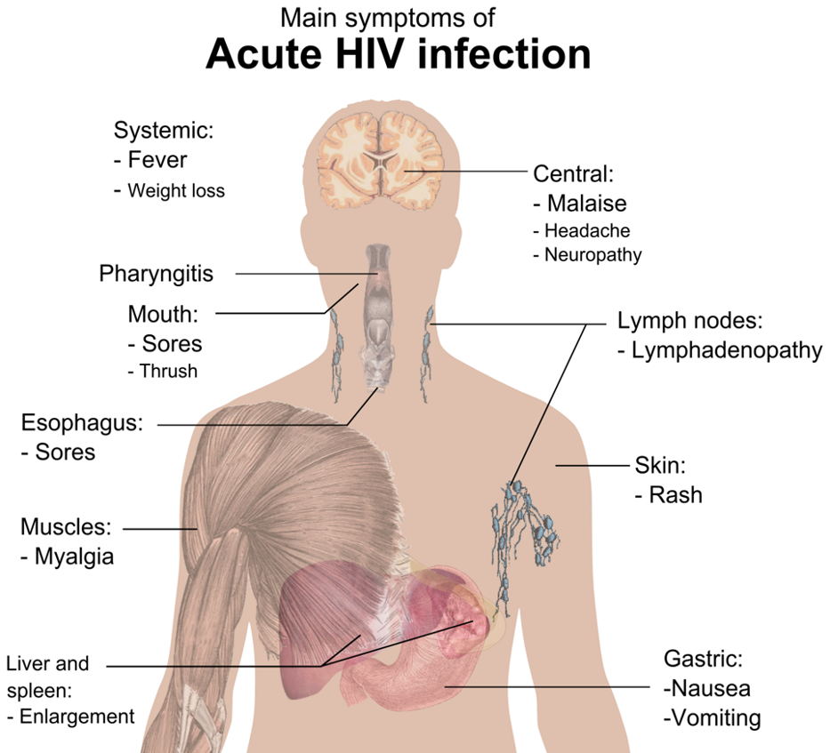
Step 4: Establish Eligibility for CAB-LA
No evidence of AHI​
  Assess for flu-like symptoms within the last 4 weeks.
Weight >35 kg
  Weigh the client if needed
Not taking contraindicated medications
  Ask about seizure or TB medications
Not pregnant or breastfeeding
  Pregnancy testing or contraception may be required (per national guidelines)
No buttock implants or fillers
No history of allergic or hypersensitivity reactions to CAB
Willingness to use CAB-LA as prescribed
See Module 1 for more information about AHI screening.​

Slide 90
Review: Contraindicated Medications with CAB-LA​
Anticonvulsants:​
  Carbamazepine​
  Oxcarbazepine​
  Phenobarbital​
  Phenytoin ​
Anti-mycobacterial/TB medications:​
  Rifampin/rifampicin​
  Rifapentine​
  Rifabutin​
These drugs should not be co-administered with CAB-LA, and clients using them should select a different PrEP method or HIV prevention strategy. ​

Slide 91
Case Scenario​
Esther's pregnancy test today is negative, she is not taking any contraindicated medications, and has no history of adverse reactions to any drugs. She weighs 65 kg and has no implants. She understands the schedule for CAB-LA and is willing to attend all visits.
You find her to be eligible for CAB-LA.
How would you initiate Esther on CAB-LA today?
Notes:
Facilitator guidance:
Read the scenario and question on the slide asking participants, "How would you initiate Esther on CAB-LA today?" [Answer: Provide the following to initiate Esther on CAB-LA today: Counseling on adherence, risk reduction, side effects and AHI symptoms; STI screening and management; Administer injection and schedule follow-up appointment]
Ask participants to raise hands and share their answers.
Provide the answer and allow time for follow up question and discussion as needed.

Slide 92
Suggested Clinical Pathway: CAB-LA PrEP Initiation
1
2
3
4
5
Confirm HIV Negative Status​
Screen for Substantial Risk for HIV ​
Informed Choice
PrEP Counseling​
Establish Eligibility for CAB-LA
Initiate PrEP​
Perform rapid HIV test or other HIV test per national guidelines Link people found to be living with HIV to care and treatment​
Member of a population eligible for PrEP according to national guidelines
Educate about available PrEP options Shared decision making to start CAB-LA
No evidence of AHI Willingness to use CAB-LA as prescribed No contraindications to receiving CAB-LA
Counseling on adherence, risk reduction, side effects and AHI symptoms STI screening and management Administer injection and schedule follow-up appointment
See Module 6 for more information about informed choice counseling​

Slide 93
Step 5: Initiate CAB-LA PrEP
Provide counseling on the importance of adherence to appointments, risk reduction and AHI symptoms
Provide counseling on side effects and side effect management
Screen for STIs
  Consider HBV, HCV, and RPR testing if available
Administer the first CAB-LA injection
Schedule a follow-up appointment for the second loading dose in 4 weeks (range 3 to 5 weeks)

Slide 94
QUESTION
What do you need to think about when administering an injection?
Notes:
Facilitator guidance:
Read the question on the slide.
Prompt participants by asking, “In your experience, what are some key things to think about when administering an injection?”
Ask participants to raise their hands to answer the question.
Take a few volunteer responses.
Reveal the answer on the following slide.
Allow time for follow-up discussion as needed.

Slide 95
ANSWER
Considerations when administering an injection include:
Ensuring adequate privacy
Preparing the injection
Knowing where to inject the medication into the body
Following proper IPC procedures
Notes:
Facilitator guidance:
Reveal the answer on the slide.
Allow time for questions and follow-up discussion as needed.
Continue to the following slides for a detailed description of how to administer CAB-LA injections

Slide 96
Preparation to Inject
Ensure the injection is administered in a private setting.
Let the client know what to expect with the injection and allow enough time to address their questions.
The injection requires a 23-gauge, 1.5-inch (3.8 cm) needle, although a client’s build and body mass index (BMI)* should be considered to select an appropriate needle length.
  A 2-inch (5 cm) needle is recommended for clients with a BMI ≥30.
  A 1.5-inch (3.8 cm) needle is recommended for clients with BMI <30.
*BMI= kg/m² where kg is a person’s weight in kilograms and m² is their height in meters squared.

Slide 97
Preparation to Inject (continued)
The medication vial should be brought to room temperature before administering the injection, but make sure the vial does not get above 30°C.
  After removing the vial from the refrigerator, let it sit for at least 15 minutes to reach room temperature.
  Do not use any heating methods other than warming with hands.
  Vials may sit at room temperature for a maximum of 6 hours.
It is best to inject room temperature CAB-LA as soon as possible after drawing it up. However, CAB-LA can remain in the syringe for up to 2 hours before injecting.
  The filled syringe should not be placed in the refrigerator.
  If 2 hours are exceeded, the filled syringe and needle must be discarded.

Slide 98
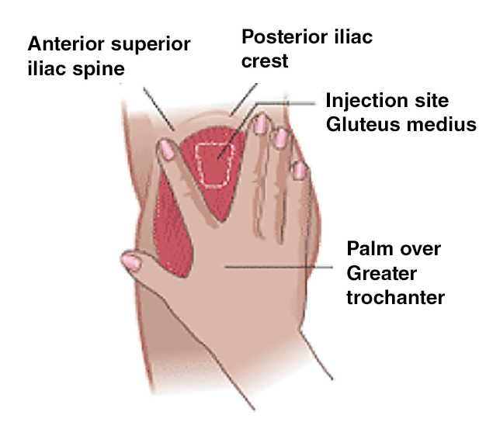
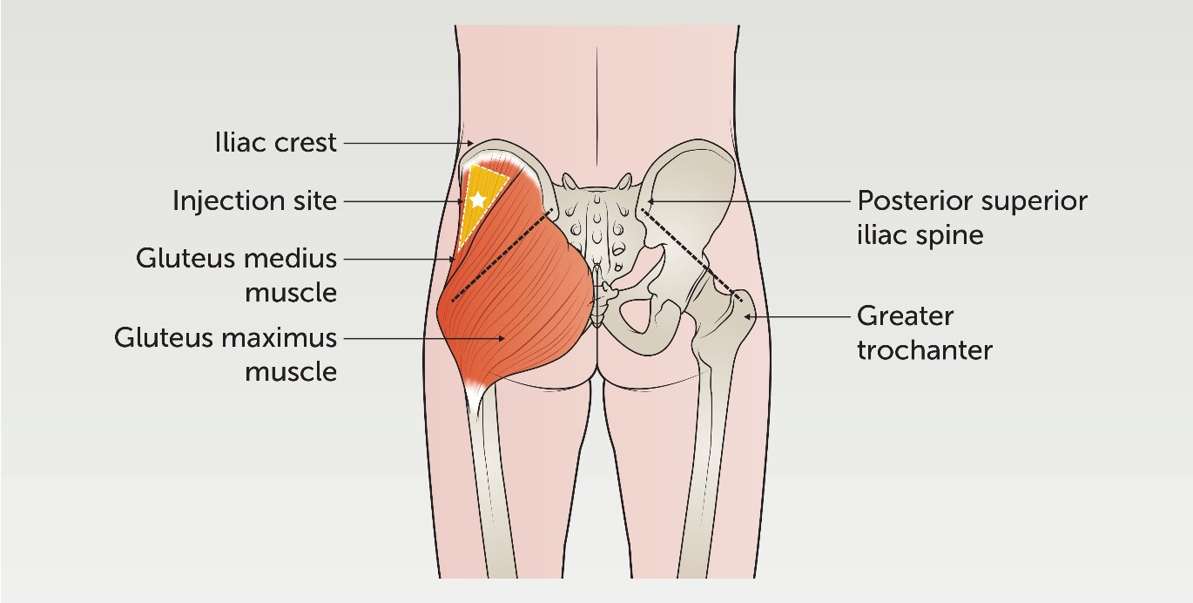
CAB-LA Injection Administration
Ventrogluteal site
The ventrogluteal approach into the gluteus medius muscle is recommended because it is located away from major nerves and blood vessels.
A dorsogluteal approach (upper outer quadrant) into the gluteus medius muscle is acceptable, if preferred by the healthcare provider.
The injection should not be administered in any other site, as it is not known if CAB-LA will be safe or effective in any other part of the body.
Source: springer.com
Dorsogluteal site
Source: rch.org.au

Slide 99
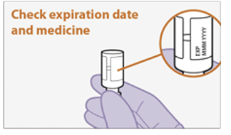
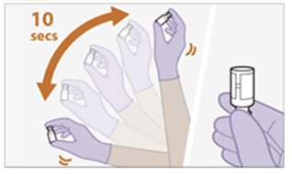
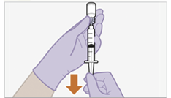
Injection Steps: Preparing to Inject
1
1
Inspect the vial.
Check expiration date
Look for any foreign matter
Ensure the vial is at room temperature
Shake the vial vigorously for 10 seconds.
Slowly draw up the medication.
Use a vial adaptor or general-use syringe with a hypodermic needle.
Note:
Once CAB-LA has been drawn up into a syringe, it must be administered within 2 HOURS.
2
2
3
3
Do not inject if medication is expired or appears contaminated
Source: ViiV Healthcare Package Insert

Slide 100
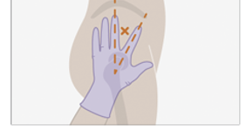
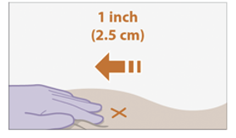
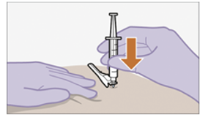
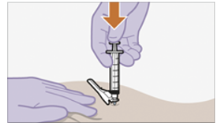
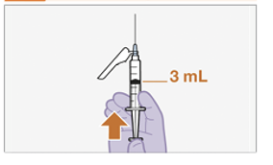
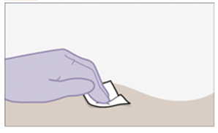
Injection Steps: Administering the Injection
4
6
Prepare the injection site
Identify the injection site and clean it with an alcohol wipe.
Inject using the Z-track injection method
Pull skin back 2.5 cm (1 inch)
Insert the needle at a 90-angle to the skin
Press the plunger all the way down
Withdraw the needle, then release the stretched skin immediately
5
7
Prepare the dose
Hold the needle upright and press the plunger to the 3mL mark on the syringe, removing extra liquid and any air bubbles.
Assess the injection site
Apply pressure to the site with a sterile gauze pad. Cover with a band aid if bleeding occurs
Source: ViiV Healthcare Package Insert

Slide 101
Ensuring Injection Safety
A safe injection is one that:
  Does not harm the recipient
  Does not expose the provider to avoidable risk
  Does not result in any waste that is dangerous for other people
General safety practices include:
  Perform good hand hygiene before and after the procedure
  Use single-use gloves
  Prepare and disinfect the skin
  Use a sterile needle, syringe and gauze
  Discard the used needle and syringe immediately into a container for sharps
Providers should ensure they are following local health and safety regulations for administering IM injections
WHO, 2010

Slide 102
QUESTION
What information would a client need after receiving the injection?
Notes:
Facilitator guidance:
Read the question on the slide.
Prompt participants by asking, “Based on what you have learnt about CAB-LA, what would be important for clients to know before they leave?"
Ask participants to raise their hands to answer the question.
Take a few volunteer responses.
Reveal the answer on the following slide.
Allow time for follow-up discussion as needed.

Slide 103
ANSWER
How to manage ISRs
How to manage other common side effects
Education on signs and symptoms warranting urgent evaluation
Next appointment date for follow-up injections
Notes:
Facilitator guidance:
Reveal the answer on the slide.
Allow time for questions and follow-up discussion as needed.
Continue to the following slides for a detailed description of what to do after the injection is administered.

Slide 104
Managing Injection Site Reactions (ISRs)
It is important to counsel clients to anticipate possible ISRs and provide reassurance that the symptoms will usually improve on their own within 2-3 days.
Measures to manage symptoms associated with ISRs include:
  Over-the-counter pain medication like acetaminophen or ibuprofen within a couple of hours before or after the injection, continued as needed for 2-3 days
  Warm compress or heating pad on injection site for 15-20 minutes after the injection (e.g., after arriving back home)
It also important to counsel clients that these reactions become less common and less severe over time with subsequent injections.
Counseling in advance of ISRs can help to avoid surprises that might result in a client deciding to discontinue CAB-LA prematurely.

Slide 105
Managing Other Common Side Effects
It is also important to counsel clients on other potential side effects, including headache, dizziness, nausea, diarrhea, fever and fatigue.
Reassure them that these side effects are normal, usually mild and will improve with time.
If symptoms are moderate or bothersome, they can be managed with medication.
  E.g., over-the-counter pain medication for headache, anti-emetic for nausea, anti-diarrheal for diarrhea
If symptoms are severe, counsel them to return to be evaluated for other causes.
Clients who are considering stopping CAB-LA because of side effects should consult with a provider first.

Slide 106
Counsel on Signs and Symptoms Warranting Urgent Evaluation
While very rare, clients should also be counseled on signs and symptoms that suggest an adverse reaction to CAB and warrant urgent evaluation by a medical provider. Clients with these signs and symptoms should return for assessment immediately, and not wait until their next scheduled visit to report them.
Concern | Signs and Symptoms​
Hypersensitivity reaction | Severe generalized rash Blisters, including sores in the mouth Fever Shortness of breath
Infection at the injection site | Severe pain and swelling at the injection site Discharge or abscess formation at the injection site
Liver dysfunction | Jaundice (yellowing of the skin or eyes) Persistent nausea/vomiting Abdominal pain in the right upper quadrant Darker urine or lighter stool color
Depression | New onset or worsening depressive symptoms, such as feeling sad or hopeless Suicidal ideation

Slide 107
Schedule Next Appointment
After the first injection has been administered, schedule the next appointment for the second loading dose in a month’s time, with an allowable range of 3 to 5 weeks.
To help clients remember their appointments, they can set a consistent date to be their ‘Target Injection Date’.
  Clients may pick a day within their window period that is easy to remember and plan to adhere to scheduled appointments for that date (e.g., first day of the month, last day of the month, their birthday day).
Other strategies to help clients remember their appointment include:
  Set a calendar reminder on their phone
  Obtain accurate contact information to provide appointment reminders via text message or phone call
  Provide appointment reminder cards or calendars for clients to take home

Slide 108

Case Scenario​
Thomas received his first injection of CAB-LA yesterday and returns to the clinic with pain and redness at the injection site.
How would you manage his ISR?
Notes:
Facilitator guidance:
Explain to participants that a case scenario is provided to apply their knowledge of CAB-LA injection.
Read the scenario and question on the slide asking participants, "How would you manage Thomas's injection site reaction (ISR)?"
Ask participants to raise hands and share their answers.
Continue to the following slide to provide the answer after receiving inputs from participants.

Slide 109
Case Scenario​
You assess the injection site, looking for signs of infection (swelling, fluctuance, drainage, warmth) and assess his level of discomfort.
The injection site is red, but you do not see any evidence of an infection. He reports moderate pain that is bothering him during the day.
How would you counsel Thomas?
Notes:
Facilitator guidance:
Read the scenario and question on the slide asking participants, "How would you counsel Thomas?"
Ask participants to raise hands and share their answers.
Continue to the following slide to provide the answer after receiving inputs from participants.

Slide 110
Case Scenario​
You recommend he take an over-the-counter pain killer, such as ibuprofen.
You reassure him that this is a common occurrence, and that the reaction will improve within a couple of days.
You also reassure him that reactions become less frequent with subsequent injections.
For future injections, you advise him to consider taking a pain medication before the injection and to use a warm compress for 15-20 minutes after the injection.
Notes:
Facilitator guidance:
Read the answer on the slide.
Ask participants if they have any questions or comments for further discussion of this case scenario.

Slide 111
How confident do you feel to initiate a client on CAB-LA?
Do you have any questions about initiating clients on CAB-LA?
DISCUSSION​
Notes:
Facilitator guidance:
Time: 10 minutes.
Encourage everyone to participate and call on everyone who raises a hand.
Prompt participants with questions such as, "On a scale of 1-5, how confident do you feel to initiate a client on CAB-LA?, with 1 being not at all confident, and 5 being completely confident. What do you feel confident about in administering CAB-LA? What do you find challenging about administering CAB-LA? Do you have any further questions for discussion or clarification?"
Wrap up the discussion by repeating and summarizing main points.

Slide 112
4.4 CAB-LA Follow-up Injection Visits

Slide 113
CAB-LA Follow-Up Visits
Clients on CAB-LA require regular visits with a healthcare provider.
The CAB-LA injection schedule is:
Second loading dose injection a month after the initial injection
Every 2 months thereafter
HIV testing must be conducted before each injection, according to the national algorithm.
Outside of regular monitoring visits, clients should consult their providers if they experience signs or symptoms of adverse events, persistent side effects, or signs or symptoms of AHI.
Month 1
LOADING
DOSES
Month 2
Month 4
CONTINUATION
Month 6
Month 8

Slide 114


Case Scenario​
APRIL
Thomas received his third injection on the 5th of April, which was a Wednesday.
When should he schedule his fourth injection?
MAY
JUNE
Notes:
Facilitator Guidance:
Read the case scenario on the following slides to test participants knowledge of scheduling CAB-LA follow-up injection visits.
All of the answers are provided on the slides.
Allow participants to ask questions and provide clarification as needed.

Slide 115
Case Scenario​
APRIL
Thomas’ Target Injection Date would be 8 weeks from his last injection, which is Wednesday, May 31st.
However, Thomas thinks it will be difficult for him to come in on Wednesdays, as he is starting a new job.
He is also finding it hard to remember what date he is scheduled to come in.
What would you say to him?
MAY
JUNE

Slide 116
Case Scenario​
APRIL
You tell Thomas that he can pick a day that works for his schedule anytime in his window period, which is between May 24th and June 7th.
You also tell him, that he could pick an easy-to-remember day of the month within his window period and aim to return on that day for future visits.
MAY
JUNE

Slide 117
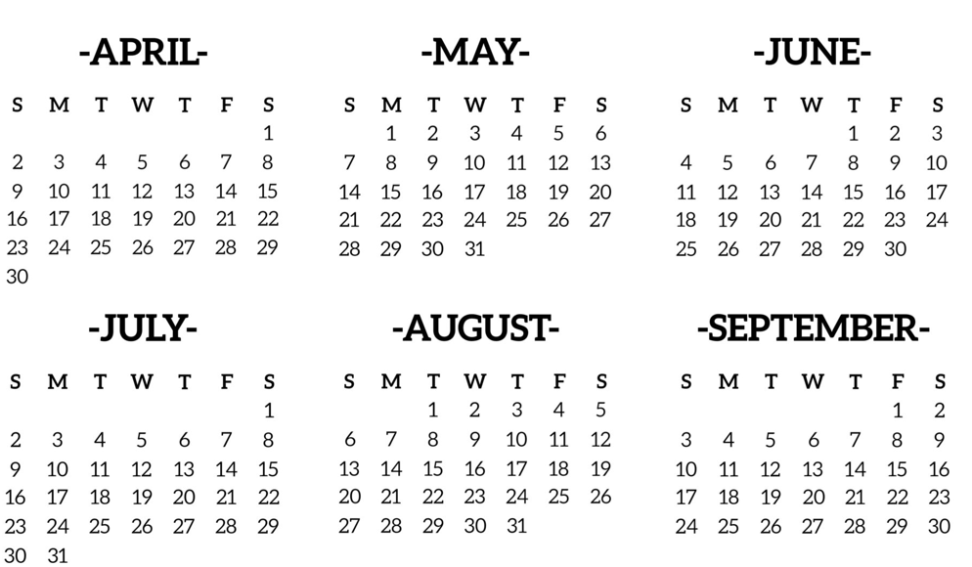
Case Scenario​
APRIL
MAY
Thomas selects Thursday, June 1st and comes in for his fourth shot on that day.
He finds the first day of the month easy to remember, so he schedules his next visit for August 1st.
JUNE
JULY
AUGUST
SEPTEMBER

Slide 118
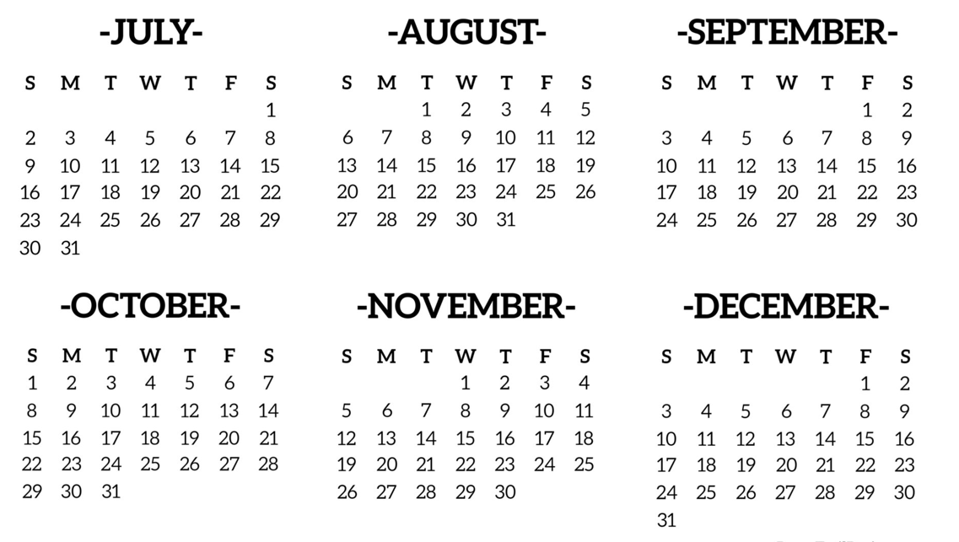
Case Scenario​
JULY
AUGUST
After his visit on August 1st, he would like to return on October 1st for his next injection.
However, you note on the calendar this is a Sunday and the clinic will not be open.
What can Thomas do?
SEPTEMBER
OCTOBER
NOVEMBER
DECEMBER

Slide 119
Case Scenario​
JULY
AUGUST
Thomas will have to come on another day during his window period.
His Target Injection Date is September 26th, so his window period is from September 19th to October 3rd.
SEPTEMBER
OCTOBER
NOVEMBER
DECEMBER

Slide 120
Case Scenario​
JULY
AUGUST
Thomas decides to come in on Friday the 29th of September this time.
He schedules his next injection for December 1st.
SEPTEMBER
OCTOBER
NOVEMBER
DECEMBER

Slide 121
CAB-LA Follow-Up Injection Visit Procedures
Intervention​ | Schedule Following CAB-LA Initiation​
Confirmation of HIV-negative status | Prior to every injection
Review the client’s HIV risk and desire to continue CAB-LA | Every visit
Brief medical history | Every visit
Address side effects | Every visit
Pregnancy testing (women only) | According to national guidelines
Administer CAB-LA injection | Every visit
Confirm next appointment date | Every visit
Counsel clients on importance of attending scheduled visits, CAB-LA discontinuation processes, and medication-related signs and symptoms warranting urgent evaluation | Every visit
Provide STI screening, condoms and contraception | Every visit, and as needed

Slide 122
Follow-up HIV Testing with CAB-LA
HIV testing is needed to inform decisions on whether to continue or discontinue PrEP.
Follow-up HIV testing should be done using the national algorithm.
Follow-up HIV testing is recommended prior to each injection: 1 month after starting CAB-LA, every 2 months thereafter.
Serological tests are limited during AHI in the ‘window’ period from HIV infection to detection of antibodies.
Exposure to ARVs such as CAB can decrease sensitivity of serological tests.
  HIV self-testing is not adequate to confirm HIV-negative status for CAB-LA clients
Do not administer CAB-LA if a client tests positive for HIV.

Slide 123
Brief Medical History
Obtain a brief medical history, focusing on any changes since the last visit.
This should include assessment of:
  Any changes to medications, specifically starting any new medications that should not be used with CAB, such as those for seizure or TB.
  Side effects experienced since the last injection, including ISR and evidence of adverse reactions.
  Pregnancy and breastfeeding status, as well as any pregnancy intentions (women only).

Slide 124
CAB-LA Follow-Up Counseling
What to discuss during follow-up visits
Assessment of continued risk for HIV and need for PrEP, e.g., sexual and drug use behaviors
Non-PrEP sexual health protection strategies, e.g., condom use, STI screening
Assessment of understanding of CAB-LA dosing schedule and the importance of adhering to appointments
Common side effects and management
Signs and symptoms of adverse reactions warranting return for urgent evaluation
Any challenges with CAB-LA use and intention to remain on CAB-LA
Explore the need for bridging with oral PrEP if client anticipates missing an injection
Alternative PrEP products and process for discontinuing CAB-LA, if applicable

Slide 125
QUESTION
What could make a provider decide NOT to proceed with a CAB-LA injection?
Notes:
Facilitator guidance:
Read the question on the slide.
Prompt participants by asking, “Based on what you have learnt about CAB-LA, what are some reasons a you may not continue with CAB-LA injections?"
Ask participants to raise their hands to answer the question.
Take a few volunteer responses.
Reveal the answer on the following slide.
Allow time for follow-up discussion as needed.

Slide 126
ANSWER
If a client:
Reports signs and symptoms of adverse reactions
Is no longer at risk for HIV
Does not want to continue with CAB-LA as PrEP
Started a new medication that is contraindicated with CAB-LA
Becomes pregnant (per national guidelines)
Notes:
Facilitator guidance:
Reveal the answer on the slide.
Allow time for questions and follow-up discussion as needed.
Continue to the following slides for a detailed description of adverse reactions and contraindications to CAB-LA use

Slide 127
Side Effect Evaluation and Management
Ask the client if they experienced any side effects after their last injection.
For any side effects reported, assess the severity and whether the client is still experiencing them.
If mild to moderate side effects are persistent, consider management of symptoms.
Side Effect | Management
ISR, including redness, pain, and swelling at the injection site | Over-the-counter pain medication (e.g., acetaminophen, ibuprofen) within a couple of hours before or after the injection and continue as needed for 2-3 days. Warm compress or heating pad on injection site for 15-20 minutes after the injection (e.g., after arriving back home)
Headache | Over-the-counter pain medication
Nausea | Anti-emetic medication
Diarrhea | Anti-diarrheal medication
Fever | Over-the-counter antipyretic medication
If a client reports severe ongoing side effects, refer them for an evaluation of other causes

Slide 128
Adverse Reactions Warranting Discontinuation of CAB-LA
While adverse reactions to CAB-LA were very rare (<1%) in the clinical trials, it is important to assess for any related signs or symptoms.
Adverse reactions of concern are:
  Hepatoxicity/liver dysfunction
  Hypersensitivity reaction
  New or worsening depression (see next slide)
If hepatoxicity or a hypersensitivity reaction is suspected, do not administer CAB-LA and offer other HIV prevention options, including oral PrEP.

Slide 129
Evaluating Depression
Depression is a common mental health condition, so it is important to evaluate any reported symptoms to assess:
  If symptoms are related to CAB-LA use, i.e., did symptoms begin with CAB-LA initiation or significantly worsen after initiation?
  Do the symptoms warrant discontinuing CAB-LA?
Evaluate for depression, depressed mood and suicidal ideation.
  Symptoms may include feelings of sadness, hopelessness, irritability, loss of interest in activities, sleep disturbances, fatigue, changes in appetite, feelings of guilt and thoughts of suicide or suicide attempts.
  Programs may choose to do formal screening for depression, using validated screening tools e.g., Patient Health Questionnaire-2 (PHQ-2) .
  Support all clients reporting these symptoms with appropriate mental health services or referrals

Slide 130
Evaluating Depression (continued)
Evaluate timing of symptoms
  Symptoms that began prior to CAB-LA use are less likely to be related
Evaluate for other factors that can contribute to depression, including:
  Personal stressors (e.g., bereavement, financial stress, family stress)
  Substance use
If new or worsening symptoms are thought to be due to CAB-LA use (i.e., timing aligns, no other contributing factors):
  Weigh the severity of depressive symptoms against the level of HIV risk and consider whether other forms of PrEP would be preferable.
  If a client reports severe depressive symptoms (e.g., suicidal ideation or attempts), pause CAB-LA injections and refer them for an evaluation. Offer them other forms of HIV prevention, including oral PrEP, if eligible.

Slide 131
Other Medical Contraindications to Continuing CAB-LA
Beyond adverse reactions, there may be other reasons a client should not continue CAB-LA:
If they started a new medication that interacts with CAB-LA:
  Anticonvulsants: carbamazepine, oxcarbazepine, phenobarbital, phenytoin
  Anti-mycobacterial/anti-TB medications: rifampin/rifampicin, rifapentine, rifabutin
If they are pregnant or breastfeeding, or intend to become pregnant (based on national guidelines)
  Pregnancy testing and/or contraception may be a requirement for continuing CAB-LA for women of child-bearing potential.
These clients should select a different PrEP method or HIV prevention strategy.

Slide 132
Break into groups of 3. Take turns role-playing for CAB-LA follow-up counseling.
CAB-LA clinical provider: Deliver key counseling messages for following up with a client on CAB-LA.
CAB-LA user: Pretend to be a client who is at their second visit for CAB-LA. Talk about or share any side effects you have been experiencing, risk behaviors, intentions to stay on CAB-LA, or questions about other PrEP methods.
Observer: Silently observe the interaction and notice if the provider is delivering all the key counseling messages. Did they miss anything?
Discuss among you. What worked well? What could be improved? Were there any key counseling messages that were missed or should be added?
ROLE-PLAY AND DISCUSSION
Notes:
Facilitator guidance:
Time: 40 minutes
Explain that participants will now work in small groups to role-play CAB-LA PrEP follow-up counseling.
Divide participants into groups of 3 participants each.
Define participant roles. One participant will role-play as the PrEP clinical provider. One participant will role-play as the PrEP user. One participant will observe. Take turns to explore each of the 3 roles.
The participant in the role of the PrEP clinical provider will deliver key counseling messages for follow-up of a candidate on CAB-LA . Allow this participant to reference the previous slides.
The participant in the role of the PrEP user will pretend to be taking CAB-LA and should talk about or share any side effects you have been experiencing, risk behaviors, intentions to stay on CAB-LA, or questions about other PrEP methods.
The participant in the role of the observer should silently observe the interaction between the PrEP clinical provider and PrEP user and notice if the provider is delivering the key counseling messages or if they missed anything. Allow this participant to reference the previous slides as needed.
Allow 5 minutes for the role-play.
Discuss among participants in the small group. What worked well? What could be improved? Were there any key counseling messages that were missed or should be added?
Allow 5 minutes for discussion.
Switch roles until each participant has played in each of the 3 roles.
Return to the larger group and discuss what you experienced and learned from the role-play. Allow 10 minutes for large group discussion

Slide 133
Planning for Missed Injections
There may be situations when clients are unable to make their injection appointment, e.g., they are traveling away from the clinic.
In this scenario the client can use oral PrEP with TDF as a ‘bridge’ until their next injection.
  Clients should alert the clinic in advance of any anticipated missed injections to ensure they receive a supply of oral PrEP before they are away.
Oral PrEP cannot be used as a bridge between the first and second injection. Clients should not initiate CAB-LA if they anticipate not being able to make it back for the second loading dose injection after a month.
Note: Oral PrEP as a bridge should only be used rarely, with special circumstances. Clients who require bridging regularly may not be good candidates for CAB-LA and should consider other HIV prevention and PrEP options.

Slide 134
Bridging Considerations
Oral PrEP should be started 8 to 9 weeks after the last injection.
Injections can be restarted the day oral PrEP is stopped or within 3 days
Injection schedules after a bridge are the same as with other clients who miss injections (see Section 4.5)
Ask clients how long they intend to postpone their injection and ensure they have enough pills to cover this time period.

Slide 135
CAB-LA Discontinuation
Starting PrEP does not mean staying on PrEP for life. A variety of things may prompt a person to stop PrEP, including:
A partner with HIV achieves viral suppression on ART
A relationship with a HIV-negative partner becomes mutually monogamous
Sex work or injection drug use stops
Other risks change
Preferences change
Clients who decide to stop CAB-LA should:
Contact their healthcare provider and attend a discontinuation visit
Be counseled on the risk of INSTI resistance if they acquire HIV during the next 12 months and consider whether an alternative PrEP option should be used

Slide 136
Alternative PrEP Options
Based on availability and eligibility, it may be appropriate to discuss other PrEP options.​
Consider offering other PrEP options based on any challenges or preferences expressed​
Challenges | Alternative PrEP Option​
Struggle to attend injection appointments as scheduled | Oral daily PrEP Oral ED-PrEP (if eligible) DVR (if eligible)
Injection side effects | Oral daily PrEP Oral ED-PrEP (if eligible) DVR (if eligible)
Desire to stop and start PrEP more easily | Oral daily PrEP Oral ED-PrEP (if eligible)
For more information on PrEP options see Module 1 and Module 6​

Slide 137
AHI Symptoms and Indeterminate HIV Test Results
CAB-LA reduces a person’s antibody response to the HIV virus, which may result in delayed seroconversion and antibody-based HIV tests, such as rapid diagnostic tests, can be falsely negative.
If AHI is strongly suspected or if the HIV testing algorithm gives indeterminant or discordant results, obtain an antigen-based test or NAT, if possible, to rule out HIV infection.
If no antigen-based test or NAT are available, follow national guidelines for management.

Slide 138
Managing Seroconversion
If a person using CAB-LA tests positive for HIV, they should not receive any further injections, and they should be referred for prompt initiation of HIV treatment.
Transition from PrEP to HIV treatment without a gap avoids the risk elevated viral load, damage to the immune system, and secondary transmission.
Note: CAB is an INSTI, which is the same ARV drug class as DTG.
If someone on CAB acquires HIV, there is a chance that DTG may be less effective as treatment.
The treatment provider and other relevant health authorities should be made aware that the person was on CAB and manage their HIV treatment according to national guidance. Prior exposure to CAB should also be documented clearly in the client’s medical record.

Slide 139
Administer the Injection and Schedule Next Appointment
If the client is eligible and willing to receive the next injection, administer it as described in Section 4.3.
  In the process, inspect the prior injection site to evaluate for signs of infection.
  If there are signs of infection refer or manage accordingly. Do not inject in an area that may be infected.
  Consider administering the injection on alternating buttock sides for the client’s comfort.
Schedule a follow-up appointment in 7 to 9 weeks.
Counsel and support the client to attend the next appointment.

Slide 140
How confident do you feel to follow-up with a client on CAB-LA?
Do you have any questions about following up with clients on CAB-LA?
DISCUSSION​
Notes:
Facilitator guidance:
Time: 10 minutes.
Encourage everyone to participate and call on everyone who raises a hand.
Prompt participants with questions such as, "On a scale of 1-5, how confident do you feel to follow-up a client on CAB-LA?, with 1 being not at all confident, and 5 being completely confident. What do you feel confident about and what do you find challenging? Do you have any further questions for discussion or clarification?"
Wrap up the discussion by repeating and summarizing main points.

Slide 141
4.5 Missed Visits and Resuming/Restarting CAB-LA

Slide 142
Type of Missed Appointments
A client is considered to have missed their appointment if they return >7 days after their Target Injection Date.
  The Target Injection Date for the second loading dose is 4 weeks after the first injection.
  The Target Injection Date for all other injections is 8 weeks after the prior injection.
How clients returning after a missed appointment are managed depends on the time that has passed since their last Target Injection Date.
  Categorized as ≤4 weeks or >4 weeks since their last Target Injection Date
  This will determine if they can RESUME injections or if they need to RESTART with loading doses
It is also important to assess whether this was a planned or unplanned missed appointment. This helps provide information about whether a client is a good candidate to continue CAB-LA.

Slide 143
Assessment of Returning Clients
For all returning clients:
Determine the length of time since their last Target Injection Date
Assess their reason for disengagement from CAB-LA services and for returning now
Assess HIV prevention measures taken during their time away, including any bridging with oral PrEP
Assess for signs and symptoms of AHI
Asses ongoing need for HIV prevention
Assess understanding of visit schedules and CAB-LA discontinuation processes
Discuss whether CAB-LA is still a good PrEP option for them

Slide 144
Considerations for Whether to Resume/Restart CAB-LA
Type of returning client | Assessment
Unplanned missed appointment | Reasons for missing their appointment Pattern or history of missing appointments Desire to remain on CAB-LA
Planned missed appointment | Use of oral PrEP bridge, including length of time bridging and if used correctly i.e., started 8-9 weeks after last injection, daily adherence, continued until next injection Pattern or history of missing appointments (planned or unplanned) Desire to remain on CAB-LA
Return after discontinuing CAB-LA | Reasons for discontinuing CAB-LA Attendance of discontinuation and post-discontinuation visits Reasons for returning and desire to restart CAB-LA Prior experience with CAB-LA and adherence to injection appointments

Slide 145
Decision to Resume/Restart CAB-LA
A client may not be a good candidate to resume/restart CAB-LA if:
They frequently miss appointments, whether intentionally or not
They anticipate missing appointments in the future (e.g., will be leaving the area)
They struggled to use an oral PrEP bridge correctly or used bridging for >3 months
They suddenly discontinued CAB-LA, and did not attend a discontinuation visit
They did not regularly attend CAB-LA post-discontinuation visits (see section 4.6)
They are not at ongoing risk of HIV infection
They have no desire to continue CAB-LA (e.g., due to side effects, schedule, personal preference)
If you determine a client is not a good candidate for CAB-LA, do not resume/restart injections and instead offer other effective HIV prevention options, including oral PrEP if appropriate.

Slide 146
Resuming vs. Restarting CAB-LA
If you have determined that a client remains a good candidate for CAB-LA:
Proceed with other follow-up visit procedures (see Section 4.4)
Determine if they need to RESUME injections or RESTART injections (see next slide)
Note:
The injection schedule is the same whether or not they used oral PrEP as a bridge
Oral PrEP can be stopped from 3 days before the injection to the day of the injection

Slide 147
Injection Schedule After Missed Visits
The Target Injection Date is based on the date of the last injection received and what type of injection it was.
Target Injection Date
= 4 weeks after the first injection
= 8 weeks after all other injections
Time since Target Injection Date?
≤4 weeks
>4 weeks
RESUME with next injection
RESTART with two loading dose injections 1 month apart
Continue with injections every 2 months
After loading doses continue with injections every 2 months

Slide 148
Resuming/Restarting Visits After Missed Injections​
The Target Injection Date is based on the date of the last injection received and what type of injection it was.
Target Injection Date
= 4 weeks after the first injection
= 8 weeks after all other injections
Target
Injection Date
When the client returns
Week 1
Week 2
Week 3
Week 4
Week 5
Week 6
Within the widow period, continue with injections
RESUME
injections according
to schedule
RESTART
injections with
two loading doses
1 month apart

Slide 149

Case Scenario​
Floyd received his first CAB-LA injection seven weeks ago and returns to the clinic today after he missed his second loading dose injection appointment.
Can he receive his second injection today?
When should he receive the third injection?
Notes:
Facilitator Guidance:
Read the case scenarios and questions on the slide to test participants knowledge of resuming/restarting CAB-LA.
Ask participants to raise their hands to answer the questions on the slide.
Continue to the next slide to reveal the answer.
Allow participants to ask questions and provide clarification as needed.

Slide 150



Case Scenario​
Month 1
Initiation visit with first loading dose
1
Less than one month has passed since his Target Injection Date, so you can RESUME by proceeding with administering the second injection today and schedule the third injection for eight weeks later.
Month 2
Missed second loading dose Target Injection Date
X
Client presents here for second loading dose
2
Month 3
Last possible day for resuming with second loading dose (≤ 4 weeks since Target Injection Date)
Notes:
Facilitator guidance:
Read the answer on the slide.
Allow participants to ask questions for clarification as needed.

Slide 151

Case Scenario​
Amina received her first CAB-LA injection nine weeks ago and returns to the clinic today after she missed her second loading dose injection.
Can she receive her second loading dose injection today?
When should she receive subsequent injections?
Notes:
Facilitator Guidance:
Read the case scenarios and questions on the slide to test participants knowledge of resuming/restarting CAB-LA.
Ask participants to raise their hands to answer the questions on the slide.
Continue to the next slide to reveal the answer.
Allow participants to ask questions and provide clarification as needed.

Slide 152
Case Scenario​
Month 1
Initiation visit with first loading dose
1
More than one month has passed since her Target Injection Date, so you should RESTART CAB-LA with her first loading dose today, and her second loading dose in one month.
Month 2
Missed second loading dose Target Injection Date
X
Month 3
Last possible day for resuming with second loading dose (≤ 4 weeks since Target Injection Date)
2
Client presents here for second loading dose
Notes:
Facilitator guidance:
Read the answer on the slide.
Allow participants to ask questions for clarification as needed.

Slide 153
4.6 Discontinuation and Post-Discontinuation Monitoring Visits

Slide 154
Visit Schedule
Discontinuation visit
Should occur 8 weeks after the last injection (range 7-9 weeks)
Could be a planned discontinuation visit or a follow-up visit in which the decision is made not to continue with injections
Reinforce the need for effective HIV prevention and follow-up throughout the 12-month tail phase
Post-discontinuation visits
Should occur every 3 months after the discontinuation visit for 12 months (4 visits)
Reinforce the need for effective HIV prevention and to complete follow-up until the end of the 12-month tail phase

Slide 155
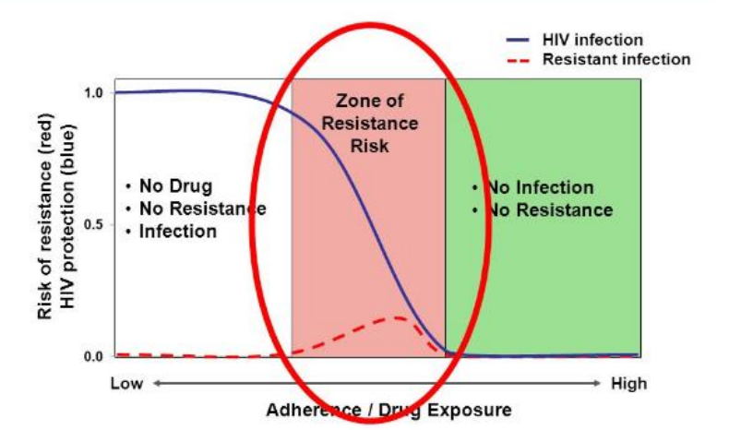
Importance of the Post-Discontinuation Tail Phase
After discontinuation, CAB levels slowly decrease during the ‘tail’.
At some point during the tail phase, CAB levels fall below a protective threshold, and the client is at risk of HIV acquisition.
Low levels of CAB may be sufficient to apply selective pressure for viral strains with mutations that confer resistance to CAB or other INSTIs.
Infection with INSTI-resistant virus may complicate HIV treatment, making effective HIV prevention and early detection important during the tail phase.
Source: CDC

Slide 156
Key Counseling Messages: Tail Phase
CAB-LA will remain in your body for 12 months. During the period after your last injection, the levels of CAB-LA in your body will slowly decrease. This is sometimes called the CAB-LA ‘tail’.
It is important to protect yourself from HIV during this time. If you get HIV during this time, it may be harder to detect and treat. It is important that you use other effective HIV prevention methods.
Continue to come to visits during this time. It is important that you attend visits to test for HIV every 3 months during this time. We can also support you to use effective HIV prevention methods.

Slide 157
CAB-LA Discontinuation and Post-discontinuation Visits
Discontinuation and Post-Discontinuation Visit Procedures
HIV testing
Address any lingering side effects
Counsel on need for HIV prevention during the ‘tail’ period and offer effective prevention services, including oral PrEP if eligible
Counsel on need to attend post-discontinuation visits for 12 months
Provide STI screening, condoms and contraception as needed
Assess pregnancy and breastfeeding status among women (per national guidelines)

Slide 158
Break into groups of 3. Take turns role-playing for CAB-LA PrEP discontinuation counseling
CAB-LA clinical provider: Deliver key counseling messages for discontinuing a client on CAB-LA.
CAB-LA user: Pretend to be a client who is considering stopping CAB-LA. Ask questions about the process for stopping and the next steps.
Observer: Silently observe the interaction and notice if the provider is delivering all of the key counseling messages. Did they miss anything?
Discuss among you. What worked well? What could be improved? Were there any key counseling messages that were missed or should be added?
ROLE-PLAY AND DISCUSSION
Notes:
Facilitator guidance:
Time: 40 minutes
Explain that participants will now work in small groups to role-play CAB-LA PrEP discontinuation counseling.
Divide participants into groups of 3 participants each.
Define participant roles. One participant will role-play as the PrEP clinical provider. One participant will role-play as the PrEP user. One participant will observe. Take turns to explore each of the 3 roles.
The participant in the role of the PrEP clinical provider will deliver key counseling messages for discontinuation of a client on CAB-LA. Allow this participant to reference the previous slide with key counseling messages.
The participant in the role of the PrEP user will pretend to be a client who is considering stopping CAB-LA. Ask questions about the process for stopping and the next steps.
The participant in the role of the observer should silently observe the interaction between the PrEP clinical provider and PrEP user and notice if the provider is delivering the key counseling messages or if they missed anything. Allow this participant to reference the previous slide with key counseling messages as needed.
Allow 5 minutes for the role-play.
Discuss among participants in the small group. What worked well? What could be improved? Were there any key counseling messages that were missed or should be added?
Allow 5 minutes for discussion.
Switch roles until each participant has played in each of the 3 roles.
Return to the larger group and discuss what you experienced and learned from the role-play. Allow 10 minutes for large group discussion

Slide 159
Summary

Slide 160
Module 4 Summary
CAB-LA is a form of long-acting PrEP administered as an IM injection.
CAB-LA is a highly efficacious form of PrEP if taken on schedule.
CAB-LA has several advantages as PrEP, including not having to remember pills and increased privacy, but may not be right for some individuals.
CAB-LA has a 12-month ‘tail’ that requires special considerations, including regular HIV testing and effective HIV prevention during this period.
Clients must be supported to make an informed choice to start CAB-LA.
ISRs are common after CAB-LA injections and clients should be counseled on how to manage them.
Clients on CAB-LA require ongoing monitoring and support.

Slide 161
Module 4 Learning Objectives
Review the learning objectives from this module. After completing Module 4, how confident do you feel to do the following?
Define injectable CAB-LA as PrEP
Explain the rationale for adding CAB-LA to the array of HIV prevention tools
Describe the evidence base for CAB-LA
Define the eligible and ineligible populations for CAB-LA
Guide clients to make an informed choice about using CAB-LA as PrEP
Describe advantages and disadvantages of CAB-LA
Counsel clients on how to adhere to requirements for CAB-LA
Conduct CAB-LA initiation
Effectively conduct monitoring visits for CAB-LA
Describe the process for resuming, restarting and discontinuing CAB-LA

Slide 162
Share your experience with this module.
What did you learn?
What did you find helpful?
What will you implement in your practice?
Do you have any questions?
DISCUSSION​
Notes:
Facilitator guidance:
• Time: 10 minutes
• Explain that participants who want to speak should raise their hands.
• Keep the discussion on target and moving along.
• Encourage everyone to participate and call on everyone who raises a hand.
• Ask questions to encourage more responses to a question—for example: “What else?” “What other ideas do you have?”
• Wrap up the discussion by repeating and summarizing main points.

Slide 163
CAB-LA Resources for Providers
World Health Organization. Guidelines on long-acting injectable cabotegravir for HIV prevention. Geneva: WHO; 2022
The Reaching Impact, Saturation, and Epidemic Control (RISE) project Provider Training Toolkit on use of CAB for PrEP, available at jhpiego.org/HIVPrEPToolkit
U.S. Centers for Disease Control and Prevention: A Clinical Practice Guideline for PrEP and Clinical Providers’ Supplement for PrEP
Drug manufacturer's website: apretude.com

Slide 164
Local CAB-LA Resources​
[Insert local CAB-LA resources, organizations, clinics, studies, etc.] ​

Slide 165
References
Ahluwalia AK, Inzaule S, Baggaley RC, et al. Characterization of dolutegravir drug resistance in persons diagnosed with HIV after exposure to long-acting injectable cabotegravir for preexposure prophylaxis. AIDS. 2022;36(13):1897.
Delany-Moretlwe S, Hughes JP, Bock P, et al. Cabotegravir for the prevention of HIV-1 in women: Results from HPTN 084, a phase 3, randomised clinical trial. Lancet. 2022;399(10337):1779-1789.
Landovitz RJ, Donnell D, Clement ME, et al. Cabotegravir for HIV prevention in cisgender men and transgender women. N Engl J Med. 2021;385(7):595-608.
World Health Organization. Guidelines on long-acting injectable cabotegravir for HIV prevention. Geneva; 2022. License: CC BY-NC-SA 3.0 IGO.
World Health Organization. WHO best practices for injections and related procedures toolkit. Geneva; 2010.

Slide 166

Thank You

Slide 167
Acknowledgements
This package is a product of the Clinical and Laboratory Unit of ICAP at Columbia University. The material was conceptualized, designed and developed by Cassia Wells, with support from Julie Franks and technical input from Ellen Morrison, Andrea Howard and Gillian Doherty. Formatting and graphic design was provided by the ICAP Communications Team.
Portions of this training updated and modified previous PrEP package material developed by ICAP at Columbia University in collaboration with the U.S. Centers for Disease Control and Prevention (CDC), with funding from the U.S. President’s Plan for AIDS Relief (PEPFAR) under the terms of cooperative agreement #U2GGH000994.
Some technical content in this module was informed by training developed by Jhpiego’s Reaching Impact, Saturation, and Epidemic Control (RISE) project, funded by the U.S. President’s Plan for AIDS Relief (PEPFAR) through the United States Agency for International Development (USAID), under the terms of the cooperative agreement 7200AA19CA00003.
Its contents are solely the responsibility of the authors and do not necessarily represent the views of the U.S. Government or other organizations.

