Slide 1

Module 4: Pre-test Information and
DBS Collection for Infant Virological Testing
Infant HIV Testing
Training Curriculum for Healthcare Providers

Slide 2

Session 4.1
Infant HIV Testing: Pre-test Information
Session Objective
Conduct the HIV pre-test information session for HIV-exposed infant testing

Slide 3
Routine HIV Testing
WHO recommends routine HIV testing for infants whose mothers are living with HIV
Like other diagnostic tests, routine HIV testing requires:
  Consent: testing must be voluntary
    Provide brief pre-test information to the caregiver
    Get verbal agreement for testing (written consent is not required)
  Opportunity to refuse testing:
    Inform caregiver of testing process and right to decline testing

Slide 4

Routine HIV Testing
Testing of infants may be conducted by healthcare providers—nurses, midwives, doctors, counsellors, social workers, and laboratorians—or lay providers who are trained and supervised
WHO recognizes the importance of task sharing with lay providers to support implementation of infant HIV testing
  Lay providers perform functions related to healthcare delivery
  Lay providers do not have a formal certificate or degree but are trained
  Lay providers relieve upper level healthcare providers of certain day-to-day activities

Slide 5
HIV Testing of HIV-exposed Infants: The Pre-test Session
Although PMTCT interventions are very effective, they do not eliminate the risk of HIV transmission to the infant
Routine HIV testing of HIV-exposed infants is necessary
Benefits of testing infants in the first 6 weeks of life:
  Provide reassurance to families, particularly if infant tests HIV-negative
  Identify infected infants early so that they can initiate ART early, thereby increasing chance of survival

Slide 6
HIV Testing of HIV-exposed Infants: The Pre-test Session
Pre-test information may be provided in a group setting and then continued with a one-to-one discussion between caregiver and provider
Healthcare provider is expected to use listening and learning skills, see Appendix 4A: Listening and Learning Skills Checklist
The key points and model scripts should be adapted to meet the client’s situation, based on:
  Type of test used
  Infant age
  Whether the test is an initial or follow-up test

Slide 7
HIV Testing of HIV-exposed Infants: The Pre-test Session
What do you say during the pre-test session to the caregiver of an HIV-exposed infant who is being tested for HIV at 4–6 weeks of age?

Slide 8
Pre-test Session, HIV-exposed Infant, NAT
Key point | Script/Key points NAT (0–18 months of age)
Assess the parent/caregiver’s and child’s knowledge of HIV and the diagnostic procedure. | Use a question and answer format to gauge level of understanding: What is HIV? How is HIV passed from mother to baby? How can mother-to-child HIV transmission be prevented? Emphasize the importance of the breastfeeding mother taking and adhering to her ART regimen.

Slide 9
Pre-test Session, HIV-exposed Infant, NAT
Key point | Script/Key points NAT (0–18 months of age)
HIV testing is routine for all HIV-exposed infants/benefit of testing | Even if you and the baby received medicine for PMTCT, there is still a small chance that he is HIV-infected Because of this small chance, we routinely test babies for HIV at this age If your baby is HIV-infected, the sooner we know the sooner we can start him on ART; if we can start ART before he gets sick he’ll stay healthier longer We will do a test today, and your baby should be re-tested at regular intervals until a final test after the end of breastfeeding

Slide 10
Pre-test Session, HIV-exposed Infant, NAT
Key point | Script/Key points NAT (0–18 months of age)
How the test will be conducted | We will take a few drops of blood by pricking the [heel, toe or finger based on age] The blood will be collected on a card that will be sent for testing Although we strongly recommend testing, you have the right to decline If the test result is not available same day: We will schedule you for an appointment to return for your result

Slide 11
Pre-test Session, HIV-exposed Infant, NAT
Key point | Script/Key points NAT (0–18 months of age)
Confidentiality | The test result and anything we discuss today is confidential/private and will not be shared with anyone else unless you give permission

Slide 12
Pre-test Session, HIV-exposed Infant, NAT
Key point | Script/Key points NAT (0–18 months of age)
Explanation of result. 5a. What a positive result means | If the baby’s test result indicates that he/she is HIV-positive, he will be started on ART right away ART will help him to stay healthy.
5b. What a negative result means | If the baby tests HIV-negative, then this is the first test in a series of tests to confirm that he doesn’t have HIV Adapt based on infant age: Your baby will also be tested at 9 months of age and 3 months after breastfeeding ends (or at 18 months if you stop breastfeeding early)

Slide 13
Pre-test Session, HIV-exposed Infant, NAT
Key point | Script/Key points NAT (0–18 months of age)
Return | POC testing: Your result will be ready in an hour If the test result is not available same day: You will need to return to the clinic in ___ weeks for the baby’s result. If the result comes back early, we may also contact you so that you can get the test result as soon as it is available. If you agree that we can contact you, we’d like to make sure that we have your correct phone number and address. [Confirm contact information]
Client questions | What questions do you have about HIV testing?

Slide 14
Child Health Card
Please refer to country Child Health Card/Booklet and/or mother’s health card and identify where to record information on the pre-test session

Slide 15
Exercise 1
Infant HIV testing pre-test information:
Role play

Slide 16
Session 4.2: Dried Blood Spot Collection, Drying, Packing and Shipment
Session Objectives
Understand the steps in collecting a blood sample using dried blood spot (DBS) procedure
Dry, pack and store DBS specimens to send to the laboratory
Distinguish between valid and invalid DBS samples
Record DBS results in the designated database or register/log and follow up on missing or delayed results

Slide 17
DBS Introduction
HIV infection in children under 18 months can be diagnosed with virological testing using NAT technologies. NAT can be conducted on:
  High throughput instruments:
    Operated by trained laboratorians
    Based in regional laboratories
    Use DBS specimens
  PoC/near PoC instruments:
    Alere™ q HIV-1/2 Detect uses drops of freshly collected blood samples
    Cepheid AB Xpert® HIV-1 Qual Assay can use either drops of freshly collected blood or DBS

Slide 18

DBS Technology
Widely used in US & Europe since the 1970s to screen newborns for genetic disorders
More recently, used to test samples for HIV using NAT and for viral load testing
Overview of procedure:
  Small drops of whole blood are taken from a heel, toe, or finger using a lancet
  Blood is collected on strips of special filter paper
  Paper is then dried, packaged, and sent to a lab for analysis
Advantages of DBS testing:
  Lower volume of blood required for testing ⇨ specimen collection is easier
  DBS specimens have longer lifespan, more stable ⇨ easier to store & transport to distant laboratories
  Because specimens are dried, they pose little biohazard risk ⇨ safer to handle

Slide 19

Healthcare Provider’s Responsibilities for DBS collection
Collect valid samples
Label the samples correctly
Dry, package and store samples appropriately until they are transported to the laboratory
Correctly complete all related documentation
The collection procedure you are about to learn is for DBS specimens that are sent to a laboratory for testing
POC testing follows different procedures depending on platform used
  Providers using POC testing should receive additional training on these methods

Slide 20
DBS Collection, Getting Started: Documentation
The laboratory requisition form, sent with samples to laboratory, typically includes:
    Child’s name
    Date of birth
    Mother’s name
    Child/patient identification number
    Name of clinical site
    Mame of provider requesting the test
    Information about where to send the results
    Date and time of specimen collection
  Complete for each specimen sent to the lab
A sample laboratory requisition form appears in Appendix 4B

Slide 21

DBS Collection, Getting Started: Documentation
Specimen delivery/transport checklist tracks quantity and quality of specimens along the chain of custody
Electronic (database) or paper-based register/log used for recording and tracking NAT specimens and results, for example:
  EID/NAT/DBS Specimen Tracking Register/Log or
  Baby Testing and Follow-up Register/Log
A sample specimen delivery/transport checklist appears in Appendix 4C

Slide 22
DBS Collection, Necessary Supplies
Supplies needed to collect a DBS specimen from an infant or child:
DBS cards
2mm lancets
Gloves, preferably powder-free
Pen
Laboratory requisition forms
Disinfectant for skin, such as 70% spirits
Gauze or cotton wool
Sharps container

Slide 23
DBS Collection, Necessary Supplies
Supplies required for DBS drying and packaging include:
Gloves, preferably powder-free
Drying racks
Glassine paper
Sealable plastic bags
Desiccant packets
Humidity cards
Envelopes for mailing
Marker/pen
Specimen delivery checklist

Slide 24
Universal Precautions, When Collecting Specimens
What are some examples of safety practices that should be followed when collecting blood specimens?

Slide 25
Universal Precautions, When Collecting Specimens
Wear gloves when in contact with blood, body fluids, secretions, excretions, mucous membranes and contaminated items
Wear gloves when handling the DBS card (even before it has blood on it)
Wash hands before putting on gloves and immediately after removing them
  If using gloves with powder, wash the powder off (after putting on gloves)
Handle sharps with care and dispose in sharps containers
Clean up spills promptly
Ensure that contaminated patient care equipment, supplies and linen are discarded, disinfected or sterilized
In the event of a sharps injury, inform supervisor immediately and follow national protocol for PEP

Slide 26
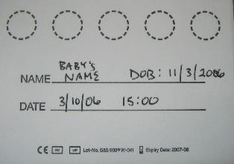
Procedure for DBS Blood Sample Collection
Gather all necessary supplies
Complete all necessary documentation including:
  Clinic register(s)
  Lab requisition form
  Label the DBS card with baby’s name, birth date, site code, date of collection, time of collection, and any other requested information

Slide 27
Procedure for DBS Blood Sample Collection
Do not touch the circles with anything other than infant’s blood
  Your hands, glove powder, ink, or dirt will affect the result
It is important not to contaminate cards by contact with blood from other sources such as touching another DBS card

Slide 28

Procedure for DBS Blood Sample Collection
Decide where you will prick the infant according to baby’s size and age:
  Heel prick:
  Small infants up to about 4 months & up to 5 kg
  The best area is the lateral section of the heel
  Do not prick the back of the heel where the bone is

Slide 29

Procedure for DBS Blood Sample Collection
Prick the big toe:
Larger infants between 4 and 10 months, or 5–10 kg:
  Never stick the other toes in children; it is too easy to hit and damage the bone
  The lateral side or outside part of the big toe works best
  Do not prick the very end of the toe where the bone is close to the skin

Slide 30

Procedure for DBS Blood Sample Collection
Finger prick:
Older infants over 10 month or 10 kg+
The best finger is the ring finger on the left hand; least used by the baby
Select the lateral side of the fingertip
Do not stick the very end of the finger where the bone is close to the skin
Thumb is not recommended because it is the most painful

Slide 31
Procedure for DBS Blood Sample Collection
Wash hands and then put on powder-free gloves
  If powdered gloves are used, rinse gloved hands to remove powder

Slide 32
Procedure for DBS Blood Sample Collection
Position the baby and clean the area to be pricked:
  Have the mother sit on the examination bed with baby on her lap
  Show her how to properly hold the baby depending on the site to be pricked
  The baby’s foot or hand should be below the level of his heart
  Warm the area you will prick, especially if the infant is cold
    The mother can hold the baby’s foot or hand in her hand
    Rubbing it gently may help
    A cloth or nappy soaked in warm water can be used—keep on for about 3 minutes

Slide 33
Procedure for DBS Blood Sample Collection
Clean the area to be pricked (continued):
  Clean the area with 70% spirit or alcohol swabs
  Allow to dry for 30 seconds so that the spirit does not mix with the blood when you prick the site

Slide 34
Procedure for DBS Blood Sample Collection
Gently squeeze and release the area to be pricked until it is ready to be bled
  Prick the infant’s heel, toe or finger with a 2mm lancet
  This lancet is the correct length to puncture safely without damaging baby’s bone

Slide 35
Procedure for DBS Blood Sample Collection
Wipe away the first drop of blood with dry cotton wool
  Allow a large drop to form on the puncture site

Slide 36
Procedure for DBS Blood Sample Collection
Touch the DBS card gently against the large drop and allow it to completely fill the circle on the paper
  The first drop should fill the circle
  Do not press the paper against the heel, toe or finger
  Just allow the droplet to touch the paper

Slide 37
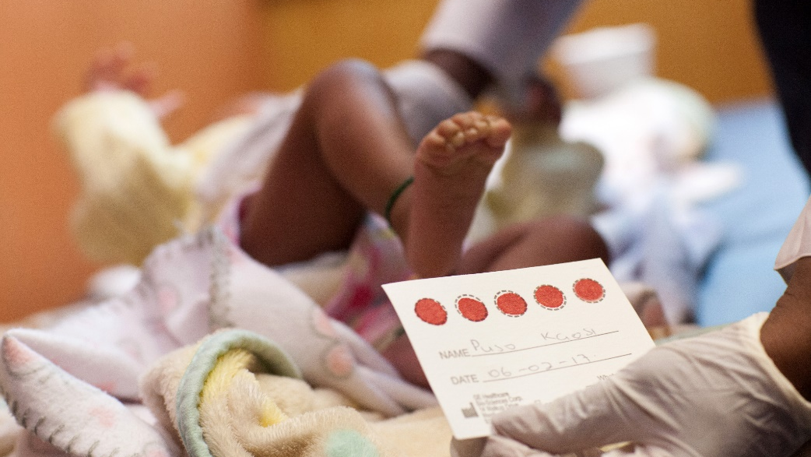
Procedure for DBS Blood Sample Collection
Fill all circles if possible
Three complete circles are needed by the laboratory
If a circle is poorly done, move to the next one

Slide 38
Procedure for DBS Blood Sample Collection
Tips:
Do not “milk” or squeeze the area that has been punctured ⇨ this will cause tissue fluid to mix with blood and contaminate the sample
If there is not enough blood, you can gently pump and release or apply gentle pressure to the above the puncture site
  If this is not successful, you may need to prick the infant in another location
Note: It is important not to touch the circles with anything other than the infant’s blood; fingerprints, glove powder, ink or dirt may all affect the result.

Slide 39
Procedure for DBS Blood Sample Collection
When enough circles have been filled:
  Clean puncture site
  Press with cotton wool until bleeding stops
  Do not use a bandage
Ensure wound is clean and bleeding has stopped for at least 5 minutes
Complete documentation and recheck the wound before the baby leaves
See “Appendix 4E: Collection of DBS from Infants for PCR Testing”; also available at https://www.childrenandaids.org/HEI_Toolkit

Slide 40
Drying and Packaging DBS for Transport to the Laboratory, Supplies

Slide 41
Drying DBS for Transport to the Laboratory
Leave DBS on a drying rack in a clean, dry, protected area until dried completely ⇨ at least 4 hours or overnight
  While drying, DBS should not be touched
  Keep out of direct sunlight
  If your site collects DBS for both EID and VL, then dry in separate racks
    Label one drying rack for EID DBS and the other for VL DBS
    Label the DBS cards “EID” or “VL” at the time of specimen collection
    Keep lab request forms with DBS cards

Slide 42
Drying DBS for Transport to the Laboratory

Slide 43
Packaging DBS for Transport to the Laboratory
Key points
Separate each DBS card with glassine paper so that the cards do not contaminate each other
Package DBS for EID and VL at different times to prevent contamination
Packaging may depend on clinic volume and available supplies

Slide 44
Packaging DBS for Transport to the Laboratory
Place each DBS in a glassine paper or envelope so that DBS cards will not have direct contact with one other
Insert up to 10 individually wrapped DBS cards into the batch bag
  Add 10 desiccant packets
Add at least one humidity card per batch bag
  Gently press the bag to remove air before sealing
  See Appendix 4F: Drying and Packaging
  DBS Samples for Transport
  if glassine packaging is not available

Slide 45
Packaging DBS for Transport to the Laboratory
Place the bag of DBS, all the DBS lab forms and the specimen delivery checklist into shipping envelope
  Use specimen delivery checklist to verify that you have a lab form for each DBS
  Label the envelope with:
    Clinic name
    “EID” or “VL”
    Date specimens will be sent to lab
  Place the envelope in designated area to be picked up

Slide 46
Packaging DBS for Transport to the Laboratory
After the DBS has been prepared for transport, it can be stored at room temperature for up to two weeks
  If DBS specimens cannot be shipped within two weeks, store at -70°C until shipment (or -20°C if freezer at -70°C is not available)
  If a sample has been at the clinic for
  longer than two weeks without
  appropriate storage, then a new
  sample is needed

Slide 47
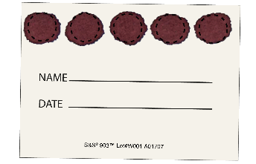
Valid and Invalid DBS Specimens
When specimens are not collected correctly, they may be rejected by the laboratory or the result may be inaccurate
Try to fill all 5 spots on the card completely
  If that is not possible, at least 3 completely filled spots are needed
  Remember: 3 well-filled spots are better than 5 partially filled spots
Above is a valid DBS specimen

Slide 48
Valid DBS Specimen
Circles are completely filled
The card has been labelled with appropriate identification
Blood is soaked through to the other side of the card
Baby Patient DOB 23/04/2019
06/06/2019 13:15

Slide 49
Valid DBS Specimen
Blood is spreading from one circle to another due to anaemia (anaemic blood is more fluid)
  This is still considered a valid specimen
Note: the third and fifth circles have been punched by laboratory staff
Photo: WHO. Blood Collection and Handling — Dried Blood Spot (DBS)

Slide 50

Valid DBS Specimen
Circles are imperfectly misaligned
Some slightly over or under filled
This specimen is also valid
Photo: Thumbay Labs. http://www.thumbaylabs.com/guidelines.html

Slide 51


Invalid Specimens
Why do you think this specimen was not acceptable?
Not enough blood for testing

Slide 52
Not Enough Blood for Testing
Why did this happen?
Possible causes:
Removing filter paper before blood had completely filled circle or before blood has soaked through to the other side
Applying blood to filter paper with a capillary tube
The filter paper coming in contact with gloved or un-gloved hands or substances such as hand lotion or powder, either before or after blood specimen collection

Slide 53

Invalid Specimens
Why do you think this specimen was not acceptable?
Specimen is bright red

Slide 54
Specimen is Bright Red
Why did this happen?
Possible cause:
Specimen was not dried before mailing
DBS specimens must dry a minimum of 4 hours before packaging and shipping

Slide 55

Invalid Specimens
Why do you think this specimen was not acceptable?
Specimen is too saturated

Slide 56
Specimen Saturated
Why did this happen?
Possible causes:
Both sides of the card were soaked
Blood may have been applied with a syringe

Slide 57

Invalid Specimens
Why do you think this specimen was not acceptable?
Specimens appear clotted or layered

Slide 58
Specimens Clotted or Layered
Why did this happen?
Possible cause:
Touching the same circle on the filter paper several times to blood drop
Filling circle on both sides of filter paper

Slide 59


Invalid Specimens
Why do you think these specimens were not acceptable?
Specimen exhibits serum rings, serum has separated from cells

Slide 60
Specimen Exhibits Serum Rings
Serum has Separated from Cells
Why did this happen?
Possible causes:
Not allowing alcohol to dry at
puncture site before making
skin puncture
Allowing filter paper to come in
contact with alcohol, hand lotion, etc.
Excessive milking or squeezing area surrounding puncture site
Drying specimen improperly
Applying blood to filter paper with a capillary tube

Slide 61

Invalid Specimens
Why do you think this specimen was not acceptable?
Contaminated sample spots

Slide 62
Contaminated Sample Spots
Why did this happen?
Possible cause:
Another liquid has been in contact with the card e.g., water, urine, tea, coffee, etc

Slide 63
Common DBS Errors
Error/Problem | Solution
Labelling and documentation errors | Complete DBS card, lab requisition forms and all other documentation completely, accurately and with legible handwriting
Yellow rings around the spots due to disinfectant or tissue fluid contamination | Allow disinfectant to dry completely before pricking the patient Do not squeeze the skin directly around the spot where the patient was pricked
Scratches or smudges on the filter paper | Do not scratch or dab blood on the filter paper surface

Slide 64
Common DBS Errors
Error/Problem | Solution
Drops are too small | Warm the site Apply pressure (but not right at the site) Consider choosing another site For fingerpick: ensure hand is below the level of the heart
Caking or layering blood on the filter paper | Do not put a new drop of blood on top of a drop that is already dry
Drop is not centred on the card | Ensure site is centred directly over the centre of the spot Show caregiver how to hold the infant/child firmly so that he/she is not moving during the procedure
Specimens are not dried or packaged properly | Do not start packaging until DBS specimens are completely dry (4 hours or longer). See Appendix 4F

Slide 65
Responsibilities of the Laboratory
Lab acknowledges receipt of all specimens by completing and returning the specimen delivery checklist
Any specimen rejected at the laboratory should be identified on specimen delivery checklist
  Lab immediately informs sending facility that sample was rejected and reason for rejection
  Facility traces infants and organizes drawing of a new sample as soon as possible
All specimens should be entered in the register
  Lab keeps the second copy of the checklist for reference
Lab ensures there is a system to notify a health facility of a positive infant virologic test result on the same day of testing

Slide 66
Ways to Return Results from the Lab to the Health Facility
How are infant HIV test results returned to your clinic?

Slide 67
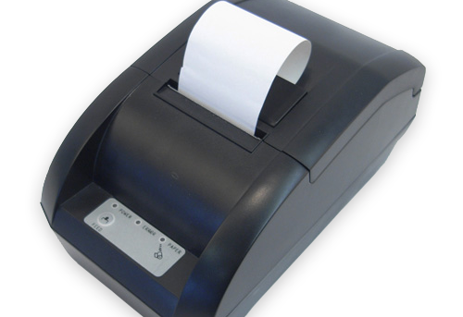
Ways to Return Results from the Lab to the Health Facility
Even when results are returned as hard copies, WHO recommends use of technology to expedite return of results to the clinic and, in turn, to the patient.
Examples of methods for returning results electronically:
(1) Short message service (SMS) printers: Small battery operated printers that can take a SIM card and receive messages without the need for a handset
  SMS printers can receive and print test results without computer or internet access

Slide 68
Ways to Return Results from the Lab to the Health Facility
(2) SMS text messages:
  Can notify health providers of test results and notify caregivers that results are available at the health facility
  Text messages to caregivers should encourage them to come to the clinic to get test results and not disclose any confidential information
(3) Secure webpage or electronic medical record system:
  Password protected clinic-specific webpages on which results are posted to be accessed by clinic staff
  Viable option where clinics and laboratories have reliable access to the internet
  Some electronic medical record systems can flag positive results for the health care provider

Slide 69
Ways to Return Results from the Lab to the Health Facility
(4) Telephone:
  To notify caregivers of test results, especially for urgent follow-up of positive test results.
  Always follow-up phone calls with paper printout for medical record
Notes:
In many settings, results are returned using a combination of methods, e.g., internet in urban centres and SMS printers in remote areas
POC testing has the potential of same-day results
  Avoiding the challenges of specimen transport and delayed turn-around time

Slide 70
Steps When Receiving Results
What do you do in your clinic when DBS test results are returned?
What do you do if you do not receive results?

Slide 71

Steps When Receiving Results
The steps are the same regardless of method of return (electronic or paper):
Document receiving the results and date receipt/review of results
Write the results in designated register and/or clinical database; and patient chart
  File paper copies in patient chart
If HIV-positive: re-enter baby’s name, together with the necessary tracing details, in the designated register to enable prompt follow-up and linkage to ART

Slide 72
Steps When Receiving Results
It is important that the designated register is completed accurately
Registers are used for monitoring and reporting
When the caregiver receives test result, enter the post-test counselling date in patient chart and register
Ensure caregiver knows child will be retested:
  If the 6-week NAT is negative, retest at 9 months and at 18 months or 3 months after completion of breastfeeding (whichever is later)
  If the NAT is positive, collect a second DBS specimen to be retested for confirmation of the first result
    Initiate child on ART immediately

Slide 73
Tracking No Shows
Do you think your clinic’s procedure is effective, i.e., are you able to get results to caregivers quickly?
What improvements need to be made to ensure caregivers get their infants’ results efficiently?

Slide 74
Tracking No Shows
Every clinic should have a mechanism for identifying patients that did not attend for testing, scheduled clinic visits or for post-test result
Use Infant DBS Register to identify patients who have not returned to receive test results
Where available, use computer-based records and appointment systems to identify patients who miss appointments
Ask patient at time of enrolment for permission to trace them by phone or home visit
If the patient consents, document locator information (address/location and phone number) at the health facility

Slide 75

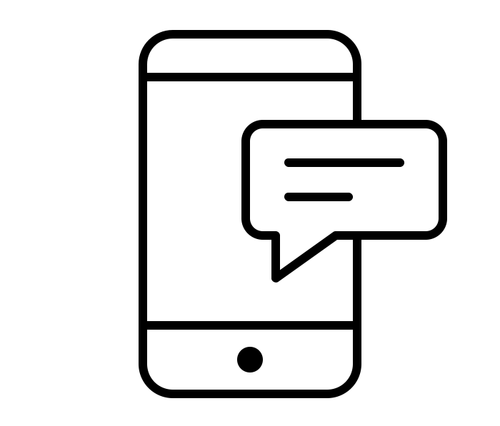
Tracking No Shows
Once a patient has been identified as missing an appointment or lost to follow-up, that individual must be traced
Where the technology is available, invite patients back into care using SMS messages, phone calls, or e-mail
Where that technology is not available, then consider making a home visit
Patients who have not yet collected a positive HIV test result, should be reached in person via an outreach worker or other peer navigator if they do not respond within 1–2 days of an electronic message

Slide 76
Missing and Delayed Results
What is turn-around time (TAT)?
What is reasonable TAT? When will you say result is “lost”?
What do you do if results are deemed “lost”?

Slide 77
Missing and Delayed Results
Healthcare providers have an important role in ensuring that all requested test results are returned in a timely manner
NAT test results should be returned to caregiver as soon as possible, but at the very latest within 4 weeks of specimen collection
HIV-positive infants should be identified and followed up as soon as possible to enable early initiation in care and treatment
Responsibilities for ensuring timely results are:
  Health facility: use the designated register to identify results not received within 28 days, and immediately notify the laboratory
  Laboratory: check if samples were received, when was the test done and date when the results were dispatched

Slide 78

Re-collection of Specimens
If results have not been received within 28 days and tracing result with the laboratory is unsuccessful
  ⇨ Use the post-test appointment to take another DBS specimen
If infant did not have an appointment or does not show for the appointment
  ⇨ Phone or visit the caregiver as soon as possible to ask them to come in for retesting

Slide 79
Exercise 2
DBS specimen collection practice: Pair work

Slide 80
Exercise 3
Packing samples and receiving results: Demonstration in large group

Slide 81
Module 4: Key Points
HIV testing of HIV-exposed infants is routinely conducted at the 4–6 weeks, 9 months and 18 months of age (or 3 months after stopping breastfeeding, whichever is later). The pre-test counselling should cover 7 points:
  Assess: assess caregiver’s knowledge of HIV
  Routine testing: explain that we routinely test all HIV-exposed babies for HIV
  Explain the procedure: discuss the steps of the testing procedure
  Confidentiality: explain that the discussion is private
  Result: explain what a positive or negative result means
  Return: discuss when to return for results and routine care
  Questions: ask if the caregiver has any questions

Slide 82
Module 4: Key Points
Dried blood spot (DBS) refers to small drops of whole blood that are collected on strips of special filter paper that are then dried. If properly dried and stored, specimens remain stable for an extended period of time and can be transported with minimal special handling to a central laboratory
Follow standardized procedures for collecting, drying and packaging DBS specimens, including complete and accurate documentation
When results are received, record them in the designated register/database as well as the patient chart

Slide 83
Module 4: Key Points
If a client does not come for the scheduled post-test counselling session, ensure s/he is tracked by phone, text or e-mail if available. If she does not respond to electronic messaging, or does not have a phone, reach her in person via outreach staff
If a positive NAT result is received, trace the caregiver immediately for post-test counselling and ART initiation
Actively follow up delayed results. If the patient shows for the post-test session and the results are not available, contact the laboratory. If the sample was lost or rejected by the laboratory, use the visit as an opportunity to take a new specimen for testing

Slide 84

Credits
“Discussion” icon by Hoeda from the Noun Project
“Blood” icon by Adrien Coquet from the Noun Project
“Book” icon by Cédric Villain from the Noun Project
“Hospital chart” icon by Llisole from the Noun Project
“Phone” icon by Alice Design from the Noun Project
“Text message” icon by throwaway icons from the Noun Project
“One month” icon by Muneer A. Safiah from the Noun Project

