Slide 1

Pre-Exposure Prophylaxis (PrEP) Training for Providers in Clinical Settings
Module 2: Oral Daily PrEP
Last update: January 2024​

Slide 2


Slide 3

Training Overview
Oral PrEP
MODULE 1: PrEP Basics ​
MODULE 2: Oral Daily PrEP​
MODULE 3: Oral Event-Driven PrEP (ED-PrEP)​
MODULE 4: Injectable Long-Acting
Cabotegravir (CAB-LA)​
MODULE 5: Dapivirine Vaginal Ring (DVR)​
MODULE 6: Person-Centered PrEP Counseling
PrEP Vaginal Ring
Injectable PrEP

Slide 4
PrEP Competencies​
By the end of this training program, you should be able to:​
Explain the use of PrEP for HIV prevention​
Identify candidates eligible for PrEP​
Initiate clients on PrEP​
Conduct follow-up management for PrEP ​
Provide person-centered counseling for PrEP​​

Slide 5
Symbols Key​
Preliminary recommendation based on available evidence and may change​
Adaptation required or suggested based on local context​
Content repeated in other modules​
Unknown at the moment, more information required​

Slide 6

Learning Activities​
Question & Answer​
Review national guidelines​
Case scenario​
Role-play​
Discussion​
Share experiences​
Notes:
Facilitator guidance:
This training is designed to be interactive and to engage participants in learning and knowledge sharing. Rather than simply lecturing to participants, we encourage facilitators to use a variety of participatory methodologies, including question and answer, discussion, case scenarios, role-play, and other small group activities. These activities are provided for you and were designed to elicit and build on participants’ experience and knowledge, to promote discussion and reflection on key issues, to provide hands-on practice of content learned, and to help participants learn from one another. In addition, these participatory methodologies promote higher retention of content and create an open, engaging, and supportive learning environment.
Review the learning activities in advance to facilitation:
Question & Answer
Questions and answers are included throughout the module to keep learners engaged and actively participating. Q&A are offered to encourage participants to reflect on their existing knowledge before a new topic is introduced. Q&A are also offered after lecture content is delivered to test participants knowledge recall.
How To Facilitate Q&A
Read the question on the slide.
Ask participants to raise their hands to answer the question.
Take a few volunteer responses.
Reveal the answer on the following slide.
Allow time for follow-up discussion as needed (see below).
2. Discussion
A discussion is a dialogue between participants and the trainer, with participants responding to discussion questions and to one another’s ideas. During discussions, new questions may surface. When the trainer leads a large group discussion, she or he must manage the discussion by keeping participants focused, actively eliciting responses, and limiting participants who like to talk a lot. When participants have small group discussions, they must do likewise.
How To Facilitate Discussion
• Set a time limit and keep track of time.
• Explain that participants who want to speak should raise their hands.
• Keep the discussion on target and moving along.
• Encourage everyone to participate and call on everyone who raises a hand.
• Limit participants who like to talk a lot.
• Ask questions to encourage more responses to a question—for example: “What else?” “What other ideas do you have?”
• Wrap up the discussion by repeating and summarizing main points.
3. Case scenarios
A case scenario is a brief description of a realistic situation that participants discuss and analyze. Case scenarios give participants the opportunity to apply newly acquired knowledge to a particular problem or situation and to generate possible solutions to challenges presented in the scenario.
How to Facilitate Case Scenarios
• If participants will use the scenario in small groups or pairs, give clear instructions.
• If you write your own scenarios, make them simple and brief. Use realistic situations similar to those that participants face. Give essential information and leave out unnecessary details.
• Provide questions to guide participants in analyzing the scenario and a list of essential points to be covered in discussion for yourself and co-facilitators.
4. Role-Play
A role-play is a brief informal performance where participants act out roles in order to practice handling a particular problem or situation and to experience what it is like to be in those roles. Role-playing is informal; participants do not need to memorize dialogue or perform perfectly— the point is to experience the situation and learn from that experience.
How To Facilitate a Role-Play
• Give clear instructions for the role-play
• Set a time limit for role-play practice and performance, and manage the time well.
• Remind participants that role-playing does not require a perfect performance but rather provides an opportunity to practice handling real-life situations. It is fine to make mistakes during role-play.
• Debrief the role-play with a large group discussion
5. Small group activities
The facilitator divides participants into small groups to do a learning activity. Examples of small group activities include discussions, scenarios, and role-play practice as described above. Small groups allow each person to participate more than they would in the large group. Small group work also helps participants get to know one another and work with new colleagues.
How To Facilitate Small Group Work
• Before you divide participants into small groups, give clear instructions for the small group task.
• Group participants so that they are not always working with people they know well. To vary groups’ composition: Ask participants to count off or draw at random from a deck of playing cards and then group by suit or numbers. Or ask participants to draw at random from a container of colored objects or slips of paper and then group by colors. Or group participants by birthday (seasons or months), by first letter of first or last name, by last digit of their phone number, or by height—then, based on how many fall into each category, regroup these groups so that you have groups of an optimal size.
• Instruct the groups to make sure that all group members participate.
• Have each group choose a timekeeper.
• Keep track of time yourself and provide half-time, 5-minute, and 1-minute warnings.
• As the groups are working, move from one to another to make sure that participants have understood the task and are making progress.

Slide 7
Module 2: Oral Daily PrEP​

Slide 8
Introduction​
Welcome to Module 2: Oral Daily PrEP ​
In this module you will learn how to initiate and conduct follow-up management for clients on oral daily PrEP. You will learn to identify persons eligible for oral daily PrEP, conduct assessments and counseling to start oral daily PrEP, and provide ongoing monitoring for as long as the person needs oral daily PrEP.

Slide 9
Module 2 Learning Objectives​
After completing Module 2, participants will be able to:​
Describe the efficacy and common side effects of oral daily PrEP
Explain the relationship between oral daily PrEP effectiveness and adherence
Explain the recommendations for starting and stopping oral daily PrEP
Specify the procedures for initiating oral daily PrEP
Deliver key counseling messages for the initial oral daily PrEP visit
Conduct effective monitoring visits for oral daily PrEP
Perform adherence evaluations and counseling for oral daily PrEP
Explain how to manage creatinine elevation
Explain how to manage HIV seroconversion

Slide 10
What is YOUR EXPERIENCE initiating and managing clients on oral daily PrEP? ​
Do you have any successes or challenges to share?​
What would you like to learn about initiating and managing clients on oral daily PrEP?​
DISCUSSION​
Notes:
Facilitator guidance:
• Time: 10-20 minutes. Timing will vary based on size of the group and time allowed for training. Set a time limit and keep track of time.
• Explain that participants who want to speak should raise their hands.
• Keep the discussion on target and moving along.
• Encourage everyone to participate and call on everyone who raises a hand.
• Limit participants who like to talk a lot.
• Ask questions to encourage more responses to a question—for example: “What else?” “What other ideas do you have?”
• Wrap up the discussion by repeating and summarizing main points.

Slide 11
2.1 Introduction to Oral Daily PrEP

Slide 12
QUESTION
What is oral daily PrEP and how effective is it?​
Notes:
Facilitator guidance:
Read the question on the slide.
Ask participants to raise their hands to answer the question.
Take a few volunteer responses.
Reveal the answer on the following slide.
Allow time for follow-up discussion as needed.

Slide 13
ANSWER
Oral daily PrEP is one pill taken daily to prevent HIV infection.
Taken correctly, oral daily PrEP is very effective (>95%) and will reduce the risk of HIV infection to almost zero.​
Notes:
Facilitator guidance:
Reveal the answer on the slide.
Allow time for questions and follow-up discussion as needed.

Slide 14
Efficacy of Oral Daily PrEP with Tenofovir Disoproxil Fumarate
Meta-analyses of randomized oral PrEP trials found a ~50% reduction in risk of HIV infection in those using PrEP with tenofovir disoproxil fumarate (TDF)​ versus placebo or no PrEP.^{1,2}
Level of HIV protection was strongly correlated with adherence to the daily regimen​.^{1,2}
  Most effective among participants with blood drug levels consistent with ≥70% adherence.​
  No protective effect found when blood drug levels consistent with <40% adherence​.
The level of protection does not differ by age, sex or mode of sexually acquiring HIV (rectal, penile or vaginal).​^{2,3}
When taken every day, oral PrEP is >95% effective for preventing HIV infection.
1. Chou et al., 2019; 2. Fonner et al., 2016; 3. Baeten et al., 2014

Slide 15
Evidence for Daily Oral PrEP with Tenofovir Alafenamide
The DISCOVER trial compared the efficacy and safety of daily oral PrEP with tenofovir alafenamide/emtricitabine (TAF/FTC) versus TDF/FTC among cisgender men who have sex with men and transgender women who have sex with men.​
PrEP with TAF was non-inferior to PrEP with TDF over 8,756 person-years.​
  0.16 infections per 100 person-years (95% confidence interval 0.06-0.33) in the TAF group versus 0.34 infections per 100 person-years (95% confidence interval 0.19-0.56) in the TDF group.​
There was evidence of more favorable renal and bone mineral density outcomes with TAF compared to TDF, but there was no difference in clinically significant adverse events between the groups. ​
The efficacy of oral PrEP with TAF has not been determined for cisgender women and TAF is currently ​not recommended for anyone exposed to HIV through receptive vaginal sex.​
Mayer et al., 2020

Slide 16
QUESTION
What antiretroviral (ARV) drug regimens are recommended for oral daily PrEP by the World Health Organization (WHO)?​
Notes:
Facilitator guidance:
Read the question on the slide.
Ask participants to raise their hands to answer the question.
Take a few volunteer responses.
Reveal the answer on the following slide.
Allow time for follow-up discussion as needed

Slide 17
ANSWER
The WHO currently recommends TDF-based regimens for oral daily PrEP.
Notes:
Facilitator guidance:
Reveal the answer on the slide.
Allow time for questions and follow-up discussion as needed.

Slide 18
Oral Daily PrEP History​
2010 | iPrEX randomized clinical trial demonstrates efficacy of daily oral PrEP with TDF/FTC to reduce incident HIV infections​
2012 | Food and Drug Administration (FDA) approves oral daily PrEP with TDF in the United States​
2015 | WHO recommends oral daily PrEP with TDF for people at substantial risk of HIV infection​
2019 | FDA approves TAF/FTC as oral daily PrEP in the United States, excluding individuals who may be exposed to HIV via receptive vaginal sex or injection drug use
By 2023, 61 countries had approved oral PrEP with TDF and 8 had approved oral PrEP with TAF.​
For latest numbers, please refer to: data.prepwatch.org
Last updated: January 2024

Slide 19
Discuss the available and recommended regimens for oral daily PrEP in your setting. ​
DISCUSSION​
Notes:
Facilitator guidance:
Time: 20 minutes
Explain that participants will now work in small groups to review national guidelines for recommended regimens for oral daily PrEP in their setting.
Divide participants into groups of 4 to 6 participants each.
Small groups may go online to research the information. As the groups are working, circulate and help as needed. Allow 10 minutes to work.
When the groups have finished, take volunteer responses from the groups. Allow 10 minutes for discussion.
Present the next slide to summarize and confirm what participants have shared.

Slide 20
ARVs Recommended for Oral PrEP by the WHO​
The WHO recommends these regimens for oral PrEP:​
TDF 300 mg/FTC 200 mg ​
TDF 300 mg/lamivudine (3TC) 300 mg ​
Single-agent TDF 300 mg*​
In [insert country name] the recommended oral PrEP regimens include: [insert available regimen(s)]​
Note: The rest of this module will focus on oral PrEP with TDF.​
*Less common and may not be suitable for all populations​
Notes:
Facilitator guidance:
Edit this slide in advance to the training by inserting the country name and available oral PrEP regimens in your country.
Present this slide to summarize and confirm what participants have shared in the previous discussion.

Slide 21
QUESTION
Does oral daily PrEP have any side effects?​
Notes:
Facilitator guidance:
Read the question on the slide.
Ask participants to raise their hands to answer the question.
Take a few volunteer responses.
Reveal the answer on the following slide.
Allow time for follow-up discussion as needed

Slide 22
ANSWER
Many people experience no side effects from oral PrEP. ​
Some might experience mild issues like nausea, vomiting, fatigue and dizziness, but these usually disappear within a week or two. ​
In rare cases oral daily PrEP can affect kidney function.​
Notes:
Facilitator guidance:
Reveal the answer on the slide.
Allow time for questions and follow-up discussion as needed.

Slide 23
Safety and Side Effects of Oral Daily PrEP with TDF​
No difference was found in the rate of serious adverse events in those receiving PrEP versus placebo in randomized clinical trials.​
Approximately 10% of PrEP users experienced gastrointestinal side effects.
  Symptoms include nausea, vomiting and abdominal pain
  Symptoms were typically mild and did not persist beyond the first month
PrEP use was also associated with an increased risk of: ​
  Creatinine elevation, typically subclinical and reversible after stopping PrEP.
  Loss of bone mineral density, typically subclinical and recovers after stopping PrEP
Chou et al., 2019;

Slide 24
Stopping and Starting Oral PrEP: Basics​
Sex hormones affect the metabolism of oral PrEP with TDF and bacteria that live in the vagina may break down TDF.​
To effectively prevent HIV infection, drug concentrations need to reach a protective level in the body before exposure to HIV.​
Protective drug concentration levels must also be maintained after the last HIV exposure until the risk of infection has passed.​
The time required to reach pre-exposure protective levels and to maintain post-exposure protective levels varies by gender and HIV exposure route. ​

Slide 25
Starting and Stopping Oral PrEP: Classifications​
For starting and stopping oral PrEP individuals are classified into one of two groups:
People assigned male sex at birth with sexual exposure to HIV only​
  Excluding those taking exogenous estradiol-based hormones, such as for gender-affirming therapy​.
Everyone else​
  People assigned female sex at birth​
  People assigned male sex at birth taking exogenous estradiol-based hormones​
  Parenteral HIV exposure from injection drug use​
These groupings provide guidance on starting and stopping oral PrEP for those who are taking oral PrEP every day.
WHO, 2022

Slide 26
Stopping and Starting Oral PrEP: WHO Recommendations​
​ | Assigned male sex at birth ​ + NO​T taking estradiol-based hormones ​ + sexual HIV exposure only. | Assigned female sex at birth ​ OR taking estradiol-based hormones ​ OR parenteral HIV exposure. ​
Starting oral PrEP​ | Start with 2 pills 2-24 before sexual exposure | Start 7 consecutive days before exposure​
Stopping oral PrEP​ | Stop after 2 days post-exposure​ | Stop after 7 days post-exposure​
Groups included​ | Cisgender men​ Transgender women and non-binary individuals assigned male sex at birth NOT taking gender-affirming hormones. ​ | Cisgender women​ Transgender women and non-binary individuals assigned male sex at birth taking gender-affirming hormones​. Transgender men and non-binary individuals assigned female sex at birth.​ Individuals with exposure through injecting practices.​
Note: These categories are also used to define who is eligible for ED-PrEP.
For more information on ED-PrEP see Module 3.​​
WHO, 2022

Slide 27
QUESTION
​What are some of the advantages of oral daily PrEP?​
Notes:
Facilitator guidance:
Read the question on the slide.
Ask participants to raise their hands to answer the question.
Take a few volunteer responses.
Reveal the answer on the following slide.
Allow time for follow-up discussion as needed

Slide 28
ANSWER
Oral daily PrEP is widely available, highly effective, safe for everyone with few side effects, and easy to use.​
Notes:
Facilitator guidance:
Reveal the answer on the slide.
Allow time for questions and follow-up discussion as needed.

Slide 29
Advantages and Disadvantages of Oral Daily PrEP​
Advantages
Highly effective with good adherence ​ Most commonly available form of PrEP worldwide Over ten years of implementation experience and safety data Generic options widely available Simple drug administration ​ Broad and simple eligibility criteria (recommended for all genders and HIV exposure routes) Easy to stop and start
Disadvantages
Adherence to a daily pill is a challenge for many people Limited privacy with pill bottles The same medication is used to treat HIV, which contributes to stigma

Slide 30
2.2 Oral Daily PrEP Eligibility​

Slide 31
QUESTION
Who can take oral daily PrEP?​
Notes:
Facilitator guidance:
Read the question on the slide.
Ask participants to raise their hands to answer the question.
Take a few volunteer responses.
Reveal the answer on the following slide.
Allow time for follow-up discussion as needed

Slide 32
ANSWER
Oral daily PrEP is appropriate for EVERYONE at substantial risk for HIV who meet other eligibility criteria. ​
Notes:
Facilitator guidance:
Reveal the answer on the slide.
Allow time for questions and follow-up discussion as needed.

Slide 33
Eligibility Criteria for Oral Daily PrEP
 | HIV seronegative
 | No suspicion of acute HIV infection (AHI)
 | At substantial risk for HIV infection or requesting PrEP
 | Willingness to use PrEP as prescribed
 | Low risk for or no evidence of kidney function impairment*
*Risk-based creatinine clearance (CrCl) evaluation, using estimated glomerular filtration rate (eGFR) calculation.
See Module 1 for more information about general PrEP eligibility criteria. ​

Slide 34
Kidney Function Monitoring for Oral PrEP​
TDF can be associated with a small decrease in estimated creatinine clearance (CrCl), also known as estimated glomerular filtration rate (eGFR)*.
This can occur early during oral PrEP use and usually does not progress.​
PrEP containing TDF is contraindicated if CrCl is less than 60ml/min.​
The WHO recommends risk-based screening and monitoring of renal function, based on age and medical co-morbidities.​
If indicated, CrCl should be evaluated using a serum creatinine test within 1-3 months of PrEP initiation.​
Creatinine testing should not be a barrier to starting PrEP!
* Calculate eGFR using the Cockcroft-Gault equation:​
Estimated CrCl = [140-age (years)] x weight (kg) x f ​
where f=1.23 for men and 1.04 for women / [72 x serum creatinine (μmol/L)]​​
WHO, 2022

Slide 35
Rationale for Kidney Function Monitoring Recommendations​
A systematic review and meta-analysis of global program data found:​
Less than 1% of individuals who were screened before starting oral PrEP had abnormal CrCl levels.
Less than 3% of oral PrEP users experienced a decline in CrCl to <60 ml/min​.
Older individuals, especially those over 50 years, with baseline CrCl of <90 ml/min and with kidney-related comorbidities such as diabetes or hypertension, had a higher probability of declining to abnormal levels of CrCl.​
Less than 1% of oral PrEP users less than 30 years of age experienced abnormal CrCl. ​
​
Schaefer et al., 2022

Slide 36
WHO Recommendations: Risk-Based Kidney Function Monitoring for Oral PrEP​
Population |  | CrCl at PrEP initiation? | CrCl at PrEP follow-up?
Kidney-related comorbidities? | Age (years)
No | <30 | Optional | Optional (until age 30 or kidney-related comorbidities develop)
 |  |  | If baseline done and CrCl <90ml/min, conduct follow-up every 6-12 months
No | 30-49 | Conduct once within 1-3 months after oral PrEP initiation | If baseline CrCl ≥90ml/min, optional (until age 50 or kidney-related comorbidities develop)
 |  |  | If baseline CrCl <90ml/min, screening every 6-12 months
Yes | Any age | Conduct once within 1-3 months after oral PrEP initiation | Screening every 6-12 months
No | 50+
WHO, 2022

Slide 37
Considerations for Specific Populations​
People who inject drugs​
Data on the ability of PrEP to prevent HIV infection through parenteral exposure are limited. Nonetheless oral daily PrEP is still recommended for people who inject drugs, as there is evidence of some benefit.^{1, 2}
There is also often concomitant sexual risk in this population, which makes them eligible for oral daily PrEP.​
Women​ of child-bearing potential
There is no evidence that oral PrEP alters the effectiveness of hormonal contraception.​ Oral PrEP can be safely used with hormonal contraception.
Oral PrEP is safe to take during pregnancy and the breastfeeding period.​³
The WHO recommends oral PrEP be offered to eligible pregnant and breastfeeding women given the elevated risk of incident HIV infection in this population.⁴
1. Choopanya et al., 2013; 2. Martin et al., 2015; 3. Mofenson et al., 2017; 4. WHO, 2017

Slide 38
Considerations for Specific Populations​ (continued)
Transgender people​
Drug-drug interactions between PrEP and gender-affirming hormone therapy for transgender women have been observed in some studies, with lower blood plasma TDF levels among transgender women compared to cisgender men.​
Nonetheless, protective concentrations can be reached with daily use of oral PrEP even in the presence of gender-affirming hormones, and daily oral PrEP should be offered to transgender and non-binary people at substantial risk of HIV. ​
Serum hormone concentrations are not affected by TDF/FTC PrEP use.​

Slide 39
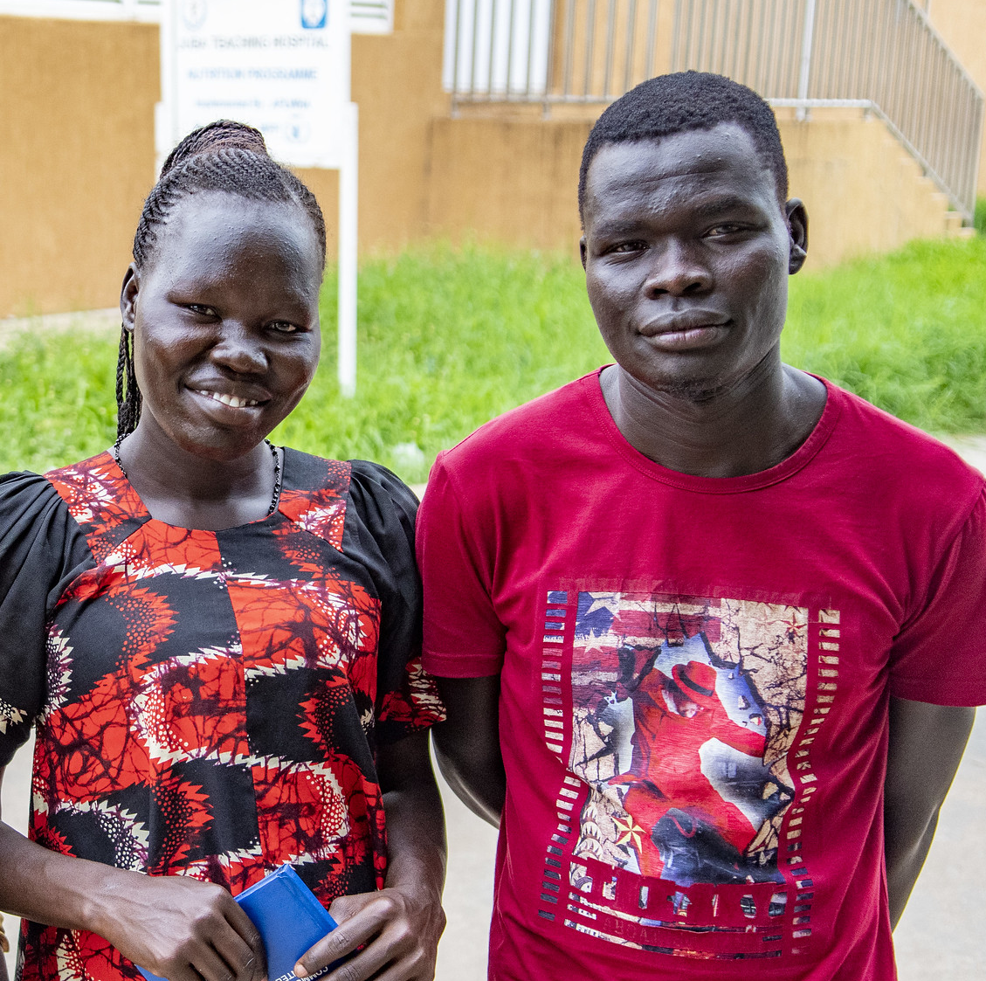
Case Scenario​
Esther and Vincent are a married couple who would like to have a baby together. Vincent is living with HIV and Esther is HIV negative.
Is it safe for Esther to take oral daily PrEP while she is trying to get pregnant and during pregnancy? ​
Notes:
Facilitator guidance:
Read the question on the slide.
Ask participants to raise their hands to answer the question.
Take a few volunteer responses.
Reveal the answer on the following slide.
Allow time for follow-up discussion as needed.

Slide 40
ANSWER
YES
Oral daily PrEP is appropriate for everyone at substantial and ongoing risk for HIV who meet eligibility criteria, including pregnant women.
Notes:
Facilitator guidance:
Reveal the answer on the slide.
Allow time for questions and follow-up discussion as needed.

Slide 41
2.3 Oral Daily PrEP Initiation Visit​

Slide 42
QUESTION
What are the procedures for initiating a client on oral daily PrEP?​
Notes:
Facilitator guidance:
Read the question on the slide.
Ask participants to raise their hands to answer the question.
Take a few volunteer responses.
Reveal the answer on the following slide.
Allow time for follow-up discussion as needed

Slide 43
ANSWER
Essential procedures for initiating a client on oral daily PrEP include: ​
HIV testing
Symptom assessment to rule out AHI​
Assessment of HIV risk and last potential exposure​
Determination of need for creatinine testing
Counseling and education ​
Notes:
Facilitator guidance:
Reveal the answer on the slide.
Allow time for questions and follow-up discussion as needed.

Slide 44
Oral Daily PrEP Initiation Visit: Essential Procedures​
Procedure​ | Rationale​
HIV test using national algorithm or assisted HIV self-test​ | Assess HIV infection status​
AHI symptom checklist​ | Assess for AHI
Ask about last potential HIV exposure​ | If last exposure <72 hours prior, post-exposure prophylaxis (PEP) may be more appropriate before transitioning to PrEP
Determine age and assess for medical co-morbidities that may impair renal function (e.g., diabetes, hypertension)​ | Determine whether a serum creatinine test is indicated
PrEP initiation counseling​ | Assess substantial risk for HIV​ Assess HIV prevention needs and educate about options Discuss desire for PrEP and willingness to take PrEP Plan for effective PrEP use and sexual and reproductive health

Slide 45
Oral Daily PrEP Initiation Visit: Suggested Procedures​
Procedure​ | Rationale​
Hepatitis B surface antigen (HBsAg)​ testing | Identify undiagnosed hepatitis B virus (HBV) infection Identify those eligible for HBV vaccination​
Hepatitis C antibody ​testing | Identify undiagnosed hepatitis C virus (HCV) infection; determine if eligible for HCV treatment​
Rapid plasma regain (RPR)​ testing | Diagnose and treat syphilis infection
Sexually transmitted infection (STI) screening​ | Diagnose and treat STIs Syndromic or diagnostic STI testing, depending on local guidelines
Pregnancy testing​ | Ascertain pregnancy status (women only)
Per the WHO, availability or access to these tests should NOT be a barrier to PrEP initiation. ​
These tests are not a requirement for oral PrEP use.​

Slide 46
Viral Hepatitis and PrEP​
Individuals at substantial risk of HIV infection may also be at a higher risk for HBV and HCV infection. ​
PrEP services provide an important opportunity to screen for HBV and HCV infection and provide linkages to care.​
  HBsAg testing within 1-3 months of PrEP initiation is strongly encouraged where feasible, particularly in highly endemic countries. ​
  HCV antibody testing is strongly encouraged within 1-3 months of PrEP initiation and every 12 months thereafter where PrEP services are provided to populations at high risk of HCV infection. ​
WHO, 2022

Slide 47
Viral Hepatitis and PrEP (continued)​
TDF-based oral daily or ED-PrEP can be offered to people with HBV or HCV infection. ​
Lack of HBV and HCV testing should not be a barrier to PrEP initiation or use. ​
PrEP can be initiated before HBV and HCV test results are available. ​
HBV and HCV testing are not a requirement for PrEP use!​
For people known to have chronic HBV infection:​
  Daily TDF effectively suppresses HBV, however, HBV may occasionally flare and lead to worsening liver function when TDF is discontinued. ​
  Providers should consider monitoring for signs and symptoms of hepatitis in those who stop TDF.​
  TDF should not be taken with a medication used to treat chronic HBV called adefovir, as they are similar drugs.​
WHO, 2022

Slide 48
What procedures are required for initiation of oral daily PrEP according to your national guidelines?​
DISCUSSION​
Notes:
Facilitator guidance:
Time: 20 minutes
Explain that participants will now work in small groups to review national guidelines for initiation of oral daily PrEP.
Divide participants into groups of 4 to 6 participants each.
Discuss this question in your small group: What procedures are required for initiation of oral daily PrEP according to your national guidelines?
Small groups may go online to research the information. As the groups are working, circulate and help as needed. Allow 10 minutes to work.
When the groups have finished, take volunteer responses from the groups. Allow 10 minutes for discussion.
Present the next slide to summarize and confirm what participants have shared.

Slide 49
PrEP Initiation Visit: National Guidelines​
In [insert country name], the following procedures are required during an oral daily PrEP initiation visit:​
[insert procedures according to local guidelines]​
Notes:
Facilitator guidance:
Edit this slide in advance to the training by inserting the country name and PrEP initiation visit procedures according to local guidelines.
Present this slide to summarize and confirm what participants have shared in the previous discussion.
Allow time for follow up questions and discussion.

Slide 50
QUESTION
What are the steps to initiate someone on oral daily PrEP?​
​
Notes:
Facilitator guidance:
Read the question on the slide.
Ask participants to raise their hands to answer the question.
Take a few volunteer responses.
Reveal the answer on the following slide.
Allow time for follow-up discussion as needed

Slide 51
ANSWER
Steps for initiating a client on oral daily PrEP include: ​
Confirm HIV negative status​
Screen for substantial risk for HIV ​
Provide PrEP counseling, including informed choice counseling (if applicable)​
Establish eligibility for oral daily PrEP​
Initiate oral daily PrEP
Notes:
Facilitator guidance:
Reveal the answer on the slide.
Allow time for questions and follow-up discussion as needed.

Slide 52
Suggested Clinical Pathway: Oral Daily PrEP Initiation ​
1
2
3
4
5
Confirm HIV Negative Status​
Screen for Substantial Risk for HIV ​
PrEP Counseling​
Establish Eligibility for Oral Daily PrEP​
Initiate PrEP​
Perform rapid HIV test or assisted HIV self-test per national guidelines ​ Link people found to be living with HIV to care and treatment​
Member of a population eligible for PrEP according to national guidelines​
Informed choice counseling about available PrEP options​ (if more than one available) Educate about oral daily PrEP Shared decision making to start oral daily PrEP​
No evidence of AHI​ Willingness to use oral daily PrEP as prescribed​ Low risk for or no evidence of kidney function impairment​
Counseling on adherence, risk reduction, side effects and AHI symptoms​ STI screening and management ​ Dispense PrEP medication and schedule follow-up appointment​
See Module 6 for more information about informed choice counseling​

Slide 53

Case Scenario​
Imani, a young woman, comes to the clinic because she is afraid she might have HIV. She explains that she has been having sex for money to provide for her new baby and does not know about the HIV status of her partners. ​
Could Imani be initiated on oral daily PrEP today? ​
Follow the steps in the clinical pathway to decide. ​
Notes:
Facilitator guidance:
Explain to participants that a case scenario is provided for them to practice using each step of the clinical pathway for oral daily PrEP initiation, according to their practice and local context.
Read the scenario and question on the slide asking participants, "Can Imani be initiated on oral daily PrEP today?" [Answer: Maybe]
Prompt the participants with follow up questions, "What is the first step in the clinical pathway for oral daily PrEP initiation?" [Answer: The first step in the clinical pathway is to determine if she is HIV negative]
Ask participants to raise hands and share their answers.
Continue to the following slide to provide the answer after receiving inputs from participants.

Slide 54
Suggested Clinical Pathway: Oral Daily PrEP Initiation ​
1
2
3
4
5
Confirm HIV Negative Status​
Screen for Substantial Risk for HIV ​
PrEP Counseling​
Establish Eligibility for Oral Daily PrEP​
Initiate PrEP
Perform rapid HIV test or assisted HIV self-test per national guidelines ​ Link people found to be living with HIV to care and treatment​
Member of a population eligible for PrEP according to national guidelines​
Informed choice counseling about available PrEP options​ (if more than one available) Educate about oral daily PrEP Shared decision making to start oral daily PrEP​
No evidence of AHI​ Willingness to use oral daily PrEP as prescribed​ Low risk for or no evidence of kidney function impairment​
Counseling on adherence, risk reduction, side effects and AHI symptoms​ STI screening and management ​ Dispense PrEP medication and schedule follow-up appointment​
See Module 6 for more information about informed choice counseling.​

Slide 55
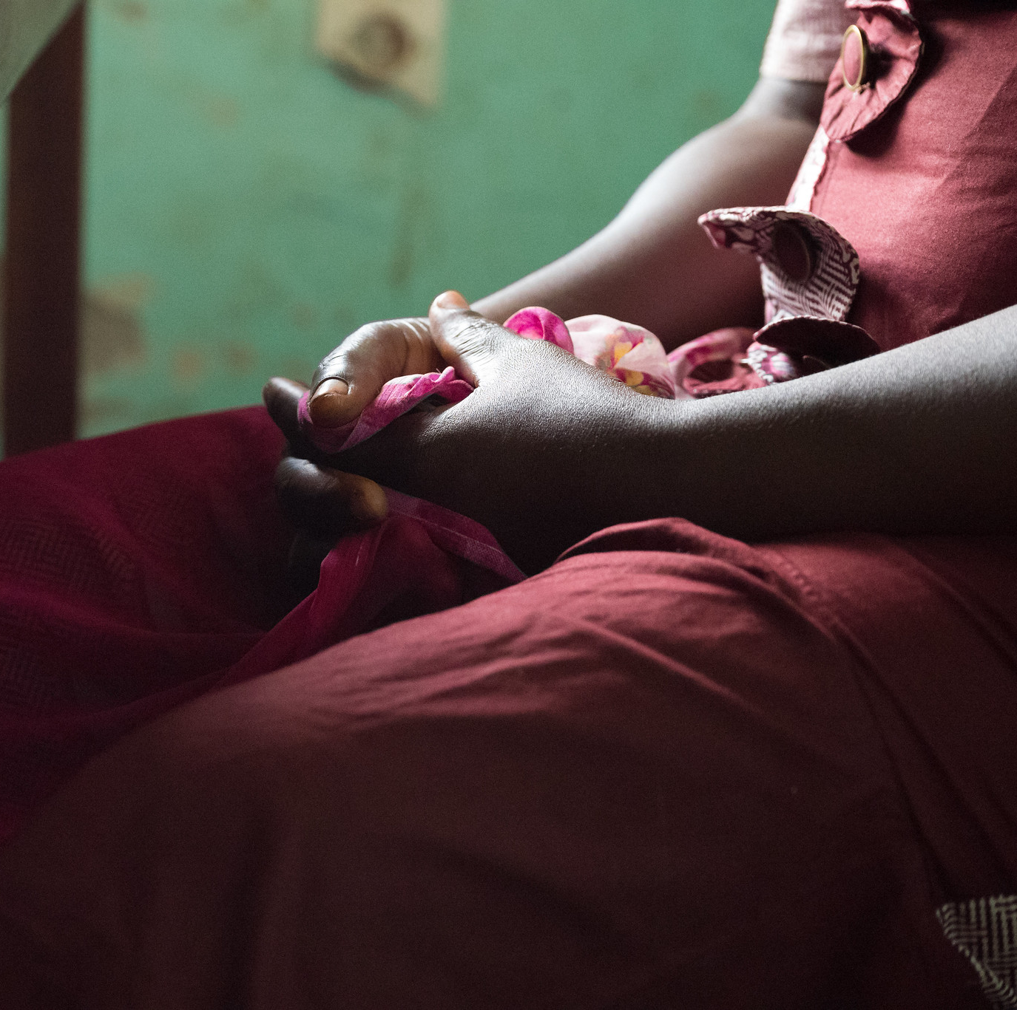
Case Scenario​
You perform a rapid HIV test and Imani's rapid HIV antibody test today is negative.​
Can she be initiated on oral daily PrEP?​
What is the next step? ​
Notes:
Facilitator guidance:
Read the scenario and question on the slide asking participants, "Can Imani be initiated on oral daily PrEP today?" [Answer: Maybe]
Prompt the participants with follow up questions, "What is the next step in the clinical pathway for oral daily PrEP initiation?" [Answer: The next step in the clinical pathway is to screen for substantial risk for HIV.]
Ask participants to raise hands and share their answers.
Continue to the following slide to provide the answer after receiving inputs from participants.

Slide 56
Suggested Clinical Pathway: Oral Daily PrEP Initiation ​
1
2
3
4
5
Confirm HIV Negative Status​
Screen for Substantial Risk for HIV ​
PrEP Counseling​
Establish Eligibility for Oral Daily PrEP​
Initiate PrEP
Perform rapid HIV test or assisted HIV self-test per national guidelines ​ Link people found to be living with HIV to care and treatment​
Member of a population eligible for PrEP according to national guidelines​
Informed choice counseling about available PrEP options​ (if more than one available) Educate about oral daily PrEP Shared decision making to start oral daily PrEP​
No evidence of AHI​ Willingness to use oral daily PrEP as prescribed​ Low risk for or no evidence of kidney function impairment​
Counseling on adherence, risk reduction, side effects and AHI symptoms​ STI screening and management ​ Dispense PrEP medication and schedule follow-up appointment​
See Module 6 for more information about informed choice counseling​

Slide 57
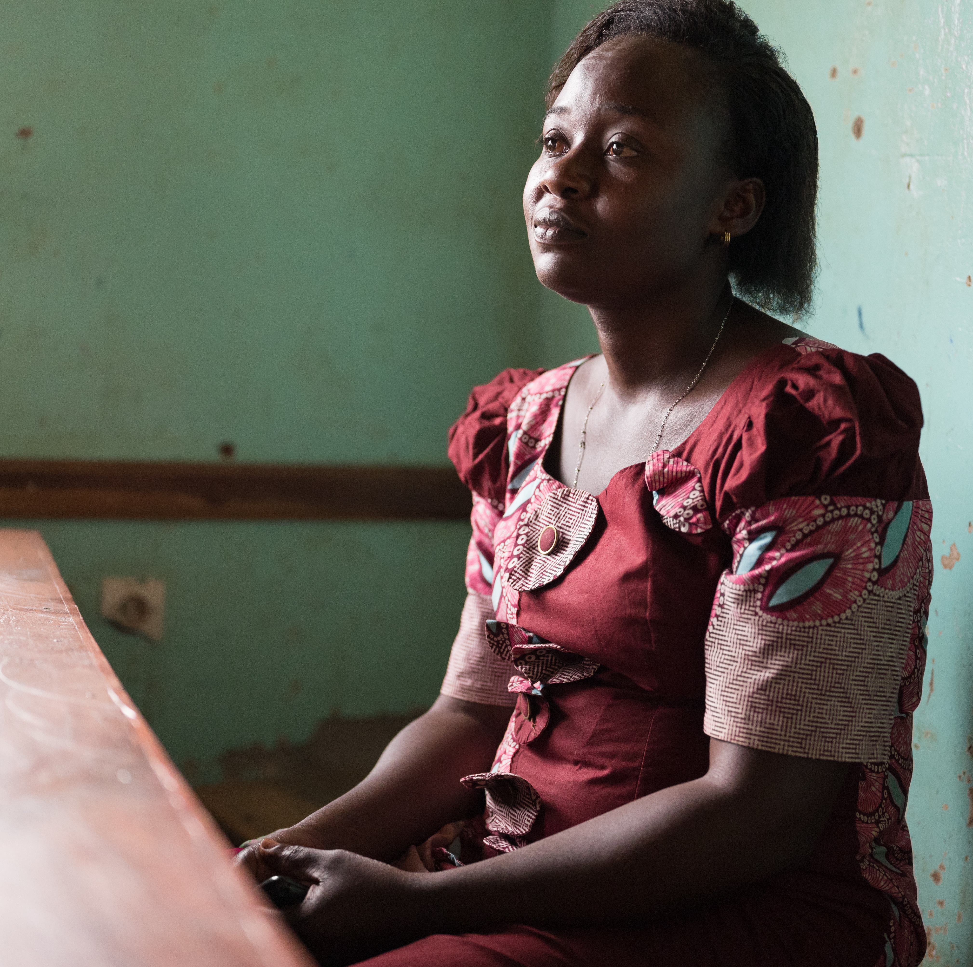
Case Scenario​
Imani reports that she has had sex with multiple partners in the last 6 months, including sex without condoms, and sex in exchange for money. ​
Is Imani at substantial risk for HIV? ​
Can Imani be initiated on oral daily PrEP today?​
What is the next step?​
Notes:
Facilitator guidance:
Read the scenario and question on the slide asking participants, "Is Imani at substantial risk for HIV?" [Answer: Yes]
Prompt the participants with follow up questions, "Can Imani be initiated on oral daily PrEP today?" [Answer: Maybe] "What is the next step in the clinical pathway for oral daily PrEP initiation?" [Answer: PrEP Counseling]
Ask participants to raise hands and share their answers.
Continue to the following slide to provide the answer after receiving inputs from participants.

Slide 58

Step 2: Screen for Substantial Risk for HIV​
Does the client report any one of the following in the past six months?​
 | Sexual activity in a high HIV prevalence population or key population group
 | Vaginal or anal intercourse without condoms with more than one partner
 | Sex partner with one or more HIV risk factor
 | History of an STI (based on lab test, syndromic STI treatment, or self-report)
 | History of use of PEP
 | History of sharing of injection material and/or equipment with another person
 | Having a sexual partner who is HIV positive and has been ART for less than 6 months or has inconsistent or unknown adherence
 | Asking for PrEP. This may indicate risk behavior they are unwilling to share.
Screen for substantial risk for HIV according to national guidelines. ​

Slide 59
Suggested Clinical Pathway: Oral Daily PrEP Initiation ​
1
2
3
4
5
Confirm HIV Negative Status​
Screen for Substantial Risk for HIV ​
PrEP Counseling
Establish Eligibility for Oral Daily PrEP​
Initiate PrEP
Perform rapid HIV test or assisted HIV self-test per national guidelines ​ Link people found to be living with HIV to care and treatment​
Member of a population eligible for PrEP according to national guidelines​
Informed choice counseling about available PrEP options​ (if more than one available) Educate about oral daily PrEP Shared decision making to start oral daily PrEP​
No evidence of AHI​ Willingness to use oral daily PrEP as prescribed​ Low risk for or no evidence of kidney function impairment​
Counseling on adherence, risk reduction, side effects and AHI symptoms​ STI screening and management ​ Dispense PrEP medication and schedule follow-up appointment​
See Module 6 for more information about informed choice counseling

Slide 60
Step 3: PrEP Counseling​
Initial oral daily PrEP counseling should:​
Increase awareness of PrEP as a prevention choice
Explain how PrEP works
Discuss sexual health and emphasize that PrEP should be used as part of a package of HIV prevention services
Help clients decide whether PrEP is right for them
Educate about the importance of adherence and follow-up visits
Describe common oral PrEP side effects and side effects management​
Educate about how to safely stop and start oral PrEP
Educate about other PrEP options and support informed decision making (if applicable)
See Module 6 for more information about informed choice counseling​

Slide 61
Key Initial Visit Counseling Messaging: Oral PrEP Basics​
Oral PrEP works when taken regularly! ​ Oral PrEP prevents HIV infection and is effective for everyone when taken every day.​
PrEP does not prevent STIs other than HIV. ​ Using condoms with every act of sexual intercourse provides some protection against many of these infections.​
PrEP does not prevent pregnancy. ​ Use effective contraception unless you want pregnancy.​
PrEP is safe.​
Oral PrEP side effects usually go away within the first month.​ Gastrointestinal side effects (e.g., nausea, diarrhea, stomach pain) can occur, but usually go away over time. ​

Slide 62
Review: Stopping and Starting Oral PrEP
​ | Assigned male sex at birth ​ + NO​T taking estradiol-based hormones ​ + sexual HIV exposure only. | Assigned female sex at birth ​OR taking estradiol-based hormones ​OR parenteral HIV exposure. ​
Starting oral PrEP​ | Start with 2 pills 2-24 before sexual exposure | Start 7 consecutive days before exposure​
Stopping oral PrEP​ | Stop after 2 days post-exposure​ | Stop after 7 days post-exposure​
Groups included​ | Cisgender men​ Transgender women and non-binary individuals assigned male sex at birth NOT taking gender-affirming hormones. ​ | Cisgender women​ Transgender women and non-binary individuals assigned male sex at birth taking gender-affirming hormones​. Transgender men and non-binary individuals assigned female sex at birth.​ Individuals with exposure through injecting practices.​
WHO, 2022

Slide 63
Questions to Determine Recommendations for Starting and Stopping Oral PrEP​
Male
What sex was the
individual assigned at birth?​
Female
HIV exposure through injecting practices?​
YES
Start 7 consecutive days before exposure and stop after 7 days post-exposure​
NO
Taking estradiol-based hormones as gender-affirming hormone therapy?​
YES
NO
Start with 2 pills 2-24h before sexual exposure and stop after 2 days post-exposure​

Slide 64
Key Initial Visit Counseling Messaging: Starting and Stopping Oral PrEP​
For individuals assigned male sex at birth
+ not taking estradiol-based hormones
+ sexual HIV exposure only
Starting oral PrEP​ Start PrEP with two pills (loading dose) taken between 2 and 24 hours before you expect to have sex. Ideally, this loading dose should be taken closer to 24 hours before your potential sexual exposure.​
Stopping oral PrEP​ If you would like to stop taking oral PrEP, continue to take one dose every day until 2 days after the day of your last potential sexual exposure.

Slide 65
Key Initial Visit Counseling Messaging: Starting and Stopping Oral PrEP​
For individuals assigned female sex at birth
or taking estradiol-based hormones
or parenteral HIV exposure​
Starting oral PrEP​ Start PrEP with one dose every day for 7 consecutive days to achieve protective levels in your body. Alternative HIV prevention methods should be used during this time. ​
Stopping oral PrEP​ If you would like to stop taking PrEP, continue taking one dose every day and stop 7 days after your last potential exposure to HIV. ​

Slide 66
PrEP Re-Initiation
Some clients may be re-initiating oral PrEP after previously stopping PrEP.​
It is important to evaluate their current knowledge and previous experience with oral PrEP and to tailor counseling appropriately.​
To support their PrEP use going forward, evaluate the reason(s) they previously stopped oral PrEP and address any barriers (if applicable).​
Reasons for stopping could include:​
  Periods of low or no HIV risk​
  PrEP side effects​
  Difficulty remembering to take pills​
  Difficulty attending visits and/or getting refills​
  Change in PrEP access, e.g., change in location, finances, PrEP programs ​
See Module 6 for more information on PrEP counseling approaches​

Slide 67
Break into groups of 3. Take turns role-playing for oral daily PrEP initiation counseling. ​
PrEP clinical provider: Deliver key counseling messages for initiating a candidate on oral daily PrEP. ​
PrEP candidate: Pretend to be a client considering PrEP. Ask lots of questions to decide if PrEP is right for you. ​
Observer: Silently observe the interaction and notice if the provider is delivering all of the key counseling messages. Did they miss anything? ​
Discuss among you. What worked well? What could be improved? Were there any key counseling messages that were missed or should be added? ​
ROLE-PLAY AND DISCUSSION
Notes:
Facilitator guidance:
Time: 40 minutes
Explain that participants will now work in small groups to role-play oral daily PrEP initiation counseling.
Divide participants into groups of 3 participants each.
Define participant roles. One participant will role-play the PrEP clinical provider. One participant will role-play the PrEP candidate. One participant will observe. Take turns to explore each of the 3 roles.
The participant in the role of PrEP clinical provider will deliver key counseling messages for initiating a candidate on oral daily PrEP. Allow this participant to reference the previous slides with key counseling messages.
The participant in the role of PrEP candidate will pretend to be considering starting PrEP and should ask questions to decide if PrEP is right for them.
The participant in the role of the observer should silently observe the interaction between the PrEP clinical provider and PrEP candidate and notice if the provider is delivering the key counseling messages or if they missed anything. Allow this participant to reference the previous slides with key counseling messages as needed.
Allow 5 minutes for the role-play.
Discuss among participants in the small group. What worked well? What could be improved? Were there any key counseling messages that were missed or should be added?
Allow 5 minutes for discussion.
Switch roles until each participant has played in each of the 3 roles.
Return to the larger group and discuss what you experienced and learned from the role-play. Allow 10 minutes for large group discussion.

Slide 68
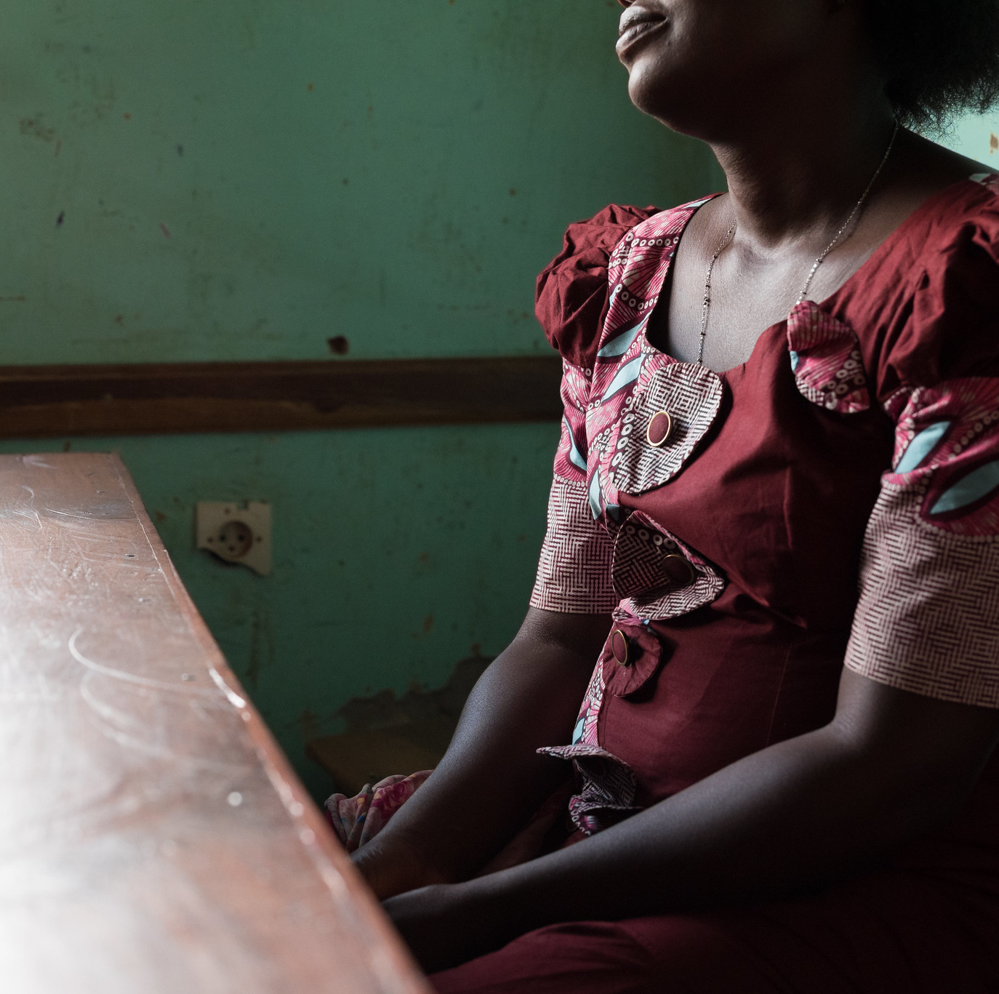
Case Scenario​
Imani decides that she would like to start taking PrEP as a daily pill to protect herself against HIV. ​
Can she be initiated on oral daily PrEP today? ​
Follow the steps in the clinical pathway to decide. ​
Notes:
Facilitator guidance:
Read the scenario and question on the slide asking participants, "Can Imani be initiated on oral daily PrEP today?" [Answer: Maybe]
Prompt the participants with follow up questions, "What is the next step in the clinical pathway for oral daily PrEP initiation?" [Answer: Establish eligibility for oral daily PrEP]
Ask participants to raise hands and share their answers.
Continue to the following slide to provide the answer after receiving inputs from participants.

Slide 69
Suggested Clinical Pathway: Oral Daily PrEP Initiation ​
1
2
3
4
5
Confirm HIV Negative Status​
Screen for Substantial Risk for HIV ​
PrEP Counseling​
Establish Eligibility for Oral Daily PrEP​
Initiate PrEP
Perform rapid HIV test or assisted HIV self-test per national guidelines ​ Link people found to be living with HIV to care and treatment​
Member of a population eligible for PrEP according to national guidelines​
Informed choice counseling about available PrEP options​ (if more than one available) Educate about oral daily PrEP Shared decision making to start oral daily PrEP​
No evidence of AHI​ Willingness to use oral daily PrEP as prescribed​ Low risk for or no evidence of kidney function impairment​
Counseling on adherence, risk reduction, side effects and AHI symptoms​ STI screening and management ​ Dispense PrEP medication and schedule follow-up appointment​
See Module 6 for more information about informed choice counseling

Slide 70
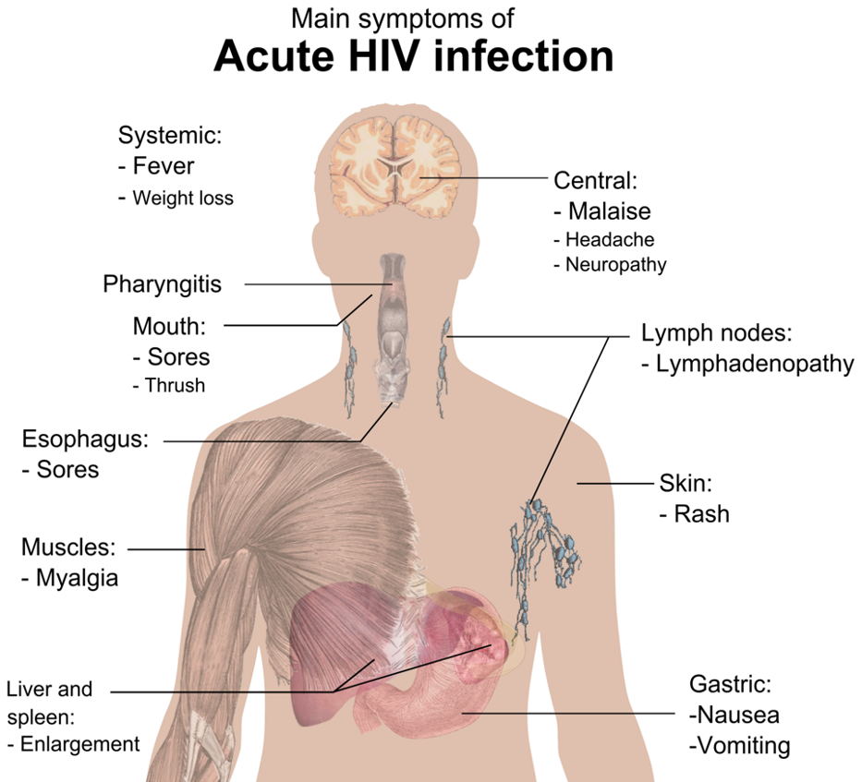
Step 4: Establish Eligibility for Oral Daily PrEP
No evidence of AHI​
Assess for flu-like symptoms within the last 4 weeks.​
Low risk for or no evidence of kidney function impairment​
Determine age and assess for medical co-morbidities that may impair renal function (e.g., diabetes, hypertension)​
Determine whether a serum creatinine test is indicated (see next slide)
See Module 1 for more information about AHI screening​

Slide 71
Decision Algorithm for Kidney Function Monitoring During Oral PrEP Initiation​
Does the individual have any known kidney-related co-morbidities (e.g., diabetes or hypertension)? ​
NO
YES
What age is the individual?​
<30 years​
30+ years​
Evaluate CrCl once within 1-3 months after oral PrEP initiation​
CrCl evaluation optional​

Slide 72
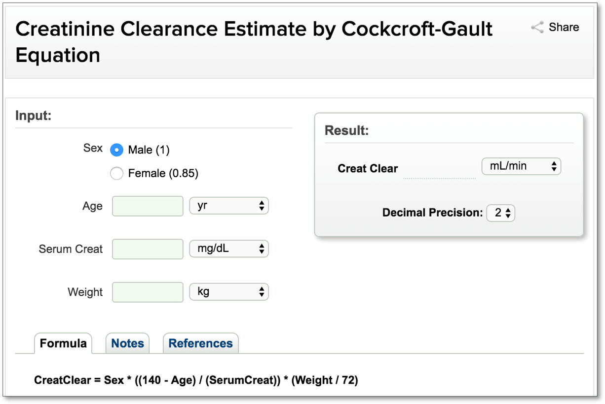
Online Cockcroft-Gault Calculator​
https://reference.medscape.com/calculator/51/crcl-cockroft-gault

Slide 73
Case Scenario​
Imani reports feeling well and hasn’t had any recent flu symptoms or potential exposure to HIV in the last 72 hours.
Imani is 22 years old and has no medical comorbidities.
Do you suspect AHI? ​Is she at risk for kidney function impairment? ​
What will you do next?​
Notes:
Facilitator guidance:
Read the scenario and question on the slide asking participants, "Do you suspect AHI?" [Answer: No], "Is she at risk for kidney function impairment?" [Answer: No, it is very unlikely]
Prompt the participants with follow up questions, "What will you do next?" [Answer: Initiate PrEP]
Ask participants to raise hands and share their answers.
Continue to the following slide to provide the answer after receiving inputs from participants

Slide 74
Suggested Clinical Pathway: Oral Daily PrEP Initiation ​
1
2
3
4
5
Confirm HIV Negative Status​
Screen for Substantial Risk for HIV ​
PrEP Counseling
Establish Eligibility for Oral Daily PrEP​
Initiate PrEP​
Perform rapid HIV test or assisted HIV self-test per national guidelines ​ Link people found to be living with HIV to care and treatment​
Member of a population eligible for PrEP according to national guidelines​
Informed choice counseling about available PrEP options​ (if more than one available) Educate about oral daily PrEP Shared decision making to start oral daily PrEP​​
No evidence of AHI​ Willingness to use oral daily PrEP as prescribed​ Low risk for or no evidence of kidney function impairment​
Counseling on adherence, risk reduction, side effects and AHI symptoms​ STI screening and management ​ Dispense PrEP medication and schedule follow-up appointment​
See Module 6 for more information about informed choice counseling

Slide 75
Step 5: Initiate Oral Daily PrEP
Prescribe oral daily PrEP
  One pill taken at the same time daily
Counsel on adherence, risk reduction, side effects and AHI symptoms ​
  Clients should be encouraged to return early if they experience AHI symptoms
Screen for STIs
  HBV, HCV, RPR, and pregnancy testing (women only) are recommended but not required
Dispense PrEP medication ​
Schedule follow-up appointment​

Slide 76
Key Initial Visit Counseling Messaging: Supporting Adherence
Taking oral PrEP each day is easiest if you make taking the pills a daily habit, linked to something else you do daily without fail.​
If you forget to take a pill or miss a dose, take it as soon as you remember. ​ For example, if you usually take PrEP in the morning but realize at 10pm one night that you forgot, it is okay to take your pill then and resume your usual schedule the following morning.
PrEP pills can be taken any time of day, with or without food.​
PrEP is safe and effective even if you are taking hormonal contraceptives, sex hormones, or non-prescription drugs. ​

Slide 77
Prescribe Oral Daily PrEP and Schedule a Follow-up Visit​
A follow-up visit should occur one month after initiation to:​
  Evaluate adherence and provide counseling on effective use
  Evaluate and manage any side effects
  Repeat an HIV test to rule out AHI that may have been present at initiation​
A client should be prescribed at least a 1-month supply (e.g., 1 pill bottle with 30 pills) and the next follow-up visit should be scheduled before their supply runs out.​
If blood tests are done, any abnormal results should be shared with the client before the next visit.​
Some programs allow a multi-month supply to be dispensed at the initiation visit with virtual follow-up visits.​
In [insert country name] during oral PrEP initiation visits [number of pills] are dispensed and follow up is scheduled for [insert follow-up time period and place].​
Notes:
Facilitator guidance:
Edit this slide in advance of the training by inserting the country name, number of pills to be dispensed during oral PrEP initiation visits, and follow-up time period and place in your setting.

Slide 78
How do you conduct visits for oral daily PrEP initiation in your setting?​
Consider your approach to HIV testing, HIV risk screening, PrEP counseling, eligibility assessment, and PrEP initiation, dispensing and follow-up. ​
What are the successes and challenges from your experience? What is working well? What can be improved? ​
DISCUSSION​
Notes:
Facilitator guidance:
• Time: 10 minutes
• Explain that participants who want to speak should raise their hands.
• Keep the discussion on target and moving along.
• Encourage everyone to participate and call on everyone who raises a hand.
• Ask questions to encourage more responses to a question—for example: “What else?” “What other ideas do you have?”
• Wrap up the discussion by repeating and summarizing main points.

Slide 79
2.4 Oral Daily PrEP Follow-up Visits​

Slide 80
QUESTION
What are the procedures for oral daily PrEP follow-up visits? ​
How are visits scheduled?​
Notes:
Facilitator guidance:
Read the question on the slide.
Ask participants to raise their hands to answer the question.
Take a few volunteer responses.
Reveal the answer on the following slide.
Allow time for follow-up discussion as needed

Slide 81
ANSWER
Follow-up visits should be provided one month after starting oral daily PrEP and continue every 3 months. ​
Essential follow-up visit procedures include HIV testing, HIV risk assessment, side effects management, and adherence counseling. ​
Notes:
Facilitator guidance:
Reveal the answer on the slide.
Allow time for questions and follow-up discussion as needed.

Slide 82
PrEP Follow-Up Visits​
Clients on PrEP require regular visits with a health provider.​
Programs should decide on the optimal frequency of visits for monitoring PrEP use. The suggested follow-up visit schedule is:​
  A month after initiating PrEP
  Every 3 months thereafter
Outside of regular monitoring visits, clients should also consult their providers if they experience adverse events, side effects, or signs or symptoms of AHI.​
Follow-up can be provided using a differentiated service delivery (DSD) approach in outpatient or community-based settings, using peer or virtual support. ​

Slide 83
Oral PrEP Follow-Up Visit Procedures​
Intervention​ | Schedule Following PrEP Initiation​
Confirmation of HIV negative status | At one month follow-up ​ Every 3 months
Review the client’s HIV risk | Every visit
Address side effects | Every visit
Brief adherence evaluation and counseling | Every visit
Determine need for creatinine clearance evaluation​ | Every visit
Screening for HBV and HCV (optional) | Once within 3 months of initiation
Counsel on stopping/starting PrEP, AHI symptoms and advise to come back as soon as possible for evaluation if AHI symptoms occur | Every visit
Provide STI screening, condoms and contraception | Every visit, and as needed

Slide 84
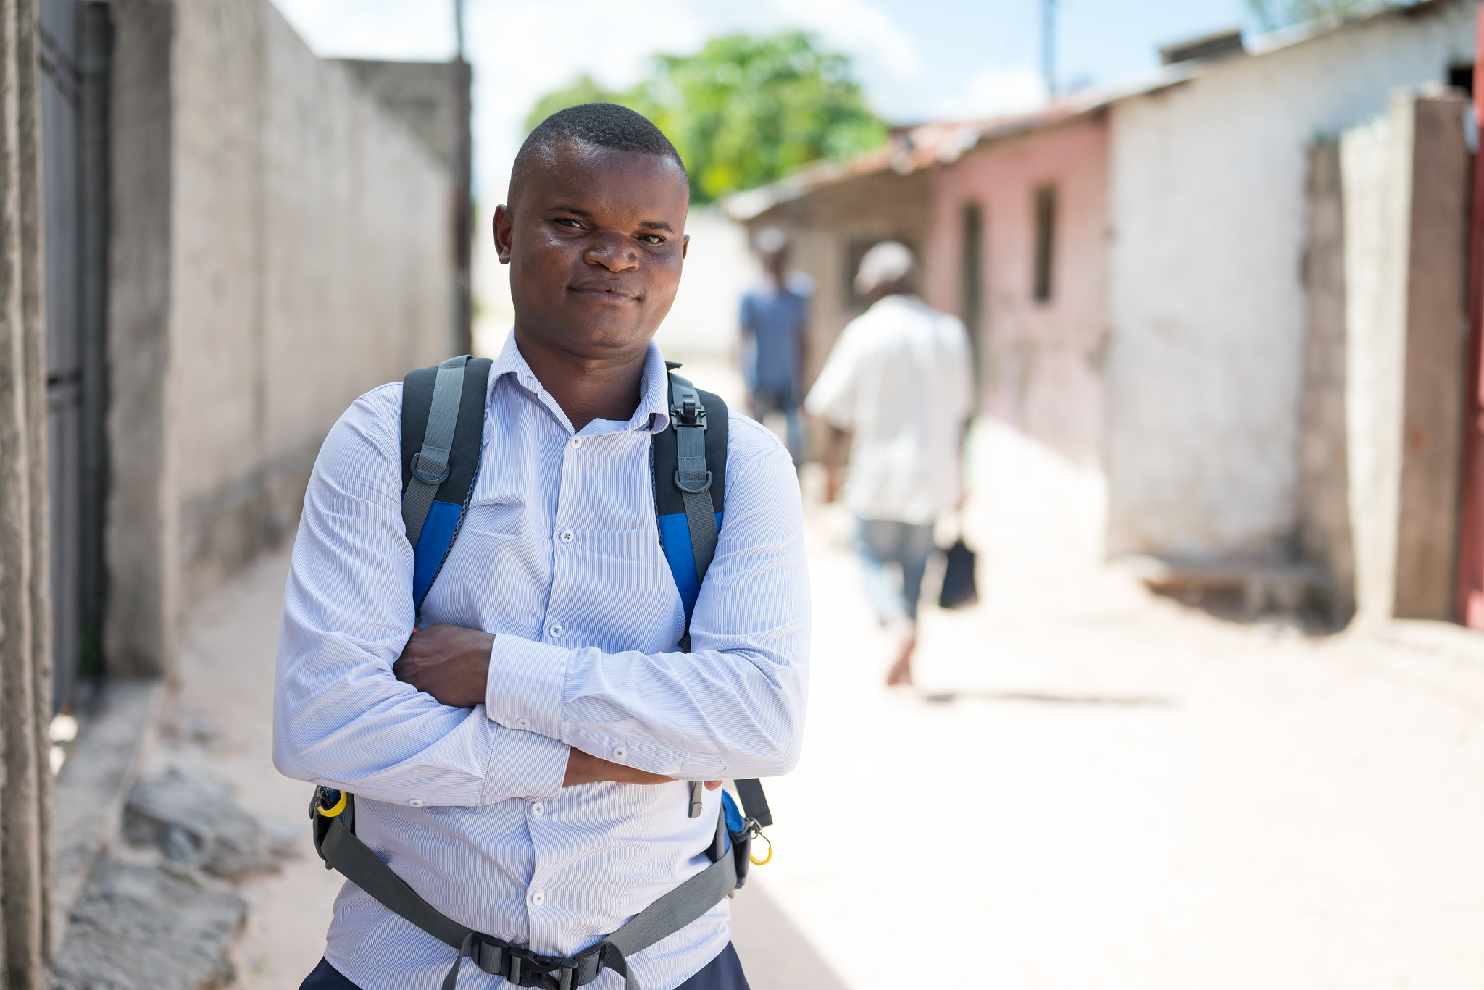
Case Scenario​
Joseph returns to the clinic 1 month after starting oral daily PrEP.
What is the first step to determine if he can continue taking PrEP? ​
Notes:
Facilitator guidance:
Explain to participants that a case scenario is provided for them to practice applying their knowledge to each step of the clinical pathway for oral daily PrEP follow-up according to their practice and local context.
Read the scenario and question on the slide asking participants, "Can Joseph continue taking oral daily PrEP?" [Answer: Maybe]
Prompt the participants with follow up questions, "What is the first step in the clinical pathway for oral daily PrEP follow up?" [Answer: Confirmation that he is still HIV negative]
Ask participants to raise hands and share their answers.
Continue to the following slide to provide the answer after receiving inputs from participants.

Slide 85
Oral PrEP Follow-Up Visit Procedures​
Intervention​ | Schedule Following PrEP Initiation​
Confirmation of HIV negative status | At one month follow-up ​ Every 3 months
Review the client’s HIV risk | Every visit
Address side effects | Every visit
Brief adherence evaluation and counseling | Every visit
Determine need for creatinine clearance evaluation​ | Every visit
Screening for HBV and HCV (optional) | Once within 3 months of initiation
Counsel on stopping/starting PrEP, AHI symptoms and advise to come back as soon as possible for evaluation if AHI symptoms occur | Every visit
Provide STI screening, condoms and contraception | Every visit, and as needed

Slide 86
Follow-up HIV Testing for PrEP​
HIV follow-up testing schedule:​
  1 month after starting PrEP​
  Every 3 months thereafter​
HIV test result:​
  HIV negative test: safe to continue PrEP use
  HIV positive test: stop PrEP and link to HIV care and treatment immediately ​
Method (follow national guidelines): ​
  Rapid HIV test at point-of-care
  HIV self-tests (HIVST) outside of clinical setting ​
Note: Serological tests are limited during AHI in the “window” period from HIV infection to detection of antibodies. Exposure to ARVs can decrease sensitivity of serological tests. Stop PrEP if you suspect AHI

Slide 87
HIVST Use With PrEP​
According to the WHO, HIVST can complement existing HIV testing strategies for PrEP to support DSD approaches, remove barriers to accessing PrEP and increase uptake, persistence and effective use.​
HIVST can be considered as part of PrEP delivery for:​
  Demand generation and linkage to PrEP​
  Starting oral PrEP ​
  Restarting oral PrEP ​
  Continuing oral PrEP ​
HIVST can be more convenient, protects privacy and promotes self-managed care.
HIVST may be particularly appropriate to support PrEP continuation and re-initiation for more experienced PrEP users. ​
WHO, 2022

Slide 88
HIVST Use With PrEP (continued)​
Regular interactions between PrEP providers and clients remains important to ensure that PrEP users have adequate counselling and can raise any issues or concerns with providers. ​
HIVST-supported PrEP delivery models that reduce clinic visits should be balanced with the benefits of provision of comprehensive services​.
Clear and concise messages are critical: ​
  For initiation, following a reactive HIVST, individuals should not initiate PrEP and seek further testing by a trained provider.​
  For continuation, following a reactive HIVST, PrEP users should not discontinue PrEP and seek further testing by a trained provider immediately.​
  Regular HIV testing is important while taking PrEP to identify an HIV infection as soon as possible. ​
WHO, 2022

Slide 89
HIV Positive Test Result: Managing Seroconversion on PrEP​
HIV seroconversion after prescribing oral PrEP can occur if PrEP is not used correctly or consistently, or if HIV infection was undiagnosed at the time of PrEP initiation.​
Counseling should include information to help PrEP users recognize AHI signs and symptoms, which should prompt a clinic visit without delay.​
If a person using PrEP tests positive for HIV, PrEP should be stopped immediately, and the person referred for prompt initiation of HIV treatment. ​
Transition from PrEP to HIV treatment without a gap avoids the risk of an elevated viral load, damage to the immune system, and secondary transmissions.​

Slide 90
Oral PrEP Follow-Up Visit Procedures​
Intervention​ | Schedule Following PrEP Initiation​
Confirmation of HIV negative status | At one month follow-up ​ Every 3 months
Review the client’s HIV risk | Every visit
Address side effects | Every visit
Brief adherence evaluation and counseling | Every visit
Determine need for creatinine clearance evaluation​ | Every visit
Screening for HBV and HCV (optional) | Once within 3 months of initiation
Counsel on stopping/starting PrEP, AHI symptoms and advise to come back as soon as possible for evaluation if AHI symptoms occur | Every visit
Provide STI screening, condoms and contraception | Every visit, and as needed

Slide 91
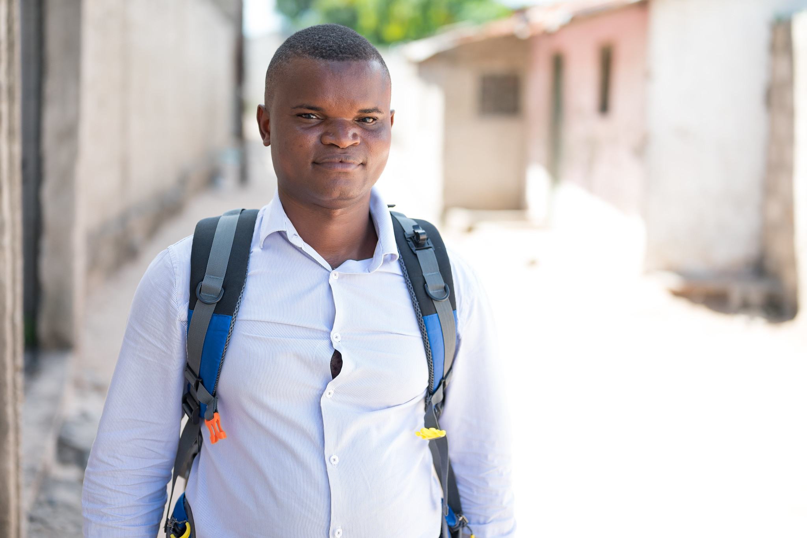
Case Scenario​
Joseph is relieved to hear that his HIV test is negative today. He reports that in the past month since he started PrEP, he had anal sex with a new partner of unknown HIV status without a condom. He thinks his partner may occasionally use injection drugs.​
Is Joseph at substantial risk for HIV? ​
Should he continue using PrEP? ​
Notes:
Facilitator guidance:
Read the scenario and question on the slide asking participants, "Is Joseph at substantial risk for HIV?" [Answer: Yes]
Prompt the participants with follow up questions, “Should Joseph continue using oral daily PrEP?" [Answer: Yes]
Ask participants to raise hands and share their answers.
Continue to the following slide to provide the answer after receiving inputs from participants.

Slide 92
Step 2: Screen for Substantial Risk for HIV​
Does the client report any one of the following in the past six months?​
 | Sexual activity in a high HIV prevalence population or key population group
 | Vaginal or anal intercourse without condoms with more than one partner
 | Sex partner with one or more HIV risk factor
 | History of an STI (based on lab test, syndromic STI treatment, or self-report)
 | History of use of PEP
 | History of sharing of injection material and/or equipment with another person
 | Having a sexual partner who is HIV positive and has been ART for less than 6 months or has inconsistent or unknown adherence
 | Asking for PrEP. This may indicate risk behavior they are unwilling to share.
Screen for substantial risk for HIV according to national guidelines. ​

Slide 93
Oral PrEP Follow-Up Visit Procedures​
Intervention​ | Schedule Following PrEP Initiation​
Confirmation of HIV negative status | At one month follow-up ​ Every 3 months
Review the client’s HIV risk | Every visit
Address side effects | Every visit
Brief adherence evaluation and counseling | Every visit
Determine need for creatinine clearance evaluation​ | Every visit
Screening for HBV and HCV (optional) | Once within 3 months of initiation
Counsel on stopping/starting PrEP, AHI symptoms and advise to come back as soon as possible for evaluation if AHI symptoms occur | Every visit
Provide STI screening, condoms and contraception | Every visit, and as needed

Slide 94
Case Scenario​
Joseph says that since he started taking oral daily PrEP one month ago, he has experienced some mild nausea.
What counseling or intervention will you provide? ​
Notes:
Facilitator guidance:
Read the scenario and question on the slide asking participants, "What counseling or intervention will you provide" [Answer: Address side effects, reassure him these side effects are common and usually go away on their own]
Prompt the participants with follow up questions, "What is the next step in oral daily PrEP follow-up visit procedures?" [Answer: Adherence evaluation and counseling]
Ask participants to raise hands and share their answers.
Continue to the following slide to provide the answer after receiving inputs from participants.

Slide 95
Oral PrEP Follow-Up Visit Procedures​
Intervention​ | Schedule Following PrEP Initiation​
Confirmation of HIV negative status | At one month follow-up ​ Every 3 months
Review the client’s HIV risk | Every visit
Address side effects | Every visit
Brief adherence evaluation and counseling | Every visit
Determine need for creatinine clearance evaluation​ | Every visit
Screening for HBV and HCV (optional) | Once within 3 months of initiation
Counsel on stopping/starting PrEP, AHI symptoms and advise to come back as soon as possible for evaluation if AHI symptoms occur | Every visit
Provide STI screening, condoms and contraception | Every visit, and as needed

Slide 96
Oral Daily PrEP Follow-Up Counseling​
What to discuss during follow-up visits
Current context of sexual health e.g., sexual and drug use behaviors
Non-PrEP sexual health protection strategies e.g., condom use
Assessment of continued risk of HIV and continuing need for PrEP
Intention to remain on PrEP
Facilitators and barriers to PrEP use​
Adherence problems ​
Common adherence strategies​
Challenges connected with PrEP use e.g., stigma​
Alternative PrEP options, if applicable and appropriate

Slide 97
Oral Daily PrEP Follow-Up Counseling​ (continued)​
What to discuss during follow-up visits​
Reasons for ongoing monitoring while on PrEP
Dosing requirements for HIV protection
What to do if a dose is missed
How to recognize symptoms of AHI​
Side effects and their management​
How to safely discontinue and restart oral PrEP

Slide 98
Defining Adherence for Oral Daily PrEP​
Adherence to drugs means that an individual is taking prescribed medications correctly and consistently.
It involves taking the correct drug at the correct dose:​
  With consistent frequency (the same number of times per day)
  At a consistent time of day
Adherence with follow-up means that clients attend all scheduled clinic visits and observe all required protocols, including:​
  Clinical and lab assessments
  Prescription refills

Slide 99
Assessing Oral PrEP Adherence ​
Monitoring PrEP use and adherence is important.​
It is essential that the monitoring be done in an open-ended and non-judgmental manner.​
Take a neutral approach to adherence behavior to support the client in finding solutions to adherence challenges​.
A neutral assessment of adherence allows for a constructive discussion that can support the client in finding solutions to adherence challenges. ​
See Module 6 for more information on PrEP counseling approaches​

Slide 100
Assessing Oral PrEP Adherence (continued)​
Normalize adherence challenges.
  For example:​ Many people have trouble remembering to take a daily pill, especially when starting a new medication. Has this happened to you?
Ask about difficulties adhering, not non-adherence​:
  For example: Tell me about any difficulties you have had in taking your daily pill.
  Instead of:​ Have you missed doses of your medication?
See Module 6 for more information on PrEP counseling approaches​

Slide 101
Discussion Prompts for Follow-Up Visits ​
Sample open-ended questions about adherence​
How has it been for you to take PrEP? ​
What side effects have you had, if any? ​
What or who helps you remember to take your pill? ​
What challenges do you experience in taking the pills? When are you more likely to forget? ​
What are your concerns about missing PrEP pills? ​
What have been your experiences with missing PrEP doses? ​
What helps or might help you to take your pills regularly? Helpful strategies may include the following [see next slide]… ​
Adapted from WHO, 2017

Slide 102
Adherence Strategies​
Here are some strategies you could try to help with PrEP adherence:
Use a pillbox ​
Take the pill at the same time every day
Link PrEP to daily routine or event like brushing teeth or eating breakfast
Take PrEP pills with other daily medicines
Use reminder alarms, text messages, or a calendar
Have more support from your partner, a family member, or a friend
Have a back-up supply of pills in a bag or purse​
Carry extra pills in case routines are disrupted, e.g., stay out overnight, go on holiday

Slide 103
Additional Considerations with Sub-Optimal Adherence to Daily PrEP
In addition to adherence counseling, if a client reports sub-optimal PrEP adherence providers should:​
Evaluate for AHI symptoms ​
Evaluate for any potential recent HIV exposure that would make them eligible for PEP​
Counsel clients on other prevention options, including other PrEP options (if applicable)​
Assess for any pill bottles they still have at home:​
  Instruct clients on how to check bottles for expiration dates and inform them not to take expired pills. ​
  Consider adjusting the amount of medication dispensed to account for the number of usable, unopened bottles they still have. ​

Slide 104
Case Scenario​
Joseph says he has missed a few days since he started taking PrEP because he forgot.
What strategies can you suggest to support Joseph's adherence to oral daily PrEP? ​
Notes:
Facilitator guidance:
Read the scenario and question on the slide asking participants, "What strategies can you suggest to support Joseph's adherence to oral daily PrEP?
Ask participants to raise hands and share their answers.
Answer:
Some potential strategies include:.
Use a pillbox
Take the pill at the same time every day
Link PrEP to daily routine or event like brushing teeth or eating breakfast
Take PrEP pills with other daily medicines.
Use reminder alarms, text messages, or a calendar
Have more support from your partner, a family member, or a friend.

Slide 105
Oral PrEP Follow-Up Visit Procedures​
Intervention​ | Schedule Following PrEP Initiation​
Confirmation of HIV negative status | At one month follow-up ​ Every 3 months
Review the client’s HIV risk | Every visit
Address side effects | Every visit
Brief adherence evaluation and counseling | Every visit
Determine need for creatinine clearance evaluation​ | Every visit
Screening for HBV and HCV (optional) | Once within 3 months of initiation
Counsel on stopping/starting PrEP, AHI symptoms and advise to come back as soon as possible for evaluation if AHI symptoms occur | Every visit
Provide STI screening, condoms and contraception | Every visit, and as needed

Slide 106
Decision Algorithm for Kidney Function Monitoring During Oral PrEP Follow-up Visits​
Does the individual have any known kidney-related co-morbidities (e.g., diabetes or hypertension)? ​
YES
NO
What age is the individual?​
<50 years​
50+ years​
Evaluate CrCl every 6-12 months ​
NO
Was a baseline CrCl
estimation done?​
What age is the individual?​
30+ years​
<30 years​
YES
≥90ml/min​
<90ml/min​
Evaluate
CrCl once​
CrCl optional​

Slide 107
Monitoring Creatinine Results​
Impaired kidney function is a contraindication for the use of TDF-based oral PrEP​.
  Defined as an eGFR or an estimated CrCl of <60 ml/min
Before stopping oral PrEP due to reduced kidney function, the kidney function test should be repeated on another day. ​
Creatinine elevations usually reverse after stopping PrEP.​
Other HIV prevention options should be discussed with clients when stopping PrEP. ​

Slide 108
Managing Creatinine Elevation​
Stop PrEP if creatinine elevation is confirmed on a separate specimen and if estimated creatinine clearance decreases to <60 ml/min.​
After PrEP is stopped, creatinine should be checked for another 1 to 3 months and PrEP can be restarted if eGFR returns to >60 ml/min.​
Consider additional causes and management of creatinine elevations if:​
  Creatinine elevation reaches more than 3 times the baseline
  Renal function or creatinine elevations do not return to normal levels within 3 months after stopping PrEP
Common causes of chronic or severe renal insufficiency include diabetes, uncontrolled hypertension, hepatitis C infection, liver failure, and pre-eclampsia during pregnancy.​

Slide 109
Case Scenario​
Joseph is 29 years old and turns 30 next month. He does not have any known medical problems and did not have a baseline creatinine test done.
Does he need to have a creatinine test with this PrEP visit? ​
What about when he returns in 3 months?​
Notes:
Facilitator guidance:
Read the scenario and question on the slide asking participants, "Does he need to have a creatinine test with this PrEP visit?" [Answer: Optional as he is under 30 and has no known co-morbidities that would affect his kidney]
Prompt the participants with follow up questions, "What about when he returns in 3 months?" [Answer: Yes, once he turns 30 it is recommended that he has a baseline creatinine test done]
Ask participants to raise hands and share their answers.
Provide the answer and allow time for follow up question and discussion as needed.

Slide 110
Follow-Up PrEP Visit Procedures​
Intervention​ | Schedule Following PrEP Initiation​
Confirmation of HIV negative status​ | At one month follow-up ​ Every 3 months.​
Review the client’s HIV risk​ | Every visit​
Address side effects​ | Every visit​
Brief adherence evaluation and counseling​ | Every visit​
Determine need for creatinine clearance evaluation​ | Every visit​
Screening for HBV and HCV (optional)​ | Once within 3 months of initiation ​
Counsel on stopping/starting PrEP, AHI symptoms and advise to come back as soon as possible for evaluation if AHI symptoms occur. | Every visit
Provide STI screening, condoms and contraception | Every visit, and as needed

Slide 111
Case Scenario​
Joseph is screened for HBV and HCV at his visit today.
Can he continue taking PrEP while he waits for the results?
What considerations should be made for taking oral PrEP if he is found to have chronic HBV infection? ​
What other screening and counseling would you provide?​
Notes:
Facilitator guidance:
Read the scenario and question on the slide asking participants, "Can he continue taking PrEP while he waits for the results" [Answer: Yes]
Prompt the participants with follow up questions, ”What considerations should be made for taking oral PrEP if he is found to have chronic HBV infection?”​ [Answer: He can take oral PrEP with TDF, but providers should monitor him for signs of hepatitis if he stops PrEP. He should also not take PrEP with a medication used to treat chronic HBV called adefovir, as they are similar drugs.​]
Prompt the participants with follow up questions, "What other screening and counseling would you provide?" [Answer: Counsel him on how to stop and start PrEP, how to recognize AHI symptoms and advise him to come back as soon as possible for evaluation if AHI symptoms occur. Provide STI screening, condoms, and contraception as needed.]
Ask participants to raise hands and share their answers.
Provide the answer and allow time for follow up question and discussion as needed.

Slide 112
PrEP Discontinuation​
Starting PrEP does not mean staying on PrEP for life​
  Education and support for safe stops and restarts of PrEP use are essential ​
A variety of life changes may prompt a person to stop PrEP, including:​
  A partner with HIV achieves viral suppression on ART
  A relationship becomes mutually monogamous
  Sex work or injection drug use stops
  Other risks change
Clients who decide to stop oral PrEP should:​
  Contact their health care providers
  Continue to take oral PrEP after their last potential exposure to HIV for 2 or 7 days (see next slide)

Slide 113
Review: Stopping and Starting Oral PrEP
​ | Assigned male sex at birth ​ + NO​T taking estradiol-based hormones ​ + sexual HIV exposure only. | Assigned female sex at birth ​OR taking estradiol-based hormones ​OR parenteral HIV exposure. ​
Starting oral PrEP​ | Start with 2 pills 2-24 before sexual exposure | Start 7 consecutive days before exposure​
Stopping oral PrEP​ | Stop after 2 days post-exposure​ | Stop after 7 days post-exposure​
Groups included​ | Cisgender men​ Transgender women and non-binary individuals assigned male sex at birth NOT taking gender-affirming hormones. ​ | Cisgender women​ Transgender women and non-binary individuals assigned male sex at birth taking gender-affirming hormones​. Transgender men and non-binary individuals assigned female sex at birth.​ Individuals with exposure through injecting practices.​
WHO, 2022

Slide 114
Alternative PrEP Options
Based on availability and eligibility, it may be appropriate to discuss other PrEP options.​
Consider offering other PrEP options based on any challenges or preferences expressed​
Challenges | Alternative PrEP Option​
Infrequent or periodic sexual risk behavior | ED-PrEP (if eligible)
Difficulty adhering to daily medication regimen | CAB-LA ED-PrEP (if eligible) DVR (if eligible)
Desire for more discrete options | CAB-LA DVR (if eligible)
For more information on PrEP options see Module 1 and Module 6​

Slide 115
Case Scenario​
Joseph says that since he started taking PrEP one month ago, he has had some difficulty remembering to take the pill every day. He had sex a few times with a new partner about 2 weeks ago and has not had sex since then.
Is there an alternative option to oral daily PrEP that Joseph can consider? ​
Notes:
Facilitator guidance:
Read the scenario and question on the slide asking participants, "Is there an alternative option to oral daily PrEP that Joseph can consider?" [Answer: Yes. Event driven ED-PrEP may be an option for Joseph to consider. Continue to module 3 to learn more about this option.]
Ask participants to raise hands and share their answers.

Slide 116
How do you conduct follow-up visits for oral daily PrEP management in your setting?
Consider your approach to HIV testing, HIV risk screening, side effects management, PrEP adherence counseling, kidney function monitoring, STI screening, and counseling on stopping/starting, switching, or discontinuing PrEP.
Do you have any experience to share?
Do you have any comments or questions?
DISCUSSION​
Notes:
Facilitator guidance:
• Time: 10 minutes
• Explain that participants who want to speak should raise their hands.
• Keep the discussion on target and moving along.
• Encourage everyone to participate and call on everyone who raises a hand.
• Ask questions to encourage more responses to a question—for example: “What else?” “What other ideas do you have?”
• Wrap up the discussion by repeating and summarizing main points.

Slide 117
Summary

Slide 118
Module 2 Summary​
Oral PrEP is highly effective if taken every day to prevent HIV infection.​
Kidney function monitoring recommendations vary based on a client’s age and medical co-morbidities.​
Recommendations for starting and stopping oral PrEP vary depending on a client’s characteristics and risk factors.​
Adherence evaluations and counseling are an important part of oral daily PrEP service delivery.​
Regular HIV testing is essential and HIVST can be used to support oral PrEP services.​
Evaluation for HBV infection is optional and should not be a barrier to oral PrEP.​
PrEP service delivery should be differentiated and person-centered.​

Slide 119
Module 2 Learning Objectives​
Review the learning objectives from this module. After completing Module 2, how confident do you feel to do the following? ​
Describe the efficacy and common side effects of oral daily PrEP
Explain the relationship between oral daily PrEP effectiveness and adherence
Explain the recommendations for starting and stopping oral daily PrEP
Specify the procedures for initiating oral daily PrEP
Deliver key counseling messages for the initial oral daily PrEP visit
Conduct effective monitoring visits for oral daily PrEP
Perform adherence evaluations and counseling for oral daily PrEP
Explain how to manage creatinine elevation
Explain how to manage HIV seroconversion

Slide 120
Share your experience with this module.​
What did you learn?​
What did you find helpful?​
What will you implement in your practice? ​
Do you have any questions?​
DISCUSSION​
Notes:
Facilitator guidance:
• Time: 10 minutes
• Explain that participants who want to speak should raise their hands.
• Keep the discussion on target and moving along.
• Encourage everyone to participate and call on everyone who raises a hand.
• Ask questions to encourage more responses to a question—for example: “What else?” “What other ideas do you have?”
• Wrap up the discussion by repeating and summarizing main points.

Slide 121
Oral Daily PrEP Resources for Providers
WHO implementation modules and oral PrEP tool app, available at who.int/tools/prep-implementation-tool.
Oral PrEP eLearning course, available at hivoralprep.org
Meeting Targets and Maintaining Epidemic Control (EpiC) project training, available at prepwatch.org/resources/oral-prep-training-for-providers
South African Department of Health Online Course for the Clinical Management of Oral PrEP

Slide 122
Local Oral Daily PrEP Resources​
[Insert local PrEP resources, organizations, clinics, studies, etc.] ​

Slide 123
References: Reports
Consolidated guidelines on HIV prevention, testing, treatment, service delivery and monitoring: recommendations for a public health approach. Geneva: World Health Organization; 2021. License: CC BY-NC-SA 3.0 IGO.​
Differentiated and simplified pre-exposure prophylaxis for HIV prevention: update to WHO implementation guidance. Technical Brief. Geneva: World Health Organization; 2022. License: CC BY-NC-SA 3.0 IGO.
WHO Technical brief: Preventing HIV during pregnancy and breastfeeding in the context of pre-exposure prophylaxis (PrEP). Geneva: World Health Organization; 2017. License: CC BY-NC-SA 3.0 IGO

Slide 124
References: Articles
Baeten JM, Donnell D, Mugo NR, et al. Single-agent tenofovir versus combination emtricitabine plus tenofovir for pre-exposure prophylaxis for HIV-1 acquisition: An update of data from a randomised, double-blind, phase 3 trial. Lancet Infect Dis. 2014;14(11):1055-1064.
Choopanya K, Martin M, Suntharasamai P, et al. Antiretroviral prophylaxis for HIV infection in injecting drug users in Bangkok, Thailand (the Bangkok Tenofovir Study): A randomised, double-blind, placebo-controlled phase 3 trial. Lancet. 2013;381(9883):2083-2090.
Chou R, Evans C, Hoverman A, et al. Preexposure prophylaxis for the prevention of HIV infection: Evidence report and systematic review for the US Preventive Services Task Force. JAMA. 2019;321(22):2214-2230.
Fonner VA, Dalglish SL, Kennedy CE, et al. Effectiveness and safety of oral HIV preexposure prophylaxis for all populations. AIDS. 2016;30(12):1973.

Slide 125
References: Articles
Martin M, Vanichseni S, Suntharasamai P, et al. The impact of adherence to preexposure prophylaxis on the risk of HIV infection among people who inject drugs. AIDS. 2015;29(7):819-824
Mayer KH, Molina J, Thompson MA, et al. Emtricitabine and tenofovir alafenamide vs emtricitabine and tenofovir disoproxil fumarate for HIV pre-exposure prophylaxis (DISCOVER): Primary results from a randomised, double-blind, multicentre, active-controlled, phase 3, non-inferiority trial. Lancet. 2020;396(10246):239-254.​
Mofenson LM, Baggaley RC, Mameletzis I. Tenofovir disoproxil fumarate safety for women and their infants during pregnancy and breastfeeding. AIDS. 2017;31(2):213-232.
Schaefer R, Amparo da Costa Leite PH, Silva R, et al. Kidney function in tenofovir disoproxil fumarate-based oral pre-exposure prophylaxis users: A systematic review and meta-analysis of published literature and a multi-country meta-analysis of individual participant data. Lancet HIV. 2022;9(4):e242-e253.

Slide 126

Thank You

Slide 127
Acknowledgements
This package is a product of the Clinical and Laboratory Unit of ICAP at Columbia University. The material was conceptualized, designed and developed by Cassia Wells, with support from Julie Franks and technical input from Ellen Morrison, Andrea Howard and Gillian Doherty. Formatting and graphic design was provided by the ICAP Communications Team.
Portions of this training updated and modified previous PrEP package material developed by ICAP at Columbia University in collaboration with the U.S. Centers for Disease Control and Prevention (CDC), with funding from the U.S. President’s Plan for AIDS Relief (PEPFAR) under the terms of cooperative agreement #U2GGH000994.
Some technical content in this module was informed by training developed by the Meeting Targets and Maintaining Epidemic Control (EpiC) project as part of a global cooperative agreement (7200AA19CA00002) led by FHI 360 with core partners Right to Care, Palladium International, Population Services International (PSI), and Gobee Group.
Its contents are solely the responsibility of the authors and do not necessarily represent the views of the U.S. Government or other organizations.

