Slide 1
Module 2
COVID-19 Clinical Care: Assess
V4: August 2022

Slide 2
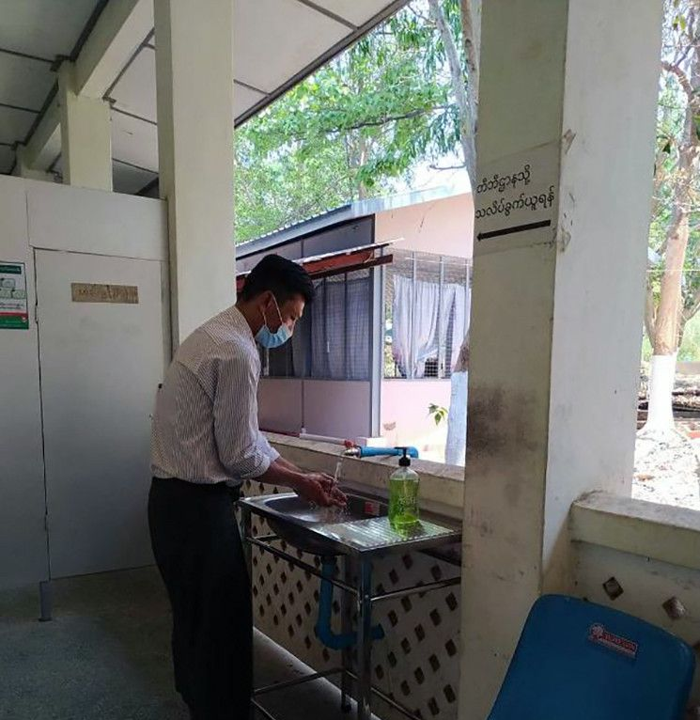

Module 2 Outline
Review Learning Objectives
Natural history of COVID-19 including
the clinical presentation & course of illness
Clinical Care Pathway: Assess
  A) Symptoms & Exam Findings
  B) Severity
  C) Risk Factors

Slide 3



By the end of this module, the learner should be able to:
Describe the clinical presentation of COVID-19
Understand the time course to resolution of symptoms or progression to severe disease
Assess a patient and categorize their disease as non severe, severe, or critical illness
Identify risk factors for progressing to severe COVID-19 or death

Slide 4

Pre-test Questions
Classification of COVID-19 severity is used to:
Establish the best COVID-19 care pathway
Identify patients at greatest risk of mortality
Provide algorithms of care appropriate to patient needs
All of the above
(True/False) It is very uncommon for COVID-19 patients to deteriorate rapidly
True / False
(True/False) A chest x-ray is necessary for all patients who have COVID-19.
True / False
(True/False) Most patients with COVID-19 develop severe disease.
True / False
Risk factors for severe COVID-19 include:
Older age, especially age over 60 years
Diabetes mellitus and cardiovascular disease
Measles
Pre-eclampsia
A, B, and D
Notes:
These will be reviewed during this Module.

Slide 5
Module 2 Outline
Review Learning Objectives
Natural history of COVID-19 including
the clinical presentation & course of illness
Clinical Care Pathway: Assess
  A) Symptoms & Exam Findings
  B) Severity
  C) Risk Factors

Slide 6
Incubation Period – time from exposure to symptoms
Range: 2-14 days. Omicron variants have a shorter incubation – generally 2 – 4 days
Notes:
This data in this graph comes from data collected early in the COVID-19 epidemic. One study reported that 97.5% of persons with COVID-19 who develop symptoms will do so within 11.5 days of SARS-CoV-2 infection.³
Lauer SA, Grantz KH, Bi Q, et al. The Incubation Period of Coronavirus Disease 2019 (COVID-19) From Publicly Reported Confirmed Cases: Estimation and Application. Ann Intern Med 2020.

Slide 7
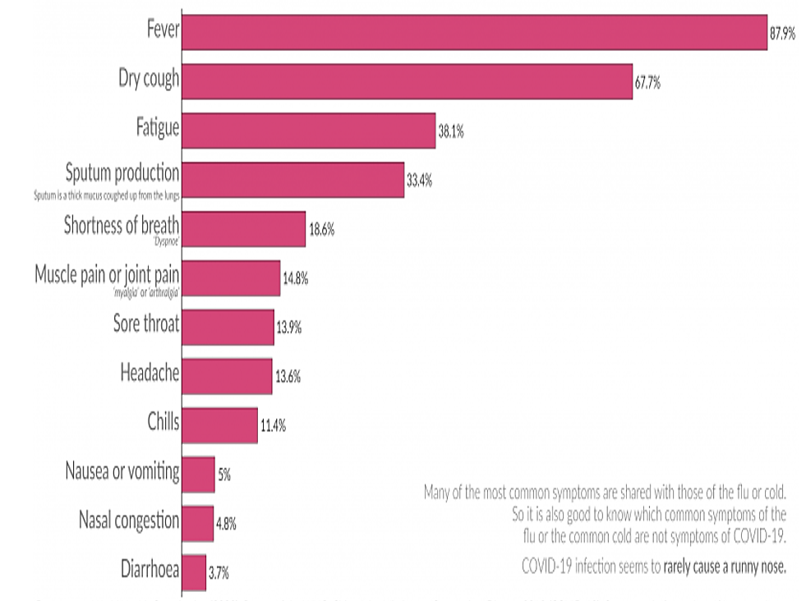
Clinical symptoms of COVID-19
Omicron variants have a higher frequency of runny nose, sore throat, and disabling fatigue but are less likely to affect taste or sense of smell
Notes:
These are the initially reported symptoms of COVID-19. Increasingly over time (with change to omicron variants and a greater proportion of the population being vaccinated) more patients report URI symptoms and a much smaller proportion have fever or severe cough

Slide 8
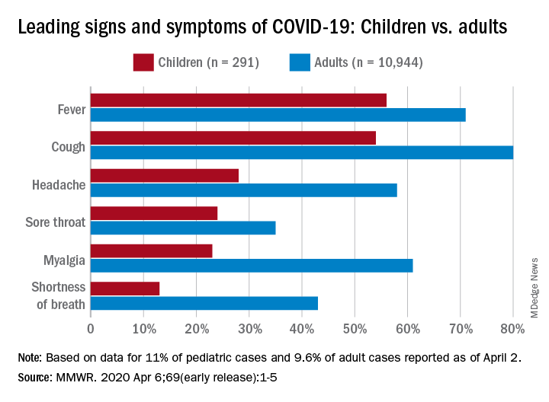
Clinical Features Amongst Pediatric Clients
Notes:
Several studies have reported that the signs and symptoms of COVID-19 in children are similar to adults but are usually milder compared to adults. However, there is a new syndrome which is though to be post infectious in children which can present with toxic shock like syndrome or similar to Kawasaki disease. We will discuss that syndrome when we review severe disease

Slide 9
COVID-19 in Children
Children are just as likely to become infected with SARS-CoV-2 as adults
Children have milder COVID-19 symptoms - most have a mild URI
Children are likely an important source of community spread
Children may also present severely ill with a multisystem inflammatory syndrome known as MIC-C
  A post COVID-19 inflammatory syndrome (about 4 weeks after infection)
  Fever, rash, red eyes, diarrhea and vomiting, mental status aberrations (sleepy or confused). Presentation is similar to Kawasaki Syndrome
  Can be severe and life threatening
  Treated with steroids and/or intravenous immunoglobulin or other immune suppressants

Slide 10

The usual clinical course of COVID-19 among the
~ 80% of people who have non severe disease is that symptoms resolve over 1 - 3 weeks
Those who progress to severe disease may worsen very precipitously; this often occurs in the second week of illness. ~15 % become severe and ~5% critical
Notes:
For non-severe cases that are recovering…Fatigue may linger. Cough may resolve very slowly. A substantial minority of patient develop post-COVID symptoms that will be discussed in Module 3. When people progress to severe disease they tend to worsen

Slide 11
Phases of COVID-19 Illness among those who progress
Chen et al. J Clin Invest 2020; https://doi.org/10.1172/JCI137244 Qin et al, Clin Infect Dis 2020; doi: 10.1093/cid/ciaa248
Notes:
Patients often worsen in the second week of illness
Elevations in CRP, PCT (procalcitonin), and ferritin
• CRPs can become quite elevated
• Ferritins also rise
Perturbations in lymphocyte and neutrophil numbers
• Lymphopenia associated with severe disease
• Some patients develop neutrophilia
-Cytokine derangements

Slide 12
Time to Progression in first wave of COVID-19- China (N=41)
Notes:
This slide shows the progression of disease among 41 early cases from China. This timeline is similar to subsequent published observations. Among patients who develop severe disease, the median time to dyspnea ranges from 5 to 8 days, the median time to acute respiratory distress syndrome (ARDS) ranges from 8 to 12 days, and the median time to ICU admission ranges from 10 to 12 days. Clinicians should be aware of the potential for some patients to rapidly deteriorate about a week after illness onset. Among all hospitalized patients, a quarter to a third of patients are admitted to the ICU. Mortality among patients admitted to the ICU ranges from 39% to 72% depending on the study. These numbers will vary dependent upon resources available (which determines the threshold for admission and escalation of care).

Slide 13
Module 2 Outline
Review Learning Objectives
Natural history of COVID-19 including
the clinical presentation & course of illness
Clinical Care Pathway : Assess
  A) Symptoms & Exam Findings
  B) Severity
  C) Risk Factors

Slide 14
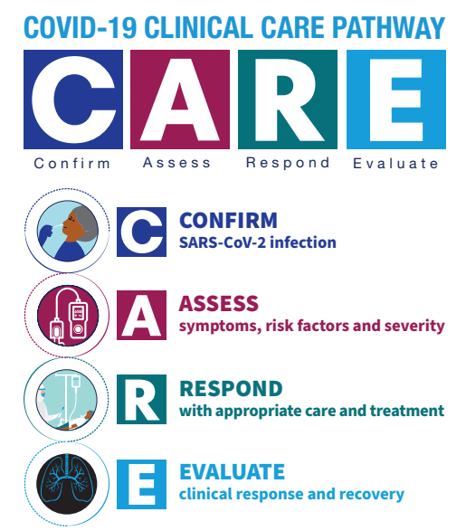

WHO Clinical Care Pathway updated April 2022
https://www.who.int/tools/covid-19-clinical-care-pathway
Notes:
Let’s return to the WHO COVID-19 Clinical Care Pathway. After infection is confirmed, one then assesses the patient.

Slide 15

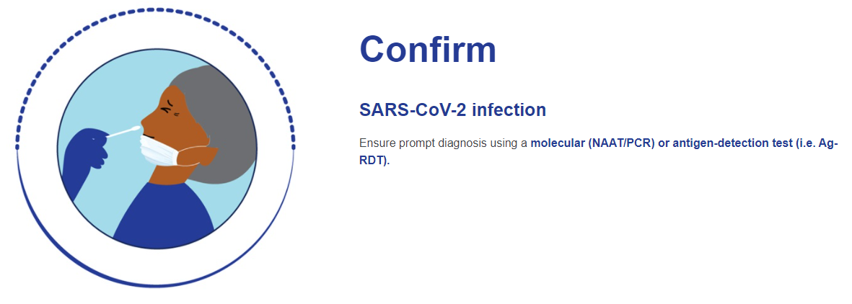

Notes:
Testing was discussed in Module 1. This is the first step in the COVID-19 care pathway.

Slide 16
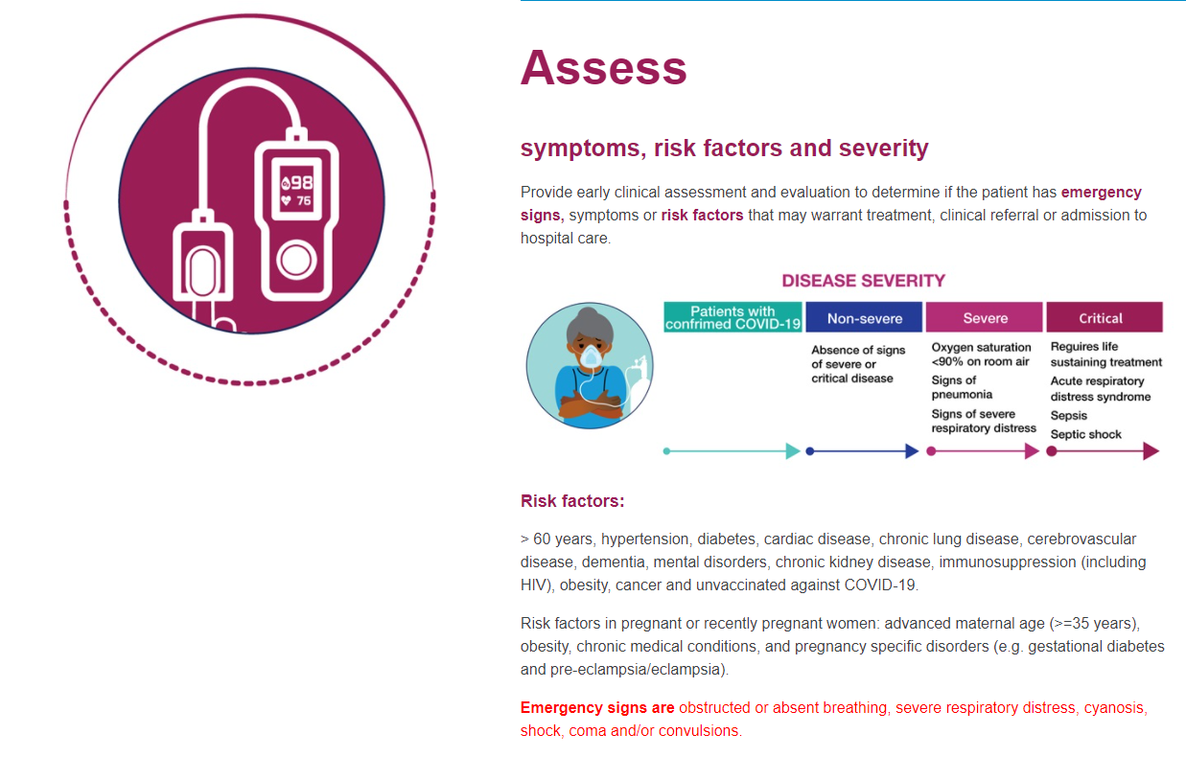

Slide 17
COVID-19 Clinical Care Pathway
[Insert local clinical care pathway here and discuss ways it differs from WHO]

Slide 18
Physical Exam in COVID-19 Assessment
General appearance
Mentation
Vital signs (count the respiratory rate), include oxygen saturation if available
Ability to speak in full sentences, use of accessory muscles for respiration, air movement, findings on auscultation of the lungs
Auscultation of the heart
+ additional assessment based on patient report of symptoms

Slide 19
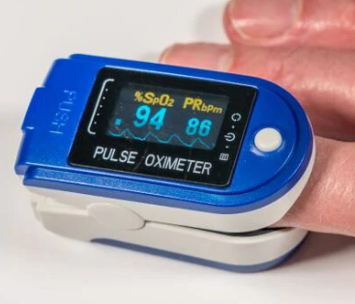
Measuring oxygen saturation
Pulse oximetry is a non-invasive method of measuring the saturation of oxygen in blood
Probe attaches to a finger, forehead, nose, foot, ear or toes
Device transmits or reflects 2 wavelengths of light through the skin to a photodetector
oxygenated hemoglobin absorbs light differently than nonoxygenated hemoglobin
Must remove all nail polish prior to taking measurements
A normal saturation is 95-100%, lower values are seen chronically in people who have cardiopulmonary disease
May give erroneous readings (reporting values that are spuriously higher
than actual) in dark skinned people or those who have poor circulation
Notes:
Measurement of oxygen saturation has become a standard part of the physical exam of patients who have COVID-19. It is also a criterion used in assessing disease severity

Slide 20
COVID-19 WHO Adult Disease Severity Classification
Category | Definition
Non-severe | No severe symptoms
Severe | Clinical signs of pneumonia, severe respiratory distress (use of accessory muscles, inability to speak in sentences, Respiratory rate > 30 breaths per minutes) SpO2 < 90% on room air
Critical | ARDS: worsening symptoms of respiratory failure not explained by cardiac disease or volume overload Sepsis: acute life-threatening organ dysfunction as a response to infection which may include altered mental status, difficult or fast breathing, low oxygen saturation, reduced urine output, fast heart rate, cold extremities or low blood pressure, mottled skin, or labs demonstrating coagulopathy, thrombocytopenia, acidosis, high lactate, or hyperbilirubinemia.
Notes:
Patients may present with a wide spectrum of disease severity. This is particularly common when people seek care in the second week of illness
Note that the NIH guidelines define severe COVID-19 as respiratory frequency >30 breaths per minute, SpO2 ≤93% on room air, or lung infiltrates >50% on CXR

Slide 21
COVID-19 WHO Child Disease Severity Classification
Category | Definition
Non-severe | Absence of any signs of severe disease
Severe | Clinical signs of pneumonia; respiratory distress (grunting, severe chest indrawing); danger signs (inability to breastfeed or drink; lethargy, unconsciousness, or convulsions)
Critical | ARDS: worsening symptoms of respiratory failure not explained by cardiac disease or volume overload (scored based on degree of hypoxemia) Sepsis: suspected or proven infection and > 2 age-based systemic inflammatory response syndrome criteria. Hypotension or any 2: altered mental status; brady/tachycardia; prolonged capillary refill/weak pulse; fast breathing; mottled/cool skin or petechial or purpuric rash; high lactate; reduced urine; hyperthermia or hypothermia

Slide 22
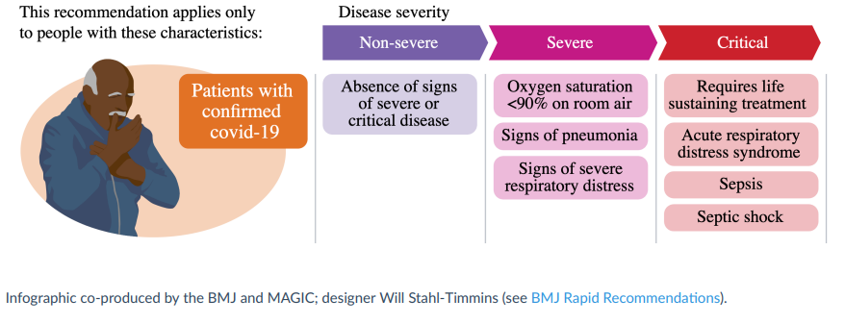

Response begins with assessment of COVID-19 severity at presentation
Notes:
Module 2 focused on patient assessment. The first component of the assessment is determining disease severity at presentation.

Slide 23
Module 2 Outline
Review Learning Objectives
Natural history of COVID-19 including
the clinical presentation & course of illness
Clinical Care Pathway : Assess
  A) Symptoms & Exam Findings
  B) Severity
  C) Risk Factors

Slide 24


Assessment of patient risk factors for progression to severe disease or death facilitates decisions in the response…… risk assessment impacts treatment decisions and/or whether the patient should receive hospital or community care

Slide 25
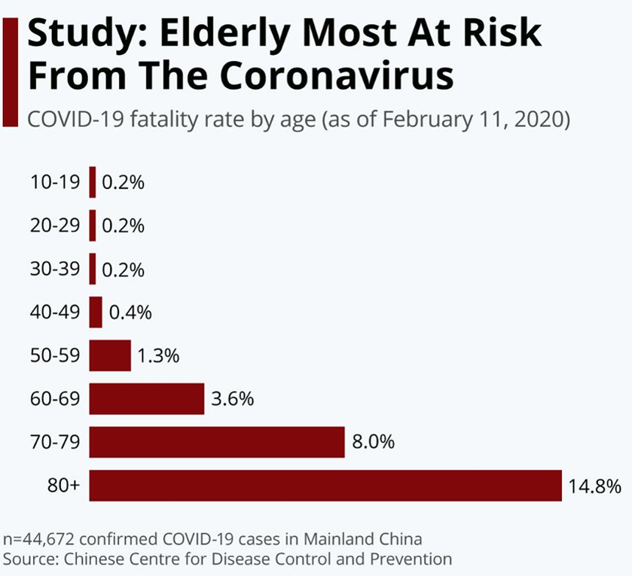
COVID-19 death rate by age, China and New York City
Age distribution of critically ill patients in New York City
NYC DOH data
Source: NYC DOH May 29, 2020
Notes:
Age was identified as the major risk factor for mortality very early in the pandemic

Slide 26
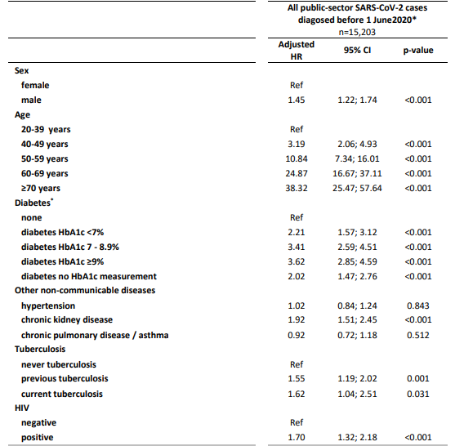
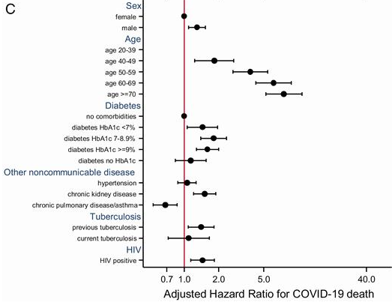

Risk of dying from COVID-19
Data from Western Cape, South Africa
Risk Factors
Boulle, 2020
Notes:
This graph is from Western Cape, DOH. It shows the risk of death from COVID based on risk factors. This was the first data set which is from high HIV prevalence country.
Similar to data from NY and China risk of mortality is higher in males compared to females. Older age, DM, cardiac disease and chronic kidney disease increase risk of COVID-19 death. HIV infection showed a 1.7 HR for death
It is difficult to quantify the effect of HIV & TB. Data shows a modest ~1.5 times risk of COVID-19 death associated with HIV or TB
This may be over-estimated if they haven’t fully disentangled all comorbidities & risks e.g. overweight and socio-economic status. Almost all the people with HIV who died had other comorbidities apart from HIV. About half of them were diabetic, about half were hypertensive. The people who are dying with COVID and HIV are not people who have advanced HIV, they’re actually people who have done well enough on their HIV treatment to live long enough to develop these comorbidities,”
Note that those with HIV & TB tend to be younger where overall risk of COVID-19 death is low.
There was also no difference in mortality by viral suppression. Also not that this is not disaggregated by CD4
Davies et al, 2020

Slide 27
Predictors of Mortality Among COVID-19–Positive
Hospitalized Patients in the UK
Multivariate Survival Analysis
Prospective observational cohort study of hospital admissions in England, Wales, and Scotland during February 6 - April 19, 2020 (N = 20,133)
  Significantly increased risk of mortality among older patients, men, and those with chronic comorbidities
Characteristic
HR (95% CI)
P Value
< 50 yrs
50-59 yrs
60-69 yrs
70-79 yrs
≥ 80 yrs
Female sex
Chronic cardiac disease
Chronic pulmonary disease
Chronic kidney disease
Diabetes
Obesity
Chronic neurological disorder
Dementia
Malignancy
Moderate/severe liver disease
2.63 (2.06-3.35)
4.99 (3.99-6.25)
8.51 (6.85-10.57)
11.09 (8.93-13.77)
0.81 (0.75-0.86)
1.16 (1.08-1.24)
1.17 (1.09-1.27)
1.28 (1.18-1.39)
1.06 (0.99-1.14)
1.33 (1.19-1.49)
1.17 (1.06-1.29)
1.40 (1.28-1.52)
1.13 (1.02-1.24)
1.51 (1.21-1.88)
< .001
< .001
< .001
< .001
< .001
< .001
< .001
< .001
.087
< .001
.001
< .001
.017
< .001
1
2
5
10
Docherty. BMJ. 2020;369:m1985.
Slide credit: clinicaloptions.com

Slide 28
Comorbidity Status at Hospital Admission Among COVID-19–Positive Patients in New York City Area
Case series of sequentially hospitalized patients admitted to 12 Northwell Health system hospitals in NYC, Long Island, and Westchester County, NY during March 1-April 4, 2020 (N = 5700)
  Median number of total comorbidities at admission: 4 (IQR: 2-8)
Comorbidity Number | Admissions (N = 5700)
> 1 | 87.6%
1 | 6.3%
None | 6.1%
Specific Comorbidity | Admissions (N = 5700)
Hypertension | 56.6%
Obesity | 41.7%
Diabetes | 33.8%
Richardson. JAMA. 2020;[Epub].
Notes:
Co-morbidities were high among patients who required hospital care. Mild cases received care at home so admission is a proxy for more severe illness. Risk factors are clearly additive

Slide 29

Pregnancy
Most young healthy pregnant people have an uncomplicated [non-severe] course of COVID-19
People who are pregnant or recently pregnant are more likely to:
Have severe illness, require ICU admission, ventilation, or advanced life support, die, or deliver preterm
Highest risks are seen with older maternal age (> 35 years), obesity, chronic medical conditions, and complications of pregnancy (pre-eclampsia or gestational diabetes)
Despite the maternal risks, infants are at low risk for severe disease. Breastfeeding and skin to skin postpartum care is advised unless the mother is too sick to provide care.
Strid, 2022
https://www.cdc.gov/coronavirus/2019-ncov/need-extra-precautions/pregnant-people.html

Slide 30

WHO risk factors for progression to severe COVID-19
Age over 60 years (risk related to age increases progressively with age)
Pregnant or recently pregnant (see prior discussion)
Underlying noncommunicable diseases (NCDs):
Diabetes mellitus
Hypertension
Cardiac disease
Chronic lung disease (including asthma)
Cerebrovascular disease
Dementia
Mental disorders
Chronic kidney disease
Immunosuppression
Obesity
Cancer
being unvaccinated against COVID-19
Notes:
This is the WHO list of risk factors for severe COVID-19. Some of these are very broad categories

Slide 31
CDC Includes Some Additional [possible] Risk Factors for Severe COVID-19
Disabilities (ADHD, Cerebral palsy, spinal cord injuries, intellectual disabilities, birth defects, etc.)
On steroids or other immune suppressive medications
Liver disease (alcohol-related, nonalcoholic steatohepatitis, autoimmune)
Tuberculosis
Primary immunodeficiencies
HIV
Smoking
Hepatitis B and/or C
Alpha 1 antitrypsin deficiency
Sickle Cell disease
Substance use disorders
Cystic fibrosis
Thalassemia

Slide 32

Let’s assess a patient…a 40 year-old man
.
A 40 year-old man with no significant history presents with a runny nose, sore throat and myalgias for the last 3 days
Vitals : T 37.7ºC, BP 130/75, RR: 18, HR: 80, O₂ saturation 97% on room air
He is in no respiratory distress, lungs are clear and the remainder of the exam is normal
What is the differential diagnosis?
If RT-PCR is positive, what is his disease severity? Does he have risk factors for progression to severe disease?
Notes:
Construct a differential. Symptoms are most c/w COVID-19, influenzae or other respiratory viruses. He has no evidence of lower respiratory tract involvement and has an acceptable oxygen saturation.
We would like to confirm his diagnosis of COVID-19. Follow the local clinical care pathway. His disease would be classified as non severe and he has no risk factors for development of severe disease

Slide 33
Case 2: a 59 year-old man
.
A 59 year-old man with a history of hypertension, who resides in an informal settlement, presents with difficulty breathing for the last 3 days associated with fever and chest pain on inspiration.
Vitals : T 38.7ºC, BP 140/95, RR: 32, HR: 110, O₂ saturation 86% on room air
On examination he is in respiratory distress and sweating; there is no pallor, no jaundice and no peripheral edema
What is the differential diagnosis?
If SARS-CoV-2 RT-PCR is positive, what is his disease severity?
Notes:
Construct a differential. May include COVID-19, influenzae, other respiratory viruses, bacterial pneumonias, viral myocarditis. CHF does not usually cause fever. The acuity of onset makes TB or PCP less likely. Could have an MI (ascertainment of character of the pain might be helpful) but fever is not typical unless there is a second infectious process present. Pulmonary embolus could be considered.
He should be tested for COVID-19; his symptoms are very suggestive. If his test is positive, his disease would be classified as severe based on his oxygen saturation of 86% and respiratory rate of 32. It is noted that he has psychosocial factors that may complicate his care.

Slide 34



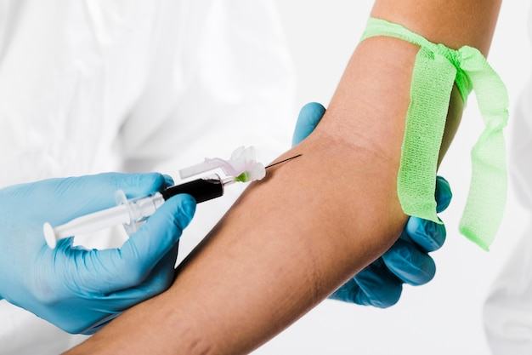
Most patients presenting with
COVID-19 will have non-severe disease and will not require additional testing
freepik

Slide 35

Diagnostic tests that may be helpful in select patients (atypical presentations, comorbidities or severe illness)
  Pulse oximetry [preferred for everyone if available]
  Complete blood count
  Biochemistry (electrolytes, creatinine, glucose, liver enzymes)
  C-reactive protein (CRP)
  Blood cultures, urinalysis
  Sputum or tracheal aspirate for gram stain/culture or rapid diagnostics
  Coagulation profile, D-dimer
  Troponin
  Sputum for GeneXpert (for detection of M. tuberculosis)
  Chest X-ray
  Testing for other endemic infections per local guidelines
Notes:
There is no requirement to do extensive testing. These represent tests that may be considered and helpful for some patients. Testing can assist in initial patient assessment (gauging the severity of illness and making treatment decisions) or later to evaluate response or assess new problems

Slide 36
Radiologic and Lab Abnormalities by Disease Severity Among COVID-19 Patients in Mainland China
Radiologic or Lab Finding % [n/N or IQR] | All Patients (N = 1099) | Nonsevere Disease (n = 926) | Severe Disease (n = 173)
Abnormalities on chest radiograph | 59% [162/274] | 54% [116/214] | 77% [46/60]
Abnormalities on chest CT | 86% [840/975] | 84% [682/808] | 95% [158/167]
Median white cell count per mm³ (IQR) | 4700 [3500-6000] | 4900 [3800-6000] | 3700 [3000-6200]
Median lymphocyte count per mm³ (IQR) | 1000 [700-1300] | 1000 [800-1400] | 800 [600-1000]
Median platelet count x 1000 per mm³ (IQR) | 168 [132-207] | 172 [139-212] | 137 [99-180]
C-reactive protein ≥ 10 mg/L | 61% [481/793] | 56% [371/658] | 82% [110/135]
D-dimer ≥ 0.5 mg/L | 46% [260/560] | 43% [195/451] | 60% [65/109]
Lactate dehydrogenase ≥ 250 U/L | 41% [277/675] | 37% [205/551] | 58% [72/124]
AST > 40 U/L | 22% [168/757] | 18% [112/615] | 40% [56/142]
ALT > 40 U/L | 21% [158/741] | 20% [120/606] | 28% [38/135]
IQR = interquartile range (upper band of lowest quartile to lower band of upper quartile)
Guan. NEJM. 2020;382:1708.
Slide credit: clinicaloptions.com

Slide 37
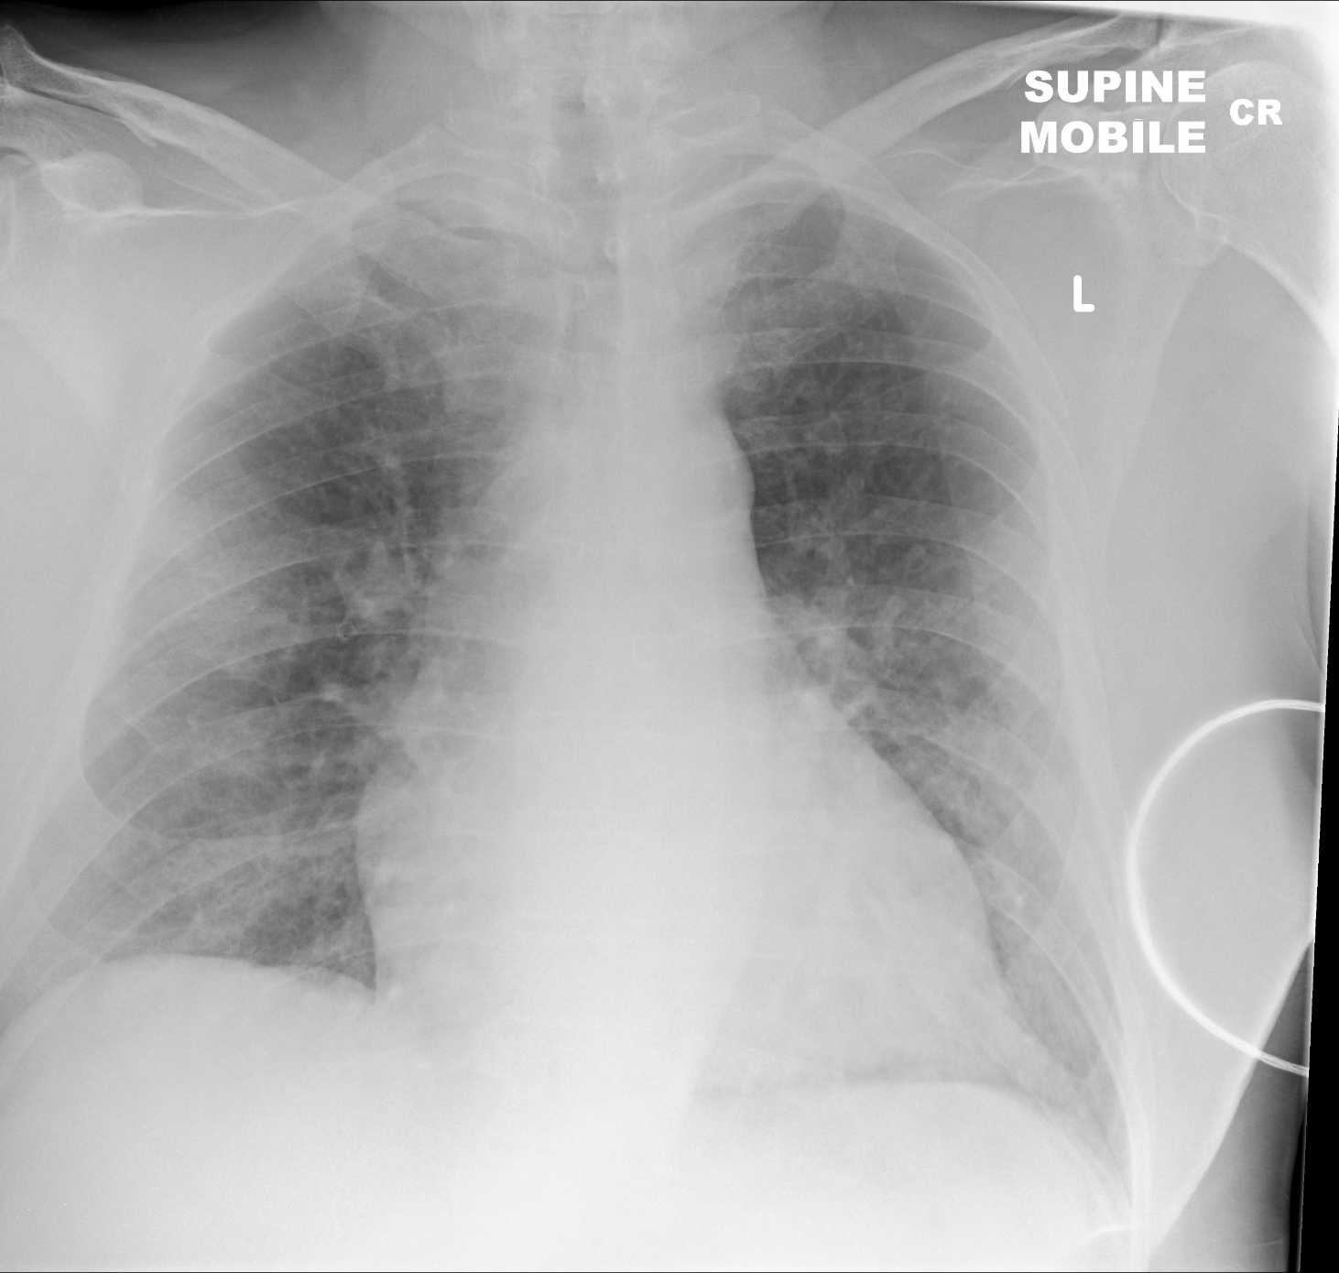
Chest radiographic findings in COVID-19
Common CXR findings
Many CXRs are normal
Bilateral air-space consolidation is common
Peripheral ground glass opacities are also common
Less common CXR findings
Pleural effusions
Lobar consolidation
Marked lymphadenopathy
Xray courtesy of Dr Derek Smith, Radiopaedia.org, rID: 75249
Notes:
Explain ground glass opacity- area of hazy increased lung opacity through which vessels and bronchial structures may still be seen. It is less opaque than consolidation, in which such structures are obscured

Slide 38
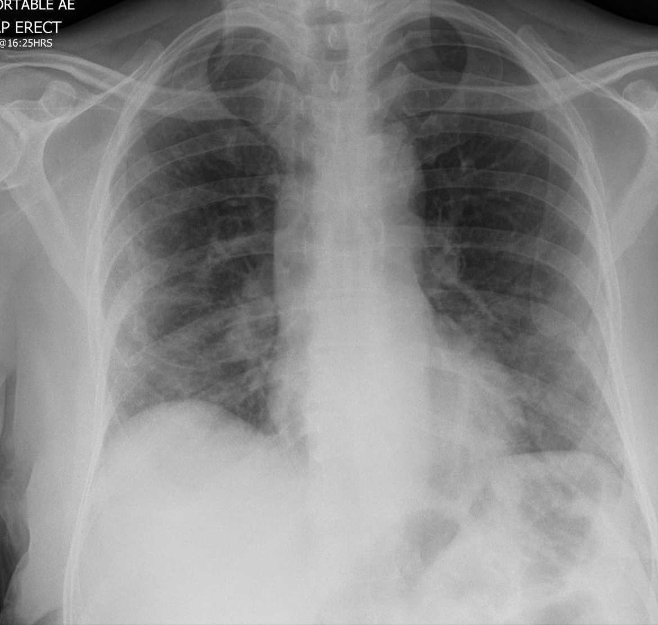
Routine chest imaging is not necessary
Chest imaging may be helpful
  in identifying severe COVID-19 or need for intensive care (ICU)
  in evaluating progression or non-response to treatment
CT is much more sensitive and specific than CXR (higher costs & more radiation)
CT angiography useful for suspected pulmonary embolism
Ultrasound for pleural effusions or assessment of cardiac function (not usually helpful in assessing the lungs)
WHO: Chest imaging in COVID-19, 2020
Image courtesy of Dr. Mohammad Al-Tibi, Radiopaedia.org, rID: 75305
Notes:
CXR will be the preferred imaging modality in most LMIC

Slide 39
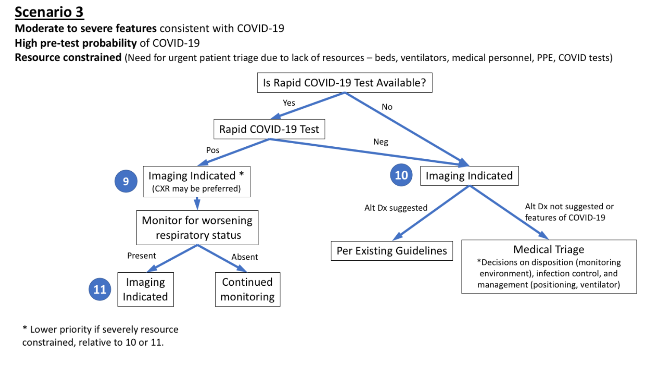
Situations in which chest imaging may be helpful
Rubin et al. Radiology 2020 Apr 7:201365. doi: 10.1148/radiol.2020201365

Slide 40
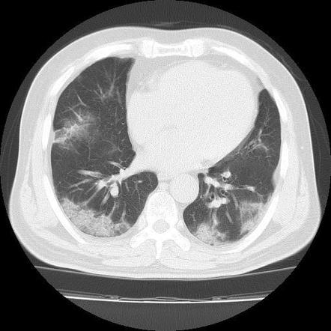
CT scan
Most common finding:
Peripheral ground
glass opacities
involving multiple
lobes and greatest
posteriorly
Caruso, 2020; Ai, 2020
Notes:
CT imaging was widely used in China and Italy. In China, imaging was sometimes positive in patients who presented with symptoms suggestive of COVID-19, but had negative for SARS-COV-2 by RT-PCR. Many of these patients were RT-PCR positive for SARS-COV-2 on repeat testing. The most common pattern of COVID-19 pneumonia on CT is peripheral ground glass opacities involving multiple lobes, especially posteriorly. Subsegmental vessel enlargement may be seen on CTA.

Slide 41
Case 3 is a 36 year-old pregnant woman
.
A 36 year-old previously healthy pregnant woman presents at 28 weeks of gestation with three days of cough and fever. She denies shortness of breath and reports normal fetal movements
PE : T 38.7ºC, BP 104/82, RR: 18, HR: 90,
O₂ saturation 96% on room air
CV-RRR, lungs-clear to auscultation, sweating, abdomen – gravid, + fetal heartbeat
Her RT-PCR SARS-CoV-2 is positive
Categorize the severity of this woman’s COVID-19
Are there any special concerns in managing COVID-19 in a pregnant woman?
Notes:
This woman presents with non-severe COVID-19. However, she is early in her clinical disease (day 3 of symptoms). Pregnancy is a risk factor for progression to severe COVID-19 and her age (> 35) is a pregnancy-related risk factor

Slide 42
Case 4 is a 9 year-old school child
.
This child is brought to the health center during a widespread community outbreak of COVID-19. The mother reports that her child has been sick for four days with fever, red eyes, red blotches on the skin and vomiting.
Could this be COVID-19?
Are there any special concerns about SARS-CoV-2 in children?
Notes:
It could be COVID-19 but rash and red eyes are not usually seen in acute SARS-CoV-2 infection. This presentation is also concerning for MIS-C, a post COVID-19 inflammatory syndrome and can be fatal. MIS-C responds best to steroid and immunoglobulin or other immunosuppressant medications

Slide 43
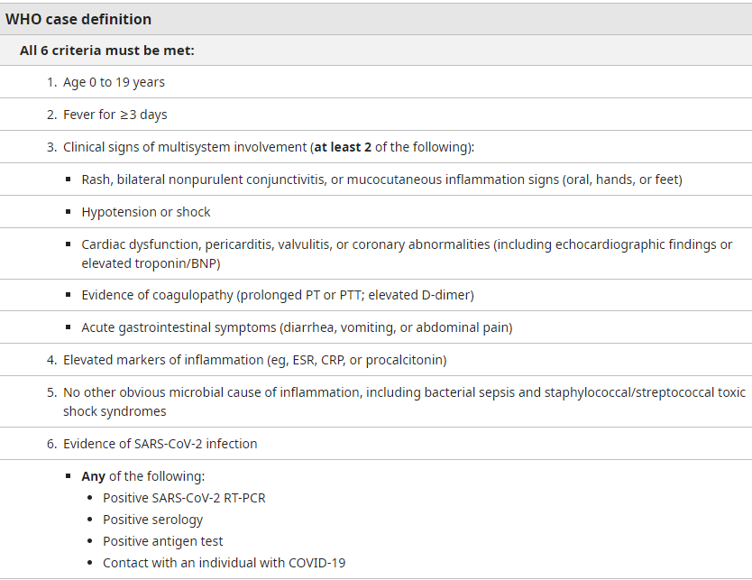
Multisystem Inflammatory
Syndrome in Children – MIS-C

Slide 44
Post-test Questions
Classification of COVID-19 severity is used to:
Establish the best COVID-19 care pathway
Identify patients at greatest risk of mortality
Provide algorithms of care appropriate to patient needs
All of the above
(True/False) It is very uncommon for COVID-19 patients to deteriorate rapidly
True / False
(True/False) A chest x-ray is necessary for all patients who have COVID-19.
True / False
(True/False) Most patients with COVID-19 develop severe disease.
True / False
Risk factors for severe COVID-19 include:
Older age, especially age over 60 years
Diabetes mellitus and cardiovascular disease
Measles
Pre-eclampsia
A, B, and D
Notes:
Answers:
D
F
F
F
E

Slide 45
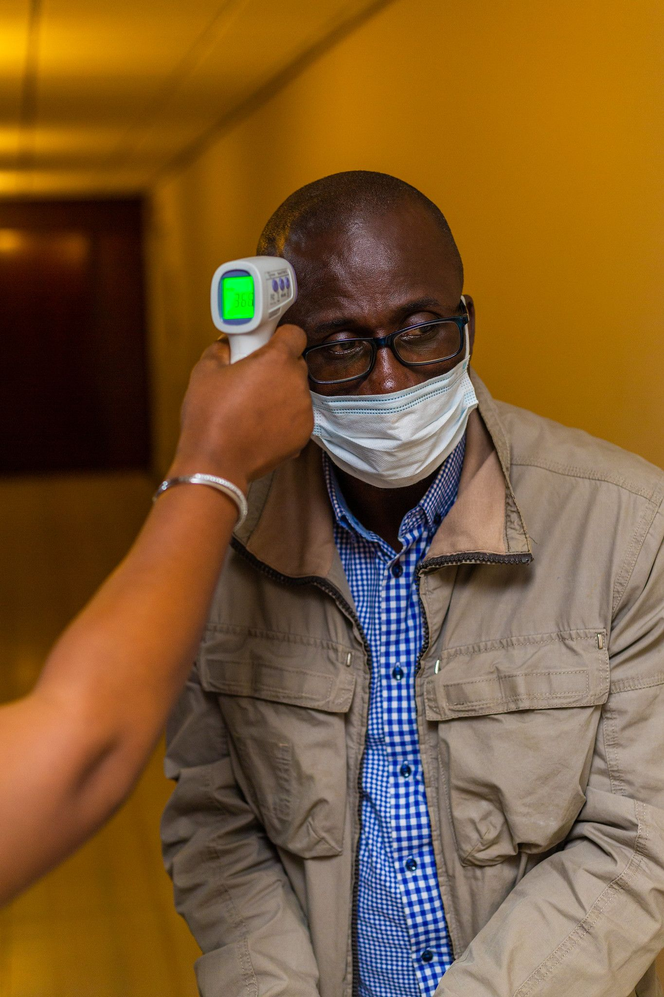

Reflection Questions
Reflect on the learning from today. Consider the following questions:
Do you understand the importance of assessing both severity at presentation and risk of progression?
Are you able to classify COVID-19 as non severe, severe, or critical?
Do you need additional practice or training on any of the topics from this module?
Notes:
Can be done in a group if done in person.

Slide 46
Q&A / Discussion

Slide 47
Thank You

