Slide 1
Intervention Approaches in Global Mental Health: Current Strategies and Future Directions
ICAP GRAND ROUNDS
May 21, 2024

Slide 2
Gillian Dougherty,
PMHNP-BC, MPH, RN,
Deputy Director,
Human Resources for Health Development,
ICAP at Columbia University

Slide 3
Agenda
Reminders:
Welcome and Introduction –
Presentation
Q & A
For questions to the panelists, use the Q&A box
The webinar recording and slides will be posted on www.icap.columbia.edu

Slide 4
Susan Michaels-Strasser, PhD, MPH, RN, FAAN
Senior Director,
Human Resources for Health Development,
ICAP at Columbia University

Slide 5
Mental health
An issue whose time has come.

Slide 6
To achieve 95-95-95
We MUST appreciate and develop programs that address the mind-body connection

Slide 7
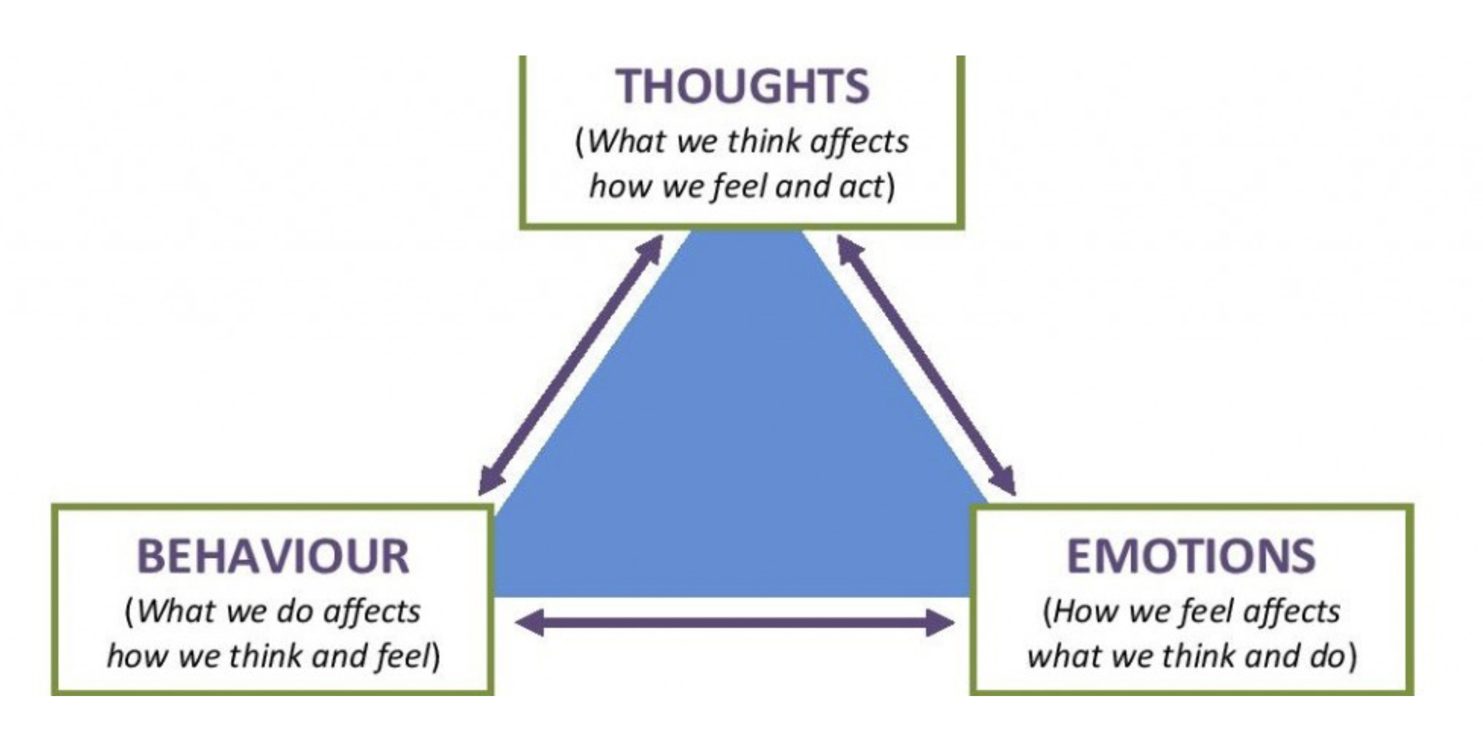
Mind-Body Connection (joannasoh.com)
Trust and the Cycle of Thoughts, Feelings, and Behaviors - LIFE Marriage Retreats
Notes:
A healthy body keeps you well and active
A healthy mind keeps you focused and engaged

Slide 8
Mental Health Care Evolution
Blame
Stigma
Reluctance
Evidence-based mental health care

Slide 9
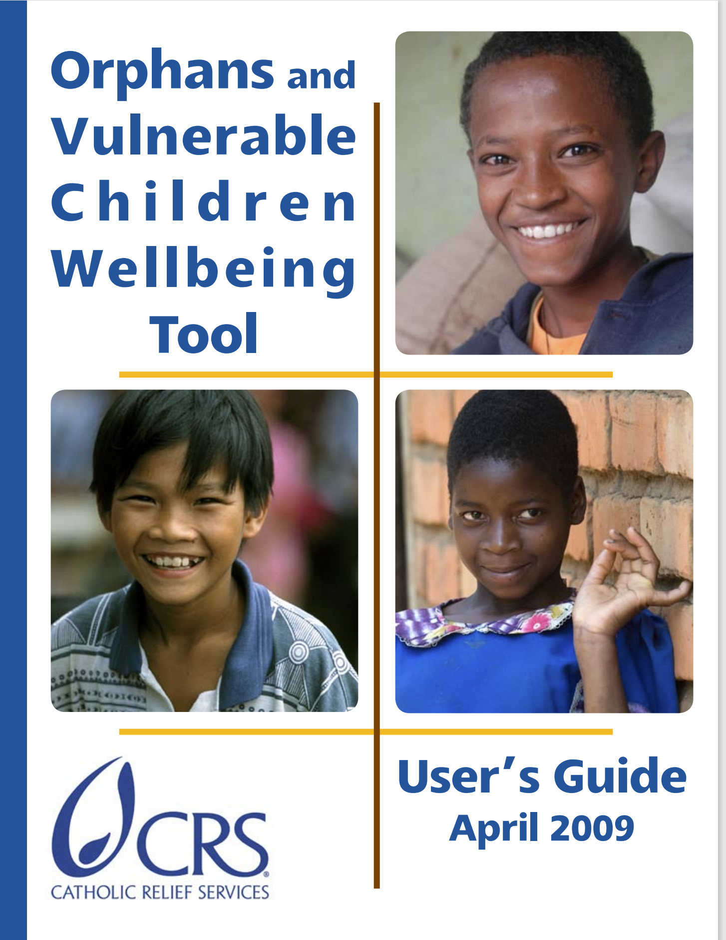
Research and Advocacy- 2009
Senefeld, S., Strasser, S., Campbell, J.
Notes:
The success of antiretroviral therapy (ART) has sparked a global commitment to strengthen health systems for an improved response. The response, however, is largely biomedical. Far less attention and funding exist for mental health and psychosocial support services (PSS). While the evidence-base for these services is less developed, the Elizabeth Glaser Pediatric AIDS Foundation (EGPAF) has responded to glaring needs through a “learn by doing” approach. This paper documents lessons learned as we responded to expressed needs for child-centered HIV support in Zambia.
We formed a multidisciplinary working group to improve support for children on ART. In collaboration with the Zambian Ministry of Health (MOH) and with support from the U.S. President's Emergency Plan for AIDS Relief (PEPFAR), we began, in 2008, by implementing a pediatric HIV counseling course focusing on disclosure, adherence, and stigma. Play therapy and adolescent-support programs followed. In 2013, with funding from the Conrad N. Hilton Foundation, EGPAF established HIV and developmental delay centers.
Through working with the Zambia MOH, we have forged a national response. This involved training pediatric HIV counselors, play therapy counselors, adult mentors and positive peer mentors, as well as clinicians and volunteers in HIV and early childhood development. We have learned that providing health workers with skills to dialog with HIV-affected children and families in honest and developmentally-sensitive ways yields results. Thousands of children have been reached and improved adherence and acceptance of one's status have been reported. Non-medical services have been developed by busy practitioners to meet glaring clinic gaps using a “learn by doing” approach. More resources are required to scale up these programs and for ‘good practice’ evidence to be gathered.

Slide 10
2011

Slide 11
2014

Slide 12
2023

Slide 13
Claire Greene, PhD, MPH,
Epidemiologist,
Assistant Professor of Population and Family Health,
Columbia University
Jeremy Kane, PHD, MPH,
Psychiatric Epidemiologist,
Assistant Professor of Epidemiology, Columbia University

Slide 14
Intervention approaches in global mental health: current strategies and future directions
Jeremy C. Kane, PhD, MPH
M. Claire Greene, PhD, MPH

Slide 15
Outline
Introduction to global mental health
Key populations: HIV-affected and migrant populations
Fundamentals of global mental health interventions
Transdiagnostic approach: CETA
Adolescents
Stepped-care
Implementation approaches
Integrated and multisectoral interventions
Current gaps and future directions
Q&A
Notes:
Idea will be to cover a breadth of topics in GMH interventions

Slide 16
What is global mental health and why is it needed?
“An area for study, research and practice that places a priority on improving [mental] health and achieving equity in [mental] health for all people worldwide”
Koplan et al. 2009

Slide 17
There is no health without mental health.
Patel et al (2018)
Notes:
So you’ve heard this before, right….there is no health without mental health.
This is a sentiment that was expressed way back in 1954 by the first Director-General of the World Health Organization (WHO),
As you’ve maybe learned about in this course already mental and physical health are inextricably linked, with bidirectional pathways through which mental health impacts physical health and vice versa.
And mental health and substance use disorders are a huge driver of the global burden of disease. These graphs are of disability-adjusted life years, or DALYS, which are an economic indicator of health and represents number of healthy years of life lost due to ill-health, disability, or death. It is a really common indicator used in global health.
And what the left graph on the screen here shows is that a substantial percentage of DALYS , particularly among younger and middle-aged populations but also throughout the life course are attributable to mental health and substance use disorders as well as self-harm, which they consider a separate category. So a substantial global burden of disease.
And the graph on the right shows the burden of mental and substance use disorders stratified by SDI, which is a composite measure of a geographic region’s sociodemographic development. And you can see that in the past 30 years, there is a general trend, regardless of high income or low income region, that the burden of mental and substance use disorders is increasing.

Slide 18
There is no health without mental health. yet….
Low- and middle-income countries comprise over 80% of the global population but have less than 20% of mental health resources
1% of health budgets on average dedicated to mental health
Mental Health Treatment Gap
90% of persons in LMIC with a mental health or substance use problem do not receive adequate care
75% receive no care at all
This inequity has been described as a ‘violation of human rights’
Patel and Prince (2010); Demyttenaere (2004)
Notes:
So there is considerable burden globally, burden that is increasing….
We say that there is no health without mental health.
And yet….
Low and middle income countries comprise over 80% of the global population but have less than 20% of mental health resources.
And that brings us to the mental health treatment gap, which we will talk more about in Part 3 of this lecture….but this is maybe the most talked about aspect in global mental health:
That 90% of persons with a mental health or substance use problem living in low and middle-income countries do not receive adequate care for those problems; and 75% receive basically no care at all.
So, to put it simply, this is the definition of Inequity, which is why a dedicated field of GMH is necessary.
In many ways the inequity has been and should be described as a violation of human rights.

Slide 19
IN 2019, ONE IN EIGHT PEOPLE GLOBALLY WERE LIVING WITH A MENTAL DISORDER (970 MILLION PEOPLE)
WHO, 2022
Notes:
And we’ll wrap up this part of the lecture with some context.
We are going to spend a lot of time this semester talking about research methods and study designs.
But what I want you to try and continue to keep in mind is that in the year 2016, the last year data like this were available, over a billion people around the world—a billion-- were affected by a MH or SU problem
In epidemiology we deal with numbers and data points --- not usually quite this big--- but it can be easy as an epidemiologist to get lost in the numbers, to think about study design and methods exclusively and not remember the bigger picture.
And what we need to continuously think about and remind ourselves is that every one of those billion is a real person, with a real family, and a story, and who is experiencing a very difficult disorder. Remember the humanity in what we do as public health professionals.

Slide 20
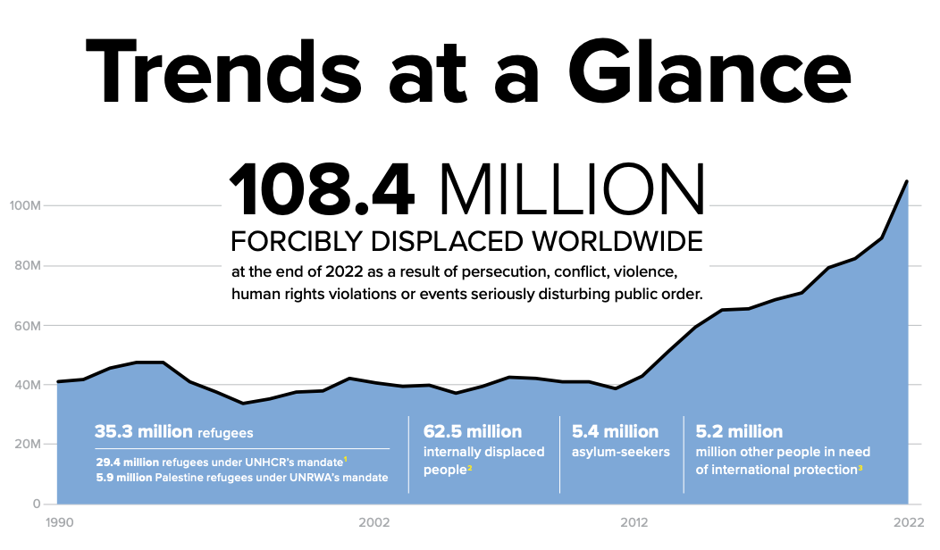
Humanitarian health and global mental health
The vast majority of wars, conflicts, natural disasters, and refugee crises are in LMIC
Humanitarian settings…
can contribute to mental health, alcohol, and substance use problems through a number of mechanisms
are where the fewest mental health resources are
UNHCR, 2020
Notes:
And similar to global mental health, the field of humanitarian health is primarily focused in low and middle income countries. And the reason that is the case is that the vast majority of wars, conflicts, natural disasters, and refugee and displaced person crises are in LMIC.
And humanitarian health settings can furthermore contribute to mental health, alcohol, and substance sue problems through a number of mechanisms, which we will talk about in a minute. And as we just mentioned, LMIC have the fewest mental health resources.
And as an aside – LMIC countries likely to be hardest hit by climate change, which many believe will exacerbate wars, conflicts, and natural disasters. So it is almost like this vicious cycle of inequity and poor mental health risk.
And the figure on the left here from UNHCR—the United Nations High Commissioenr for Refugees summarizes some data that really underscores the scope of the current refugee crisis that exists….
There are currently about 80 million people globally who are displaced, which is an all-time record. this includes 26 million refugees and 45.7 million internally displaced people. and so this equates to 1 % of the worlds population being displaced, which is remarkable as are the rest of these statistics:
80% of displaced people are in countries affected by food insecurity and malnutrition; 40% of those displaced are children, and this gets at it right– 85% of displaced people are in low and middle in come countries. – the top hosting countries are turkey, Colombia, Pakistan, and Uganda.

Slide 21
Notes:
And so what I wanted to do was just share with you how common mental health, alcohol, and substance use problems are among PLWH.– how the burden may be increased among this population.
I’ve listed here on the left side of the screen 5 recent meta-analysis reviews on depression, anxiety, PTSD, alcohol, and substance use among PLWH, which are great resources.
And the graph on the right summarizes the pooled prevalence estimates from those reviews across their included studies.
And what they found across the board, was that there were significantly elevated levels of mental health and substance use problems among PLWH. Almost suggesting that basically almost a third of PLWH are experiencing at least one of these problems.
And so this again is why we consider HIV-affected populations to be a priority when it comes to mental health.

Slide 22
Fundamentals of global mental health intervention approaches

Slide 23
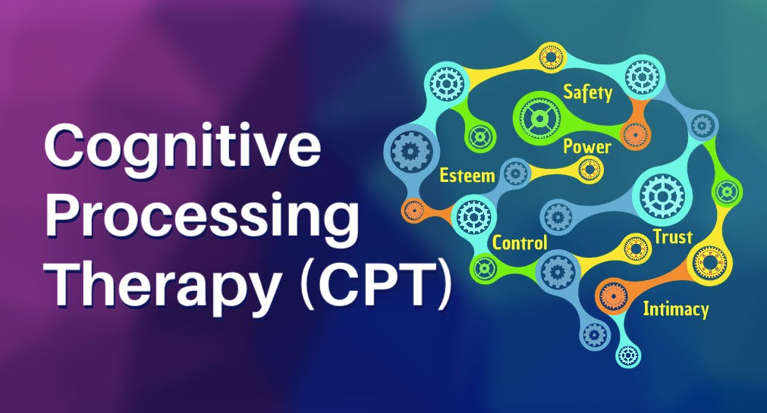
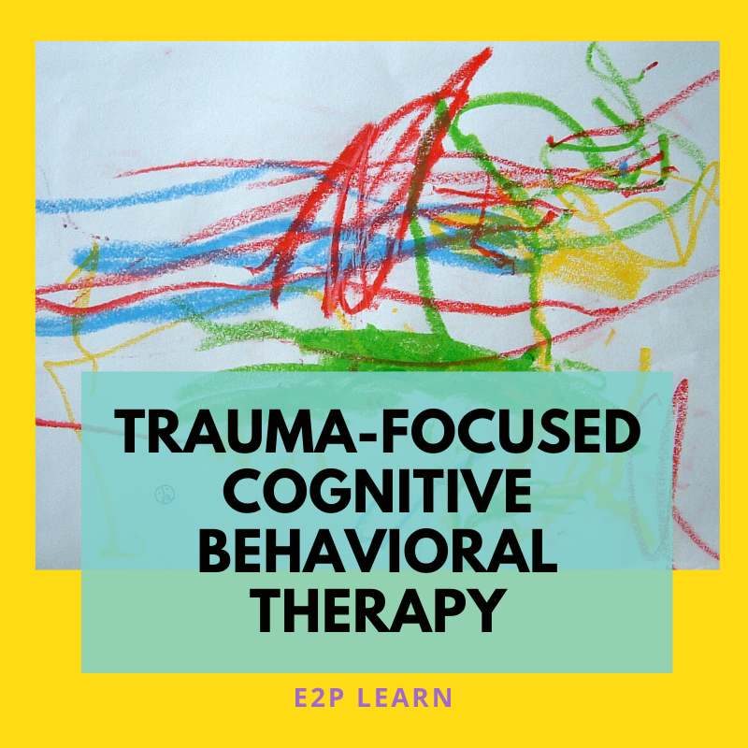
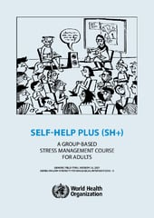
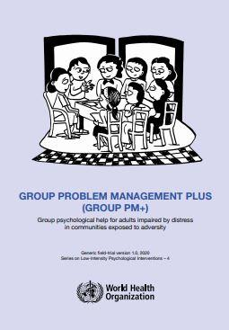
Commonly used intervention approaches in GMH

Slide 24
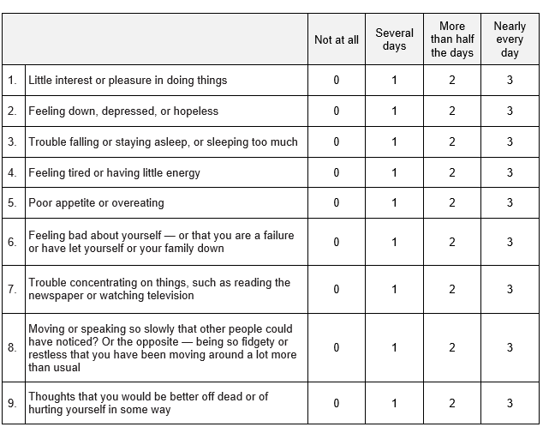
Cultural concepts of distress
“Tired head”
- Democratic Republic of the Congo
“Thinking too much”
- South Sudan (+ many other contexts)
“Carrying pain in my heart and my head”
- South Africa
“Ataque de nervios”
- Puerto Rico
“Soul loss”
- Nepal

Slide 25
Barriers to mental health interventions in LMIC
Few resources dedicated to mental health
Lack of trained mental health providers
Notes:
And one consequence of having so few resources available to address mental health in low resource countries is that there are very few highly trained mental health providers in those settings.
This is probably the most well known and talked about barrier to mental health interventions in global mental health.

Slide 26
Task-shifting (aka task-sharing)
Task shifting involves the rational redistribution of tasks among health workforce teams. Specific tasks are moved, where appropriate, from highly qualified health workers to health workers with shorter training and fewer qualifications in order to make more efficient use of the available human resources for health
Notes:
The main thing that they have in common is that they feature a task-shifting, also known as a task-sharing approach. Those of you in the global health certificate program or who have been involved especially in HIV research or programs globally will likely be familiar with this method.
And so WHO has released global recommendations and guidelines on task shifting and I’ve put the manual in your supplemental reading.
Task shifting according to WHO involves the rational redistribution of tasks among health workforce teams. Specific tasks are moved, where appropriate, from highly qualified health workers to health workers with shorter training and fewer qualifications in order to make more efficient use of the available human resources for health.

Slide 27
In global mental health, nearly all interventions are provided by lay counselors
Notes:
And so what this means practically, is that in global mental health – in almost all of the intervention studies and programs you will read – nearly all interventions are provided through a task-shifting approach, in which the interventions are provided by lay counselors; in other words, individuals who are not mental health experts.
In studies we’ve talked about in this class, we’ve talked about interventions that have been delivered in refugee camps by refugees themselves, in HIV clinics by HIV peer workers, and by community-based healthcare workers.

Slide 28
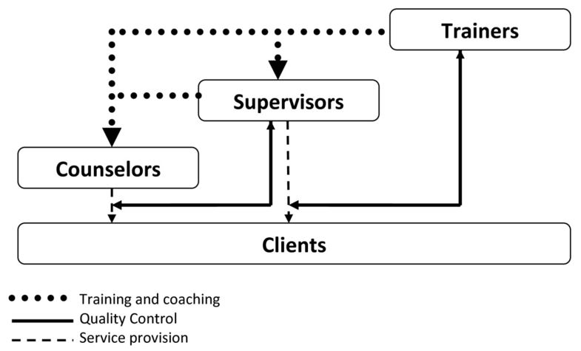
Apprenticeship model and train the trainer
Notes:
And so first is the apprenticeship model, and I’m going to walk through this in some more detail in the Rise module but it is really important so I wanted to mention it here as well.
And so the apprenticeship model is really a strategy at the heart of a task-shifting approach.
The idea is that expert trainers– so typically psychiatrist and psychologists and clinical social workers provide intensive training and coaching to lay counselors. This typically is about a two week training during which time some counselors who are clearly not qualified do not continue, and we will talk in a second about counselor competency. Among the counselors being trained, those who are particularly highly qualified and show lots of promise are chosen to be local clinical supervisors. They receive additional training by the expert trainers on both the counseling itself and also how to supervise counselors.
So we have three tiered levels here. So clients receive treatment by locally trained counselors, the counselors are supervised by the supervisors who provide quality control, and the supervisors are supervised each week, typically remotely by Zoom if the trainer is in another country for additional levels of quality control. So each week there is supervision meetings between the local supervisors and the local counselors to discuss each client’s progress. And also each week there are supervision meetings between the local supervisors and the expert trainers usually via Zoom. So there are two additional levels of quality control for the counselor in which all client cases are reviewed. The supervision meetings focus on symptom change in the clients, safety, and counselor fidelity to the treatment model.
And of course a natural extension of this model is a train-the trainer approach, right, where the goal is for expert trainers train other experienced counselors on how to be trainers themselves. And we will talk about this more in the Rise module.
But a key way that lay counselors have been able to provide evidence-based mental health interventions has often been through a training and supervision apprenticeship model

Slide 29
Transdiagnostic Approaches
The Common Elements Treatment Approach (CETA)

Slide 30
Depression
PTSD
Anxiety
Substance Use
Alcohol use
Aggression
Risky behaviors
Mental Health Impact
Comorbidity!
Notes:
So we talked about the challenge of having a lack of resources– and why task shifting and the apprenticeship model is helpful for addressing that..
Another challenge we have in global mental health intervention work though, that is not talked about nearly as much is this-----that among people who have a mental health, alcohol or substance use problem, - having more than one mental health and/or substance use problem is common.
So common, in fact, that it should be considered the rule not the exception.
Our epidemiologic research across a number of studies in Zambia among PLWH or at risk for HIV has shown that among participants presenting with a mental health or substance use problem, over 50% had more than one presenting problem.

Slide 31
Current Approach – Siloed
Trauma
Depression
Substance use
Alcohol use
Notes:
And I think that comorbidity– or at least the way we address or don’t address comorbidity is a contributor to the treatment gap.
Why is that the case?
I think that it is the case because despite the reality of comorbidity, the high prevalence of comorbidity, mental health systems are not designed to address it in LMIC,
Health systems are not set up to address overlapping or co-occurring conditions.
What we have found is that in most cases, substance use and mental health problems are instead thought about and treated separately, one at a time, in siloes---so a silo for substance use over here and a silo for depression over there and a silo for trauma over there

Slide 32
Common Elements Treatment Approach (CETA)
Notes:
Ceta features many of the aspects we discussed– task shifting, apprenticeship model, and train the trainer
It is also transdiagnostic…

Slide 33
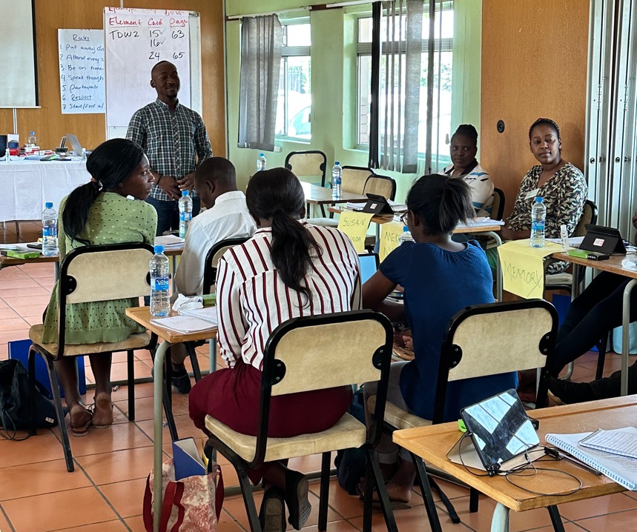
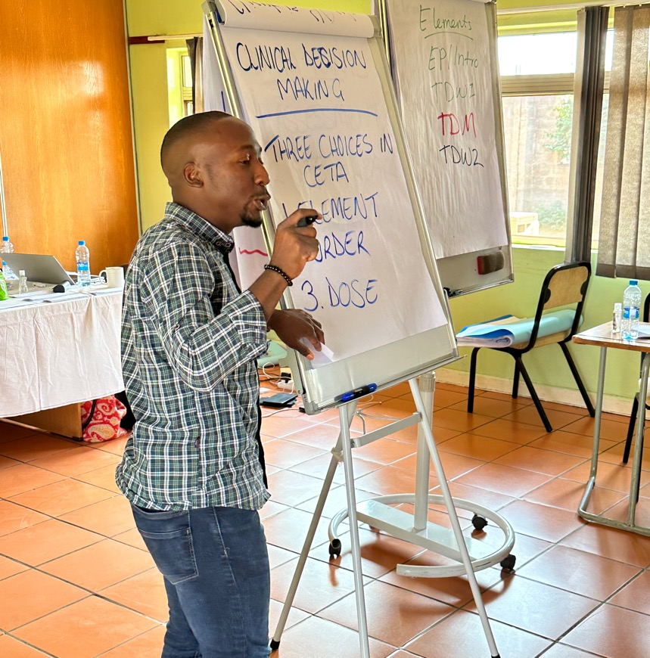
CETA Train the Trainer
Notes:
I was a counselor, and I didn’t
And I’m here for you if you need a trainer for a CETA training.
Before CETA:
Becoming a CETA trainer:
Accomplishments as a trainer: I’ve trained and supervised over 120 CETA providers in 3 years in Zambia, Uganda, and South Africa. Trained CETA providers in community health clinics, NGOs, HIV clinics for PLWH, in schools, and for healthcare workers.
How CETA changed my life: Give back to community, built capacity, leadership
Recommendations/Next steps: Recommend CETA be rolled out not only in the healthcare sector for mental health, but integrated into other medical programs such as HIV, TB, and others and in education, community programs, the justice system.

Slide 34
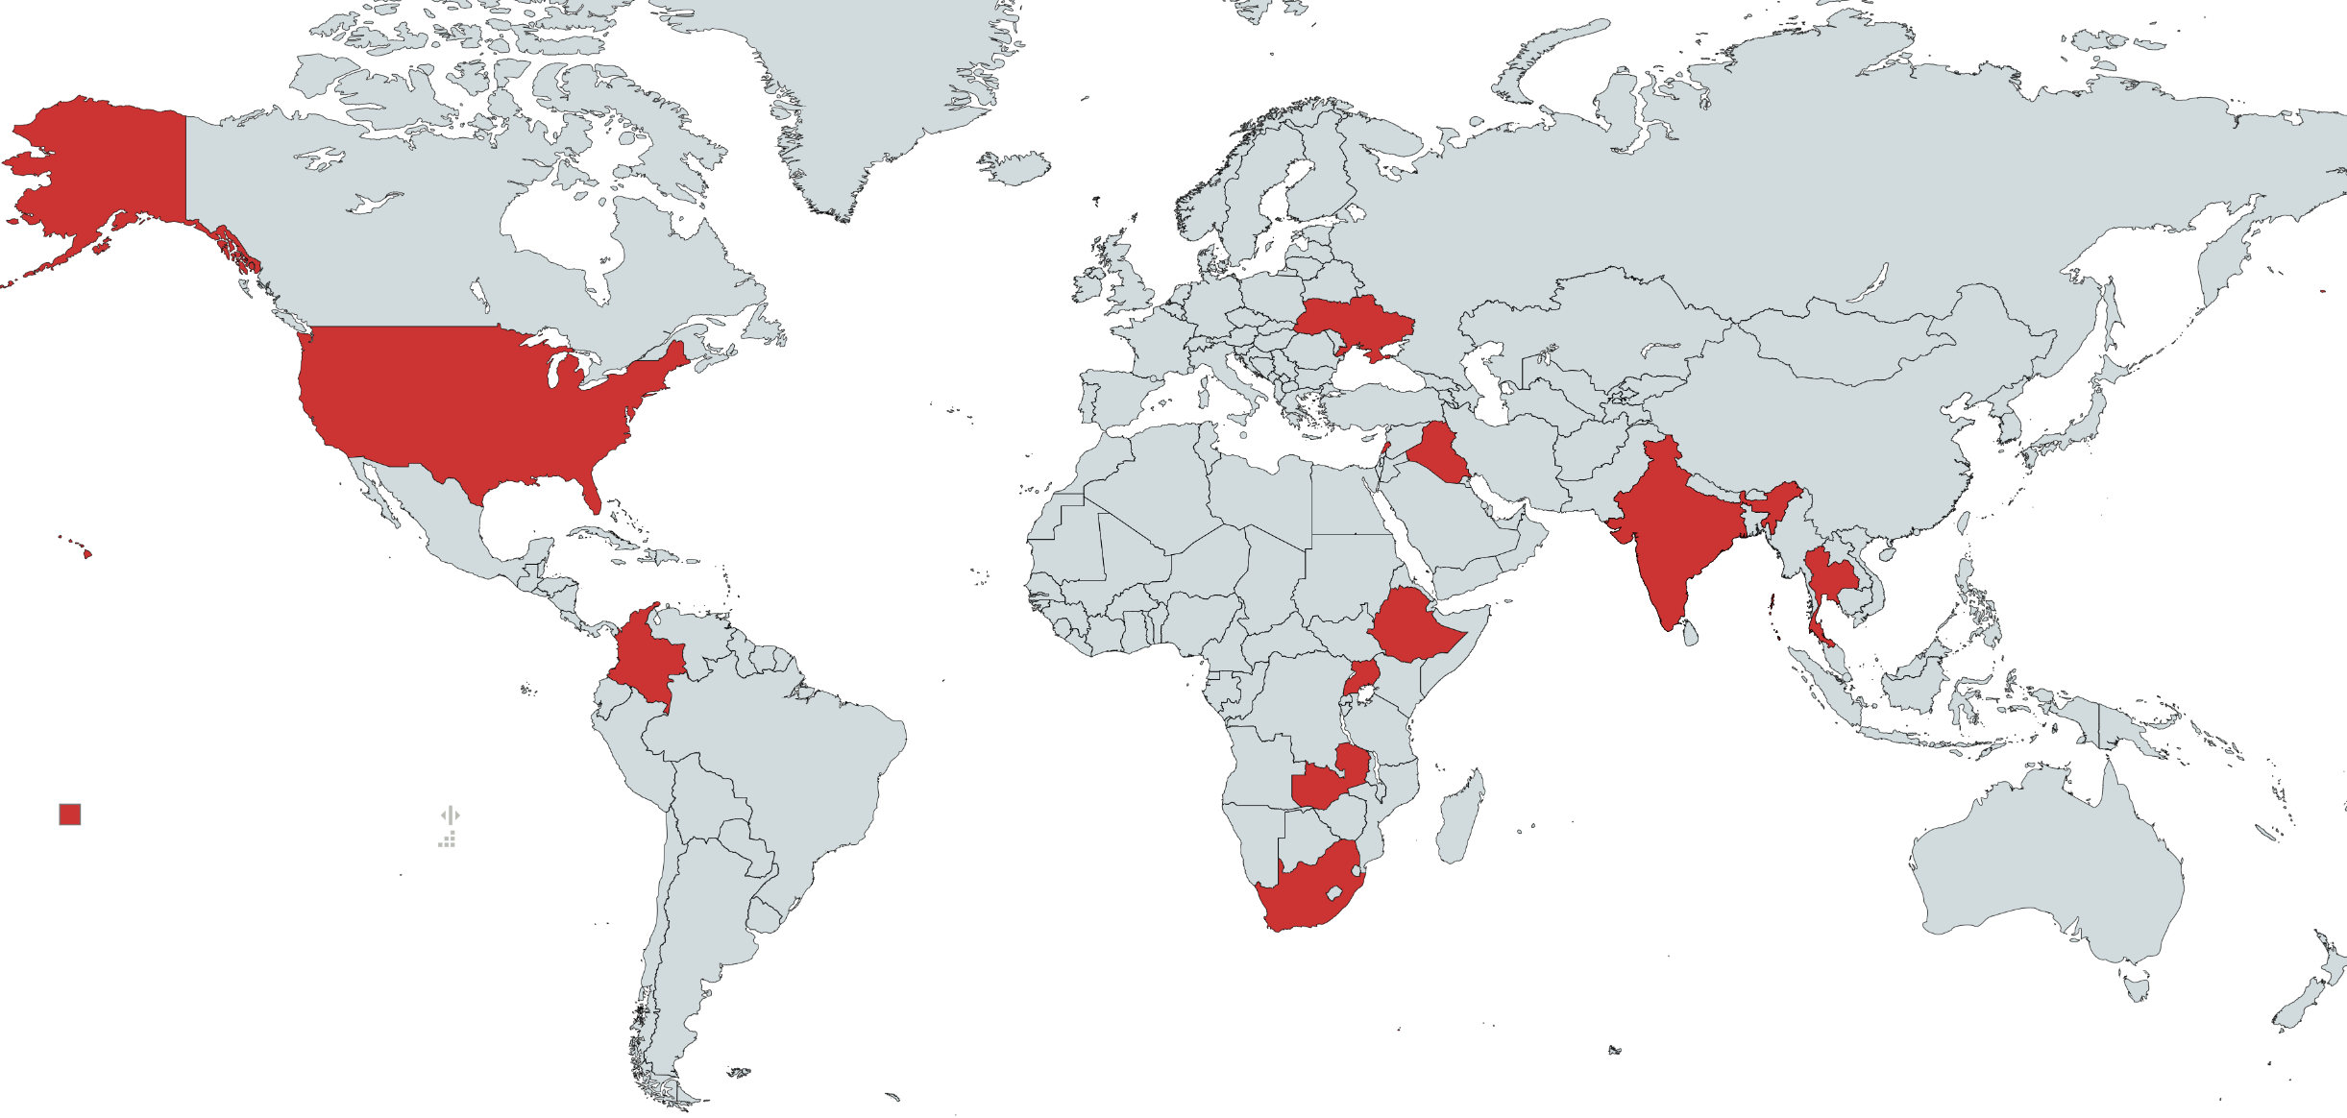
CETA studies and programs globally
Veterans of the war with Russia in Ukraine
Trauma survivors in Iraq
People with HIV and unhealthy alcohol use in rural Alabama
Burmese refugees in Thailand
Survivors of systematic violence in Colombia
Five RCTs in Zambia
Women living with HIV and survivors of IPV
Notes:
In all instances, ceta has been effect
In all instances CETA has been better than control conditions in improving mental health, in most cases with medium to large clinical effect sizes

Slide 35
Three Zambia CETA Studies
Zambia Telehealth Study with Adolescents
Adolescents and young adults
People with HIV and unhealthy alcohol use
Ukuundapwa Chapamo RCT
Congolese refugees and Zambian host community members in northern Zambia/DRC border
Zambia CETA Alcohol Pilot (ZCAP)

Slide 36
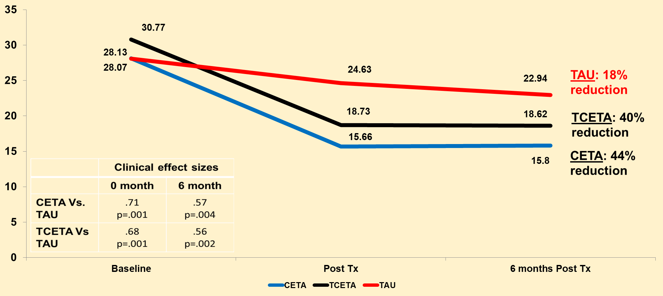
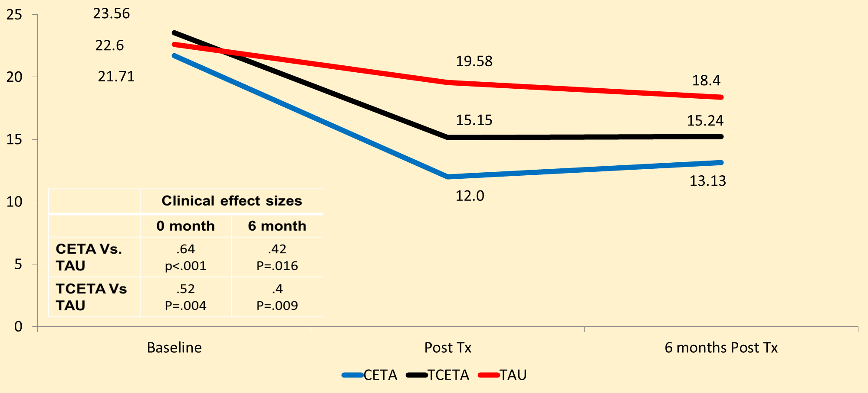
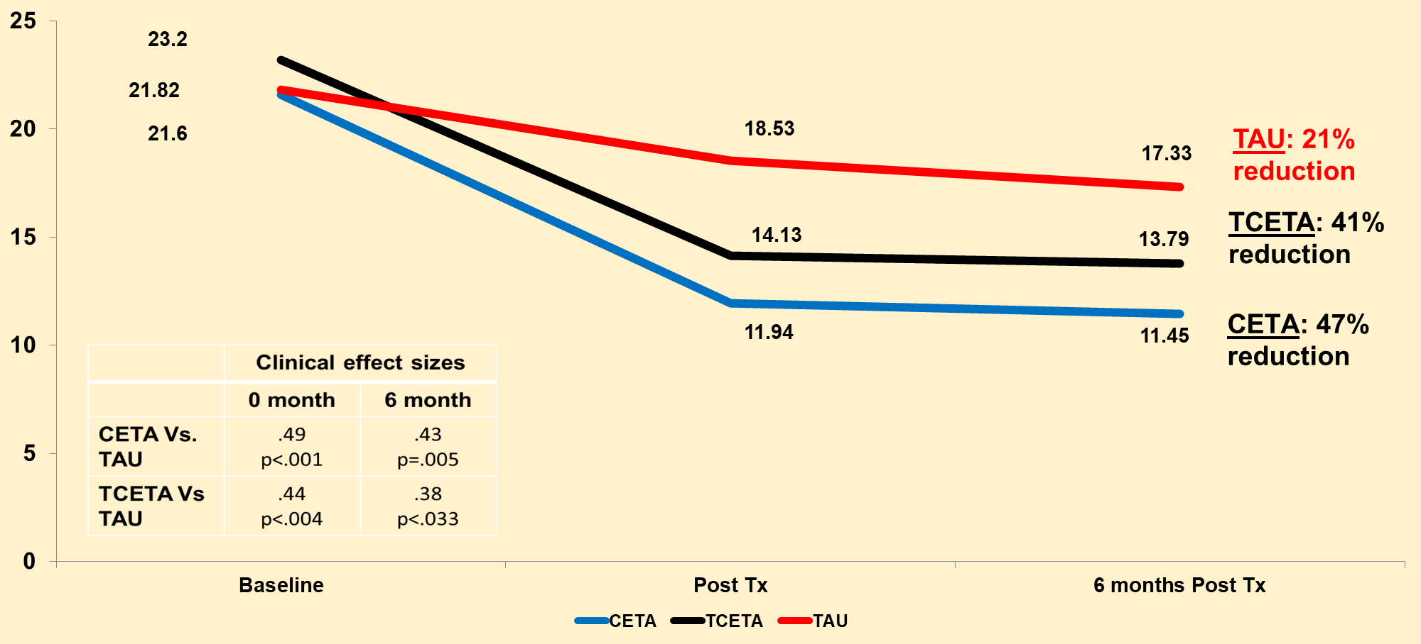
Telehealth study among AYA
400 AYA with PTSD, internalizing, or externalizing symptoms
Compared CETA and T-CETA to treatment as usual at post-treatment and 6-month follow-up
Internalizing
PTSD
Externalizing

Slide 37
Stepped Care Model
Screening
Brief intervention
Treatment
12-session CETA: MH + SUD comorbidities
Moderate – severe AUD/SUD
Screen positives – hazardous use

Slide 38
ZCAP Trial:
Alcohol use (AUDIT) stratified by comorbidity status
Kane et al. 2023 AIDS and Behavior
Take home messages: BI effective for reducing unhealthy alcohol use among PLWH without comorbidities; BI + CETA necessary when PLWH have comorbidities
Notes:
And before getting into our current trial, I also just wanted to share these key results from a prior pilot study we did with this intervention package.
We conducted a pilot randomized controlled trial that we did in Lusaka, Zambia within HIV clinics. And in that trial we tested this SBIRT package that included the brief intervention and full version of CETA.
And our results were really interesting….. The main takeaways were that among people living with HIV who had unhealthy alcohol use but who had no other mental health or substance use comorbidities– the brief intervention—CETA BI by itself was really effective in reducing unhealthy alcohol use.
But for individuals who had one or more mental health or other substance use comorbidities– the brief intervention followed by CETA was necessary to improve symptoms.
So these pilot trial results basically supported our hypothesis that an SBIRT stepped care package where individuals receive a level of care commensurate with their symptom severity or complexity, was effective in this HIV care setting. And so we thought this showed strong potential for an intervention approach that could be used in a humanitarian setting, refugee camp

Slide 39
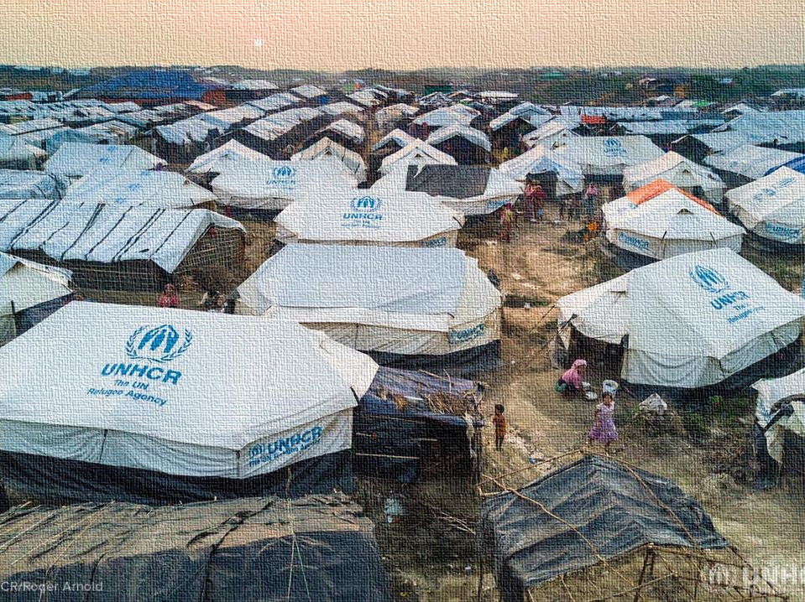
Ukuundapwa Chapamo Randomised Controlled Trial
Notes:
Ukuundapwa Chapamo is Bemba for ‘let’s get treated together’, which is the name of our study and the title was informed by community members
We are grateful to be included today and share with you an example of CETA being used in a humanitarian setting in Zambia– in the Mantapala refguee settlement
This is a much different setting than others you have heard about today and underscores how flexible the intervention is—it can literally be used almost anywhere
Our study is a true collaborative effort across a number of fantastic partners– WiLDAF, CARE, Columbia University, Johns Hopkins University, UNHCR, UNODC, UNZA, and of course the Ministry of Health

Slide 40
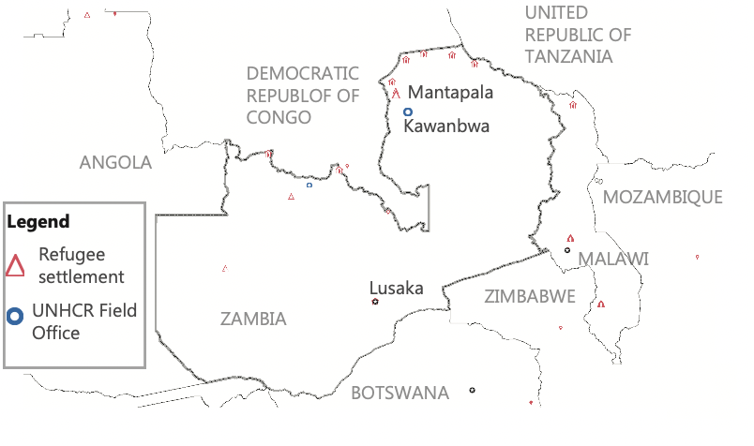
Study Location: Mantapala Settlement
Settlement opened in 2018; located in rural Luapula Province, near Nchelenge
At the beginning of our study in 2020, Mantapala hosted over 20,000 people of concern from DRC; approximately 5,000 Zambians also live in the surrounding host community
Officials are now expecting 20,000 more refugees from DRC may arrive in the coming months
Notes:
The location of our study is Mantapala refugee settlement, which opened in 2018 and is located in the rural northern province of Luapula, in Zambia.
When our study started in 2020, Mantapala was hosting over 20,000 people of concern from DRC; there were also about 5,000 Zambians in the area part of the host community
The number of people in the settlement has fluctuated over the years, with some repatriating back to DRC; but we just received word recently that there could be a very big influx of individuals from DRC in the coming months– perhaps another 20,000

Slide 41
Baseline Data
Comorbidities
100% have unhealthy alcohol use
85% have depression
47% have PTSD
44% have anxiety
33% use an illicit substance

Slide 42
Summary
Transdiagnostic approaches more efficient and effective than single-disorder treatments
Evidence for CETA strong in a variety of populations, however, not widely used in practice yet
Need to establish more impactful systems of care

Slide 43
Global mental health implementation research: Bridging research and practice

Slide 44
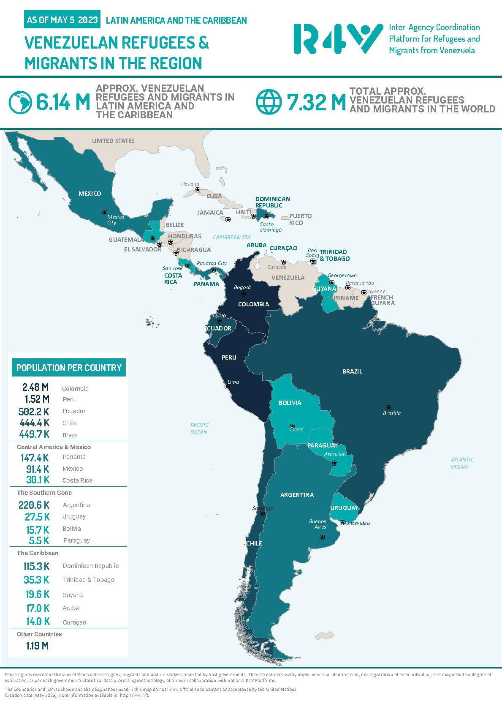
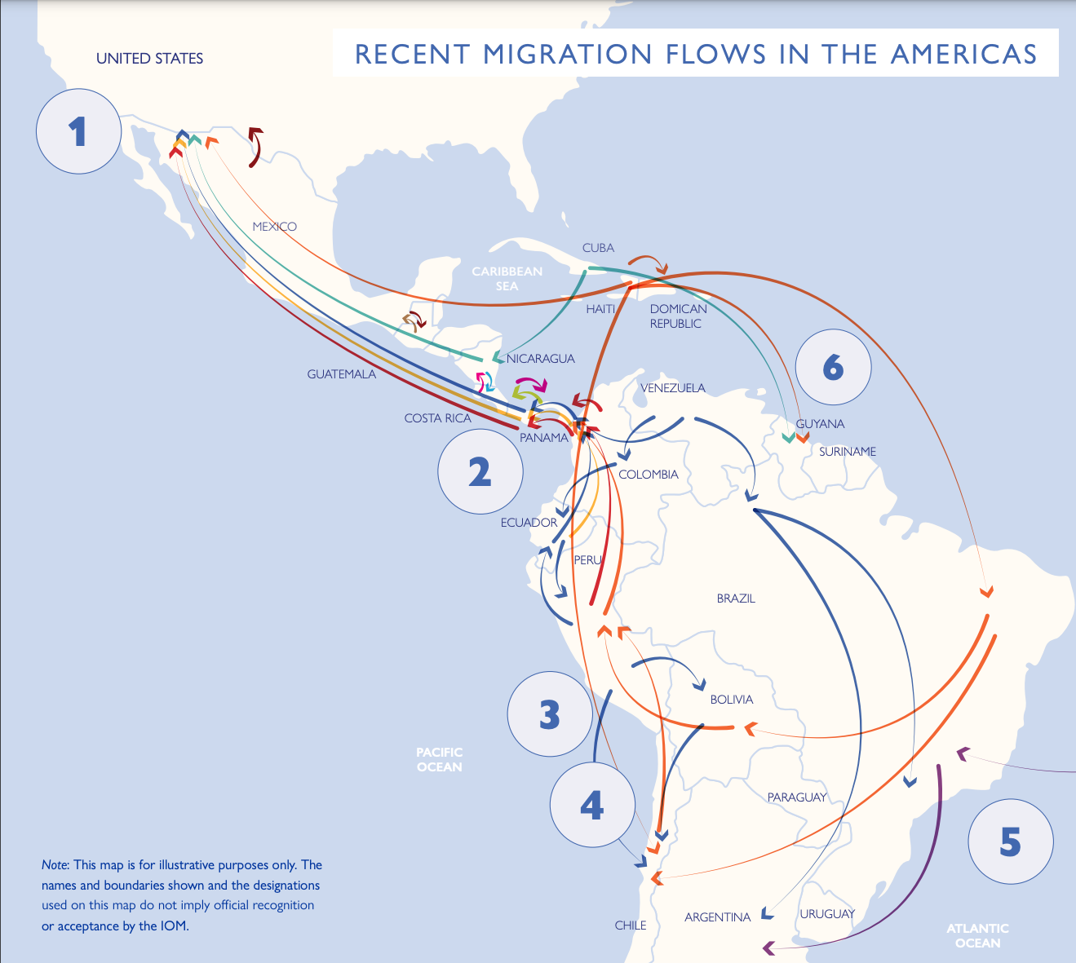
Migration in Latin America

Slide 45
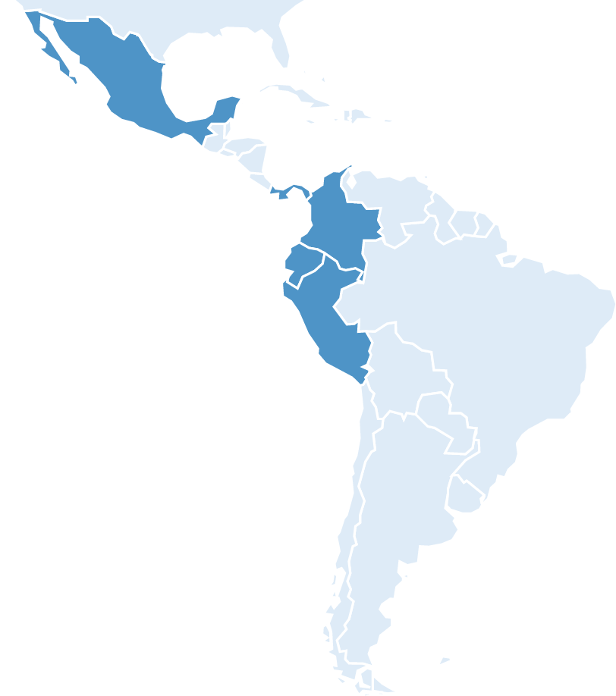
Evaluating mental health and psychosocial support (MHPSS) interventions for refugee, migrant, and host communities in Latin America
Panamá City/
West
Barranquilla
Tulcán
Guayaquil
2020-2023 | Entre Nosotras, n=225 | Group Problem Management Plus, n=128 | Interpersonal Counseling, n=32
Study design | Cluster feasibility trial | Hybrid type II trial | Pilot cohort study
Intervention targets | Promote social support, wellbeing, community connectedness, safety | Reduce common mental health problems through problem solving and CBT strategies | Reduce common mental health problems and promote engagement in mental healthcare
# sessions | 5 | 5 | 3
Provider | 2 lay providers | 1 lay provider | 1 provider
Training and supervision | In-person, psychologist and peers | In-person, psychologist or non-specialist supervisor | Remote, psychologists
Format | Group, community, in-person and remote | Group, community, in-person | Individual, remote
Lima
Tacna
Notes:
Claire

Slide 46
Characteristics of the pooled sample (n=385)
Participant characteristics
Age, M(SD) | 35.2 (11.4)
Female, n(%) | 384 (99.7)
Nationality, n(%)
Venezuelan | 284 (74.5)
Colombian | 43 (11.3)
Ecuadorian | 28 (7.4)
Other | 26 (6.8)
Unemployed, n(%) | 192 (50.3)
Education: Primary school or less, n(%) | 136 (35.5)
Migration status (self-reported)
Host community member | 36 (9.4)
Internally displaced/returnee | 7 (1.8)
Refugee/migrant/asylum seeker | 340 (88.8)
Reason for migration (n=221)
Economic/work opportunities | 104 (47.1)
Violence or conflict | 28 (12.7)
Notes:
Claire - cut

Slide 47
Those who are most vulnerable and likely in greatest need appear to be the hardest to reach with MHPSS
25% of people enrolled in MHPSS interventions never attend
23% drop out before completing the intervention
Correlates of reach and retention
More stable and formal employment
Less mobility
Less distress and better functioning
Strategies to promote reach and retention need to be tailored to the hardest-to-reach populations and must consider social and structural determinants of mental health
Notes:
Claire

Slide 48
Implementation strategies to promote access to MHPSS for hard-to-reach displaced populations
Multisectoral integration
Integrating MHPSS into poverty alleviation programs for refugee and migrant families in Quito, Ecuador
Co-designing mental health intervention strategies with migrants in transit within shelters along key migration routes Colombia
Co-design and optimization

Slide 49
Multisectoral integration of mental health and economic interventions for refugee and migrant families in Ecuador
Bidirectional relationship
“I can’t take the day off to attend because I can’t pay rent. I’m a single mother. I just live with my baby daughter and my son… NGOs do help me with the food card, but I have to pay for [my baby’s] diapers. I’m very busy so sometimes I don’t come [to the intervention]. I start selling cold cakes and stuff at home, and I go out to sell any little thing. I can’t stop working.”
– Participant in Tulcán, Ecuador, 25 years
Mental Health
Quito, Ecuador
Economic Wellbeing
Formal employment supports mental health services engagement, retention, and outcomes among Venezuelan migrants in Ecuador

Slide 50
Integration of economic and MHPSS interventions for refugee and migrant families in Ecuador
Community-based MHPSS
Socioeconomic Support Program (SESP)
Individual intervention by psychologist for key populations; Referrals to specialized care
Cash assistance
Entrepreneurship/ employment
Financial education
Social Protection
Capacity building
Target: families in poverty with specific protection needs
Duration: 12-15 months
Group MHPSS interventions
INTEGRATION
Train community promoters; Community integration and protection programs
Inter-institutional and inter-sectoral coordination, referrals, knowledge sharing and capacity building
Monthly home visits and guidance in rights access and integration by social promoter and economic inclusion advisor
Notes:
Efrén + someone from EI (Sara, Adri, Yescarleth)

Slide 51
Preliminary findings suggest that integrating focused, non-specialized MHPSS can reduce symptoms of common mental disorders (n=50 families)

Slide 52
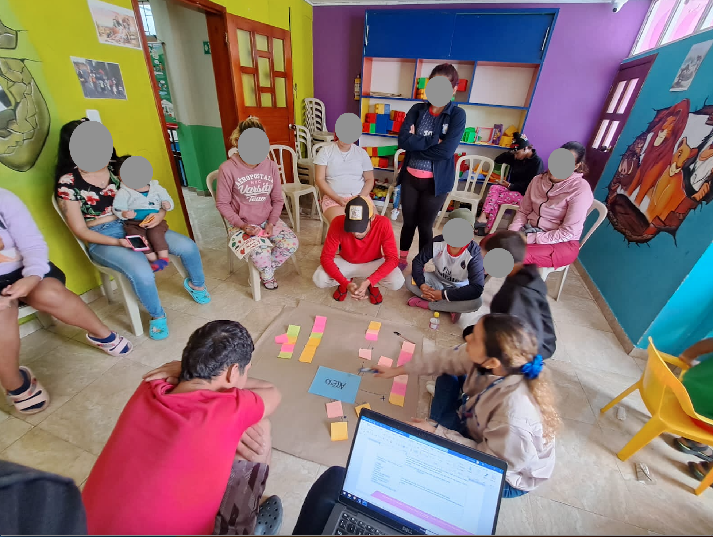
Co-designing strategies to promote access to care for migrants in transit in Colombia
Bogotá
Ipiales

Slide 53
Emerging strategies to promote reach and retention in MHPSS for migrants in transit in Colombia
MHPSS
REACH
RETENTION
Institutional and regional networks & coordination
Location of services
Access to information
Multisectoral and integrated approach
Family-based interventions
Flexible modes of delivery (phone, in-person, self)
Notes:
Claire

Slide 54
Completed and ongoing studies
Community-based participatory design of Entre Nosotras for migrant and host community women in Ecuador and Panamá (2020-2023, Funder: USAID)
Comparing training/supervision strategies for Group PM+ delivered through task sharing to migrants, refugees, and host community members in Colombia (2021-2023, Funder: USAID)
Remote delivery, training, and supervision of interpersonal counseling for migrants and refugees in Perú (2021-2022, Funder: Columbia)
Integration of MHPSS and economic interventions for migrant and refugee families in Ecuador (2022-2024, Funder: Columbia)
MHPSS for migrants in transit in Colombia (2022-2027, Funder: NIH)
Identifying risk and protective factors for mental health problems among migrants in transit in México (2023-2026, Funder: NIH)
Notes:
Claire

Slide 55
Gaps and future directions
Limited population-level mental health epidemiological data
Incorporate mental health indicators into population-based surveys
Measure community and population-level impact of interventions
Barriers to scalability, sustainability, and impact of interventions
Integrate mental health into existing systems of care (e.g., HIV programming)
Tailor mental health interventions for key populations
Need for implementation research and multistakeholder collaborations

Slide 56
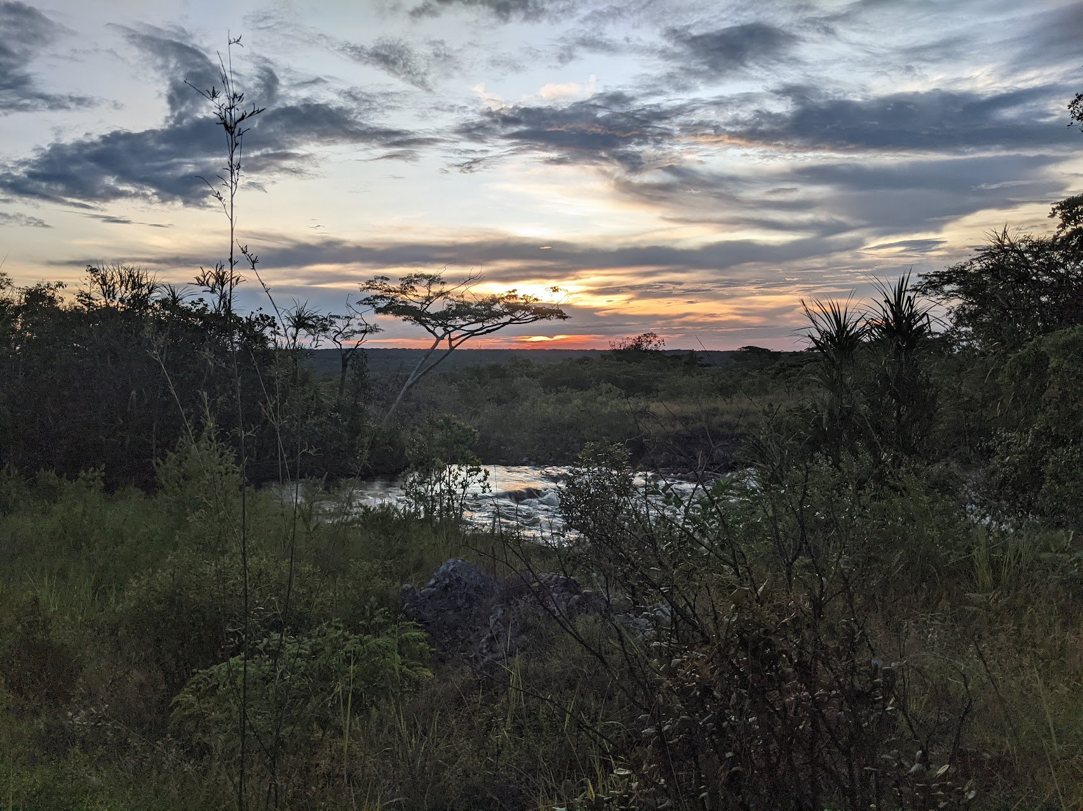
Thank you!
Claire Greene
mg4069@cumc.columbia.edu
Jeremy Kane
jk4397@cumc.columbia.edu

Slide 57
Q&A

Slide 58
This webinar recording and slides will be posted on www.icap.columbia.edu

Slide 59
Please join us for next month’s
Grand Rounds:
State of the Mpox Epidemic: Global, National, and Local Perspectives
Tuesday, June 25, 2024

Slide 60
Thank you

