Slide 1
Module 5
Dapivirine Vaginal Ring (DVR)​
Job Aid Collection

Slide 2
Module 5: DVR
Eligibility Criteria for the DVR
 | Cisgender woman
 | Unwilling or unable to use other forms of PrEP
 | HIV seronegative
 | No suspicion of acute HIV infection
 | At substantial risk for HIV infection or requesting PrEP
 | Willingness to use PrEP as prescribed
 | No contraindications to receiving the DVR | Not pregnant or breastfeeding* No history of allergy or hypersensitivity to silicone or dapivirine
*As per national guidelines

Slide 3
Module 5: DVR
Comparison of the DVR With Other Common HIV Prevention Methods for Women
 | Condoms | Oral Daily PrEP | DVR
Use How frequently must it be used? | Every time a women has sex | Daily | Replaced every month
Adherence How easy is it to use as intended? | Need to remember or negotiate use during every sex act | Need to remember to take daily pills | Need to remember to change every month
Discretion Can it be used without a partner knowing? | No | Yes | Maybe
Efficacy How well does it work to prevent HIV? | >95% efficacy when used consistently and correctly | >95% efficacy when used consistently | 30%-50% efficacy
HIV exposure What kind of HIV exposure does it protect against? | Vaginal sex Anal sex | Vaginal sex Anal sex Injection drug use | Vaginal sex

Slide 4
Module 5: DVR
DVR Initiation Visit:
Essential Procedures
Procedure | Rationale
HIV test using national algorithm or assisted HIVST | Assessment of HIV infection status
Acute HIV symptom checklist | Assess for acute HIV infection
Ask about last potential HIV exposure | If last exposure <72 hours prior, post-exposure prophylaxis (PEP) may be more appropriate before transitioning to PrEP
PrEP initiation counseling, including informed choice counseling on PrEP options | Assess substantial risk for HIV Assess HIV prevention needs and educate about options Discuss desire for PrEP and willingness to take PrEP Support informed decision to start the DVR, including understanding that it only offers partial HIV protection Plan for effective DVR use and sexual and reproductive health
Ask about any known allergies | Assess for any known allergies to DAP or silicone
Assess for use of other vaginal products or vaginal practices | Woman being treated with vaginal antimicrobial products should complete their treatment before using the DVR. Women using a ring, diaphragm or cervical cap for contraception, or who engage in vaginal cleaning or drying practices, should be willing to stop while using the DVR. Offer other contraception and prevention options as needed
Assess pregnancy and breastfeeding status (per national guidelines) | Determine if they are pregnant or breastfeeding This may make them ineligible for DVR per national guidelines Pregnancy testing or contraception may be required or recommended by national guidelines
Educate the client on effective DVR use, including self-insertion and removal procedures and schedule | Ensure the client is aware of how the DVR is used and is willing to use the DVR as instructed Offer to assist with the first insertion and answer all client questions about using the DVR

Slide 5
Module 5: DVR
DVR Initiation Visit:
Suggested Procedures
Procedure | Rationale
STI screening (per national guidelines) | Diagnose and treat STI Syndromic or diagnostic STI testing, depending on local guidelines
Pelvic exam (per national guidelines) | Evaluate for evidence of pelvic inflammatory disease or lower genital tract infections. If evidence of infection, may delay use of the DVR until treated.
Hepatitis B surface antigen (HBsAg) test | Identify undiagnosed hepatitis B (HBV) infection Identify those eligible for HBV vaccination
STI = sexually transmitted infection

Slide 6
Module 5: DVR
Clinical Pathway for DVR Initiation
1
2
3
4
5
Confirm HIV Negative Status
Screen for Substantial Risk for HIV
Informed Choice PrEP Counseling
Establish Eligibility for DVR
Initiate PrEP
Perform rapid HIV test or assisted HIV self-test per national guidelines Link people found to be living with HIV to care and treatment
Member of a population eligible for PrEP according to national guidelines​
Educate about available PrEP options Shared decision making to start the DVR as PrEP
No evidence of acute HIV infection Willingness to use the DVR as prescribed No contraindications to receiving the DVR
Counsel on effective ring use, risk reduction, side effects and acute HIV symptoms STI screening and management Provide education on DVR self-insertion and removal Prescribe DVR packs and offer to assist with first insertion
STI = sexually transmitted infection

Slide 7
Module 5: DVR
Key Initial Visit Counseling Messaging: Introduction to the DVR
The DVR is a flexible silicon ring that is inserted into your vagina. The DVR will release medication in your vagina that partially protects you from HIV. This only protects you if you are having vaginal sex. It will not protect you from HIV if you are having anal sex or injecting drugs.
You will insert and remove the DVR yourself. We will teach you how to put in and remove the DVR for yourself.
The DVR is replaced once a month. Keep the DVR in place for a month and then replace it with a new one. We will give you a supply of DVRs and you will need to remember to remove and replace it every month.
You should keep the DVR in place continuously The DVR works best if it is kept in place continuously for the entire month. This ensures you always have some protection against HIV. You should not remove and reinsert the same DVR throughout the month, as this increases your risk of infection.
The DVR can prevent HIV infections but does not offer complete protection. The DVR as PrEP is less effective than other forms of PrEP for protection against HIV. Partial HIV protection starts 24 hours after the ring has been inserted and ends as soon as the ring has been removed. It is important that you continue to use other HIV prevention methods, such as condoms, with the ring and immediately after it is removed.
The DVR does not prevent pregnancy or STIs other than HIV. Using condoms with every act of sexual intercourse provides protection against many STI infections. Use effective contraception unless you want pregnancy.

Slide 8
Module 5: DVR
Key Initial Visit Counseling Messaging: Safety, Side Effects and Follow-up
The DVR is safe to use. Very little medication from the DVR gets into the rest of your body and side effects are rare. The DVR is painless, and most women cannot feel it once it is in place.
You may experience minor side effects in your genital area or pelvis. Some women have experienced urinary infections, discharge, itching and pain. These symptoms are usually mild and go away within the first month without removing the ring.
The DVR cannot get lost in your body. The DVR cannot move up into other parts of your body and cannot get lost. However, it can sometimes get pushed high into the vagina such that it is difficult to reach. If you are struggling to reach it, you can ask a medical provider or someone else you trust to assist you with removal.
You will need to be tested for HIV every 3 months It is important that you attend visits and get tested for HIV every three months while you are using the DVR. You may return sooner if you have problems or questions about the DVR or if you would like to switch PrEP methods.
You may stop using the DVR whenever you like If you decide to stop using the DVR, we ask that you return to us for an HIV test and to discuss your HIV prevention needs going forward. HIV protection ends as soon as the DVR is removed.
You may switch to another PrEP method at any point If you would like to switch to another PrEP method, the new method can be started right away.

Slide 9
Module 5: DVR
Key Initial Visit Counseling Messaging: Common Questions
Leave the DVR in place during sex. The ring does not interfere with sexual intercourse and will not get stuck on your partner’s penis. It can be safely used with either male or female condoms and water-based lubricant. Sometimes your male partner may feel the DVR during sex; if this happens it will not cause any harm, but the DVR may need to be pushed further up into the vagina.
The DVR can be used with some, but not all contraceptive methods. The DVR can be used with many contraceptive methods such as condoms, the pill, injectables, IUD and implants. However, it cannot be used with contraceptive methods that are placed in the same part of the vagina, such as diaphragms, cervical caps or contraceptive vaginal rings.
You can leave the DVR in place during menstruation. The ring does not cover the cervix or interrupt the flow of menstrual fluid. Pads and tampons can be safely used while wearing the DVR, however menstrual cups are not recommended. If tampons are used, it is important to ensure the DVR is left in place when tampons are removed. Contact with vaginal fluids, and blood during menses, may change the color of the ring, but this does not affect how well the DVR works.
Do not use products to clean or dry out the inside of your vagina while using the DVR You should not use soap or other products to clean the inside of your vagina when using the DVR. The vagina cleans itself. You should also not use any products to dry out your vagina for sex when using the DVR. These practices may affect how well the ring works.
IUD = intrauterine device

Slide 10
Module 5: DVR
Preparing to Insert the DVR
Before inserting the DVR, a client should:
Check the expiry date on the package label. If expired, the ring should not be used.
Wash her hands in clean water and dry them before removing the DVR from its package.
Tear the DVR package to open it. She should not use scissors to open the package. If the DVR is damaged or broken, it should not be inserted.
Choose a position that is comfortable for her to insert the DVR, for example raising one leg, squatting or lying down.
Position options
Source: European Medicines Agency

Slide 11
Module 5: DVR
Inserting the DVR
To insert the DVR, a client should:
Hold the DVR between her thumb and index finger, twisting it into the shape of the number 8 by pressing the sides together (Figure 1)
Use her other hand to hold open the folds of the skin around the vagina
Place the tip of the ring in the vagina opening (Figure 2), then use her index finger to gently push the folded ring into the vagina as far as possible (Figure 3)
Wash her hands in clean water and dry them after the ring is inserted
1
2
3
Note: If the ring feels uncomfortable, it may not be pushed far enough into the vagina. Use an index finger to gently push the ring as far as possible. If it still feels uncomfortable, she should try re-inserting the ring or contacting her healthcare provider.
Ring insertion should be painless. If a client has bleeding or pain, she should contact her healthcare provider
Source: European Medicines Agency

Slide 12
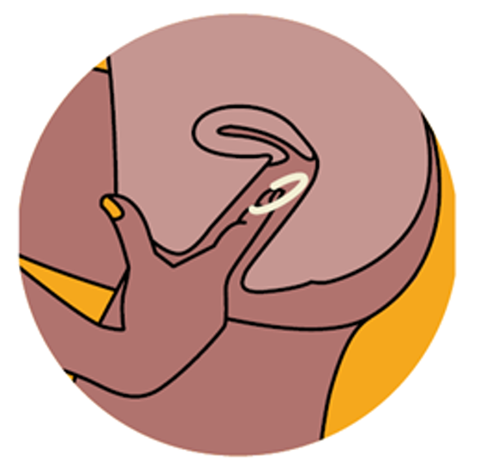
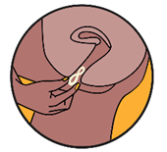
Module 5: DVR
Removing the DVR
To remove the DVR, a client should:
Remove the DVR one month from the day it was inserted
Wash her hands in clean water and dry them
Choose a comfortable position with her legs apart (Figure 1)
Use her finger to hook the ring (Figure 2) and gently pull it out of her vagina (Figure 3)
Immediately insert a new DVR, following the instructions for insertion
1
2
3
Note: Ring removal should be painless. If a client has bleeding or pain, she should contact her health care provider
Source: European Medicines Agency

Slide 13
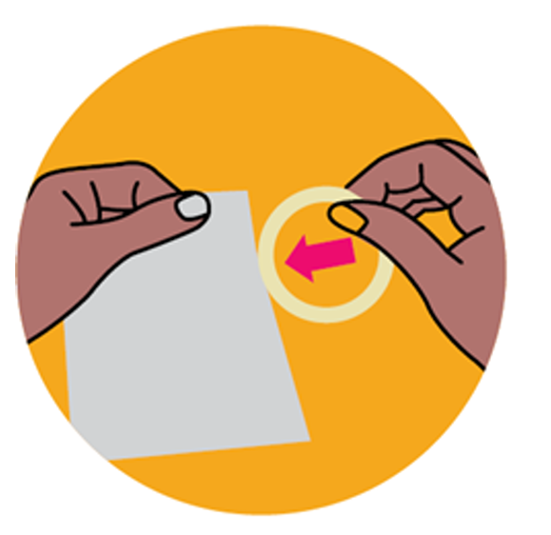
Module 5: DVR
Disposing of the DVR
The used DVR may be placed inside the empty pouch of the new ring. Alternatively, the used DVR may be wrapped in tissue or toilet paper.
A refuse bin, which is kept out of reach of children or pets, should be used for disposal.
The ring should not be disposed in the toilet.
The client should wash her hands in clean water and dry them after handling the ring.
Source: European Medicines Agency

Slide 14
Module 5: DVR
DVR Follow-Up Visit Procedures
Intervention | Schedule Following DVR Initiation
Confirmation of HIV-negative status | At one month follow-up Every 3 months
Assess for acute HIV infection, counsel on symptoms and advise them to come back as soon as possible for evaluation if acute HIV symptoms occur | Every visit
Review the client’s HIV risk, including specific risk behaviors | Every visit
Address side effects | Every visit
Evaluate ring adherence and provide brief counseling on effective ring use | Every visit
Assess for contraindications to continued DVR use | Every visit
Provide STI screening, condoms and contraception. | Every visit, and as needed
STI = sexually transmitted infection

Slide 15
Module 5: DVR
Assess for Contraindications to Continued DVR Use
Condition or Practice | Rationale
Pregnant or breastfeeding (per national guidelines) | Pregnancy and/or breastfeeding may be a contraindication to using the DVR in some countries.
New microbicides administered vaginally | DVR use may need to be paused if a woman is being treated with a vaginal microbicide.
New contraceptive product used in the vagina | If a woman is unwilling or unable to use other forms of contraception, the DVR should be stopped.
Change in vaginal practices, such as cleaning or drying practices | If a woman is unwilling or unable to stop these practices, the DVR should be stopped.
Pain or bleeding with insertion or removal of the ring | The DVR should be stopped while these symptoms are evaluated. A pelvic exam may be required to evaluate for pelvic inflammatory disease or lower genital tract infection.

Slide 16
Module 5: DVR
Follow-up Visit Counseling:
Assess Adherence to the DVR
Questions to ask to help assess DVR adherence
How has it been for you to use the ring?
Have you had any problems with inserting or removing the ring?
Have you been able to keep the ring in continuously for the whole month?
Have you forgotten to change the ring after one month, or has there ever been a gap between removing a used ring and putting in a new one?
Have you had any side effects?
What else have you been doing to protect yourself from HIV (e.g., using condoms, discussing HIV status and/or testing with partners)?
Have you experienced any other challenges with using the ring?

Slide 17
Module 5: DVR
Follow-up Visit Counseling:
Assess Barriers and Facilitators to DVR
Questions to help understand contextual factors
Do you have any concerns about using the ring?
Have you disclosed to your partner that you are using the ring? Has your partner been able to feel the ring during sex?
Have you had any trouble with your partner related to the ring use (e.g., violence, verbal abuse, relationship problems)?
Note: If intimate partner violence is reported related to DVR use, provide services and discuss alternative prevention options
Aside from your partner, does anyone else know you are using the ring? What was their reaction?
In addition to using the ring, how do you plan to stay HIV negative?
Do you ever engage in anal sex or injection drug use?
Note: if a client reports HIV exposure through anal sex or injection drug use, discuss alternative PrEP options

Slide 18
Module 5: DVR
Follow-up Visit Counseling:
Improve Effective Use
Suggestions to improve effective use of the DVR
Always come to your appointments and obtain refills for the DVR on schedule.
Set monthly reminders using the calendar on your phone or add the dates to a physical calendar.
Always replace the old DVR with a new one immediately after you remove it.
It may be helpful to pick one day of the month that is easy to remember, between the 1st and the 28th of the month, and plan to change the ring on that day every month.
If you will be traveling when you are scheduled to replace the DVR, ensure you bring a supply with you.
Remember to use other forms of protection, such as condoms, for the best HIV prevention.

