Slide 1
Module 4
Injectable Long-Acting Cabotegravir (CAB-LA)​
Job Aid Collection

Slide 2
Module 4: CAB-LA
Eligibility Criteria for CAB-LA​
 | HIV seronegative
 | No suspicion of acute HIV infection
 | At substantial risk for HIV infection or requesting PrEP
 | Willingness to use PrEP as prescribed
 | No contraindications to receiving CAB-LA​ | Weight >35 kg​ Not taking contraindicated medications​ Not pregnant or breastfeeding*​ No buttock implants or fillers​ No history of allergic or hypersensitivity reactions to cabotegravir
*As per national guidelines​
Anticonvulsants:​
Carbamazepine​
Oxcarbazepine​
Phenobarbital​
Phenytoin
Anti-tuberculosis medications:​
Rifampin/rifampicin​
Rifapentine​
Rifabutin​
Contraindicated Medications with CAB-LA

Slide 3
Module 4: CAB-LA
CAB-LA Dosing Schedule
Month 1
LOADING
DOSES
Month 2
Month 4
CONTINUATION
Month 6
Month 8
First 2 loading dose injections given 4 weeks apart
Then 1 injection every 8 weeks thereafter
Window period for injections is +/- 1 week

Slide 4
Module 4: CAB-LA
Initiation Schedule and Window​
Target Injection Date for second loading dose injection
First loading dose injection
Week 1
Week 2
Week 3
Week 4
Week 5
Week 6
Window period to receive the second loading dose injection

Slide 5
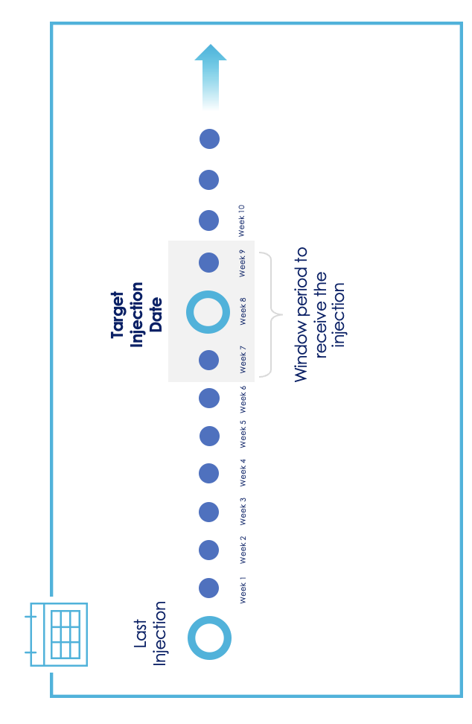
Module 4: CAB-LA
Continuation Schedule and Window​

Slide 6
Module 4: CAB-LA
CAB-LA Initiation Visit:
Essential Procedures​
Procedure​ | Rationale​
HIV test according to national guidelines ​ | Assessment of HIV infection status
Acute HIV symptom checklist | Assess for acute HIV infection​
Ask about last potential HIV exposure​ | If last exposure <72 hours prior, post-exposure prophylaxis (PEP) may be more appropriate before transitioning to PrEP
Identify medications client is currently taking. Specifically ask if they are taking any medication for seizures or TB | Determine if they are taking a medication that is contraindicated for use with CAB-LA
PrEP initiation counseling, including informed choice counseling | Assess substantial risk for HIV.​ Assess HIV prevention needs and educate about options Discuss desire for and willingness to take PrEP Support informed decision to start CAB-LA. Plan for effective PrEP use and sexual and reproductive health.
Assess the client’s weight | Determine if they are >35 kg and what size needle to use
Ask about any allergies to medications | Assess for any known allergies to CAB or other INSTI drugs
Ask the client if they have any buttocks implants or fillers, or if they plan to get them soon | Clients with buttock implants or fillers are ineligible for CAB-LA
Assess pregnancy and breastfeeding status, as well as any pregnancy intentions (women only) | Determine if they are pregnant or breastfeeding, or if they intend to be soon. This may make them ineligible for CAB-LA per national guidelines Pregnancy testing or contraception may be required or recommended by national guidelines
Assess the client’s understanding and ability to attend visits as scheduled | Ensure the client is aware of visit requirements and can attend the clinic at recommended intervals for injections

Slide 7
Module 4: CAB-LA
Clinical Pathway for CAB-LA Initiation
1
2
3
4
5
Confirm HIV Negative Status​
Screen for Substantial Risk for HIV ​
Informed Choice PrEP Counseling​
Establish Eligibility for CAB-LA
Initiate PrEP​
Perform rapid HIV test or other HIV test per national guidelines Link people found to be living with HIV to care and treatment​
Member of a population eligible for PrEP according to national guidelines
Educate about available PrEP options Shared decision making to start CAB-LA
No evidence of acute HIV infection Willingness to use CAB-LA as prescribed No contraindications to receiving CAB-LA
Counseling on adherence, risk reduction, side effects and acute HIV symptoms STI screening and management Administer injection and schedule follow-up appointment

Slide 8
Module 4: CAB-LA
Key Initial Visit Counseling Messaging: Introduction to CAB-LA
CAB-LA works very well as PrEP when taken on schedule! CAB-LA is very effective if you come to all your injection visits on time.
CAB-LA does not prevent STIs other than HIV. Using condoms with every act of sexual intercourse provides some protection against many of these infections.
CAB-LA does not prevent pregnancy. Use effective contraception unless you desire pregnancy.
CAB-LA is a long-acting form of PrEP. CAB-LA is a drug that stays in your body and protects you from HIV for several weeks.
You do not need to remember to take CAB-LA. CAB-LA will be given to you as an injection in the clinic. Unlike other forms of PrEP, you do not need to remember to do anything when you are at home. However, it is important that you remember to come to your clinic appointments for the injections.
Protection against HIV depends on when you get injections. HIV protection starts 1 week after your first injection and lasts until 8 weeks after your last injection.
CAB-LA can be kept private. No one has to know that you are using CAB-LA as PrEP. You do not need to take anything home with you. This helps with stigma some people experience when using PrEP.​

Slide 9
Module 4
Key Initial Visit Counseling Messaging: Administration, Schedule and Side Effects
CAB-LA is an injection in the buttocks. CAB-LA is an injection that goes into your muscles. We will give it to you in the buttocks where there is a large muscle.
CAB-LA is safe.
A common side effect is a reaction at the injection site. This includes redness, pain or swelling around the area where the injection goes into your skin. This is usually temporary and becomes less common over time. This can be treated with a common medication for pain.
Some people experience other side effects. Occasionally people experience headache, nausea, diarrhea, fever or tiredness. These symptoms usually do not last long and are not severe.
It is very important to come to your injection visits as scheduled. We can support you to remember to come to your visits. However, if you think you will struggle to come to visits, we should discuss other prevention options.
The first two injections are one month apart. The first two injections are called the ‘loading doses’. We can give you the first one today and the second one in a month.
After the first two injections, you will get injections every 2 months. We will discuss strategies to help you remember these visits.

Slide 10
Module 4
Key Initial Visit Counseling Messaging: Stopping and Restarting CAB-LA
If you miss your injection, you will need to use another HIV prevention method. If you are more than a week late for your scheduled injection, you should use another HIV prevention method. This could include using oral PrEP until you return for your next injection.
You may stop CAB-LA whenever you like, but you should still follow-up with us. It is important for you to tell us if you would like to stop CAB-LA.
After you stop CAB-LA it will remain in your body for 12 months. During this period, the levels of CAB-LA in your body will slowly decrease and it will no longer protect you from HIV. This is sometimes called the CAB-LA ‘tail’. If you get HIV during this time, it may be harder to detect and treat. It is important that you use other HIV prevention methods and continue to come to visits to test for HIV every 3 months during this time.
You may start CAB-LA injections again after you stop. If you choose to come back for CAB-LA injections after missing an appointment or after choosing to stop, the timing of your first few doses will depend on how long it has been since your last injection.

Slide 11
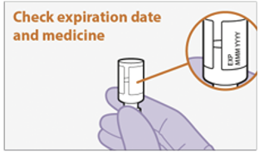
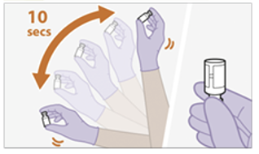
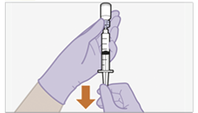
Module 4
Injection Steps: Preparing to Inject
Inspect the vial.
Check expiration date, look for any foreign matter and ensure the vial is at room temperature
1
2
Shake the vial vigorously for 10 seconds
Slowly draw up the medication.
Use a vial adaptor or general-use syringe with a hypodermic needle.
3
Source: ViiV Healthcare Package Insert
Note:
Once CAB-LA has been drawn up into a syringe, it must be administered within 2 hours.
Do not inject if medication is expired or appears contaminated

Slide 12
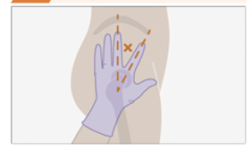
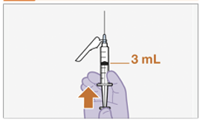
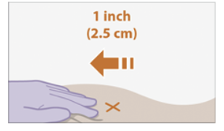
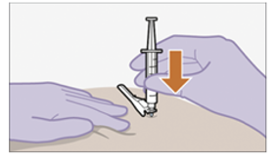
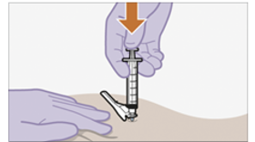
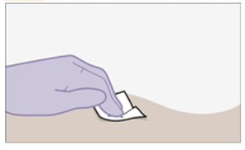
Module 4: CAB-LA
Injection Steps: Administering the Injection
4
5
Prepare the injection site.
Identify the injection site and clean it with an alcohol wipe.
Prepare the dose.
Hold the needle upright and press the plunger to the 3mL mark on the syringe, removing extra liquid and any air bubbles.
6
Inject using the Z-track injection method:
Pull skin back 2.5 cm (1 inch)
Insert the needle at a 90-angle to the skin
Press the plunger all the way down
Withdraw the needle, then release the stretched skin immediately
7
Remember to safely dispose of any sharps
Assess the injection site.
Apply pressure to the site with a sterile gauze pad. Cover with a band aid if bleeding occurs
Source: ViiV Healthcare

Slide 13
Module 4: CAB-LA
CAB-LA Follow-Up Injection Visit Procedures
Intervention​ | Schedule Following CAB-LA Initiation​
Confirmation of HIV-negative status | Prior to every injection
Review the client’s HIV risk and desire to continue CAB-LA | Every visit
Brief medical history | Every visit
Address side effects | Every visit
Pregnancy testing (women only) | According to national guidelines
Administer CAB-LA injection | Every visit
Confirm next appointment date | Every visit
Counsel clients on importance of attending scheduled visits, CAB-LA discontinuation processes, acute HIV symptoms and medication-related signs and symptoms warranting urgent evaluation. | Every visit
Provide STI screening, condoms and contraception. | Every visit, and as needed
STI = sexually transmitted infection

Slide 14
Module 4: CAB-LA
CAB-LA Side Effect Management
Side Effect | Management
Injection site reaction, including redness, pain, and swelling at the injection site | Over-the-counter pain medication within a couple of hours before or after the injection and continue as needed for 2-3 days. Warm compress or heating pad on injection site for 15-20 minutes after the injection.
Headache | Over-the-counter pain medication
Nausea | Anti-emetic medication
Diarrhea | Anti-diarrheal medication
Fever | Over-the-counter antipyretic medication
If a client reports severe ongoing side effects, refer them for an evaluation of other causes
Signs and Symptoms Warranting Urgent Evaluation
Concern | Signs and Symptoms​
Hypersensitivity reaction | Severe generalized rash Blisters, including sores in the mouth Fever Shortness of breath
Infection at the injection site | Severe pain and swelling at the injection site Discharge or abscess formation at the injection site
Liver dysfunction | Jaundice (yellowing of the skin or eyes) Persistent nausea/vomiting Abdominal pain in the right upper quadrant Darker urine or lighter stool color
Depression | New onset or worsening depressive symptoms Suicidal ideation

Slide 15
Module 4: CAB-LA
Considerations for Whether to Resume/Restart CAB-LA
Type of returning client | Assessment
Unplanned missed appointment | Reasons for missing their appointment Pattern or history of missing appointments Desire to remain on CAB-LA
Planned missed appointment | Use of oral PrEP bridge, including length of time bridging and if used correctly i.e., started 8-9 weeks after last injection, daily adherence, continued until next injection Pattern or history of missing appointments (planned or unplanned) Desire to remain on CAB-LA
Return after discontinuing CAB-LA | Reasons for discontinuing CAB-LA Attendance of discontinuation and post-discontinuation visits Reasons for returning and desire to restart CAB-LA Prior experience with CAB-LA and adherence to injection appointments
Client may not be a good candidate to resume/restart CAB-LA if:
They frequently miss appointments, whether intentionally or not
They struggled to use an oral PrEP bridge correctly or used bridging for >3 months
They suddenly discontinued CAB-LA, and did not attend a discontinuation visit
They did not regularly attend CAB-LA post-discontinuation visits
They have no desire to continue CAB-LA (e.g., due to side effects, schedule, personal preference)

Slide 16
Module 4: CAB-LA
Decision to Resume or Restart After a Missed Injection​
The Target Injection Date is based on the date of the last injection received and what type of injection it was.
Target Injection Date
= 4 weeks after the first injection
= 8 weeks after all other injections
Target Injection Date
When the client returns
Week 1
Week 2
Week 3
Week 4
Week 5
Week 6
Within the widow period, continue with injections
RESUME
injections according
to schedule
RESTART
injections with
two loading doses
1 month apart

Slide 17
Module 4: CAB-LA
Injection Schedule After Missed Visits
Time since Target Injection Date?
≤4 weeks
>4 weeks
RESUME with next injection
RESTART with two loading dose injections 1 month apart
Continue with injections every 2 months
After loading doses continue with injections every 2 months
The Target Injection Date is based on the date of the last injection received and what type of injection it was.
Target Injection Date
= 4 weeks after the first injection
= 8 weeks after all other injections

Slide 18
Module 4: CAB-LA
CAB-LA Discontinuation and Post-Discontinuation Visits
Discontinuation and Post-Discontinuation Visit Procedures
HIV testing
Address any lingering side effects
Counsel on need for HIV prevention during the ‘tail’ period and offer effective prevention services, including oral PrEP if eligible
Counsel on need to attend post-discontinuation visits for 12 months
Provide STI screening, condoms and contraception as needed.
Assess pregnancy and breastfeeding status among women (per national guidelines)
Key Messages
CAB-LA will remain in your body for 12 months. During the period after your last injection, the levels of CAB-LA in your body will slowly decrease. This is sometimes called the CAB-LA ‘tail’.
It is important to protect yourself from HIV during this time. If you get HIV during this time, it may be harder to detect and treat. It is important that you use other effective HIV prevention methods.
Continue to come to visits during this time. It is important that you attend visits to test for HIV every 3 months during this time. We can also support you to use effective HIV prevention methods.

