Slide 1
Module 1
PrEP Basics
Job Aid Collection

Slide 2
Module 1: PrEP Basics
Comparing PrEP, PEP​ and ART
PrEP​ | PEP | ART
HIV negative persons​ Prevent HIV infection BEFORE exposure​ Ongoing use during period of substantial risk | HIV negative persons​ Prevent HIV infection AFTER exposure​ Limited use for 28 days after exposure​ | People living with HIV​ Treat HIV infection and prevent transmission to others Lifelong use​
PEP = post-exposure prophylaxis
ART = antiretroviral therapy

Slide 3
Module 1: PrEP Basics
General PrEP Eligibility Criteria​
 | HIV negative
 | No suspicion of acute HIV infection
 | At substantial risk for HIV infection or requesting PrEP
 | Willingness to use PrEP as prescribed
 | No contraindication to PrEP drug or administration route

Slide 4
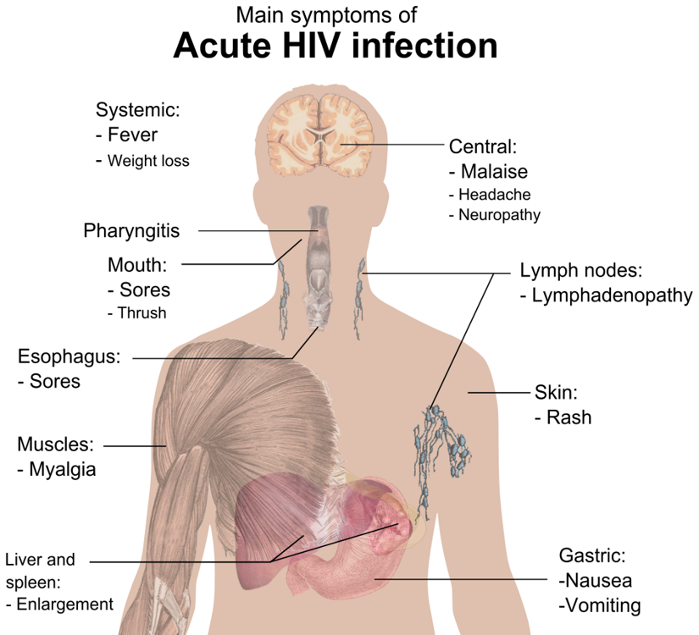
Module 1: PrEP Basics
Screening for Acute HIV Infection
1. Assess for recent HIV exposure
ASK: In the past 72 hours, have you had sex without a condom with someone whose HIV status is positive or not known to you, or have you shared injection equipment with someone whose HIV status is positive or unknown to you? If answer is yes, consider PEP first. Do not start PrEP.​
ASK: How about in the last 4 weeks?​
2. Assess for flu-like symptoms
ASK: In the past 4 weeks, have you had any cold or flu symptoms, including fever, fatigue, sore throat, headache, swollen glands, rash, mouth ulcers or muscle pain/soreness? ​
Note: Many of these symptoms are commonly due to other illnesses. Use clinical judgement in determining whether symptoms are consistent with HIV or may be explained by an alternative cause. History of a potential HIV exposure within the last 4 weeks should increase suspicion for acute HIV infection in a person with symptoms.​
Never start PrEP if acute HIV infection is suspected​

Slide 5
Module 1: PrEP Basics
PrEP Eligibility: Substantial Risk for HIV Infection or Requesting PrEP​
Does the client report any one of the following in the past six months?​
Sexual activity in a high HIV prevalence population or key population group ​
Vaginal or anal intercourse without condoms with more than one partner
Sex partner with one or more HIV risk factors
History of an STI (based on lab test, syndromic STI treatment, or self-report)​
History of use of PEP
History of sharing of injection material and/or equipment with another person
Having a sexual partner who is HIV positive and has been on ART for less than 6 months or has inconsistent or unknown adherence
Asking for PrEP
STI = sexually transmitted infection
PEP = post-exposure prophylaxis
ART = antiretroviral therapy

Slide 6
Module 1: PrEP Basics
Screening a Person Who Has a Partner Living with HIV​
Offer PrEP to HIV-negative partners in a serodifferent (a.k.a. serodiscordant) relationship when:​
The partner living with HIV has been on ART for <6 months
The HIV-negative partner is not confident of their partner’s adherence to HIV treatment
The HIV-negative partner is aware of gaps in their partner’s adherence to HIV treatment​
The partner living with HIV is known to have an elevated viral load or be failing HIV treatment.
The couple is not communicating openly about HIV treatment adherence and viral load test results
Questions for a Person Who Has a Partner Living with HIV
Is your partner taking ART for HIV?​
Has your partner been on ART for more than 6 months?​
Do you regularly discuss your partner’s adherence to HIV treatment?​
Do you know your partner’s last viral load result? And when was the testing done?​
Do you wish to have a child with your partner?​
Are you and your partner consistently using condoms?​
ART = antiretroviral therapy

Slide 7
Module 1: PrEP Basics
PrEP Options Recommended by the World Health Organization​
Oral Daily PrEP
Oral Event-Driven PrEP (ED-PrEP) ​
Injectable Long-Acting Cabotegravir (CAB-LA)​
Dapivirine Vaginal Ring (DVR)

Slide 8
Module 1: PrEP Basics
Oral Daily PrEP​
Key Information
TDF 300 mg/FTC 200 mg or TDF 300 mg/ 3TC 300 mg pill
Take as one pill daily​
Short-acting​
For everyone at substantial risk ​
>95% efficacy ​to prevent HIV infection
Common side effects: short-term gastrointestinal symptoms​
Follow-up every 3 months for HIV testing​
TDF = tenofovir disoproxil fumarate
FTC = emtricitabine
3TC = lamivudine

Slide 9
Module 1: PrEP Basics
Oral ED-PrEP​
Key Information
TDF 300 mg/FTC 200 mg pill
Taken as needed pre- and post- sexual exposure
Pre: 2 pills 2-24 hours before sex​
Post: 1 pill daily until 2 days after last sexual exposure​
Short-acting​
For men (male sex at birth) and sexual exposure only​
Unless taking estradiol-based hormones, such as for gender-affirming hormone therapy​
>95% efficacy ​to prevent HIV infection
Common side effects: short-term gastrointestinal symptoms​
Follow-up every 3 months for HIV testing​
TDF = tenofovir disoproxil fumarate
FTC = emtricitabine

Slide 10
Module 1: PrEP Basics
CAB-LA
Key Information
600 mg (3mL) cabotegravir liquid suspension
Intermuscular injection into the buttock every 8 weeks​
Except first two injections, which are 4 weeks apart
Long-acting​
For everyone at substantial risk ​
>95% efficacy ​​to prevent HIV infection
Common side effect: injection site reactions​
Follow-up every 8 weeks after first two injections for injection administration and HIV testing

Slide 11
Module 1: PrEP Basics
DVR
Key Information
Silicone vaginal ring containing 25 mg of dapivirine
Self-insert into the vagina every 28 days
Long-acting
For women (female sex at birth) with receptive vaginal exposure to HIV only
30-50% efficacy ​to prevent HIV infection
Common side effects: short-term urinary tract and vaginal irritation
Follow-up every 3 months for HIV testing​

Slide 12
Module 1: PrEP Basics
PrEP Eligibility Based on HIV Exposure​
Sexual exposure​
Female sex at birth | Male sex at birth​
Oral Daily PrEP​
Oral Daily PrEP​
CAB-LA​
CAB-LA​
DVR*
Oral ED-PrEP**​
Injection drug use exposure​
Female or male sex at birth​
Oral Daily PrEP​
CAB-LA​
*For receptive vaginal sex only​
**Unless taking estradiol-based hormones, such as for gender-affirming hormone therapy​

Slide 13
Module 1: PrEP Basics
Comparison of PrEP Efficacy​
High​ >95% efficacy
CAB-LA​
Oral Daily PrEP​
Oral ED-PrEP​
Medium 30%-50% efficacy
DVR
Efficacy rates for preventing HIV infection when PrEP is taken as prescribed with optimal adherence​.

