Slide 1




Have we met before?
Understanding predictors of repeat HIV testing in Eswatini using HIV-1 recent infection surveillance data
Presenter: Claire Steiner, MD MPH
ICAP at Columbia University
December 9th, 2021
Co-authors: Dumile Sibandze, Lenhle Dube, Vusie Lokotfwako, Munyaradzi Pasipamire, Eugenie Poirot, Cebisile Ngcamphalala, Prudence Mkhabela, Ruben Sahabo, Melissa Arons, Kathryn Lupoli, Trudy Dobbs, Suzue Saito, Harriet Nuwagaba-Biribonwoha, Samkelo Simelane
Notes:
Hello everyone, my name is Claire Steiner and I will be presenting “Have we met before, understanding predictors of repeat HIV testing in Eswatini using HIV-1 recent infection surveillance data”

Slide 2

Accurate Data to Assess Global Treatment Targets are Critical
Population-based data indicates:
  87% of PLHIV aged 15 years and older know their HIV status
  88% of those are on ART¹
Population-based studies are periodic and expensive
Reliable estimation of new HIV diagnoses using routinely collected program data is needed to monitor progress.
1. Government of the Kingdom of Eswatini, et al, Swaziland HIV Incidence Measurement Survey (SHIMS2) 2016-17: Summary Sheet, in 2017, Government of the Kingdom of Eswatini, CDC and ICAP: Mbabane, Eswatini, Atlanta, Georgia and New York, New York, USA.
Notes:
Eswatini is rapidly approaching conditions needed to reach epidemic control: 87% of PLHIV aged 15 years and older know their HIV status and 88% of those are on A-R-T¹. Such estimates, however, rely on periodic population-level studies with large budgets¹⁻³. Reliable estimation of new HIV diagnoses identified through routine HIV testing are needed to accurately monitor progress towards UNAIDS 95-95-95 targets on an ongoing basis.

Slide 3
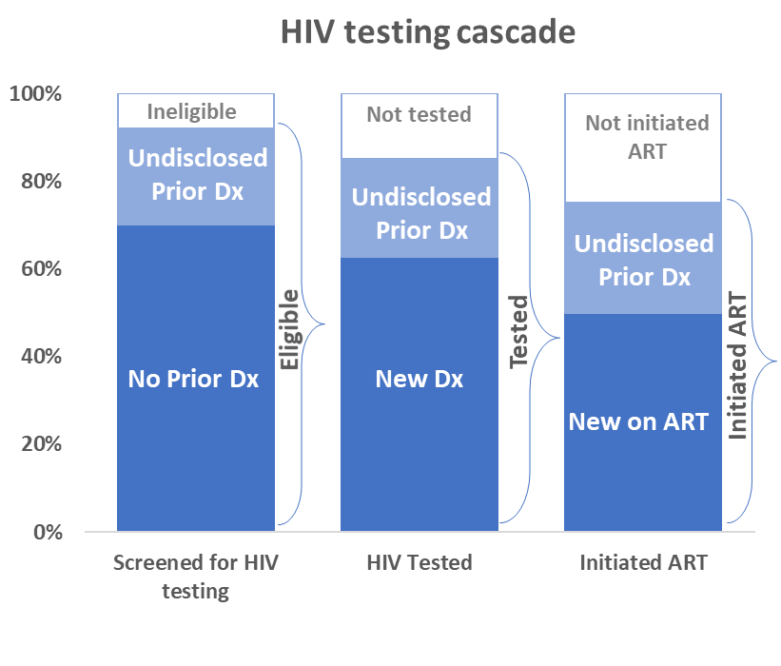
Repeat Testing Makes Monitoring Targets to Progress Challenging
  Non-disclosure of prior HIV diagnosis and ARV use during screening → overestimation of testing and ART progress.
  Problematic where case-surveillance or EMR systems weak, inaccessible
  Literature is scarce on estimates of undisclosed ARV use in PLHIV accessing routine HIV testing
*Schematic, not actual data
Notes:
Non-disclosure of prior HIV diagnosis and ARV use at the time of testing results in individuals being double counted towards programmatic HIV testing targets and could result in overestimation of progress.
The schematic on the left (which is not real data) shows the screening, testing and treatment initiation cascade for those presenting for HIV testing in routine care settings.
What we’re trying to display here is that of everyone who is screened, tested for HIV and initiated on ART (in the blue bands), there is a proportion (in light blue), of an unknown number, of clients who conceal their diagnostic and care status and are counted again as new diagnoses, yet are in fact already on ARVs. This becomes problematic where case-surveillance systems or electronic medical records are weak or inaccessible making it difficult to verify and correct.
Research on this topic beyond clinical trials is scarce, particularly from routine settings, where resource constraints prevent universal use of viral load or ARV metabolite testing.

Slide 4
ESWATINI HIV-1 RECENT INFECTION SURVEILLANCE (EHRIS) PROGRAM
Notes:
First some background on ESWATINI HIV-1 RECENT INFECTION SURVEILLANCE or EHRIS program

Slide 5
Eswatini HIV-1 Recent Infection Surveillance
C
LT
Recency testing: A rapid point-of-care HIV test that distinguishes recent (<12 mo) from long-term (≥12 mo) infection
Objectives: Identify and characterize new infections by geographic, demographic and HIV risk behavior characteristics.
Launched July 2019
143/164 health facilities reporting and 17,908 RTRI tests conducted as of July 2021
V
Long term
Recent
Inconclusive
Definitions:
RTRI: rapid test for recent infection
RITA: recent infection testing algorithm
  RTRI Recent and HIV RNA ≥1000 c/mL
Notes:
The MOH of Eswatini with technical assistance from ICAP stood up an HIV-1 recent infection surveillance program in July 2019, aiming to identify and characterize new infections by geographic, demographic and HIV risk behavior on a near real-time basis to inform public health response.
The program uses a rapid serology test (RTRI) that exploits differences in antibody avidity to distinguish likely recent (<12 months) vs. long-term (≥12 months) infection. (click)
The limitation of the RTRI is that it can misclassify those who are already on ART and therefore not newly diagnosed as a recent infection. Viral load measurement for RTRI recent cases completes the recent infection testing algorithm.

Slide 6
Recent Infection Testing Algorithm (RITA)
New HIV+ diagnoses (15 years +)
(National HTS algorithm)
Opt Out | Screening | Questionnaire
RTRI Recent
RTRI Long-term
Viral load
≥1,000 copies/ml
Viral load
<1,000 copies/ml
Misclassified recent = proxy for non-disclosure of HIV diagnosis and ART use
RITA Recent
RITA Long term
Notes:
The EHRIS program uses an opt-out approach for all adults 15 years and above, diagnosed with HIV through routine care using the national HIV testing algorithm (click)
Screening questions determine eligibility based on age, no prior diagnosis or no ART use.
Eligible individuals complete a questionnaire, where they are again asked for prior diagnosis and ART use, then offered recency testing (click)
The RTRI provides a preliminary recent, (click) or long-term result
RTRI recent plus VL >= 1000 copies/ml
are classified as “RITA recent” (click)
RTRI Recent plus viral load suppression
are classified at RITA long-term (click)
It is these PLHIV who are recent on RTRI yet are virally suppressed that we refer to as ‘misclassified’ and considered to have not disclosed their prior diagnosis and are likely already on ART.

Slide 7
METHODS
Notes:
Now to our methods…

Slide 8
Study population: Adults ≥15, self-report new HIV diagnosis, HIV tested July 2019 – July 2021
17,908
HIV + by national HTS algorithm
3,100
14,808
Offered/accepted recency testing
1,072
13,736
Eligible
12,445
1,291
RTRI Recent
227
1,064
With VL result
Notes:
During the time period from July 2019 to July 2021, of 17,908 newly HIV diagnosed adults (click)
14,808 accepted recency testing, (click)
13,736 were eligible and had an RTRI result
1,291 tested ‘recent on RTRI’ hence eligible for viral load by the algorithm (click)
Excluding 227 who did not have a viral load result, we’re left with 1,064 RTRI recent cases with viral load in our analysis.

Slide 9
Statistical Analysis
We report misclassification as a proxy for non-disclosure of prior HIV diagnosis and ARV use.
Prevalence of misclassification among RTRI recent infections by demographic, testing setting, and time-period (pre- post-March 24, 2020 COVID-19 “stay-at-home” guidance).
2. Log-binomial regression modelling to analyze associations between same variables
Notes:
For our analysis we report misclassification of RTRI recent cases as a proxy for non-disclosure of prior HIV diagnosis and ARV use.
To do this, we estimated prevalence of misclassification among RTRI recent infections, broken down by age, sex/pregnancy, marital status, testing setting (community or facility) and whether the person presented for testing before or after March 24 2020, when the Government of Eswatini instituted it’s first ‘stay-at-home’ order related to COVID-19.
We then conducted univariable and multivariable log-binomial regression to estimate the relative risk of misclassification by these same variables.

Slide 10
RESULTS
Notes:
I will now take you through our results…

Slide 11
Prevalence of misclassification among RTRI recent
Notes:
Of 1064 RTRI recent infections with VL reported during this period, (click)
39.4% were misclassified (click)
Broken out by age, we see misclassification was 33.8% among younger age groups and 44.6% among adults >=25 years and (click)
By sex and pregnancy, we estimated 43% among pregnant females, 39.4% among non-pregnant females and 34.8% misclassification among males.

Slide 12
Prevalence of misclassification among RTRI recent
Notes:
(click) In community testing settings we estimated 50.7% misclassification, compared to 37.5% in facility-based settings, (click)
By marital status, we estimated 48.6% misclassification among divorced, widowed, separated (thought CI is very wide), 42.7% if clients were married/living together and 38.0% if never married. (click)
By time period, misclassification was estimated to be 34.3% if testing occurred before COVID-19 and 43.8% during COVID-19.

Slide 13
Adjusted Relative Risk of Misclassification Among RTRI Recent
Adjusted Relative Risk
Notes:
We then used step-wise forwards and backwards regression modeling to arrive at the final fully adjusted model for relative risk of misclassification (displayed here).
As you can see, the adjusted relative risk (ARR) of misclassification among RTRI recent infections was statistically higher if:
testing was performed at community sites vs facility sites (ARR=1.5)
During COVID-19 vs before (ARR=1.3),
If client age ≥25 years vs 15-24 years (ARR=1.4)
Borderline significant association among pregnant vs non-pregnant women (ARR=1.2).

Slide 14
Summary
High ‘misclassification’ (RTRI recent with VLS) suggests non-disclosure of prior diagnosis is common in routine HIV testing in Eswatini.
Particularly in community testing settings, during COVID-19, and in older adults.
Notes:
Over one-third of RTRI recent PLHIV in our analysis were misclassified as recent infections. This suggests that non-disclosure of prior diagnosis and repeat testing among PLHIV in routine testing settings is common.
This is particularly evident in community testing settings, during HIV testing since the first ”COVID-19 stay-at-home” order, and in older adults.

Slide 15
Limitations
Viral load available on <10% of all new HIV diagnoses,
Estimates relied on self-report of prior diagnosis and VL, without verification against EMR/case-surveillance databases,
Study did not test for ARV metabolite biomarkers.
Notes:
Our analysis was not without some limitations

Slide 16
Public Health Implications
1 Deeper inquiry is needed to understand motivations among repeat testers to adapt screening tools and counselling messages.
2 Ensuring clinicians adopt client centered approaches will help to identify and address specific needs.
3 EHRIS data is being used by MOH GKoE to improve HTS screening and improve national guidelines.
4 Underscores need for robust accessible EMR/CS systems, especially in community settings.
Notes:
Reasons for repeat testing may be many, from seeking simple routes to transfer care between health centers to poor health literacy. (click)
As always, further inquiry is needed to better understand the motivations among repeat testers and allow programs to adapt screening and counselling to better identify clients already engaged in care. (click)
At the core is a need to improve ‘client centered approaches’ to ensure availability of supportive and responsive HIV care.
For example, a successful client-centered program with tools and procedures in place to support seamless transfer of care, so that providers or clients will not need to resort to retesting as a means re-engage or transfer care. (click)
In Eswatini, these findings have led to revision of HIV testing guidelines to ensure providers are adopting a client centered approach, aiming to ensure appropriate use of HIV services. (click)
Finally, the practice of PLHIV cycling back through the system via HIV testing underscores once again the need for robust and accessible EMR or surveillance systems, especially in community settings, that will more effectively weed out repeat testers, aid clinicians to offer suitable services and improve accuracy of progress estimates.

Slide 17
Acknowledgements
Ministry of Health, Government of the Kingdom of Eswatini, Mbabane, Eswatini
Co-authors: Dumile Sibandze, Lenhle Dube, Vusie Lokotfwako, Munyaradzi Pasipamire, Eugenie Poirot, Cebisile Ngcamphalala, Prudence Mkhabela, Ruben Sahabo, Melissa Arons, Kathryn Lupoli, Trudy Dobbs, Suzue Saito, Harriet Nuwagaba-Biribonwoha, Samkelo Simelane
Centers for Disease Control and Prevention, Eswatini
Centers for Disease Control and Prevention, Atlanta
ICAP at Columbia University, Mailman School of Public Health, Mbabane, Kingdom of Eswatini
ICAP at Columbia University, Mailman School of Public Health, New York, USA
Department of Epidemiology, Mailman School of Public Health, Columbia University, New York, USA
Notes:
I would like to acknowledge my co-authors, the ministry of health Eswatini, CDC PEPFAR Eswatini and Atlanta and ICAP at Columbia University.
Thank-you and I look forward questions and discussion.

Slide 18
Extra Slides

Slide 19
Unadjusted Relative Risk of Misclassification Among RTRI Recent
Unadjusted Relative Risk

