Slide 1
Differences in recent HIV infections among newly diagnosed persons, before and during COVID-19—Eswatini, July 2019 - December 2020
Presenter: Mackenzie V. Robinson, MPH
CDC-Kenya
PHI/CDC Global Health Fellowship
December 8th, 2021
Co-authors: Melissa Arons, Samkelo Simelane, Randy Yee, Lenhle Dube, Trudy Dobbs, Cebisile Ngcamphalala, Eugenie Poirot, Caroline Ryan, Michelle Li, Dumile Sibandze, Suzue Saito, Jennifer Favarolo, Munyaradzi Pasipamire
Notes:
Hello everyone, my name is Mackenzie Robinson, and I will be presenting on an analysis our team conducted to analyze the effects of the COVID-19 pandemic on recent HIV infection surveillance data in Eswatini.

Slide 2
Background
Notes:
First, I will take us through some background information to provide context to the analysis conducted.

Slide 3
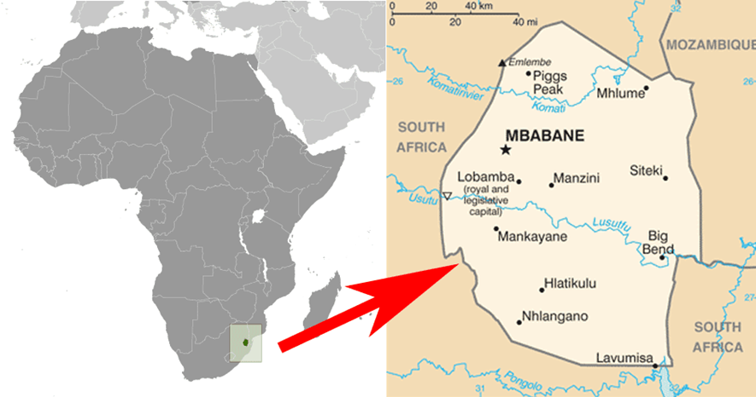
HIV in the Kingdom of Eswatini
1.1-million-person population with a HIV
prevalence of ~27%
Eswatini is one of few countries to show
a decrease in adult (18-49yrs) HIV incidence:
UNAIDS estimates Eswatini achieved the ’95-95-95’ global HIV targets in 2020
Eswatini HIV Recent Infection (Recency) Surveillance (EHRIS) aims to:
Describe where and among whom new/recent (w/in previous 12 months) HIV infections occur
Understand factors driving ongoing HIV transmission
Tailor response in specific regions and/or among subpopulations
2.5% in 2011
1.4% in 2017
Notes:
The Kingdom of Eswatini has a population of approximately 1 million people with a HIV prevalence of ~27% among those 15-49 years old, the highest of any other country in the world. The Government of the Kingdom of Eswatini (GKoE) and its development partners have made major investments into scaling up and expanding access to HIV testing services nationwide. As a result, Eswatini is one of few countries to decrease HIV incidence among adults 18-49 years old from 2.5% in 2011 to 1.4% in 2017. UNAIDS estimates Eswatini reached 95-95-95 targets in December 2020, which will be verified by Swaziland HIV Incidence Measurement Survey (SHIMS3) that is nearing completion.
Part of this investment has also been the introduction of the Eswatini HIV Recent Infection Surveillance system that aims to detect ‘recent’ HIV infections. It further aims to describe where and among whom new infections are taking place to better understand the factors driving ongoing transmission. Lastly, using this information, a public health response can then be tailored and implemented to help maintain HIV epidemic control.

Slide 4
HIV Recent Infection Testing Services during COVID-19
We examined the potential impact of COVID-19 on persons newly diagnosed with HIV enrolled in recent infection surveillance to describe changes in testing and diagnosis to guide public health response, ‘post-pandemic’.
Notes:
It is suspected that the COVID-19 pandemic has caused disruptions in HIV testing services throughout the world. Consequently, this disruption is feared to have widened the testing gap, especially among key populations, women, and girls. (Global Fund Results Report 2021). This analysis used EHRIS Data collected from July 2019 through December 2020.

Slide 5
Timeline of COVID-19 Pandemic in Eswatini
Partial country lockdown begins
Reduced public transportation
Reduced health service delivery
Pause in HIV testing at community-based testing sites
EHRIS implementation initiated
First COVID-19 case detected
COVID-19
1st wave
COVID-19
2nd wave
March 14, 2020
June 2020
December 2020
July 2019
March 27, 2020
Notes:
*Click*
EHRIS implementation started in July 2019 and was integrated within HTS following stakeholder engagement.
*Click*
In Eswatini, the first COVID-19 case was detected on March 14, 2020 with a partial country lockdown beginning on March 27
*Click*
This resulted in:
Reduced public transportation
Reduced health service delivery
Pause in HIV testing at community-based testing sites
*Click*
The country then experienced its first and second waves in June 2020 and *click* December 2020.
Yet, despite these obstacles, Eswatini continued with recency surveillance throughout the pandemic.

Slide 6
Recent HIV Infection Surveillance Algorithm
HIV +
Newly-Diagnosed HIV+ among clients 15+ yrs
Preliminary recency classification using Rapid Test for Recent Infection (RTRI) result
RTRI Recent
RTRI Long-term
Viral Load (VL)
VL ≥1000 copies/mL
VL <1000 copies/mL
Recent Infection Testing Algorithm (RITA) for classifying recent infections using RTRI and VL
RITA Recent Infection
RITA Long-term Infection
Notes:
I will now show a diagram that illustrates the recent infection testing algorithm, RITA.
*Click*
At HTS, consenting newly diagnosed clients 15 yrs or older are tested by a Point of care test called
*Click*
a rapid test for recent infection to classify their infection as either ‘recent’ (contracted within the past 12 months) or long-term (contracted more than 12 months ago).
*Click*
For all those who have a ‘Recent’ RTRI result, a blood sample is collected and sent to a lab for Viral Load testing to reduce misclassification.
*Click*
if the viral load is greater than or equal to 1,000 copies/mL, it is classified as RITA ‘Recent.’
*Click*
2) If the viral load is less than 1,000 copies/mL, it is re-classified as RITA ‘Long-term’ and categorized as long-term together with the RTRI ‘Long-term’ cases.
I will also note that:
clients DO NOT receive their RTRI or RITA results as these are used for surveillance purposes.
And the client’s care is not affected by their result

Slide 7
Methods
Notes:
Now, I will take us through the methods used for our analysis.

Slide 8
Methods – Study Period
Partial country lockdown begins
Reduced public transportation
Reduced health service delivery
Pause in HIV testing at community-based testing sites
EHRIS implementation initiated
First COVID-19 case detected
COVID-19
1st wave
COVID-19
2nd wave
March 14, 2020
June 2020
December 2020
July 2019
March 27, 2020
Pre-COVID = July 2019-March 2020
During COVID = April-December 2020
Notes:
As mentioned before, EHRIS was first implemented at facilities in Eswatini in July 2019 and continues today to be scaled-up nation wide. This timeline shows how we divided our data from July 2019-December 2020 into two periods:
*Click*
with ‘pre-COVID’ being from July 2019-March 2020 and
*Click*
during COVID’ being from April-December 2020, each of which are 9-months long.

Slide 9
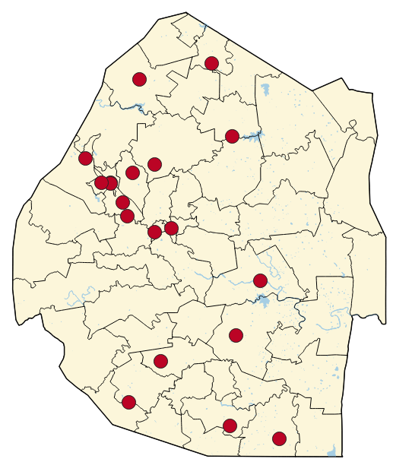
Methods - Sample
Results from 19 Health Facilities with at least 1 RTRI test conducted per month, each month during entire study period
Accounted for approximately 30% of HIV diagnoses over the 18 month
Enrollment fluctuating between 64-96%
Notes:
We compared data from health facilities that reported consistent RTRI testing throughout the entire 18 months; those having at least 1 RTRI result each month. These 19 facilities were followed throughout the study period and accounted for approximately 30% of total HIV diagnoses. The red circles in the map on the right show the distribution of the selected facilities across the country.
*Click*
About 70% *click* were in the Hhohho and Manzini regions.

Slide 10
Methods – Statistical Analysis
Descriptive statistics of % RITA recent infections identified by region, age, sex, and testing point
Percent change in RTRI tests conducted for each month of study period
Binomial Logistic Regression Modeling to analyze associations between RITA recent infections, COVID time period, and key demographic variables
Notes:
Using the data from this facility sample, we developed descriptive statistics, including % RITA recent cases by demographic groups. Then, we analyzed monthly percent change in total RTRI tests conducted to determine the change in testing volume throughout the study period. We then conducted a binomial logistic regression to determine if and how the onset of COVID-19 affected recent infection detection before and during the pandemic.

Slide 11
Results
Notes:
Now, I will take us through our results.

Slide 12
RITA recent infections, July 2019 - December 2020
Newly-diagnosed HIV+ adults from July 2019-December 2020 (n=4,268)
RTRI Long-term (n=3,934)
92% of all newly-diagnosed HIV+ adults
RTRI Recent (n=334)
8% of all newly-diagnosed HIV+ adults
VL <1000 copies/mL (n=78)
23% of RTRI Recent Cases
VL ≥1000 copies/mL (n=256)
77% of RTRI Recent Cases
RITA Long-term (n=4,012)
94% of all newly-diagnosed HIV+ adults
RITA Recent (n=256)
6% of all newly-diagnosed HIV+ adults
Detected pre-COVID (n=184)
72% of RITA Recent Cases
Detected during COVID (n=72)
28% of RITA Recent Cases
Notes:
This diagram shows the breakdown of recent infection surveillance data at the 19 facilities:
*Click*
4,268 newly-diagnosed clients were tested by RTRI.
*Click*
Among those, 92%, were RTRI long-term cases and 8%, were RTRI recent cases
*Click*
After viral load testing, 256, or 6%, of the 4,268 newly diagnosed adults were RITA recent
*Click*
Among those 256 RITA Recent cases 72%, were detected pre-COVID with 28% during COVID.

Slide 13
All Tests among sampled facilities, July 2019 – December 2020
 |  | RTRI Tests |  |  | RITA Recent
 |  | Total | Pre-COVID n(%) | During COVID n(%) | Total | Pre-COVID n(%) | During COVID n(%)
Region | Hhohho | 1,790 (42.6) | 1,015 (43.3) | 775 (41.8) | 118 (46.8) | 79 (43.9) | 39 (54.2)
 | Lubombo | 389 (9.3) | 212 (9.1) | 177 (9.5) | 26 (10.3) | 23 (12.8) | 3 (4.2)
 | Manzini | 1,297 (30.9) | 717 (30.6) | 580 (31.3) | 73 (29.0) | 59 (32.8) | 14 (19.4)
 | Shiselweni | 681 (16.2) | 398 (17.0) | 283 (15.3) | 34 (13.5) | 18 (10.0) | 16 (22.2)
 | Other Country | 41 (1.0) | 1 (0.0) | 40 (2.2) | 1 (0.4) | 0 | 1 (0.6)
Age group | 15-19 | 258 (6.0) | 145 (6.0) | 113 (6.1) | 34 (13.3) | 23 (12.5) | 11 (15.3)
 | 20-24 | 755 (17.7) | 461 (19.1) | 294 (15.9) | 98 (38.3) | 75 (40.8) | 23 (31.9)
 | 25-29 | 916 (21.5) | 513 (21.3) | 403 (21.7) | 61 (23.8) | 39 (21.2) | 22 (30.6)
 | 30-34 | 847 (19.9) | 476 (19.7) | 371 (20.0) | 24 (9.4) | 17 (9.2) | 7 (9.7)
 | 35-39 | 670 (15.7) | 378 (15.7) | 292 (15.7) | 25 (9.8) | 19 (10.3) | 6 (8.3)
 | 40+ | 822 (19.3) | 440 (18.3) | 382 (20.6) | 14 (6.0) | 11 (6.0) | 3 (4.2)
Sex | Female | 2,598 (60.9) | 1,447 (60.0) | 1,151 (62.1) | 201 (78.5) | 139 (75.5) | 62 (86.1)
 | Male | 1,670 (39.1) | 966 (40.0) | 704 (38.0) | 55 (21.5) | 45 (24.5) | 10 (13.9)
Notes:
This table displays the breakdown of all RTRI tests conducted and RITA Recent cases detected by demographic groups (region, age group, and sex)
*Click*
The greatest number of tests were conducted in Hhohho region, home to one of Eswatini’s capitals - Mbabane. 43% of all tests conducted and 47% of all RITA recent cases occurred in this region.
*Click*
Following Hhohho is Manzini. The country's most populous city is in Manzini and this region accounted for 31% of all tests conducted and 29% of all RITA recent cases.
*Click*
Among age groups, while 25-29 year olds had the most tests conducted, 20-24 year olds comprised the most RITA recent results at ~38%.
*Click*
Lastly, 61% of all tests and 79% of all RITA recent cases were among females

Slide 14
Monthly % change in RTRI tests conducted
1st Wave
2nd Wave
COVID - March 31
Aug ‘19
Sep ‘19
Oct ‘19
Nov ‘19
Dec ‘19
Jan ‘20
Feb ‘20
Mar ‘20
Apr ‘20
May ‘20
June ‘20
July ‘20
Aug ‘20
Sep ‘20
Oct ‘20
Nov ‘20
Dec ‘20
Notes:
This graph shows the monthly percent change in all RTRI tests conducted throughout the study period, with increases shown in dark purple, and decreases shown in light purple.
*Click*
Once we denote the onset of COVID within this graph, we can easily see the fluctuations in testing both before and after the onset. Before COVID, we see large spikes in testing in August 2019 and January 2020, with slight decreases in February and March 2020. At the pandemic’s onset, there was a decrease in testing by 37.5% in April 2020. Following this onset, we see a gradual increase from May-June 2020, followed by a sharp decline corresponding to…
*Click*
Eswatini’s first wave. Testing starts recovering in September until…
*Click*
It ends the year with a 25% decline marking Eswatini’s second wave.

Slide 15
The odds of detecting recent infections were 2.1 times higher pre-COVID compared to during.*
Pre-COVID
Time Period | N = 256 | Odds Ratio | 95% CI
Prior to COVID | 184 | 2.1 | 1.6 | 2.9
During COVID | 72 | 0.5 | 0.4 | 0.7
0.0
1.0
2.0
3.0
Odds Ratio
*Model was adjusted for sex, age, region, education level, testing point, high risk sexual behaviors, experiencing sexual violence.
Notes:
Our regression model revealed that RITA Recent infections were more than two times as likely to be detected prior to COVID in Eswatini (p-value<0.001). Conversely, they were half as likely to be detected during COVID (p-value<0.001).

Slide 16
This association did not vary by sex, age, or testing point.
Interaction | Odds Ratio | P-value | 95% CI
Prior to COVID*Sex (Female) | -0.4 | 0.3 | -1.3 | 0.4
Prior to COVID*Age
15-19 years | -0.3 | 0.8 | -1.9 | 1.3
20-24 years | -0.2 | 0.8 | -1.6 | 1.2
25-29 years | -0.8 | 0.3 | -2.2 | 0.7
30-34 years | -0.7 | 0.4 | -2.3 | 0.9
35-39 years | -0.3 | 0.8 | -1.9 | 1.3
40+ | Reference
Prior to COVID*Testing Point
Laboratory | -1.2 | 0.2 | -3.0 | 0.7
VCT | -0.3 | 0.7 | -1.7 | 1.2
OPD | -1.3 | 0.1 | -2.7 | 0.1
RMCH | -0.5 | 0.5 | -2.0 | 1.0
Index | 2.2 | 0.3 | -1.6 | 6.1
Other | Reference
Notes:
We also conducted an interaction model to determine if there were any significant interactions between time period (pre vs. during COVID), sex, age, and testing point, of which the interaction model revealed none.

Slide 17
Limitations
Small sub-sample – 19 facilities out of ~around 100 sites reporting at any given point, the most of which was 128
~76% of RTRI Recent cases had confirmatory viral load results
Self-reported data of previous HIV testing and diagnosis
Notes:
Our analysis was not without some limitations, including a small sub-sample relative to total facilities participating in EHRIS during the study period. Also, only 76% of RTRI recent cases had matching viral load results. Ideally, this would be 100%. Lastly, recency surveillance depends on self-reported data from clients being tested, and we were not able to verify previous HIV testing/diagnoses of clients included in this analysis.

Slide 18
Conclusion & Next Steps
Notes:
In conclusion…

Slide 19
Conclusion
Recent infections were twice as likely to be detected prior to COVID-19 than during.
Results suggest a possible shift in access to testing, that did not affect one group significantly more than another. This may be related to COVID-19 mitigation efforts resulting in less access to HIV testing services and client mobility.
Further planned analysis:
All sites during both time periods (Manuscript in process)
GIS Hotspot Analysis to determine geographical areas with higher rates of infection
Notes:
Overall, we saw that recent infections were twice as likely to be detected pre-COVID than during among the facility sample. Furthermore, there was no significant impact of the time period on sex, age, and testing point. This may reflect decreased access to HIV Testing Services related to COVID-19 mitigation efforts. However, further analyses are needed. The team is currently working on a manuscript to analyze data from all sites with GIS mapping of Recent Infection hotspots both before and during the pandemic. These findings at the very least, can support Eswatini’s public health response stakeholders to guide HIV testing post-pandemic and continue to control the country’s HIV epidemic.

Slide 20
Acknowledgements
Ministry of Health, Government of the Kingdom of Eswatini
PEPFAR
U.S. Centers for Disease Control and Prevention (CDC), Kingdom of Eswatini
U.S. Centers for Disease Control and Prevention (CDC) Headquarters, Atlanta, Georgia, USA
ICAP - Kingdom of Eswatini
ICAP Headquarters - Columbia University, New York, USA
USAID
Notes:
This concludes my presentation, and I would like to acknowledge the ministry of health of Eswatini, CDC PEPFAR Eswatini and Atlanta and ICAP at Columbia University.

Slide 21
