Slide 1
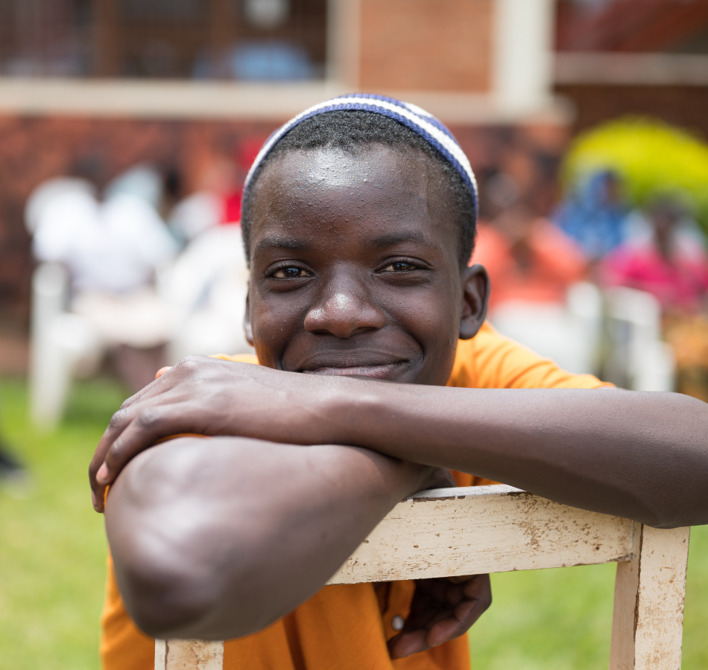
HIV, Mental Health, and Beyond: How Research Could Protect Youth in a Rapidly Changing World
ICAP GRAND ROUNDS
August 15, 2023

Slide 2
Elaine Abrams, MD
Senior Research Director,
ICAP at Columbia University

Slide 3
Agenda
Reminders:
Welcome and Introduction – Elaine Abrams
Presentation
Q & A (Moderator: Elaine Abrams)
For questions to the panelists, use the Q&A box
The webinar recording and slides will be posted on www.icap.columbia.edu

Slide 4
Lucie Cluver,
Professor, Oxford University and the University of Cape Town
Elona Toska,
Associate Professor, University of Cape Town, Research Associate, University of Oxford

Slide 5
HIV AND BEYOND: HOW RESEARCH COULD PROTECT YOUTH IN A RAPIDLY CHANGING WORLD
A/Prof Elona Toska & Prof Lucie Cluver, University of Oxford & University of Cape Town
August 2023
Notes:
Team effort
Across faculties

Slide 6
ACTIVIST ACADEMICS WITH A DREAM Safe & successful adolescents living in Africa
Generating evidence to improve health, education and violence prevention
Helping national governments to achieve the SDGs at scale.
Finding the most effective, cost-effective programming
Engaging young people in evidence-based policymaking
6

Slide 7
PRECISION SCIENCE
Pillay & Bond (1995) International Journal of Health Services

Slide 8
COMPLEX REALITY
Factors associated with HIV risk among AGYW
Poverty/ Inequality
Socio-economic issues/ Orphanhood
Transactional/ Commercial sex
Age disparate sex
Migration
Multiple sexual partners
Food and resource insecurity
Poor access to services
No condom use
STIs
Adverse weather events
School dropout/ non-progression
Lack knowledge/ risk perception
Poor service uptake
HIV incidence
HIV+ partners
Unsafe sex
Being married
Gender discrimination and harmful norms and cultural norms + legal dualism
GBV + IPV
Stigma
Early sexual debut
Early marriage
Motherhood
8

Slide 9
CHANGING RISKS
30-50%
Every week
Adolescent girls and young women are infected with HIV
(UNAIDS, 2023)
by 2030
42%
4000
Of the world’s adolescents and youth will live in Africa
(UN Population Estimates, 2022)
Of adolescents are able to take ART consistently (UNICEF, 2023)

Slide 10
CHANGING WORLD
450 million
1 Billion
Every year the risk of a global pandemic grows by
(Marani, 2021)
2%
children are at extreme risk due to climate crisis (UNICEF, 2021)
Children live in conflict zones
(OHCHR, 2022)

Slide 11
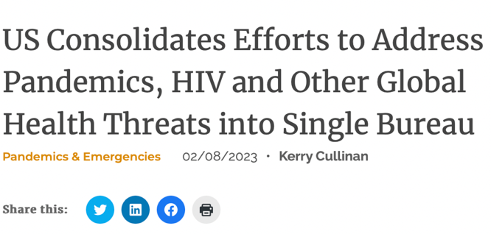
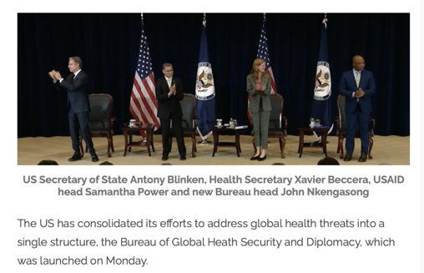
CHANGING RESPONSE

Slide 12
1
DEVELOPMENT ACCELERATORS

Slide 13
NEED FOR MULTI-IMPACT INTERVENTIONS
Sherr, Desmond, Cluver, Aber, Webb, Dhaliwal et al (2020) Lancet Global Health

Slide 14
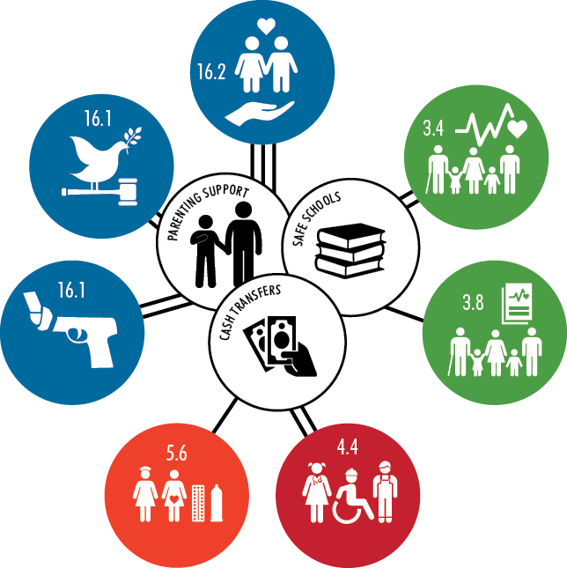
DEVELOPMENT ACCELERATORS
Adolescents living with HIV in South Africa, n=1000
3-year, 2-stage cohort
No Abuse
+51%
No community violence
+20%
Good mental health
+33%
No violence perpetration
+34%
HIV care retention
+22%
No high-risk sex
+19%
School progression
+34%
Cluver, Orkin, Toska, Campeau, Webb, Carlqvist, Sherr, (2019) Lancet CAH

Slide 15
LEAN PACKAGES N=1850, South Africa: Unexpected findings on package size
Sharp increase in impact up to packages of 2-3 accelerator interventions – after this, many effects plateau.
0
1
2
3
4
5
15
Sherr, Haag, Tomlinson, Skeen, Meinck, Du Toit, Roberts, Gordon, Desmond, Cluver (i2023) PLOS One

Slide 16
2
ACCELERATORS IN THE VIOLENCE AGAINST CHILDREN STUDIES New analyses
16

Slide 17
LESOTHO
VACS 2018, n=6850 girls nationally representative
Food security, gender-equitable attitudes, and good parenting are associated with reduced HIV risk & violence victimisation among girls.
Relative percentage change
Absolute change
100
90
80
70
60
50
40
30
20
10
0
Inconsistent condom use or don’t know HIV status
Child marriage
Age-disparate or transactional sex
Early sex (<16) or early pregnancy (<20)
Multiple sexual partners
Sexual violence
IPV (physical or emotional)
Peer violence (physical or emotional)
Child abuse (physical or emotional)
Mental distress
Not in school or paid work
19%
43.2 | → | 35.0
9.4 | → | 4.0
17.6 | → | 12.7
24.8 | → | 13.0
6.4 | → | 0.9
9.8 | → | 3.3
13.9 | → | 1.0
27.4 | → | 7.8
13.2 | → | 2.1
15.8 | → | 4.8
31.7 | → | 25.4
57%
28%
47%
Food security
86%
67%
93%
Positive gender norms
72%
84%
Good Parenting
70%
20%
Modelled marginal effects accounting for covariates
Toska, Banougnin, Hertzog, Little, Yates, Cluver et al. paper in progress.
Notes:
Not significant: Heavy drinking

Slide 18
KENYA
VACS 2019, n=1344 girls, nationally representative
Food security, gender-equitable attitudes, and good parenting are associated with reduced HIV risk & violence victimisation among girls.
Food security
Relative percentage change
Absolute change
100
90
80
70
60
50
40
30
20
10
0
Adolescent pregnancy
Child marriage
IPV (physical or emotional)
Sexual violence
24.0 | → | 7.9
11.0 | → | 1.5
20.1 | → | 3.6
20.0 | → | 5.9
Positive gender norms
67%
86%
Good Parenting
82%
71%
Banougnin et al.
Modelled marginal effects accounting for covariates
Notes:
No impact on high-risk sex or not in school or paid work.
Outcomes reduced to have sufficient power (significantly smaller n(1300) than other countries). These analyses (and outcome selection) focus on the triple threat policy framework for Kenya.
No significant associations for high-risk sex (inconsistent condom use + [multiple sexual partnerships, age-disparate or transactional sex) or not in school or paid work. (Previous analyses also found no impact on child abuse or mental distress.)

Slide 19
NAMIBIA
VACS 2019, n=4189 girls, nationally representative
Food security, gender-equitable attitudes, and good parenting are associated with reduced HIV risk & violence victimisation among girls.
Relative percentage change
Absolute change
100
90
80
70
60
50
40
30
20
10
0
Inconsistent condom use or don’t know HIV status
Child marriage (lifetime)
Early sexual debut (<16) or early pregnancy (<20)
Age-disparate or transactional sex
Sexual violence
IPV (physical or emotional)
Peer violence (physical or emotional)
Child abuse (physical or emotional)
Mental distress
Not in school or paid work
18%
35.6 | → | 29.1
3.0 | → | 0.1
12.2 | → | 5.8
14.3 | → | 11.4
14.7 | → | 6.8
15.7 | → | 8.0
28.4 | → | 14.0
30.4 | → | 10.8
47.9 |  | 30.0
23.3 |  | 18.1
97%
Positive gender norms
52%
20%
54%
Food security
49%
51%
64%
Good Parenting
37%
22%
Little, Hertzog, Rudgard, Toska, & Cluver.
Modelled marginal effects accounting for covariates
Notes:
No impact on multiple sexual partners or heavy drinking.

Slide 20
ZIMBABWE
VACS 2017, n=7912 girls, nationally representative
Food security, gender-equitable attitudes, and good parenting are associated with reduced HIV risk & violence victimisation among girls.
Relative percentage change
Absolute change
100
90
80
70
60
50
40
30
20
10
0
30%
36.3 | → | 25.4
23.1 | → | 16.8
8.2 | → | 4.6
18.1 | → | 8.8
6.1 | → | 1.8
5.5 | → | 0.8
4.6 | → | 1.5
13.7 | → | 2.1
2.7 | → | 1.2
25.5 | → | 7.4
46.7 | → | 42.0
Inconsistent condom use or don’t know HIV status
Age-disparate or transactional sex
Early sexual debut (<16) or early pregnancy (<20)
Child marriage (before age 18, lifetime)
Sexual violence
IPV (physical)
Peer violence (physical)
Child abuse (physical or emotional)
Heavy drinking
Mental distress
Not in school or paid work
27%
44%
51%
Food security
70%
85%
67%
Positive gender norms
85%
56%
Good Parenting
71%
10%
Mchenga, Hertzog, Toska, Banougnin, Dzumbunu, Yates, Cluver et al. paper under progress.
Modelled marginal effects accounting for covariates
Notes:
All variables are significantly associated with at least one accelerator.

Slide 21
PATTERNS ACROSS CONTEXTS (multiple studies)
Adolescent friendly health services
Peer support, mental health, aspirations
Cash / economic strengthening
Supporting caregivers with parenting skills
School-based Interventions & CSE

Slide 22
3
SUPPORTING THE GLOBAL FUND HIV prevention for AGYW
22

Slide 23
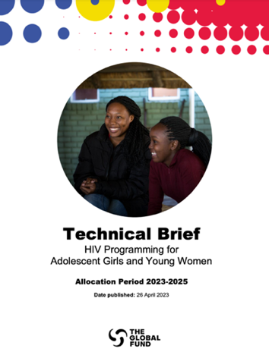
EVIDENCE REVIEWS
University of Cape Town and Global Fund
Cameroon, Eswatini, Kenya, Lesotho and Mozambique
Cost and programmatic effectiveness of AGYW programmes for HIV prevention.
Identify potential interventions that take into consideration evidence on what works, local context and epidemiology, best practice, and costing analyses.

Slide 24
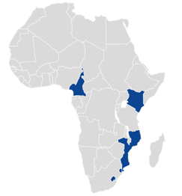
Know your interventions- response
EVIDENCE MAPPING APPROACH
National guidelines, strategies and policies (aligned with the AGYW PSAT)
Evidence reviews of interventions (single and combinations)
Evidence on Interventions
Quantitative evidence reviews
Qualitative data on implementation models, experiences and acceptability
Additional analyses (DREAMS, VACS, other)
Overview of existing
AGYW-specific/ relevant interventions & detailed “checklist”
Extract effect sizes for individual interventions
Extract data on impact of packages and combinations
Summarise by evidence strengths/ levels
Combine with Theory of Change & Targeting needs
Co-design Implementation Framework
(CONSULTATIONS WITH COUNTRY COLLEAGUES)
EVIDENCE SUMMARY/ META-ANALYSES (2023)
Toska, Nyamukondiwa et al 2023

Slide 25
Know your interventions - bringing it all together
WHAT WORKS FOR AGYW? (preliminary summary)
Reviews in progress | Primary SRH/ HIV outcomes | SRH/ HIV knowledge & risk behaviour | GBV outcomes | Mental health & well-being | Educational outcomes | Economic outcomes
Condoms | ⦁ | ⦁
PrEP & PEP & ART | ⦁
School-based prevention (CSE) |  | ⦁ | ⦁ | ⦁
SBCC | ⦁ | ⦁ | ⦁ | ⦁
HTS, ART, VMMC & SBCC for men | ⦁ | ⦁
Community mobilization (NO REVIEW)
SBCC+ (Social assets, social norms, demand creation) | ⦁ | ⦁ | ⦁ | ⦁
Multi-media and new media (NO REVIEW)
Economic & Livelihood strengthening | ⦁ | ⦁ | ⦁ | ⦁ | ⦁ | ⦁
School-based support/ incentives (keep in school) | ⦁ | ⦁ | ⦁ |  | ⦁
Integration with SRHR & GBV prevention | ⦁ | ⦁ | ⦁ | ⦁
Enhanced leadership (NO REVIEW)
CORE
POLICY & STRUCTURAL
Toska, Nyamukondiwa et al 2023
Notes:
* PrEP systematic review: https://pubmed.ncbi.nlm.nih.gov/35545381/ O Murchu E, Marshall L, Teljeur C, et al. Oral preexposure prophylaxis (PrEP) to prevent HIV: a systematic review and meta-analysis of clinical effectiveness, safety, adherence and risk compensation in all populations. BMJ Open 2022;12:e048478. doi:10.1136/ bmjopen-2020-048478

Slide 26
Know your interventions - economic & livelihood strengthening
SUMMARY
INTERVENTION TYPES | Primary SRH*/ HIV* outcomes | SRH/HIV knowledge & risk behaviour | GBV* outcomes | Mental health | Educational outcomes | Economic outcomes
Financial incentives | ⦁ | ⦁
Food assistance | ⦁ | ⦁ |  | ⦁ |  | ⦁
Education support | ⦁ | ⦁ |  | ⦁ | ⦁
Savings groups |  | ⦁ | ⦁ | ⦁ | ⦁ | ⦁
Financial capabilities |  | ⦁ | ⦁ | ⦁ | ⦁
VET | ⦁ | ⦁ | ⦁ | ⦁ | ⦁ | ⦁
Income generation |  | ⦁ |  |  | ⦁ | ⦁
Microcredit |  | ⦁ | ⦁ | ⦁ |  | ⦁
Asset building | ⦁ | ⦁ | ⦁ | ⦁ | ⦁ | ⦁
Employment support + GBV |  |  | ⦁
Cash transfers (alone/plus) | ⦁ | ⦁ | ⦁ | ⦁ | ⦁ | ⦁
Kruyer, Bergh, Yates, & Toska (underway); Haberland, N. (2021); van der Wal, R. (2021); Malhotra, A. et al. (2021); Kabeer, N. (2018)

Slide 27
Know your interventions - response DESIGN & DELIVERY OF PACKAGES Anchor in this case: CASH TRANSFER
Explicit co-ordination of interventions but delivered by separate entities e.g., adolescent girl testing positive for HIV referred for nutrition services (supported by MoH and WFP/civil society partners)
Interventions delivered by same entity e.g., girls’ empowerment and financial literacy through existing girls’ clubs
Interventions delivered in same geographical areas with loose co-ordination e.g., condom distribution/HIV self testing at community events (e.g., sports)
Add in life/skills SRHR within secondary schools
Visual created by Madison Little from research findings by Arriagada & colleagues (2018)

Slide 28
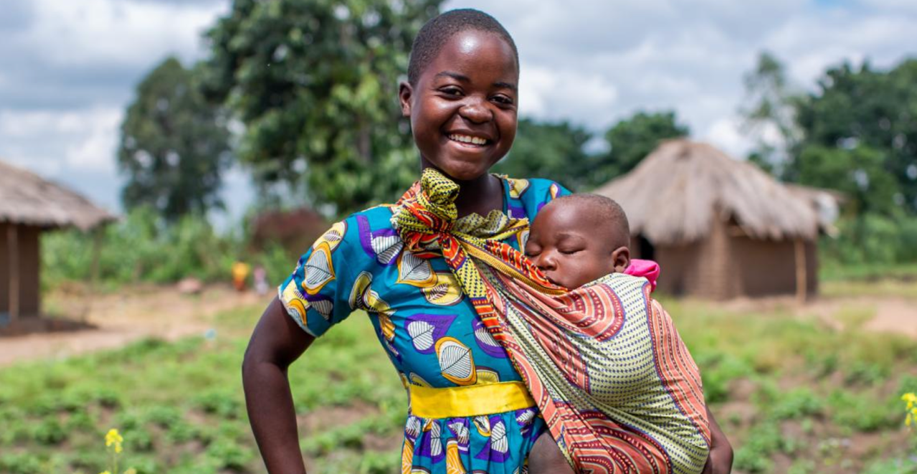
4
ACCELERATORS FOR THE MOST VULNERABLE
28

Slide 29
HIV & MOTHERHOOD IN EARLY ADOLESCENCE (Co-occurrence | Timing | Disclosure)
aOR 1.53; 95% CI: 1.24-1.89)
Adolescents
(vulnerability of youth)
Pregnancy
(vulnerability of mother & baby)
HIV
(vulnerability of illness)
N=19,932 | 15-19 year old females | 10 countries
Groves et al. 2022. Journal of Adolescent Health 70 (2022) 895e901 (thank you Luwam Gebrekristos for graph). Luseno, W. et al. (oral AIDSImpact) HIV and pregnancy disclosure among unmarried adolescents in the Nyanza region of western Kenya.
Moodley, S. (2021) Hidden Realities: Lived experiences with teenage pregnancy, motherhood and HIV in Botshabelo, South Africa.
Notes:
15-19 year olds adolescent girls from Demographic and Health Survey with HIV test results (N=19,932)
countries: Eswatini, Kenya, Lesotho, Malawi, Mozambique, South Africa, Tanzania, Uganda, Zambia, and Zimbabwe.
One fifth were mothers (range: 9.80%-38.90%)
HIV prevalence among all adolescent girls was 3.3% (range: 1.03%-10.07%).

Slide 30
HEIGHTENED RISK & VULNERABILITY: ADOLESCENT MOTHERS IN LESOTHO
(N=7,100 | VACS 2018)
32%
.1
78%
8%
45%
48%
39%
on children
16%
5%
9%
10%
8%
Inconsistent Condom Use
Multiple sexual partners
Age-disparate sex
Inequitable sexual partnerships
Highest risk sex
(condomless sex in the context of multiple sexual partners, age-disparate sex, or inequitable sex)
Toska, E. Baruwa, J. Banougnin, B et al. analysis in progress.
Cluver, Rudgard et al. (2022) JIAS.
30
Notes:
Physical violence: 41% from school and peers. Between 24-32% of adolescents reported exposure to physical abuse from a caregiver, teacher or peer.
Emotional abuse 0 27 form caregivers

Slide 31
SYNDEMIC OF HIV & MOTHERHOOD
Education
The joint effect of motherhood and HIV is associated with a two-fold increase in non-enrolment in school compared to their separate effect
53% of the non-enrolment in school attributed to the interaction of these HIV and motherhood.
Banougnin, Busakhwe et al. (analyses in progress). | Jochim, Groves & Cluver (2020) SAMJ. | Jochim et al. (2022) Psychology, Health and Medicine.
31
Notes:
HIV TREATMENT-RELATED OUTCOMES
Adolescent mothers living with HIV were
More likely to report detectable viral load and past-week non-adherence
Less likely to report retention in care and continuation of treatment
CLINIC EXPERIENCES
No difference by motherhood in experiences of ART stockouts (96%), adolescent-friendly services (94%), clinic travel time <1 hour (94-95%), confidentiality (56%) and feeling safe at facility (96-98%)
Adolescent mothers living with HIV less likely to
Attend support groups
Have short clinic waiting times
Be satisfied by services
Afford to be get to the facility

Slide 32
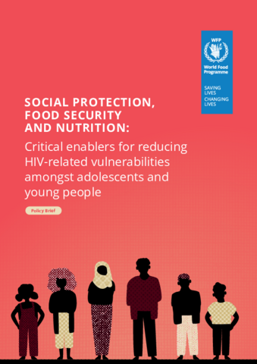
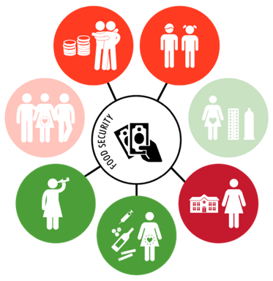
FOOD SECURITY
(South Africa, 1,040+)
Transactional sex
16% → 3%
(-13ppts, 95% CIs -17; -8)
Age-disparate sex
27% → 20%
(-7ppts, 95% CIs -13; -1)
Multiple sexual partners
Unprotected sex
Alcohol use
8% → 4%
(-4ppts, 95% CIs -7; -1)
Not in education/ employment
50% → 39%
(-11ppts, 95% CIs -17; -5)
Sex on substances
12% → 7%
(-5pts, 95% CIs -9; -1)
Cluver L*, Rudgard WE*, et al. (2022) JIAS

Slide 33
PACKAGE OF SERVICES FOR ADOLESCENT MOTHERS
Best package for adolescent mothers:
Outcomes*:
1. Attempted suicide or planned suicide
Mental
health
1
Food security
2. Any mental health symptoms (depression, anxiety, or posttraumatic stress
3. Age disparate or transactional sex
HIV risks
2
Formal childcare use
4. Condomless sex with multiple partners
5. Sex on substances
3
Safe parenting
6. No contraception use
7. Intimate partner violence
Violence
8. Sexual violence
4
Respectful clinics
9. No school enrolment or work engagement
Education & future
10. Lower self-efficacy (believe in oneself to achieve goals)
* Results are adjusted for multiple comparisons
Jochim, Cluver et al. (in progress)

Slide 34
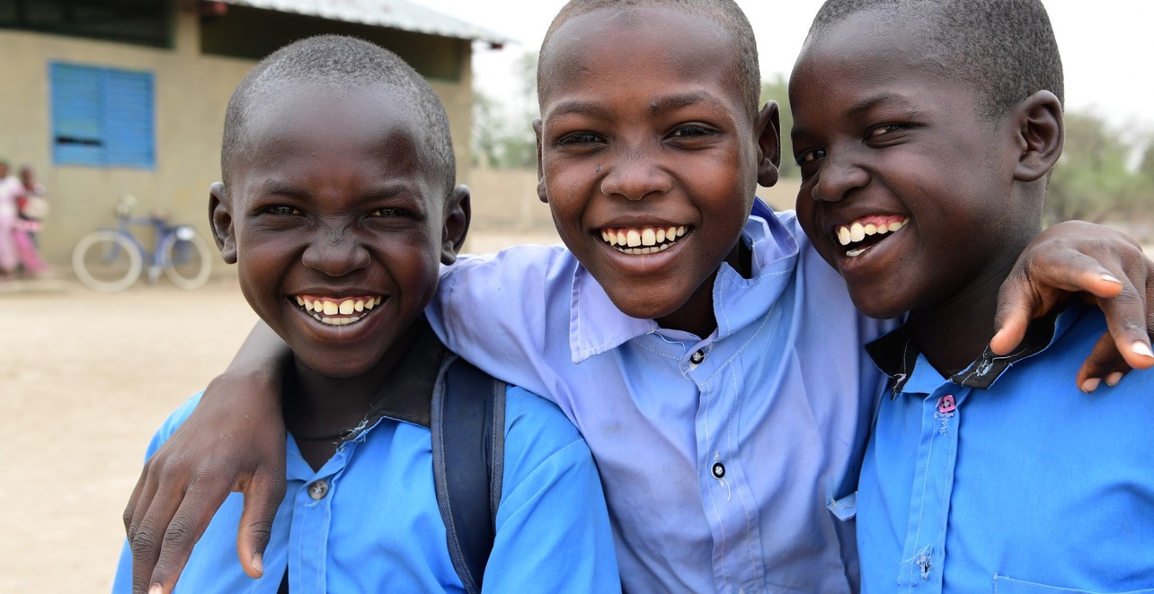
5
ACCELERATORS FOR CHILDREN AND ADOLESCENTS LIVING WITH HIV
34

Slide 35
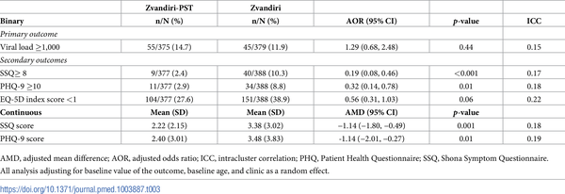
ZVANDIRI + FRIENDSHIP BENCH
Improved VL, improved mental health
Table 3. Intervention effect on primary and secondary outcomes at 48 weeks.
Simms V, Weiss HA, Chinoda S, Mutsinze A, Bernays S, et al. (2022) Peer-led counselling with problem discussion therapy for adolescents living with HIV in Zimbabwe: A cluster-randomised trial. PLOS Medicine 19(1): e1003887. https://doi.org/10.1371/journal.pmed.1003887 https://journals.plos.org/plosmedicine/article?id=10.1371/journal.pmed.1003887

Slide 36
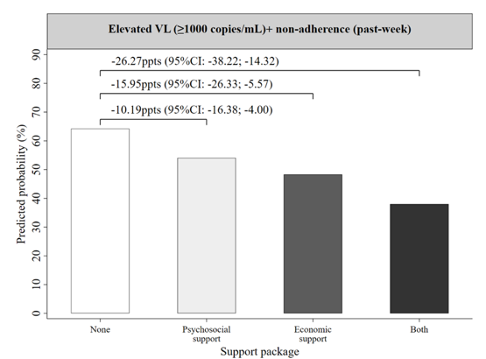
IMPACT OF SOCIAL-ECONOMIC SUPPORT on elevated VL among 933 adolescents living with HIV (10-19 year olds) in South Africa: Data from three survey waves (2014-2018)
Multivariable associations shown as predicted probabilities, between social support (emotional and practical), and economic support (cash transfers or food parcels) on elevated VL and non-adherence adjusted for age, sex, rural, informal housing, mode of HIV-acquisition. (total surveyed adolescents=933, total survey responses=2799, 2014-2018).

Slide 37
YOUTH-FRIENDLY HEALTH SERVICES
Adolescent girls and young women living with HIV
(n=792, South Africa)
“I was scared to go to the clinic. The nurses are not polite, so I thought…. I was just scared…. They were talking about how nurses are not polite, they make you feel down” (Nande, 21 years, living without HIV)
Relative percentage change
Absolute change
100
90
80
70
60
50
40
30
20
10
0
Viral suppression (<1000 copies/ml)
Clinic attendance
No TB symptoms
No treatment interruptions
Adherence to ART
16%
61,0 | → | 77,0
72,0 | → | 89,0
48,0 | → | 71,0
56,0 | → | 84,0
62,0 | → | 87,0
Accessible clinics (Safe & affordable)
17%
22%
Adolescent-responsive healthcare (respectful & kind staff)
28%
25%
37

Slide 38
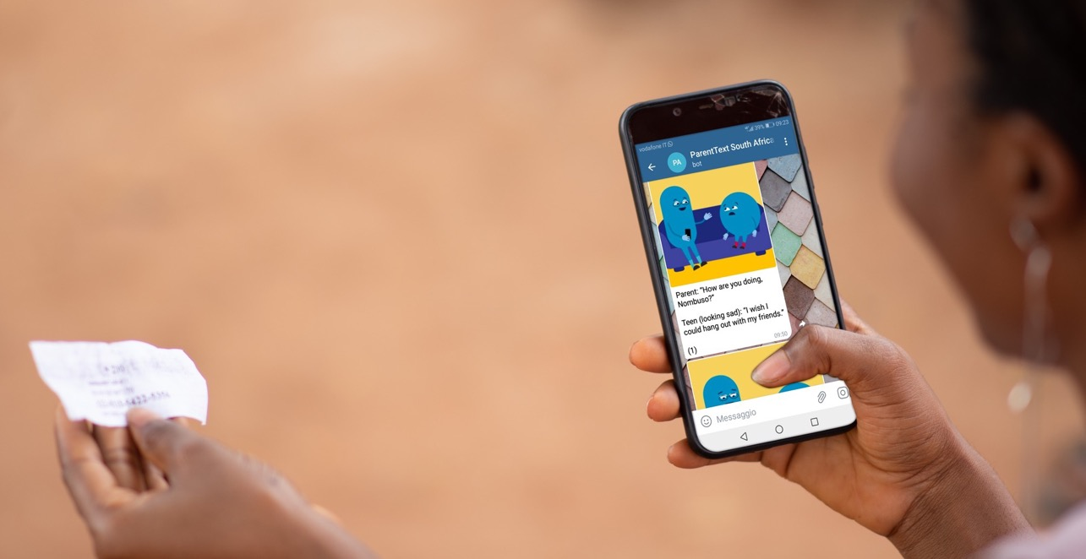
6
INCREASING SCALE REDUCING COST
38

Slide 39
CHALLENGES OF SCALE AND COST
Need to address multiple outcomes to reduce HIV risks and improve wellbeing
In-person programs are expensive and human resource intensive
Limited reach and impact of current delivery models
How do we maintain impact at scale with reduced resources?

Slide 40
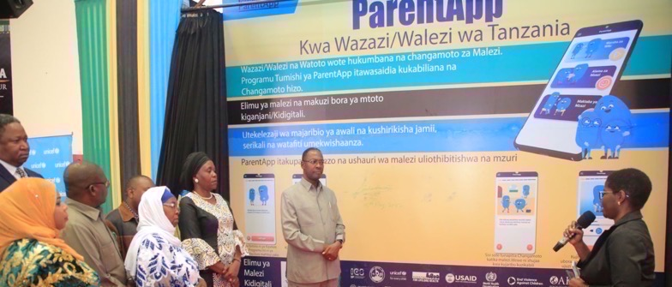
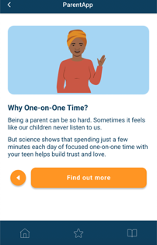
EXAMPLE
PLH ParentApp in Tanzania
Notes:
New digital parenting programmes

Slide 41
INITIAL EVIDENCE
Tanzania, ParentApp, pre-post pilot (n=200), Feb 2023
Outcome* |  | Significant effect | % change
Physical Abuse | Caregiver report/adolescent report | ✓✓ | 74% reduction/49% reduction
Sexual violence risk | Caregiver report/adolescent report | ✓✓ | 64% reduction/28% reduction
Verbal Abuse | Caregiver report/adolescent report | ✓✓ | 67% reduction/49% reduction
Corporal punishment | Caregiver report/adolescent report | ✓✓ | 63% reduction/34% reduction
Positive parenting | Caregiver report/adolescent report | ✓✓ | 48% increase/30% increase
Involved parenting | Caregiver report/adolescent report | ✓✓ | 31% increase/23% increase
Good parental supervision | Caregiver report/adolescent report | ✓✓ | 56% increase/24% increase
Sexual risk communication | Caregiver report/adolescent report | ✓✓ | 44% increase/ 48% increase
Mental health distress | Caregiver self-report/adolescent self-report | ✓✓ | 38% reduction/32% reduction
Positive gender norms | Caregiver self-report/adolescent self-report | - ✓ | NS / 17% increase
Adolescent behavior problems | Caregiver report (caregiver report only) | ✓ | 53% reduction
Family monthly poverty | Caregiver report/adolescent report | ✓✓ | 22% reduction/22% reduction

Slide 42
OPEN-SOURCE, MODULAR DELIVERY?
42
Cluver, Lachman et al (2022) British Medical Journal

Slide 43
UNCERTAIN TIMES NEED
CREATIVE SCIENCE
“We are living in uncertain times. ” ACHIM STEINER, UN DEVELOPMENT REPORT 2022.

Slide 44
THANK YOU
lucie.cluver@spi.ox.ac.uk & elona.toska@uct.ac.za
44

Slide 45
Q&A

Slide 46
This webinar recording and slides will be posted on www.icap.columbia.edu

Slide 47
Next Grand Rounds – Tuesday, September 19, 2023
9 am ET
Health Under Fire: Public Health in Conflict Zones
Presented by
Elizabeth Radin and Seema Jilani,
International Rescue Committee (IRC)

Slide 48
Thank you

