Slide 1
This project has been supported by the President’s Emergency Plan for AIDS Relief (PEPFAR) through the U.S. Centers for Disease Control and Prevention (CDC) under the terms of U2GGH000994

Slide 2
Overview
Section
Slide number
Counseling Instructions
Introduction to LPV/r granules
Administering LPV/r granules to infants <6 months
Administering LPV/r granules to infants and young children ≥6 months
Tips for healthcare workers and caregivers
Solving challenges
3-4
5-12
13-34
35-52
TBD
TBD

Slide 3
How to Use Counseling Flipchart to Counsel Caregivers on Administration of ARVs
This Flipchart is for any health care worker who works with infants and children living with HIV and their families. This Flipchart will help introduce new pediatric ARV formulations to caregivers as well as provide guidance and support to appropriately administering ARVs to their children including addressing challenges that may arise.
The first section will focus on the administration of LPV/r 40mg/10mg oral pellets including
• Administration of LPV/r pellets to infants <6 months who are exclusively breastfeeding
• How to express breastmilk
• Administration of LPV/r pellets to infants and young children ≥ 6 months with soft food or liquids
The second section focuses on addressing common challenges when administering pellets such as:
• Vomiting
• Refuses to take or spits out because of bad taste
• Child chews pellets
• Child refusing food that has pellets mixed in
• Child unable to swallow all pellets
• Child holding pellets in the mouth without swallowing or does not finish full amount
Directions on how to use the flip chart:
• Place flip chart on table so that the caregiver has a good view of the pictures while you use the side with notes.
• Use only those cards which are applicable to the caregiver you are counseling
• The notes prompt and guide discussion with the caregiver, including specific questions to review covered material and assess the caregiver’s understanding.

Slide 4
Good Counseling and Communication Skills
Good counselling and communication skills are essential.
Here are some useful tips:
Always make eye contact with the patient
Sit face to face
Speak clearly and in a non-threatening voice
Be non-judgmental and respectful – do not blame or criticize!
To be most effective in counselling, use the following OARS techniques
O Open-ended questions
A Affirmation
R Reflective listening
S Summary statements
O: Open-ended questions (avoid questions that are answered as Yes/No)
What makes it difficult for your child to take his/her ARVs every day?
What have you already done to help your child try to take his/her ARVs every day?
What do you think is likely to happen if your child keeps taking ARVs as s/he is now?
A: Affirmation
I appreciate that you are able to be honest about the way your child takes his/her ARVs.
You are clearly a resourceful person to manage so many challenges.
You’ve worked really hard to help your child take his/her medications despite these challenges.
R: Reflective listening
You say you feel frustrated when your child refuses to take ARVs
So you said you feel anxious about being able to give your child ARVs at the same time every day
What I hear you saying is that you have so many other important things to do, it can be difficult to spend so much time giving your child ARVs.
S: Summary statements
Let me see if I understand so far. You want your child to be healthy, but you are struggling to give your child ARVs because it takes too much time and you often don’t have food or the other things you need to give it the way you have been told to
Here’s what I’ve heard you say, let me know if it is right. Your child takes some ARVs easily but one is more difficult to give so you sometimes don’t give it

Slide 5
There are three ARVs in an ART regimen
+
+
ABC= Abacavir
3TC = Lamivudine
LPV/r = Lopinavir/ritonavir
ABC
3TC
+
+
A complete regimen usually contains three different ARVs but they may be combined in different ways
It is important to give all three ARVs to your child no matter how they are combined
ABC
3TC
+
ABC
LPV/r
3TC
+
ABC
LPV/r
3TC
+

Slide 6
There are three ARVs in an ART regimen
Say
Ask
Review
A complete regimen usually contains three different ARVs.
As you can see from this picture, the three ARVs may be different bottles of syrup, or three different tablets.
Sometimes, more than one ARV is combined into one pill.
It is important to give all three ARVs to your child no matter how they are combined.
Do you know the names of the three ARVs your child is taking?
The names of the ARVs the child has been prescribed.
Ask
Explain
How are your child’s ARVs combined?
Can you point to the picture that looks most like the ARVs your child is taking?
Medicines can come in different forms such as capsules, tablets or liquids. Stress that it is the same drug no matter the form.

Slide 7
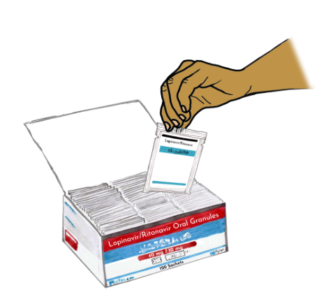
LPV/r oral granules

Slide 8
LPV/r oral granules
Say
Ask
Explain
Your child is taking a new formulation of medicine called “LPV/r granules”.
You will need to give the granules to your child in a special way.
This is what the box of the granules looks like.
In each box there are 120 sachets of granules.
What do you know about how these granules are given?
These granules need to be given in a different way from other medicines you may have used before. Let us review the right way to administer the granules.

Slide 9
LPV/r oral granules: Giving the correct dose
Based on your child’s weight, the pharmacist will tell you how many sachets to give in the morning and evening
Weight (kg) | Number of sachets
 | Morning | Evening
3.0-5.9 | 2 | 2
6.0-9.9 | 3 | 3
10.0-13.9 | 4 | 4
14.0-19.9 | 5 | 5

Slide 10
LPV/r oral granules: Giving the correct dose
Say
Ask
Explain
The pharmacist will tell you how many sachets to give in the morning and evening based on your child’s weight
What is your child's weight?
Your child will need more medicine as he or she grows (Use the dosing table to show how the treatment will change).
Ask
Review
How many sachets is your child supposed to take?
The number of sachets that should be given in the morning and evening.

Slide 11
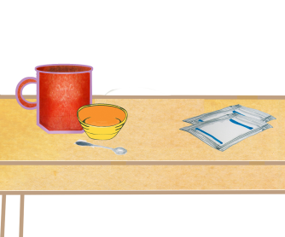
LPV/r oral granules: Preparing to give the granules
You will need the correct number of sachets, 2 clean bowls or cups, and a small spoon

Slide 12
LPV/r oral granules: Preparing to give the granules
Say
Ask
Go to
In order to give your child the medicine, you will need the correct number of sachets, two clean bowls or cups, and a small spoon
How old is your child?
If < 6 months turn to cards review cards 13-29
If >6 months turn to cards review cards 29-42

Slide 13
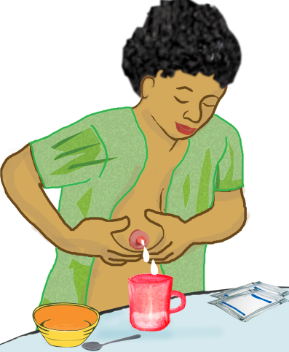
Infants <6 months: Giving LPV/r granules with breastmilk
Granules can be given with breastmilk
It is easier to give granules with expressed breastmilk

Slide 14
Say
Explain
Ask
Granules can be given with breastmilk.
It may be easier to give granules with expressed breastmilk.
Exclusive breastfeeding is best for infants under six months.
Usually babies take milk directly from the breast.
They can also be given breastmilk that has been expressed into a cup or bowl.
What has been your experience with expressing breastmilk?
Explain
Ask
Go to
Expressing breastmilk into a clean cup or bowl makes it easier to mix with the granules to give to the baby.
Would it be helpful to review how to express breastmilk by hand?
If yes, use the next 3 cards to review how to express breastmilk.
If no, turn to card 18.

Slide 15
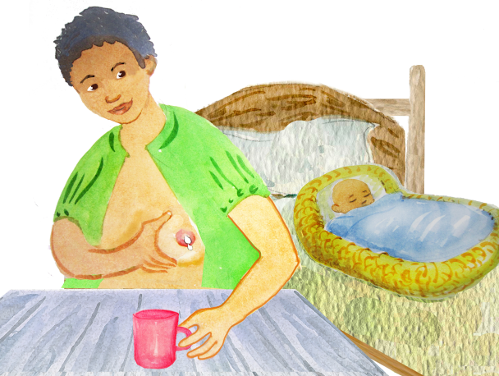
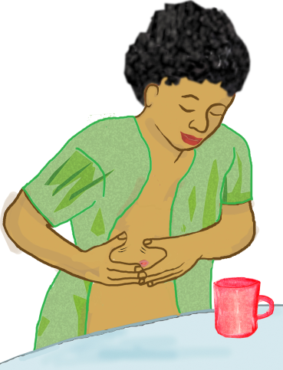
How to express breastmilk
Expressing breastmilk into a cup or bowl is easy to learn
It may take some time, but becomes easier with practice

Slide 16
How to Express Breastmilk
Say
The first step is to wash your hands and have a clean cup or bowl nearby
Bend forward a little, this will help the milk come down.
Start by massaging around your breast with your fingers using a circular motion.
Start towards the top of the breast and work around the breast circling closer to the nipple as you massage.
Next place you thumb just above your nipple and your forefinger below.
Your palm and other fingers should be supporting your breast.
Use your palm and fingers to gently press your breast against your chest, then use your thumb and forefinger to squeeze gently around the nipple and pull it forward to help the milk come out.
You can repeat this motion to press the breast, then squeeze gently, then relax.
Once milk starts flowing you can collect it in the clean cup or bowl.

Slide 17
Expressing breastmilk: Troubleshooting
Sit near your baby or smell a piece of cloth or clothing that smells like your child
Take a deep breath and relax
Leaning forward slightly may also help

Slide 18
Expressing breastmilk: Troubleshooting
Ask
Say
What do you do already to make breastfeeding easier?
May I offer some suggestions that may make it easier for you?
Expressing breastmilk is easy to learn.
It may take some time, but becomes easier with practice.
Sit somewhere quiet where you can relax and are comfortable sitting.
Being near your baby helps your body make milk, so having your baby nearby may help. If your baby is not nearby you can look at a picture, or even hold a piece of clothing that smells like your baby.
Take a few deep breaths to help you relax.
You can experiment to see what works best for you.
You can work on one breast at a time, or switch back and forth based on what is most comfortable for you.
Hand expressing should not be painful.
Be gentle.
It may take some time to become comfortable and find the right way for you.

Slide 19
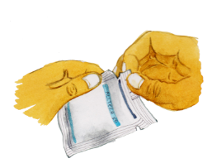
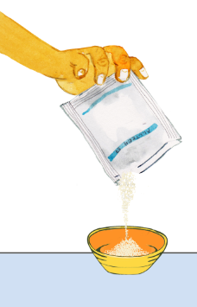
Infants <6 months: Preparing to give the granules
Starting at the notch tear off the top of the first sachet of granules open
Empty all the granules into the empty bowl or cup

Slide 20
Infants <6 months: Preparing to give the granules
Demonstrate
Explain
Demonstrate
Hold the sachet up so the notches are on the top and the granules settle to the bottom.
Start at the notch and carefully tear the top of the first sachet of granules open and empty all the granules into the empty bowl or cup.
Tear the sachet and empty the granules into a bowl.
Say
Once the sachet is opened, pour the granules into the empty cup or bowl that you prepared.

Slide 21
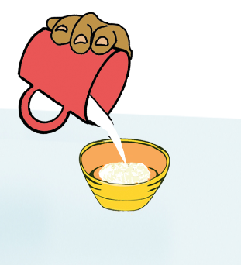
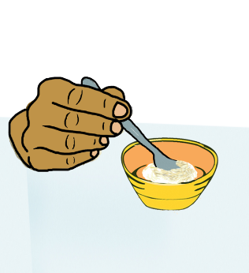
Infants <6 months: Adding breastmilk to granules
Pour a small amount of expressed breastmilk over the granules
Put only enough milk in the cup or bowl that you know your baby will take entirely
Stir the mixture so the granules and milk are combined

Slide 22
Infants <6 months: Adding breastmilk to granules
Say
Explain
Ask
Pour a small amount of expressed breastmilk over the granules.
Put only enough milk in the cup or bowl that you know your baby will take entirely.
Carefully stir the mixture so the granules and milk are combined.
The granules will not dissolve in the milk, but will be mixed together with it.
Why do you think it is important to only mix in a small amount of milk with the granules?
Explain
It is important that the baby take the full sachet of granules.
If too much milk is added, the baby may not be able to finish all of it and the baby will not have taken the full dose of granules.

Slide 23
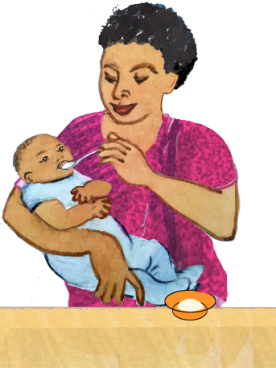
Infants <6 months: Feeding your baby the mixture of breastmilk and granules
Feed your baby the mixture immediately after stirring it. You can use the spoon to feed the baby.
Make sure your baby drinks all the milk and granules

Slide 24
Infants <6 months: Feeding your baby the mixture of breastmilk and granules
Say
Explain
Say
Feed your baby the mixture immediately. You can use the spoon to feed the baby.
Make sure your baby drinks all the milk and granules.
Stir the mixture with each spoonful you give to make sure none of the granules have settled to the bottom.
If you finish all the milk and there are still some granules in the bottom of the cup or bowl, pour a little extra milk over them, mix and give the rest to make sure your baby takes all the granules.
Explain
Expressing breastmilk into a clean cup or bowl makes it easier to mix with the granules to give to the baby.

Slide 25
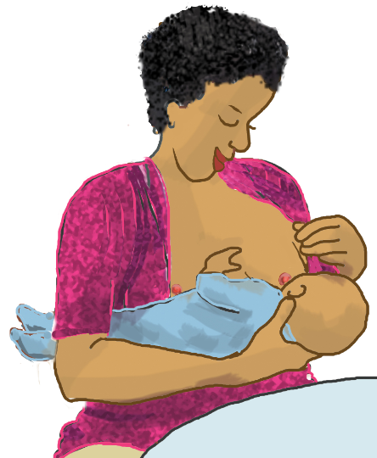
Infants<6 months: Making sure your baby takes all the granules
After your baby takes the full mixture you can breastfeed regularly to make sure all the granules are swallowed, and no bitter taste remains in the mouth

Slide 26
Infants<6 months: Making sure your baby takes all the granules
Say
After your baby takes the full mixture you can breastfeed regularly.
Make sure all the granules are swallowed so no bitterness remains in the mouth.

Slide 27
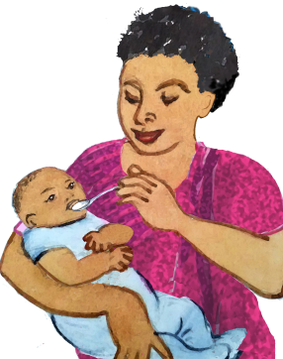
Giving granules directly to your baby
You can give granules directly to your baby
Use a spoon to give your baby a little bit of the granules
Immediately after giving a spoon of granules breastfeed normally so the baby swallows all granules

Slide 28
Giving granules directly to your baby
Say
Explain
Another way to give the granules to your baby is directly by spoon.
After emptying the granules into a clean cup or bowl a small spoon can be used to put some of the granules directly onto your baby’s tongue. You may have to give it bit by bit.
After each spoonful, the baby should be breastfed normally. It is important for the baby to breastfeed right away to make sure the granules are completely swallowed.
Repeat these steps until all the granules have been taken.

Slide 29
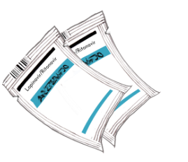
Infants <6 months: Giving the rest of the dose
Your baby will have to take more then 1 sachet of granules
It may be easiest to give one sachet of granules at a time and repeat for all the sachets

Slide 30
Infants <6 months: Giving the rest of the dose
Say
Ask
Explain
Your baby will have to take more then 1 sachet of granules.
It may be easiest to give one sachet of granules at a time and repeat the steps I shared with you for all of the sachets.
Do you think it will be easier to give all the granules at the same time or give them one by one?
It may be difficult to give several sachets at once, and may be easier to give them one by one while breastfeeding normally in between.
Depending on how easily the baby takes the granules, it may even be necessary to give half of a sachet at a time.
It is okay to try different things to see what works best.
The most important thing is to make sure that the baby takes the granules in all the sachets that have been prescribed.

Slide 31
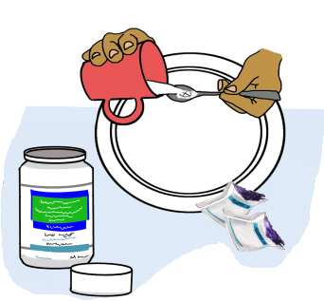
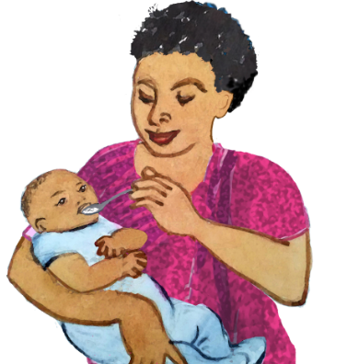
Giving the other ARVs
The granules are only 1 of the ARVs that your child needs
You still need to give the other ARVs at the same time

Slide 32
Giving the other ARVs
Say
Ask
Review
The granules are only one of the ARVs that your child needs.
You still need to give the other ARVs at the same time.
What are the names of the other ARVs your baby is taking?
Is your baby taking any other medicines, including any traditional medicines or herbs?
The names of the other two ARVs (NRTI backbone) the child is taking and confirm if the child is taking cotrim or any other medicines.
Ask
Explain
How do you normally give the other ARVs or the other medicines?
The other two ARVs should be taken at the same time as the granules.
They may be taken before or after the granules.
If the baby likes the taste of the other ARVs or medicines they can be given after the granules are given.
It will also help to wash away any bad taste from the granules.

Slide 33
Wrap Up

Slide 34
Wrap Up
Ask
Explain
Ask
Can you review the steps for giving your baby the granules so I can make sure I explained it well? You can use the pictures to help you.
This is different compared to other medicines or ARVs.
It is worth the extra work because this is the best drug we have to keep children living with HIV healthy.
What do you think about giving your baby granules?
Go to
The appropriate card in the “Solving Challenges section” if there are any concerns about giving granules.

Slide 35
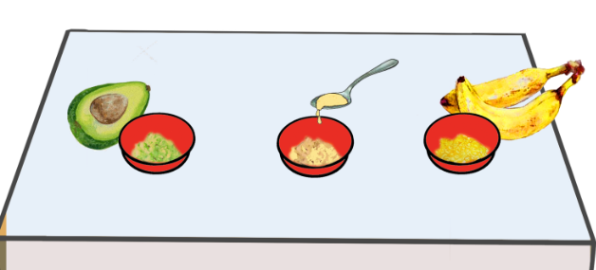
Infants and children >6 months: LPV/r granules can be given with soft foods
Granules can be mixed with soft food
Some foods you can use are yogurt, soft porridge, mashed fruit or any other soft food your child likes to eat
Your child must be able to swallow this food without having to chew
Food should be at room temperature, but not hot

Slide 36
Infants and children >6 months: LPV/r granules can be given with soft foods
Say
Ask
Explain
Granules can be mixed with soft food.
Your child must be able to swallow the food easily without having to chew.
Some foods you can use are yogurt, soft porridge, mashed fruit or vegetable.
The food should be ready at the time you are going to give ARVs to your child.
What soft foods does your child enjoy?
The granules can be mixed with any soft food that the child will eat.
It does not have to be the same food every time.
It is helpful if it is something the child enjoys eating.

Slide 37
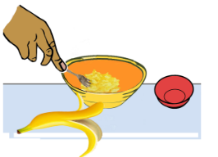
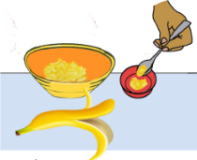
Infants and children >6 months: Giving LPV/r granules with soft foods
Put a small amount of soft food into the clean cup or bowl
Put only enough food in the small cup or bowl that you know your child will take in two or three bites

Slide 38
Infants and children >6 months: Giving LPV/r granules with soft foods
Say
Explain
Ask
Put one or two small spoons of soft food into the clean cup or bowl.
The amount should be something your child can easily eat in one or two bites.
It is important to mix the granules with an amount of food that your child will completely finish.
What do you think may happen if you mix the granules in a large amount of food?
Explain
If the granules are mixed into a large amount of food then your child may not eat all of it and will not have the full dose.

Slide 39
Preparing to give the granules with soft food
Starting at the notch, tear off the top of the first sachet of granules open
Empty all the granules into the cup or bowl on top of the small amount of food

Slide 40
Preparing to give the granules with soft food
Demonstrate
Explain
Demonstrate
Hold the sachet up so the notches are on the top and the granules settle to the bottom.
Start at the notch and carefully tear the top of the first sachet of granules open and empty all the granules into the empty bowl or cup.
Tear the sachet and empty the granules into a bowl.
Say
Once the sachet is opened, pour the granules over the food in the small bowl.
Tap the bottom of the packet to make sure it is emptied completely.

Slide 41
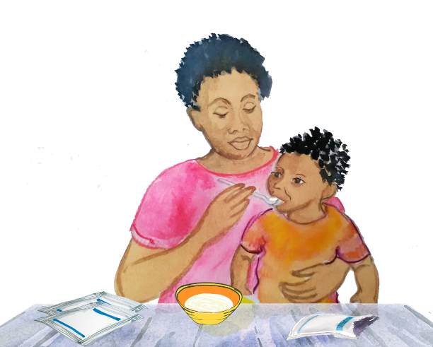
LPV/r oral granules: Administering the mixture of granules
Stir the granules into the food and feed the mixture immediately after stirring to your child using the spoon
It is important that your child takes the entire mixture that is in the bowl

Slide 42
LPV/r oral granules: Administering the mixture of granules
Say
Explain
Say
Stir the granules into the food and immediately feed the mixture to your child using the spoon.
It is important the the mixture be given quickly before the granules develop a bad taste.
Your child should be able to quickly swallow the amount of the mixture in one or two spoonful’s of food.
It is important to make sure your child eats the entire mixture of granules and food.
If a bad taste develops you can follow each spoonful of mixture with plain food or something else that he/she enjoys eating.
This helps to remove any bad taste from the granules and make sure all the granules are swallowed.

Slide 43
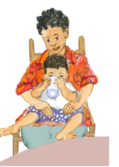
Giving granules with liquid
Granules can also be given with any liquid such as milk, juice or clean water if there is no food available

Slide 44
Giving granules with liquid
Say
Explain
Say
Granules can also be given with any liquid such as milk, juice or clean water.
Instead of soft foods, you can empty a sachet of granules into a bowl or cup, pour a small amount of liquid over it and mix with a spoon.
You can let your child drink from the cup or feed the mixture to your child with the spoon.
Explain
Granules may become sticky in liquid but it is important that all of them are taken.
If you finish all the milk and there are still some granules in the the cup or bowl, pour a little extra liquid over them, mix and give the rest to make sure your child takes all the granules.

Slide 45
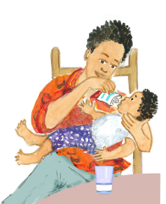
Giving granules directly to your child
You can also give your child granules directly by pouring them on the tongue
Then give food or drink that is easy to swallow immediately after putting granules on the tongue

Slide 46
Giving granules directly to your child
Say
Explain
Say
Another way to give your child granules is to put them directly on the tongue followed by drinking milk or another liquid to help swallow all the granules.
The granules may be poured from the packet into the mouth or may be emptied into a bowl and given by spoon.
It is important that the child swallow the granules right away with something to drink before the granules develop a bitter taste.

Slide 47
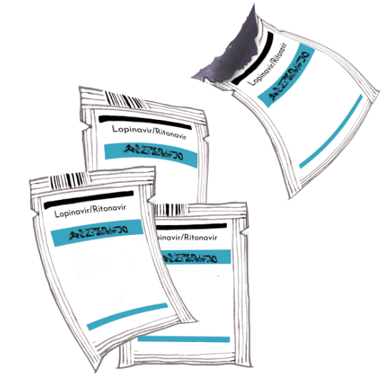
LPV/r oral granules: Giving the entire dose
Your child will have to take more than 1 sachet of granules
It may be easiest to give one sachet of granules at a time and repeat for all of the sachets

Slide 48
LPV/r oral granules: Giving the entire dose
Say
Ask
Explain
Your child will have to take more than 1 sachet of granules.
Do you think it will be easier give all the granules at the same time or give them one-by-one?
It may be difficult to give several sachets at once.
It may be easier to give them one-by-one and give spoons of other food in between.
Say
It is okay to try different things to see what works best.
It is important that the child takes all of the granules in all the sachets that have been prescribed in the morning and evening.

Slide 49
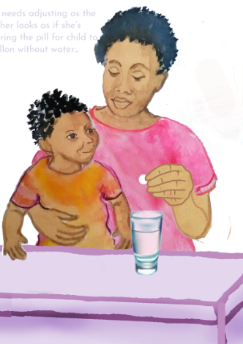
Giving the other ARVs
The granules are only 1 of the ARVs that your child needs
You still need to give the other ARVs at the same time

Slide 50
Giving the other ARVs
Say
Ask
Explain
The granules are only 1 of the ARVs that your child needs.
You still need to give the other ARVs at the same time.
How do you normally give the other ARVs or the other medicines?
The other two ARVs should be taken at the same time as the granules.
They may be taken before or after the granules.
If the child likes the taste of the other ARVs or medicines they can be given after the granules are given which will also help to wash away any bad taste from the granules.
Ask
Explain
Can you review the steps for giving your child the granules?
Giving granules is different from the way other ARVs are given and they do not taste good.
This is different from other medicines but it is the best ARV we have to keep children living with HIV healthy.

Slide 51
Wrap Up

Slide 52
Wrap Up
Ask
Explain
Ask
Can you review the steps for giving your baby the granules so I can make sure I explained it well?
Granules are very different to other medicines you may have given in the past.
This is one of the best drugs we have to keep children living with HIV healthy.
What do you think about giving your baby granules?
Go to
The appropriate card in the “Solving Challenges section” if there are any concerns about giving granules.

