Slide 1
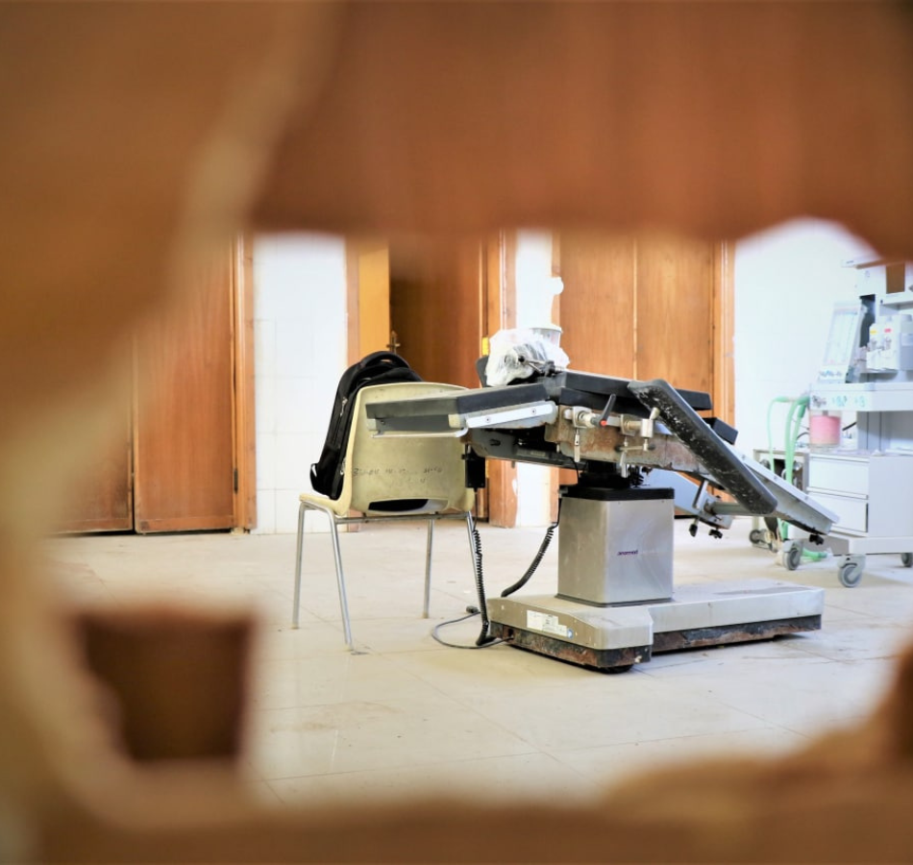
Health Under Fire: Public Health in Conflict Zones
ICAP GRAND ROUNDS
September 19. 2023

Slide 2
Jessica Justman
Senior Technical Director,
ICAP at Columbia University

Slide 3
Agenda
Reminders:
Welcome and Introduction –
Presentation
Q & A
For questions to the panelists, use the Q&A box
The webinar recording and slides will be posted on www.icap.columbia.edu

Slide 4
Oksana Dereviankina, MD, MBA
National Program Coordinator
ICAP in Ukraine
Elizabeth Radin,
Director,
Health Policy,
International Rescue Committee
Seema Jilani,
Senior Technical Advisor, Emergency Health,
International Rescue Committee

Slide 5
Public Health in Conflict Zones: UKRAINE
Oksana Dereviankina, MD, MBA
National Coordinator, ICAP in Ukraine
09/19/2023

Slide 6
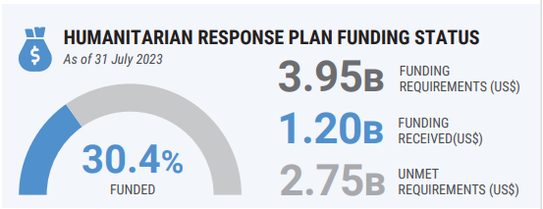
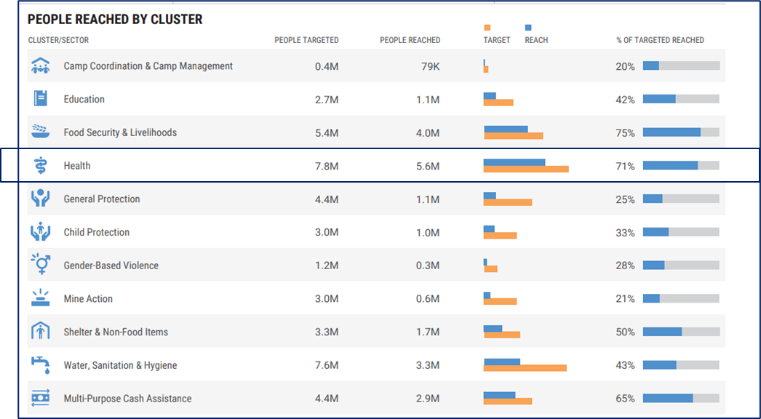
UKRAINE Humanitarian Response Snapshot*
Health Cluster requirements: ~300 M US$
Funding received: ~60 M US$
(20%)
*Sources: Humanitarian partners via ICCG reporting to the 2023 HRP, Financial Tracking Service (FTS) as of 31 July 2023.
Creation date: 29 August 2023

Slide 7
Activities funded by Ukraine Health Security Assistance Portfolio in support of Ukrainian health system recovery STREAMS:
Disease surveillance
Continuous surveillance
Syndromic surveillance
Laboratory-based surveillance
Event-based surveillance
Environmental surveillance
Strengthening laboratory systems
Antimicrobial resistance
Public health emergency management
Data modernization
PARTNERS:
Ukraine Government
Regional CDC’s
Ministry of Health
Center for Public Health of MOH
ICAP at Columbia University
University of Washington’s International Training
World Health Organization
Regional Health Facilities
Notes:
Worked with the UCPH to launch a community of practice among members of multidisciplinary teams (MDTs) at three pilot hospitals to discuss AMR response efforts, including laboratory testing, antimicrobial stewardship (AMS), and infection prevention and control (IPC) measures.
facilitated bi-weekly clinical and laboratory twinning calls
with the European Society of Clinical Microbiology and Infectious Diseases (ESCMID)
and periodic meetings
Reviewed and provided feedback on some antimicrobial stewardship and lab standard operation procedures (SOPs).

Slide 8
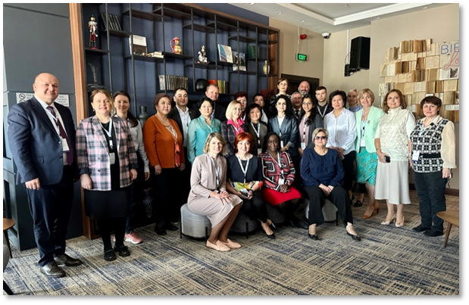
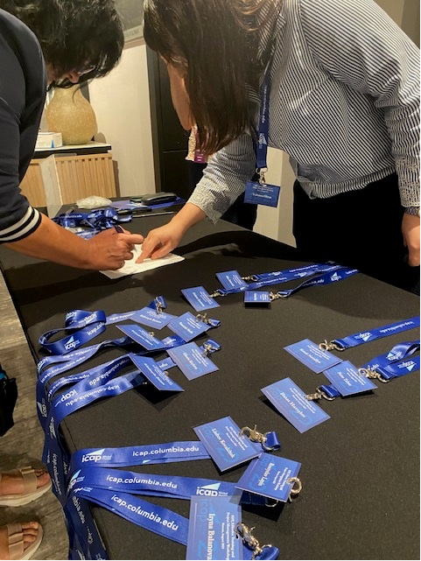
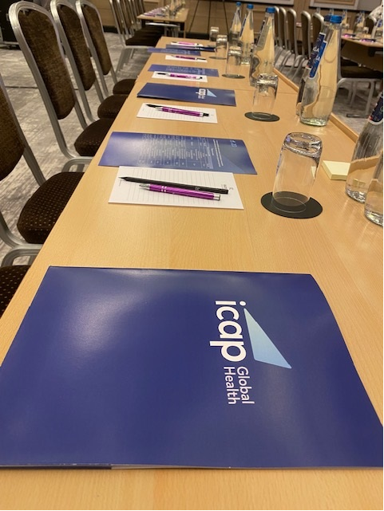
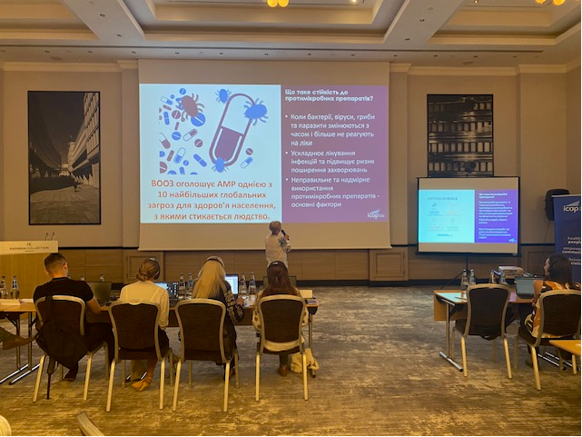
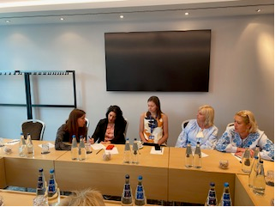
THANK YOU FOR YOUR ATTENTION!

Slide 9
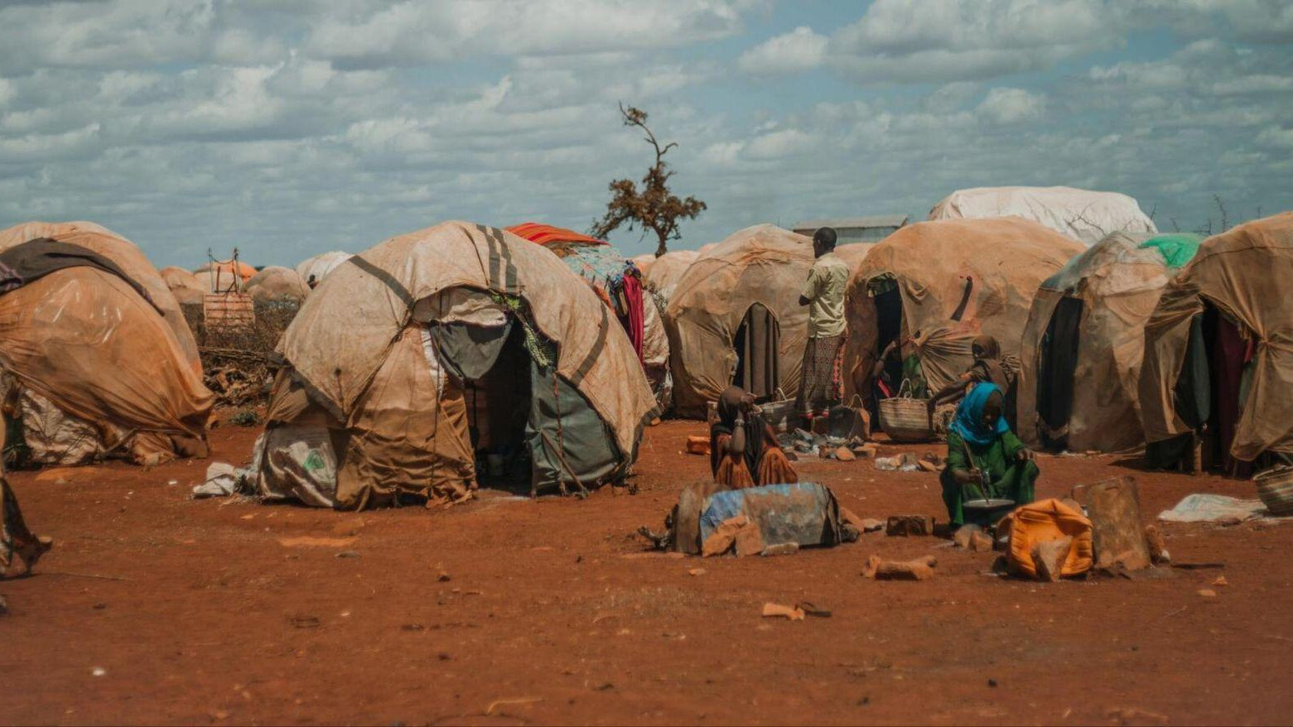
Health Under Fire:
Public Health in Conflict Zones
ICAP Grand Rounds | September 19, 2023
Seema Jilani, MD, FAAP
Senior Technical Advisor, Emergency Health, International Rescue Committee
Elizabeth Radin, PhD, MPP
Director, Health Policy, Advocacy and Communications, International Rescue Committee
Lecturer, Department of Epidemiology, Mailman School of Public Health, Columbia University

Slide 10
In this presentation we will:
Describe the dynamics of global conflict and the impact on public health
Characterize humanitarian health needs with a focus on Ukraine and Sudan
Highlight two key solutions IRC has used to deliver emergency health response in Ukraine and Sudan
Share two longer term solutions with potential to improve health in the context of protracted conflict and fragility
Notes:
We picked these to illustrate two very different conflicts and context, we'll say more on that in a minute

Slide 11
Who is the IRC?
The International Rescue Committee (IRC) helps people affected by humanitarian crises—including the climate crisis—to survive, recover and rebuild their lives.
Founded at the call of Albert Einstein in 1933, the IRC is now at work in over 40 crisis-affected countries.
We deliver lasting impact by providing health care, helping children learn, and empowering individuals and communities to become self-reliant, always seeking to address the inequalities facing women and girls.
Over half of IRC’s international work is focused on health
3.5M
670K
29M
PEOPLE SERVED BY WATER SERVICES
CHILDREN TREATED FOR MALARIA, DIARRHEA & PNEUMONIA BY CHWS
HAD ACCESS TO SERVICES

Slide 12
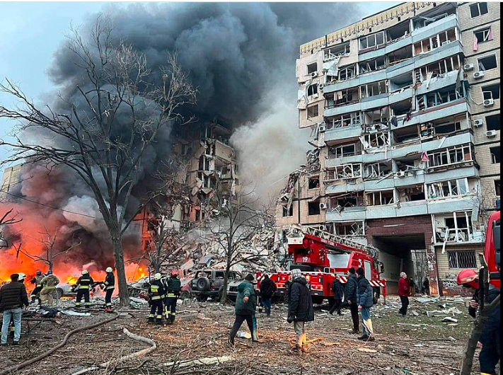
Violent conflict is on the rise
UN warns we are seeing the highest number of violent conflicts since World War II¹
Today, 2 billion people live in settings affected by conflict¹
In 2022, 79 countries saw an increase in conflict; deaths from conflict rose 96%²
Conflict is driving 80% of humanitarian need, based on IRC’s analysis³
Residential building in Dnipro, Ukraine, after Russian missile strike on 14 January 2023, Source: Govt of Ukraine
References: 1. UN Security Council Meeting Coverage, 26 January 2023. .https://press.un.org/en/2023/sc15184.doc.htm; 2. Key Trends in the Global Peace Index https://www.visionofhumanity.org/maps/#/; 3. IRC 2023 Emergency watchlist https://www.rescue.org/report/2023-emergency-watchlist

Slide 13
Health Ramifications of Conflict
Infectious Disease Outbreaks: People living in fragile contexts are twice as likely to lack access to safe WASH services.¹
Women’s Health: Half of all worldwide maternal deaths between 1998-2008 occurred in six countries, all involved in an armed conflict. ²
Children’s Health: In places where IRC works, maternal and child mortality remain up to 5 times higher than global averages. ³
Mental Health: 1/5 (22%) people who have experienced conflict in the previous 10 years, will have depression, anxiety, PTSD, or other mental illnesses. ⁴
Attacks on Health Facilities: In 2022, the Safeguarding Health in Conflict Coalition documented almost 2,000 incidents of violence against or obstruction of health care in conflicts across 32 countries and territories. Incidents increased by 45% in 2022 compared to 2021 and marked the highest annual number of incidents that the SHCC has recorded since it began tracking.⁵
References: 1. UNICEF https://www.unicef.org/press-releases/billions-people-will-lack-access-safe-water-sanitation-and-hygiene-2030-unless ; 2. Hogan, Margaret C et al. “Maternal mortality for 181 countries, 1980-2008: a systematic analysis of progress towards Millennium Development Goal 5.” Lancet (London, England) vol. 375,9726 (2010); 3 UNICEF Data; 4. Charlson, Fiona, et al. "New WHO prevalence estimates of mental disorders in conflict settings: a systematic review and meta-analysis." The Lancet 394.10194 (2019): 240-248.5. Safeguarding Health in Conflict 2022 Annual Report https://www.safeguardinghealth.org/resources

Slide 14
Sudan Context
April 15, 2023: Clashes erupt between Rapid Response Forces (RSF) and Sudanese Armed forces (SAF) in Khartoum, resulting in civilian deaths, damage to health infrastructure, regional instability, and looting of facilities have rendered the population forced to flee.
Affected population:
Major Health Issues:
Pre-existing high morbidity and mortality from vaccine-preventable disease outbreaks: Dengue Fever, Measles, Cholera ¹
3.4 million children under five suffer from malnutrition annually, of whom over 610,000 suffer from severe acute malnutrition.^{1,2}
>40 percent of population projected to suffer from acute food insecurity, an increase by 74% from last year’s projection. ³
SRH and sexual violence: Prior to 15 April, more than 3 million women and girls in Sudan were at risk of gender-based violence. Now 4.2 million people. ⁴
References: 1. UN OCHA Sudan Country Report; 2 UNICEF: Malnutrition in Sudan; 3 Health Cluster Report Sudan; 4. UNICEF: Sudan Top Officials Sound Alarm on Violence Against Women and Girls

Slide 15
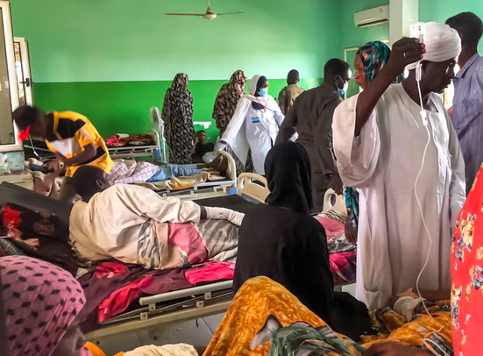
Sudan: Two challenges for humanitarian health
Limited Humanitarian Access: :
Safety/Security: No clear delineations of conflict (urban warfare in Khartoum) → complexity of last mile delivery is intensified
9 states are accessible, 3 are partially accessible and 6 are not accessible
Disrupted Health Services:
One-third of the population in need of humanitarian assistance
prior to current crisis
<20% of health facilities in Khartoum remain fully functional ¹
Looting of humanitarian assets (including IRC warehouses)
Operational: Extensive customs import clearances needed
National government systems paralyzed during assault on
Khartoum
A crowded hospital in N. Darfur.
Credit: Ali Shukur)/AFP/Getty/MSF
References: 1. Sudan: revised humanitarian response plan 2023

Slide 16
A strategy to deliver in Sudan: Localization
Localization means working with and through government and civil society systems at national and subnational level to deliver assistance.
Engaging community partners to reach patients in inaccessible zones by:
Supporting community groups who drive women in labor or with pregnancy complications to HFs, connect them with midwives/gynecologists.
Supporting local organizations that deliver essential meds/services to neighbors: cover staff salaries and overhead cost of HFs, provide accommodation and meals for pediatric oncology patients
Supporting the existing health system to address disruptions by:
Engaging directly with district level authorities while national MOH is over-extended
Conducting needs assessments to inform programming jointly with local staff and authorities
Providing training (eg in Community Management of Acute Malnutrition) and supportive clinical supervision to build capacity of existing staff to meet the needs of the displaced population

Slide 17
Progress through localization
The IRC provides an integrated health, nutrition and water, sanitation, and hygiene (WASH) program and also provides child protection services and comprehensive women and girls’ protection and empowerment services including to gender-based violence (GBV) survivors. The IRC supports:
8 health facilities in Wad Madani, a host community seeing a surge in IDPs
9 Health facilities in Gedaref
21 health facilities in Blue Nile
Wad Madani Data: May 28 - To Date
 | Total Outpatient Consultations | Nutrition Screens | Therapeutic Feeding Center Admissions | Antenatal Care | EPI (Vaccines) | Mental Health | Outpatient Therapeutic Feeding Program
Patient consults | 44,118 | 5,085 | 713 | 2,545 | 8,463 | 277 | 339

Slide 18
Ukraine Context
February 24, 2022: Russia invades Ukraine resulting in civilian casualties, damage to health infrastructure, supply chain disruptions, compounded by health care staff attrition due to military conscription enforced under Martial Law. Over 17 million people in Ukraine require urgent humanitarian support, including more than 5 million people internally displaced by the war.
Population in need: IDPs fleeing west, those unable to leave shelter in hard to access areas people with disabilities, elderly, pregnant/lactating women.
Non-displaced households: 48% of respondents >50 years, 37% had a member of their household who was chronically ill. 56% IDP households had members traveling with them >50 years old
Health Issues: exacerbated NCDs due to interruptions of health continuity/monitoring/medications, chronic illness (TB, HIV, Hepatitis,) Mental Health, SRH (perinatal care and Clinical Management of Rape)
Health Systems: Middle-income country with robust national health system in place. Highly centralized systems with National and Oblast MoH oversight
Notes:
UNHCR’s response plan and financial requirements for the Ukraine situation in 2023 (funding appeal) The total needs amount to $1.1 billion – $602.5 million inside Ukraine and $517 million in countries hosting refugees from Ukraine in Europe. (https://reliefweb.int/report/ukraine/ukraine-situation-unhcr-supplementary-appeal-2023#:~:text=This%20document%20sets%20out%20UNHCR's,refugees%20from%20Ukraine%20in%20Europe.)
ement Cheick’s outstanding updates and any potenUal health response planning, please find
aYached the WHO emergency appeal, ciUng the following health risks and prioriUes:
Health risks for morbidity and mortality from communicable and non-communicable diseases (NCDs):
Poor/no access to primary health care insUtuUons due to restricted mobility and security concerns,
especially in areas of intense fighUng, this disrupts the referral system; thereby making not only primary,
but also secondary and terUary care (hospitals and specialist centers) inaccessible to the populaUon.
Poor/no access to state health programmes, such as “affordable drugs” and free insulin for diabeUc
paUents.
Damage/disrupFons to health care infrastructure, curtailed access to referral hospitals and pharmacies,
and personnel fleeing from conflict-affected areas are compounding to paralyse the health system. Health
care services disrupUons coupled with conflict condiUons increase the affected populaUon’s vulnerability
to communicable diseases, such as COVID-19, polio and measles.
Poor vaccinaFon coverage increases the risk of outbreaks of preventable communicable diseases,
parUcularly among children; the COVID-19 pandemic and the recent reported cases of polio in the western
part of the country compound this risk.
Confinement condiFons in shelters, populaUon displacement, and infrastructure damage, make hygiene
difficult to maintain, increasing the risk of respiratory and diarrheal diseases, which could rapidly have a
large impact on the health of the populaUon.
Health prioriFes
• Immediate emergency care for injured paUents
• Provision of essenUal medical supplies and services to fill urgent gaps, to include SRH, HIV/TB, NCDs,
and mental health
• ConUnuity of COVID-19 and polio outbreak response acUviUes
• Infrastructural support for hospitals and health faciliUes
• Strengthening health informaUon management

Slide 19
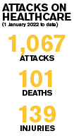
Ukraine: Delivering healthcare near the front lines
Opportunities:
Supply importation less cumbersome under Martial Law
Qualified staff available to work, many IDPs themselves
National and Oblast MoH + multitude of iNGOs→enhanced coordination
Response funded at 47% vs 31% in Sudan^{1,2}
Challenges:
Obtaining access to remaining populations in areas near lines of aggression
Operating where static HFs and critical infrastructure have been demolished
Key specialty services centralized: Ob/Gyn and mental health care need referrals
Sustained continuity required to manage chronic illnesses in elderly and perinatal care
References: 1. UN OCHA Situation Report, Ukraine; 2. UN OCHA Situation Report Sudan

Slide 20
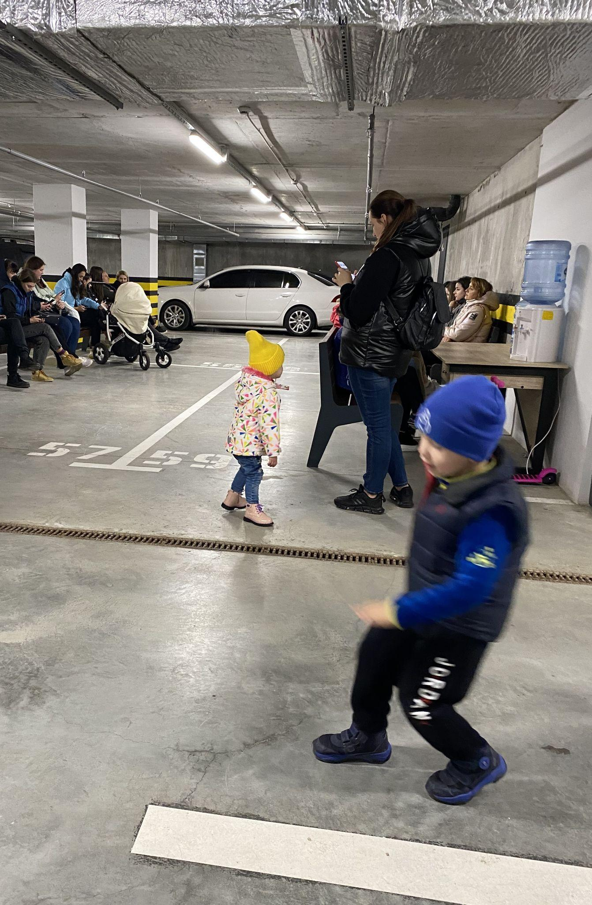
A solution to deliver in Ukraine: Mobile Health
Mobile Health: Providing health services through a non-fixed location (eg door to door or out of vehicles)
In Ukraine, IRC:
Supports 3 HFs and runs 1 IRC mobile unit and 4 partner led mobile unit
Supports local mobile vans organized by IDP doctors and nurses, supplies vans with essential medicines and health supplies
Vans then provide health services in newly accessible areas, where MoHs are unable to access otherwise
Provides PHC, NCD care, (diabetes management, hypertension medication, thyroid medications,) vital labs for NCD management, as well as perinatal care, integrated with mental health & protection services
Identifies and transports high acuity and complexity patients requiring referral to secondary facilities
Conducts mental health, CMR, and survivor centered approach trainings at HFs
Children play in a bomb shelter in Ukraine.
Credit: S. Jilani

Slide 21
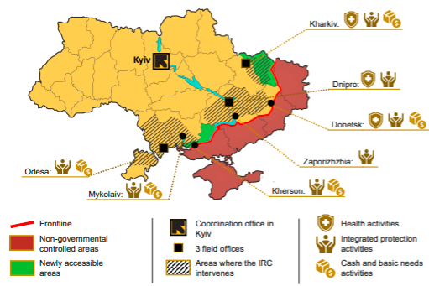
Ukraine: Progress through mobile health
Mobile Medical Unit Data: Oct. 2022 - Aug. 2023
 | MMU: (IRC + Partner) | NCDs | Comm. Disease | SRH | Mental Health | GBV Referred
Total | 20,789 (13,781+7008) | 19,733 | 1,056 | 1,806 | 5,267 | 980
Majority demographic: Female, >50 years old

Slide 22
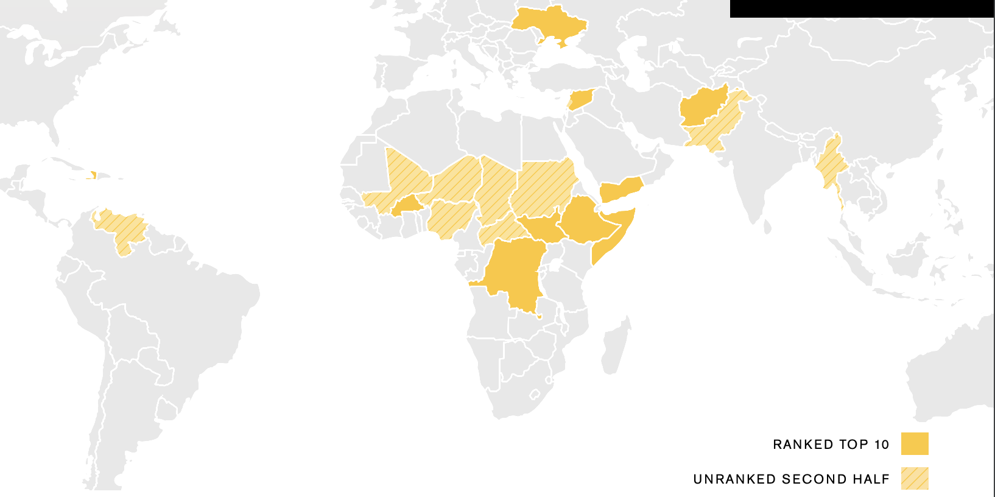
Protracted conflicts are the rule, not the exception
Among the 20 countries on IRC’s 2023 watchlist, the average duration of conflict is 12 years
Notes:
Requires solutions that can sustain and extend services despite chronic disruption to health and economic systems, infrastructure and mobility.

Slide 23
Protracted conflicts require systems change to deliver under chronic disruption
Two systems changes where we see potential:
A simplified, decentralized, approach to treating acute malnutrition
Engaging civil society to deliver immunizations to people that governments cannot or will not reach
Notes:
Requires solutions that can sustain and extend services despite chronic disruption to health and economic systems, infrastructure and mobility.

Slide 24
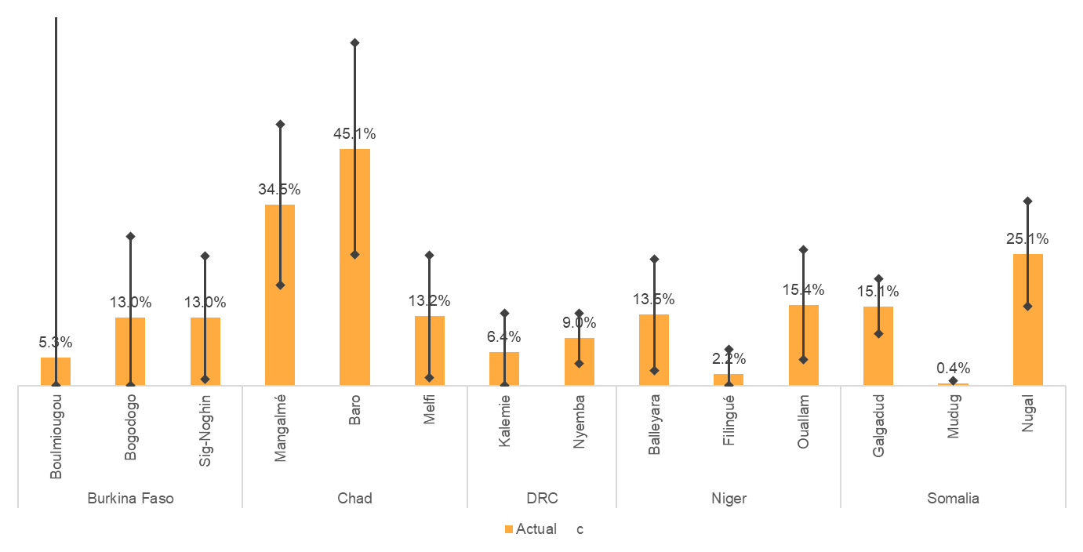
The Problem: Acute Malnutrition Treatment Gap
Acute malnutrition is common in conflict settings, affecting up to 50% of children in Somalia this year
Treatment using a fortified peanut paste is highly effective but, 4 in 5 children lack access
% Children with Severe Acute Malnutrition Treated, by District
Reference: Heymsfield G, Radin E, Biotteau M, et al. Estimating program coverage in the treatment of acute malnutrition using population-based cluster survey methods: Results from surveys in five countries in the Horn, Sahel, and the African Great Lakes regions. Research Square; 2023. DOI: 10.21203/rs.3.rs-2895485/v1
Notes:
Reference: Heymsfield G, Radin E, Biotteau M, et al. Estimating program coverage in the treatment of acute malnutrition using population-based cluster survey methods: Results from surveys in five countries in the Horn, Sahel, and the African Great Lakes regions. Research Square; 2023. DOI: 10.21203/rs.3.rs-2895485/v1
With MOH partners, the IRC conducted population-based surveys estimating the coverage of AM treatment in 15 conflict affected districts across the Horn and Sahel.
District level treatment coverage of treatment among children with Severe Actue Malnutrition ranged from <1% to 45%, with 11 districts below 20%

Slide 25
The system to deliver treatment is unnecessarily costly and complex
IRC has developed a simplified protocol feasible in conflict setting

Slide 26
Research testing effectiveness and efficiency of a simplified protocol
The ComPAS trial, an IRC-led 4,000 patient RCT in South Sudan and Kenya, found:
A simplified protocol was noninferior to the standard more complex approach (76.3% recovery with a simplified protocol vs 73.5% with standard treatment)¹
Operational research with over 90,000 children in 5 countries found:
85-95% of children recovered in programmatic settings
A prospective cohort study of >40,000 children in Nara, Mali, found:
Treating a severely wasted child using the simplified protocol cost 24% less per child
Simplified protocol uses ~40% less treatment product per severely wasted child
94% of children treated by a community health worker recovered ²
References: 1. Bailey J, Opondo C, Lelijveld N, Marron B, Onyo P, et al. (2020) A simplified, combined protocol versus standard treatment for acute malnutrition in children 6–59 months (ComPAS trial): A cluster-randomized controlled non-inferiority trial in Kenya and South Sudan. PLOS Medicine 17(7): e1003192. https://doi.org/10.1371/journal.pmed.1003192; 2. Kangas, S.T.; Marron, B.; Tausanovitch, Z.; Radin, E.; Andrianarisoa, J.; Dembele, S.; Ouédraogo, C.T.; Coulibaly, I.N.; Biotteau, M.; Ouologuem, B.; Daou, S.; Traoré, F.; Traoré, I.; Nene, M.; Bailey, J. Effectiveness of Acute Malnutrition Treatment at Health Center and Community Levels with a Simplified, Combined Protocol in Mali: An Observational Cohort Study. Nutrients 2022, 14, 4923. https://doi.org/10.3390/nu14224923
Notes:
References
Bailey J, Opondo C, Lelijveld N, Marron B, Onyo P, et al. (2020) A simplified, combined protocol versus standard treatment for acute malnutrition in children 6–59 months (ComPAS trial): A cluster-randomized controlled non-inferiority trial in Kenya and South Sudan. PLOS Medicine 17(7): e1003192. https://doi.org/10.1371/journal.pmed.1003192
Kangas, S.T.; Marron, B.; Tausanovitch, Z.; Radin, E.; Andrianarisoa, J.; Dembele, S.; Ouédraogo, C.T.; Coulibaly, I.N.; Biotteau, M.; Ouologuem, B.; Daou, S.; Traoré, F.; Traoré, I.; Nene, M.; Bailey, J. Effectiveness of Acute Malnutrition Treatment at Health Center and Community Levels with a Simplified, Combined Protocol in Mali: An Observational Cohort Study. Nutrients 2022, 14, 4923. https://doi.org/10.3390/nu14224923

Slide 27
Findings strongly support adoption of a simplified protocol in conflict settings
✔ Effective at recovering even the most vulnerable children
✔ Cost effective compared to the standard approach
✔ Requires less treatment product which is often in short supply
✔ Feasible to deliver through community health workers, even those with low literacy
✔ Analogous to the public health approach that simplified and decentralized HIV treatment

Slide 28
The Problem: Immunization coverage has plateaued
Global Immunization Coverage by Antigen (1980-2019)
Source: WHO/UNICEF Estimates of National Immunization Coverage, 2019 Revision.
Notes:
WHO/UNICEF Estimates of National Immunization Coverage, 2019 Revision.

Slide 29
Poor coverage persists in areas beyond government reach, especially conflict zones
Baseline data from the Gavi REACH consortium, an IRC-led non-governmental alliance to expand vaccine access in Ethiopia, Sudan, South Sudan and Somalia
Source: The Gavi REACH Consortium: Delivering Immunization Services to Zero-Dose Children in the Horn of Africa

Slide 30
REACH strategies and progress
NGO/CSO Coalition Strategies:
Leveraging civil society to negotiate humanitarian access with governments and armed groups
Optimizing delivery locations by launching mobile and cross border campaigns based on analysis of GIS and population data
Gathering client feedback to design non-traditional client centered approaches, e.g. co-locating immunization services for children and livestock
Initial Progress (January-June 2023):
With critical shifts in the political context (Tigray Peace Agreement) access negotiations have reduced inaccessible areas from 43% to 13%
Delivered 298,559 doses of Diphtheria, Tetanus, Pertussis (DTP) and Measles Containing Vaccine (MCV).
Source: The Gavi REACH Consortium: Delivering Immunization Services to Zero-Dose Children in the Horn of Africa

Slide 31
Conclusion
Rising global conflict has a devastating impact on health outcomes and health inequities
But there are solutions to deliver and safeguard health even in the most challenging settings
We can improve health and reverse inequalities by fine tuning and scaling these solutions
We take action to drive hope rather than relying on hope to drive action, we’re always looking for partners in action.

Slide 32
Thank You

Slide 33
Protracted conflicts require systems change to deliver under chronic disruption
Among the 20 countries on IRC’s 2023 watchlist, the average duration of conflict is 12 years
Two systems changes where we see potential:
A simplified, decentralized, public health approach to treating acute malnutrition
Engaging civil society to deliver immunizations to people that governments cannot or will not reach
Notes:
Requires solutions that can sustain and extend services despite chronic disruption to health and economic systems, infrastructure and mobility.

Slide 34
Q&A

Slide 35
This webinar recording and slides will be posted on www.icap.columbia.edu

Slide 36
Next Grand Rounds – Tuesday, October 17, 2023
9 am ET
Violence Against Children Survey (VACS) in Eswatini

Slide 37
Thank you

