Slide 1
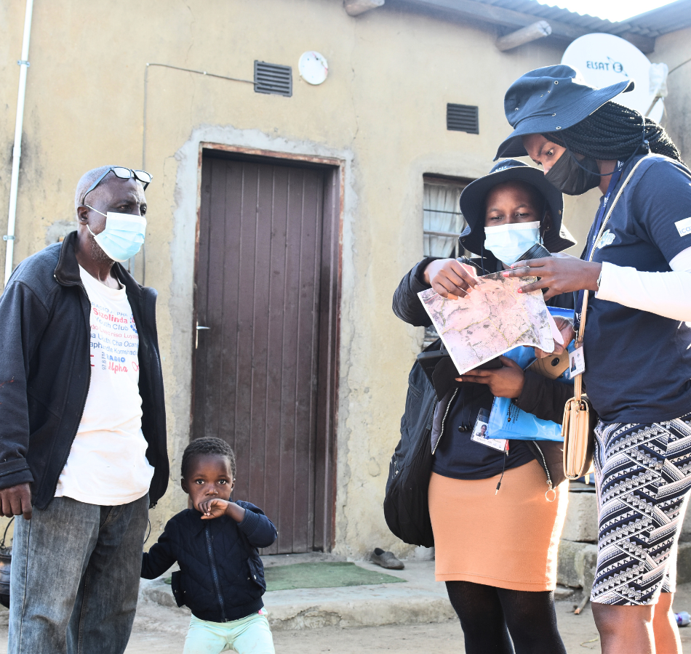
Building an evidence-base to Address Violence Against Children and Youth: Survey Findings from EswatinI
ICAP GRAND ROUNDS
October 17. 2023

Slide 2

Wafaa El-Sadr, MD, MPH, MPA,
Director,
ICAP at Columbia University

Slide 3
Agenda
Reminders:
Welcome and Introduction –
Presentation
Q & A
For questions to the panelists, use the Q&A box
The webinar recording and slides will be posted on www.icap.columbia.edu

Slide 4



Mpho Maziya,
Social Welfare Officer, Deputy Prime Minister’s Office in Eswatini
Harriet Nuwagaba-Biribonwoha,
Research Director,
ICAP in Eswatini
Michelle Li,
Epidemiologist and Strategic Information Branch Chief,
CDC in Eswatini

Slide 5



Building an evidence-base to Address Violence Against Children and Youth: Survey Findings from Eswatini
Poppy Mavis Sithole, Harriet Nuwagaba-Biribonwoha, Choice Ginindza, Bonisile Nhlabatsi, Michelle Li, Mpho Maziya, Harrison Kamiru, Siphiwe Shongwe-Gama, Cebisile Ngcamphalala, Ruben Sahabo, Seya Marie Kaye Francis Annor, Boateng, Laura Chiang on behalf of the Eswatini VACS 2022 Team
ICAP Grand Rounds, 17 October 2022
5
Notes:
DPMO: Mpho

Slide 6
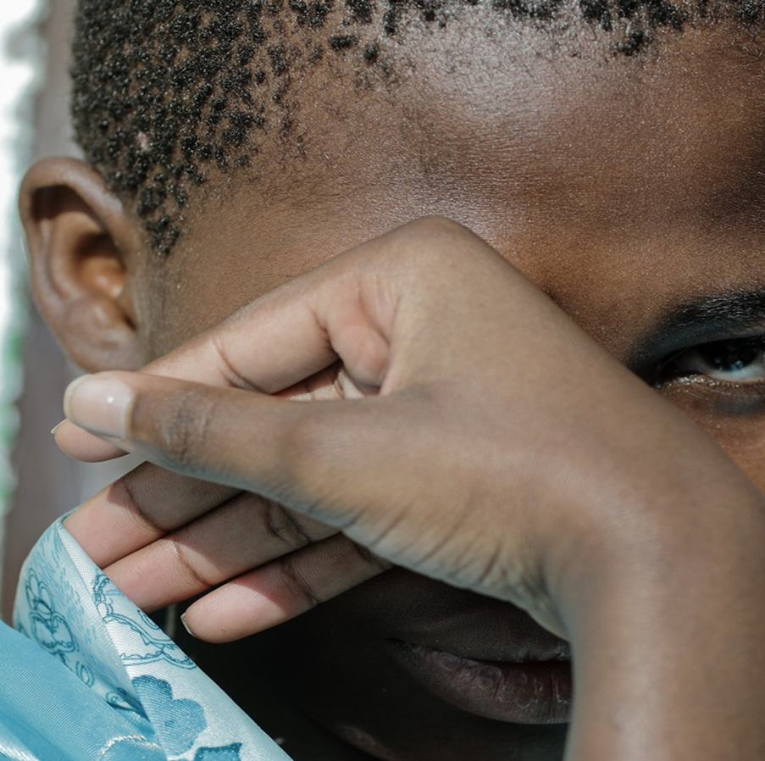
Outline
Introduction/Background
Methods
Key findings
Data use
Notes:
This is the outline of our talk today.

Slide 7
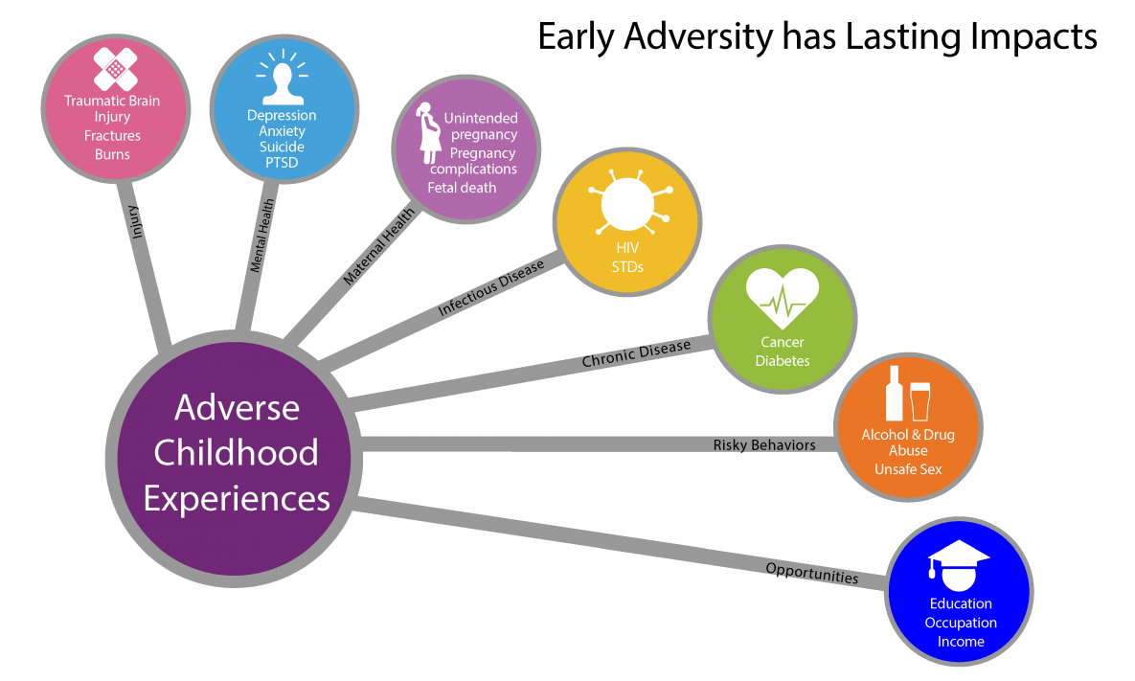
What is Violence and Why is it Important?
The intentional use of physical force or power, threatened or actual, against oneself, another person, or against a group or community, that either results in or has a high likelihood of resulting in injury, death, psychological harm, maldevelopment or deprivation.
https://www.who.int/groups/violence-prevention-alliance/approach
Notes:
Let us start by defining what violence is and why it is important. The WHO defines violence as (read definition). Any kind of adverse experience like this experienced in childhood or over a person’s lifetime can have lasting impact on their physical and mental health as well as their social well-being as shown in the infographic on the left.

Slide 8
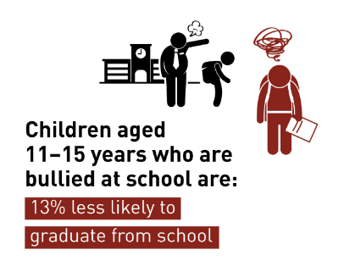
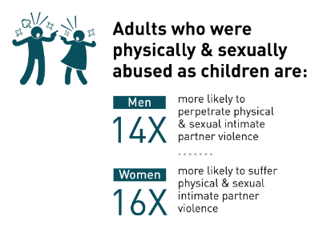
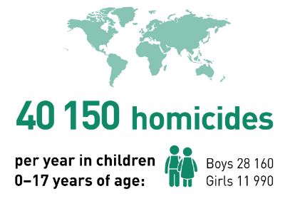
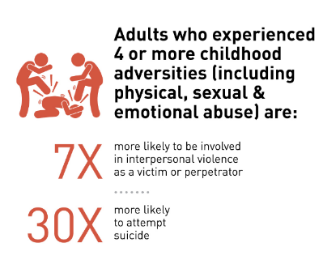
Consequences of Violence against Children and Youth
https://www.who.int/teams/social-determinants-of-health/violence-prevention/global-status-report-on-violence-against-children-2020
Notes:
As examples, consequences of violence against children and youth include loss of life, failure to complete school, and perpetuation of that violence by victims of violence becoming themselves perpetrators of violence. Adults who experienced 4 or more experiences of childhood are themselves more likely to be involved in future incidences of violence, and 30 times more likely to attempt to take their life

Slide 9
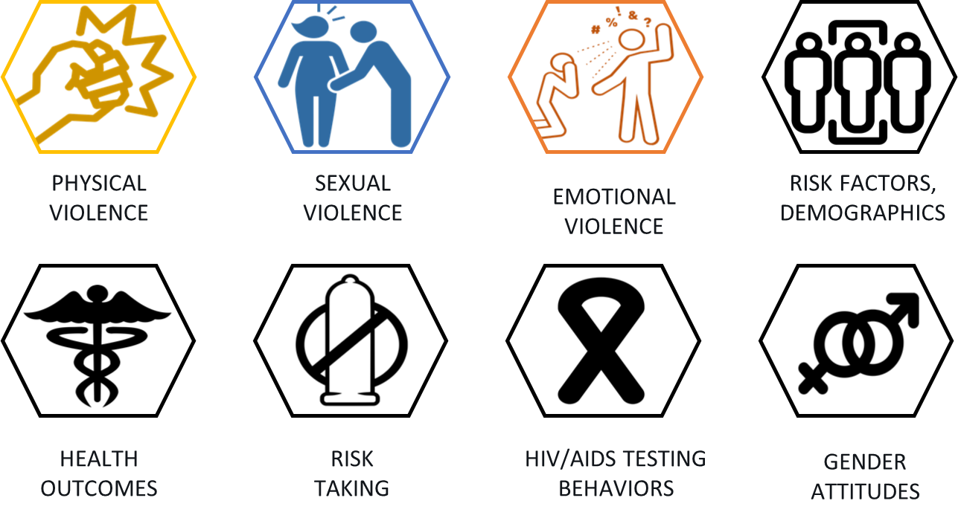
What is a VACS?
‘The Violence Against Children Survey (VACS) is a national, household survey designed to capture the magnitude and prevalence of violence against children in a given country’ .
Chiang LF et al
VACS use standardized survey methodology to collect comprehensive data for program action.
LF Chiang, H Kress, SA Summer, et al Inj Prev. 2016 April ; 22(Suppl 1): i17–i22. doi:10.1136/injuryprev-2015-041820.
Notes:
The Violence Against Children Survey (VACS) is a national, household survey designed to capture the magnitude and prevalence of violence against children in a given country
VACS use standardized survey methodology to collect comprehensive data on the prevalence and risk factors of sexual, emotional and physical violence, the perpetrators, the event location, and the impact of the violence; all to inform programs and action plans against violence.

Slide 10
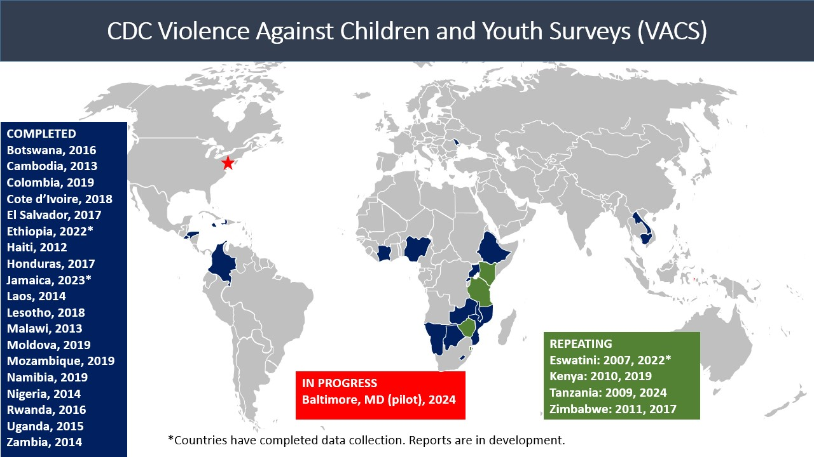

Violence Against Children and Youth Surveys (VACS) Globally
First VACS in 2007 in Eswatini (then Swaziland)
~ 28 surveys completed in 25 countries
https://www.togetherforgirls.org/en/about-the-vacs
Notes:
The first VACS was conducted in the Kingdom of Eswatini in 2007. Then it was called The Kingdom of Swaziland. And in case you are wondering where that is, we are a lower-mid income country in Sothern Africa (here), with a population of 1.1 million people. We share borders with South Africa and Mozambique.

Slide 11
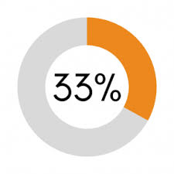
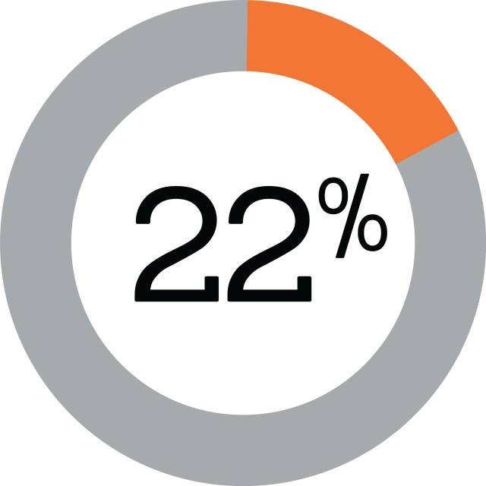
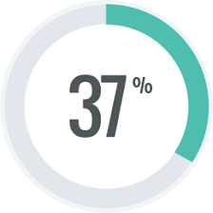
Swaziland/Eswatini VACS 2007
Included 40 randomly selected enumeration areas (EAs), 1,900 households, and 1,244 females 13-24 years interviewed
Physical violence | Emotional violence | Sexual violence
  More than 50% of all incidents of child sexual violence were not reported to anyone, only 1 out of 5 cases sought help from available services. This sparked multi-stakeholder interventions to address violence against children
Reza, A., et al., Sexual violence and its health consequences for female children in Swaziland: a cluster survey study. Lancet, 2009. 373.
Notes:
So what did we learn from the first VACS? This survey conducted in randomly selected EAs and nearly 2000 households only included females 13-24 years and high prevalence of violence as shown here.
More than 50% of all incidents of child sexual violence were not reported to anyone, only 1 out of 5 cases sought help from available services. This sparked multi-stakeholder interventions to address violence against children

Slide 12
Eswatini Implemented Multi-stakeholder Interventions to Address Violence against Children
The Deputy Prime Minister’s Office led enactment/strengthening of legislature, policies and plans to protect children
National sensitization, community education, law enforcement
Strategic partnerships with development partners work together to respond to the survey findings and secure resources for those responses.
2009
National Children Policy
2011
National Plan for Action for Children 2011-2015
2012
Child Protection and Welfare Act
2018
National Violence Strategy 2023
Sexual Offences and Domestic Violence Act (SODV)
2023
National Plan for Action for Children 2023-2027
Person with disability Act
National Violence Strategy 2023-2027
Notes:
As a nation, we then embarked on a series of multi-stakeholder intervention to address violence against children. The response was led by the Deputy Prime Minister’s office, one of the highest offices in the nation. Through this office and the department of social welfare, we conducted national sensitization, community education and legislature to protect children and women from violence. We established strategic partnerships with development partners and secured resources to help us with this response. To the right (in blue) are some of the policies, laws and plans passed to ensure protection of rights of children and prevent violence in the nation.

Slide 13
Eswatini VACS 2022
Survey Objectives
Led by Eswatini Government
  DPMO, Ministry of Health, Central Statistical Office
Collaboration with CDC/DVP
Technical partnership with ICAP at Columbia University)
Collaboration with key stakeholders
  UN agencies
  Implementing partners
Magnitude and nature of violence against children
Physical, Sexual, Emotional
Examine
Examine health consequences (Mental health, substance use, STIs, health risk behaviors (e.g., condom use)
Identify
Potential risk and protective factors
Family connectedness, friends, community
Assess
Knowledge and utilization of services
Estimate
HIV Prevalence
Help
Help guide prevention programs and policies
INSPIRE Indicators
Post-violence care, HIV testing
Association between HIV and violence against children
Describe
Notes:
Mpho: I will now handover to Dr. Harriet Biribonwoha who will lead us through the survey methodology and results
For youth ages 13-24, INSPIRE indicators include data on Response and Support Services and Education and Life Skills.
One of the partners is the Global Partnership to End Violence Against Children (End Violence) which was formed in 2015 and also includes governments, UN agencies, international organizations, the private sector, academics and children themselves, with an objective of holding themselves accountable and working together to prevent and respond to violence. In 2016, End Violence released INSPIRE: Seven Strategies for Ending Violence Against Children, a technical package that includes evidence-based strategies with demonstrated success in preventing and responding to violence in childhood. The seven strategies that INSPIRE encompasses are: Implementation and enforcement of laws; Norms and values; Safe environments; Parent and caregiver support; Income and economic strengthening; Response and support services; and Education and life skills. World Health Organization. (2016). INSPIRE: Seven Strategies for Ending Violence Against Children.

Slide 14

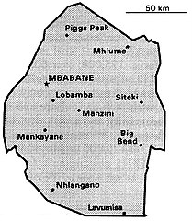
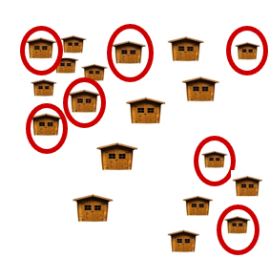



Eswatini VACS 2022 Methodology
Three-stage cluster sample survey design
353 EAs across all 4 regions
Separate EAs for males and Females
25-30 households per EA
1 participant per household
Interview team visits EAs
Stage 1: Randomly select EAs throughout Eswatini
353 EAs selected
Stage 2: Randomly select households within an EA
25-30 households selected per EA
Stage 3: Randomly select 1 eligible participant per household

Slide 15
Survey Procedures
Consent
Permission from a parent or guardian (13-17 years)
Respondent Questionnaire
Head of Household questionnaire
HIV Testing
HIV rapid testing in the household by survey staff or self-testing
Response Activities
If violence reported, respondents linked to support team for further support
Participant Questionnaire (administered by same-sex interviewer)
Verbal agreement from participants
Referral for HIV prevention services
Referrals for HIV care & treatment
Multi-level stakeholder and partner engagement: technical, community, social workers
Notes:
The participant questionnaire included the following topics: demographics; parent-youth relationships; education; connectedness to family, friends and community; endorsement of traditional gender norms; perceptions of safety; witnessing violence in the home or community; sexual history and risk-taking behaviour; experiences of physical and sexual and emotional violence; violence perpetration; pregnancy; health outcomes and risk behaviour; violence disclosure, service-seeking and use of services; and HIV service history.
The head of household and participant questionnaire contained modules specifically requested by Eswatini which included questions about COVID-19, SES, gender and violence norms

Slide 16
Definitions and Types of Violence
Childhood violence
Experiences of violence prior to 18y as report by respondents 18-24-years
Physical violence
Parent, adult caregiver, or other individual slapping, pushing, shoving, shaking, or intentionally throwing something to hurt; punching, kicking, whipping, or beating; choking, smothering, tried to drown, or burned; using or threatening with a weapon
Sexual violence
Unwanted sexual touching; attempted forced sex; pressured or coerced sex; physically forced sex
Emotional violence
Parent, adult caregiver, or other adult relative saying you were not loved, wishing you had never been born or were dead; being ridiculed
Peers who made you scared, excluded, called you names, were mean
Intimate partner who insulted, humiliated, kept you from having own money, kept you from seeing or talking to your family or friends; made threats to physically harm you.
Any violence
Physical, sexual or emotional violence, as reported by respondents

Slide 17
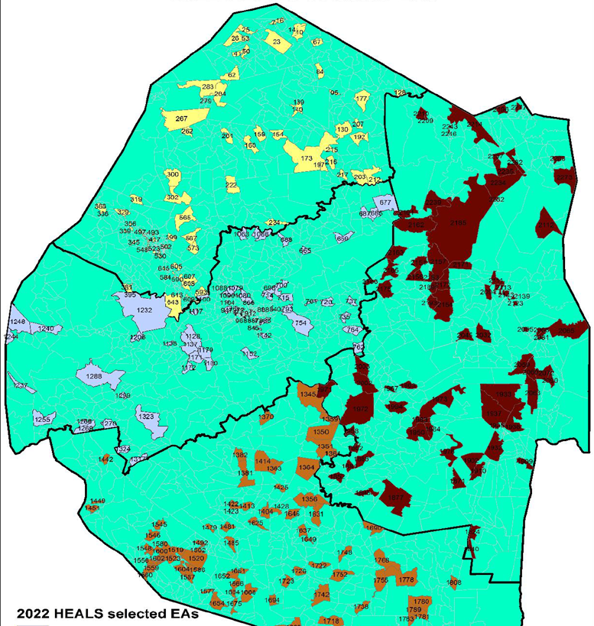
Data Collected and Data Analysis
VACS Data Monitoring Indicators | Target Number | Achieved (Response rate)
Enumeration areas | 353 | 353
Household response rate | 8,825 | 9,541
Respondent response rates Females Males | 7,100 1,725 | 6,716 (90%) 1,571 (85%)
Survey estimates are weighted for unequal probability of selection, differential non-response, and calibration to the census population
Descriptive statistics
Some unstable estimates for sub-analyses (where numbers were too small) are highlighted with an asterix (*)
xxxx

Slide 18
Outline
Introduction/Background
Methods
Key findings
Data use

Slide 19








Participant Characteristics
Background characteristics of adolescents ages 13-17 years
Background characteristics of young adults ages 18-24 years
Most currently enrolled in school
92.0% males
92.6% females
Ever married or cohabited
2.7% males
10.4% females
Orphans
21.1% males
21.3% females
Orphans by age 18 years
32.3% males
33.6% females
Worked for money (past year)
16.1% males
3.5% females
Worked for money (past year)
34.7% males
21.4% females
Disabilities
12.8% males
14.5% females
Disabilities
13.7% females
10.4% males.

Slide 20


Lifetime Experience of Violence
25.5%
31.7%
Reported by individuals who were 13-24 years
Notes:
Before we look at specific types of violence, I want to highlight a summary of lifetime violence among 13-24 years

Slide 21

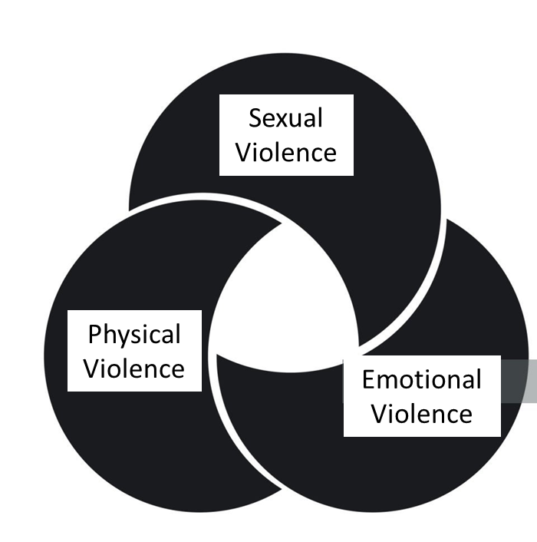
Multiple Experiences of Lifetime Violence
Females
Males
6.7% females and 9.3% males experienced two types of violence
Sexual Violence
2.4%
1.2%
Physical Violence
Emotional Violence
Notes:
Twice as many females experienced three types of violence as compared to males

Slide 22
Childhood Violence
15.8%
21.0%
Reported by individuals who were 18-24 years, reporting violence that occurred when they were <18 years
First sexual intercourse was coerced, pressured, or forced for 7.2% females and 0,7% males, as reported by participants who had sexual intercourse before age 18y

Slide 23




Perpetrators of Lifetime Violence Experienced by Females
Sexual Violence*
Physical Violence
Emotional Violence
13.8% Classmate/
School/friend
30.6% Family members
5.8% Current or ex intimate partner
25.3% Current or ex intimate partner
4.3% Parent or adult relative
7.7% Current or ex intimate partner
3.8% Classmate/
School/friend
4.6% Parent or adult relative
13.6% Neighbors
*First incidence of sexual violence, this occurred commonly at home among (66.1%) at an outside location (25.4%), or at school (9.3%)
Any sexual violence: 8.1%: unwanted sexual touching 4.6%, unwanted attempted sex 3.7%, coerced sex 1.7%, physically forced sex 2.2%
Notes:
Outside location such as a road/street, market/shop, school, lake/river or other body of water, and field/other natural area.

Slide 24



Perpetrators of Lifetime Violence Experienced by Males
Sexual violence*
Physical violence
Emotional violence
45.8% Classmate/
School/friend
18.4% Classmate/ School/friend
13.9% Classmate/
School/friend
18.0% Current or
ex partner
7.9% Parent or adult relative
6.5% Current or
ex partner
18.4 % Strangers
1.8 % Current or
ex partner
3.3 % Parent or adult relative
*First incidence of sexual violence, this occurred commonly at home among (47.9%), at school (22.4%) or other location (17.4%)
Any sexual violence 3.3%: unwanted sexual touching 1.5%, unwanted attempted sex 1.6%, coerced sex 0.6%, physically forced sex **
Notes:
Other locations included inside a car/bus, alcohol outlet (e.g., restaurant, bar, disco, club, etc), religious institutions, and office.
** unstable estimate for physically forced sex

Slide 25






Disclosure and Services Sought/received for Lifetime Sexual Violence
  63.3%
  told someone
  48.4%
  told someone
  50.5%
  knew a place to seek help
  59.3%
  knew of a place to seek help
  25.7%
  Sought Services
  **
  23.1% got help
  **
** Unstable estimate with RSE > 50%, therefore estimates are suppressed.
This is specific to the indicators for “sought professional services for any incident of sexual violence” and “received professional services for any incident of sexual violence.
Notes:
59% males knew places to seek help but less than half of those who knew a place sought professional help.

Slide 26
Disclosure and Services Sought/received for Lifetime Physical Violence
  67.3%
  told someone
  50.4%
  told someone
  67.9%
  knew a place to seek help
  80.9%
  knew of a place to seek help
  31.4%
  sought services
  24.1% sought services
  18.1% got help
17.7%
got Help

Slide 27
Characteristics Associated with Experiencing Sexual or Physical Violence Among Participants 13–17 years
 |  | Females | Males
 |  | Weighted % (95% CI) | Weighted % (95% CI)
Orphan status | Violence among orphans | 8.2 (5.7-10.7) | 12.9 (4.8-20.9)*
 | Violence among non-orphans | 8.2 (6.6-9.7) | 11.9 (7.5-16.3)
School attendance | Violence among those not attending school | 12.1 (6.8-17.4) | 19.6 (5.7-33.5)
 | Violence among those attending school | 7.7 (6.4-8.9) | 11.5 (7.7-15.3)
Employment | Violence among youth who worked | 8.1 (2.9-13.2)* | 26.6 (16.4-36.9)
 | Violence among youth who did not work | 8.0 (6.7-9.2) | 9.2 (5.3-13.1)
Witnessing violence | Violence among youth who witnessed violence at home | 21.4 (15.6-27.2) | 29.3 (19.5-39.0)
 | Violence among youth who did not witness violence at home | 6.5 (5.3-7.7) | 8.8 (5.4-12.2)
Food Security | Violence among youth who experienced food insecurity | 9.1 (7.3-10.8) | 14.9 (9.5-20.2)
 | Violence among youth who did not experience food insecurity | 6.6 (4.8-8.5) | 7.6 (3.9-11.4)
Disability | Violence among youth with a disability | 17.3 (13.1-21.5) | 16.3 (6.2-26.4)*
 | Violence among youth with no disability | 6.4 (5.1-7.7) | 11.4 (7.4-15.4)
 | Violence includes sexual or physical violence experienced in the past 12 months

Slide 28
Characteristics Associated with Experiencing Sexual or Physical Violence Among Participants 18-24 years
 |  | Females | Males
 |  | Weighted % (95% CI) | Weighted % (95% CI)
Orphan status | Violence among orphans | 9.6 (7.2-12.0) | 6.5 (2.8-10.1)
 | Violence among non-orphans | 7.7 (5.8-9.6) | 9.9 (7.1-12.6)
Level of Education | Violence among youth who completed primary school or less | 15.9 (9.9-21.9) | 9.4 (4.9-13.9)
 | Violence among youth who completed secondary school | 9.7 (6.9-12.5) | 14.0 (9.0-19.0)
 | Violence among youth who completed more than secondary school | 6.6 (5.1-8.0) | 6.3 (3.7-9.0)
Employment | Violence among youth who worked | 8.3 (5.8-10.8) | 13.0 (7.5-18.5)
 | Violence among youth who did not work | 8.2 (6.4-10.0) | 6.6 (4.0-9.2)
Witnessed violence at home | Violence among youth who witnessed violence at home | 22.9 (15.5-30.4) | 23.5 (14.6-32.3)
 | Violence among youth who did not witness violence at home | 6.8 (5.6-8.1) | 6.3 (4.3-8.3)
Marriage or cohabitation | Violence among youth who have ever been married or cohabited | 16.6 (11.8-21.4) | 19.9 (5.5-34.3)*
 | Violence among youth who have never been married or cohabited | 7.3 (5.7-8.8) | 8.5 (6.4-10.6)
Food insecurity | Violence among youth who experienced food insecurity | 9.4 (7.4-11.5) | 9.6 (6.7-12.5)
 | Violence among youth who did not experience food insecurity | 6.2 (4.4-8.0) | 7.5 (3.7-11.4)
Disability | Violence among youth with a disability | 13.1 (8.5-17.6) | 20.0 (11.9-28.1)
 | Violence among youth without a disability | 7.5 (6.0-9.0) | 7.5 (5.4-9.6)

Slide 29
Impact of Sexual Violence on Mental Health and Social Well-being
* Ever attempted suicide was estimated among those who ever had suicidal ideation.
Statistically significant differences in mental distress, self-harm and suicidal ideation among females. Similar pattern for physical and emotional violence. Similar trend among males, but smaller numbers (unstable estimates)

Slide 30
Impact of Violence (Continued)
 | Females | Males
 | Weighted % (95% CI) | Weighted % (95% CI)
Missed school due to any childhood sexual violence | 9.8 (6.6 - 12.9) | **
Missed school due to any childhood physical violence | 12.5 (9.1 - 15.9) | 9.1 (5.2 - 13.1)
Pregnancy | 4.5 (2.0 - 7.0) | N/A

Slide 31
HIV Prevalence
 | Females | Males
 | Weighted % (95% CI) | Weighted % (95% CI)
Living with HIV | 6.6 (5.8-7.4) | 3.3 (2.5-4.2)
HIV status and any lifetime violence
HIV positive among those who experienced any lifetime violence | 7.4 (5.8-8.9) | 3.4 (1.8-5.0)
HIV positive among those who experienced no lifetime violence | 6.4 (5.5- 7.2) | 3.3 (2.2-4.4)
HIV status and sexual violence
HIV positive among those who experienced lifetime sexual violence | 9.2 (6.5-12.1) | **
HIV positive among those who experienced no lifetime sexual violence | 6.4 (5.6-7.2) | 3.4 (2.5-4.2)
Notes:
Among those living with HIV: self-report* of Diagnosed-on Treatment-Virally Suppressed: FEmales 88-93-57, Males 92-91-67

Slide 32
Progress since 2007: Sexual Violence
[1] Pressured or physically forced sex: in 2007 includes being persuaded, tricked, forced to have sex, or was raped; in 2022 includes being persuaded, pressured, or forced to have sex. Sexual intercourse in 2007 includes “vaginal or anal intercourse” and in 2022 includes “vaginal, oral, or anal sex or the insertion of hands, fingers, or other objects into your vagina or anus by someone else“
[2] Pressured sex: in 2022 includes feeling overwhelmed by continual arguments and pressure.
Notes:
I will now handover to Michelle Li, who is with CDC Eswatini to review the progress since the first VACS, talk about data use and conclude the presentation.
Comparison is limited
Females only
Extensive questionnaire changes e.g.
Pressured or physically forced sex: in 2007 includes being persuaded, tricked, forced to have sex, or was raped; in 2022 includes being persuaded, pressured, or forced to have sex.
Sexual intercourse in 2007 includes “vaginal or anal intercourse” and in 2022 includes “vaginal, oral, or anal sex or the insertion of hands, fingers, or other objects into your vagina or anus by someone else.“
Differences in prevalence of lifetime sexual violence among females from 2007 to 2022
There were significant reductions in pressured or physically forced sex at sexual debut.
There were significant reductions in lifetime sexual violence, as well as in every type of sexual violence.
Differences in prevalence of childhood sexual violence among females from 2007 to 2022
There were significant reductions in childhood sexual violence, as well as in every type of sexual violence.
Differences in HIV testing and HIV status from 2007 to 2022
There were significant increases in the proportion of females who were ever tested for HIV.

Slide 33
Progress since 2007: Physical and Emotional Violence

Slide 34



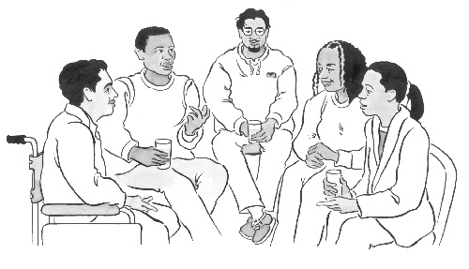


Inspire Indicators
INSPIRE Indicators among 13-17-year-olds
INSPIRE Indicators among 18-24-year-olds
Positive relationships with mothers
97.0% males
91.6%) females
Endorsement of traditional gender norms
47.3% Males
17.3% Females
Food insecurity
62.5% males
58.7% females
Early sexual debut
11.3% males
4.7% females
Peer social supports
73.0% males
63.8% females
Binge drinking
7.6% males
3.2% females
Caring relationship with an adult
78.3% males
90.3% females
Notes:
Michelle
Add set of questions for endorsement of gender norms

Slide 35
Norms and Values
More males than females endorsed norms supportive of corporal punishment and traditional gender norms
Among youth ages 18-24, Eswatini VACS 2022
Notes:
Q44 - Do you believe that in order to bring up (raise/educate) a child properly, a parent or caregiver needs to physically punish the child, for example by spanking or hitting the child with a hand?

Slide 36
Summary
Where there were comparable variables, sexual, physical and emotional violence had substantially declined between 2007 and 2022
However, lifetime experience of any violence remains common
1 in 3 females, commonly sexual violence, commonly occurring at home, perpetrated by family members
  1 in 3 males, commonly physical violence, commonly perpetrated by peers
The majority of participants disclosed the violence or knew where to go for help, but only about 1 in 5 sought help
Survey Strengths
  Nationally representative survey with detailed data on the context of violence informs programmatic and policy strategies to address violence
  Separation of male/female EAs and same-sex interviewers to promote truthful responses
  Multi-stakeholder planning for ownership

Slide 37
Limitations of the Survey
This was a household Survey: did not collect data on children outside households such as in care homes, residential institutions, or homeless
VACS collects contextual data on the first and most recent incidents
  No complete context by each incident for participants who experienced more than one event
  No qualitative data to complement the quantitative assessment
Self report of violence may underestimate the true prevalence if the respondent does not feel comfortable disclosing his or her experiences.
  Vulnerable to recall bias (mitigated by interviewing young respondents <25 years)
Certain types of disabilities disqualified participants from participating (deaf participants excluded, language barriers): no measure of violence in such populations

Slide 38
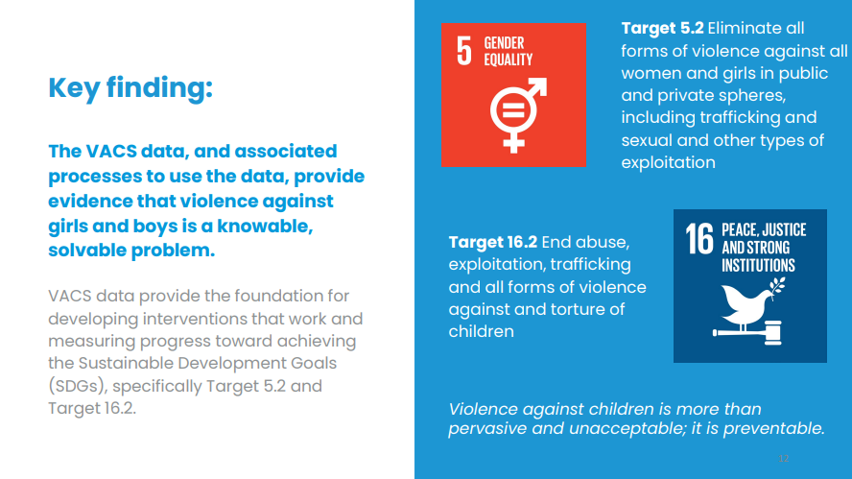
VACS Data Provide Critical Evidence
The VACS data and D2A process provide:
EVIDENCE that violence against girls and boys is a knowable and solvable problem.
the FOUNDATION for developing interventions that work and measuring progress toward the Sustainable Development Goals (SDGs), specifically Target 5.2 and 16.2.
Notes:
VACS data and D2A efforts propel policy reform and strengthen programs

Slide 39
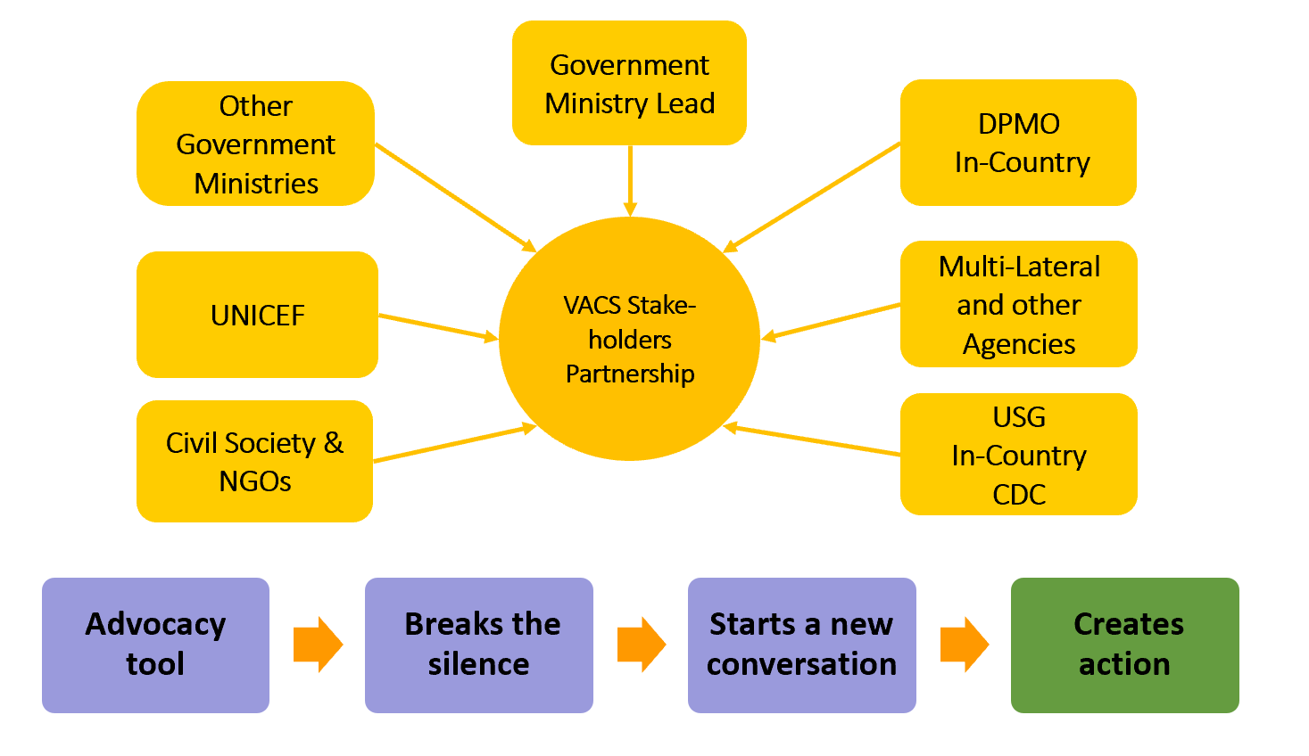

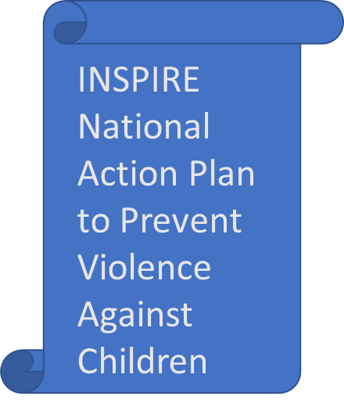
Using VACS to Catalyze Action
VACS Data
Social Services
Health
Education
Justice
Civil society
Policy, finance, development
Eswatini Action
Notes:
One of the unique methodologies of the VACS initiative is that we require a multi-sectoral approach, therefore,
VACS creates opportunities to engage multi-sectoral teams to review the magnitude of the problem of violence against children and advocate for, develop and implement a response plan to prevent and respond to violence against children

Slide 40
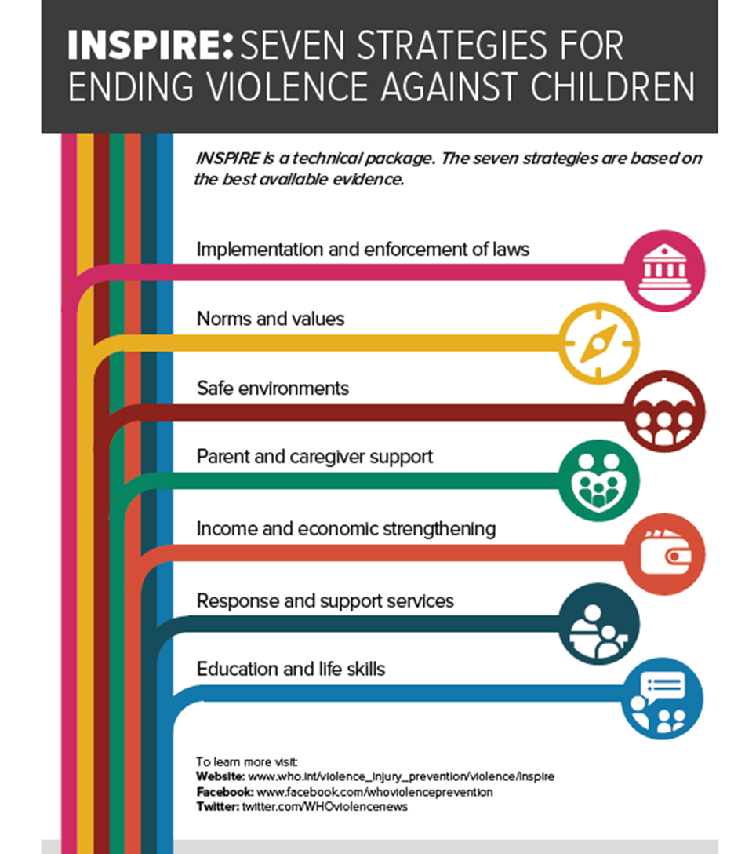
Eswatini VACS Data to Action Workshop
1.
Review data from VACS
2.
Discuss and develop priorities for action based on VACS data
Develop a framework for an INSPIRE-based National Action Plan to address violence against Children in Eswatini
3.
5
Review INSPIRE: 7 Strategies to Prevent Violence Against Children (global technical package)
4.
Discuss gaps in Violence Prevention in Eswatini and how these gaps may be addressed with INSPIRE strategies

Slide 41
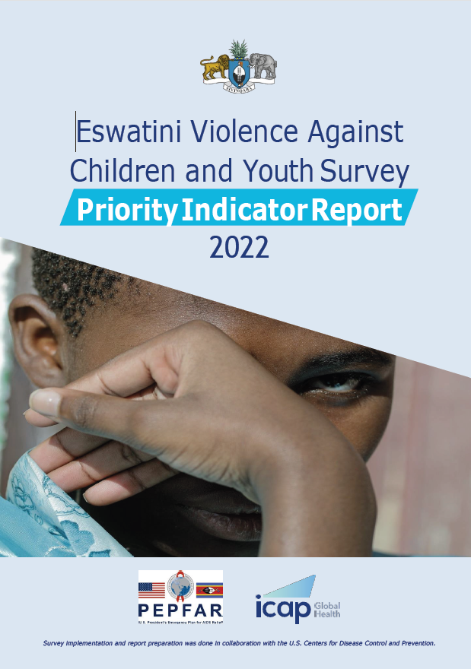
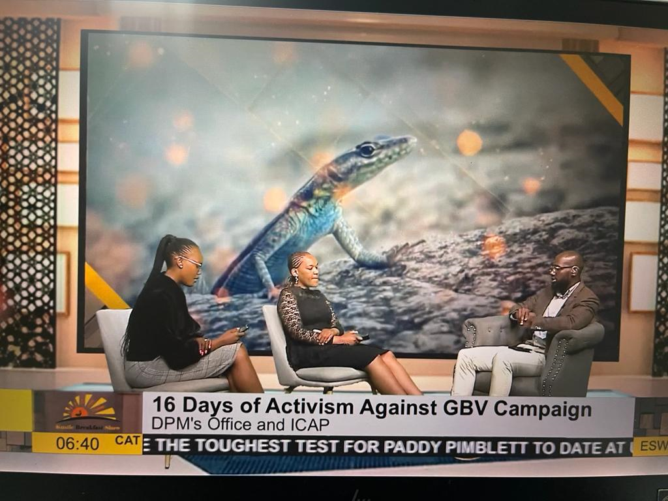

VACS Local Data Dissemination and Data Use Activities
VACS Priority Indicator Report released and discussed with stakeholders during the 16 days of activism against GBV between Nov-Dec 2022
Disseminated results to high school headteachers in all 4 regions
VACS full report writing workshop, 21-24 March, 2023
Release of VACS 2022 Results Tables for use in national program planning conducted in July 2023
Multisectoral review of preliminary VACS data during the Data to Action workshop
Presented VACS in local media platforms such as Kusile breakfast show and Tenhlalakahle Eswatini Live Radio Program
VACS full report disseminated Sep 2023
Notes:
Multisectoral stakeholders
•Review preliminary data from the VACS.
•Discuss and develop priorities for action based off the VACS data.
•Review INSPIRE: 7 Strategies to Prevent Violence Children (a global technical package).
•Discuss gaps in violence prevention in Eswatini and how these gaps may be addressed with INSPIRE Strategies.
•Develop a framework for an INSPIRE-based National Action Plan to address violence against children in Eswatini.

Slide 42
Conclusion
“Safety and Security don’t just happen, they are the result of collective consensus and public investment. We owe our children the most vulnerable citizens in our society, a life free of violence and fear.”
Nelson Mandela
Notes:
Add source of quote

Slide 43

Acknowledgements
DPMO
ICAP-Eswatini
CDC-Eswatini, DVP-Atlanta
ICAP-NY and
Regional
Amos Zwane (Co-Investigator)
Abigail Greenleaf (Co-Investigator)
Sindi Dube (Co-Investigator)
Ministry of Health
Rejoice Nkambule (Co-Investigator)
Central Statical Office
Shamagonam James
Michelle Adler
Phumzile Mndzebele (Co-Investigator)
Sam Kudhlande (Co-Investigator)
Sabelo Simelane
Ronald Malangwane
Robert Fakudze
Ruben Sahabo (Co-Investigator)
Tesfay Abreha (Co-Investigator)
Cebisile Ngcamphalala
Harrison Kamiru (Co-Investigator)
Nozipho Motsa
Marcelia Neves
Simanga Maseko
Mcusi Shongwe
Muhle Dlamini (Co-Investigator)
Sindi Dlamini (Co-Investigator)
Lenhle Dube (Co-Investigator)
Nokuthula Mahlalela (Co-Investigator)
Sebentile Myeni (Co-Investigator)
Musa Ginindza
Trevor Sithole
Lungile Mkhweli
Musa Ginindza
Laura Chiang (Co-Investigator)
Caroline Stamatakis
Francis Annor
Jose Carlosana
Poppy Sithole (PI)
Bonsile Nhlabatsi (PI)
Choice Ginindza (PI)
Harriet Nuwagaba-Biribonwoha (PI)
Michelle Li (PI)
Themba Shabalala
Marie-Kaye Seya (PI)
Caroline Ryan (Co-Investigator)*
Siphiwe Shongwe
Participants, Baylor Eswatini, Field Teams, Admin Team, Collaborators
Siphiwe Shongwe, Study Manager

Slide 44



Siyabonga (Thank you!)
Strengthening National Epidemiologic and Research Capacity to Track the HIV/TB Epidemic and Improve
Health Outcomes in the Kingdom of Eswatini under the President's Emergency Plan for AIDS Relief (#NU2GGH002291)

Slide 45
Q&A

Slide 46
This webinar recording and slides will be posted on www.icap.columbia.edu

Slide 47
Next Grand Rounds – Thursday, November 30, 2023
9 am ET
AI and Digital Innovation in Public Health
Presented by
Huguette Diakabana,
Member, WHO Digital Health Technical Advisory Group,
Co-Founder, African Alliance of Digital Health Networks,
Harvard faculty member

Slide 48
Thank you

