Slide 1
Improving Epidemic Preparedness
ICAP GRAND ROUNDS
July 18, 2023

Slide 2
Susan Michaels-Strasser, PhD, MPH, RN, FAAN
Senior Director, Human Resources for Health Development,
ICAP at Columbia University

Slide 3
Agenda
Reminders:
Welcome and Introduction – Susan Michaels-Strasser
Presentation
Q & A (Moderator: Susan Michaels-Strasser)
For questions to the panelists, use the Q&A box
The webinar recording and slides will be posted on www.icap.columbia.edu

Slide 4
Stacey Mearns
Director, Epidemic Ready Primary Healthcare (ERPHC), Resolve to Save Lives
Mohammed Lamorde
Project Director, 7-1-7 Alliance,
Resolve to Save Lives

Slide 5
Epidemic Ready Primary Healthcare
ICAP July Grand Rounds
Dr. Stacey Mearns
Director, Epidemic Ready Primary Healthcare

Slide 6
COVID-19 highlighted major gaps in PHC systems around the world
Lack of integration between PHC services and public health response functions
Disruption of routine healthcare services
Lack of protection for HCWs, staffing shortages and burnout
Inadequate infrastructure and resources
Information overload and misinformation
Key learnings underscore the importance of strengthening PHC systems, building resilience, and investing in preparedness to mitigate the negative impacts of future epidemics/pandemics on PHC facilities and the communities they serve

Slide 7
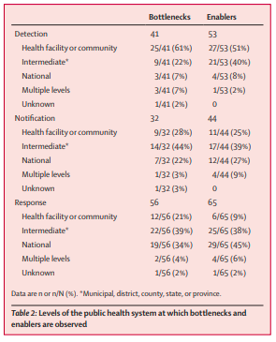
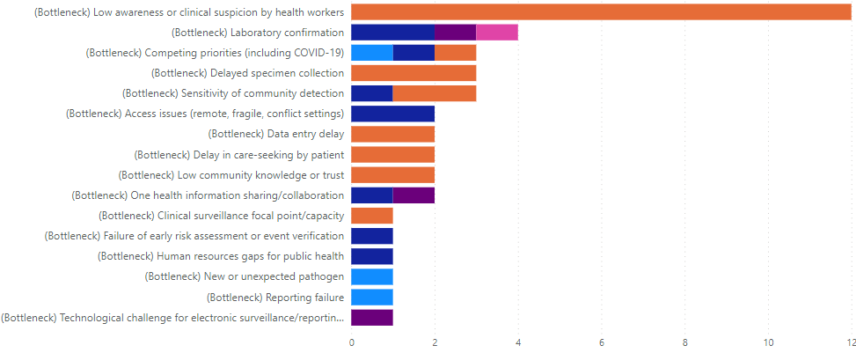
PHC is often the first point of contact with the health system
Well prepared PHC facilities can serve as the first line of defence in detecting and responding to epidemics
7-1-7 findings:
Most 7-1-7 outbreaks were detected in health facilities (41% at PHC level), yet most bottlenecks for detection and notification were also at this level
The most frequently observed bottleneck to detection was low awareness or clinical suspicion by health workers
Bochner, et al (2023) Implementation of the 7-1-7 target for detection, notification, and response to public health threats in five countries: a retrospective, observational study. Lancet Global Health; Volume 11, Issue 6. ,

Slide 8
What is epidemic-ready primary health care (ERPHC)?
An approach to increasing the resilience of PHC
A PHC system that can prevent, prepare for, respond to and learn from infectious disease outbreaks, while continuing to deliver quality essential health services
Bridging the gap between health service delivery and public health systems at the health facility-level to improve PHC resiliency and epidemic preparedness, and contribute to health security
Health Service Delivery
Public Health Systems
ERPHC

Slide 9
Why is Epidemic Ready Primary Healthcare important?
1.
Early detection
2.
Timely and effective response
Importance of Epidemic Ready Primary Healthcare
Ensure continuity of essential health services
3.
4.
Protect health workers and patients

Slide 10
HOW DO WE GET THERE?

Slide 11
What capacities do health facilities need to be epidemic ready?
Epidemic-ready primary health facilities should be able to:
Provide preventive services, diagnose and treat disease;
Detect new outbreaks;
Notify the appropriate authorities within the right timeframe, collect and send appropriate specimens, and provide appropriate and timely care;
Support outbreak prevention and response activities;
Maintain quality of care, essential services, and HCW and patient safety during outbreaks;
Serve as a trusted source of information and services for the community.
ERPHC Capacities
1. Effective surveillance and early warning systems
2. Safe heath service delivery
3. Protected and epidemic ready workforce
4. Connected, engaged and protected communities

Slide 12
ERPHC enablers
Capacity alone is not sufficient
Key health system enablers must also be strengthened to achieve ERPHC
WHO Health System Building Blocks

Slide 13
ERPHC Components ACROSS THE HEALTH SYSTEM
ERPHC and the WHO Health System Building Blocks
Leadership and governance
Coordination between PHC and Public Health Agencies
Integration of PHC into health security, epidemic preparedness and response plans
Health system financing
Increased PHC funding
Emergency financial mechanisms (inclusive of PHC enabling rapid allocation at the local level during emergencies)
Health workforce
Adequate numbers and compensation of HCWs
Training and education (public health and PHEM competencies)
Safety and protection of HCWs (IPC)
Community health workers (task-sharing, team-based care, and community outreach)
Designated HF focal points for IPC, surveillance, and coordination with public health agencies
Surge capacity
Service delivery
Integration of core public health functions into PHC services (Surveillance and early warning; Case management; Vaccination)
Preparedness plans and resources for maintaining the delivery of essential health services
Effective linkages across health service delivery levels
Community engagement (Epidemic preparedness strategies at the community level; Outreach initiatives; Collaboration with other community-based services)
Medical products, vaccines and technologies
Stable and reliable supply chains to ensure availability of medications, diagnostics, and personal protective equipment
Access to point-of-care diagnostics and a quality-assured and timely laboratory network
WASH infrastructure
Health information system
Bidirectional communication between PHC HF, sub-national level and national level
Inclusive of multisectoral risk monitoring and early action
Well-integrated information systems allow PHC providers and facilities to closely monitor populations, identifying changes in disease patterns and service demand in real time.

Slide 14
Achieving epidemic-ready primary health care
Integrating health security and health systems strengthening
Capacities and Enablers for ERPHC
Resilient PHC
Impact
Supply chain + infrastructure
Leadership + governance
Prevent outbreaks
Detect outbreaks
Respond early and effectively
Maintain the delivery of essential health services
Learn and adapt
Aware
Reduced morbidity and mortality + Reduced socio-economic costs = Improved health and wellbeing
Agile
Effective surveillance and early warning systems
Safe health service delivery
Protected and epidemic ready workforce
Connected, engaged and protected communities
Absorptive
Adaptive
Financing
Health workforce
Transformative

Slide 15
Achieving epidemic-ready primary health care
Requires a fundamental shift in our approach to healthcare governance, financing, and integration with public health
Sustained political and financial commitment
Multi-level interventions
Progress is likely to be stepwise and incremental
The evidence base is weak concerning which specific interventions countries should implement at the primary health-care level to improve resilience

Slide 16
ERPHC Pilot
ERPHC Pilot Model
Focus on the safety of health care workers through enhanced infection prevention and control (IPC) interventions, ensuring a protected workforce and safe health service delivery
Mitigate the impact of health threats through prompt detection and reporting of notifiable diseases and unusual health events through strengthening Integrated Disease Surveillance and Response (IDSR) implementation at PHC level
Support linkages between service delivery and public health and improve coordination and communication among different levels of the health system
Strengthen Public Health Emergency Management (PHEM) approaches at the health facility and sub-national levels to ensure the continuity of essential health service delivery during a health threat
Collaboration with partners in four countries: Nigeria, Ethiopia, Uganda, and Sierra Leone
Goal
Prototype and test an implementation model that can:
Integrate critical public health functions with health service delivery
Be scaled and sustained with domestic support
Demonstrate the importance of PHC in health security

Slide 17
ERPHC Pilot
Core intervention package
Implemented across health system levels
Health Facility Level
Conduct regular quality improvement site visits
Build capacity of facility staff in IPC and IDSR
Shift mentoring activities from external staff to facility staff
Data use to guide improvements
Improve IDSR indicator-based surveillance at health facilities
Support HCW-specific surveillance activities (I.e., internal/external reporting, case identification, data analysis and use, etc.)
Continuous quality improvement and workforce development
Data for Performance Improvement
Health Facility and sub-national preparedness
Communication, coordination and integration
Subnational Level
Strengthen capacity at the subnational level on data collection, synthesis, and use
Regular synthesis of data from health facilities, communication of findings, and data use for decision making, monitoring and evaluation, and coordination with health facilities and the national level
Mentorship visits to strengthen capacity at the health facility level
Bidirectional communication between health facilities and the subnational level
Rapid mobilization when outbreaks are identified
National Level
Support advocacy efforts for models of ERPHC in national planning
Strengthen national IPC programs through TA and development of national policies, training materials, and advocacy efforts for dedicated domestic funding for IPC
Learn, refine, adapt

Slide 18
Summary
PHC plays a critical role in epidemic prevention and control
ERPHC aims to integrate critical public health functions with health service delivery to increase the readiness and resilience of PHC to detect and respond to outbreaks, while maintaining essential health services
Achieving ERPHC will require:
Sustained financial and political commitment
Effective integration between public health​ functions and health service delivery
Intentional integration and linkages between Global Health Security and Health Systems Strengthening
Inclusion of PHC as a core part of advancing health security

Slide 19
THANK YOU
smearns@rtsl.org

Slide 21
The 7-1-7 framework
Improving timeliness and effectiveness of public health responses

Slide 22
Public health events
Any event that represents immediate threat to human health and requires prompt action*
*implementation of control and/or mitigation measures to protect the health of the public

Slide 23
152 events (127 outbreaks) monitored in WHO AFRO
Week of June 19

Slide 24
Challenges
Climate change
Zoonotic spillover
Increasing population, high mobility
Misinformation/disinformation
Lack of therapeutics and vaccines

Slide 25
What is 7-1-7?

Slide 26
7-1-7 timeliness metrics and milestones
Notes:
A simple set of timeliness metrics, with corresponding targets, can help jurisdictions to identify bottlenecks and propose actions to address those bottlenecks, improving pandemic preparedness
The 7-1-7 approach includes three timeliness metrics and targets:
1. Time to Detect: 7 days to identify a suspected public health threat (time between emergence of a public health threat and detection)
2. Time to Notify: 1 day to inform the appropriate public health authorities (time between detection and notification)
3. Time to Complete Early Response: 7 days to initiate an effective response (time between notification and early response completion)

Slide 27
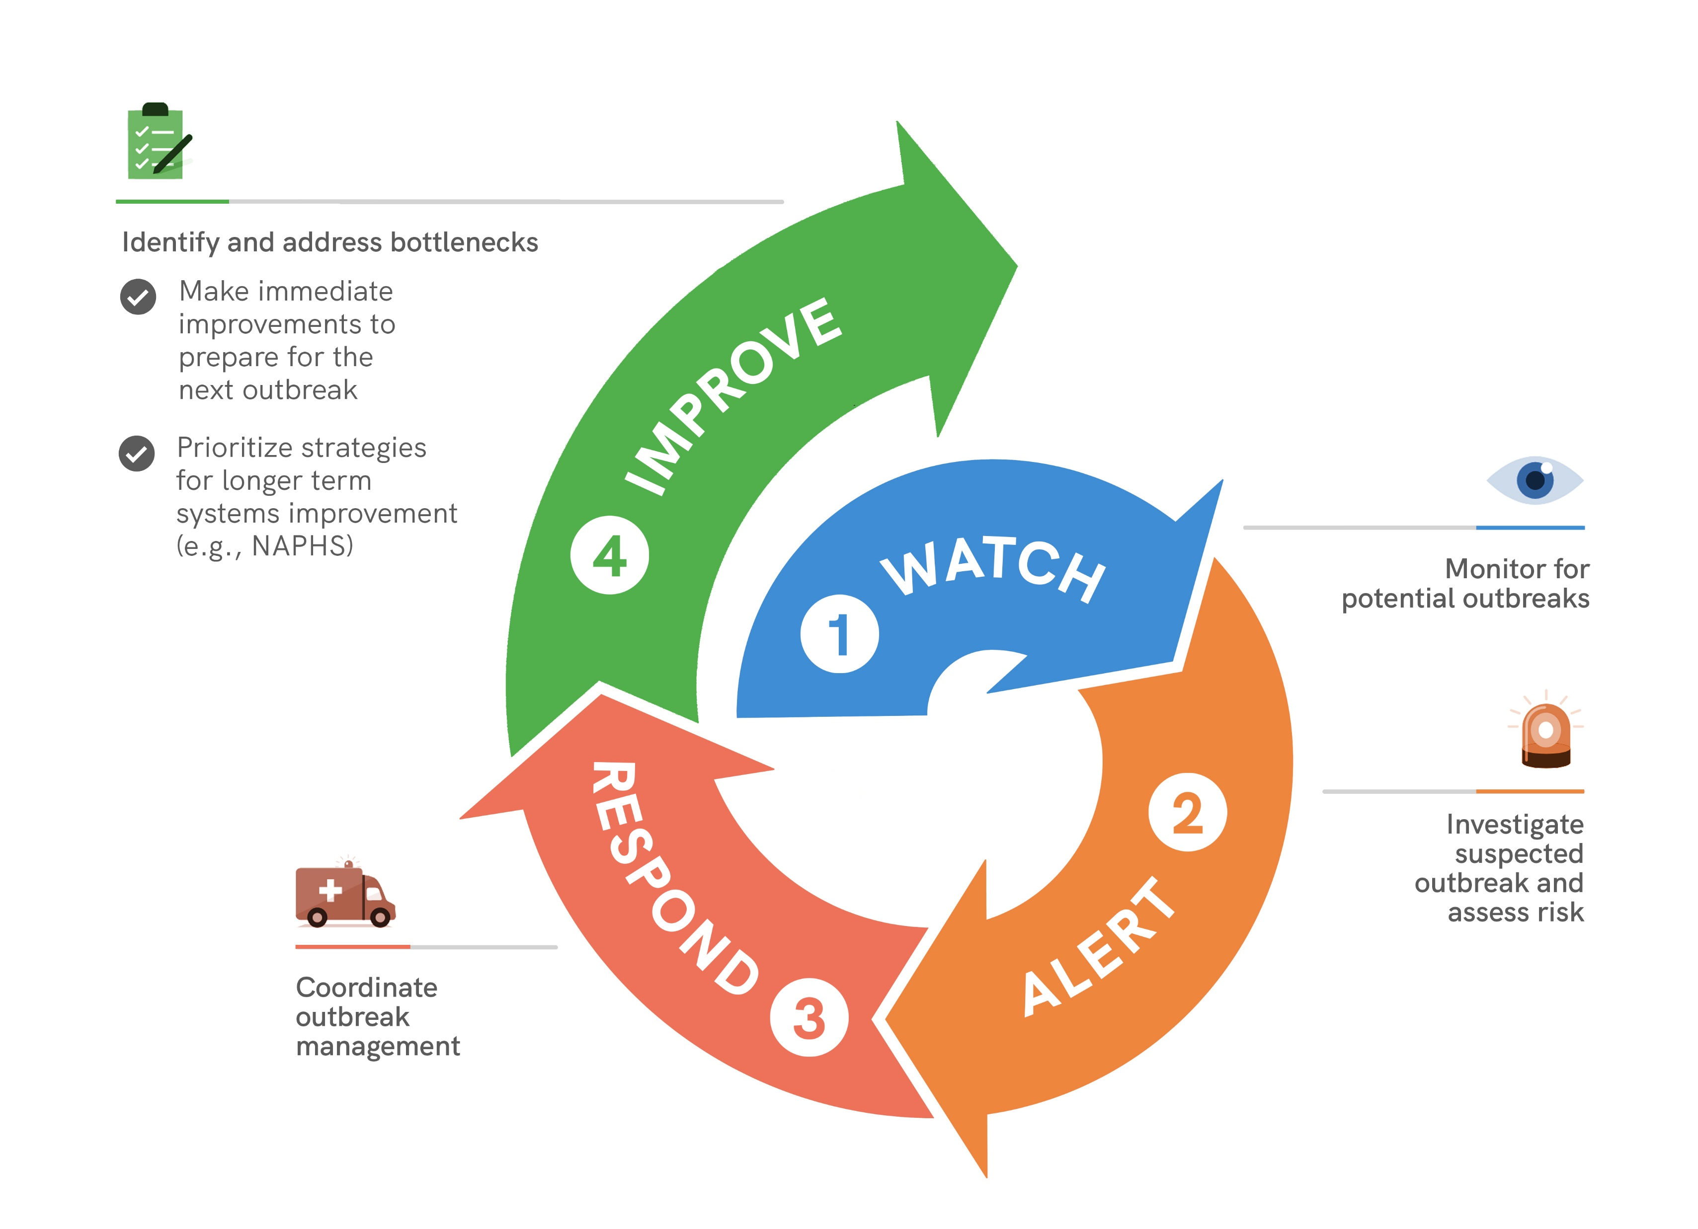
Every public health event is an opportunity to learn and improve
Notes:
The 7-1-7 approach was developed based on the idea that every public health event is an opportunity to review performance, learn and improve.

Slide 28
Performance improvement for a single event
Capture and assess 7-1-7 performance
Use 7-1-7 performance to identify bottlenecks and enablers
Identify and implement actions
Real-time implementation to support an ongoing response immediately after an event is detected
Retrospective review immediately after response concludes or in AAR for larger events.​
Emergence Detection Notification Response End Post-event
Bottlenecks
Enablers
Use to support advocacy objectives (best practices, improvements, etc.)
Hindered timeliness
Facilitated timeliness
Consider for planning and funding opportunities
Immediate actions
Implement as soon as possible
Medium to longer-term actions
Necessary resources already available
Necessary resources not currently available

Slide 29
How can the 7-1-7 approach improve public health action?
Performance improvement
Delays and bottlenecks are easily identified and quantified, and remedial actions are taken to drive rapid improvement
Prioritization for financing and systems strengthening
Data on real-world system performance informs prioritization of available and needed financing (complementing the JEE and SPAR)
Communication and advocacy
When presented with simple metrics, political leaders and donors can clearly visualize resource needs and necessary policy interventions, substantiated by clear data
Accountability and reporting
Reporting against simple metrics can monitor performance, evaluate interventions and improve transparency

Slide 31
Retrospective study in Brazil, Ethiopia, Liberia, Nigeria, and Uganda
41 public health events
22 (54%) met a target of 7 days to detect (median 6 days)
29 (71%) met a target of 1 day to notify (0 days )
20 (49%) met a target of 7 days to complete all early response actions (8 days )
11 (27%) events met the complete 7-1-7 target

Slide 32
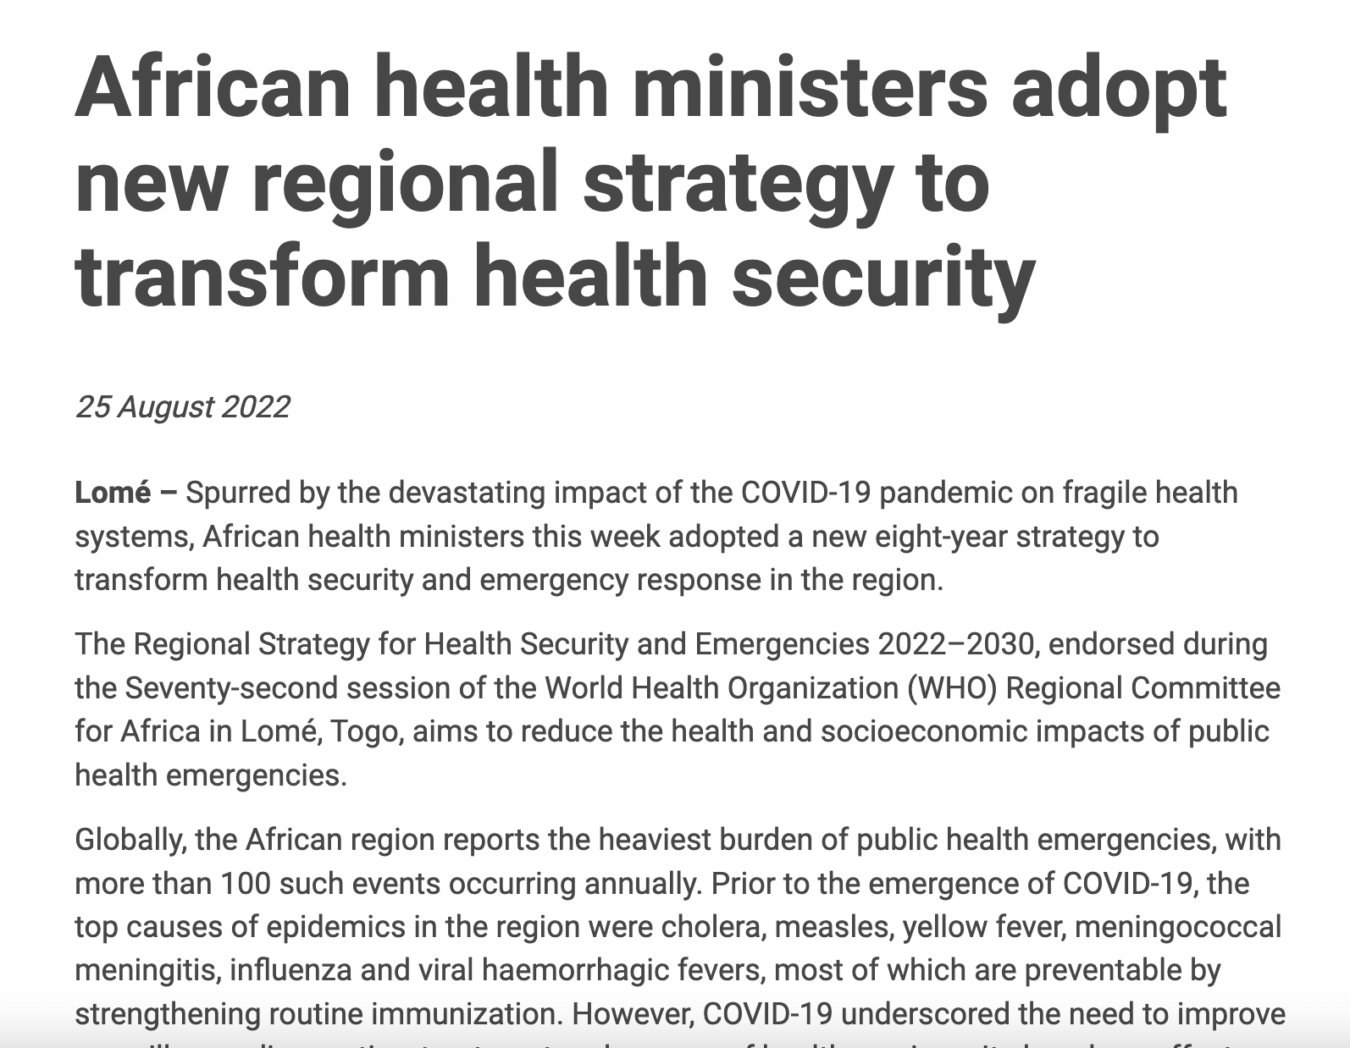
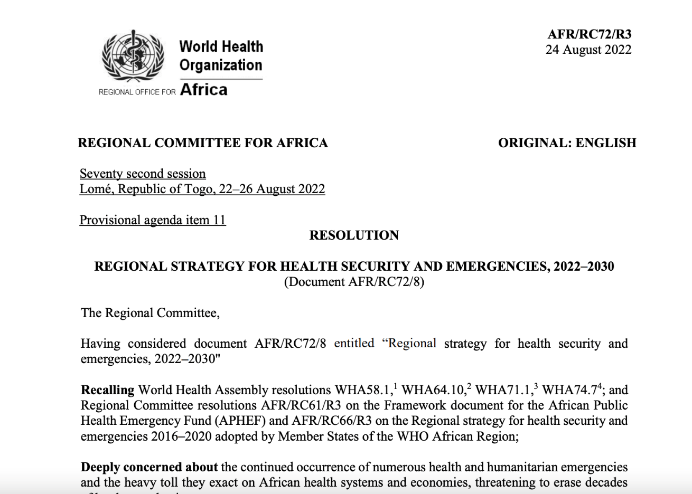
Regional Strategy for Health Security and Emergencies 2022–2030 (August 2022, Lomé)
WHO AFRO Regional Strategy for Health Security and Emergencies 2022-2030 adopts the 7-1-7 target
Notes:
WHO AFRO adopted the 7-1-7 target in their Regional Strategy for Health Security and Emergencies 2022–2030.
It includes using 7-1-7 as an indicator with the objective to have all 47 Member states meeting the 7-1-7 target by 2024.
Available at: https://www.afro.who.int/sites/default/files/2022-07/AFR-RC72-8%20Regional%20strategy%20for%20health%20security%20and%20emergencies%202022-2030%20.pdf

Slide 33
Utilizing 7-1-7: Sudan Virus Disease Outbreak Response Mubende, Uganda
DETECT
Target: 7 days
NOTIFY
Target: 1 day
RESPOND
Target: 7 days
TARGET
TIMELINE
46 DAYS
<1 DAY
9 DAYS
Date of emergence
Date of emergence
5 August 2022
Date of detection
17 September 2022
Date of notification
17 September 2022
Date of detection
Date of notification
Date of early response
Date of early response
26 September 2022
BOTTLENECKS
Lack of knowledge on IDSR suspected case definitions at private facilities
Lack of clear roles on notification
if a suspected case is detected at the regional referral
Isolation unit was partially functional with no sanitation facilities
From COVID, community-based surveillance was fatigued and failed to identify the unusual cluster of deaths
Under-utilization of prepaid SMS
for notification for new staff
Delays in accessing funds for rapid response team to conduct contact tracing
ENABLERS
Syndromic surveillance for acute febrile illness at Mubende Regional Referral who suspected VHF and notified district
Regional referral hospital immediately called district rapid response team and alerted them of the case
Regional referral hospital
mobilized resources for initial investigation of community deaths
IMMEDIATE: Identify a building with better facilities for an isolation unit; Identify partners with funds available for contact tracing
LONG TERM: Increase nationwide IDSR trainings for providers at private facilities
REMEDIAL
ACTIONS
Notes:
An example applying 7-1-7 to a real-world event in Uganda

Slide 34
The 7-1-7 Alliance is a country-led initiative providing technical assistance, financial support and a growing, global community of practice to help all countries achieve the 7-1-7 target for outbreak detection and control.​
The Alliance provides:
Technical support and tools
Catalytic country grants​
Global community of practice and learning​
Operational research

Slide 35
Q&A

Slide 36
This webinar recording and slides will be posted on www.icap.columbia.edu

Slide 37
Next Grand Rounds – Tuesday, August 15, 2023
9 am ET
HIV, Mental Health, and Beyond: How Research Could Protect Youth in a Rapidly Changing World
Presented by
Lucie Cluver, professor, Oxford University and the University of Cape Town
Elona Toska, associate professor, University of Cape Town, research associate, University of Oxford

Slide 38
Thank you

