Slide 1
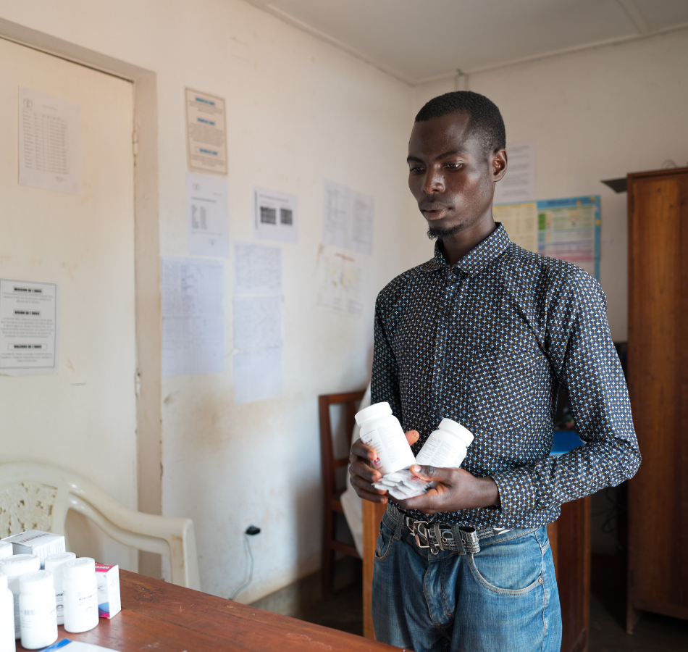
Ending the STI Epidemic through prevention
ICAP GRAND ROUNDS
February 20, 2024

Slide 2

Jessica Justman,
Senior Technical Director,
ICAP at Columbia University

Slide 3
Agenda
Reminders:
Welcome and Introduction –
Presentation
Q & A
For questions to the panelists, use the Q&A box
The webinar recording and slides will be posted on www.icap.columbia.edu

Slide 4


Jason Zucker,
Assistant Professor of Medicine,
Division of Infectious Diseases, Columbia University Medical Center;
Assistant Medical Director,
New York City STD Prevention Training Center
Harriet Nuwagaba-Biribonwoha
Assistant Professor of Epidemiology,
Columbia University’s Mailman School of Public Health;
Research Director, ICAP in Eswatini.

Slide 5
Ending the STI Epidemic Worldwide
Through Prevention
Jason Zucker, MD
Assistant Professor of Medicine at the Columbia University Irving Medical Center
Assistant Medical Director, NYC STD Prevention Training Center
JZ2700@cumc.columbia.edu

Slide 6
Disclosures
I have no commercial relationships to disclose.
I receive NIH funding for HIV prevention and STI-related research
I receive CDC funding for research related to Mpox
I am a medical consultant to the CDC for an upcoming version of the STI guidelines

Slide 7
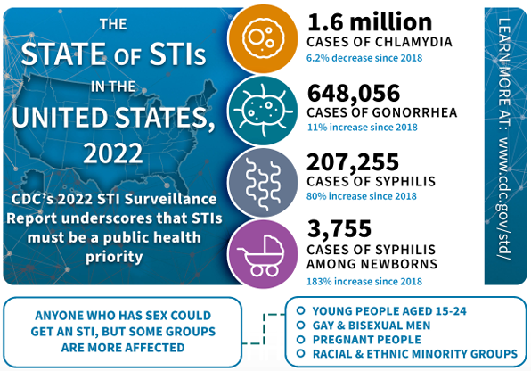
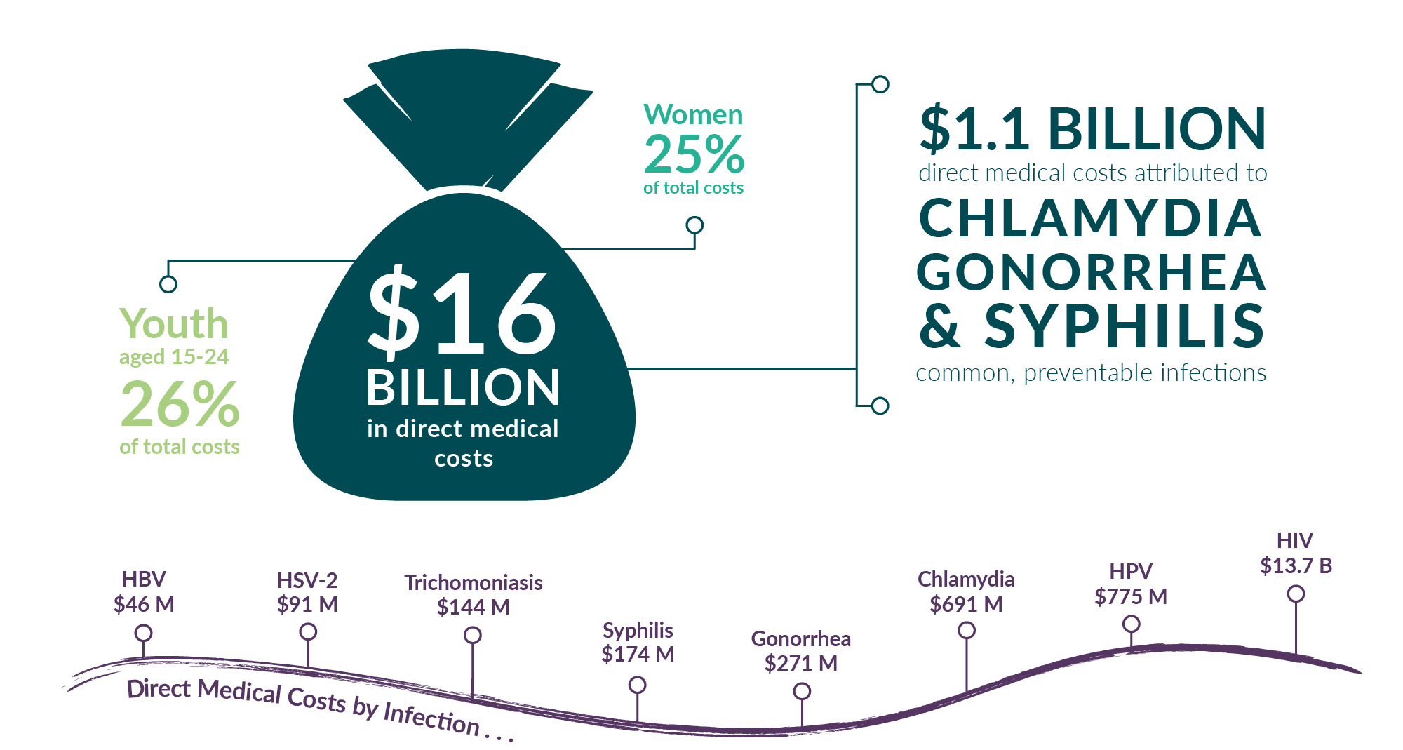
An Epidemic of Sexually Transmitted Infections
https://www.cdc.gov/std/statistics/infographic.htm

Slide 8
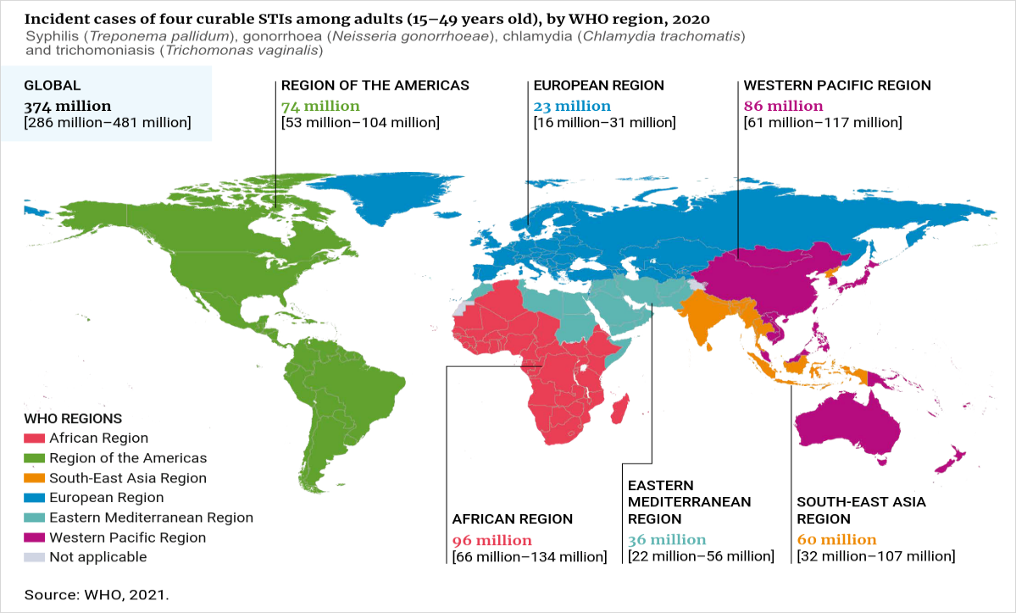
STIs Are Worldwide Epidemic
1 million STIs are acquired every day
Annual new infections:
Chlamydia 129 million
Gonorrhea 82 million
Syphilis 7.1 million
https://www.who.int/teams/global-hiv-hepatitis-and-stis-programmes/stis/strategic-information
https://www.who.int/news-room/fact-sheets/detail/sexually-transmitted-infections-(stis)

Slide 9
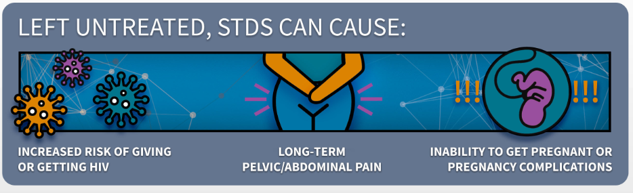
We Need to Prevent STIs
STIs Are Not Benign
Increased risk of HIV
Pelvic inflammatory disease
Chronic pelvic pain
Infertility
Adverse pregnancy outcomes
  Prematurity
  Stillbirth
Urethral strictures
Gastrointestinal fistulas
Peri-rectal abscesses
Severe complications of syphilis

Slide 10
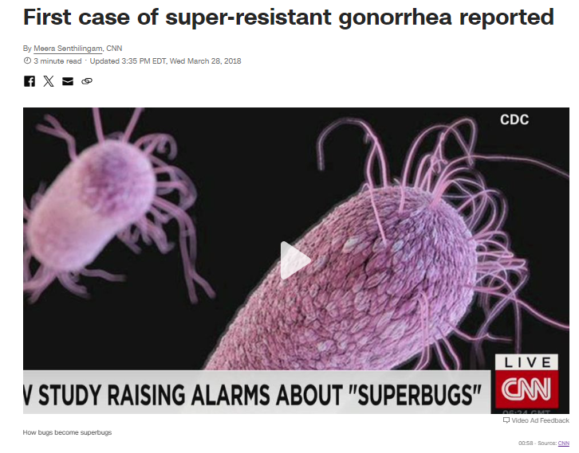
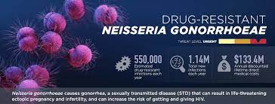
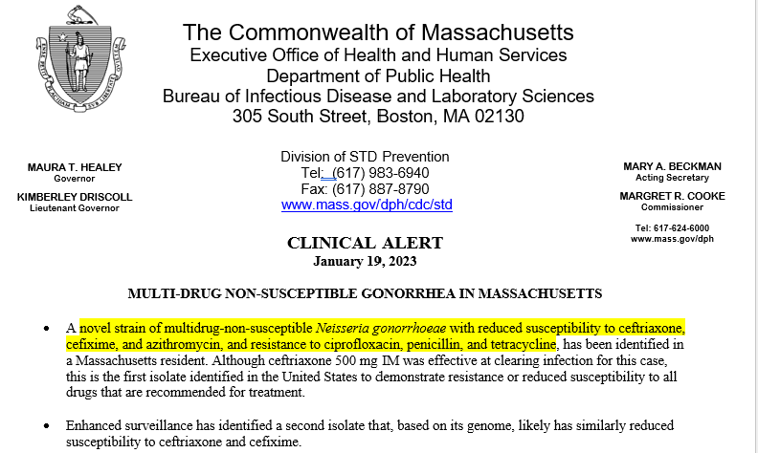
We Need to Prevent STIs
Rising Gonorrhea Resistance

Slide 11
STI Prevention Landscape
Primary Prevention
Condoms
Risk Reduction Counseling
Vaccination
Medication Prophylaxis
Primary Prevention
Primary Prevention
Secondary Prevention
Routine Screening
Syndromic
testing/treatment
Presumptive treatment
Partner services/EPT

Slide 12

Meet Igor
29-year-old male
Takes HIV PrEP for HIV prevention
Sexually active with men
  Four condomless partners since his last visit
  Is a walks in to clinic between quarterly visits with 2 days of green penile discharge
Routine testing for HIV, syphilis, and three-site gonorrhea/chlamydia testing performed
Treated empirically with Ceftriaxone and Doxycycline

Slide 13
Igor’s Prevention Plan
Condoms
Risk Reduction Counseling
Vaccination
Medication Prophylaxis
Primary Prevention
Secondary Prevention
Routine Screening
Syndromic
testing/treatment
Presumptive treatment
Partner services/EPT

Slide 14
Igor's Prevention Plan
Primary Prevention
Risk reduction counseling
Vaccination
Hepatitis A/B
Meningococcal ACYW
Secondary Prevention
Routine screening (Q3 months)
HPV
Medication
HIV PrEP
Syndromic testing and treatment
Presumptive treatment
Mpox

Slide 15

Igor’s Results
Lab results:
Urine GC/CT – GC positive
Pharyngeal GC/CT – GC positive
Rectal GC/CT – GC positive
RPR – Negative
HIV Ab/Ag – non-reactive

Slide 16
Igor
Returned 6 weeks later saying that, “I got totally better but now it hurts again when I pee”
  Seven condomless partners since his last visit
  Confident that his regular partners were treated for gonorrhea and syphilis
  Repeat routine testing for HIV, syphilis, and three-site gonorrhea/chlamydia testing was performed
  Treated empirically with Ceftriaxone and Doxycycline
  “This is frustrating, is there anything I can do so I stop getting STIs?”

Slide 17
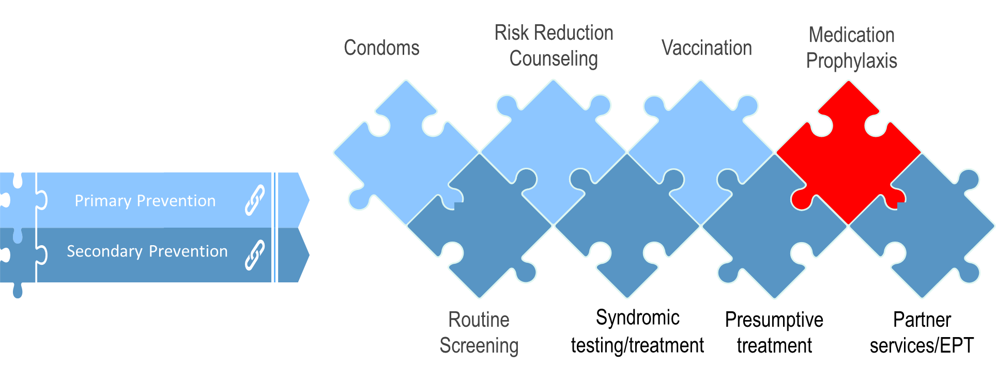
Medication Prophylaxis
Medication Prophylaxis
HIV post-exposure prophylaxis (PEP)
HIV pre-exposure prophylaxis (PrEP)
Doxy-PEP

Slide 18
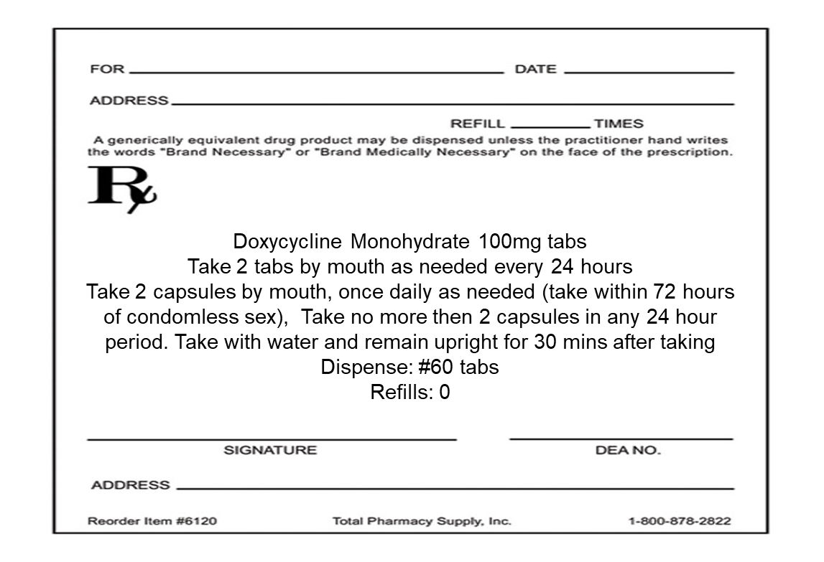
What is Doxy-PEP?
Doxycycline 200mg by mouth up to 72 hours after a condomless sexual encounter at any anatomic site

Slide 19
Doxy-PEP Considerations
Benefits
Risks
Implementation

Slide 20
Doxy-PEP Considerations
Benefits
Risks
Implementation
Does Doxy-PEP Prevent STIs?

Slide 21
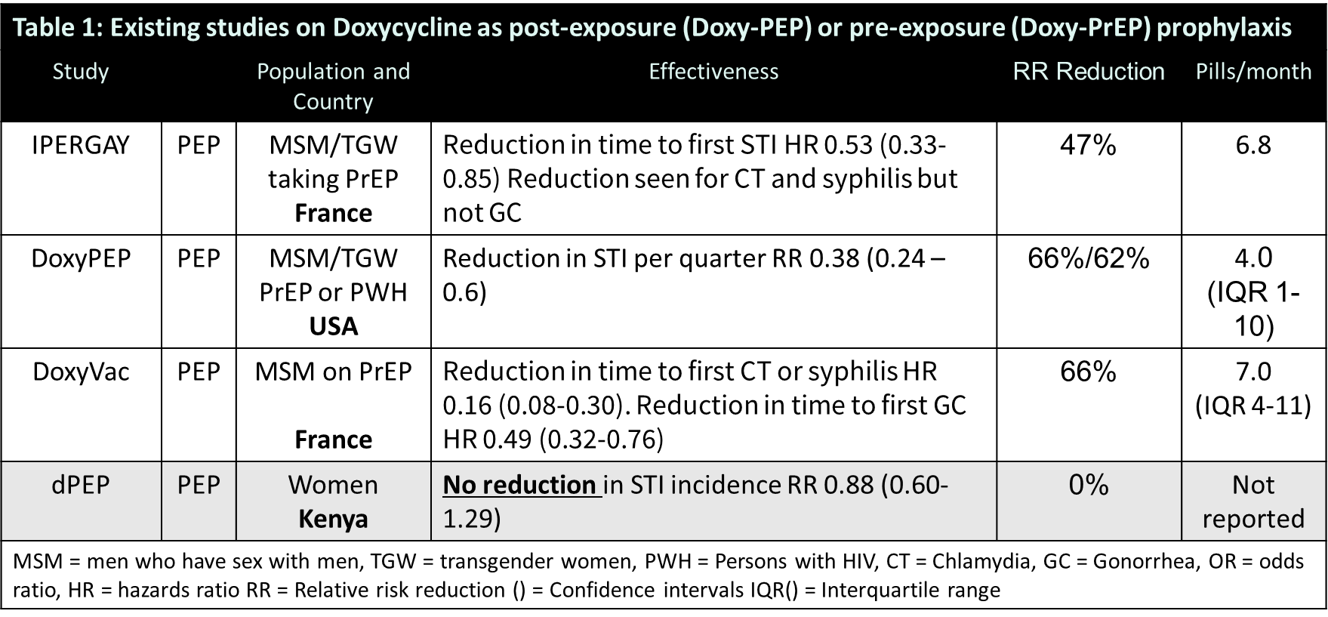
What We Know About the Benefits of Doxy-PEP

Slide 22
What We Know About the Benefits of Doxy-PEP
Doxycycline post-exposure prophylaxis (PEP) is safe and well tolerated
Doxy-PEP prevents STIs in MSM and transgender women
Doxy-PEP did not prevent STIs in cis-women in the dPEP study

Slide 23
Doxy-PEP Considerations
Benefits
Risks
Implementation
How will Doxy-PEP impact sexual behavior?
How will Doxy-PEP change the presentation or diagnosis of STIs
How will Doxy-PEP impact antimicrobial resistance
How will Doxy-PEP change overall antibiotic and doxycycline usage

Slide 24
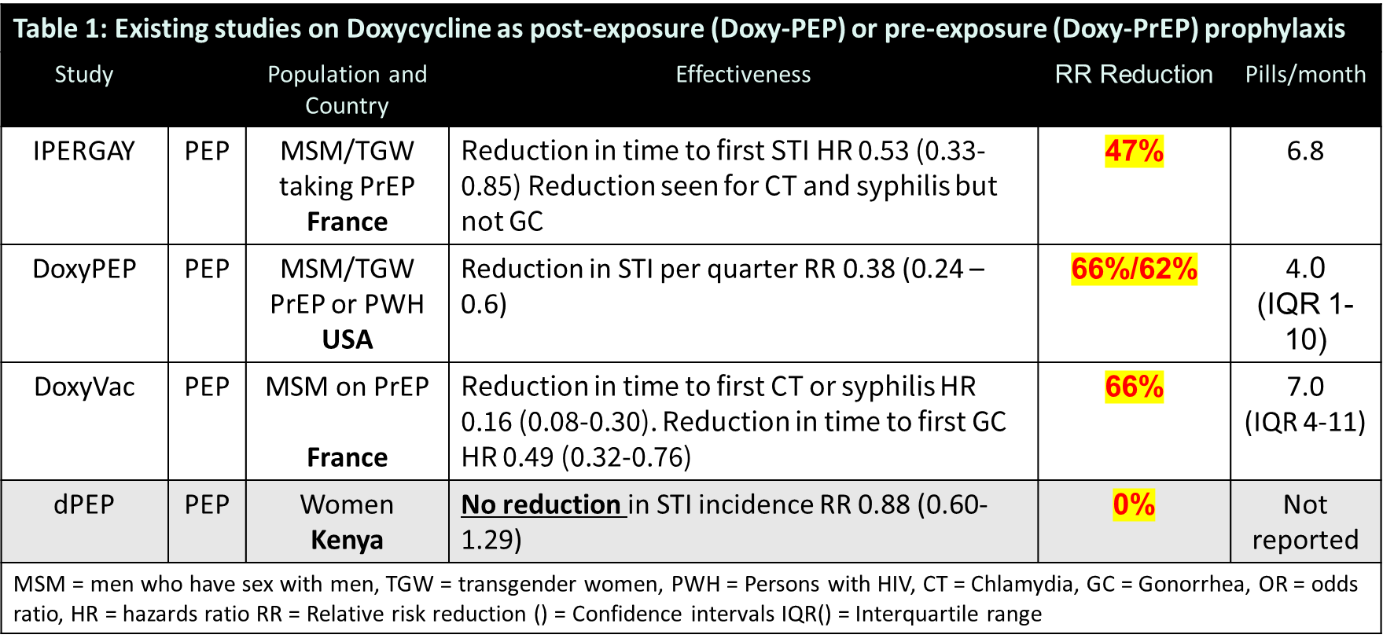
Doxy-PEP and Behavior Change
How will Doxy-PEP impact sexual behavior?
DoxyPEP and DoxyVAC
  No impact on sexual behavior
  Changes in sexual behavior could impact Doxy-PEPs effectiveness

Slide 25
Doxy-PEP and STI Presentations
Antibiotic prophylaxis may change the presentation or diagnosis of STIs
No data so far
Notable concern about the impact on syphilis serological testing
  Partial treatment
  Delayed diagnosis
  False negatives

Slide 26
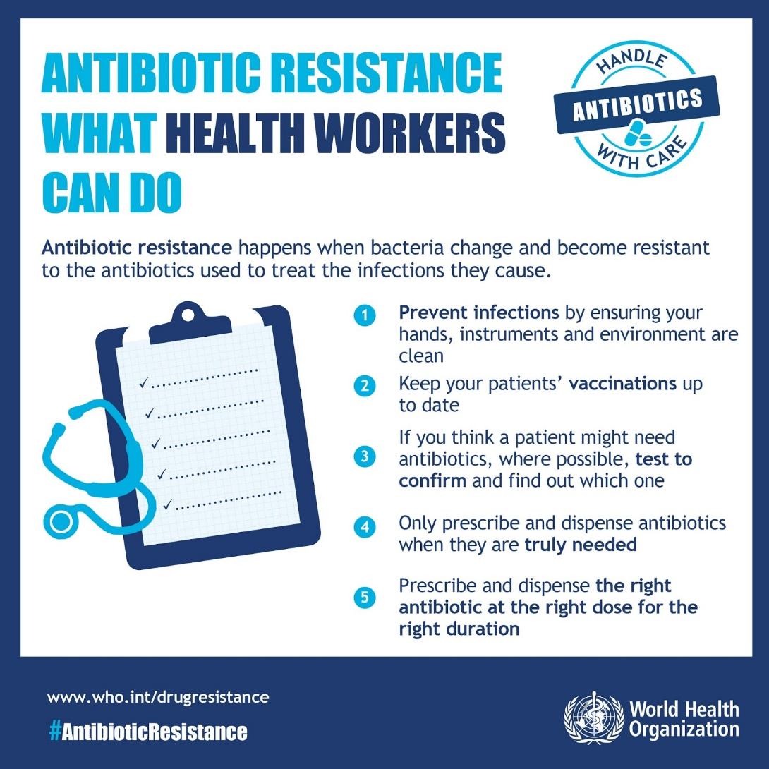
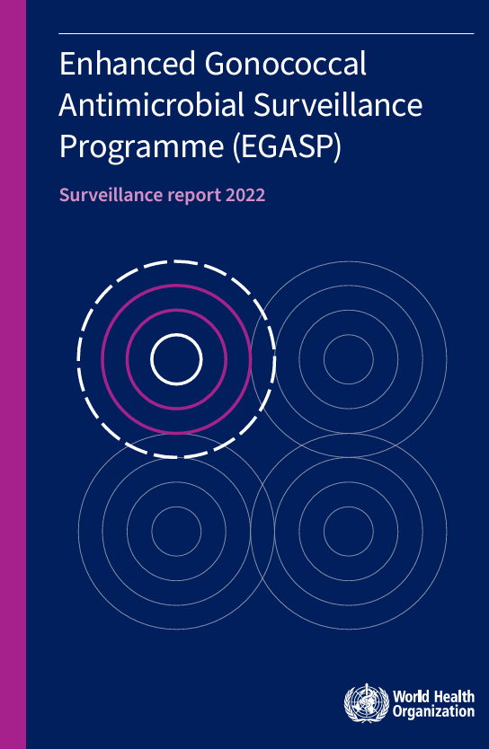
How will Doxy-PEP Impact Antimicrobial Resistance?

Slide 27
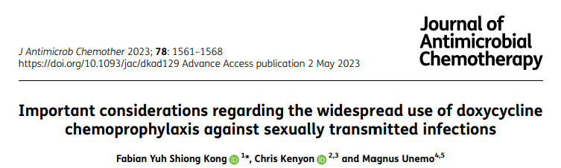
How will Doxy-PEP Impact Antimicrobial Resistance?
Antimicrobial Resistance in STIs
  Treponema pallidum
  Chlamydia trachomatis
  Mycoplasma Genitalium
  Neisseria Gonorrhea
Antimicrobial Resistance in other bacterial species
  Commensal bacteria
Kong FYS, Kenyon C, Unemo M. Important considerations regarding the widespread use of doxycycline chemoprophylaxis against sexually transmitted infections. J Antimicrob Chemother. 2023;78(7):1561-1568. doi:10.1093/jac/dkad129

Slide 28
Antimicrobial Resistance – Chlamydia and Syphilis
Chlamydia
Syphilis
No clinical resistance to tetracyclines in Chlamydia trachomatis
Tetracycline resistance has been seen in C.suis (pigs)
  tetC (efflux pump)
No clinical resistance to tetracyclines in Treponema pallidum
Widespread macrolide resistance was seen with a single-point mutation
Benamri I, Azzouzi M, Sanak K, Moussa A, Radouani F. An overview of genes and mutations associated with Chlamydiae species' resistance to antibiotics. Ann Clin Microbiol Antimicrob. 2021;20(1):59. Published 2021 Sep 3. doi:10.1186/s12941-021-00465-4
Beale MA, Marks M, Sahi SK, et al. Genomic epidemiology of syphilis reveals independent emergence of macrolide resistance across multiple circulating lineages. Nat Commun. 2019;10(1):3255. Published 2019 Jul 22. doi:10.1038/s41467-019-11216-7

Slide 29
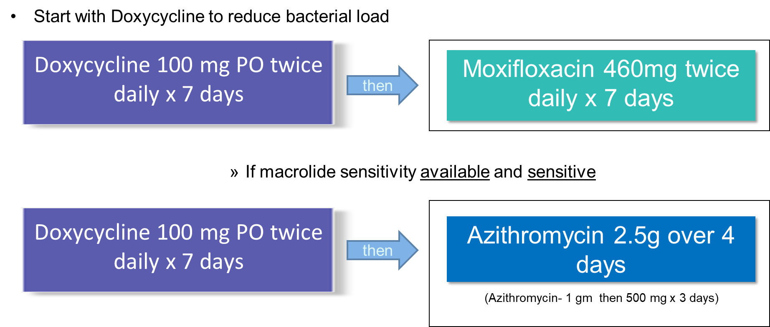
Antimicrobial Resistance – M. Genitalium
Mycoplasma genitalium
  Previously an “emerging” STI
  Persistent urethritis in men and women
  Test using first-void urine or urethral swab, send for NAAT
  Treatment based on testing availability
Intrinsically resistant to:
  Cell wall and folic acid inhibitors
High resistance rates to:
  Protein synthesis inhibitors
    Macrolides 77%
    Tetracyclines, 60%
  Nucleic acid synthesis inhibitors
    quinolones, 90%

Slide 30
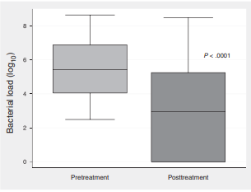
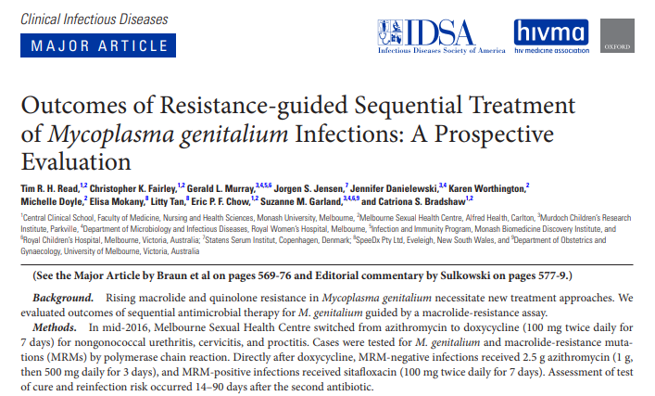
Antimicrobial Resistance – M. Genitalium
Read TRH, Fairley CK, Murray GL, et al. Outcomes of Resistance-guided Sequential Treatment of Mycoplasma genitalium Infections: A Prospective Evaluation. Clin Infect Dis. 2019;68(4):554-560. doi:10.1093/cid/ciy477

Slide 31
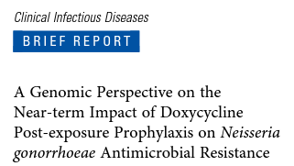
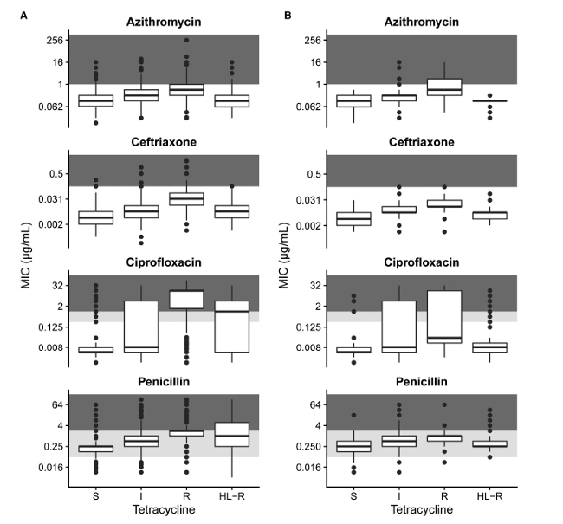
Antimicrobial Resistance - Gonorrhea
Risk of resistance to tetracyclines (doxycycline) in gonorrhea
Risk of cross resistance to other antimicrobials including beta-lactams like Ceftriaxone
Mortimer TD, Grad YH. A genomic perspective on the near-term impact of doxycycline post-exposure prophylaxis on Neisseria gonorrhoeae antimicrobial resistance [published online ahead of print, 2023 May 4]. Clin Infect Dis. 2023;ciad279. doi:10.1093/cid/ciad279

Slide 32
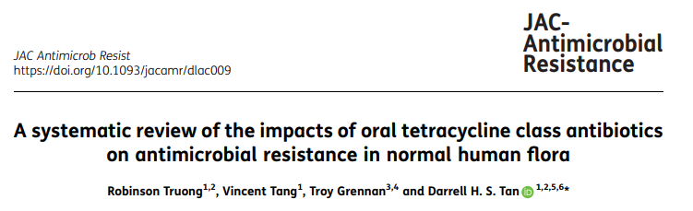
Antimicrobial Resistance – Commensal Bacteria
Limited data from small prospective studies may suggest that oral tetracyclines for 2–18 weeks increase resistance in subgingival, gastrointestinal and upper respiratory tract flora.
Truong R, Tang V, Grennan T, Tan DHS. A systematic review of the impacts of oral tetracycline class antibiotics on antimicrobial resistance in normal human flora. JAC Antimicrob Resist. 2022;4(1):dlac009. Published 2022 Feb 15. doi:10.1093/jacamr/dlac009

Slide 33
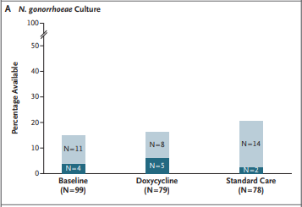
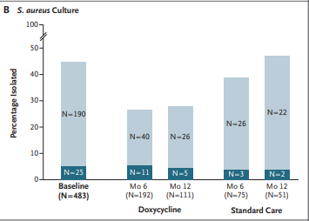
Antimicrobial Resistance – DoxyPEP Study
Luetkemeyer AF, Donnell D, Dombrowski JC, et al. Postexposure Doxycycline to Prevent Bacterial Sexually Transmitted Infections. N Engl J Med. 2023;388(14):1296-1306. doi:10.1056/NEJMoa2211934

Slide 34
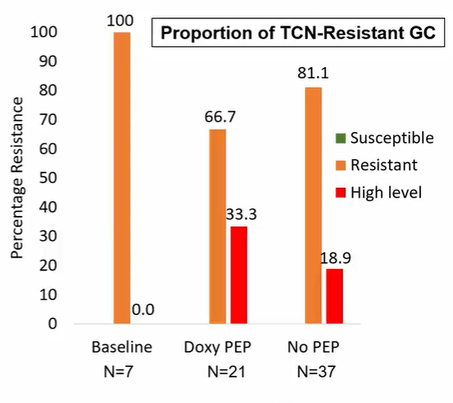
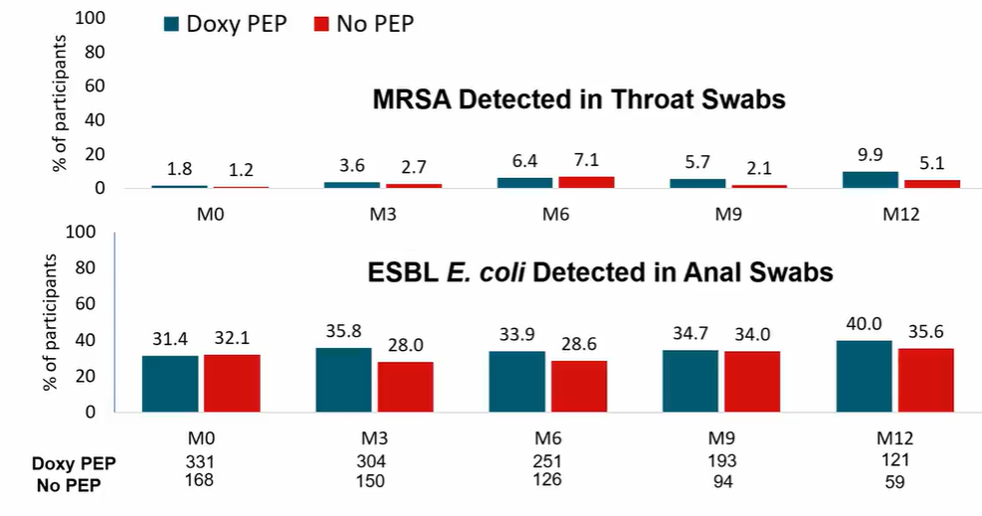
Antimicrobial Resistance – DoxyVac Study
Molina et al DOXYVAC CROI 2023 Abstract 119
Liu AY, Buchbinder SP. CROI 2023: Epidemiologic Trends and Prevention for HIV and Other Sexually Transmitted Infections. Top Antivir Med. 2023;31(3):468-492.

Slide 35
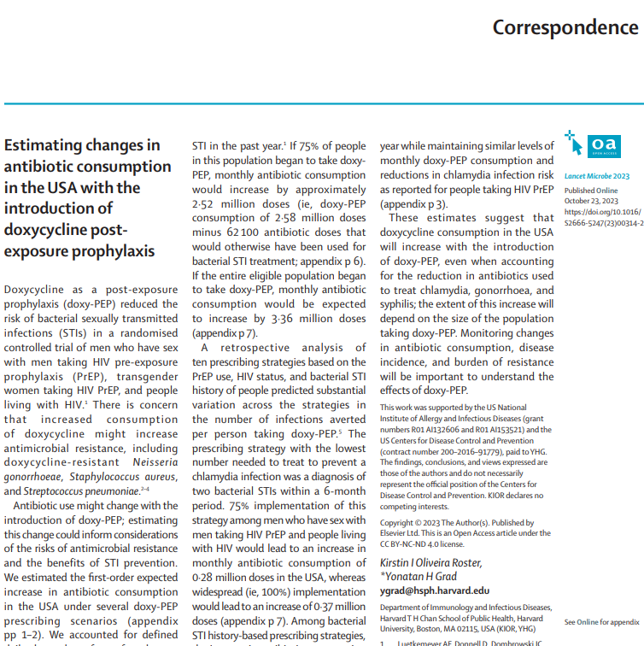
Doxy-PEP Will Increase Doxycycline Usage
“Fully balancing doxy-PEP consumption …would require restricting prescriptions to a group with an incidence of 7·8 infections per person year…
Doxycycline consumption in the USA will increase with the introduction of doxy-PEP, even when accounting for the reduction in antibiotics used
Monitoring changes in antibiotic consumption, disease incidence, and burden of resistance will be important to understand the effects of doxy-PEP
https://www.thelancet.com/journals/lanmic/article/PIIS2666-5247(23)00314-2/fulltext#articleInformation

Slide 36
Doxy-PEP Considerations
Benefits
Risks
Implementation
Who should be given DoxyPEP?
What is the proper interval for STI testing for individuals on Doxy-PEP?
How does this impact STI treatment?

Slide 37
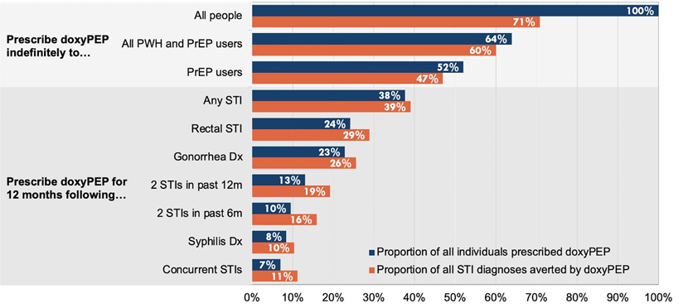
Who should be given DoxyPEP?
The most efficient prescribing strategies were based on STI history rather than HIV status or PrEP use.
Traeger MW, Mayer KH, Krakower DS, Gitin S, Jenness SM, Marcus JL. Potential impact of doxycycline post-exposure prophylaxis prescribing strategies on incidence of bacterial sexually transmitted infections [published online ahead of print, 2023 Aug 18]. Clin Infect Dis. 2023;ciad488. doi:10.1093/cid/ciad488

Slide 38
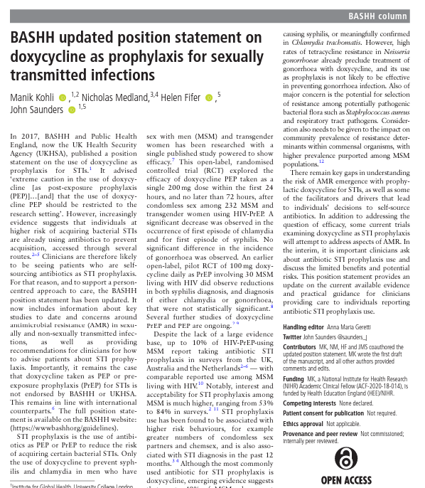
BASHH (British) Recommendations
“Importantly, it remains the case that doxycycline taken as PEP or pre- exposure prophylaxis (PrEP) for STIs is not endorsed by BASHH or UKHSA”
Kohli M, Medland N, Fifer H, Saunders J. BASHH updated position statement on doxycycline as prophylaxis for sexually transmitted infections. Sex Transm Infect. 2022;98(3):235-236. doi:10.1136/sextrans-2022-055425

Slide 39
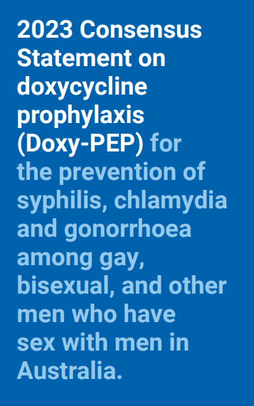
Australian Recommendations
“Doxy-PEP should be considered primarily for the prevention of syphilis in GBMSM who are at risk of this STI, although for some individuals the reduction in chlamydia, and the lesser reduction of gonorrhoea might be important.”
  Some stakeholders held the view that Doxy-PEP should be considered only for the prevention of syphilis in GBMSM….
Doxy-PEP users should be assisted to maximise the benefits of Doxy-PEP while minimising overall antibiotic use.
  For example, if a Doxy-PEP user tends to have multiple sexual partners during weekends but few during the week, then a single Monday morning dose of 200mg Doxy-PEP should adequately cover their STI risk, rather than multiple doses over the weekend
https://ashm.org.au/about/news/doxy-pep-statement/#:~:text=infections%20(STI).-,Among%20gay%2C%20bisexual%2C%20and%20other%20men%20who%20have%20sex%20with,to%20varying%20levels%20of%20tetracycline

Slide 40
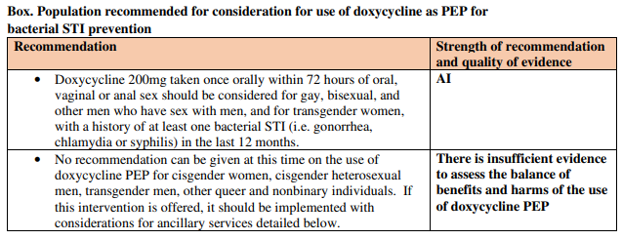
CDC Preliminary Guidance
Should be considered

Slide 41
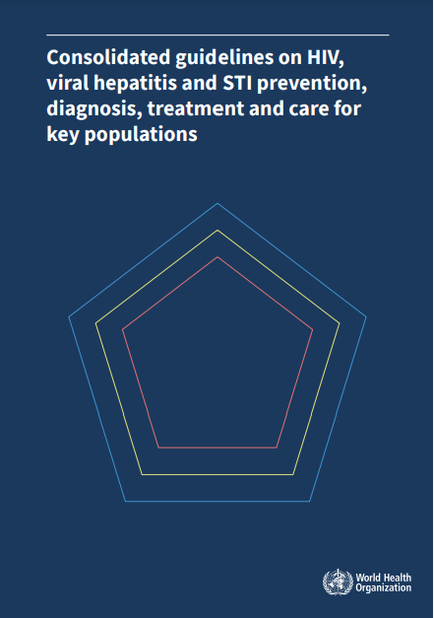
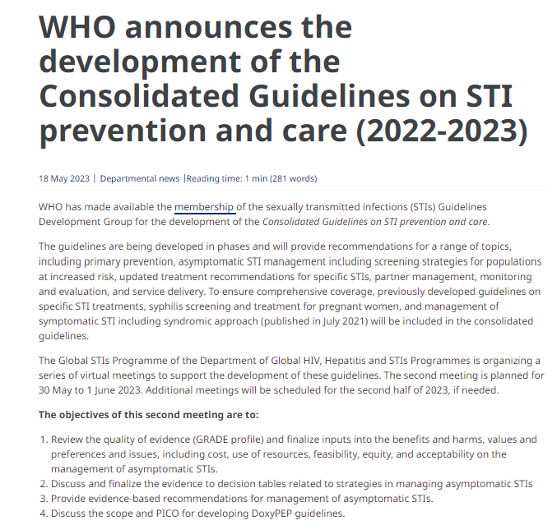
WHO Guidelines Pending
https://www.who.int/publications/i/item/9789240052390
https://www.who.int/news/item/18-05-2023-who-announces-the-development-of-the-consolidated-guidelines-on-sti-prevention-and-care-2022-2023

Slide 42
What is the Proper Interval for STI testing?
Not 100%
  Only ~2/3 effective
Gonorrhea effectiveness expected to decrease
Need to continue routine screening based on local guidance and availability
Workowski KA, Bachmann LH, Chan PA, et al. Sexually Transmitted Infections Treatment Guidelines, 2021. MMWR Recomm Rep. 2021;70(4):1-187. Published 2021 Jul 23. doi:10.15585/mmwr.rr7004a1

Slide 43
What is the Proper Interval for STI testing?
Population | Recommendations
Men who have sex with men | At least annually, test at each site of exposure (urethra, rectum) for sexually active MSM regardless of condom use or every 3-6 months if at increased risk.
Patients taking PrEP | All patients starting and taking oral PrEP should have genitourinary and extra-genital testing performed at baseline and every 3 months.
Persons living with HIV | For sexually active individuals, screen at first HIV evaluation and at least annually thereafter. More frequent screening might be appropriate depending on individual risk behaviors and local epidemiology
Non-pregnant Women | Test at least annually for sexually active women under 25 years of age and those aged 25 years and older if at increased risk Rectal chlamydial testing can be considered in females based on sexual behaviors and exposure through shared clinical decision making.
Men who have sex with women*** | Consider screening young men in high prevalence clinical settings (adolescent and STI clinics and correctional facilities)
Pregnant Women | All pregnant women under 25 years of age and those aged 25 years and older if at increased risk. retest during 3rd trimester if under 25 years of age or at risk.
Need to continue routine screening based on local guidance and availability
Workowski KA, Bachmann LH, Chan PA, et al. Sexually Transmitted Infections Treatment Guidelines, 2021. MMWR Recomm Rep. 2021;70(4):1-187. Published 2021 Jul 23. doi:10.15585/mmwr.rr7004a1

Slide 44
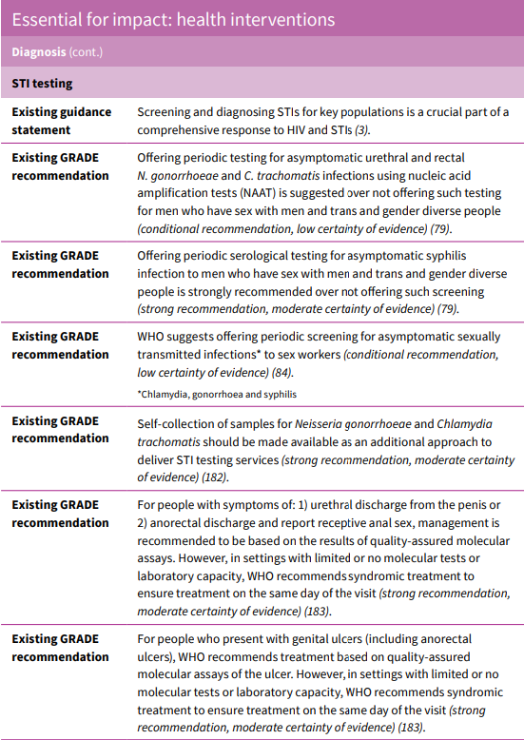
What is the Proper Interval for STI testing?
Need to continue routine screening based on local guidance and availability
https://www.who.int/publications/i/item/9789240052390

Slide 45


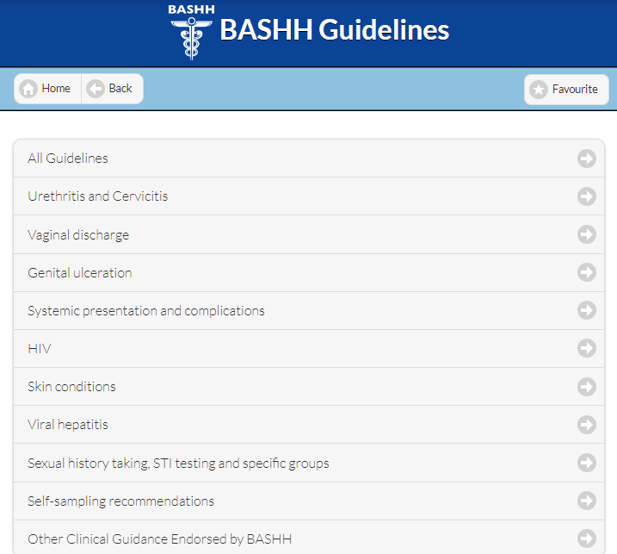
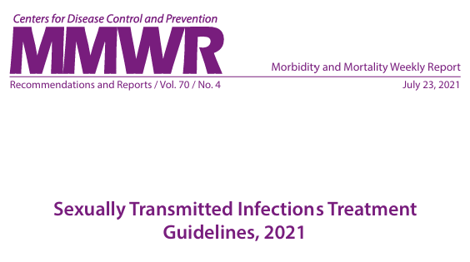
How Does Doxy-PEP Impact STI treatment?
Continue to follow local treatment guidance
Exception
    Consider in-person and exam and deferring empiric treatment for “exposure”

Slide 46
Igor’s Results
Lab results:
Urine GC/CT – GC positive
Pharyngeal GC/CT – GC positive
Rectal GC/CT – negative
RPR – 1:4
HIV Ab/Ag - Negative

Slide 47
Igor’s Gonorrhea Culture
Lab results:
Ciprofloxacin – resistant (MIC 1)
Ceftriaxone – susceptible (MIC 0.016)
Cefixime – Susceptible (48mm)
Tetracycline – resistant (MIC 12)
Azithromycin – susceptible (MIC 0.125)
Is there anything else you can offer me?

Slide 48
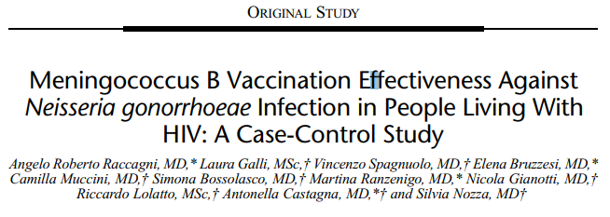

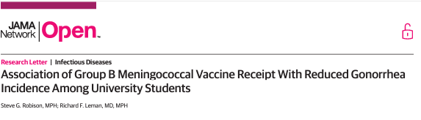
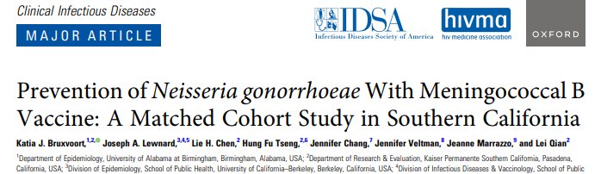
Does 4CMenB Vaccine Prevent Gonorrhea?
Pop: MSM living with HIV
Efficacy: 44% (9-65%)
Location: Italy
Pop: Age 16 - 23
Efficacy: 40% (23-53%)
Location: USA (East Coast)
Pop: College students
Efficacy: 47% (13%-68%)
Location: Australia
Pop: Teens and Young Adults
Efficacy: 46% (24-66%)
Location: USA (West Coast)
Raccagni AR, Galli L, Spagnuolo V, et al. Meningococcus B Vaccination Effectiveness Against Neisseria gonorrhoeae Infection in People Living With HIV: A Case-Control Study. Sex Transm Dis. 2023;50(5):247-251. doi:10.1097/OLQ.0000000000001771
Abara WE, Bernstein KT, Lewis FMT, et al. Effectiveness of a serogroup B outer membrane vesicle meningococcal vaccine against gonorrhoea: a retrospective observational study. Lancet Infect Dis. 2022;22(7):1021-1029. doi:10.1016/S1473-3099(21)00812-4
Bruxvoort KJ, Lewnard JA, Chen LH, et al. Prevention of Neisseria gonorrhoeae With Meningococcal B Vaccine: A Matched Cohort Study in Southern California [published correction appears in Clin Infect Dis. 2023 Jan 11;:]. Clin Infect Dis. 2023;76(3):e1341-e1349. doi:10.1093/cid/ciac436

Slide 49
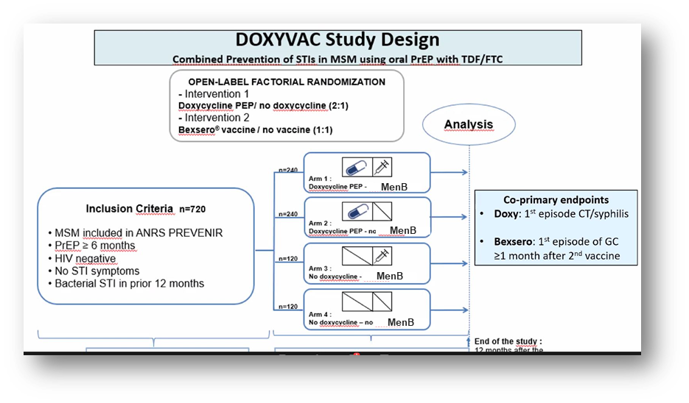
DoxyVac Study
CROI 2023
Interim analysis
  Incidence of first episode of gonorrhea: 9.8 vs 19.7 per 100 person years in the 4CmenB vaccine vs no vaccine arms
  (aHR, 0.49; 95% CI, 0.27-0.88)
DSMB recommended to stop the study and that all the participants be offered doxycycline and/or the meningococcal B vaccine
Molina et al DOXYVAC CROI 2023 Abstract 119
Liu AY, Buchbinder SP. CROI 2023: Epidemiologic Trends and Prevention for HIV and Other Sexually Transmitted Infections. Top Antivir Med. 2023;31(3):468-492.

Slide 50
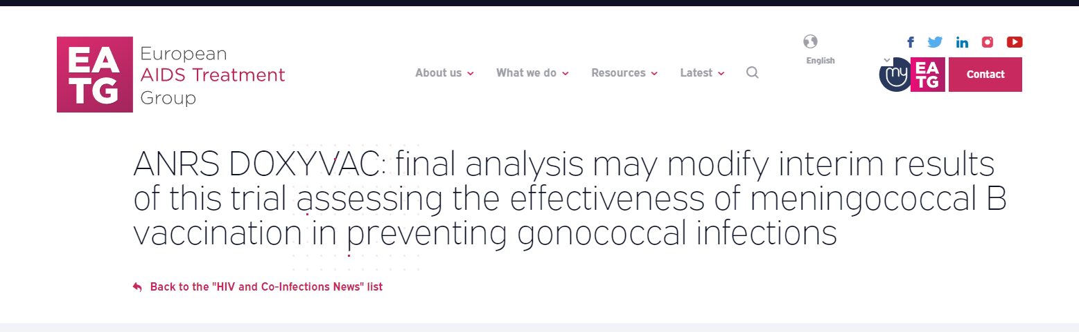
Does MenB Vaccination Prevent Gonorrhea?
Discrepancy between interim and final analysis on the effectiveness of the meningococcal B vaccine on gonococcal infections
Re-analysis is ongoing
CROI 2023 ABSTRACT 119

Slide 51
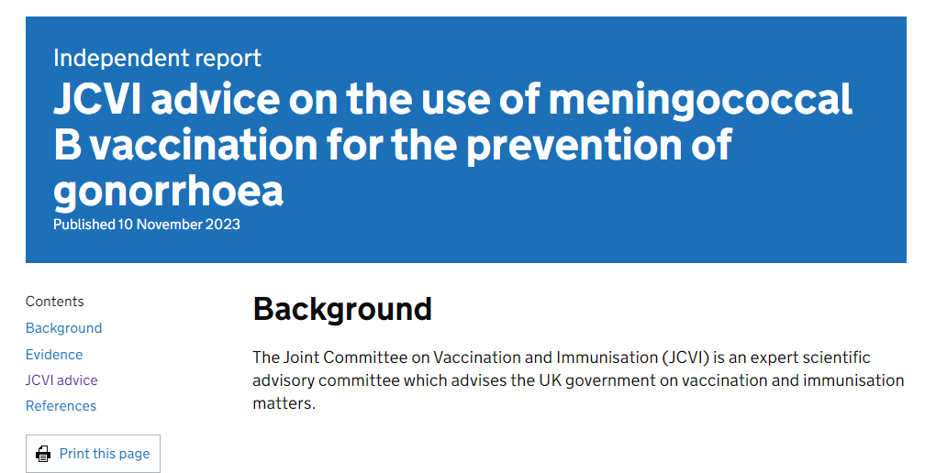
Does MenB Vaccination Prevent Gonorrhea?
“The committee agreed that a targeted programme should be initiated using the 4CMenB vaccine for the prevention of gonorrhoea in those who are at greatest risk of infection.”
https://www.gov.uk/government/publications/meningococcal-b-vaccination-for-the-prevention-of-gonorrhoea-jcvi-advice-10-november/jcvi-advice-on-the-use-of-meningococcal-b-vaccination-for-the-prevention-of-gonorrhoea#jcvi-advice

Slide 52
STI Prevention Summary
We are in an era of STI prevention choice and patients should be aware of their options
Doxy-PEP
  Doxy-PEP works to prevent STIs in men who have sex with men and transgender women living with and without HIV
  Doxy-PEP did not work to prevent STIs in persons assigned female at birth in the Kenyan study
  There remain unknowns about the overall impact, risks, and unintended consequences of Doxy-PEP that potential users should be aware of (Shared Decision Making)
4CMenB vaccine MAY reduce an individual's risk of gonorrhea
  4CMenB vaccination prevents against gonorrhea in observational studies, but randomized clinical trial data is not confirmatory
Flexibility is key, management will change as we learn more
Research is needed to help us better understand the risks and benefits of different STI prevention modalities

Slide 53
Thank you!
Primary Prevention
Condoms
Risk Reduction Counseling
Vaccination
Medication Prophylaxis
Primary Prevention
Primary Prevention
Secondary Prevention
Routine Screening
Syndromic
testing/treatment
Presumptive treatment
Partner services/EPT

Slide 54

Feasibility and acceptability of point of care testing for sexually transmitted infections in outpatient clinics offering integrated services in Eswatini
Harriet Nuwagaba-Biribonwoha, Samkelo Simelane, Trevor Sithole, Sindisiwe Dlamini, Mpumelelo Mavimbela, Nkululeko Dube, Siboniso Mamba, Mabutho Mamba, Ritha Ncube-Sihlongonyane, Tesfay Abreha, Ruben Sahabo, Wafaa El Sadr, Elaine Abrams, Jessica Justman, on behalf of the STI POC Study Team
ICAP Grand Rounds: Ending the STI Epidemic Through Prevention
20 February 2024
Notes:
Thank you for the opportunity to participate in this ground rounds session, and to present this work on behalf of my co-authors.

Slide 55


Context: Kingdom of Eswatini
Population | 1.1 million
Adult HIV prevalence | 24%
Highest HIV prevalence  Women 40-44 years  Men 45-49 years | 57% 50%
Annual HIV incidence  Women 15-49 years  Men 15-49 years | 1.45% 0.20%
UNAIDS 95-95-95 indicators | 94-97-96
STI Prevalence  PLHIV 15-24 years (2018)  Sexually active women 15-49 years (2015) | 15% 19%
327 primary health care facilities offering integrated outpatient services
  HIV testing care and treatment
  Reproductive health services
  Diagnostic and treatment services
STIs managed syndromically: by reported symptoms
  No laboratory diagnosis of STIs conducted routinely
Notes:
To start with a bit of context: Eswatini located in southern Africa (here), with 4 administrative regions and with 1.1 million people. It is a nation with one the severest HIV epidemics globally. In some age groups, 1 in 2 adults is living with HIV. Annual HIV incidence among women exceeds 1%. Eswatini has aggressively implemented programs to address the HIV epidemic, and achieved the UNAIDS 95-95-95 indicators. The country has a severe STI disease burden and progress with STI management hasn’t been in tandem with that observed with HIV: STIs are managed syndromically in primary health care facilities.

Slide 56
Objectives
Assess feasibility of STI point of care testing (STI POCT) for two curable STI (CT and NG) among adult men and women in Eswatini
Describe the STI cascade from diagnosis to treatment i.e., number of men and women offered STI point of care testing, number tested, number of individuals diagnosed with STIs, number treated, and number of partners notified.
Assess acceptability among the target population and healthcare workers (HCW) engaged in the pilot
Assess correlates of prevalent CT/NG infections to inform future prioritization of populations for this intervention
Notes:
Our small pilot study aimed to measure feasibility of introducing STI POCT services for CT and NG. We wanted to understand if and how this would work by assessing 1) practicality (process indicators for duration of recruitment, duration of STI POCT procedures, time to return of results); 2) acceptability among the target population (uptake: the number of individuals accepting STI POCT services, the resulting STI cascade of services, and overall satisfaction among adults accessing STI POCT services); 3) acceptability among healthcare workers (HCW) providing STI POCT (perceived benefits and overall satisfaction); 4) demand among clients and HCW (likelihood to use STI POCT in future and to recommend it to others). To inform future prioritization of populations for this intervention, we also assessed correlates of prevalent CT/NG infections.

Slide 57
Pilot Study Methods
Engaged Ministry of Health and participating clinics in protocol development
Engaged participating clinics to identify facility flow patterns that allowed STI POCT
Procured Cepheid sample collection kits and cartridges with inbuilt controls
Training and site activation
STI assessment tool to capture STI history and testing outcomes
  Target recruitment 250 participants in 2 months
Self-collected samples run on existing GeneXpert 4- and 8- module platforms
  Participants offered a choice to wait for results or get them by phone
  Time for procedures captured using tablets
Follow-up telephone calls to capture treatment outcomes, satisfaction with services, demand for future services
HCW poll at the end of pilot for likes, dislikes, demand
We run descriptive analyses: Frequencies, time differences, and 2xn tabulations and a logistic regression model for correlates of CT/NG
Eligibility: Adults 18-45 years who were sexually active in the previous 3 months AND
Any condom less sexual intercourse in the previous 3 months? OR More than 1 sexual partner in the previous 6 months? OR Any new sexual partner in the previous 6 months? OR Any genital symptoms in the previous 6 months?
To assess acceptability of self-collected samples, females were randomized 1:1 to provide urine or a vaginal swab (VS)
250
160 Females
80 VS
80 Urine
90 Males
90 Urine
Target number of participants
Participant sex
Sample collection
Notes:
This is a highly summarised methods slide:
We conducted a cross sectional study at 2 outpatient clinics in the most populous region of the country, which also has a high number of HIV recent infections.
We engaged MOH (go through text box).
Individuals eligible for STI POCT were adults 18 years and older (go through right side of the slide)
We run descriptive analyses: Frequencies, time differences, and 2xn tabulations and a logistic regression model for correlates of CT/NG

Slide 58

Results: Practicality and Uptake of STI POCT
Number offered
STI POCT
N=250
Declined STI POCT
N=2 (0.8%)
Completed STI POCT
N=248 (99.2%)
Males
N=89 (36%)
Females
N=159 (64%)
Urine sample
N=79 (50%)
Vaginal swab
N=80 (50%)
99% of adults offered STI POCT accepted it.
  89/90 (99%) males
  159/160 (99%) females
No differences in acceptability by sex
No differences in acceptability by VS or urine sample among women
250 participants approached/recruited as targeted within two months (15 August 2022 and 14 October 2022)
Notes:
The 250 participants were recruited as targeted (within two months) between 15 August 2022 and 14 October 2022. Only 1 male and 1 female did not participate: the male said he was in a hurry and the female took a VS collection kit and did not return the sample.
So overall, uptake of the STI POCT was 99% with no differences by sex or whether women we requested to provide a urine sample or vaginal swab.

Slide 59
Practicality: Median duration of STI POCT procedures and return of results
Laboratory testing (3 hours)
Return of results (24 hours)
Pre-laboratory testing (22 min)
2Min
Triage
Ref for consent
7Min
Consent
13Min
STI assessment tool
Sample collection
3Hrs
STI POCT (GeneXpert platform)
24Hrs
Return of results
Median
2-3Min
10-17Min
2.5-4Hrs
6-8Min
0-1 Days
IQR
1-9Min
10Min-2Hrs
1.5-8Hrs
5-16Min
0-50 Days*
Range
* Most participants received their results within a day (same day or next day): 90%, 224/248. Nearly all participants received their results within 7 days: 97% (240/248). Only 7/247 (3%) participants received their results after 7 days, 4/7 of these participants received their results within the second week. Of the participants with CT/NG, 54/55 received their results within 7 days, 1/55 male with NG never received their result.
Notes:
The pre-laboratory procedures took a median of 22 minutes: 2 minutes for triage, 7 minutes for verbal, and 13 minutes for STI assessment and sample collection.
The in-laboratory testing process took a median of 3 hours. Nearly all samples were run successfully on the GeneXpert platform (244/248, 98%). The four samples that failed were turbid urine samples (3 females and 1 male), all were re-tested, the male sample had NG detected, CT/NG was not detected in the three female samples.
Most participants (90%) received their results within 24 hours (61% same day, and 29% the next day).

Slide 60
Choice of Return of Results
All Participants | Males | Females
Most adults preferred to receive their results by phone
Nearly all results were returned: 247/248 (99%)
  Results not returned to 1 participant: phone not reachable
    This participant was NG positive and treated syndromically

Slide 61
Participant Characteristics
 |  | Total, N=248 (%) | Male, N=89 (%) | Female, N=159 (%)
Age (years) | Median (IQR) | 30 (24-36) | 31 (26-37) | 29 (24-35)
Screening risk factor | Condomless sex (3M) | 238 (96) | 87 (98) | 151 (94)
 | Genital symptoms (6M) | 138 (55) | 41 (46) | 97 (61)
 | >1 Sexual partner (6M) | 95 (38) | 54 (61) | 41 (26)
 | New partner (6M) | 85 (34) | 41 (46) | 44 (28)
Marital status | Never married | 165 (67) | 56 (63) | 109 (69)
 | Married | 46 (19) | 15 (17) | 31 (19)
 | Living together | 29 (12) | 16 (18) | 13 (8)
 | Separated, widowed | 8 (3) | 2 (2) | 6 (4)
HIV status | HIV negative | 131 (53) | 52 (59) | 79 (50)
 | Known PLHIV on treatment | 109 (46) | 35 (39) | 74 (46)
 | Unknown | 7 (3) | 1 (1) | 6 (4)
Number of sexual partners in the past 6 months | 1 | 153 (62) | 35 (40) | 118 (74)
 | 2 | 55 (22) | 21 (24) | 34 (21)
 | 3+ | 40 (16) | 33 (36) | 7 (4)
Most recent sexual encounter | Within the last 7 days | 135 (54) | 48 (53) | 87 (54)
 | Within 8-30 days ago | 76 (31) | 31 (35) | 56 (29)
 | Over 30 days ago | 37 (14) | 10 (11) | 27 (17)
Notes:
Men we slightly older, most participants were having condomless sex, and about half had recent STI symptoms.
Most participants were single, nearly half were living with HIV, and one in three had 2 or more sexual partners

Slide 62
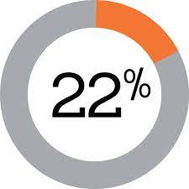
STI cascade among adults accessing STI POCT in the Eswatini feasibility study
CT/NG Detected
Notes: 51 participants reported as treated 41 from clinic records, and 9 by self-report over the phone. 4/55 participants were not treated: 3 reported being far from clinics, 1 did not receive their results. 1/55 participant not counselled on partner notification because they did not receive their results.

Slide 63
CT/NG Prevalence by Age and Sex
CT/NG Detected among Males
CT/NG Detected among Females by Specimen Type
CT/NG was detected in all age groups
NG more frequently detected among males
CT more frequently detected among females
1 male and 2 females had CT/NG coinfection
Among females: CT/NG detection didn’t vary by specimen type
Notes:
A few points to make here. Even though our pilot sample was small, CT/NG were detected in all genders and age-groups
3 participants had both infections
And we didn’t observe differences in CT/NG detection by sample (urine or vaginal swab) or by sex

Slide 64
Missed opportunities to mitigate spread of STIs
Of 55 adults with CT/NG:
7% of adults with CT/NG listed 27% of the partners
STI participants with 1 partner | STI participants with 2 partners | STI participants with 3 partners | STI participants with 4+ partners
32
32
12
24
6
18
4
28
Notes:
Of 146 individuals with recent symptoms, only 39 (27%) had CT/NG

Slide 65
Priority Populations for CT/NG Testing
Logistic regression model: odds of CT/NG detection were higher among
  Youth 18-24 years (vs older adults 25-45 years)
  Those sexually active within the past week (ref: over 1 month ago)
  Condomless sex
No correlation with HIV status or STI symptoms

Slide 66
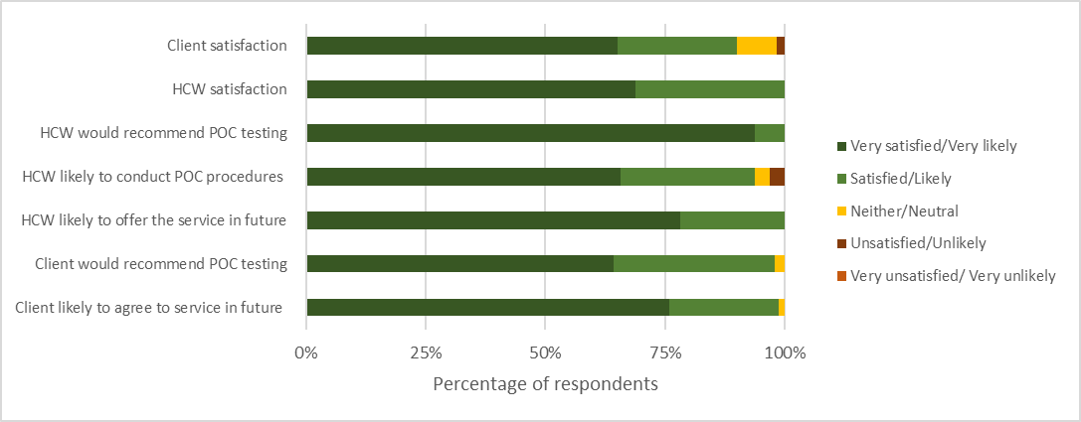
Participant and Healthcare Worker (HCW) Satisfaction

Slide 67
Feedback from participants and healthcare workers (HCW)

Slide 68
Conclusions
We demonstrated that introduction of STI POCT testing was feasible and acceptable to the recipient population and HCW
High prevalence of CT/NG among adults
  Particularly among youth and those reporting condomless sex
STI POCT using existing lab platforms can be used for a ‘test and treat’ approach to STI management
  But with a median turnaround time of 3 hours, service is ‘near point of care’
STI POCT that meet REASSURED criteria are needed to mitigate continued spread of undiagnosed STIs
Notes:
REASSURED (Real-time connectivity, Ease of specimen collection, Affordable, Sensitive, Specific, User-friendly, Rapid and robust, Equipment-free and Deliverable to end-users)

Slide 69
Acknowledgments
MOH ENAP/EHLS | Themba Dlamini Lungile Mkhweli
ICAP at Columbia University | Nokuphila Magagula Siphesihle Gama Zanele Mdluli Laura Baras Dr. Cebisile Ngcampalala Sehlephi Kuhlase-Dlamini Pinky Khubeka
AHF | Dr. Nkosana Dube Dr. Yves Mafulu Sr. Khetsiwe Maseko Sr. Princess Donga Nonhlanla Dlamini Mxolisi Mamba
CDC Eswatini | Phumzile Mndzebele
Funding | Calderone Award for Junior Faculty Development, awarded through Columbia University, Mailman School of Public Health
69

Slide 70
Q&A

Slide 71
This webinar recording and slides will be posted on www.icap.columbia.edu

Slide 72
Please join us for next month’s Grand Rounds on MARCH 19, 2024

Slide 73
Thank you

