Slide 1
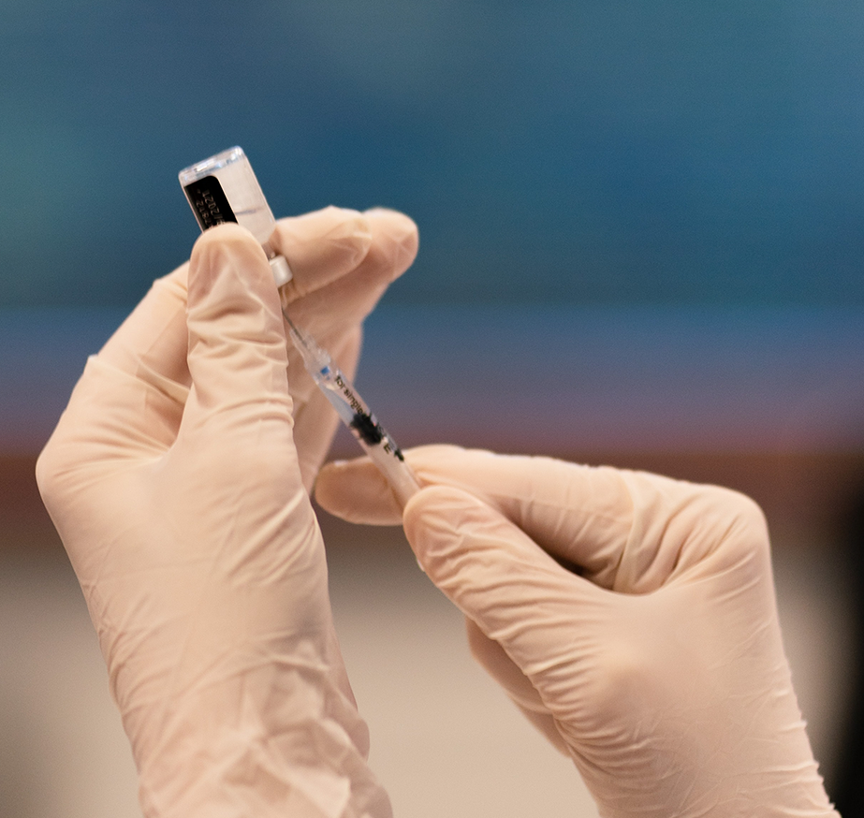
Long-Acting Injectable Cabotegravir for HIV Prevention:
Promises and Pitfalls
ICAP GRAND ROUNDS
November 15, 2022

Slide 2

Jessica Justman, MD
Senior Technical Director, ICAP

Slide 3
Agenda
Reminders:
Welcome
Presentation
Q & A
For questions to the panelists, use the Q&A box
The webinar recording and slides will be posted on www.icap.columbia.edu

Slide 4

Raphael Landowitz, MD
UCLA Center for Clinical AIDS Research & Education
and the Center for HIV Identification, Prevention, and Treatment Services

Slide 5
Long-Acting Injectable Cabotegravir for HIV Prevention: Promises and Pitfalls
Raphael J. Landovitz, MD MSc
Professor of Medicine
UCLA Center for Clinical AIDS Research & Education
ICAP Grand Rounds, November 15, 2022

Slide 6
Disclosures
Raphael J. Landovitz has served on Scientific Advisory Boards for Gilead and Merck, and served as a consultant to Cepheid.

Slide 7
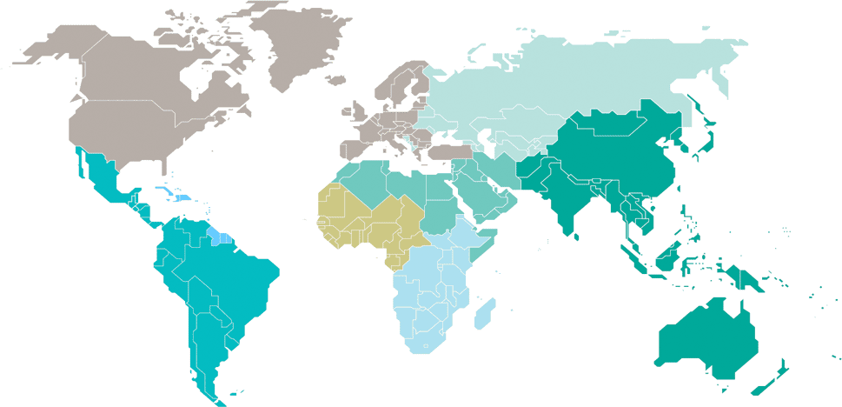
40 years into the HIV Epidemic, despite remarkable scientific discoveries
Eastern Europe
and central Asia
160 000
[130 000–180 000]
North America and western and central Europe
63 000
[51 000–67 000]
Caribbean
14 000
[11 000–18 000]
Middle East and North Africa
14 000
[11 000–18 000]
Western and central Africa
190 000
[140 000–270 000]
Asia and the Pacific
260 000
[190 000–360 000]
Latin America
110 000
[68 000–150 000]
Eastern and southern Africa
670 000
[530 000–900 000]
Total: 1.5 million [1.1 million–2.0 million]
UNAIDS Global AIDS Update 2022

Slide 8
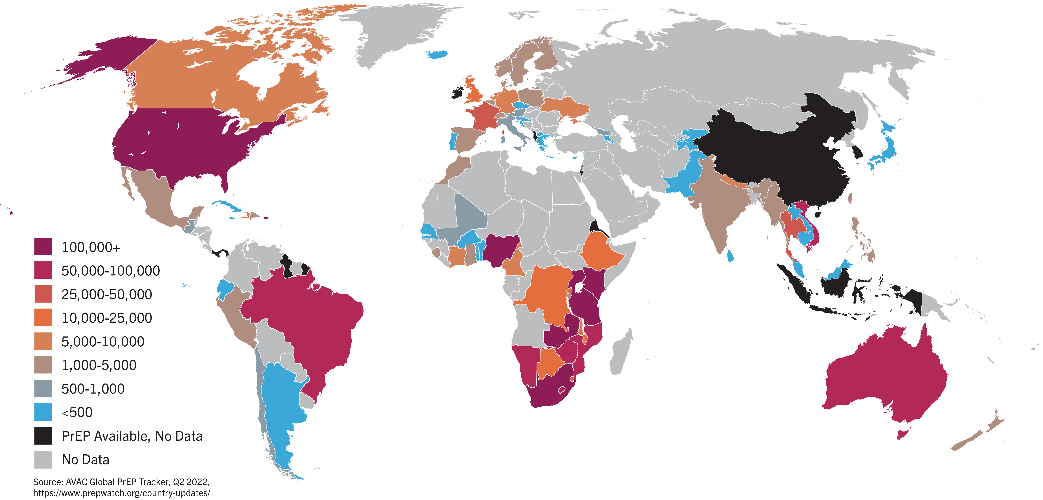
Global PrEP Uptake – 10 years in
PrEP initiations ~2,797,304
UN target: 3 million users by 2020

Slide 9






PrEP Scale-up: Effect HIV Incidence
San
Francisco¹
Rural Kenya/
Uganda⁴
Seattle²
London³
Sydney⁵
France⁶
(2012 – 2018)
(2014 – 2020)
(2015 – 2020)
(2016 – 2020)
(2016 – 2017)
(2016 – 2018)
58%
Reduction
50%
Reduction
54%
Reduction
74%
Reduction
32%
Reduction
81%
Reduction
1. Buchbinder SP et al. JAIDS. 2019
2. Seattle & King County and the Infectious Disease Assessment Unit. HIV/AIDS Epidemiology Report. 2021
3. UK Health Security Agency. HIV Report. 2021.
4. Koss et al., PLoS Med. 2021.
5. Grulich A et al. Lancet HIV. 2018
6. Tassi MF et al. J Antimicrob Chemother. 2021

Slide 10

Today’s Oral PrEP Options
1
iPrEx
(TDF/FTC)
2
FEM-PrEP
(TDF/FTC)
3
TDF2
(TDF/FTC)
4
Partners PrEP
(TDF) (TDF/FTC)
42%
6%
42%
49%
63%
71%
84%
66%
CI: 15, 63
CI: -52, 41
CI: 27, 97
CI: -22, 81
CI: 20, 83
CI: 37, 87
CI: 54, 94
CI: 28, 84
5
VOICE
(TDF) (TDF/FTC)
6
PROUD
(TDF/FTC)
7
IPERGAY
(TDF/FTC)
8
DISCOVER
(TDF/FTC) (TAF/FTC)
-49%
-4.4%
86%
86%
Incidence rate
0.30%
Incidence rate
0.16%
CI: 3, -129
CI: 27, -149
CI: 64, 96
CI: 40, 99
Grant et al. NEJM. 2010.
Van Damme et al. NEJM. 2012.
Thigpen et al. NEJM. 2012.
Baeten et al. NEJM. 2012.
Marrazzo et al. NEJM. 2015.
McCormack et al. Lancet. 2016.
Molina et al. NEJM. 2015.
Mayer et al. Lancet. 2020.

Slide 11
HPTN 083 and 084:
Long-Acting Injectable Cabotegravir for PrEP
Phase 3 studies
Double-blind, placebo-controlled persons at high-risk for HIV infection in general good health
No IDU, HCV, HBV, seizure disorder, CVD, abnormal liver function
HPTN 083: MSM/transgender women
HPTN 084: cisgender women
Double-Blind, Placebo-Controlled
Step 1
(5 Weeks)
Step 2
(~3 years)
Step 3
(1 Year)
Oral
Cabotegravir
30 mg qd
Cabotegravir 600 mg
IM injection q8 weeks
Daily Oral
FTC/TDF
Daily Oral
FTC/TDF
Daily Oral
FTC/TDF
Daily Oral
FTC/TDF
Week 0 5 190 238
DSMB recommended early termination of blinded phase of both studies
Matching oral and IM placebos included in the oral and injection phase double-blind arms.
HPTN 083 was conducted in US, Brazil, Peru, Argentina, South Africa, Vietnam, and Thailand.
HPTN 084 was conducted in Botswana, Kenya, Malawi, South Africa, Swaziland, Uganda, and Zimbabwe.
Landovitz RJ, et al. N Engl J Med. 2021;385:595-608.
Delany-Moretlwe S, et al. Lancet. 2022;399:1779-1789.
Delany-Moretlwe S, et al. J Int AIDS Soc. 2022;25(suppl 3):227-228. Abstract OALBX0107.
Notes:
Slide: HPTN 083 and 084: Long-Acting Injectable Cabotegravir for PrEP
HPTN 083 and 084 are phase 3 randomized multicenter double-blind, double-dummy, clinical trials evaluating safety and efficacy of long-acting injectable cabotegravir compared to daily oral F/TDF for HIV PrEP. The blinded trial portion of both trials were stopped at a preplanned interim DSMB review in May 2020 (HPTN 083) and November 2020 (HPTN 084).^{1,2}
References
Landovitz RJ, Donnell D, Clement ME, et al. Cabotegravir for HIV prevention in cisgender men and transgender women. N Engl J Med. 2021;385:595-608.
Delany-Moretlwe S, Hughes JP, Bock P, et al. Cabotegravir for the prevention of HIV-1 in women: results from HPTN 084, a phase 3, randomised clinical trial. Lancet. 2022;399:1779-1789.
Delany-Moretlwe S, Hughes JP, Bock P, et al. Long acting cabotegravir: updated efficacy and safety results from HPTN 084. J Int AIDS Soc. 2022;25(suppl 3):227-228. Abstract OALBX0107.

Slide 12
HPTN 083 and 084: HIV Incidence
HPTN 083 (MSM/TGW)
HPTN 084 (Cisgender Women)
Updated
Primary Blinded Period
Year 1
Unblinded Analysis
Primary
Blinded Period
Year 1
Unblinded Analysis
HR: 0.31
(0.17-0.58)
HR: 0.35
(0.18-0.69)
HR: 0.12
(0.05-0.31)
HR: 0.11
(0.05-0.24)
2.27
1.85
1.70
HIV Incidence (per 100 person-years)
HIV Incidence (per 100 person-years)
1.29
0.82
0.41
13 infections
41 infections
12 infections
32 infections
0.20
35 infections
0.18
56 infections
4 infections
6 infections
Injectable
Cabotegravir
(n=2241)
Daily Oral
F/TDF
(n=2247)
Injectable
Cabotegravir
(n=1663)
Daily Oral
F/TDF
(n=1627)
Injectable
Cabotegravir
(n=1614)
Daily Oral
F/TDF
(n=1610)
Injectable
Cabotegravir
(n=1613)
Daily Oral
F/TDF
(n=1610)
Landovitz RJ, et al. N Engl J Med. 2021;385:595-608.
Delany-Moretlwe S, et al. Lancet. 2022;399:1779-1789.
Delany-Moretlwe S, et al. J Int AIDS Soc. 2022;25(suppl 3):227-228. Abstract OALBX0107.
Landovitz RJ, et al. HIV Glasgow. 2022. Abstract O21.
Notes:
Slide: HPTN 083 and 084: HIV Incidence
Both agents were highly effective for HIV prevention. In both study populations, long-acting injectable cabotegravir was superior to daily oral F/TDF.^{1,2}
References
Landovitz RJ, Donnell D, Clement ME, et al. Cabotegravir for HIV prevention in cisgender men and transgender women. N Engl J Med. 2021;385:595-608.
Delany-Moretlwe S, Hughes JP, Bock P, et al. Cabotegravir for the prevention of HIV-1 in women: results from HPTN 084, a phase 3, randomised clinical trial. Lancet. 2022;399:1779-1789.
Delany-Moretlwe S, Hughes JP, Bock P, et al. Long acting cabotegravir: updated efficacy and safety results from HPTN 084. J Int AIDS Soc. 2022;25(suppl 3):227-228. Abstract OALBX0107.

Slide 13
HIV Testing Algorithms
Notes:
I prefer this revised slide -

Slide 14
Schematic for HPTN 083 Seroconversions
Retrospective testing
HPTN Lab Center
Ag/Ab test
-
-
-
-
+
+
Qualitative RNA test
+
+
+
+
+
+
Confirmatory Ab test
+
+
Viral load test
50,080
20,760
700
204
1,660
4,829
1st HIV POS visit
(Qual RNA, LLOD 30)
1st Site POS visit
rapid and/or Ag/Ab test
CAB-LA injection
5-week oral lead-in
CAB concentration
20
CAB (mcg/mL)
[CAB]
8xPAIC₉₀
1.33
0.664
0.166
BLQ
0
1
2
3
4
5
6
7
8
9
10
Weeks since enrollment
Eshleman S et al. CROI 2022, #95

Slide 15
Group A Case Example:
HIV Infected at Enrollment
Case A2
HIV Subtype C
CAB concentration
CAB injection
First HIV positive visit
First site positive visit
First HIV positive visit and first site positive visit
Time between first HIV positive visit and first site positive visit
Time between last injection and first HIV positive visit

Slide 16
Group B Case Example:
HIV Infected w/o Recent CAB Exposure
Case B3
HIV Subtype A/E
CAB concentration
CAB injection
First HIV positive visit
First site positive visit
First HIV positive visit and first site positive visit
Time between first HIV positive visit and first site positive visit
Time between last injection and first HIV positive visit

Slide 17
Group BR Case Example:
HIV Infected >6 Months after the Last CAB Injection and an Injection Given at the Time of the First Positive Visit
Case BR1
HIV Subtype B/C
CAB concentration
CAB injection
First HIV positive visit
First site positive visit
First HIV positive visit and first site positive visit
Time between first HIV positive visit and first site positive visit
Time between last injection and first HIV positive visit

Slide 18
Group C Case Example:
HIV Infected During Oral Lead-in
Case C1
HIV Subtype B
CAB concentration
CAB injection
First HIV positive visit
First site positive visit
First HIV positive visit and first site positive visit
Time between first HIV positive visit and first site positive visit
Time between last injection and first HIV positive visit

Slide 19
Group D Case Example #1:
HIV Infected in the Setting of On-time CAB Injections
Case D2
HIV Subtype Unknown (Likely B)
CAB concentration
CAB injection
First HIV positive visit
First site positive visit
First HIV positive visit and first site positive visit
Time between first HIV positive visit and first site positive visit
Time between last injection and first HIV positive visit

Slide 20
Group D Case Example #2:
HIV Infected in the Setting of On-time CAB Injections
Case D5
HIV Subtype F
CAB concentration
CAB injection
First HIV positive visit
First site positive visit
First HIV positive visit and first site positive visit
Time between first HIV positive visit and first site positive visit
Time between last injection and first HIV positive visit

Slide 21
Group DX Case Example:
HIV Infected While on CAB with at Least One 10-Week Delayed Injection
Case DX1
HIV Subtype B
CAB concentration
CAB injection
First HIV positive visit
First site positive visit
First HIV positive visit and first site positive visit
Time between first HIV positive visit and first site positive visit
Time between last injection and first HIV positive visit

Slide 22
Summary of HPTN 083 Major INSTI RAMs
CAB INITIATED OR RE-INITIATED WITH OCCULT HIV INFECTION
N (%) RAMs
A1-4 1 (25) E138E/K, Q148K/R
BR1-2 1 (50) Q148R
HIV ACQUISITION DURING OLI
C1-3 2 (66) E138E/A/K, G140G/S, Q148R
HIV BREAKTHROUGH INFECTION WITH ON-TIME INJECTIONS
D1-6 6 (100) E138K, G140A, Q148R, N155H, R263K
HIV BREAKTHROUGH INFECTION WITH AT LEAST ONE 10+ WEEK DELAY
DX1-3 0 (0)
HIV INFECTION 6+ MONTHS FROM LAST INJECTION
B1-16* 0 (0)
*No result for B4
GenoSure PRIme (Monogram Biosciences) | Low VL INSTI Genotyping
Notes:
Cases C1-3: Change E138A/E/K to E138E/A/K. DONE
There was no genotyping results from B4 (failed genotyping). – footnote added - DONE
Changed assay names - DONE

Slide 23
HIV Testing Algorithms for CAB-LA PrEP
Apretude (CAB-LA) package insert (US FDA):
Individuals must be tested for HIV-1 infection prior to initiating APRETUDE…and with each subsequent injection….using a test approved or cleared by the FDA for the diagnosis of acute or primary HIV-1 infection
US CDC/DHHS 2021: PrEP guidance for CAB-LA PrEP
Perform HIV RNA testing with the most sensitive test available
Within 1 week before starting CAB PrEP
1 month after the 1st injection, then bi-monthly with each injection
Quarterly for 12 months after stopping injections
Apretude package insert: https://www.accessdata.fda.gov
US CDC, DHHS. PrEP for the prevention of HIV infections in the United States – 2021 Update
Notes:
These findings are consistent with language in the Apretude package insert.
The insert states that individuals on Apretude must be tested for HIV infection before starting the drug and with each injection using a test approved by the US FDA for diagnosis of acute or primary HIV infection.
→ The US CDC recommends RNA testing with the most sensitive assay available within 1 week before starting the drug, with each injection, and quarterly for 1 year after injections stop.

Slide 24
Assessments for Injectable Cabotegravir PrEP Follow-Up Care
1 Month
After
1st Injection
Every 2 Months
Beginning With
3rd Injection
Every 4 Months
Beginning With
3rd Injection
Every 6 Months
Beginning With
5th Injection
At Least
Every
12 Months
HIV Ag/Ab test
HIV-1 RNA assay
HIV Ag/Ab test
HIV-1 RNA assay
Bacterial STI screening for MSM and TGW who have sex with men
  Gonorrhea/ chlamydia (oral, rectal, urine)
  Syphilis (blood)
Bacterial STI screening for all heterosexually-active cisgender women and cisgender men
  Gonorrhea/ chlamydia (oral, rectal, urine)
  Syphilis (blood)
Assess desire to continue injections for PrEP
Chlamydia screening
  Heterosexually active cisgender women and cisgender men (vaginal, urine)
When discontinuing cabotegravir injection
  Re-educate patients about the “tail” and risks during declining cabotegravir levels
  Assess ongoing HIV risk and prevention plans
  If PrEP is indicated, prescribe daily oral F/TDF or F/TAF beginning within 8 weeks after last injection
  Continue follow-up visits with HIV testing (including RNA testing) quarterly for 12 months
PWID: although controversial, some may consider assessing access to clean needles/syringes and drug treatment services every 2 months beginning with 3rd injection.
CDC. https://www.cdc.gov/hiv/pdf/risk/prep/cdc-hiv-prep-guidelines-2021.pdf. Published December 2021.
Notes:
Slide: Assessments for Injectable Cabotegravir PrEP Follow-Up Care
Once cabotegravir injections are initiated, patients should return for follow-up visits 1 month after the initial injection and then every 2 months.¹
Reference
Centers for Disease Control and Prevention: US Public Health Service: Preexposure prophylaxis for the prevention of HIV infection in the United States—2021 Update: a clinical practice guideline. https://www.cdc.gov/hiv/pdf/risk/prep/cdc-hiv-prep-guidelines-2021.pdf. Published December 2021.

Slide 25
Comparison of acute HIV infection (AHI) to infections that occur in the setting of long-acting early viral inhibition (LEVI)
 | AHI | LEVI
Cause | Phase of natural HIV infection | Long-acting anti-viral PrEP agent (prototype: CAB-LA)
Onset | New infection | Infection during PrEP Initiation of PrEP agent during acute/early infection
Viral replication | Explosive | Smoldering
Symptoms | Fever, chills, rash, night sweats, muscle aches, sore throat, fatigue, swollen glands | Protean, often no symptoms reported
Detection | Ag/Ab assay, RNA assays (including less sensitive POC and pooled tests), DNA assays, total nucleic acid assays | Ultrasensitive RNA assay (often low or undetectable RNA, low/undetectable DNA, diminished/delayed Ab production)
Duration | 1-2 weeks (until Ab detection) | Months (until viral breakthrough, cessation of anti-viral exposure or ART start)
Persistence | Rare* | Weeks-months after anti-viral agent is discontinued
Transmission | Very likely | Unlikely (except possibly through blood transfusion)
Drug resistance | No (unless transmitted) | Yes (can emerge early when viral load is low)
Eshelman, S. Advancing HIV, STI and Viral Hepatitis Testing Conference. 2022.
Notes:
AHI is a phase of natural HIV infection. In contrast, LEVI occurs in the setting of a long-acting anti-viral PrEP agent (with CAB-LA as the prototype agent).
AHI only occurs in new HIV infection. In contrast, LEVI can occur if a person becomes infected while or PrEP or if PrEP is initiated in someone with AHI.
Viral replication is explosive in AHI, but smolders at very low levels in LEVI.
AHI is associated with a distinct set of signs and symptoms. In contrast, symptoms in LEVI are variable – often no symptoms are reported.
AHI is easily detected using both Ag/Ab and RNA assays, including less sensitive RNA assays, total nucleic assays, DNA assays, and pooled RNA testing (which is done in the setting of blood donor screening). In contrast, infections are often missed in LEVI using standard testing algorithms; LEVI is characterized by low levels of RNA and DNA and delayed or dimished Ab production.
AHI usually lasts 1-2 weeks. In contrast, LEVI often lasts for months; if infection is not detected, LEVI usually ends with viral breakthrough when drug concentrations decline or the virus acquires resistance mutations that can overcome drug suppression of viral replication.
There are rare situations where AHI persists for longer periods. In contrast, LEVI typically persists for weeks or months, even after the long-acting PrEP agent is discontinued.
HIV transmission is very likely during AHI due to the high levels of HIV RNA. In contrast, transmission likely to be rare during LEVI, except possibly in the setting of blood transfusion.
Finally, AHI is not associated with drug resistance unless a drug-resistant variant is transmitted. In contrast, resistance can be emerge during LEVI – often when the viral load is low; it may take several weeks for resistant variants to break through with CAB-LA unless drug levels fall or until the type or number of resistance mutations is sufficient to overcome drug-induced viral suppression.
I welcome your feedback on this new concept.

Slide 26
Making Good Decisions Absent Good Data
What to start?
  Whatever the patient will adhere/persist with best
  There is no ethical/moral “obligation” to use CAB
Onset of protection?
  PK suggests time from first injection (irrespective of OLI) to 8x PA-IC90 is median 2 days, 95% by 7 days
  Durability – incredibly interpatient variability (077 data), likely varies by sex (maybe BMI), wouldn’t assume more than 9-10 weeks for males, 12? for females
Breakthroughs (nee: failures)
  Poorly understood to date
  Salvage with DOR or r/PI if infection likely to have occurred within 1 year, DTG/BIC-based ART >6-12 months?
Notes:
Aptima HIV-1 Quant Dx Assay (Hologic, LLOD: 12 copies/mL, 700 uL)
Cobas HIV-1/HIV-2 Qualitative Test (Roche, LLOD: 12.8 c/mL, 650 uL) 6800/8800 system

Slide 27
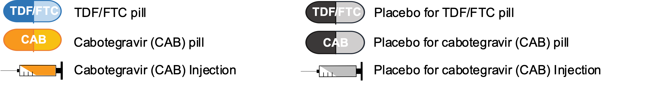
HPTN 083 Study Design: Open-label Extension

Slide 28



Learning from and Building on Oral PrEP
Oral PrEP Implementation Studies
Key Takeaways from early Oral PrEP rollout
Post-approval studies and projects
131
  Distinct post-approval oral PrEP implementation projects and studies; most were small-scale
Post-approval studies were not all designed to address decision-maker questions
Countries
Data from research was not well timed to inform decision making at global or country level
68
Different countries conducted projects including multiple in the same country (e.g. 25 in one country)
Stakeholders
54
Different organizations involved in oral PrEP implementation research
Complex, fragmented stakeholder landscape
Lessons Lessons From Oral PrEP Programs & Implications for Next Generation Prevention
Warren M, HIV Glasgow. 2022.
Notes:
Aptima HIV-1 Quant Dx Assay (Hologic, LLOD: 12 copies/mL, 700 uL)
Cobas HIV-1/HIV-2 Qualitative Test (Roche, LLOD: 12.8 c/mL, 650 uL) 6800/8800 system

Slide 29

The Way Forward
Requirements of Collaboratively Planning for Successful Introduction:
Ideal Scenario for Future Px Products:
Mapping decision-maker questions against studies
Post-approval studies are well designed to address decision-maker questions
Planning in parallel with clinical trials
Data from research is well timed to inform decision-making at global and country level
Shared strategy developed by diverse stakeholders
Coordinated stakeholder landscape with roles agreed upon in advance
BioPIC CAB-LA initial Introduction Strategy
Warren M, HIV Glasgow. 2022.
Notes:
Aptima HIV-1 Quant Dx Assay (Hologic, LLOD: 12 copies/mL, 700 uL)
Cobas HIV-1/HIV-2 Qualitative Test (Roche, LLOD: 12.8 c/mL, 650 uL) 6800/8800 system

Slide 30
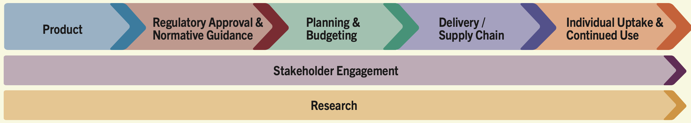
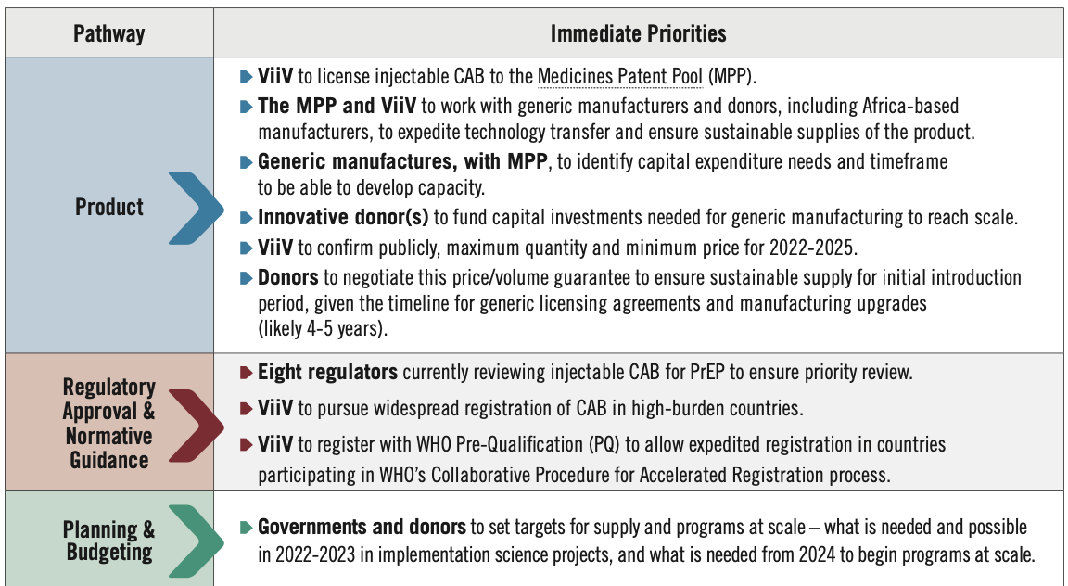
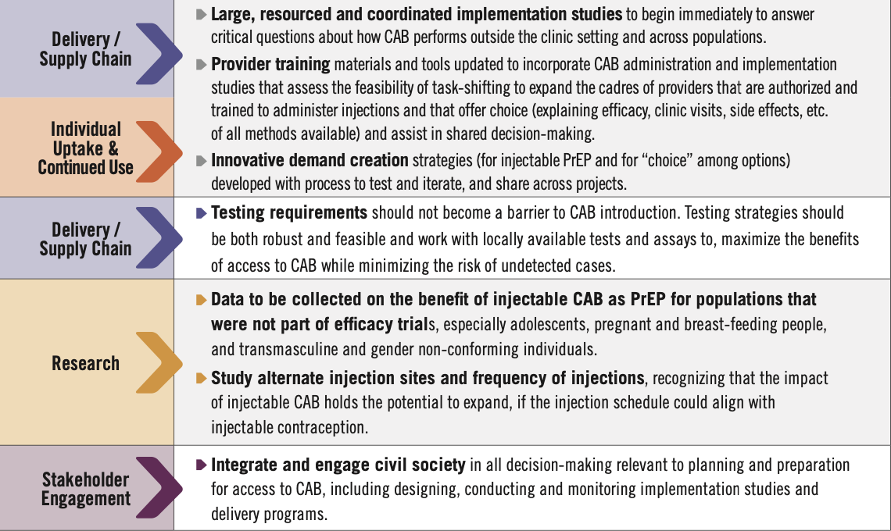
Pathway to Access & Impact
Warren M, HIV Glasgow. 2022.
Notes:
Aptima HIV-1 Quant Dx Assay (Hologic, LLOD: 12 copies/mL, 700 uL)
Cobas HIV-1/HIV-2 Qualitative Test (Roche, LLOD: 12.8 c/mL, 650 uL) 6800/8800 system

Slide 31
Parallel Universe & Journeys
Providers & Health Systems
Users
Who is at risk?
Where do I find them?
What do I tell them?
Where can I provide px info and products to them?
What px options can I provide them?
Oral, ring, injectable, condoms, DPP?
When I can test them?
What do I want?
Do I want an HIV test?
Where do I want to get an HIV test?
Do I need and want HIV prevention?
What kind of HIV px do I want?
Who do I want to talk with about sex and relationships?
Where and from whom do I want it?
Oral, ring, injectable, condoms, DPP?
Choice
Choice
Warren M, HIV Glasgow. 2022.
Notes:
Aptima HIV-1 Quant Dx Assay (Hologic, LLOD: 12 copies/mL, 700 uL)
Cobas HIV-1/HIV-2 Qualitative Test (Roche, LLOD: 12.8 c/mL, 650 uL) 6800/8800 system

Slide 32
Coalition to Accelerate Access
Convened by Unitaid, WHO, UNAIDS, Global Fund and PEPFAR, with AVAC as the Secretariat
Coordinate key stakeholder activities on PrEP access, including:
  Building on lessons learned from oral PrEP
  Coordinate key stakeholder activities on PrEP access
  Jointly develop strategies to identify and overcome access challenges for new PrEP options in the near to medium term (as relates to ViiV’s injectable CAB, including generics, and dapivirine vaginal ring) and the medium to longer term (as relates to future PrEP products)
  Ensure new, longer-acting PrEP options reaching the market will be available and equitably accessible to all who need them more quickly than ever before
Warren M, HIV Glasgow. 2022.
Notes:
Aptima HIV-1 Quant Dx Assay (Hologic, LLOD: 12 copies/mL, 700 uL)
Cobas HIV-1/HIV-2 Qualitative Test (Roche, LLOD: 12.8 c/mL, 650 uL) 6800/8800 system

Slide 33
Product Considerations
For each product, understand and balance:
Clinical
Biologic efficacy
Dosing/duration
Reversibility
Side effect profile
Systemic/Topical
Policy & Programs
Delivery channel(s)
Health system burden
Product cost
Program cost
Provider training
Demand creation
Personal
User effectiveness
User preference
User burden
Discretion of use
Contribution to stigma
It’s never just “the product” – it’s the program;
new options can’t solve for everything
Warren M, HIV Glasgow. 2022.
Notes:
Aptima HIV-1 Quant Dx Assay (Hologic, LLOD: 12 copies/mL, 700 uL)
Cobas HIV-1/HIV-2 Qualitative Test (Roche, LLOD: 12.8 c/mL, 650 uL) 6800/8800 system

Slide 34
Accelerating Introduction of New Px Options
Those who Use; Those who Choose; Those who Pay the Dues
FUNDERS
What we need to know – and fast
What is the cost for procurement AND for programming?
What is the cost-effectiveness?
What is the market size, generally and relative to other PrEP products?
How will introduction affect the current market share and size of other PrEP?
Warren M, HIV Glasgow. 2022.
Notes:
Aptima HIV-1 Quant Dx Assay (Hologic, LLOD: 12 copies/mL, 700 uL)
Cobas HIV-1/HIV-2 Qualitative Test (Roche, LLOD: 12.8 c/mL, 650 uL) 6800/8800 system

Slide 35
Accelerating Introduction of New Px Options
Those who Use; Those who Choose; Those who Pay the Dues
FUNDERS
What we need to know – and fast
What is the cost for procurement AND for programming?
What is the cost-effectiveness?
What is the market size, generally and relative to other PrEP products?
How will introduction affect the current market share and size of other PrEP?
PROGRAMS
What policies need to change to to plan for & introduce new option?
How to overcome siloes in procurement & service delivery?
What type of training & support do providers need?
What are optimal service delivery platforms and communication channels?
Warren M, HIV Glasgow. 2022.
Notes:
Aptima HIV-1 Quant Dx Assay (Hologic, LLOD: 12 copies/mL, 700 uL)
Cobas HIV-1/HIV-2 Qualitative Test (Roche, LLOD: 12.8 c/mL, 650 uL) 6800/8800 system

Slide 36
Accelerating Introduction of New Px Options
Those who Use; Those who Choose; Those who Pay the Dues
FUNDERS
What we need to know – and fast
What is the cost for procurement AND for programming?
What is the cost-effectiveness?
What is the market size, generally and relative to other PrEP products?
How will introduction affect the current market share and size of other PrEP?
PROGRAMS
What policies need to change to to plan for & introduce new option?
How to overcome siloes in procurement & service delivery?
What type of training & support do providers need?
What are optimal service delivery platforms and communication channels?
USERS
Who prefers which option, and what are their motivators and barriers?
Where/from whom do potential users desire to hear about and access product?
How will product use/preference change over time?
How can we increase & support adherence?
What is the end user's path to initiation and continued, effective use?
How can peer groups/influencers be leveraged to support uptake & adherence?
How can providers be supported to have more knowledge and empathy?
How can the product be packaged to better support uptake/ adherence?
Warren M, HIV Glasgow. 2022.
Notes:
Aptima HIV-1 Quant Dx Assay (Hologic, LLOD: 12 copies/mL, 700 uL)
Cobas HIV-1/HIV-2 Qualitative Test (Roche, LLOD: 12.8 c/mL, 650 uL) 6800/8800 system

Slide 37
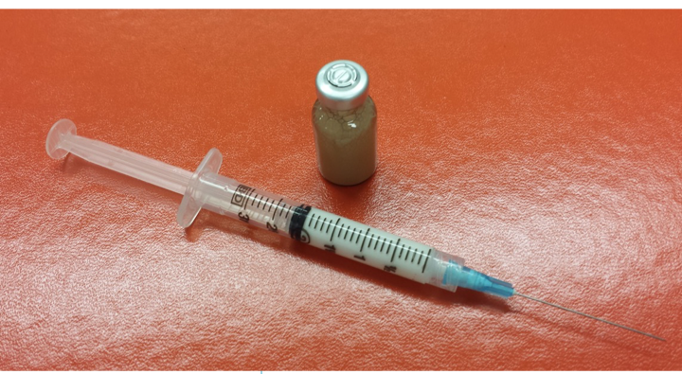
So, Now What for CAB-LA?
Notes:
Aptima HIV-1 Quant Dx Assay (Hologic, LLOD: 12 copies/mL, 700 uL)
Cobas HIV-1/HIV-2 Qualitative Test (Roche, LLOD: 12.8 c/mL, 650 uL) 6800/8800 system

Slide 38
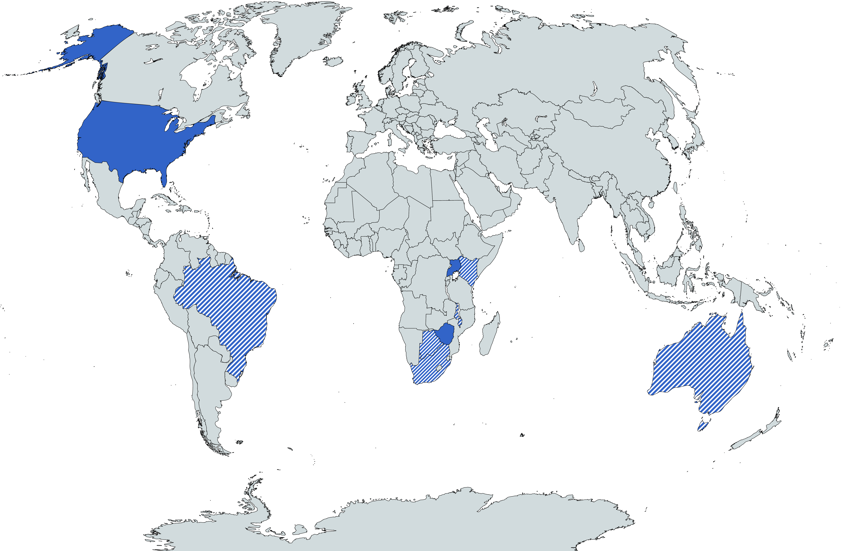
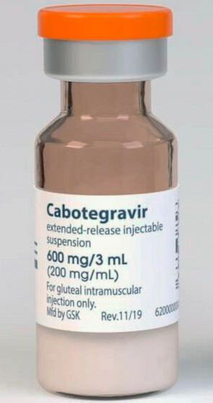

Approved by the US FDA for PrEP:
December 20, 2021
Approved for PrEP
Submitted for approval
for PrEP

Slide 39
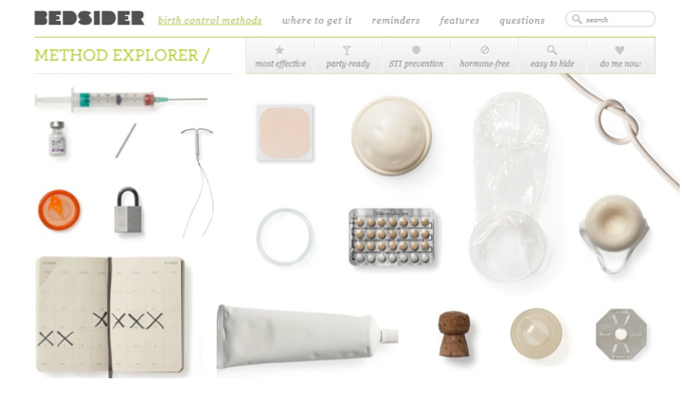
Birth Control Methods
Notes:
Aptima HIV-1 Quant Dx Assay (Hologic, LLOD: 12 copies/mL, 700 uL)
Cobas HIV-1/HIV-2 Qualitative Test (Roche, LLOD: 12.8 c/mL, 650 uL) 6800/8800 system

Slide 40
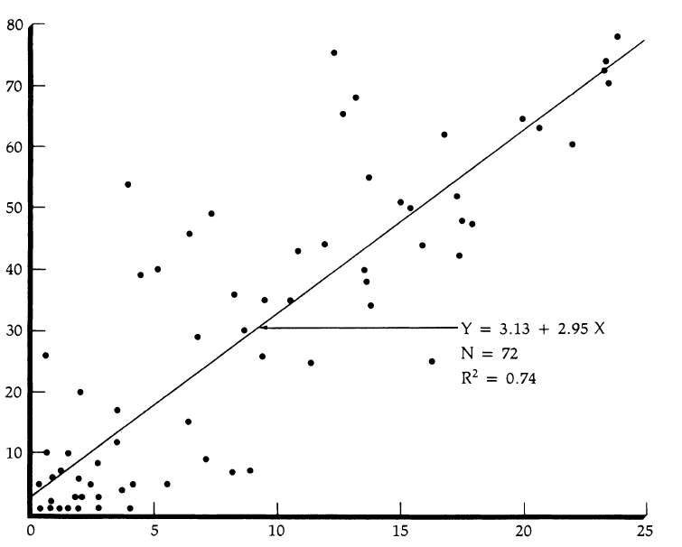
CHOICE Matters
WHO systematic review (231 articles) showed increased choice associated with:
  Increased persistence on chosen method
  Better health outcomes
  12% increase in contraceptive prevalence for each additional method
Similar to contraceptive needs: different people have different HIV prevention needs at different times
Contraceptive prevalence rate
Index of Contraceptive Availability
Warren M, HIV Glasgow. 2022.
Notes:
Aptima HIV-1 Quant Dx Assay (Hologic, LLOD: 12 copies/mL, 700 uL)
Cobas HIV-1/HIV-2 Qualitative Test (Roche, LLOD: 12.8 c/mL, 650 uL) 6800/8800 system

Slide 41
Now What?
Translate biomedical options into viable choices for users, providers and health systems
  Intro new options as part of marketing and programming for choice
  Identify (and differentiate) service delivery models that work for users
  Ask and answer critical implementation science questions for each product, while building prevention platforms for the future
Understand testing and initiation needs for PrEP
Ensure robust civil society engagement in intro/implementation research and planning
Procurement/commodity funding – for launch and ongoing
Provider training – both clinical guidelines AND appropriate counseling, support, empathy
Realistic targets for interventions, especially intro – and not just coverage targets
Identify what products can “solve for” – and what they can’t
Ensure we do better, more equitable intro with ring and injectable than with oral PrEP and COVID-19 vaccines
Warren M, HIV Glasgow. 2022.
Notes:
Aptima HIV-1 Quant Dx Assay (Hologic, LLOD: 12 copies/mL, 700 uL)
Cobas HIV-1/HIV-2 Qualitative Test (Roche, LLOD: 12.8 c/mL, 650 uL) 6800/8800 system

Slide 42

Acknowledgements
HPTN 083/084: Sponsor
DAIDS
Overall support for the HIV Prevention Trials Network (HPTN) is provided by the National Institute of Allergy and Infectious Diseases (NIAID), Office of the Director (OD), National Institutes of Health (NIH), National Institute on Drug Abuse (NIDA), the National Institute of Mental Health (NIMH), and the Eunice Kennedy Shriver National Institute of Child Health and Human Development (NICHD) under Award Numbers UM1AI068619-15 (HPTN Leadership and Operations Center), UM1AI068617-15 (HPTN Statistical and Data Management Center), and UM1AI068613-15 (HPTN Laboratory Center).
Additional funding from ViiV Healthcare
Adeola Adeyeye
Carl Dieffenbach
Sheryl Zwerski
Melissa Kin
Maryanne Luzar
Katie Shin
Linda Ehler
Usha Sharma
HPTN Leadership
HPTN 083/084: Pharmaceutical Support
Myron Cohen
Wafaa El-Sadr
Deborah Donnell
Sue Eshleman
Mark Marzinke
Nirupama Sista
Kathy Hinson
Beth Farrell
ViiV Healthcare
Gilead Sciences, Inc.
Implementation Discussions
Mitchell Warren
Beatriz Grinsztejn
Marybeth McCauley
Rachel Bageley
Michelle Rodolph
Robin Schaeffer
HPTN 083/084 Teams, Sites, Site Staff
HPTN 083/084 Participants and their families and communities

Slide 43

Thank you!
Questions? Email rlandovitz@mednet.ucla.edu or @doc_in_a_box

Slide 44
This webinar recording and slides will be posted on www.icap.columbia.edu

Slide 45

Upcoming
ICAP World AIDS
Day Event
Exploring the latest insights into the global HIV response
Thursday, December 1
11 am EST
(In-person and online)

