Slide 1
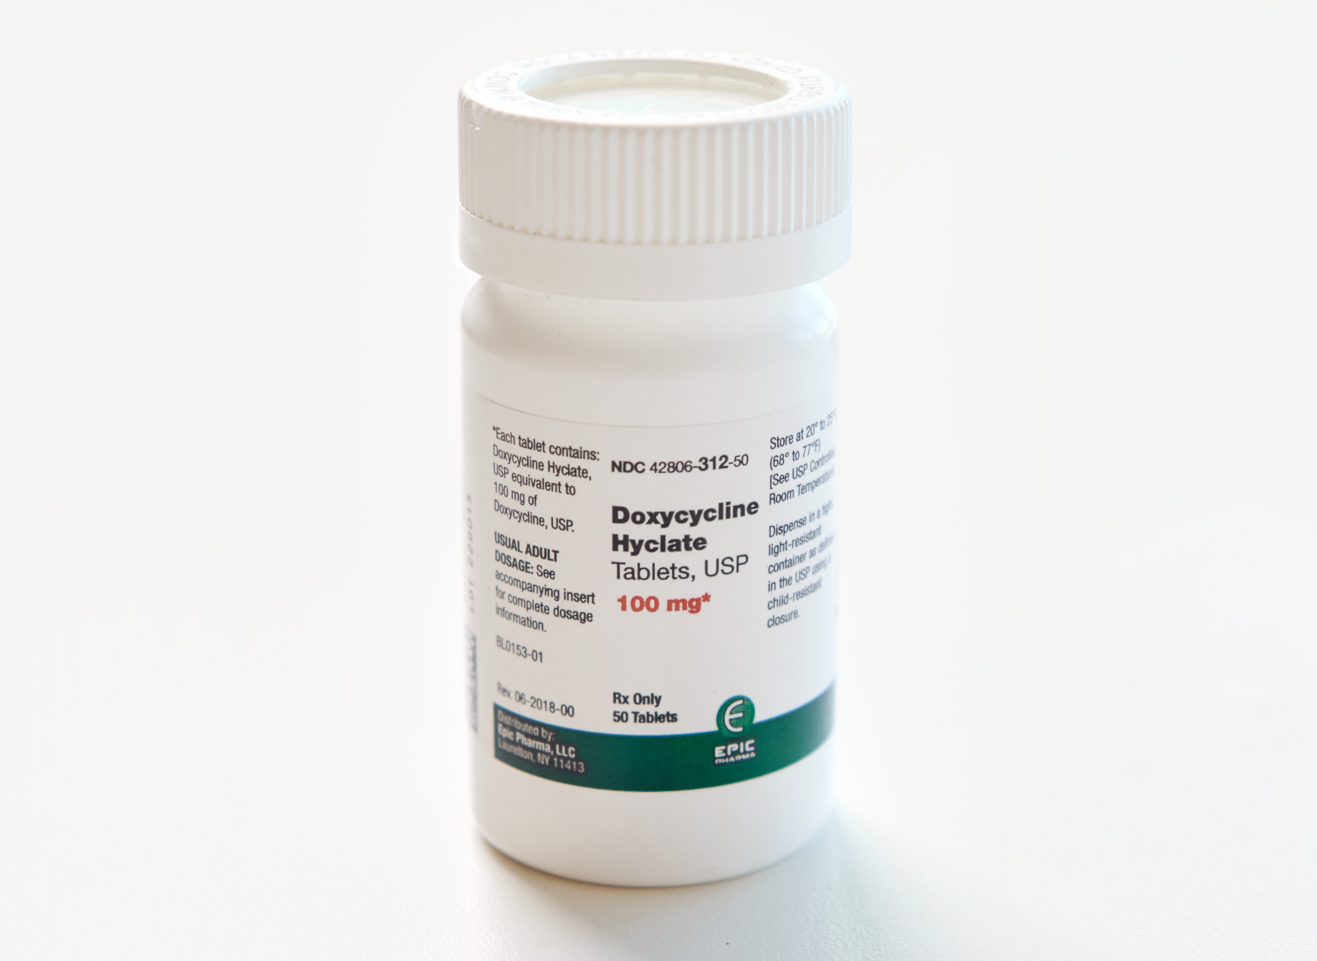
Doxycycline Post-Exposure Prophylaxis for Bacterial STIs and its Impact on Antimicrobial Resistance
ICAP GRAND ROUNDS
December 16, 2025
Photo: San Francisco AIDS Foundation

Slide 2

Wafaa El-Sadr, MD, MPH, MPA
Global Director,
ICAP at Columbia University

Slide 3
Agenda
Reminders:
For questions to the panelists, use the Q&A box
The webinar recording and slides will be posted on www.icap.columbia.edu
Welcome and Introduction
Presentation
Q & A

Slide 4

Jean-Michel Molina, MD, PhD Professor of Medicine at the University of Paris Cité,
Head of the Infectious Diseases Department at the Saint-Louis and Lariboisière Hospitals, Paris

Slide 5



Doxycycline Post-Exposure Prophylaxis for Bacterial STIs and Impact on Antimicrobial Resistance
Jean-Michel Molina, MD
Department of Infectious Diseases
Hospitals Saint-Louis and Lariboisière
University of Paris Cité,
Notes:
5

Slide 6
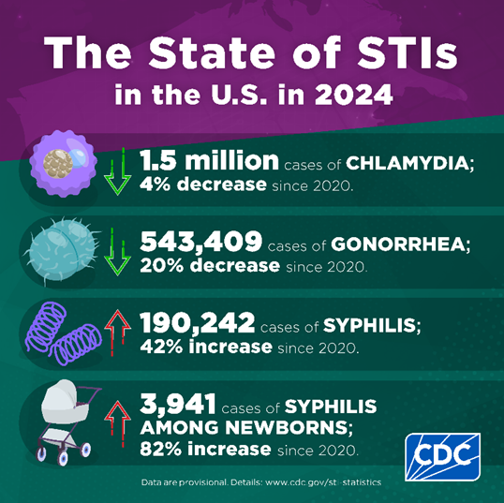
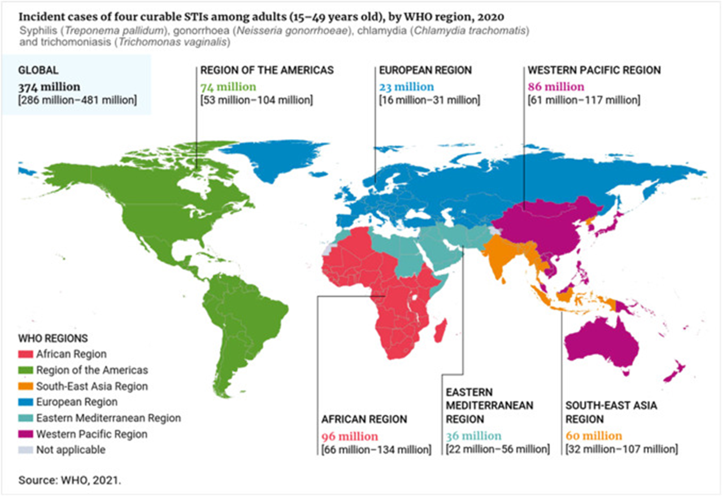
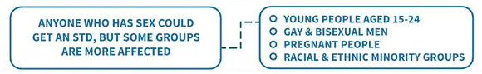
Dramatic Increases in Bacterial STI Incidence
in an Era of Effective HIV Treatment and Prevention
WHO estimates > 374 million new curable STIs each year
28% ↑
Gonorrhea: threat of increasing incidence of antimicrobial resistance
Syphilis: spread into heterosexuals with congenital syphilis (>1M pregnant W)
Reappearance of classics: LGV proctitis in MSM
WHO global progress report on HIV, viral hepatitis and sexually transmitted infections 2021; https://www.cdc.gov/std;
Pathela Sex Transm Dis 2019; WHO; Oliver Clin Infect Dis 2018; Braun DL CID 2018, Marrazzo JM. CROI 2019 Seattle USA
Notes:
I will add relevant abstracts being presented

Slide 7
Distribution of Participants and STI Diagnoses among MSM on PrEP in Australia
25% of participants accounted for 76% of all STIs
Proportion, %
Participants n=2981
STIs diagnosed
N=2928
1.1 year of follow-up
Traeger MW et al. JAMA. 2019;321:1380-1390.
Notes:
7
1,1 year follow-up

Slide 8
How to contain the STI Epidemic?
A, B and C: Promotion of condom use
- Counselling and behavioural changes
Test and Treat
- Frequent testing for STIs MSM on PrEP and immediate treatment
Partner notification and treatment
Vaccines for viral STIs (hepatitis A and B, HPV, MPox)
Vaccines for bacterial STIs: a work in progress…
Antibiotic prophylaxis

Slide 9

Doxycycline PEP in MSM
Randomized open-label trial from 07/2015 to 06/2016
On Demand PEP with doxycycline
(200 mg, within 24-72h after sex)
N=116
HIV-negative MSM on PrEP
Enrolled in the ANRS IPERGAY open-label extension study
No contra-indication to Doxy
No PEP
N=116
* < 3 doses per week to limit AB exposure: use of a median of 6.8 pills/month per patient
Visits at baseline and every two months with serologic assays for HIV and syphilis and PCR assays for CT and NG in urine samples, anal and throat swabs
PCR, Polymerase chain reaction; CT, chlamydia trachomatis; NG, Neisseria gonorrhoeae
Molina JM et al. Lancet Inf Dis. 2018;18:308-317
Notes:
9

Slide 10
Why Testing Doxycycline for PEP ?
No known resistance to doxycycline in C. trachomatis and T. pallidum
Doxycycline PEP successfully used for prevention of Lyme disease and Leptospirosis (Nadelman, NEJM 2001; Takafuji, NEJM 1984)
Limited use of doxycycline in France for the treatment of bacterial infections, mostly used for acnea and malaria prophylaxis
92% of N. gonorrhoeae in France already resistant to tetracycline in 2020-22 (MIC breakpoint 0.5 mg/L) including 20-30% high-level resistance with tetM acquisition)

Slide 11
Tetracycline Resistance in N. gonorrhoeae
Tetracycline
Chromosomal mediated
30S sub-unit
rpsJ (S10)
Plasmid mediated
Low level Resistance
High level Resistance
MtrCDE
Tn916
tetM
PorB
bla_{TEM}
Multiple resistance determinants plasmid and/or chromosomal mediated
Scharabaai 2007; Pachulec 2010
Notes:
Tetracycline produced by Streptomyces blocks protein synthesis by binding to small ribosomal subunit 16S (30S) (different from large ribosomal subunit 50S 24S). Doxycycline available in 1967 by FDA

Slide 12
Incidence of Chlamydia
among MSM on PrEP
0.5
0.4
Log-rank test p=0.003
Median follow-up
of 8.7 months
(IQR: 7.8–9.7)
0.3
Cumulative probability of first STI
No PEP
0.2
0.1
PEP
0
0
2
4
6
8
10
months
No at risk : No PEP
PEP
116
116
112
114
102
111
93
105
68
84
9
22
CT: 21 in no PEP arm (incidence: 28.6/100 PY), 7 in PEP arm (incidence: 8.7/100 PY)
Hazard Ratio: 0.30 (95% CI: 0.13-0.70, p=0.006) 70% reduction of Chlamydia incidence
Hazard Ratio: 0.27 (95% CI: 0.07–0.98, p<0.05) 73% reduction of Syphilis incidence
Molina JM et al. Lancet Inf Dis. 2018;18:308-317
Notes:
12
12

Slide 13
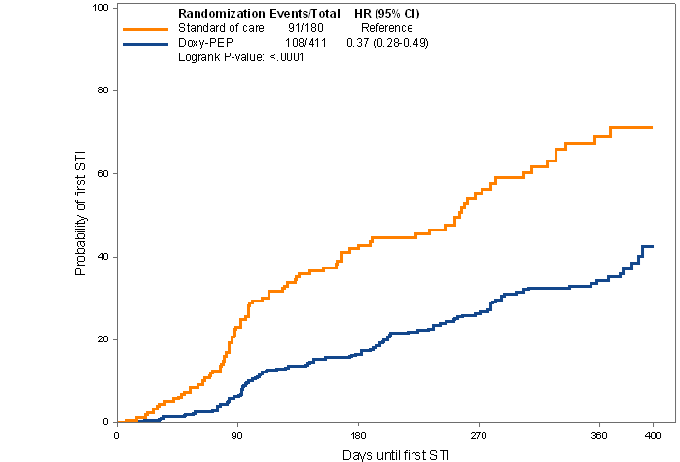

DoxyPEP Study Design and Results
Intervention: Open label doxycycline 200 mg as PEP within 72 hours after condomless sexual contact, max 200mg /daily
Doxy PEP
MSM & TW
living with HIV or 2:1 randomization
on PrEP
No PEP
Month
STI testing
0
3
6
9
12
DoxyPEP Results
Overall 65% ↓ reduction in bacterial STIs each quarter
≈ 80% ↓ chlamydia & syphilis
≈ 50% ↓ gonorrhea
Effectiveness independent of HIV serostatus
HR 0.37 (0.28-0.29)
Log-rank p-value < 0.0001
Probability of first STI
Luetkemeyer et al NEJM 2023
Days until first STI

Slide 14
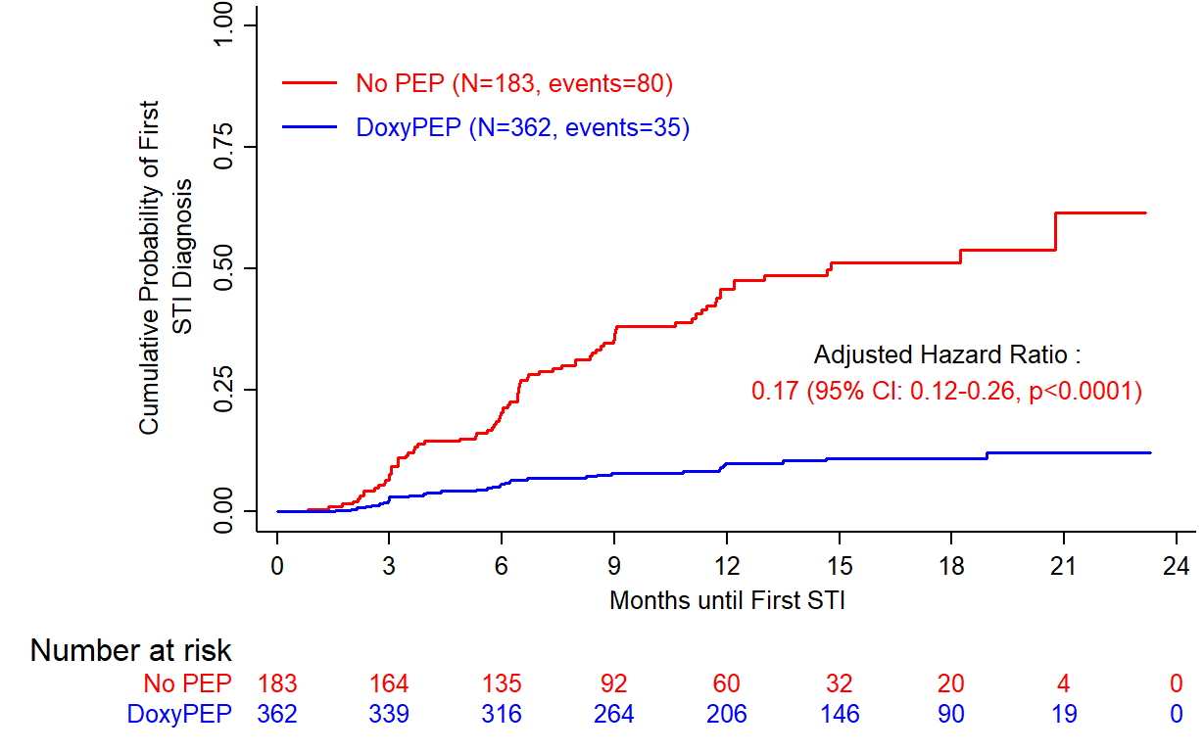
ANRS DOXYVAC among MSM on PrEP
Time to First CT or Syphilis Infection
No interaction between Doxy PEP and 4CMenB vaccine (p=0.83)
Median follow-up:
14 months (IQR: 9-18)
115 subjects infected
80 in No PEP arm
(incidence: 53.2/100 PY),
35 in Doxy PEP arm
(incidence: 8.8/100 PY)
83% reduction in Chlamydia and syphilis incidence
Molina et al. Lancet Inf Dis 2024
For CT multi-sites infection = 1 single event
Notes:
14
14

Slide 15
Adherence to DoxyPEP in DOXYVAC Trial
Percent of Pts with quantifiable levels of doxycycline in plasma and urine
Limit of quantification: 2.5 ng/mL and 50 ng/ml in plasma and urine, respectively
Median (IQR) time to PEP intake: 15h (3-13) after sex
Plasma
Urine
Median no. of 200 mg doses/month: 3 doses IQR (1-6):
Incidence of cumulative infections with chlamydia and syphilis dropped from 15.5 to 3.7/100 PY in those with Doxy detectable at M6 and M12 in urine (56% of participants, p=0.0002)
P=0.47
P<0.001
P=0.35
P<0.001
Median plasma concentration at M6
250 and 160 ng/ml in the DoxyPEP and No PEP arms
Median urine concentration at M6
4218 and 83 ng/μmol creatininuria in the DoxyPEP and No PEP arms
Goldwirt et al EACS 2025

Slide 16
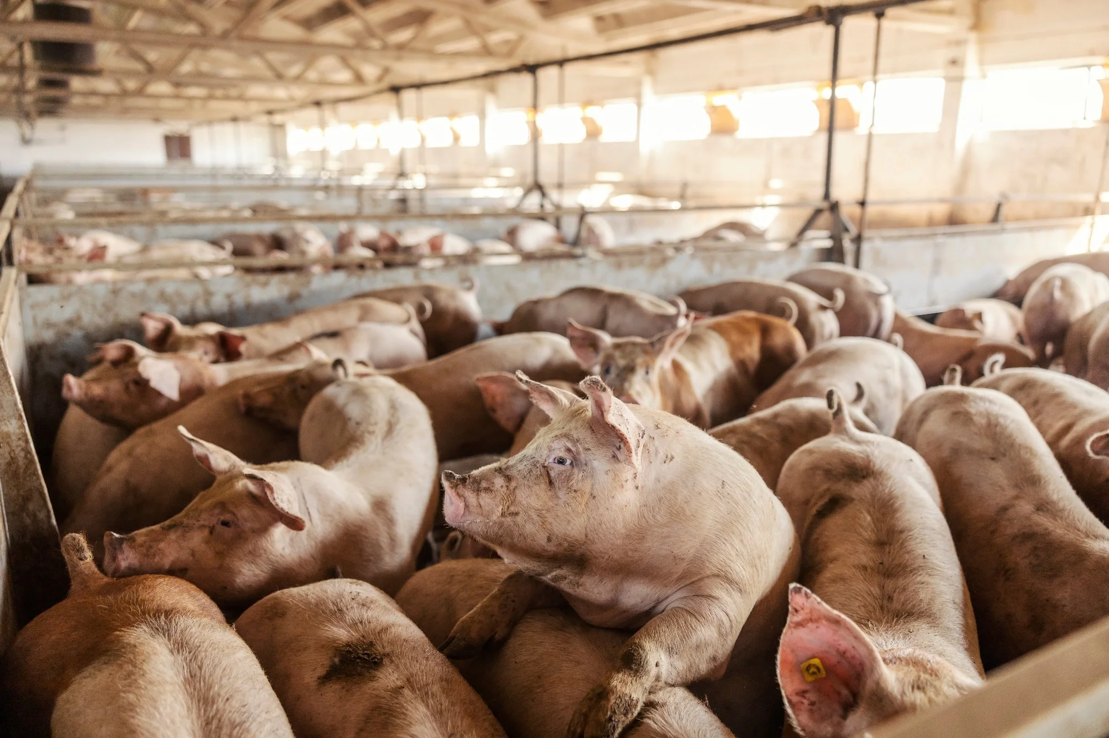
Chlamydia and Tetracycline Resistance
No stable tetracycline resistance identifed so far in humans in C. trachomatis and in the Doxyvac trial
Resistance described in pigs, C. suis, via an efflux pump encoded by tet(C) gene : nearly 90% resistance
In vitro: gene transfer possible between C. suis and C. trachomatis during co-infection
Rare human infections with C. suis in pig farmers (conjunctivitis)
No selection of in vitro resistance or mutation in 16S rRNA gene, in tissue culture at sub-inhibitory concentrations of tetracycline, for up to 30 passages
Unemo and Shafer Clin Microbiol Rev 2014, 27:587, Sandoz and Rockey Future Microbiol 2010; 5:1427; O’Neil et al. Microbiology 2013; Suchland et al AAC 2009; Stamm et al . Antimirob Ag Chemo 2010; 54:583; Fraser et al, Science 1998; Le Roy C. et al; JAC 2021; Tantalo LC et al. J Inf Dis 2024
Notes:
History of discovered and recommended antimicrobials and evolution of resistance in NG, including the emergence of genetic resistance determinants
SPT: spectinomycin, CRO ceftriaxone, OFX ofloxacin, CFM cefixime

Slide 17
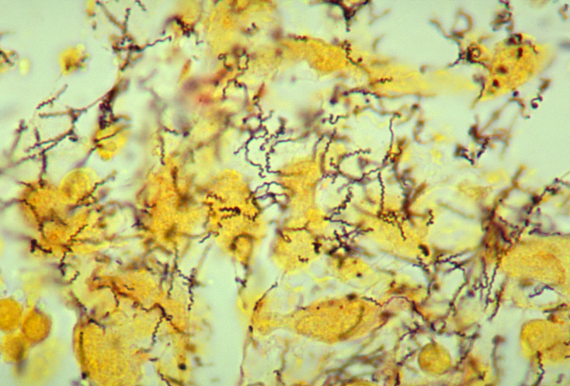
Syphilis and Tetracycline Resistance
T. pallidum: limited genome plasticity and no plasmid: low likelihood of resistant genes encoding efflux pumps (tetB)
Lack of penicillin and tetracycline resistance after > 6 decades
Single point mutation in 23S rRNA led to azithromycin resistance in 1977, now widespread
Single point mutations in the 16S rRNA gene could select for tetracycline resistance, none was found in the Doxyvac trial
In vitro exposure of T. pallidum in tissue culture to sub-bactericidal doxycycline did not induce resistance or selection of mutation by WGS analysis, after nearly 30 weekly passages.
Unemo and Shafer Clin Microbiol Rev 2014, 27:587, Sandoz and Rockey Future Microbiol 2010; 5:1427; O’Neil et al. Microbiology 2013; Suchland et al AAC 2009; Stamm et al . Antimirob Ag Chemo 2010; 54:583; Fraser et al, Science 1998; Le Roy C. et al; JAC 2021; Tantalo LC et al. J Inf Dis 2024
Notes:
History of discovered and recommended antimicrobials and evolution of resistance in NG, including the emergence of genetic resistance determinants
SPT: spectinomycin, CRO ceftriaxone, OFX ofloxacin, CFM cefixime

Slide 18




Decline in Citywide Chlamydia and early Syphilis cases in MSM and TGW in SF after release of Doxy-PEP Guidelines
 | In Nov 2023, observed chlamydia cases were 50% |  |  | In Nov 2023, observed syphilis cases were 51%
350 | (95% CI 38%-59%) lower than model forecasts |  |  | (95% CI 43%-58%) lower than model forecasts
300 |  |  | 100
250 |  |  | 80
200
150 |  |  | 60
100 |  |  | 40
50 |  |  | 20
0 |  |  | 0
120
Pre-period trend
Predicted trend
Post-period trend
Sankaran M, JAMA Intern Med 2025

Slide 19
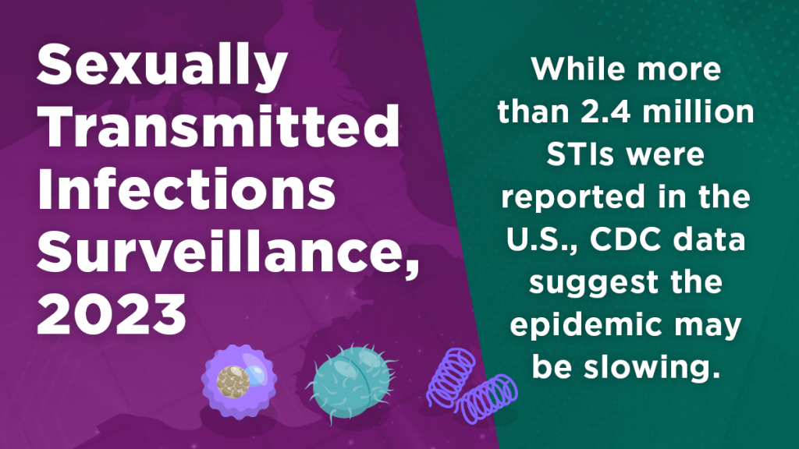

Gonorrea cases dropped for a second year - declining 7% from 2022 and falling below pre-COVID-19 pandemic levels (2019) and Chlamydia cases remain similar to 2022
Syphilis increased only 1% after years of double digit increases and primary and secondary syphilis dropped 13% among MSM for the first time since CDC began reporting trends among this population in mi-2000
We should continue to invest in STI prevention (Jonathan Mermin, former Director of CDC’s National Center for HIV, viral hepatitis, STD and TB prevention).
CDC Press Release November 12, 2024

Slide 20
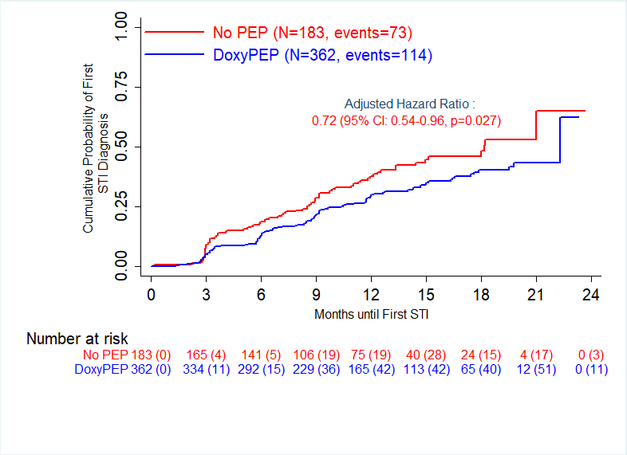
ANRS DOXYVAC among MSM on PrEP Time to First M. genitalium infection
73 in no-PEP arm (incidence 44.9/100 PY)
114 in Doxy-PEP arm (incidence 32.2/100 PY)
High level AMR
90% AZT
40% FQ
15% TC 16S RNA mut.
No increase in DoxyPEP
28% of relative decrease of MG incidence in the Doxy-PEP arm
Bébéar et al. IUSTI meeting, September 2024, Zagreb, Croatia

Slide 21
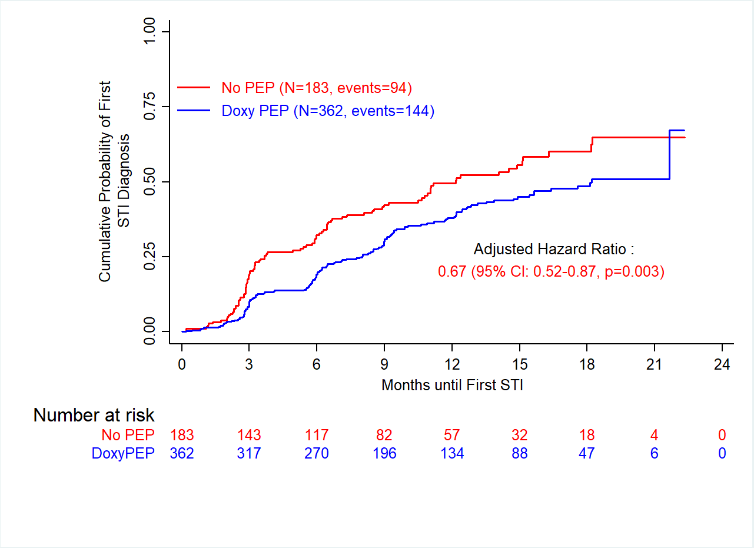
ANRS DOXYVAC among MSM on PrEP
Time to First N. gonorrhoeae Infection
GC
33% reduction in
Gonorrhea
incidence
238 subjects infected
94 in No PEP arm (incidence: 68.4/100 PY)
144 in Doxy PEP arm (incidence: 45.5 /100 PY)
GC multi-sites infection = 1 single event

Slide 22
Prevention of All Symptomatic STIs
 | No PEP (N=183) | DoxyPEP (N=362) | Incidence Rate Ratio (95% CI) | p-value
 | Incidence/100 py (Events) | Incidence/100 py (Events)
Chlamydiae (all sites) | 8.2 (17) | 0.5 (2) | 0.06 (0.01-0.25) | <10⁻⁴
Gonorrhea (all sites) | 10.6 (22) | 5.2 (22) | 0.49 (0.27-0.89) | 0.02

Slide 23
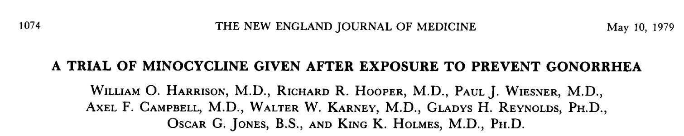
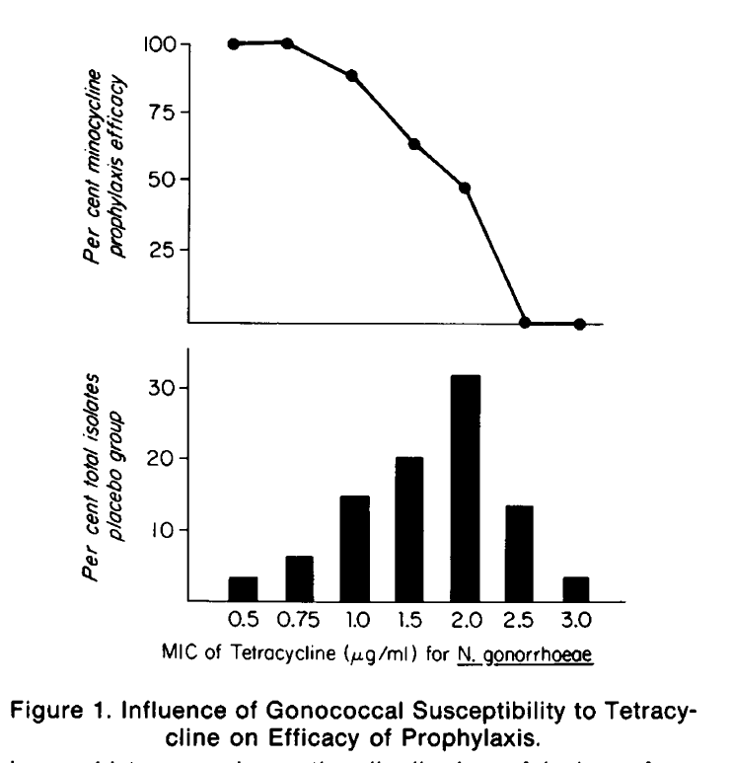
1089 men were given oral minocycline (200 mg) or placebo after sex (median : 8 h)
At sea, gonorrhea in 57/565 (10%) with placebo and 24/515 (4.7%) with PEP (p<0.001)
Isolates from patients given PEP were more resistant to tetracyclin vs. those given placebo
Efficacy of PEP related to NG MIC
High failure rate with minocycline treatment: 65%
« Limited effectiveness as a public health measure »
Notes:
1089 men on a vessel in the Philippines, PEP during a 3 day liberty period
9 days after the ship departure from port
The distribution of MIC for isolates from patients who received placebo appears in the lower half of Fig 1. The prophylactic efficacy of Mino, expressed as the percentage of cases of gonorrhea prevented is plotted for each MIC in the upper part of the figure, based on the ratio of the expected number of isolates at each MIC from the minocycline treated group
< 0.5 susceptible, > 1 low level resistance

Slide 24
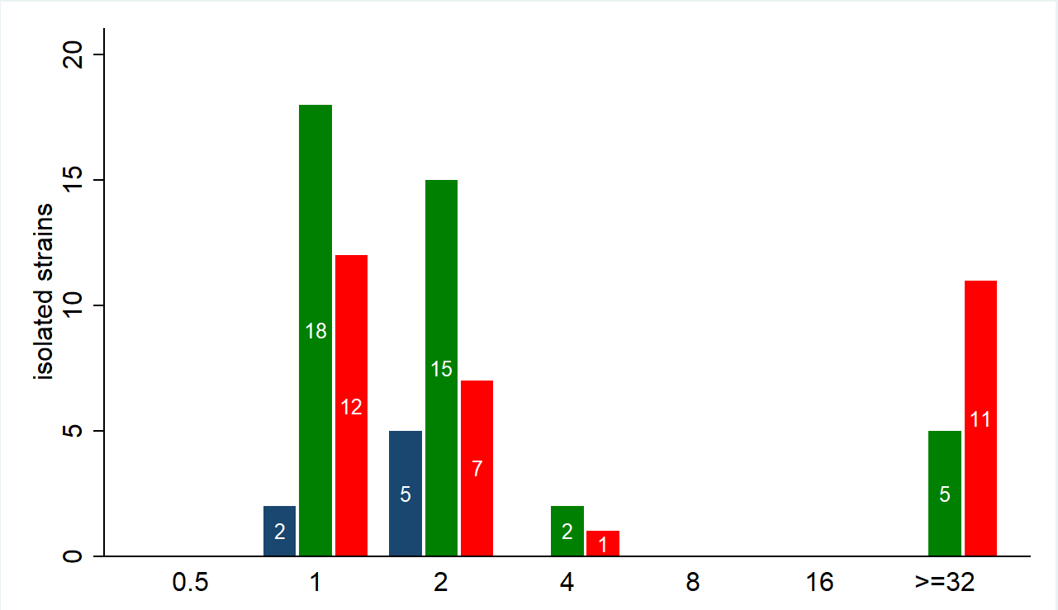
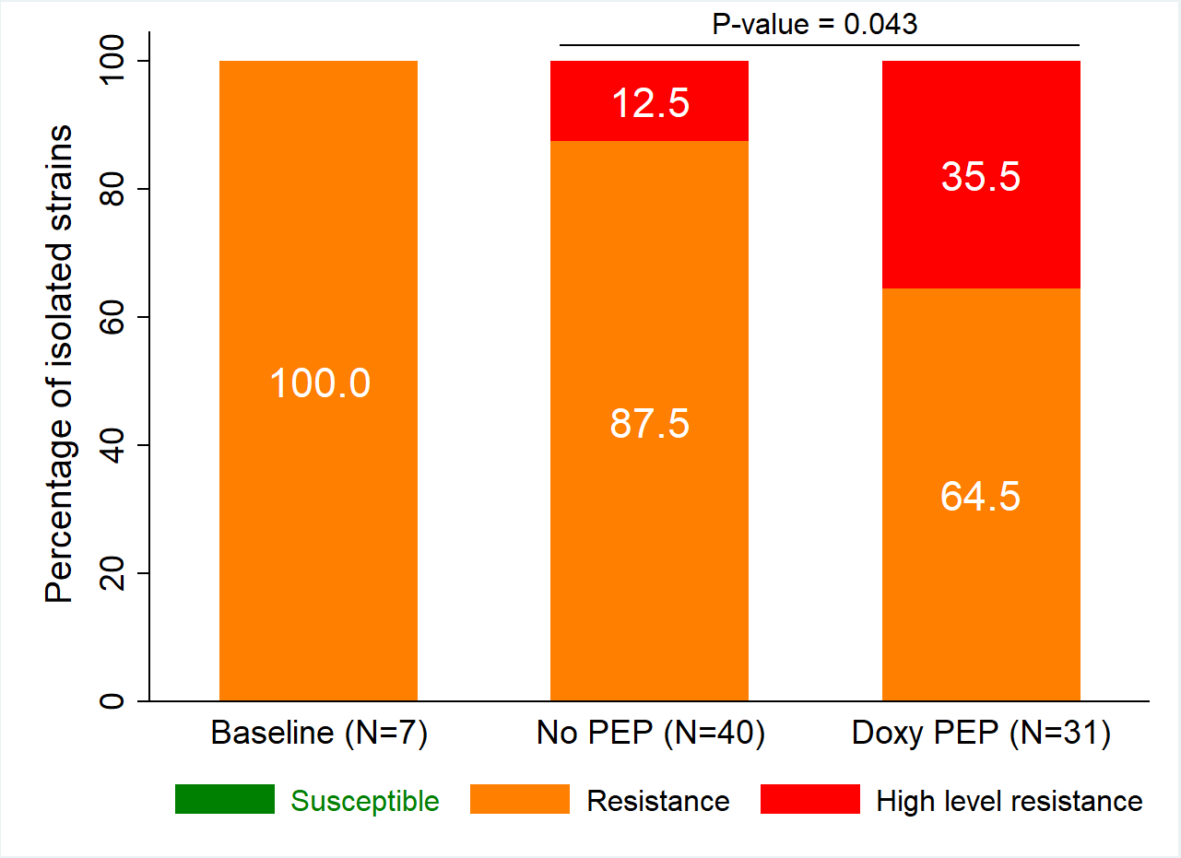

Resistance to Tetracycline, MIC Distribution
78 GC isolates
More high-level tetracycline-resistant isolates in the DoxyPEP arm
Low Level Resistance High Level Resistance
12.5
35.5
100
87.5
64.5
Baseline (N=7)
NoPEP (N=40)
DoxyPEP (N=31)
Resistance MIC > 0.5 mg/L, High Level Resistance MIC > 8 mg/L
Molina et al, Lancet Inf Dis, 2024 May 23:S1473-3099(24)00236-6.; www.eucast.org/clinical_breakpoints/

Slide 25

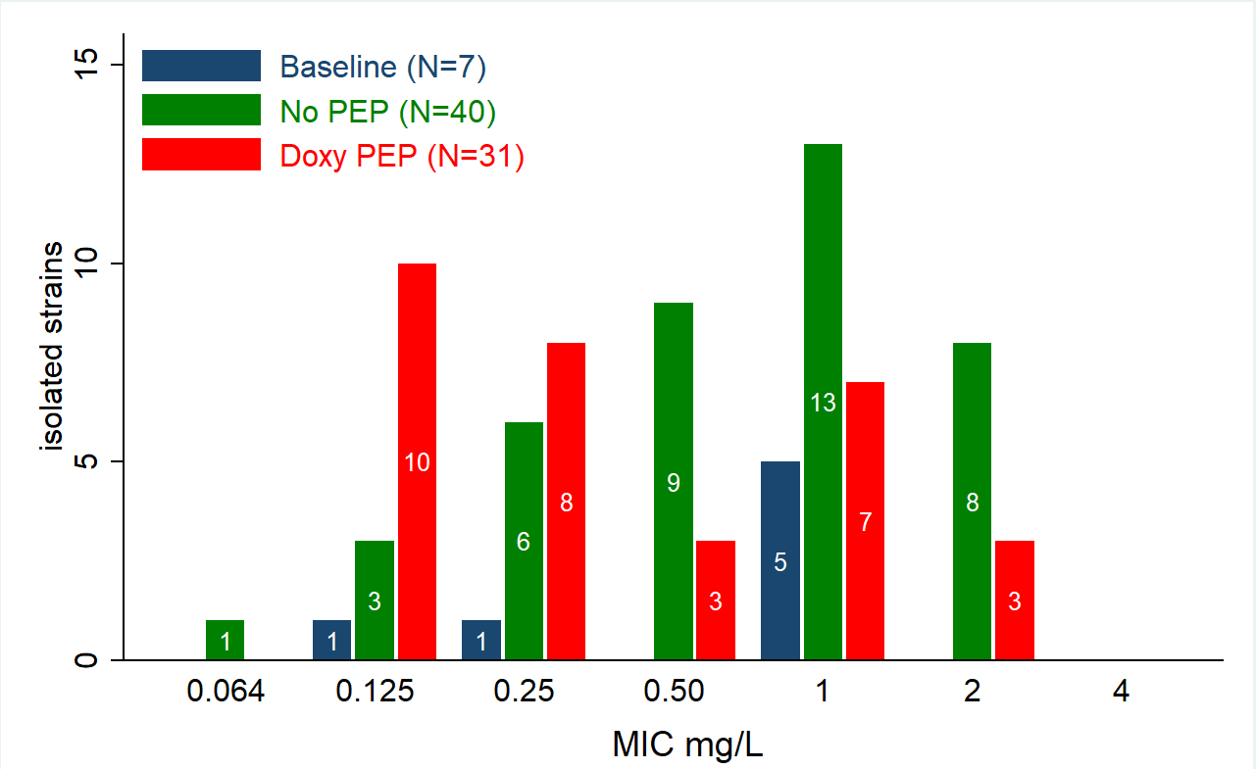
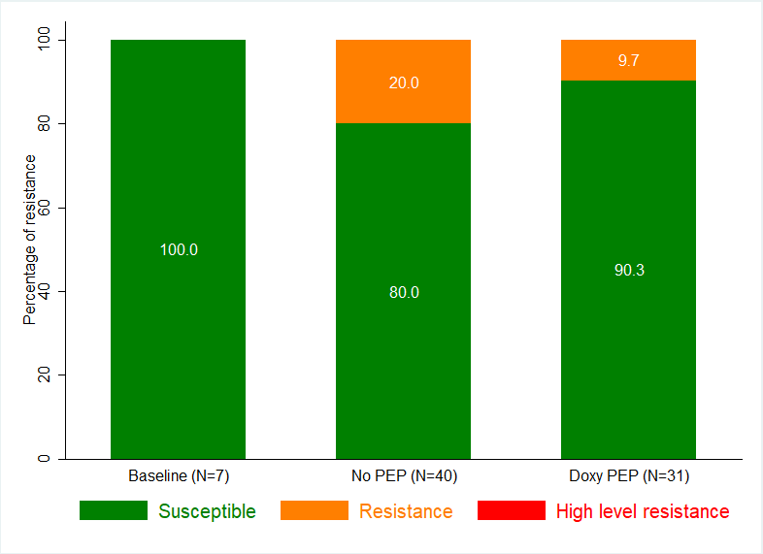
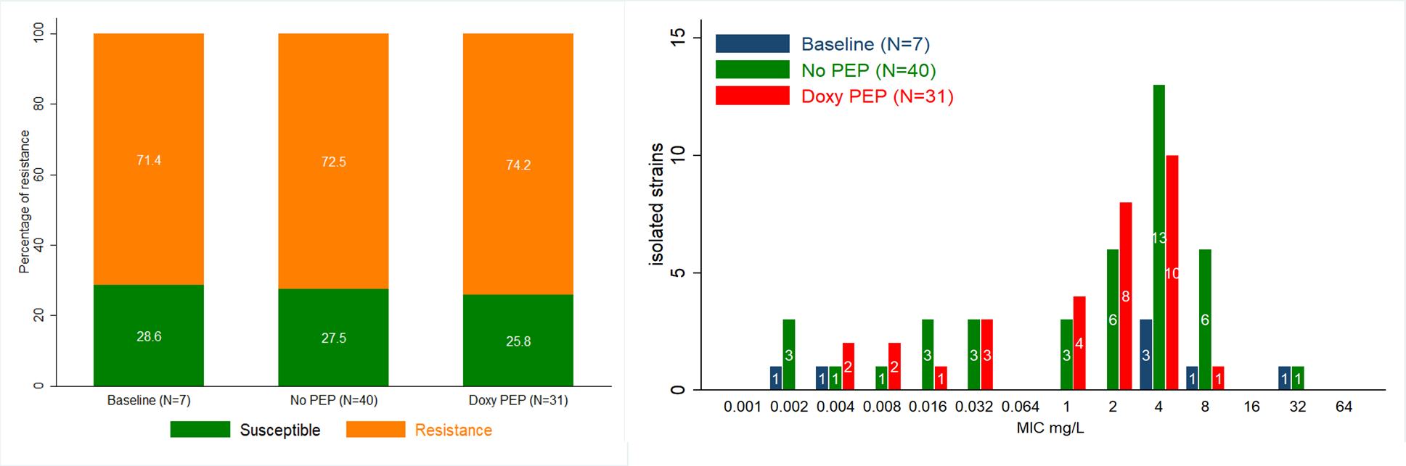
Resistance to Azithromycin and Ciprofloxacin
Azitrhromycin
R
78 GC isolates for resistance testing using EUCAST breakpoints
(17% of PCR + events)
Ciprofloxacin
Similar distribution of MICs in each arm
R

Slide 26
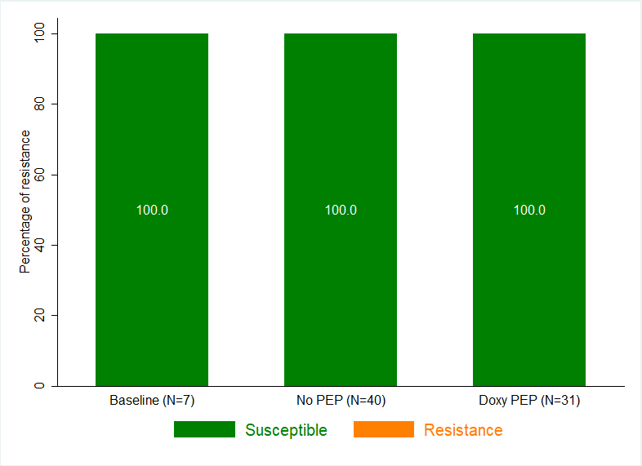
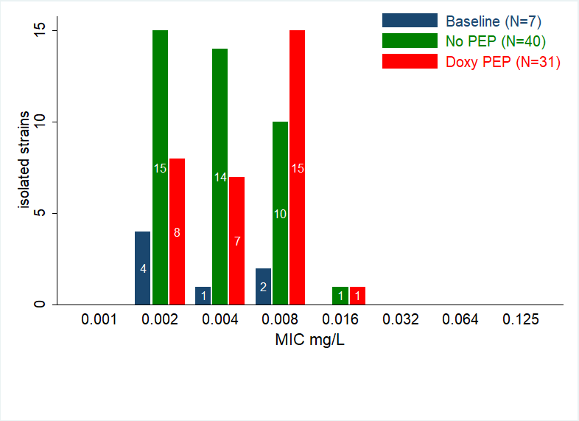
Susceptibility to Ceftriaxone, MIC distribution
78 GC isolates
All GC isolates were fully susceptible to ceftriaxone
Percentage of isolated strains
Decreased Susceptibility (DS)
Resistant
100
100
100
Baseline (N=7)
NoPEP (N=40)
DoxyPEP (N=31)
Resistance: MIC>0.125 mg/L, Decreased Susceptibility 0.125≤MIC>0.032 mg/L
www.eucast.org/clinical_breakpoints/

Slide 27
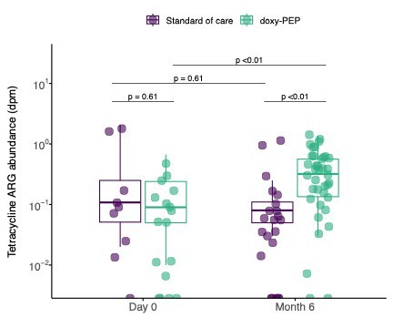
Doxy-PEP Associated with Higher Number of AMR Genes without Significant Alteration of Microbiome Diversity
Comparison of actively expressed AMR genes in 46 dPEP and 24 SOC ppts
No difference in gut bacterial microbiome α- or β-diversity or total abundance between arms at M0 or M6, or over time by arm
Actively expressed TCN-R genes increased by median of 2 in dPEP group (P<0.01) without change to non-TCN classes
Increase in TCN AMR genes btwn M0 to M6 among Doxy-PEP participants
Chu, et al. Nat Med 2025

Slide 28
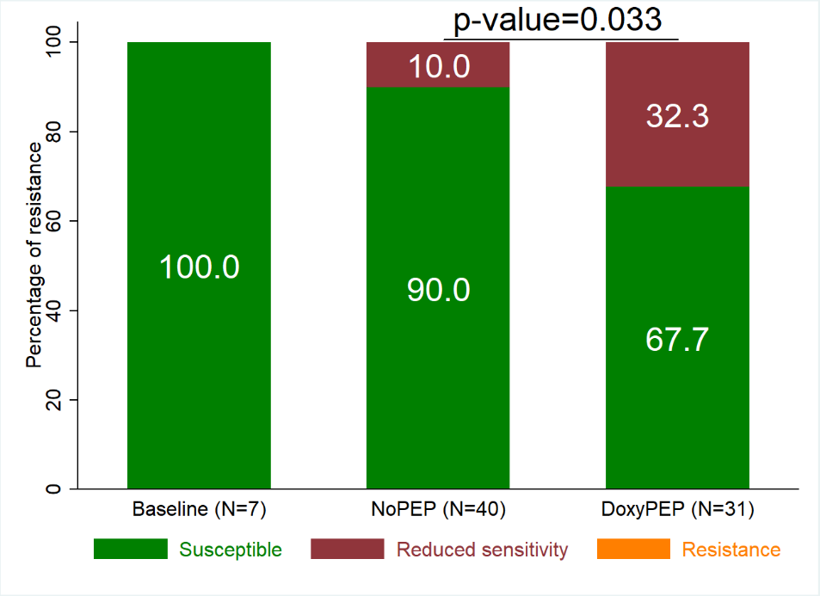
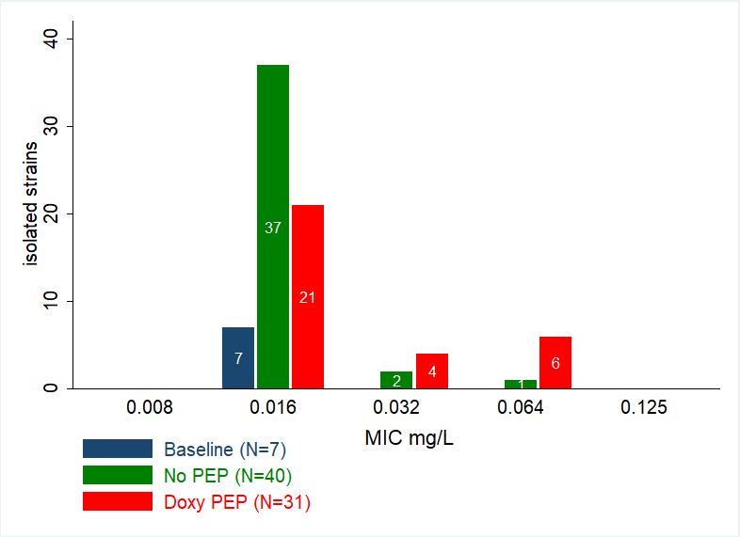
Susceptibility to Cefixime
78 GC isolates
Isolates with Decreased Susceptibility to cefixime were more frequent in the doxyPEP arm.
Decreased
Susceptibility
Resistant
penA34.007
allele
detected
Resistance: MIC>0.125 mg/L, Decreased susceptibility 0.125≤MIC>0.032 mg/L
Bercot B. et al CID 205
www.eucast.org/clinical_breakpoints/
Notes:
Concerning the cefixime which is an oral cephalosporin no longer recommended for treatment, we highlighted GC isolates with decreased susceptibility to cefixime. It was more frequent in the doxyPEP arm by the power is low as we have only 6 isolates in the pep arm versus 1 in the nopep arm.
We have sequenced theses strains and we found that these GC isolates with DS harbor in their genome a novel mosaic variant penA called panA thirty four point O O seven responsible of this decreased susceptibilty.

Slide 29
Presence of a cluster carrying the penA34.007 allele associated with Decreased Susceptibility to cefixime
Phylogenetic tree of the 78 GC isolates obtained by WGS
Ceftriaxone: S
Azithromycin: S
Cefixime: DS
Tetracycline: HLR
Ciprofloxacin: R
penA34.007
Pts Visit Arm TetM TEM MLST
0.064
0.064
0.064
0.064
0.016
0.008
0.008
0.008
0.032
0.032
0.032
0.008
0.008
0.008
0.064
0.032
0.064
0.064
0.008
0.008
0.008
0.008
0.032
0.032
0.004
0.004
Bercot et al CID 2025
Notes:
You can show the arm in red for pep arm, the penA variant, the MIC followed by the susceptibilty or not to the antibiotic cefixime with decreased susceptibility.
We could observed in the first cluster of 11 isolates an association of decreased susceptibility to cefixime and HLR to tetracycline mediated by the tetM gene
By contratst we do not found this association in the second group regrouping 2 isolates.

Slide 30
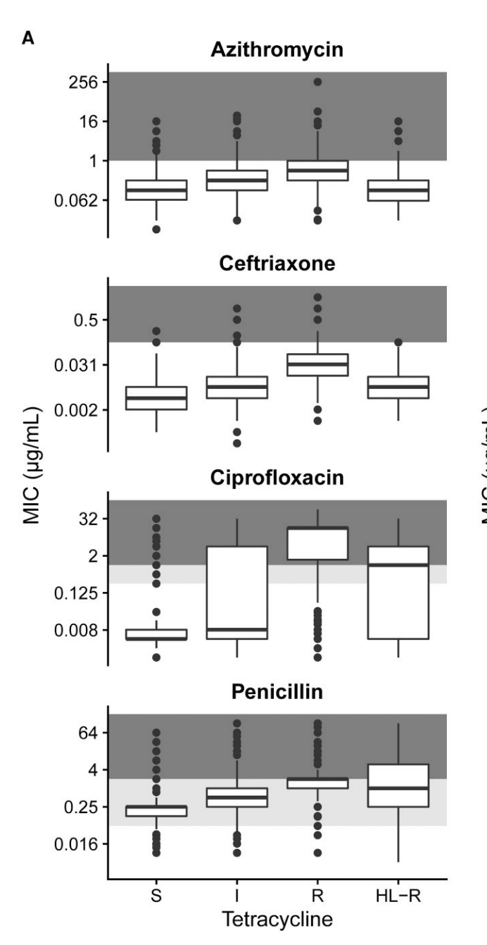
N. Gonorrhoeae and Tetracycline Resistance
14,000 GC sequences from 2018 to 2024 in the USA
- Increase in isolates carrying tetM increased from <10% in 2020 to >30% in 2024% : role of shift away from AZT, more doxyPEP
- Since 2020, 2/4 major tetM carrying lineages also carried the penA variant including penA 34
- Fear of selection of strains with increased resistance to ceftriaxone and other antimicrobials
Genomic and antimicrobial susceptibility data of 5644 Ng isolates
Co-resistance in isolates with chromosomally encoded tetracycline-R (rpsJ mutations)
Plasmid-encoded tetracycline-R (tet M) associated with HLR to tetracycycline but less co-resistance to other antimicrobials
Helekal, Mortimer and Grad, NEJM 2025; Mortimer TD and Grad YH. CID 2023
Notes:
History of discovered and recommended antimicrobials and evolution of resistance in NG, including the emergence of genetic resistance determinants
SPT: spectinomycin, CRO ceftriaxone, OFX ofloxacin, CFM cefixime

Slide 31
NG surveillance data from King County in MSM (WA, USA) Following Release of DoxyPEP Guidelines
- NG with high-level tetR increased from 30 to 65% (Q2 2024) (p<0001) and associated with > 3 doses of DoxyPEP/month
- Nasopharyngeal colonization with S. aureus less common (27 vs 36%) but increase in tet-R (18 vs 8%, p<0.001)
-Nasopharyngeal colonization with Group A Streptococcus more frequent (9 vs 4%) with increase in tet-R (9 vs 4%, p<0.008).
Soge OO, et al CID 2025

Slide 32
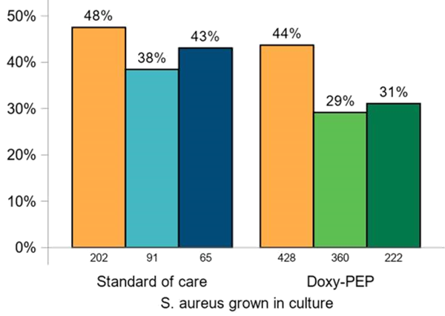
S. aureus colonization: 14% absolute decrease in Doxy-PEP arm
p = 0.15
p < 0.01
S. aureus colonization is associated with subsequent clinical Staph infections, such as surgical infections and bacteremia.¹
DoxyPEP use associated with 14% absolute decrease in S. aureus colonization.
14% point ↓
1. Oestergard AIM 2016; Jacobsson Scand JID 2008; Septimus CID
2016; Bode NEJM 2010

Slide 33
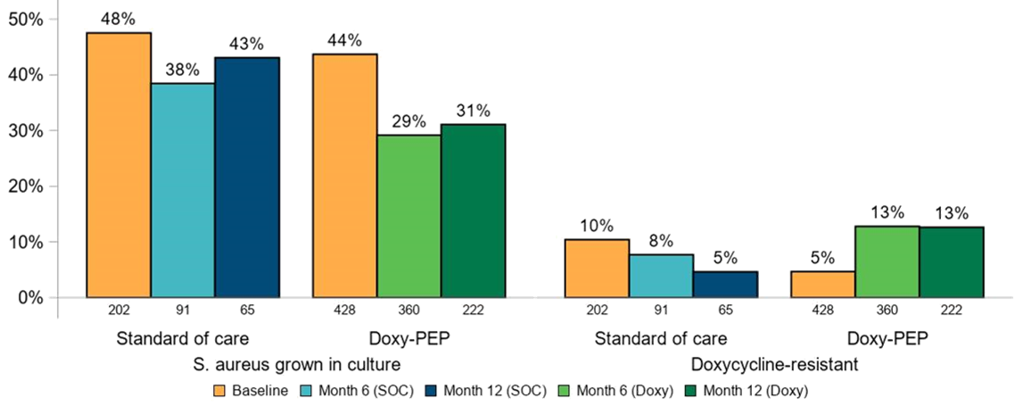
S. aureus: 8% absolute increase in doxycycline resistance
p = 0.15
p < 0.01
Doxy-R low in both arms; imbalance at baseline.
8% absolute increase in resistance in doxy-PEP arm from baseline.
p < 0.01
p = 0.16
8% point↑

Slide 34
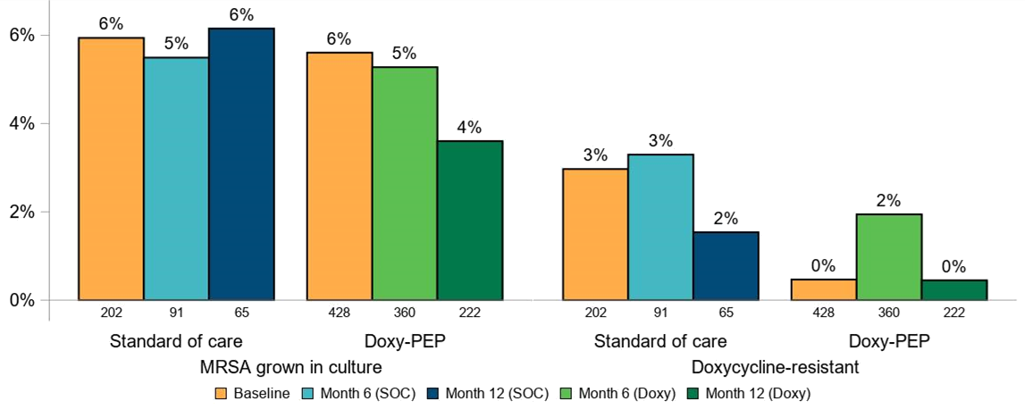
MRSA: Low Colonization rate and No change in Doxycycline Resistance with doxy-PEP
p = 0.95
p = 0.44
p = 0.81
p = 0.09

Slide 35

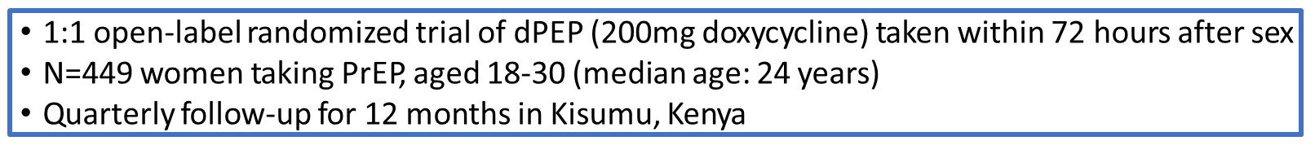


Doxycycline PEP for Prevention of STIs among Kenyan Women on HIV PrEP

Slide 36
Failure of Doxy PEP among Young Women on PrEP in Kenya
Analysis | Endpoint | Total | PEP (N=224) | SOC (N=225) | RR | 95% CI | P-value
Intention to Treat | All STIs | 109 | 50 | 59 | 0.88 | 0.60-1.29 | 0.51
 | Chlamydia | 85 | 35 | 50 | 0.73 | 0.47-1.13 | 0.16
 | Gonorrhea | 31 | 19 | 12 | 1.64 | 0.78-3.47 | 0.19
Genomic test for tetracycline R (tetC): 0 % (0/76) for Ct
Genomic test for tetracycline R (tetM) 100 % (48/48) for Ng
No HIV and 1 syphilis
DoxyPEP self-reported adherence 78% but Doxy detected in hair in only 29% of visits
Stewart J. et al. NEJM 2023

Slide 37
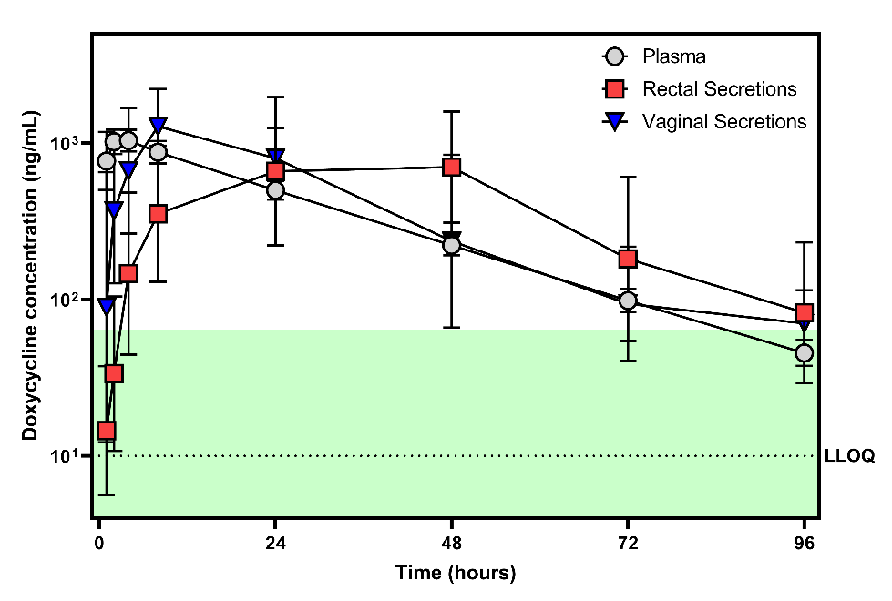
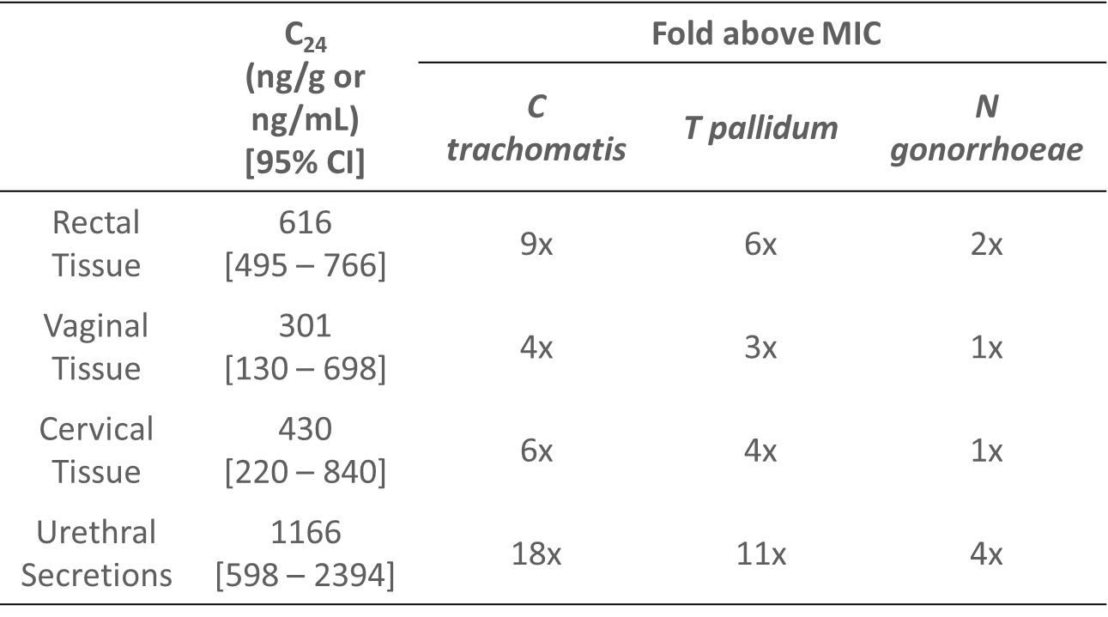
Doxycycline Concentrations with 200 mg SD
11 Males and 9 females |  | Time above C. trachomatis MIC
 | C_{max} | MIC | 4x MIC
Plasma | 16x | 87 hr | 44 hr
Rectal Secretions | 11x | 97 hr | 62 hr
Vaginal Secretions | 20x | 101 hr | 45 hr
Minimum Inhibitory Concentrations (MIC): C trachomatis MIC₉₀ = 64 ng/mL and T. pallidum MIC₉₀ = 100 ng/mL (Zheng Sex Transm Dis 2015)
Mucosal doxycycline concentrations greater than in plasma
Reach >10x C trachomatis MIC
Remain >4x C trachomatis MIC up to 2 days after dosing
Haaland R et al. Ebiomedicine 2024

Slide 38









Weekly Doxycycline Prophylaxis for STI Prevention Among Cisgender Women in Kenya
Design: Open-label, single arm pilot study
Intervention: 200mg doxycycline hyclate every 7 days (+/- 1 day) as directly observed therapy at study clinic, pharmacy, or peer delivery
Population: 60 nonpregnant cisgender women, aged 18-30, taking HIV PrEP, in Kisumu, Kenya 2024-2025
Approach: Quarterly follow-up with endocervical CT/GC NAAT and plasma RPR testing for 6 months
Analysis: Descriptive analysis of quarterly surveys and GEE and Cox comparison with first 6 months of follow-up SOC group in dPEP Kenya Study (censoring pregnancy and clinical hold time).
Incident chlamydia rate weekly doxycycline: 11.2 /100 PY
Incident chlamydia rate dPEP Kenya SOC : 29.6 /100 PY
Endpoint | Weekly Doxy DOT (N=60) | SOC dPEP Kenya (N=225) | RR | 95%CI | P-value
All STIs | 6/57 (10.5%) | 31/220 (14.1%) | 0.73 | 0.28-1.91 | 0.52
Chlamydia | 3/57 (5.3%) | 29/220 (13.2%) | 0.39 | 0.12-1.25 | 0.11
Gonorrhea | 4/57 (7.0%) | 5/220 (2.3%) | 3.03 | 0.637-14.40 | 0.16
When taken, doxycycline prophylaxis may prevent STIs among people who were assigned female sex at birth.
Adolescent Trial Network will be launching a trial of on-demand doxyPEP vs weekly doxy vs SOC among AGYW in USA (ATN-173/HPTN-115)
Stewart J. et al STI and HIV 2025

Slide 39
Daily Doxycycline (100 mg/d) for STI Prophylaxis
170
Randomized open-label trial in 30 HIV-infected patients with prior syphilis in the USA
At week 48: HR of STI 0.27 (95%CI 0.09-0.83) with daily doxycycline (Bolan et al Sex Transm Dis 2015)
Randomized Open-label trial in 52 MSM on PrEP with prior syphilis in Canada
At week 24, 79% reduction in syphilis, 92% for Chlamydiae and 68% for gonorrhea. At week 48: aOR: 0.36 (0.15-0.89) (Grennan et al CID 2025).
Retrospective study in 40 female sex workers in Japan
After daily doxycycline initiation, incidence of STIs dropped from 232 to 79 per 100 PY with no more case of syphilis: IRR 0.33, p=0.02) For chlamydia IRR: 0.35, p=NS) (Abe et al JAC Antimicrob Resistance).
Notes:
Remarque : pas d’efficacité de la prophylaxie par doxycycline attendue sur le gonocoque.
Excellente observance à la doxycycline administrée quotidiennement.
Cette étude est à rapprocher de celle réalisée dans l’essai ANRS-IPERGAY avec la doxycyline en PEP à la demande. (Molina JM et al, Lancet Infectious Diseases 2017).

Slide 40
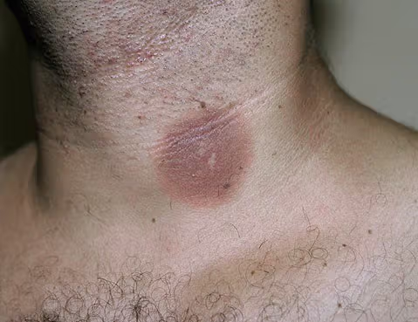
Adverse Events in ANRS DOXYVAC
Nb of Participants (%) | DoxyPEP N=369 | No PEP N=187 | P value
Any Serious AE | 65 (18) | 27 (14) | 0.57
Any drug-related SAE* | 1 (<1) | 0 (0.0)
Any Grade 3 or 4 AE | 21 (6) | 10 (5) | 0.75
Drug-Related AEs | 25 (7)
Treatment D/C for Drug-related Aes** | 6 (2)
Drug-Related AEs in > 3 pts
Nausea/vomiting | 11 (3)
Abdominal pain | 7 (2)
Diarrhea | 4 (1)
* Fixed drug eruption
** for diarrhea, abdominal pain, vomiting
Molina et al Lancet ID 2024

Slide 41
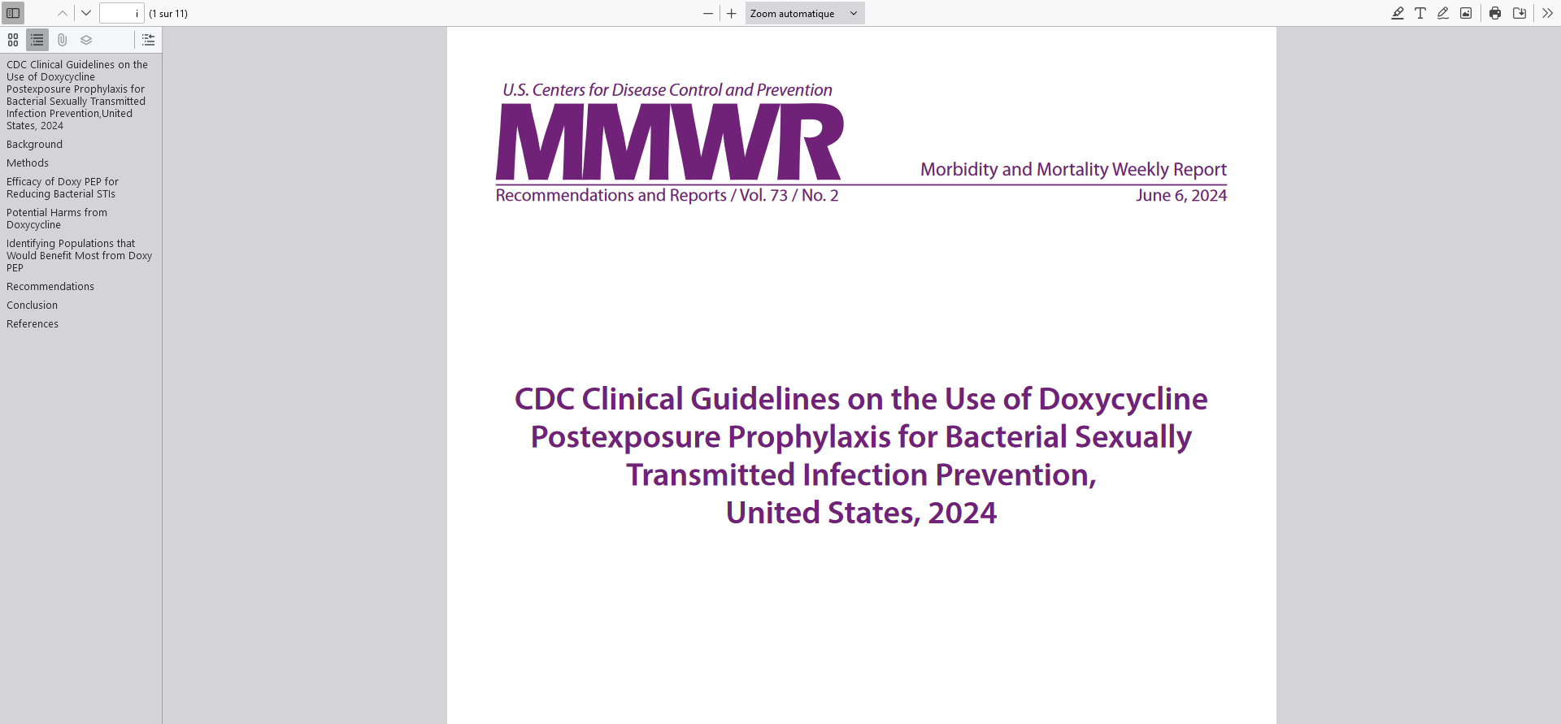
CDC recommends that MSM and TGW who have had a bacterial STI (specifically syphilis, chlamydia, or gonorrhea) diagnosed in the past 12 months should receive counseling that doxy PEP can be used as postexposure prophylaxis to prevent these infections.

Slide 42
How to Use Doxy PEP
MSM and TGW living with or without HIV and bacterial STI in past 12 months
Oral, vaginal or anal sex with casual partners without regular use of condoms
Screen and treat for GC, CT, and syphilis before starting PEP
No tetracycline allergy and no concomitant treatment with retinoïds or anticonvulsivant
Doxy PEP prescription:
200 mg Doxy with food and a full glass of water > 1 h before lying down
ASAP after sex, and no later than 72h
Counseling of Doxy PEP:
Discuss and assess potential harms: photosensitivity, oesophagitis, gastrointestinal intolerance
Counsel on DDI: separate by 2h dairy products, antacids, supplements with Ca, Iron, magnesium, sodium bicarbonate
Testing for STIs every 3-6 months
Ongoing need for DoxyPEP should be reassessed every 3-6 months
MMWR 2024
Notes:
42

Slide 43
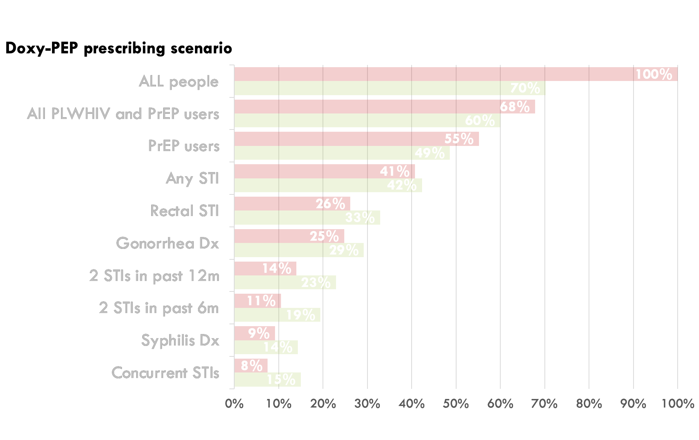
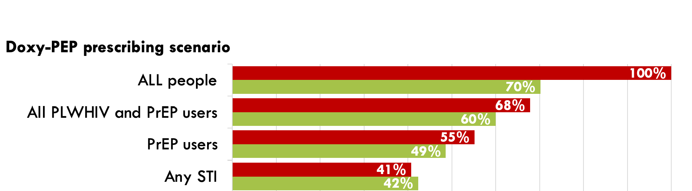
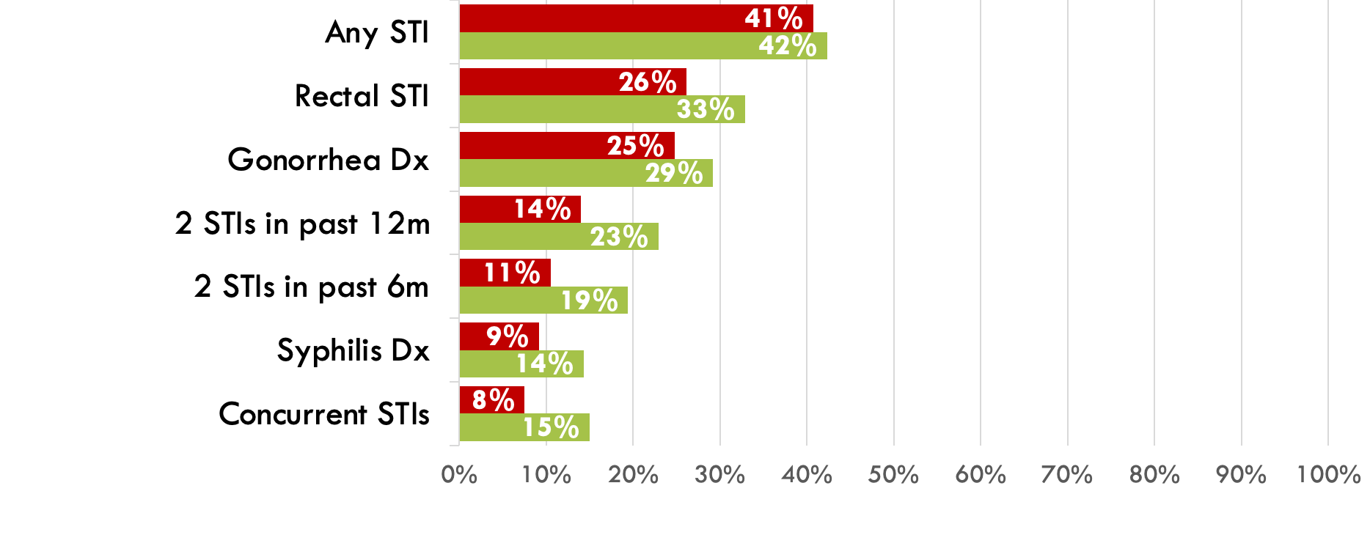

DoxyPEP Use vs STIs Averted in a US Sexual Health Clinic
Prescribe doxy-PEP to:
Prescribe doxy-PEP following:
27
Confidential. Please do not distribute.
Traeger M, CID 2023
Notes:
Cohort of 10,562 persons, 94% MSM at Fenway 54% on PrEP, 14% HIV, 37,4% STI incidence

Slide 44
DoxyPEP Guidelines
France (2025)
DoxyPEP not recommended among MSM and TGW but it is “possible to prescribe it in people at high risk with at least 2 STIs in past 12 months”
UK (2025)
DoxyPEP recommended for GBMSM and TGW at elevated risk of acquiring syphilis. Can be considered in women on a case by case basis.
Australia (2024)
DoxyPEP should be considered primarily for the prevention of syphilis among GBMSM at risk for this STI, with a secondary benefit of reductions in other STIs
IUSTI Europe (2024)
Considerable uncertainties remain over long-term benefit, population impact, AMR, and scalability.
Decision to offer DoxyPEP should be taken in the context of local STI epidemiology, user involvement with patient information.
WHO is working on recommandations for use of DoxyPEP
Notes:
44

Slide 45
Summary on DoxyPEP
Short-term benefits of Doxycycline PEP among MSM and TGW at high risk
Strong reduction of syphilis and chlamydia incidence with no immediate threat for resistance
Impact on gonorrhoea likely to be limited and wane over time
Overall well tolerated with high acceptability and adherence
Long-term uncertainties: Continue research
Monitor AMR : risk of selection and dissemination of resistant GC lineages
Impact on the microbiome and off-target effects
Time for cautious DoxyPEP implementation in MSM and TGW at high risk
Limit to 1-2 doses per week of DoxyPEP
Perform test of cure if Doxy is used for treatment of breakthrough STI
Continue active surveillance for GC AMR
Notes:
45

Slide 46








Acknowledgments
Annie Luetkemeyer
Connie Celum
Jenell Stewart
Béatrice Bercot
Cécile Bébéar
Notes:
46
46

Slide 47
Q&A

Slide 48
This webinar recording and slides will be posted on www.icap.columbia.edu

Slide 49
Thank you

