Slide 1
Detecting Recent Infections In Outpatient Departments:
A Multi-Country Analysis
Suzue Saito, PhD, MIA, MA
ICAP at Columbia University New York, NY USA
None
Notes:
On behalf of my co-authors, I am please to present our abstract:
“Detecting Recent Infections in Outpatient Departments: A Multi-Country Analysis”.

Slide 2
Background
Diagnosing all persons living with HIV (PLHIV) as early as possible after infection is critical to reach and sustain HIV epidemic control.
The U.S. President’s Emergency Plan for AIDS Relief (PEPFAR) has prioritized targeted testing approaches, such as index testing as the most efficient means to locate PLHIV.
HIV recent infection surveillance using recent infection testing algorithms (RITA) in routine HIV testing services (HTS) can help identify which testing approaches are effective at identifying PLHIV earlier to inform their public health response.
Notes:
Diagnosing all persons living with HIV as early as possible after infection is critical to reach and sustain HIV epidemic control.
The U.S. President’s Emergency Plan for AIDS Relief or PEPFAR has prioritized targeted testing approaches such as index testing as the most efficient means to locate persons living with HIV.
HIV recent infection surveillance using recent infection testing algorithms in routine HIV testing services can help identify which testing approaches are effective at identifying persons living with HIV earlier to inform their public health response.

Slide 3
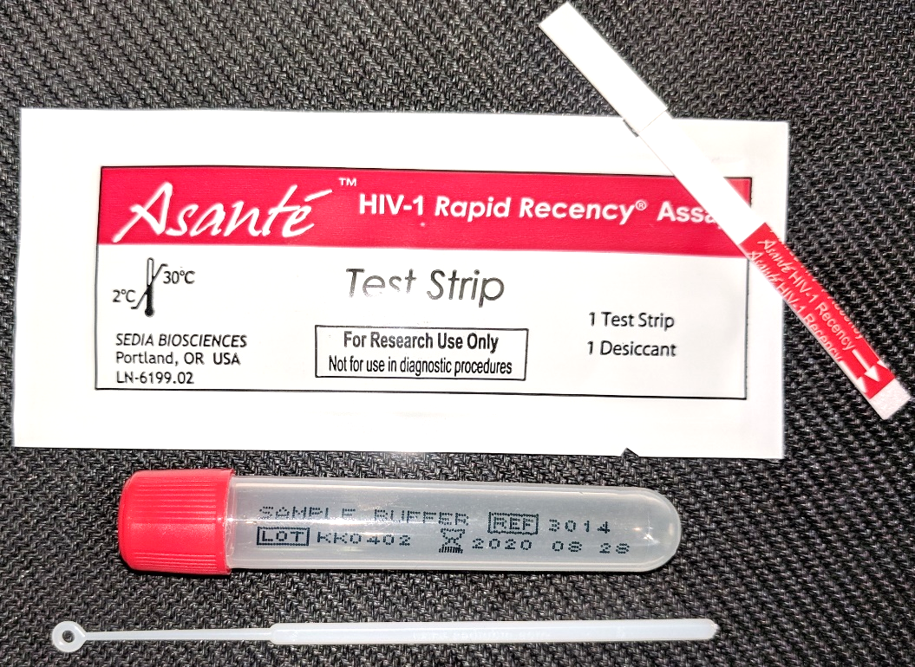
Methods: HIV-1 Recent Infection Testing
Rapid Test for Recent Infection (RTRI): A rapid point-of-care HIV test that distinguishes recent (<12 mo) from long-term (≥12 mo) infection among newly diagnosed ≥15 yrs
RTRIs are not recommended for use in re-testers on ART (30-50% of clients presenting for HIV diagnosis)
RITA: Baseline VL among RTRI recent to reclassify those with HIV RNA <1000 copies/mL not having a new diagnosis
LT
V
C
Negative
Recent
Long-term
Notes:
Rapid test for recent infection or RTRI is a rapid point of care HIV test that distinguishes recent infection, from a long-term infection among clients presenting for HIV diagnosis at age 15 and older. The cut off used in the assay that is widely used around the world shown on the right is 12 months, where a recent infection is an infection acquired less than 12 months ago and a long-term infection is an infection acquired 12 months and longer ago.
RTRIs is not recommended for use in re-testers on ART, which is estimated to account for 30-50% of clients presenting for HIV diagnosis in many HIV programs.
In this context, use of recent infection testing algorithm or RITA is important, where those who test RTRI recent have their baseline viral load measured. Those who have baseline viral load with HIV RNA of <1000 copies/mL are assumed on ART and reclassified to not having a new HIV diagnosis.

Slide 4
Methods: Data
 | 2019 |  |  |  |  |  | 2020 |  |  |  |  |  |  |  |  |  |  |  | 2021
268 Sites 27-month period | July | August | September | October | November | December | January | February | March | April | May | June | July | August | September | October | November | December | January | February | March | April | May | June | July | August | September
DRC RITA; Elig. ≥18y |  |  |  |  |  |  |  |  |  |  |  |  |  |  |  |  | 77 sites, 11 months |  |  |  |  |  |  |  |  |  | 11 months
Eswatini RITA; Elig. ≥15y | 162 sites, 27 months |  |  |  |  |  |  |  |  |  |  |  |  |  |  |  |  |  |  |  |  |  |  |  |  |  | 27 months
Lesotho RTRI; Elig. ≥18y |  | 29 sites, 9 months |  |  |  |  |  |  |  | 9 months
Notes:
We analyzed recent infection surveillance data from 268 sites across 3 countries over a 27-month period as shown in the schematic here.
Eswatini contributed the largest amount of data throughout the period. In DRC, recent infection surveillance began in November of 2020 during the COVID pandemic while in Lesotho the surveillance began in August of 2019 and halted due to the COVID pandemic.
In DRC and Eswatini, RITA was used while in Lesotho RTRI was used without baseline VL on RTRI recent samples.
Eligibility criteria slightly differenced across countries: Recent infection testing was offered to those 18 years and older in DRC and Lesotho while in Eswatini those 15 years and older were included.
Democratic Republic of Congo (DRC): November 2020–September 2021
Eswatini: July 2019–September 2021
Lesotho: August 2019–April 2020.

Slide 5
Methods: Analysis
$\text{Share} \text{of} \text{Recent} \text{Cases}$:
$$\frac{\text{Number} \text{of} \text{RITA} \text{or} \text{RTRI} \text{recent} \text{cases} \text{at} \text{a} \text{testing} \text{location}}{\text{Total} \text{number} \text{of} \text{RITA} \text{or} \text{RTRI} \text{recent} \text{cases} \text{in} \text{the} \text{country}}$$
$$\text{Yield} \text{of} \text{Recents} \text{Cases}\text{:}$$
$$\frac{\text{Number} \text{of} \text{RITA} \text{or} \text{RTRI} \text{recent} \text{cases} \text{at} \text{a} \text{testing} \text{location}}{\text{Total} \text{number} \text{of} \text{RITA} \text{or} \text{RTRI} \text{tested} \text{at} \text{the} \text{testing} \text{location}}$$
ANC
VCT
OPD
Recent
Long Term
Notes:
We examined the share and yield of RITA or RTRI recent cases by testing location.
The share of recent cases is defined as:
The number of RITA or RTRI recent at a testing location over the total number of RITA or RTRI recent cases in the country
The yield of recent cases is defined as:
RITA or RTRI recent at a testing location over the total number of RITA or RTRI tested at the testing location.
T
We further stratified these measures by age and sex.

Slide 6
Methods: Analysis
Testing Locations Included:
Outpatient Department (OPD)/Emergency
Index Testing
Voluntary Counseling and Testing (VCT)
Mobile Clinic, Community Outreach
Antenatal Care, Labor & Delivery, Postnatal Care, Child Welfare Clinics
Inpatient/TB
Voluntary Medical Male Circumcision
Family Planning
STI Clinic
ART Clinic
Stratified by age (<30, ≥30 years), and sex (M/F).
Poisson regression (Stata 15, College Station, TX) to assess statistical significance for both measures.
Notes:
We examined share and yield by testing location listed here from OPD to ART Clinic.
Note that index testing here includes both facility and community-based index testing.
We used Poisson regression to assess statistical significance for both share and yield in each testing location.
StataCorp. 2017. Stata Statistical Software: Release 15. College Station, TX: StataCorp LLC.

Slide 7
Results: Recency Testing Cascade, by Country
RITA Recent
RITA Recent
RTRI Recent
Notes:
This slide shows the recency testing cascade. For each country panel, the blue bars from the left represent the number of HIV+ diagnosed, among those who underwent RTRI testing, and of those who were tested RITA or RTRI recent. The red dot represents the proportion of RITA or RTRI recent among those RTRI tested. Proportion.
Overall, 18,170 individuals were tested with the majority of testing occurring in ESwatini with 14,540 tests done, which is about 78% of 18641 clients presenting for HIV diagnosis.
In DRC and Eswatini similar proportions of those tested were RITA recent at 4 and 5 % respectively.
In Lesotho where VL testing was not done on recent samples, 18% of those presenting for HIV diagnosis were RTRI recent.

Slide 8
Results: Share of Recent Cases by Testing Location
DRC
Eswatini
Lesotho
Similar results in age and sex stratified analyses; In Eswatini, Females < 30 years ANC/L&D/PNC/CWC were additionally important testing location
Notes:
Here we show the share of recent cases by testing location. In all countries, OPD accounted for the largest share of recent infections identified. In Eswatini, VCT and index testing were additionally significantly associated with identifying recent infections.
The predominance of OPD remained in age/sex disaggregated analyses, with the exception of females <30 years in Eswatini for whom ANC/L&D/PNC/CWC clinics were additionally significantly associated with identifying recent infections.
We did not see this in DRC/Lesotho.

Slide 9
Results: Yield of Recent Cases, by Testing Location
*
* p < 0.05
*
*
DRC (RITA)
*
RTRI Tests Administered
% Recent
*
*
*
Eswatini (RITA)
*
Lesotho (RTRI)
OPD/ Emergency | Index Testing | VCT | Mobile/ Community Outreach | ANC/L&D/ PNC/CWC | Inpatient/ TB | VMMC | Family Planning | Other/ Missing/NR | STI Clinic | ART Clinic
Notes:
Here we show the yield of recent cases. The red dots represent the yield while the blue bars represent the number of tests done. Yield of recent infections were highest in VCT clinics in DRC, family planning and STI clinics in Eswatini, and antenatal care, labor and delivery and post natal care and child welfare clinics in Lesotho. However, testing volume in these settings are very modest compared to outpatient departments.

Slide 10
Limitations
Recency surveillance remains limited in geographical coverage in DRC and Lesotho, as they prepare to scale up in 2022.
Lesotho has not used RITA, therefore people on ART who retest may be included as recent; findings may change as Lesotho begins RITA in 2022
Notes:
Recency surveillance remains limited in geographical coverage to 2 provinces in DRC and 1 district in Lesotho, as they prepare to scale up in 2022. These findings may change as countries scale up recency testing.
Lesotho has not used RITA to date, therefore people on ART who retest may be included as RTRI recent; Lesotho will begin RITA in 2022.

Slide 11
Conclusion
OPD is a critical testing location to identify recent infections in diverse country settings.
Recency testing can inform HIV testing efforts in OPDs to improve efficiency in countries at epidemic control; but still a critical testing location to maintain.
FP, STI, VCT, ANC/L&D/PNC/CWC had higher yield in some settings; however, the number of recent infections identified were modest with potentially limited program impact.
HIV recent infection surveillance can generate data and analyses that can help inform testing interventions to reach and sustain epidemic control.
Notes:
In conclusion,
Outpatient department is a critical testing location to identify recent infections in diverse settings including Lesotho and Eswatini that have reached epidemic control as well as in DRC which has still yet to reach epidemic control.
Recency testing can inform HIV testing efforts in OPDs, to improve efficiency in testing with for example improved screening in countries at epidemic control. However, OPDs will continue to be an important testing location to maintain the gains made to achieve epidemic control.
Family planning, STI, VCT, antenatal care, labor and delivery, postnatal care and child welfare clinics have higher yield in some settings; however, the number of recent infections identified were modest with potentially limited program impact.
HIV recent infection surveillance can generate data and analyses that can help inform testing interventions to reach and sustain epidemic control.

Slide 12
Acknowledgements
Special thanks: Neil Thivalapill
Co-Authors: Neil Thivalapill, Lenhle D. Nsibandze, Samkelo Simelane,
Dumile Sibandze, Vusie Lokotfwako, Munyaradzi Pasipamire, Peter Fonjungo,
Aime Mboyo, Tania L. Tchissambou, Mugyenyi Asiimwe, Appolinaire Tiam,
Tlhomola Mphotleng, Keisha Jackson, Michael Martin, Stephanie Behel
Colleagues: Ministries of Health and CDC in DRC,
Eswatini, & Lesotho; ICAP HQ and regional recency
surveillance teams
This project is supported by the United States President’s Emergency Plan for AIDS Relief (PEPFAR) through the U.S. Centers for Disease Control and Prevention (CDC) under grant NU2GGH002171. The contents are solely the responsibility of ICAP and do not necessarily reflect the views of the United States Government.

Slide 13
Results: Share of Recent Cases for Females <30 in Eswatini
Eswatini - Overall
Eswatini – Females < 30
Notes:
The predominance of OPD remained in age/sex disaggregated analyses, with the exception of females <30 years in Eswatini for whom ANC/L&D/PNC/CWC clinics were additionally significantly associated with identifying recent infections.
We did not seet his in DRC/Lesotho.

