Slide 1
Is the Next Pandemic Already Here? The Looming Threat of H5N1 Co-sponsored by ICAP and the New York City Pandemic Response Institute (PRI)
ICAP GRAND ROUNDS
August 27, 2024

Slide 2
Jessica Justman, MD,
Senior Technical Director,
ICAP at Columbia University

Slide 3
Agenda
Reminders:
Welcome and Introduction –
Presentation
Q & A
For questions to the panelists, use the Q&A box
The webinar recording and slides will be posted on www.icap.columbia.edu

Slide 4
Vivien Dugan, PhD
Director, Influenza Division,
National Center for Immunization and Respiratory Diseases,
Centers for Disease Control and Prevention
Aspen Hammond, VMD, MPH,
Technical Officer,
Global Influenza Program,
World Health Organization

Slide 5
Global overview of avian influenza A(H5)
Aspen Hammond
ICAP Ground Rounds
27 August 2024

Slide 6
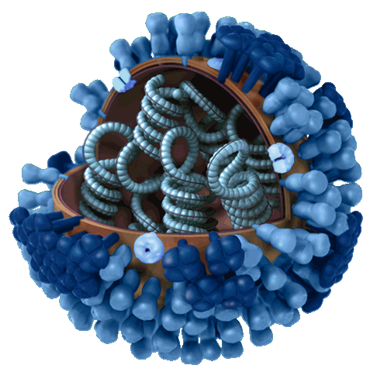
Influenza A viruses
Subtyped based on surface proteins
Hemagglutinin (H) and neuraminidase (N)
Current human (seasonal) subtypes: H1N1 & H3N2
Birds = natural reservoir for all subtypes
Wide host range = infects multiple species
Swine, horses, dogs, cats, whales, seals, reptiles, livestock...
Capacity for ‘species jumping’
Capable of epidemics and pandemics

Slide 7
Seasonal, pandemic, zoonotic influenza
Need for:
Global approach to monitor, prevent, and control seasonal influenza, detect and respond to novel and pandemic influenza
Monitoring the interface between humans and animals
Animal influenza
Influenza viruses that circulate in animals; includes avian and swine influenza viruses; H5 and H7 avian influenza viruses can be high or low pathogenicity in birds
Zoonotic influenza
An animal influenza virus that crosses species to humans
Pandemic influenza
An animal influenza virus that begins to spread among humans, who have no or little natural immunity
Seasonal influenza
An influenza virus that has adapted to humans, causing seasonal epidemics

Slide 8
Pandemic potential Necessary factors for a pandemic
New avian or zoonotic influenza virus emerges.
Virus has ability to cause sustained human-human transmission.
Human population has little or no immunity to the virus.
Note: It is clear that little changes of amino acids of the virus can cause a pandemic
Notes:
So again the things that we're worried about, that we pay attention to regarding a pandemic is, a new virus emerges or one that we know is circulating in Birds or in animals that, it then acquires the ability to be transmitted in a sustained fashion from one person to one person. Meaning you don't need contact with an animal to be infected. The reason why this is concerning is that there may be more and more because there's very little immunity to this virus. There’s no vaccination, most likely people have not been infected with this virus before so, there's a large population that is susceptible and it could spread quickly through a very susceptible human population. And it's important to note that, a virus is made up of amino acids and any one small change in those amina in amino acids could change the property of that virus and could have the effect of changing its transmission meaning, it could change the virus so that it's more likely to be spread from one infected person to another. And this is again why we emphasize it's very important that we keep a close eye on these viruses and, that we like to know the sequence of these viruses so we can detect these changes before they become a large problem.

Slide 9
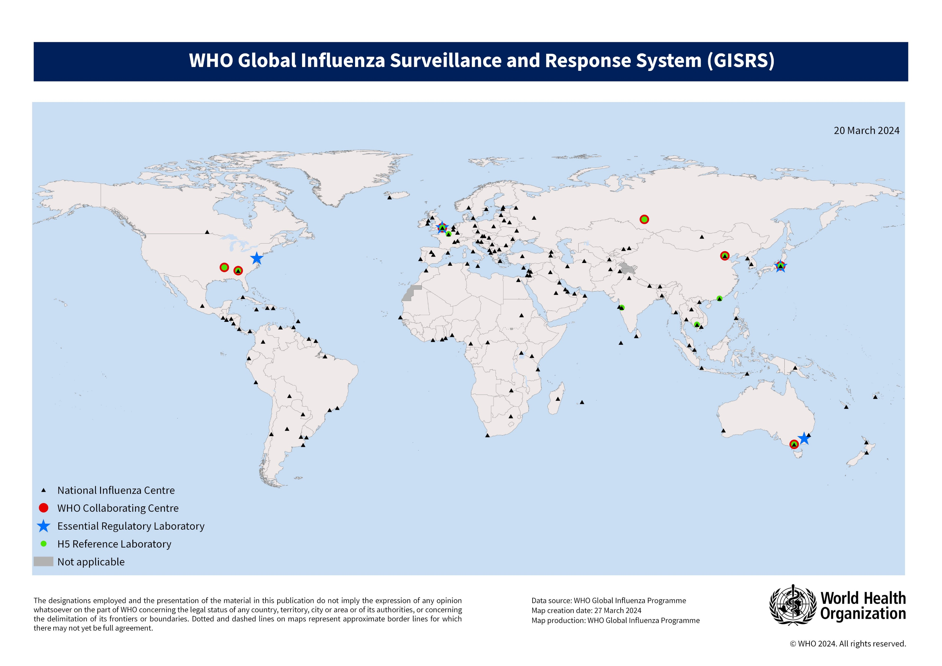
WHO approach to influenza since 1952 - GISRS
For over 70 years, the Global Influenza Surveillance and Response System (GISRS) has been the foundation for influenza surveillance, preparedness and response
Enormous commitment from Member States
Enormous support from international agencies & partners
https://www.who.int/initiatives/global-influenza-surveillance-and-response-system
Notes:
Because of the diversity of influenza viruses and their propensity to evolve and change, there is a critical need for global surveillance and characterization of influenza viruses.
152 NICs in 133 CATs or 130 MS
4 ERLs in 4 CAT or 4 MS
7 CCs in 6 CAT or MS
12 H5 ref labs in 10 CAT or 9 MS

Slide 10
GISRS monitoring of zoonotic influenza, 2003-2024
Notes:
In addition to surveillance of seasonal influenza, GISRS also monitors human infections with animal viruses. Here we can see the epidemic curve of zoonotic influenza infections since 2003. Nearly 900 detections of A(H5N1) in humans reported from over 20 countries since 2003, in red. The peaks in blue from 2023 thru 2017 represent human infections with A(H7N9) viruses. But infections with a variety of subtypes continue presently.

Slide 11
GISRS monitoring of zoonotic influenza, 2003-2024
Notes:
In addition to surveillance of seasonal influenza, GISRS also monitors human infections with animal viruses. Here we can see the epidemic curve of zoonotic influenza infections since 2003. Nearly 900 detections of A(H5N1) in humans reported from over 20 countries since 2003, in red. The peaks in blue from 2023 thru 2017 represent human infections with A(H7N9) viruses. But infections with a variety of subtypes continue presently.

Slide 12
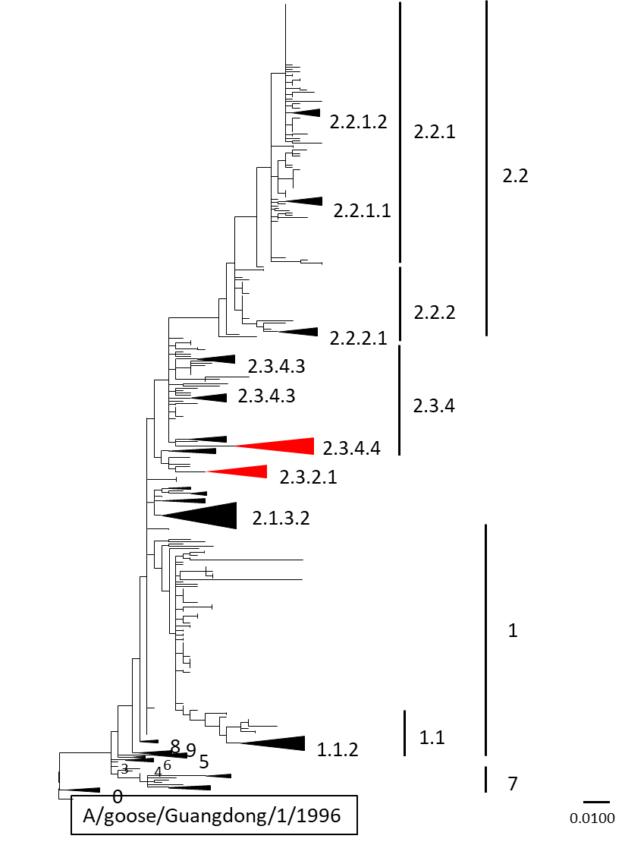
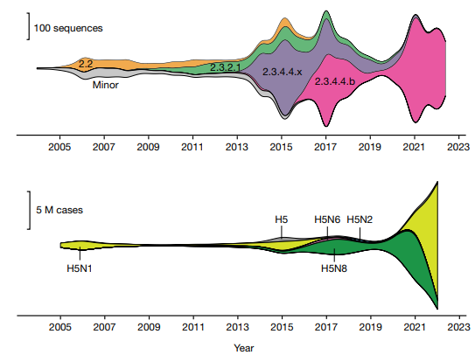
Eurasian lineage A(H5) viruses
Between 1996 (the emergence of A(H5N1) Gs/GD lineage virus) and 2004, the viruses diversified to 10 clades (0-9) in the HA gene.
The GsGd-lineage clades 2.2, 2.3.2, and 2.3.4.4 have been reported to cause global epidemics in both wild birds and poultry.
From 2016 onwards, 2 virus clades persisted and diversified into multiple subclades.
The clade 2.3.4.4 H5 viruses that emerged in 2008 contained HA mutations, allowing reassortment with numerous NAs, creating multiple A(H5Nx) subtype viruses.
HPAI H5 outbreak reports, subtypes and clades.
Above; clades, bottom; subtypes.
Nature 622, 810–817 (2023). https://doi.org/10.1038/s41586-023-06631-2

Slide 13
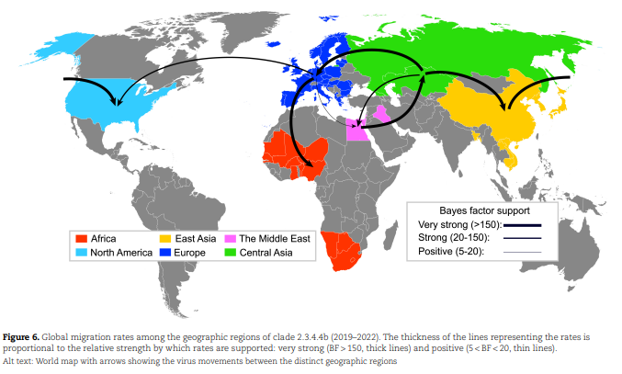
Clade 2.3.4.4b viruses have consistently expanded since 2020
More species, including wild birds and terrestrial and marine mammals have been infected with H5 viruses over the past few years.
2003-2019
2020-2023
Since 2020, avian influenza viruses, notably, H5N1 2.3.4.4b viruses spread predominantly via migratory birds to many parts of Africa, Asia, Europe, North & South America and Antarctica.
Emerg Infect Dis. 2024;30(3):444-452.
Fusaro, A. et al (2024). High pathogenic avian influenza A(H5) viruses of clade 2.3.4.4b in Europe - Why trends of virus evolution are more difficult to predict. Virus Evolution, 10(1).

Slide 14
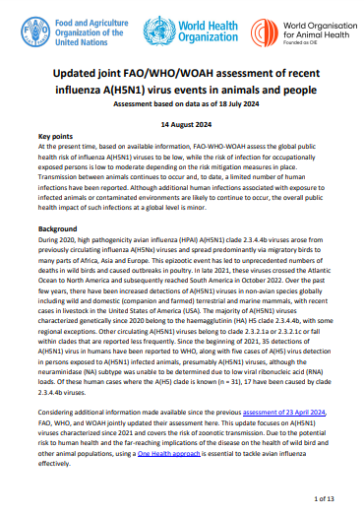
Ongoing FAO-WHO-WOAH avian influenza risk assessments
At the present time, based on available information, FAO-WHO-WOAH assess the global public health risk of influenza A(H5N1) viruses to be low, while the risk of infection for occupationally exposed persons is low to moderate depending on the risk mitigation measures in place. Transmission between animals continues to occur and, to date, a limited number of human infections have been reported. Additional human infections associated with exposure to infected animals or contaminated environments are likely to continue to occur.
This risk is reliant on strong surveillance, timely detection and sharing of information, sequences and viruses.
Updated joint FAO/WHO/WOAH assessment of recent influenza A(H5N1) virus events in animals and people

Slide 15
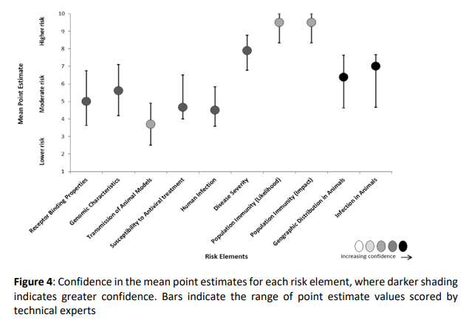
Risk assessment: Tool for Influenza Pandemic Risk Assessment
TIPRA focuses on the HAZARD component: influenza viruses with pandemic potential
An interdisciplinary One Health approach for close monitoring and assessment of virus dynamics in human and non-human populations
Supports preparedness for potential influenza pandemics.
Guides the provision/generation of candidate vaccine viruses
Aids countries in prioritizing their selection of pre-pandemic vaccine virus candidates for the potential to produce stockpiles of vaccines in the event of a future pandemic
https://www.who.int/publications/i/item/tool-for-influenza-pandemic-risk-assessment-(tipra)-2nd-edition

Slide 16
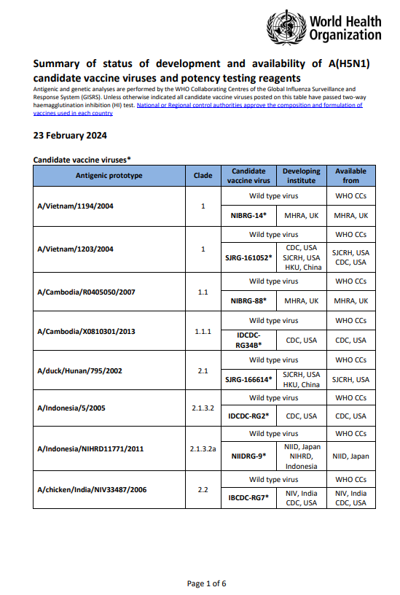
Candidate vaccine virus development for pandemic preparedness
The development of influenza candidate vaccine viruses (CVVs), coordinated by WHO, remains an essential component of the overall global strategy for influenza pandemic preparedness.
Zoonotic influenza viruses continue to be identified and evolve both genetically and antigenically, leading to the need for additional CVVs for pandemic preparedness purposes.
Meetings twice a year to update CVVs – upcoming meeting in September 2024.
Previous meeting: Genetic and antigenic characteristics of zoonotic influenza A viruses and development of candidate vaccine viruses for pandemic preparedness, February 2024
An update was published in May 2024 given new information on the H5N1 viruses identified in diary cattle in the USA: Genetic and antigenic characteristics of clade 2.3.4.4b A(H5N1) viruses identified in dairy cattle in the United States of America
A(H5N1) - Northern hemisphere 2024-2025

Slide 17
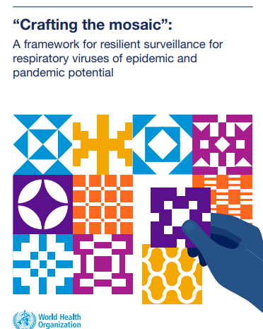
Surveillance
Surveillance for zoonotic influenza
Objectives
rapidly detect human cases of A(H5) virus infection
assess and monitor changes in transmission patterns and detect early any unusual events that may signal human-to-human transmission of the virus
characterize and monitor changes in influenza A(H5) viruses infecting humans – relative to those in animals- to inform control strategies
describe the clinical presentation of illness and identify risk factors for infection and severe outcomes.
The timely detection of a virus that could emerge, spread and cause illness in humans requires multiple event-based and indicator-based systems to work together.
“Crafting the mosaic”: a framework for resilient surveillance for respiratory viruses of epidemic and pandemic potential

Slide 18
Surveillance
Surveillance approaches
Health facility event-based surveillance
Workers at health care facilities, including private clinics, should be
informed about the possible signs and symptoms of infection with a zoonotic influenza virus,
and about how and to whom they should report any suspected cases.
Community event-based surveillance
Notifiable disease surveillance
Laboratory networks
Targeted special population surveillance
Monitor the health of people exposed to animals with influenza or to other people with zoonotic influenza.
Media event-based surveillance
Syndromic surveillance (ILI and SARI, etc)
Investigations and studies

Slide 19
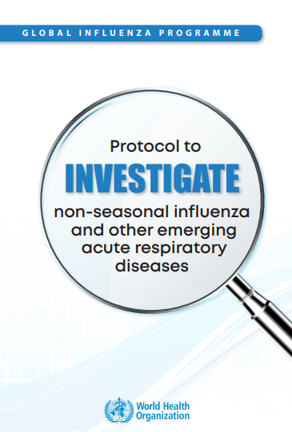
Investigations
Thoroughly investigate and monitor closely all suspected and confirmed cases and implement immediate public health actions:
include testing for animal influenza viruses in investigation and laboratory protocols,
assess exposure to animals and travel history,
contact tracing and active searching for other cases,
and the early identification of any unusual respiratory events that could signal person-to-person transmission of the virus.
Public health and animal health authorities should work together in a One Health approach and share information during investigations of human cases of zoonotic influenza,
assessing the role of local animals as sources of exposure,
understanding if any illnesses / deaths have occurred in local animals,
and whether animal influenza viruses are circulating in local animals.
https://www.who.int/publications/i/item/WHO-WHE-IHM-GIP-2018.2

Slide 20
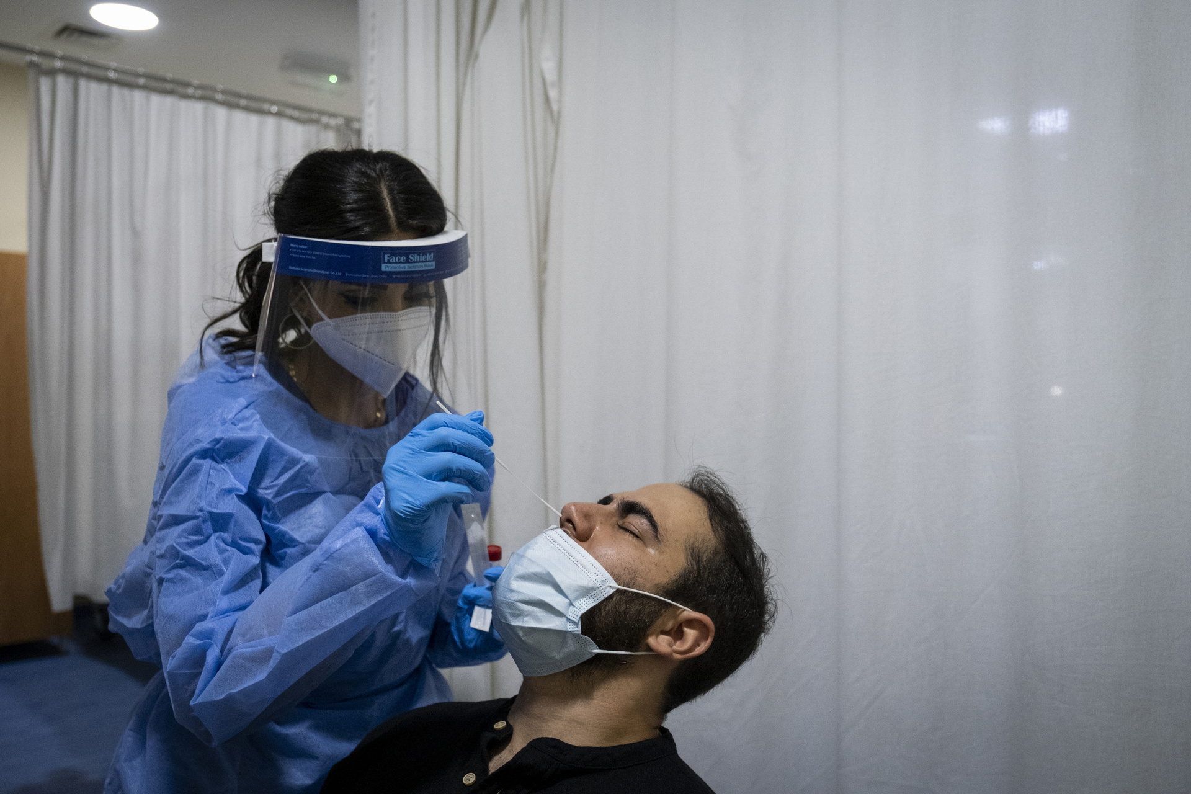
Diagnosis and virus characterization
The collection of appropriate specimens from suspected human cases for virus identification, typing and subtyping by a qualified laboratory – together with rapid and precise characterization of the virus and/or its isolate at specialized reference laboratories – is essential.
It is important for the early detection of cases, proper management of patients, public health risk assessment and developing proper response measures.
Appropriate specimen collection is vital for monitoring resistance to antivirals, producing effective vaccines and evaluating laboratory methods.

Slide 21
Clinical management
Anyone who may have been exposed to infected or potentially infected animals should be advised to promptly seek health care if they feel unwell, and to inform their health care provider of their possible exposure.
Following prompt testing, early and appropriate clinical management should be initiated, and precautionary measures put in place to assess and prevent potential further spread among humans and animals.
Multiple antiviral medications are available.
The WHO Clinical Practice Guidelines for influenza virus infections are currently being updated to include zoonotic influenza virus exposure and infection.

Slide 22
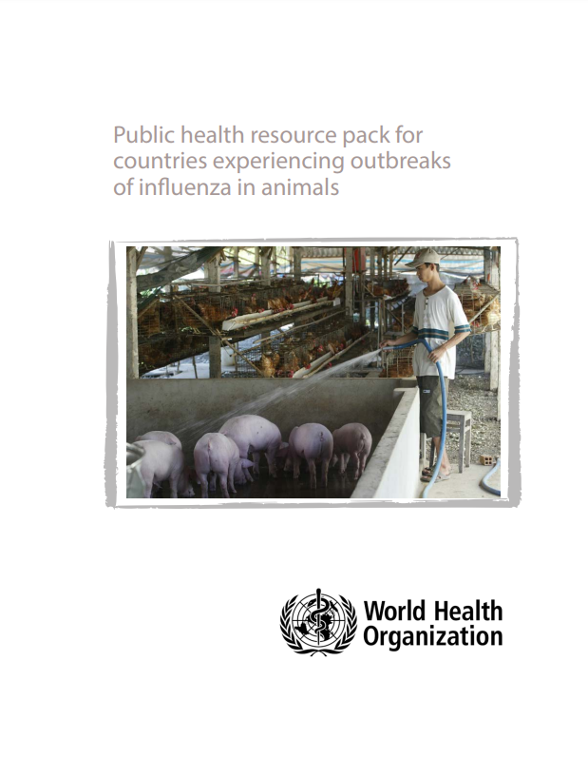
Reducing exposure
Report sick or unexpectedly dead animals to local authorities
Follow good food safety and personal hygiene practices (especially hand washing)
Properly handle and cook eggs, poultry meat and other animal products
Only slaughter healthy animals for human consumption – animals that have unexpectedly died should not be consumed and should be disposed of appropriately in accordance with national regulations;
Avoid consuming raw/unpasteurized milk
Comply with all other national or local official measures put in place (for example, animal movement restrictions).
People at risk of exposure to infected or potentially infected animals through the course of their work should wear appropriate personal protective equipment (PPE).
PPE must be correctly fitted, used and removed, and safely disposed of or decontaminated. Individuals needing to use PPE should be provided with it and trained in its appropriate use.
Public health resource pack for countries experiencing outbreaks of influenza in animals

Slide 23
Risk communication
Develop, test and review strategies for communication.
Map, set up partnerships and build trust among stakeholders and partners, networks and communities to lay the foundations for response activities.
Ensure that structures are in place to support a “One Voice” approach.
Cocreate and share influenza prevention messages, materials and health guidance with affected communities and stakeholders.

Slide 24
Summary of current situation
Nearly 900 detections of A(H5N1) in humans reported from over 20 countries since 2003.
Sporadic with direct or indirect exposure to infected animals or contaminated environments.
Infections can be severe and even fatal.
Available genetic sequences of the virus from the human cases similar to those from local animals.
No sustained human-to-human transmission.
Avian influenza A(H5N1) viruses, especially those of clade 2.3.4.4b, continue to diversify genetically and spread geographically.
It is a concerning, evolving situation but not an influenza pandemic.
Prompt & thorough investigations are critical, early identification of any unusual events that could signal person-to-person transmission of the virus and timely reporting are key to optimal outcome of response.
Advancing pandemic influenza preparedness at national, regional and global levels.
Global collaboration and coordination are key to optimal outcome
Sharing of sequences and viruses from humans and animals is critical.
GISRS is an effective foundation for surveillance, preparedness and response.

Slide 25
Thank you

Slide 26
Highly Pathogenic Avian Influenza A(H5N1) Virus
Vivien G. Dugan, PhD
Director, Influenza Division​
National Center for Immunization and Respiratory Diseases
Centers for Disease Control and Prevention
August 27, 2024

Slide 27
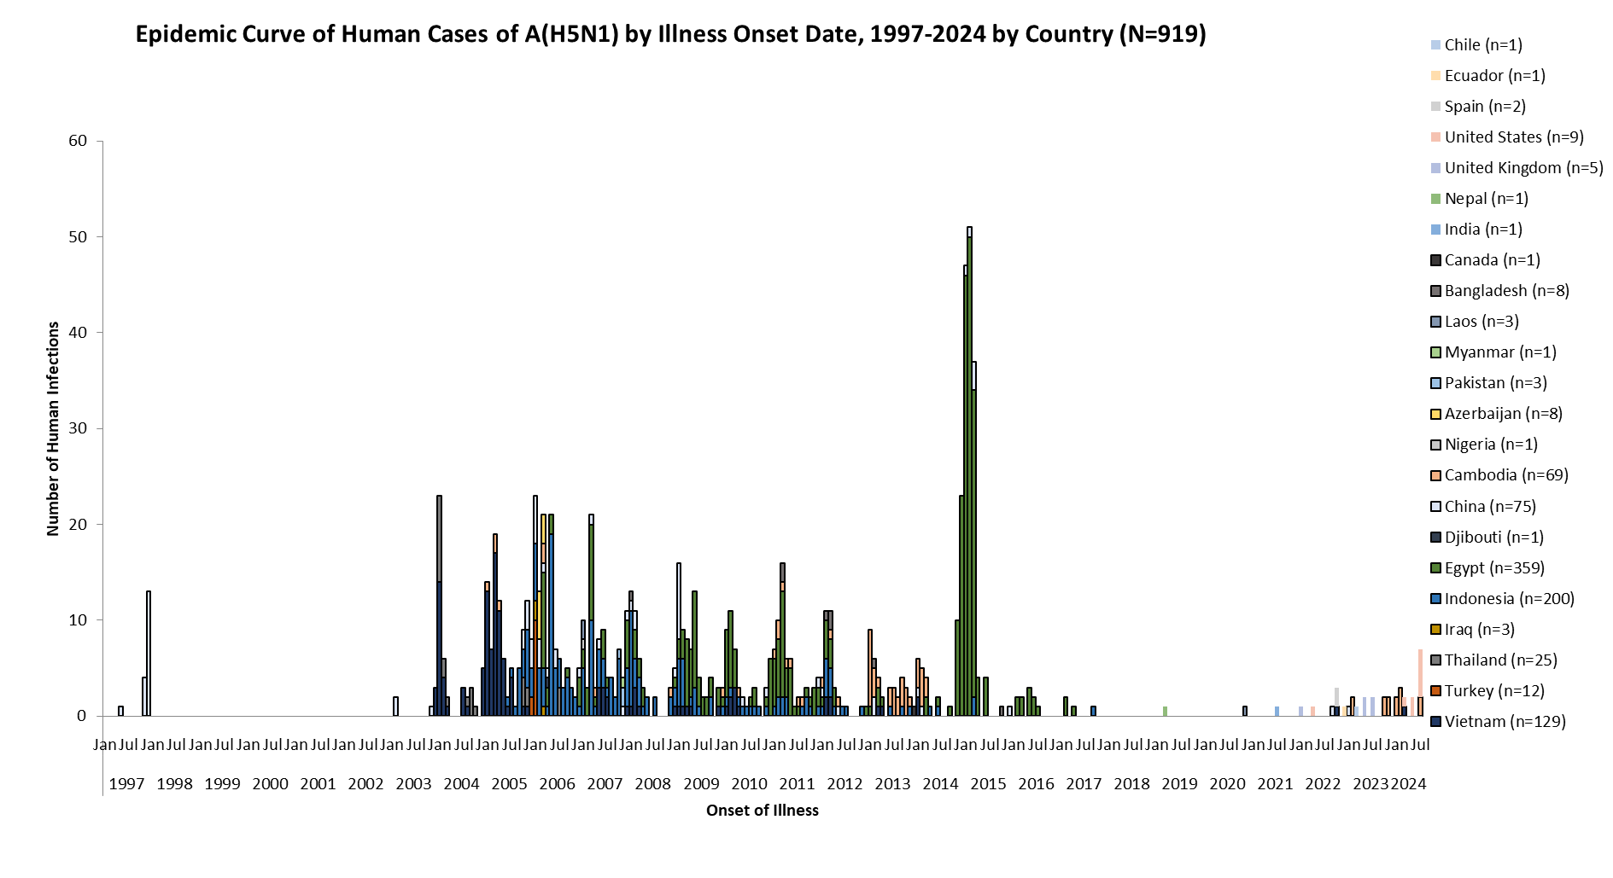
HPAI A(H5N1) Cases Since 1997*
Figure 1. Epidemic Curve of Human Cases of A(H5N1) by Illness Onset Date, 1997-2023 by Country: Technical Report: June 2024 Highly Pathogenic Avian Influenza A(H5N1) Viruses | Bird Flu | CDC
*Includes some A(H5)+, presumed H5N1 cases

Slide 28
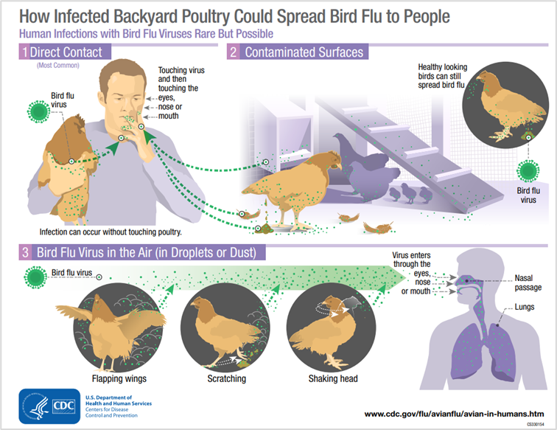
Historical Human Exposures to HPAI A(H5N1) Viruses
Historically, human infections have been the result of:
Poultry exposures
Direct/close contact with sick/dead poultry
Visiting a live poultry market
Exposure to other infected animals
Direct contact or close exposure (swans, dairy cows)
Limited, non-sustained human-to-human transmission has occurred globally in the past (not in U.S.)

Slide 29
HPAI A(H5N1) in Dairy Cattle: Current Situation and Response Updates

Slide 30
CDC’s Priorities
Supporting and engaging public health and agricultural partners
Protecting human health and safety
Understanding risk to people from highly pathogenic avian influenza (HPAI) A(H5N1) viruses
Assessing HPAI A(H5N1) viruses for genetic changes

Slide 31
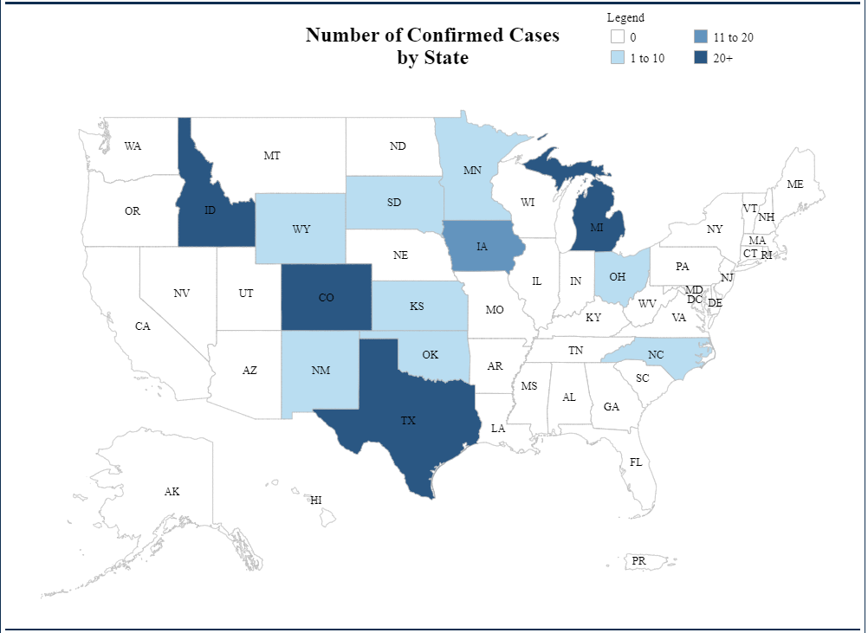
H5N1 Situation Update – Dairy Herds
To date, USDA confirmed HPAI A(H5N1) in dairy herds in >190 farms across 13 states
Dairy cow illness was observed in early 2024
Significant decreases in milk production and quality
March 25, 2024: USDA reported HPAI A(H5N1) confirmed in cows from Texas and Kansas
Highly Pathogenic Avian Influenza (HPAI) Detections in Livestock | Animal and Plant Health Inspection Service (usda.gov)

Slide 32
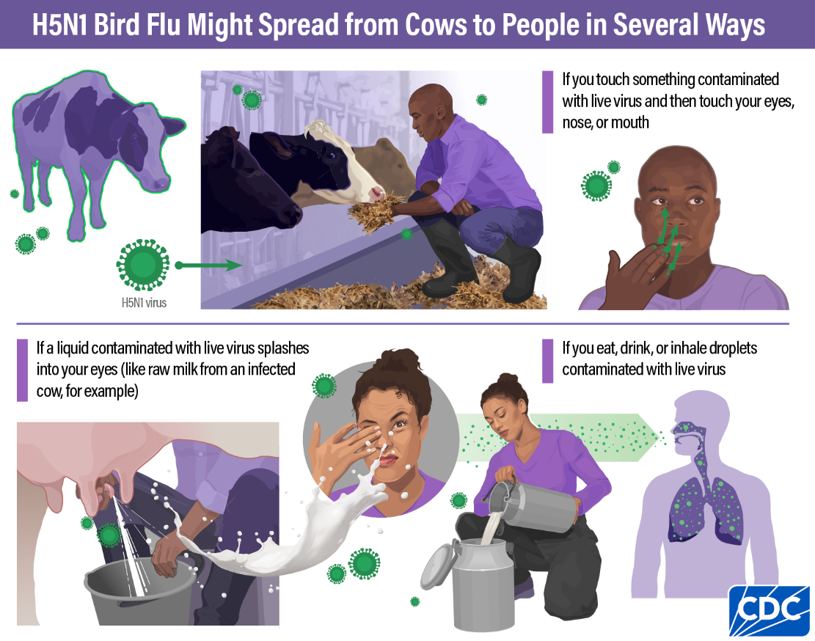
HPAI A(H5) Human Cases, United States, 2022-2024
Human cases (n=14), 13 associated with the current 2024 outbreak
Associated with dairy cattle exposures: 4
March - July 2024: 4 cases in dairy farm workers (Texas, Michigan (2), Colorado) with exposure to infected or presumed infected dairy cattle
All cases were clinically mild, offered antivirals, not hospitalized
Associated with poultry exposures: 10
April 2022: 1 case depopulating poultry (Colorado)
July 2024: 9 cases in workers depopulating poultry (Colorado)
All cases were clinically mild, offered antivirals, not hospitalized
No human-to-human transmission

Slide 33
H5 Human Cases– Virus Sequences to Date
Sequences maintain primarily avian genetic characteristics and lack changes that would make the virus better adapted to infect or spread among humans
Diagnostics: No impact to current CDC influenza diagnostic assay's ability to detect A(H5N1) viruses ​
Treatments: No known markers of resistance to FDA approved and recommended antiviral drugs ​
Candidate Vaccine Viruses (CVVs)​
HA of human influenza virus very closely related to two available CVVs​
Vaccines made with CVVs would be expected to provide good protection against this virus​
How CDC is monitoring influenza data among people to better understand the current avian influenza A (H5N1) situation | Bird Flu | CDC

Slide 34
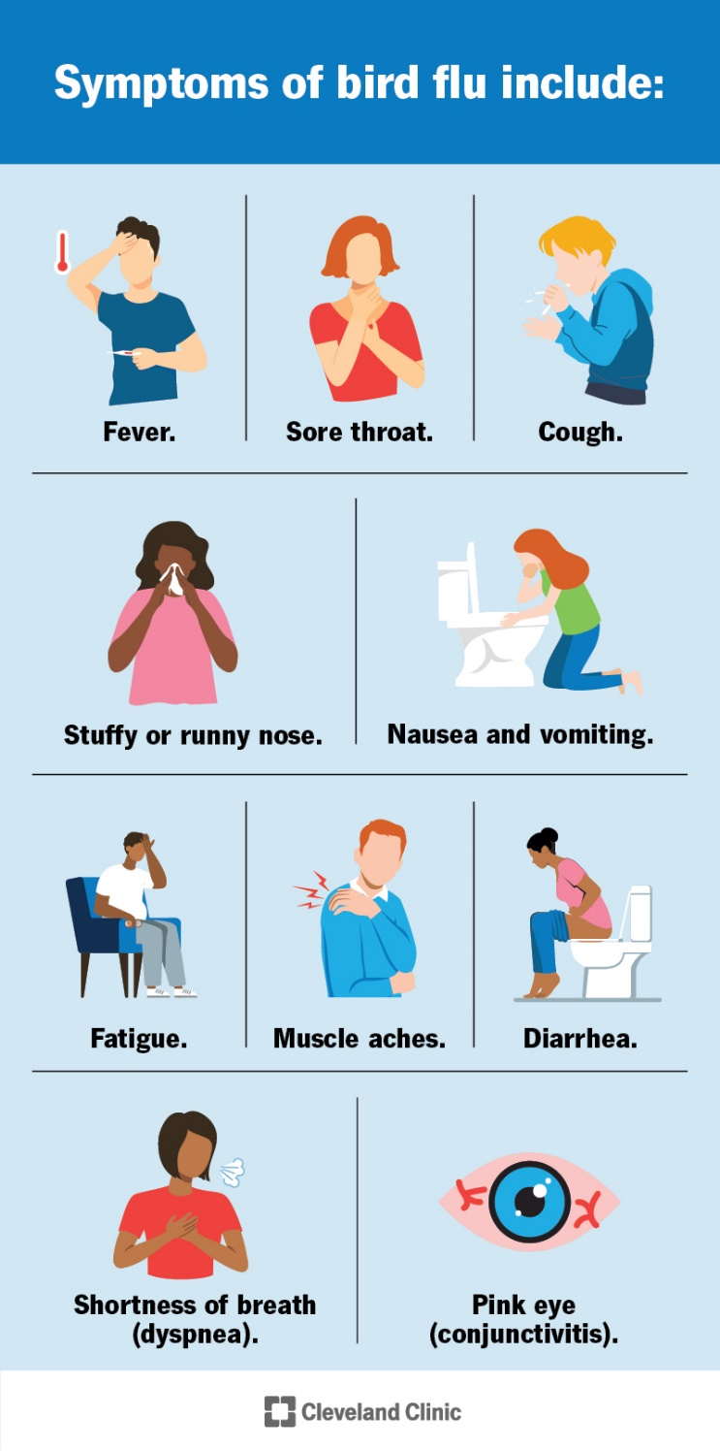
Symptom Monitoring Recommendations
All people with direct or close exposure to infected animals should be monitored for illness during exposure and for 10 days after their last exposure.
Signs/symptoms may include:
feeling feverish, cough, sore throat, runny or stuffy nose, muscle or body aches, headaches, fatigue, eye redness (or conjunctivitis), shortness of breath or difficulty breathing
less commonly, diarrhea, nausea, vomiting, or seizures
If signs/symptoms develop, seek medical care and testing
State and local health departments are monitoring workers on impacted farms and can facilitate testing and treatment
https://my.clevelandclinic.org/health/diseases/22401-bird-flu

Slide 35
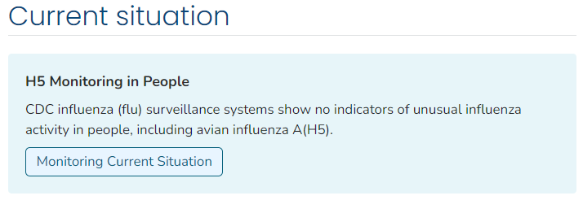
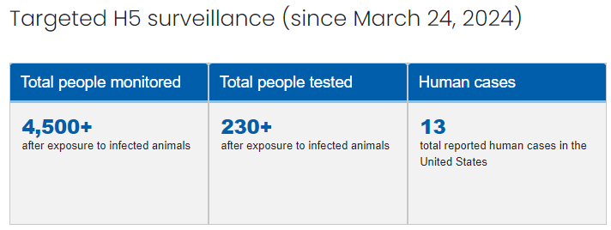
Ongoing Human Monitoring
CDC is continuing to support state and local health departments monitoring exposed people during and for 10 days after last exposure
Since March 24, 2024 there have been:
At least 4,500 people monitored
1,980 with exposures to dairy cows
2,600 with exposures to birds and other animals including poultry (non-dairy cow source)
At least 230 persons tested for novel influenza A
72 with exposures to dairy cows
160 with exposures to birds and other animals including poultry (non-dairy cow source)

Slide 36
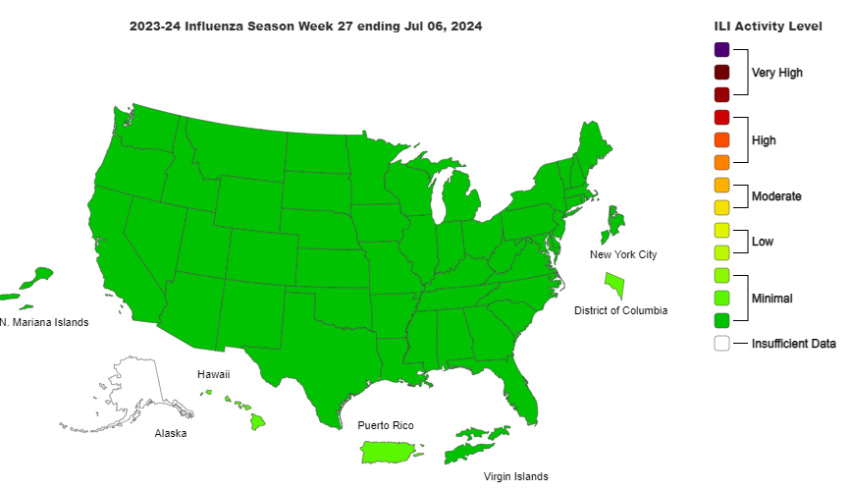
Surveillance, Human Monitoring, and Testing
Since February 2024, public health laboratory monitoring includes testing of more than 43,000 specimens using a protocol that would have detected H5
No indicators of unusual influenza activity in people, including avian influenza A(H5N1)
36
How CDC is monitoring influenza data among people to better understand the current avian influenza A (H5N1) situation | Bird Flu | CDC, Weekly U.S. Influenza Surveillance Report | CDC

Slide 37
Michigan Seroprevalence Study
In June 2024, Michigan Department of Health collected blood samples from 35 dairy workers
had varying roles, but most worked with infected cows
less than half reported using masks or goggles
Samples were tested for antibodies against H5N1 virus and a seasonal influenza virus
None of the participants showed neutralizing antibodies specific to avian influenza A(H5N1) virus, although many showed antibody responses to seasonal influenza
This suggests that these people were not previously infected with H5N1 despite high risk of exposure

Slide 38
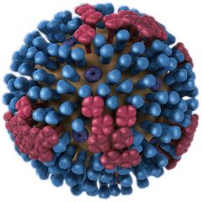
CDC Influenza Risk Assessment Tool (IRAT)
Evaluative tool for prioritizing resources for pandemic preparedness
Emergence is the risk of a novel influenza virus acquiring the ability to spread easily and efficiently in people
Public health impact is the potential severity of human disease caused by the virus, the burden on society if a novel influenza virus were to begin spreading efficiently and sustainably among people
Viruses scored using 10 risk elements by USG SMEs for emergence and public health impact
Genomic variation
Receptor binding
Transmission in Laboratory animals
Antivirals and Treatment Options
Existing Population Immunity
Disease Severity and Pathogenesis
Antigenic Relationship to Vaccine Candidates
Global Geographic Distribution
Infection in Animals, Human Risk of Infection
Human Infections and Transmission
Virus
Population
Ecology
Influenza Risk Assessment Tool (IRAT) | Pandemic Flu | CDC

Slide 39
IRAT Virus Emergence and Impact – Comparison of Risk Scores
Data label | Influenza Virus | Emergence Score | Impact Score
A | A(H1N1) [A/swine/Shandong/1207/2016] | 7.5 | 6.9
B | A(H3N2) variant [A/Ohio/13/2017] | 6.6 | 5.8
C | A(H7N9) [A/Hong Kong/125/2017] | 6.5 | 7.5
E | A(H9N2) Y280 lineage [A/Anhui-Lujiang/13/2018] | 6.2 | 5.9
F | A(H3N2) variant [A/Indiana/08/2011] | 6.0 | 4.5
X | A(H5N1) clade 2.3.4.4b [A/Texas/37/2024A] | 5.8 | 6.1
G | A(H1N2) variant [A/California/62/2018] | 5.8 | 5.7
I | A(H5N6) clade 2.3.4.4b [A/Sichuan/06681/2021] | 5.3 | 6.3
J | A(H5N1) Clade 1 [A/Vietnam/1203/2004] | 5.2 | 6.6
K | A(H5N1) Clade 2.3.4.4b [A/mink/Spain/3691- 8_22VIR10586-10/2022] | 5.1 | 6.2
L | A(H5N6) [A/Yunnan/14564/2015] – like | 5.0 | 6.6
N | A(H5N8) clade 2.3.4.4b [A/Astrakhan/3212/2020] | 4.6 | 5.2
O | A(H5N1) clade 2.3.4.4b [A/American wigeon/South Carolina/AH0195145/2021] | 4.4 | 5.1
Q | A(H5N8) [A/gyrfalcon/Washington/41088/2014] | 4.2 | 4.6
U | A(H7N8) [A/turkey/Indiana/1573-2/2016] | 3.4 | 3.9
V | A(H7N9) [A/chicken/Tennessee/17-007431-3/2017] | 3.1 | 3.5
X: Texas H5N1 2024
K: mink/Spain H5N1 2022
O: wigeon/SC H5N1 2021
X: H5N1 clade 2.3.4.4b [A/Texas/37/2024ª] (X)
Emergence = 5.8, Impact = 6.1
A: Highest emergence score Eurasian Avian/swine H1N1 in China
Emergence = 7.5, Impact = 6.9
C: Highest Impact score avian H7N9 in China
Emergence = 6.5, Impact = 7.5
Influenza Risk Assessment Tool (IRAT) | Pandemic Influenza (Flu) | CDC

Slide 40
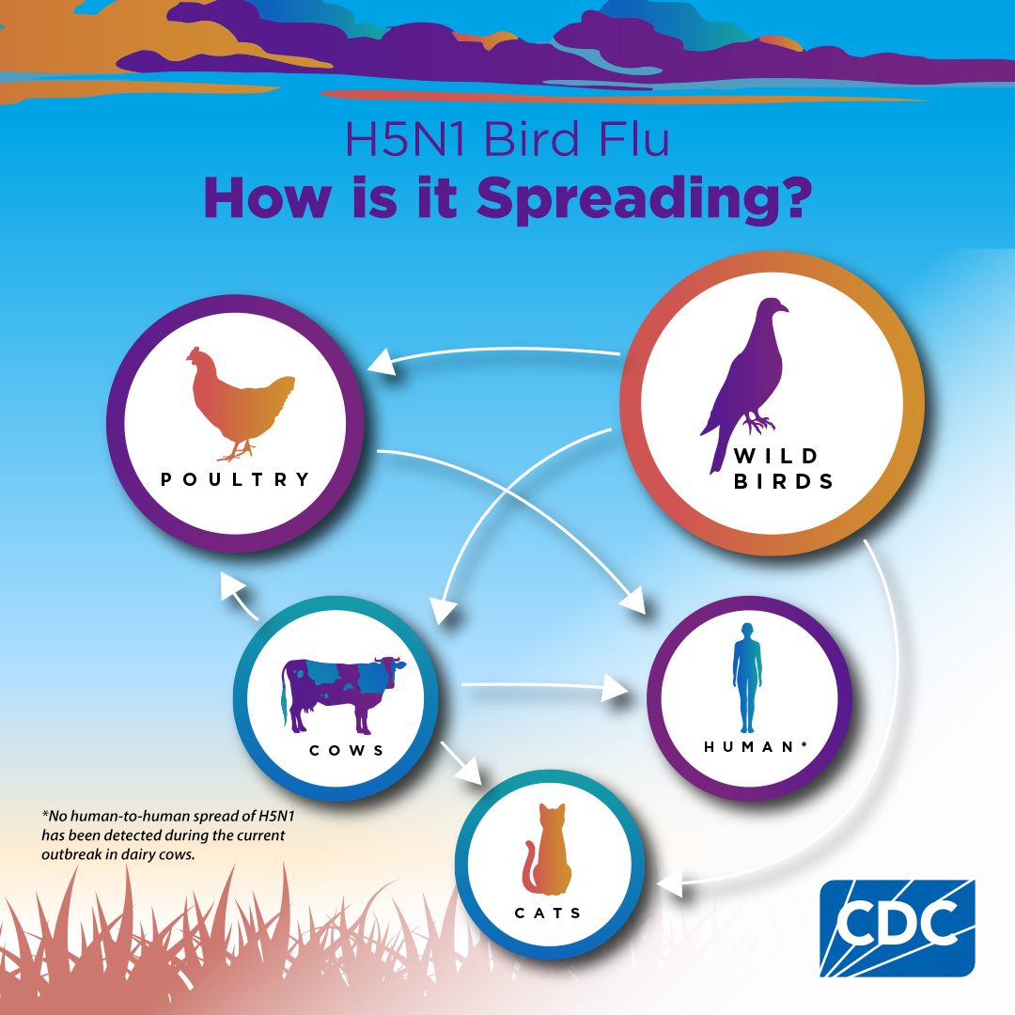
Public Health Risk
Overall risk to the public remains low
Increased risk with exposure to infected animals or environment – occupational, recreational
Exposed individuals should monitor for symptoms after first exposure and for 10 days after last exposure
Highly Pathogenic Avian Influenza A(H5N1) Virus in Animals: Interim Recommendations for Prevention, Monitoring, and Public Health Investigations | Avian Influenza (Flu) (cdc.gov)

Slide 41
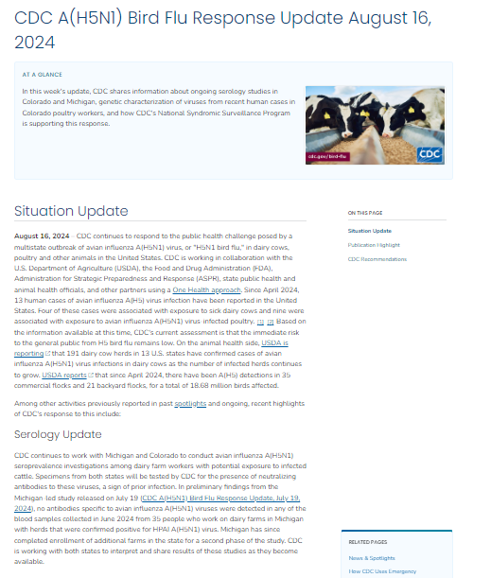
Resources from CDC
Situation Updates:
CDC A(H5N1) Bird Flu Response Update | Avian Influenza (Flu)
Surveillance Updates
How CDC is monitoring influenza data among people to better understand the current avian influenza A (H5N1) situation | Avian Influenza (Flu)
Technical Report
Technical Report: Highly Pathogenic Avian Influenza A(H5N1) Viruses | Avian Influenza (Flu) (cdc.gov)
Updated Recommendations
Highly Pathogenic Avian Influenza A(H5N1) Virus in Animals: Interim Recommendations for Prevention, Monitoring, and Public Health Investigations
Recommendations for Worker Protection and Use of Personal Protective Equipment (PPE) to Reduce Exposure to Novel Influenza A Viruses Associated with Severe Disease in Humans

Slide 42
Thank you

Slide 43
Q&A

Slide 44
This webinar recording and slides will be posted on www.icap.columbia.edu

Slide 45
Thank you

