Slide 1
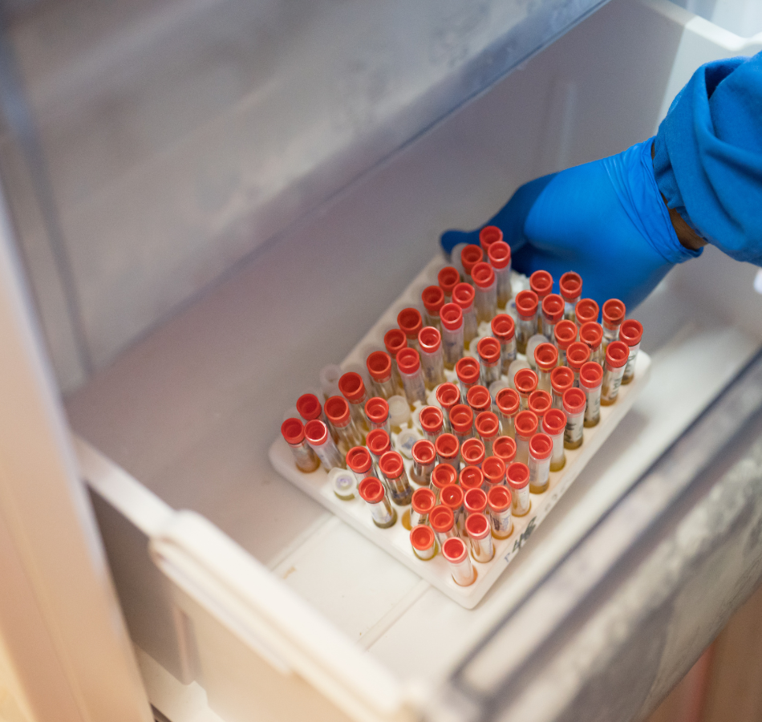
Marburg and Beyond: The Viral Hemorrhagic Fever Threat
ICAP GRAND ROUNDS
August 19, 2025

Slide 2

Jessica Justman, MD
Senior Technical Director,
ICAP at Columbia University

Slide 3
Agenda
Reminders:
1. TRANSLATION: If you would like to hear the French translation of this webinar, please turn on the French channel by clicking on “Interpretation” at the bottom of the screen, which looks like this:
Then, select “French.”
For questions to the panelists, use the Q&A box
The webinar recording and slides will be posted on www.icap.columbia.edu
2. WEBINAR:
Welcome and Introduction – Presentation
Announcements
Q & A

Slide 4

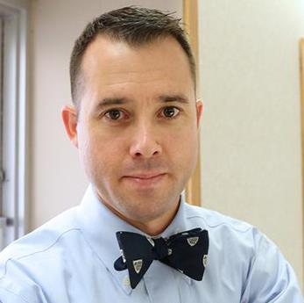
Misaki Wayengera, PhD,
Senior Lecturer & Chief Scientist, Uganda Ministry of Health
William Fischer II, MD,
Director, Emerging Pathogens, The Institute of Global Health and Infectious Diseases, University of North Carolina at Chapel Hill

Slide 5
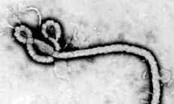
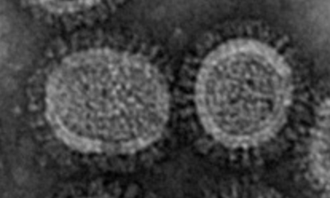
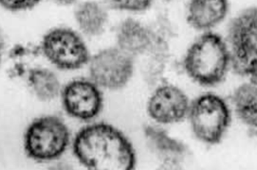
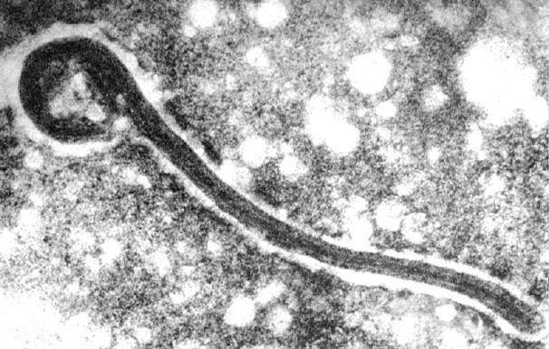
Changing the Paradigm from Isolation to Patient-centric care
Advancing Care in Filovirus Outbreaks
William A Fischer, MD
Division of Pulmonary and Critical Care Medicine
Director of Emerging Pathogens
Director UNC Special Pathogens Response Center
Institute of Global Health and Infectious Diseases
The University of North Carolina at Chapel Hill
Notes:
Filoviruses once among the most feared diseases are now treatable infections
Clinical care needed to improve survival is not hard but its complicated and it requires more than a good clinician
The reservoir of these infections may be changing and as a result these outbreaks will happen again but we must move faster and more comprehensively

Slide 6
Key messages
1. Filovirus disease are TREATABLE infections
2. Shifting from facility- to patient-centric care will improve outbreak response
3. We will see this again

Slide 7
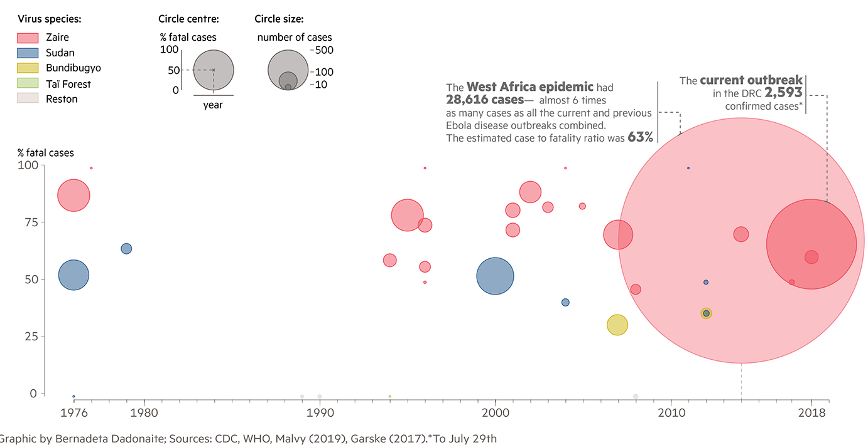
Filovirus Outbreaks are Increasing in Scale + Frequency
Marburg
2024
EVD in US/Europe
Adapted from https://www.behance.net/gallery/86026221/Ebola-timeline-for-FT
Notes:
Since Marburg virus and Ebola virus were first identified in 1967 and 1976 respectively, we’ve seen an increase in the frequency and size of outbreaks. This figure is adapted from one made for the Financial times during the 2018 Ebola virus disease outbreak in N. Kivu. Superimposed on it are Marburg virus outbreaks in purple.
The problem with this figure is that this is NOT due to an increase in surveillance, but more likely represents an increase in spillover events.
So what was once thought of as a rare tropical disease has really emerged into a global public health threat.

Slide 8

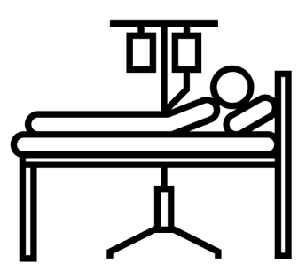
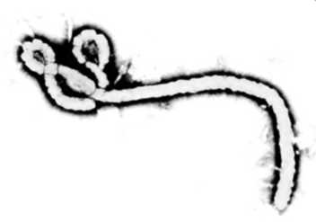
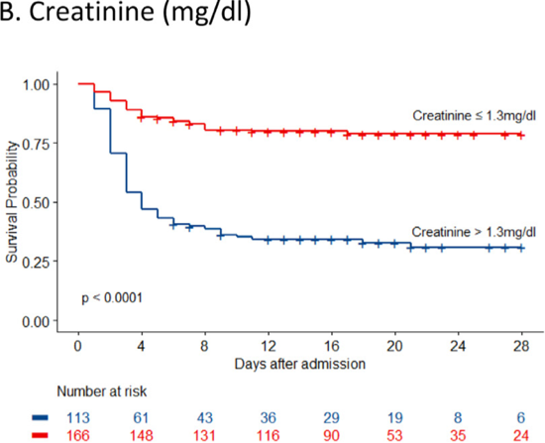
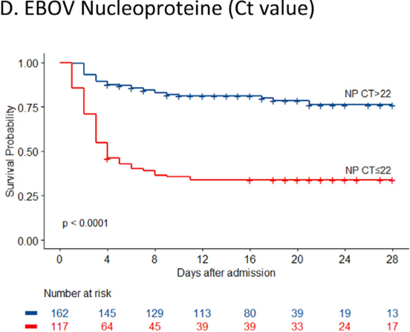
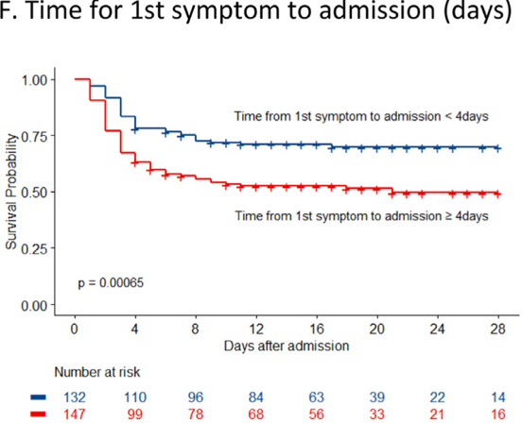
Independent Predictors of EVD Mortality
Organ Failure
Viral Load
Time
Jaspard, M et al. eClinMed 2022
Notes:
Observational data consistently pointed to these three factors as independent risk fac tors for mortality which provides the roadmap for what is needed by the patient and the disease process
These are complications we know how to take care

Slide 9
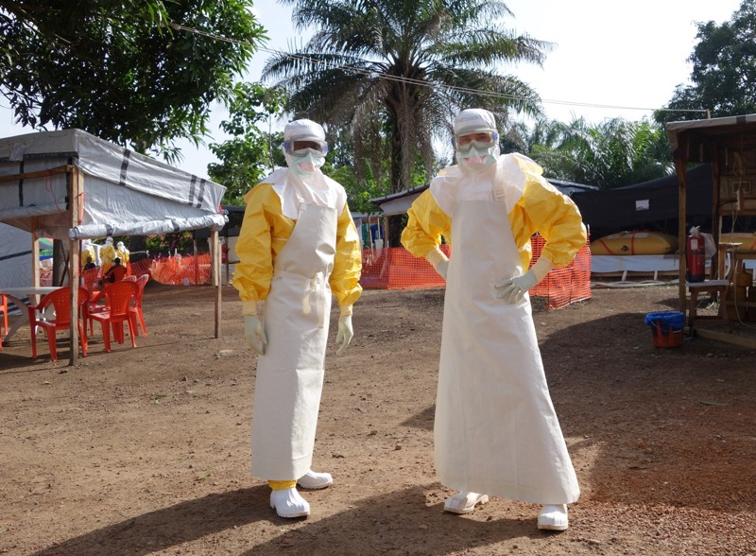
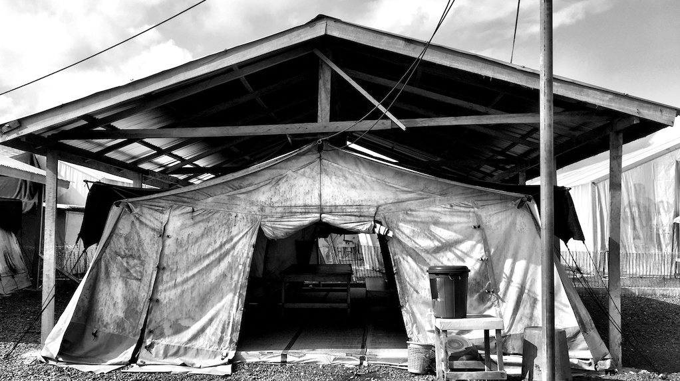
Outbreak response centered on isolation sustains high mortality
Limits access to patients by HCWs
Restricts capacity to deliver advanced care + therapeutics
Increases resistance of patients + families
Prevents continuous observation and learning
Notes:
Outbreak response centered on isolation sustains high mortality, fuels mistrust, and impairs learning.
for the forty years that we knew about the virus the treatment paradigm has been– identify the infected patient, isolate the infected patient, and then track all contacts of the infected patient so that we can isolate them when they become symptomatic – identify, isolate and track and this identify isolate and track paradigm has been incredibly effective at stopping outbreaks because patients with acute EVD are thought not to be infectious until they become symptomatic (caveat is some survivors that harbor in immune privileged sites) and for forty years this has worked really well at stopping transmission
But a paradigm based on isolation comes at a cost – by creating distance between providers and patients it has the potential to sustain high mortality and impair learning and by separating patients from their communities it has the potential to fuel mistrust.
We’ve seen this similar story play out in responses to other high consequence pathogens including HIV, including SARS, SARSCoV2, and including MPOX

Slide 10
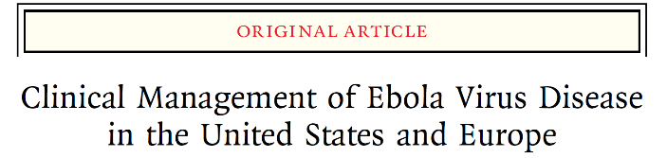
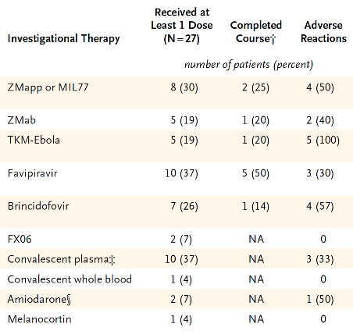
Preparation + Resources → Better Outcomes
Increased HCW-patient ratio
IV access: 100%
Supplemental Oxygen: 70%
Vasopressors: 30%
Renal replacement therapy: 19%
Received at least 1 dose of an investigational therapeutic: 85%
CFR: 18.5% (5/27)
Uyeki, T. et al. NEJM 2016

Slide 11

Optimized Supportive Care for EVD
Assessment and reassessment: staffing ratio 1:4
GI loss (diarrhea/vomiting):
  administer fluids to keep up with losses
Septic shock physiology:
  Volume resuscitation (monitor for vascular leak/ pulmonary edema)
Electrolyte abnormalities (GI losses and renal failure):
  Monitoring (e.g., Laboratory)
  Oral or IV replacement
  K+, glucose, HCO3-
  May be proximal cause of death (arrhythmia, cardiac arrest, seizure)
Symptomatic management of nausea, vomiting, diarrhea, seizures, myalgia, abdominal pain
Prophylactic antibiotic use for possible gut translocation of bacteria and sepsis
Special considerations: pediatric, obstetrics, nutrition
Notes:
Staffing ratio of one or more clinicans for four EVD patients
Assessment performed at least 3 times per 24 hours
Oral rehydration in patients who can drink
Parenteral to those who are unable to drink or who have severe dehydration or shock
Daily biochemistry labs during acute phase of illness and hematology as needed
Serum glucose checked at least 3 times a day with vital signs
Treatment of potential co-infections
Provide enteral nutrition
Symptomatic care of fever, pain and nausea
Prevention of catether associated infections and pressure ulcers.

Slide 12

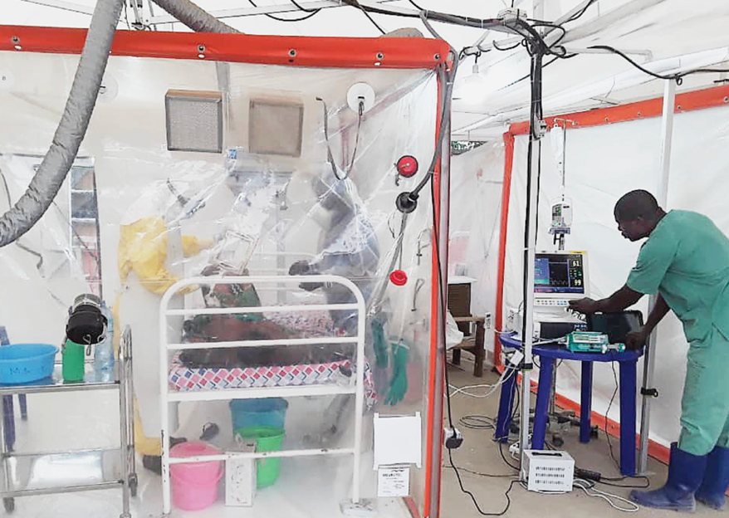
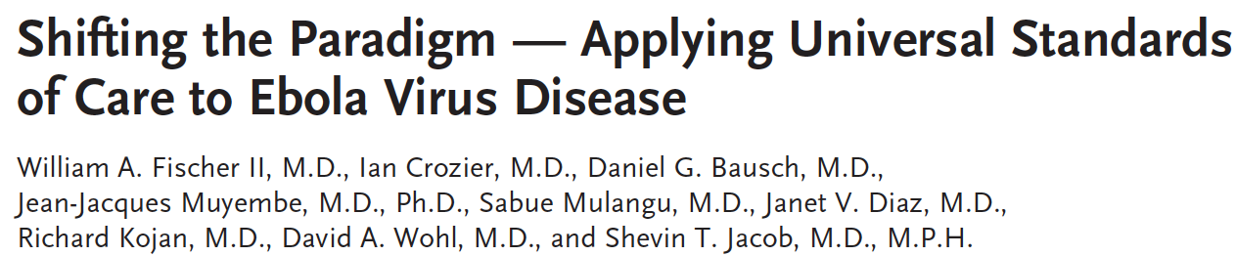
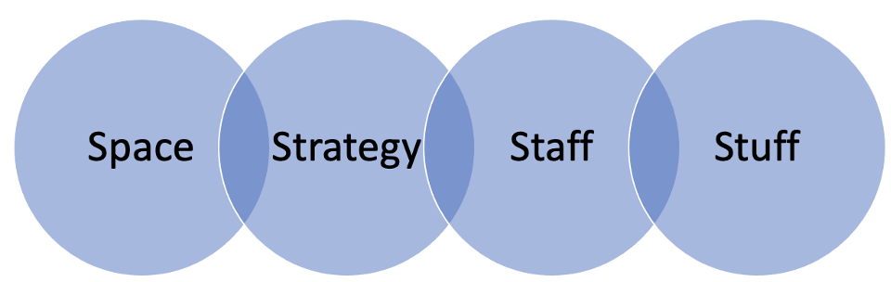
Patient Centric Response Involves Increased Provider-Patient Access
Notes:
Roadmap for Change
C.U.B.E
Chambre d’urgence Biosecurite des epidemies
Individual isolation of suspect, confirmed, and/or critically ill patients
Allows continuous monitoring
Easy access to provide care quickly
Bio-secure space for high risk interventions (critically ill patients, child birth, surgery,)
Maintain contact and visibility between patient and family
Facilitates learning

Slide 13
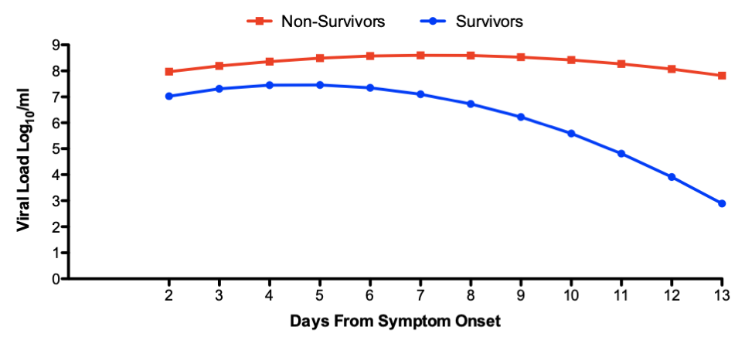
EBOV Viral Kinetics Are Strongly Associated with Mortality
Day 2: 0.94 log cp/ml
(95%CI 0.21-1.67; p=0.011)
Day 7: 1.5 log cp/ml
(95% CI 0.99-2.01; p<0.001)
Day 13: 4.94 log cp/ml
(95% CI 3.63-6.25; p<0.001)
Survivors n = 38 5 5 6 11 15 13 13 12 12 6 8 8
Non-survivors n = 46 9 7 14 17 20 16 21 19 16 9 8 5
Graph generated using data from Lanini, S. et al. JCI 2015
Notes:
84 individuals 38 survivors 46 nonsurvivors
Mean
At day 2 after onset of symptoms (which represents the model intercept), viremia levels were significantly higher in nonsurvivors compared with survivors (0.94 log cp/ml [95% CI, 0.21–1.67]; P = 0.011). This difference increased to 1.50 log cp/ml (95% CI, 0.99–2.01; P < 0.001) and 4.94 log cp/ml (95% CI, 3.63–6.25; P < 0.001) at day 7 and day 13 after the onset of symptoms, respectively (Table 4).
Goderich emergency

Slide 14
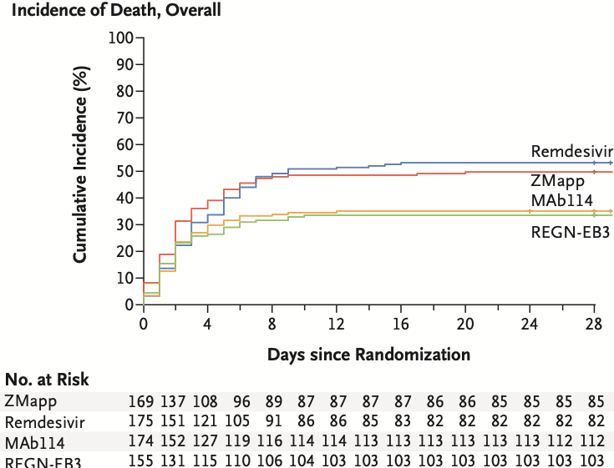
Controlling viral replication reduces mortality
N=681
Mortality | ZMapp | Remdesivir | MAb114 | REGN-EB3
Overall | 49.7% | 53.1% | 35.1% | 33.5%
“low viral load” | 24.5% | 29% | 9.9% | 11.2%
“high viral load” | 84.5% | 85.3% | 69.9% | 63.6%
Mulangu, S. et al. NEJM 2019
Notes:
FDA approval
MAb114 [ansuvimab-zykl (Ebanga)]
REGN-EB3 [atoltivimab, maftivimab and odesivimab-ebgn (Inmazeb)]
Because of this trial two therapeutics have been approved.
CT<22

Slide 15
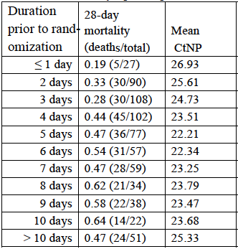
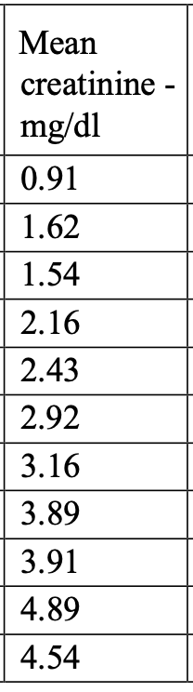
Delays in Treatment Increases Mortality
11% increase in mortality for every day from symptom onset to treatment
Mulangu, S. et al. NEJM 2019; Figure adapted from Cross, R. et al JCI Insight 2022 and Kuang, E. et al https://www.biorxiv.org/content/10.1101/2022.01.06.475142v1.full.pdf
Notes:
The degree of organ failure on admission in the MEURI and PALM data suggests that filovirus-specific therapeutics cannot be uncoupled from critical supportive care that is the foundation of treatment for all severe infections.
Patients enrolled a mean 5.5 days from symptom onset
→ highest viral load
→ organ failure
Filovirus-specific therapy cannot be uncoupled from optimized supportive care (oSOC)

Slide 16
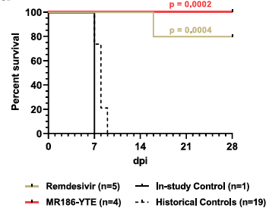
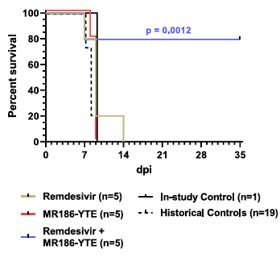
mAbs have a Modifiable therapeutic window
5 Days
Post Infection
6 Days
Post Infection
Mulangu, S. et al. NEJM 2019
Cross, R. et al Nature Communications 2021
Notes:
The degree of organ failure on admission in the MEURI and PALM data suggests that filovirus-specific therapeutics cannot be uncoupled from critical supportive care that is the foundation of treatment for all severe infections.
Patients enrolled a mean 5.5 days from symptom onset
→ highest viral load
→ organ failure
Filovirus-specific therapy cannot be uncoupled from optimized supportive care (oSOC)

Slide 17

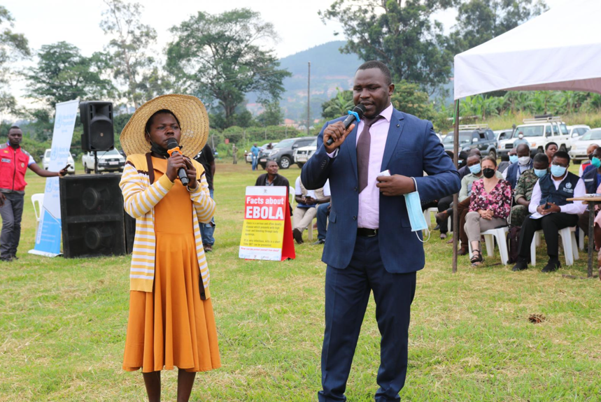
Outbreaks begin and end in communities
Increases transparency and understanding about:
  Importance of timing
  Supportive care
  Investigational interventions
  Prevention
  Diagnostics
https://www.afro.who.int/fr/node/16724
Notes:
Early community engagement

Slide 18
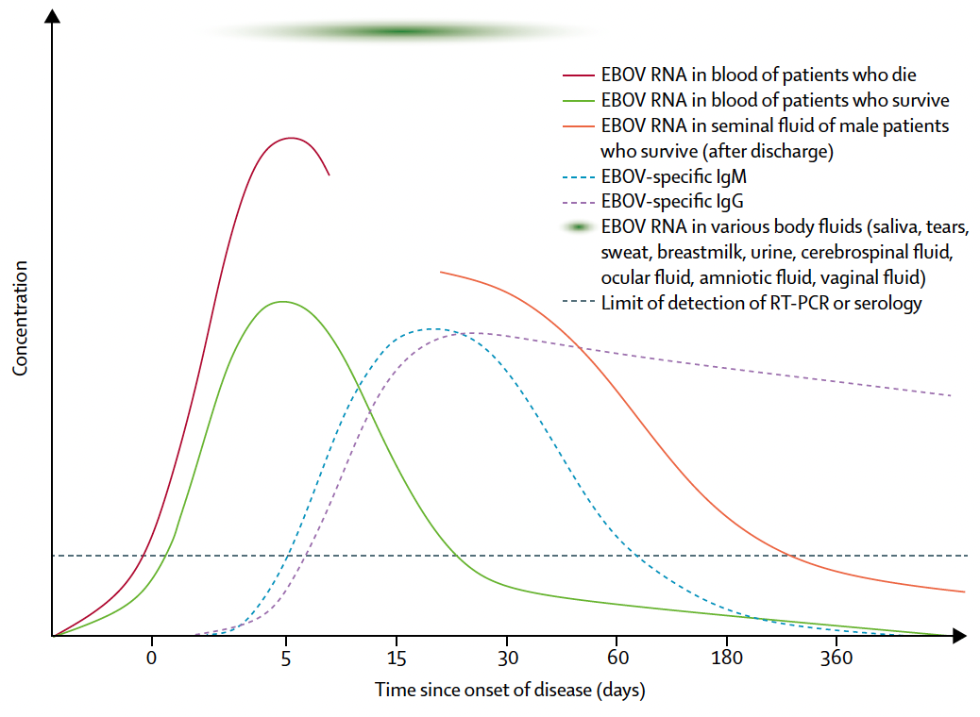
Early Isolation Reduces Community Transmission
Malvy, D. et al. Lancet 2019
Notes:
This works against us.

Slide 19
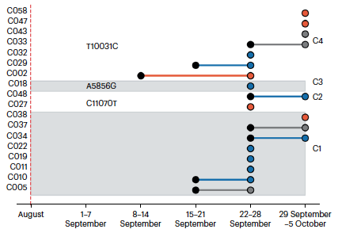

MVD Outbreak Rwanda 2024
Cluster 4: 7 identical sequences from HCWs at both Hospital 1 and 2 (C002)
Cluster 2: 2 HCWs who worked in both Hospital 1 and 2
Cluster 1: 8 identical sequences mostly from HCWs from Hospital 1 and 1 from Hospital 2
Butera, Y et al. Nature Medicine February 2025
Notes:
Between September 22 and 28 26 cases were reported in HCWs at two hospitals in Kigali.
Genetic sequencing identified 3-4 clusters including
1. a cluster of eight identical sequences the majority of which were isolated from HCWs at Hospital 1 with symptom onset as early as mid Sept. This cluster also contained a sample from a HCW at Hospital 2 at the end of September suggesting dissemination between the two healthcare facilities. Among these are healthcare workers that work at both Hospital 1 and 2.
2. Cluster two consists of two healthcare workers from Hospitals 1 and 2 respectively
3. Cluster 3 consists of 7 identical sequences sampled between Hospitals 1 and 2; C002 is a HCW employed at both H1 an dH2 and is believed to have acquired the infection at Hospital 1 and became the index case at H2 leading to a nosocomial cluster at H2

Slide 20
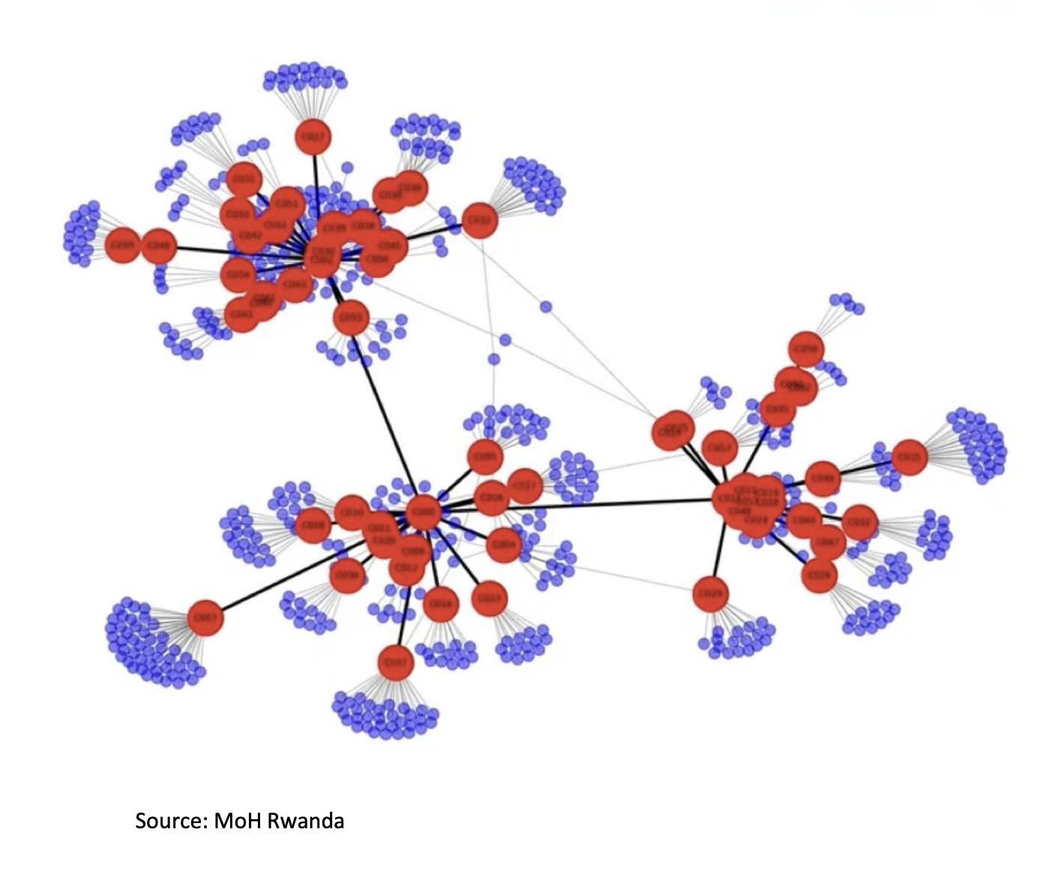
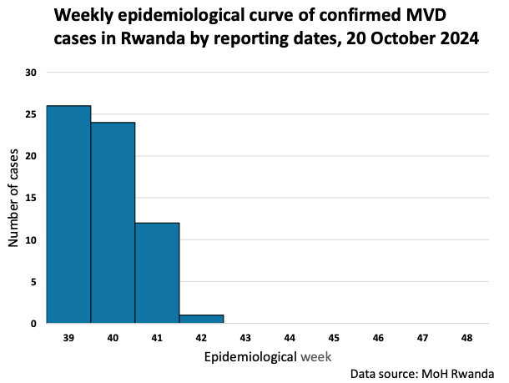
Marburg virus in Rwanda – a different response
Use of near real-time sequencing to identify index case
Quarantine of high-risk contacts
Early and rapid diagnostic testing
Designation of a hospital as the National Treatment Center
Spouse
https://apps.who.int/gb/COVID-19/pdf_files/2024/24_10/Item1.pdf
Index
Notes:
A team of clinicians and epidemiologists conducted a retrospective chart review of patients admitted to the ICU at Hospital 1 between July and September looking for patients with a temperature >38 and at least one other symptom suggestive of VHF.
25 yo F transferred to Hospital 1 on August 26 s/p Csection concerning for HELLP syndrome – had ARF, coagulopathy, and respiratory failure but died within 24 hours. The first confirmed patient was admitted with DKA to the ICU bed next to hers.
The deceased woman’s husband is a 27 yo miner who had a fever, headache and fatigue in August but recovered without seeking care. His wife developed similar sx in mid august, their baby died of an unexplained febrile illness one week after birth. Testing of the man revealed high titer IgG and no IgM
Case investigation found the wife of a miner was admitted to Hospital 1 at the end of August
The husband (miner) was MARV IgG positive
3 contacts of the minor were MARV IgG positive

Slide 21
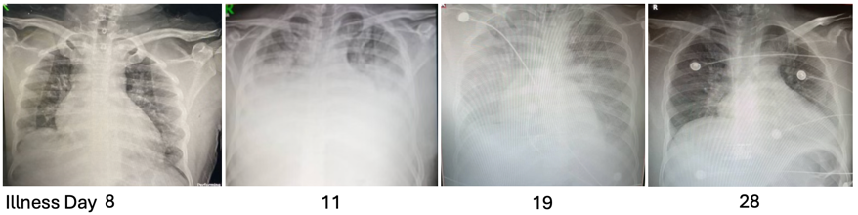
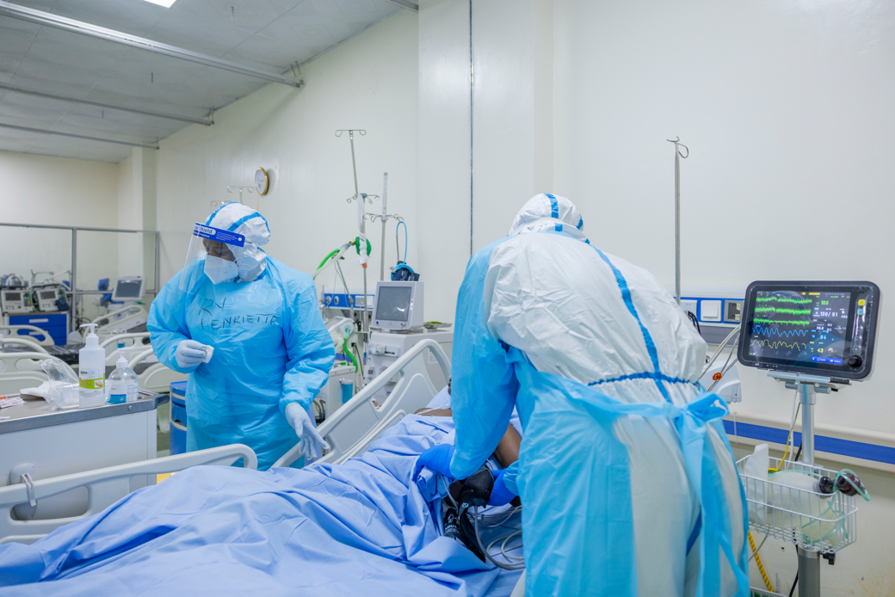
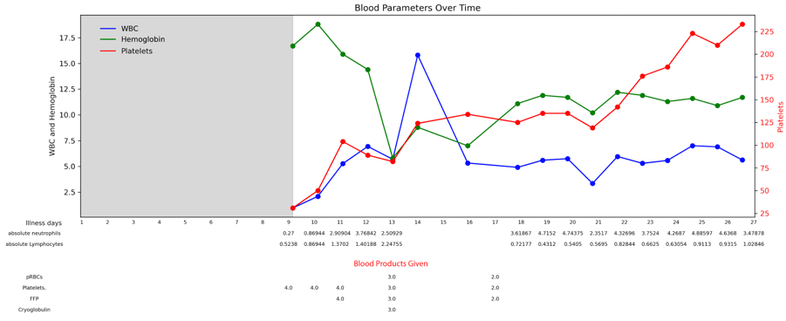
Early diagnostics + patient-centric care
CFR 22.7%
Shared with permission from Dr. Eric Seruyange; Seruyange, E. et al Lancet ID

Slide 22
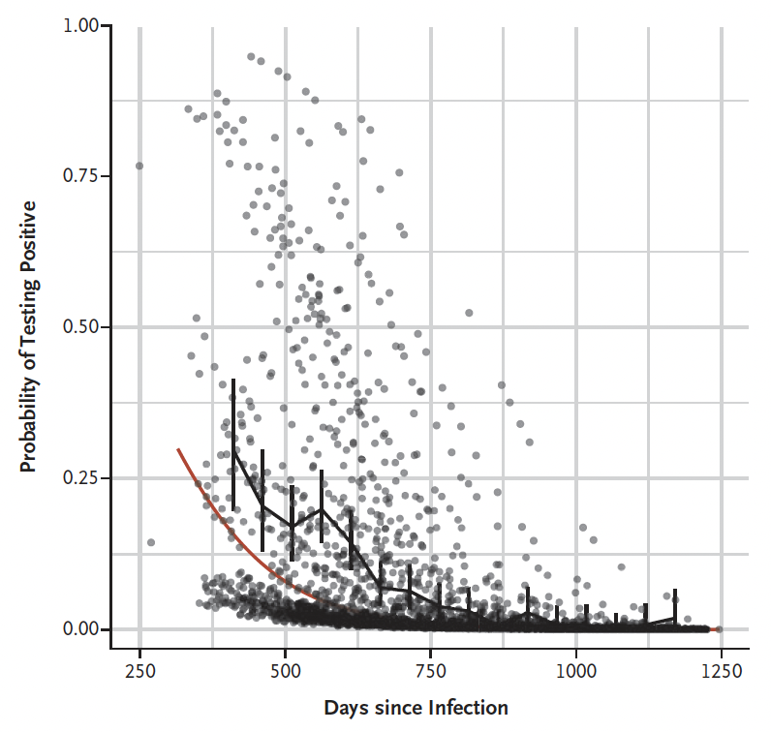
EBOV Persistence in Semen
N=267 Ab+ Male survivors
  Median Age (IQR) 33 years (26, 41)
  Median time from symptom onset to first collection – 551 days
GeneXpert Assay
  LoD 1,000cp/ml
Detection in 81 (30%)
Intermittent detection 31%
Longest time from acute illness to detection – 40 months
PREVAIL III NEJM 2019
Loftis, A et al. JID 2016
Notes:
Collected every 4-6 weeks if negative and every 2 weeks if positive
No correlation between persistence of viral RNA in seen and presence of symptoms or plasma levels of ddimer.
The second study is from Prevail and is the largest to report on outcomes of semen testing including 267 male survivors over the age of 18 from Liberia using the GeneXpert Assay developed by Jamie Pettit and Lisa Hensley and validated by Saturday Quellie and Amy James Loftis from our group. This is important because that assay’s probit limit of detection meaning the level that could be detected 95% of the time was 1000cp/ml. This really brought home the idea that a not detected result is not the same as a negative result. Samples were collected every 4-6 weeks for participants that tested negative and every 2 weeks for participants that tested positive. The figure shows model-based estimates of the probability of testing positive for individual samples. The black piece-wise linear curve I believe represents observed sample proportions whereas the red curve represents a model-based population trend for the probability of a sample testing positive. This model suggests much higher pcr positivity at 1 year of around 20-35% and approaches zero at closer to two years.

Slide 23
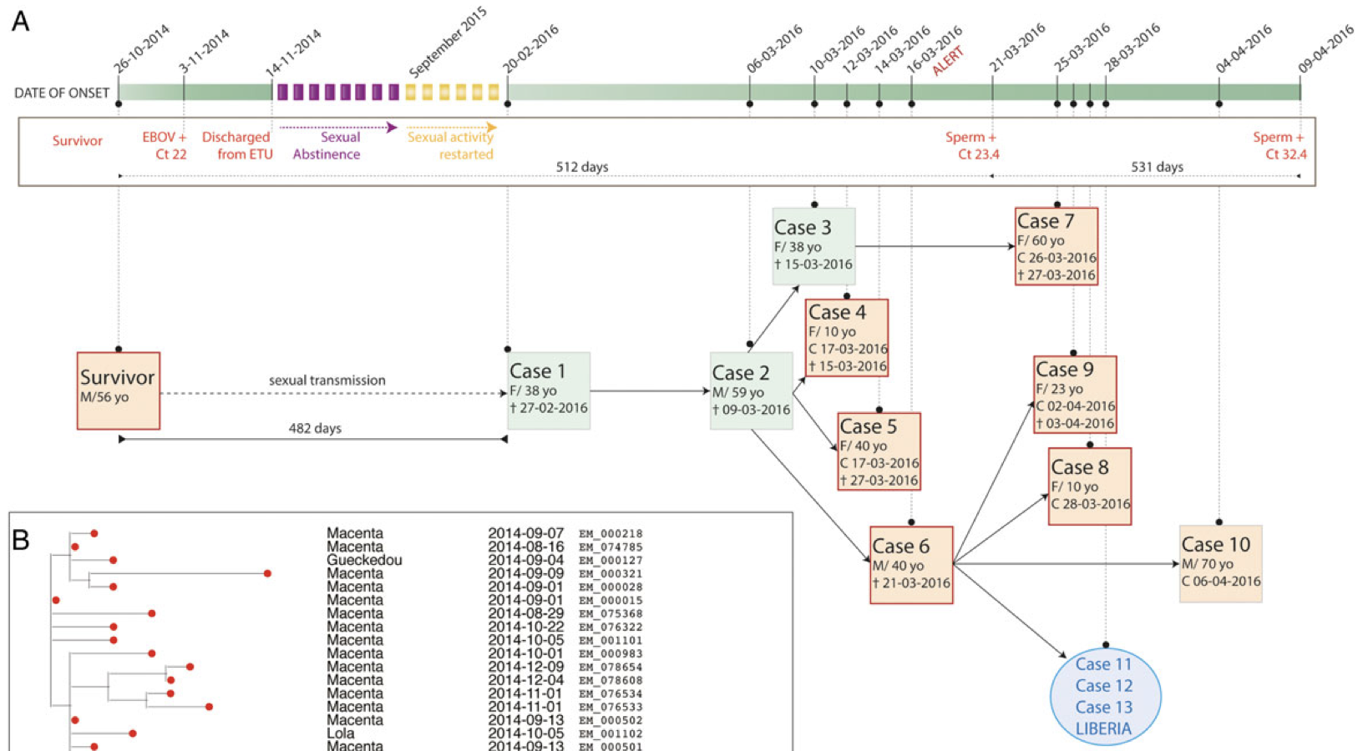
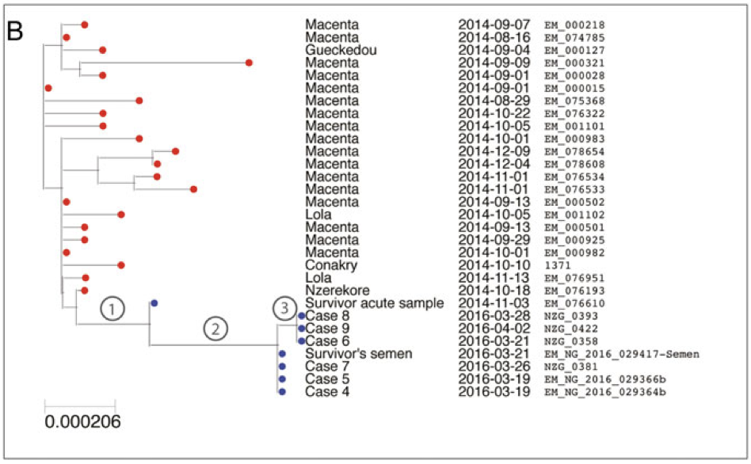
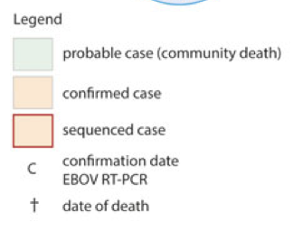
Molecular Evidence of Sexual Transmission
Diallo, B et al. CID 2016
Notes:
On 29 December 2015, the World Health Organization declared
the end of Ebola virus (EBOV) transmission in the Republic of
Guinea. On 16 March 2016, the health authorities of Nzerekore
Blood samples from the cases were sequenced in Conakry using MinIon technology and confirmed using the Ion torrent platform in SL.
These sequences were then compared with a database of 1066 previously sequenced EBOV genomes in order to place the sequences into geographical and historical context.
They were closely related to viruses from the 2014-2016 outbreak ruling out a new introduction from an animal reservoir.
The viruses did not belong to the GN1 or SL3 lineages that were circulating in Guinea in the second half of 2015 but instead belonged to a cluster of cases from N’zerekore and Macenta that was detected in 2014.
The most closely related sequence in the database had been obtained from a male patient on admission to the ETU in Gueckedou in November 2014 – he survived
Epidemiologic investigation identified the same survivor as the likely source of the new cluster.
The investigation revealed that case 1 had sexual intercourse with a male EVD survivor from the village of Koropara Centre. This survivor reported sexual abstinence from November through August as recommended by WHO (initially 3 months). From September 2015 he had occasional sexual intercourse with various partners including Case 1 at the end of January.
Except for asthenia he reported no post-EVD complications.
The virus in seminal fluid from 21 March was sequenced and revealed it was identifcal to cases 4 and 5 suporting the epidemiologic evidence of sexual tranmssion.
Additional sequencing confirmed that the entire cluster is linked with the survivor. The sequences are either identical to or only differ by up to 1 nucleotide from that of the survivors semen.
The EBOV genome substitiution rate in the Makona strain has been estimated at between 0.87x10^-3 and 1.42x10^-3 mutations per site per year. This is equivalent to 16-27 mutations in each genome, meaning that sequences diverge rapidly enough to identify distinct sub-lineages during a prolonged epidemic.

Slide 24

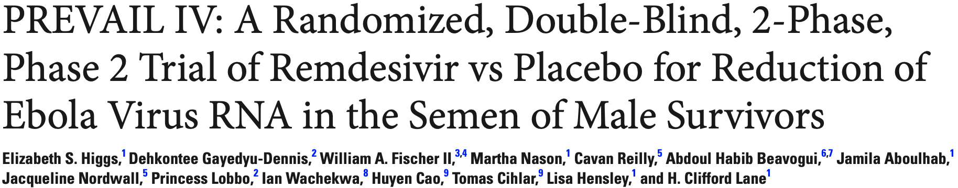
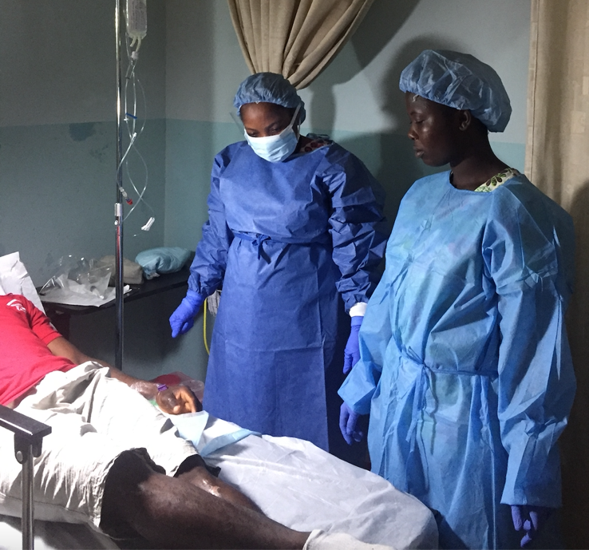
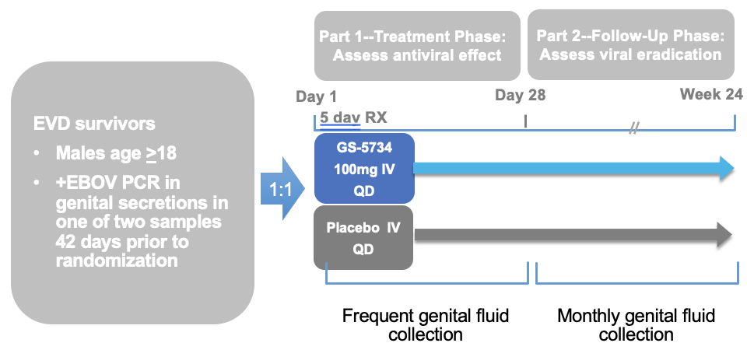
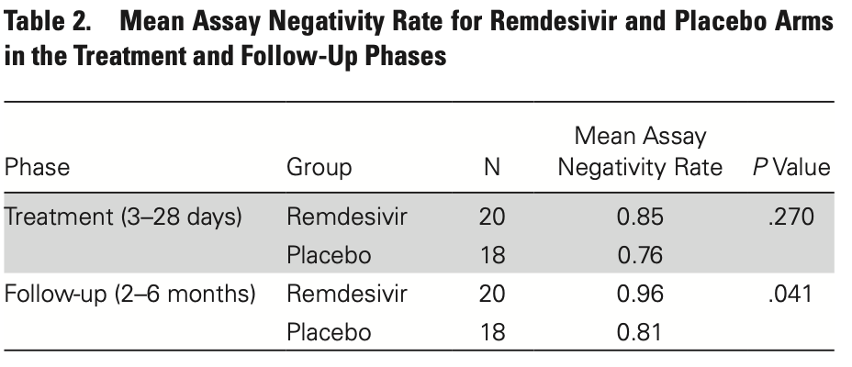
Days 4, 8, 11, 16, 24, and 28
Weeks 8, 12, 16, and 24
Notes:
Men with persistent seminal Ebola RNA were recruited in Liberia and Guinea.
Participants were randomized 1:1 to receive intravenous remdesivir (GS-5734; Gilead Sciences) or matching placebo administered once daily by intravenous infusion over 1 hour on 5 consecutive days.
Stratification was by country and number of positive (1 or 2) preenrollment semen tests.
We evaluated the difference in mean assay negativity rate (ANR), that is, the proportion of negative tests for each participant in each group in the treatment (days 1–28) and follow-up (months 2–6) phases on an intention-to-treat basis.
Planned enrollment was 60-120.

Slide 25
We are Not Moving Fast Enough
Shifting from isolation to patient/disease-centric care saves lives + ends outbreaks
Early identification reduces community transmission and improves outcomes
This will require international collaboration*, community engagement, screening*, and decentralized* diagnostics
Supportive care + critical care + pathogen-specific therapeutics
Filovirus persistence creates a human reservoir
→ We need therapeutics that can eradicate compartmental replication*
Clinical research prepares us for this and the next emerging pathogen
Rules of the pathogen
Risk factors for severe disease
Randomized controlled trials to identify safe and effective therapeutics*
Viral persistence
(*critical gap)
Notes:
Isolation in some situations can reduce and stop transmission but it comes with a human cost
Optimized supportive care must be determined by the patient and disease not by whats avialble.
Drivers of pathogenesis.
Role of immune response in pathogenesis
Mechanisms underlying organ dysfunction
Efficacy of combination therapy

Slide 26
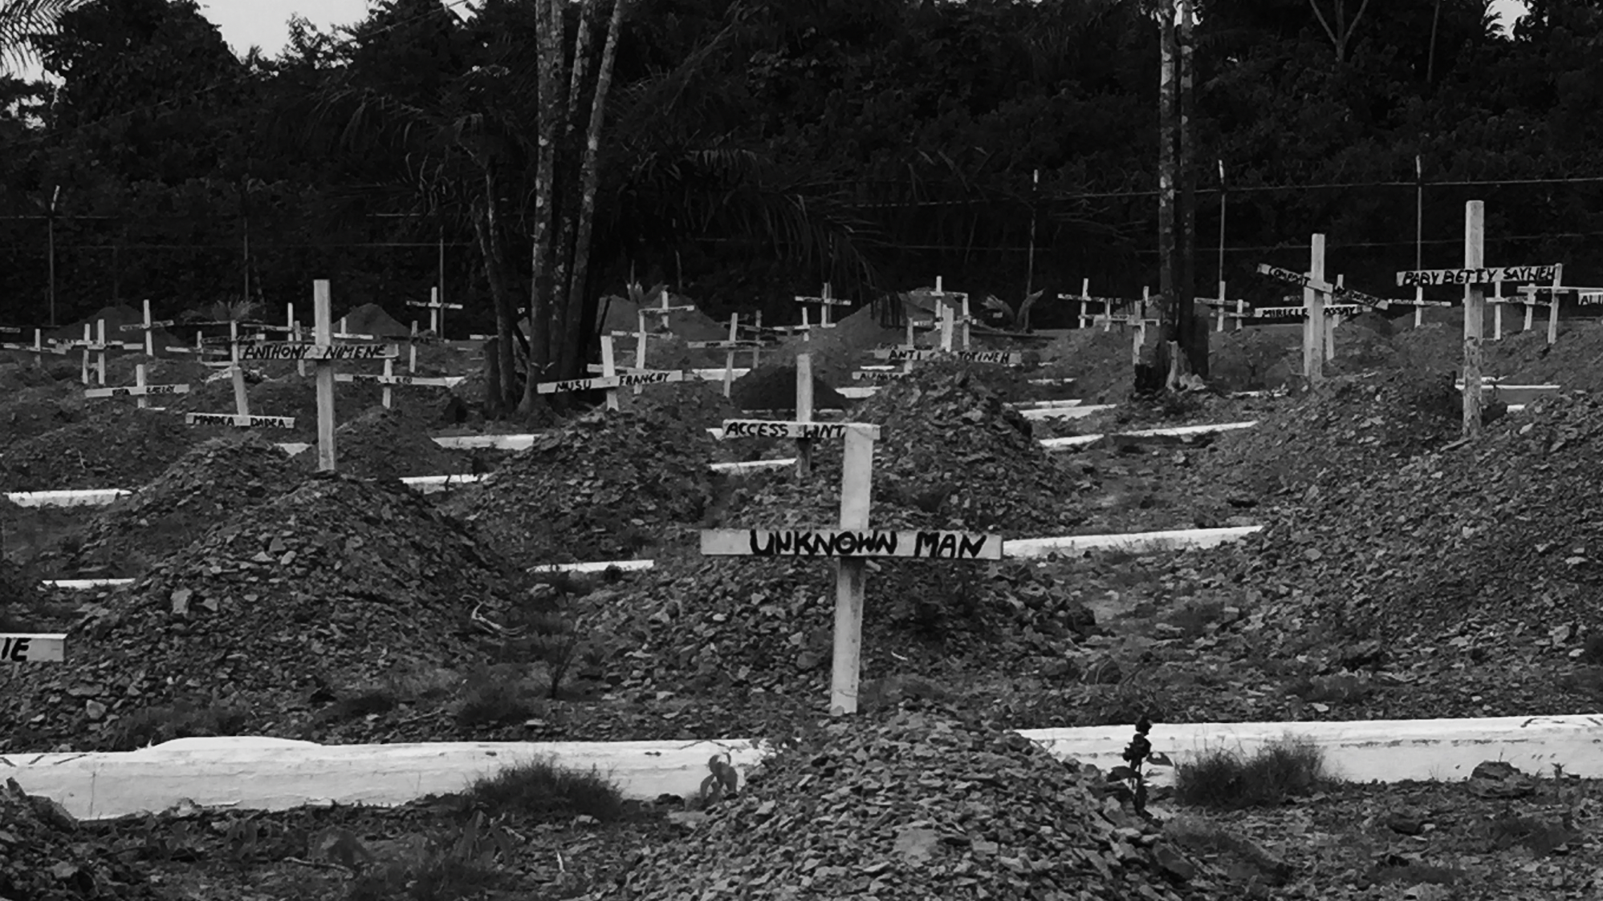
This will happen again.
Notes:
Epidemic response must evolve from crisis response to integrated cycles of preparedness, response and recovery

Slide 27
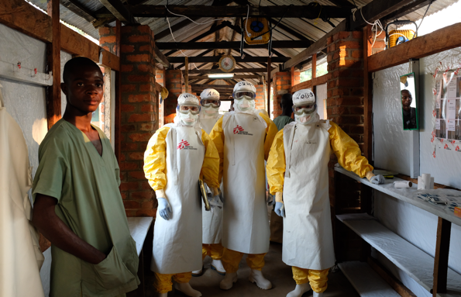
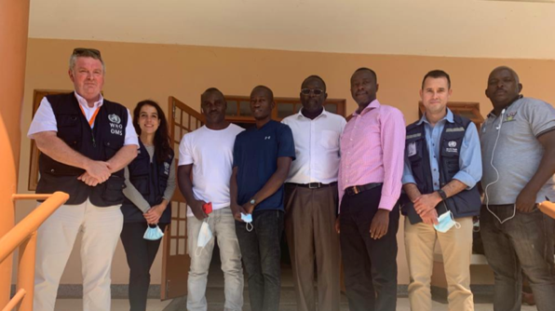
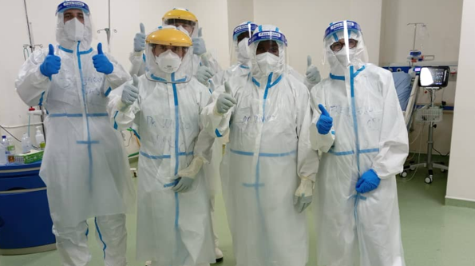
Thank You
Rwandan Medical Team
Dr. Eric Seruyange
Dr. Theogen Twagirumugabe
Dr. Menelas Nkeshimana
Dr. David Turatsinze
Bosco
Many others
UNC
Mike Cohen
David Wohl
Shannon Carson
Joe Eron
Tim Sheahan
Diana Stanley
McKenzie Colt
Thomas Remont
Hanan Shuayto
Katie Mollan
Jean DeMarco
Rosie Watts
Amy Loftis James
Many Others
WHO
Dr. Mike Ryan
Dr. Janet Diaz
Dr. Tom Fletcher
Dr. Ian Crozier
Dr. Marta Lado
Dr. Daniel Youkee
Dr. Ana-Maria Restrepo
Dr. Pierre Formenty
Many others
MSF
Dr. Kerry Dierberg
Dr. Sascheeven Singh
Dr. Armand Sprecher
Dr. Ruggero Giuliani
Many others
CDC
Dr. Sherif Zaki
Dr. Christina Spiropoulou
Dr. Stuart Nichol
Dr. Pierre Rollin
Dr. Joel Montgomery
Many others
INRB
Dr. Jean Jacque Muyembe
Dr. Placide Mbala
Dr. Olivier Tshiani
Dr. Sabue Mulangu
Dr. Daniel Murkadi
Many others
ALIMA
Dr. Richard Kojan
Dr. Hans Joerg

Slide 28

IMPLEMENTING AN INTRA-OUTBREAK EBOLA SUDAN RING VACCINATION TRIAL IN UGANDA: EXPERIENCES AND FUTURE PERSPECTIVES
DR. MISAKI WAYENGERA

Slide 29
Uganda SUDV HotSpot
6 of the last 8 outbreaks of SUDV on Continent
2022 outbreak with 142 cases and 56 (39.4% ) fatalities revealed major gaps in global filovirus and EVD vaccine R & D landscape
No approved Vaccines for SUDV
No prior concerted global efforts to evaluate for licensure—existing candidates
Efforts to implement similar ring vaccination trials as was done in West Africa for EBOV, faced Bottlenecks in A. administrative, R. regulatory and L.logistics frameworks to allow for timely deployment
Despite these early shortcomings, opted to uphold protocol and keep it alive; adopt it to integrate bridging immunogenicity work; keep the only un withdrawn IP in appropriate storage
Thus, we opted to do 2 things
Not only keep the ring vaccination trial protocol alive; but adapt it to include bridging safety and immunogenicity arm.
Despite withdrawal of 2 of the other candidate vaccines (Oxford ChAd, GSK-Ad5); maintained in country storage of the available IAVI-rVSV vaccine
These strategic decisions underlie the ability to rapidly deploy. WHO and partners supplemented these ef

Slide 30
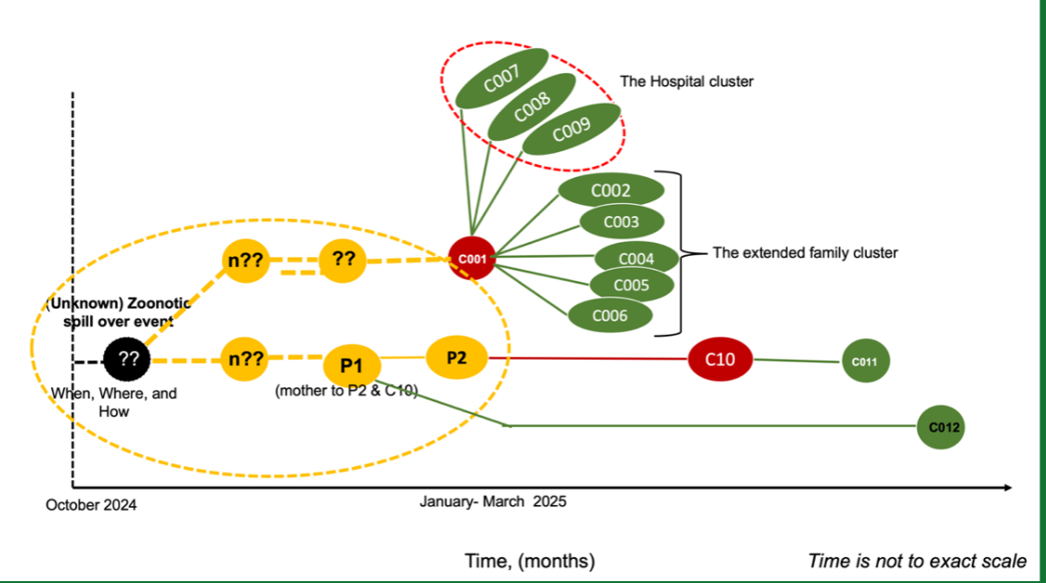
2025 SUDV outbreak: Clusters

Slide 31
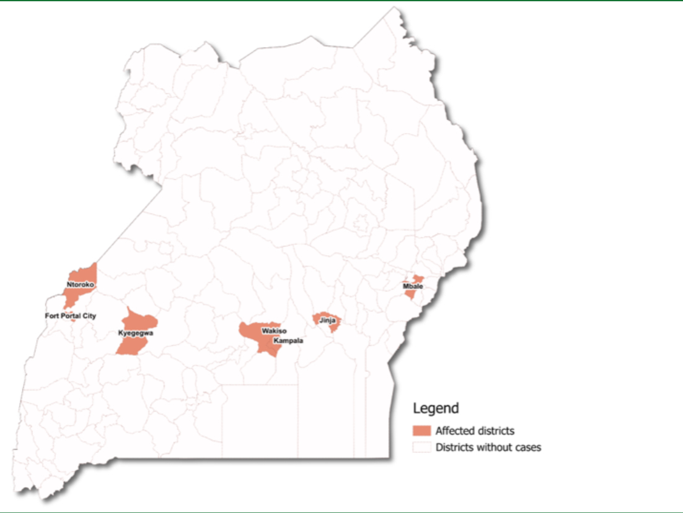
Geographic Spread

Slide 32
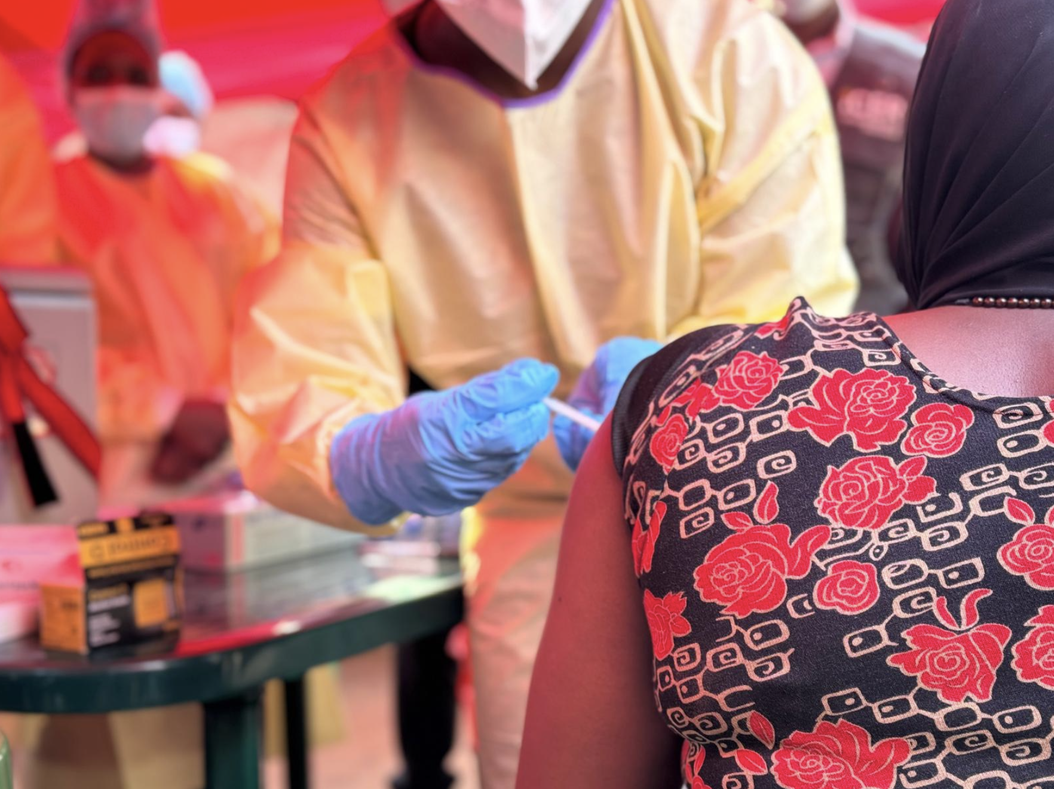
Ring vaccination trial
Ring vaccination trial to evaluate the efficacy, safety & immunogenicity of a Sudan ebolavirus vaccine in Uganda – Tokomeza Ebola

Slide 33
REASONS FOR SWIFT IMPLEMENTATION
Stewardship from sponsors (WHO and MOH) during the 2022 and 2025 EVD outbreaks
Ability of the implementing institutes to prefinance the trial while awaiting funds from the sponsor
A pre-developed and approved trial protocol kept alive through annual renewals
In country availability of the rVSV vaccine manufactured by IAVI
South-south collaboration - technical team that conducted a similar trial in West Africa worked with Ugandan scientists

Slide 34
Supportive ethics/ regulatory systems
Research capacity established during 2022 – trained a trial team that could be called upon
Close collaborations between investigators and MOH response teams
Maintenance of logistics from 2022 outbreak and good standing with service providers

Slide 35
CHALLENGES
Vaccine hesitancy – especially among health workers
Some cases had moved over wide geographical areas – identifying all contacts took longer than anticipated
Samples had to be transported over long distances to processing laboratory
High volumes of blood collected caused fear among some participants

Slide 36
CONCLUSION
Lessons will be consolidated as part of research capacity strengthening for both intra and inter-outbreak periods
Strong collaborations, pre-existing research capacity and agile ethical approval processes are key in timely execution of clinical trials in an outbreak
Mobile research laboratories with capacity to do safety tests and PBMC isolation could help overcome the challenge of distance.

Slide 37
THANK YOU

Slide 38
Q&A

Slide 39
Save the Date:
OCTOBER 14 (in-person and online) –
The New Frontier in HIV Pre-exposure Prophylaxis: Lenacapavir Update

Slide 40
This webinar recording and slides will be posted on www.icap.columbia.edu

Slide 41
Thank you

