Slide 1
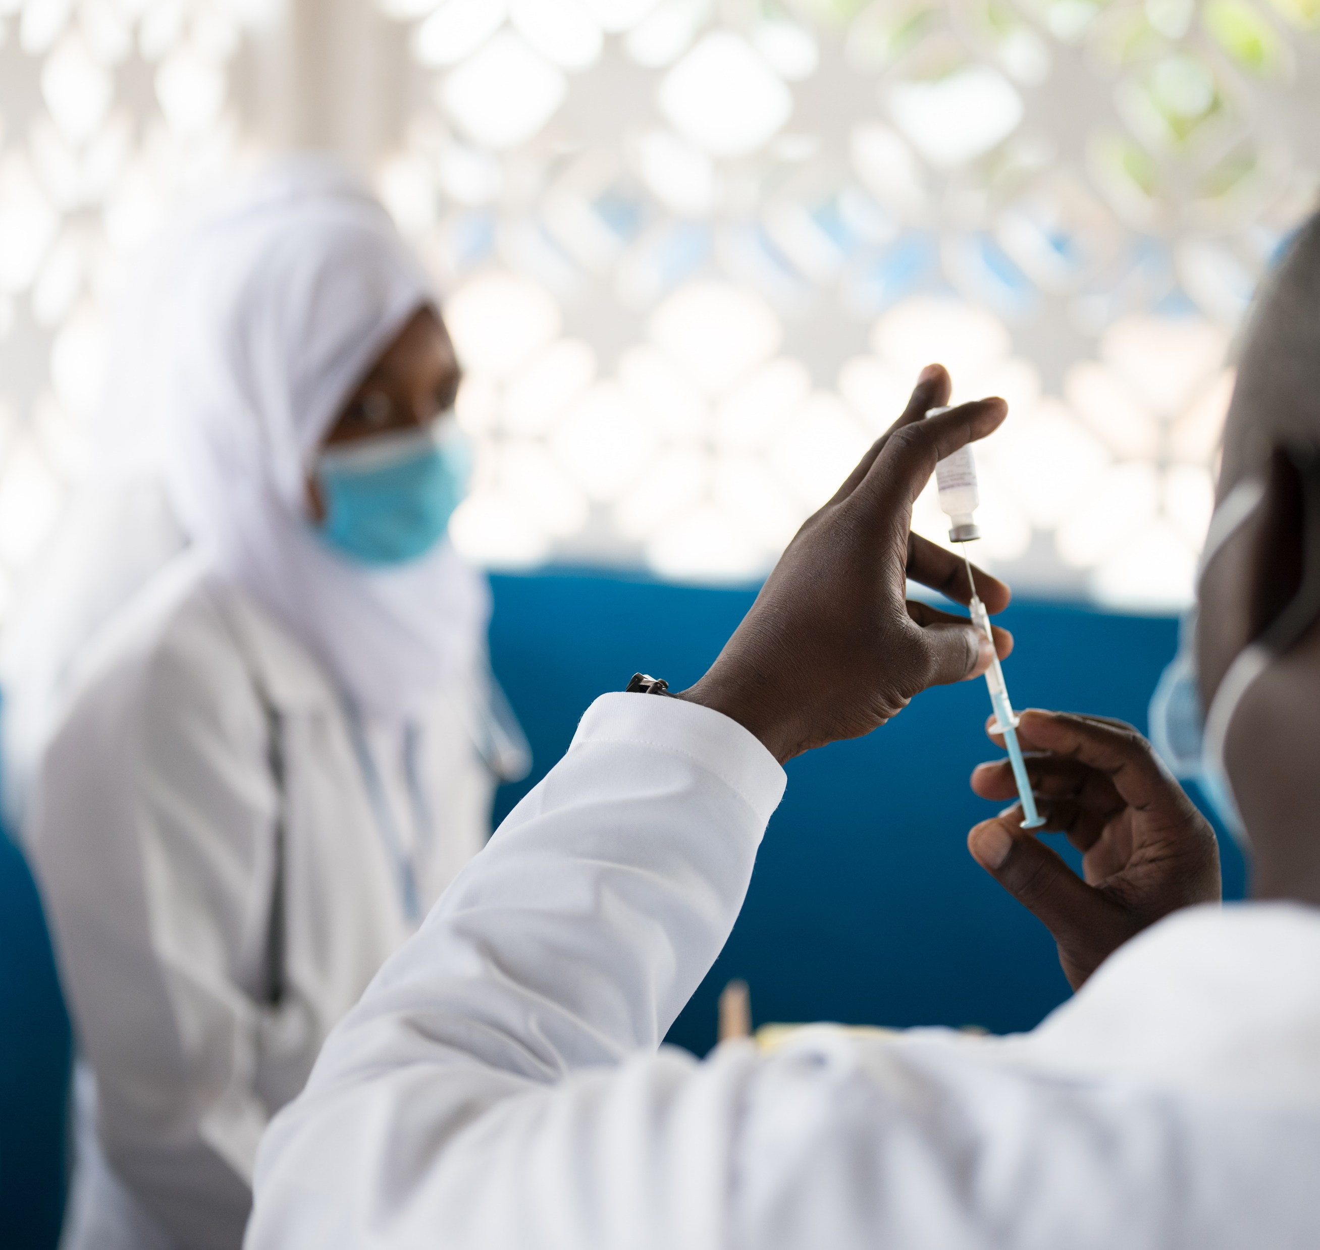
MALAria vaccine implementation in sierra leone
ICAP GRAND ROUNDS
April 16, 2024

Slide 2
Susan Michaels-Strasser, PhD, MPH, RN, FAAN
Senior Director,
Human Resources for Health Development,
ICAP at Columbia University

Slide 3
Agenda
Reminders:
Welcome and Introduction –
Presentation
Q & A
For questions to the panelists, use the Q&A box
The webinar recording and slides will be posted on www.icap.columbia.edu

Slide 4
Desmond Maada Kangbai,
Program Manager,
Expanded Program on Immunization,
Ministry of Health and Sanitation, Government of Sierra Leone
Baboucarr Boye,
Immunization Specialist,
UNICEF,
Sierra Leone

Slide 5
Introduction and Rollout of Malaria Vaccines in Sierra Leone: Early Lessons and Experiences, April 2024
April 16, 2024
EPI Program

Slide 6
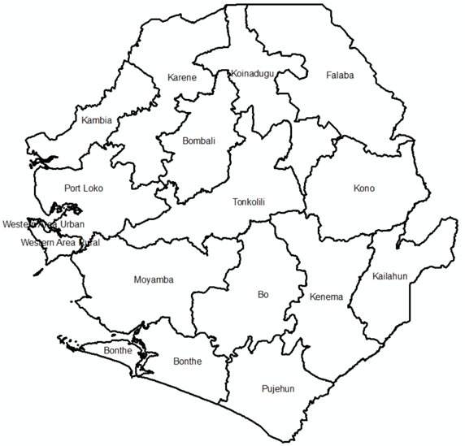
Sierra Leone country profile
Location: Western Coast of West Africa
Area: 71,740 sq KM
Total Population: 8,078,687 people (Statistic SL Mid-term Census 2021)
Infant mortality: 78.3 deaths per 1000 live births
Under five mortality: 104.7 deaths per 1000 live births

Slide 7
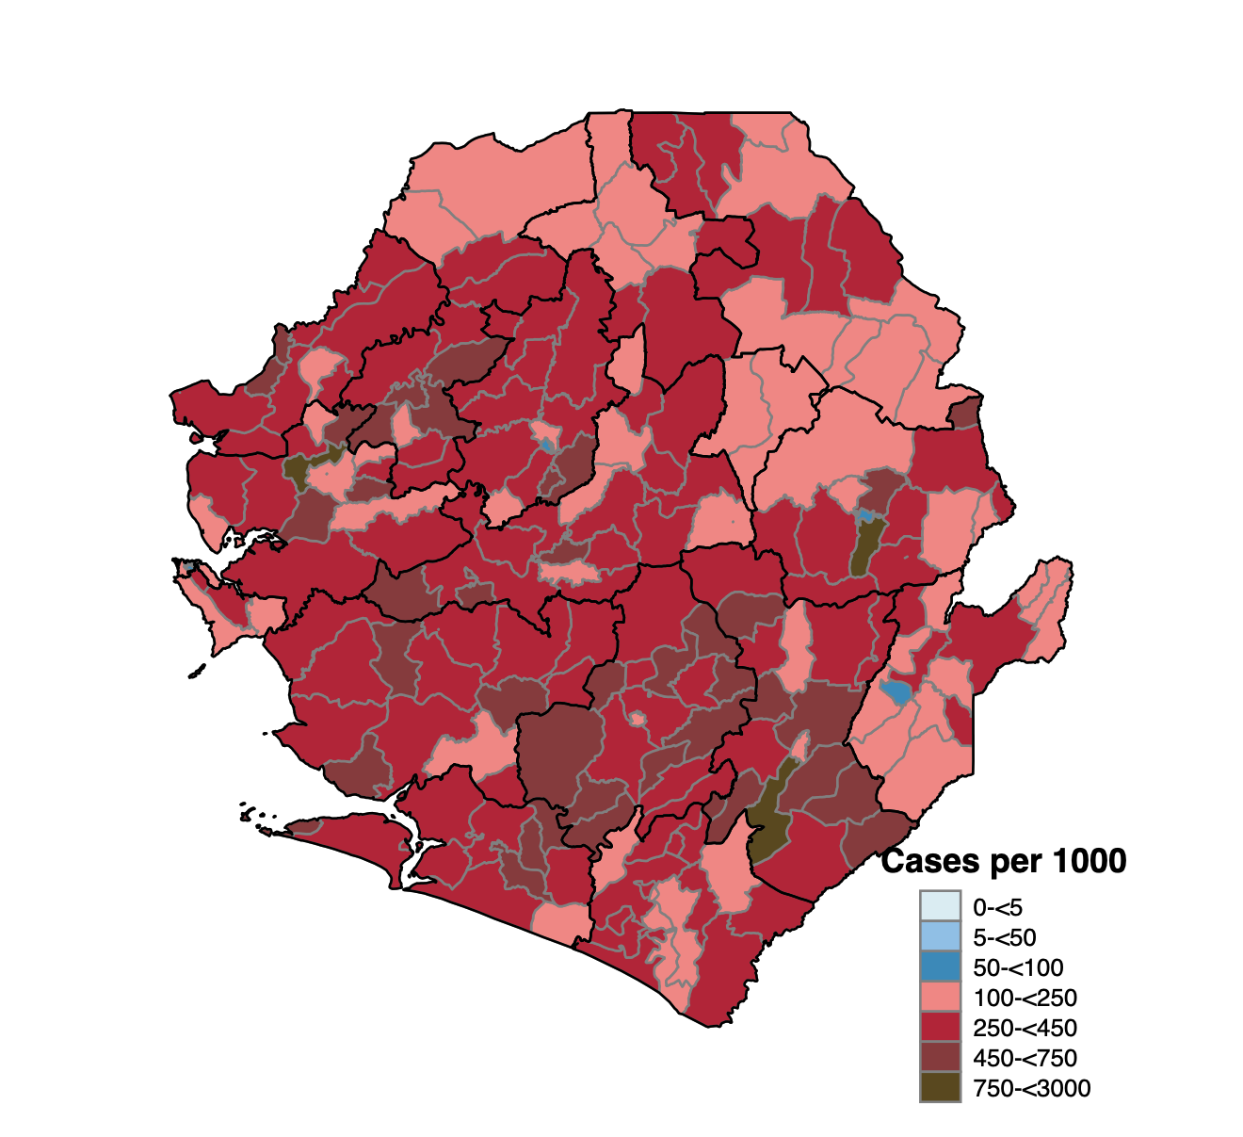
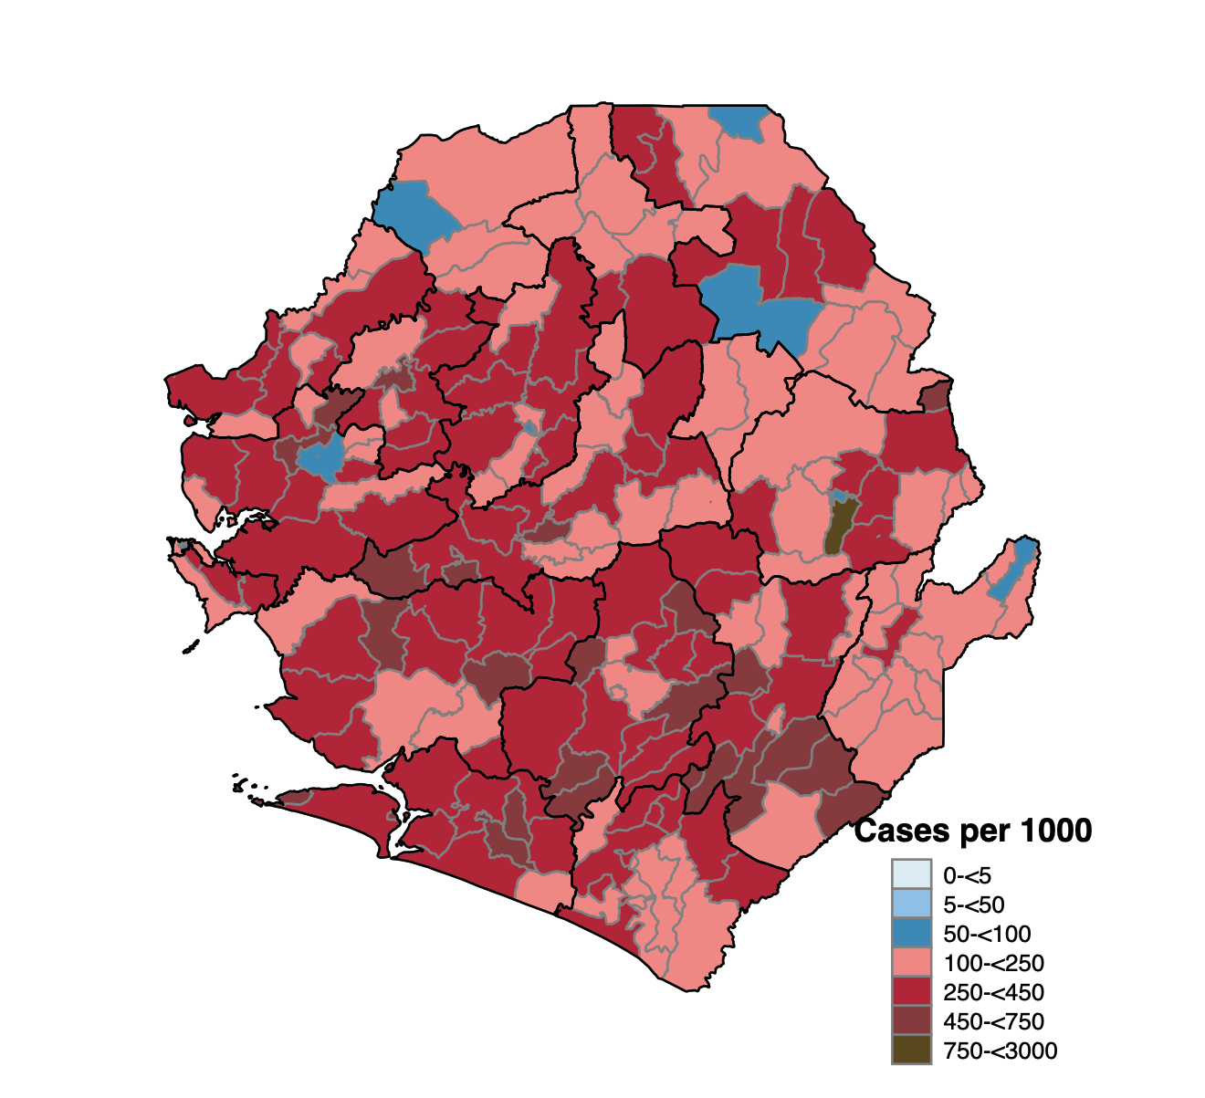
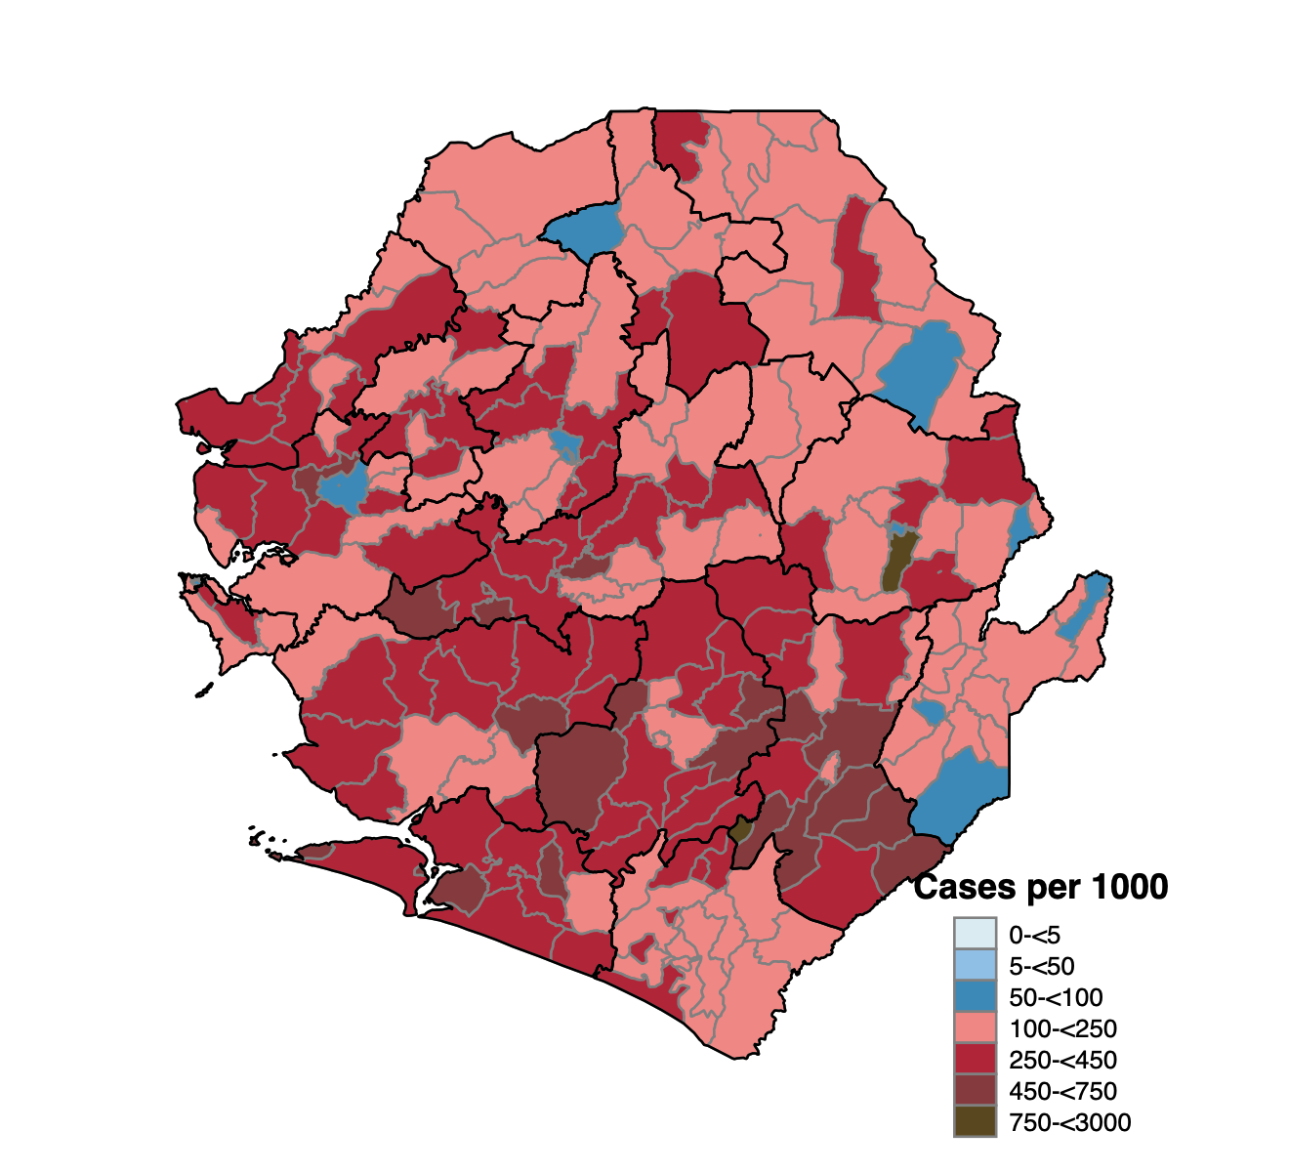
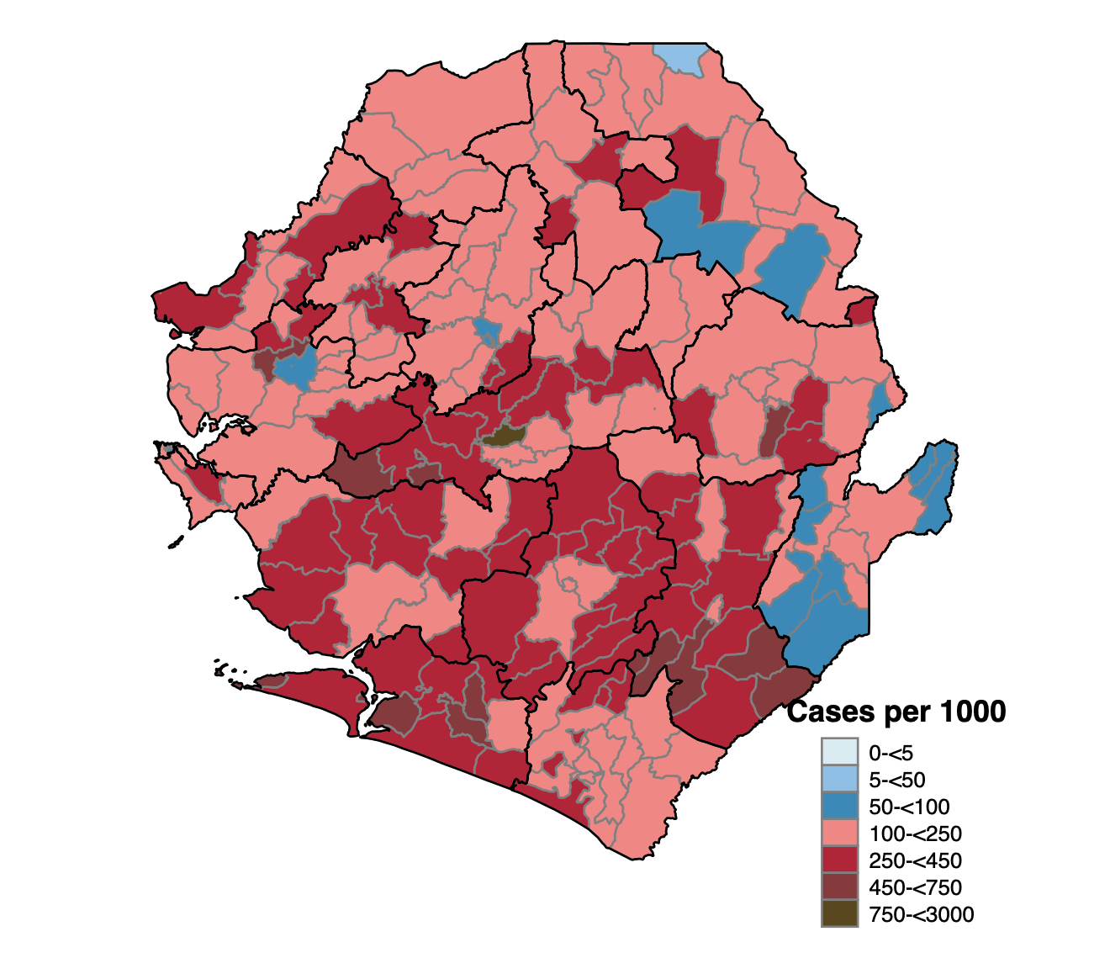
COVID-19 Country Situation, August 25, 2022
Malaria disease burden in Sierra Leone
Malaria remains the leading cause of morbidity and mortality.
Prevalence of malaria is almost two times higher in rural areas (25.6%) than in urban areas (14.2%)
Accounts for:
20% of children under 5 mortalities
40.3% of outpatient attendance for all ages
37.6% of hospitalized cases for all ages
Over the last years, with the implementation of comprehensive disease control measures, case incidence due to malaria has gradually reduced
2019
2020
2021
2022

Slide 8
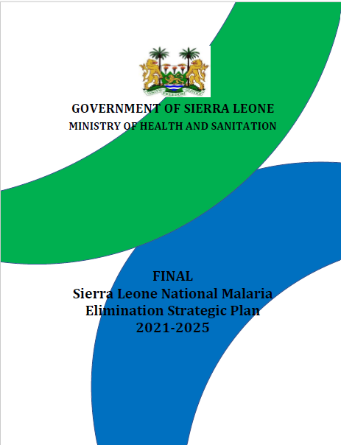
National malaria control strategies
Vision - is to accelerate the implementation of Malaria Control Interventions toward a Malaria-free Sierra Leone.
Goal - by the end of 2025, to contribute significantly to the improvement of the well-being of the population by reducing the malaria burden.
Integrated Vector Management
ITN Distribution (mass and routine)
IRS
Case Management
Prompt diagnosis with mRDTs, Microscopy
Treatment with AL, AA, Inj AS
Prevention/Chemoprophylaxis
IPTp
IPTi (now PMC)
Malaria Vaccine
Therapeutic Efficacy Studies
Insecticide Resistance Monitoring
Community case management by CPBs (now CHWs)

Slide 9
Malaria Vaccine introduction roadmap in Sierra Leone
PBSL Clearance on Vaccines
NITAG SL Recommendation
550,000 Vaccine doses Arrive in the country
Development of communication strategy
First readiness Assessment
Microplanning
Formation of district TWGs
Vaccination launch and rollout
Development and validation of training Materials
Vaccine distribution
Training of supervisors and vaccination
Nov 2023
Dec 2023
Jan 2024
Feb 2024
Mar 2024
April 2024

Slide 10
Early Lessons and Experiences

Slide 11
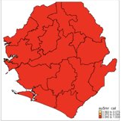
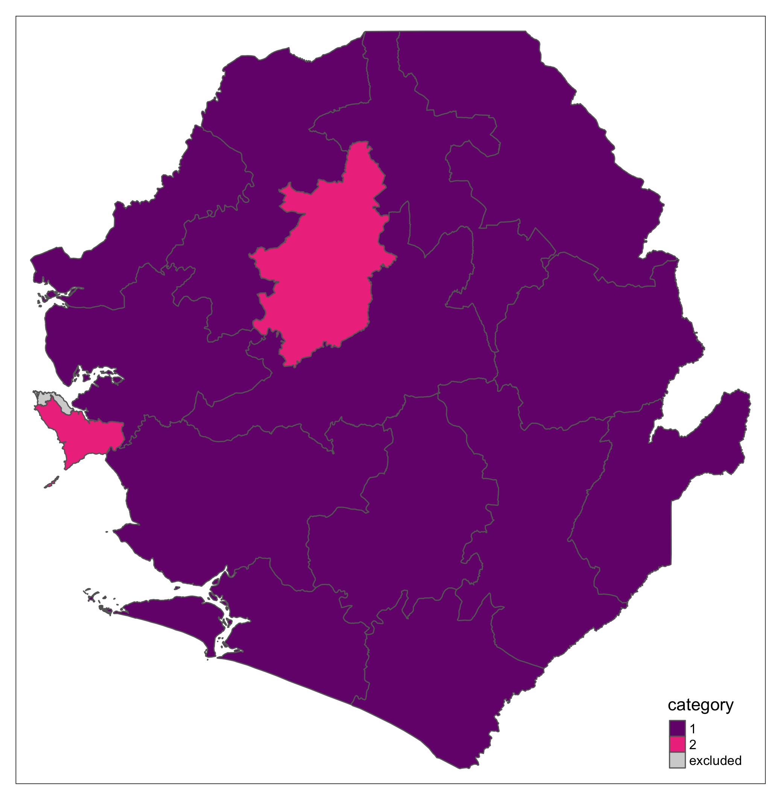
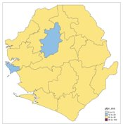
Prioritization of moderate to high transmission areas guided the phased approach to the Malaria Vaccines introduction
Two indicators guided the prioritization of districts
All cause under 5 mortality (HDS 2017)
All districts, except Western Area Urban (WAU), were considered high
Plasmodium falciparum parasite rate (PfPR) (Malaria Indicator Survey 2021).
13 districts have a prevalence rate of 20 – 30%
2 districts, Bombali & Western Area Rural, had a prevalence rate of 10 – 20%
WAU had a prevalence of < 10%
All cause U-5 mortality (2017)
Combination of the two indicators
PfPR estimates (2021)

Slide 12
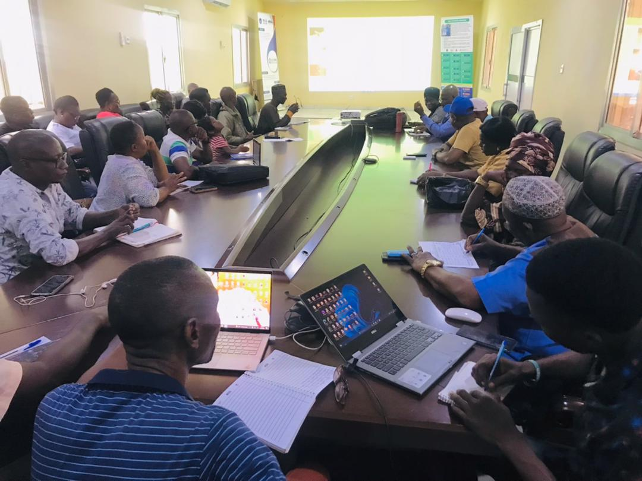
COVID-19 vaccination daily trends, Sierra Leone, March 2021-August 17, 2022
Creation of Malaria Vaccine TWGs at national and district levels strengthened the designing, implementation, monitoring, and reporting
Malaria Vaccine TWGs provided a platform for reviewing implementation progress, identification of gaps and development of corrective action plans, and monitoring their implementation
At national level, meetings were held weekly (twice weekly in the last month)
At district level, meetings were weekly
Malaria Vaccine TWG meeting session at Port Loko District

Slide 13
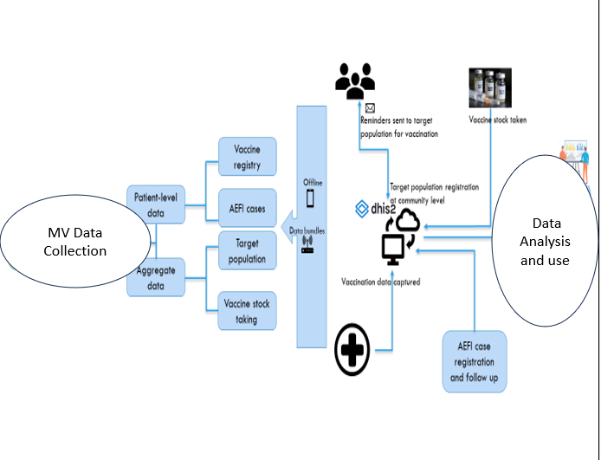
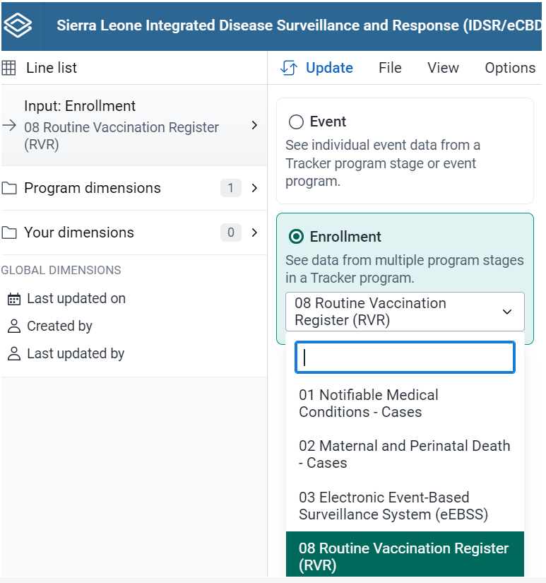
COVID-19 vaccination Coverages, Sierra Leone, March 2021-August 29, 2022
Robust electronic case-based data monitoring systems using DHIS2 to fast-track vaccinees
Malaria Vaccination case-based data capture in dhis2 has provided a platform for piloting the long-awaited electronic routine vaccination registry
Electronic case-based immunization registry infrastructure

Slide 14
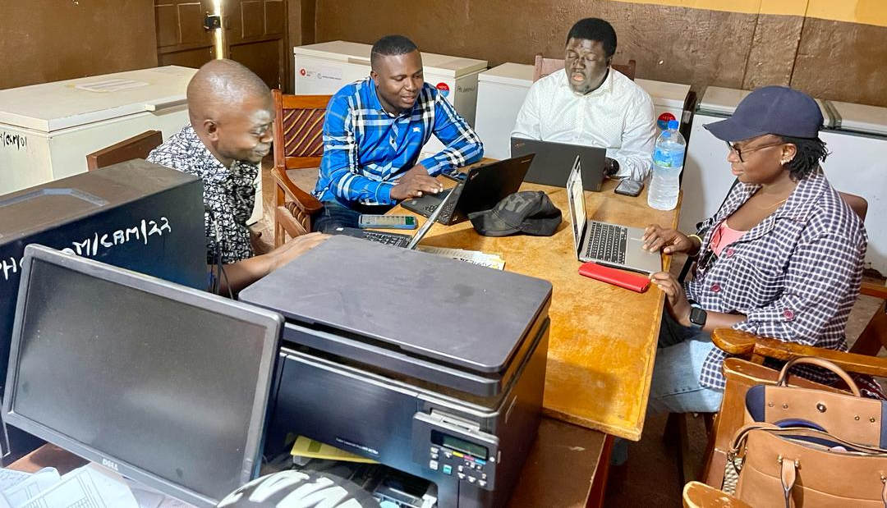
COVID-19 vaccination Coverages, Sierra Leone, March 2021-August 29, 2022
Succinct vaccination targets set at subnational level guided microplanning
Population-based target setting based on surviving infants at district and Chiefdom levels has facilitated effective microplanning
During the first year, 95% of 286,253 targeted infants in 15 districts will receive 3 vaccine doses
Microplanning session at DHMT, January 2024

Slide 15
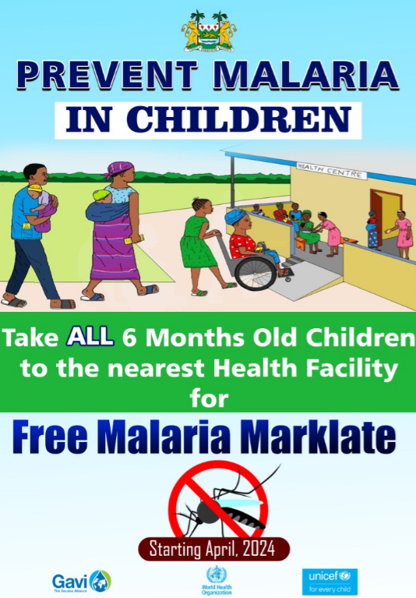
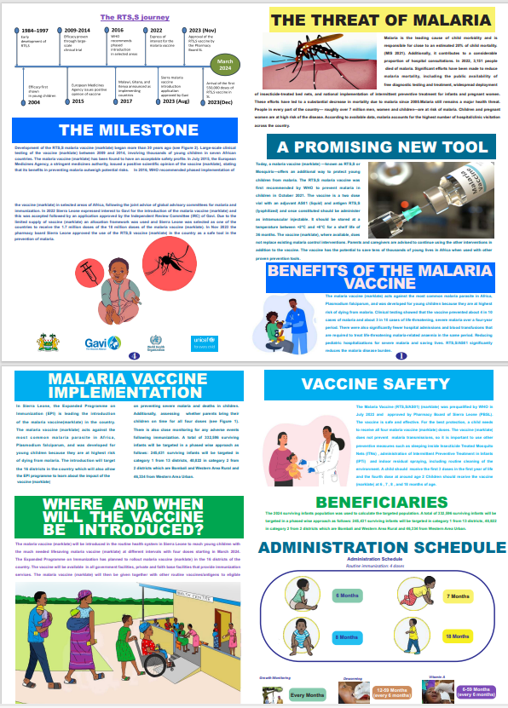
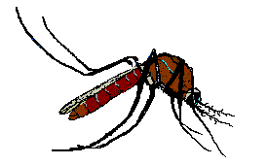
Full COVID-19 vaccination coverage, Sierra Leone, August 29,2022
Effective public health communication tools for disseminating accurate information to the public to address common queries, concerns, and misconceptions

Slide 16
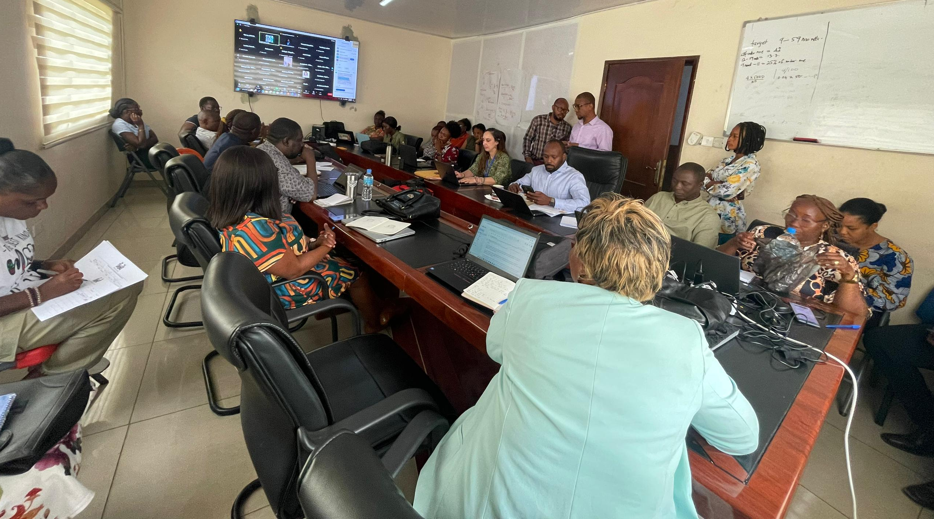
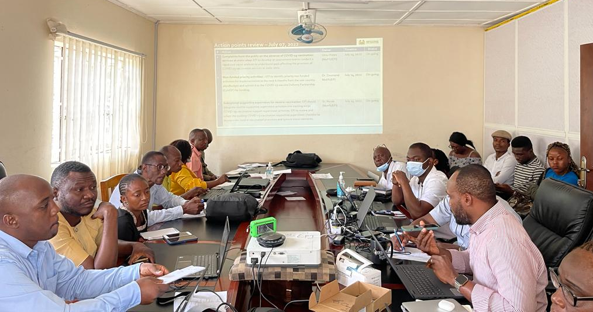
Effective coordination of COVID-19 vaccine deployment, Sierra Leone
Inclusive routine immunization coordination platforms improved planning and resource mobilization
Engaging stakeholders through regular coordination meetings to foster dialogue among shareholders, mobilize resources, and create synergies on Malaria Vaccine Introduction
Inter-agency Coordination Committee technical meetings chaired by the Hon. Minister for Health have been a cornerstone for mobilizing funding for the introduction phase
Technical coordination committees (TCC) chaired by the EPI Program manager brought together technical agencies and MOH technical staff to develop overarching implementation plans, monitor their implementation, and identify gaps for corrective action plans
TCC meeting sessions at EPI Conference Hall

Slide 17
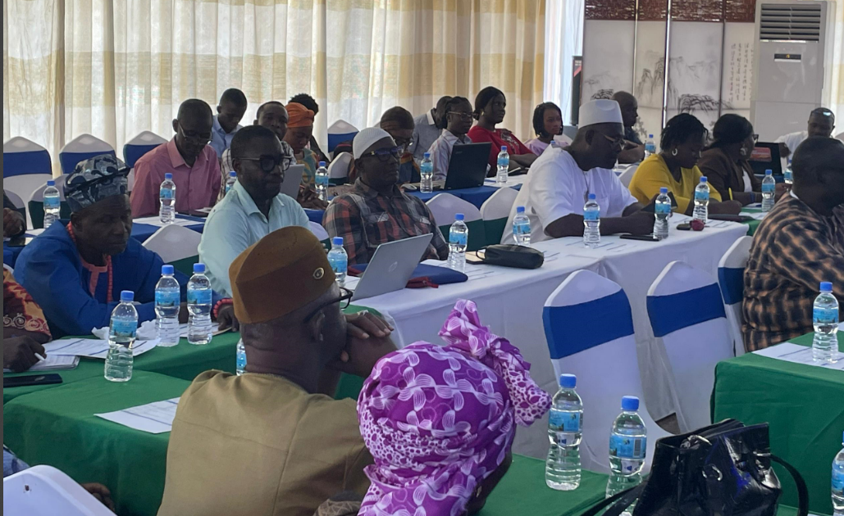
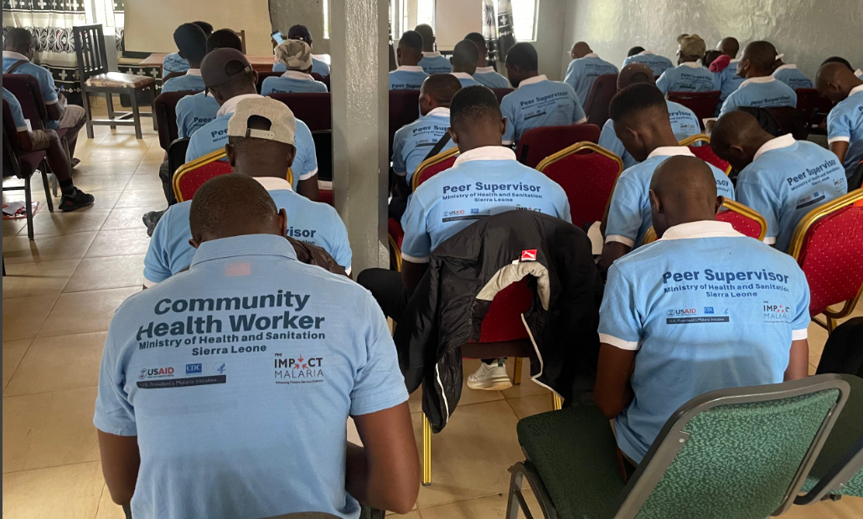
Effective community engagement builds trust and feedback for new vaccine introduction
National Engagement Meeting with the National Council of Paramount Chiefs on Malaria Vaccine Introduction
Regional training for community healthcare workers on Malaria Vaccine Implementation

Slide 18
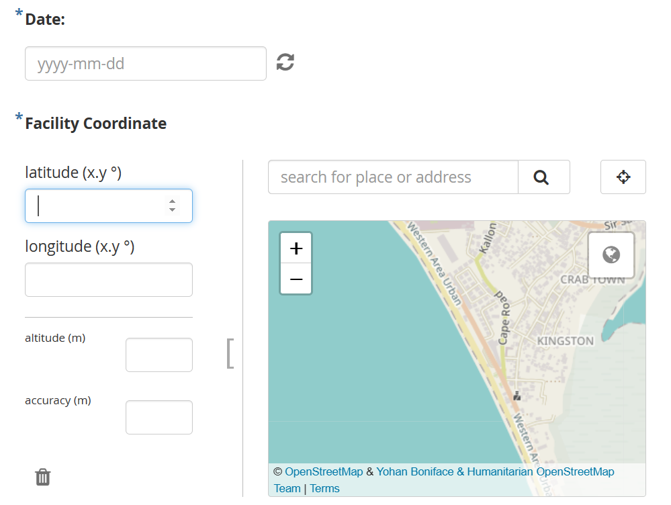
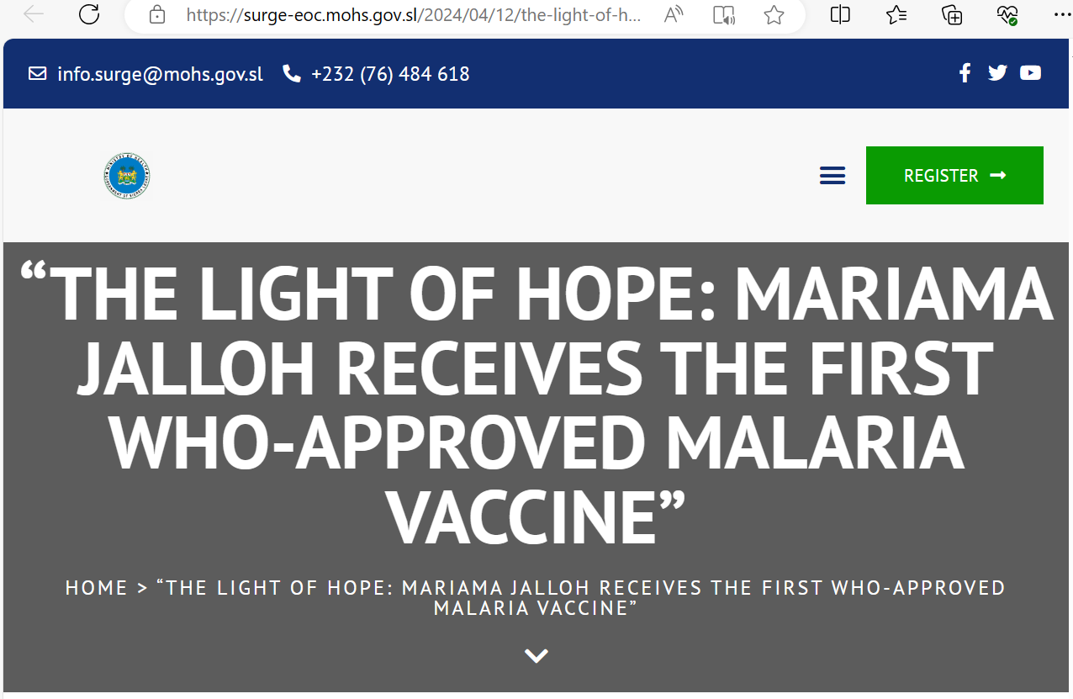
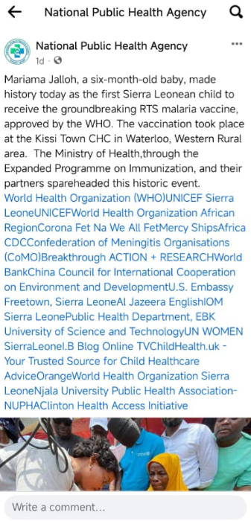
Fostering relationships through electronic media platforms to promote rapid dissemination of information on malaria vaccines within and outside program
Health facility Malaria Vaccine introduction supportive supervision checklist in Kobo Collect tool allows timely identification of issues for correction in real time
Ministry of Health social media channel for prompt dissemination of news through social media handlers https://surge-eoc.mohs.gov.sl/2024/04/12/the-light-of-hope-mariama-jalloh-receives-the-first-who-approved-malaria-vaccine/

Slide 19
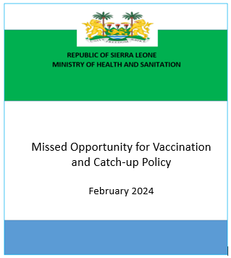
Other Achievements
Timely adaptation of existing guidelines, protocols, and tools has led to effective and efficient integration of Malaria Vaccines into routine immunization
Adapted existing policies, guidelines, SOPs, and tools for routine immunization to include Malaria vaccination in the country
Missed Opportunity for Vaccination and Catch-up Policy – guides the implementation of approaches for missed vaccination(s) and other child health interventions
Monitoring and evaluation tools have been reviewed and updated to include Malaria Vaccine data elements to facilitate harmonized national and global reporting

Slide 20
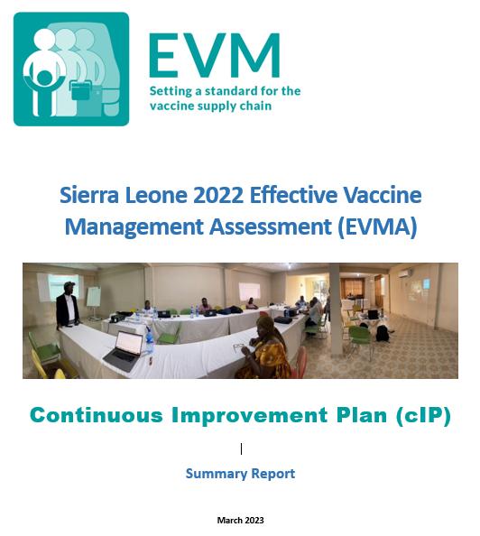
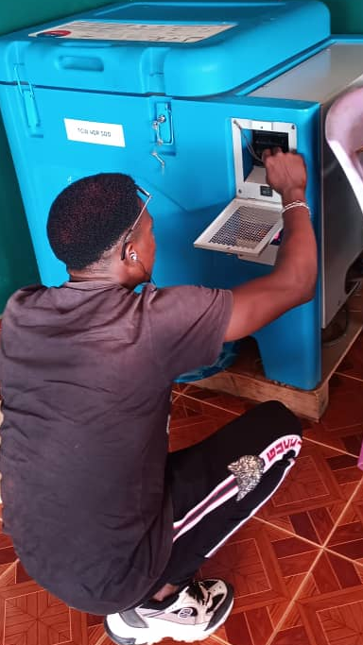
Other Achievements
Leveraged existing information on the vaccine supply chain to bolster the country’s capacity to meet additional cold chain requirements
Scaled-up cold chain infrastructure at central, district, and Health facility levels based on the Effective Vaccine Management Assessment (EVMA)
Repair of non-functional refrigerators and substitution of low for higher volume refrigerators have been implemented to promote vaccine availability at the service delivery point by maintaining efficient immunization supply chain systems
Technicians undertake repair and maintenance in the PHU

Slide 21
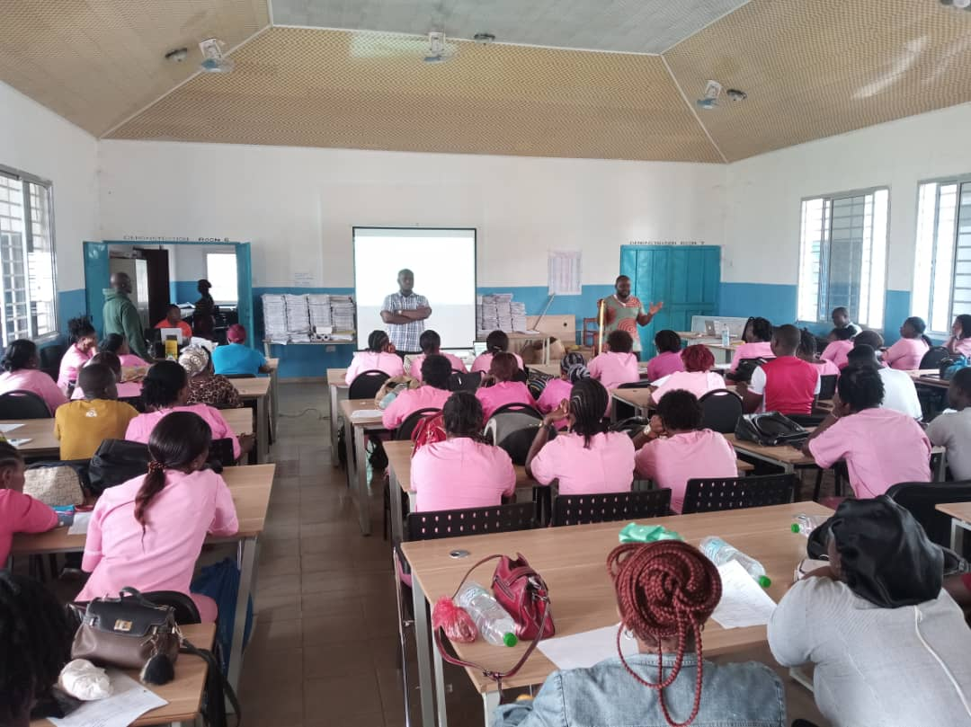
Other Achievements
Workforce development
Developed Malaria Vaccine introduction curriculum and supportive supervision tools based on WHO guidance, vaccine efficacy, and safety data from manufacturers and pilot countries
1,503 teams trained in vaccine administration and handling, data management, risk communication, and safety management
64 national supervisors are currently deployed in each of the 15 to ensure an effective and efficient vaccine introduction process

Slide 22
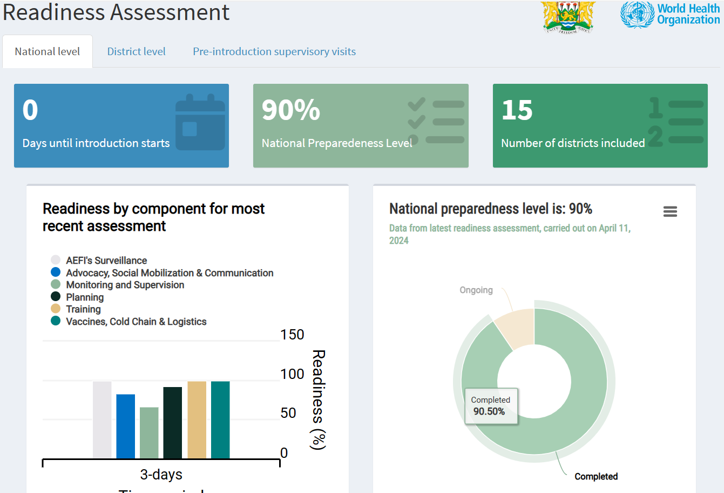
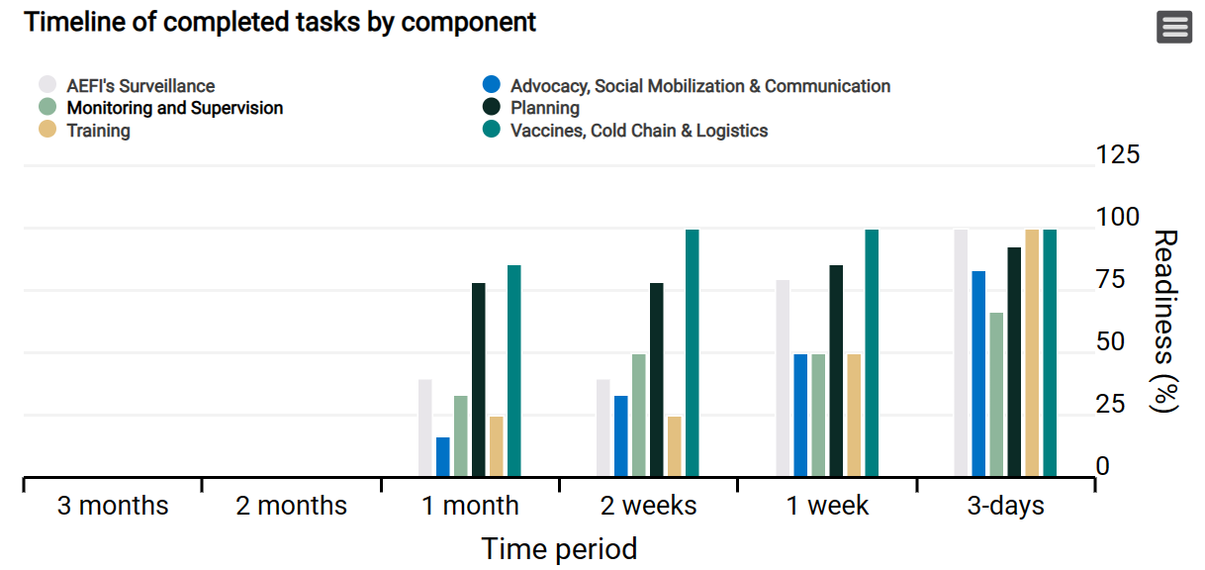
Other Achievements
Continuous assessment of internal capacities for improvement throughout the malaria vaccine pre-introduction period
National level readiness assessment results, 3 days to vaccine introduction
Tends of national-level readiness assessment results four the last four rounds

Slide 23
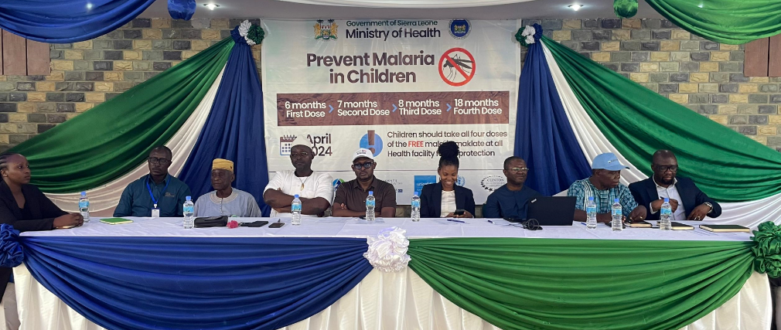
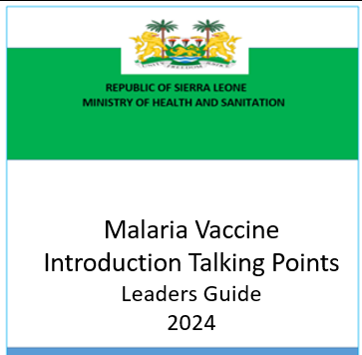
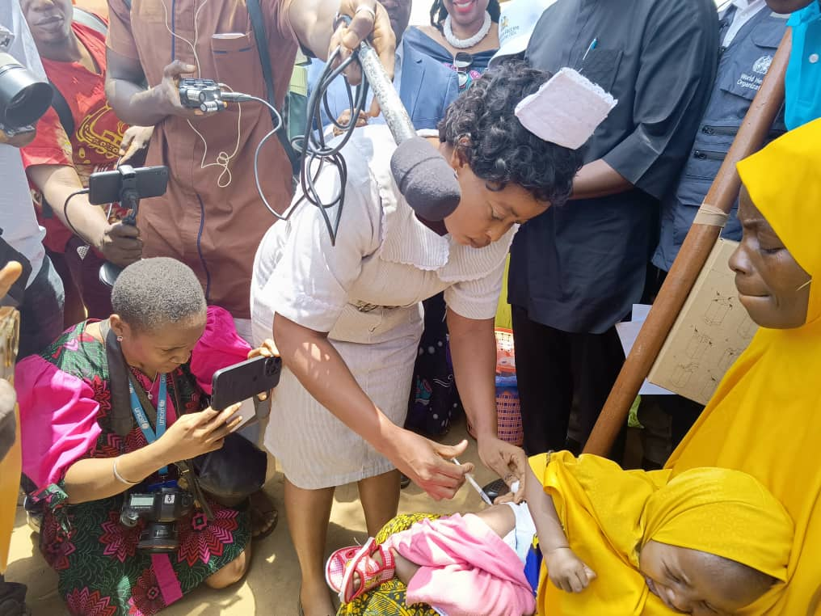
Political commitment for COVID-19 vaccination
Trust in the country’s leadership and the information they provide has been essential in addressing vaccine safety concerns
National and district leaders have been engaged throughout the vaccine application and introduction process.
Talking points based on information needs developed and shared are guiding the unified messaging process
Sub-nationwide launch and vaccination demonstrations held in each of the 15 districts have fortified the momentum for vaccine uptake
A national launch officiated by H.E the President of Sierra Leone, scheduled for April 25, 2024, will further provide synergy to the current vaccine uptake drive
Pic of leadership and Launch
Witnessing the Sub-national launch and demonstration in WAR district

Slide 24
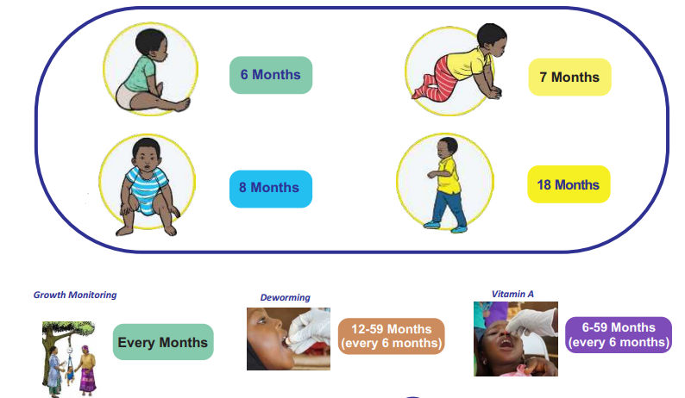
Proportion of COVID-19 vaccine doses received by source , Sierra Leone, March 2022 – August 29, 2022
Four Malaria Vaccination visits, an opportunity to improve coverage of other vaccines and to provide other childhood health interventions
At all visits, healthcare workers have an opportunity to:
Remind caregivers about upcoming vaccinations for both childhood and adult (Td, HPV, and COVID-19)
Remind caregivers of the importance of using other malaria prevention such as ITN and IPTi (Perennial Malaria Chemoprevention-PMC)
Provide canceling for reproductive health interventions, including family planning, STIs, and cervical cancer screening

Slide 25
Other Achievements
Challenges and solutions during the pre-implementation phase
# | Challenges | Solutions
1 | Sub-optimal funding for some of the critical components of the introduction process | Government of Sierra Leone, in collaboration with Health Development Partners (HDPs), through the ICC Mobilized additional funding for some of the prioritized underfunded activities Integrating activities to with other funded activities – for example microplanning and vaccine distribution and reverse logistics
2 | Emerging public health challenges, including the circulating vaccine-derived Polio Virus 2 (cVDPV2) outbreak | Oral Polio Vaccine 2 supplemental immunization activities (SIAs) have been integrated into the Malaria Vaccine introduction workplan – for example, the first round of OPV 2 readiness assessment has been jointly conducted with the last round of Malaria vaccine readiness assessment

Slide 26
Other Achievements
Looking forward
Study case-based malaria vaccination data to document progress, vaccine safety, and identification of early forms of inequities
Enhance learning through post-introduction evaluation

Slide 27
Partner support for immunization services

Slide 28
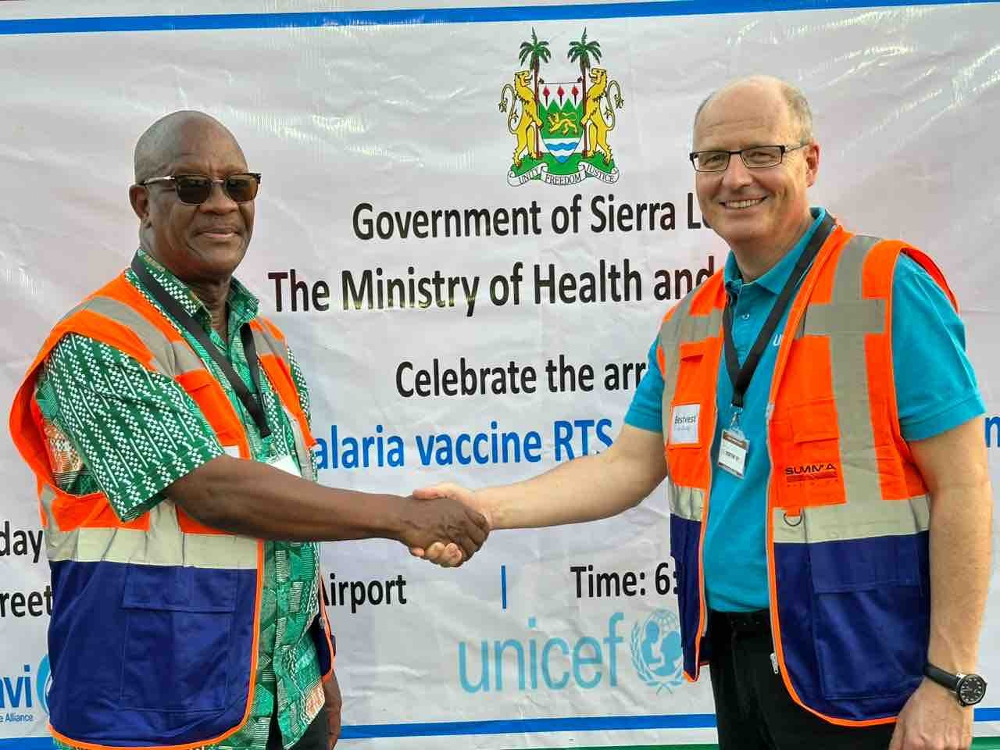
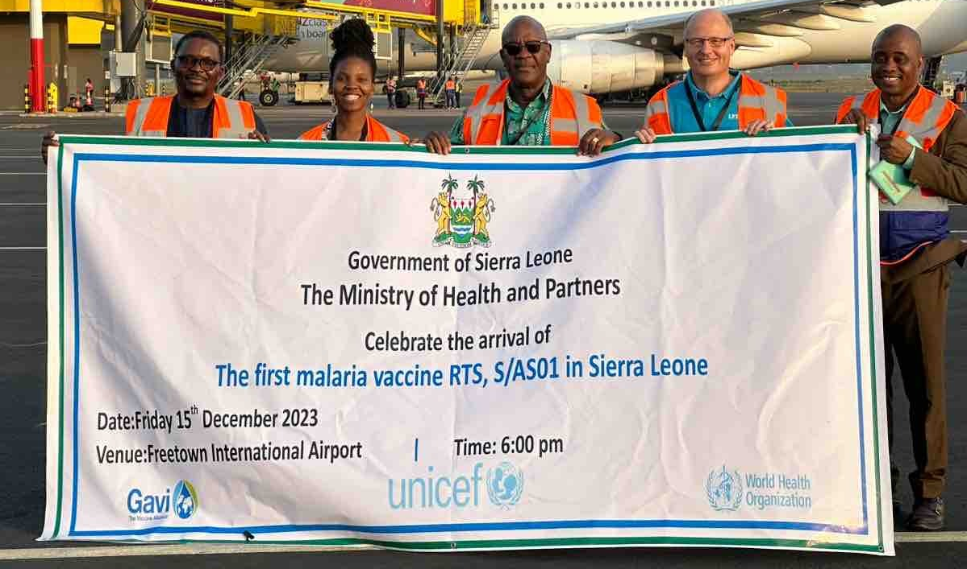
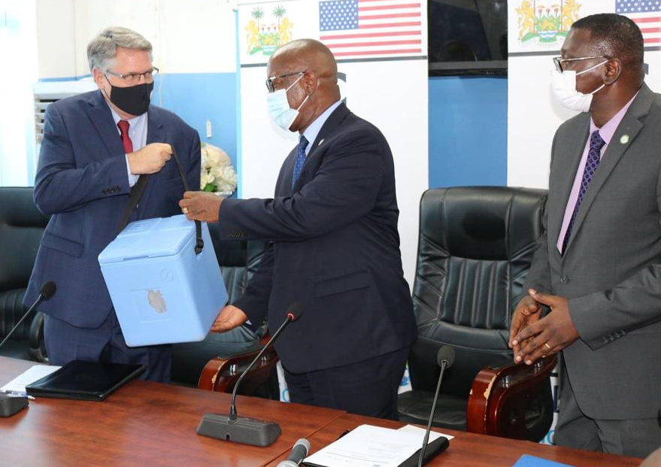
Proportion of COVID-19 vaccine doses received by source , Sierra Leone, March 2022 – August 29, 2022
Building credible partnerships: Collaborations with health development partners have been key in ensuring the availability of vaccines within the country
Sierra Leone receives the first Malaria Vaccines in December 2023
Symbolic ceremony: Handover of vaccines to MoH

Slide 29
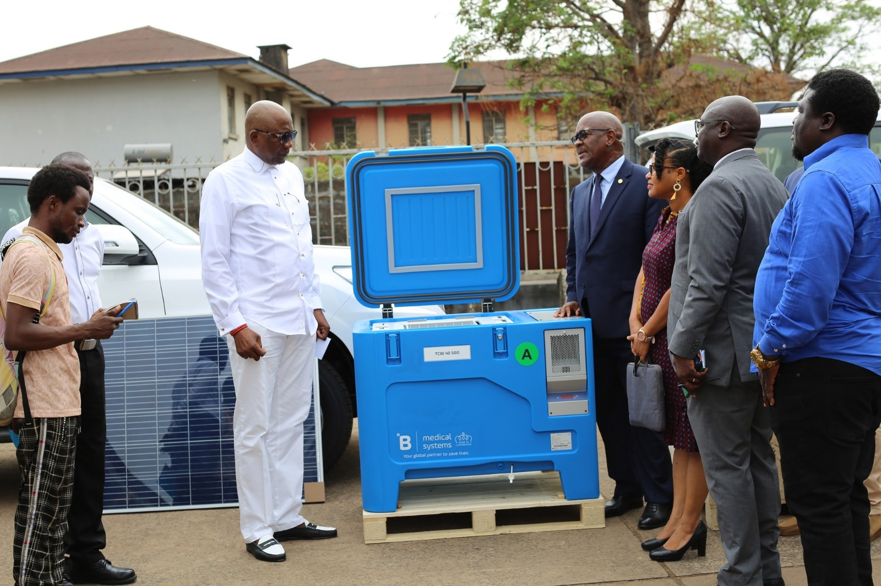
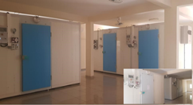
Proportion of COVID-19 vaccine doses received by source , Sierra Leone, March 2022 – August 29, 2022
Building credible partnerships: Ensuring optimal cold chain maintenance for safe and efficacious vaccines throughout the country
Handover ceremony for solar powered refrigerators
Expansion of cold chain at national vaccine store

Slide 30
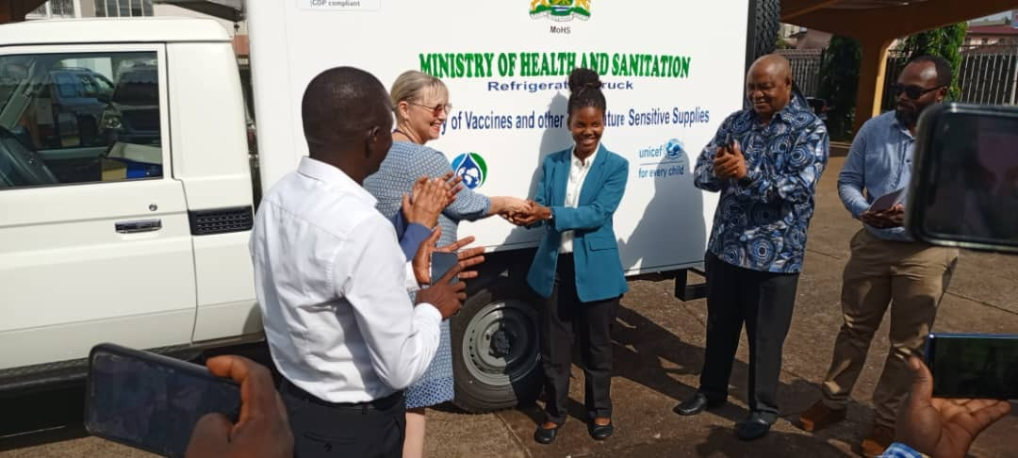
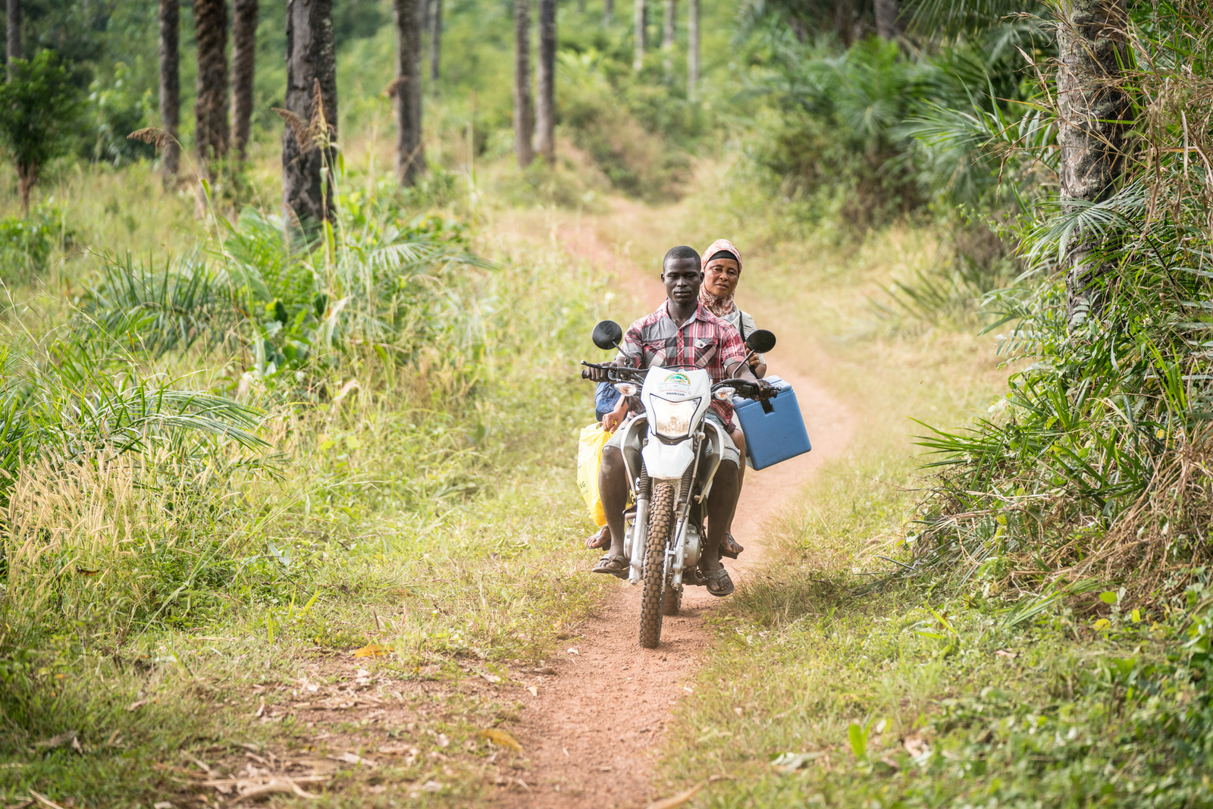
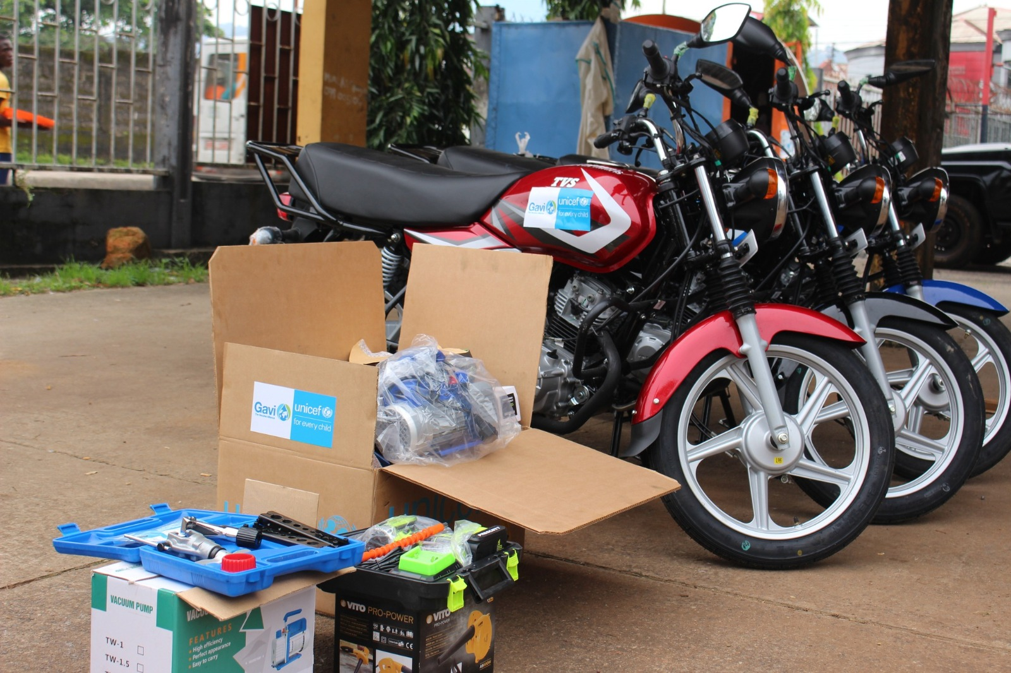
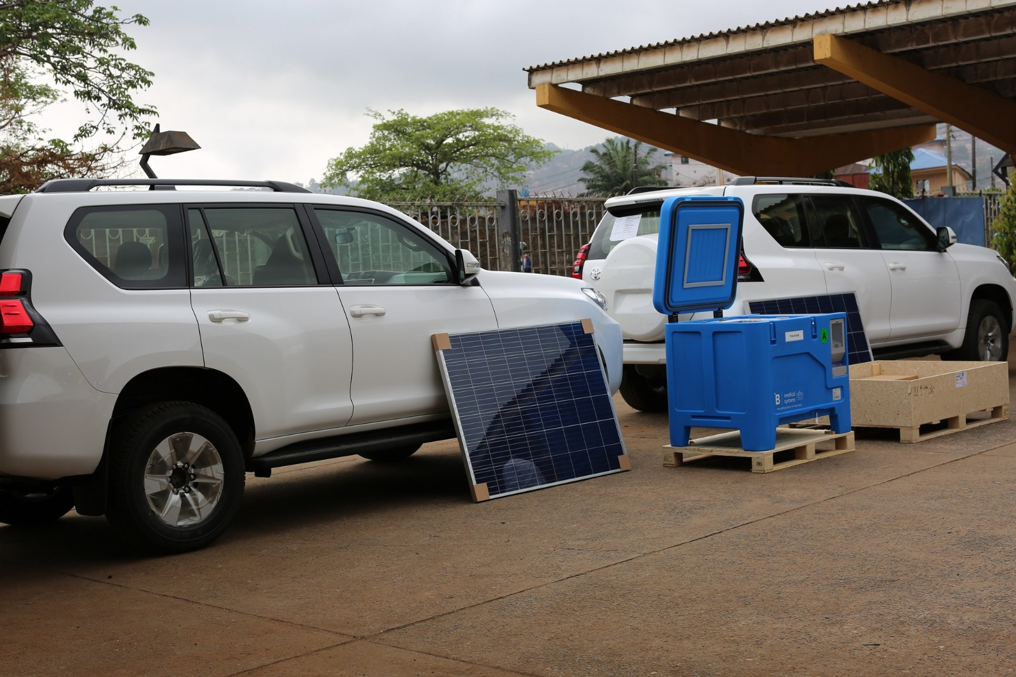
Proportion of COVID-19 vaccine doses received by source , Sierra Leone, March 2022 – August 29, 2022
Building credible partnerships: Facilitating national and subnational level immunization activity coordination has been key in achieving equitable last-mile vaccine access
MOH receives transportation facilities, including mini refrigerated vans, motorbikes and Land Cruizers, from Partners
A vaccination team moving to a hard-to-reach community to deliver vaccines

Slide 31
Acknowledgments

Slide 32
Q&A

Slide 33
This webinar recording and slides will be posted on www.icap.columbia.edu

Slide 34
Please join us for next month’s Grand Rounds on
MAY 21, 2024
Intervention Approaches in Global Mental Health: Current Strategies and Future Directions

Slide 35
Thank you

