Slide 1




Viral Load Monitoring and Enhanced Adherence Counseling
Flipchart
Adolescents
The mark “CDC” is owned by the US Dept. of Health and Human Services and is used with permission. Use of this logo is
not an endorsement by HHS or CDC of any particular product, service, or enterprise.
Version 2: August 2019

Slide 2
This job tool was created by ICAP at Columbia University with funding from the U.S. President’s Emergency Plan for AIDS Relief (PEPFAR) through the Centers for Disease Control and Prevention (CDC) under the terms of cooperative agreement #U2GGH000994. Its contents are solely the responsibility of the authors and do not necessarily represent
the views of the U.S. Government.
This flipchart is intended for use by health care workers in order to provide information to patients living with HIV and their families. For questions about the contents or use, please
contact ICAP at icap-communications@columbia.edu.

Slide 3
HOW TO USE THE VIRAL LOAD MONITORING AND
ENHANCED ADHERENCE COUNSELING FLIPCHART
The purpose of this flipchart is to provide information about viral load monitoring to adolescents who know their HIV status and are receiving antiretrovirals (ARVs) in order to explain the meaning of viral load results, and to help with adherence assessment and counselling. This is especially important for adolescents with elevated viral loads who warrant enhanced adherence counseling. It was developed for a range of health care workers (e.g. adherence counsellors, doctors, nurses, pharmacists, community health workers) who work with patients living with HIV and their families in setting where viral load testing is being performed.
Consider who should be involved in counseling taking into account any regulations regarding parental rights or age of consent that may apply in your setting. Include the adolescent and any family member who may be helping him/her take ARVs if appropriate.
Each card, or set of cards, focuses on a specific topic important to the care and support of patients on ARVs who will have a viral load test done or who already have a viral load result. Topics are color-coded for ease of use.
Directions on how to use the flip chart:
Place flip chart on table so that the patient has a good view of the pictures while you use the side with notes.
Key messages to convey to the patients and instructions to providers are in bold.
There are notes to prompt and guide discussion with the patient, including specific questions to review covered material and assess the patient’s understanding.
There are certain cards for specific visits, including when starting ARVs, when a viral load test is being sent, and when results are available. If the viral load result is low, there are corresponding cards to use. If the viral load result is high, there are a series of cards to be used to explain the result and to conduct enhanced adherence counseling sessions. There are also cards for undetectable viral loads that address issues of sexual transmission. Note that these cards may be used, when appropriate, in addition to the low viral load cards.
A separate document, the Enhanced Adherence Plan tool, is used to document findings and plan for cards 8-21 and should be included in the patient’s file.
Card 22 should be repeated at each of the scheduled follow-up enhanced adherence counseling sessions.
Use cards 23-24 when the patient has a low viral load test result following enhanced adherence counseling.
Use card 25 when the patient has a high viral load test result following enhanced adherence counseling . Cards 8-21 can then be used for repeated enhanced adherence counseling sessions.

Slide 5








Card Topic (also shown to patient)
Image from
card front
KEY MESSAGES:
Also shown to the
TALKING POINTS:
Some instructions for providers
patients
Notes to prompt and guide discussion
Key points are bolded
Let’s Review:
Points to guide review with the patient
Document:
Tells providers which forms to use to document discussions with the patient
Provider Instructions:
Gives providers specific instructions about their interaction and conversation with the patient

Slide 7
Good counseling and communication skills
Key Tips:
Always make eye contact with the patient
Sit face to face
Speak clearly and in a nonthreatening voice
Be non-judgmental and respectful – do not blame or criticize!
Facts about Adolescent Development: The brain’s ability to think about how today’s actions will affect the future (e.g. taking medicine will keep a person healthy and well in the future) develops slowly with the brain developing into the mid-20s. It is normal for adolescents to feel as if nothing can hurt them and to think more about immediate problems (“I don’t want to take pills”) than later problems (“If I don’t take pills now, I could get sick or die”). Therefore, we are asking adolescents to be wise beyond their years with their health.
Ask more than Tell: Adolescents do not respond well to “You will die if you don’t take this.” It rarely helps change their behavior and, likely, they will not feel as if you are listening or care. Stay non-judgmental and focus on immediate benefits that matter to the person.
Find out what is important to him or her: “What do you like to do in your free time?”
Be interested in the responses: “I’d like to hear more about that.”
Before giving advice, make sure you are clear about what information would be helpful and ask if they want information. After giving the information, check with the person about what they heard. For example:
  Ask: “A lot of people struggle taking ARVs, what do you find most difficult?”
  Confirm you’re listening. “I bet that is really frustrating.
  Ask: “Would you like more information about why taking ARVs keeps you healthy?”
  Inform: Focus on immediate benefits like keeping partners healthy, fewer medical visits, keeping body and brain healthy and fewer medications.
  Ask: “What questions do you have about that information?” “Did any of those benefits seem important to you?” “With that information, how does it change how you think about ARVs?”

Slide 9
Good counseling and communication skills (continued)
OARS techniques for improving motivation to change:
O: Open-ended questions (avoid questions that are answered as Yes/No)
What makes it difficult to take your ARVs every day?
What have you already done to try and take your ARVs every day?
What do you think is likely to happen if you keep taking your ARVs as you are now?
A: Affirmation
I appreciate that you are able to be honest about the way you take your ARVs.
You are clearly a resourceful person to manage so many challenges.
You’ve worked really hard to take your medications despite these challenges.
O Open-ended questions
A Affirmation
R Reflective listening
S Summary statements
R: Reflective listening
You’re wondering if it matters if you take your ARVs.
So you said you feel angry when you think about taking your ARVs and that makes it really hard.
What I hear you saying is you are so overwhelmed, your health is the least of your problems right now.
S: Summary statements
Let me see if I understand so far. You are struggling to take your ARVs because you want to be well and healthy, but you also have other problems in your life that make it difficult to focus on your health.
Here’s what I’ve heard you say, let me know if it is right. You feel fine when you miss a dose and are feeling really uncertain about whether ARVs are necessary to keep you healthy.

Slide 11









HOW TO USE THE COUNSELING CUE CARDS FLIPCHART: BY VISIT
Initiating ART: 1
Sending viral load test: 2 - 3
First viral load test result is low: 4 - 5 Viral load test result is undetectable: 6 First viral load test result is high: 7 Enhanced adherence counseling: 8 - 21 Follow-up viral load test: 22
Follow-up viral load test result is low: 23-24
Follow-up viral load test result is high: 25

Slide 13
COUNSELING CUE CARD TOPICS
How to use the viral load monitoring and enhanced adherence counseling flipchart Good counseling and communication skills
You’re starting ARVs
What is a viral load?
Why is a low viral load good?
Your viral load is LOW
Keeping your virus low
Your viral load is UNDETECTABLE
Your viral load is HIGH
How are you taking your ARVs?
What are the challenges in taking your ARVs? (1 of 3)
What are the challenges in taking your ARVs? (2 of 3)
What are the challenges in taking your ARVs? (3 of 3)
Tips to improve taking ARVs (1 of 3)
Tips to improve taking ARVs (2 of 3)
Tips to improve taking ARVs (3 of 3)
Additional help to take ARVs
Remembering to take ARVs
Understanding your ARVs
Making it easier
Tips for pill swallowing
Who to tell and why
Taking charge of your ARVs
Follow up on how you are taking ARVs
You’ve successfully reduced your viral load
Keeping your virus low
ARVs are not working well

Slide 14
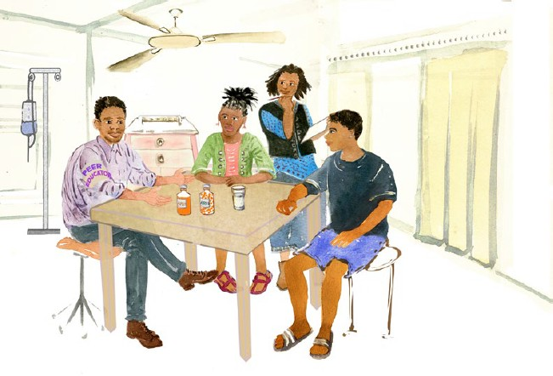
1. You’re starting ARVs
ARVs stop HIV from making more virus, allowing you to become healthier.
It is important to take ARVs every day as prescribed.
In six months we will check your viral load to see if ARVs are working well.

Slide 15

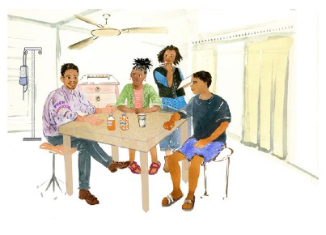




1. You’re starting ARVs
KEY MESSAGES:
ARVs stop HIV from making more virus, allowing you to
TALKING POINTS:
What do you know about ARVs?
It sounds like you know some things about ARVs, now I’m going to help you learn even more.
become healthier.
It is important to take ARVs every day as prescribed.
In six months we will check your viral load to see if ARVs are working well.
ARVs stop HIV from making more virus and help prevent
you from getting sick.
It is important to take ARVs every day as prescribed to make sure they work well and keep HIV from harming you.
ARVs do not cure HIV, which is why you must continue taking them.
A late dose is better than a missed dose.
We will do a test called viral load in six months to see if ARVs are working well. If you are taking ARVs every day and they are working well, the viral load will usually be low or even undetectable.
Undetectable means that the amount of HIV in your blood is so low that it is too low to count on the viral load blood test.
Keeping the virus low in your body has many benefits:
Helps you live a longer life.
Prevents serious illnesses from developing over time. Low viral load can keep you from getting sick.
Keeps your brain healthy and your memory strong.
Keeps you from having extra visits to the clinic.
For those who are sexually active, always using condoms is the best way to prevent spread of HIV to your sexual partners and to prevent other sexually transmitted infections. Having a low viral load can help further. If your viral load becomes and remains undetectable, you will no longer be at risk of transmitting HIV to your sexual partners
A low viral load will help prevent spreading HIV to your baby during pregnancy or breastfeeding and will give them strong, healthy parents.
Provider Instructions:
Here are some tips on how to introduce yourself to the adolescent patient.
Find out what is important to him/her. “What do you like to do in your free time?”
Be interested in the responses. “I’d like to hear more about that.”
Let’s Review:
What do you think will be hard about taking ARVs every day?
In your own words, what do ARVs do?
Are there any benefits of a low viral load that surprised you or that you have questions about?

Slide 16
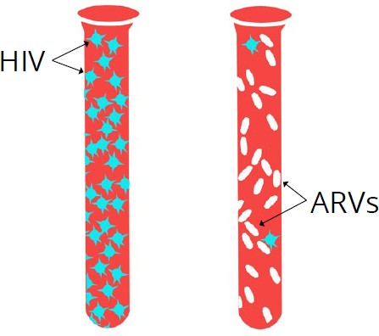
2. What is a viral load?
ARVs stop HIV from making more virus, allowing you to become healthier and preventing the virus from harming you.
Viral load tests measure how much HIV is in the blood and if ARVs are working well – the goal is an undetectable viral load.
It is important for you to return to clinic so you can get your viral load results.

Slide 17
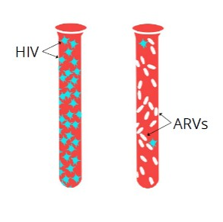



2. What is a viral load?
KEY MESSAGES:
TALKING POINTS:
The “viral load” test tells us how much virus is in about one drop of blood.
ARVs stop HIV from making
more virus, allowing you to
become healthier and preventing the virus from harming you.
Viral load tests measure how much HIV is in the blood and if ARVs are working well – the goal is an undetectable viral load.
It is important for you to return to clinic so you can get your viral load results.
ARVs stop HIV from producing more virus and bring the viral load down. The viral load test tells us whether ARVs are working to stop HIV from making more virus.
If you have a high viral load, you may not look sick, but the virus is harming your body.
Remember, ARVs do not cure HIV, so you must continue taking them.
If ARVs are working well, and you are taking ARVs every day, the viral load will usually be low or undetectable after six months. Undetectable means the amount of HIV in your blood is so low that the test cannot detect it.
Please come back in weeks for viral load results.
Let’s Review:
In your own words, what is a viral load?
How does a low viral load help you?
When will you return for your viral load results?
Provider Instructions:
Tip: Adolescents don’t want to be ‘lectured.’ it is important to have them be part of the decision to learn new information. For example:
Ask: “What do you know about viral load?”
Confirm you’re listening: “It sounds like people talk about it a lot, but you aren’t sure what it means, is that right?
Ask: “Would you like more information about this test and why we think it is important to keep you healthy?”
Ask: “What questions do you have about that information?” “Did any of those benefits seem important to you?” “With that information, how does it change how you think about ARVs?”

Slide 18

3. Why is a low viral load good?
A low viral load keeps your body and mind healthy.
A low viral load decreases the chance of transmitting HIV to sexual partners or during pregnancy or breastfeeding.

Slide 19


3. Why is a low viral load good?
KEY MESSAGES:
A low viral load keeps your body and mind
TALKING POINTS:
Keeping the virus low in your body has
many benefits:
healthy.
A low viral load decreases the chance of transmitting HIV to sexual partners or during pregnancy or breastfeeding.
Keeps your mind healthy. Having a low viral load helps keep your mind healthy.
Prevents other serious illnesses from developing.
Keeps you physically and emotionally strong.
A low viral load reduces the risk of transmitting HIV to a sexual partner or from mother to baby during pregnancy
if you are sexually active or have children.
Provider Instructions:
Why would it be better for you if you had a low viral load?
  Allow the person to respond. This should be a conversation. Remember, use reflective and summary statements to make sure you understand what they are saying.
  Example: “I hear you really care about keeping your partner healthy.” “You are saying is really important to you.” Taking your ARVs will allow you to keep doing this.”
Let’s Review:
What other benefits do you see from taking your ARVs and keeping your viral load low?
Are there are any of these that surprised you or that you have questions about?

Slide 20

4. Your viral load is LOW
A low viral load means your ARVs are working.
This doesn’t mean you can stop ARVs.
Continue to take your ARVs every day!
Keep up the good work!

Slide 21


4. Your viral load is LOW
KEY MESSAGES:
A low viral load means your ARVs are working.
TALKING POINTS:
You have a low viral load! Keeping the virus
low in your body has many benefits:
Keeps your mind healthy. Having a low
This doesn’t mean ARVs can be stopped.
Continue to take your ARVs every day!
Keep up the good work!
viral load helps keep your mind healthy.
Prevents other serious illnesses from developing.
Keeps you physically and emotionally strong.
A low viral load reduces the risk of transmitting HIV to a sexual partner or from mother to baby during pregnancy if you are sexually active or have children.
Many people find it difficult to take their medications. How have you been so successful? (Smile and complement their hard work).
A low viral load [insert patient’s result here] is a sign that the medication is working.
This does not mean you can stop ARVs and if you are sexually active this does not mean you can stop using condoms.
It is important to continue to take ARVs consistently every day to keep the virus from reproducing and to stay healthy.
For those who are sexually active, continuing to take ARVs can help prevent the spread of the virus to sexual partners or your baby (for pregnant adolescents).
Let’s Review:
What does a low viral load mean?
Why is it important to continue taking your ARVs every day?
Ask these questions to review their success:
I can see from the test results you have been doing very well. What has helped you remember to take your ARVs?
Are there things that have made it hard at times to take your ARVs?
Have you had any trouble remembering to take them?
What do you think might get in the way of taking them in the future?

Slide 22
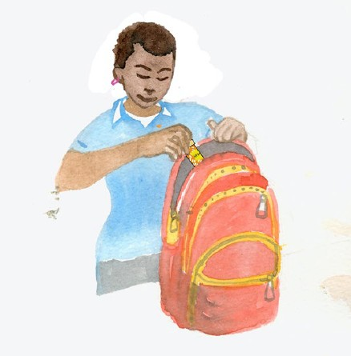
5. Keeping your virus low
Your viral load is low so you are protecting your health.
If you are sexually active, having a low viral load makes it less likely that you will pass HIV to your partner.
Even though you know it’s good for your health, it may be hard to keep taking ARVs, especially when so many things are changing in your life.

Slide 23
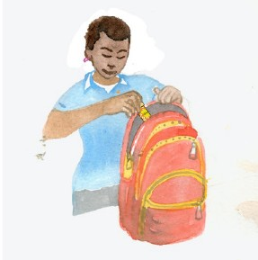


5. Keeping your virus low
KEY MESSAGES:
TALKING POINTS:
Your viral load is low so you are protecting your health.
Does anyone help you take your ARVs? Tell me how that works.
If you are sexually active, having a low viral load makes it less likely that you will pass HIV to your partner.
Even though you know it’s good for your health, it may be hard to keep taking ARVs, especially when so many things are changing in your life.
How do you think that might change in the future?
Who knows that you are HIV+?
Who might be a good source of support for you as you manage your HIV?
Are there changes going on your life?
How do think those changes may affect you taking ARVs?
Additional tips:
Put ARVs somewhere easy to remember, near something that you use every day, and keep a bottle of water there if needed.
Set an alarm on your phone to remind you to take your medication.
Carry ARVs with you so if you forget before leaving for the day, you have a spare.
Use pillboxes and a calendar to mark and keep track of when medications are taken for the day.
Ask for extra medication if gaps between refills is a problem.
If someone asks to share your medications, help them find a clinic and support. If you share, the medications won’t work for either of you.
Let’s Review:
Do you think ARVs will help you?
Are you taking any other treatments for your HIV?
Are you seeking help from anyone outside of this clinic for your HIV?
Provider Instructions:
Screen for other health beliefs or difficulty with disclosure/privacy. Review card 17 (Understanding your ARVs), card 20 (Who to tell and why), or card 21 (Taking charge of your ARVs) in these areas as helpful.

Slide 24

6. Your viral load is UNDETECTABLE
Undetectable means that the amount of virus in your blood is too low for the viral load test to count it.
People who take their ARVs daily and maintain an undetectable viral load cannot pass HIV to other people through sex.
Continue to take your ARVs every day and have your viral load checked regularly to be sure your viral load stays undetectable.

Slide 25
6. Your viral load is UNDETECTABLE
KEY MESSAGES:
TALKING POINTS:
Undetectable means that the amount of HIV in your blood is
Undetectable means that the amount of virus in your blood is less than 200
too low for the viral load test to count it.
People who take their ARVs daily and maintain an undetectable viral load cannot pass HIV to other people through sex.
Continue to take your ARVs every day and have your viral load checked regularly to be sure your viral load stays undetectable.
or too low to count on a viral load test.
Undetectable does not mean that your HIV is cured; it means that the ARVs have stopped the virus from growing and making new viruses
You must take your ARVs every day in order to remain undetectable.
This means your ARVs are working really well
An undetectable viral load helps you to live a healthy, long life and prevent passing HIV to your sexual partners.
See your provider if you stop your ARVs or begin missing doses. Your HIV may become detectable again if you don’t take your ARVs regularly as prescribed.
Two consecutive undetectable viral load tests are necessary to be certain that a person won’t transmit HIV to their sexual partner.
Being undetectable does not protect you from getting sexually transmitted infections or prevent pregnancy; condoms used correctly every time you have sex can prevent other STIs and pregnancy.
Regular viral load testing is important. Your next viral load test should be done [insert date here].
Let’s Review:
In your own words, what is an undetectable viral load?
What are the benefits of achieving an undetectable viral load?
How do you keep an undetectable viral load?

Slide 26
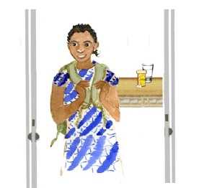

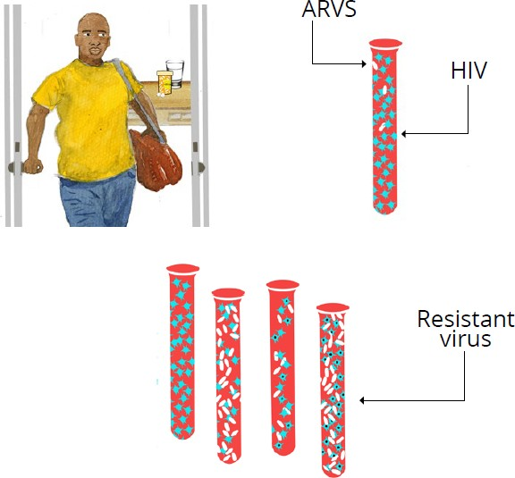
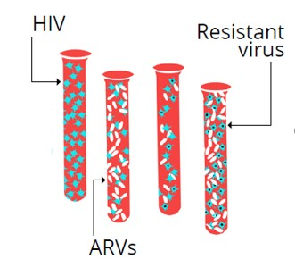
7. Your viral load is HIGH
This means that HIV is making more virus and harming your body.
This could happen if you forget or do not to take your ARVs some days.
If you have been taking your ARVs every day, your virus may be resistant. It may have changed so that your ARVs are no longer working.

Slide 27

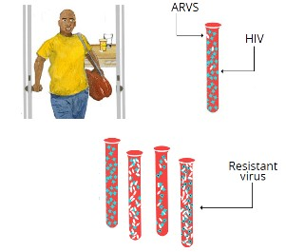


7. Your viral load is HIGH
KEY MESSAGES:
This means that HIV is making more virus and
TALKING POINTS:
The viral load test result is high
[insert patient’s result], the goal is to
keep it as low as possible.
harming your body.
This could happen if you forget or do not to take your ARVs some days.
If you have been taking your ARVs every day, your virus may be resistant. It may have changed so that your ARVs are no longer working.
This means that HIV is making more virus in the body.
This may be because you are not taking ARVs properly.
With so much virus in the blood, your immune (defense) system becomes weaker. This can affect the brain, heart, liver and kidneys, and make you sick.
If ARVs are not taken properly, the virus can change and become “resistant” to the ARVs, meaning that even if taken properly, they will no longer work.
With a high viral load it’s easier to spread HIV to your partner, so it is especially important to use condoms all the time.
Using ARVs to lower your viral load can also help prevent spread of HIV during pregnancy or breastfeeding.
Let’s Review:
What are the possible reasons for a high viral load?
What can happen when your viral load is high?
What would be good about a low viral load?
How important do you think it is for your long-term health?
What do you think happens if you don’t take ARVs regularly?
Provider Instructions:
Remember to use non- judgmental and respectful language – do not blame or criticize:
“I am glad you came to get your viral load test results. Now we can help you work towards a low viral load.”

Slide 28
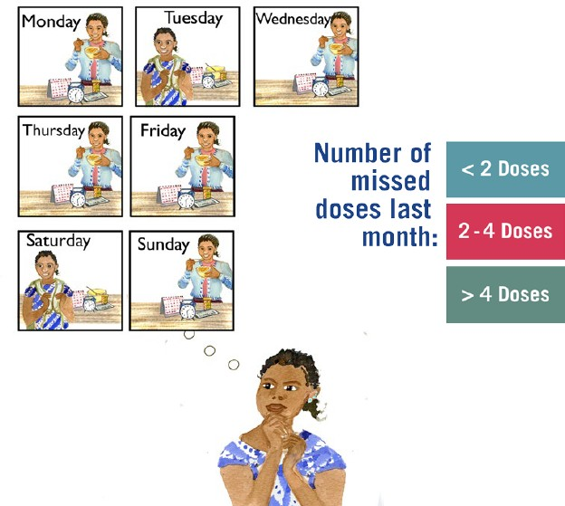
8. How are you taking ARVs?
It can be hard to take ARVs every day.
Let’s talk about how you take your ARVs and see if we can find ways to make it easier for you to take them every day.

Slide 29
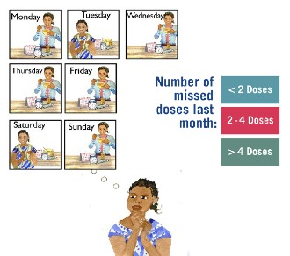



8. How are you taking ARVs?
KEY MESSAGES:
It can be hard to take ARVs every day.
TALKING POINTS:
Some people find it difficult to take ARVs every day.
Let’s talk about how you take your ARVs and see if we can find ways to make it easier for you to take them every day.
Many people have problems taking their pills at some point.
Please think back to the past WEEK, how many ARV doses (days) do you think you missed?
Was this a typical week?
Now what about the past month?
Provider Instructions
Determining Adherence
Ask the patient to recall the last week and how many doses they missed.
Ask if this is typical.
Determine how many doses were missed in the last month.
Using the table to the left, determine if the patient’s adherence is good, fair or
Number of doses missed per month | Adherence category
Patients taking once daily regimens
< 2 doses | Good
2-4 doses | Fair
> 4 doses | Poor
Patients taking twice daily regimens
< 4 doses | Good
4-8 doses | Fair
> 8 doses | Poor
Document
Complete the first column of enhanced adherence session 1 on the Enhanced Adherence Plan Tool and mark adherence as good, fair, or poor, according to the number of doses missed per month (as per table).
poor.
Drug Pick-Up
Review drug pick-up information if available or ask patient when the last pick-up was.
Having delayed or inconsistent pick-ups may indicate problems with adherence.

Slide 30
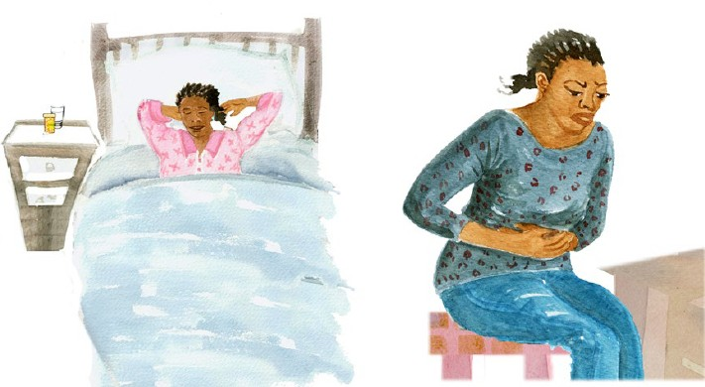
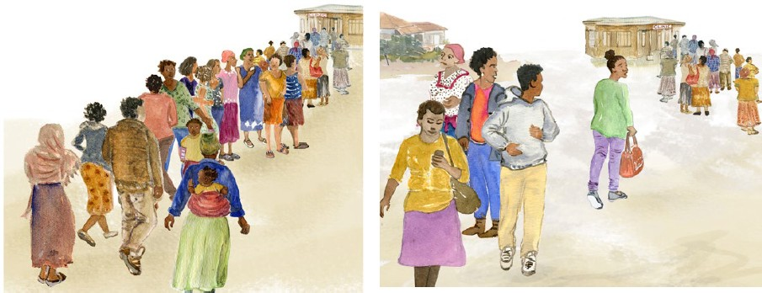
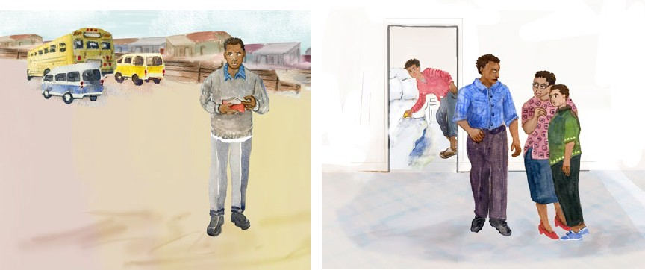
9. What are the challenges in taking your ARVs?
Together we will review the way you take your ARVs.

Slide 31






9. What are the challenges in taking your
ARVs?
KEY MESSAGES:
Together we will review the way you take your ARVs.
TALKING POINTS:
It is great you have come back to get your results, by coming back, you are taking steps to improve your health.
I’d like to talk to you more about any challenges you may be facing when taking ARVs.
Please feel comfortable telling me about challenges you are facing; I am asking because I want to try to find ways to make it easier.
Can you recall and describe the circumstances around the last missed dose?
Provider Instructions:
Explore barriers and challenges with the patient.
O: Open-ended Questions (Avoid questions that are answered as Yes/No), for example:
What makes it difficult to take your ARVs every day?
What have you already done to try and take your ARVs every day?
What do you think is likely to happen if you keep taking your ARVs as you are now?
BARRIERS | QUESTIONS TO ASSESS BARRIERS
INDIVIDUAL
Stigma and discrimination | Are you afraid that people will find out about your HIV? Does that prevent you from coming to clinic or taking ARVs?
Knowledge deficit | Can you tell me the names of your ARVs? What is your understanding of how you are supposed to take ARVs (e.g. what time of day, how much [if liquid], how many [if pills]? What is your understanding of the purpose of the ARVs?
Side effects | Have the ARVs affected the way you feel? Do you think the ARVs have made you feel ill in any way? If yes, please describe what problems they cause (e.g. nausea, diarrhea, sleep disturbance).
Forgot | Have you ever forgotten or do you often forget to take ARVs? Do you take them at a set time of day(s)? What is your method of remembering/reminding yourself to take ARVs?
Feeling better | Do you take ARVs even when you are feeling well?
Physical illness | Have you had illnesses that have prevented you from taking ARVs?
Alcohol /drug use | Do you use alcohol or drugs? Do you feel this affects your ability to take ARVs?
Emotional issues/ depression | How is your mood in general? Have you been feeling sad or confused? If yes, has this affected your ability to take ARVs?
Document
Document the specific barriers you identify with the patient on the Enhanced Adherence Plan Tool.

Slide 32
10. What are the challenges in taking your ARVs?
Together we will review the way you take your ARVs.

Slide 33

10. What are the challenges in taking your
ARVs?
KEY MESSAGES:
Together we will review the way you take your ARVs.
TALKING POINTS:
Let’s continue to explore any challenges you may be facing when taking ARVs (individual and household level barriers).
Provider Instructions:
Summarize what was learned from the patient about any specific barriers identified on this card.
A: Affirmations, for example:
I appreciate that you are able to be honest about the way you take your ARVs.
You are clearly a resourceful person to manage so many challenges.
You’ve worked really hard to take your medications despite these challenges.
BARRIERS | QUESTIONS TO ASSESS BARRIERS
INDIVIDUAL (continued)
Pill burden | Is the number of pills or amount of liquid a challenge for you?
Lost/ran out of pills | Have you lost or run out of ARVs?
Transportation problems | Do you have difficulty getting to the health center to collect ARVs? If yes, what are the reasons (e.g. long distance, expense, job)? Do you know how to get to the clinic? What help do you need to get to the clinic?
Scheduling difficulty | Have you ever been too busy or faced a schedule change that has made it difficult to take ARVs? Who is responsible for making your appointments and keeping track of when they are? Do you feel like you know how to make an appointment? What number would you call? Who might you ask for?
HOUSEHOLD
Share with others | Have you ever shared your ARVs with others?
Fear of disclosure | Have you disclosed your HIV status to your family or your partner?
Family/partner relationships | Has your family or partner been non-supportive or kept you from taking ARVs?
Inability to pay | Have clinic or other fees kept you from taking ARVs?
Food insecurity | Has a lack of adequate food ever been a problem for taking ARVs?
Document
Document the specific barriers you identify with the patient on the Enhanced Adherence Plan Tool.

Slide 34
11. What are the challenges in taking your ARVs?
Together we will review the way you take your ARVs.

Slide 35


11. What are the challenges in taking your
ARVs?
KEY MESSAGES:
Together we will review the way you take your ARVs.
TALKING POINTS:
Let’s continue to explore any challenges you may be facing when taking ARVs
(institutional and community level barriers).
Provider Instructions
Summarize what was learned from the patient about any specific barriers identified on this card using Reflective Listening or Summary Statements, for example:
So you said you feel angry when you think about taking your ARVs and that makes it really hard.
Let me see if I understand so far. Because of the long distance you have to travel and long wait times at the clinic it’s hard to make all of your appointments.
BARRIERS | QUESTIONS TO ASSESS BARRIERS
INSTITUTIONAL/COMMUNITY
Drug stock-out | Have you ever come to the health facility and found that there were no ARVs available, or you were only given a small supply?
Long wait times | Have you ever left the health facility before receiving your ARVs because of long wait times?
Stigma and discrimination | Are you fearful that people in the community will find out about your HIV? Does that prevent you from coming to clinic or taking ARVs?
Political crisis/war/natural disaster | Is it ever unsafe for you to pick up ARVs from the health facility?
Document
Document the specific barriers you identify with the patient on the
Enhanced Adherence Plan Tool.

Slide 36
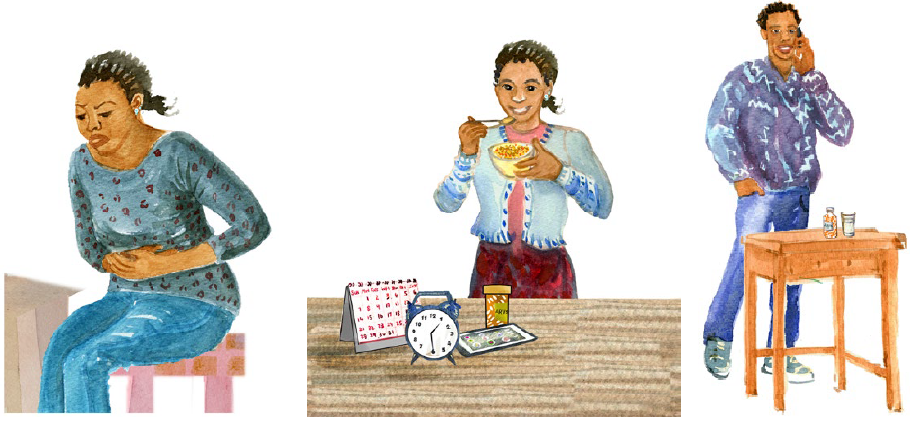
12. Tips to improve taking ARVs
Together we will find ways to make taking ARVs better for you.

Slide 37



12. Tips to improve taking ARVs
KEY MESSAGES:
Together we will find ways to make
TALKING POINTS:
I appreciate that you are able to be honest about challenges of taking ARVs.
taking ARVs better for you.
What I hear you saying is… (summarize main challenges and barriers).
Let’s explore ways in which we can make it better for you to take ARVs.
Do you have ideas how to make it easier to take ARVs in response to each barrier we discussed?
Missing more than two or three doses in a month can lead to medications not working well.
Provider Instructions
After giving a tip, ask if it seems helpful or if there are questions:
“How likely do you
think it is that this will help you?”
How likely are you to try…?”
“What questions do
you have about…?”
BARRIERS | INTERVENTIONS TO ADDRESS BARRIERS AND IMPROVE ADHERENCE
INDIVIDUAL
Knowledge deficit | Individual counseling for basic HIV/ARV education | Group counseling/peer support group | Written instructions
Side effects | Nausea à take with food, anti-emetic Headache à paracetamol, evaluate for meningitis | Diarrhea à anti-diarrheal once infections ruled out, hydration Fatigue à check Hgb, consider substitution if on AZT | Anxiety/depression à take before bed
Forgot | Medication organizer (i.e. pillbox) Treatment buddy or supporter Directly Observed Therapy | Visual medication schedule (e.g. calendar, journal/log) Announced pill count at next session | Reminder devices (e.g. phone calls, SMS, alarm) Take pills late, do not skip dose
Feeling better | Basic HIV/ARV education
Physical illness | Clinical care to address comorbidities | Directly Observed Therapy | Treatment buddy
Document
Document planned interventions to address barriers identified by patient on the Enhanced Adherence Plan Tool.

Slide 38
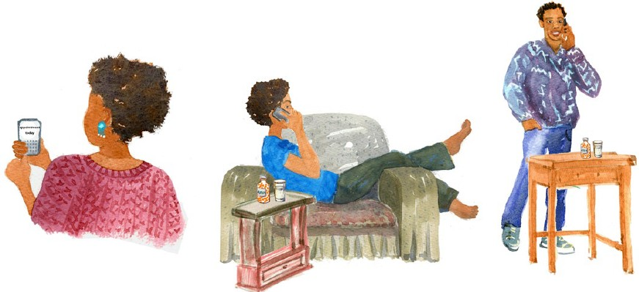
13. Tips to improve taking ARVs
Together we will find ways to make taking ARVs better for you.

Slide 39
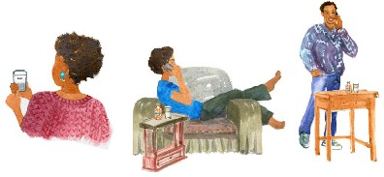
13. Tips to improve taking ARVs
KEY MESSAGES:
Together we will find ways to make
TALKING POINTS:
Let’s continue to explore ways in which we can make taking ARVs better (individual level).
taking ARVs better for you.
BARRIERS | INTERVENTIONS TO ADDRESS BARRIERS AND IMPROVE ADHERENCE
INDIVIDUAL (continued)
Depression | Screening for and management of depression | Individual counseling Peer support group | Treatment buddy
Pill burden | Change to fixed-dose combination or once-daily dosing if possible
Lost/ran out of pills | Extra supply of pills | Drug pick-up group | Educate patient to alert facility if it occurs
Transportation problems | Drug pick-up group | Three month supply when feasible | ART group
Health beliefs | Individual counseling for basic HIV/ARV education | Group counseling | Peer support group
Scheduling difficulty | Education (e.g. combine with daily routine such as bedtime or brushing teeth) Three month supply when feasible | Reminder devices (e.g. phone calls, SMS, alarm) ART group | Treatment buddy Keep a few doses of ARVs in different locations (e.g. at work) for easy access
Alcohol or drug use | Opioid substitution therapy Individual counseling | Directly Observed Therapy | Peer support group
Provider Instructions
Collaborate to come up with solutions, for example:
“What have you already tried?”
“You have thought a lot about this, what are other ways to solve this problem?”
Document
Document planned interventions to address barriers identified by patient on the Enhanced Adherence Plan Tool.

Slide 40
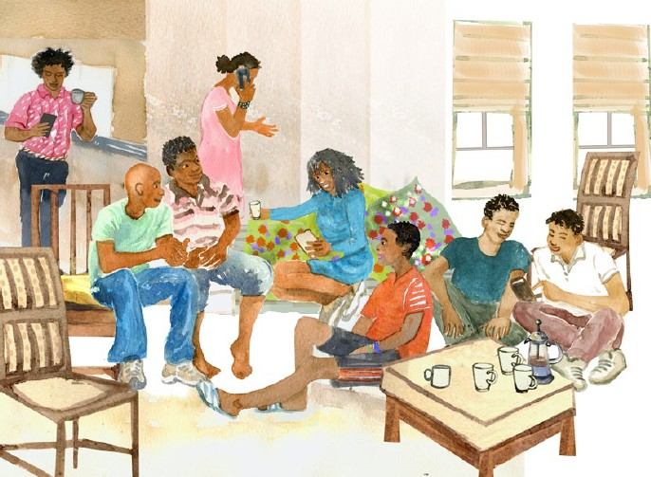
14. Tips to improve taking ARVs
Together we will find ways to make taking ARVs better for you.

Slide 41
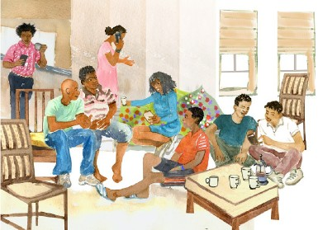


14. Tips to improve taking ARVs
KEY MESSAGES:
Together we will find ways to make
TALKING POINTS:
Let’s continue to explore ways in which we can make taking ARVs better (household and institutional/community level).
taking ARVs better for you.
Provider Instructions
Offer suggestions to overcome specific barriers that have been identified.
BARRIERS |  | INTERVENTIONS TO ADDRESS BARRIERS AND IMPROVE ADHERENCE
HOUSEHOLD
Share with others |  | Individual counseling for basic HIV/ARV education | Group counseling | Facilitate enrollment into care/PrEP for family members
Fear of disclosure |  | Individual counseling Treatment buddy Couples counseling and testing | Group counseling Unmarked pill bottle | Peer support group ART group
Family/partner relationships |  | Group counseling
Inability to pay |  | Refer to social worker, peer worker or NGO
Food insecurity |  | Refer to social worker, peer worker, NGO or community-based services
INSTITUTIONAL/COMMUNITY
Long wait times | Nurse-led or community- based care |  | Three month supply where feasible | ART group
Stigma and discrimination | Individual /group counseling |  | Peer support group | ART group
Political crisis/war/natural disaster | Individual counseling |  | Case management
Document
Document interventions and any needed referrals on the Enhanced Adherence Plan Tool.
Summarize results and plan made. Have the patient repeat back the plan.
Tell the patient the next follow-up date and whether it is for another adherence session or for repeat viral load test.

Slide 42

15. Additional help to take ARVs
Together we will find ways to make taking your ARVs better for you.

Slide 43
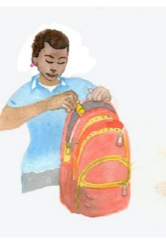
15. Additional help to take ARVs
KEY MESSAGES:
Together we will find ways to make taking your ARVs better for you.
TALKING POINTS:
Let’s look closer at a few of the common barriers to taking ARVs.
Of the areas we discussed, what is the biggest problem you have taking ARVs?
Here’s what I’ve heard you say. Let me know if I understand correctly. [Reflect back on identified challenges]
  Go to card 16 (labeled Remembering to take ARVs) for “forgets”
  Go to card 17 (labeled Understanding your ARVs) for “knowledge”
  Go to card 18 (labeled Making it easier) for “side effects,” “emotional issues,” or “pill burden”
  Go to card 19 (labeled Tips for pill swallowing” for “difficulty swallowing pills”
  Go to card 20 (labeled Who to tell and why) for “disclosure”
  FOR ALL ADOLESCENTS go to card 21 (labeled Taking charge of your ARVs) after discussing other interventions.

Slide 44
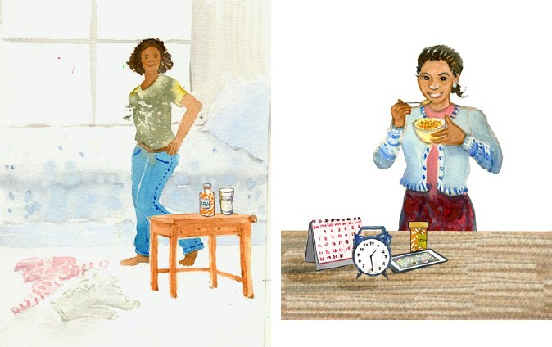
16. Remembering to take ARVs
Always remembering to take ARVs can be difficult.
If you don’t take your ARVs every day, the amount of HIV in your blood will be high which can harm your body.

Slide 45





16. Remembering to take ARVs
KEY MESSAGES:
Always remembering to take ARVs can be difficult.
TALKING POINTS:
What have you already tried to help you remember?
If you don’t take your ARVs every day, the amount of HIV in your blood will be high which can harm your body.
Let me make sure I understand. What I hear
you saying is [circumstance for missing doses]. Here are some things others have found helpful:
Put ARVs somewhere easy to remember, near something that you use every day, and keep a bottle of water there if needed.
Set an alarm on your phone to remind you to take your ARVs.
Let’s Review:
Remembering to take ARVs can be challenging. I’d like to check with you about a few things we discussed.
What changes do you plan to make to help you remember to take your ARVs?
How do you track whether you have taken your medications?
Help the adolescent put a reminder in the phone and show them how to do this if they don’t know.
Carry ARVs with you so if you forget before leaving for the day, you have a spare.
Use pillboxes and a calendar to mark and keep track of when ARVs are taken for the day.
Ask for extra ARVs if you will not be able to return to the health facility in time for your next refills.
Ask: “Is there someone who can help you remember to take your ARVs?”
Provider Instructions:
Identify with the patient a daily activity that they can schedule taking their pills around.
If there are other resources such as directly observed therapy (DOT), peer support, having school give medications, or other supports in the area, assess the need and discuss with the patient.
Document
Document planned interventions to address barriers identified by patient on the Enhanced Adherence Plan Tool.

Slide 46
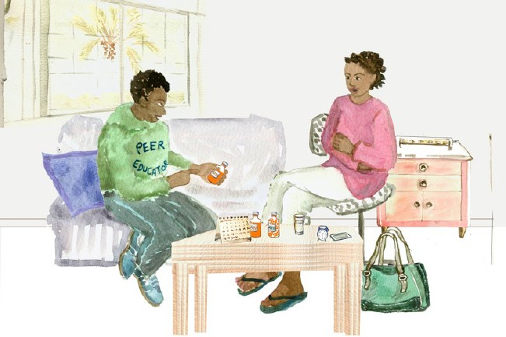
17. Understanding your ARVs
It is important for you to know how ARVs work, understand how and when you should take them, and the best ways to avoid side effects. This will make is easier for you to take your ARVs and keep your viral load low.

Slide 47
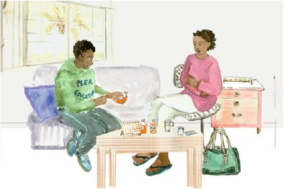


17. Understanding your ARVs
KEY MESSAGES:
It is important for you to know how ARVs work, understand
TALKING POINTS:
Which area is the patient having the most difficulty with?
how and when you should take them, and the best ways to avoid side effects. This will make is easier for you to take your ARVs and keep your viral load low.
Names and frequency of medications
à Provide education and fact sheets.
How medications work
à Review earlier cards from prior visits or answer questions.
Health beliefs
à Instruct patient to take ARVs whether they feel healthy or sick, unless otherwise specified by a doctor.
àProbe for specific beliefs about ARVs and health, for example:
Let’s Review:
Let’s go over these instructions again to see if you have any questions.
Can you tell me how you understand what ARVs do and how you are supposed to take them, and tips to avoid side effects?
Provide patient with written resources if available.
“Have you heard others say negative things about ARVs?”
“Are there other remedies that you think work better than ARVs?”
Document
Document planned interventions to address barriers identified by patient on the Enhanced Adherence Plan Tool.

Slide 48
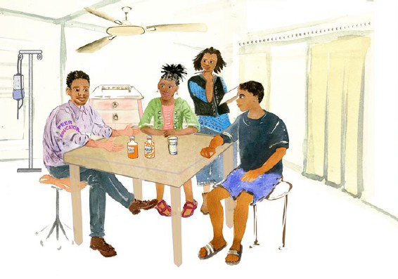
18. Making it easier
Taking ARVs is difficult because all the good things come in “the future.”
Sometimes there are things that are tough about taking ARVs that happen today – like side effects.
Let’s discuss ways to make taking ARVs better for you.

Slide 49
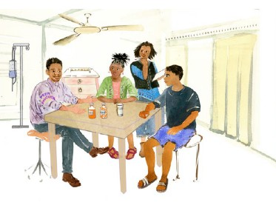


18. Making it easier
KEY MESSAGES:
Taking ARVs is difficult because all the good things come in “the future.”
Sometimes there are things that are tough about taking ARVs that happen today – like side effects.
Let’s discuss ways to make taking ARVs better for you.
TALKING POINTS:
Managing Side Effects:
Take with food (nausea/headache).
Take at night (drowsiness/mood).
Many people feel angry, sad, or afraid of being HIV+.
Feeling upset by ARVs can make it hard to take them every day. Sometimes when taking a dose, people have thoughts like “I hate that I have to take this.” Does this happen to you?
Eat strong, pleasant-flavored food immediately after dose to mask taste (like a mint or sweet candy).
Practice pill swallowing training tips (see card 18).
Put pill in a small amount of a soft food (like honey or jam) on a spoon, and take medicine from the spoon.
Pair taking medications with something happy or good.
Take medications with a treat.
Think thoughts like “I’m keeping myself healthy” or “I’m taking care of my body.”
Talk and share with trusted friends and/or family to get support.
Managing Emotions:
Difficulty Taking Pills:
Document
Document planned interventions to address barriers identified by patient on the Enhanced Adherence Plan Tool.
Other Tips:

Slide 50
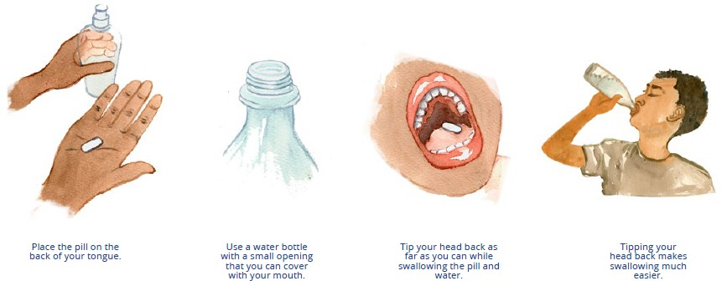
19. Tips for pill swallowing
Using a water bottle is a good way to help swallow pills.

Slide 51
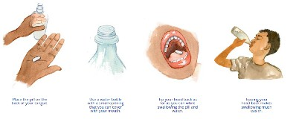
19. Tips for pill swallowing
KEY MESSAGES:
Using a water bottle is a good way to swallow pills.
Place the pill on the back of your tongue.
Use a water bottle with a small opening that you can cover with your mouth.
Tip your head back as far as you can while swallowing the pill and the water.
Tipping your head back makes swallowing much easier.

Slide 52
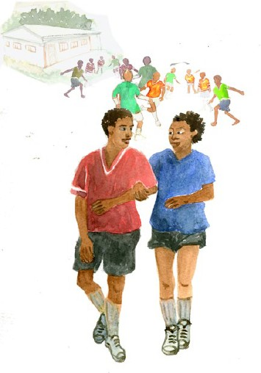
20. Who to tell and why
Sharing your status with someone you trust can help you take your ARVs every day.

Slide 53

20. Who to tell and why
KEY MESSAGES:
Sharing your status with someone you trust can help you take your ARVs every day.
TALKING POINTS:
Ways to protect privacy:
Use an unmarked pill bottle.
Use pill boxes rather than bottles.
Brainstorm places where the patient can keep ARVs out of the sight of others, but that are easily visible/accessible to the patient.
Discuss ways to decide who to share their diagnosis with and how to share:
What characteristics do you think make a good choice for someone to share your status?
What are benefits of someone knowing your status?
How do you decide whether you can trust someone?
Are you concerned that harm might come to you if you disclose your HIV status?
If patient is in a relationship:
What might be beneficial for your partner if you were taking your ARVs every day?
How do you think your partner might support you to take your ARVs?
Document
Document planned interventions to address barriers identified by patient on the Enhanced Adherence Plan Tool.

Slide 54

21. Taking charge of your ARVs
By being in charge of your ARVs, you are setting yourself up to lead a healthy life.
Most people still find support helpful, even if you are in charge.

Slide 55


21. Taking charge of your ARVs
KEY MESSAGES:
By being in charge of your ARVs, you are setting yourself up to lead a healthy life.
Most people still find support helpful, even if you are in charge.
TALKING POINTS:
You are the only one living in your body – it is your job to make sure you take your
Many people have support in taking ARVs, but ultimately it is your job. You can do this by setting treatment goals, such as: My goal is to achieve zero missed appointments, zero missed drugs, and zero viral load.
Look at strengths within yourself to see how they can be used to enhance treatment adherence: Resilience (I can work hard and endure challenging situations), Positive outlook into the future (I will keep my viral load suppressed so I will be more productive in life), and educatable (I understand my treatment and the benefits of good adherence)
I can help you develop a personal treatment plan that works for you. Some things to consider when developing your plan are:
  Where are you living? Who lives with you? How might this affect you taking your ARVs?
  Who currently helps you take your medications? How do you think that might change in the future?
  Who knows that you are HIV+?
  Who might be a good source of support for you as you manage your ARV?
I hear you saying you have lots of changes in your life right now, how do you think this might affect you taking ARVs?
It sounds like you have a busy schedule! I hear it is important to you to stay healthy to keep this up. What time do you take your ARVs? How do you think taking ARVs can fit into your schedule?
ARVs to protect it.
Let’s Review:
Do you think ARVs will help you?
Are you taking any other treatments for your HIV?
Are you seeking help from anyone outside of this clinic for your HIV?

Slide 56
22. Follow up on how you are taking ARVs
Together we’ll review the plan made last time to see how you are taking ARVs.

Slide 57



22. Follow up on how are you taking ARVs
KEY MESSAGES:
Together we’ll review the plan made last time to
TALKING POINTS:
Last time we met, we identified
(fill in barriers
discussed at last session) and planned (fill in
interventions decided upon at last session) to help you take ARVs.
see how you are taking ARVs.
How has that been going?
Are there any new challenges taking ARVs?
  Please think back to the past WEEK, how many ARV doses (days) do you think you missed?
  Was this a typical week?
  Now what about the past month?
I can see you’ve been putting a lot of effort into this. Do you have any new ideas how to make it easier to take your ARVs?
  Use adherence assessment tables on prior cards as needed to look for new
barriers and interventions.
Provider Instructions
For patient whose prior viral load was high, viral load will be repeated after three months of “good adherence.” Advise care recipient of when repeat viral load test will be done.
If adherence is fair or poor, continue monthly adherence sessions using cards in this flipchart and additional pages of the Enhanced Adherence Plan Tool until adherence is good.
Document
Complete the first column of enhanced adherence session 2 or 3 on the Enhanced Adherence Plan Tool and mark adherence as good, fair, or poor, according to the number of doses missed per month (as per table).
Complete the other two columns with any new barriers found and interventions planned.
Number of doses missed per month | Adherence category
Patients taking once daily regimens
< 2 doses | Good
2-4 doses | Fair
> 4 doses | Poor
Patients taking twice daily regimens
< 4 doses | Good
4-8 doses | Fair
> 8 doses | Poor

Slide 58
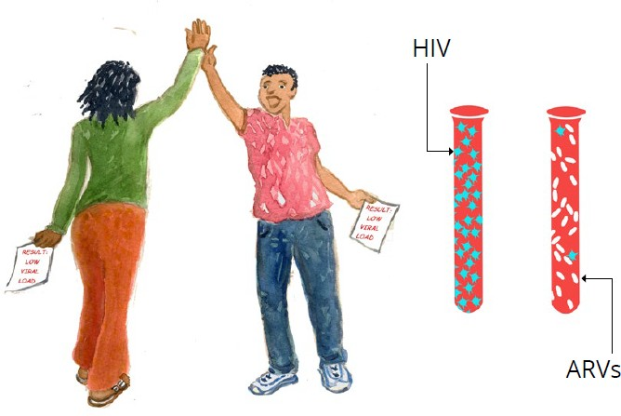
23. You’ve successfully reduced your viral load
The repeat viral load is low!
The
medications are working!

Slide 59
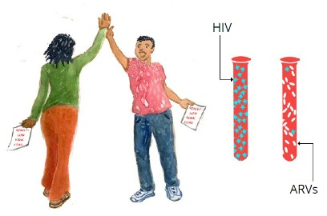




23. You’ve successfully reduced your viral
load
KEY MESSAGES:
You have taken your ARVs well.
TALKING POINTS:
A low viral load [insert patient’s result here] is a sign that the medications are
working.
The medications are working!
Your changes in (insert intervention) have been successful and you are getting the ARVs you need to stay well.
It is important that you continue to take your ARVs every day to keep HIV from making more virus and to stay healthy.
It’s important to keep track of how much medication you have so that you don’t run out of ARVs before the next appointment.
If you notice that medication is running low, come to the clinic
even if you don’t have an appointment.
We will check the viral load again in six months if there are no new problems or problems taking ARVs.
Please let your provider know if there are any problems taking ARVs in the future, so that he/she can help you address them.
Let’s Review:
Let’s briefly review what a low viral load means, and your plans for continuing to take your ARVs:
In your own words, what does having a low viral load mean?
Why is it important to continue ARVs?
What has helped you remember to take your ARVs?
Are there new things or do you
expect there to be new things that will make it hard at times to take your ARVs?
Document
Document results of repeat viral load on Enhanced Adherence Plan Tool.
Provider Instructions:
Use Cards 23 & 24 for patients whose repeat viral load is low.
Can also review cards 2 & 3 for basic viral load information.

Slide 60
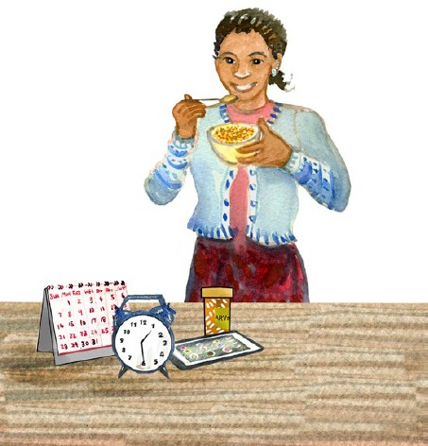
24. Keeping your virus low
Your virus is low so you are protecting your health and your partners.
You are the champion of your own health, and by working to achieve your treatment goals you can maintain your low viral load.

Slide 61
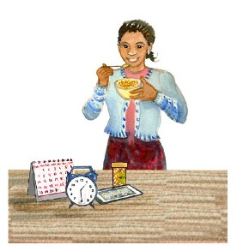


24. Keeping your virus low
KEY MESSAGES:
Your virus is low so you are protecting your health and
TALKING POINTS:
Does anyone help you take your ARVs?
Tell me how that works.
your partners.
You are the champion of your own health, and by working to achieve your treatment goals you can maintain your low viral load.
How do you think that might change in the future?
Who knows that you are HIV+?
Who might be a good source of support for you as you manage your HIV?
Are there changes going on in your life?
How do you think [those changes] may affect you taking ARVs?
Additional Tips:
Put ARVs somewhere easy to remember, near something that you use every day, and keep a bottle of water there if needed.
Set an alarm on your phone to remind you to take ARVs.
Carry ARVs with you so if you forget before leaving for the day, you have a spare.
Use pillboxes and a calendar to mark and keep track of when medications are taken for the day.
Let’s Review:
Do you think ARVs will help you?
Are you taking any other treatments for your HIV?
Are you seeking help from
anyone outside of this clinic for your HIV?
Provider Instructions:
Screen for other health beliefs or difficulty with disclosure/privacy. Review card 17 (Understanding your ARVs), card 20 (Who to tell and why), or card 21 (Taking charge of your ARVs) in these areas as helpful.

Slide 62
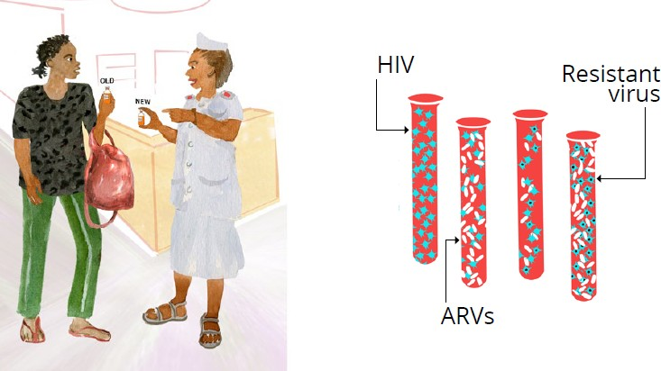
25. ARVs are not working well
It is likely that the virus is resistant, meaning that it has changed and ARVs are no longer working.
Changing ARVs is recommended.

Slide 63
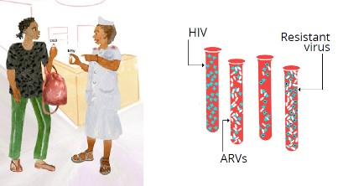




25. ARVs are not working well
KEY MESSAGES:
It is likely that the virus is resistant, meaning that it has
TALKING POINTS:
I appreciate the effort that it has taken to get to good adherence.
Even though you are taking ARVs every day,
changed and ARVs are no longer working.
your repeat viral load result is still high.
It is likely that ARVs are not working well due to the virus being resistant.
I understand this might feel disappointing.
We expect now that you are able to take ARVs every day, the new medications will reduce the viral load and keep you well.
We recommend to change ARVs to .
Changing ARVs is recommended.
Let’s Review:
We have discussed a lot of new information. I’d like to make certain that I have explained everything well and I have answered your questions.
Can you please tell me what you understand to
be the next steps and why we advise changing ARVs?
In your own words, what does resistance mean?
What are the new ARVs and how will you take them?
What has helped you to take your ARVs? It will be important to do these things now too to take the new ARVs exactly as prescribed.
When is your next appointment?
If you have any problems taking your ARVs before then, come to the clinic.
We will check your viral load again in
months to see how the new ARVs are working.
Do you have questions?
Provide detailed instructions on new regimen.
Discuss possible side effects and how to avoid/manage.
Provide written instructions.
It is extremely important to take your new ARVs properly. Do you anticipate any challenges with these new medications?
Please let a provider know if you have any trouble so that you can get assistance.
If you start other medications, such as TB medications, please let your provider know right away.
Your next appointment is .
Document
Document new ARVs on the Enhanced Adherence Plan Tool.
Provider Instructions:
At subsequent visits use relevant cards for adherence assessments and counseling, and explanation of viral load results. For example, at the first follow-up visit after ARV switch, use the cards beginning with “How are you taking ARVs?” (Card 8) to assess adherence to new regimen and provide counseling. Can also review cards 2 & 3 for basic viral load information.

Slide 64
A global health leader since 2003, ICAP was founded at Columbia University with one overarching goal: to improve the health of families and communities. Together with its partners—ministries of health, large multilaterals, health care providers, and patients—ICAP strives for a world where health is available to all. To date, ICAP has addressed major public health challenges and the needs of local health systems through 6,000 sites across 30 countries.
For more information about ICAP, visit: icap.columbia.edu

