Slide 1
Pre-Exposure Prophylaxis (PrEP) Training for Providers in Clinical Settings
Module 3: Oral Event-Driven PrEP (ED-PrEP)​
Last update: September 2023​

Slide 2


Slide 3

Training Overview
Oral PrEP
MODULE 1: PrEP Basics ​
MODULE 2: Oral Daily PrEP​
MODULE 3: Oral Event-Driven PrEP (ED-PrEP)​
MODULE 4: Injectable Long-Acting
Cabotegravir (CAB-LA)​
MODULE 5: Dapivirine Vaginal Ring (DVR)​
MODULE 6: Person-Centered PrEP Counseling
PrEP Vaginal Ring
Injectable PrEP

Slide 4
PrEP Competencies​
By the end of this training program, you should be able to:​
Explain the use of PrEP for HIV prevention​
Identify candidates eligible for PrEP​
Initiate clients on PrEP​
Conduct follow-up management for PrEP ​
Provide person-centered counseling for PrEP​

Slide 5
Symbols Key​
Preliminary recommendation based on available evidence and may change​
Adaptation required or suggested based on local context​
Content repeated in other modules​
Unknown at the moment, more information required​

Slide 6

Learning Activities​
Question & Answer​
Fill in the blank​
Review national guidelines​
Case scenario
Partner practice​
Discussion​
Share experiences​
Notes:
Facilitator guidance:
This training is designed to be interactive and to engage participants in learning and knowledge sharing. Rather than simply lecturing to participants, we encourage facilitators to use a variety of participatory methodologies, including question and answer, discussion, case scenarios, role-play, and other small group activities. These activities are provided for you and were designed to elicit and build on participants’ experience and knowledge, to promote discussion and reflection on key issues, to provide hands-on practice of content learned, and to help participants learn from one another. In addition, these participatory methodologies promote higher retention of content and create an open, engaging, and supportive learning environment.
Review the learning activities in advance to facilitation:
Question & Answer
Questions and answers are included throughout the module to keep learners engaged and actively participating. Q&A are offered to encourage participants to reflect on their existing knowledge before a new topic is introduced. Q&A are also offered after lecture content is delivered to test participants knowledge recall.
How To Facilitate Q&A
Read the question on the slide.
Ask participants to raise their hands to answer the question.
Take a few volunteer responses.
Reveal the answer on the following slide.
Allow time for follow-up discussion as needed (see below).
2. Discussion
A discussion is a dialogue between participants and the trainer, with participants responding to discussion questions and to one another’s ideas. During discussions, new questions may surface. When the trainer leads a large group discussion, she or he must manage the discussion by keeping participants focused, actively eliciting responses, and limiting participants who like to talk a lot. When participants have small group discussions, they must do likewise.
How To Facilitate Discussion
• Set a time limit and keep track of time.
• Explain that participants who want to speak should raise their hands.
• Keep the discussion on target and moving along.
• Encourage everyone to participate and call on everyone who raises a hand.
• Limit participants who like to talk a lot.
• Ask questions to encourage more responses to a question—for example: “What else?” “What other ideas do you have?”
• Wrap up the discussion by repeating and summarizing main points.
3. Case scenarios
A case scenario is a brief description of a realistic situation that participants discuss and analyze. Case scenarios give participants the opportunity to apply newly acquired knowledge to a particular problem or situation and to generate possible solutions to challenges presented in the scenario.
How to Facilitate Case Scenarios
• If participants will use the scenario in small groups or pairs, give clear instructions.
• If you write your own scenarios, make them simple and brief. Use realistic situations similar to those that participants face. Give essential information and leave out unnecessary details.
• Provide questions to guide participants in analyzing the scenario and a list of essential points to be covered in discussion for yourself and co-trainers.
4. Role Play
A role-play is a brief informal performance where participants act out roles in order to practice handling a particular problem or situation and to experience what it is like to be in those roles. Role-playing is informal; participants do not need to memorize dialogue or perform perfectly— the point is to experience the situation and learn from that experience.
How To Facilitate a Role-Play
• Give clear instructions for the role-play
• Set a time limit for role-play practice and performance, and manage the time well.
• Remind participants that role-playing does not require a perfect performance but rather provides an opportunity to practice handling real-life situations. It is fine to make mistakes during role-play.
• Debrief the role-play with a large group discussion
5. Small group activities
The facilitator divides participants into small groups to do a learning activity. Examples of small group activities include discussions, scenarios, and role-play practice as described above. Small groups allow each person to participate more than they would in the large group. Small group work also helps participants get to know one another and work with new colleagues.
How To Facilitate Small Group Work
• Before you divide participants into small groups, give clear instructions for the small group task.
• Group participants so that they are not always working with people they know well. To vary groups’ composition: Ask participants to count off or draw at random from a deck of playing cards and then group by suit or numbers. Or ask participants to draw at random from a container of colored objects or slips of paper and then group by colors. Or group participants by birthday (seasons or months), by first letter of first or last name, by last digit of their phone number, or by height—then, based on how many fall into each category, regroup these groups so that you have groups of an optimal size.
• Instruct the groups to make sure that all group members participate.
• Have each group choose a timekeeper.
• Keep track of time yourself and provide half-time, 5-minute, and 1-minute warnings.
• As the groups are working, move from one to another to make sure that participants have understood the task and are making progress.

Slide 7
Module 3: Oral Event-Driven PrEP (ED-PrEP)​

Slide 8
Introduction​
Welcome to Module 3: Oral Event-Driven PrEP (ED-PrEP) ​
In this module you will learn how to initiate and conduct follow-up management for clients on ED-PrEP. You will learn to identify persons eligible for ED-PrEP, conduct assessments and counseling to start ED-PrEP, and provide ongoing monitoring for as long as the person needs ED-PrEP. ​
​

Slide 9
Module 3 Learning Objectives​
After completing Module 3, participants will be able to:​
Define oral ED-PrEP
Define the eligible and ineligible populations for oral ED-PrEP
Identify good candidates for oral ED-PrEP
Describe advantages and disadvantages of oral ED-PrEP
Counsel clients on how to take oral ED-PrEP effectively
Describe the process for switching between oral ED-PrEP and oral daily PrEP
Specify the procedures for initiating oral ED-PrEP
Conduct effective monitoring visits for ED-PrEP​

Slide 10
What is YOUR EXPERIENCE initiating and managing clients on oral ED-PrEP? ​
Do you have any successes or challenges to share?​
What would you like to learn about initiating and managing clients on oral ED-PrEP?​
DISCUSSION​
Notes:
Facilitator guidance:
• Time: 10-20 minutes. Timing will vary based on size of the group and time allowed for training. Set a time limit and keep track of time.
• Explain that participants who want to speak should raise their hands.
• Keep the discussion on target and moving along.
• Encourage everyone to participate and call on everyone who raises a hand.
• Limit participants who like to talk a lot.
• Ask questions to encourage more responses to a question—for example: “What else?” “What other ideas do you have?”
• Wrap up the discussion by repeating and summarizing main points.

Slide 11
3.1 Introduction to Oral ED-PrEP ​

Slide 12
QUESTION
What is oral ED-PrEP?​
Notes:
Facilitator guidance:
Read the question on the slide.
Ask participants to raise their hands to answer the question.
Take a few volunteer responses.
Reveal the answer on the following slide.
Allow time for follow-up discussion as needed.

Slide 13
ANSWER
ED-PrEP is an oral, non-daily dosing regimen for HIV prevention. ​
It is also called: ​
On-demand PrEP​
2-1-1 PrEP​
Notes:
Facilitator guidance:
Reveal the answer on the slide.
Allow time for questions and follow-up discussion as needed.

Slide 14
ED-PrEP Dosing​
2​ | Start with two pills 2 to 24 hours before sex. This is the “loading dose”.​
+​ | ​
1​ | One pill 24 hours after the loading dose.​
+​ | ​
1​ | One more pill 24 hours after the 3rd pill.​

Slide 15
Fill in the blank: ED-PrEP Dosing​
X​ | Start with ___ pill(s) ___ to ___ hours before sex. This is the “loading dose”.​
+​ | ​
X​ | ___ pill(s) ___ hours after the loading dose.​
+​ | ​
X​ | ___ more pill(s) ___ hours after the 3rd pill.​
Notes:
Facilitator guidance:
Instruct participants to fill in the blank with the correct number of pills and hours for ED-PrEP dosing.
Ask participants to raise their hands to answer the question.
Take a few volunteer responses.
Reveal the answer on the following slide.
Allow time for follow-up discussion as needed.

Slide 16
Answer: ED-PrEP Dosing​
2​ | Start with two pills of 2 to 24 hours before sex. This is the “loading dose”.​
+​ | ​
1​ | One pill 24 hours after the loading dose.​
+​ | ​
1​ | One more pill 24 hours after the 3rd pill.​

Slide 17
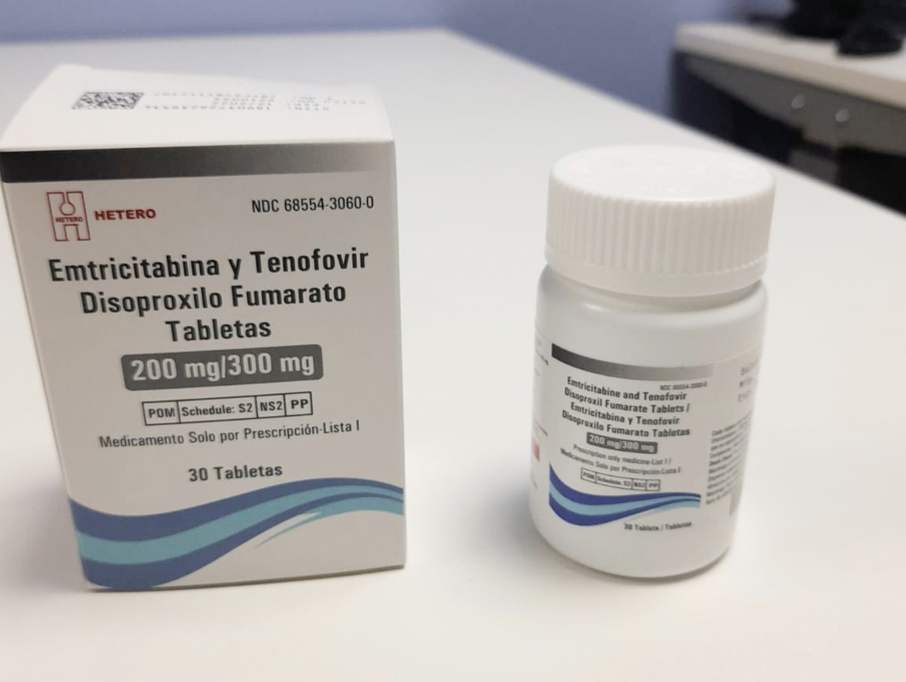
Formulation for ED-PrEP​
Oral tenofovir disoproxil fumarate 300mg/emtricitabine 200mg (TDF/FTC or Truvada®) is the only approved formulation for ED-PrEP.​
Tenofovir alafenamide/emtricitabine (TAF/FTC or Descovy®) or other formulations should not be used for ED-PrEP.​

Slide 18
Evidence Base for ED-PrEP​
IPERGAY^{​1}
Placebo-controlled trial among over 400 men who have sex with men (MSM) in France and Canada.​
HIV risk reduced by 86% among MSM randomized into the ED-PrEP group.​
PREVENIR²
Prospective observational study among over 3,000 MSM in France.​
Participants allowed to choose between ED-PrEP or daily PrEP dosing and half chose ED-PrEP.​
No difference in HIV incidence between the groups (1.1 cases per 1,000 person-years in both groups).​
1. Molina et al., 2015; 2. Molina et al., 2022

Slide 19
ED-PrEP: World Health Organization Recommendations​
2019 | World Health Organization (WHO) recommends ED-PrEP as an additional PrEP option for MSM exposed to HIV through sex.​
2022 | WHO expands ED-PrEP eligibility to all individuals assigned male sex at birth exposed to HIV through sex, who are not taking exogenous estradiol-based hormones, such as those used for gender-affirming hormone therapy.​

Slide 20
WHO Recommendations Rationale
Rationale for expanded eligibility ​
Evidence for ED-PrEP is predominately in MSM, however the WHO extrapolated this evidence to broaden eligibility criteria:​
ED-PrEP is effective for cisgender MSM regardless of sexual positioning, therefore it is reasonable to assume it would be effective for cisgender men having sex with women, as insertive vaginal sex is lower risk than insertive or receptive anal sex.​
Effectiveness is assumed to be similar for individuals assigned male sex at birth who are not using estradiol-based exogenous hormones.​
WHO, 2022

Slide 21
​What are the recommended regimens for ED-PrEP in your setting?​
Who may use ED-PrEP in your setting?
What are some of the advantages of ED-PrEP? ​
DISCUSSION​
Notes:
Facilitator guidance:
Time: 20 minutes
Explain that participants will now work in small groups to review national guidelines for recommended regimens for ED-PrEP in their setting, who may use ED-PrEP, and what are the advantages and disadvantages of ED-PrEP.
Divide participants into groups of 4 to 6 participants each.
Small groups may go online to research the information. As the groups are working, circulate and help as needed. Allow 10 minutes to work.
When the groups have finished, take volunteer responses from the groups. Allow 10 minutes for discussion.
Present the next slide in order to summarize and confirm what participants have shared.

Slide 22
National Guidelines​
In [insert country name] the recommended oral PrEP regimens are [insert available regimen(s)]​ and ED-PrEP is recommended for the following groups:
[insert groups according to national guidelines]​
ED-PrEP is not recommended for these groups:
[insert groups according to national guidelines]​
Notes:
Facilitator guidance:
Edit this slide in advance to the training by inserting the country name, available ED-PrEP regimens, and recommended groups in your country.
Present this slide in order to summarize and confirm what participants have shared in the previous discussion.

Slide 23
Advantages and Disadvantages of Oral ED-PrEP​
Advantages
Highly effective with good adherence to dosing schedule ​ Lower pill burden Generic options widely available​ Easy switching between ED- PrEP and daily oral PrEP
Disadvantages
Requires ability to anticipate sex More complex dosing, requiring self-management of variable dosing​ Limited privacy with pill bottles The same medication is used to treat HIV, which contributes to stigma Fewer eligible populations than oral daily PrEP

Slide 24
3.2 Oral ED-PrEP Eligibility​

Slide 25
QUESTION
Who can take
oral ED-PrEP?​
Notes:
Facilitator guidance:
Read the question on the slide.
Ask participants to raise their hands to answer the question.
Take a few volunteer responses.
Reveal the answer on the following slide.
Allow time for follow-up discussion as needed.

Slide 26
ANSWER
Oral ED-PrEP is for individuals who meet PrEP eligibility criteria and in addition: ​
Are assigned male sex at birth ​
Are NOT taking exogenous estradiol-based hormones​
Have sexual HIV exposure only​
Have infrequent or episodic sex​
Can plan for sex at least 2 hours in advance​
Notes:
Facilitator guidance:
Reveal the answer on the slide.
Allow time for questions and follow-up discussion as needed.

Slide 27
Eligibility Criteria for Oral ED-PrEP
 | HIV seronegative
 | No suspicion of acute HIV infection (AHI)
 | At substantial risk for HIV infection or requesting PrEP
 | Willingness to use PrEP as prescribed
 | Low risk for or no evidence of kidney function impairment*
 | Member of a group eligible for ED-PrEP
 | Infrequent or episodic sex​
 | Can plan for sex ≥ 2 hours in advance, or delay sex for ≥ 2 hours
*Risk-based creatinine clearance (CrCl) evaluation, using estimated glomerular filtration rate (eGFR) calculation.

Slide 28
Who is Eligible for ED-PrEP Dosing?​
Eligible for ED-PrEP​ | Not eligible for ED-PrEP​
Assigned male sex at birth ​ ​+ NOT taking exogenous estradiol-based hormones​ ​+ Sexual HIV exposure only​ | Assigned female sex at birth​ OR​ Taking exogenous estradiol-based hormones OR​ Parenteral HIV exposure ​
Groups include:​ Cisgender men​ Transgender women and non-binary individuals assigned male sex at birth NOT taking gender-affirming hormones ​ | Groups include:​ Cisgender women​ Transgender women and non-binary individuals assigned male sex at birth taking gender-affirming hormones​ Transgender men and non-binary individuals assigned female sex at birth​ Individuals with HIV exposure through injecting practices​
WHO, 2022

Slide 29
Rationale for Ineligible ED-PrEP Clients​
Oral PrEP medication absorbs more slowly into vaginal tissue than anal tissue, taking longer for TDF to reach therapeutic concentrations in vaginal tissue.​
Estradiol-based gender-affirming hormone therapy in transgender women affects the metabolism of TDF, which suggests caution with ED-PrEP.​
The efficacy of ED-PrEP to prevent HIV infection through injection drug use has not been evaluated.​
Note: No trials have included anyone under 18 years of age.​

Slide 30
Questions to Determine Who is Eligible for ED-PrEP​
MALE
What sex was the individual assigned at birth?​
FEMALE
HIV exposure through injecting practices?​
YES
Not eligible for ED-PrEP​
NO
Taking estradiol-based hormones, such as gender-affirming hormone therapy?​
YES
NO
Eligible for ED-PrEP​

Slide 31
Kidney Function Monitoring for Oral PrEP​
TDF can be associated with a small decrease in estimated creatinine clearance (CrCl), also known as estimated glomerular filtration rate (eGFR)*.
This can occur early during oral PrEP use and usually this does not progress.​
PrEP containing TDF is contraindicated if CrCl is less than 60ml/min.​
The WHO recommends risk-based screening and monitoring of renal function, based on age and medical co-morbidities.​
If indicated, CrCl should be evaluated using a serum creatinine test within 1-3 months of PrEP initiation.​
Creatinine testing should not be a barrier to starting PrEP!
* Calculate eGFR using the Cockcroft-Gault equation:​
Estimated CrCl = [140-age (years)] x weight (kg) x f ​
where f=1.23 for men and 1.04 for women / [72 x serum creatinine (μmol/L)]​​
WHO, 2022

Slide 32
WHO Recommendations: Risk-Based Kidney Function Monitoring for Oral PrEP​
Population |  | CrCl at PrEP initiation? | CrCl at PrEP follow-up?
Kidney-related comorbidities? | Age (years)
No | <30 | Optional | Optional (until age 30 or kidney-related comorbidities develop)
 |  |  | If baseline done and CrCl <90ml/min, conduct follow-up every 6-12 months
No | 30-49 | Conduct once within 1-3 months after oral PrEP initiation | If baseline done CrCl ≥90ml/min, optional (until age 50 or kidney-related comorbidities develop)
 |  |  | If baseline CrCl <90ml/min, screening every 6-12 months
Yes | Any age | Conduct once within 1-3 months after oral PrEP initiation | Screening every 6-12 months
No | 50+
WHO, 2022

Slide 33
Key Take Away​
Oral daily PrEP is appropriate for EVERYONE at substantial and ongoing risk for HIV.​
Oral ED-PrEP is appropriate for SOME people at risk for HIV.​

Slide 34

Case Scenario​
Veronica, a transgender woman who is at risk for HIV infection, comes to the clinic to explore her options for oral PrEP. She has been taking gender-affirming hormones with estrogen injections for the last 6 months.
Is Veronica a good candidate for oral ED-PrEP? ​
​
Notes:
Facilitator guidance:
Explain to participants that a case scenario is provided to apply their knowledge of ED-PrEP initiation.
Read the scenario and question on the slide asking participants, "Is Veronica a good candidate for oral ED-PrEP?"
Prompt the participants with follow up questions, "Why or why not?"
Ask participants to raise hands and share their answers.
Continue to the following slide to provide the answer after receiving inputs from participants.

Slide 35

Case Scenario​
Veronica is not eligible for oral ED-PrEP because she is taking gender-affirming hormones.
Estradiol-based gender-affirming hormone therapy in transgender women affects the metabolism of oral PrEP.
Veronica can consider oral daily PrEP instead. ​
Notes:
Facilitator guidance:
Read the answer on the slide.
Allow time for follow up questions and discussion as needed.

Slide 36
3.3 Oral ED-PrEP Initiation Visit

Slide 37
QUESTION
What are the procedures
for initiating a client on
oral ED-PrEP?​
Notes:
Facilitator guidance:
Read the question on the slide.
Ask participants to raise their hands to answer the question.
Take a few volunteer responses.
Reveal the answer on the following slide.
Allow time for follow-up discussion as needed.

Slide 38
ANSWER
Essential procedures for initiating a client on oral ED-PrEP include: ​
HIV testing
Symptom assessment to rule out AHI​
Assessment of HIV risk and last potential exposure​
Determining if creatinine testing is warranted
Counseling and education
Notes:
Facilitator guidance:
Reveal the answer on the slide.
Allow time for questions and follow-up discussion as needed.

Slide 39
Oral ED-PrEP Initiation Visit: Essential Procedures​
Procedure​ | Rationale​
HIV test using national algorithm or assisted HIV self test​ | Assess HIV infection status​
AHI symptom checklist​ | Assess for AHI​
Ask about last potential HIV exposure​ | If last exposure <72 hours prior, post-exposure prophylaxis (PEP) may be more appropriate before transitioning to PrEP​
Determine age and assess for medical co-morbidities that may impair renal function, e.g., diabetes, hypertension​ | Determine whether a serum creatine test is indicated​
PrEP initiation counseling, including informed choice counseling ​​ | Assess substantial risk for HIV​ Assess HIV prevention needs and educate about options​ Discuss desire for PrEP and willingness to take PrEP​ Support informed decision to start ED-PrEP Plan for effective PrEP use and sexual and reproductive health​

Slide 40
Oral ED-PrEP Initiation Visit: Suggested Procedures​
Procedure​ | Rationale​
Hepatitis B surface antigen (HBsAg)​ testing | Identify undiagnosed hepatitis B virus (HBV) infection To identify those eligible for HBV vaccination.
Hepatitis C antibody ​testing | Identify undiagnosed hepatitis C virus (HCV) infection; determine if eligible for HCV treatment
Rapid plasma regain (RPR)​ testing | Diagnose and treat syphilis infection​
Sexually transmitted infection (STI) screening​ | Diagnose and treat STIs Syndromic or diagnostic STI testing, depending on local guidelines
Per the WHO availability of or access to these tests should NOT be a barrier to PrEP initiation. ​
These tests are not a requirement for oral PrEP use.​

Slide 41
Viral Hepatitis and PrEP​
Individuals at substantial risk of HIV infection may also be at a higher risk for HBV and HCV infection. ​
PrEP services provide an important opportunity to screen for HBV and HCV infection and provide linkages to care.​
  HBsAg testing within 1-3 months of PrEP initiation is strongly encouraged where feasible, particularly in highly endemic countries. ​
  HCV antibody testing is strongly encouraged within 1-3 months of PrEP initiation and every 12 months thereafter where PrEP services are provided to populations at high risk of HCV infection. ​
WHO, 2022

Slide 42
Viral Hepatitis and PrEP (continued)​
TDF-based oral daily or ED-PrEP can be offered to people with HBV or HCV infection. ​
Lack of HBV and HCV testing should not be a barrier to PrEP initiation or use. ​
PrEP can be initiated before HBV and HCV test results are available. ​
HBV or HCV testing are not a requirement for PrEP use!​
For people known to have chronic HBV infection:​
  Daily TDF effectively suppresses HBV, however, HBV may occasionally flare and lead to worsening liver function when TDF is discontinued. ​
  Providers should consider monitoring for signs and symptoms of hepatitis in those who stop TDF.​
  TDF should not be taken with a medication used to treat chronic HBV called adefovir, as they are similar drugs.​
WHO, 2022

Slide 43
PrEP Initiation Visit: National Guidelines​
In [insert country name], the following procedures are required during an oral ED-PrEP initiation visit:​
[insert procedures according to local guidelines]​
Notes:
Facilitator guidance:
Edit this slide in advance of the training by inserting the country name and procedures for ED-PrEP initiation in your country.

Slide 44
QUESTION
What are the steps to initiate someone on oral ED-PrEP?​
Notes:
Facilitator guidance:
Read the question on the slide.
Ask participants to raise their hands to answer the question.
Take a few volunteer responses.
Reveal the answer on the following slide.
Allow time for follow-up discussion as needed.

Slide 45
ANSWER
Steps for initiating a client on oral ED-PrEP include: ​
Confirming HIV negative status​
Screening for substantial risk for HIV ​
Providing PrEP counseling, including informed choice counseling ​
Establish eligibility for oral ED-PrEP​
Initiate oral ED-PrEP
Notes:
Facilitator guidance:
Reveal the answer on the slide.
Allow time for questions and follow-up discussion as needed.

Slide 46
Suggested Clinical Pathway: Oral ED-PrEP Initiation
1
2
3
4
5
Confirm HIV Negative Status​
Screen for Substantial Risk for HIV ​
Informed Choice
PrEP Counseling​
Establish Eligibility
for Oral ED-PrEP​
Initiate PrEP
Perform rapid HIV test or assisted HIV self test per national guidelines Link people found to be living with HIV to care and treatment​
Member of a population eligible for PrEP according to national guidelines​
Member of a group eligible for ED-PrEP Educate about available PrEP options, including daily oral PrEP​ Shared decision making to start oral ED-PrEP
No evidence of AHI​ Willingness to use oral ED-PrEP as prescribed​ Low risk for or no evidence of kidney function impairment
Counseling on adherence, risk reduction, side effects and AHI symptoms​ STI screening and management Dispense PrEP medication and schedule follow-up appointment​
See Module 6 for more information about informed choice counseling​

Slide 47
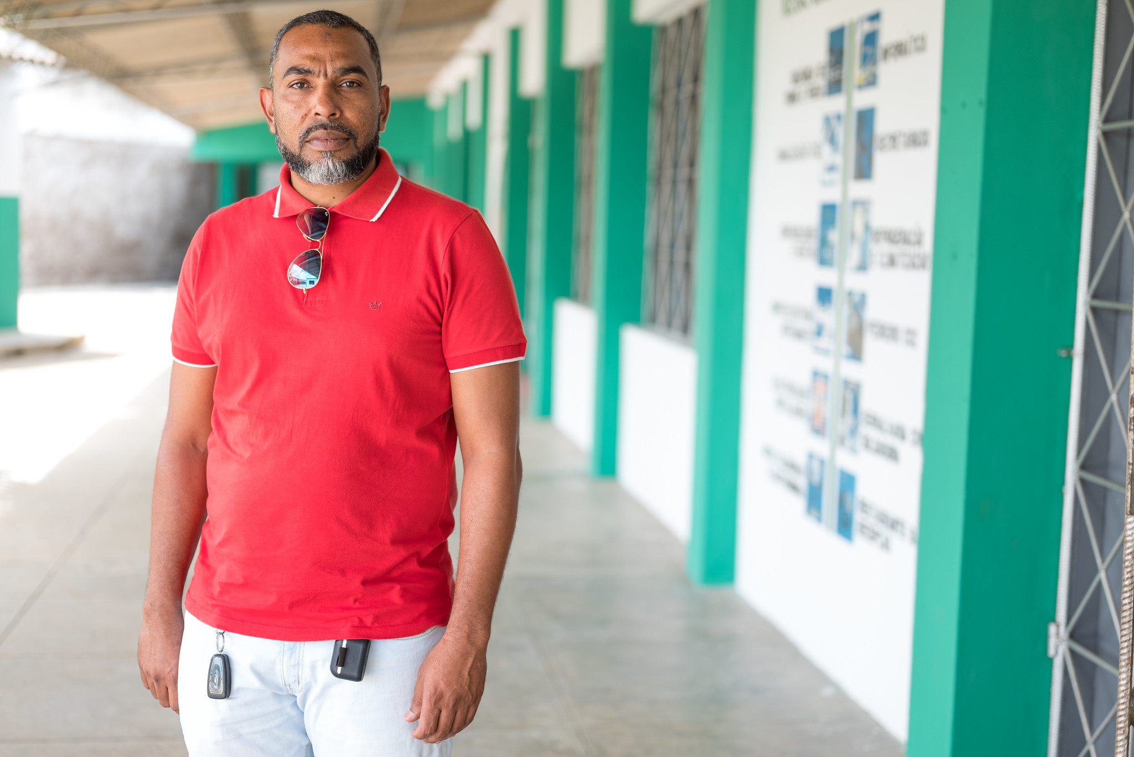
Case Scenario​
Innocent is a 32-year-old man who comes to the clinic requesting routine STI screening and HIV testing. He is having sex with a few male partners and using condoms sometimes. ​
Follow the clinical pathway to determine if Innocent can be initiated on oral ED-PrEP. ​
Notes:
Facilitator guidance:
Explain to participants that a case scenario is provided for them to apply newly acquired knowledge to each step of the clinical pathway for oral ED-PrEP initiation according to their practice and local context.
Read the scenario and follow the clinical pathway on the following slides to determine if Innocent can be initiated on oral ED-PrEP.

Slide 48
Suggested Clinical Pathway: Oral ED-PrEP Initiation
1
2
3
4
5
Confirm HIV Negative Status​
Screen for Substantial Risk for HIV ​
Informed Choice
PrEP Counseling​
Establish Eligibility
for Oral ED-PrEP​
Initiate PrEP
Perform rapid HIV test or assisted HIV self test per national guidelines Link people found to be living with HIV to care and treatment​
Member of a population eligible for PrEP according to national guidelines​
Member of a group eligible for ED-PrEP Educate about available PrEP options, including daily oral PrEP​ Shared decision making to start oral ED-PrEP
No evidence of AHI​ Willingness to use oral ED-PrEP as prescribed​ Low risk for or no evidence of kidney function impairment
Counseling on adherence, risk reduction, side effects and AHI symptoms​ STI screening and management Dispense PrEP medication and schedule follow-up appointment​
See Module 6 for more information about informed choice counseling​

Slide 49
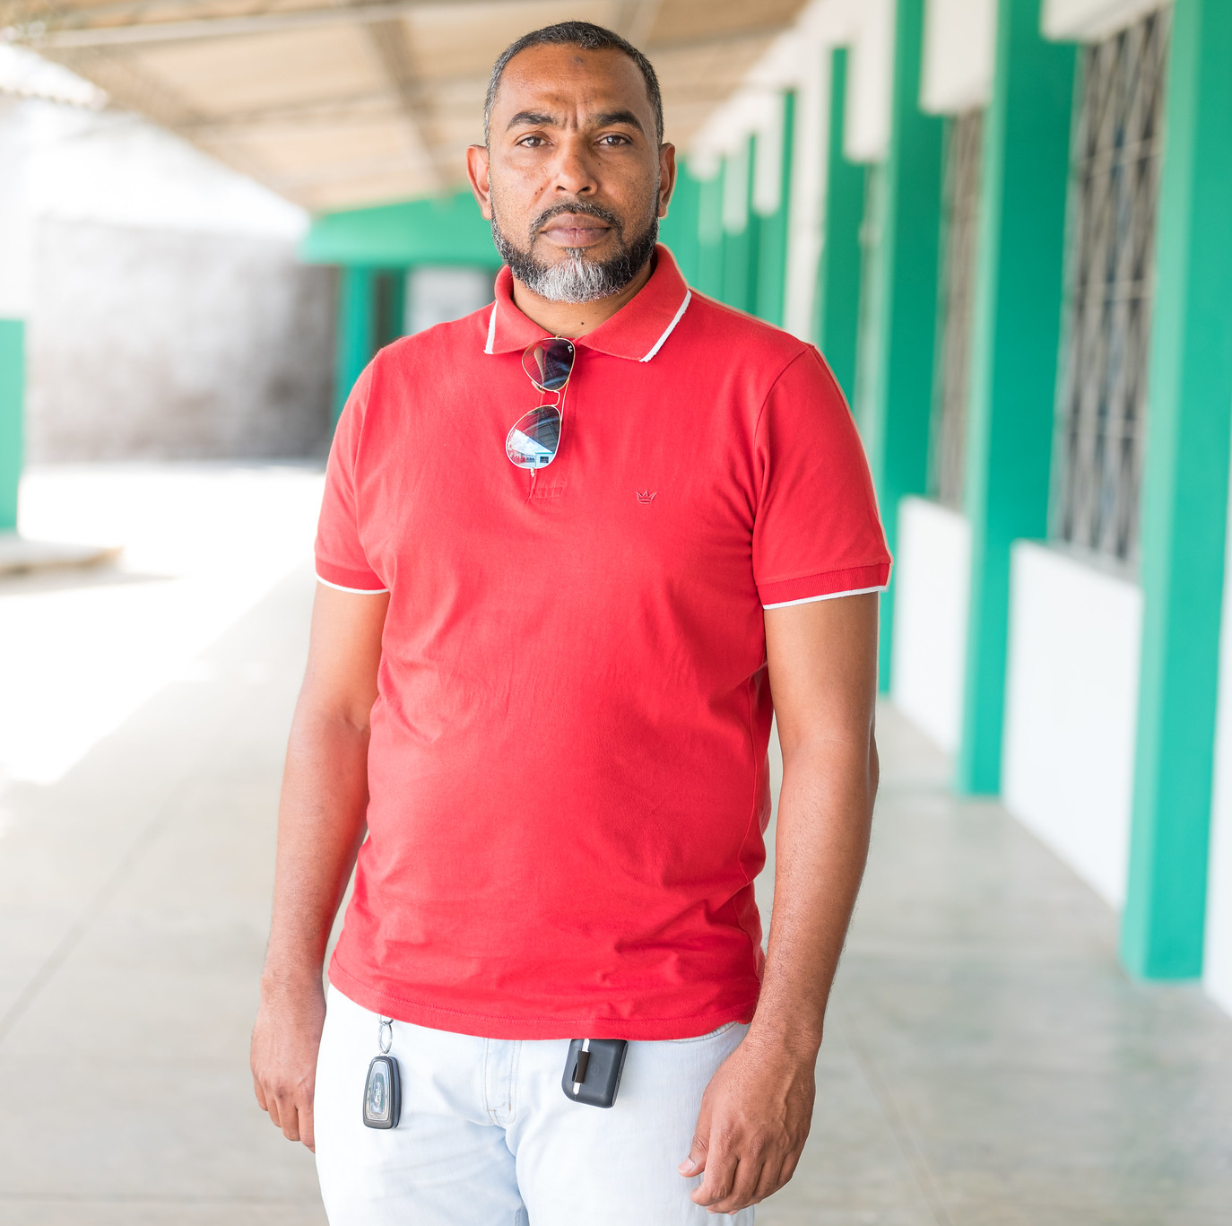
Case Scenario​
You perform a rapid HIV test and Innocent tests negative. ​
What is the next step to determine if Innocent can begin oral ED-PrEP today? ​
Notes:
Facilitator guidance:
Read the scenario and question on the slide asking participants, "What is the next step to determine if Innocent can begin oral ED-PrEP today?" [Answer: Screen for substantial risk for HIV]
Ask participants to raise hands and share their answers.
Continue to the following slide to provide the answer after receiving inputs from participants.

Slide 50
Suggested Clinical Pathway: Oral ED-PrEP Initiation
1
2
3
4
5
Confirm HIV Negative Status​
Screen for Substantial Risk for HIV ​
Informed Choice
PrEP Counseling​
Establish Eligibility
for Oral ED-PrEP​
Initiate PrEP
Perform rapid HIV test or assisted HIV self test per national guidelines Link people found to be living with HIV to care and treatment​
Member of a population eligible for PrEP according to national guidelines​
Member of a group eligible for ED-PrEP Educate about available PrEP options, including daily oral PrEP​ Shared decision making to start oral ED-PrEP
No evidence of AHI​ Willingness to use oral ED-PrEP as prescribed​ Low risk for or no evidence of kidney function impairment
Counseling on adherence, risk reduction, side effects and AHI symptoms​ STI screening and management Dispense PrEP medication and schedule follow-up appointment​
See Module 6 for more information about informed choice counseling​

Slide 51
Case Scenario​
Innocent reports that he has had unprotected anal sex with 2 partners in the last 6 months and was treated for an STI 3 months ago.
Is he considered at substantial risk for HIV and eligible for PrEP?​
Notes:
Facilitator guidance:
Read the scenario and question on the slide asking participants, "Is Innocent considered at substantial risk for HIV and eligible for PrEP? " [Answer: Yes, he is considered at substantial risk for HIV. Continue in the clinical pathway to determine if he meets other eligibility criteria for oral ED-PrEP.]
Ask participants to raise hands and share their answers.
Continue to the following slide to provide the answer after receiving inputs from participants.

Slide 52

Step 2: Screen for Substantial Risk for HIV​
Does the client report any one of the following in the past six months?​
 | Sexual activity in a high HIV prevalence population or key population group
 | Vaginal or anal intercourse without condoms with more than one partner
 | Sex partner with one or more HIV risk factor
 | History of an STI (based on lab test, syndromic STI treatment, or self-report)
 | History of use of PEP
 | History of sharing of injection material and/or equipment with another person
 | Having a sexual partner who is HIV positive and has been ART for less than 6 months or has inconsistent or unknown adherence
 | Asking for PrEP. This may indicate risk behavior they are unwilling to share
Screen for substantial risk for HIV according to national guidelines. ​

Slide 53
Suggested Clinical Pathway: Oral ED-PrEP Initiation
1
2
3
4
5
Confirm HIV Negative Status​
Screen for Substantial Risk for HIV ​
Informed Choice
PrEP Counseling​
Establish Eligibility
for Oral ED-PrEP​
Initiate PrEP
Perform rapid HIV test or assisted HIV self test per national guidelines Link people found to be living with HIV to care and treatment​
Member of a population eligible for PrEP according to national guidelines​
Member of a group eligible for ED-PrEP Educate about available PrEP options, including daily oral PrEP​ Shared decision making to start oral ED-PrEP
No evidence of AHI​ Willingness to use oral ED-PrEP as prescribed​ Low risk for or no evidence of kidney function impairment
Counseling on adherence, risk reduction, side effects and AHI symptoms​ STI screening and management Dispense PrEP medication and schedule follow-up appointment​
See Module 6 for more information about informed choice counseling​

Slide 54
Case Scenario​
Innocent confirms he was assigned male sex at birth and is not on any hormone therapy. He says he has usually only has sex when he goes out on the weekends, which is typically once a month.
You think he is a candidate for ED-PrEP.
What are some of the key messages you will offer to Innocent so that he can make an informed choice between oral daily PrEP and ED-PrEP? ​
Notes:
Facilitator guidance:
Read the scenario and question on the slide asking participants, "What are some of the key messages you will offer to Innocent so that he can make an informed choice between oral daily PrEP and ED-PrEP? " [Answer: Explain the key differences between daily and ED-PrEP use, including dosing schedule requirements, the need to be able to predict sex and that ED-PrEP only protects against sexual HIV exposure]
Ask participants to raise hands and share their answers.
Continue to the following slide to provide the answer after receiving inputs from participants.

Slide 55
Step 3: Informed Choice PrEP Counseling​
Initial ED-PrEP counseling should:​
Increase awareness of PrEP as a prevention choice​
Explain how PrEP works
Discuss sexual health and emphasize that PrEP should be used as part of a package of HIV prevention services​
Help clients decide whether PrEP is right for them
Educate about PrEP options and support informed decision making, including choosing between oral daily PrEP and ED-PrEP
Educate about the importance of adherence to dosing regimen and follow-up visits
Describe common oral PrEP side effects and side-effects management
See Module 6 for more information about informed choice counseling.​

Slide 56
Key Initial Visit Counseling Messaging: ED-PrEP Basics​
Oral ED-PrEP works when taken on schedule! ​ ED-PrEP prevents HIV infection and is effective if taken as recommended around when you have sex.​
ED-PrEP does not prevent STIs other than HIV. ​ Using condoms with every act of sexual intercourse provides some protection against many of these infections. ​
ED-PrEP does not prevent pregnancy in your partners. ​ Use effective contraception unless you want pregnancy.​
ED-PrEP is safe.​
ED-PrEP side effects usually go away within the first month.​ Gastrointestinal side effects (e.g., nausea, diarrhea, stomach pain) can occur, but usually go away over time. ​

Slide 57
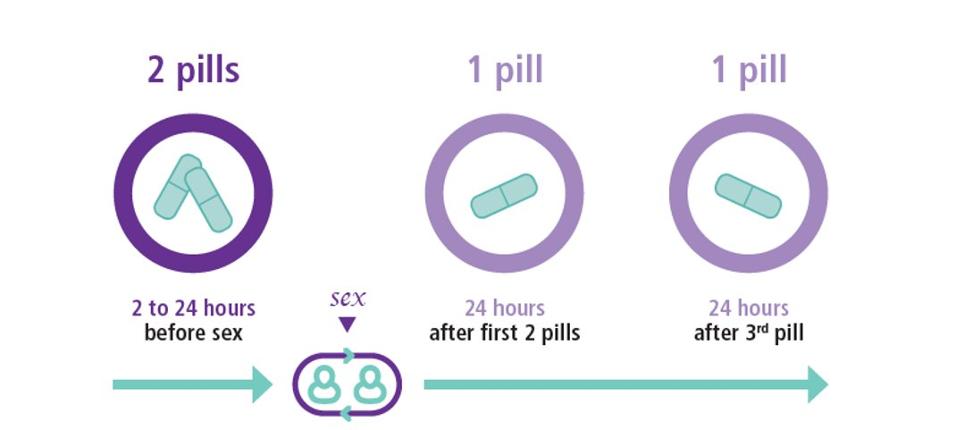
Key Initial Visit Counseling Messaging: 2-1-1 Dosing Schedule​
Start ED-PrEP before you have sex Take two pills of oral PrEP (called the loading dose) between 2 and 24 hours before you expect to have sex.
Continue for two more days Take one pill 24 hours after the loading dose and one pill 24 hours after the 3rd pill.
Graphic: WHO, 2019

Slide 58
Dosing Guidance Scenarios​
Sex over multiple consecutive days:​
Clients should continue taking one pill daily for as long as the sex continues and for two days after the last time they had sex.​
Sex on non-consecutive days while on ED-PrEP: ​
If a client is still taking ED-PrEP and has sex again during this period, they should continue taking one pill each day until two days after the last time they had sex.​
No sex:
If a client does not have sex after taking the loading dose, they can stop taking PrEP.

Slide 59
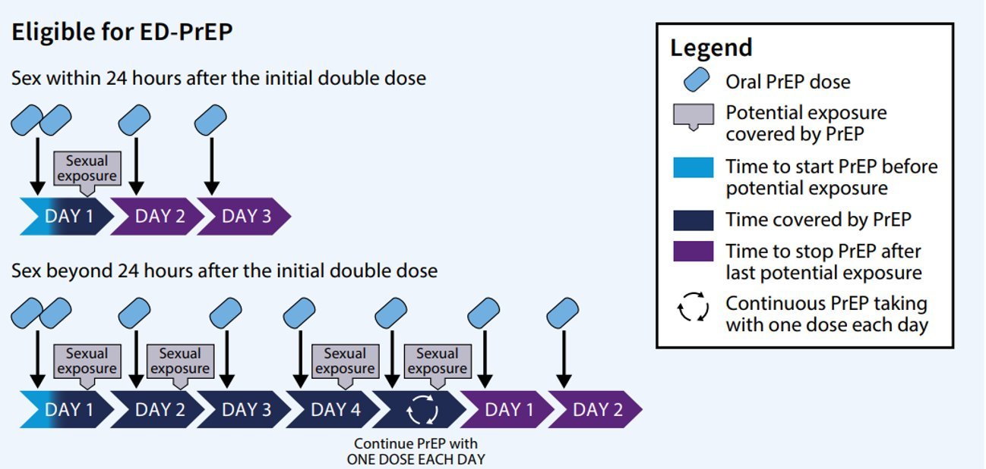
Key Initial Visit Counseling Messaging: Ongoing Sexual Exposure​
Continue to take pills if you continue to have sex After initial 2-1-1 dosing, continue to take one pill per day until two days after the day you last had sex.​
Graphic: WHO, 2019

Slide 60
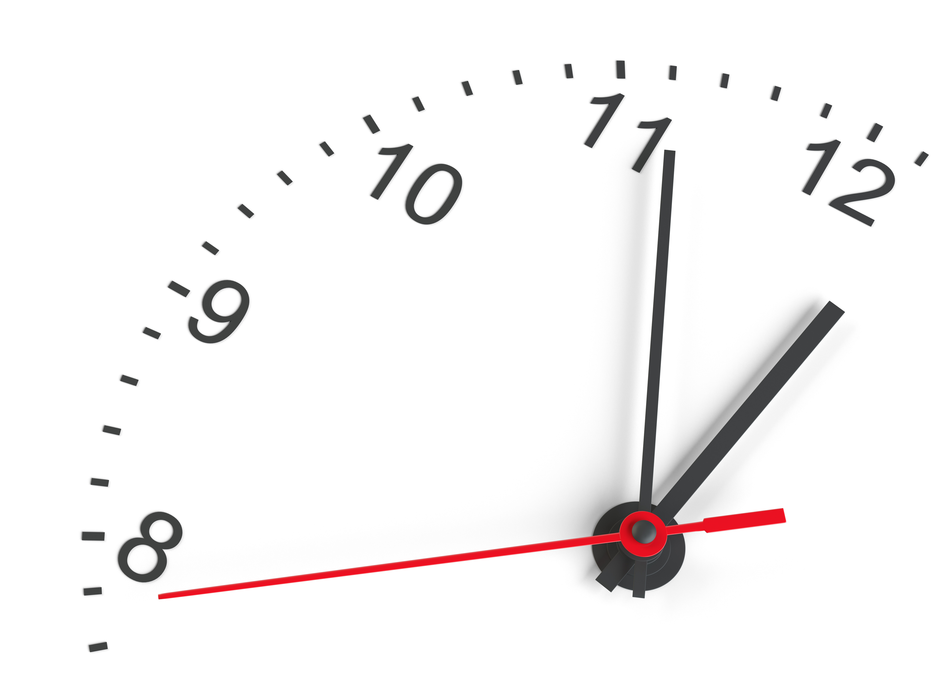
Tip!
Taking the pills closer to 24 hours before sex is better than taking it 2 hours before sex.​
But clients can take 2 pills as soon as 2 hours before sex.​

Slide 61
Key Initial Visit Counseling Messaging: Supporting Adherence​
ED-PrEP works best when you can anticipate when you will have sex. ​ If you think you might have sex, take two pills beforehand. You can stop taking ED-PrEP if you do not have sex. ​
Taking two PrEP pills 24 hours before sex provides the best protection ​ Taking the initial dose as little as two hours before sex also helps protect against HIV. ​
You may need to refill your prescription less often if you use ED-PrEP ​ You should still come in every three months for testing to make sure you do not have undiagnosed HIV or other STIs. ​
PrEP pills can be taken any time of day, with or without food.​

Slide 62
Key Initial Visit Counseling Messaging: Switching PrEP Dosing Methods
ED-PrEP can switch to daily PrEP dosing. You can decide to switch to taking oral PrEP every day if you prefer.​
Daily PrEP can switch to ED-PrEP dosing​ You can go back to ED-PrEP from daily oral PrEP if you prefer.​
Stopping ED-PrEP​ Continue to take one dose per day until two days after the day of the last potential sexual exposure. Make sure you use condoms or another prevention method when not taking ED-PrEP. ​

Slide 63
Switching from ED-PrEP to Daily PrEP​
What are some of the reasons why someone would want to switch from ED-PrEP to daily PrEP?​
Frequent sex​
Unpredictable sex​
Difficulty remembering to take the doses if not on a daily schedule​

Slide 64
Example: From ED-PrEP to Daily Prep​
Sex event
Fri
Sat
Sun
Mon
Thu
Tue
Wed
Fri
Sat
Sun
Tues
Mon
Wed
Thurs
Fri
Sat
Sun
Pill dose
ED-PrEP
Daily PrEP
11PM
3PM
3PM
2AM
1PM
11AM
4PM
9AM
9AM
9AM
9AM
9AM
9AM
9AM
9AM
9AM
9AM
9AM

Slide 65
Switching from Daily PrEP to ED-PrEP​
What are some of the reasons why someone would want to switch from daily PrEP to ED-PrEP?​
To save money​
Infrequent sex​
Predictable sex​
Concerns about toxicity ​
Concerns about adherence ​

Slide 66
From ED-PrEP to No PrEP​
What are some of the reasons why someone would want to stop their ED-PrEP use?​
No ongoing HIV risk​
Change in relationship ​
Eliminate experience of side effects​
Diagnosed with HIV​
​

Slide 67
Key Initial Visit Counseling Messaging: Missed Dose​
Use protection if you miss your loading dose If sex occurs less than two hours after taking the loading dose or the loading dose is missed, use other HIV prevention methods, such as condoms and lubricant, to reduce your risk of acquiring HIV. ​
Note:
If a client has sex without a condom less than two hours after taking the loading dose or after missing the loading dose, they may be a candidate for PEP per national guidelines.​
Because the timing and type of the sexual risk event will vary for each client in relation to the timing of the missed dose(s), such cases will require individual consideration and best clinical judgment.​

Slide 68
Choosing Between Daily PrEP and ED-PrEP​
​ | Daily PrEP​ | ED-PrEP​
When to use it? ​ | Every day​ | Every time you have sex​
Works best ​ | Taking one pill every day​ | Taking it with every partner​
Effectiveness ​ | Effective when used daily​ | Effective when used every time you have sex​
Taking pills ​ | Take one pill every day​ | Requires planning and reminders to take 2-1-1 dosing​
Planning ​ | No planning around sex​ | Need at least 2 hours of notice to take pills before sex​
Side Effects ​ | Same as ED-PrEP​ | Same as daily PrEP​

Slide 69
Suggested Clinical Pathway: Oral ED-PrEP Initiation
1
2
3
4
5
Confirm HIV Negative Status​
Screen for Substantial Risk for HIV ​
Informed Choice
PrEP Counseling​
Establish Eligibility
for Oral ED-PrEP​
Initiate PrEP
Perform rapid HIV test or assisted HIV self test per national guidelines Link people found to be living with HIV to care and treatment​
Member of a population eligible for PrEP according to national guidelines​
Member of a group eligible for ED-PrEP Educate about available PrEP options, including daily oral PrEP​ Shared decision making to start oral ED-PrEP
No evidence of AHI​ Willingness to use oral ED-PrEP as prescribed​ Low risk for or no evidence of kidney function impairment
Counseling on adherence, risk reduction, side effects and AHI symptoms​ STI screening and management Dispense PrEP medication and schedule follow-up appointment​
See Module 6 for more information about informed choice counseling​

Slide 70
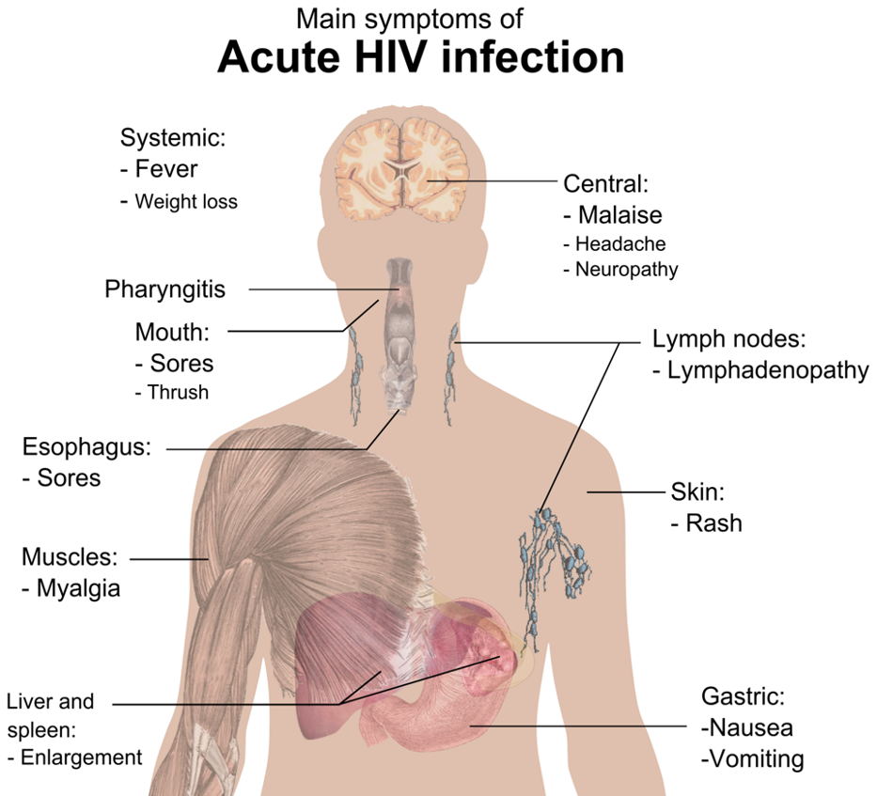
Step 4: Establish Eligibility for Oral ED-PrEP
No evidence of AHI​
Assess for flu-like symptoms within the last 4 weeks.​
Low risk for or no evidence of kidney function impairment​
Determine age and assess for medical co-morbidities that may impair renal function (e.g., diabetes, hypertension)​
Determine whether a serum creatinine test is indicated (see next slide)
See Module 1 for more information about AHI screening.​

Slide 71
Decision Algorithm for Kidney Function Monitoring During Oral PrEP Initiation​
Does the individual have any known kidney-related co-morbidities (e.g., diabetes or hypertension)? ​
NO
YES
What age is the individual?​
<30 years​
30+ years​
Evaluate CrCl once within 1-3 months after oral PrEP initiation​
CrCl evaluation optional​

Slide 72
Case Scenario​
Innocent is 32 years old and a healthy man with no co-morbidities. He understands the 2-1-1 dosing schedule and would like to start oral ED-PrEP.​
Does he need to take have a creatinine blood test to start oral ED-PrEP today? ​
Notes:
Facilitator guidance:
Read the scenario and question on the slide asking participants, "Does he need to have a creatinine blood test to start oral ED-PrEP today?" [Answer: No. Because he is over 30 years old and has no known co-morbidities that would affect his kidneys, it is recommended that Innocent have a CrCl evaluation within 1-3 months after starting ED-PrEP but he does not need to have one before starting ED-PrEP today]
Ask participants to raise hands and share their answers.
Provide the answer and allow time for follow up question and discussion as needed.

Slide 73
Suggested Clinical Pathway: Oral ED-PrEP Initiation
1
2
3
4
5
Confirm HIV Negative Status​
Screen for Substantial Risk for HIV ​
Informed Choice
PrEP Counseling​
Establish Eligibility
for Oral ED-PrEP​
Initiate PrEP
Perform rapid HIV test or assisted HIV self test per national guidelines Link people found to be living with HIV to care and treatment​
Member of a population eligible for PrEP according to national guidelines​
Member of a group eligible for ED-PrEP Educate about available PrEP options, including daily oral PrEP​ Shared decision making to start oral ED-PrEP
No evidence of AHI​ Willingness to use oral ED-PrEP as prescribed​ Low risk for or no evidence of kidney function impairment
Counseling on adherence, risk reduction, side effects and AHI symptoms​ STI screening and management Dispense PrEP medication and schedule follow-up appointment​
See Module 6 for more information about informed choice counseling​

Slide 74
Case Scenario​
Innocent can start oral ED-PrEP today!
How many pills will you dispense to him and when will you schedule his follow-up visit? ​
Notes:
Facilitator guidance:
Read the scenario and question on the slide asking participants, "How many pills will you dispense to him and when will you schedule his follow-up visit? " [Answer: Clients starting ED-PrEP should be given enough pills for daily use until their next visit. A follow-up visit should occur within one month after initiation.]
Ask participants to raise hands and share their answers.
Continue to the following slide to provide the answer after receiving inputs from participants.

Slide 75
Step 5: Initiate Oral ED-PrEP
Prescribe oral ED-PrEP
Counsel on effective use, adherence, risk reduction, side effects and AHI symptoms
  Clients should be encouraged to return early if they experience AHI symptoms.​
Screen for STIs
  HBV, HCV, and RPR testing are recommended but not required ​
Dispense PrEP medication ​
Schedule follow-up appointment

Slide 76
Prescribe Oral PrEP and Schedule a Follow-up Visit​
Clients starting ED-PrEP should be given enough pills for daily use until their next visit. Clients may not use all their pills, but this allows them to switch to daily PrEP if they desire before the next visit.​
A follow-up visit should still occur one month after initiation to:​
  Evaluate adherence and provide counseling on effective use.​
  Evaluate and manage any side effects.​
  Repeat an HIV test to rule out AHI that may have been present at initiation.​
If blood tests are done, any abnormal results should be shared with the client before the next visit.​
Some programs allow for a multi-month supply to be dispensed at the initiation visit with virtual follow-up visits.​
In [insert country name] during ED-PrEP initiation visits [number of pills] are dispensed and follow up is scheduled for [insert follow-up time period and place].​
Notes:
Facilitator guidance:
Edit the slide in advance by entering the country name and number of pills dispensed at initiation visit and follow up time period and place.
Note: These answers will vary by country and program.
Allow time for discussion as needed.

Slide 77
Paired Practice​
Participants will now work pairs to determine ED-PrEP dosing guidance for the following clinical scenarios. ​
Notes:
Facilitator guidance:
Time 20 minutes
Divide participants into groups of two to apply their knowledge of ED-PrEP dosing to the following clinical scenarios.
Review the dosing guidance on the following 3 slides before asking participants to apply this to the scenarios.

Slide 78
Review: 2-1-1 Dosing Schedule​
Take two pills of oral PrEP (loading dose) between 2 and 24 hours before sexual exposure. ​
Take one pill 24 hours after the loading dose and one pill 24 hours after the 3rd pill.​
Graphic: WHO, 2019

Slide 79
Review: Dosing for Ongoing Sexual Exposure​
After initial 2-1-1 dosing, continue to take one dose per day until two days after the day of the last potential sexual exposure.​
Graphic: WHO, 2019

Slide 80
Review: Dosing Guidance Scenarios​
Sex over multiple consecutive days:​
Clients should continue taking one pill daily for as long as the sex continues and for two days after the last time they had sex.​
Sex on non-consecutive days while on ED-PrEP: ​
If a client is still taking ED-PrEP and has sex again during this period, they should continue taking one pill each day until two days after the last time they had sex.​
No sex:
If a client does not have sex after taking the loading dose, they can stop taking PrEP.

Slide 81

José and Mark​
José invited Mark to his place on Friday night. They’ve had sex before, so José is fairly sure they’ll have sex again. ​
He’s hoping that if all goes well he’ll be having sex around 11pm on Friday night. ​
When does José take the 4 pills?​
Notes:
Facilitator guidance:
Read the question on the slide.
Ask the groups to work together to answer the question.
Take a few volunteer responses.
Reveal the answer on the following slide.
Allow time for follow-up discussion as needed.

Slide 82
José’s Dosing
José should take two pills 2-24 hours before having sex and take one pill each day for the 2 days following sex. After that, if José stops having sex, he can stop taking PrEP.
Fri
Sat
Sun
Mon
Thu
Tue
Wed
11pm
9am
9am
9am
Sex event
Pill dose
Notes:
Facilitator guidance:
Jose’s Dosing
Explain the dosing as outlined on the slide.
Discuss the range of time that Jose could take the first 2 pills, from 11pm on Thursday to 9pm on Friday. Remind the participants that the loading dose is more effective if taken closer to 24 hours in advance of sex.
Remind participants that timing of the loading dose affects when pills 3 and 4 should be taken. Pills 3 and 4 should be taken 24 hours after the loading dose. Since Jose took the loading dose at 9am on Friday, he can take pills 3 and 4 at 9am on Saturday and Sunday.

Slide 83
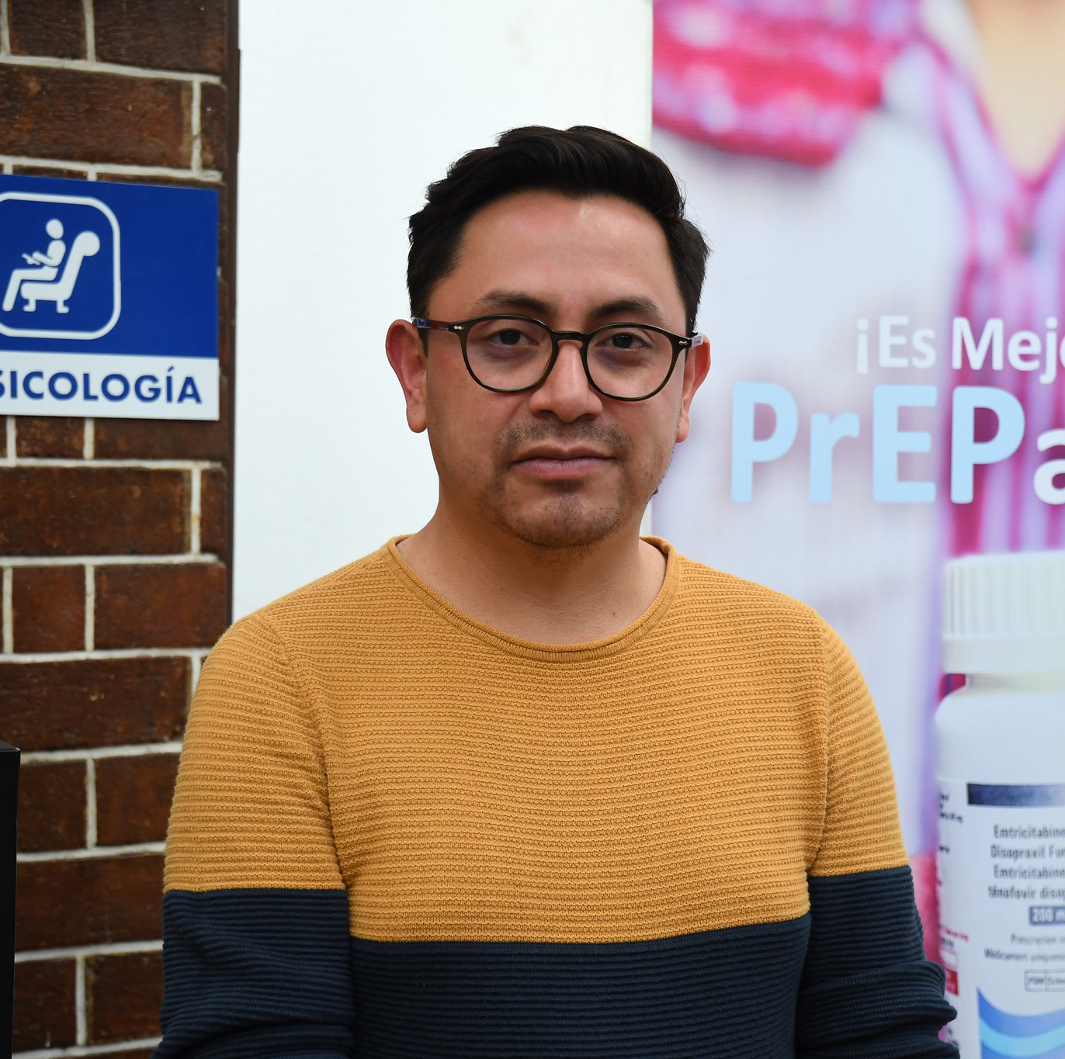
Roberto​
Roberto usually is busy working during the week. On the weekends, he likes to cut loose and have fun. This weekend was no exception. Roberto had sex on Friday night at 11pm, Saturday at 10pm, and on Sunday at 4am. ​
When does Roberto take his pills?​
Notes:
Facilitator guidance:
Read the question on the slide.
Ask the groups to work together to answer the question.
Take a few volunteer responses.
Reveal the answer on the following slide.
Allow time for follow-up discussion as needed.

Slide 84
Roberto’s Dosing
Roberto took two pills on Friday morning. He had sex Friday night and took one pill on Saturday morning. Saturday night he had sex again and then again early Sunday morning. Roberto took one pill on Sunday, Monday, and Tuesday mornings at 9am.
Fri
Sat
Sun
Mon
Thu
Tue
Wed
11pm
10pm
4am
9am
9am
9am
9am
9am
Sex event
Pill dose
Notes:
Facilitator guidance:
Roberto’s Dosing
Explain the dosing as outlined on the slide.
Explain that clients who have sex over multiple days should continue taking one pill each day for two days after the last time they had sex. In Roberto’s case, that means that his last pill is on Tuesday.
Discuss the range of time that Roberto could take the first 2 pills, from 11pm on Thursday to 9pm on Friday. Timing of the loading dose affects when pills 3 and 4 are taken.
Remind the participants that the loading dose is more effective if taken closer to 24 hours in advance of sex.

Slide 85
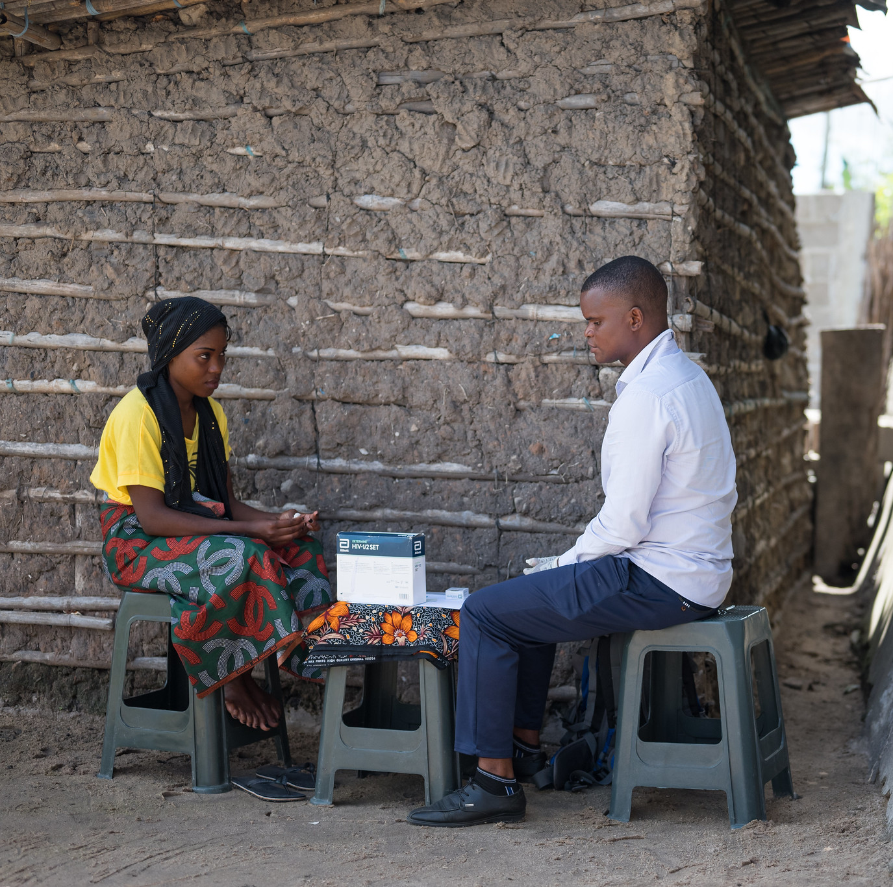
Abdul and Mary​
Abdul went out on a date with Mary on Friday. It went really well, and they ended up having sex on Friday night. They decided to go out again on Sunday and had sex again.​
When does Abdul take his doses of PrEP?​
Notes:
Facilitator guidance:
Read the question on the slide.
Ask the groups to work together to answer the question.
Take a few volunteer responses.
Reveal the answer on the following slide.
Allow time for follow-up discussion as needed.

Slide 86
Abdul’s Dosing
Abdul took two pills Friday morning before having sex on Friday night. On Saturday and Sunday, he took another pill each day. They had sex on Sunday, so he continued taking a pill each day on Monday and Tuesday.
Fri
Sat
Sun
Mon
Thu
Tue
Wed
11pm
10pm
9am
9am
9am
9am
9am
Sex event
Pill dose
Notes:
Facilitator guidance:
Abdul’s Dosing
Explain the dosing as outlined on the slide.
Explain that clients who have sex on non-consecutive days while still taking ED-PrEP should continue taking one pill each day for two days after the last time they had sex. In Abdul’s case, that means that his last pill should be on Tuesday and that he takes PrEP for 5 consecutive days.

Slide 87
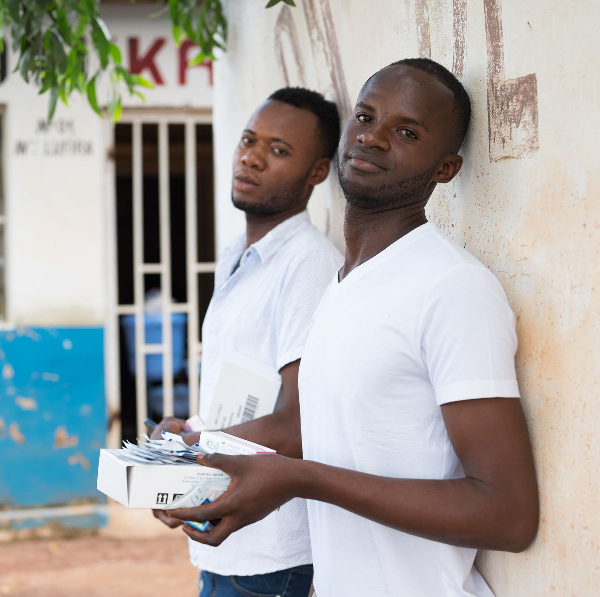
Patrick and James​
Patrick has a date planned with James on Friday night. When they have gone out before, sometimes they have sex and sometimes they don’t. They go out on Friday, but do not end up having sex.​
When should Patrick take his pills?​
Notes:
Facilitator guidance:
Read the question on the slide.
Ask the groups to work together to answer the question.
Take a few volunteer responses.
Reveal the answer on the following slide.
Allow time for follow-up discussion as needed.

Slide 88
Patrick’s Dosing
Patrick took two pills Friday morning before his date on Friday night. However, since they did not have sex, he does not need to take a pill on Saturday or Sunday.
Fri
Sat
Sun
Mon
Thu
Tue
Wed
11pm
9am
Sex event
Pill dose
Notes:
Facilitator guidance
Patrick’s dosing
Explain the dosing as outlined on the slide.
Explain that clients who do not have sex do not need to take the following 2 pills on the next 2 days.

Slide 89
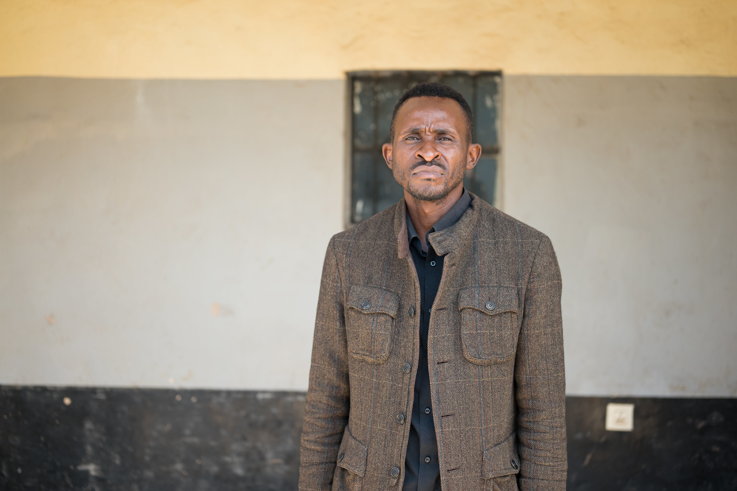
George​
George went out on date with Jay on Friday. It went really well, and they ended up having sex on Friday night. ​
During the following week, George started to talk with Manuel online. They continued to talk over the weekend and met on Tuesday. They had sex that night.​
When does George take his pills?​
Notes:
Facilitator guidance:
Read the question on the slide.
Ask the groups to work together to answer the question.
Take a few volunteer responses.
Reveal the answer on the following slide.
Allow time for follow-up discussion as needed.

Slide 90
George’s Dosing
George took two pills Friday morning before having sex on Friday night. On Saturday and Sunday, he took another pill each day. He next had sex on the following Tuesday night. Since it had been several days since his last dose, George starts with a 2-pill loading dose.
Fri
Sat
Sun
Mon
Thu
Tue
Wed
Fri
Sat
Sun
Mon
Tues
Wed
Thu
11pm
10pm
9am
9am
9am
9am
9am
9am
Sex event
Pill dose
Notes:
Facilitator guidance
George’s dosing
Explain the dosing as outlined on the slide.
Explain that clients who have stopped taking PrEP after their last encounter must re-start ED-PrEP with a 2-pill loading dose. In George’s case, that means he restarts ED-PrEP with two pills on Tuesday of the second week.

Slide 91
Paired Practice​
Participants will now return to the group and discuss their work in pairs to determine ED-PrEP dosing guidance for the clinical scenarios. ​
Share findings, questions, and lessons learned. ​
Notes:
Facilitator guidance:
Allow 10 minutes for discussion of findings from the partner practice, answer any questions, and summarize lessons learned.

Slide 92
What is YOUR EXPERIENCE initiating clients on ED-PrEP? ​
Do you have any successes or challenges to share?​
Do you have any questions about initiating clients on ED-PrEP?
DISCUSSION​
Notes:
Facilitator guidance:
• Time: 10-20 minutes. Timing will vary based on size of the group and time allowed for training. Set a time limit and keep track of time.
• Explain that participants who want to speak should raise their hands.
• Keep the discussion on target and moving along.
• Encourage everyone to participate and call on everyone who raises a hand.
• Limit participants who like to talk a lot.
• Ask questions to encourage more responses to a question—for example: “What else?” “What other ideas do you have?”
• Wrap up the discussion by repeating and summarizing main points.

Slide 93
3.4 Oral ED-PrEP Follow-up Visits​

Slide 94
QUESTION
What are the procedures for oral ED-PrEP follow-up visits?
How are visits scheduled?​
Notes:
Facilitator guidance:
Read the question on the slide.
Ask participants to raise their hands to answer the question.
Take a few volunteer responses.
Reveal the answer on the following slide.
Allow time for follow-up discussion as needed.

Slide 95
ANSWER
Follow-up visits should be completed 1 month after starting oral ED-PrEP and continue every 3 months. ​
Essential follow-up visit procedures include HIV testing, HIV risk assessment, side effects management, and adherence counseling. ​
Notes:
Facilitator guidance:
Reveal the answer on the slide.
Allow time for questions and follow-up discussion as needed.

Slide 96
PrEP Follow-Up Visits​
Clients on PrEP require regular visits with a health provider.​
Programs should decide on the optimal frequency of visits for monitoring PrEP use. The suggested follow-up visit schedule is:​
  1 month after initiating PrEP
  Every 3 months thereafter
Outside of regular monitoring visits, clients should also consult their providers if they experience adverse events, side effects, or signs or symptoms of AHI.​
Follow-up can be provided using a differentiated service delivery (DSD) approach in outpatient or community-based settings, using peer or virtual support. ​

Slide 97
Oral PrEP Follow-Up Visit Procedures​
Intervention​ | Schedule Following PrEP Initiation​
Confirmation of HIV-negative status | At 1 month follow-up ​ Every 3 months
Review the client’s HIV risk | Every visit
Address side effects | Every visit
Brief adherence evaluation and counseling | Every visit
Determine need for creatinine clearance evaluation​ | Every visit
Screening for HBV and HCV (optional) | Once within 3 months of initiation
Counsel on stopping/starting PrEP, AHI symptoms and advise to come back as soon as possible for evaluation if AHI symptoms occur.​ | Every visit
Provide STI screening, condoms and contraception. | Every visit, and as needed

Slide 98
Oral PrEP Follow-Up Visit Procedures​
Intervention​ | Schedule Following PrEP Initiation​
Confirmation of HIV-negative status | At one month follow-up ​ Every 3 months
Review the client’s HIV risk | Every visit
Address side effects | Every visit
Brief adherence evaluation and counseling | Every visit
Determine need for creatinine clearance evaluation​ | Every visit
Screening for HBV and HCV (optional) | Once within 3 months of initiation
Counsel on stopping/starting PrEP, AHI symptoms and advise to come back as soon as possible for evaluation if AHI symptoms occur.​ | Every visit
Provide STI screening, condoms and contraception. | Every visit, and as needed

Slide 99
Follow-up HIV Testing for PrEP​
HIV follow up testing schedule:​
  1 month after starting PrEP​
  Every 3 months thereafter​
HIV test result:​
  HIV negative test: safe to continue PrEP use ​
  HIV positive test: stop PrEP and link to HIV care and treatment immediately ​
Method (follow national guidelines): ​
  Rapid HIV test at point-of-care
  HIV self-tests (HIVST) outside of clinical setting ​
Note: Serological tests are limited during AHI in the “window” period from HIV infection to detection of antibodies. Exposure to antiretroviral drugs can decrease sensitivity of serological tests. Stop PrEP if you suspect AHI

Slide 100
HIVST Use With PrEP​
According to the WHO, HIVST can complement existing HIV testing strategies for PrEP to support DSD approaches, remove barriers to accessing PrEP and increase uptake, persistence and effective use.​
HIVST can be considered as part of PrEP delivery for:​
  Demand generation and linkage to PrEP​
  Starting oral PrEP ​
  Restarting oral PrEP ​
  Continuing oral PrEP ​
HIVST can be more convenient, protects privacy and promotes self-managed care.
HIVST may be particularly appropriate to support PrEP continuation and re-initiation for more experienced PrEP users. ​
WHO, 2022

Slide 101
HIVST Use With PrEP (continued)​
Regular interactions between PrEP providers and clients remains important to ensure that PrEP users have adequate counselling and can raise any issues or concerns with providers. ​
HIVST-supported PrEP delivery models that reduce clinic visits should be balanced with the benefits of provision of comprehensive services​.
Clear and concise messages are critical: ​
  For initiation, following a reactive HIVST, individuals should not initiate PrEP and seek further testing by a trained provider.​
  For continuation, following a reactive HIVST, PrEP users should not discontinue PrEP and seek further testing by a trained provider immediately.​
  Regular HIV testing is important while taking PrEP to identify an HIV infection as soon as possible. ​
WHO, 2022

Slide 102
HIV Positive Test Result: Managing Seroconversion on PrEP​
HIV seroconversion after prescribing oral PrEP can occur if PrEP is not used correctly or consistently, or if HIV infection was undiagnosed at the time of PrEP initiation.​
Counseling should include information to help PrEP users recognize AHI signs and symptoms, which should prompt a clinic visit without delay.​
If a person using PrEP tests positive for HIV, PrEP should be stopped immediately, and the person referred for prompt initiation of HIV treatment. ​
Transition from PrEP to HIV treatment without a gap avoids the risk of an elevated viral load, damage to the immune system, and secondary transmissions.​

Slide 103
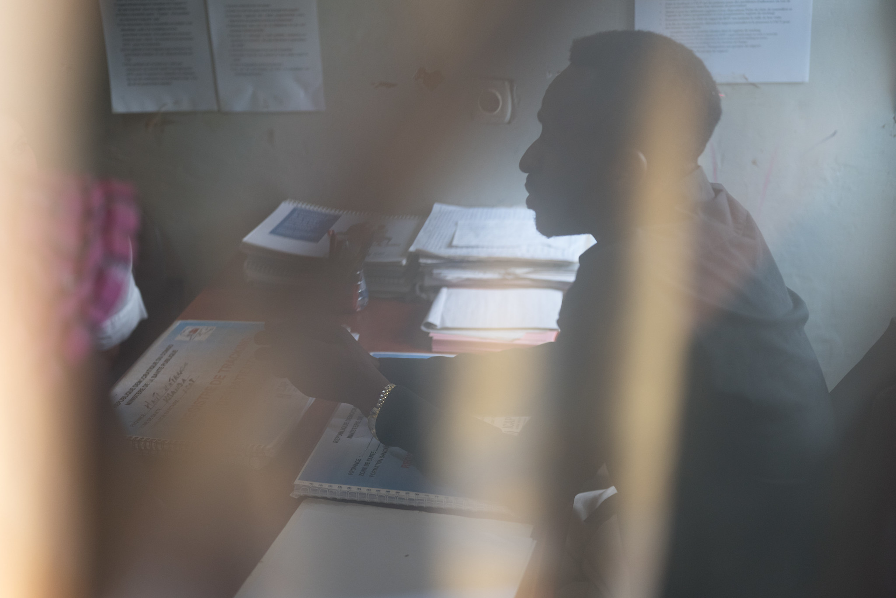
Case Scenario​
George returns to the clinic for a follow-up visit 1 month after starting oral ED-PrEP. His HIV test is negative today. ​
When should he take his next HIV test?​
What can you tell George about HIV self-testing? ​
Notes:
Facilitator guidance:
Explain to participants that a case scenario is provided for them to apply newly acquired knowledge to each step of the clinical pathway for oral ED-PrEP initiation according to their practice and local context.
Read the scenario and question on the slide asking participants, "When should he take his next HIV test? [Answer: 3 months later]
Prompt the participants with follow up questions, "What can you tell George about HIV self-testing? " [Answer: HIVST can be more convenient and protects privacy. For continuation, following a reactive HIVST, PrEP users should not discontinue PrEP and seek further testing by a trained provider immediately. Regular HIV testing is important while taking PrEP to identify an HIV infection as soon as possible.]
Ask participants to raise hands and share their answers.
Provide the answer and allow time for follow up question and discussion as needed.

Slide 104
Oral PrEP Follow-Up Visit Procedures​
Intervention​ | Schedule Following PrEP Initiation​
Confirmation of HIV-negative status | At one month follow-up ​ Every 3 months
Review the client’s HIV risk | Every visit
Address side effects | Every visit
Brief adherence evaluation and counseling | Every visit
Determine need for creatinine clearance evaluation​ | Every visit
Screening for HBV and HCV (optional) | Once within 3 months of initiation
Counsel on stopping/starting PrEP, AHI symptoms and advise to come back as soon as possible for evaluation if AHI symptoms occur.​ | Every visit
Provide STI screening, condoms and contraception. | Every visit, and as needed

Slide 105
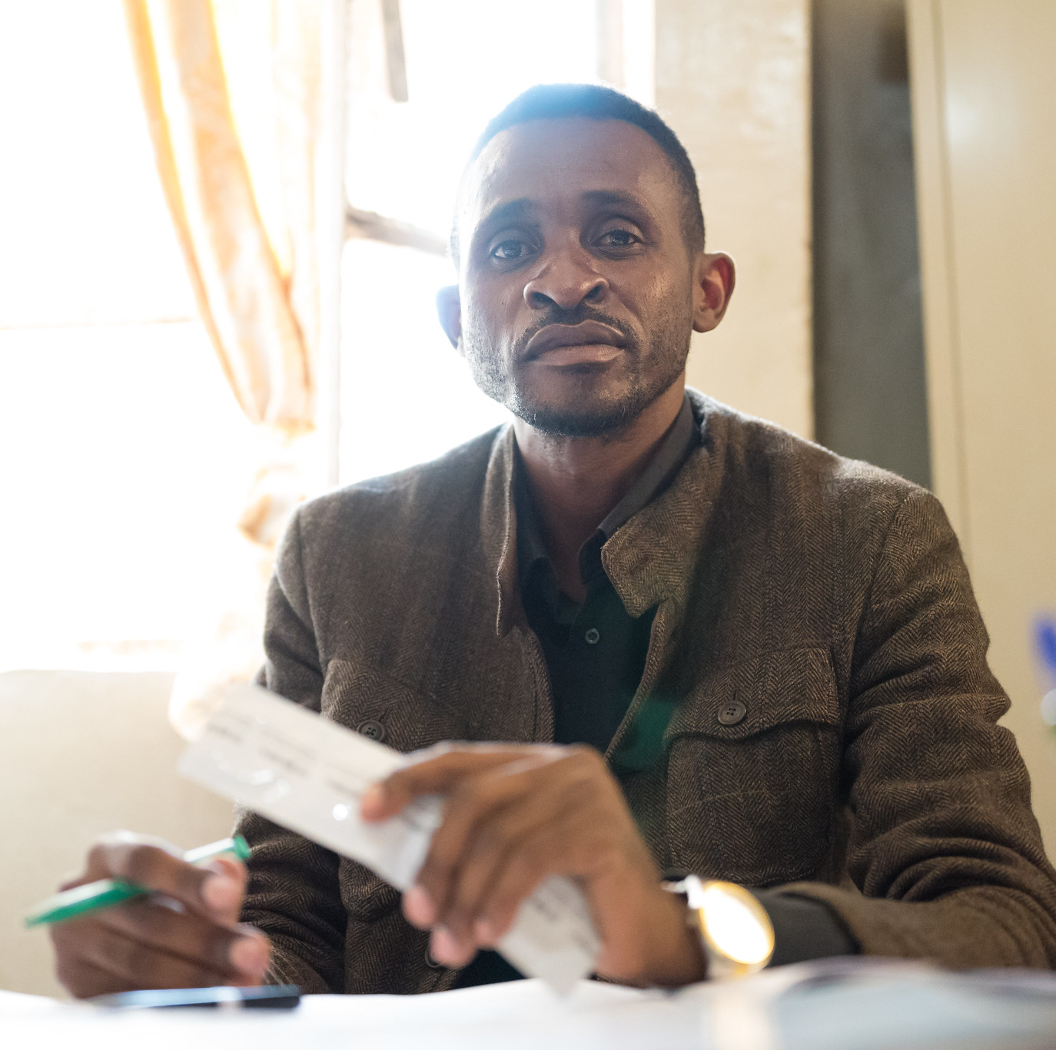
Case Scenario​
George tells you that he had sex last week with a new partner and that the condom broke. Afterward, the partner told him that he recently tested HIV positive. George does not know if the partner is taking ART. ​
Based on your screening, does George classify as substantial risk for HIV? ​
Notes:
Facilitator guidance:
Read the scenario and question on the slide asking participants, "Based on your screening, does George classify as substantial risk for HIV? [Answer: Yes]
Ask participants to raise hands and share their answers.
Continue to the following slide to provide the answer after receiving inputs from participants.

Slide 106
Step 2: Screen for Substantial Risk for HIV​
Does the client report any one of the following in the past six months?​
 | Sexual activity in a high HIV prevalence population or key population group
 | Vaginal or anal intercourse without condoms with more than one partner
 | Sex partner with one or more HIV risk factor
 | History of an STI (based on lab test, syndromic STI treatment, or self-report)
 | History of use of PEP
 | History of sharing of injection material and/or equipment with another person.
 | Having a sexual partner who is HIV positive and has been ART for less than 6 months or has inconsistent or unknown adherence
 | Asking for PrEP. This may indicate risk behavior they are unwilling to share.
Screen for substantial risk for HIV according to national guidelines. ​

Slide 107
Oral PrEP Follow-Up Visit Procedures​
Intervention​ | Schedule Following PrEP Initiation​
Confirmation of HIV-negative status | At one month follow-up ​ Every 3 months
Review the client’s HIV risk | Every visit
Address side effects | Every visit
Brief adherence evaluation and counseling | Every visit
Determine need for creatinine clearance evaluation​ | Every visit
Screening for HBV and HCV (optional) | Once within 3 months of initiation
Counsel on stopping/starting PrEP, AHI symptoms and advise to come back as soon as possible for evaluation if AHI symptoms occur.​ | Every visit
Provide STI screening, condoms and contraception. | Every visit, and as needed

Slide 108
Oral ED-PrEP Follow-Up Counseling​
What to discuss during follow-up visits
Current context of sexual health e.g., sexual and drug use behaviors
Non-PrEP sexual health protection strategies e.g., condom use
Assessment of continued risk of HIV and continuing need for PrEP
Intention to remain on PrEP
Facilitators and barriers to PrEP use
Adherence problems
Common adherence strategies
Challenges connected with PrEP use e.g., stigma
Alternative PrEP options, including daily oral PrEP if appropriate

Slide 109
Oral ED-PrEP Follow-Up Counseling​ (continued)​
What to discuss during follow-up visits​
Reasons for ongoing monitoring while on PrEP​
Dosing schedule for highest protection ​
How to recognize symptoms of AHI
Side effects and side effects management
Note: ED-PrEP is only appropriate for those exposed to HIV though sex. If a client reports exposure through injection drug use, they should be counseled on other HIV prevention methods and encouraged to choose another PrEP method such oral daily PrEP.

Slide 110
Assess Adherence​
Questions to help assess adherence
Did your normal routine change at all since the last time we met?​
Have there been times when you forgot to take your PrEP before you had sex?​
Have there been times when you forgot to take the daily pills after your ‘loading dose’?​
Have there been times when you could not predict when you would have sex?​
How many PrEP pills do you take in an average week? How many pills a month?​

Slide 111
Adherence Strategies​
Suggestions to improve adherence
Set reminders on the phone
Use a phone app to remind you
Carry pills with you
Plan to carry extra doses if going on vacation or to social event
Keep up with refill appointments and refills to always have a supply on hand

Slide 112
Additional Considerations with Sub-Optimal Adherence to ED-PrEP
In addition to adherence counseling, if a client reports sub-optimal ED-PrEP adherence providers should:​
Evaluate for AHI symptoms ​
Evaluate for any potential recent HIV exposure that would make them eligible for PEP​
Counsel clients on other prevention options, including other PrEP options such as daily oral PrEP dosing.

Slide 113
Additional Assessments During Follow-Up Visits for ED-PrEP​
Assess any switching between ED-PrEP and daily PrEP
Assess if ED-PrEP continues to be an appropriate PrEP choice​
Discuss adherence to ED-PrEP dosing; assess if daily PrEP is more appropriate
Need for refills ​

Slide 114
Case Scenario​
George tells you that he did not take PrEP the last time he had sex because he went away for the weekend and did not take the pills with him as he was not expecting to have sex.
What suggestions could you make to support George's adherence? ​
Notes:
Facilitator guidance:
Read the scenario and question on the slide asking participants, "What suggestions could you make to support George's adherence?" [Answer: Suggestions to improve adherence: Carry pills with you. Plan to carry extra doses if going away for the weekend just in case.]
Ask participants to raise hands and share their answers.
Provide the answer and allow time for follow up question and discussion as needed.

Slide 115
Oral PrEP Follow-Up Visit Procedures​
Intervention​ | Schedule Following PrEP Initiation​
Confirmation of HIV-negative status | At one month follow-up ​ Every 3 months
Review the client’s HIV risk | Every visit
Address side effects | Every visit
Brief adherence evaluation and counseling | Every visit
Determine need for creatinine clearance evaluation​ | Every visit
Screening for HBV and HCV (optional) | Once within 3 months of initiation
Counsel on stopping/starting PrEP, AHI symptoms and advise to come back as soon as possible for evaluation if AHI symptoms occur.​ | Every visit
Provide STI screening, condoms and contraception. | Every visit, and as needed

Slide 116
Decision Algorithm for Kidney Function Monitoring During Oral PrEP Follow-up Visits​
Does the individual have any known kidney-related co-morbidities (e.g., diabetes or hypertension)? ​
YES
NO
What age is the individual?​
<50 years​
50+ years​
Evaluate CrCl every 6-12 months ​
NO
Was a baseline CrCl
estimation done?​
What age is the individual?​
30+ years​
<30 years​
YES
≥90ml/min​
<90ml/min​
Evaluate
CrCl once​
CrCl optional​

Slide 117
Monitoring Creatinine Results​
Impaired kidney function is a contraindication for the use of TDF-based oral PrEP​.
  Defined as an eGFR or an estimated CrCl of <60 ml/min
Before stopping oral PrEP due to reduced kidney function, the kidney function test should be repeated on another day. ​
Creatinine elevations usually reverse after stopping PrEP.​
Other HIV prevention options should be discussed with clients when stopping PrEP. ​

Slide 118
Managing Creatinine Elevation​
Stop PrEP if creatinine elevation is confirmed on a separate specimen and if estimated creatinine clearance decreases to <60 ml/min.​
After PrEP is stopped, creatinine should be checked for another 1 to 3 months and PrEP can be restarted if eGFR returns to >60 ml/min.​
Consider additional causes and management of creatinine elevations if:​
  Creatinine elevation reaches more than 3 times the baseline
  Renal function or creatinine elevations do not return to normal levels within 3 months after stopping PrEP
Common causes of chronic or severe renal insufficiency include diabetes, uncontrolled hypertension, hepatitis C infection, and liver failure.

Slide 119

Case Scenario​
George is 28 years old and was diagnosed with type 1 diabetes as a child.
Should he have kidney function monitoring while using PrEP?
When should the tests be done?
How would you identify and manage creatinine elevation?​
Notes:
Facilitator guidance:
Read the scenario and question on the slide asking participants, "Should he have kidney function monitoring while using PrEP?" [Answer: Yes, because he has diabetes, which is a condition known to affect kidney function]
Ask "When should the tests be done?" [Answer: Every 6-12 months is recommended for someone with his condition]
Ask "How would you identify and manage creatinine elevation?" [Answer: Impaired kidney function is defined as eGFR or an estimated CrCl of <60 ml/min, and is a contraindication for the use of TDF-based oral PrEP. Before stopping oral PrEP due to reduced kidney function, the kidney function test should be repeated on another day. Stop PrEP if creatinine elevation is confirmed on a separate specimen and if estimated creatinine clearance decreases to <60 ml/min. After PrEP is stopped, creatinine should be checked for another 1 to 3 months and PrEP can be restarted if eGFR returns to >60 ml/min. Other HIV prevention options should be discussed with clients when stopping PrEP.]
Ask participants to raise hands and share their answers.
Review previous slides to provide the answer after receiving inputs from participants.

Slide 120
Oral PrEP Follow-Up Visit Procedures​
Intervention​ | Schedule Following PrEP Initiation​
Confirmation of HIV-negative status | At one month follow-up ​ Every 3 months
Review the client’s HIV risk | Every visit
Address side effects | Every visit
Brief adherence evaluation and counseling | Every visit
Determine need for creatinine clearance evaluation​ | Every visit
Screening for HBV and HCV (optional) | Once within 3 months of initiation
Counsel on stopping/starting PrEP, AHI symptoms and advise to come back as soon as possible for evaluation if AHI symptoms occur.​ | Every visit
Provide STI screening, condoms and contraception. | Every visit, and as needed

Slide 121
Case Scenario​
George did not get HBsAg testing when he initiated PrEP and your clinic cannot provide it for him today.
Can he continue taking oral PrEP?
Are there any other screenings you can offer Joseph today?
What other counseling would you provide?​
Notes:
Facilitator guidance:
Read the scenario and question on the slide asking participants, "Can he continue taking oral PrEP?" [Answer: Yes. Screening for HBV is optional and can be done within 3 months after starting PrEP. George started taking PrEP one month ago so can still be screened for HBV at a later visit and lack of HBV screening availability should not prevent him from continuing PrEP.]
Ask "Are there any other screenings you can offer Joseph today? [Answer: STI screenings should be provided at every visit as needed.]
Ask "What other counseling would you provide? [Answer: Counseling should be provided at every visit on stopping and starting PrEP, AHI symptoms and advising him to come back as soon as possible if AHI symptoms occur.]
Ask participants to raise hands and share their answers.
Review previous slides to provide the answer after receiving inputs from participants.

Slide 122
Alternative PrEP Options
Based on availability and eligibility, it may be appropriate to discuss other PrEP options.​
Consider offering other PrEP options based on any challenges or preferences expressed​
Challenges | Alternative PrEP Option​
Frequent or unpredictable sexual risk behavior​ | Oral daily PrEP​ CAB-LA​
Difficulty with adhering to dosing schedule ​ | Oral daily PrEP​ CAB-LA​
Desire for more discrete options​ | CAB-LA​
For more information on PrEP options see Module 1 and Module 6​

Slide 123
PrEP Dispensing During ED-PrEP Follow-up Visits​
Clients opting for ED-PrEP should be given enough pills for daily use until their next visit.​
Clients may not use all these pills and may not require a full refill at follow-up visits.​
Instruct clients on how to check bottles for expiration dates and inform them not to take expired pills.​
Ask about any usable, unopened pill bottles they still have at home. ​
The number of bottles dispensed will depend on the number of usable, unopened bottles a client has at home and the amount of time until the next visit.​

Slide 124
Case Scenario​
You provide George with counseling on AHI, STI screening and condoms.
George he says he is probably going to start having sex more often, probably a few times a week.
Would you consider counseling George on switching from ED-PrEP to another option? ​
Notes:
Facilitator guidance:
Read the scenario and question on the slide asking participants, "Would you consider counseling George on switching from ED-PrEP to another option? " [Answer: Since George is planning to have more frequent sex, he can consider alternative PrEP options including oral daily PrEP or CAB-LA, if it is available. He can switch to oral daily PrEP whenever he needs to and can go back to ED-PrEP if his behavior changes, so this many be the best option for him]
Ask participants to raise hands and share their answers.
Review previous slides to provide the answer after receiving inputs from participants.

Slide 125
How do you conduct follow-up visits for oral ED-PrEP management in your setting?​
Do you have any experience to share? ​
Do you have any comments or questions? ​
DISCUSSION​
Notes:
Facilitator guidance:
• Time: 10 minutes
• Explain that participants who want to speak should raise their hands.
• Keep the discussion on target and moving along.
• Encourage everyone to participate and call on everyone who raises a hand.
• Ask questions to encourage more responses to a question—for example: “What else?” “What other ideas do you have?”
• Wrap up the discussion by repeating and summarizing main points

Slide 126
Summary​

Slide 127
Module 3 Summary​
ED-PrEP can be used by HIV-negative persons to reduce the risk of HIV infection.​
ED-PrEP with TDF/FTC is currently recommended for certain groups. ​
ED-PrEP should be taken as an additional prevention intervention. ​
ED-PrEP is effective if taken correctly around sexual exposure.
ED-PrEP can be used by most people assigned male sex at birth who are HIV negative.
ED-PrEP is safe and has minimal side effects.​
Clients can switch between oral ED-PrEP and oral daily PrEP.

Slide 128
Module 3 Learning Objectives​
Review the learning objectives from this module. After completing Module 3, how confident do you feel to do the following? ​
Define oral ED-PrEP
Define the eligible and ineligible populations for oral ED-PrEP
Identify good candidates for oral ED-PrEP
Describe advantages and disadvantages of oral ED-PrEP
Counsel clients on how to take oral ED-PrEP effectively
Describe the process for switching between oral ED-PrEP and oral daily PrEP
Specify the procedures for initiating oral ED-PrEP
Conduct effective monitoring visits for ED-PrEP​

Slide 129
Share your experience with this module.
What did you learn?
What did you find helpful?
What will you implement in your practice?
Do you have any questions?
DISCUSSION​
Notes:
Facilitator guidance:
• Time: 10 minutes
• Explain that participants who want to speak should raise their hands.
• Keep the discussion on target and moving along.
• Encourage everyone to participate and call on everyone who raises a hand.
• Ask questions to encourage more responses to a question—for example: “What else?” “What other ideas do you have?”
• Wrap up the discussion by repeating and summarizing main points.

Slide 130
Oral ED-PrEP Resources for Providers
World Health Organization. What’s the 2+1+1? Event-driven oral pre-exposure prophylaxis to prevent HIV for men who have sex with men: Update to WHO’s recommendation on oral PrEP. Geneva: WHO; 2019
World Health Organization. Differentiated and simplified pre-exposure prophylaxis for HIV prevention: update to WHO implementation guidance. Technical Brief. Geneva: WHO; 2022
Meeting Targets and Maintaining Epidemic Control (EpiC) project training, available at prepwatch.org/resources/oral-prep-training-for-providers

Slide 131
References
Reports
What’s the 2+1+1? Event-driven oral pre-exposure prophylaxis to prevent HIV for men who have sex with men: Update to WHO’s recommendation on oral PrEP. Geneva: World Health Organization; 2019 (WHO/CDS/HIV/19.8). Licence: CC BY-NC-SA 3.0 IGO.
Differentiated and simplified pre-exposure prophylaxis for HIV prevention: update to WHO implementation guidance. Technical Brief. Geneva: World Health Organization; 2022. License: CC BY-NC-SA 3.0 IGO.
Articles
Molina J, Capitant C, Spire B, et al. On-demand preexposure prophylaxis in men at high risk for HIV-1 infection. N Engl J Med. 2015;373(23):2237-2246
Molina J, Ghosn J, Assoumou L, et al. Daily and on-demand HIV pre-exposure prophylaxis with emtricitabine and tenofovir disoproxil (ANRS PREVENIR): A prospective observational cohort study. Lancet HIV. 2022;9(8):e554-e562.

Slide 132

Thank You

Slide 133
Acknowledgements
This package is a product of the Clinical and Laboratory Unit of ICAP at Columbia University. The material was conceptualized, designed and developed by Cassia Wells, with support from Julie Franks and technical input from Ellen Morrison, Andrea Howard and Gillian Doherty. Formatting and graphic design was provided by the ICAP Communications Team.
Portions of this training updated and modified previous PrEP package material developed by ICAP at Columbia University in collaboration with the U.S. Centers for Disease Control and Prevention (CDC), with funding from the U.S. President’s Plan for AIDS Relief (PEPFAR) under the terms of cooperative agreement #U2GGH000994.
Some technical content in this module was informed by training developed by the Meeting Targets and Maintaining Epidemic Control (EpiC) project as part of a global cooperative agreement (7200AA19CA00002) led by FHI 360 with core partners Right to Care, Palladium International, Population Services International (PSI), and Gobee Group.
Its contents are solely the responsibility of the authors and do not necessarily represent the views of the U.S. Government or other organizations.

