Slide 1
Pre-Exposure Prophylaxis (PrEP) Training for Providers in Clinical Settings
Module 1: PrEP Basics
Last update: September 2023​

Slide 2

Welcome!​
We are excited for you to join us in learning to provide pre-exposure prophylaxis (PrEP) to prevent HIV in clinical settings. Thank you for the important work you are doing to prevent the spread of HIV and empower people with choices to live healthy lives. ​

Slide 3


Slide 4

What is included in this training? ​
Oral PrEP
MODULE 1: PrEP Basics ​
MODULE 2: Oral Daily PrEP​
MODULE 3: Oral Event-Driven PrEP (ED-PrEP)​
MODULE 4: Injectable Long-Acting
Cabotegravir (CAB-LA)​
MODULE 5: Dapivirine Vaginal Ring (DVR)​
MODULE 6: Person-Centered PrEP Counseling
PrEP Vaginal Ring
Injectable PrEP

Slide 5
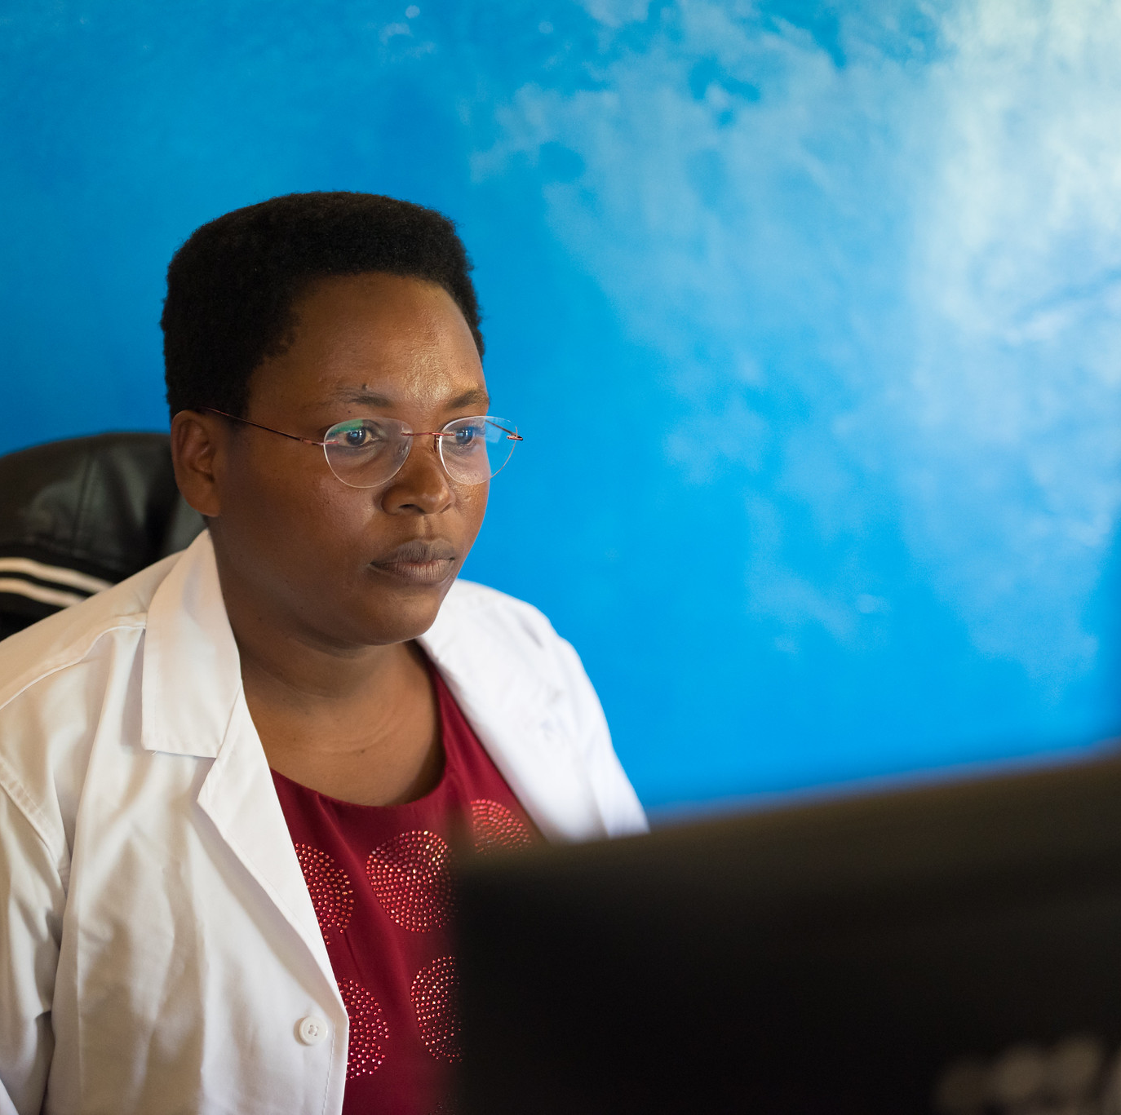
PrEP Competencies​
By the end of this training program, you should be able to:​
Explain the use of PrEP for HIV prevention​
Identify candidates eligible for PrEP​
Initiate clients on PrEP​
Conduct follow-up management for PrEP ​
Provide person-centered counseling for PrEP​

Slide 6
Symbols Key​
Preliminary recommendation based on available evidence and may change​
Adaptation required or suggested based on local context​
Content repeated in other modules​
Unknown at the moment, more information required​

Slide 7

Learning Activities​
Question & answer​
Fill in the blank​
Review national guidelines​
Case scenario​
Discussion​
Share experiences​
Notes:
Facilitator guidance:
This training is designed to be interactive and to engage participants in learning and knowledge sharing. Rather than simply lecturing to participants, we encourage facilitators to use a variety of participatory methodologies, including question and answer, discussion, case scenarios, role-play, and other small group activities. These activities are provided for you and were designed to elicit and build on participants’ experience and knowledge, to promote discussion and reflection on key issues, to provide hands-on practice of content learned, and to help participants learn from one another. In addition, these participatory methodologies promote higher retention of content and create an open, engaging, and supportive learning environment.
Review the learning activities in advance to facilitation:
Question & Answer
Questions and answers are included throughout the module to keep learners engaged and actively participating. Q&A are offered to encourage participants to reflect on their existing knowledge before a new topic is introduced. Q&A are also offered after lecture content is delivered to test participants knowledge recall.
How To Facilitate Q&A
Read the question on the slide.
Ask participants to raise their hands to answer the question.
Take a few volunteer responses.
Reveal the answer on the following slide.
Allow time for follow-up discussion as needed (see below).
2. Discussion
A discussion is a dialogue between participants and the trainer, with participants responding to discussion questions and to one another’s ideas. During discussions, new questions may surface. When the trainer leads a large group discussion, she or he must manage the discussion by keeping participants focused, actively eliciting responses, and limiting participants who like to talk a lot. When participants have small group discussions, they must do likewise.
How To Facilitate Discussion
• Set a time limit and keep track of time.
• Explain that participants who want to speak should raise their hands.
• Keep the discussion on target and moving along.
• Encourage everyone to participate and call on everyone who raises a hand.
• Limit participants who like to talk a lot.
• Ask questions to encourage more responses to a question—for example: “What else?” “What other ideas do you have?”
• Wrap up the discussion by repeating and summarizing main points.
3. Case scenarios
A case scenario is a brief description of a realistic situation that participants discuss and analyze. Case scenarios give participants the opportunity to apply newly acquired knowledge to a particular problem or situation and to generate possible solutions to challenges presented in the scenario.
How to Facilitate Case Scenarios
• If participants will use the scenario in small groups or pairs, give clear instructions.
• If you write your own scenarios, make them simple and brief. Use realistic situations similar to those that participants face. Give essential information and leave out unnecessary details.
• Provide questions to guide participants in analyzing the scenario and a list of essential points to be covered in discussion for yourself and co-trainers.
4. Role Play
A role-play is a brief informal performance where participants act out roles in order to practice handling a particular problem or situation and to experience what it is like to be in those roles. Role-playing is informal; participants do not need to memorize dialogue or perform perfectly— the point is to experience the situation and learn from that experience.
How To Facilitate a Role-Play
• Give clear instructions for the role-play
• Set a time limit for role-play practice and performance, and manage the time well.
• Remind participants that role-playing does not require a perfect performance but rather provides an opportunity to practice handling real-life situations. It is fine to make mistakes during role-play.
• Debrief the role-play with a large group discussion
5. Small group activities
The facilitator divides participants into small groups to do a learning activity. Examples of small group activities include discussions, scenarios, and role-play practice as described above. Small groups allow each person to participate more than they would in the large group. Small group work also helps participants get to know one another and work with new colleagues.
How To Facilitate Small Group Work
• Before you divide participants into small groups, give clear instructions for the small group task.
• Group participants so that they are not always working with people they know well. To vary groups’ composition: Ask participants to count off or draw at random from a deck of playing cards and then group by suit or numbers. Or ask participants to draw at random from a container of colored objects or slips of paper and then group by colors. Or group participants by birthday (seasons or months), by first letter of first or last name, by last digit of their phone number, or by height—then, based on how many fall into each category, regroup these groups so that you have groups of an optimal size.
• Instruct the groups to make sure that all group members participate.
• Have each group choose a timekeeper.
• Keep track of time yourself and provide half-time, 5-minute, and 1-minute warnings.
• As the groups are working, move from one to another to make sure that participants have understood the task and are making progress.

Slide 8
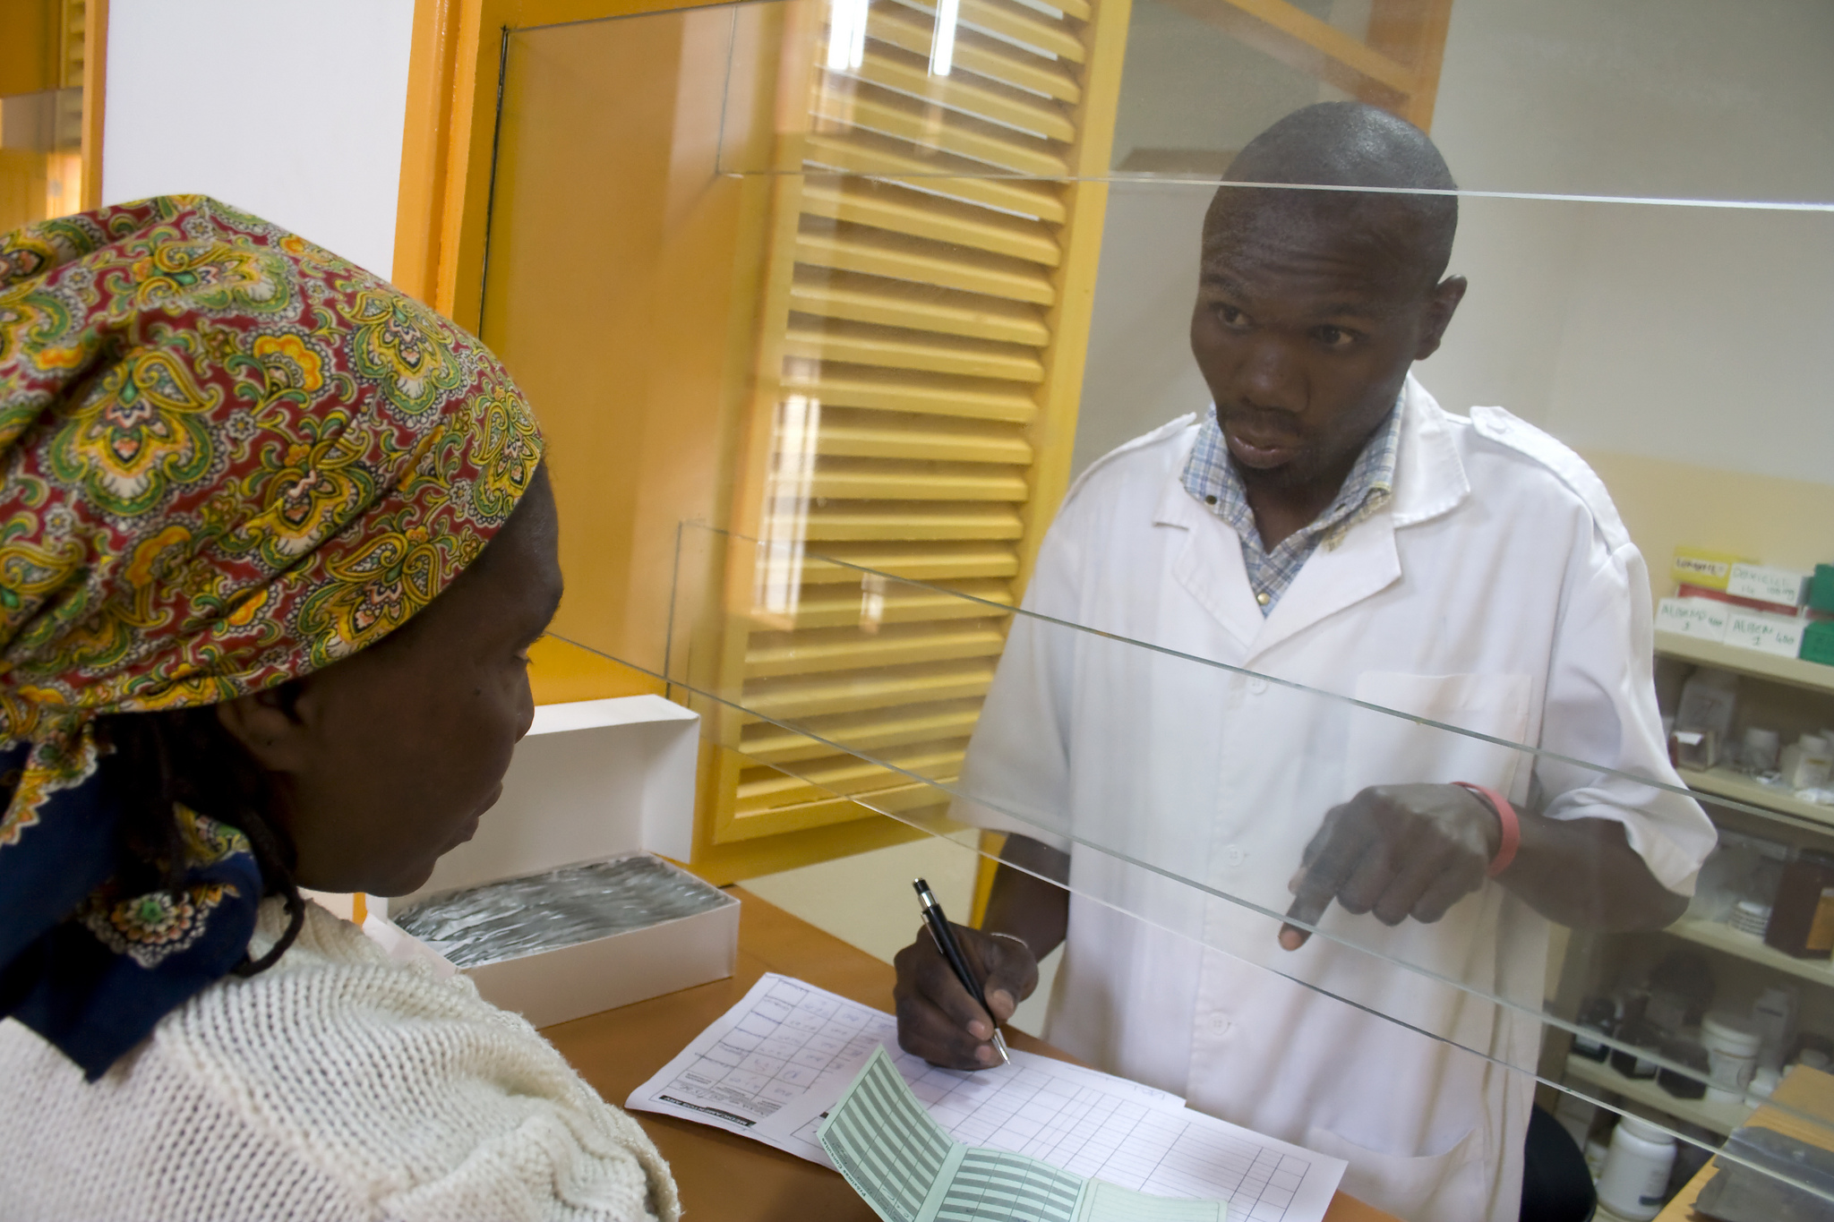
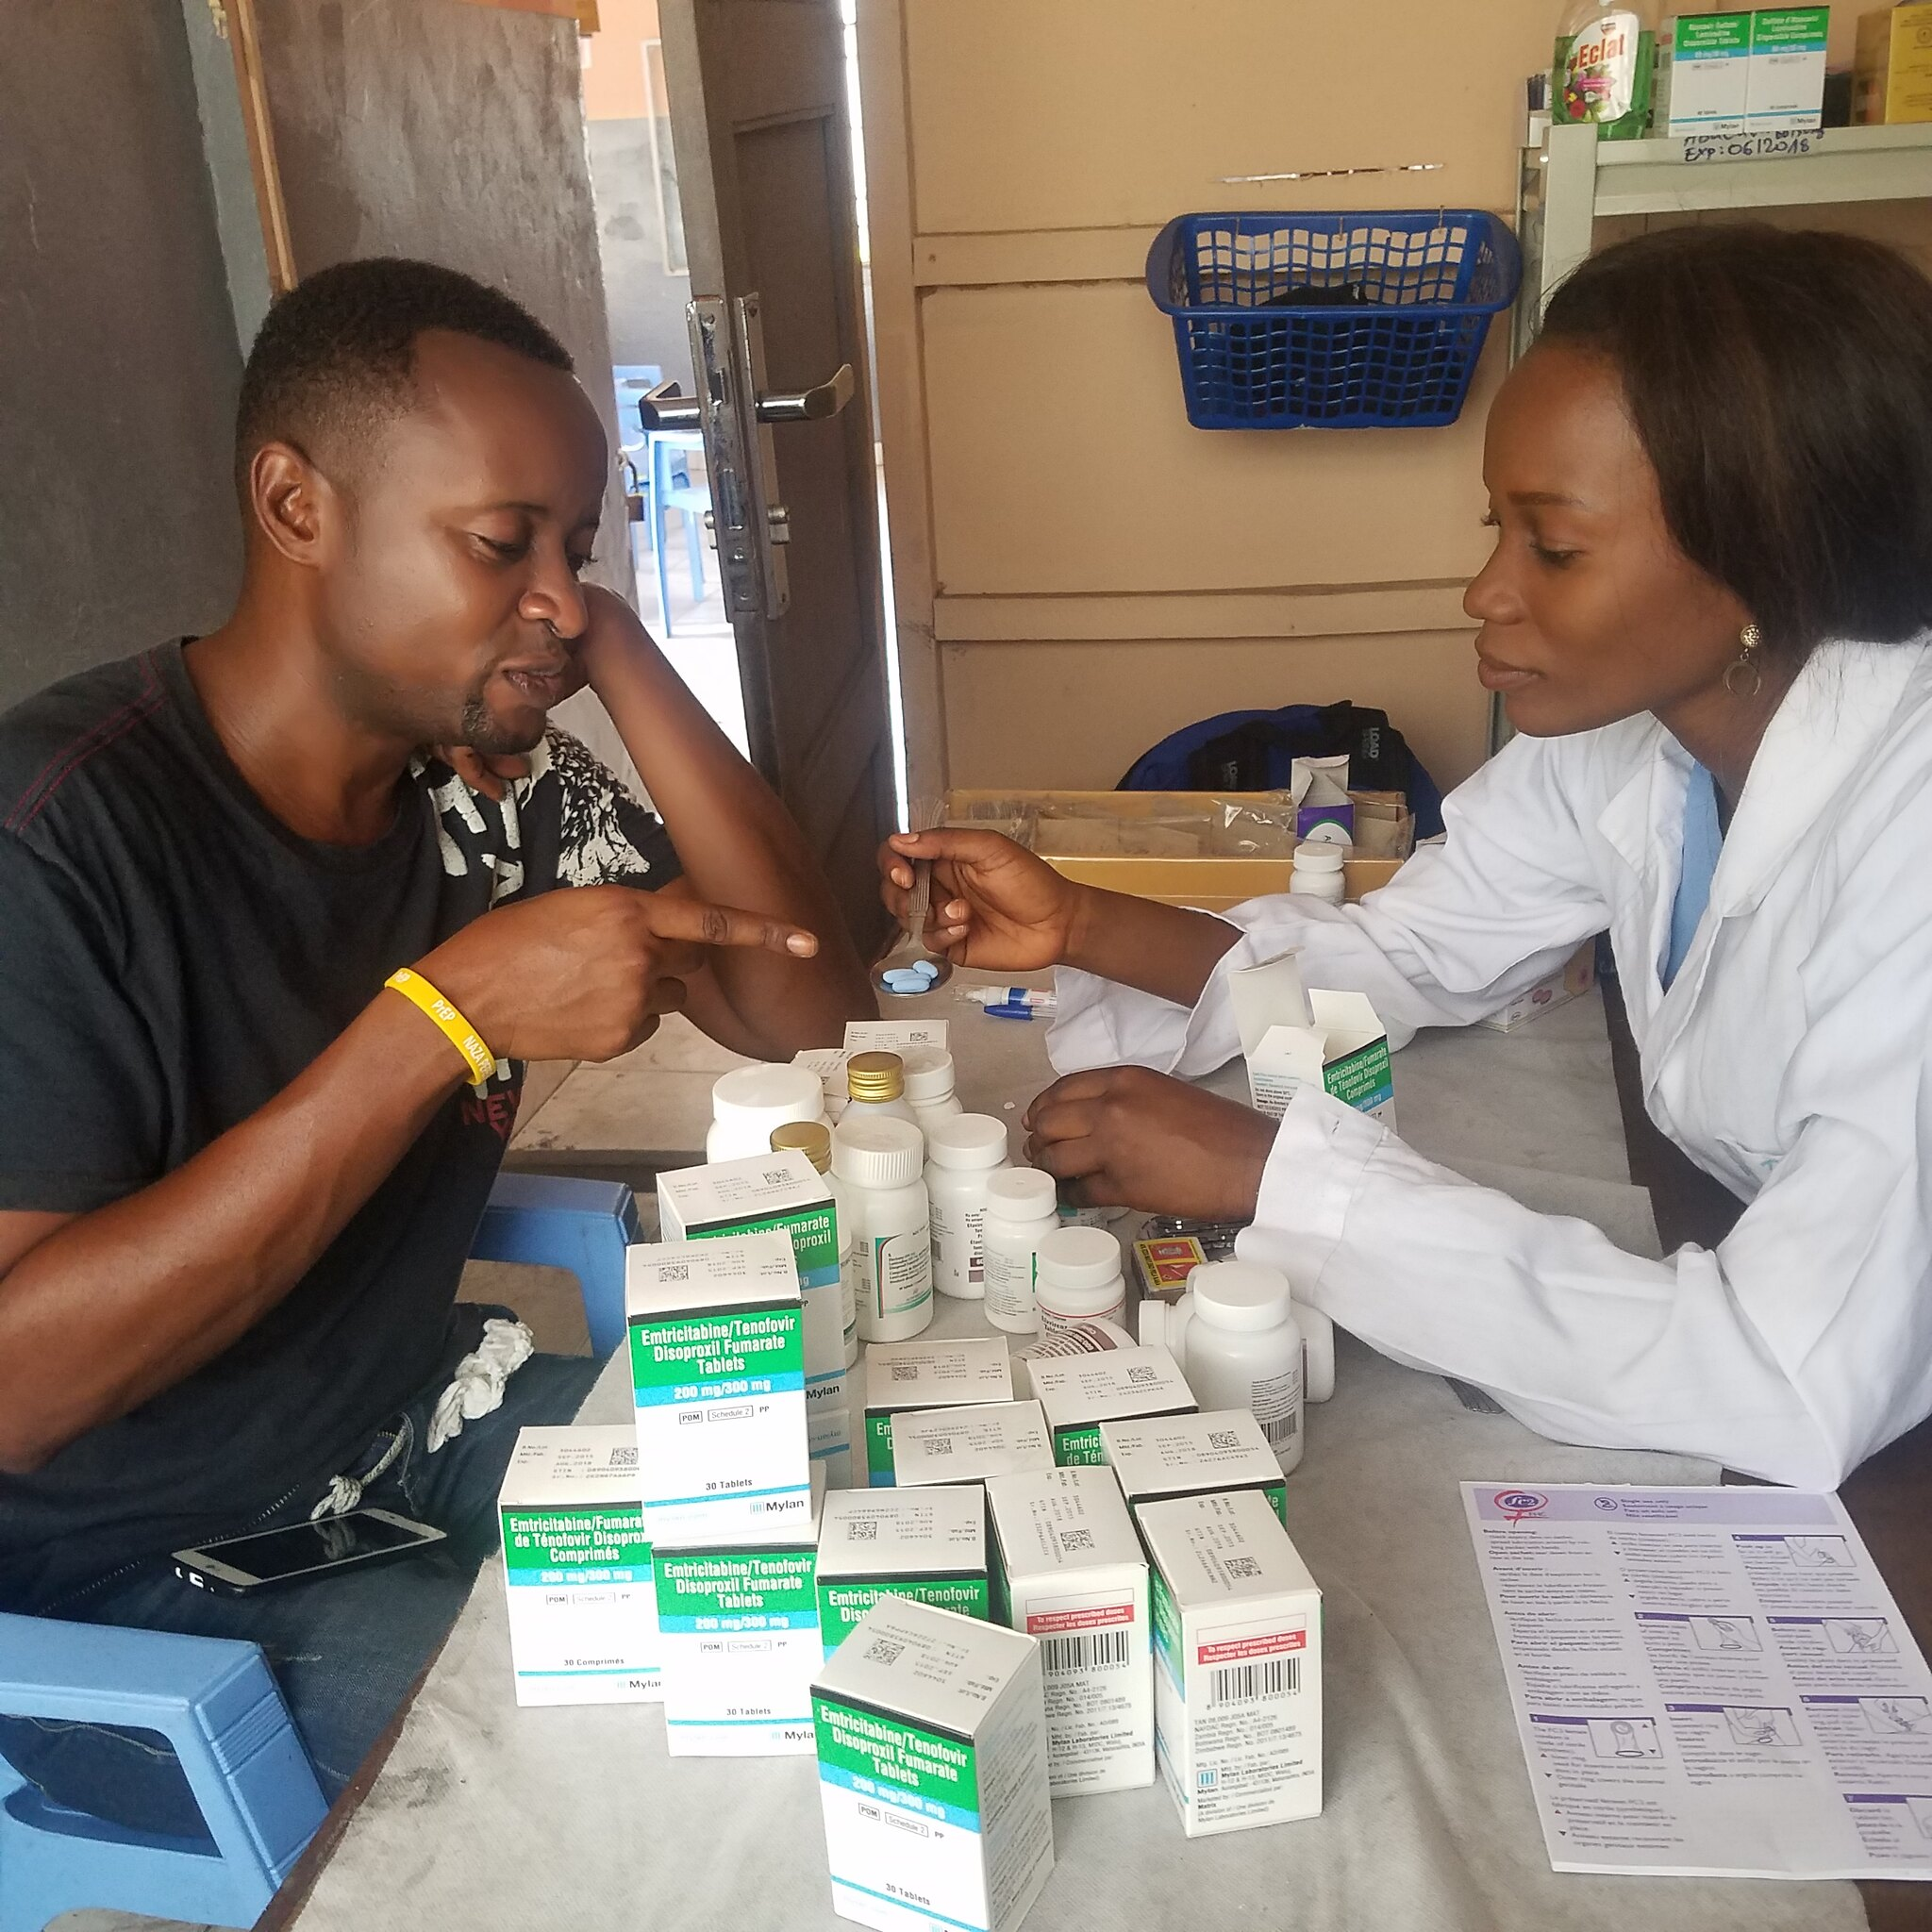
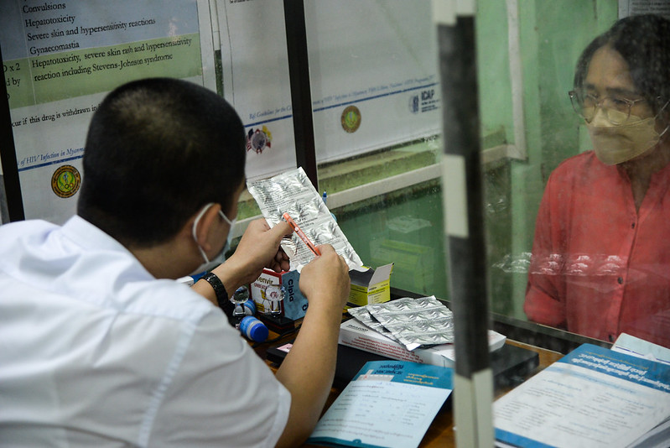
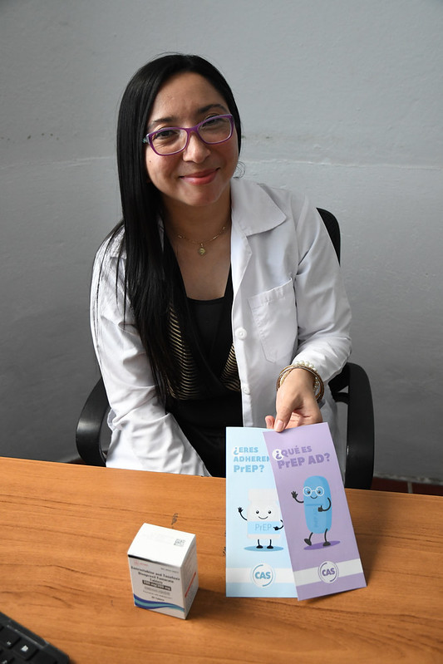
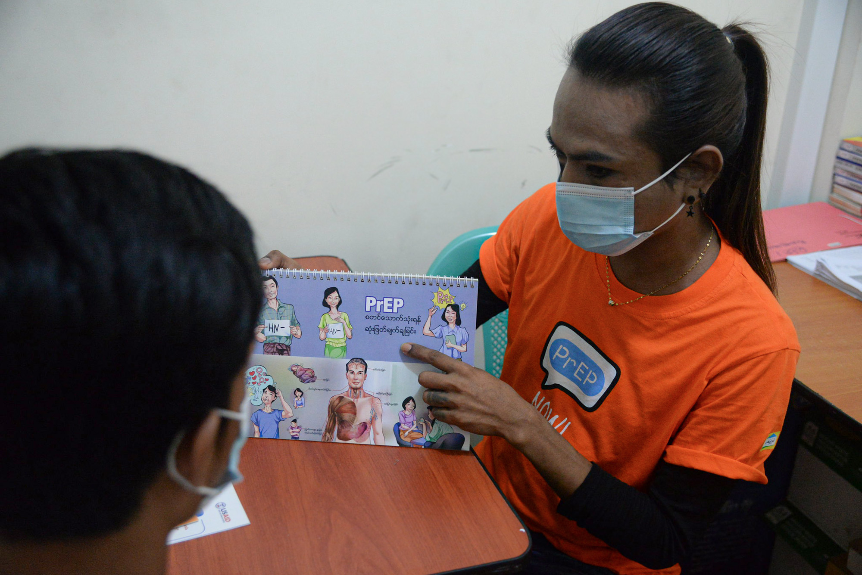
DISCUSSION​
What is YOUR EXPERIENCE as a provider of PrEP?​
What successes and challenges with PrEP can you share?​
What are you most excited to learn in this training? ​
Notes:
Facilitator guidance:
• Time: 10-20 minutes. Timing will vary based on size of the group and time allowed for training. Set a time limit and keep track of time.
• Explain that participants who want to speak should raise their hands.
• Keep the discussion on target and moving along.
• Encourage everyone to participate and call on everyone who raises a hand.
• Limit participants who like to talk a lot.
• Ask questions to encourage more responses to a question—for example: “What else?” “What other ideas do you have?”
• Wrap up the discussion by repeating and summarizing main points.

Slide 9
Module 1: PrEP Basics​

Slide 10
Introduction​
In this module we will introduce the basics of PrEP including: ​
Overview: What is PrEP, why is it needed, and what is recommended.​
Eligibility: Who can take PrEP and how you can identify people eligible for PrEP.​
Options: What products are available, comparing eligibility, administration route, frequency, efficacy, side effects, and follow up.​
Service Delivery: How PrEP can be integrated within combination HIV prevention, differentiated service delivery, and person-centered care. ​
Common Questions: How to address commonly asked questions about PrEP.​

Slide 11
Module 1: Learning Objectives​
After completing this module, you will be able to:​
Define PrEP and differentiate PrEP from post-exposure prophylaxis (PEP) and antiretroviral therapy (ART)
Describe the need for PrEP
Identify key populations and priority populations for PrEP at the local level
Specify PrEP products recommended by the World Health Organization (WHO) and within your own country
Describe the similarities and differences between available PrEP products
Name the 5 main eligibility criteria for PrEP
Explain how to exclude acute HIV infection (AHI)​
Identify people at risk for HIV infection
Answer common questions regarding PrEP implementation

Slide 12
1.1 Introduction to PrEP​

Slide 13
QUESTION
What is PrEP?
Notes:
Facilitator guidance:
Read the question on the slide.
Ask participants to raise their hands to answer the question.
Take a few volunteer responses.
Reveal the answer on the following slide.
Allow time for follow-up discussion as needed.

Slide 14
ANSWER
PrEP is the use of antiretrovirals (ARVs) by HIV negative people before exposure to HIV, to PREVENT HIV infection. ​
PrEP is an additional tool for HIV prevention​
PrEP is different from post-exposure prophylaxis (PEP) and antiretroviral therapy (ART)​
Notes:
Facilitator guidance:
Reveal the answer on the slide.
Allow time for questions and follow-up discussion as needed.

Slide 15
Pre-Exposure Prophylaxis (PrEP)​
PrEP is the ongoing use of ARVs by people who are HIV negative,​ BEFORE potential exposure to the virus,​ to prevent HIV infection.​
Pre | Before
Exposure | Activity that can lead to HIV infection
Prophylaxis | Prevention

Slide 16
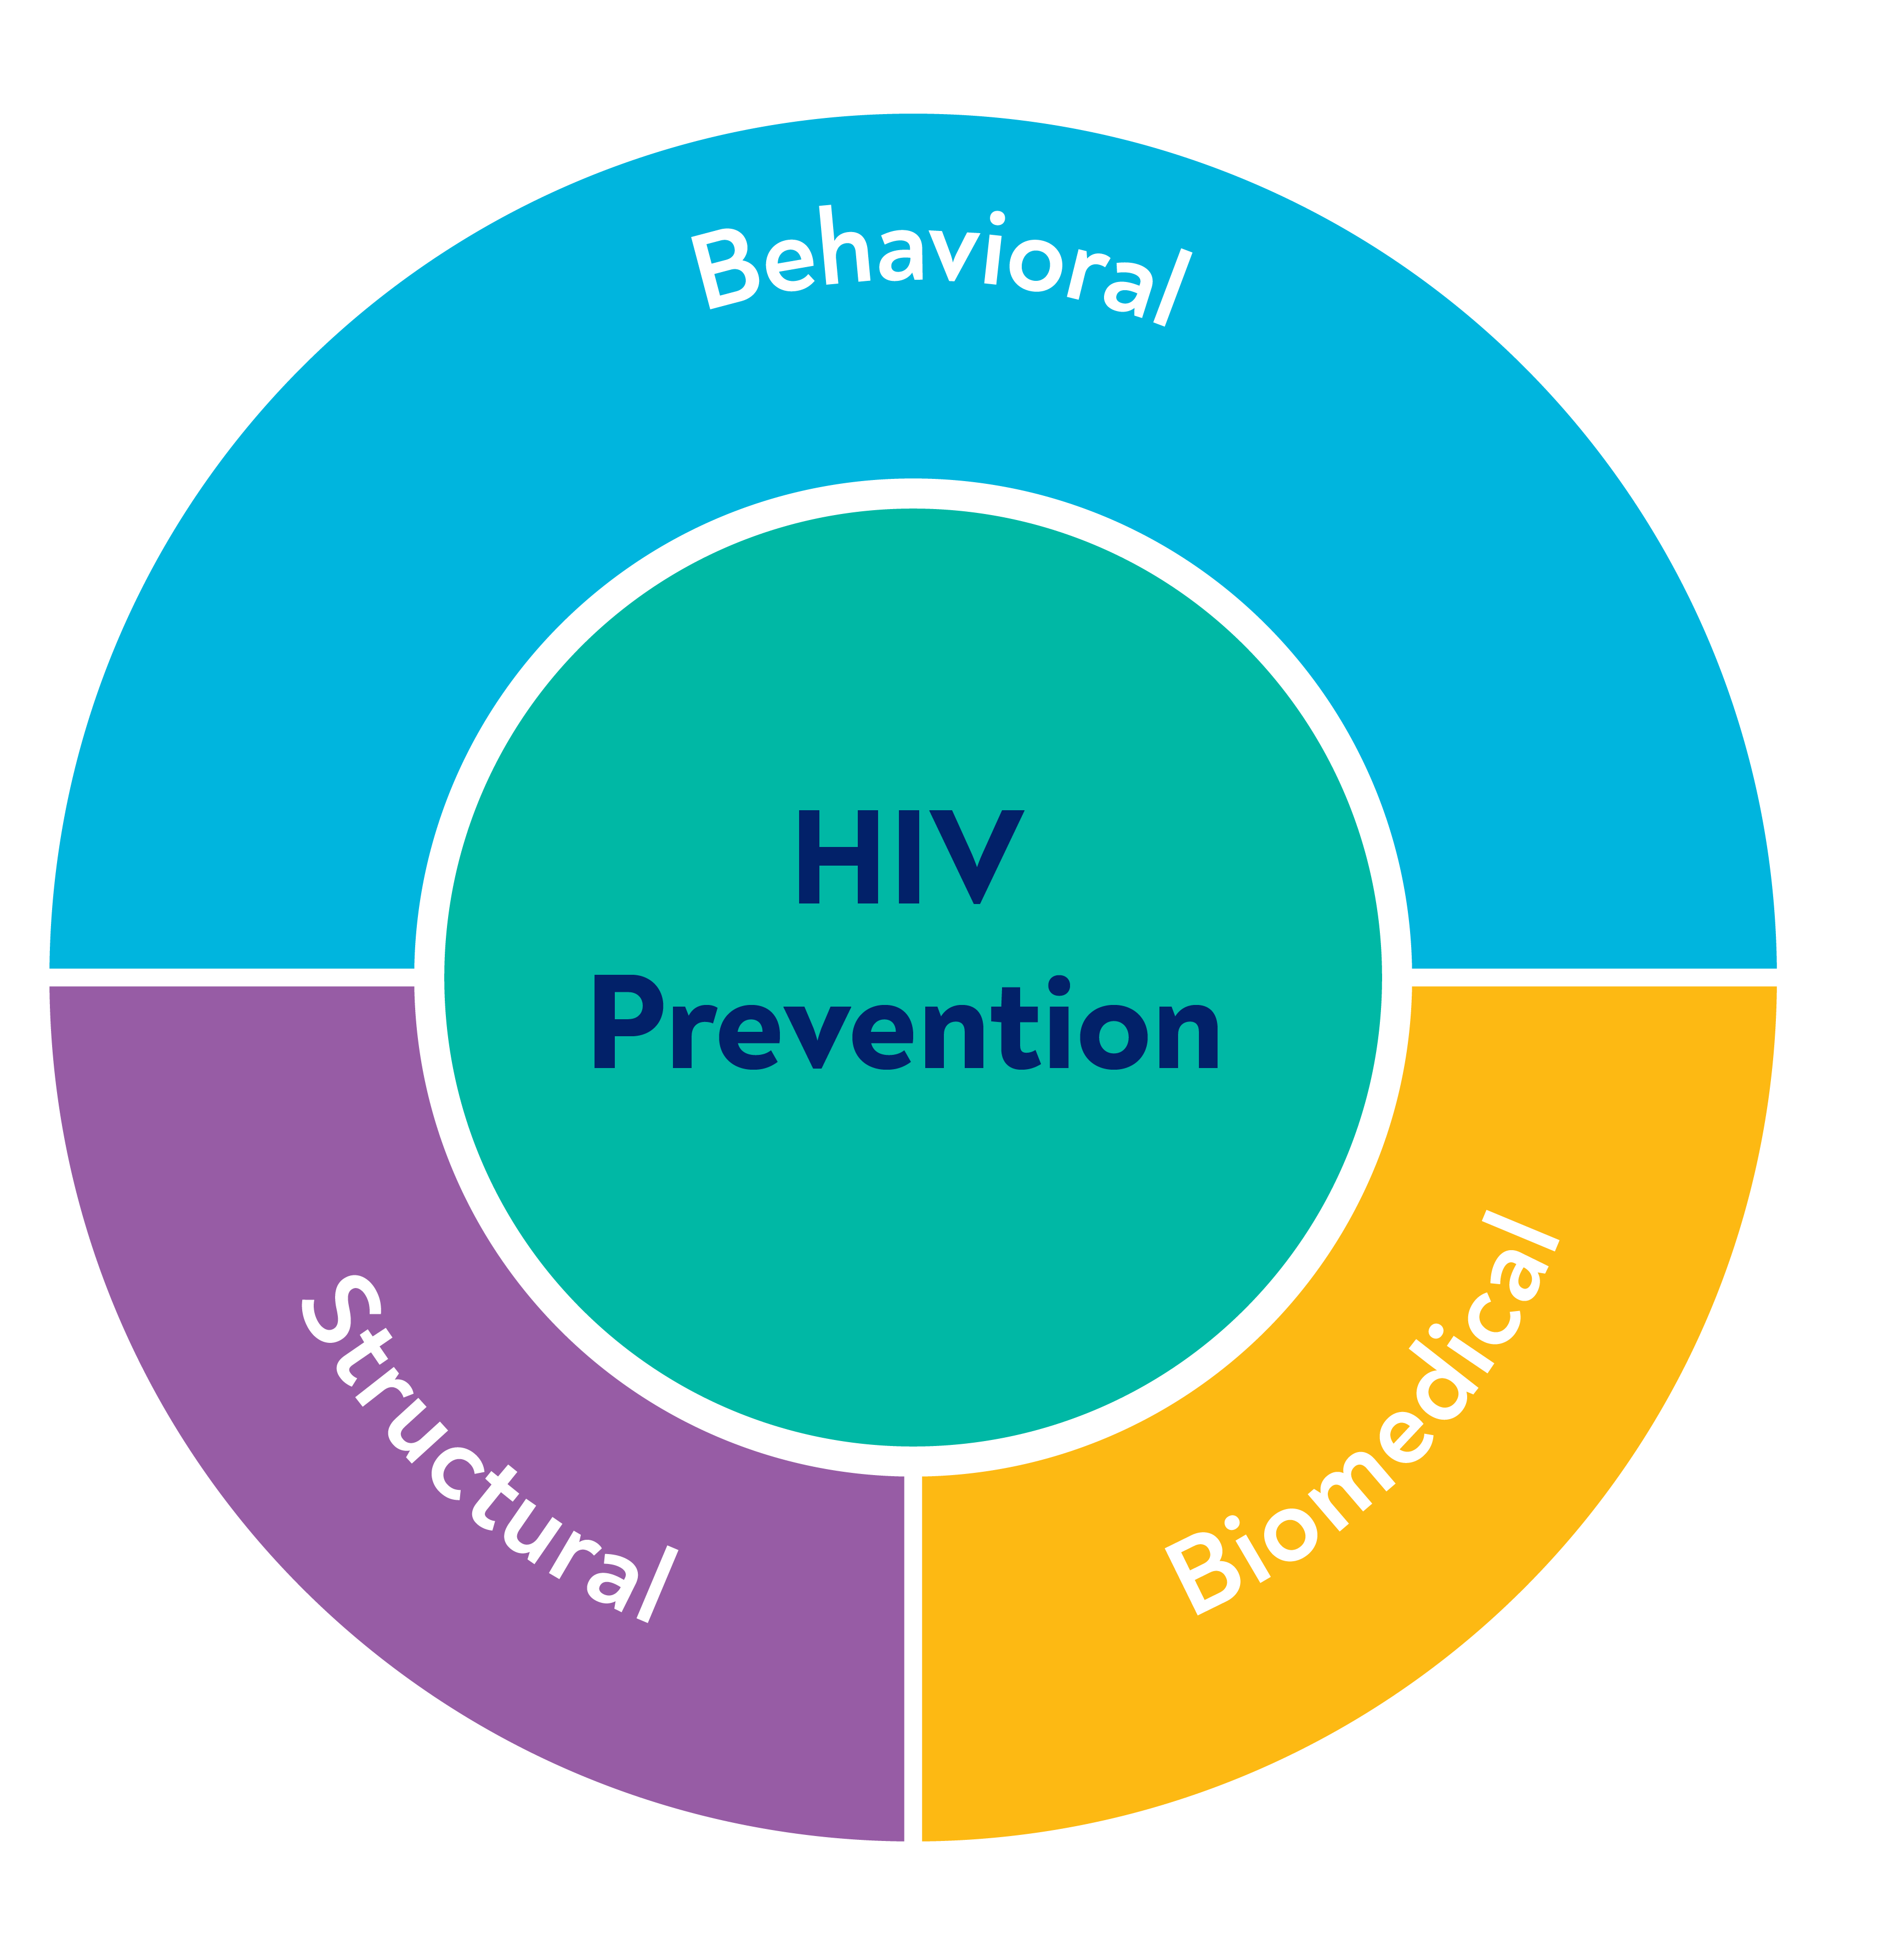
Combination HIV Prevention​
Behavioral​
Education​
Counseling​
Stigma reduction​
Harm reduction​
Adherence support
Biomedical
HIV testing​
Condoms​
Voluntary medical male circumcision
Prevention of mother-to-child transmission
Sexually transmitted infection (STI) treatment​
PEP​
ART for prevention (U=U)​
Opioid substitution therapy​
Clean injection equipment ​
Oral and long-acting PrEP
Structural
Policy​
Laws
Regulations
Cultural norms​
Economic​ systems

Slide 17
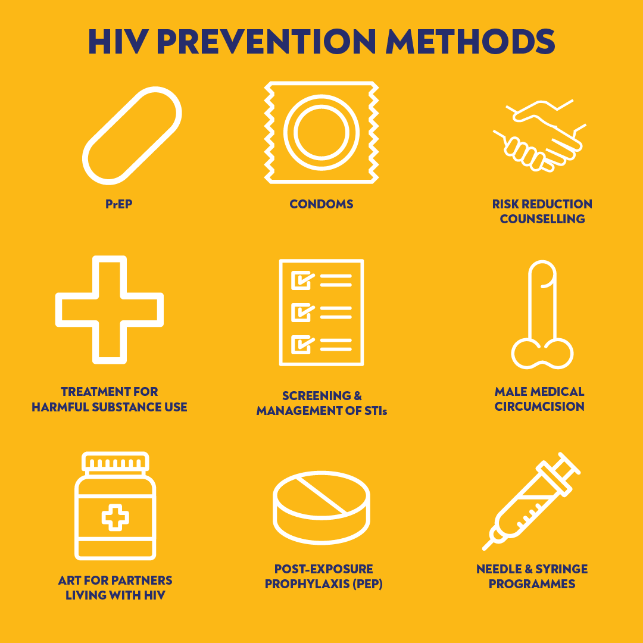
PrEP and Combination HIV Prevention​
HIV prevention needs change over a lifetime.​
Combination prevention is a mix of biomedical, behavioral, and structural interventions that decrease risk of HIV infection.​
Greater impact comes from combining approaches than from using single interventions alone.​
An important additional prevention tool is PrEP: using ARVs for prevention.

Slide 18
QUESTION
What is the difference
between PrEP and PEP?​
What is the difference
between PrEP and ART?
Notes:
Facilitator guidance:
Read the question on the slide.
Ask participants to raise their hands to answer the question.
Take a few volunteer responses.
Reveal the answer on the following slide.
Allow time for follow-up discussion as needed.

Slide 19
ANSWER
PrEP is used before exposure to HIV, while PEP is used after exposure to HIV.
PrEP is used by HIV negative persons, while ART is used to treat HIV infection in persons living with HIV.
Notes:
Facilitator guidance:
Reveal the answer on the slide.
Allow time for questions and follow-up discussion as needed.

Slide 20
Post-Exposure Prophylaxis (PEP)​
PEP is short-term us of ARVs to reduce the likelihood of HIV infection after potential HIV exposure, either occupationally or non-occupationally—for instance, through sexual intercourse. ​

Slide 21
Comparing PrEP and PEP​
PrEP​
HIV negative persons​ Prevent HIV infection BEFORE exposure​ Ongoing use during period of substantial risk
PEP​
HIV negative persons​ Prevent HIV infection AFTER exposure​ Limited use for 28 days after exposure​

Slide 22
Comparing PrEP and ART​
PrEP​
HIV negative persons​ Use during periods of substantial risk​ Prevent HIV infection
ART
People living with HIV​ Lifelong use​ Treat HIV infection and prevent transmission to others

Slide 23
QUESTION
How does
PrEP work?​
Notes:
Facilitator guidance:
Read the question on the slide.
Ask participants to raise their hands to answer the question.
Take a few volunteer responses.
Reveal the answer on the following slide.
Allow time for follow-up discussion as needed.

Slide 24
ANSWER
ARVs in PrEP stop
the HIV virus from replicating. ​
When taken correctly before exposure, there will be high enough levels of ARVs in the body to prevent HIV infection.
Notes:
Facilitator guidance:
Reveal the answer on the slide.
Allow time for questions and follow-up discussion as needed.

Slide 25
QUESTION
What are the
options for PrEP?​
Notes:
Facilitator guidance:
Read the question on the slide.
Ask participants to raise their hands to answer the question.
Take a few volunteer responses.
Reveal the answer on the following slide.
Allow time for follow-up discussion as needed

Slide 26
ANSWER
PrEP is most commonly available in pill form. ​
Additional options, including a long-acting injectable and vaginal ring, are newly recommended and becoming available in some countries. ​
Notes:
Facilitator guidance:
Reveal the answer on the slide.
Allow time for questions and follow-up discussion as needed.

Slide 27
QUESTION
How safe is PrEP?​
Notes:
Facilitator guidance:
Read the question on the slide.
Ask participants to raise their hands to answer the question.
Take a few volunteer responses.
Reveal the answer on the following slide.
Allow time for follow-up discussion as needed

Slide 28
ANSWER
PrEP has a few, mild side effects and is safe for most people with correct use and monitoring. ​
Notes:
Facilitator guidance:
Reveal the answer on the slide.
Allow time for questions and follow-up discussion as needed.

Slide 29
QUESTION
Who should
use PrEP?​
Notes:
Facilitator guidance:
Read the question on the slide.
Ask participants to raise their hands to answer the question.
Take a few volunteer responses.
Reveal the answer on the following slide.
Allow time for follow-up discussion as needed

Slide 30
ANSWER
People who are HIV negative and at substantial risk for HIV infection are good candidates for PrEP.
Notes:
Facilitator guidance:
Reveal the answer on the slide.
Allow time for questions and follow-up discussion as needed.

Slide 31
QUESTION
Why is PrEP needed?​
Notes:
Facilitator guidance:
Read the question on the slide.
Ask participants to raise their hands to answer the question.
Take a few volunteer responses.
Reveal the answer on the following slide.
Allow time for follow-up discussion as needed

Slide 32
ANSWER
HIV incidence is high, especially
among key population groups. ​
There is an unmet need for HIV prevention and PrEP is effective for decreasing the spread of HIV.
Notes:
Facilitator guidance:
Reveal the answer on the slide.
Allow time for questions and follow-up discussion as needed.

Slide 33
Need for PrEP​
HIV incidence remains high ​
Global annual HIV infections are consistently higher than targets set by the Joint United Nations Programme on HIV/AIDS (UNAIDS). ​
There were 1.5 million new HIV infections in 2020, compared to the target of less than 500,000.​
Key populations are especially at risk
HIV incidence remains disproportionately high among key populations and their partners.​
Two-thirds of new infections globally occur in key populations or their partners.​​
UNAIDS, 2022

Slide 34
Key and Priority Populations​
Key Populations
Defined by the WHO as groups who, due to specific higher-risk behaviors, are at increased risk of HIV irrespective of the epidemic type or local context. Key populations often experience legal and social issues related to their behaviors that increase their vulnerability to HIV.
Priority Populations
Defined by the WHO as groups of people who are particularly vulnerable to HIV infection only in certain situations or contexts.​ Sometimes called vulnerable populations, these populations are not affected by HIV uniformly across all countries and epidemics.​
WHO, 2016

Slide 35
Key and Priority Populations​ (continued)
Key Populations
The WHO defines five key population groups: ​ Men who have sex with men (MSM) ​ Sex workers People who inject drugs ​ Transgender people People in prisons and other closed settings
Priority Populations
Examples of priority populations include: ​ Adolescent girls and young women in Sub-Saharan Africa​ Migrant workers ​ Mobile workers e.g., truck drivers​ Fishing communities ​
WHO, 2016

Slide 36
Need for PrEP​
PrEP is effective at decreasing HIV incidence. ​
Decrease in HIV incidence has been reported in places with oral PrEP scale up. ​
Greater impact by combining approaches to HIV prevention ​
PrEP provides an additional prevention intervention to be used together with existing interventions.​
PrEP is not meant to replace or be a substitute for existing prevention interventions, such as condoms.
​

Slide 37
Impact of PrEP ​
Multi-faceted interventions that included oral PrEP scale up have been effective in reducing new HIV infections.​
Setting​ | Time period ​ | New HIV infections​
San Francisco, USA ^{1​} | 2012-2018​ | ​ | 58%​
Seattle, USA ^{2​} | 2014-2020​ | ​ | 36%​
United Kingdom ^{3​} | 2019-2021​ | ​ | 33%​
Rural Kenya and Uganda ^{4​} | 2016-2020​ | ​ | 74%​
New South Wales, Australia ^{5​} | 2016-2017​ | ​ | 25%​
1. Buchbinder et al., 2019; 2. Seattle & King County and the Infectious Disease Assessment Unit, 2021; 3. UK Health Security Agency, 2022; 4. Koss et al., 2021; 5. Grulich et al., 2018​

Slide 38
QUESTION
Who should use
PrEP according to the WHO?​
Notes:
Facilitator guidance:
Read the question on the slide.
Ask participants to raise their hands to answer the question.
Take a few volunteer responses.
Reveal the answer on the following slide.
Allow time for follow-up discussion as needed.

Slide 39
ANSWER
The WHO recommends PrEP for people who considered to be at substantial risk for HIV infection or people who are requesting PrEP.​
Notes:
Facilitator guidance:
Reveal the answer on the slide.
Allow time for questions and follow-up discussion as needed.

Slide 40
PrEP Recommendations: WHO Guidelines​
PrEP should be offered as an additional prevention choice for people at substantial risk for HIV infection as part of combination HIV prevention approaches.​
Substantial risk for HIV infection has been defined as populations with HIV incidence greater than 3 per 100 person-years in the absence of PrEP. ​
Individual characteristics and behavior are also very important when considering who might benefit from PrEP. ​
Individuals requesting PrEP should be offered PrEP, as many people find it difficult to disclose their risk behaviors or concerns regarding behaviors of their partner(s). ​
WHO, 2021

Slide 41
Review local HIV epidemiology and national guidelines. ​
What is the incidence of HIV in your country?​
What populations have higher risk for HIV infection?​
What populations are prioritized for PrEP in the national guidelines and recommendations?​
DISCUSSION​
Notes:
Facilitator guidance:
Time: 20 minutes
Explain that participants will now work in small groups to review local HIV epidemiology and national guidelines for PrEP.
Divide participants into groups of 4 to 6 participants each.
Discuss these questions with your small group: What is the incidence of HIV in your country? What populations have higher risk for HIV infection? What are the national guidelines and recommendations for PrEP?
Small groups may go online to research the information. As the groups are working, circulate and help as needed. Allow 10 minutes to work.
When the groups have finished, ask each of the questions in turn, and take volunteer responses from the groups. Confirm or correct responses as needed. Allow 10 minutes for discussion.
Present the next slide in order to summarize and confirm what participants have shared. Edit the following slide in advance by presenting local HIV epidemiology.

Slide 42
Local HIV Epidemiology & National Guidelines​
In [insert country name], there are [insert most recent incidence data] new infections annually.​
Most new infections are happening amongst [insert populations]. PrEP is an appropriate HIV prevention tool for these populations. ​​
In the national guidelines, [insert populations] are considered eligible for PrEP.​​
Notes:
Facilitator guidance:
Edit this slide in advance of the training by inserting the country name, recent incidence data, and the national populations most impacted by HIV, and populations identified as eligible for PrEP in national guidelines.
Present this slide in order to summarize and confirm what participants have shared in the previous discussion.

Slide 43
1.2 PrEP Eligibility​

Slide 44
QUESTION
How do you identify who is eligible for PrEP?​
Notes:
Facilitator guidance:
Read the question on the slide.
Ask participants to raise their hands to answer the question.
Take a few volunteer responses.
Reveal the answer on the following slide.
Allow time for follow-up discussion as needed

Slide 45
ANSWER
People who are at substantial risk​ for HIV infection, or request PrEP, ​and meet eligibility criteria ​can be offered PrEP.
Notes:
Facilitator guidance:
Reveal the answer on the slide.
Allow time for questions and follow-up discussion as needed.

Slide 46
PrEP Eligibility Criteria​
 | HIV negative
 | No suspicion of acute HIV infection (AHI)
 | At substantial risk for HIV infection or requesting PrEP
 | Willingness to use PrEP as prescribed
 | No contraindication to PrEP drug or administration route*
* See Modules 2-5 for more information on specific PrEP products​

Slide 47
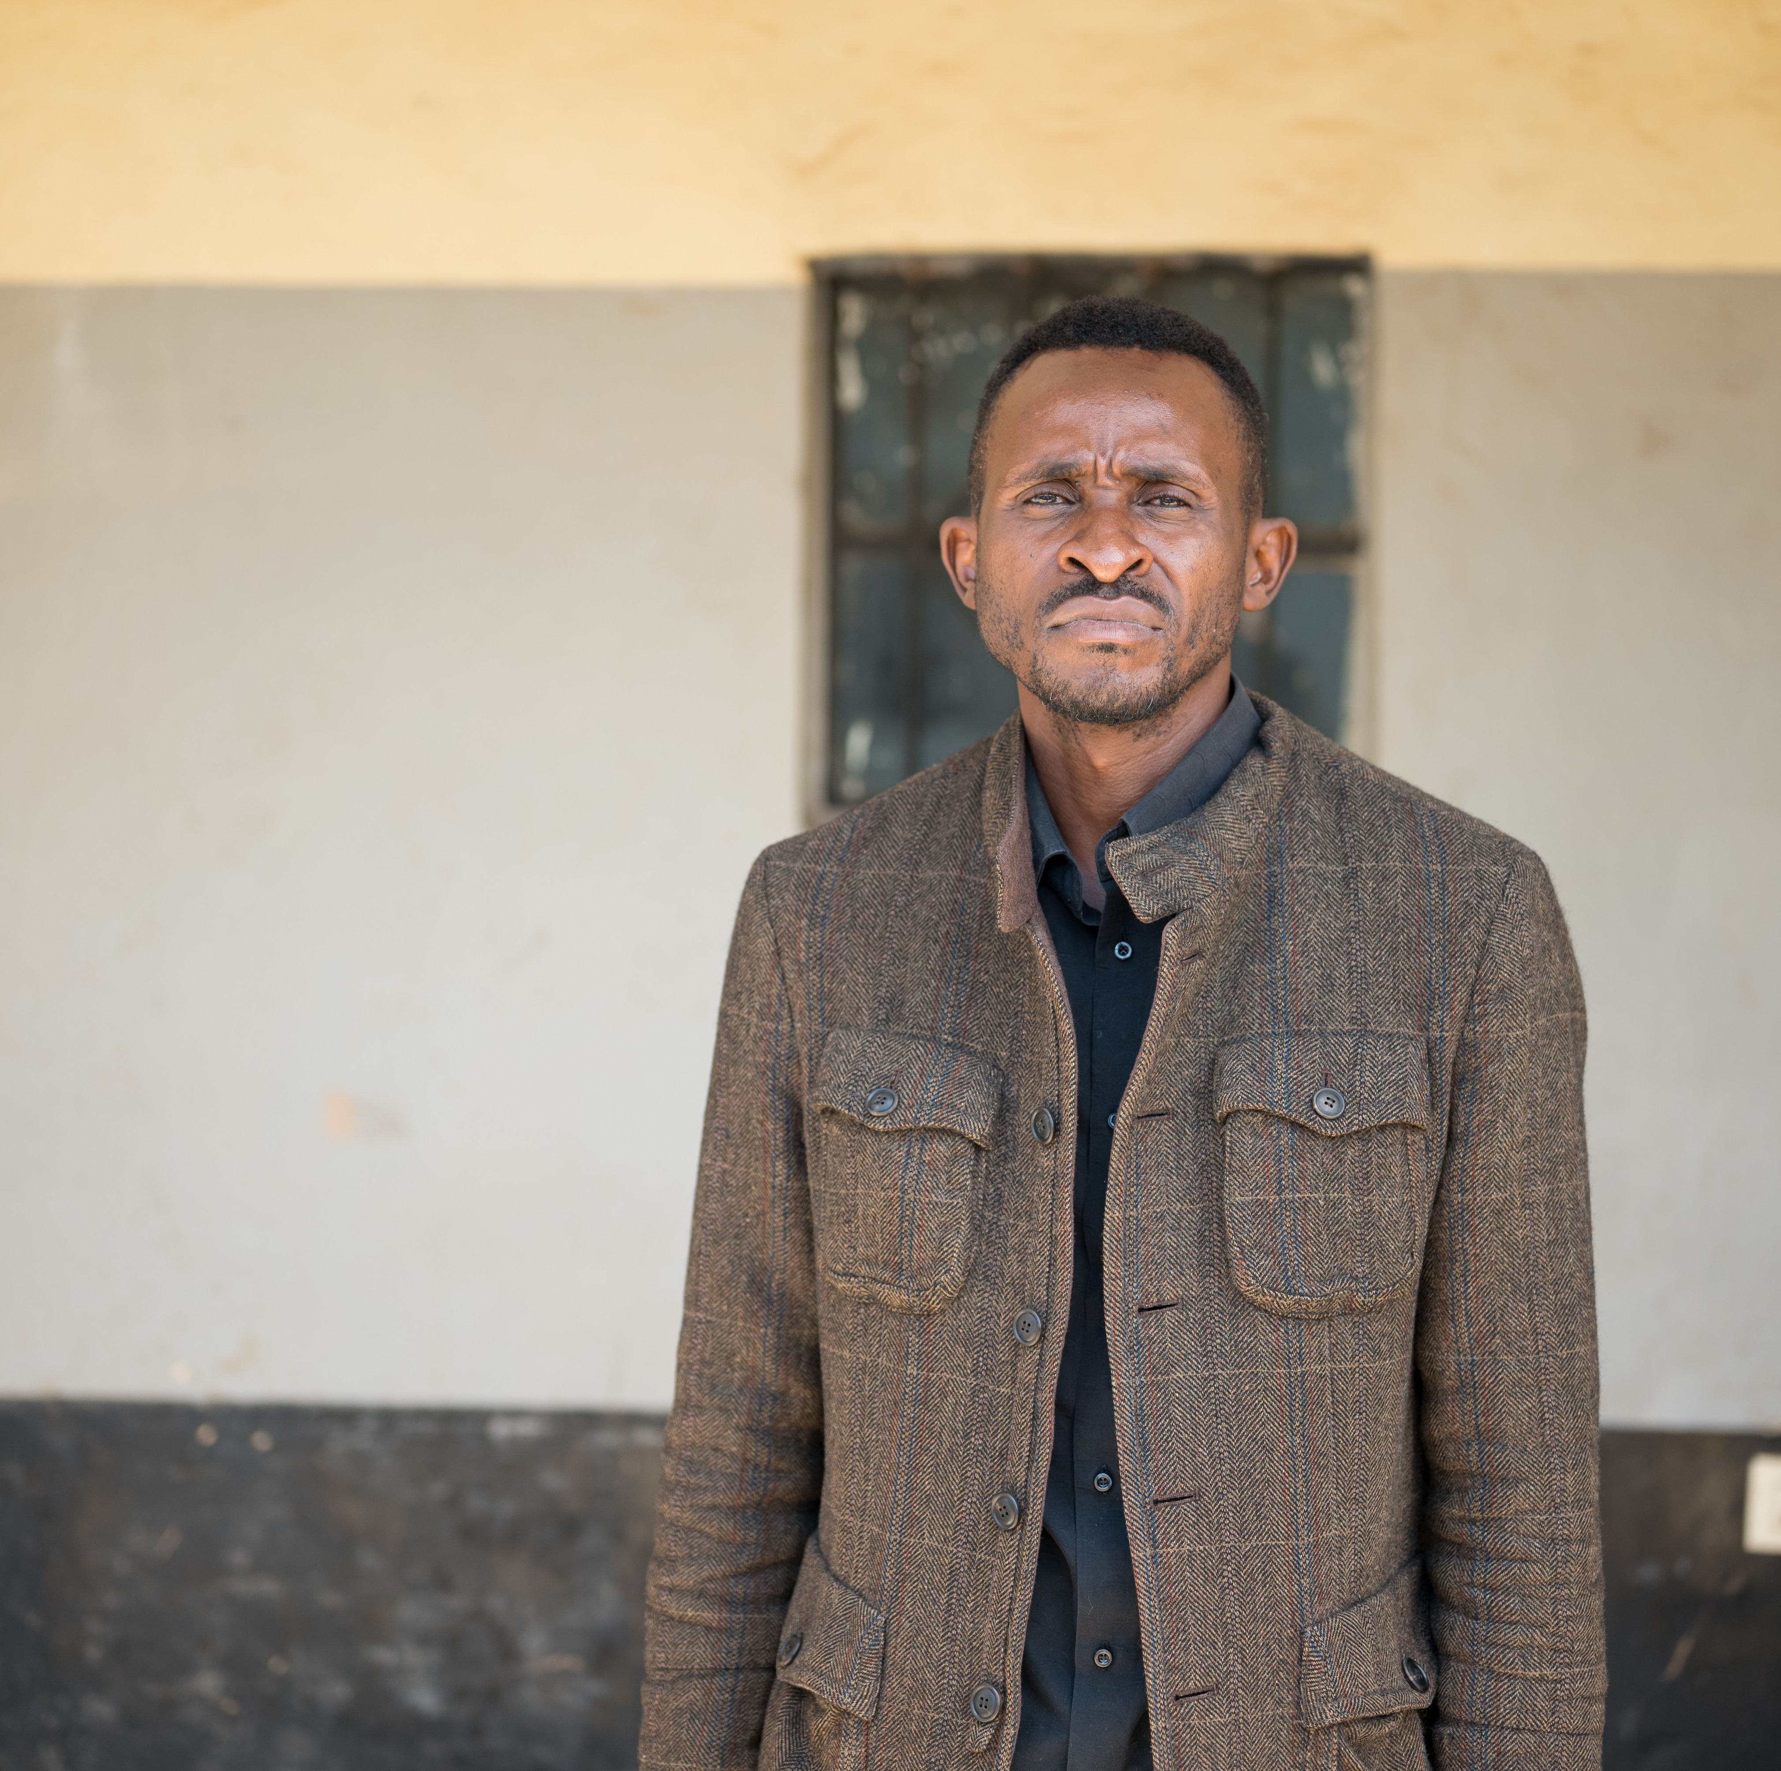
Case Scenario​
Joseph is a new client who comes to your clinic requesting a prescription for PrEP.​
Can he start PrEP today? ​
Notes:
Facilitator guidance:
Explain to participants that a case scenario is provided for their analysis to apply their knowledge to each step of determining PrEP eligibility according to their practice and local context.
Read the scenario and question on the slide asking participants, "Can he start PrEP today?"
Prompt the participants with follow up questions, "What information do we need to make this decision?"
Ask participants to raise hands and share their answers.
Continue to the following slide to provide the answer after receiving inputs from participants.

Slide 48
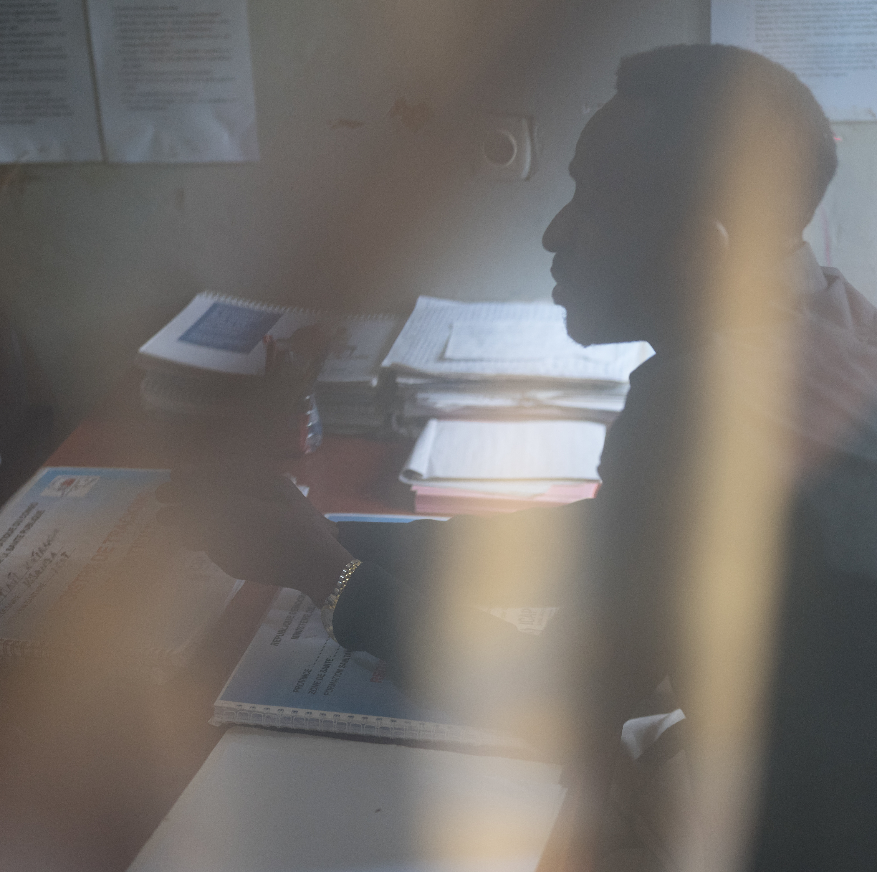
Case Scenario​
Joseph can start PrEP today if he meets the eligibility criteria.​
Let's review eligibility criteria and find out if Joseph is a good candidate for PrEP. ​
​
Notes:
Facilitator guidance:
Read the answer on the slide.
Ask participants if they have any questions for clarification.
Continue with the following slides to prompt participants to apply their learning of eligibility criteria to this case scenario.

Slide 49
PrEP Eligibility Criteria: HIV Negative​
 | HIV negative
 | No suspicion of AHI
 | At substantial risk for HIV infection or requesting PrEP
 | Willingness to use PrEP as prescribed
 | No contraindication to PrEP drug or administration route*
* See Modules 2-5 for more information on specific PrEP products​

Slide 50
HIV Negative
HIV negative persons at substantial risk for HIV may be eligible for PrEP. ​
Perform HIV testing BEFORE starting PrEP to exclude HIV infection. ​
Provide HIV testing according to national guidelines and algorithms: ​
  Rapid HIV test at point of care​
  HIV self tests (HIVST) ​
Persons who test HIV negative may be eligible for PrEP.
Persons who test positive for HIV should be immediately linked to HIV care and treatment services. ​

Slide 51
HIVST for PrEP​
The WHO says HIVST can be used to complement existing HIV testing strategies.​
  HIVST can be used for starting, restarting, and continuing PrEP
Potential advantages include: ​
  Supporting differentiated service delivery (DSD) approaches​
  Removing barriers to accessing PrEP and increasing PrEP uptake, persistence and effective use
  Generating demand and linkage to PrEP
  More convenient, protects privacy, and promotes self-managed care
WHO, 2022

Slide 52
Review your national HIV testing guidelines.​
​What HIV testing methods are required before starting PrEP?​
Do you offer HIVST in your setting?
Do you have any experience to share? ​
​
DISCUSSION​
Notes:
Facilitator guidance:
Time: 20 minutes
Explain that participants will now work in small groups to review local HIV testing guidelines for PrEP and to share experience from their setting.
Divide participants into groups of 4 to 6 participants each.
Discuss these questions with your small group: What HIV testing methods are required before starting PrEP? Do you offer HIVST in your setting? Do you have any experience to share?
Small groups may go online to research the information. As the groups are working, circulate and help as needed. Allow 10 minutes to work.
When the groups have finished, ask each of the questions in turn, and take volunteer responses from the groups. Confirm or correct responses as needed. Allow 10 minutes for discussion.
Present the next slide in order to summarize and confirm what participants have shared.

Slide 53
National HIV Testing Guidelines​
In [insert country name] the use of [insert recommended HIV testing method(s)] is required before initiating PrEP and [insert recommended HIV testing method(s)] are required for follow-up testing while people are on PrEP.​
The national HIV testing algorithm:​
[Add country-specific text here]​
Notes:
Facilitator guidance:
Edit this slide in advance of the training by inserting the country name, HIV testing methods, and the national HIV testing algorithm in your country.
Present this slide to summarize and confirm what participants have shared in the previous discussion.

Slide 54
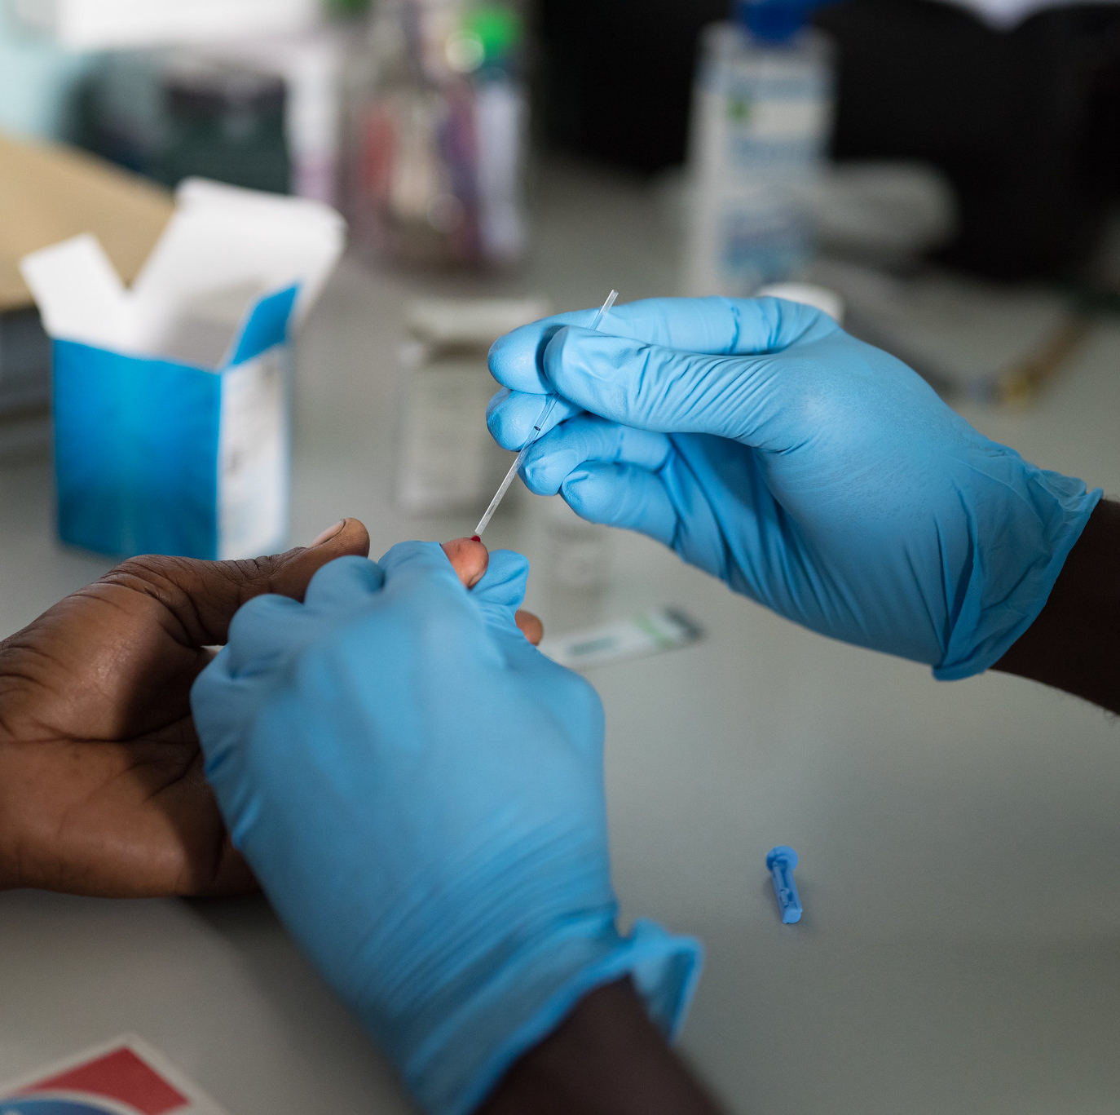
Case Scenario​
Joseph consents to a rapid HIV test in the clinic today and his result is HIV negative. ​
Can he start PrEP today? ​
​
​
Notes:
Facilitator guidance:
Read the scenario and question on the slide asking participants, "Can he start PrEP today?"
Prompt the participants with follow up questions, "What information do we need to make this decision?"
Ask participants to raise hands and share their answers.
Continue to the following slide to provide the answer after receiving inputs from participants.

Slide 55
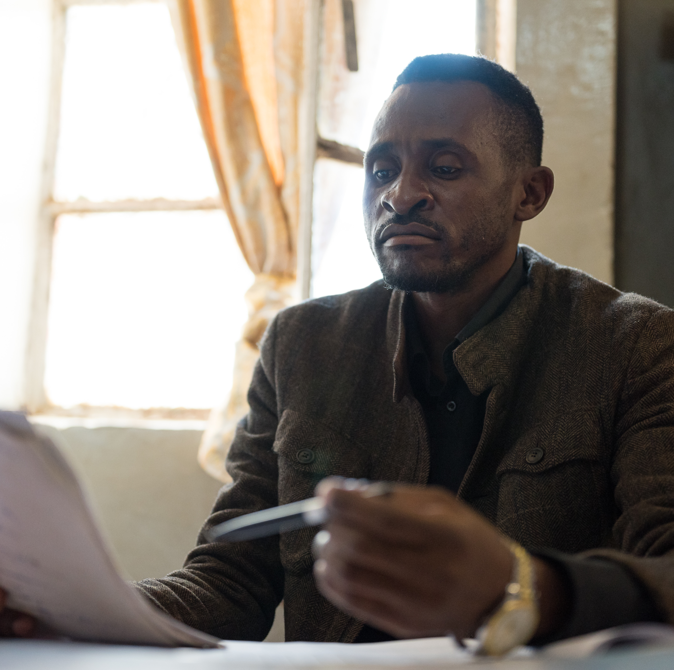
Case Scenario​
Maybe. ​
Joseph has met the first of five eligibility criteria to start PrEP. Continue to see if Joseph meets the other eligibility criteria. ​
​
Notes:
Facilitator guidance:
Read the answer on the slide.
Ask participants if they have any questions for clarification.
Continue with the following slides to prompt participants to apply their learning of eligibility criteria to this case scenario.

Slide 56

PrEP Eligibility Criteria: No Suspicion of AHI
 | HIV negative
 | No suspicion of AHI
 | At substantial risk for HIV infection or requesting PrEP
 | Willingness to use PrEP as prescribed
 | No contraindication to PrEP drug or administration route*
* See Modules 2-5 for more information on specific PrEP products​

Slide 57
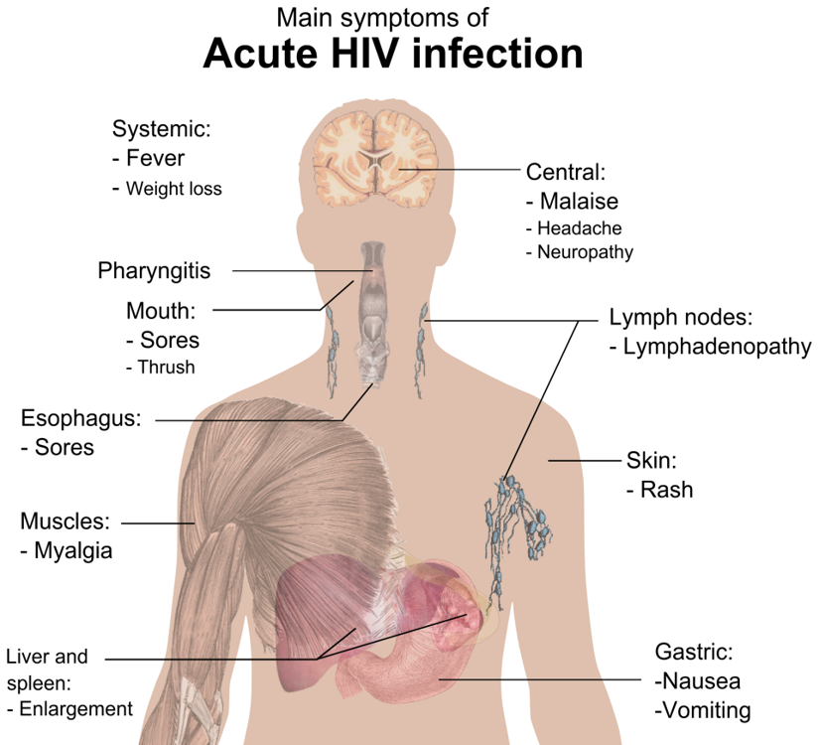
Clinical Assessment for AHI
AHI is the early phase of HIV disease characterized by an initial burst of viremia.​
Develops within 2 to 4 weeks after someone is infected with HIV.​
40–90% will experience flu-like symptoms. Symptoms are not specific to HIV but occur in many other viral infections. ​
Clients with AHI can be asymptomatic.​
Never start PrEP if AHI is suspected​

Slide 58
Diagnosis of AHI ​
During AHI, antibodies to HIV might be absent or be below the level of detection. Serological testing using rapid tests might be falsely negative. ​
AHI can be diagnosed using “direct” viral tests like HIV RNA or HIV antigen testing.​
In the absence of HIV RNA and antigen testing, defer PrEP for 4 weeks if AHI is suspected. Repeat the HIV serological test after 4 weeks to reassess eligibility.​
Never start PrEP if AHI is suspected​

Slide 59
AHI Screening​
Assess for recent HIV exposure
  In the past 72 hours, have you had sex without a condom with someone whose HIV status is positive or unknown to you, or have you shared injection equipment with someone whose HIV status is positive or unknown to you?
  If answer is yes, consider PEP first. Do not start PrEP.​
  How about in the last 4 weeks?​
Assess for any flu-like symptoms
  In the past 4 weeks, have you had any cold or flu symptoms, including fever, fatigue, sore throat, headache, swollen glands, rash, mouth ulcers or muscle pain/soreness? ​
Note: Many of these symptoms are commonly due to other illnesses. Providers need to use clinical judgement in determining whether symptoms are consistent with HIV or may be explained by an alternative cause. History of a potential HIV exposure within the last 4 weeks should increase a provider’s suspicion for AHI in a person with symptoms.​

Slide 60
Case Scenario​
Upon history taking and physical exam, Joseph denies and does not present with any flu-like signs or symptoms. ​
He has not had any sex or injected drugs within the last 3 days and thinks the last time he had unprotected sex was around 3 months ago.​
Do you suspect AHI? ​
​
Notes:
Facilitator guidance:
Read the scenario and question on the slide asking participants, "Do you suspect AHI?"
Prompt the participants with follow up questions, "What assessments should be made to screen for AHI and what consideration is important to remember for AHI screening?"
Ask participants to raise hands and share their answers.
Continue to the following slide to provide the answer after receiving inputs from participants.

Slide 61
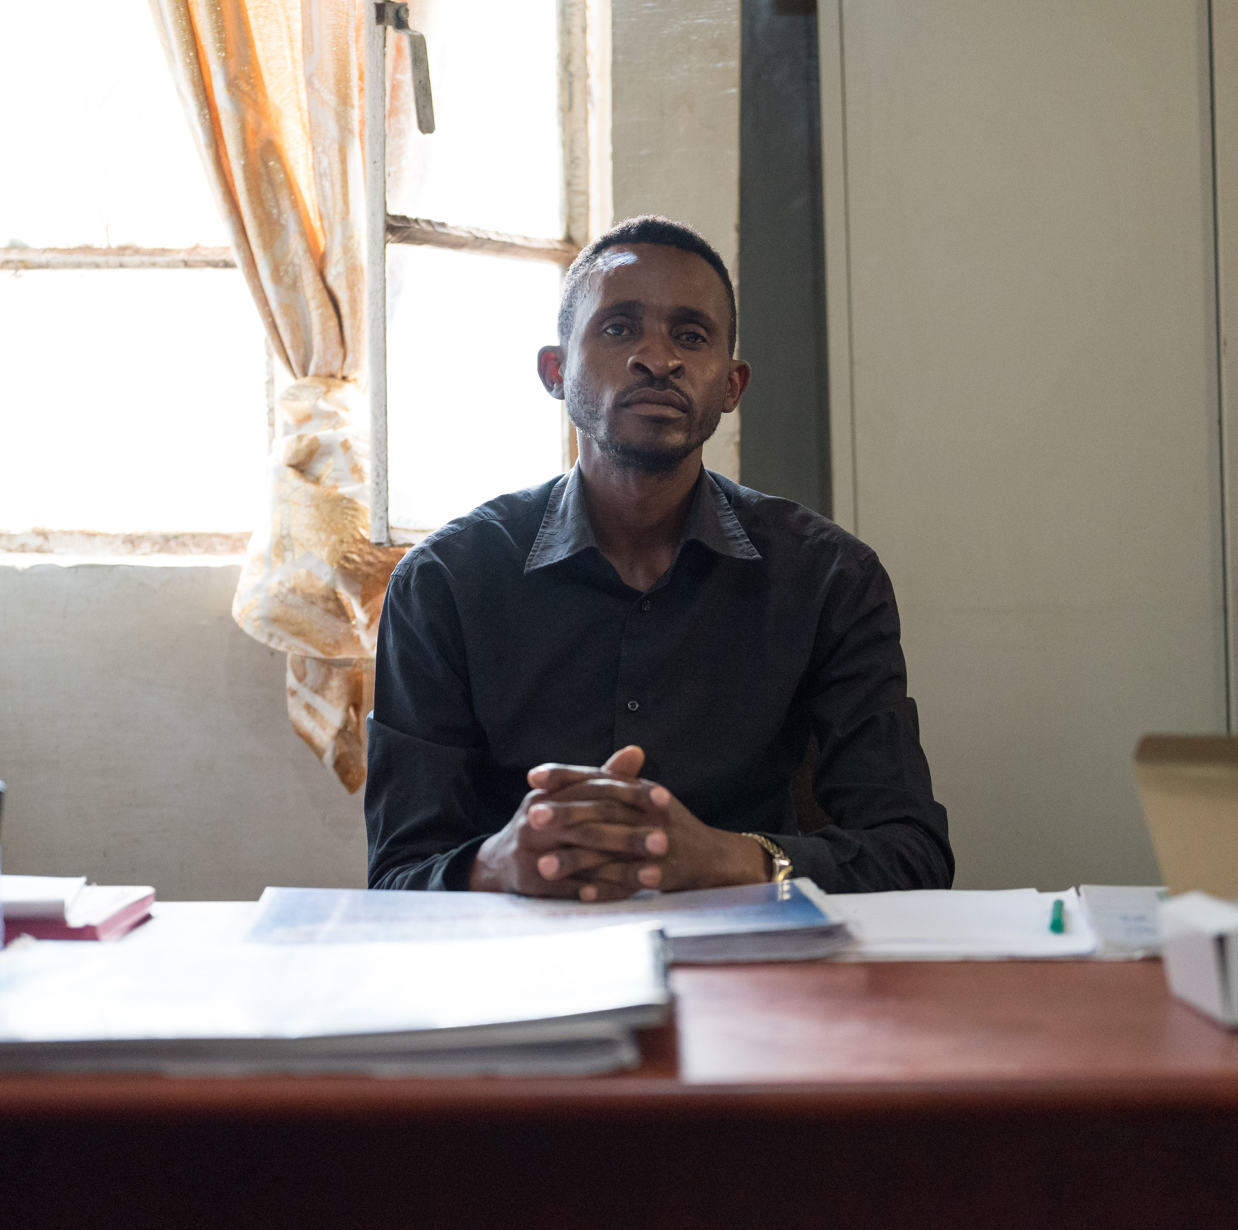
Case Scenario​
Joseph does not present with any signs or symptoms of AHI and has not had a recent potential exposure to HIV.​ You do not suspect AHI.
Remember:
AHI may be asymptomatic. If AHI is suspected based on a history of recent HIV exposure, defer PrEP for 4 weeks.​​
Notes:
Facilitator guidance:
Read the answer on the slide.
Ask participants if they have any questions for clarification.
Continue on with the following slides to prompt participants to apply their learning of eligibility criteria to this case scenario.

Slide 62
PrEP Eligibility Criteria: Substantial Risk for HIV Infection or Requesting PrEP​
 | HIV negative
 | No suspicion of AHI
 | At substantial risk for HIV infection or requesting PrEP
 | Willingness to use PrEP as prescribed
 | No contraindication to PrEP drug or administration route*
* See Modules 2-5 for more information on specific PrEP products​

Slide 63
Substantial Risk for HIV Infection or Requesting PrEP​
Does the client report any one of the following in the past six months?​
Sexual activity in a high HIV prevalence population or key population group ​
Vaginal or anal intercourse without condoms with more than one partner
Sex partner with one or more HIV risk factor
History of an STI (based on lab test, syndromic STI treatment, or self-report)
History of use of PEP
History of sharing of injection material and/or equipment with another person
Having a sexual partner who is HIV positive and has been on ART for less than 6 months or has inconsistent or unknown adherence
Asking for PrEP

Slide 64
Substantial Risk for HIV Infection or Requesting PrEP
Asking for PrEP is enough!​
Asking for PrEP is enough, even if no risk factors are reported.​
Asking for PrEP may indicate a risk behavior clients are unwilling to share. ​
Not everyone will feel comfortable reporting their risk behaviors or concerns regarding behaviors of their partner(s).​
Respect privacy and confidentiality​.
Never pressure or demand someone report risk behaviors. ​
WHO, 2021

Slide 65
General Screening Questions​
Consider PrEP if a client is from a high-prevalence setting or a high-prevalence population or answers “yes” to any of the following questions.​
Over the past 6 months:​
  Have you had sex with more than one partner?​
  Have you had sex without a condom?​
  Have you had sex with people whose HIV status you do not know?​
  Are any of your partners at risk for HIV infection?​
  Have you had sex with a person who has HIV?​
  Have you injected drugs or hormones using shared equipment?​
Remember to also consider PrEP for anyone asking for it, as this may indicate risk behavior they are unwilling to share.​

Slide 66
Screening a Person Who Has a Partner with HIV​
PrEP can protect the HIV negative partner in a serodifferent (a.k.a. serodiscordant) relationship if:​
  The partner living with HIV has been on ART for less than 6 months. PrEP can provide a useful bridge to full viral suppression during this time.​
  The HIV negative partner is not confident of their partner’s adherence to HIV treatment.​
  The HIV negative partner is aware of gaps in their partner’s adherence to HIV treatment.​
  The partner living with HIV is known to have an elevated viral load or be failing HIV treatment.​
  The couple is not communicating openly about HIV treatment adherence and viral load test results.​

Slide 67
Questions for a Person Who Has a Partner Living with HIV
Questions to guide discussion with a person who has a partner living with HIV:​
Is your partner taking ART for HIV?​
Has your partner been on ART for more than 6 months?​
Do you regularly discuss your partner’s adherence to HIV treatment?​
Do you know your partner’s last viral load result? And when was the testing done?​
Do you wish to have a child with your partner?​
Are you and your partner consistently using condoms?​

Slide 68
Contextual Risk Factors
Other contextual factors may indicate higher HIV risk​. Has the client:​
Received money, housing, food, or gifts in exchange for sex?​
Been forced to have sex against their will?
Been physically assaulted by anyone, including a sex partner?​
Taken PEP to prevent HIV infection?​
Had an STI?​
Used recreational or psychoactive drugs?​
Been required to leave their home or moved to a new place?​
Lost their job?​
Had fewer than 12 years of schooling or left school early?​

Slide 69
Approach to Screening
Sensitive, non-stigmatizing, and non-discriminatory screening​
As a PrEP provider, remember to be sensitive, inclusive, non-judgmental, and supportive. ​
Be careful not to develop a screening process that might discourage PrEP use.​
Ask the person if they are willing to answer some questions about behaviors to help you better understand their risk for HIV. ​
Frame screening questions in terms of people’s behavior rather than their sexual identity.​
In your screening questions, refer to a defined time period, e.g., 6 months.​
Tell the person that they can choose NOT to answer any questions. ​
Assure the person that their answers are private and confidential. ​

Slide 70

Case Scenario​
Joseph reports that he had sex with 2 male partners in the last 6 months and used condoms sometimes. He says he wants to start taking PrEP to have safer sex. ​
Is he a good candidate for PrEP? ​
​
Notes:
Facilitator guidance:
Read the scenario and question on the slide asking participants, "Is he a good candidate for PrEP?"
Prompt the participants with follow up questions, "Is he at risk for HIV? Is he requesting PrEP?"
Ask participants to raise hands and share their answers.
Continue to the following slide to provide the answer after receiving inputs from participants.

Slide 71
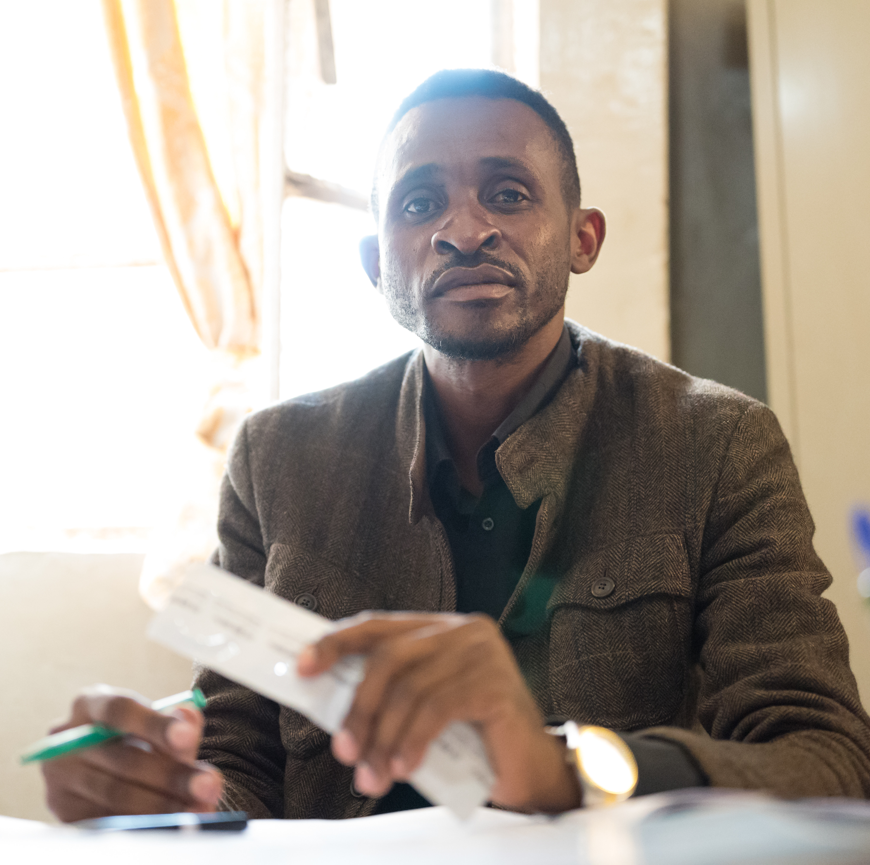
Case Scenario​
Yes! ​
Joseph has been sexually active in a high HIV prevalence population in the past 6 months.​
It's great that Joseph is asking for PrEP and empowering himself to practice safer sex. ​
If he meets the remaining eligibility criteria he can begin PrEP today. ​
Notes:
Facilitator guidance:
Read the answer on the slide.
Ask participants if they have any questions for clarification.
Continue on with the following slides to prompt participants to apply their learning of eligibility criteria to this case scenario.

Slide 72
PrEP Eligibility Criteria: Willingness to Use PrEP as Prescribed​
 | HIV negative
 | No suspicion of AHI
 | At substantial risk for HIV infection or requesting PrEP
 | Willingness to use PrEP as prescribed
 | No contraindication to PrEP drug or administration route*
* See Modules 2-5 for more information on specific PrEP products​

Slide 73
Willingness to Use PrEP as Prescribed​
Adherence is higher among people who are aware that they are at risk for HIV infection and are motivated to take PrEP.​
Education and counseling must be provided to support clients to make an informed choice about PrEP. ​
Clients must not be coerced into using PrEP.​
If more than one PrEP option is available, clients should be counseled to make an informed decision about which PrEP product works best for them.​
The best PrEP option is one the client will use consistently and correctly!​
See Module 6 for more information about informed decision-making ​

Slide 74
PrEP Eligibility Criteria: No Contraindication to PrEP Drug or Administration Route​ ​
 | HIV negative
 | No suspicion of AHI
 | At substantial risk for HIV infection or requesting PrEP
 | Willingness to use PrEP as prescribed
 | No contraindication to PrEP drug or administration route*
* See Modules 2-5 for more information on specific PrEP products​

Slide 75
No Contraindication to PrEP Drug or Administration Route​​
Examples of possible contraindications​:
Oral PrEP
Unable to swallow pills​
Known to have poor renal function
Injectable PrEP
Taking medications known to have drug-drug interactions
Buttock fillers or implants
Vaginal ring PrEP​
Male sex at birth​
See Modules 2-5 for more information on PrEP drugs, administration routes and contraindications​.

Slide 76
Case Scenario​
Joseph says he has heard that there are different types of PrEP available and asks which form of PrEP is best for him.
How will you determine which PrEP option Joseph is eligible to start taking today?
Notes:
Facilitator guidance:
Read the scenario and question on the slide asking participants, "How will you determine which form of PrEP Joseph is eligible to start taking today?"
Prompt the participants with follow up questions, "Which forms of PrEP is he willing to use? Does he have any contraindications?"
Ask participants to raise hands and share their answers.
Continue to the following slide to provide the answer after receiving inputs from participants.

Slide 77
Case Scenario​
Discuss it with Joseph so he can make an informed choice.
Assess Joseph's willingness to use PrEP as prescribed. The best PrEP option is one the client will use consistently and correctly!
Ensure Joseph does not have any contraindications for PrEP drugs or administration routes. For example, Joseph will not be able to use the vaginal ring as he is man.
Notes:
Facilitator guidance:
Read the answer on the slide.
Ask participants if they have any questions for clarification.
Continue with the following slides to learn more about the different PrEP options.

Slide 78
PrEP Eligibility Criteria Review
 | HIV negative
 | No suspicion of AHI
 | At substantial risk for HIV infection or requesting PrEP
 | Willingness to use PrEP as prescribed
 | No contraindication to PrEP drug or administration route*
* See Modules 2-5 for more information on specific PrEP products​

Slide 79
1.3 PrEP Options​

Slide 80
QUESTION
What are the
options for PrEP?​
Notes:
Facilitator guidance:
Read the question on the slide.
Ask participants to raise their hands to answer the question.
Take a few volunteer responses.
Reveal the answer on the following slide.
Allow time for follow-up discussion as needed

Slide 81
ANSWER
There are four options for PrEP:​
Oral daily PrEP​
Oral event-driven PrEP (ED-PrEP)​
Injectable long-acting cabotegravir (CAB-LA)​
Dapivirine vaginal ring (DVR)​
PrEP Vaginal Ring
Injectable PrEP
Oral PrEP
Notes:
Facilitator guidance:
Reveal the answer on the slide.
Allow time for questions and follow-up discussion as needed.

Slide 82
Global Expansion of PrEP Options​
By mid 2023:​
Estimated 4.9 million individuals have cumulatively initiated oral PrEP
Regulatory approvals exist for at least one PrEP product in 64 countries.​
  7 countries have approved the DVR as PrEP​
  9 countries have approved CAB-LA​ as PrEP
Global implementation projects: 203​
  13 projects for DVR, all in Sub-Saharan Africa​
  50 projects for CAB-LA​
Latest global data are available from The Global PrEP Tracker: data.prepwatch.org​
Last updated: September 2023​

Slide 83
Global PrEP Policy Milestones​
2012 | Food and Drug Administration (FDA) approves oral daily PrEP with tenofovir disoproxil fumarate (TDF) in the United States​
2015 | WHO recommends oral daily PrEP with TDF for people at substantial risk of HIV infection​
2019 | FDA approves tenofovir alafenamide/emtricitabine (TAF/FTC) as oral daily PrEP in the United States, excluding individuals who may be exposed to HIV via receptive vaginal sex or injection drug use ​
2019 | WHO recommends oral ED-PrEP (also known as ‘2-1-1’ PrEP) with TDF for cisgender MSM​
2021 | WHO recommends the DVR for women at substantial risk of HIV infection​
2022 | WHO recommends CAB-LA for people at substantial risk of HIV infection​
2022 | WHO expands recommendation for ED-PrEP to include:​ All cisgender men​ Transgender women and non-binary individuals assigned male sex at birth who are not taking gender-affirming hormones

Slide 84
WHO Recommendations for PrEP
Oral PrEP regimens containing TDF – daily or event-driven
TDF 300 mg/FTC 200 mg or TDF 300 mg/lamivudine (3TC) 300 mg or single-agent TDF 300 mg*
Event-driven schedule: 2 pills 2-24 hours before sex, then a pill each day until 2 days after last sexual exposure
DVR – monthly
Flexible silicone vaginal ring containing 25 mg of dapivirine
CAB-LA injections
Given as 600 mg intramuscular dose of cabotegravir in the buttocks
Four weeks apart for the first 2 injections, then every 8 weeks
*Less common and may not be suitable for all populations
See Modules 2-5 for more information on each PrEP option

Slide 85
What PrEP options are recommended and available in your country?
DISCUSSION​
Notes:
Facilitator guidance:
Time: 20 minutes
Explain that participants will now work in small groups to review what PrEP options are recommended and available in their work setting.
Divide participants into groups of 4 to 6 participants each.
Discuss this question with your small group: What PrEP options are recommended and available in your country and where you work?
Small groups may go online to research the information. As the groups are working, circulate and help as needed. Allow 10 minutes to work.
When the groups have finished, ask the question on the slide, and take volunteer responses from the groups. Confirm or correct responses as needed. Allow 10 minutes for discussion.
Present the next slide in order to summarize and confirm what participants have shared. Edit the following slide in advance with local guidelines.

Slide 86
National Guidelines Recommendations for PrEP​
In [insert country name] the available recommended PrEP options include:
[insert available option(s)]​
Notes:
Facilitator guidance:
Edit this slide in advance to the training by inserting the country name and available options for PrEP in your country.
Present this slide to summarize and confirm what participants have shared in the previous discussion.

Slide 87
PrEP Options Recommended by the WHO​
Oral Daily PrEP​ | Oral ED-PrEP​ | CAB-LA | DVR

Slide 88
Oral Daily PrEP​
Key information
One pill daily​
Short-acting​
For everyone at substantial risk ​
>95% efficacy ​
Side effects are minor and include short-term gastrointestinal symptoms​
Follow-up every 3 months for HIV testing​

Slide 89
Oral ED-PrEP​
Key information
As needed pre- and post- sexual exposure
  Pre: 2 pills 2-24 hours before sex​
  Post: 1 pill daily until 2 days after last sexual exposure​
Short-acting​
For men (male sex at birth) and sexual exposure only​
  Unless taking estradiol-based hormones, such as for gender-affirming hormone therapy​ (GAHT)
>95% efficacy ​
Side effects are minor and include short-term gastrointestinal symptoms​
Follow-up every 3 months for HIV testing​

Slide 90
CAB-LA
Key information:
Injection into the buttock by a provider every 8 weeks​
  Except first two injections, which are 4 weeks apart
Long-acting​
For everyone at substantial risk ​
>95% efficacy ​
Common side effects: injection site reactions​
Follow-up every 8 weeks after first two injections

Slide 91
DVR
Key information:
Self-insert flexible silicone ring vaginally every 28 days
Long-acting
For women (female sex at birth) and receptive vaginal exposure only
30-50% efficacy
Common side effects: urinary tract and vaginal irritation
Follow-up every 3 months for HIV testing​

Slide 92
QUESTION
What are key​
similarities and differences ​
between PrEP options?​
Notes:
Facilitator guidance:
Read the question on the slide.
Ask participants to raise their hands to answer the question.
Take a few volunteer responses.
Reveal the answer on the following slide.
Allow time for follow-up discussion as needed

Slide 93
ANSWER
Short-acting vs. long-acting​
Eligibility based on sex at birth and exposure risk​
Efficacy​
Administration routes and frequency​
Side-effects and follow-up​
Notes:
Facilitator guidance:
Reveal the answer on the slide.
Allow time for questions and follow-up discussion as needed.

Slide 94
PrEP Options​
Short-acting​
Long-acting​
Oral Daily PrEP​ | CAB-LA
Oral ED-PrEP​ | DVR
For everyone at substantial risk​
For some groups at substantial risk​

Slide 95
Eligibility​
Sexual exposure​
Female sex at birth | Male sex at birth​
Injection drug use exposure​
Female or male sex at birth​
Oral Daily PrEP​
Oral Daily PrEP​
Oral Daily PrEP​
CAB-LA​
CAB-LA​
CAB-LA​​
DVR*
Oral ED-PrEP**​
All individuals must be at substantial risk of HIV infection
​
*For receptive vaginal sex only​
**Unless taking estradiol-based hormones, such as for GAHT​

Slide 96
Efficacy​
High​ >95% efficacy
Medium 30%-50% efficacy
CAB-LA
Oral Daily PrEP​
Oral ED-PrEP​
DVR
Efficacy rates for preventing HIV infection when PrEP is taken as prescribed with optimal adherence​

Slide 97
Administration​
Delivery Route​
Frequency​
Oral Daily PrEP | Oral pills​ | Every day​
Oral ED-PrEP | Oral pills​ | As needed pre- and post-sexual exposure​
CAB-LA | Injection into the buttocks by a provider​ | Every 8 weeks​
DVR | Self-insertion into the vagina​ | Every 28 days​

Slide 98
Side Effects and Follow-up
Common side effects​
Follow-up frequency​
Prevention considerations when stopping
Oral Daily PrEP | Gastrointestinal symptoms within first month | Every 3 months | Continue PrEP daily until 2-7 days after last HIV exposure​
Oral ED-PrEP | Gastrointestinal symptoms within first month | Every 3 months | Continue PrEP daily until 2 days after last HIV exposure​
CAB-LA | Injection site reactions | Every 8 weeks (+/- 1 week) | Use other prevention for 12 months after last injection​
DVR | Urinary tract/vaginal irritation within first month | Every 3 months | Always use in combination with other prevention methods​

Slide 99
Follow-up HIV Testing​
It important for PrEP clients to get regular HIV testing, to ensure they are not receiving PrEP if they have acquired HIV.​
  People living with HIV need an effective 3-drug ART regimen to prevent drug resistance mutations that may make later treatment more challenging. ​
Per the WHO, rapid HIV tests and the national testing algorithm can be used for follow-up with all forms of PrEP and users should be tested at least every 3 months.​
  Based on country guidelines and resources, programs may consider using a viral load or antigen test for HIV if AHI is suspected or serologic testing yields indeterminate results.​
Either blood-based or oral fluid HIVST can be also used for follow-up testing with oral PrEP and the DVR.​
CAB-LA is the only form of PrEP for which HIVST use is not recommended, and users should be tested before every injection (every 2 months)*​
* See Module 4 for more information on HIV testing and CAB-LA​

Slide 100
Summary of Key Differences Between PrEP Options
Side Effects & Follow-up​
Eligibility​
Efficacy​
Administration​
Oral Daily PrEP | Everyone at substantial risk​ | >95%​ | Daily pill​ | Short-term gastrointestinal side effects​ and follow-up every 3 months​
Oral ED-PrEP | Male sex at birth*​ and sexual exposure only​ | >95%​ ​ | As needed pill pre- and post-sexual exposure​ | Short-term gastrointestinal side effects​ and follow-up every 3 months​
CAB-LA | Everyone at substantial risk​ | >95%​ ​ | Injection by a provider every 8 weeks ​ | Injection site reactions​ and follow-up every 8 weeks (+/- 1 week)​
DVR | Female sex at birth​ and vaginal sexual exposure only​ | 30-50%​ | Self-insertion into the vagina every 28 days​ | Urinary tract/vaginal irritation​ and follow-up every 3 months​
*Unless taking estradiol-based hormones, such as for GAHT

Slide 101
Fill in the Blank: Compare PrEP Options​
Side Effects & Follow-up​
Eligibility​
Efficacy​
Administration​
Oral Daily PrEP
Oral ED-PrEP
CAB-LA
DVR
Notes:
Facilitator guidance:
Time: 20 minutes
Explain that participants will now work in small groups to compare PrEP options.
Divide participants into groups of 4 to 6 participants each.
Advise participants to work together in their small group to fill in the blanks of the table on the slide to compare PrEP options. For each PrEP option listed on the left hand column, enter the eligibility criteria, efficacy rate, administration route, potential side effects and recommended follow-up.
Small groups may go online to research the information. As the groups are working, circulate and help as needed. Allow 10 minutes to work.
When the groups have finished, ask the question on the slide, and take volunteer responses from the groups. Confirm or correct responses as needed. Allow 10 minutes for discussion.
Present the next slide to summarize and confirm what participants have shared.

Slide 102
Fill in the Blank: Compare PrEP Options​
Side Effects & Follow-up​
Eligibility​
Efficacy​
Administration​
Oral Daily PrEP | Everyone at substantial risk​ | >95%​ | Daily pill​ | Short-term gastrointestinal side effects​ and follow-up every 3 months​
Oral ED-PrEP | Male sex at birth*​ and sexual exposure only​ | >95%​ ​ | As needed pill pre- and post-sexual exposure​ | Short-term gastrointestinal side effects​ and follow-up every 3 months​
CAB-LA | Everyone at substantial risk​ | >95%​ ​ | Injection by a provider every 8 weeks ​ | Injection site reactions​ and follow-up every 8 weeks (+/- 1 week)​
DVR | Female sex at birth​ and vaginal sexual exposure only​ | 30-50%​ | Self-insertion into the vagina every 28 days​ | Urinary tract/vaginal irritation​ and follow-up every 3 months​
*Unless taking estradiol-based hormones, such as for GAHT​
Notes:
Facilitator guidance:
Present this slide to provide answers for the fill in the blank exercise completed on the previous slide.
Allow participants to ask any questions for clarification.

Slide 103
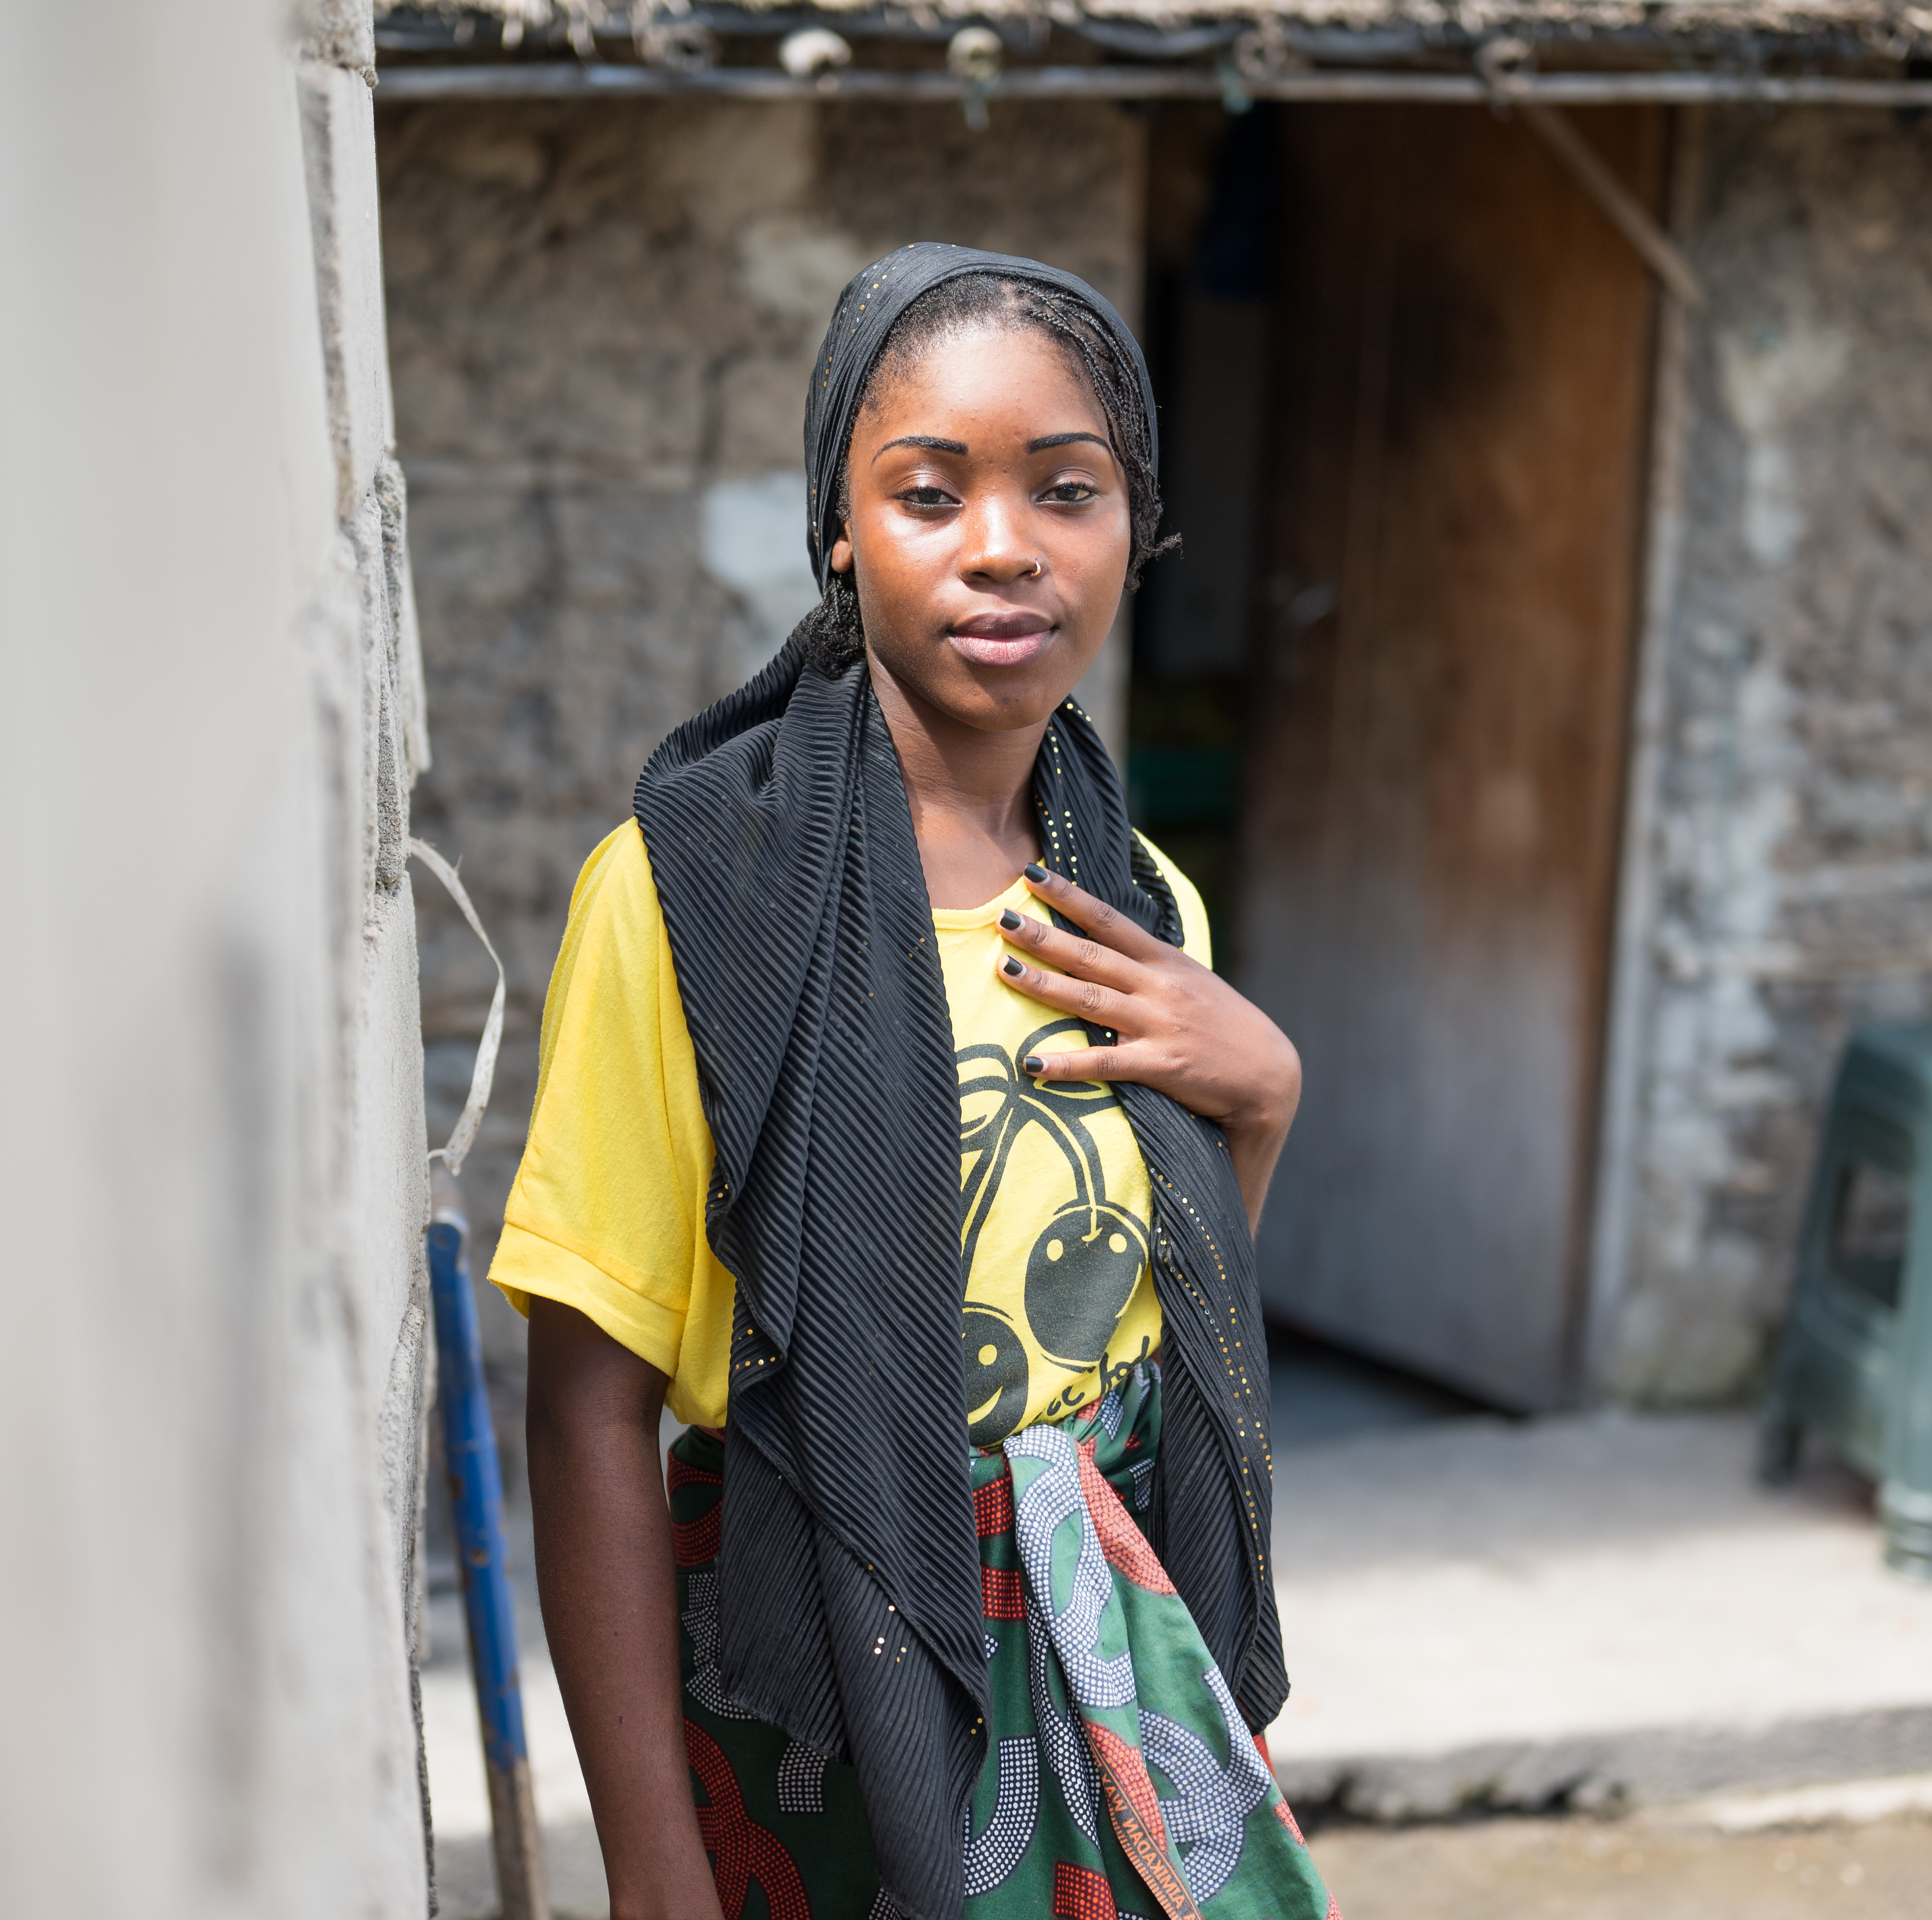
Case Scenario​
Amina is a female sex worker who is currently taking oral daily PrEP to prevent HIV infection. ​
What other PrEP options could she be eligible for and what are the similarities and differences between these options?​
​
​
​
Notes:
Facilitator guidance:
Explain to participants that a case scenario is provided for their analysis to apply their knowledge of comparing PrEP options.
Read the scenario and question on the slide asking participants, "What other PrEP options are available for Amina? What are the similarities and differences between these options?"
Prompt the participants with follow up questions, "Which alternatives to oral daily PrEP could Amina be eligible to take? What are the similarities and differences in efficacy, administration route, side effects, and follow-up between PrEP options?"
Ask participants to raise hands and share their answers.
Continue to the following slide to provide the answer after receiving inputs from participants.

Slide 104
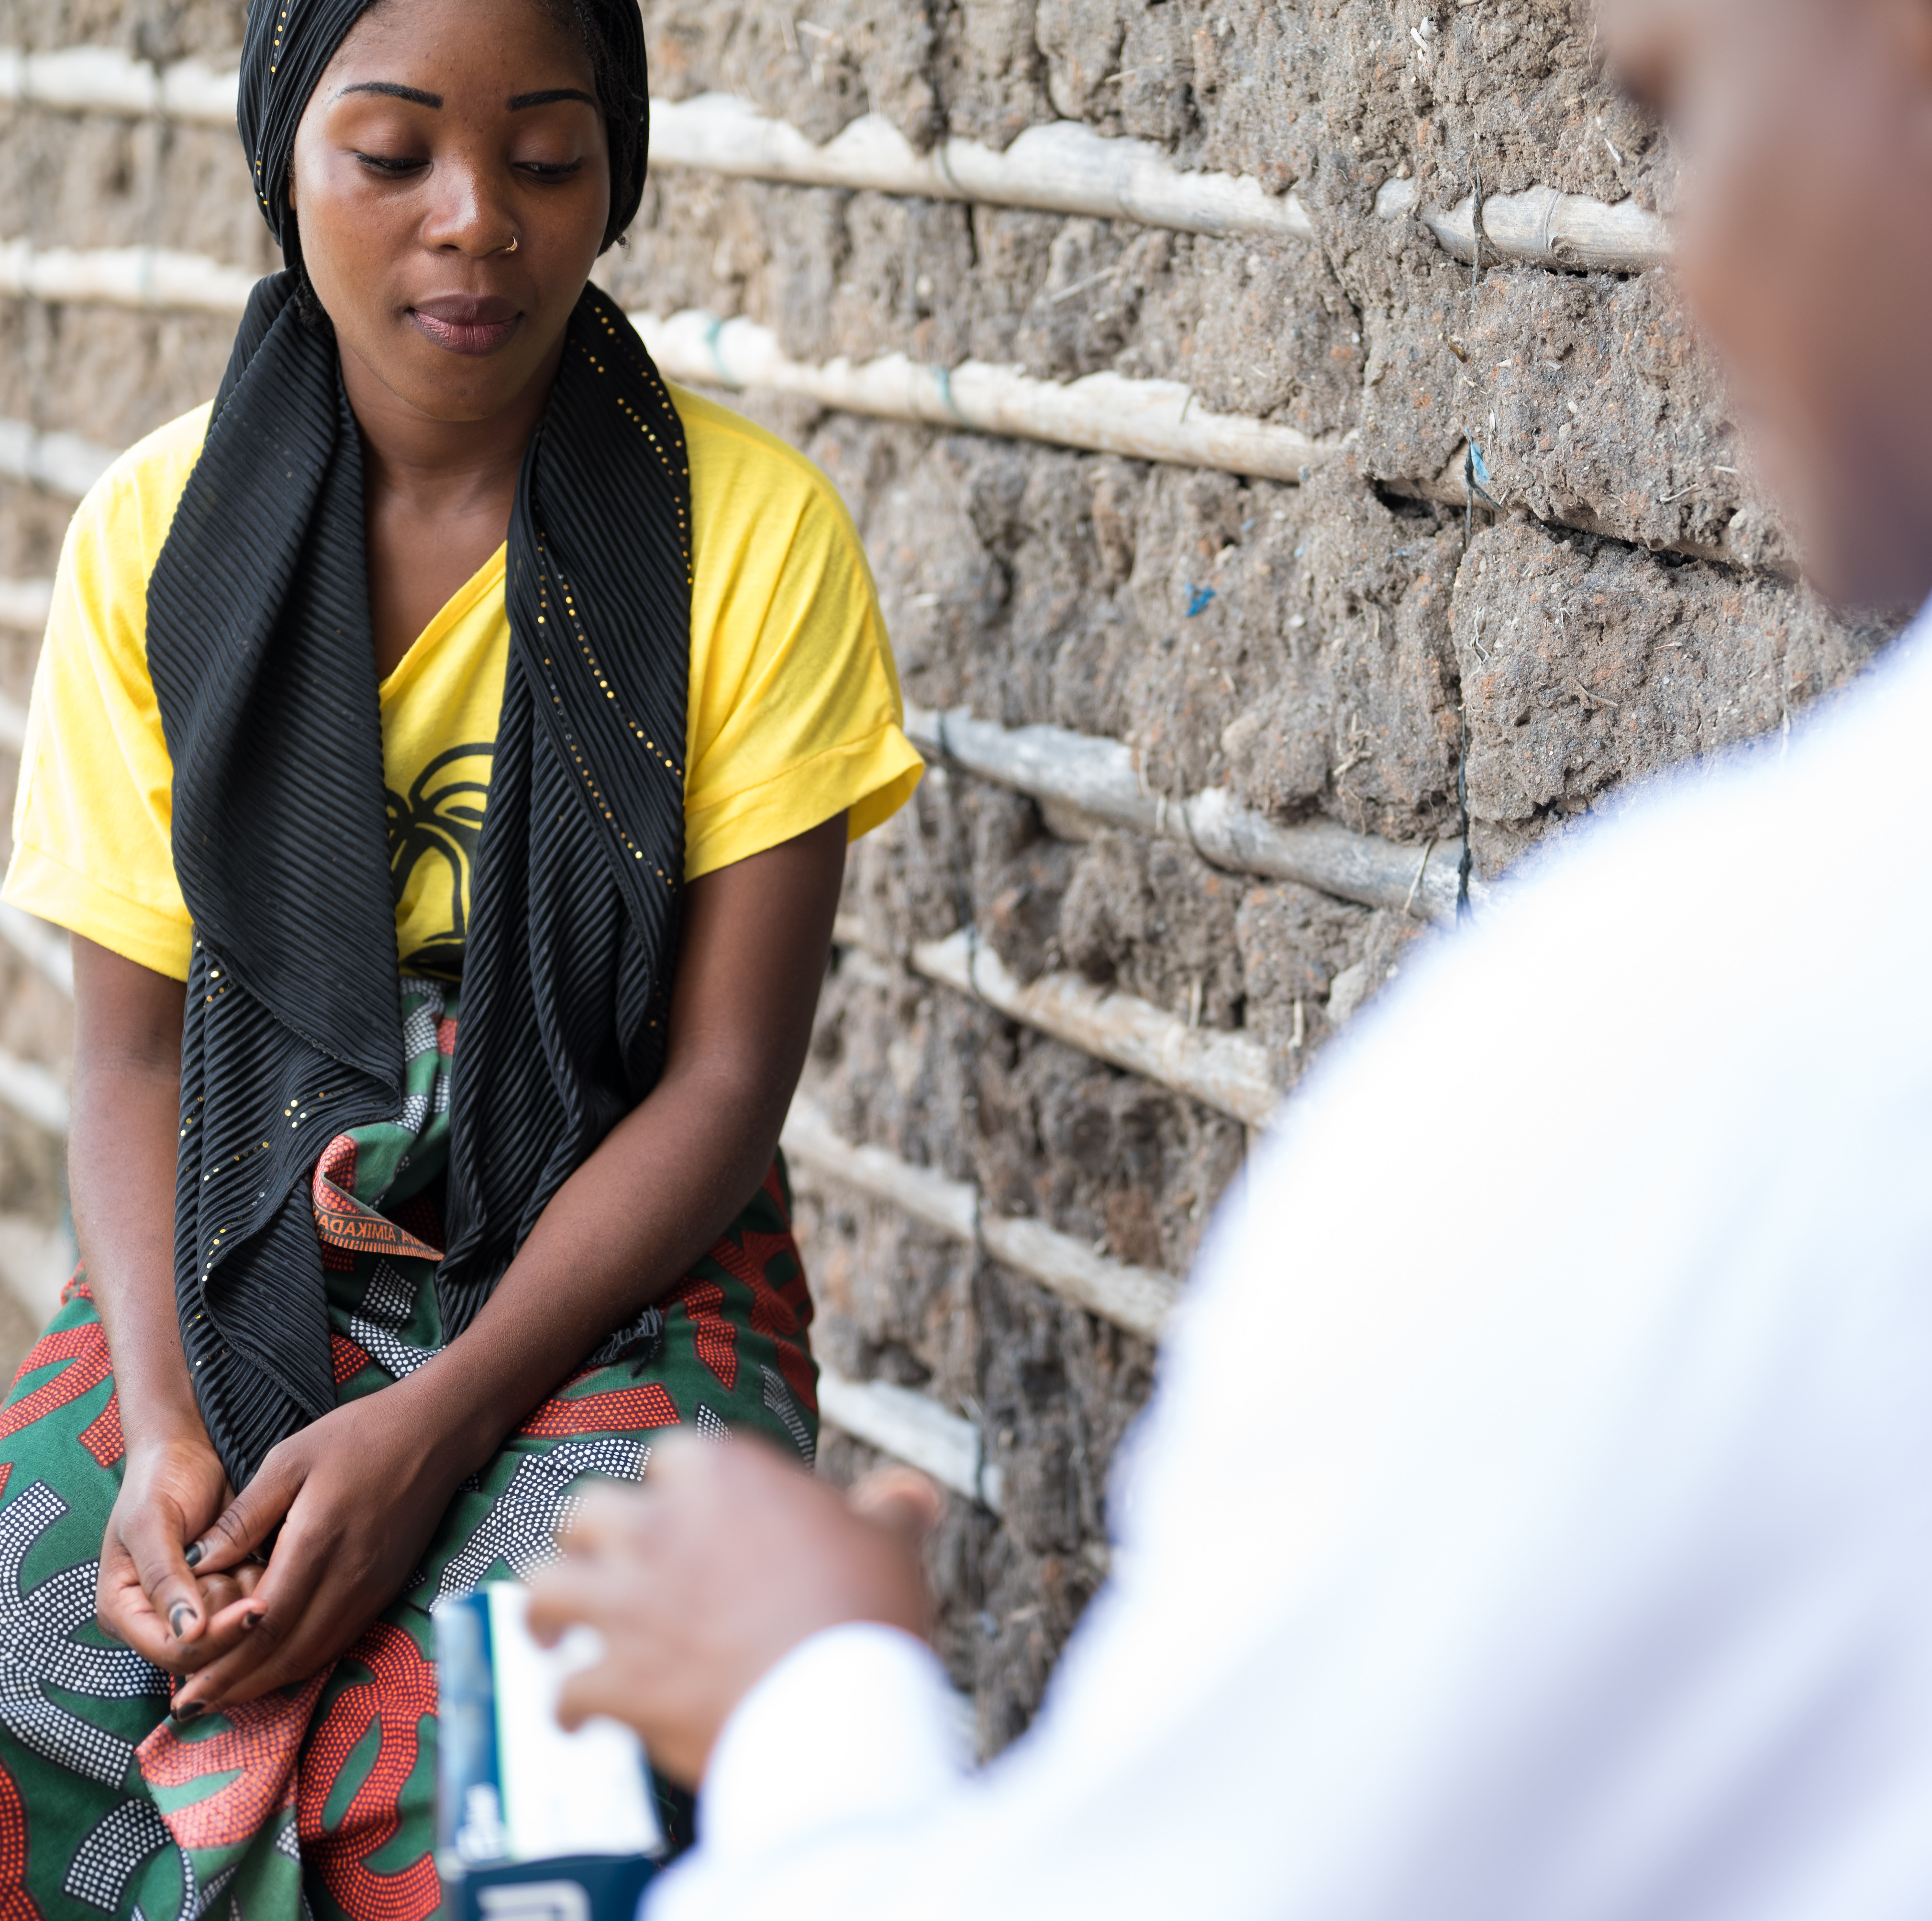
Case Scenario​
CAB-LA and DVR are long-acting alternatives to oral daily PrEP. ​
Instead of taking a daily pill she can receive an injection every 8 weeks or insert a new vaginal ring every 28 days. ​
DVR is less effective. She can use it in combination with other prevention methods. ​
CAB-LA and DVR do not have gastrointestinal side effects but may have injection site reactions or vaginal irritation, respectively. ​
Follow up is more frequent for CAB-LA at every 8 weeks instead of 3 months for other methods.​
Notes:
Facilitator guidance:
Read the answer on the slide.
Ask participants if they have any questions for clarification.
Allow time for questions and follow-up discussion as needed.

Slide 105
Looking Ahead: Ongoing Research to Expand PrEP Options​
PURPOSE 1​
Phase 3 study planned among 5,010 adolescent girls and young women in South Africa and Uganda from 2021-2027
Evaluating lenacapavir given every 6 months subcutaneously and oral emtricitabine/ tenofovir alafenamide (F/TAF) as PrEP
PURPOSE 2​
Phase 3 study planned among 3,000 cisgender men, transgender women, transgender men, and gender non-binary individuals who have sex with partners assigned male at birth in the United States, South Africa, Peru, and Brazil from 2021-2027
Evaluating lenacapavir given every 6 months subcutaneously as PrEP
For the latest information on these studies visit: www.purposestudies.com

Slide 106
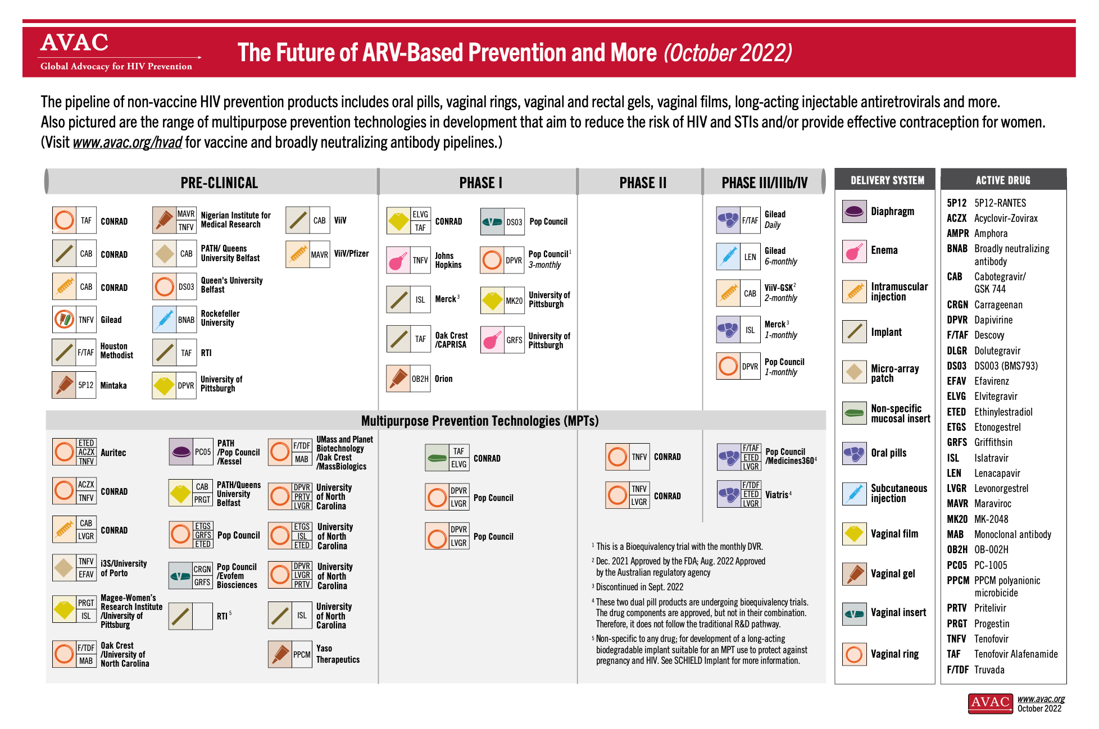
Looking Ahead: Future Products​
For the latest information visit the AVAC website:
avac.org/resource/infographic/the-future-of-arv-based-prevention-and-more

Slide 107
1.4 PrEP Service Delivery​

Slide 108
QUESTION
How is PrEP best delivered?
Notes:
Facilitator guidance:
Read the question on the slide.
Ask participants to raise their hands to answer the question.
Take a few volunteer responses.
Reveal the answer on the following slide.
Allow time for follow-up discussion as needed

Slide 109
ANSWER
PrEP should be integrated into services using person-centered approaches. ​
Notes:
Facilitator guidance:
Reveal the answer on the slide.
Allow time for questions and follow-up discussion as needed.

Slide 110
Common Service Entry Points for PrEP​
Outpatient clinic or site​
  HIV testing (the most common)​
  STI services​
  PEP services
  Key or priority population services​
  Sexual and gender-based violence services ​
  Harm reduction and other drug treatment services​
  Antenatal, gynecology and other reproductive health services​, including referrals of HIV negative partners of pregnant women living with HIV.
Community-based and outreach HIV services

Slide 111
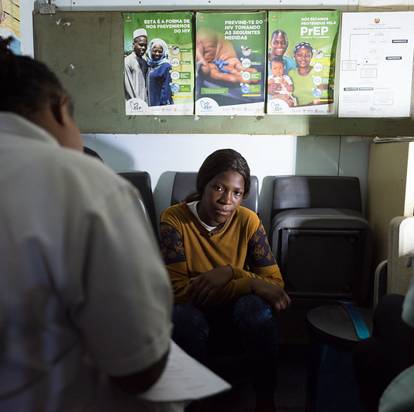
Case Example​
Key Population Drop-in Centers​
Stigma and discrimination are significant barriers to health-seeking behaviors among key populations in many countries. Therefore, to successfully implement PrEP, several programs offer PrEP at community-led drop-in centers where these groups feel safe. This has been an effective prevention strategy, with high PrEP uptake among key populations in many settings. ​

Slide 112
Where are the service entry points for PrEP in your setting? ​
Where can safe spaces be created in the community for key and priority populations to access PrEP? ​
What experiences can you share?
DISCUSSION​
Notes:
Facilitator guidance:
Time: 10 minutes.
Read the questions on the slide, "Where are the service entry points for PrEP in your setting?" "Where can safe spaces be created in the community for key and priority populations to access PrEP? What experiences can you share?"
Explain that participants who want to speak should raise their hands. Keep the discussion on target and moving along. Encourage everyone to participate and call on everyone who raises a hand.
Ask questions to encourage more responses, for example: “What else?” “What other ideas do you have?”
Wrap up the discussion by repeating and summarizing main points.

Slide 113
DSD for PrEP​
PrEP clients are generally healthy and feel well, therefore is it important to ‘de-medicalize’ PrEP services as much as possible.​
Person-centered, differentiated approaches to PrEP delivery adapts services to the needs and preferences of those who are interested in and could benefit from PrEP. ​
Differentiated services may make PrEP services more acceptable and accessible and support PrEP uptake, persistence and effective use. ​
A common framework for DSD utilizes the four building blocks of:​
  WHAT (service package) ​
  WHERE (service location)​
  WHO (service provider)​
  WHEN (service frequency)​

Slide 114
The ‘WHAT’ of PrEP Services
The WHERE, WHO and WHEN of PrEP services may vary, but the WHAT should be standardized and provided in accordance with national guidelines for all PrEP users.
Basic components of PrEP service delivery should include:
Initial risk assessment​ and follow-up assessments of continued need for PrEP​
Informed choice counseling​ to support PrEP method choice and follow-up assessments of satisfaction with chosen method​*
HIV testing and other eligibility assessments​
Clinical service package​ per national guidelines, including condoms, family planning, STI screening and management, gender-based/intimate partner violence screening and referrals, and risk reduction counseling
PrEP prescription or administration​
Side effect monitoring and management ​
Adherence assessments, counseling​ and support to overcome barriers to effective PrEP use​
*If more than one method is available

Slide 115
DSD Approach to PrEP Services​
​ | Identifying PrEP clients​ | Starting PrEP​ | PrEP Follow-up Visits​ | PrEP Continuation Support​
WHAT​ | Risk assessment​ Informed choice counseling | HIV test​ing Eligibility assessment​ PrEP prescription or administration*​ Clinical service package​ | HIV test​ing Side effect monitoring ​ Assess continued need for PrEP​ Assess satisfaction with chosen method​ PrEP prescription or administration*​ Clinical service package ​ | Adherence assessment and counseling​ Evaluation and support to overcome barriers to effective PrEP use​
WHERE​ | Clinical setting​ Community​ Virtual​ | Clinical setting​ Community setting​ | Clinical setting​ Community setting​ | Clinical setting​ Community setting​ Virtual​
WHO​ | Healthcare providers​ Lay health workers​ Peers ​ Clients (self-screen)​ | Healthcare providers​ | Healthcare providers​ | Healthcare providers​ Lay health workers ​ Peers​
WHEN ​ | Prior to periods of risk​ During periods of risk​ | First initiation visit​ Re-initiation visit​ | One month after initiation​ Every 2-3 months*​ | As needed in between visits​ Regular schedule​ Before visits​
*CAB-LA should be administered during visits and requires follow-up every 2 months. Other forms of PrEP can be prescribed and require follow-up every 3 months.​
Adapted from WHO, 2022

Slide 116
Review the example DSD approach to PrEP services. Pick a PrEP option that is available in your setting and discuss the WHERE, WHO and WHEN for your setting.​
​ | Identifying PrEP clients​ | Starting PrEP​ | PrEP Follow-up Visits​ | PrEP Continuation Support​
WHAT​ | Risk assessment​ Informed choice counseling | HIV test​ing Eligibility assessment​ PrEP prescription or administration*​ Clinical service package​ | HIV test​ing Side effect monitoring ​ Assess continued need for PrEP​ Assess satisfaction with chosen method​ PrEP prescription or administration*​ Clinical service package ​ | Adherence assessment and counseling​ Evaluation and support to overcome barriers to effective PrEP use​
WHERE​
WHO​
WHEN ​
DISCUSSION​
*CAB-LA should be administered during visits and requires follow-up every 2 months. Other forms of PrEP can be prescribed and require follow-up every 3 months.​
Notes:
Facilitator guidance:
Time: 20 minutes
Explain that participants will now work individually to consider examples of DSD in their setting. Participants will review the example DSD approach to PrEP services. Pick a PrEP option that is available in their setting and discuss the where, who, and when in their setting.
Prompt participants with questions, "Where is PrEP provided in your setting?" "Who administers PrEP in your setting?" "When is PrEP delivered in your setting?"
Ask participants to fill in the blank in the table with their answers from their individual settings.
Allow 10 minutes for individual work.
Ask participants to share their answers with the group.
Prompt participants with questions for discussion, "Are there differences between the DSD example and your setting? What are the challenges for DSD in your setting? Are there opportunities to expand DSD in your setting?"
Allow 10 minutes for group discussion and sharing.

Slide 117
PrEP Service Integration​
Integrating PrEP into other services, such as HIV testing and primary health care services, can:​
Increase convenience and acceptability​
Support initiation, persistence and effective use of PrEP
Support engagement with care for other health needs unrelated to PrEP and may improve multiple health outcomes ​
Support the provision of holistic and integrated care

Slide 118
PrEP Service Integration​
Integration of services depends on the context and unique needs of PrEP user populations and may include:​
Peer support, mental health and social services, gender-based violence services, and PEP​
Antenatal, postnatal and family planning services
Sexual and reproductive health services, including STI testing and treatment, partner services, and human papillomavirus (HPV) screening
Gender-affirming services for trans and gender diverse people
Substance use and harm reduction services for people who use drugs, including services addressing chemsex

Slide 119
PEP and PrEP Service Integration ​
Clients who present for PEP may be candidates for PrEP.​
PEP encounters should be viewed as a prevention opportunity to help at-risk persons engage in sustained risk reduction and HIV prevention services, including PrEP. ​
PrEP offers more consistent protection against HIV than repeated courses of PEP.​
PrEP can be started after 28 days of PEP.​
Clients who present for PrEP may be candidates for PEP.​
Before initiating PrEP, clients should be screened for recent (<72 hours) HIV exposure.​
If they have been exposed recently, they should receive PEP first, then transition to PrEP.​
Clients returning for PrEP refills who report suboptimal adherence should also be evaluated for PEP eligibility.​

Slide 120
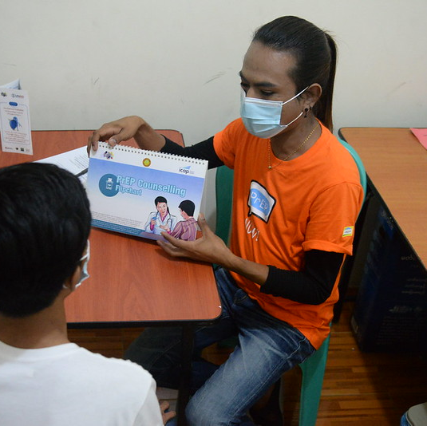
Case Example​
PrEP service integration into gender-affirming services​
In several countries, clinics serving transgender populations provide PrEP and other HIV services that are fully integrated with gender-affirming care. They are often managed by trained transgender staff and gender-sensitive healthcare providers. The model has been very successful for reaching this at-risk group with PrEP.​

Slide 121
Where is PrEP being integrated into other services in your setting?​
What is working well and what can be improved? ​
How can PrEP service integration be expanded? ​
DISCUSSION​
Notes:
Facilitator guidance:
Time: 10 minutes.
Read the questions on the slide, "Where is PrEP being integrated into other services in your setting? What is working well and what can be improved? How can PrEP service integration be expanded?"
Explain that participants who want to speak should raise their hands. Keep the discussion on target and moving along. Encourage everyone to participate and call on everyone who raises a hand.
Ask questions to encourage more responses, for example: “What else?” “What other ideas do you have?”
Wrap up the discussion by repeating and summarizing main points.

Slide 122
Peer Outreach for Follow-Up​
Trained peer supporters can play an important role in outreach to PrEP clients.​
Peer outreach workers may be better able than other clinic staff to reach clients in community settings.​
Clients may feel more able to discuss adherence and retention challenges with peer supporters than with health professionals.​
Peers who are also PrEP users can play an important role in increasing the acceptability and uptake of PrEP among clients.

Slide 123
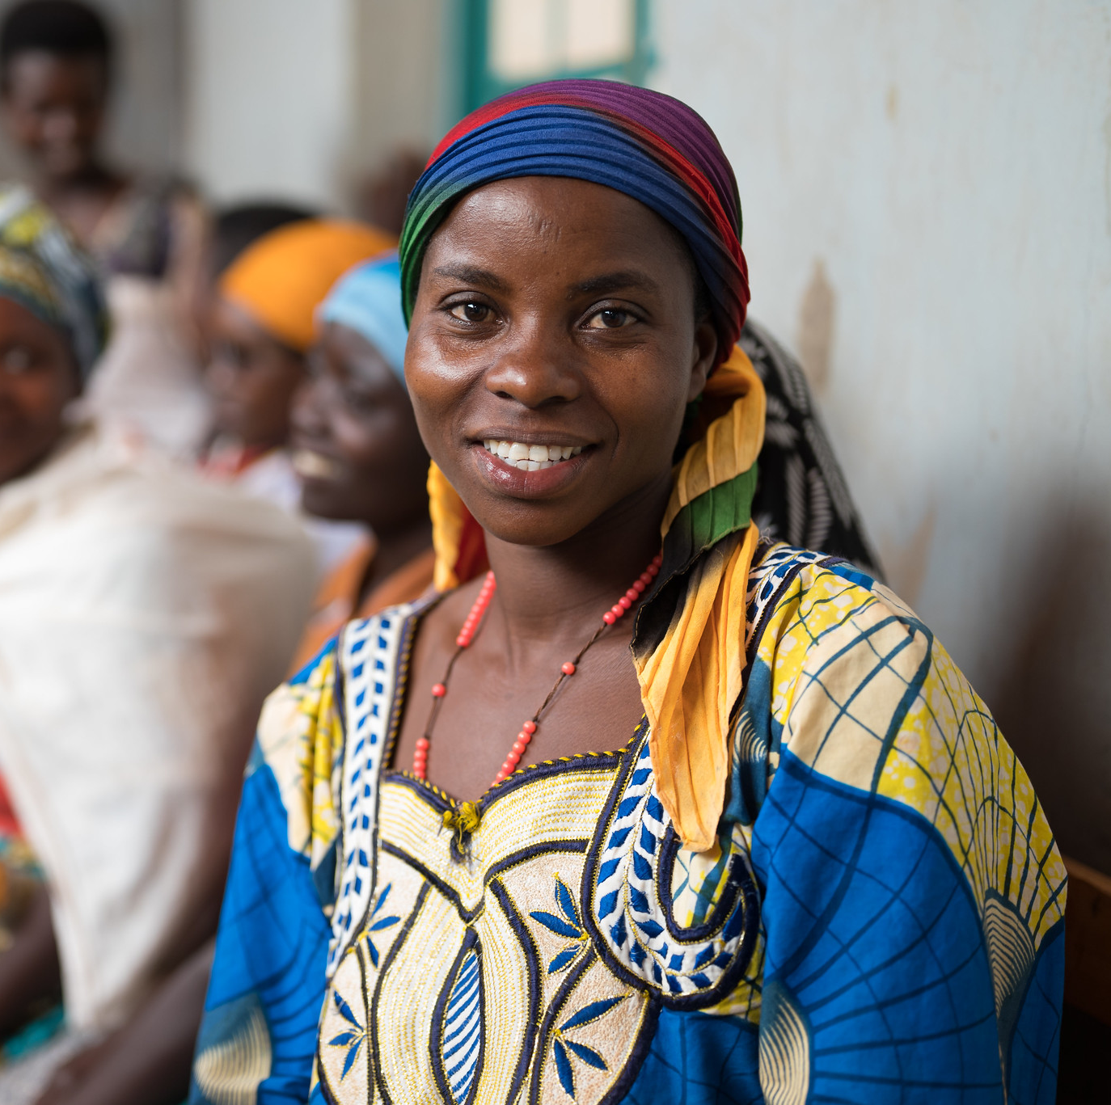
Case Scenario​
Faith is a healthy young woman who has not returned to the clinic since she started taking PrEP 3 months ago.​
What DSD approaches could be considered to offer her follow-up and support? ​
Notes:
Facilitator guidance:
Read the scenario and question on the slide asking participants, "What DSD approaches could be considered to offer Faith follow-up and support?"
Prompt the participants with follow up questions, "Where could PrEP services be provided if Faith cannot come to the clinic? Who could provide PrEP follow up and support for Faith?"
Ask participants to raise hands and share their answers.
Continue to the following slide to provide the answer after receiving inputs from participants.

Slide 124
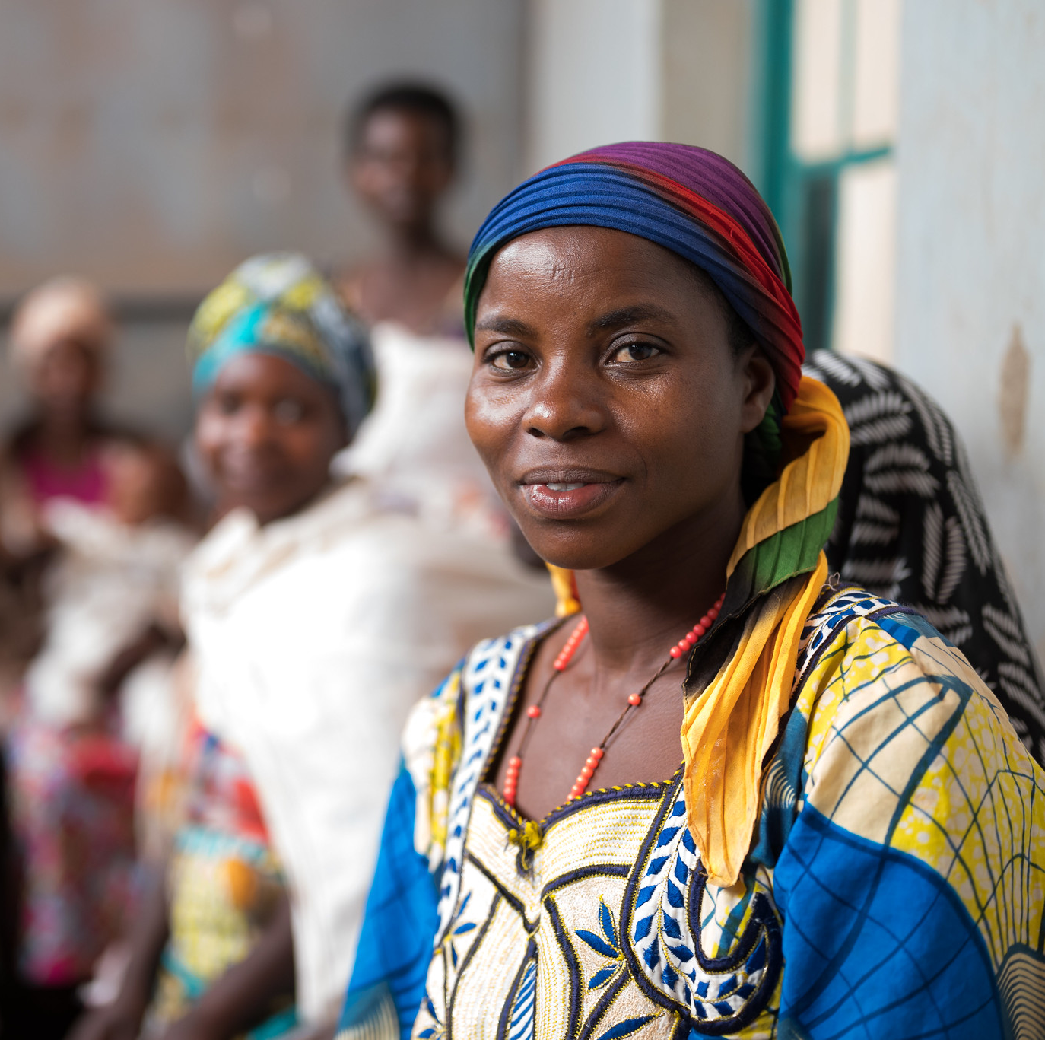
Case Scenario​
Peer outreach in community settings to provide adherence counseling in between clinic visits could be a great option to support Faith in continuing PrEP use. ​
Notes:
Facilitator guidance:
Read the answer on the slide. This is one example of DSD that could be a good option for Faith.
Ask participants if they have any other ideas or examples to share from their experience and setting. If needed, prompt with an example such as “Community PrEP refills may also help Faith continue PrEP, as she struggles to find time to visit the clinic.”
Allow time for questions and follow-up discussion as needed.

Slide 125
How is peer outreach being utilized for PrEP follow up in your setting?​
What are some successes, challenges and lessons learned from your experience with community outreach for PrEP?​
DISCUSSION​
Notes:
Facilitator guidance:
Time: 10 minutes.
Read the questions on the slide, "How is peer outreach being utilized for PrEP follow up in your setting? What are some successes, challenges and lessons learned from your experience with peer outreach for PrEP?“
Explain that participants who want to speak should raise their hands. Keep the discussion on target and moving along. Encourage everyone to participate and call on everyone who raises a hand.
Ask questions to encourage more responses, for example: “What else?” “What other ideas do you have?”
Wrap up the discussion by repeating and summarizing main points.

Slide 126
1.5 Common Questions​
Notes:
Facilitator guidance:
Time: 20 minutes
The following slides contain a series of "common questions" about PrEP with Yes or No answers.
Ask participants to stand up.
Read the question on the slide.
Ask participants to move around the room. If their answer is "No", they will move to stand on the right side of the room. If their answer is "Yes", they will move to stand on the left side of the room. If their answer is "Maybe" or "Sometimes" or "Unsure", they will stand in the middle of the room.
Invite a few of the participants to share their reasons for choosing "Yes" or "No" and provide more context for their answers.
Read the answer on the slide.
Summarize answers and allow time for discussion of any conflicting view points, different opinions, and experiences.

Slide 127
QUESTION
Does PrEP protect against pregnancy and other STIs?​
Notes:
Facilitator guidance:
Read the question on the slide.
Ask participants to move around the room. If their answer is "No", they will move to stand on the right side of the room. If their answer is "Yes", they will move to stand on the left side of the room. If their answer is "Maybe" or "Sometimes" or "Unsure", they will stand in the middle of the room.
Invite a few of the participants to share their reasons for choosing "Yes" or "No" and provide more context for their answers.

Slide 128
ANSWER
NO
PrEP protects against HIV ONLY.​
PrEP does not protect against other STIs, including syphilis, gonorrhea, chlamydia, or HPV.​
PrEP does not protect against pregnancy.​
Only condoms protect against STIs and pregnancy.​
PrEP should be provided within a package of prevention services, including STI screening and management, risk reduction counseling, condoms, and contraceptives.​
Notes:
Facilitator guidance:
Reveal the answer on the slide.
Allow time for questions and follow-up discussion as needed.

Slide 129
QUESTION
Can women use PrEP
when they are pregnant or breastfeeding?​
Notes:
Facilitator guidance:
Read the question on the slide.
Ask participants to move around the room. If their answer is "No", they will move to stand on the right side of the room. If their answer is "Yes", they will move to stand on the left side of the room. If their answer is "Maybe" or "Sometimes" or "Unsure", they will stand in the middle of the room.
Invite a few of the participants to share their reasons for choosing "Yes" or "No" and provide more context for their answers.

Slide 130
ANSWER
YES
Oral daily PrEP is safe and can be continued during pregnancy and breastfeeding. ​
More information is required about the safety of using either DVR or CAB-LA in pregnancy.
Notes:
Facilitator guidance:
Reveal the answer on the slide.
Allow time for questions and follow-up discussion as needed.

Slide 131
QUESTION
Will PrEP make hormonal medication, such as oral contraceptives or gender-affirming hormones, less effective?​
Notes:
Facilitator guidance:
Read the question on the slide.
Ask participants to move around the room. If their answer is "No", they will move to stand on the right side of the room. If their answer is "Yes", they will move to stand on the left side of the room. If their answer is "Maybe" or "Sometimes" or "Unsure", they will stand in the middle of the room.
Invite a few of the participants to share their reasons for choosing "Yes" or "No" and provide more context for their answers.

Slide 132
ANSWER
NO
Taking PrEP and hormonal contraceptives together does not make them less effective.​​
PrEP does not affect the efficacy of hormones used for GAHT.​
However, hormones can affect how oral PrEP is metabolized in the body. Therefore, ED-PrEP is not recommended for people assigned female sex at birth or transgender women on GAHT.​
Notes:
Facilitator guidance:
Reveal the answer on the slide.
Allow time for questions and follow-up discussion as needed.

Slide 133
QUESTION
Will PrEP users engage
in more risk behaviors?​
Notes:
Facilitator guidance:
Read the question on the slide.
Ask participants to move around the room. If their answer is "No", they will move to stand on the right side of the room. If their answer is "Yes", they will move to stand on the left side of the room. If their answer is "Maybe" or "Sometimes" or "Unsure", they will stand in the middle of the room.
Invite a few of the participants to share their reasons for choosing "Yes" or "No" and provide more context for their answers.

Slide 134
ANSWER
MAYBE
Evidence is mixed on whether PrEP users engage in more risk behavior, also known as ‘risk compensation’.
Notes:
Facilitator guidance:
Reveal the answer on the slide.
Allow time for questions and follow-up discussion as needed.

Slide 135
Risk Compensation and PrEP
There was no evidence of risk compensation in blinded clinical trials, where participants received regular counseling, screening, and access to condoms and lubricants.​
Evidence from some open-label clinical trials and real-world PrEP implementation shows declines in self-reported condom use and increases in STI diagnoses among some PrEP users.
Therefore, combination prevention remains important and should include quality counseling and access to condoms and lubricants.​
Despite some evidence of risk compensation (using condoms less often and/or having more sexual partners), new HIV infections have decreased in settings where PrEP has been scaled up.​
Quaife et al., 2020

Slide 136
QUESTION
Can PrEP be used with drugs or alcohol?​
Notes:
Facilitator guidance:
Read the question on the slide.
Ask participants to move around the room. If their answer is "No", they will move to stand on the right side of the room. If their answer is "Yes", they will move to stand on the left side of the room. If their answer is "Maybe" or "Sometimes" or "Unsure", they will stand in the middle of the room.
Invite a few of the participants to share their reasons for choosing "Yes" or "No" and provide more context for their answers.

Slide 137
ANSWER
YES
Using drugs or drinking alcohol will not affect the safety or effectiveness of PrEP. ​
However, heavy drug or alcohol use could make someone forget to take PrEP as directed or miss PrEP follow-up appointments.​
Notes:
Facilitator guidance:
Reveal the answer on the slide.
Allow time for questions and follow-up discussion as needed.

Slide 138
QUESTION
Is stigma a
barrier to PrEP use?
Notes:
Facilitator guidance:
Read the question on the slide.
Ask participants to move around the room. If their answer is "No", they will move to stand on the right side of the room. If their answer is "Yes", they will move to stand on the left side of the room. If their answer is "Maybe" or "Sometimes" or "Unsure", they will stand in the middle of the room.
Invite a few of the participants to share their reasons for choosing "Yes" or "No" and provide more context for their answers.

Slide 139
ANSWER
SOMETIMES
People may face stigma if their PrEP use becomes known, especially if others mistakenly consider PrEP use to be evidence of irresponsible behavior or if they mistakenly think that PrEP is HIV treatment.​
Key populations often face stigma and discrimination, especially if their behavior is criminalized. ​
Stigma can decrease PrEP uptake and adherence if people feel that they must hide or conceal their PrEP use.​
Confidentiality is essential in PrEP services and community consultations and sensitization around PrEP are key to successful implementation.
Notes:
Facilitator guidance:
Reveal the answer on the slide.
Allow time for questions and follow-up discussion as needed.

Slide 140
QUESTION
Do PrEP users have
to stay on PrEP for life?
Notes:
Facilitator guidance:
Read the question on the slide.
Ask participants to move around the room. If their answer is "No", they will move to stand on the right side of the room. If their answer is "Yes", they will move to stand on the left side of the room. If their answer is "Maybe" or "Sometimes" or "Unsure", they will stand in the middle of the room.
Invite a few of the participants to share their reasons for choosing "Yes" or "No" and provide more context for their answers.

Slide 141
ANSWER
NO
People often move in and out of substantial risk for HIV.​
Education and support for safe stops and restarts of PrEP use are essential. ​
A variety of life changes may prompt a person to stop PrEP, including:​
  A partner with HIV achieves viral suppression on ART.​
  A relationship becomes mutually monogamous.​
  Sex work or injection drug use stops. ​
  Other risks change.​
Notes:
Facilitator guidance:
Reveal the answer on the slide.
Allow time for questions and follow-up discussion as needed.

Slide 142
QUESTION
Will PrEP lead to more HIV drug resistance (HIVDR)?​
Notes:
Facilitator guidance:
Read the question on the slide.
Ask participants to move around the room. If their answer is "No", they will move to stand on the right side of the room. If their answer is "Yes", they will move to stand on the left side of the room. If their answer is "Maybe" or "Sometimes" or "Unsure", they will stand in the middle of the room.
Invite a few of the participants to share their reasons for choosing "Yes" or "No" and provide more context for their answers

Slide 143
ANSWER
VERY RARELY
There can be a risk of HIVDR if adherence is suboptimal and HIV infection occurs while the individual is on PrEP.
Therefore, optimal PrEP adherence is crucial.
Notes:
Facilitator guidance:
Reveal the answer on the slide.
Allow time for questions and follow-up discussion as needed.

Slide 144
HIVDR and PrEP
HIVDR in PrEP users who became HIV infected was rare in clinical trials and occurred mostly in cases where the person had undiagnosed HIV infection when starting PrEP.​
HIVDR will not occur when adherence to PrEP is high and HIV seroconversion does not occur.​
In rare instances ‘break-through’ infections can occur with optimal PrEP adherence, which increases the risk of HIVDR.​
Health providers must support and monitor adherence, conduct HIV tests at recommended intervals, assess for AHI and teach PrEP users to recognize signs and symptoms of AHI. ​
HIVDR risk varies by PrEP product*
*See Modules 2-5 for more information on HIVDR with specific PrEP products
WHO, 2021

Slide 145
What other common questions have you heard about PrEP?​
Do you have any remaining questions about PrEP to discuss?​
DISCUSSION​
Notes:
Facilitator guidance:
Ask participants the questions on the slide, "What other common questions have you heard about PrEP? Do you have any remaining questions about PrEP to discuss?"
Encourage participants to raise their hands and share any remaining thoughts or questions.
Wrap up the discussion by repeating and summarizing main points.

Slide 146
Summary

Slide 147
Module 1 Summary​
PrEP can be used by HIV negative persons to reduce the risk of HIV acquisition.​
PrEP should be taken as an additional prevention intervention. ​
The WHO now recommends multiple PrEP products for people at substantial risk of HIV infection.​
PrEP should be offered to at-risk populations, including key and priority populations. ​​
PrEP eligibility criteria: ​
  HIV seronegative.​
  No suspicion of AHI. ​
  At substantial risk for HIV infection or requesting PrEP.​
  Willingness to use PrEP as prescribed.​
  No contraindication to PrEP drug or administration route. ​
PrEP services should be provided in a person-centered way, including using DSD approaches.​

Slide 148
Review Learning Objectives​
After completing Module 1, how confident do you feel to do the following? ​
Define PrEP and differentiate PrEP from PEP and ART
Describe the need for PrEP
Identify key populations and priority populations for PrEP at the local level
Specify PrEP products recommended by WHO and within your own country​
Describe the similarities and differences between available PrEP products
Name the 5 main eligibility criteria for PrEP
Explain how to exclude AHI
Identify people at risk for HIV infection
Identify common questions regarding PrEP implementation

Slide 149
Share your experience with this module.​
What did you learn?​
What did you find helpful?​
What will you implement in your practice? ​
Do you have any questions? ​
DISCUSSION​
Notes:
Facilitator guidance:
• Time: 20 minutes.
• Explain that participants who want to speak should raise their hands. Keep the discussion on target and moving along.
• Encourage everyone to participate and call on everyone who raises a hand.
• Ask questions to encourage more responses, for example: “What else?” “What other ideas do you have?”
• Wrap up the discussion by repeating and summarizing main points.

Slide 150
PrEP Resources: Key WHO Guidelines and Resources​
World Health Organization. Differentiated and simplified pre-exposure prophylaxis for HIV prevention: update to WHO implementation guidance. Technical Brief. Geneva: WHO; 2022
World Health Organization. Guidelines on long-acting injectable cabotegravir for HIV prevention. Geneva: WHO; 2022.
World Health Organization. Consolidated Guidelines on HIV Prevention, Testing, Treatment, Service Delivery and Monitoring: Recommendations for a Public Health Approach. Geneva: WHO; 2021.
World Health Organization. What’s the 2+1+1? Event-driven oral pre-exposure prophylaxis to prevent HIV for men who have sex with men: Update to WHO’s recommendation on oral PrEP. Geneva: WHO; 2019
Oral PrEP eLearning course, available at hivoralprep.org.
WHO implementation modules and oral PrEP tool app, available at who.int/tools/prep-implementation-tool.

Slide 151
Other PrEP Resources​
PrEP Watch website: www.prepwatch.org​
Global PrEP Learning Network webinars: www.prepwatch.org/global-prep-learning-network​
AVAC website: www.avac.org​
U.S. Centers for Disease Control and Prevention: www.cdc.gov/hiv/risk/prep

Slide 152
Local PrEP Resources​
[Insert local PrEP resources, organizations, clinics, studies, etc.] ​

Slide 153
References: Reports
Consolidated guidelines on HIV prevention, diagnosis, treatment and care for key populations – 2016 update. Geneva: World Health Organization; 2016. License: CC BY-NC-SA 3.0 IGO.
Consolidated guidelines on HIV prevention, testing, treatment, service delivery and monitoring: recommendations for a public health approach. Geneva: World Health Organization; 2021. License: CC BY-NC-SA 3.0 IGO.​
Differentiated and simplified pre-exposure prophylaxis for HIV prevention: update to WHO implementation guidance. Technical Brief. Geneva: World Health Organization; 2022. License: CC BY-NC-SA 3.0 IGO.
HIV/ AIDS Epidemiology Report 2021, Volume 90. HIV/AIDS Epidemiology Unit, Public Health – Seattle & King County and the Infectious Disease Assessment Unit, Washington State Department of Health; 2021
HIV drug resistance report 2021. Geneva: World Health Organization; 2021. License: CC BY-NC-SA 3.0 IGO.
HIV testing, PrEP, new HIV diagnoses, and care outcomes for people accessing HIV services: 2022 report. The annual official statistics data release (data to end of December 2021). UK Health Security Agency, London; 2022.
IN DANGER: UNAIDS Global AIDS Update 2022. Geneva: Joint United Nations Programme on HIV/ AIDS; 2022. License: CC BY-NC-SA 3.0 IGO.

Slide 154
References: Articles
Buchbinder SP, Havlir DV. Getting to zero San Francisco: A collective impact approach. J Acquir Immune Defic Syndr. 2019;82(Suppl 3):S176.
Grulich AE, Guy R, Amin J, et al. Population-level effectiveness of rapid, targeted, high-coverage roll-out of HIV pre-exposure prophylaxis in men who have sex with men: The EPIC-NSW prospective cohort study. Lancet HIV. 2018;5(11):e629-e637.
Koss CA, Havlir DV, Ayieko J, et al. HIV incidence after pre-exposure prophylaxis initiation among women and men at elevated HIV risk: A population-based study in rural Kenya and Uganda. PLoS Med. 2021;18(2):e1003492.
Quaife M, MacGregor L, Ong JJ, et al. Risk compensation and STI incidence in PrEP programmes. Lancet HIV. 2020;7(4):e222-e223.

Slide 155

Thank You​

Slide 156
Acknowledgements
This package is a product of the Clinical and Laboratory Unit of ICAP at Columbia University. The material was conceptualized, designed and developed by Cassia Wells, with support from Julie Franks and technical input from Ellen Morrison, Andrea Howard and Gillian Doherty. Formatting and graphic design was provided by the ICAP Communications Team.
Portions of this training updated and modified previous PrEP package material developed by ICAP at Columbia University in collaboration with the U.S. Centers for Disease Control and Prevention (CDC), with funding from the U.S. President’s Plan for AIDS Relief (PEPFAR) under the terms of cooperative agreement #U2GGH000994.
Its contents are solely the responsibility of the authors and do not necessarily represent the views of the U.S. Government or other organizations.

